Slide 1
CS 1699: Intro to Computer Vision
Tracking
Prof. Adriana Kovashka
University of Pittsburgh
December 3, 2015

Slide 2
Today: Tracking
Tracking how an object moves
Examples of tracking applications
Probabilistic approach to tracking
  Kalman filters
Tracking challenges
TA will have HW4 graded on Tuesday
HW5 due next Thursday
  Use a random sample of images to train the attribute classifiers

Slide 3
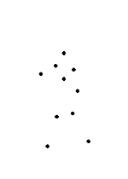
Motion: Why is it useful?
Derek Hoiem

Slide 4
Motion: Why is it useful?
Even “impoverished” motion data can evoke a strong percept
G. Johansson, “Visual Perception of Biological Motion and a Model For Its Analysis", Perception and Psychophysics 14, 201-211, 1973.
Derek Hoiem

Slide 5
Tracking Examples
Traffic: https://www.youtube.com/watch?v=DiZHQ4peqjg
Soccer: http://www.youtube.com/watch?v=ZqQIItFAnxg
Face: http://www.youtube.com/watch?v=i_bZNVmhJ2o
Body: https://www.youtube.com/watch?v=_Ahy0Gh69-M
Eye: http://www.youtube.com/watch?v=NCtYdUEMotg
Gaze: http://www.youtube.com/watch?v=-G6Rw5cU-1c
Amin Sadeghi

Slide 6
How would you do it?

Slide 7
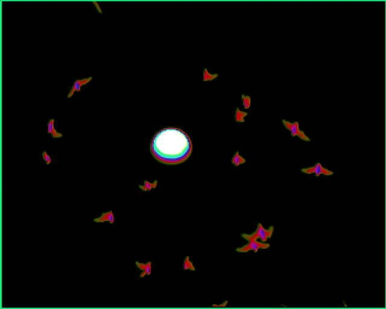
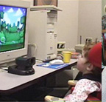
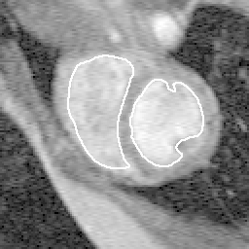
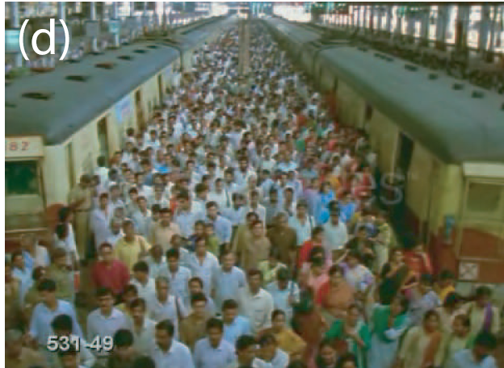
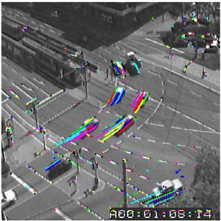
Tracking: some applications
Body pose tracking, activity recognition
Censusing a bat population
Video-based interfaces
Medical apps
Surveillance
Kristen Grauman

Slide 8
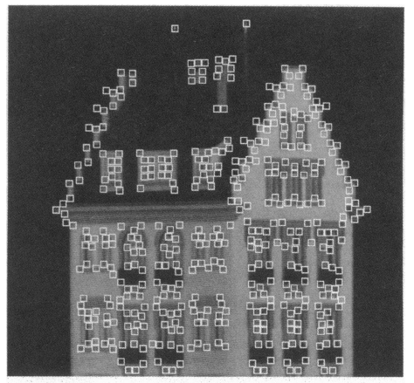
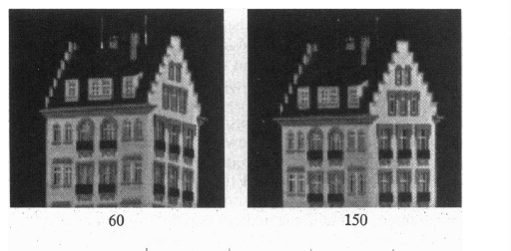
Feature tracking
  Extract visual features (corners, textured areas) and “track” them over multiple frames
Many problems (e.g. structure from motion) require matching points
Many challenges, e.g. points may change appearance over time, points may appear or disappear
Derek Hoiem

Slide 9
Feature tracking
I(x,y,t)
I(x,y,t+1)
Given two subsequent frames, estimate the point translation
The Lucas-Kanade optical flow method assumes:
  Brightness constancy: projection of the same point looks the same in every frame
  Small motion: points do not move very far
  Spatial coherence: points move like their neighbors
Adapted from Derek Hoiem

Slide 10
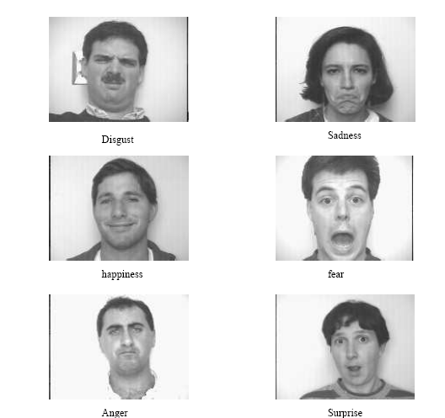
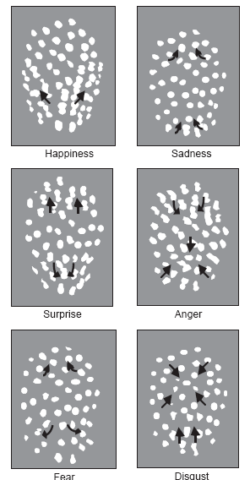
Using optical flow:
recognizing facial expressions
Recognizing Human Facial Expression (1994)
by Yaser Yacoob, Larry S. Davis
Kristen Grauman

Slide 11
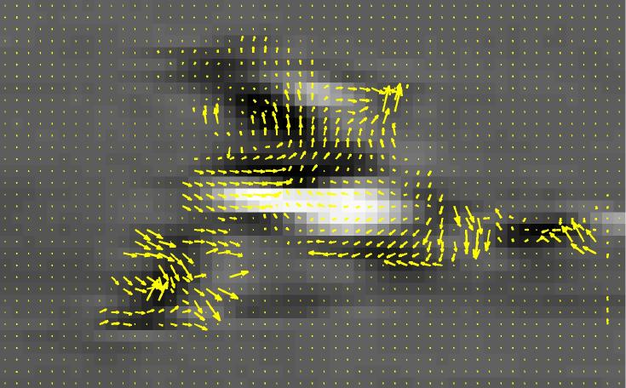
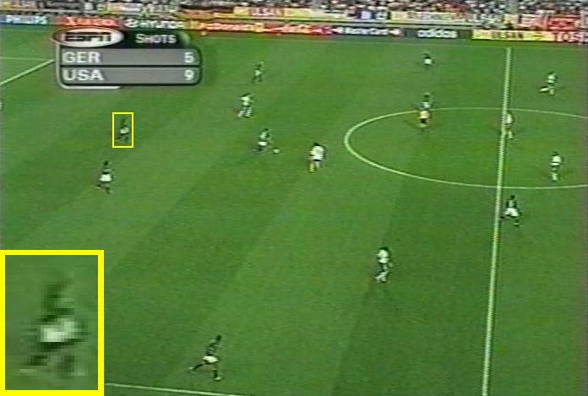
Using optical flow: action recognition at a distance
Features = optical flow within a region of interest
Classifier = nearest neighbors
The 30-Pixel Man
[Efros, Berg, Mori, & Malik 2003]
http://graphics.cs.cmu.edu/people/efros/research/action/
Kristen Grauman

Slide 12
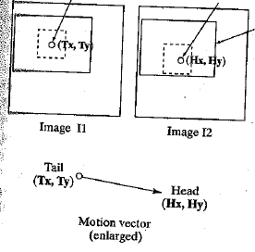
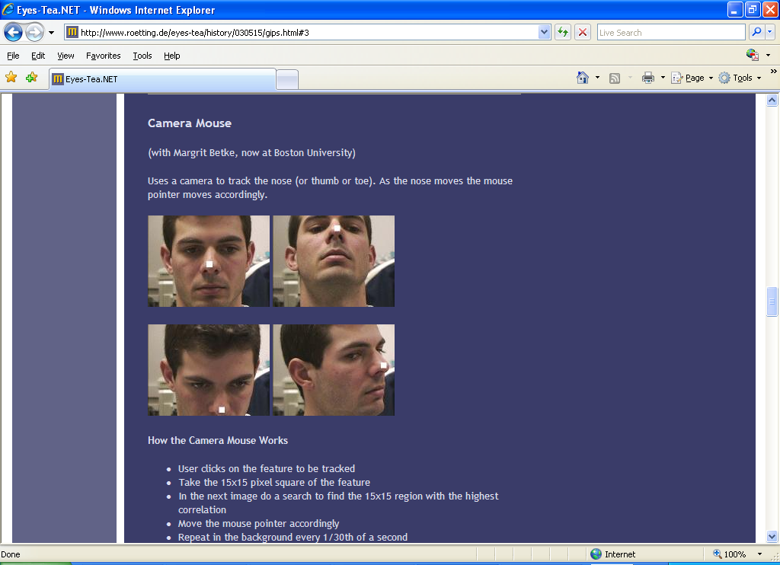
Feature-based matching for motion
Best matching neighborhood
Interesting point
Time t
Time t+1
Search window
Search window is centered at the point where we last saw the feature, in image I1.
Best match = position where we have the highest normalized cross-correlation value.
Kristen Grauman

Slide 13
Example: A Camera Mouse
Video interface: use feature tracking as mouse replacement
User clicks on the feature to be tracked
Take the 15x15 pixel square of the feature
In the next image do a search to find the 15x15 region with the highest correlation
Move the mouse pointer accordingly
Repeat in the background every 1/30th of a second
James Gips and Margrit Betke
http://www.bc.edu/schools/csom/eagleeyes/
Kristen Grauman

Slide 14
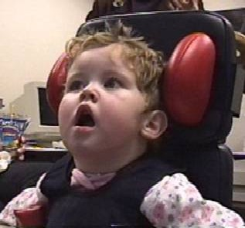
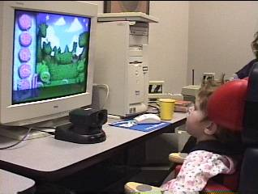
Example: A Camera Mouse
Specialized software for communication, games
James Gips and Margrit Betke
http://www.bc.edu/schools/csom/eagleeyes/
Kristen Grauman

Slide 15
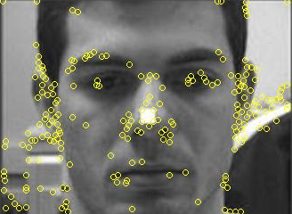
Feature-based matching for motion
For a discrete matching search, what are the tradeoffs of the chosen search window size?
Which patches to track?
  Select interest points – e.g. corners
Where should the search window be placed?
  Near match at previous frame
  More generally, taking into account the expected dynamics of the object
Kristen Grauman

Slide 16
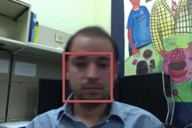
Things that make visual tracking difficult
Small, few visual features
Erratic movements, moving very quickly
Occlusions, leaving and coming back
Surrounding similar-looking objects
Amin Sadeghi

Slide 17
Strategies for tracking
Tracking by repeated detection
  Works well if object is easily detectable (e.g., face or colored glove) and there is only one
  Need some way to link up detections
  Best you can do, if you can’t predict motion
Amin Sadeghi

Slide 18
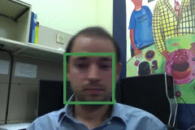
Tracking with dynamics
Key idea: Based on a model of expected motion, predict where objects will occur in next frame, before even seeing the image
  Restrict search for the object
  Measurement noise is reduced by trajectory smoothness
  Robustness to missing or weak observations
  Assumptions: camera is not moving instantly to new viewpoint, objects do not disappear and reappear in different places in the scene
Amin Sadeghi

Slide 19
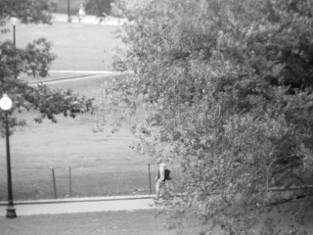
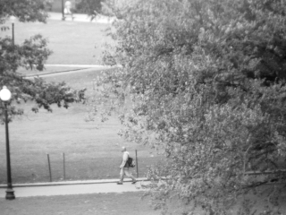
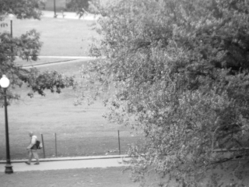

Detection vs. tracking
…
t=1
t=2
t=20
t=21
Kristen Grauman

Slide 20
Detection vs. tracking
…
Detection: We detect the object independently in each frame and can record its position over time, e.g., based on blob’s centroid or detection window coordinates
Kristen Grauman

Slide 21
Detection vs. tracking
…
Tracking with dynamics: We use image measurements to estimate position of object, but also incorporate position predicted by dynamics, i.e., our expectation of object’s motion pattern.
Kristen Grauman

Slide 22
Tracking: prediction + correction
Time t
Time t+1
Belief
Measurement
Corrected prediction
Kristen Grauman

Slide 23
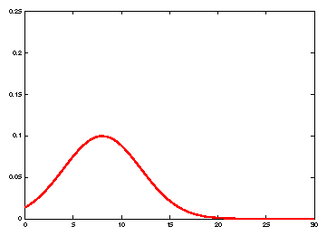
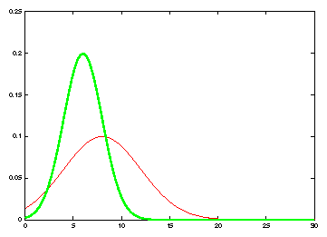
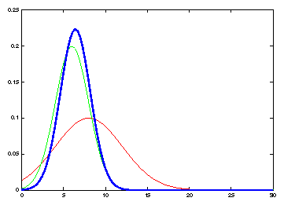
Tracking: prediction + correction
measurement
Belief: prediction
Belief: prediction
Corrected prediction
measurement
old belief
Time t
Time t+1
Kristen Grauman

Slide 24
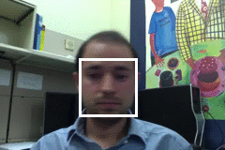
General model for tracking
state X: The actual state of the moving object that we want to estimate but cannot observe
  State could be any combination of position, pose, viewpoint, velocity, acceleration, etc.
observations Y: Our actual measurement or observation of state X, which can be very noisy
At each time t, the state changes to X_{t} and we get a new observation Y_{t}
Amin Sadeghi

Slide 25
General model for tracking
Our goal: recover most likely state X_{t} given
  All observations seen so far, i.e. y₁, y₂, …, y_{t}
  Knowledge about dynamics of state transitions
Adapted from Kristen Grauman

Slide 26
Steps of tracking
Prediction: What is the next state of the object given past measurements?
Kristen Grauman

Slide 27
Steps of tracking
Prediction: What is the next state of the object given past measurements?
Correction: Compute an updated estimate of the state from prediction and measurements
Kristen Grauman

Slide 28
Simplifying assumptions
Only the immediate past matters
dynamics model
Kristen Grauman

Slide 29
Simplifying assumptions
Only the immediate past matters
Measurements depend only on the current state
dynamics model
observation model
Kristen Grauman

Slide 30
Simplifying assumptions
Only the immediate past matters
Measurements depend only on the current state
dynamics model
observation model
…
X₀
X₁
X₂
X_{t-1}
X_{t}
Y₀
Y₁
Y₂
Y_{t-1}
Y_{t}
Amin Sadeghi

Slide 31
Problem statement
We have models for
  Likelihood of next state given current state (dynamics model):
  Likelihood of observation given the state (observation or measurement model):
We want to recover, for each t:
Amin Sadeghi

Slide 32
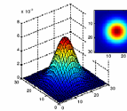
Notation reminder
Random variable with Gaussian probability distribution that has the mean vector μ and covariance matrix Σ.
x and μ are d-dimensional, Σ is d x d.
d=2
d=1
If x is 1-d, we just have one Σ parameter → the variance: σ²
Kristen Grauman

Slide 33
Dynamics and observation models
Dynamics model (represents evolution of state over time)
Observation or measurement model (at every time step we get a noisy measurement of the state)
This is how these models are defined in the Kalman filter.
Adapted from Kristen Grauman, Simon Prince

Slide 34
The Kalman filter
Linear dynamics model: state undergoes linear transformation plus Gaussian noise
Observation model: measurement is linearly transformed state plus Gaussian noise
The predicted/corrected state distributions are Gaussian
  You only need to maintain the mean and covariance
  The calculations are easy
Amin Sadeghi

Slide 35
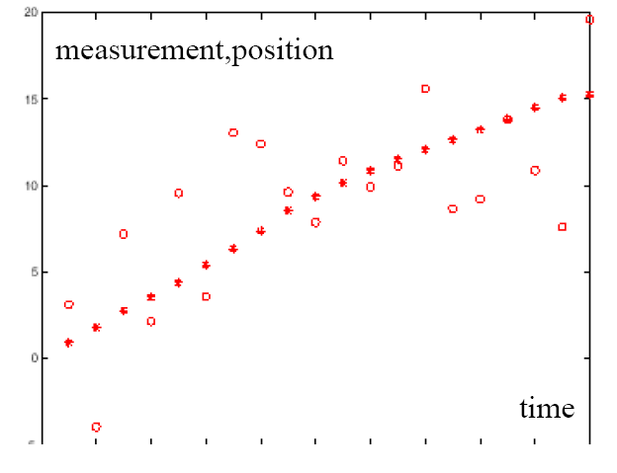
Example: Constant velocity (1D points)
1 d position
1 d position
measurements
states
time
Kristen Grauman

Slide 36
Example: Constant velocity (1D points)
State vector: position p and velocity v
Measurement is position only
Kristen Grauman

Slide 37
Probabilistic tracking
Base case:
  Start with initial prior that predicts state in absence of any evidence: P(X₀)
  For the first frame, correct this given the first measurement: Y₀=y₀
Amin Sadeghi

Slide 38
Probabilistic tracking
Base case:
  Start with initial prior that predicts state in absence of any evidence: P(X₀)
  For the first frame, correct this given the first measurement: Y₀=y₀
Amin Sadeghi

Slide 39
Probabilistic tracking
Base case:
  Start with initial prior that predicts state in absence of any evidence: P(X₀)
  For the first frame, correct this given the first measurement: Y₀=y₀
Given corrected estimate for frame t-1:
  Predict for frame t ➔
  Observe y_{t}; Correct for frame t ➔
predict
correct
Amin Sadeghi

Slide 40

Prediction
Prediction involves representing
given
Law of total probability
Amin Sadeghi

Slide 41
Prediction
Prediction involves representing
given
Conditioning on X_{t–1}
Amin Sadeghi

Slide 42
Prediction
Prediction involves representing
given
Independence assumption (only immediate past state matters)
Adapted from Amin Sadeghi

Slide 43
Prediction
Prediction involves representing
given
dynamics
model
corrected estimate
from previous step
Amin Sadeghi

Slide 44
Correction
Correction involves computing
given predicted value
Amin Sadeghi

Slide 45
Correction
Correction involves computing
given predicted value
Amin Sadeghi

Slide 46

Correction
Correction involves computing
given predicted value
Bayes’ Rule
Amin Sadeghi

Slide 47
Correction
Correction involves computing
given predicted value
Independence assumption
(observation y_{t} directly depends only on state X_{t})
Amin Sadeghi

Slide 48
Correction
Correction involves computing
given predicted value
Conditioning on X_{t}
Amin Sadeghi

Slide 49
Correction
Correction involves computing
given predicted value
observation
model
predicted
estimate
normalization factor
Amin Sadeghi

Slide 50
Summary: Prediction and correction
Prediction:
Know corrected state from previous time step, and all measurements up to (excluding) the current one →
Predict distribution over next state
Correction:
  Know prediction of state, and next measurement →
  Update distribution over current state
Time advances:
t++
Receive measurement
Kristen Grauman

Slide 51
Summary: Prediction and correction
Prediction:
Correction:
dynamics
model
corrected estimate
from previous step
observation
model
predicted
estimate
Amin Sadeghi

Slide 52
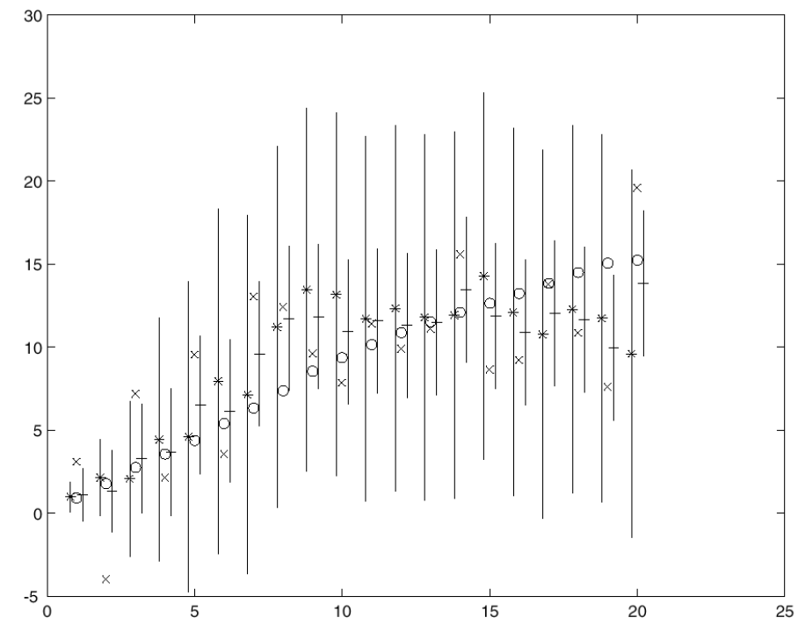
Constant velocity model
Kalman filter processing
o state
x measurement
* predicted mean estimate
+ corrected mean estimate
bars: variance estimates before and after measurements
position
time
Kristen Grauman
Time t
Time t+1

Slide 53
Constant velocity model
Kalman filter processing
o state
x measurement
* predicted mean estimate
+ corrected mean estimate
bars: variance estimates before and after measurements
position
time
Kristen Grauman
Time t
Time t+1

Slide 54
Constant velocity model
Kalman filter processing
o state
x measurement
* predicted mean estimate
+ corrected mean estimate
bars: variance estimates before and after measurements
position
time
Kristen Grauman
Time t
Time t+1

Slide 55
Constant velocity model
Kalman filter processing
o state
x measurement
* predicted mean estimate
+ corrected mean estimate
bars: variance estimates before and after measurements
position
time
Kristen Grauman
Time t
Time t+1

Slide 56
Questions
How to predict if missing a detection in the current frame?
  Prediction only depends on previous frames
How to correct if missing detection in the current frame?
  Don’t correct, just use prediction
What if we have two detections in a frame?
  Determine which of the two is more likely correct

Slide 57
Example: Kalman Filter
Ground Truth
Observation
Correction
Amin Sadeghi

Slide 58
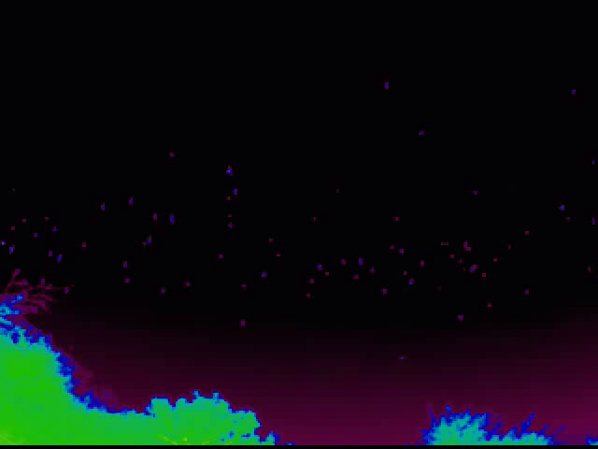
A bat census
http://www.cs.bu.edu/~betke/research/bats/
Kristen Grauman

Slide 59
Tracking issues
Initialization
  Manual
  Background subtraction
  Detection
Amin Sadeghi

Slide 60
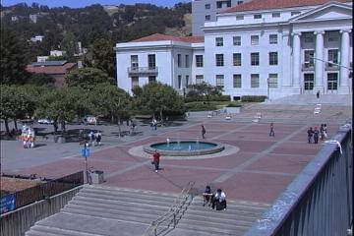
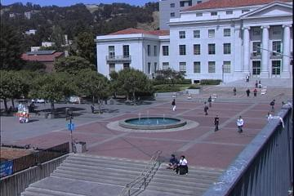
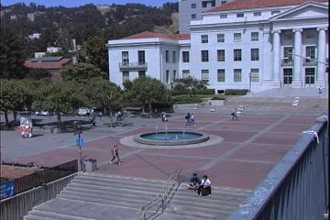



Background subtraction: average/median image
Alyosha Efros

Slide 61
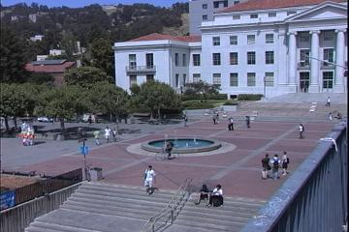

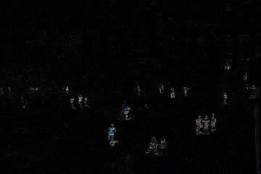
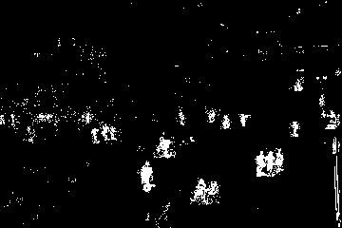
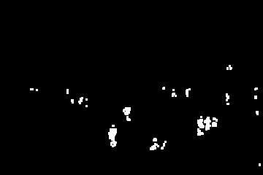
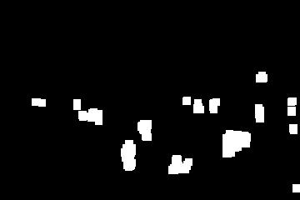
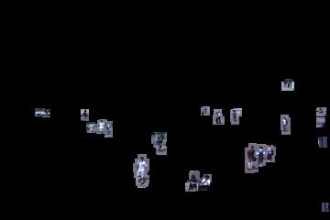
Background subtraction
-
=
Alyosha Efros

Slide 62
Tracking issues
Initialization
Obtaining observation and dynamics models
  Observation model: match a template or use a trained detector
  Dynamics model: usually specify using domain knowledge
Amin Sadeghi

Slide 63
Tracking issues
Initialization
Obtaining observation and dynamics models
Uncertainty of prediction vs. correction
  If the dynamics model is too strong, will end up ignoring the data
  If the observation model is too strong, tracking is reduced to repeated detection
Too strong dynamics model
Too strong observation model
Amin Sadeghi

Slide 64
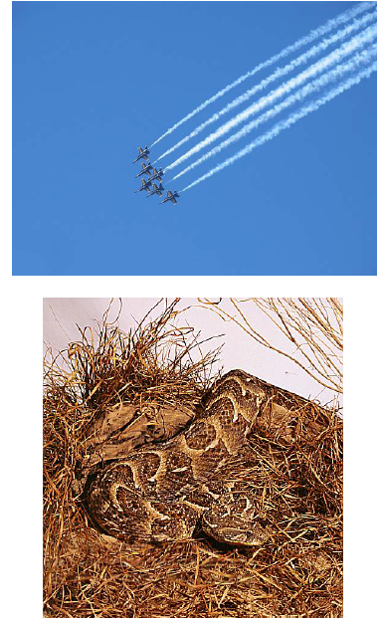
Tracking issues
Initialization
Getting observation and dynamics models
Prediction vs. correction
Data association
  When tracking multiple objects, need to assign right objects to right tracks (particle filters good for this)
Amin Sadeghi

Slide 65
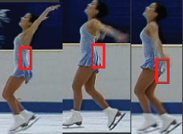
Tracking issues
Initialization
Getting observation and dynamics models
Prediction vs. correction
Data association
Drift
  Errors can accumulate over time
D. Ramanan, D. Forsyth, and A. Zisserman.
Tracking People by Learning their Appearance. TPAMI 2007.
Amin Sadeghi

Slide 66
Things to remember
Tracking objects = detection + prediction
Probabilistic framework
  Predict next state
  Update current state based on observation
Two simple but effective methods
  Kalman filters: Gaussian distribution
  Particle filters: Multimodal distribution (for multiple objects)
Challenges
Amin Sadeghi

