Slide 1
CS 1699: Intro to Computer Vision
Active Learning
Prof. Adriana Kovashka
University of Pittsburgh
November 24, 2015

Slide 2
Announcements
Homework 4 due tonight
  Just save some positive detections, not all
Homework 5 out, due December 10
  Worth 50 points total, i.e. half the work
  Still 10% of final grade
  Up to 20 points (40%) of extra credit

Slide 3
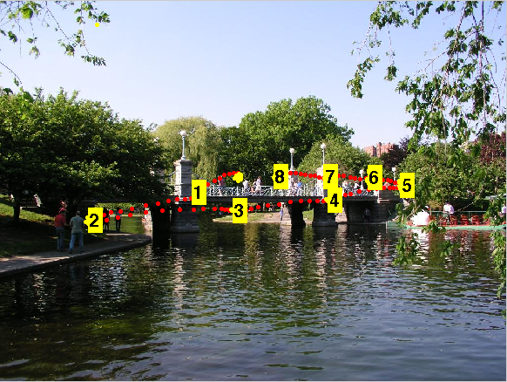
Fixations for One Person
Fixations
Vs
Saccades
Tilke Judd / Chris Thomas

Slide 4
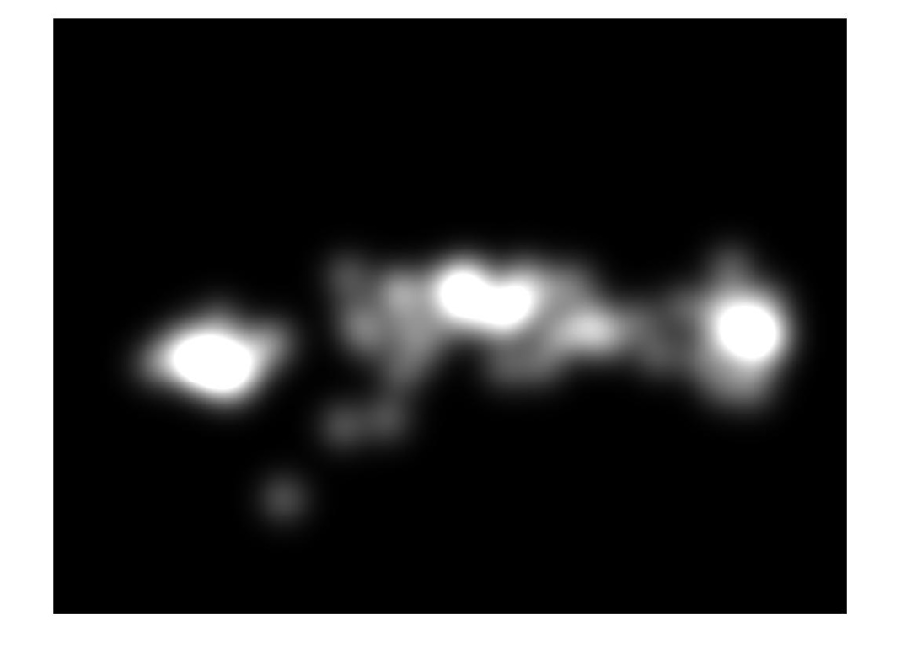
Fixation Map
Just convolve a Gaussian over the fixation positions
Can do this for a single person, or an aggregate of many people
Can also threshold:
  Choose top n %
  Yields a binary map
Tilke Judd / Chris Thomas

Slide 5
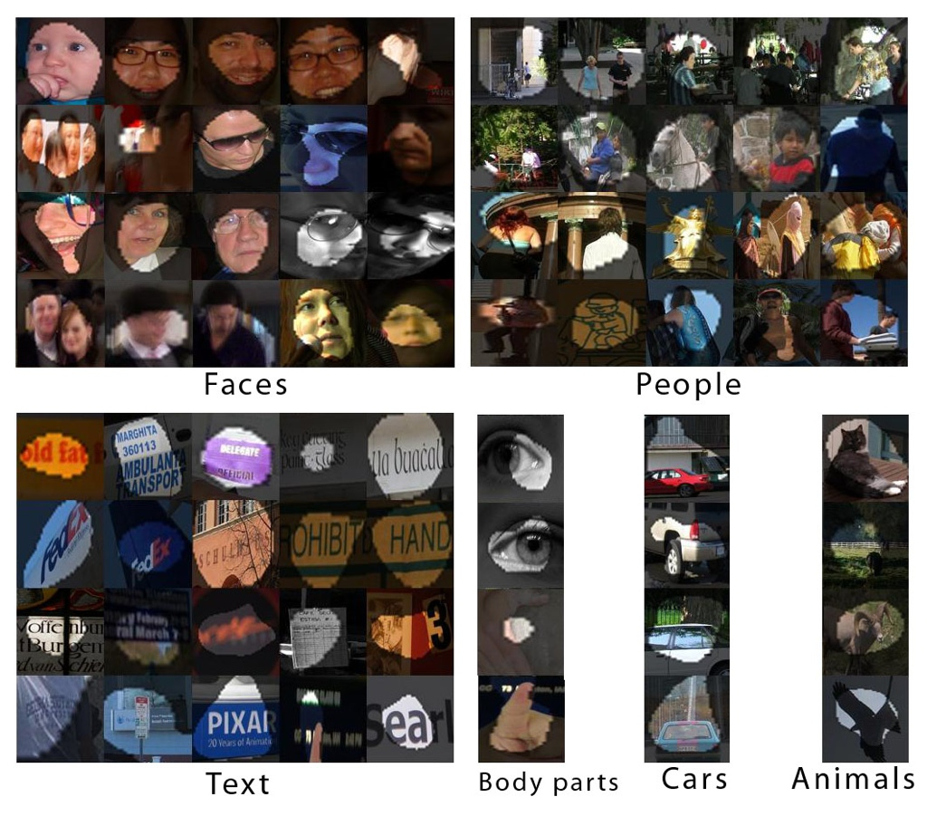
Where do people actually look?
Labeled faces / text with bounding box and horizon line (if any)
Based on the annotations:
10% fixation on faces
11% on text
40% of fixations are within the center 11% of the image
Animals, cars, human body parts
Tilke Judd / Chris Thomas

Slide 6
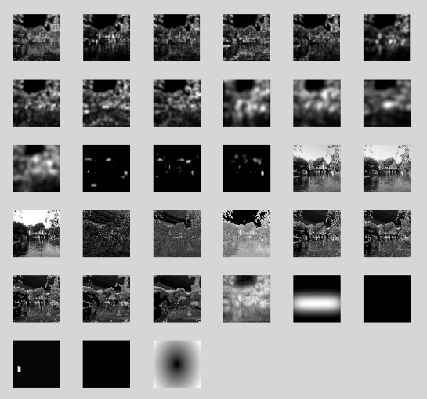

Learning a Classifier from Eye-Tracking Data
Predict where people will look for a new image, by running model on every pixel of the image
33 features
Labels
+
Support Vector Machine
Saliency Model
Learns weights for each feature that best predict a saliency label
for each pixel
Features: illumination, color, orientation, horizon line, face detector (Viola-Jones), person detector (DPM), distance to center
10 salient samples from top 20%
10 non-salient samples from bottom 70%
from each of 903
training images
Adapted from Tilke Judd / Chris Thomas

Slide 7
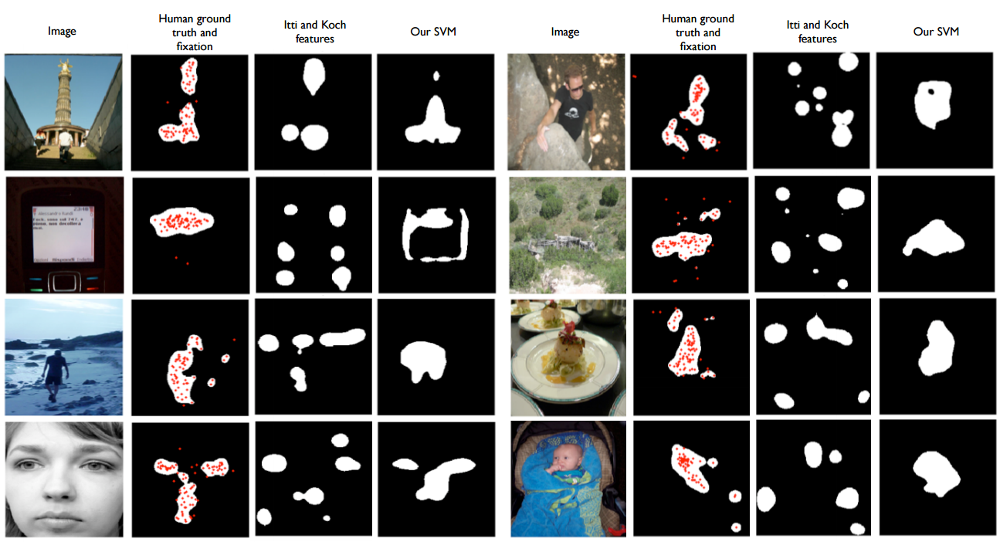
Tilke Judd / Chris Thomas

Slide 8
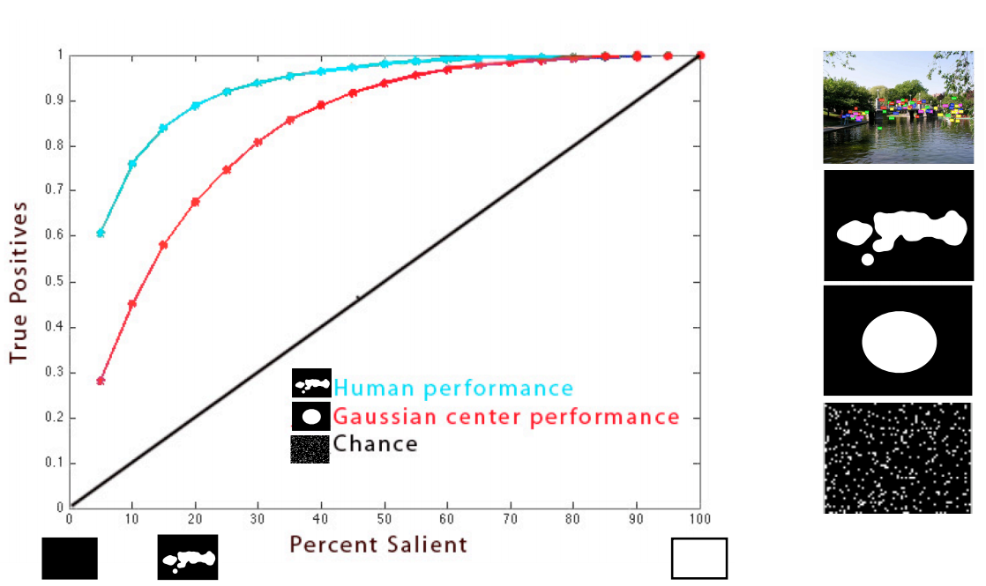
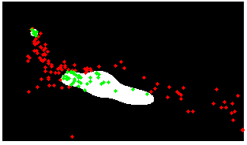
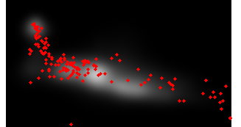
Evaluating Saliency Maps
Tilke Judd / Chris Thomas
Notes:
Skip

Slide 9
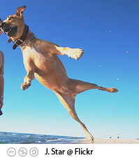
Amazon Mechanical Turk
Workers
Task
Task: Dog?
Broker
Answer: Yes
Pay: $0.01
Is this a dog?
o Yes
o No
www.mturk.com
$0.01
Alex Sorokin

Slide 10
THE ESP GAME
TWO-PLAYER ONLINE GAME
PARTNERS DON’T KNOW EACH OTHER AND CAN’T COMMUNICATE
OBJECT OF THE GAME:
TYPE THE SAME WORD
THE ONLY THING IN COMMON IS AN IMAGE
Luis von Ahn and Laura Dabbish. “Labeling Images with a Computer Game.” CHI 2004.

Slide 11
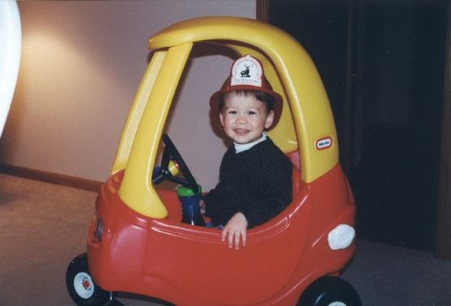
THE ESP GAME
PLAYER 1
PLAYER 2
GUESSING: CAR
GUESSING: BOY
GUESSING: HAT
GUESSING: CAR
GUESSING: KID
SUCCESS!
YOU AGREE ON CAR
SUCCESS!
YOU AGREE ON CAR
Luis von Ahn

Slide 12
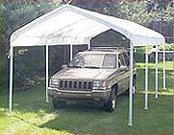
REVEALING IMAGES
GUESSER
REVEALER
CAR
BRUSH
BRUSH
CAR
CAR
GUESS
PARTNER’S
GUESS
Luis von Ahn

Slide 13
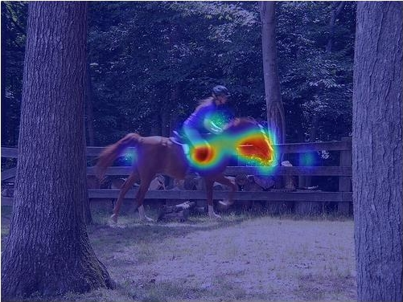
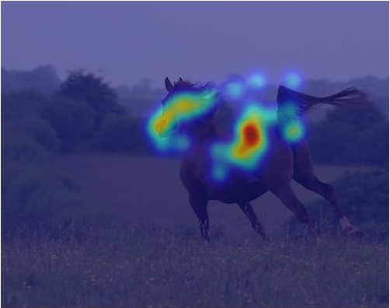
Using gaze to collect object bounding boxes
Viewing task was to determine which object category is shown
Compute a bounding box from locations that were fixated by users (faster than drawing bounding boxes)
Papadopoulos et al., “Training object class detectors from eye tracking data,” ECCV 2014

Slide 14
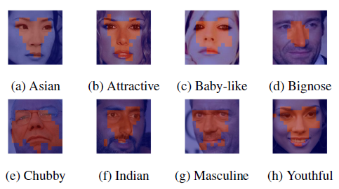
Learning attributes using human gaze
Use human gaze to learn where attributes “live”
To learn attribute models, extract features only from fixated regions

Slide 15
Today:
What to do when data is expensive to obtain?
Use data intelligently, only label useful data
  Active learning (choose labeling questions at training time)
  Human-in-the-loop recognition (choose labeling questions at test time)
Develop unsupervised methods that don’t require labels (next time)
Overview of recent research concepts; will go fast!

Slide 16



Crowdsourcing → Active Learning
Unlabeled Images
Show images,
Collect and filter labels
Find images near decision boundary
Training Labels
Training Images
Image Features
Classifier Training
Trained Classifier
Training
James Hays

Slide 17
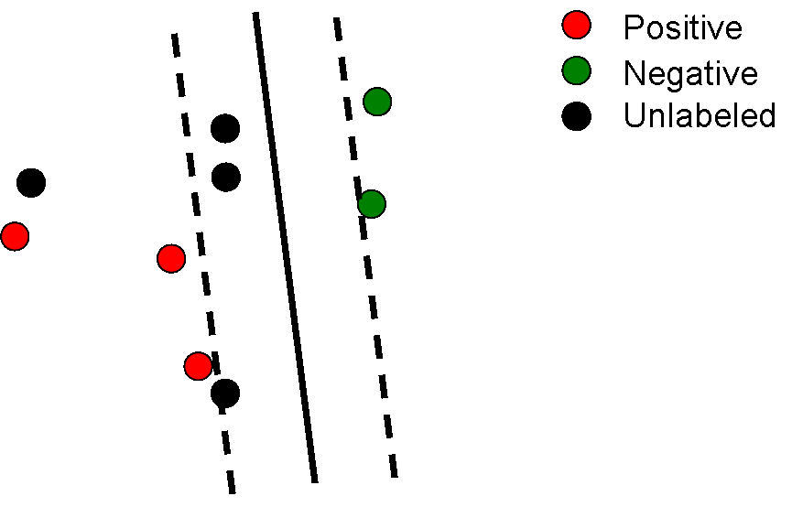
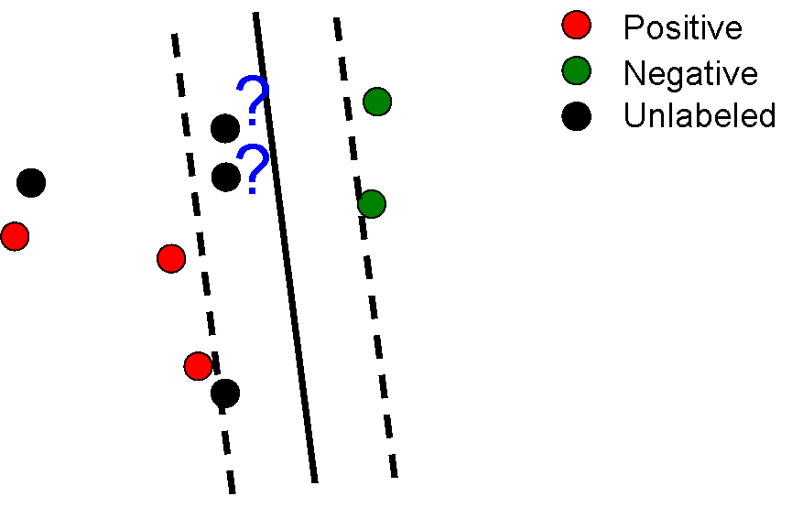
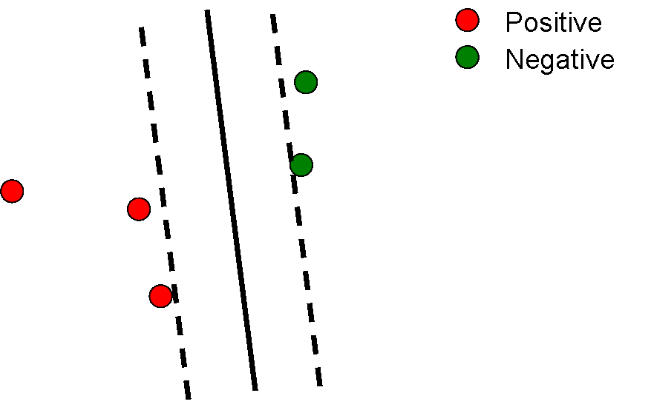
Active Learning
Traditional active learning reduces supervision by obtaining labels for the most informative or uncertain examples first.
[Mackay 1992, Freund et al. 1997, Tong & Koller 2001, Lindenbaum et al. 2004, Kapoor et al. 2007 ...]
Sudheendra Vijayanarasimhan

Slide 18
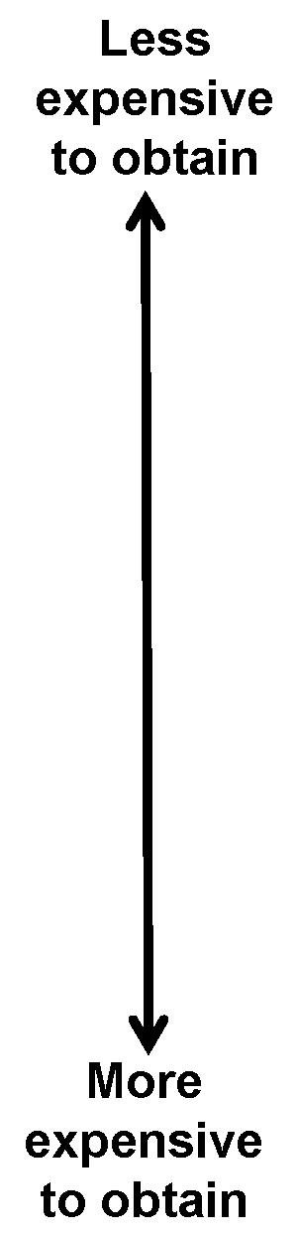
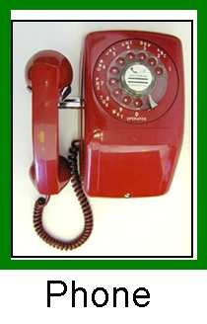
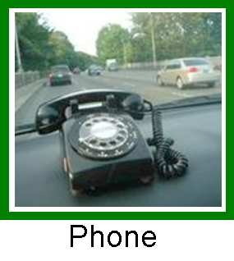
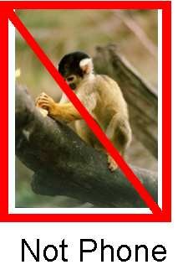

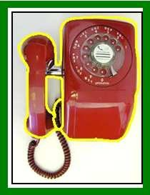
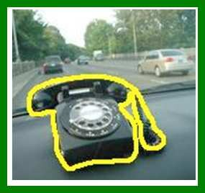
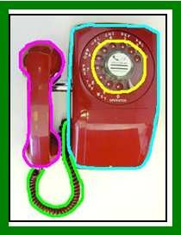
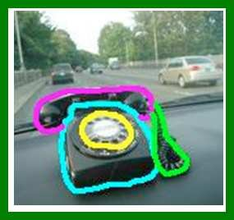
Multi-level Active Learning
Choose not only which images to label, but at what level to label them
Weak labels: informing about presence of an object
Strong labels: outlines demarking the object
Stronger labels: informing about labels of parts of objects
Sudheendra Vijayanarasimhan

Slide 19
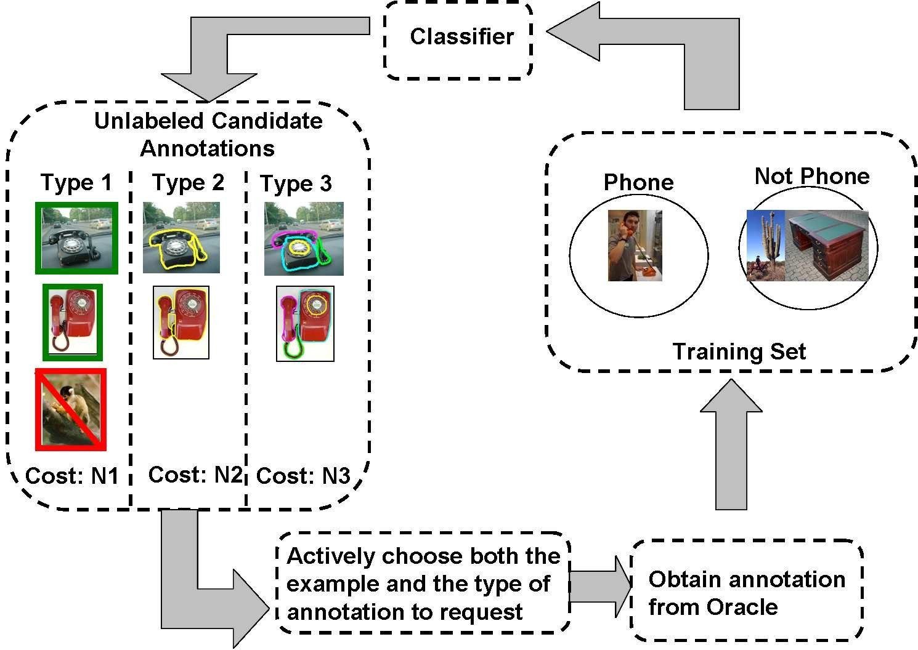
Approach: Multi-Level Active Visual Learning
Start here
Best use of manual resources may call for combination of annotations at different levels.
Choice must balance cost of varying annotations with their information gain.
Adapted from Sudheendra Vijayanarasimhan

Slide 20
Requirements
The approach requires
a classifier that can deal with annotations at multiple levels
an active learning criterion to deal with
Multiple types of annotation queries
Variable cost associated with different queries
Sudheendra Vijayanarasimhan

Slide 21
Results
Category − ajaxorange
Category − apple
Category − banana
Multi−level active
Single−level active
Multi−level random
Single−level random
85
Multi−level active
85
Multi−level active
Single−level active Multi−level random
Single−level random
102
100
98
96
94
92
80
Single−level active
Area under ROC
Multi−level random
Area under ROC
80
Area under ROC
75
Single−level random
70
75
65
70
90
60
65
88
 | 10 | 20 | 30 | 40 | 55 |  | 10 | 20 | 30 | 40 |  |  | 10 | 20 | 30 40
 |  | Cost |  |  |  |  |  | Cost |  |  |  |  |  | Cost
0
0
0
Category − checkeredscarf
Category − cokecan
Category − dirtyworkgloves
Multi−level active
Single−level active
Multi−level random
Single−level random
98
Multi−level active
Single−level active
Multi−level random
Single−level random
49
Multi−level active
Single−level active
Multi−level random
Single−level random
95
97
48
Area under ROC
Area under ROC
Area under ROC
47
46
45
90
96
95
85
94
44
43
42
80
93
0
10
30
40
92
41
20
Cost
0
10
20
Cost
30
40
0
10
20 30
Cost
40
Sample learning curves per class, each averaged over five trials. Multi-level active selection performs the best for most classes.
Vijayanarasimhan and Grauman, “Multi-Level Active Prediction of Useful Image Annotations for Recognition,” NIPS 2008.

Slide 22
Today:
What to do when data is expensive to obtain?
Use data intelligently, only label useful data
  Active learning (choose labeling questions at training time)
  Human-in-the-loop recognition (choose labeling questions at test time)
Develop unsupervised methods that don’t require labels (next time)

Slide 23
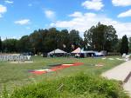
Human-in-the-loop Recognition
Human Observer
Human Estimate
Image Features
Trained Classifier
Prediction
Test Image
Outdoor
Testing
Adapted from James Hays
Notes:
Pipeline could look different, but human is involved at test time.

Slide 24


Visual Recognition With Humans in the Loop
ECCV 2010, Crete, Greece
Steve Branson
Catherine Wah
Florian Schroff
Boris Babenko
Serge Belongie
Peter Welinder
Pietro Perona

Slide 25
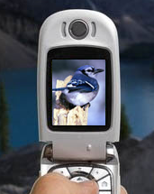
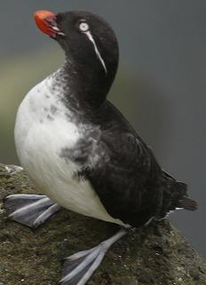
Field guides difficult for average users
Computer vision doesn’t work perfectly (yet)
Research mostly on basic-level categories
What type of bird is this?
Steve Branson
Notes:
Suppose you are taking a hike and come across this bird. You would like to know what kind of bird it is. What would you do?
You pull out your birding field guide, you fumble through it forever, and never figure it out (show Sibley)
You plug it in to your leading computer vision algorithm (show bird, if you’re lucky, it might also say it’s a chair)
S
You learn to things 1) field guides don’t work
2) Computer vision just does basic categories and doesn’t perform that well

Slide 26


Visual Recognition With Humans in the Loop
What kind of bird is this?
Parakeet Auklet
Steve Branson

Slide 27
Motivation
Supplement visual recognition with the human capacity for visual feature extraction to tackle difficult (fine-grained) recognition problems
Typical progress is viewed as increasing data difficulty while maintaining full autonomy
Here, the authors view progress as reduction in human effort on difficult data
Brian O’Neill

Slide 28
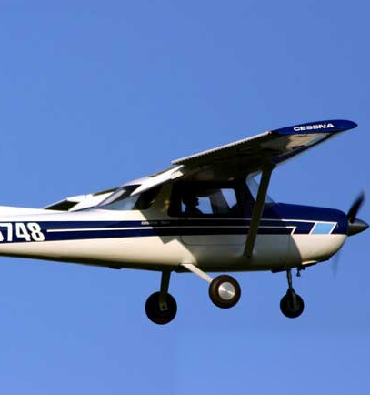
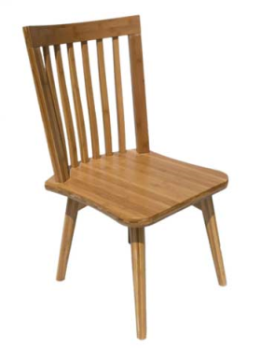
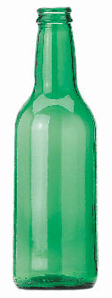
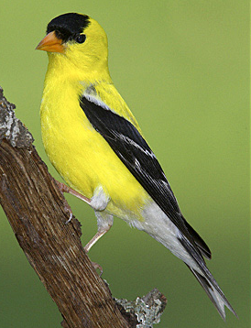
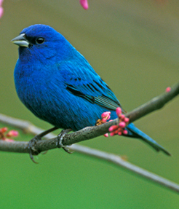
Categories of Recognition
Basic-Level
Subordinate
Parts & Attributes
Airplane? Chair? Bottle? …
American Goldfinch? Indigo Bunting?…
Yellow Belly? Blue Belly?…
Easy for Humans
Hard for Humans
Easy for Humans
Hard for computers
Hard for computers
Hard for computers
Steve Branson

Slide 29
Visual 20 Questions Game
Blue Belly? no
Cone-shaped Beak? yes
Striped Wing? yes
American Goldfinch? yes
Hard classification problems can be turned into a sequence of easy ones
Steve Branson
Notes:
It doesn’t mean they necessarily answer them correctly

Slide 30
Recognition With Humans in the Loop
Computer Vision
Cone-shaped Beak? yes
Computer Vision
American Goldfinch? yes
Computers: reduce number of required questions
Humans: drive up accuracy of vision algorithms
Steve Branson

Slide 31

Implementation
Assembled 25 visual questions encompassing 288 visual attributes extracted from www.whatbird.com
Mechanical Turk users asked to answer questions and provide confidence scores
Brian O’Neill

Slide 32
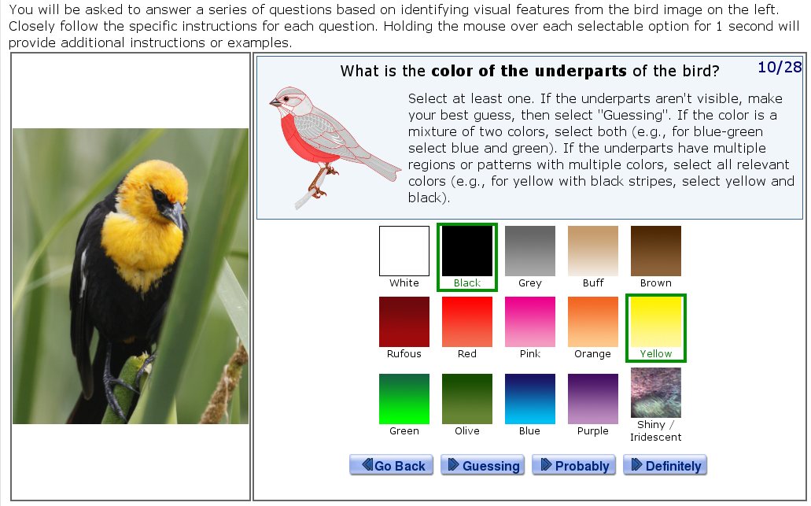
Example Questions
Steve Branson

Slide 33
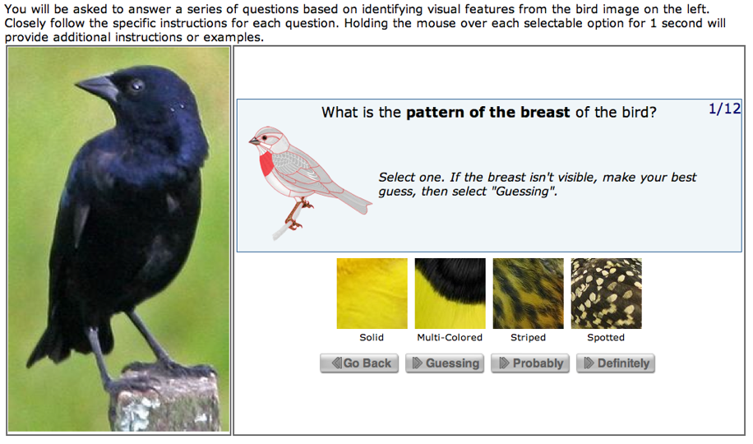
Example Questions
Steve Branson

Slide 34
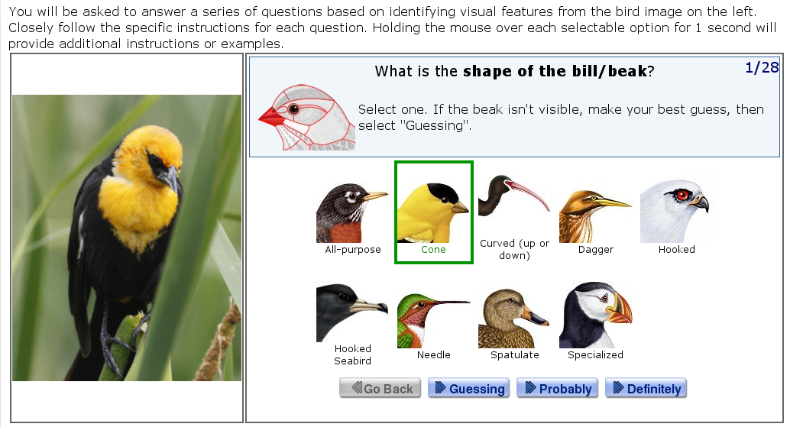
Example Questions
Steve Branson

Slide 35
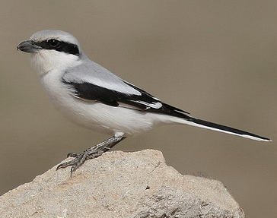
Basic Algorithm
Computer Vision
Max Expected Information Gain
Input Image ( )
Question 1:
A: NO
Is the belly black?
Max Expected Information Gain
Question 2:
A: YES
Is the bill hooked?
…
Steve Branson

Slide 36
Some definitions:
BOARD
Set of possible questions
Possible answers to question i
Possible confidence in answer i (Guessing, Probably, Definitely)
User response
History of user responses at time t
Brian O’Neill

Slide 37
Question selection
BOARD
Seek the question (e.g. “What color is the belly of the bird?”) that gives the maximum information gain (entropy reduction) given the image and the set of previous user responses
Probability of obtaining
response u_{i} to evaluated question
given image and response history
Entropy when response is added to history
Entropy at this iteration (before response to evaluated question is added to history)
where
Brian O’Neill

Slide 38
Basic Algorithm
  Select the next question that maximizes expected information gain:
  Easy to compute if we can to estimate probabilities of the form:
Object Class
Image
Sequence of user responses
Steve Branson

Slide 39
Basic Algorithm
Normalization factor
Model of user responses
Computer vision estimate
(e.g. from an SVM)
Steve Branson

Slide 40
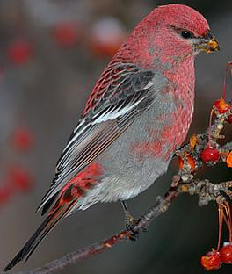
Modeling User Responses
  Assume:
  Estimate using Mechanical Turk
Definitely
grey
red
black
white
brown
blue
Probably
Guessing
grey
red
black
white
brown
blue
grey
red
black
white
brown
blue
Pine Grosbeak
What is the color of the belly?
Steve Branson

Slide 41
Details
Assume questions are answered independently
Use chain rule and Bayes rule

Slide 42
Incorporating Computer Vision
Use any recognition algorithm that can estimate: p(c|x)
We experimented with two simple methods:
1-vs-all SVM
Attribute-based classification
[Lampert et al. ’09, Farhadi et al. ‘09]
Steve Branson

Slide 43
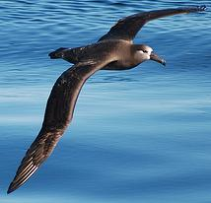
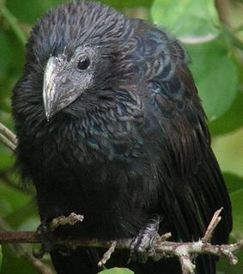
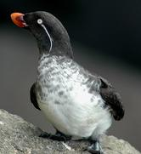
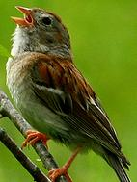
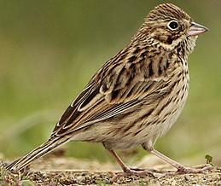
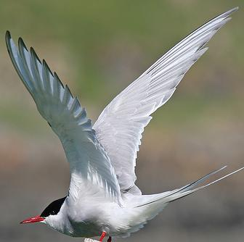
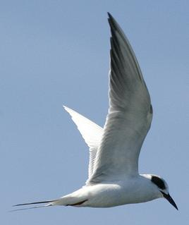
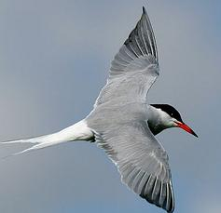
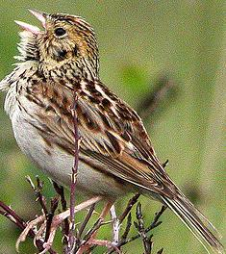
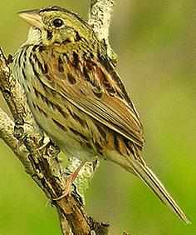
Birds 200 Dataset
200 classes, 6000+ images, 288 binary attributes
Black-footed Albatross
Groove-Billed Ani
Parakeet Auklet
Field Sparrow
Vesper Sparrow
Arctic Tern
Forster’s Tern
Common Tern
Baird’s Sparrow
Henslow’s Sparrow

Slide 44
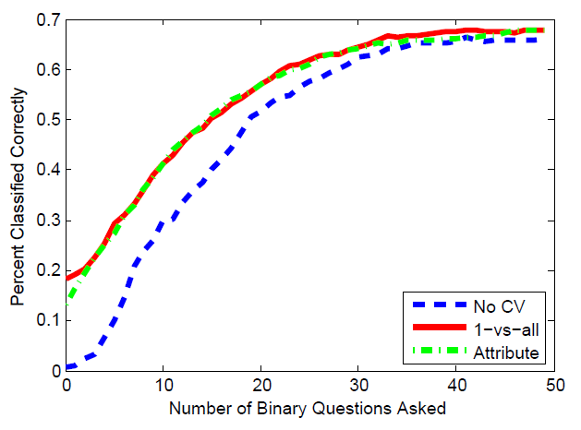
Results
Users drive performance: 19% → 68%
Fewer questions asked if CV used
Just Computer Vision
19%
Adapted from Steve Branson

Slide 45


Examples
User Input Helps Correct Computer Vision
Magnolia Warbler
Common Yellowthroat
computer vision
Common Yellowthroat
Is the breast pattern solid? no (definitely)
Magnolia Warbler
Steve Branson

Slide 46
Summary:
Human-in-the-loop training and testing
To make intelligent use of the human labeling effort during training, have the computer vision algorithm learn actively by selecting those questions that are most informative
To combine strengths of human and imperfect vision algorithms, use a human-in-the-loop at recognition time

