Slide 1
CS 1699: Intro to Computer Vision
Projective Transformations + Image Stitching
Prof. Adriana Kovashka
University of Pittsburgh
October 6, 2015

Slide 2
HW2
Part III b: 22.5 degree bins -> 45 degree bins
Due on Thursday, 11:59pm

Slide 3
Today
Wrap-up: indexing and retrieval
Image transformations (2D linear and affine)
Image formation
Image stitching (computing homographies)

Slide 4

Indexing local features: inverted file index
For text documents, an efficient way to find all pages on which a word occurs is to use an index…
We want to find all images in which a feature occurs.
To use this idea, we’ll need to map our features to “visual words”.
Kristen Grauman

Slide 5
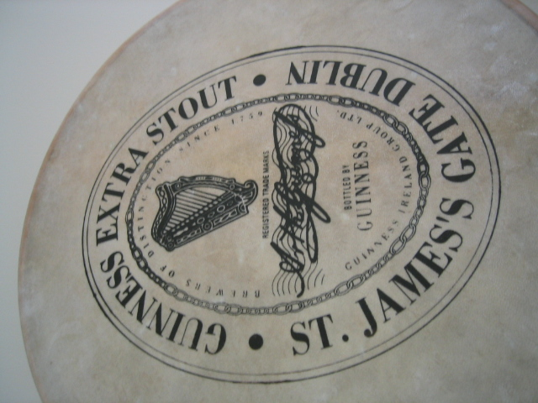
Visual words: main idea
Extract some local features from a number of images …
e.g., SIFT descriptor space: each point is 128-dimensional
D. Nister, CVPR 2006

Slide 6

Visual words: main idea
D. Nister, CVPR 2006

Slide 7
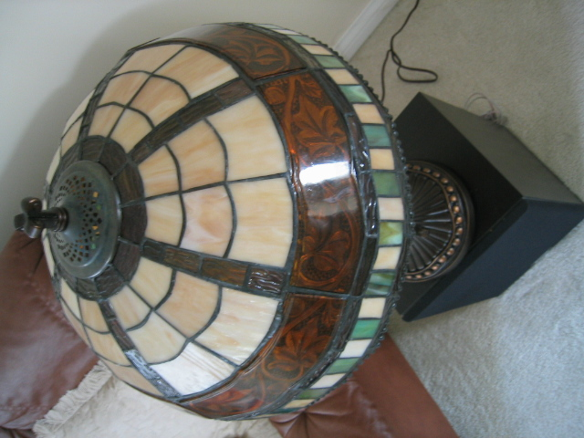
Visual words: main idea
D. Nister, CVPR 2006

Slide 8

Visual words: main idea
D. Nister, CVPR 2006

Slide 9
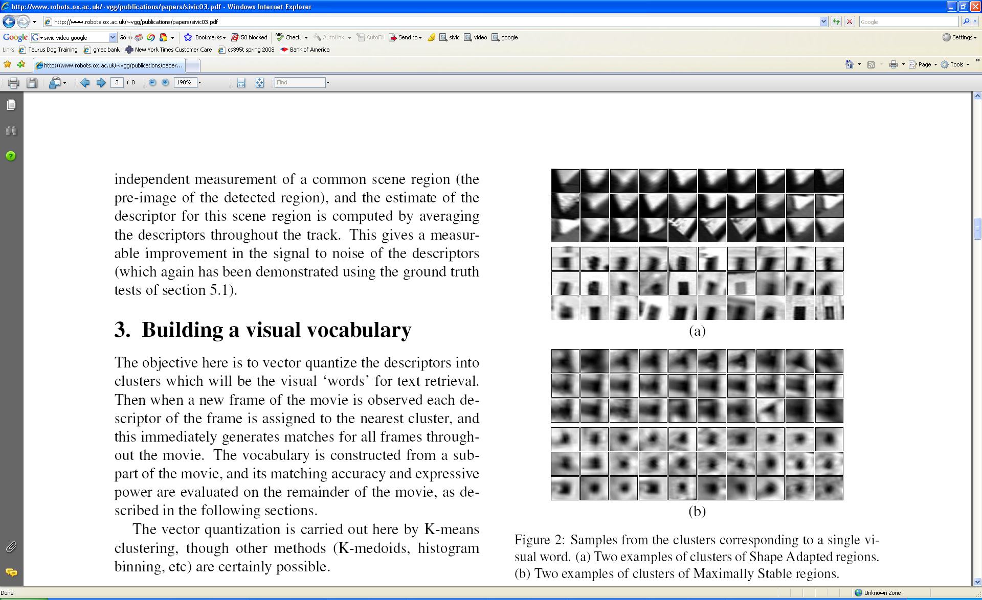
Visual words
Example: each group of patches belongs to the same visual word
Figure from Sivic & Zisserman, ICCV 2003
Adapted from Kristen Grauman

Slide 10
Visual words
Map high-dimensional descriptors to tokens/words by quantizing the feature space
Quantize via clustering, let cluster centers be the prototype “words”
1
2
Word #3
3
Determine which word to assign to each new image region by finding the closest cluster center.
Descriptor’s feature space
Query
Kristen Grauman

Slide 11
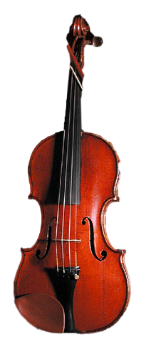
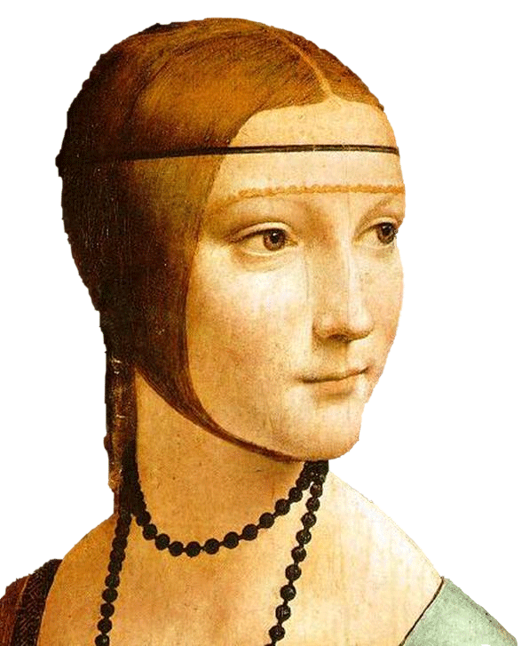
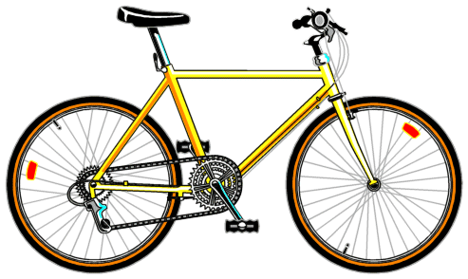
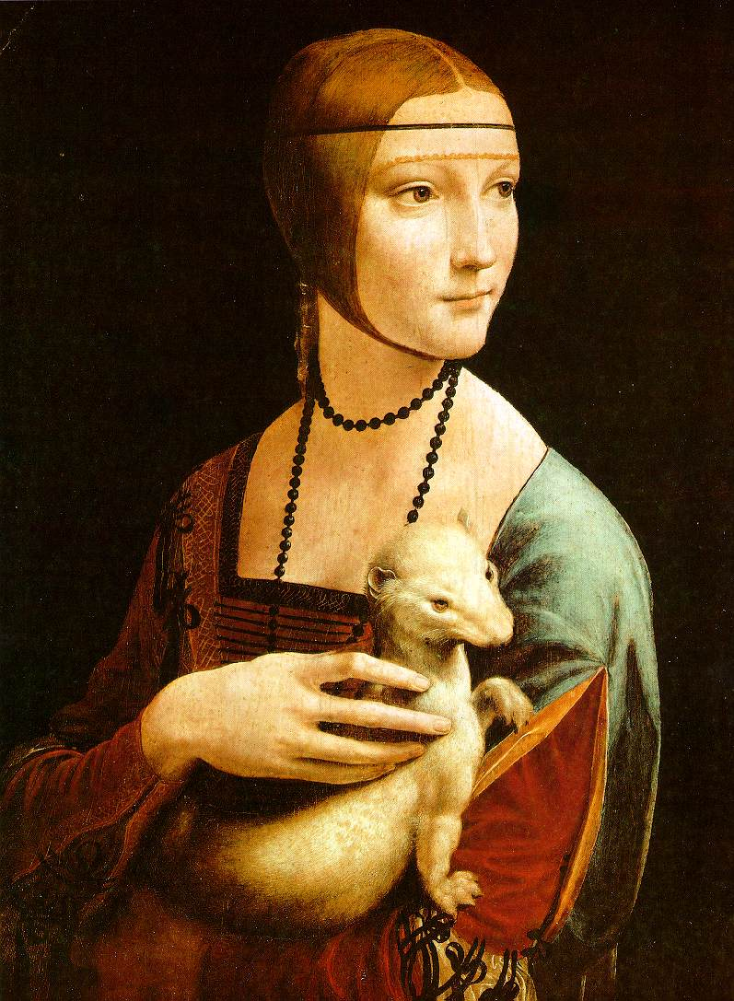

Slide 12





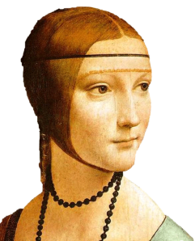
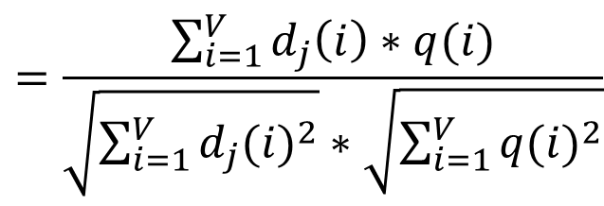
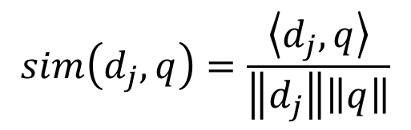
Comparing bags of words
Rank frames by normalized scalar product between their (possibly weighted) occurrence counts---nearest neighbor search for similar images.
[1 8 1 4]
[5 1 1 0]
$$sim\left(d_{j},q\right)=\frac{\left\langle d_{j},q\right\rangle }{\left\|d_{j}\right\|\left\|q\right\|}$$
$$=\frac{\sum_{i=1}^{V}{d_{j}\left(i\right)∗q(i)}}{\sqrt{\sum_{i=1}^{V}{{d_{j}(i)}^{2}}}∗\sqrt{\sum_{i=1}^{V}{{q(i)}^{2}}}}$$
for vocabulary of V words
Kristen Grauman

Slide 13
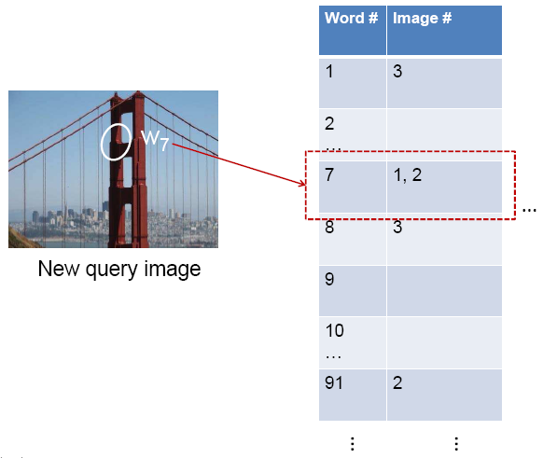
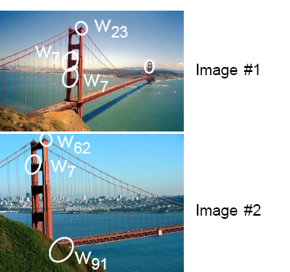
Inverted file index and
bags of words similarity
w₉₁
Extract words in query
Inverted file index to find relevant frames
Compare word counts
Adapted from Kristen Grauman

Slide 14
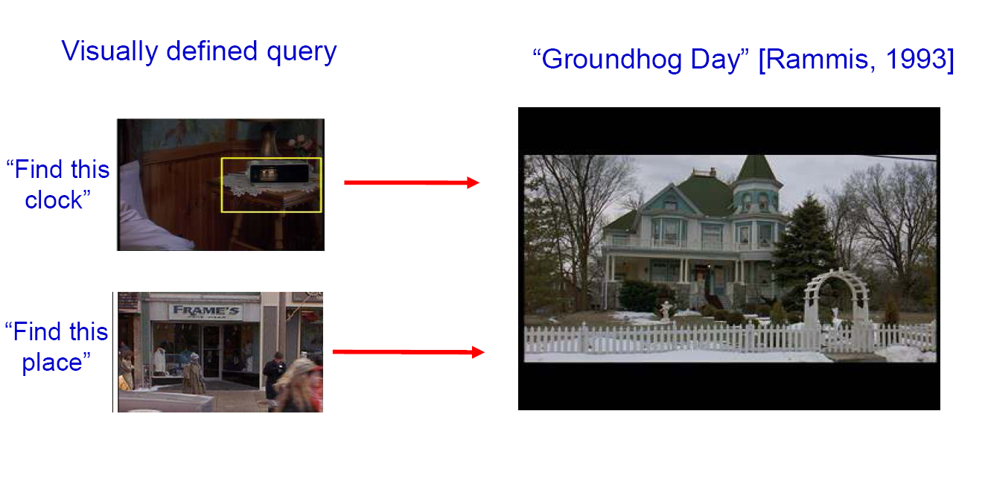
Bags of words for content-based image retrieval
Slide from Andrew Zisserman
Sivic & Zisserman, ICCV 2003

Slide 15
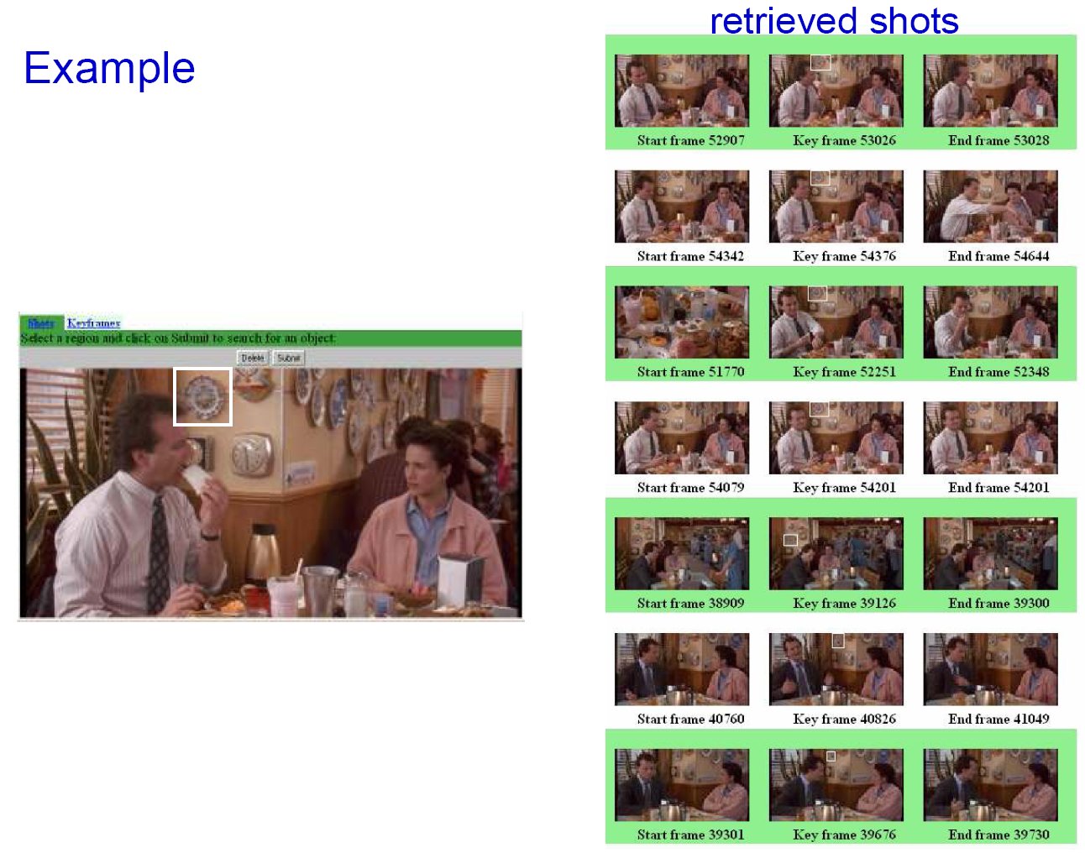
Slide from Andrew Zisserman
Sivic & Zisserman, ICCV 2003

Slide 16
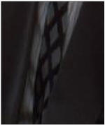
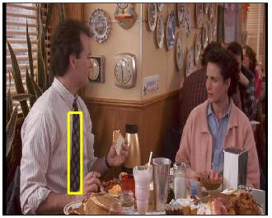
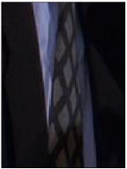
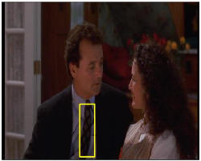
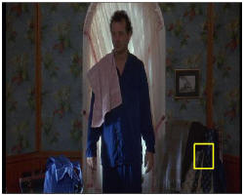
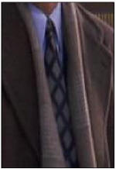
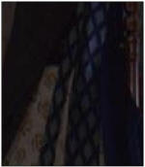
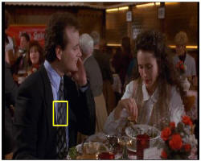
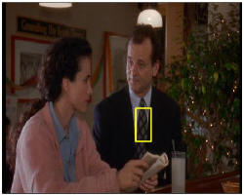
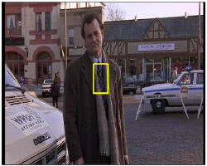
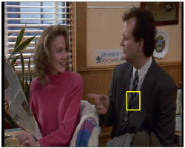
Video Google System
Query region
Collect all words within query region
Inverted file index to find relevant frames
Compare word counts
Spatial verification
Sivic & Zisserman, ICCV 2003
Demo online at : http://www.robots.ox.ac.uk/~vgg/research/vgoogle/index.html
Retrieved frames
16
K. Grauman, B. Leibe
Notes:
16

Slide 17
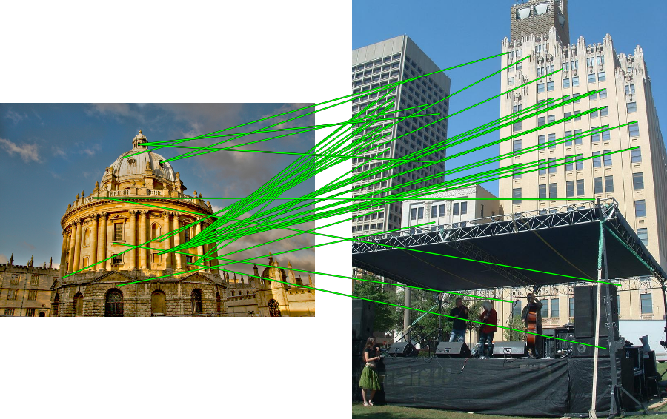
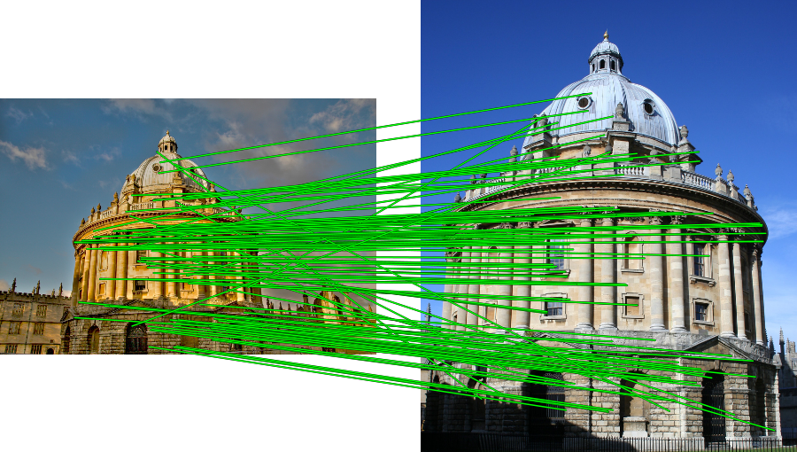
Spatial Verification
Query
Query
DB image with high BoW similarity
DB image with high BoW similarity
Both image pairs have many visual words in common.
Ondrej Chum

Slide 18
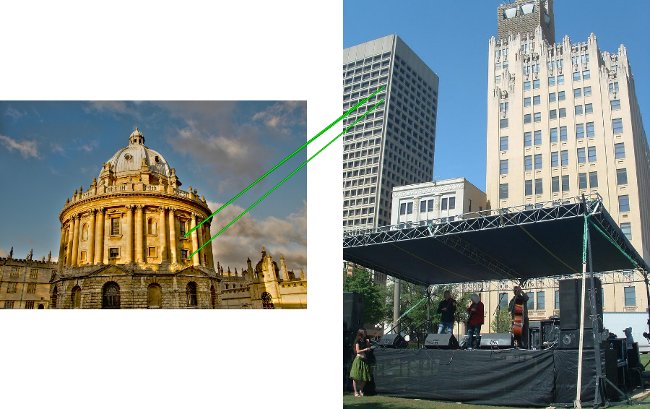
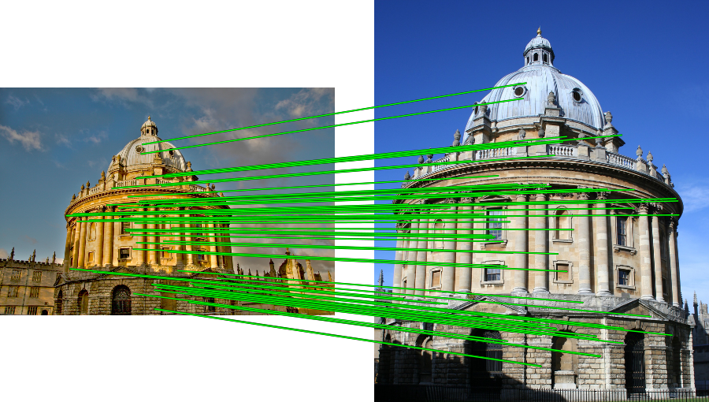
Spatial Verification
Query
Query
DB image with high BoW similarity
DB image with high BoW similarity
Only some of the matches are mutually consistent.
Ondrej Chum

Slide 19
Spatial Verification: two basic strategies
RANSAC
  Typically sort by BoW similarity as initial filter
  Verify by checking support (inliers) for possible transformations
    e.g., “success” if find a transformation with > N inlier correspondences
Generalized Hough Transform
  Let each matched feature cast a vote on location, scale, orientation of the transformation
  Verify parameters with enough votes
Kristen Grauman

Slide 20

Example: solving for translation
A₁
A₅
B₄
A₂
A₃
(t_{x}, t_{y})
B₁
A₄
B₂
B₃
B₅
Problem: outliers
RANSAC solution
Sample a set of matching points (1 pair)
Solve for transformation parameters
Score parameters with number of inliers
Repeat steps 1-3 N times
Derek Hoiem

Slide 21
Example: solving for translation
B₄
A₁
B₅
B₆
A₂
A₃
(t_{x}, t_{y})
B₁
A₄
B₂
B₃
A₅
A₆
Problem: outliers, multiple objects, and/or many-to-one matches
Hough transform solution
Initialize a grid of parameter values
Each matched pair casts a vote for consistent values
Find the parameters with the most votes
Solve using least squares with inliers
Derek Hoiem

Slide 22
RANSAC verification
Kristen Grauman

Slide 23
RANSAC verification
Kristen Grauman

Slide 24
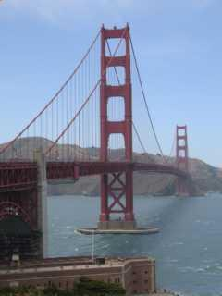
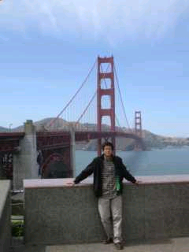
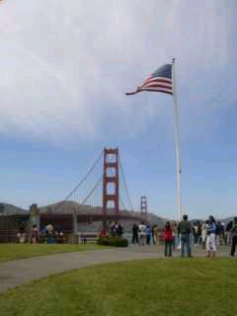
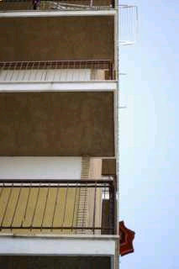
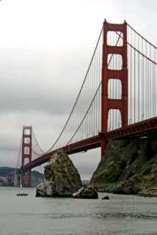
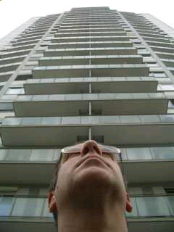
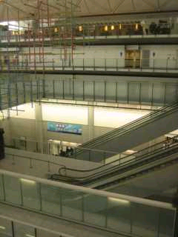
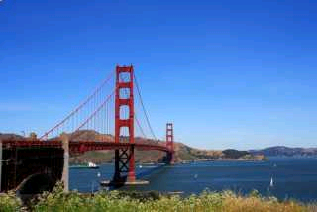

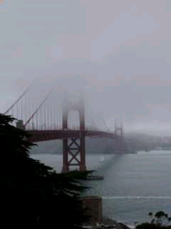
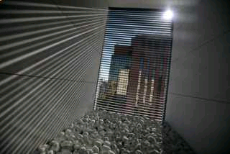
Scoring retrieval quality
Results (ordered):
Database size: 10 images
Relevant (total): 5 images
Query
precision = #relevant / #returned
recall = #relevant / #total relevant
1
0.8
0.6
precision
0.4
0.2
0
0
0.2
0.4
0.6
0.8
1
recall
Ondrej Chum

Slide 25
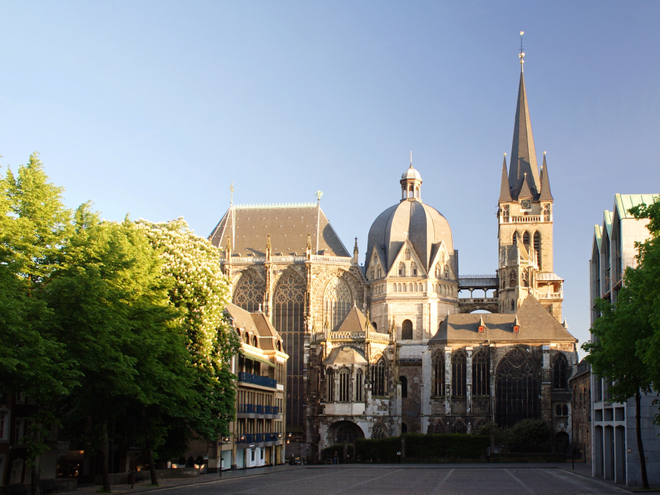

Example Applications
Aachen Cathedral
Mobile tourist guide
Object/building recognition
Self-localization
Photo/video augmentation
[Quack, Leibe, Van Gool, CIVR’08]

Slide 26
Indexing and Retrieval: Summary
Bag of words representation: quantize feature space to make discrete set of visual words
  Summarize image by distribution of words
  Index individual words
Inverted index: pre-compute index to enable faster search at query time
Recognition of instances via alignment: matching local features followed by spatial verification
  Robust fitting : RANSAC, GHT
Adapted from Kristen Grauman

Slide 27
Today
Wrap-up: indexing and retrieval
Image transformations (2D linear and affine)
Image formation
Image stitching (computing homographies)

Slide 28
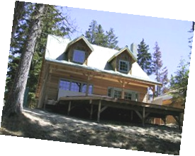
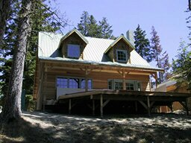
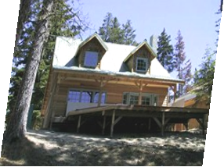
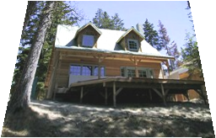
Parametric (global) warping
Examples of parametric warps:
translation
rotation
aspect
perspective
affine
Alyosha Efros

Slide 29
Parametric (global) warping
T
p = (x,y)
p’ = (x’,y’)
Transformation T is a coordinate-changing machine:
p’ = T(p)
What does it mean that T is global?
  Is the same for any point p
  can be described by just a few numbers (parameters)
Let’s represent T as a matrix:
p’ = Mp
Alyosha Efros

Slide 30

What transformations can be represented with a 2x2 matrix?
2D Scaling?
2D Rotate around (0,0)?
2D Shear?
Modified from Alyosha Efros
Fig. from https://www.siggraph.org/education/materials/HyperGraph/modeling/mod_tran/2dshear.htm

Slide 31
2-D Rotation
(x’, y’)
(x, y)
x’ = x cos(θ) - y sin(θ)
y’ = x sin(θ) + y cos(θ)
θ
Derek Hoiem

Slide 32
2-D Rotation
Polar coordinates…
x = r cos (φ)
y = r sin (φ)
x’ = r cos (φ + θ)
y’ = r sin (φ + θ)
Trig Identity…
x’ = r cos(φ) cos(θ) – r sin(φ) sin(θ)
y’ = r sin(φ) cos(θ) + r cos(φ) sin(θ)
Substitute…
x’ = x cos(θ) - y sin(θ)
y’ = x sin(θ) + y cos(θ)
(x’, y’)
(x, y)
θ
φ
Derek Hoiem

Slide 33
2-D Rotation
This is easy to capture in matrix form:
Even though sin(θ) and cos(θ) are nonlinear functions of θ,
  x’ is a linear combination of x and y
  y’ is a linear combination of x and y
What is the inverse transformation?
  Rotation by –θ
  For rotation matrices
R
Derek Hoiem

Slide 34
What transformations can be represented with a 2x2 matrix?
2D Mirror about Y axis?
2D Mirror over (0,0)?
2D Translation?
NO!
Alyosha Efros

Slide 35
2D Linear Transformations
Only linear 2D transformations can be represented with a 2x2 matrix.
Linear transformations are combinations of …
  Scale,
  Rotation,
  Shear, and
  Mirror
Alyosha Efros

Slide 36
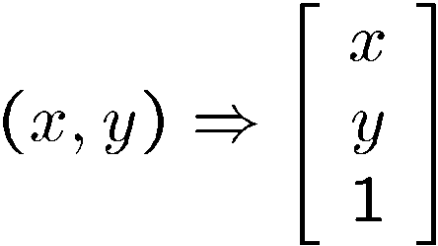
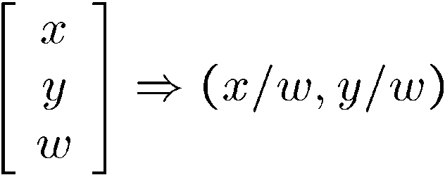
Homogeneous coordinates
To convert to homogeneous coordinates:
homogeneous image
coordinates
Converting from homogeneous coordinates
Kristen Grauman

Slide 37
Translation
Homogeneous Coordinates
t_{x} = 2
t_{y} = 1
Alyosha Efros

Slide 38
2D Affine Transformations
Affine transformations are combinations of …
  Linear transformations, and
  Translations
Parallel lines remain parallel
Alyosha Efros

Slide 39
Fitting an affine transformation
Assuming we know the correspondences, how do we get the transformation?
Alyosha Efros

Slide 40
Fitting an affine transformation
How many matches (correspondence pairs) do we need to solve for the transformation parameters?
Once we have solved for the parameters, how do we compute given ?
Where do the matches come from?
Modified from Kristen Grauman

Slide 41
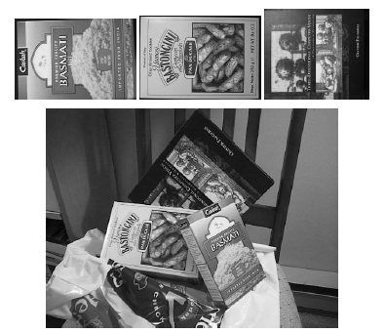
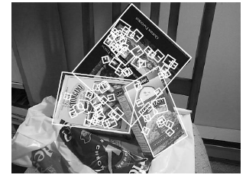
Recall: Fitting an affine transformation
The affine model approximates perspective projection.
Modified from Kristen Grauman
Figures from David Lowe, ICCV 1999

Slide 42
Projective Transformations
Projective transformations:
  Affine transformations, and
  Projective warps
Parallel lines do not necessarily remain parallel
Kristen Grauman

Slide 43
Main questions
Alignment: Given two images, what is the transformation between them?
T
Warping: Given a source image and a transformation, what does the transformed output look like?
T
Kristen Grauman

Slide 44
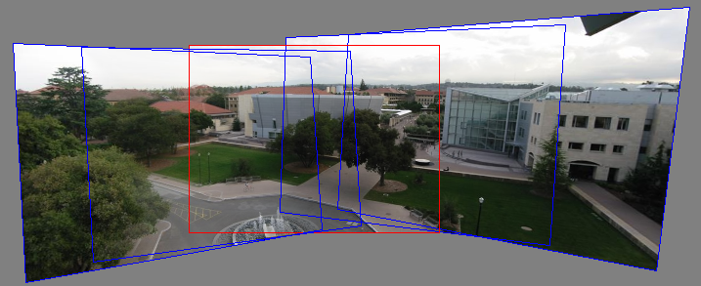
Motivation for feature-based alignment:
Image mosaics
Kristen Grauman
Image from http://graphics.cs.cmu.edu/courses/15-463/2010_fall/

Slide 45
Today
Wrap-up: indexing and retrieval
Image transformations (2D linear and affine)
Image formation
Image stitching (computing homographies)

Slide 46
Image formation
How are objects in the world captured in an image?
Kristen Grauman

Slide 47
Image formation
Let’s design a camera
  Idea 1: put a piece of film in front of an object
  Do we get a reasonable image?
Steve Seitz

Slide 48
Pinhole camera
Idea 2: Add a barrier to block off most of the rays
  This reduces blurring
  The opening is known as the aperture
  How does this transform the image?
Steve Seitz

Slide 49
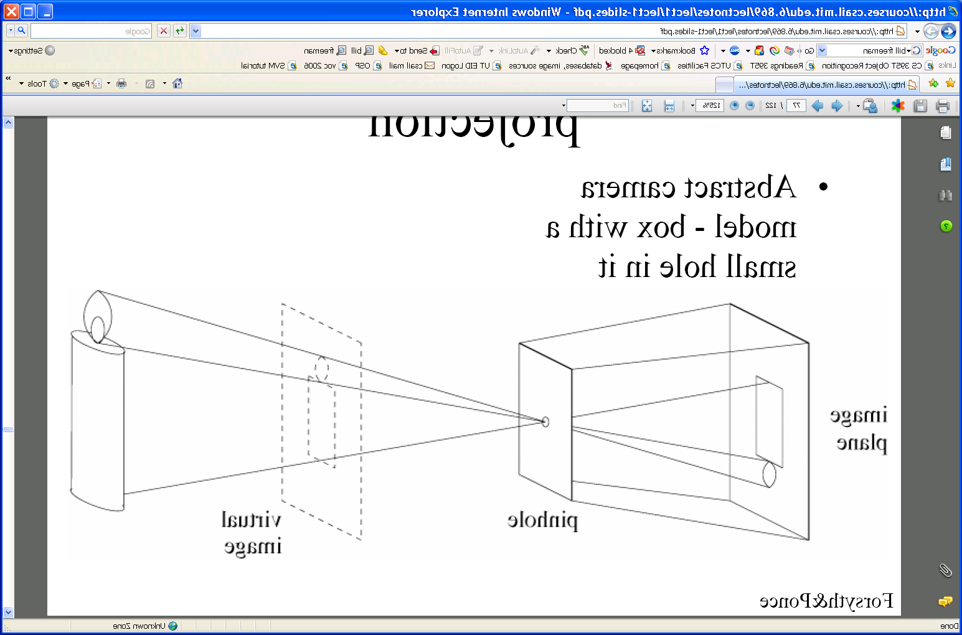
Pinhole camera
Pinhole camera is a simple model to approximate imaging process, perspective projection.
Image plane
Virtual image
Pinhole
If we treat pinhole as a point, only one ray from any given point can enter the camera.
Modified from Kristen Grauman, figure from Forsyth and Ponce

Slide 50


Camera obscura: the pre-camera
“Camera obscura” = “dark room”
First idea: Mo-Ti, China (470BC to 390BC)
First built: Alhazen, Iraq/Egypt (965 to 1039AD)
Illustration of Camera Obscura
Freestanding camera obscura at UNC Chapel Hill
Photo by Seth Ilys
Modified from Derek Hoiem
Notes:
Alhazen was born in Basra, moved to Egypt. Proposed to the king to control the Nile with a dam. Realized he couldn’t do it and feigned madness until the king died. During that time, he wrote the book of optics.

Slide 51


Camera obscura at home
How can you make your own (portable) camera?
Sketch from http://www.funsci.com/fun3_en/sky/sky.htm
http://blog.makezine.com/archive/2006/02/how_to_room_sized_camera_obscu.html

Slide 52

Camera Obscura used for Tracing
Lens Based Camera Obscura, 1568
Derek Hoiem

Slide 53


Camera obscura
Jetty at Margate England, 1898.
An attraction in the late 19th century
Around 1870s
Adapted from R. Duraiswami
http://brightbytes.com/cosite/collection2.html

Slide 54


First Photograph
Oldest surviving photograph
  Took 8 hours on pewter plate
Photograph of the first photograph
Joseph Niepce, 1826
Stored at UT Austin
Derek Hoiem

Slide 55

First Photograph of People
“Boulevard du Temple”, Louis Daguerre, 1838

Slide 56
Dimensionality Reduction Machine (3D to 2D)
3D world
2D image
Derek Hoiem
Figures © Stephen E. Palmer, 2002

Slide 57
Projection can be tricky…
Honda commercial: https://www.youtube.com/watch?v=7PGXZ-oc2-g

Slide 58

Projection can be tricky…
Slide source: Seitz

Slide 59

Projection can be tricky…
Making of 3D sidewalk art: http://www.youtube.com/watch?v=3SNYtd0Ayt0

Slide 60

Perspective effects
Kristen Grauman

Slide 61

Perspective effects
Far away objects appear smaller
Forsyth and Ponce

Slide 62

Perspective effects
Kristen Grauman

Slide 63

Perspective effects
Parallel lines in the scene intersect in the image
Converge in image on horizon line
Image plane
(virtual)
pinhole
Scene
Kristen Grauman

Slide 64
Projection properties
Many-to-one: any points along same ray map to same point in image
Points → points
Lines → lines (collinearity preserved)
Distances and angles are not preserved
Degenerate cases:
  – Line through focal point projects to a point.
  – Plane through focal point projects to line
  – Plane perpendicular to image plane projects to part of the image.
Kristen Grauman

Slide 65

Projection: world coordinates→image coordinates
.
Optical center
.
.
y
f'
z
x
.
y’
Camera center
x’
x’
y’
‘’
‘’
Scene point
Image coordinates
Modified from Derek Hoiem and Kristen Grauman

Slide 66


Homogeneous coordinates
Is this a linear transformation?
Trick: add one more coordinate:
  no—division by z is nonlinear
homogeneous image
coordinates
homogeneous scene
coordinates
Converting from homogeneous coordinates
Steve Seitz

Slide 67
Homogeneous coordinates
Invariant to scaling
Point in Cartesian is ray in Homogeneous
Homogeneous Coordinates
Cartesian Coordinates
Derek Hoiem
Notes:
Q: Suppose we have a point in Cartesian coordinates. What is that in homogeneous coordinates? A: a ray

Slide 68
Perspective Projection Matrix
Projection is a matrix multiplication using homogeneous coordinates:
divide by the third coordinate to convert back to non-homogeneous coordinates
Steve Seitz

Slide 69



Weak Perspective
Assumes scene depth << average distance to camera
Image plane
World points:
Kristen Grauman

Slide 70
Adding a lens
focal point
f
A lens focuses light onto the film
  Rays passing through the center are not deviated
  All parallel rays converge to one point on a plane located at the focal length f
Slide by Steve Seitz

Slide 71

Cameras with lenses
F
focal point
optical center
(Center Of Projection)
A lens focuses parallel rays onto a single focal point
Gather more light, while keeping focus; make pinhole perspective projection practical
Kristen Grauman

Slide 72
Today
Wrap-up: indexing and retrieval
Image transformations (2D linear and affine)
Image formation
Image stitching (computing homographies)

Slide 73



Mosaics
. . .
image from S. Seitz
Obtain a wider angle view by combining multiple images.
Kristen Grauman

Slide 74
How to stitch together a panorama (a.k.a. mosaic)?
Basic Procedure
  Take a sequence of images from the same position
    Rotate the camera about its optical center
  Compute transformation between second image and first
  Transform the second image to overlap with the first
  Blend the two together to create a mosaic
  (If there are more images, repeat)
Use the 3D geometry of the scene
Modified from Steve Seitz

Slide 75








Image Stitching Example
Combine two or more overlapping images to make one larger image
Add example
Vaibhav Vaish

Slide 76


Illustration
Camera Center
Derek Hoiem

Slide 77
Mosaics: generating synthetic views
real
camera
synthetic
camera
Can generate any synthetic camera view
as long as it has the same center of projection!
Alyosha Efros

Slide 78
Image reprojection
mosaic PP
The mosaic has a natural interpretation in 3D
  The images are reprojected onto a common plane
  The mosaic is formed on this plane
  Mosaic is a synthetic wide-angle camera
Steve Seitz

Slide 79
Image reprojection
Basic question
  How to relate two images from the same camera center?
    how to map a pixel from PP1 to PP2
PP2
Answer
  Cast a ray through each pixel in PP1
  Draw the pixel where that ray intersects PP2
Observation:
Rather than thinking of this as a 3D reprojection, think of it as a 2D image warp from one image to another.
PP1
Alyosha Efros

Slide 80
Image reprojection: Homography
A projective transform is a mapping between any two PPs with the same center of projection
  rectangle should map to arbitrary quadrilateral
  parallel lines aren’t
  but must preserve straight lines
called Homography
PP2
PP1
p’
H
p
Alyosha Efros

Slide 81
Homography
…
…
To compute the homography given pairs of corresponding points in the images, we need to set up an equation where the parameters of H are the unknowns…
Kristen Grauman

Slide 82
Solving for homographies
p’ = Hp
Can set scale factor i=1. So, there are 8 unknowns.
Set up a system of linear equations:
Ah = b
where vector of unknowns h = [a,b,c,d,e,f,g,h]^{T}
Need at least 8 eqs, but the more the better…
Solve for h. If overconstrained, solve using least-squares:
>> help lmdivide
Kristen Grauman

Slide 83
Homography
To apply a given homography H
  Compute p’ = Hp (regular matrix multiply)
  Convert p’ from homogeneous to image coordinates
p’
H
p
Kristen Grauman

Slide 84
Image warping
T(x,y)
y
y’
x
x’
f(x,y)
g(x’,y’)
Given a coordinate transform and a source image f(x,y), how do we compute a transformed image g(x’,y’) = f(T(x,y))?
Alyosha Efros

Slide 85
Forward warping
T(x,y)
y
y’
x
x’
f(x,y)
g(x’,y’)
Send each pixel f(x,y) to its corresponding location
(x’,y’) = T(x,y) in the second image
Q: what if pixel lands “between” two pixels?
Alyosha Efros

Slide 86
Forward warping
T(x,y)
y
y’
x
x’
f(x,y)
g(x’,y’)
Send each pixel f(x,y) to its corresponding location
(x’,y’) = T(x,y) in the second image
Q: what if pixel lands “between” two pixels?
A: distribute color among neighboring pixels (x’,y’)
  Known as “splatting”
Alyosha Efros

Slide 87
Inverse warping
T⁻¹(x,y)
y
y’
x
x
x’
f(x,y)
g(x’,y’)
Get each pixel g(x’,y’) from its corresponding location
(x,y) = T⁻¹(x’,y’) in the first image
Q: what if pixel comes from “between” two pixels?
Alyosha Efros

Slide 88
Inverse warping
T⁻¹(x,y)
y
y’
x
x
x’
f(x,y)
g(x’,y’)
Get each pixel g(x’,y’) from its corresponding location
(x,y) = T⁻¹(x’,y’) in the first image
Q: what if pixel comes from “between” two pixels?
A: Interpolate color value from neighbors
  nearest neighbor, bilinear…
>> help interp2
Alyosha Efros

Slide 89
Recap: How to stitch together a panorama (a.k.a. mosaic)?
Basic Procedure
  Take a sequence of images from the same position
    Rotate the camera about its optical center
  Compute transformation (homography) between second image and first using corresponding points.
  Transform the second image to overlap with the first.
  Blend the two together to create a mosaic.
  (If there are more images, repeat)
Steve Seitz

Slide 90


Homography example: Image rectification
p’
p
To unwarp (rectify) an image solve for homography H given p and p’: p’=Hp
Derek Hoiem
Notes:
15 min

Slide 91
Computing homography
Assume we have four matched points: How do we compute homography H?
Direct Linear Transformation (DLT)
p’=Hp
A
Apply SVD: UDV^{T} = A
h = V_{smallest} (column of V corr. to smallest singular value)
Derek Hoiem

Slide 92
Computing homography
Assume we have matched points with outliers: How do we compute homography H?
Automatic Homography Estimation with RANSAC
Choose number of samples N
Choose 4 random potential matches
Compute H using normalized DLT
Project points from x to x’ for each potentially matching pair:
Count points with projected distance < t
  E.g., t = 3 pixels
Repeat steps 2-5 N times
  Choose H with most inliers
Derek Hoiem
HZ Tutorial ‘99

Slide 93
Automatic Image Stitching
Compute interest points on each image
Find candidate matches
Estimate homography H using matched points and RANSAC with normalized DLT
Project each image onto the same surface and blend
  Matlab: maketform, imtransform
Derek Hoiem

Slide 94



RANSAC for Homography
Derek Hoiem

Slide 95
Summary
  Write 2d transformations as matrix-vector multiplication (including translation when we use homogeneous coordinates)
    Projection equations express how world points mapped to 2d image.
  Perform image warping (forward, inverse)
  Fitting transformations: solve for unknown parameters given corresponding points from two views (affine, projective (homography)).
  Mosaics: uses homography and image warping to merge views taken from same center of projection.
Kristen Grauman

