Slide 1
CS 1699: Intro to Computer Vision
Feature Matching +
Indexing and Retrieval
Prof. Adriana Kovashka
University of Pittsburgh
October 1, 2015

Slide 2
Today
Review (fitting)
  Hough transform
  RANSAC
Matching points
Retrieving object instances
  Indexing by visual words
  Spatial verification

Slide 3
Fitting vs Matching/Alignment
Fitting models (lines) to points, i.e. find the parameters of a model that best fits the data
  Least squares
  Hough transform
  RANSAC
Matching = finding correspondences between points, i.e. find the parameters of the transformation that best aligns points

Slide 4
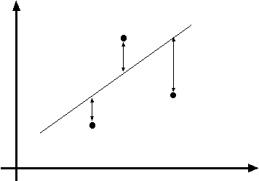
Least squares line fitting
Data: (x₁, y₁), …, (x_{n}, y_{n})
Line equation: y_{i} = m x_{i} + b
Find (m, b) to minimize
y=mx+b
(x_{i}, y_{i})
Matlab: p = A \ y;
Modified from Svetlana Lazebnik

Slide 5

Finding lines in an image: Hough space
y
b
(x₁, y₁)
y₀
(x₀, y₀)
b = –x₁m + y₁
x₀
x
m
image space
Hough (parameter) space
What are the line parameters for the line that contains both (x₀, y₀) and (x₁, y₁)?
  It is the intersection of the lines b = –x₀m + y₀ and
  b = –x₁m + y₁
Steve Seitz

Slide 6
Finding lines in an image: Hough algorithm
y
b
x
m
image space
Hough (parameter) space
How can we use this to find the most likely parameters (m,b) for the most prominent line in the image space?
Let each edge point in image space vote for a set of possible parameters in Hough space
Accumulate votes in discrete set of bins; parameters with the most votes indicate line in image space.
Steve Seitz

Slide 7
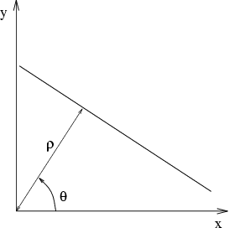
Parameter space representation
Problems with the (m,b) space:
  Unbounded parameter domains
  Vertical lines require infinite m
Alternative: polar representation
Each point (x,y) will add a sinusoid in the (θ,ρ) parameter space
Svetlana Lazebnik

Slide 8
Hough transform
P.V.C. Hough, Machine Analysis of Bubble Chamber Pictures, Proc. Int. Conf. High Energy Accelerators and Instrumentation, 1959
Use a polar representation for the parameter space
y
x
Hough space
Silvio Savarese
Notes:
􀁑 Basic ideas
• A line is represented as . Every line in the image corresponds
to a point in the parameter space
• Every point in the image domain corresponds to a line in the parameter
space (why ? Fix (x,y), (m,n) can change on the line . In other
words, for all the lines passing through (x,y) in the image space, their
parameters form a line in the parameter space)
• Points along a line in the space correspond to lines passing through the
same point in the parameter space (why ?)

Slide 9
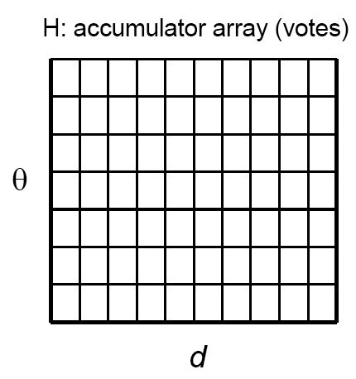
Algorithm outline
Initialize accumulator H
to all zeros
For each feature point (x,y)
in the image
For θ = 0 to 180
ρ = x cos θ + y sin θ
H(θ, ρ) = H(θ, ρ) + 1
end
end
Find the value(s) of (θ*, ρ*) where H(θ, ρ) is a local maximum
  The detected line in the image is given by
  ρ* = x cos θ* + y sin θ*
ρ
θ
Svetlana Lazebnik

Slide 10
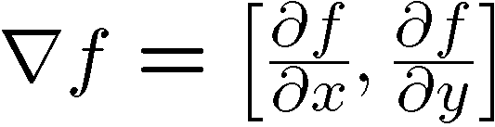

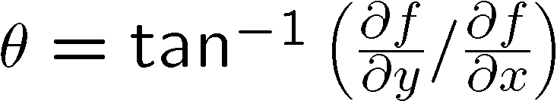
Incorporating image gradients
Recall: when we detect an
edge point, we also know its
gradient direction
But this means that the line
is uniquely determined!
Modified Hough transform:
For each edge point (x,y)
θ = gradient orientation at (x,y)
ρ = x cos θ + y sin θ
H(θ, ρ) = H(θ, ρ) + 1
end
Svetlana Lazebnik

Slide 11
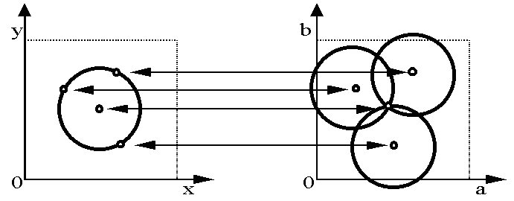
Hough transform for circles
Circle: center (a,b) and radius r
For a fixed radius r, unknown gradient direction
Image space
Hough space
Kristen Grauman

Slide 12
Hough transform for circles
Circle: center (a,b) and radius r
For a fixed radius r, unknown gradient direction
Intersection: most votes for center occur here.
Image space
Hough space
Kristen Grauman

Slide 13
Hough transform for circles
For every edge pixel (x,y) :
For each possible radius value r:
For each possible gradient direction θ:
// or use estimated gradient at (x,y)
a = x – r cos(θ) // column
b = y – r sin(θ) // row
H[a,b,r] += 1
end
end
end
x
θ
Modified from Kristen Grauman

Slide 14
Generalized Hough transform
Define a model shape by its boundary points and a reference point.
Offline procedure:
x
a
At each boundary point, compute displacement vector: r = a – p_{i}.
Store these vectors in a table indexed by gradient orientation θ.
θ
θ
p₁
p₂
Model shape
θ
…
θ
…
…
Kristen Grauman
[Dana H. Ballard, Generalizing the Hough Transform to Detect Arbitrary Shapes, 1980]

Slide 15
Hough transform: pros and cons
Pros
All points are processed independently, so can cope with occlusion, gaps
Some robustness to noise: noise points unlikely to contribute consistently to any single bin
Can detect multiple instances of a model in a single pass
Cons
Complexity of search time increases exponentially with the number of model parameters
  If 3 parameters and 10 choices for each, search is O(10³)
Non-target shapes can produce spurious peaks in parameter space
Quantization: can be tricky to pick a good grid size
Modified from Kristen Grauman

Slide 16
RANSAC
_{(RANdom SAmple Consensus) :}
Fischler & Bolles in ‘81.
Algorithm:
Sample (randomly) the number of points required to fit the model
Solve for model parameters using samples
Score by the fraction of inliers within a preset threshold of the model
Repeat 1-3 until the best model is found with high confidence
Silvio Savarese
Notes:
Let me give you an intuition of what is going on. Suppose we have the standard line fitting problem in presence of outliers.
We can formulate this problem as follows: want to find the best partition of points in inlier set and outlier set such that…
The objective consists of adjusting the parameters of a model function so as to best fit a data set.
"best" is defined by a function f that needs to be minimized.
Such that the best parameter of fitting the line give rise to a residual error lower that delta
as when the sum, S, of squared residuals

Slide 17
RANSAC
Line fitting example
Algorithm:
Sample (randomly) the number of points required to fit the model (#=2)
Solve for model parameters using samples
Score by the fraction of inliers within a preset threshold of the model
Repeat 1-3 until the best model is found with high confidence
Silvio Savarese
Notes:
Let me give you an intuition of what is going on. Suppose we have the standard line fitting problem in presence of outliers.
We can formulate this problem as follows: want to find the best partition of points in inlier set and outlier set such that…
The objective consists of adjusting the parameters of a model function so as to best fit a data set.
"best" is defined by a function f that needs to be minimized.
Such that the best parameter of fitting the line give rise to a residual error lower that delta
as when the sum, S, of squared residuals

Slide 18
RANSAC
Line fitting example
Algorithm:
Sample (randomly) the number of points required to fit the model (#=2)
Solve for model parameters using samples
Score by the fraction of inliers within a preset threshold of the model
Repeat 1-3 until the best model is found with high confidence
Silvio Savarese
Notes:
Let me give you an intuition of what is going on. Suppose we have the standard line fitting problem in presence of outliers.
We can formulate this problem as follows: want to find the best partition of points in inlier set and outlier set such that…
The objective consists of adjusting the parameters of a model function so as to best fit a data set.
"best" is defined by a function f that needs to be minimized.
Such that the best parameter of fitting the line give rise to a residual error lower that delta
as when the sum, S, of squared residuals

Slide 19
RANSAC
Line fitting example
Algorithm:
Sample (randomly) the number of points required to fit the model (#=2)
Solve for model parameters using samples
Score by the fraction of inliers within a preset threshold of the model
Repeat 1-3 until the best model is found with high confidence
Silvio Savarese
Notes:
Let me give you an intuition of what is going on. Suppose we have the standard line fitting problem in presence of outliers.
We can formulate this problem as follows: want to find the best partition of points in inlier set and outlier set such that…
The objective consists of adjusting the parameters of a model function so as to best fit a data set.
"best" is defined by a function f that needs to be minimized.
Such that the best parameter of fitting the line give rise to a residual error lower that delta
as when the sum, S, of squared residuals

Slide 20
RANSAC
Algorithm:
Sample (randomly) the number of points required to fit the model (#=2)
Solve for model parameters using samples
Score by the fraction of inliers within a preset threshold of the model
Repeat 1-3 until the best model is found with high confidence
Silvio Savarese
Notes:
Let me give you an intuition of what is going on. Suppose we have the standard line fitting problem in presence of outliers.
We can formulate this problem as follows: want to find the best partition of points in inlier set and outlier set such that…
The objective consists of adjusting the parameters of a model function so as to best fit a data set.
"best" is defined by a function f that needs to be minimized.
Such that the best parameter of fitting the line give rise to a residual error lower that delta
as when the sum, S, of squared residuals

Slide 21
RANSAC pros and cons
Pros
  Simple and general
  Applicable to many different problems
  Often works well in practice
Cons
  Lots of parameters to tune
  Doesn’t work well for low inlier ratios (too many iterations, or can fail completely)
  Can’t always get a good initialization of the model based on the minimum number of samples
Common applications
  Image stitching
  Relating two views
Svetlana Lazebnik

Slide 22
Today
Review (fitting)
  Hough transform
  RANSAC
Matching points
Retrieving object instances
  Indexing by visual words
  Spatial verification

Slide 23
Alignment problem
We have previously considered how to fit a model to image evidence
  e.g., a line to edge points
In alignment, we will fit the parameters of some transformation according to a set of matching feature pairs (“correspondences”).
Difficulties
  Noise
  Outliers
x_{i}
x_{i}
'
T
Kristen Grauman and Derek Hoiem

Slide 24
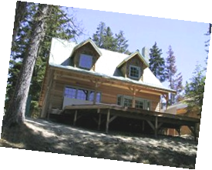
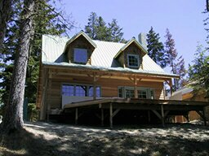
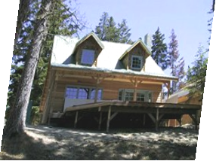
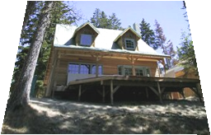
Parametric (global) warping
Examples of parametric warps:
translation
rotation
aspect
perspective
affine
Alyosha Efros

Slide 25
Parametric (global) warping
T
p = (x,y)
p’ = (x’,y’)
Transformation T is a coordinate-changing machine:
p’ = T(p)
What does it mean that T is global?
  Is the same for any point p
  Can be described by just a few numbers (parameters)
Let’s represent T as a matrix:
p’ = Mp
Alyosha Efros

Slide 26
Scaling
Scaling a coordinate means multiplying each of its components by a scalar
Uniform scaling means this scalar is the same for all components:
× 2
Alyosha Efros

Slide 27
Scaling
Non-uniform scaling: different scalars per component:
X × 2,
Y × 0.5
Alyosha Efros

Slide 28
Scaling
Scaling operation:
Or, in matrix form:
scaling matrix S
Alyosha Efros

Slide 29
2D Linear Transformations
Only linear 2D transformations can be represented with a 2x2 matrix.
Linear transformations are combinations of …
  Scale,
  Rotation,
  Shear, and
  Mirror
Alyosha Efros

Slide 30
Affine Transformations
Affine transformations are combinations of
  Linear transformations, and
  Translations
Properties of affine transformations:
  Lines map to lines
  Parallel lines remain parallel
  Ratios are preserved
  Closed under composition
or
Derek Hoiem

Slide 31
Fitting an affine transformation
Assuming we know the correspondences, how do we get the transformation?
Alyosha Efros

Slide 32
What are the correspondences?
?
Compare content in local patches, find best matches.
  e.g., simplest approach: scan with template, and compute SSD or correlation between list of pixel intensities in the patch
Kristen Grauman

Slide 33




Feature-based Keypoint Matching
1. Find a set of
distinctive key-
points
A₁
B₃
2. Define a region
around each
keypoint
A₂
A₃
B₁
B₂
3. Extract and
normalize the
region content
4. Compute a local
descriptor from the
normalized region
N pixels
e.g. color
e.g. color
N pixels
5. Match local
descriptors

Slide 34
Example: solving for translation
A₁
A₂
A₃
B₁
B₂
B₃
Given matched points in {A} and {B}, estimate the translation of the object
Derek Hoiem

Slide 35
Example: solving for translation
A₁
A₂
A₃
(t_{x}, t_{y})
B₁
B₂
B₃
Least squares solution
Write down objective function in form Ax=b
Solve using pseudo-inverse or eigenvalue decomposition
Derek Hoiem

Slide 36
Example: solving for translation
A₁
A₅
B₄
A₂
A₃
(t_{x}, t_{y})
B₁
A₄
B₂
B₃
B₅
Problem: outliers
RANSAC solution
Sample a set of matching points (1 pair)
Solve for transformation parameters
Score parameters with number of inliers
Repeat steps 1-3 N times
Solve using least squares with inliers
Derek Hoiem

Slide 37
Example: solving for translation
B₄
A₁
B₅
B₆
A₂
A₃
(t_{x}, t_{y})
B₁
A₄
B₂
B₃
A₅
A₆
Problem: outliers, multiple objects, and/or many-to-one matches
Hough transform solution
Initialize a grid of parameter values
Each matched pair casts a vote for consistent values
Find the parameters with the most votes
Solve using least squares with inliers
BOARD
Derek Hoiem

Slide 38
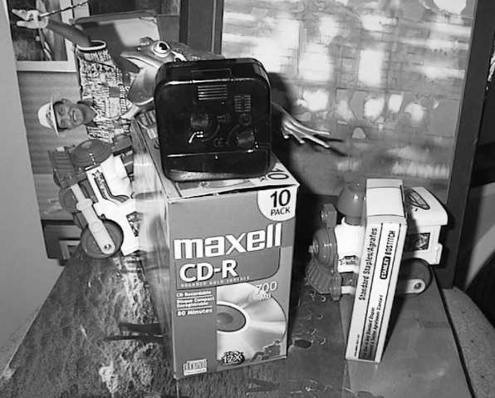
Finding objects using SIFT features
Each feature match gives an alignment hypothesis (for scale, translation, and orientation of model in image)
  Assuming we use scale, rotation, and translation invariant local features
Model
Novel image
Adapted from Svetlana Lazebnik

Slide 39
Finding objects using SIFT features
A hypothesis generated by a single match may be unreliable
So let each match vote for a hypothesis in Hough space
Model
Novel image
Kristen Grauman

Slide 40
Gen Hough Transform details (Lowe’s system)
Training phase: For each model feature, record 2D location, scale, and orientation of model (relative to normalized feature frame)
Test phase: Let each match between a test SIFT feature and a model feature vote in a 4D Hough space
  (x, y) location
  orientation
  scale
Find all bins with at least three votes and perform geometric verification
  Estimate least squares affine transformation
  Search for additional features that agree with the alignment
  Object found if at least T matched points found
David G. Lowe. "Distinctive image features from scale-invariant keypoints.” IJCV 60 (2), pp. 91-110, 2004.
Adapted from Svetlana Lazebnik

Slide 41
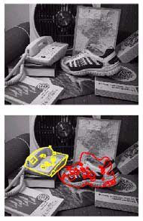
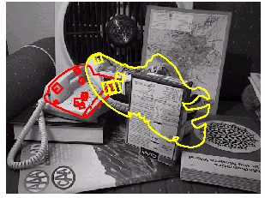
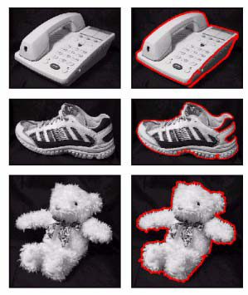
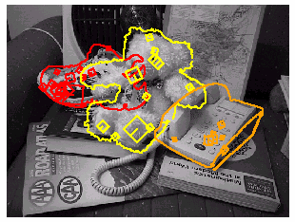
Example result
Background subtract for model boundaries
Objects recognized
Recognition in spite of occlusion
[Lowe]

Slide 42
Fitting and Matching: Summary
Fitting problems require finding any supporting evidence for a model, even within clutter and missing features.
Voting and inlier approaches, such as the Hough transform and RANSAC, make it possible to find likely model parameters without searching all combinations of features.
Can use these approaches to compute robust feature alignment/matching, and to match object templates.
Adapted from Kristen Grauman and Derek Hoiem

Slide 43



Seam Carving Results
David Fioravanti

Slide 44
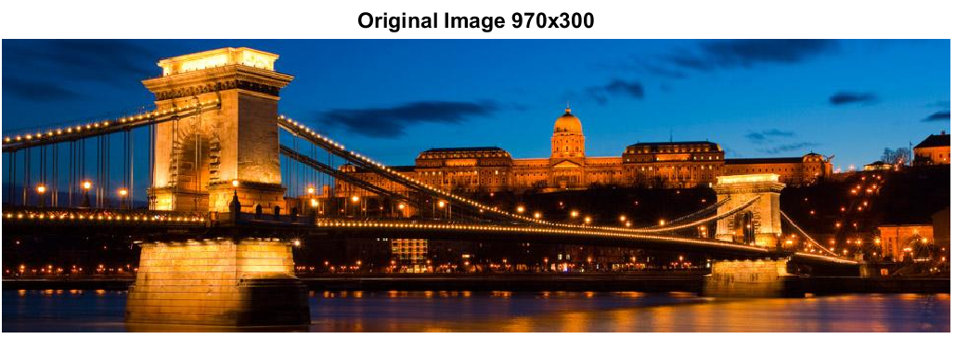
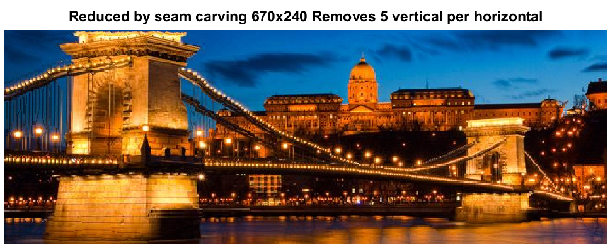
Seam Carving Results
Edwin Mellett

Slide 45
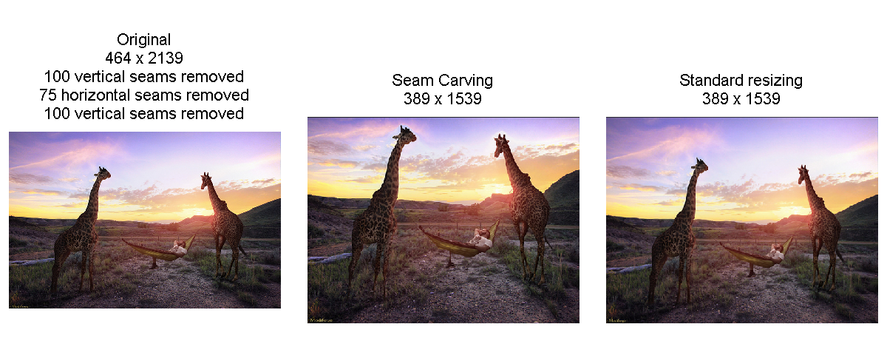
Seam Carving Results
Sarah Dubnik

Slide 46

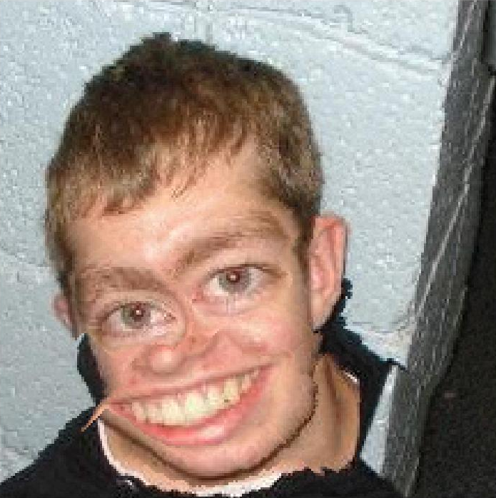
Seam Carving Results
Joel Roggeman

Slide 47
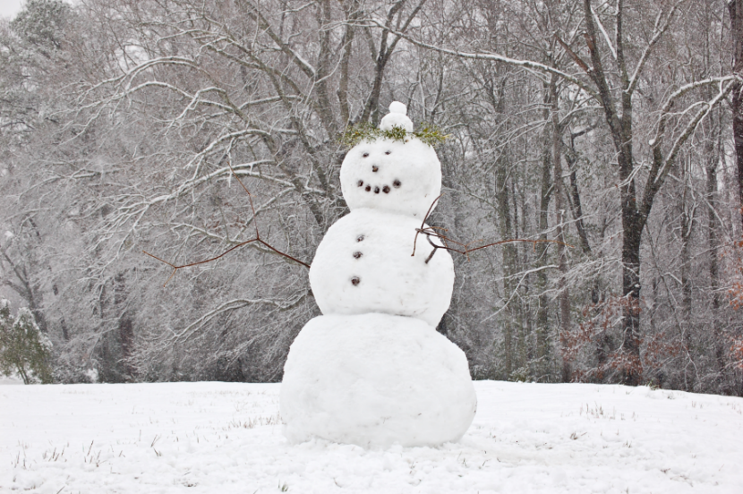
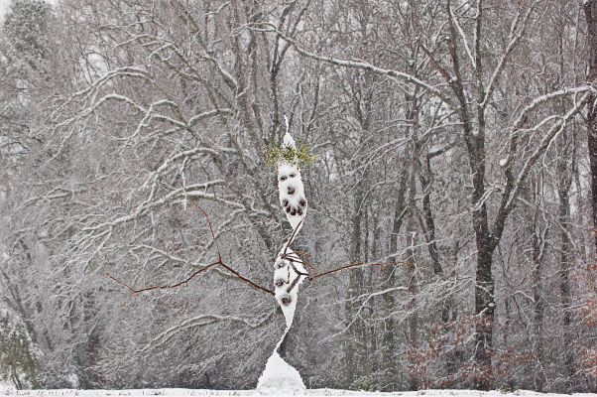

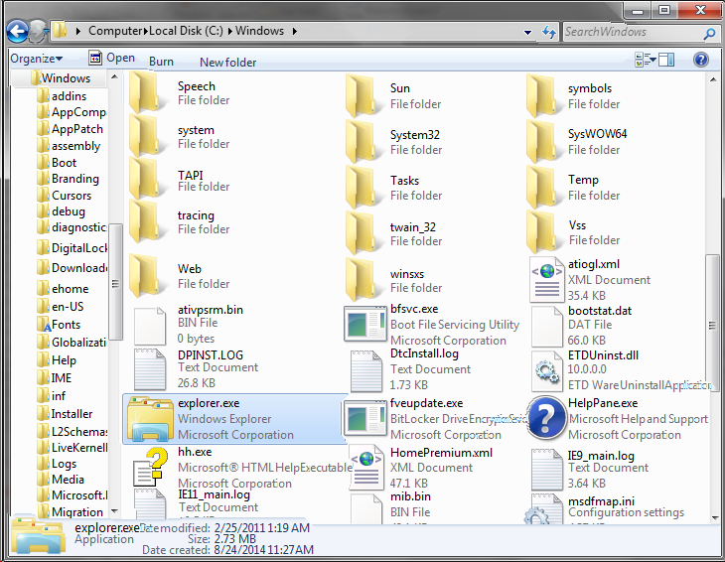
Seam Carving Results
John Phillips

Slide 48
Today
Review (fitting)
  Hough transform
  RANSAC
Matching points
Retrieving object instances
  Indexing by visual words
  Spatial verification

Slide 49
Indexing local features
Each patch / region has a descriptor, which is a point in some high-dimensional feature space (e.g., SIFT)
Descriptor’s feature space
Kristen Grauman
Notes:
49

Slide 50
Indexing local features
When we see close points in feature space, we have similar descriptors, which indicates similar local content.
Query image
Descriptor’s feature space
Database images
Kristen Grauman

Slide 51
Indexing local features
With potentially thousands of features per image, and hundreds to millions of images to search, how to efficiently find those that are relevant to a new image?
Kristen Grauman
Notes:
51

Slide 52
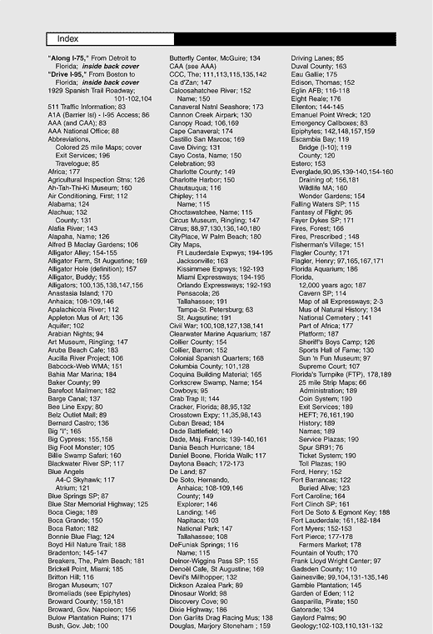
Indexing local features: inverted file index
For text documents, an efficient way to find all pages on which a word occurs is to use an index…
We want to find all images in which a feature occurs.
To use this idea, we’ll need to map our features to “visual words”.
Kristen Grauman

Slide 53
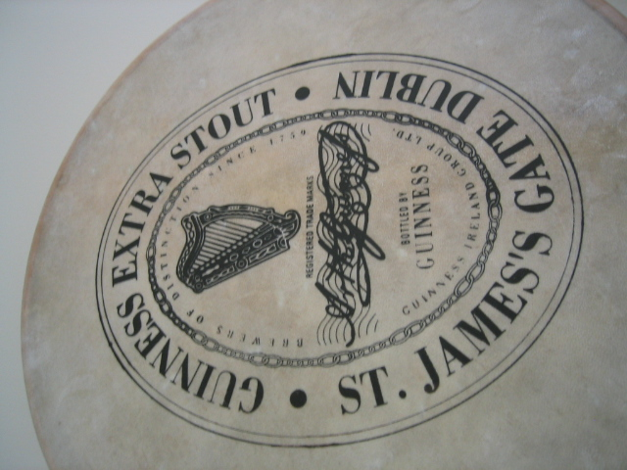
Visual words: main idea
Extract some local features from a number of images …
e.g., SIFT descriptor space: each point is 128-dimensional
D. Nister, CVPR 2006

Slide 54
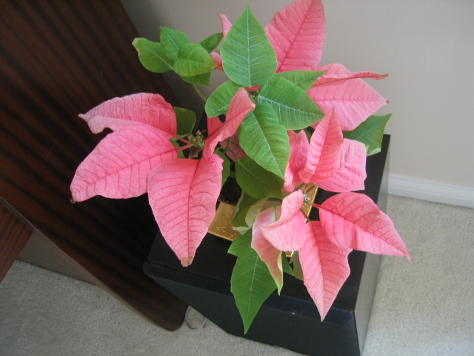
Visual words: main idea
D. Nister, CVPR 2006

Slide 55
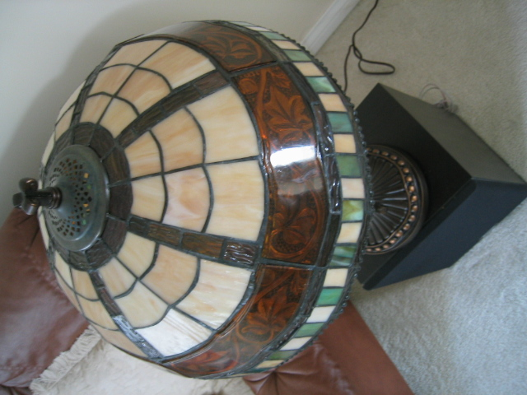
Visual words: main idea
D. Nister, CVPR 2006

Slide 56
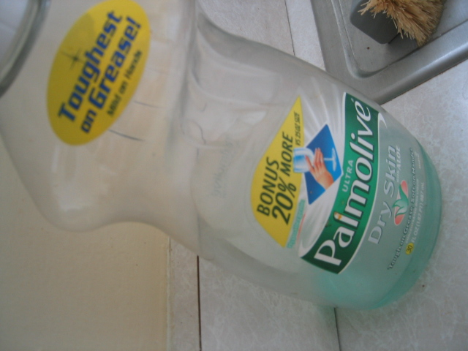
Visual words: main idea
D. Nister, CVPR 2006

Slide 57
Each point is a local descriptor, e.g. SIFT vector.
D. Nister, CVPR 2006

Slide 58
D. Nister, CVPR 2006

Slide 59
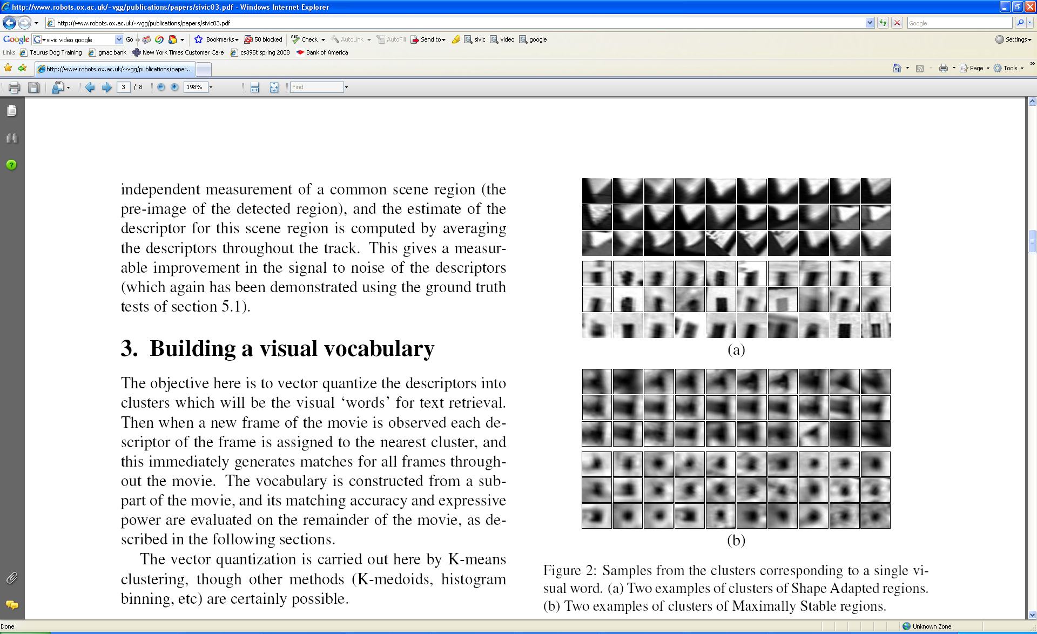
Visual words
Example: each group of patches belongs to the same visual word
Figure from Sivic & Zisserman, ICCV 2003
Adapted from Kristen Grauman

Slide 60
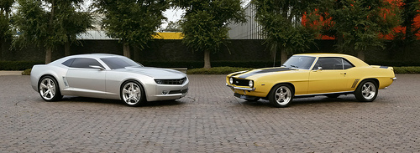
Last class
Index displacements by “visual codeword”
test image
B. Leibe, A. Leonardis, and B. Schiele, Combined Object Categorization and Segmentation with an Implicit Shape Model, ECCV Workshop on Statistical Learning in Computer Vision 2004
Svetlana Lazebnik

Slide 61
Last class
Build codebook of patches around extracted interest points using clustering (more on this later in the course)
Svetlana Lazebnik

Slide 62
Visual words
Map high-dimensional descriptors to tokens/words by quantizing the feature space
Quantize via clustering, let cluster centers be the prototype “words”
1
2
Word #3
3
Determine which word to assign to each new image region by finding the closest cluster center.
Descriptor’s feature space
Query
Kristen Grauman

Slide 63
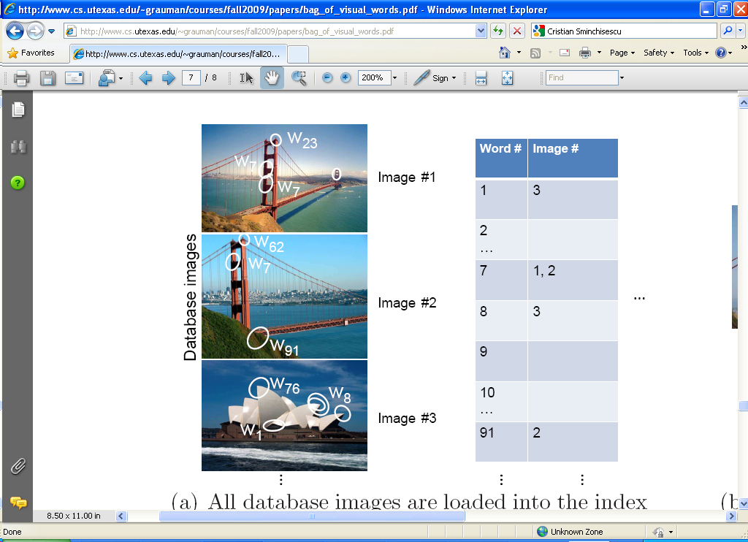
Inverted file index
Database images are loaded into the index mapping words to image numbers
Kristen Grauman

Slide 64
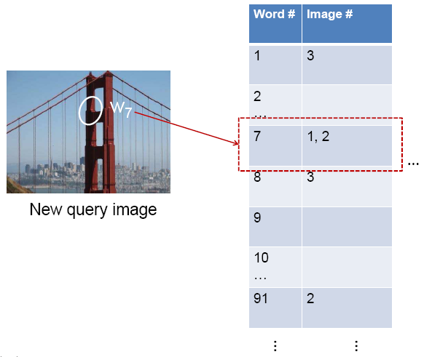
Inverted file index
When will this give us a significant gain in efficiency?
New query image is mapped to indices of database images that share a word.
We can call this retrieval process instance recognition.
Adapted from Kristen Grauman

Slide 65
Instance recognition: remaining issues
How to summarize the content of an entire image? And gauge overall similarity?
How large should the vocabulary be? How to perform quantization efficiently?
Is having the same set of visual words enough to identify the object/scene? How to verify spatial agreement?
Kristen Grauman

Slide 66

Analogy to documents
Of all the sensory impressions proceeding to the brain, the visual experiences are the dominant ones. Our perception of the world around us is based essentially on the messages that reach the brain from our eyes. For a long time it was thought that the retinal image was transmitted point by point to visual centers in the brain; the cerebral cortex was a movie screen, so to speak, upon which the image in the eye was projected. Through the discoveries of Hubel and Wiesel we now know that behind the origin of the visual perception in the brain there is a considerably more complicated course of events. By following the visual impulses along their path to the various cell layers of the optical cortex, Hubel and Wiesel have been able to demonstrate that the message about the image falling on the retina undergoes a step-wise analysis in a system of nerve cells stored in columns. In this system each cell has its specific function and is responsible for a specific detail in the pattern of the retinal image.
China is forecasting a trade surplus of $90bn (£51bn) to $100bn this year, a threefold increase on 2004's $32bn. The Commerce Ministry said the surplus would be created by a predicted 30% jump in exports to $750bn, compared with a 18% rise in imports to $660bn. The figures are likely to further annoy the US, which has long argued that China's exports are unfairly helped by a deliberately undervalued yuan. Beijing agrees the surplus is too high, but says the yuan is only one factor. Bank of China governor Zhou Xiaochuan said the country also needed to do more to boost domestic demand so more goods stayed within the country. China increased the value of the yuan against the dollar by 2.1% in July and permitted it to trade within a narrow band, but the US wants the yuan to be allowed to trade freely. However, Beijing has made it clear that it will take its time and tread carefully before allowing the yuan to rise further in value.
sensory, brain,
visual, perception,
retinal, cerebral cortex,
eye, cell, optical
nerve, image
Hubel, Wiesel
China, trade,
surplus, commerce,
exports, imports, US,
yuan, bank, domestic,
foreign, increase,
trade, value
ICCV 2005 short course, L. Fei-Fei

Slide 67
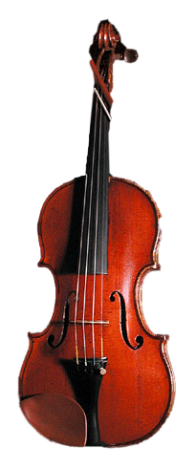
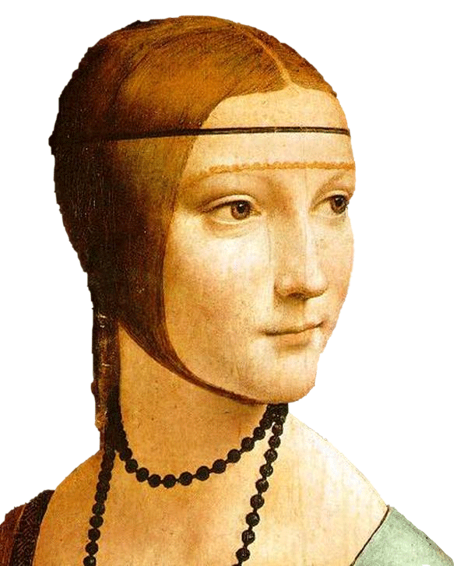
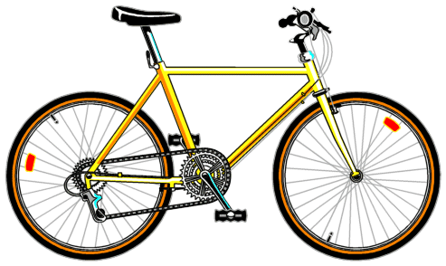
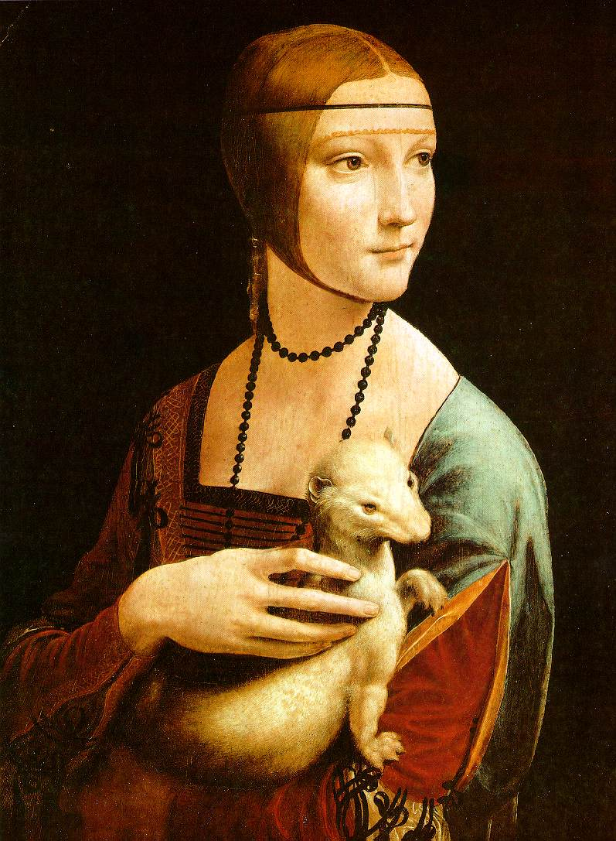

Slide 68
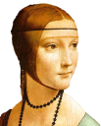






Bags of visual words
Summarize entire image based on its distribution (histogram) of word occurrences.
Analogous to bag of words representation commonly used for documents.
Notes:
68

Slide 69





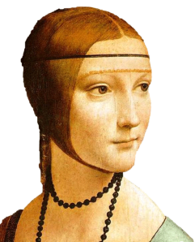
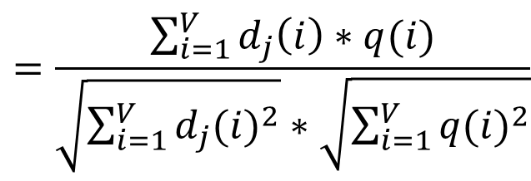
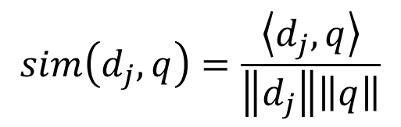
Comparing bags of words
Rank frames by normalized scalar product between their (possibly weighted) occurrence counts---nearest neighbor search for similar images.
[1 8 1 4]
[5 1 1 0]
$$sim\left(d_{j},q\right)=\frac{\left\langle d_{j},q\right\rangle }{\left\|d_{j}\right\|\left\|q\right\|}$$
$$=\frac{\sum_{i=1}^{V}{d_{j}\left(i\right)∗q(i)}}{\sqrt{\sum_{i=1}^{V}{{d_{j}(i)}^{2}}}∗\sqrt{\sum_{i=1}^{V}{{q(i)}^{2}}}}$$
for vocabulary of V words
Kristen Grauman

Slide 70
Bags of words: pros and cons
+ flexible to geometry / deformations / viewpoint
+ compact summary of image content
+ very good results in practice
basic model ignores geometry – must verify afterwards, or encode via features
background and foreground mixed when bag covers whole image
optimal vocabulary formation remains unclear
Adapted from Kristen Grauman
Notes:
70

Slide 71
Inverted file index and
bags of words similarity
w₉₁
Extract words in query
Inverted file index to find relevant frames
Compare word counts
Adapted from Kristen Grauman

Slide 72
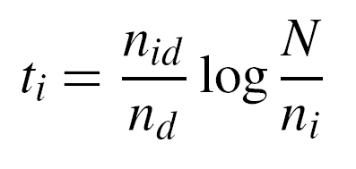
tf-idf weighting
Term frequency – inverse document frequency
Describe frame by frequency of each word within it, downweight words that appear often in the database
(Standard weighting for text retrieval)
Number of occurrences of word i in document d
Total number of documents in database
Number of documents word i occurs in, in whole database
Number of words in document d
Kristen Grauman

Slide 73
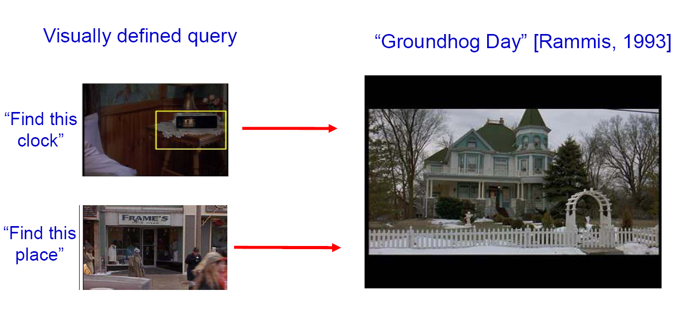
Bags of words for content-based image retrieval
Slide from Andrew Zisserman
Sivic & Zisserman, ICCV 2003

Slide 74
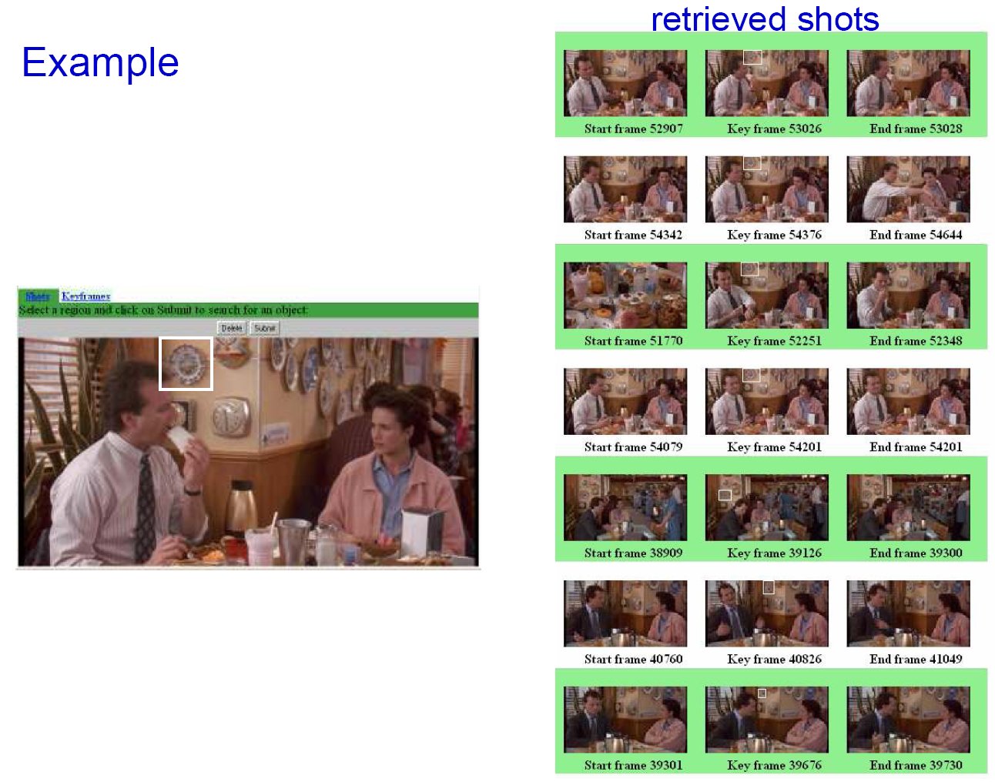
Slide from Andrew Zisserman
Sivic & Zisserman, ICCV 2003

Slide 75
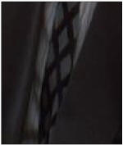
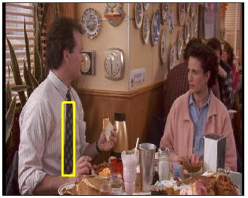
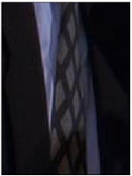
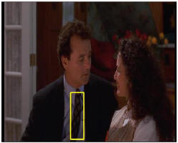
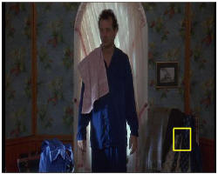
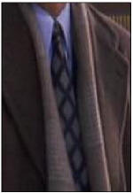
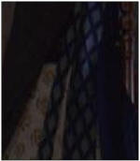
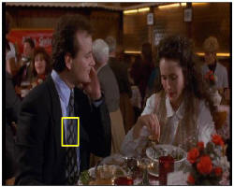



Video Google System
Query region
Collect all words within query region
Inverted file index to find relevant frames
Compare word counts
Spatial verification
Sivic & Zisserman, ICCV 2003
Demo online at : http://www.robots.ox.ac.uk/~vgg/research/vgoogle/index.html
Retrieved frames
75
K. Grauman, B. Leibe
Notes:
75

Slide 76











Scoring retrieval quality
Results (ordered):
Database size: 10 images
Relevant (total): 5 images
Query
precision = #relevant / #returned
recall = #relevant / #total relevant
1
0.8
0.6
precision
0.4
0.2
0
0
0.2
0.4
0.6
0.8
1
recall
Ondrej Chum

Slide 77
Instance recognition: remaining issues
How to summarize the content of an entire image? And gauge overall similarity?
How large should the vocabulary be? How to perform quantization efficiently?
Is having the same set of visual words enough to identify the object/scene? How to verify spatial agreement?
Kristen Grauman

Slide 78


Vocabulary size
Results for recognition task with 6347 images
Branching factors
Influence on performance, sparsity
Nister & Stewenius, CVPR 2006
Kristen Grauman

Slide 79
Vocabulary Trees: hierarchical clustering for large vocabularies
[Nister & Stewenius, CVPR’06]
Slide credit: David Nister
Tree construction:

Slide 80
Vocabulary Tree
[Nister & Stewenius, CVPR’06]
K. Grauman, B. Leibe
Slide credit: David Nister
Training: Filling the tree

Slide 81


Vocabulary Tree
[Nister & Stewenius, CVPR’06]
K. Grauman, B. Leibe
Slide credit: David Nister
Training: Filling the tree

Slide 82


Vocabulary Tree
[Nister & Stewenius, CVPR’06]
K. Grauman, B. Leibe
Slide credit: David Nister
Training: Filling the tree

Slide 83





Vocabulary Tree
[Nister & Stewenius, CVPR’06]
Slide credit: David Nister
Recognition

Slide 84
Complexity
What is the computational advantage of the hierarchical representation bag of words, vs. a flat vocabulary?
Complexity depends on branching factor and number of levels
Adapted from Kristen Grauman

Slide 85
Instance recognition: remaining issues
How to summarize the content of an entire image? And gauge overall similarity?
How large should the vocabulary be? How to perform quantization efficiently?
Is having the same set of visual words enough to identify the object/scene? How to verify spatial agreement?
Kristen Grauman

Slide 86
Today
Review (fitting)
  Hough transform
  RANSAC
Matching points
Retrieving object instances
  Indexing by visual words
  Spatial verification

Slide 87


Spatial Verification
Query
Query
DB image with high BoW similarity
DB image with high BoW similarity
Both image pairs have many visual words in common.
Ondrej Chum

Slide 88


Spatial Verification
Query
Query
DB image with high BoW similarity
DB image with high BoW similarity
Only some of the matches are mutually consistent
Ondrej Chum

Slide 89
Spatial Verification: two basic strategies
RANSAC
  Typically sort by BoW similarity as initial filter
  Verify by checking support (inliers) for possible transformations
    e.g., “success” if find a transformation with > N inlier correspondences
Generalized Hough Transform
  Let each matched feature cast a vote on location, scale, orientation of the model object
  Verify parameters with enough votes
Kristen Grauman

Slide 90
RANSAC verification
Kristen Grauman

Slide 91
RANSAC verification
Kristen Grauman

Slide 92
Video Google System
Query region
Collect all words within query region
Inverted file index to find relevant frames
Compare word counts
Spatial verification
Sivic & Zisserman, ICCV 2003
Demo online at : http://www.robots.ox.ac.uk/~vgg/research/vgoogle/index.html
Retrieved frames
Kristen Grauman
Notes:
92

Slide 93


Example Applications
Aachen Cathedral
Mobile tourist guide
Self-localization
Object/building recognition
Photo/video augmentation
[Quack, Leibe, Van Gool, CIVR’08]

Slide 94
Indexing and Retrieval: Summary
Bag of words representation: quantize feature space to make discrete set of visual words
  Summarize image by distribution of words
  Index individual words
Inverted index: pre-compute index to enable faster search at query time
Recognition of instances via alignment: matching local features followed by spatial verification
  Robust fitting : RANSAC, GHT
Adapted from Kristen Grauman

