Slide 1
CS 1699: Intro to Computer Vision
Segmentation and Grouping
Prof. Adriana Kovashka
University of Pittsburgh
September 24, 2015

Slide 2
Grouping in vision
Goals:
  Gather features that belong together
  Obtain an intermediate representation that compactly describes key image parts
Source: K. Grauman

Slide 3
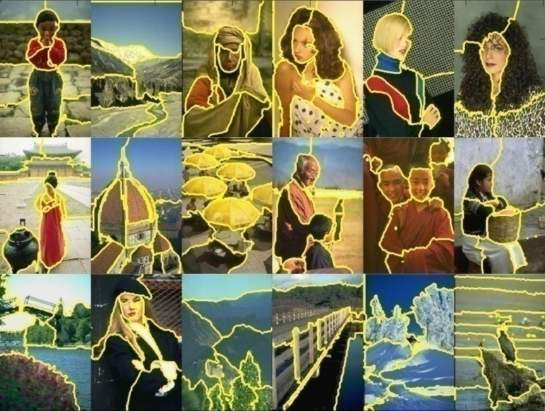
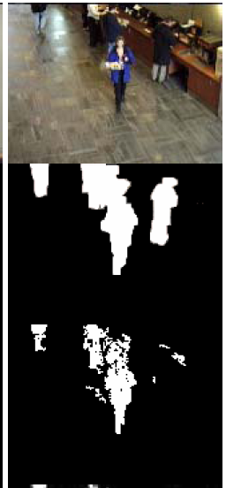
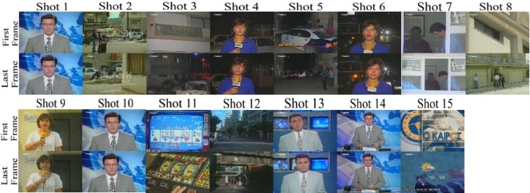
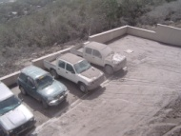
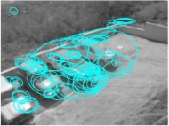
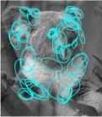
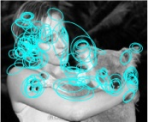

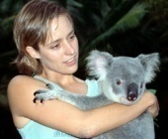
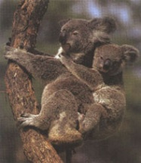
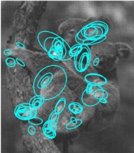
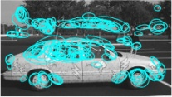
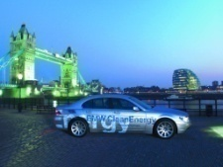
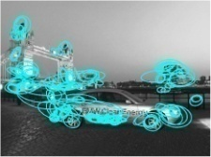




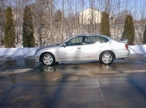
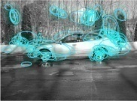

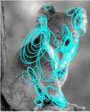
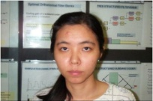
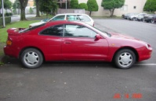
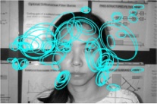
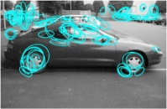
Examples of grouping in vision
[http://poseidon.csd.auth.gr/LAB_RESEARCH/Latest/imgs/SpeakDepVidIndex_img2.jpg]
Group video frames into shots
[Figure by J. Shi]
Determine image regions
Fg / Bg
[Figure by Wang & Suter]
Figure-ground
[Figure by Grauman & Darrell]
Object-level grouping
Source: K. Grauman
Notes:
3

Slide 4
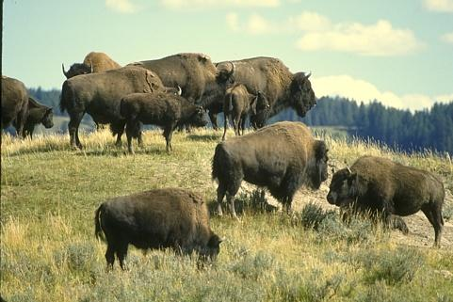
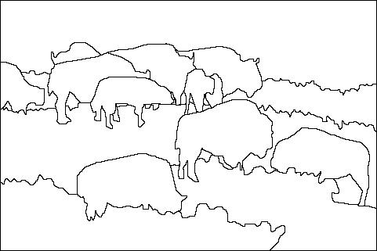
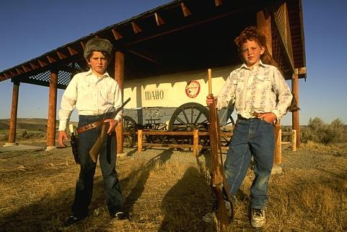
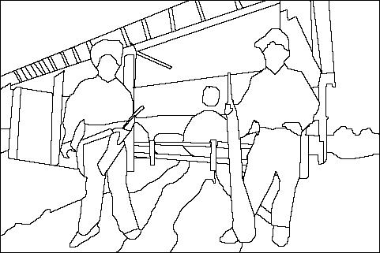
The goals of segmentation
Separate image into coherent “objects”
image
human segmentation
Source: L. Lazebnik

Slide 5
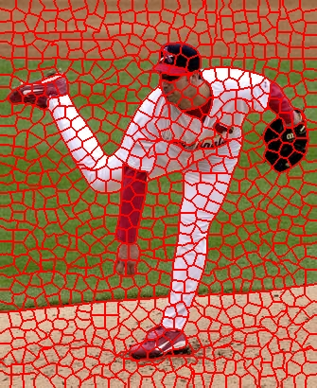
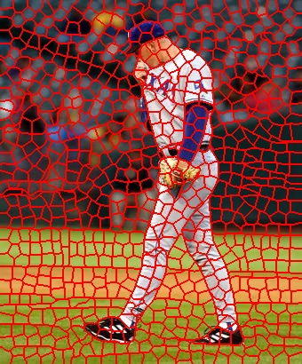
The goals of segmentation
Separate image into coherent “objects”
Group together similar-looking pixels for efficiency of further processing
“superpixels”
X. Ren and J. Malik. Learning a classification model for segmentation. ICCV 2003.
Source: L. Lazebnik

Slide 6
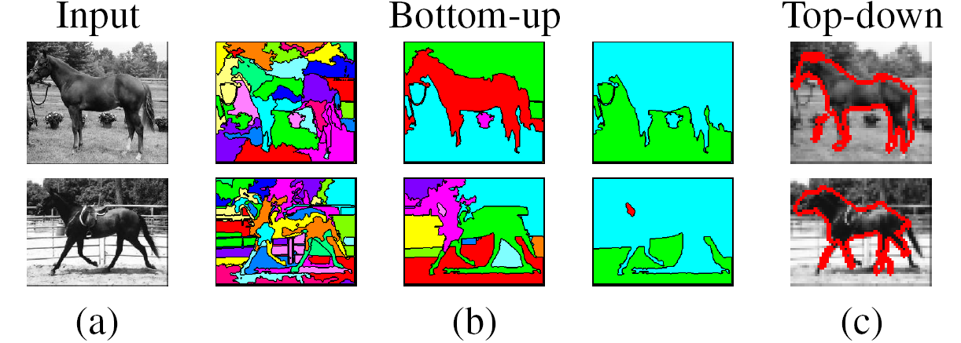
Types of segmentations
Oversegmentation
Undersegmentation
Multiple Segmentations
Source: D. Hoiem

Slide 7
Major processes for segmentation
Bottom-up: group tokens with similar features
Top-down: group tokens that likely belong to the same object
Source: D. Hoiem
[Levin and Weiss 2006]

Slide 8
Grouping in vision
Goals:
  Gather features that belong together
  Obtain an intermediate representation that compactly describes key image (video) parts
Top down vs. bottom up segmentation
  Top down: pixels belong together because they are from the same object
  Bottom up: pixels belong together because they look similar
Hard to measure success
  What is interesting depends on the app.
Source: K. Grauman

Slide 9
Today
Inspiration from human perception
  Gestalt properties
Bottom-up segmentation via clustering
  Features: color, texture, …
    Quantization for texture summaries
  Algorithms:
    Mode finding and mean shift: k-means, mean-shift
    Graph-based: normalized cuts
    Other
Source: K. Grauman
Notes:
9

Slide 10
Gestalt
Gestalt:
  Whole is greater than sum of its parts
  Relationships among parts can yield new properties/features
Psychologists identified series of factors that predispose set of elements to be grouped (by human visual system)
Source: K. Grauman
Notes:
10

Slide 11
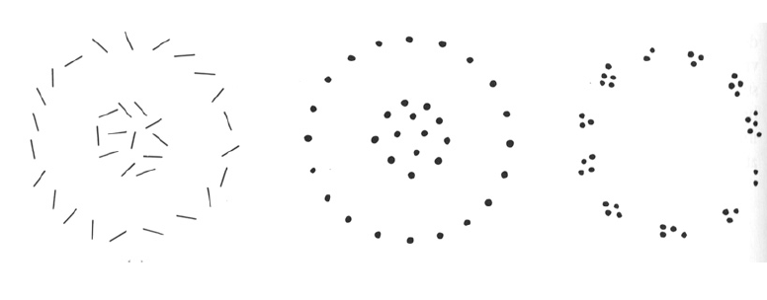
Source: K. Grauman

Slide 12
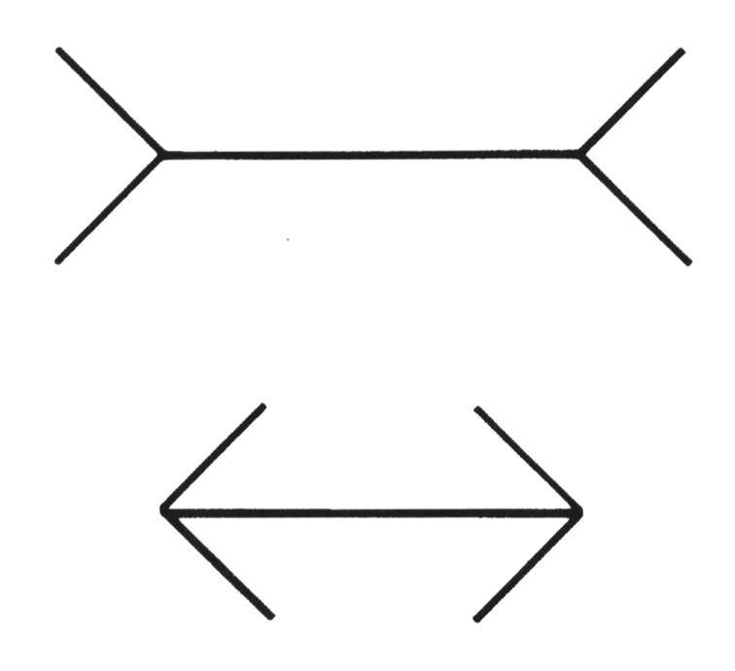
Gestaltism
The Muller-Lyer illusion
Source: D. Hoiem
Notes:
The famous Muller-Lyer illusion; the point is that the horizontal bar has properties that come only from its membership in
a group (it looks shorter in the lower picture, but is actually the same size) and that these properties can’t be discounted--- you can’t look at this figure and ignore the arrowheads and thereby make the two bars seem to be the same size.

Slide 13
We perceive the interpretation, not the senses
Source: D. Hoiem
Notes:
In one experiment, children from rural Zambia were less susceptible to the illusion.

Slide 14
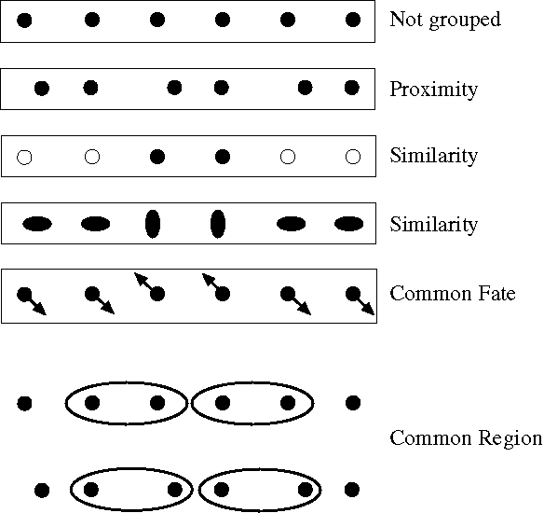
Principles of perceptual organization
Source: D. Hoiem
From Steve Lehar: The Constructive Aspect of Visual Perception
Notes:
Some criteria that tend to cause tokens to be grouped.

Slide 15
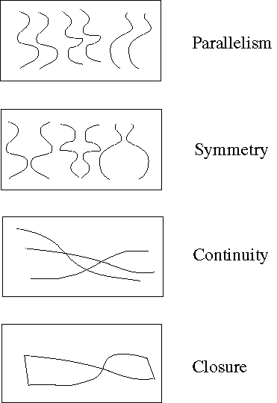
Principles of perceptual organization
Source: D. Hoiem
Notes:
More such

Slide 16
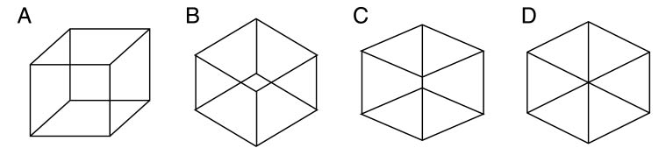
Gestaltists do not believe in coincidence
Source: D. Hoiem

Slide 17
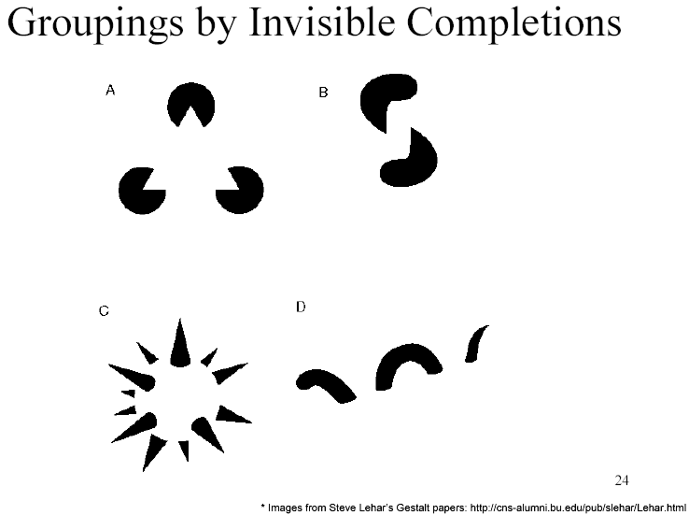
Grouping by invisible completion
Source: D. Hoiem
From Steve Lehar: The Constructive Aspect of Visual Perception

Slide 18
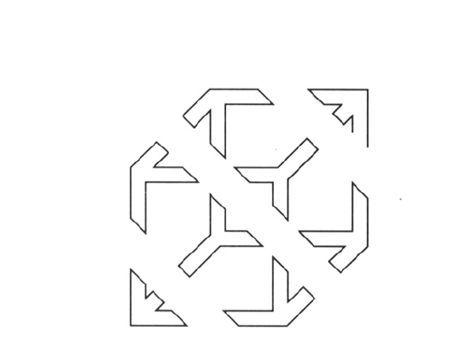
Source: K. Grauman

Slide 19
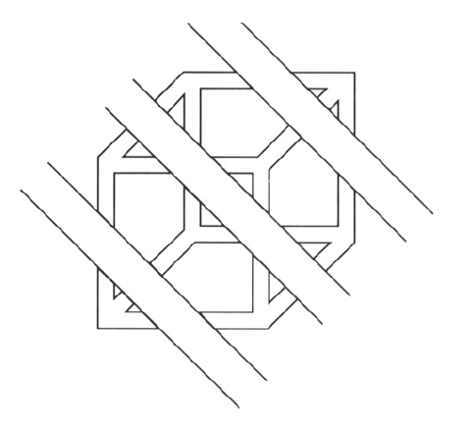
Continuity, explanation by occlusion
Source: K. Grauman

Slide 20
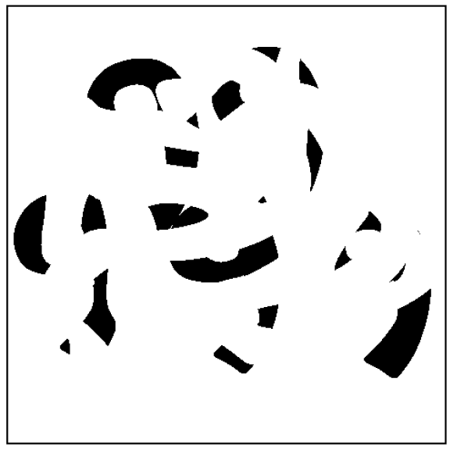
Source: D. Forsyth

Slide 21
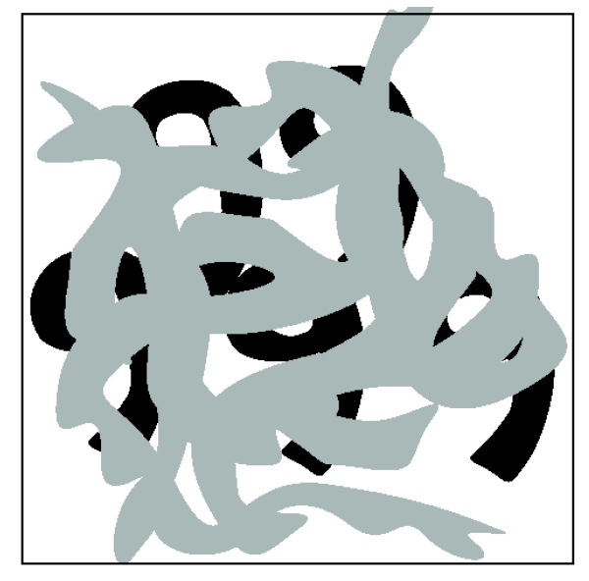
Source: D. Forsyth

Slide 22
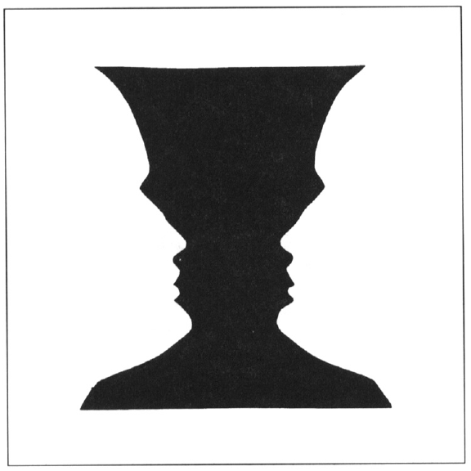
Figure-ground
Source: K. Grauman

Slide 23
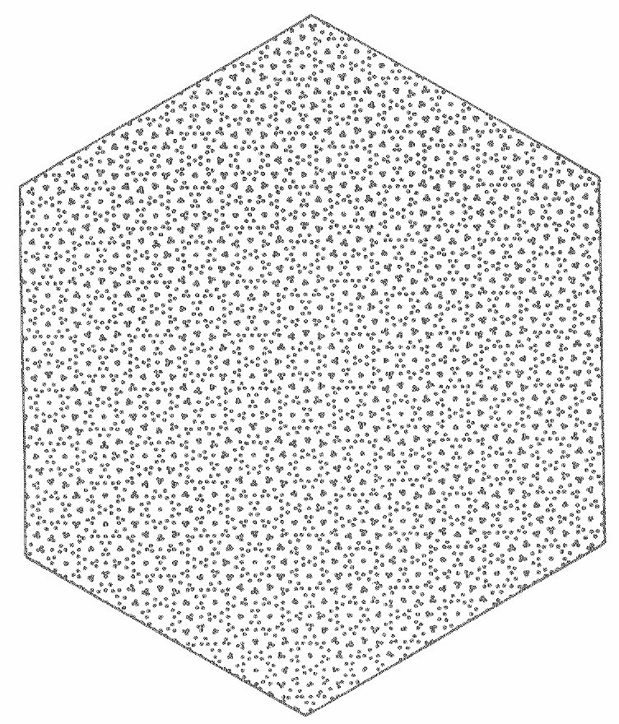
In Vision, D. Marr, 1982; from J. L. Marroquin, “Human visual perception of structure”, 1976.
Notes:
23

Slide 24
Gestalt cues
Good intuition and basic principles for grouping
Basis for many ideas in segmentation and occlusion reasoning
Some (e.g., symmetry) are difficult to implement in practice
Source: D. Hoiem

Slide 25
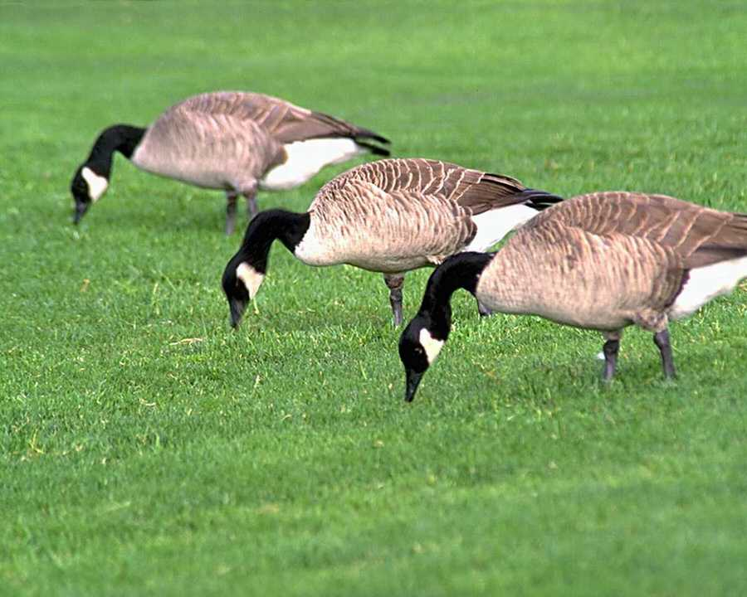
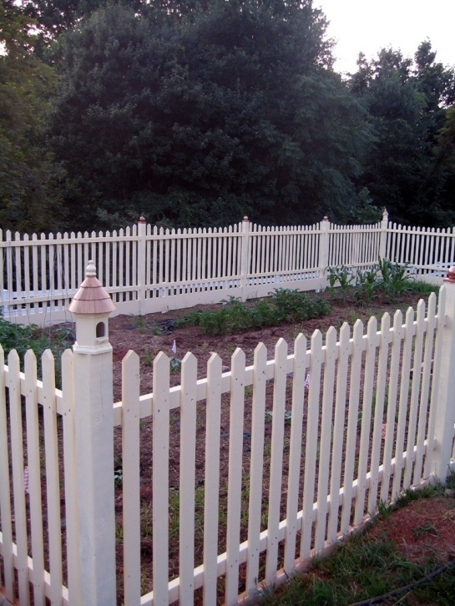
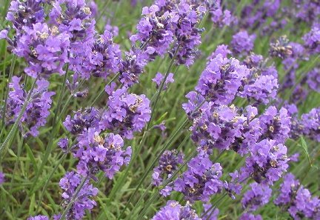
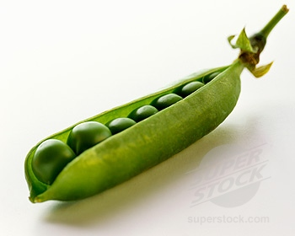
Similarity
http://chicagoist.com/attachments/chicagoist_alicia/GEESE.jpg, http://wwwdelivery.superstock.com/WI/223/1532/PreviewComp/SuperStock_1532R-0831.jpg

Slide 26
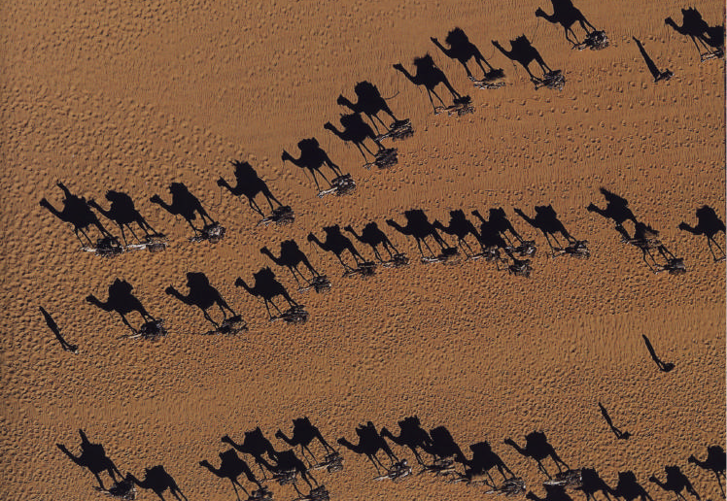
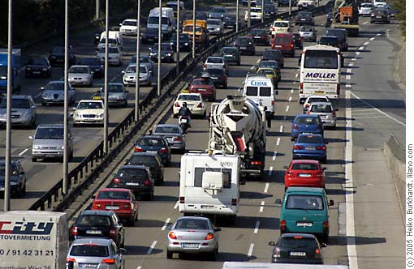
Common fate
Image credit: Arthus-Bertrand (via F. Durand)
Source: K. Grauman

Slide 27
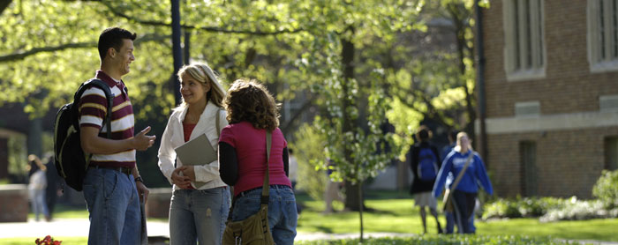

Proximity
http://www.capital.edu/Resources/Images/outside6_035.jpg

Slide 28
Today
Inspiration from human perception
  Gestalt properties
Bottom-up segmentation via clustering
  Features: color, texture, …
    Quantization for texture summaries
  Algorithms:
    Mode finding and mean shift: k-means, mean-shift
    Graph-based: normalized cuts
    Other
Source: K. Grauman
Notes:
28

Slide 29
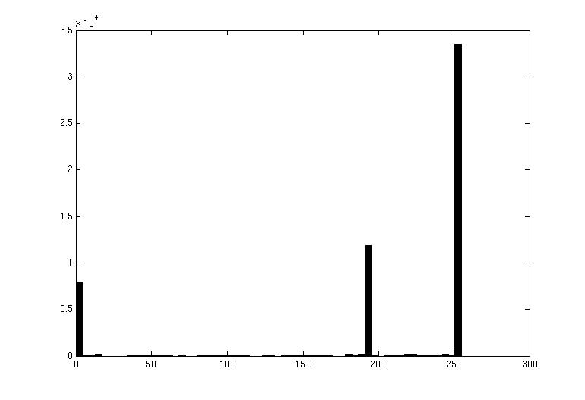

Image segmentation: toy example
white pixels
pixel count
3
black pixels
gray pixels
1
2
input image
intensity
These intensities define the three groups.
We could label every pixel in the image according to which of these primary intensities it is.
  i.e., segment the image based on the intensity feature.
What if the image isn’t quite so simple?
Source: K. Grauman

Slide 30
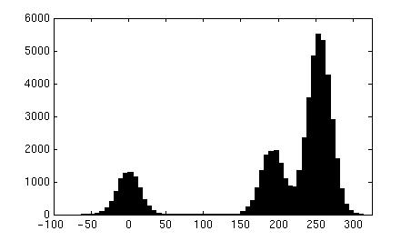
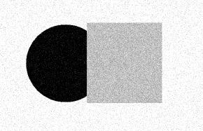
pixel count
input image
intensity
pixel count
input image
intensity
Source: K. Grauman

Slide 31
pixel count
input image
intensity
Now how to determine the three main intensities that define our groups?
We need to cluster.
Source: K. Grauman

Slide 32
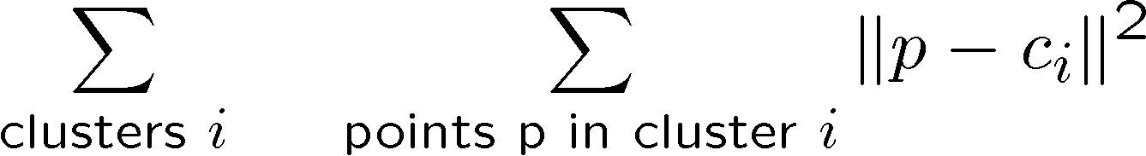
0
190
255
intensity
3
1
2
Goal: choose three “centers” as the representative intensities, and label every pixel according to which of these centers it is nearest to.
Best cluster centers are those that minimize SSD between all points and their nearest cluster center ci:
Source: K. Grauman

Slide 33
Clustering
With this objective, it is a “chicken and egg” problem:
  If we knew the cluster centers, we could allocate points to groups by assigning each to its closest center.
  If we knew the group memberships, we could get the centers by computing the mean per group.
Source: K. Grauman

Slide 34
K-means clustering
Basic idea: randomly initialize the k cluster centers, and iterate between the two steps we just saw.
  Randomly initialize the cluster centers, c₁, ..., c_{K}
  Given cluster centers, determine points in each cluster
    For each point p, find the closest c_{i}. Put p into cluster i
  Given points in each cluster, solve for c_{i}
    Set c_{i} to be the mean of points in cluster i
  If c_{i} have changed, repeat Step 2
Properties
  Will always converge to some solution
  Can be a “local minimum”
    does not always find the global minimum of objective function:
Source: Steve Seitz

Slide 35

Source: A. Moore

Slide 36

Source: A. Moore

Slide 37

Source: A. Moore

Slide 38

Source: A. Moore

Slide 39

Source: A. Moore

Slide 40
K-means clustering
Matlab demo
http://www.cs.pitt.edu/~kovashka/cs1699/kmeans_demo.m
Java demos:
http://kovan.ceng.metu.edu.tr/~maya/kmeans/index.html
http://home.dei.polimi.it/matteucc/Clustering/tutorial_html/AppletKM.html

Slide 41
Today
Inspiration from human perception
  Gestalt properties
Bottom-up segmentation via clustering
  Features: color, texture, …
    Quantization for texture summaries
  Algorithms:
    Mode finding and mean shift: k-means, mean-shift
    Graph-based: normalized cuts
    Other
Source: K. Grauman
Notes:
41

Slide 42


K-means: pros and cons
Pros
Simple, fast to compute
Converges to local minimum of within-cluster squared error
Cons/issues
Setting k?
Sensitive to initial centers
Sensitive to outliers
Detects spherical clusters
Assuming means can be computed
Source: K. Grauman
Notes:
42

Slide 43

An aside: Smoothing out cluster assignments
Assigning a cluster label per pixel may yield outliers:
original
labeled by cluster center’s intensity
?
How to ensure they are spatially smooth?
3
1
2
Source: K. Grauman

Slide 44

Segmentation as clustering
Depending on what we choose as the feature space, we can group pixels in different ways.
Grouping pixels based on intensity similarity
Feature space: intensity value (1-d)
Source: K. Grauman
Notes:
44

Slide 45


K=2
K=3
quantization of the feature space; segmentation label map
Source: K. Grauman

Slide 46

Segmentation as clustering
Depending on what we choose as the feature space, we can group pixels in different ways.
R=255
G=200
B=250
Grouping pixels based on color similarity
B
R=245
G=220
B=248
G
R=15
G=189
B=2
R=3
G=12
B=2
R
Feature space: color value (3-d)
Source: K. Grauman
Notes:
46

Slide 47
Segmentation as clustering
Depending on what we choose as the feature space, we can group pixels in different ways.
Grouping pixels based on intensity similarity
Clusters based on intensity similarity don’t have to be spatially coherent.
Source: K. Grauman
Notes:
47

Slide 48
Segmentation as clustering
Depending on what we choose as the feature space, we can group pixels in different ways.
Grouping pixels based
on intensity+position similarity
Intensity
Y
X
Both regions are black, but if we also include position (x,y), then we could group the two into distinct segments; way to encode both similarity & proximity.
Source: K. Grauman
Notes:
48

Slide 49



Segmentation as clustering
Color, brightness, position alone are not enough to distinguish all regions…
Source: L. Lazebnik

Slide 50

Segmentation as clustering
Depending on what we choose as the feature space, we can group pixels in different ways.
Grouping pixels based on texture similarity
F₁
F₂
Filter bank of 24 filters
…
F₂₄
Feature space: filter bank responses (e.g., 24-d)
Source: K. Grauman
Notes:
50

Slide 51

Recall: texture representation
Windows with primarily horizontal edges
Both
 | mean d/dx value | mean d/dy value
Win. #1 | 4 | 10
Win.#2 | 18 | 7
Win.#9 | 20 | 20
Dimension 2 (mean d/dy value)
Dimension 1 (mean d/dx value)
…
…
Windows with small gradient in both directions
Windows with primarily vertical edges
statistics to summarize patterns in small windows
Source: K. Grauman
Notes:
51

Slide 52


Segmentation with texture features
Find “textons” by clustering vectors of filter bank outputs
Describe texture in a window based on texton histogram
Count
Image
Texton map
Texton index
Count
Count
Texton index
Texton index
Malik, Belongie, Leung and Shi. IJCV 2001.
Source: L. Lazebnik

Slide 53

Image segmentation example
Source: K. Grauman

Slide 54


Pixel properties vs. neighborhood properties
These look very similar in terms of their color distributions (histograms).
How would their texture distributions compare?
Source: K. Grauman

Slide 55

Material classification example
For an image of a single texture, we can classify it according to its global (image-wide) texton histogram.
Figure from Varma & Zisserman, IJCV 2005
Source: K. Grauman

Slide 56


Material classification example
Nearest neighbor classification: label the input according to the nearest known example’s label.
BOARD
Manik Varma
http://www.robots.ox.ac.uk/~vgg/research/texclass/with.html
Source: K. Grauman

Slide 57
K-means: pros and cons
Pros
Simple, fast to compute
Converges to local minimum of within-cluster squared error
Cons/issues
Setting k?
Sensitive to initial centers
Sensitive to outliers
Detects spherical clusters
Assuming means can be computed
Source: K. Grauman
Notes:
57

Slide 58

Mean shift algorithm
The mean shift algorithm seeks modes or local maxima of density in the feature space
Feature space
(L*u*v* color values)
image
Source: K. Grauman

Slide 59

Kernel density estimation
Kernel
Estimated density
Data (1-D)
Source: D. Hoiem

Slide 60


Kernel density estimation
Kernel density estimation function
Gaussian kernel
Source: D. Hoiem

Slide 61
Mean shift
Search
window
Center of
mass
Mean Shift
vector
Slide by Y. Ukrainitz & B. Sarel

Slide 62
Mean shift
Search
window
Center of
mass
Mean Shift
vector
Slide by Y. Ukrainitz & B. Sarel

Slide 63
Mean shift
Search
window
Center of
mass
Mean Shift
vector
Slide by Y. Ukrainitz & B. Sarel

Slide 64
Mean shift
Search
window
Center of
mass
Mean Shift
vector
Slide by Y. Ukrainitz & B. Sarel

Slide 65
Mean shift
Search
window
Center of
mass
Mean Shift
vector
Slide by Y. Ukrainitz & B. Sarel

Slide 66
Mean shift
Search
window
Center of
mass
Mean Shift
vector
Slide by Y. Ukrainitz & B. Sarel

Slide 67
Mean shift
Search
window
Center of
mass
Slide by Y. Ukrainitz & B. Sarel

Slide 68
Points in same cluster converge
Source: D. Hoiem

Slide 69

Mean shift clustering
Cluster: all data points in the attraction basin of a mode
Attraction basin: the region for which all trajectories lead to the same mode
Slide by Y. Ukrainitz & B. Sarel

Slide 70

Mean shift clustering/segmentation
Compute features for each point (color, texture, etc)
Initialize windows at individual feature points
Perform mean shift for each window until convergence
Merge windows that end up near the same “peak” or mode
Source: D. Hoiem

Slide 71




Mean shift segmentation results
http://www.caip.rutgers.edu/~comanici/MSPAMI/msPamiResults.html

Slide 72

Mean shift segmentation results

Slide 73
Mean shift
Pros:
  Does not assume shape on clusters
  One parameter choice (window size)
  Generic technique
  Find multiple modes
  Robust to outliers
Cons:
  Selection of window size
  Does not scale well with dimension of feature space
Source: K. Grauman

Slide 74
Mean-shift reading
Nicely written mean-shift explanation (with math)
http://saravananthirumuruganathan.wordpress.com/2010/04/01/introduction-to-mean-shift-algorithm/
  Includes .m code for mean-shift clustering
Mean-shift paper by Comaniciu and Meer
http://www.caip.rutgers.edu/~comanici/Papers/MsRobustApproach.pdf
Adaptive mean shift in higher dimensions
http://mis.hevra.haifa.ac.il/~ishimshoni/papers/chap9.pdf
Source: K. Grauman

Slide 75
Today
Inspiration from human perception
  Gestalt properties
Bottom-up segmentation via clustering
  Features: color, texture, …
    Quantization for texture summaries
  Algorithms:
    Mode finding and mean shift: k-means, mean-shift
    Graph-based: normalized cuts
    Other
Source: K. Grauman
Notes:
75

Slide 76

Images as graphs
q
w_{pq}
w
p
Fully-connected graph
  node (vertex) for every pixel
  link between every pair of pixels, p,q
  affinity weight w_{pq} for each link (edge)
    w_{pq} measures similarity
      similarity is inversely proportional to difference (in color and position…)
Source: Steve Seitz

Slide 77
Segmentation by Graph Cuts
q
w_{pq}
w
p
A
B
C
Break Graph into Segments
  Want to delete links that cross between segments
  Easiest to break links that have low similarity (low weight)
    similar pixels should be in the same segments
    dissimilar pixels should be in different segments
Source: Steve Seitz

Slide 78
Cuts in a graph: Min cut
B
A
Link Cut
  set of links whose removal makes a graph disconnected
  cost of a cut:
Find minimum cut
  gives you a segmentation
  fast algorithms exist for doing this
Source: Steve Seitz

Slide 79

Minimum cut
Problem with minimum cut:
Weight of cut proportional to number of edges in the cut; tends to produce small, isolated components.
[Shi & Malik, 2000 PAMI]
Source: K. Grauman

Slide 80

Cuts in a graph: Normalized cut
B
A
Normalized Cut
  fix bias of Min Cut by normalizing for size of segments:
  assoc(A,V) = sum of weights of all edges that touch A
  Ncut value small when we get two clusters with many edges with high weights, and few edges of low weight between them
  Approximate solution for minimizing the Ncut value : eigenvalue problem.
      J. Shi and J. Malik, Normalized Cuts and Image Segmentation, CVPR, 1997
Source: Steve Seitz

Slide 81
Normalized cut: Algorithm
Let W be the affinity matrix of the graph (n x n for n pixels)
Let D be the diagonal matrix with entries D(i, i) = Σ_{j} W(i, j)
Solve generalized eigenvalue problem (D − W)y = λDy
for the eigenvector with the second smallest eigenvalue
  The ith entry of y can be viewed as a “soft” indicator
  of the component membership of the ith pixel
  Use 0 or median value of the entries of y to split
  the graph into two components
  To find more than two components:
    Recursively bipartition the graph
    Run k-means clustering on values of
    several eigenvectors

Slide 82









Example results

Slide 83









Results: Berkeley Segmentation Engine
http://www.cs.berkeley.edu/~fowlkes/BSE/

Slide 84
Normalized cuts: pros and cons
Pros:
Generic framework, flexible to choice of function that computes weights (“affinities”) between nodes
Does not require model of the data distribution
Cons:
Time complexity can be high
  Dense, highly connected graphs → many affinity computations
  Solving eigenvalue problem
Preference for balanced partitions
Source: K. Grauman

Slide 85
Today
Inspiration from human perception
  Gestalt properties
Bottom-up segmentation via clustering
  Features: color, texture, …
    Quantization for texture summaries
  Algorithms:
    Mode finding and mean shift: k-means, mean-shift
    Graph-based: normalized cuts
    Other
Source: K. Grauman
Notes:
85

Slide 86






Top-down segmentation
E. Borenstein and S. Ullman, “Class-specific, top-down segmentation,” ECCV 2002
A. Levin and Y. Weiss, “Learning to Combine Bottom-Up and Top-Down Segmentation,” ECCV 2006.
Slide credit: Lana Lazebnik

Slide 87


Segmentation as energy minimization
Define a labeling L as an assignment of each pixel with a 0-1 label (background or foreground)
Find the labeling L that minimizes
data term
smoothness term
How similar is each labeled pixel to the foreground or background?
Encourage spatially coherent segments
Slide credit: N. Snavely

Slide 88






GrabCut
C. Rother, V. Kolmogorov, and A. Blake, “GrabCut” — Interactive Foreground Extraction using Iterated Graph Cuts, SIGGRAPH 2004

Slide 89

Watershed algorithm
Source: D. Hoiem

Slide 90




Watershed segmentation
Image
Gradient
Watershed boundaries
Source: D. Hoiem

Slide 91
Meyer’s watershed segmentation
Choose local minima as region seeds
Add neighbors to priority queue, sorted by value
Take top priority pixel from queue
  If all labeled neighbors have same label, assign that label to pixel
  Add all non-marked neighbors to queue
Repeat step 3 until finished (all remaining pixels in queue are on the boundary)
Matlab: seg = watershed(bnd_im)
Meyer 1991

Slide 92

Segments as primitives for recognition
Image parsing or semantic segmentation:
J. Tighe and S. Lazebnik, ECCV 2010, IJCV 2013
Source: L. Lazebnik

Slide 93
Summary
Segmentation to find object boundaries or mid-level regions.
Bottom-up segmentation via clustering
  General choices -- features, affinity functions, and clustering algorithms
Grouping also useful for quantization, can create new feature summaries
  Texton histograms for texture within local region
Example clustering methods
  K-means
  Mean shift
  Graph cut, normalized cuts
Source: K. Grauman

Slide 94
Next time
Finding correspondences between features
Line and model fitting

