Slide 1
CS 1699: Intro to Computer Vision
Texture and
Other Uses of Filters
Prof. Adriana Kovashka
University of Pittsburgh
September 10, 2015
Slides from Kristen Grauman (12-52) and Derek Hoiem (54-83)

Slide 2
Plan for today
Texture (cont’d)
  Review of texture description
  Texture synthesis
Uses of filters
  Sampling
  Template matching

Slide 3
Reading
For today: Szeliski Sec. 3.1.1, 3.2, 10.5
For next time: Szeliski Sec. 3.3.2-4, 4.2 (17 pages)
Get started now on reading for 9/17 (57 pages)
I will finalize the reading for each class by 6pm the day of the class preceding it
  Readings finalized until 9/17 inclusive

Slide 4
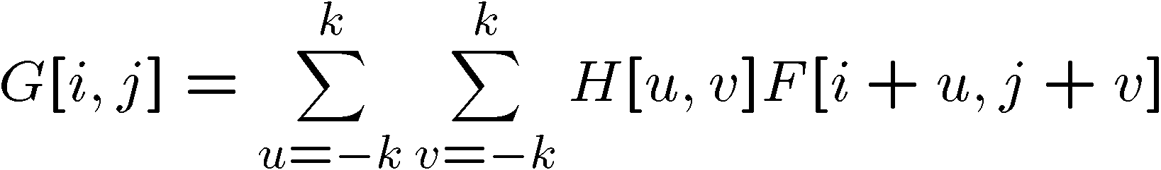

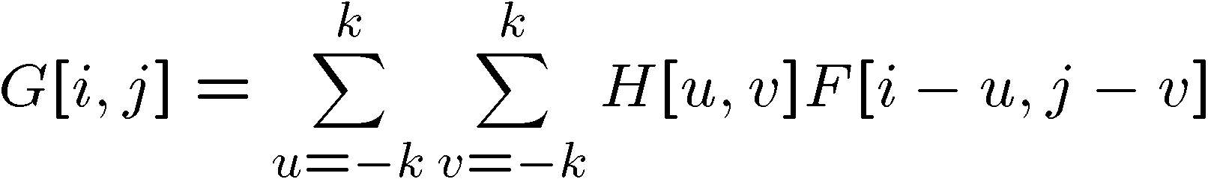

Convolution vs. correlation
Cross-correlation
F
5 | 2 | 5 | 4 | 4
5 | 200 | 3 | 200 | 4
1 | 5 | 5 | 4 | 4
5 | 5 | 1 | 1 | 2
200 | 1 | 3 | 5 | 200
1 | 200 | 200 | 200 | 1
(i, j)
u = -1,
v = -1
Convolution
H
.06 | .12 | .06
.12 | .25 | .12
.06 | .12 | .06
(0, 0)

Slide 5
Convolution vs. correlation
Cross-correlation
F
5 | 2 | 5 | 4 | 4
5 | 200 | 3 | 200 | 4
1 | 5 | 5 | 4 | 4
5 | 5 | 1 | 1 | 2
200 | 1 | 3 | 5 | 200
1 | 200 | 200 | 200 | 1
(i, j)
u = -1,
v = -1
v = 0
Convolution
H
.06 | .12 | .06
.12 | .25 | .12
.06 | .12 | .06
(0, 0)

Slide 6
Convolution vs. correlation
Cross-correlation
F
5 | 2 | 5 | 4 | 4
5 | 200 | 3 | 200 | 4
1 | 5 | 5 | 4 | 4
5 | 5 | 1 | 1 | 2
200 | 1 | 3 | 5 | 200
1 | 200 | 200 | 200 | 1
(i, j)
u = -1,
v = -1
v = 0
v = +1
Convolution
H
.06 | .12 | .06
.12 | .25 | .12
.06 | .12 | .06
(0, 0)

Slide 7
Convolution vs. correlation
Cross-correlation
F
5 | 2 | 5 | 4 | 4
5 | 200 | 3 | 200 | 4
1 | 5 | 5 | 4 | 4
5 | 5 | 1 | 1 | 2
200 | 1 | 3 | 5 | 200
1 | 200 | 200 | 200 | 1
(i, j)
u = -1,
v = -1
v = 0
v = +1
u = 0,
v = -1
Convolution
H
.06 | .12 | .06
.12 | .25 | .12
.06 | .12 | .06
(0, 0)

Slide 8
Convolution vs. correlation
Cross-correlation
F
5 | 2 | 5 | 4 | 4
5 | 200 | 3 | 200 | 4
1 | 5 | 5 | 4 | 4
5 | 5 | 1 | 1 | 2
200 | 1 | 3 | 5 | 200
1 | 200 | 200 | 200 | 1
(i, j)
u = -1,
v = -1
Convolution
H
.06 | .12 | .06
.12 | .25 | .12
.06 | .12 | .06
(0, 0)

Slide 9
Convolution vs. correlation
Cross-correlation
F
5 | 2 | 5 | 4 | 4
5 | 200 | 3 | 200 | 4
1 | 5 | 5 | 4 | 4
5 | 5 | 1 | 1 | 2
200 | 1 | 3 | 5 | 200
1 | 200 | 200 | 200 | 1
(i, j)
u = -1,
v = -1
v = 0
Convolution
H
.06 | .12 | .06
.12 | .25 | .12
.06 | .12 | .06
(0, 0)

Slide 10
Convolution vs. correlation
Cross-correlation
F
5 | 2 | 5 | 4 | 4
5 | 200 | 3 | 200 | 4
1 | 5 | 5 | 4 | 4
5 | 5 | 1 | 1 | 2
200 | 1 | 3 | 5 | 200
1 | 200 | 200 | 200 | 1
(i, j)
u = -1,
v = -1
v = 0
v = +1
Convolution
H
.06 | .12 | .06
.12 | .25 | .12
.06 | .12 | .06
(0, 0)

Slide 11
Convolution vs. correlation
Cross-correlation
F
5 | 2 | 5 | 4 | 4
5 | 200 | 3 | 200 | 4
1 | 5 | 5 | 4 | 4
5 | 5 | 1 | 1 | 2
200 | 1 | 3 | 5 | 200
1 | 200 | 200 | 200 | 1
(i, j)
u = -1,
v = -1
v = 0
v = +1
u = 0,
v = -1
Convolution
H
.06 | .12 | .06
.12 | .25 | .12
.06 | .12 | .06
(0, 0)

Slide 12
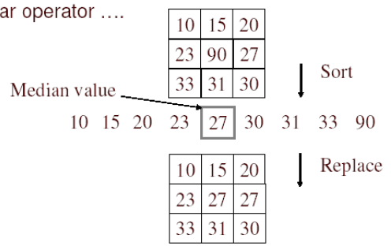
Median filter
No new pixel values introduced
Removes spikes: good for impulse, salt & pepper noise
Non-linear filter

Slide 13
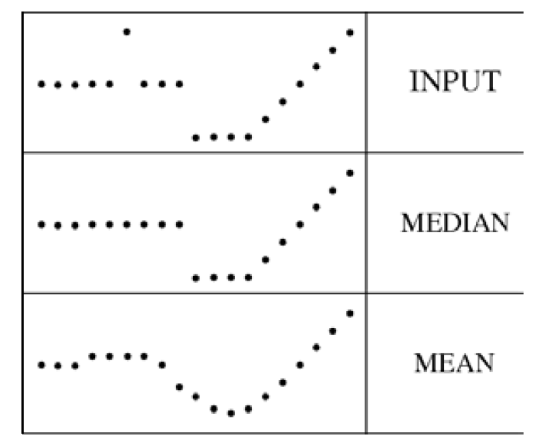
Median filter
Median filter is edge preserving

Slide 14
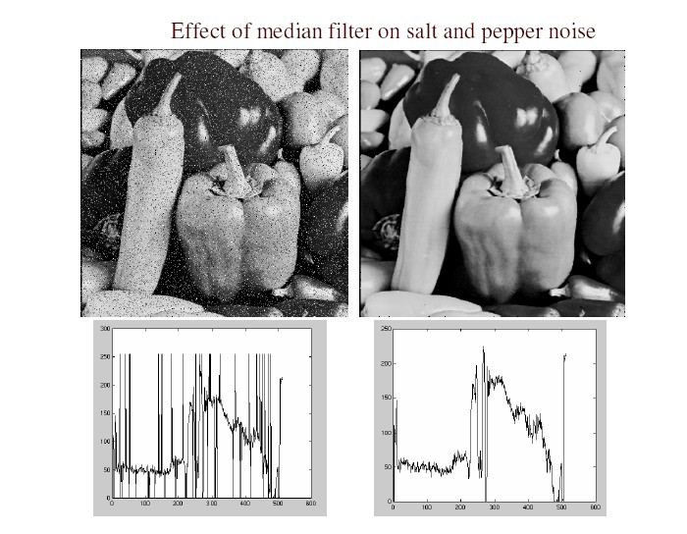
Median filter
Salt and pepper noise
Median filtered
Plots of a row of the image
Matlab: output im = medfilt2(im, [h w]);
Source: M. Hebert

Slide 15
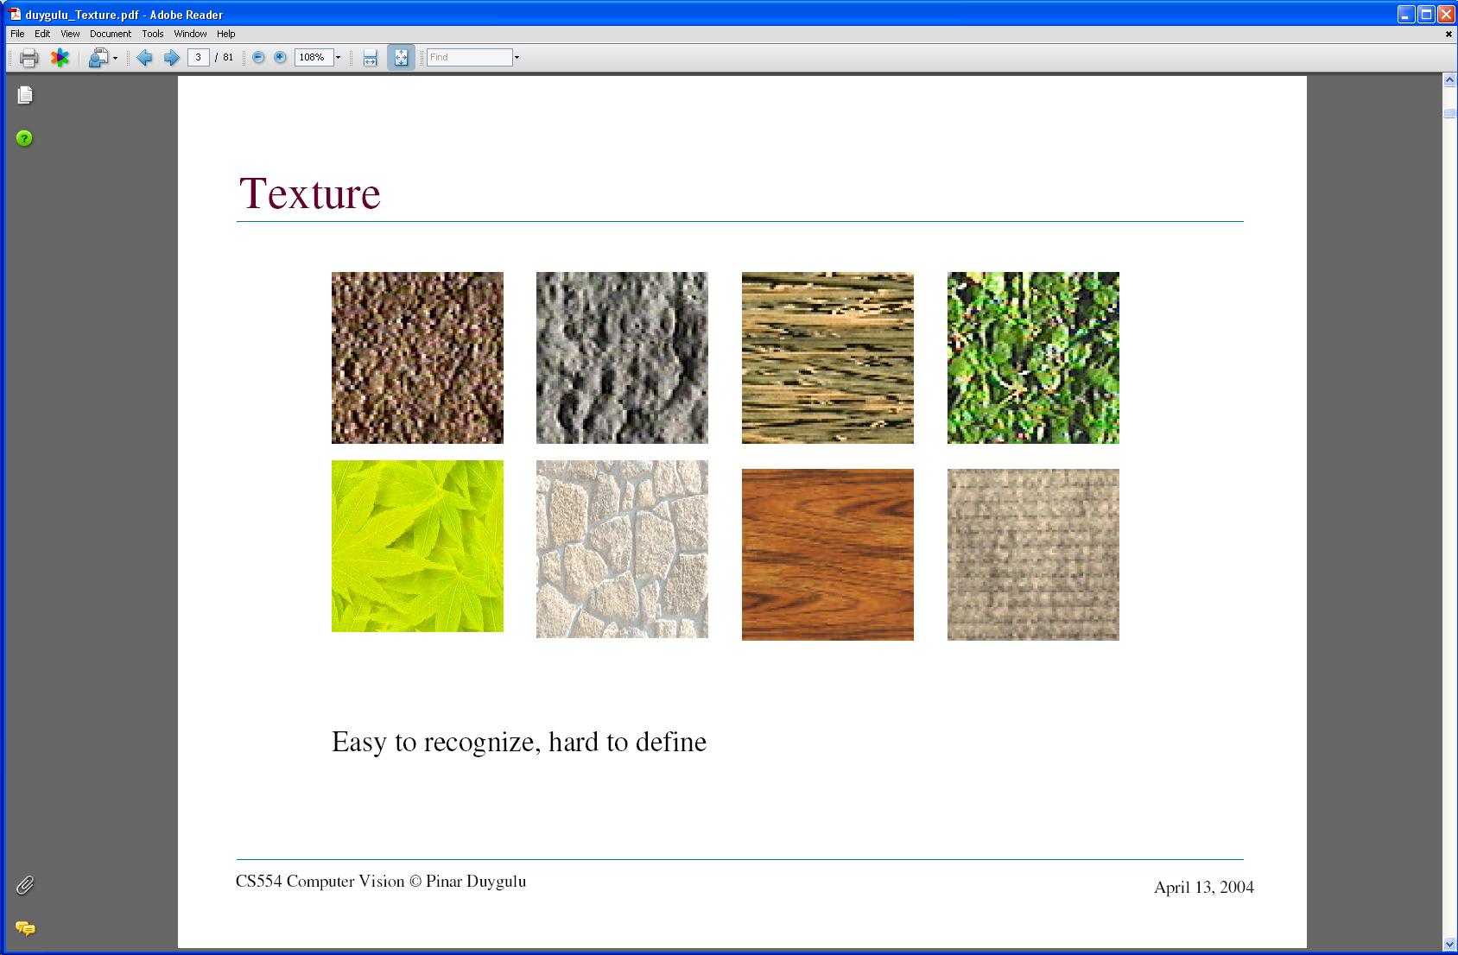
Texture
What defines a texture?

Slide 16

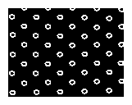
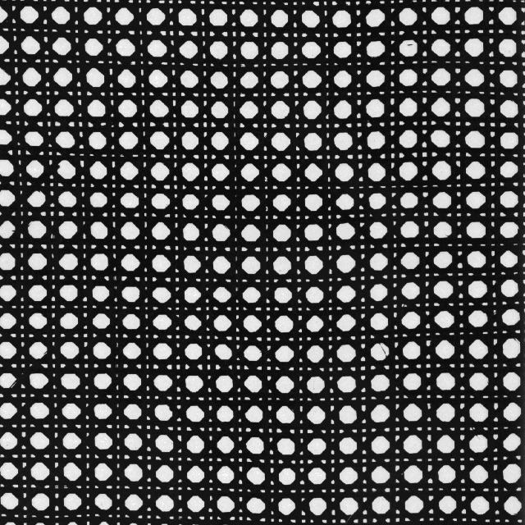
Includes: more regular patterns

Slide 17
Includes: more random patterns

Slide 18
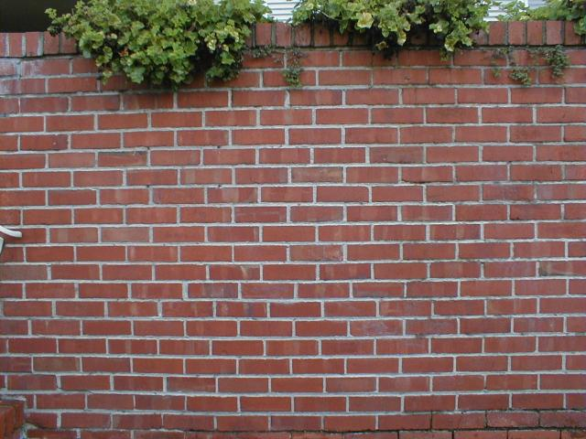
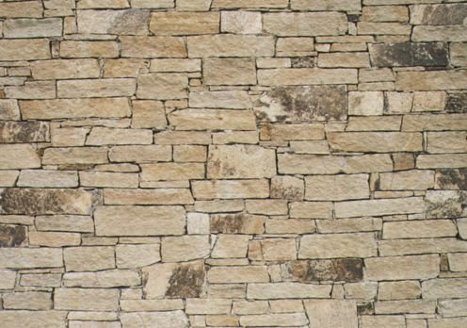
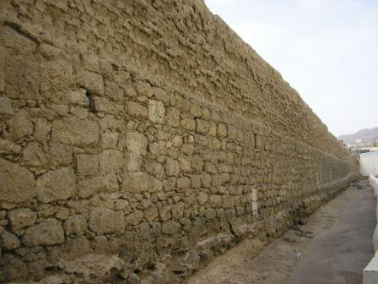
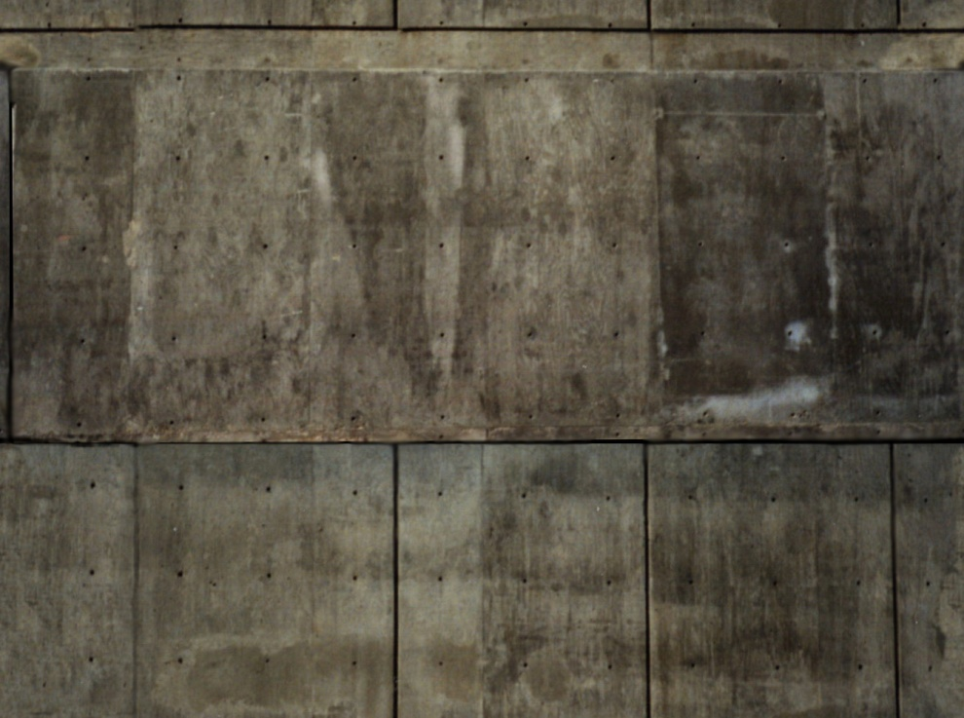
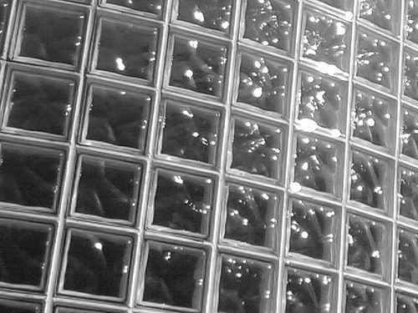

Slide 19
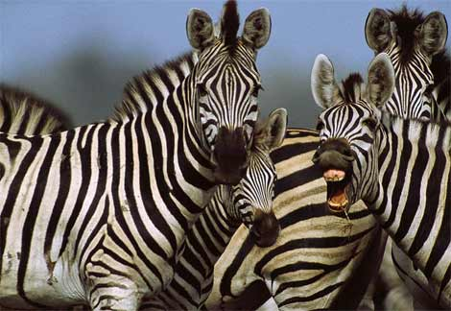
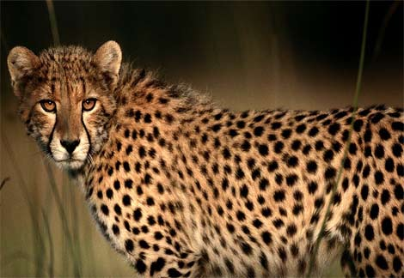
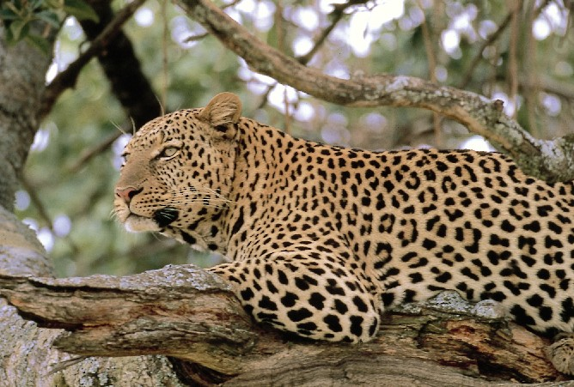
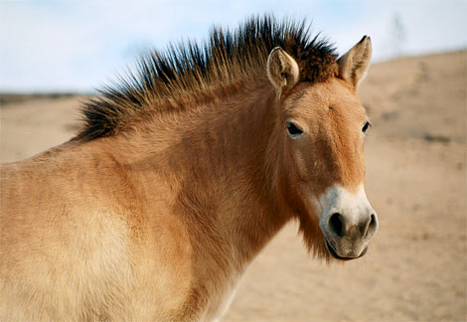
http://animals.nationalgeographic.com/

Slide 20
Texture representation
Textures are made up of repeated local patterns, so:
  Find the patterns
    Use filters that look like patterns (spots, bars, raw patches…)
    Consider magnitude of response
  Describe their statistics within each local window
    Mean, standard deviation
    Histogram
Kristen Grauman

Slide 21
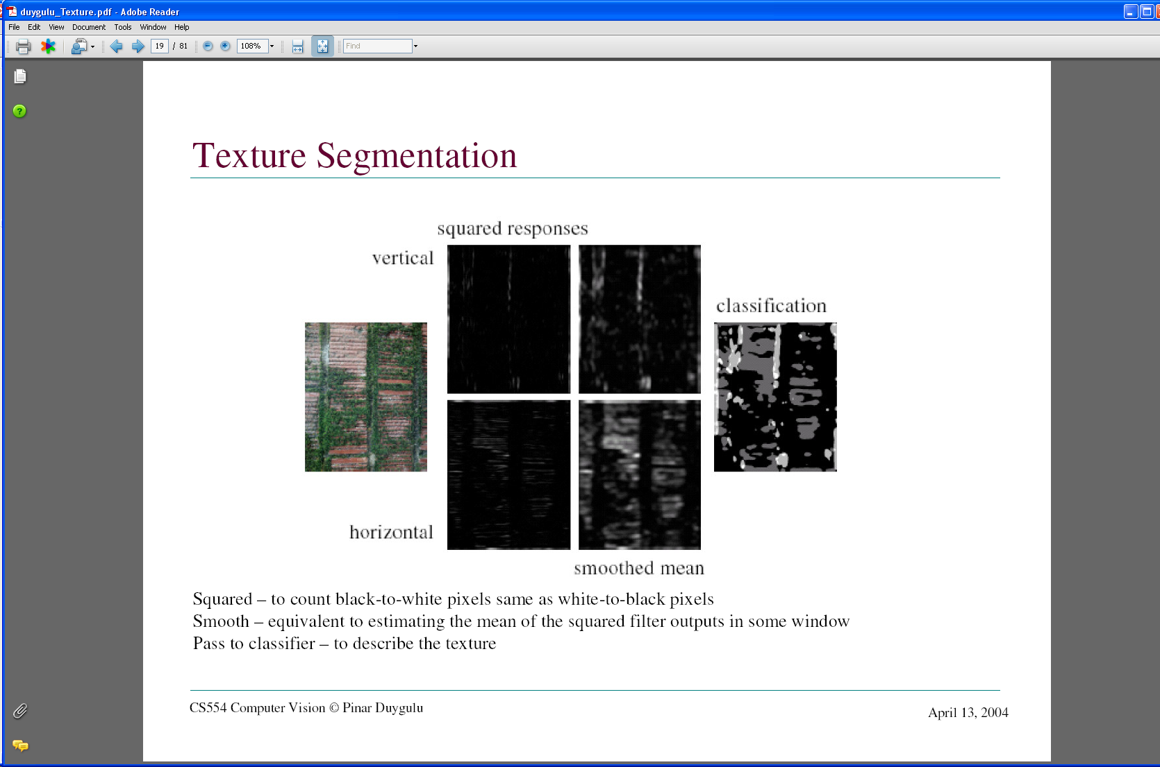
Texture representation: example
 | mean d/dx value | mean d/dy value
Win. #1 | 4 | 10
original image
…
statistics to summarize patterns in small windows
derivative filter responses, squared
Kristen Grauman

Slide 22
Texture representation: example
 | mean d/dx value | mean d/dy value
Win. #1 | 4 | 10
Win.#2 | 18 | 7
original image
…
statistics to summarize patterns in small windows
derivative filter responses, squared
Kristen Grauman

Slide 23
Texture representation: example
 | mean d/dx value | mean d/dy value
Win. #1 | 4 | 10
Win.#2 | 18 | 7
Win.#9 | 20 | 20
original image
…
…
statistics to summarize patterns in small windows
derivative filter responses, squared
Kristen Grauman

Slide 24
Texture representation: example
 | mean d/dx value | mean d/dy value
Win. #1 | 4 | 10
Win.#2 | 18 | 7
Win.#9 | 20 | 20
Dimension 2 (mean d/dy value)
Dimension 1 (mean d/dx value)
…
…
statistics to summarize patterns in small windows
Kristen Grauman

Slide 25
Texture representation: example
Windows with primarily horizontal edges
Both
 | mean d/dx value | mean d/dy value
Win. #1 | 4 | 10
Win.#2 | 18 | 7
Win.#9 | 20 | 20
Dimension 2 (mean d/dy value)
Dimension 1 (mean d/dx value)
…
…
Windows with small gradient in both directions
Windows with primarily vertical edges
statistics to summarize patterns in small windows
Kristen Grauman

Slide 26
Texture representation: example
original image
visualization of the assignment to texture “types”
derivative filter responses, squared
Kristen Grauman

Slide 27
Filter banks
Our previous example used two filters, and resulted in a 2-dimensional feature vector to describe texture in a window.
  x and y derivatives revealed something about local structure.
We can generalize to apply a collection of multiple (d) filters: a “filter bank”
Then our feature vectors will be d-dimensional.

Slide 28
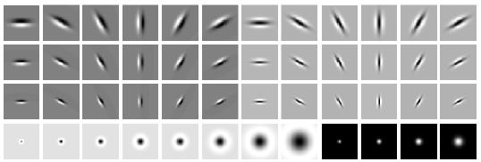
Filter banks
orientations
scales
“Edges”
“Bars”
“Spots”
What filters to put in the bank?
  Typically we want a combination of scales and orientations, different types of patterns.
Matlab code available for these examples: http://www.robots.ox.ac.uk/~vgg/research/texclass/filters.html

Slide 29
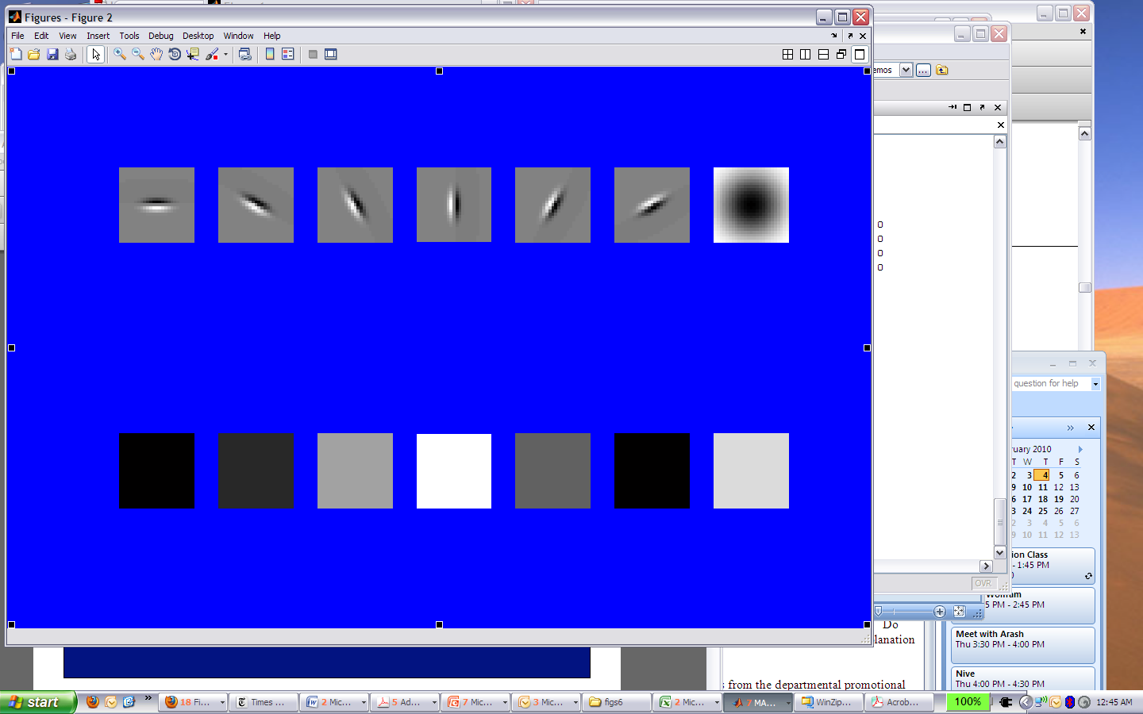
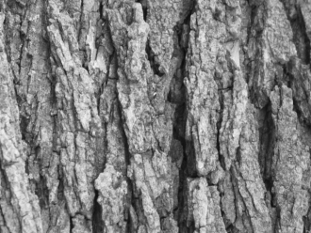
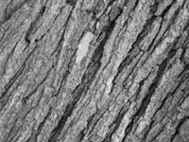
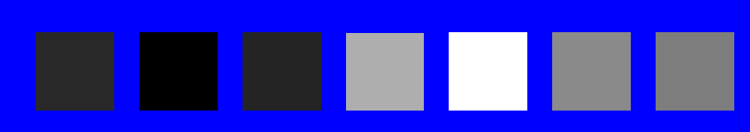
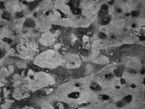
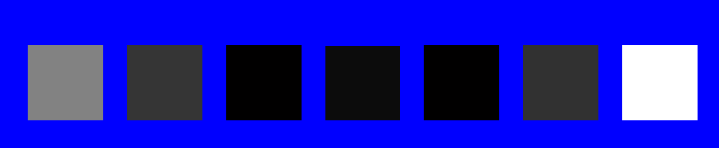
Representing texture by mean abs response
Filters
Mean abs responses
Derek Hoiem

Slide 30
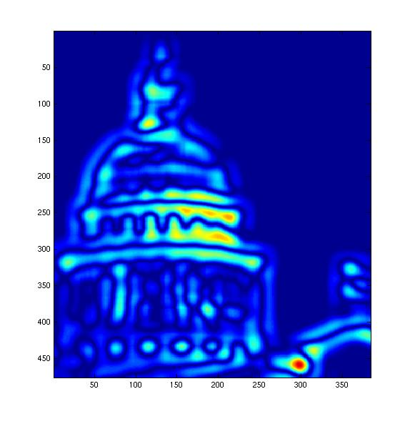
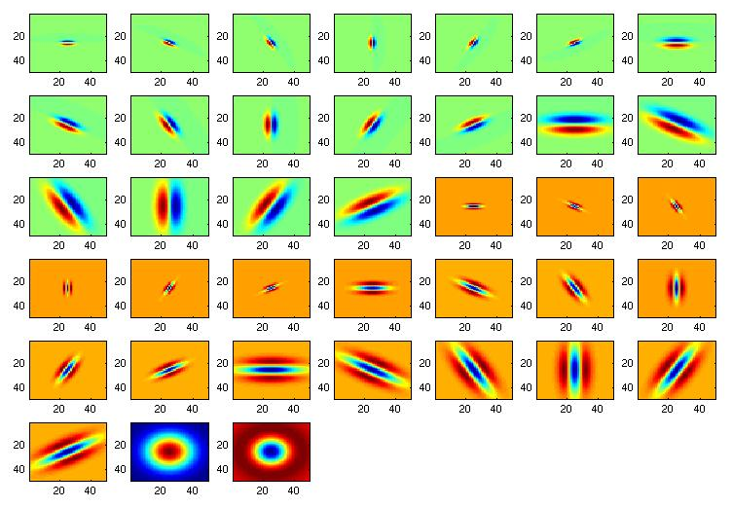
[r1, r2, …, r38]
We can form a feature vector from the list of responses at each pixel.
Kristen Grauman

Slide 31
Texture-related tasks
Shape from texture
  Estimate surface orientation or shape from image texture
Segmentation/classification from texture cues
  Analyze, represent texture
  Group image regions with consistent texture
Synthesis
  Generate new texture patches/images given some examples

Slide 32
Texture synthesis
Goal: create new samples of a given texture
Many applications: virtual environments, hole-filling, texturing surfaces

Slide 33
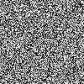

The Challenge
Need to model the whole spectrum: from repeated to stochastic texture
repeated
  Alexei A. Efros and Thomas K. Leung, “Texture Synthesis by Non-parametric Sampling,” Proc. International Conference on Computer Vision (ICCV), 1999.
stochastic
Both?

Slide 34
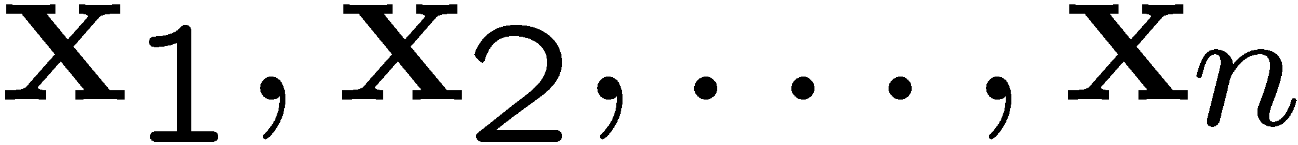
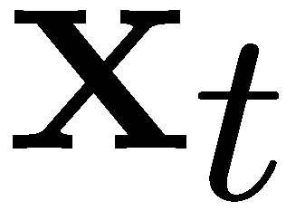
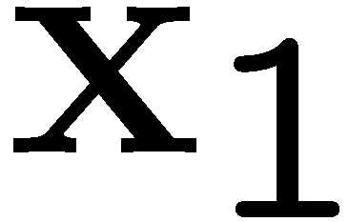
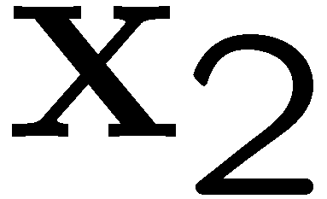
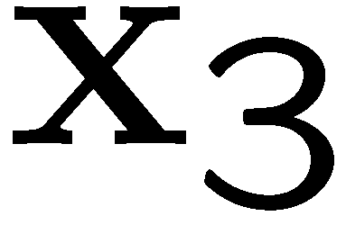
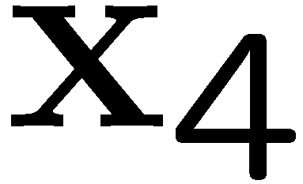
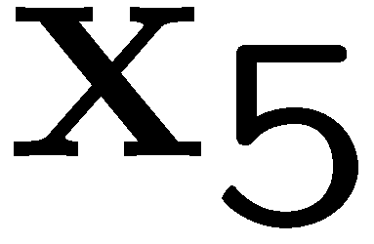
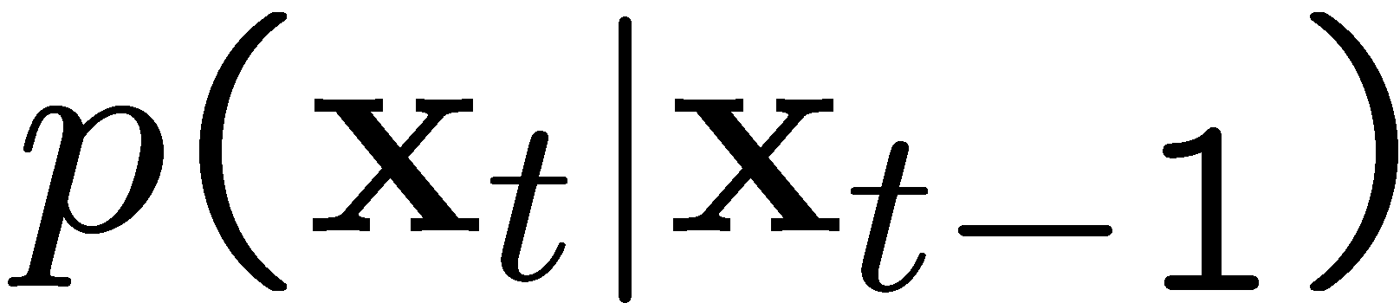
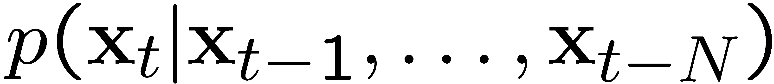
Markov Chains
Markov Chain
  a sequence of random variables
  is the state of the model at time t
  Markov assumption: each state is dependent only on the previous one
    dependency given by a conditional probability:
  The above is actually a first-order Markov chain
  An N’th-order Markov chain:
Source S. Seitz

Slide 35
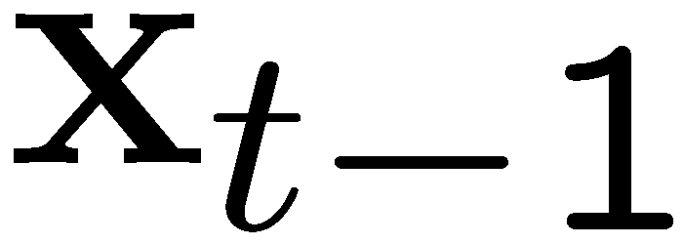
Markov Chain Example: Text
“A dog is a man’s best friend. It’s a dog eat dog world out there.”
a
 | 2/3 |  | 1/3
 |  | 1/3 |  |  |  |  | 1/3 | 1/3
1
 |  |  |  | 1
 |  |  |  |  | 1
 |  |  |  |  |  |  |  |  |  |  | 1
1
 | 1
 |  |  |  |  |  |  |  |  | 1
 |  |  |  |  |  |  |  |  |  | 1
 |  |  |  |  |  |  |  |  |  |  | 1
 |  |  |  |  |  | 1
dog
is
man’s
best
friend
it’s
eat
world
out
there
.
a
dog
is
it’s
eat
out
.
best
friend
there
man’s
world
Source: S. Seitz

Slide 36
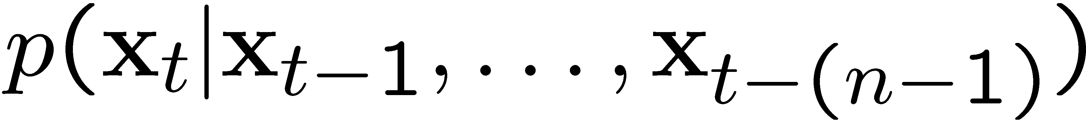
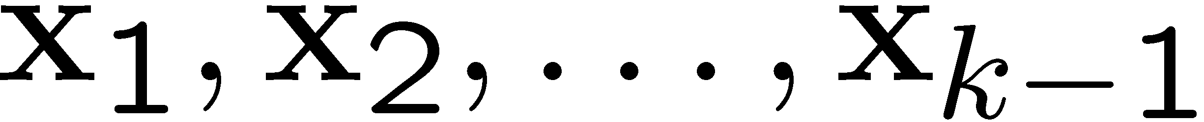
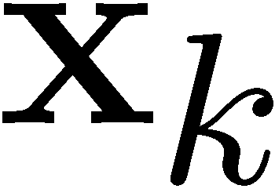
Text synthesis
Create plausible looking poetry, love letters, term papers, etc.
Most basic algorithm
  Build probability histogram
    find all blocks of N consecutive words/letters in training documents
    compute probability of occurrence
  Given words
    compute by sampling from
WE NEED
TO
EAT
CAKE
Source: S. Seitz

Slide 37
Text synthesis
Results:
  “As I've commented before, really relating to someone involves standing next to impossible.”
  "One morning I shot an elephant in my arms and kissed him.”
  "I spent an interesting evening recently with a grain of salt"
Dewdney, “A potpourri of programmed prose and prosody” Scientific American, 1989.
Slide from Alyosha Efros, ICCV 1999

Slide 38
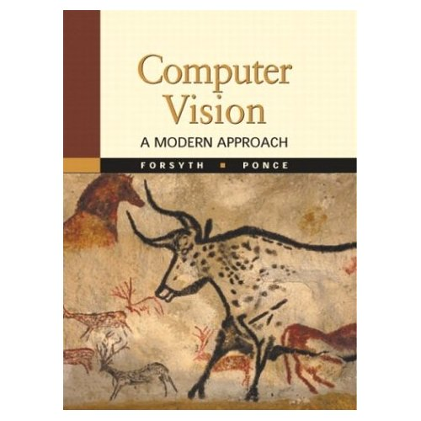
Synthesizing Computer Vision text
What do we get if we extract the probabilities from a chapter on Linear Filters, and then synthesize new statements?
Check out Yisong Yue’s website implementing text generation: build your own text Markov Chain for a given text corpus. http://www.yisongyue.com/shaney/index.php
Kristen Grauman

Slide 39
Synthesized text
This means we cannot obtain a separate copy of the best studied regions in the sum.
All this activity will result in the primate visual system.
The response is also Gaussian, and hence isn’t bandlimited.
Instead, we need to know only its response to any data vector, we need to apply a low pass filter that strongly reduces the content of the Fourier transform of a very large standard deviation.
It is clear how this integral exist (it is sufficient for all pixels within a 2k +1 × 2k +1 × 2k +1 × 2k + 1 — required for the images separately.
Kristen Grauman

Slide 40

Markov Random Field
A Markov random field (MRF)
  generalization of Markov chains to two or more dimensions.
First-order MRF:
  probability that pixel X takes a certain value given the values of neighbors A, B, C, and D:
A
D
X
B
C
Source: S. Seitz

Slide 41


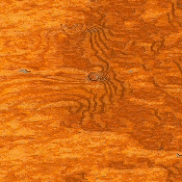
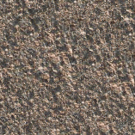
Texture Synthesis [Efros & Leung, ICCV 99]
Can apply 2D version of text synthesis
Texture corpus (sample)
Output

Slide 42
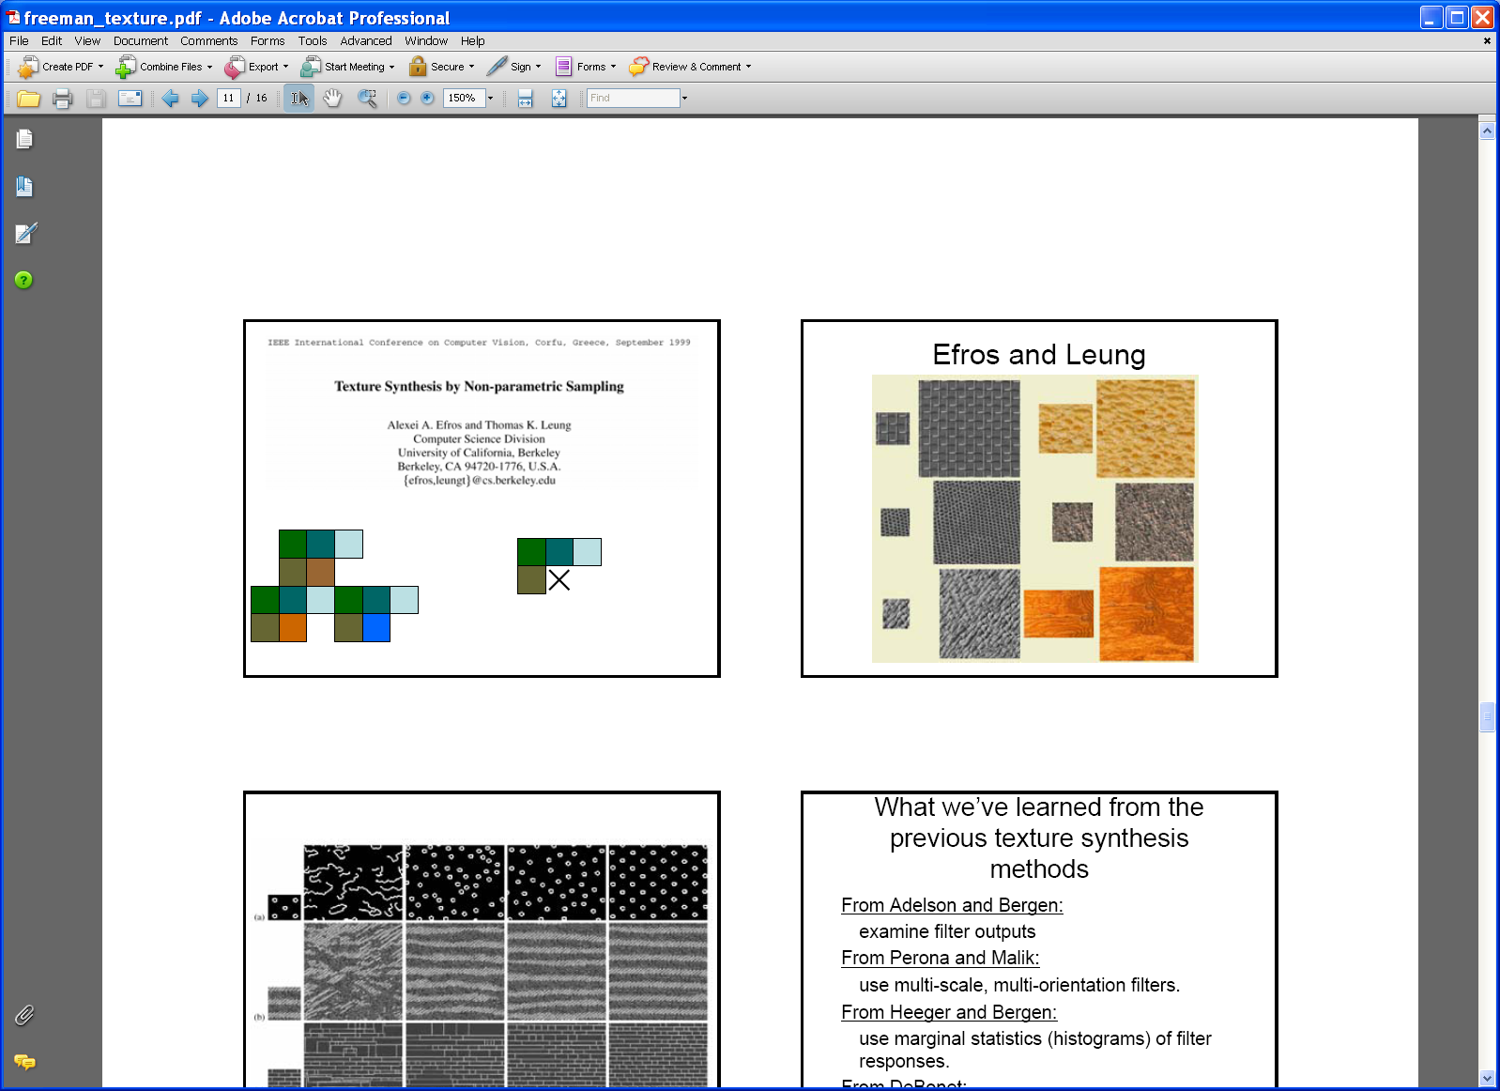
Texture synthesis: intuition
Before, we inserted the next word based on existing nearby words…
Now we want to insert pixel intensities based on existing nearby pixel values.
Place we want to insert next
Sample of the texture
(“corpus”)
Distribution of a value of a pixel is conditioned on its neighbors alone.

Slide 43
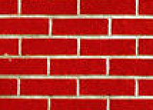

Synthesizing One Pixel
p
input image
synthesized image
  What is ?
  Find all the windows in the image that match the neighborhood
  To synthesize x
    pick one matching window at random
    assign x to be the center pixel of that window
  An exact neighbourhood match might not be present, so find the best matches using SSD error and randomly choose between them, preferring better matches with higher probability
Slide from Alyosha Efros, ICCV 1999

Slide 44

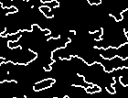
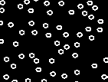
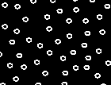
Neighborhood Window
input
Slide adapted from Alyosha Efros, ICCV 1999

Slide 45

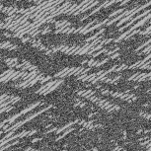







Varying Window Size
Increasing window size
Slide from Alyosha Efros, ICCV 1999

Slide 46




Synthesis results
french canvas
rafia weave
Slide from Alyosha Efros, ICCV 1999

Slide 47


Synthesis results
white bread
brick wall
Slide from Alyosha Efros, ICCV 1999

Slide 48


Synthesis results
Slide from Alyosha Efros, ICCV 1999

Slide 49



Growing Texture
  Starting from the initial image, “grow” the texture one pixel at a time
Slide from Alyosha Efros, ICCV 1999

Slide 50






Hole Filling
Slide from Alyosha Efros, ICCV 1999

Slide 51




Extrapolation
Slide from Alyosha Efros, ICCV 1999

Slide 52
Texture (summary)
Texture is a useful property that is often indicative of materials, appearance cues
Texture representations attempt to summarize repeating patterns of local structure
Filter banks useful to measure redundant variety of structures in local neighborhood
  Feature spaces can be multi-dimensional
Neighborhood statistics can be exploited to “sample” or synthesize new texture regions
  Example-based technique
Kristen Grauman

Slide 53
Plan for today
Texture (cont’d)
  Review of texture description
  Texture synthesis
Uses of filters
  Sampling
  Template matching

Slide 54


Sampling
Why does a lower resolution image still make sense to us? What do we lose?
Image: http://www.flickr.com/photos/igorms/136916757/

Slide 55

Subsampling by a factor of 2
Throw away every other row and column to create a 1/2 size image

Slide 56

Aliasing problem
1D example (sinewave):
Source: S. Marschner

Slide 57

Aliasing problem
1D example (sinewave):
Source: S. Marschner

Slide 58
Aliasing problem
Sub-sampling may be dangerous….
Characteristic errors may appear:
  “Wagon wheels rolling the wrong way in movies”
  “Checkerboards disintegrate in ray tracing”
  “Striped shirts look funny on color television”
Source: D. Forsyth

Slide 59
Sampling and aliasing

Slide 60
Nyquist-Shannon Sampling Theorem
When sampling a signal at discrete intervals, the sampling frequency must be ≥ 2 × f_{max}
f_{max} = max frequency of the input signal
This will allows to reconstruct the original perfectly from the sampled version
v
v
v
good
bad

Slide 61
Anti-aliasing
Solutions:
Sample more often
Get rid of all frequencies that are greater than half the new sampling frequency
  Will lose information
  But it’s better than aliasing
  Apply a smoothing filter

Slide 62
Algorithm for downsampling by factor of 2
Start with image(h, w)
Apply low-pass filter
  im_blur = imfilter(image, fspecial(‘gaussian’, 7, 1))
Sample every other pixel
  im_small = im_blur(1:2:end, 1:2:end);

Slide 63
Anti-aliasing
Forsyth and Ponce 2002

Slide 64



Subsampling without pre-filtering
1/2
1/4 (2x zoom)
1/8 (4x zoom)
Slide by Steve Seitz

Slide 65



Subsampling with Gaussian pre-filtering
Gaussian 1/2
G 1/4
G 1/8
Slide by Steve Seitz

Slide 66
Plan for today
Texture (cont’d)
  Review of texture description
  Texture synthesis
Uses of filters
  Sampling
  Template matching

Slide 67

Template matching
Goal: find in image
Main challenge: What is a good similarity or distance measure between two patches?
  Correlation
  Zero-mean correlation
  Sum Square Difference
  Normalized Cross Correlation

Slide 68

Matching with filters
Goal: find in image
Method 0: filter the image with eye patch
f = image
g = filter
What went wrong?
Input
Filtered Image
Notes:
Problem: response is stronger for higher intensity

Slide 69


Matching with filters
Goal: find in image
Method 1: filter the image with zero-mean eye
mean of template g
True detections
False detections
Input
Filtered Image (scaled)
Thresholded Image
Notes:
Likes bright pixels where filters are above average, dark pixels where filters are below average. Problems: response is sensitive to gain/contrast, pixels in filter that are near the mean have little effect, does not require pixel values in image to be near or proportional to values in filter.

Slide 70


Matching with filters
Goal: find in image
Method 2: SSD
True detections
Input
1- sqrt(SSD)
Thresholded Image
Notes:
Problem: SSD sensitive to average intensity

Slide 71


Matching with filters
Goal: find in image
Method 2: SSD
What’s the potential downside of SSD?
Input
1- sqrt(SSD)
Notes:
Problem: SSD sensitive to average intensity

Slide 72
Matching with filters
Goal: find in image
Method 3: Normalized cross-correlation
mean template
mean image patch
Matlab: normxcorr2(template, im)
Notes:
Invariant to mean and scale of intensity

Slide 73


Matching with filters
Goal: find in image
Method 3: Normalized cross-correlation
True detections
Input
Normalized X-Correlation
Thresholded Image

Slide 74

Matching with filters
Goal: find in image
Method 3: Normalized cross-correlation
True detections
Input
Normalized X-Correlation
Thresholded Image

Slide 75
Q: What is the best method to use?
A: Depends
Zero-mean filter: fastest but not a great matcher
SSD: next fastest, sensitive to overall intensity
Normalized cross-correlation: slowest, invariant to local average intensity and contrast

Slide 76
Q: What if we want to find larger or smaller eyes?
A: Image Pyramid

Slide 77
Sampling
Gaussian
Filter
Image
Low-Pass Filtered Image
Sample
Low-Res Image

Slide 78

Gaussian pyramid
Source: Forsyth

Slide 79
Template Matching with Image Pyramids
Input: Image, Template
Match template at current scale
Downsample image
  In practice, scale step of 1.1 to 1.2
Repeat 1-2 until image is very small
Take responses above some threshold

Slide 80



Laplacian filter
unit impulse
Gaussian
Laplacian of Gaussian
Source: Lazebnik

Slide 81

Laplacian pyramid
Source: Forsyth

Slide 82

Computing Gaussian/Laplacian Pyramid
Can we reconstruct the original from the Laplacian pyramid?
http://sepwww.stanford.edu/~morgan/texturematch/paper_html/node3.html

Slide 83






Creating the Gaussian/Laplacian Pyramid
Image = G₁
Smooth, then downsample
G₂
Downsample (Smooth(G₁))
Downsample (Smooth(G₂))
G₃
…
G_{N} = L_{N}
G₁ - Smooth(Upsample(G₂))
L₁
L₂
L₃
G₃ - Smooth(Upsample(G₄))
G₂ - Smooth(Upsample(G₃))
Use same filter for smoothing in each step (e.g., Gaussian with $σ=2$)
Downsample/upsample with “nearest” interpolation

Slide 84

Application: Hybrid Images
Aude Oliva & Antonio Torralba & Philippe G Schyns, SIGGRAPH 2006
Notes:
\

Slide 85

Application: Hybrid Images
A. Oliva, A. Torralba, P.G. Schyns,
“Hybrid Images,” SIGGRAPH 2006
Gaussian Filter
Laplacian Filter
unit impulse
Gaussian
Laplacian of Gaussian
Slide credit: Kristen Grauman

Slide 86

Aude Oliva & Antonio Torralba & Philippe G Schyns, SIGGRAPH 2006

Slide 87

Aude Oliva & Antonio Torralba & Philippe G Schyns, SIGGRAPH 2006

Slide 88
Uses of filters (summary)
Texture description
  Texture synthesis
Image compression
  Image pyramids
Template matching
Uses in object recognition
  Detecting stable interest points
  Scale search

Slide 89
Next time
Edge detection

