Slide 1
CS 1699: Intro to Computer Vision
Filters and Texture
Prof. Adriana Kovashka
University of Pittsburgh
September 8, 2015
Slides from Kristen Grauman

Slide 2
Plan for today
Filters (cont’d)
Texture description
Texture synthesis
Sampling
Template matching
Slide credit: Derek Hoiem

Slide 3
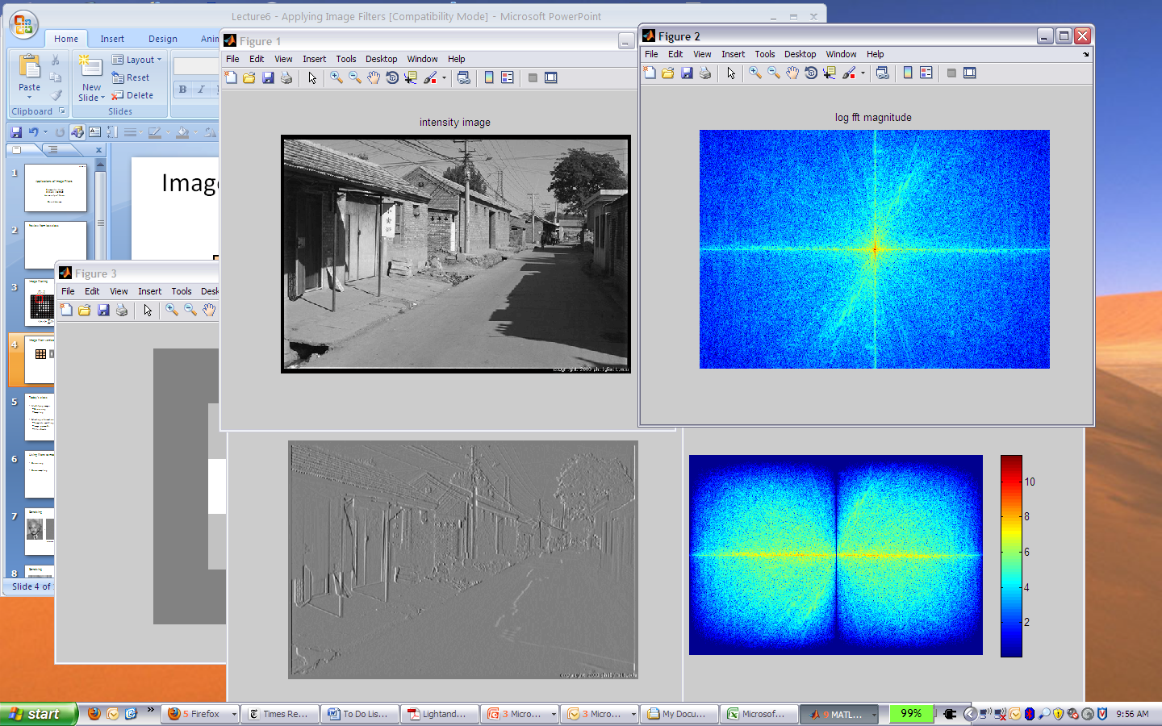
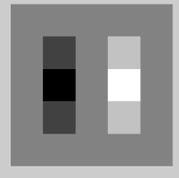
Filtering example
1
0
-1
2
0
-2
1
0
-1
*
=
Slide credit: Derek Hoiem

Slide 4
Image filtering
Compute a function of the local neighborhood at each pixel in the image
  Function specified by a “filter” or mask saying how to combine values from neighbors.
Uses of filtering:
  Enhance an image (denoise, resize, etc)
  Extract information (texture, edges, etc)
  Detect patterns (template matching)
Adapted from Derek Hoiem

Slide 5
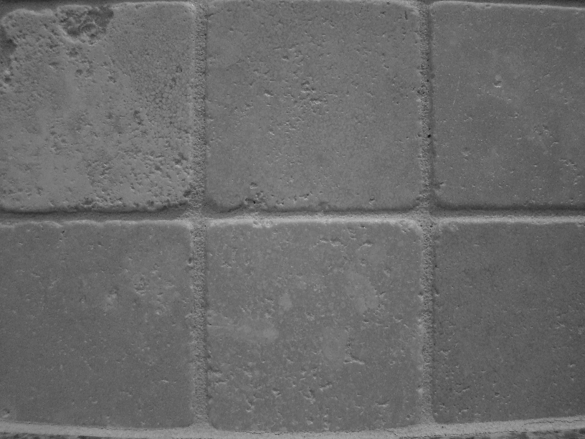
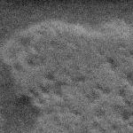
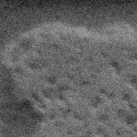

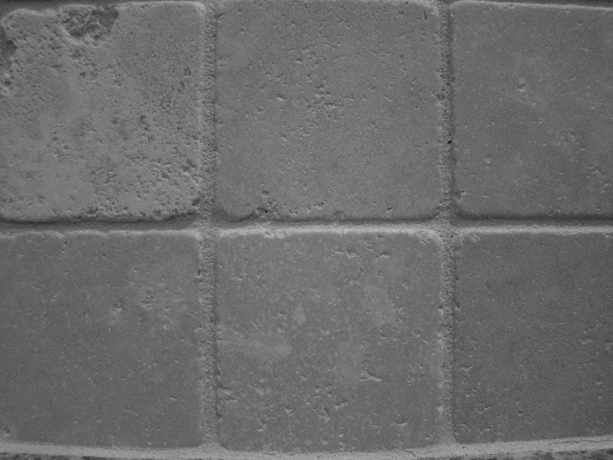
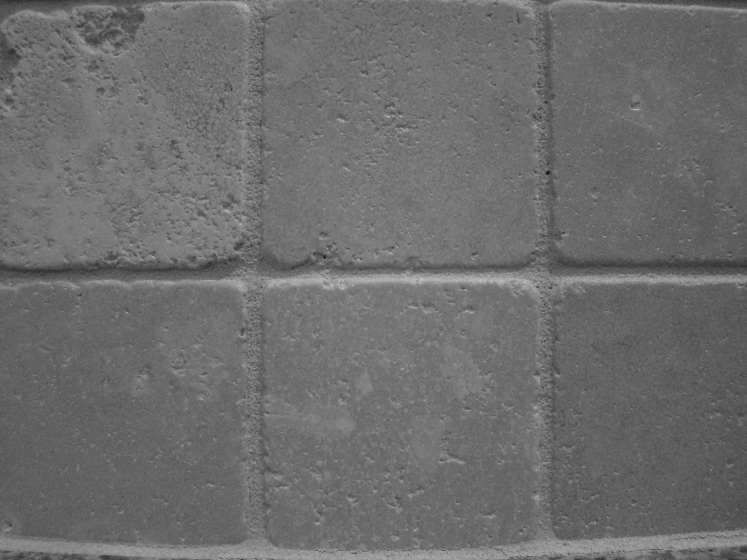


Motivation: noise reduction
Even multiple images of the same static scene will not be identical.

Slide 6
Common types of noise
  Salt and pepper noise: random occurrences of black and white pixels
  Impulse noise: random occurrences of white pixels
  Gaussian noise: variations in intensity drawn from a Gaussian normal distribution
Source: S. Seitz

Slide 7
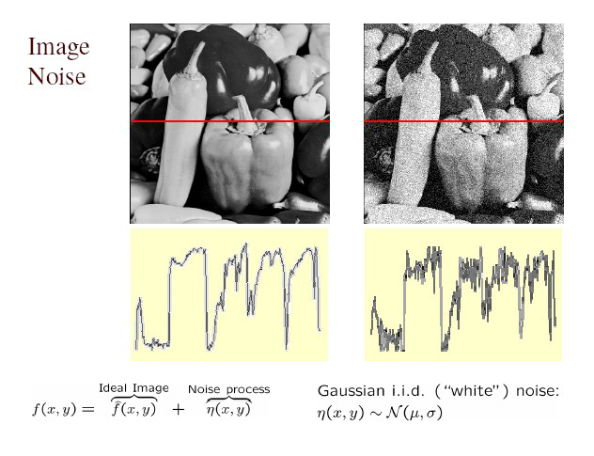
Gaussian noise
>> noise = randn(size(im)).*sigma;
>> output = im + noise;
What is impact of the sigma?
Fig: M. Hebert

Slide 8
Motivation: noise reduction
Even multiple images of the same static scene will not be identical.
How could we reduce the noise, i.e., give an estimate of the true intensities?
What if there’s only one image?

Slide 9
First attempt at a solution
Let’s replace each pixel with an average of all the values in its neighborhood
Assumptions:
  Expect pixels to be like their neighbors
  Expect noise processes to be independent from pixel to pixel

Slide 10
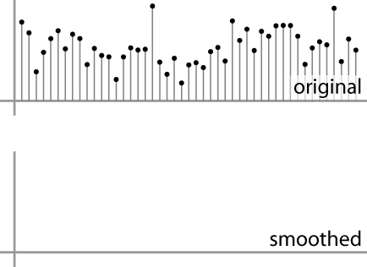
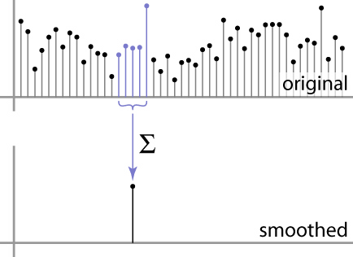
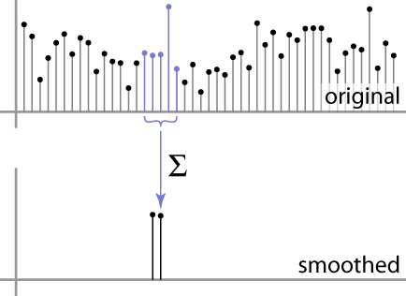
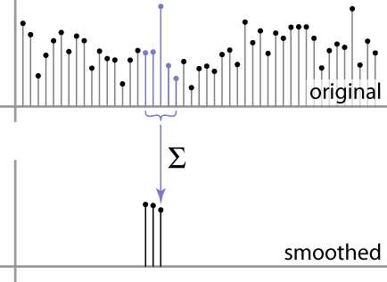
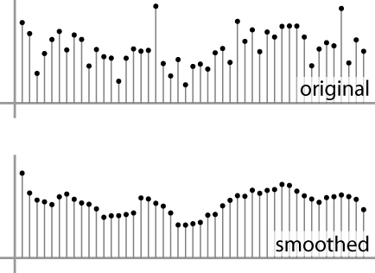
First attempt at a solution
Let’s replace each pixel with an average of all the values in its neighborhood
Moving average in 1D:
Source: S. Marschner

Slide 11
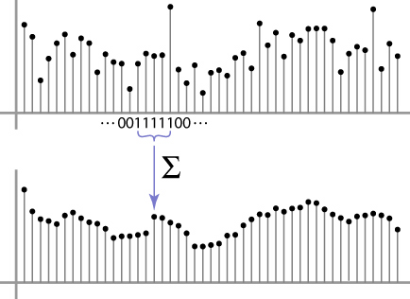
Weighted Moving Average
Can add weights to our moving average
Weights [1, 1, 1, 1, 1] / 5
Source: S. Marschner

Slide 12

Weighted Moving Average
Non-uniform weights [1, 4, 6, 4, 1] / 16
Source: S. Marschner

Slide 13


Moving Average In 2D
0 | 0 | 0 | 0 | 0 | 0 | 0 | 0 | 0 | 0
0 | 0 | 0 | 0 | 0 | 0 | 0 | 0 | 0 | 0
0 | 0 | 0 | 90 | 90 | 90 | 90 | 90 | 0 | 0
0 | 0 | 0 | 90 | 90 | 90 | 90 | 90 | 0 | 0
0 | 0 | 0 | 90 | 90 | 90 | 90 | 90 | 0 | 0
0 | 0 | 0 | 90 | 0 | 90 | 90 | 90 | 0 | 0
0 | 0 | 0 | 90 | 90 | 90 | 90 | 90 | 0 | 0
0 | 0 | 0 | 0 | 0 | 0 | 0 | 0 | 0 | 0
0 | 0 | 90 | 0 | 0 | 0 | 0 | 0 | 0 | 0
0 | 0 | 0 | 0 | 0 | 0 | 0 | 0 | 0 | 0
 | 0
0 | 0 | 0 | 0 | 0 | 0 | 0 | 0 | 0 | 0
0 | 0 | 0 | 0 | 0 | 0 | 0 | 0 | 0 | 0
0 | 0 | 0 | 90 | 90 | 90 | 90 | 90 | 0 | 0
0 | 0 | 0 | 90 | 90 | 90 | 90 | 90 | 0 | 0
0 | 0 | 0 | 90 | 90 | 90 | 90 | 90 | 0 | 0
0 | 0 | 0 | 90 | 0 | 90 | 90 | 90 | 0 | 0
0 | 0 | 0 | 90 | 90 | 90 | 90 | 90 | 0 | 0
0 | 0 | 0 | 0 | 0 | 0 | 0 | 0 | 0 | 0
0 | 0 | 90 | 0 | 0 | 0 | 0 | 0 | 0 | 0
0 | 0 | 0 | 0 | 0 | 0 | 0 | 0 | 0 | 0
Source: S. Seitz

Slide 14
Moving Average In 2D
0 | 0 | 0 | 0 | 0 | 0 | 0 | 0 | 0 | 0
0 | 0 | 0 | 0 | 0 | 0 | 0 | 0 | 0 | 0
0 | 0 | 0 | 90 | 90 | 90 | 90 | 90 | 0 | 0
0 | 0 | 0 | 90 | 90 | 90 | 90 | 90 | 0 | 0
0 | 0 | 0 | 90 | 90 | 90 | 90 | 90 | 0 | 0
0 | 0 | 0 | 90 | 0 | 90 | 90 | 90 | 0 | 0
0 | 0 | 0 | 90 | 90 | 90 | 90 | 90 | 0 | 0
0 | 0 | 0 | 0 | 0 | 0 | 0 | 0 | 0 | 0
0 | 0 | 90 | 0 | 0 | 0 | 0 | 0 | 0 | 0
0 | 0 | 0 | 0 | 0 | 0 | 0 | 0 | 0 | 0
 | 0 | 10
0 | 0 | 0 | 0 | 0 | 0 | 0 | 0 | 0 | 0
0 | 0 | 0 | 0 | 0 | 0 | 0 | 0 | 0 | 0
0 | 0 | 0 | 90 | 90 | 90 | 90 | 90 | 0 | 0
0 | 0 | 0 | 90 | 90 | 90 | 90 | 90 | 0 | 0
0 | 0 | 0 | 90 | 90 | 90 | 90 | 90 | 0 | 0
0 | 0 | 0 | 90 | 0 | 90 | 90 | 90 | 0 | 0
0 | 0 | 0 | 90 | 90 | 90 | 90 | 90 | 0 | 0
0 | 0 | 0 | 0 | 0 | 0 | 0 | 0 | 0 | 0
0 | 0 | 90 | 0 | 0 | 0 | 0 | 0 | 0 | 0
0 | 0 | 0 | 0 | 0 | 0 | 0 | 0 | 0 | 0
Source: S. Seitz

Slide 15
Moving Average In 2D
0 | 0 | 0 | 0 | 0 | 0 | 0 | 0 | 0 | 0
0 | 0 | 0 | 0 | 0 | 0 | 0 | 0 | 0 | 0
0 | 0 | 0 | 90 | 90 | 90 | 90 | 90 | 0 | 0
0 | 0 | 0 | 90 | 90 | 90 | 90 | 90 | 0 | 0
0 | 0 | 0 | 90 | 90 | 90 | 90 | 90 | 0 | 0
0 | 0 | 0 | 90 | 0 | 90 | 90 | 90 | 0 | 0
0 | 0 | 0 | 90 | 90 | 90 | 90 | 90 | 0 | 0
0 | 0 | 0 | 0 | 0 | 0 | 0 | 0 | 0 | 0
0 | 0 | 90 | 0 | 0 | 0 | 0 | 0 | 0 | 0
0 | 0 | 0 | 0 | 0 | 0 | 0 | 0 | 0 | 0
 | 0 | 10 | 20
0 | 0 | 0 | 0 | 0 | 0 | 0 | 0 | 0 | 0
0 | 0 | 0 | 0 | 0 | 0 | 0 | 0 | 0 | 0
0 | 0 | 0 | 90 | 90 | 90 | 90 | 90 | 0 | 0
0 | 0 | 0 | 90 | 90 | 90 | 90 | 90 | 0 | 0
0 | 0 | 0 | 90 | 90 | 90 | 90 | 90 | 0 | 0
0 | 0 | 0 | 90 | 0 | 90 | 90 | 90 | 0 | 0
0 | 0 | 0 | 90 | 90 | 90 | 90 | 90 | 0 | 0
0 | 0 | 0 | 0 | 0 | 0 | 0 | 0 | 0 | 0
0 | 0 | 90 | 0 | 0 | 0 | 0 | 0 | 0 | 0
0 | 0 | 0 | 0 | 0 | 0 | 0 | 0 | 0 | 0
Source: S. Seitz

Slide 16
Moving Average In 2D
0 | 0 | 0 | 0 | 0 | 0 | 0 | 0 | 0 | 0
0 | 0 | 0 | 0 | 0 | 0 | 0 | 0 | 0 | 0
0 | 0 | 0 | 90 | 90 | 90 | 90 | 90 | 0 | 0
0 | 0 | 0 | 90 | 90 | 90 | 90 | 90 | 0 | 0
0 | 0 | 0 | 90 | 90 | 90 | 90 | 90 | 0 | 0
0 | 0 | 0 | 90 | 0 | 90 | 90 | 90 | 0 | 0
0 | 0 | 0 | 90 | 90 | 90 | 90 | 90 | 0 | 0
0 | 0 | 0 | 0 | 0 | 0 | 0 | 0 | 0 | 0
0 | 0 | 90 | 0 | 0 | 0 | 0 | 0 | 0 | 0
0 | 0 | 0 | 0 | 0 | 0 | 0 | 0 | 0 | 0
 | 0 | 10 | 20 | 30
0 | 0 | 0 | 0 | 0 | 0 | 0 | 0 | 0 | 0
0 | 0 | 0 | 0 | 0 | 0 | 0 | 0 | 0 | 0
0 | 0 | 0 | 90 | 90 | 90 | 90 | 90 | 0 | 0
0 | 0 | 0 | 90 | 90 | 90 | 90 | 90 | 0 | 0
0 | 0 | 0 | 90 | 90 | 90 | 90 | 90 | 0 | 0
0 | 0 | 0 | 90 | 0 | 90 | 90 | 90 | 0 | 0
0 | 0 | 0 | 90 | 90 | 90 | 90 | 90 | 0 | 0
0 | 0 | 0 | 0 | 0 | 0 | 0 | 0 | 0 | 0
0 | 0 | 90 | 0 | 0 | 0 | 0 | 0 | 0 | 0
0 | 0 | 0 | 0 | 0 | 0 | 0 | 0 | 0 | 0
Source: S. Seitz

Slide 17
Moving Average In 2D
0 | 0 | 0 | 0 | 0 | 0 | 0 | 0 | 0 | 0
0 | 0 | 0 | 0 | 0 | 0 | 0 | 0 | 0 | 0
0 | 0 | 0 | 90 | 90 | 90 | 90 | 90 | 0 | 0
0 | 0 | 0 | 90 | 90 | 90 | 90 | 90 | 0 | 0
0 | 0 | 0 | 90 | 90 | 90 | 90 | 90 | 0 | 0
0 | 0 | 0 | 90 | 0 | 90 | 90 | 90 | 0 | 0
0 | 0 | 0 | 90 | 90 | 90 | 90 | 90 | 0 | 0
0 | 0 | 0 | 0 | 0 | 0 | 0 | 0 | 0 | 0
0 | 0 | 90 | 0 | 0 | 0 | 0 | 0 | 0 | 0
0 | 0 | 0 | 0 | 0 | 0 | 0 | 0 | 0 | 0
 | 0 | 10 | 20 | 30 | 30
Source: S. Seitz

Slide 18
Moving Average In 2D
0 | 0 | 0 | 0 | 0 | 0 | 0 | 0 | 0 | 0
0 | 0 | 0 | 0 | 0 | 0 | 0 | 0 | 0 | 0
0 | 0 | 0 | 90 | 90 | 90 | 90 | 90 | 0 | 0
0 | 0 | 0 | 90 | 90 | 90 | 90 | 90 | 0 | 0
0 | 0 | 0 | 90 | 90 | 90 | 90 | 90 | 0 | 0
0 | 0 | 0 | 90 | 0 | 90 | 90 | 90 | 0 | 0
0 | 0 | 0 | 90 | 90 | 90 | 90 | 90 | 0 | 0
0 | 0 | 0 | 0 | 0 | 0 | 0 | 0 | 0 | 0
0 | 0 | 90 | 0 | 0 | 0 | 0 | 0 | 0 | 0
0 | 0 | 0 | 0 | 0 | 0 | 0 | 0 | 0 | 0
 | 0 | 10 | 20 | 30 | 30 | 30 | 20 | 10
 | 0 | 20 | 40 | 60 | 60 | 60 | 40 | 20
 | 0 | 30 | 60 | 90 | 90 | 90 | 60 | 30
 | 0 | 30 | 50 | 80 | 80 | 90 | 60 | 30
 | 0 | 30 | 50 | 80 | 80 | 90 | 60 | 30
 | 0 | 20 | 30 | 50 | 50 | 60 | 40 | 20
 | 10 | 20 | 30 | 30 | 30 | 30 | 20 | 10
 | 10 | 10 | 10 | 0 | 0 | 0 | 0 | 0
Source: S. Seitz
Notes:
ones, divide by 9

Slide 19
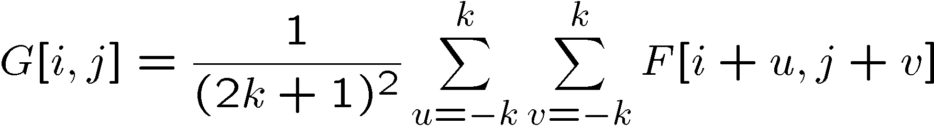
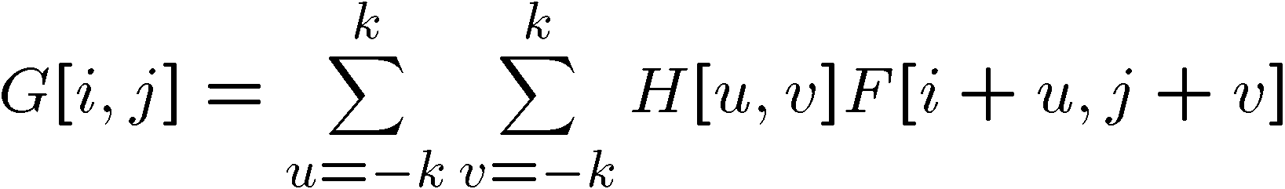
Correlation filtering
Say the averaging window size is 2k+1 x 2k+1:
Attribute uniform weight to each pixel
Loop over all pixels in neighborhood around image pixel F[i,j]
Now generalize to allow different weights depending on neighboring pixel’s relative position:
Non-uniform weights

Slide 20

Correlation filtering
This is called cross-correlation, denoted
Filtering an image: replace each pixel with a linear combination of its neighbors.
The filter “kernel” or “mask” H[u,v] is the prescription for the weights in the linear combination.

Slide 21


Averaging filter
What values belong in the kernel H for the moving average example?
0 | 0 | 0 | 0 | 0 | 0 | 0 | 0 | 0 | 0
0 | 0 | 0 | 0 | 0 | 0 | 0 | 0 | 0 | 0
0 | 0 | 0 | 90 | 90 | 90 | 90 | 90 | 0 | 0
0 | 0 | 0 | 90 | 90 | 90 | 90 | 90 | 0 | 0
0 | 0 | 0 | 90 | 90 | 90 | 90 | 90 | 0 | 0
0 | 0 | 0 | 90 | 0 | 90 | 90 | 90 | 0 | 0
0 | 0 | 0 | 90 | 90 | 90 | 90 | 90 | 0 | 0
0 | 0 | 0 | 0 | 0 | 0 | 0 | 0 | 0 | 0
0 | 0 | 90 | 0 | 0 | 0 | 0 | 0 | 0 | 0
0 | 0 | 0 | 0 | 0 | 0 | 0 | 0 | 0 | 0
 | 0 | 10 | 20 | 30 | 30
1
1
1
1
?
1
1
1
1
1
“box filter”

Slide 22
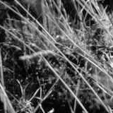
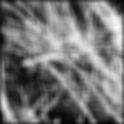
Smoothing by averaging
depicts box filter:
white = high value, black = low value
original
filtered
What if the filter size was 5 x 5 instead of 3 x 3?

Slide 23
Boundary issues
What is the size of the output?
MATLAB: output size / “shape” options
  shape = ‘full’: output size is sum of sizes of f and g
  shape = ‘same’: output size is same as f
  shape = ‘valid’: output size is difference of sizes of f and g
full
same
valid
g
g
g
g
f
f
f
g
g
g
g
g
g
g
g
Source: S. Lazebnik

Slide 24
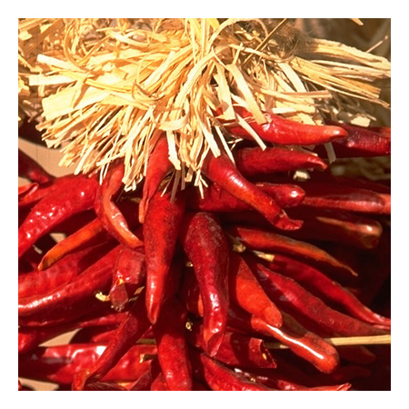


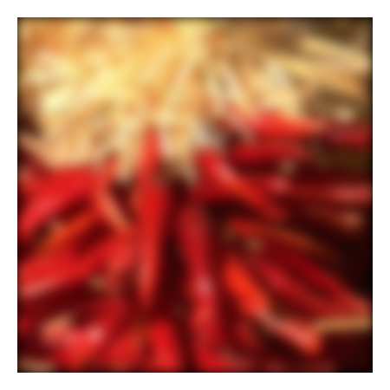


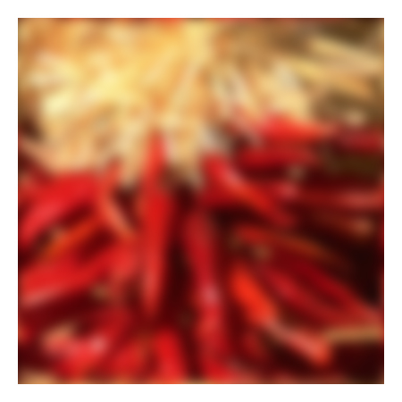






Boundary issues
What about near the edge?
  the filter window falls off the edge of the image
  need to extrapolate
  methods:
    clip filter (black)
    wrap around
    copy edge
    reflect across edge
Source: S. Marschner

Slide 25
Boundary issues
What about near the edge?
  the filter window falls off the edge of the image
  need to extrapolate
  methods (MATLAB):
    clip filter (black): imfilter(f, g, 0)
    wrap around: imfilter(f, g, ‘circular’)
    copy edge: imfilter(f, g, ‘replicate’)
    reflect across edge: imfilter(f, g, ‘symmetric’)
Source: S. Marschner

Slide 26
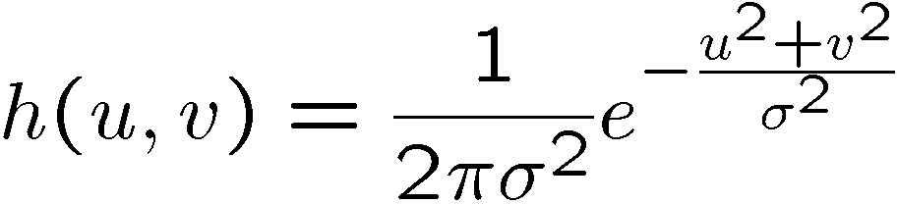
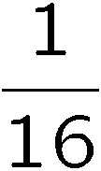
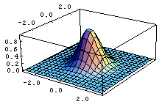
Gaussian filter
What if we want nearest neighboring pixels to have the most influence on the output?
Removes high-frequency components from the image (“low-pass filter”).
This kernel is an approximation of a 2d Gaussian function:
0 | 0 | 0 | 0 | 0 | 0 | 0 | 0 | 0 | 0
0 | 0 | 0 | 0 | 0 | 0 | 0 | 0 | 0 | 0
0 | 0 | 0 | 90 | 90 | 90 | 90 | 90 | 0 | 0
0 | 0 | 0 | 90 | 90 | 90 | 90 | 90 | 0 | 0
0 | 0 | 0 | 90 | 90 | 90 | 90 | 90 | 0 | 0
0 | 0 | 0 | 90 | 0 | 90 | 90 | 90 | 0 | 0
0 | 0 | 0 | 90 | 90 | 90 | 90 | 90 | 0 | 0
0 | 0 | 0 | 0 | 0 | 0 | 0 | 0 | 0 | 0
0 | 0 | 90 | 0 | 0 | 0 | 0 | 0 | 0 | 0
0 | 0 | 0 | 0 | 0 | 0 | 0 | 0 | 0 | 0
1 | 2 | 1
2 | 4 | 2
1 | 2 | 1
Source: S. Seitz

Slide 27

Smoothing with a Gaussian

Slide 28
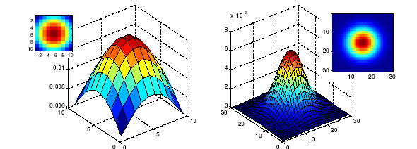
Gaussian filters
What parameters matter here?
Size of kernel or mask
  Note, Gaussian function has infinite support, but discrete filters use finite kernels
σ = 5 with 10 x 10 kernel
σ = 5 with 30 x 30 kernel

Slide 29
Practical matters
How big should the filter be?
Values at edges should be near zero ← important!
Rule of thumb for Gaussian: set filter half-width to about 3 σ
Source: Derek Hoiem

Slide 30
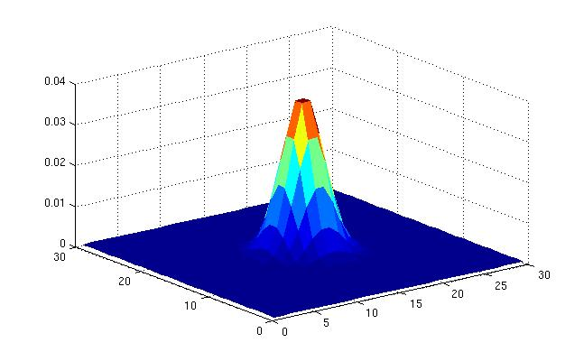
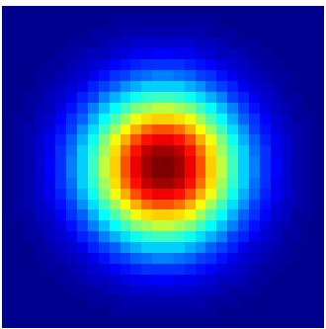
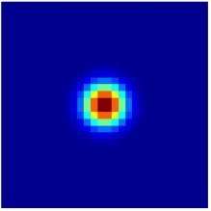
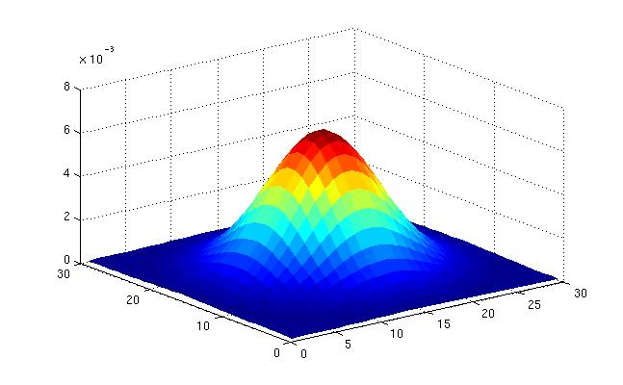
Gaussian filters
What parameters matter here?
Variance of Gaussian: determines extent of smoothing
σ = 2 with 30 x 30 kernel
σ = 5 with 30 x 30 kernel

Slide 31

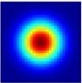
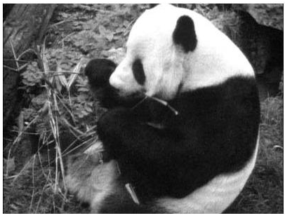
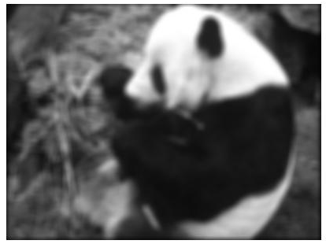
Matlab
>> hsize = 10;
>> sigma = 5;
>> h = fspecial(‘gaussian’ hsize, sigma);
>> mesh(h);
>> imagesc(h);
>> outim = imfilter(im, h); % correlation
>> imshow(outim);
outim
Notes:
In matlab, conv2 does convolution, filter2 does correlation. Imfilter does either if specified, correlation by default (‘conv’, ‘corr’ option)

Slide 32
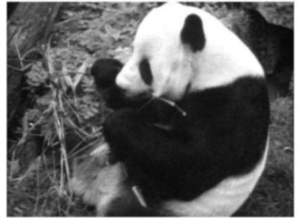
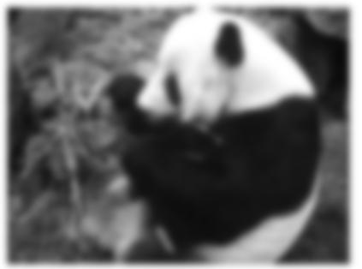
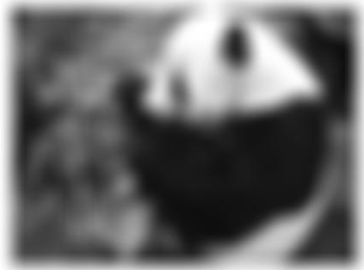
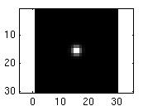
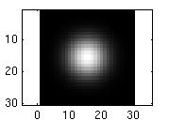
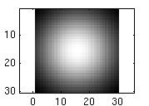
Smoothing with a Gaussian
Parameter σ is the “scale” / “width” / “spread” of the Gaussian kernel, and controls the amount of smoothing.
…
for sigma=1:3:10
h = fspecial('gaussian‘, fsize, sigma);
out = imfilter(im, h);
imshow(out);
pause;
end

Slide 33
Properties of smoothing filters
Smoothing
  Values positive
  Sum to 1 → constant regions same as input
  Amount of smoothing proportional to mask size
  Remove “high-frequency” components; “low-pass” filter

Slide 34
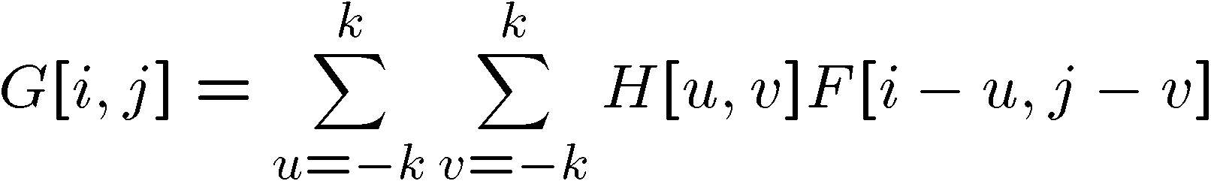
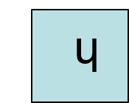

Convolution
Convolution:
  Flip the filter in both dimensions (bottom to top, right to left)
  Then apply cross-correlation
h
F
Notation for convolution operator

Slide 35
Convolution vs. correlation
Convolution
Cross-correlation
For a Gaussian or box filter, how will the outputs differ?

Slide 36
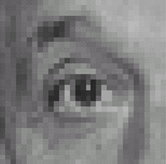
Predict the outputs using correlation filtering
0
0
0
0
0
0
*
= ?
*
= ?
0
1
0
0
0
1
0
0
0
0
0
0
0
0
0
-
1
1
1
*
= ?
0
2
0
1
1
1
0
0
0
1
1
1

Slide 37
Practice with linear filters
0
0
0
?
0
1
0
0
0
0
Original
Source: D. Lowe

Slide 38
Practice with linear filters
0
0
0
0
1
0
0
0
0
Original
Filtered
(no change)
Source: D. Lowe

Slide 39
Practice with linear filters
0
0
0
?
0
0
1
0
0
0
Original
Source: D. Lowe

Slide 40
Practice with linear filters
0
0
0
0
0
1
0
0
0
Original
Shifted left
by 1 pixel with correlation
Source: D. Lowe

Slide 41
Practice with linear filters
1
1
1
?
1
1
1
1
1
1
Original
Source: D. Lowe

Slide 42
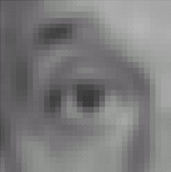
Practice with linear filters
1
1
1
1
1
1
1
1
1
Original
Blur (with a
box filter)
Source: D. Lowe

Slide 43
Practice with linear filters
0
0
0
-
1
1
1
?
0
2
0
1
1
1
0
0
0
1
1
1
Original
Source: D. Lowe

Slide 44
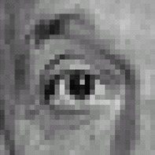
Practice with linear filters
0
0
0
-
1
1
1
0
2
0
1
1
1
0
0
0
1
1
1
Original
Sharpening filter:
  accentuates differences with local average
Source: D. Lowe

Slide 45
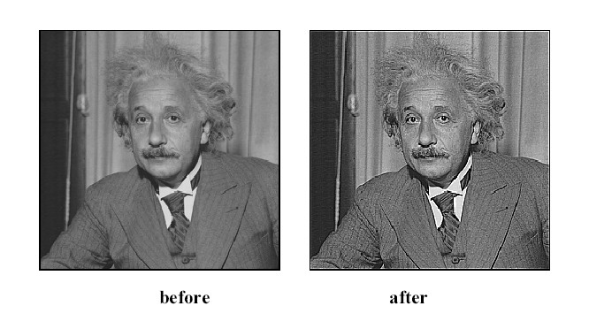
Filtering examples: sharpening

Slide 46
Properties of convolution
Shift invariant:
  Operator behaves the same everywhere, i.e. the value of the output depends on the pattern in the image neighborhood, not the position of the neighborhood.
Superposition:
  h * (f1 + f2) = (h * f1) + (h * f2)

Slide 47
Properties of convolution
Commutative:
  f * g = g * f
Associative
  (f * g) * h = f * (g * h)
Distributes over addition
f * (g + h) = (f * g) + (f * h)
Scalars factor out
kf * g = f * kg = k(f * g)
Identity:
  unit impulse e = […, 0, 0, 1, 0, 0, …]. f * e = f

Slide 48
Separability
In some cases, filter is separable, and we can factor into two steps:
  Convolve all rows
  Convolve all columns

Slide 49
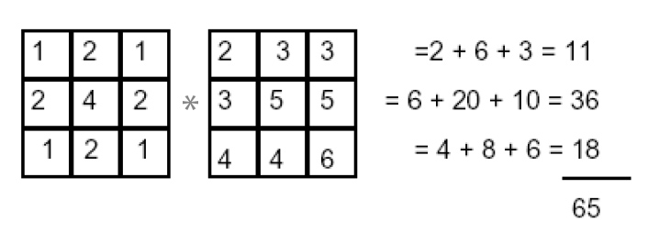
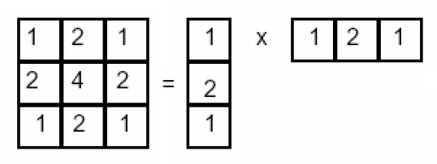
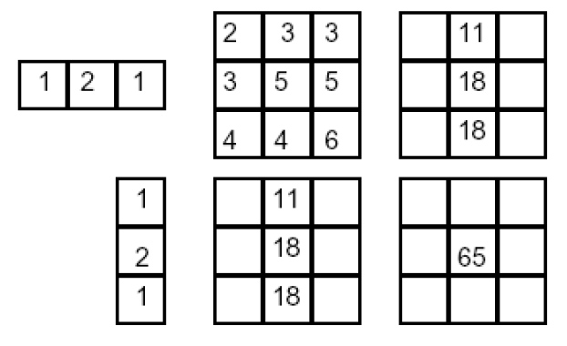
Separability example
f * (g * h) = (f * g) * h
2D filtering
(center location only)
The filter factors
into a product of 1D
filters:
Perform filtering
along rows:
*
=
Followed by filtering
along the remaining column:
*
=

Slide 50
Effect of smoothing filters
Additive Gaussian noise
Salt and pepper noise

Slide 51
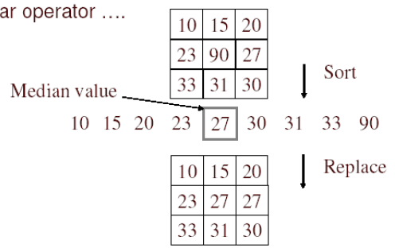
Median filter
No new pixel values introduced
Removes spikes: good for impulse, salt & pepper noise
Non-linear filter

Slide 52
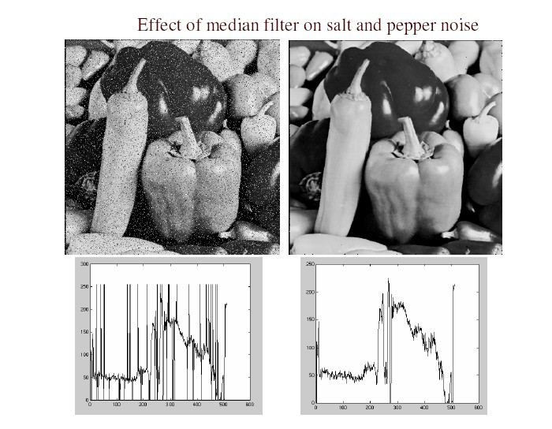
Median filter
Salt and pepper noise
Median filtered
Plots of a row of the image
Matlab: output im = medfilt2(im, [h w]);
Source: M. Hebert

Slide 53
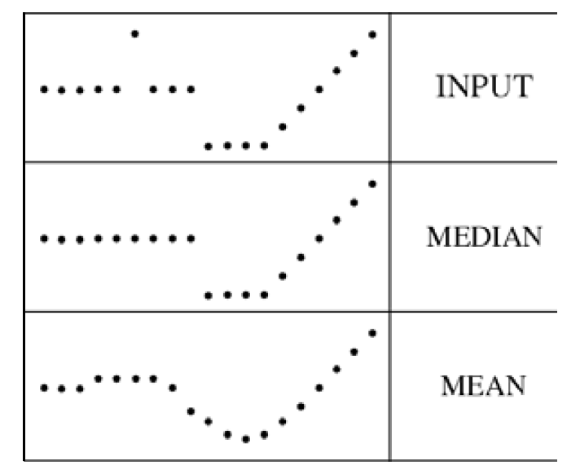
Median filter
Median filter is edge preserving

Slide 54

Application: Hybrid Images
Aude Oliva & Antonio Torralba & Philippe G Schyns, SIGGRAPH 2006
Notes:
\

Slide 55




Application: Hybrid Images
A. Oliva, A. Torralba, P.G. Schyns,
“Hybrid Images,” SIGGRAPH 2006
Gaussian Filter
Laplacian Filter
unit impulse
Gaussian
Laplacian of Gaussian

Slide 56

Aude Oliva & Antonio Torralba & Philippe G Schyns, SIGGRAPH 2006

Slide 57

Aude Oliva & Antonio Torralba & Philippe G Schyns, SIGGRAPH 2006

Slide 58
Filters (Summary)
Linear filters and convolution useful for
  Enhancing images (smoothing, removing noise)
    Box filter
    Gaussian filter
    Impact of scale / width of smoothing filter
  Detecting features
Separable filters are more efficient
Median filter: a non-linear filter, edge-preserving

Slide 59
Plan for today
Filters (cont’d)
Texture description
Texture synthesis
Sampling
Template matching

Slide 60

Texture
What defines a texture?

Slide 61



Includes: more regular patterns

Slide 62
Includes: more random patterns

Slide 63
Texture-related tasks
Shape from texture
  Estimate surface orientation or shape from image texture

Slide 64





Shape from texture
Use deformation of texture from point to point to estimate surface shape
Pics from A. Loh: http://www.csse.uwa.edu.au/~angie/phdpics1.html

Slide 65
Texture-related tasks
Shape from texture
  Estimate surface orientation or shape from image texture
Segmentation/classification from texture cues
  Analyze, represent texture
  Group image regions with consistent texture
Synthesis
  Generate new texture patches/images given some examples

Slide 66

Analysis vs. Synthesis
Why analyze texture?
Images:Bill Freeman, A. Efros

Slide 67






Slide 68





Slide 69




http://animals.nationalgeographic.com/

Slide 70
Why analyze texture?
Importance to perception:
Often indicative of a material’s properties
Can be important appearance cue, especially if shape is similar across objects
Aim to distinguish between shape, boundaries, and texture
Technically:
Representation-wise, we want a feature one step above “building blocks” of filters, edges.

Slide 71
Psychophysics of texture
Some textures distinguishable with preattentive perception– without scrutiny, eye movements [Julesz 1975]
Same or different?

Slide 72


Slide 73


Slide 75

Capturing the local patterns with image measurements
[Bergen & Adelson, Nature 1988]
Scale of patterns influences discriminability
Size-tuned linear filters

Slide 76
Texture representation
Textures are made up of repeated local patterns, so:
  Find the patterns
    Use filters that look like patterns (spots, bars, raw patches…)
    Consider magnitude of response
  Describe their statistics within each local window
    Mean, standard deviation
    Histogram
    Histogram of “prototypical” feature occurrences
Kristen Grauman

Slide 77

Texture representation: example
 | mean d/dx value | mean d/dy value
Win. #1 | 4 | 10
original image
…
statistics to summarize patterns in small windows
derivative filter responses, squared
Kristen Grauman

Slide 78
Texture representation: example
 | mean d/dx value | mean d/dy value
Win. #1 | 4 | 10
Win.#2 | 18 | 7
original image
…
statistics to summarize patterns in small windows
derivative filter responses, squared
Kristen Grauman

Slide 79
Texture representation: example
 | mean d/dx value | mean d/dy value
Win. #1 | 4 | 10
Win.#2 | 18 | 7
original image
…
statistics to summarize patterns in small windows
derivative filter responses, squared
Kristen Grauman

Slide 80
Texture representation: example
 | mean d/dx value | mean d/dy value
Win. #1 | 4 | 10
Win.#2 | 18 | 7
Win.#9 | 20 | 20
original image
…
…
statistics to summarize patterns in small windows
derivative filter responses, squared
Kristen Grauman

Slide 81
Texture representation: example
 | mean d/dx value | mean d/dy value
Win. #1 | 4 | 10
Win.#2 | 18 | 7
Win.#9 | 20 | 20
Dimension 2 (mean d/dy value)
Dimension 1 (mean d/dx value)
…
…
statistics to summarize patterns in small windows
Kristen Grauman

Slide 82
Texture representation: example
Windows with primarily horizontal edges
Both
 | mean d/dx value | mean d/dy value
Win. #1 | 4 | 10
Win.#2 | 18 | 7
Win.#9 | 20 | 20
Dimension 2 (mean d/dy value)
Dimension 1 (mean d/dx value)
…
…
Windows with small gradient in both directions
Windows with primarily vertical edges
statistics to summarize patterns in small windows
Kristen Grauman

Slide 83
Texture representation: example
original image
visualization of the assignment to texture “types”
derivative filter responses, squared
Kristen Grauman

Slide 84
Texture representation: example
 | mean d/dx value | mean d/dy value
Win. #1 | 4 | 10
Win.#2 | 18 | 7
Win.#9 | 20 | 20
Dimension 2 (mean d/dy value)
Far: dissimilar textures
Close: similar textures
Dimension 1 (mean d/dx value)
…
…
statistics to summarize patterns in small windows
Kristen Grauman

Slide 85
Texture representation: example
Dimension 2
Dimension 1
Kristen Grauman
Notes:
85

Slide 86

Texture representation: example
Dimension 2
Dimension 1
Distance reveals how dissimilar texture from window a is from texture in window b.
Kristen Grauman
Notes:
86

Slide 87

Texture representation: window scale
We’re assuming we know the relevant window size for which we collect these statistics.
Possible to perform scale selection by looking for window scale where texture description not changing.

Slide 88
Filter banks
Our previous example used two filters, and resulted in a 2-dimensional feature vector to describe texture in a window.
  x and y derivatives revealed something about local structure.
We can generalize to apply a collection of multiple (d) filters: a “filter bank”
Then our feature vectors will be d-dimensional.
  still can think of nearness, farness in feature space

Slide 89

Filter banks
orientations
scales
“Edges”
“Bars”
“Spots”
What filters to put in the bank?
  Typically we want a combination of scales and orientations, different types of patterns.
Matlab code available for these examples: http://www.robots.ox.ac.uk/~vgg/research/texclass/filters.html

Slide 90




Multivariate Gaussian

Slide 91

Filter bank

Slide 92

Image from http://www.texasexplorer.com/austincap2.jpg
Kristen Grauman

Slide 93


Showing magnitude of responses
Kristen Grauman

Slide 94


Kristen Grauman
Notes:
2

Slide 95


Kristen Grauman
Notes:
3

Slide 96


Kristen Grauman
Notes:
4

Slide 97


Kristen Grauman

Slide 98


Kristen Grauman
Notes:
6

Slide 99


Kristen Grauman
Notes:
7

Slide 100


Kristen Grauman
Notes:
8

Slide 101


Kristen Grauman
Notes:
9

Slide 102


Kristen Grauman
Notes:
10

Slide 103


Kristen Grauman
Notes:
11

Slide 104


Kristen Grauman
Notes:
12

Slide 105


Kristen Grauman
Notes:
13

Slide 106


Kristen Grauman
Notes:
14

Slide 107


Kristen Grauman
Notes:
15

Slide 108


Kristen Grauman
Notes:
16

Slide 109


Kristen Grauman

Slide 110


Kristen Grauman
Notes:
18

Slide 111


Kristen Grauman

Slide 112






You try: Can you match the texture to the response?
Filters
A
B
1
2
C
3
Mean abs responses
Derek Hoiem

Slide 113

Representing texture by mean abs response
Filters
Mean abs responses
Derek Hoiem

Slide 114
[r1, r2, …, r38]
We can form a feature vector from the list of responses at each pixel.
Kristen Grauman

Slide 115
d-dimensional features
Euclidean distance (L₂)
. . .
2d
3d
Kristen Grauman

Slide 116
Example uses of texture in vision: analysis

Slide 117

Classifying materials, “stuff”
Figure by Varma & Zisserman
Kristen Grauman

Slide 118

Texture features for image retrieval
Y. Rubner, C. Tomasi, and L. J. Guibas. The earth mover's distance as a metric for image retrieval. International Journal of Computer Vision, 40(2):99-121, November 2000,
Kristen Grauman

Slide 119


Characterizing scene categories by texture
L. W. Renninger and J. Malik. When is scene identification just texture recognition? Vision Research 44 (2004) 2301–2311
Kristen Grauman

Slide 120

Segmenting aerial imagery by textures
Kristen Grauman
http://www.airventure.org/2004/gallery/images/073104_satellite.jpg

