Slide 1
CS 1678/2078: Intro to Deep Learning
Bias, domain shifts, attacks
Prof. Adriana Kovashka
University of Pittsburgh
April 15, 2024

Slide 2
Plan for this lecture
Domain shifts due to visual style/appearance
Domain shifts due to geography
Models inheriting social biases
Deep fakes and adversarial perturbations

Slide 3
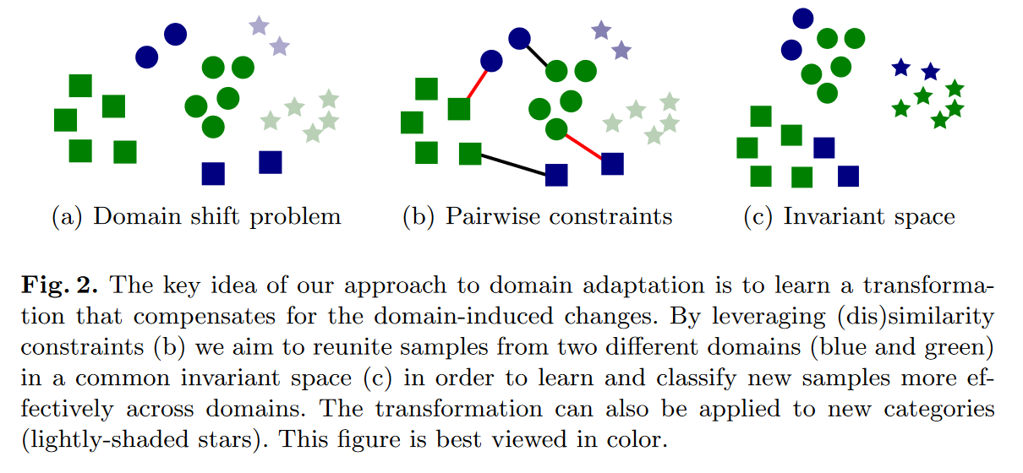
Domain Shifts
Colors = domains, shapes = classes
Saenko et al., Adapting Visual Category Models to New Domains, ECCV 2010

Slide 4
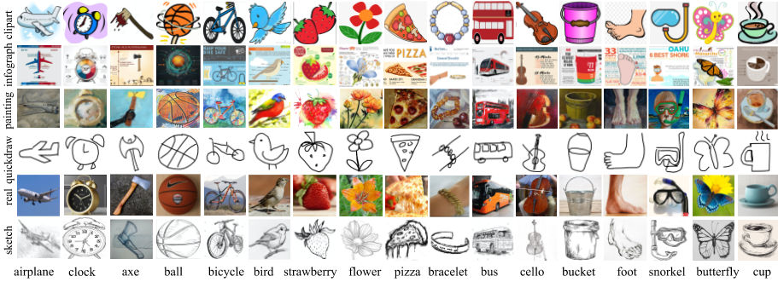
DomainNet Dataset
Peng et al. Moment matching for multi-source domain adaptation. ICCV 2019.

Slide 5
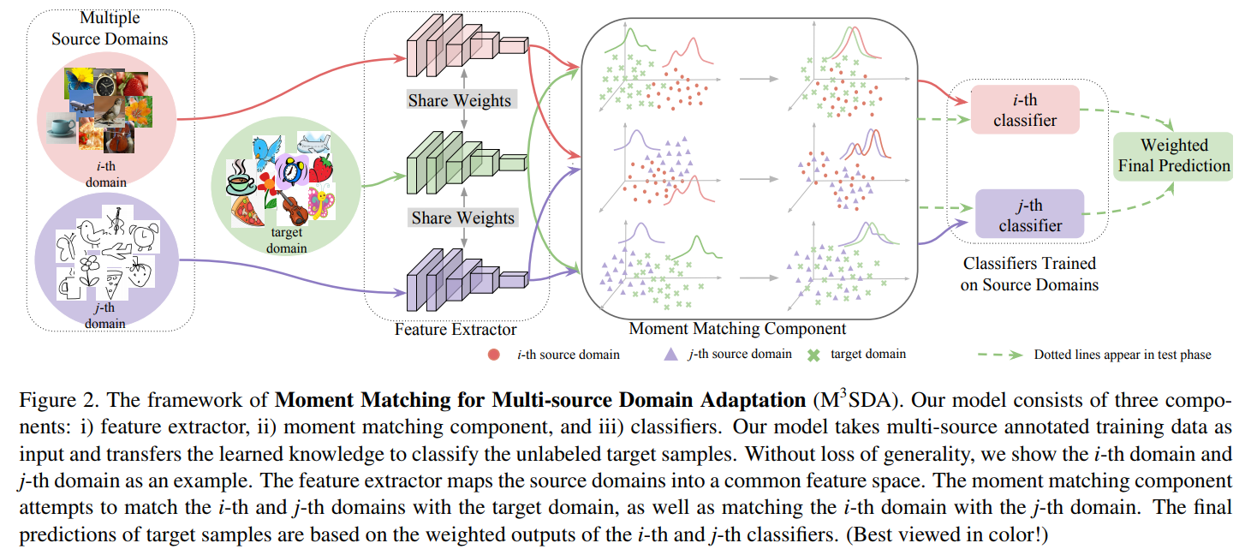
Coping with Domain Shifts
Peng et al. Moment matching for multi-source domain adaptation. ICCV 2019.

Slide 6
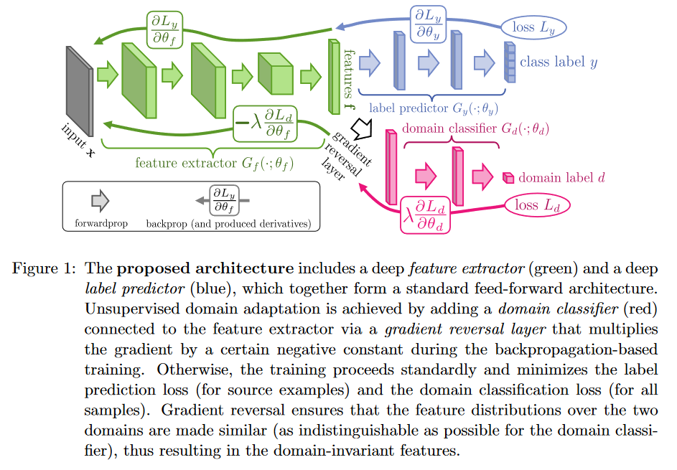
Domain Adversarial Networks
Ganin and Lempitsky. Unsupervised domain adaptation by backpropagation. ICML 2015.

Slide 7
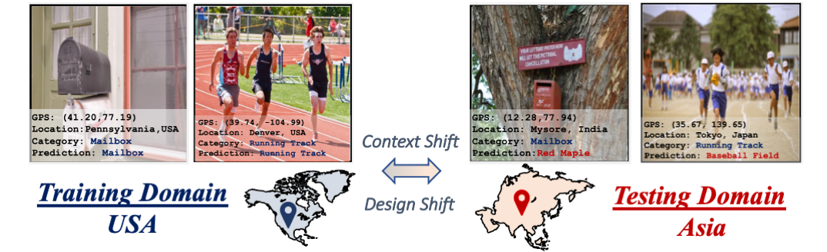
Geographic Domain Shifts
“While modern computer vision models yield human-level accuracies when trained and tested on the images from the same geographical domain, the accuracy drops significantly when presented with images from different geographies. Here, images belonging to mailbox and running track are misclassified due to design and context shifts between the domains induced by disparate geographies.”
Kalluri et al. GeoNet: Benchmarking Unsupervised Adaptation across Geographies. CVPR 2023.

Slide 8
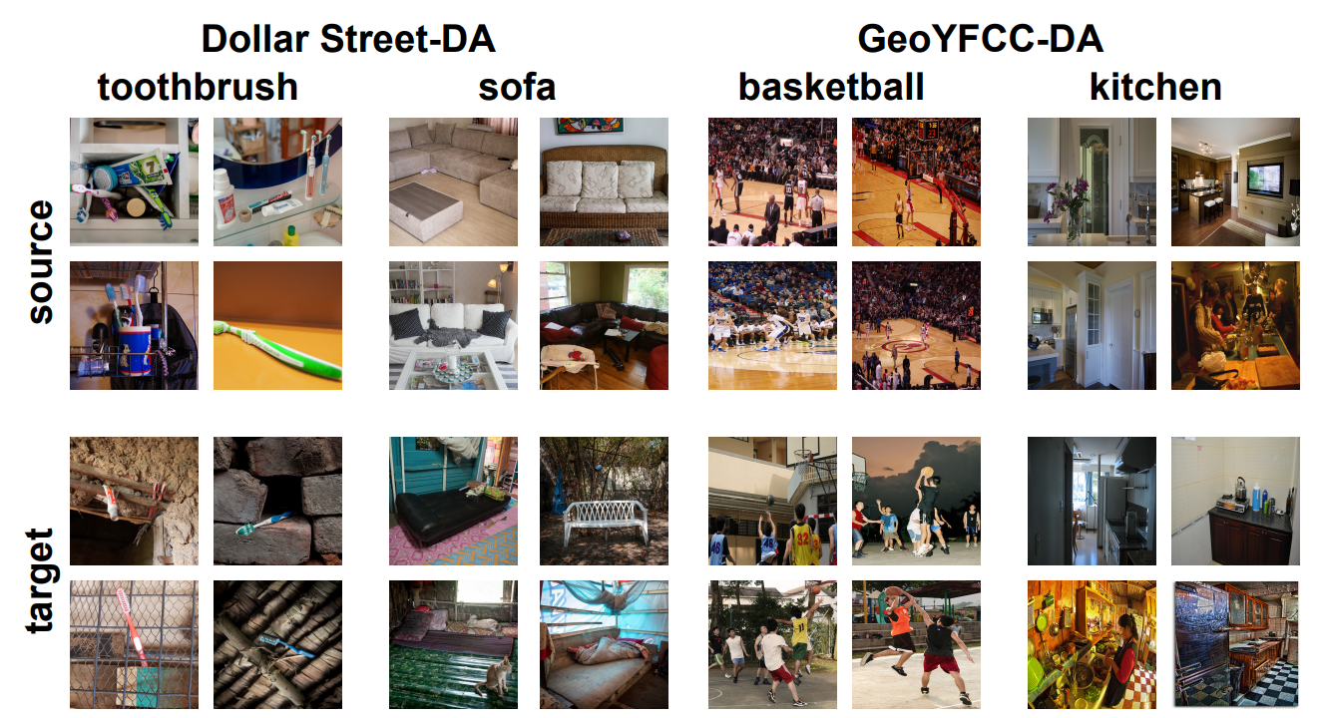
Geographic Domain Shifts
⠀Context Shift⠀
⠀Context Shift⠀
⠀Task-irrelevant⠀
⠀information⠀
⠀(e.g., background⠀
⠀or surroundings)⠀
Prabhu et al. Can domain adaptation make object recognition work for everyone? CVPRW 2022. Slide: Marcelo d’Almeida

Slide 9
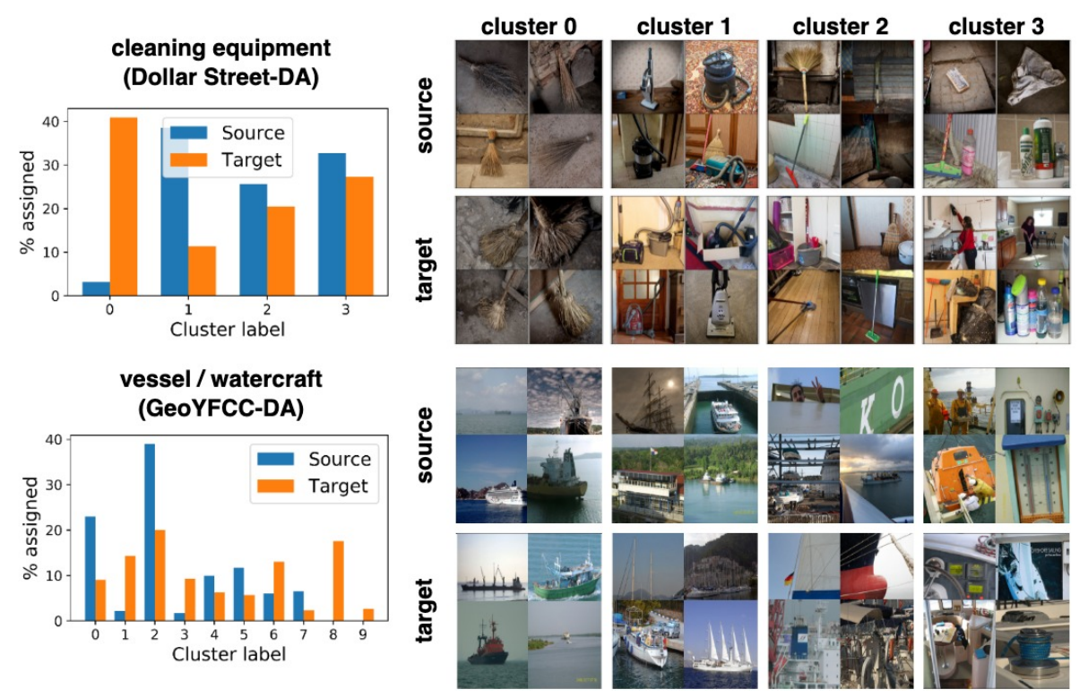
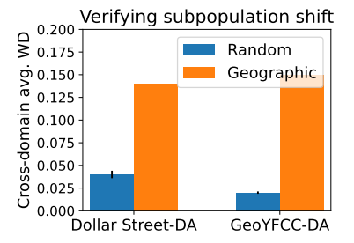
Geographic Domain Shifts
⠀Subpopulation Shift⠀
⠀Subpopulation Shift⠀
⠀Change within category⠀
(e.g., “cleaning equipment”⠀ can be brooms, mops,⠀ vacuum cleaners, etc.)⠀
Prabhu et al. Can domain adaptation make object recognition work for everyone? CVPRW 2022. Slide: Marcelo d’Almeida

Slide 10
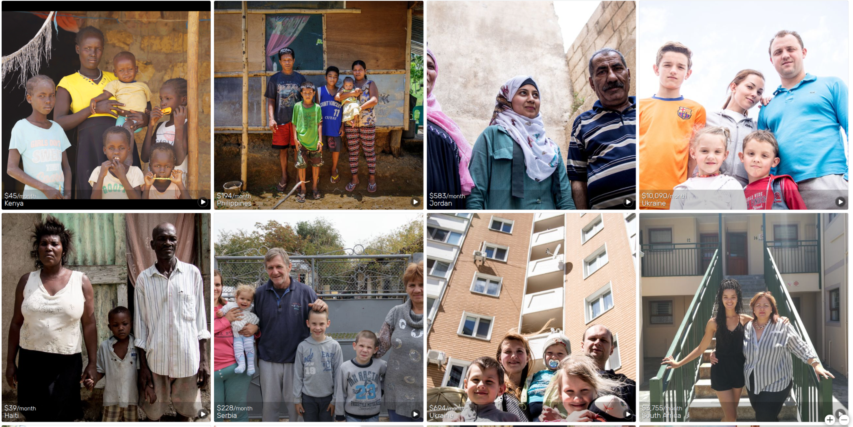
Dollar Street-DA
Geographic Domain Shifts
gapminder.org/dollar-street
⠀60 countries⠀
⠀(66 in total)⠀
⠀58 categories⠀
⠀(128 in total)⠀
Prabhu et al. Can domain adaptation make object recognition work for everyone? CVPRW 2022. Slide: Marcelo d’Almeida

Slide 11
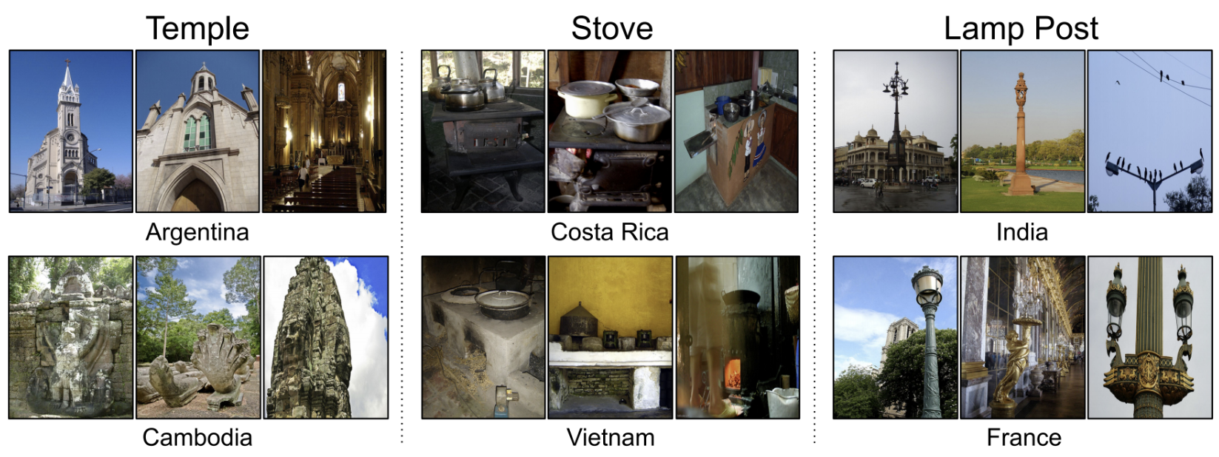
GeoYFCC-DA
Geographic Domain Shifts
⠀62 countries⠀
⠀68 categories⠀
github.com/abhimanyudubey/GeoYFCC
Prabhu et al. Can domain adaptation make object recognition work for everyone? CVPRW 2022. Slide: Marcelo d’Almeida

Slide 12
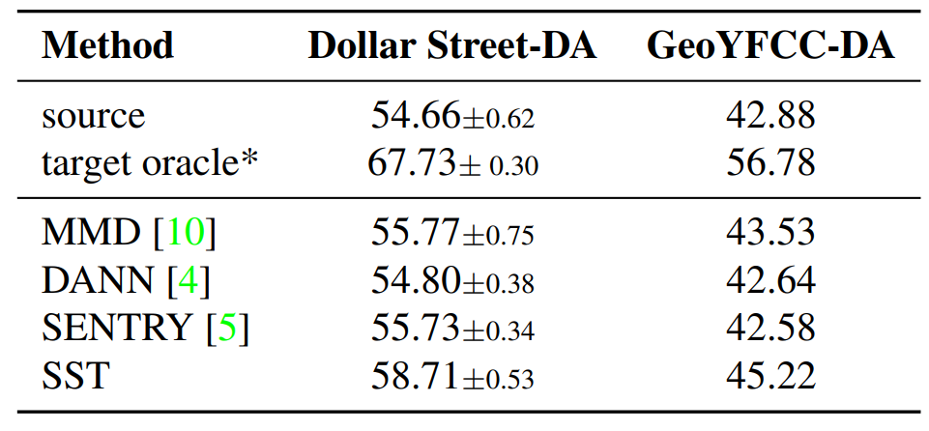
Results
Geographic Domain Shifts
⠀Significant performance⠀
⠀drops from geographical shifts⠀
⠀Limited improvements⠀ ⠀from existing DA methods⠀
*denotes that the target oracle was trained on target data non-overlapping with the test set (80%) whereas DA methods were adapted without labels on the entire target dataset.
Prabhu et al. Can domain adaptation make object recognition work for everyone? CVPRW 2022. Slide: Marcelo d’Almeida

Slide 13
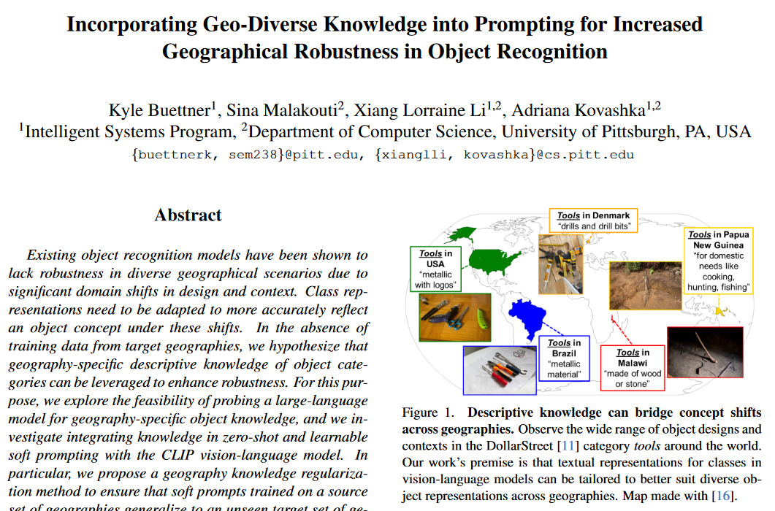
Buettner et al., CVPR 2024

Slide 14
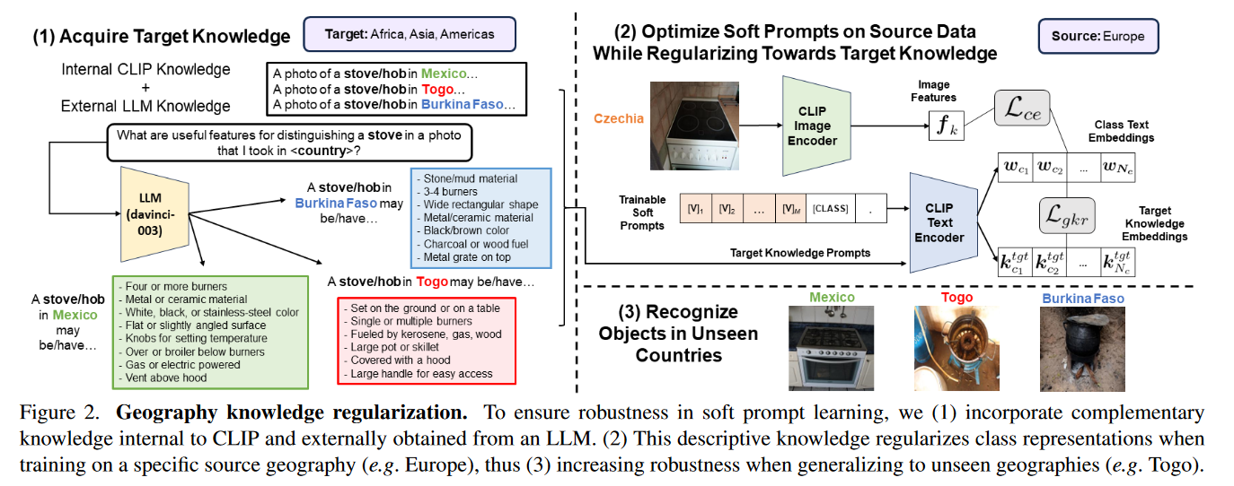
Geographic Domain Shifts
Buettner et al., CVPR 2024

Slide 15
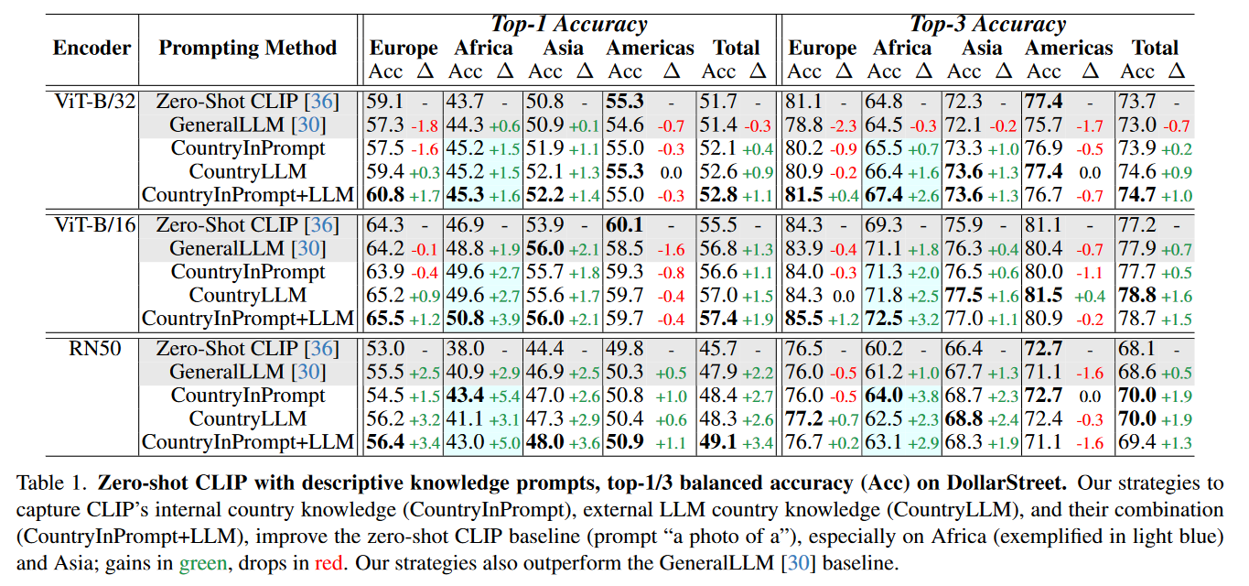
Geographic Domain Shifts
Buettner et al., CVPR 2024

Slide 16
Plan for this lecture
Domain shifts due to visual style/appearance
Domain shifts due to geography
Models inheriting social biases
Deep fakes and adversarial perturbations

Slide 17
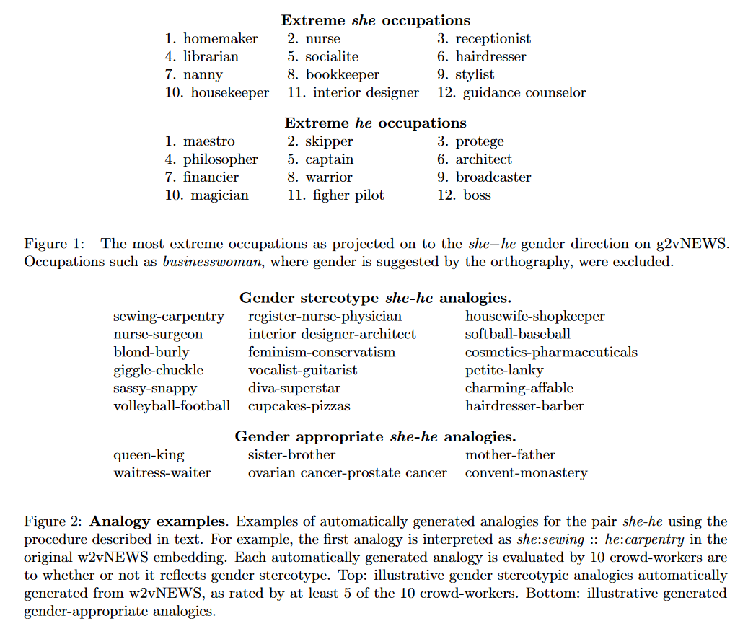
Bias in Language
Bolukbasi et al., Man is to Computer Programmer as Woman is to Homemaker? Debiasing Word Embeddings, NIPS 2016

Slide 18
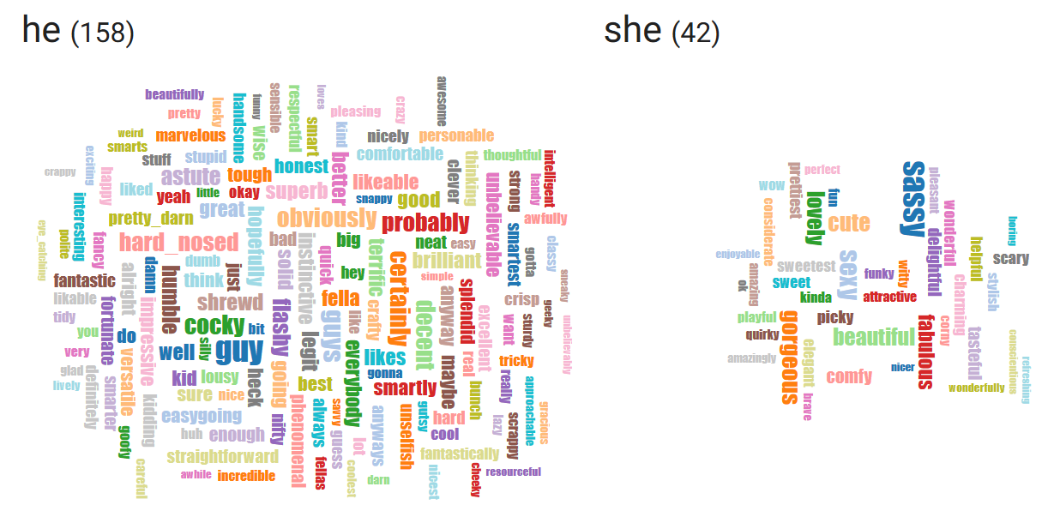
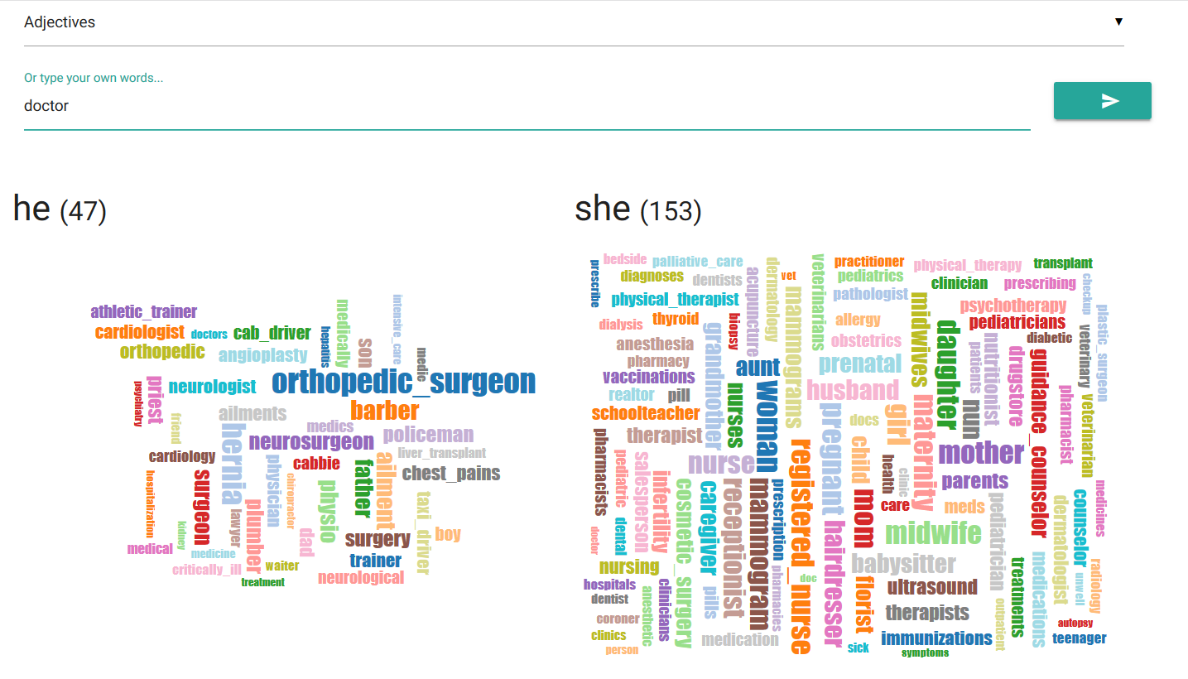
Bias in Language
http://wordbias.umiacs.umd.edu/

Slide 19
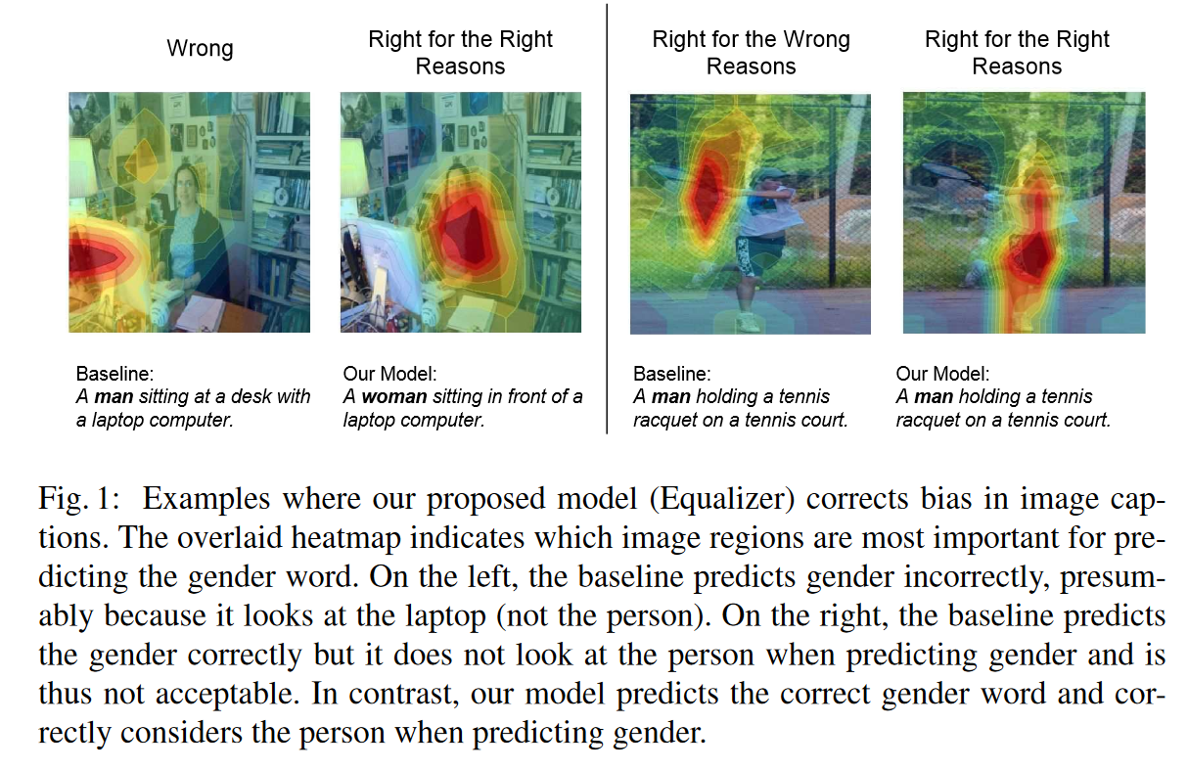
Bias in Vision
Burns et al., Women also Snowboard: Overcoming Bias in Captioning Models, ECCV 2018

Slide 20
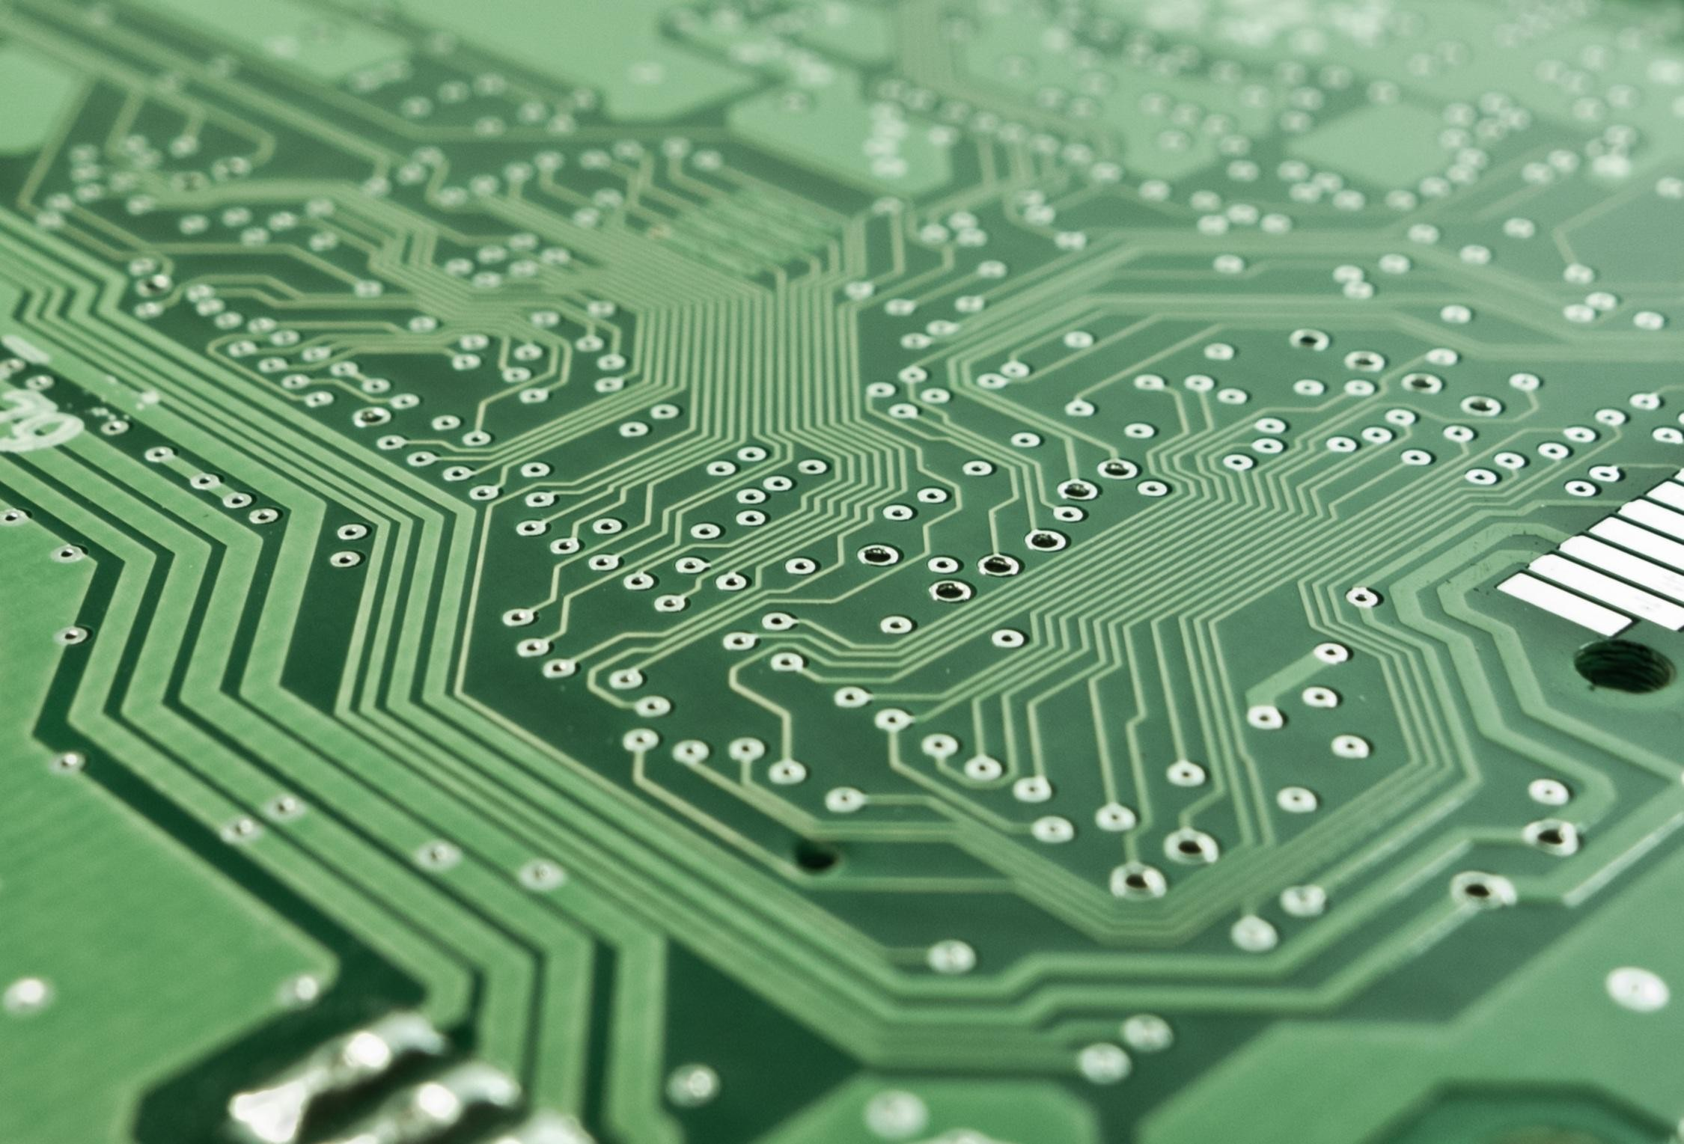
Human Reporting Bias
The frequency with which people write about actions, outcomes, or properties is not a reflection of real-world frequencies or the degree to which a property is characteristic of a class of individuals
Margaret Mitchell

Slide 21
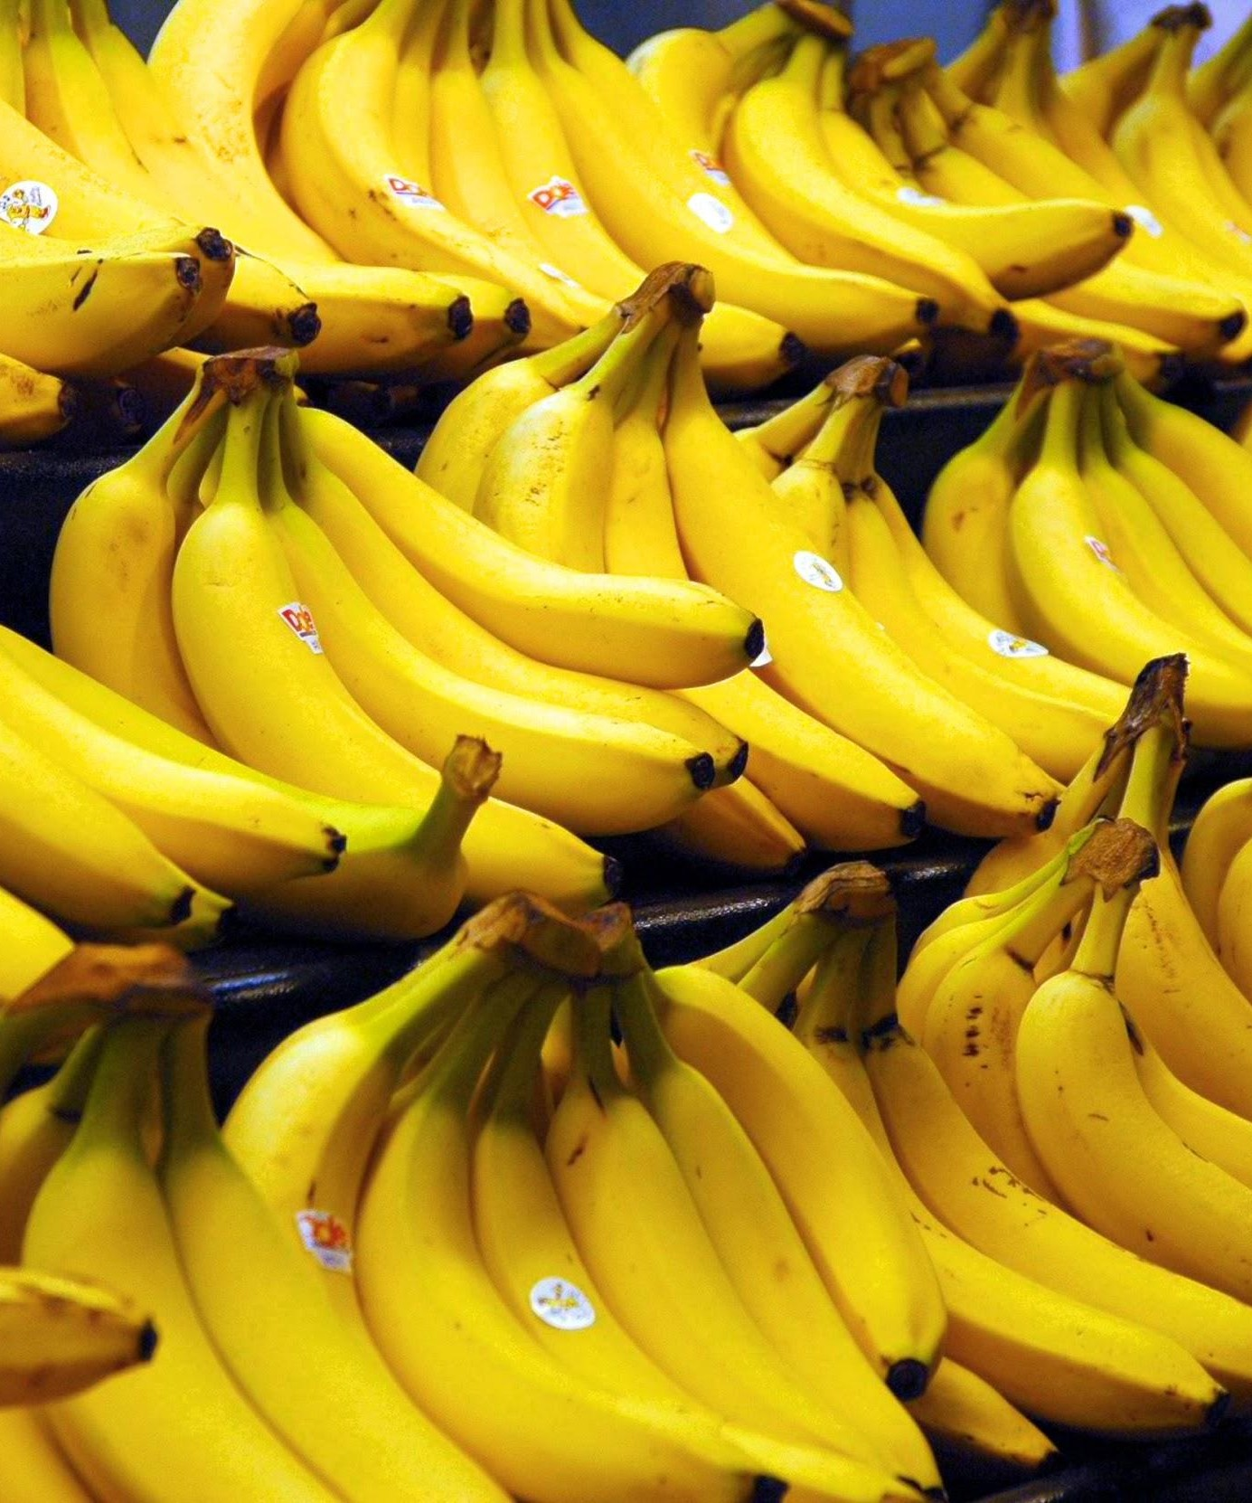
What do you see?
Bananas
Stickers
Dole Bananas
Bananas at a store
Bananas on shelves
Bunches of bananas
Bananas with stickers on them
Bunches of bananas with stickers on them on shelves in a store
...We don’t tend to say
Yellow Bananas
Margaret Mitchell

Slide 22
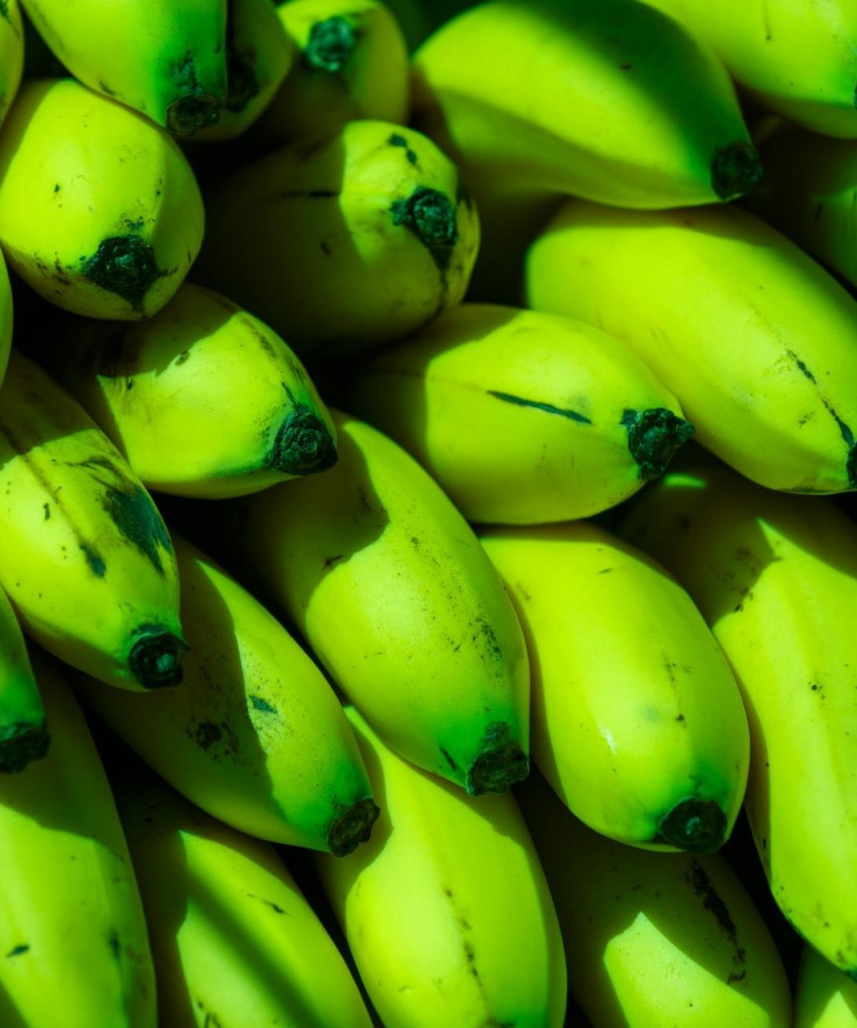
What do you see?
Green Bananas
Unripe Bananas
Margaret Mitchell

Slide 23
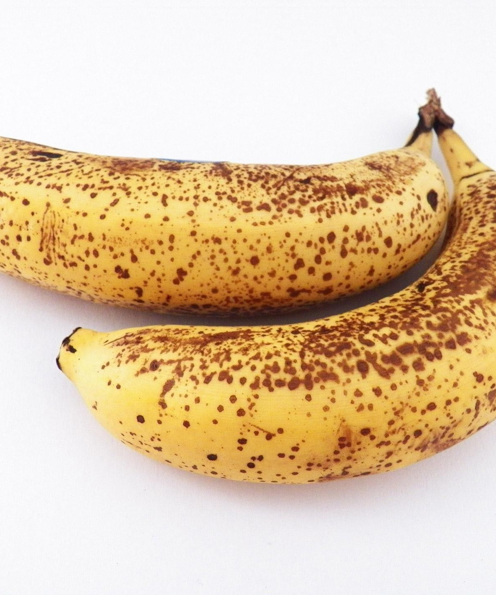
What do you see?
Ripe Bananas
Bananas with spots
Bananas good for banana bread
Margaret Mitchell

Slide 24
What do you see?
Yellow Bananas?
Yellow is prototypical for bananas
Margaret Mitchell

Slide 25
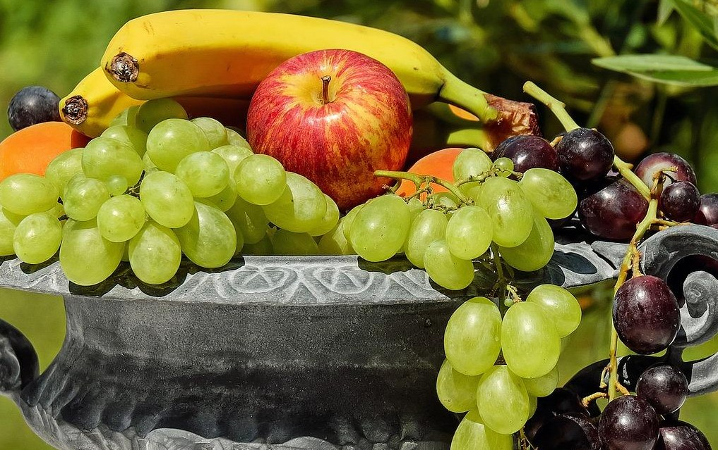
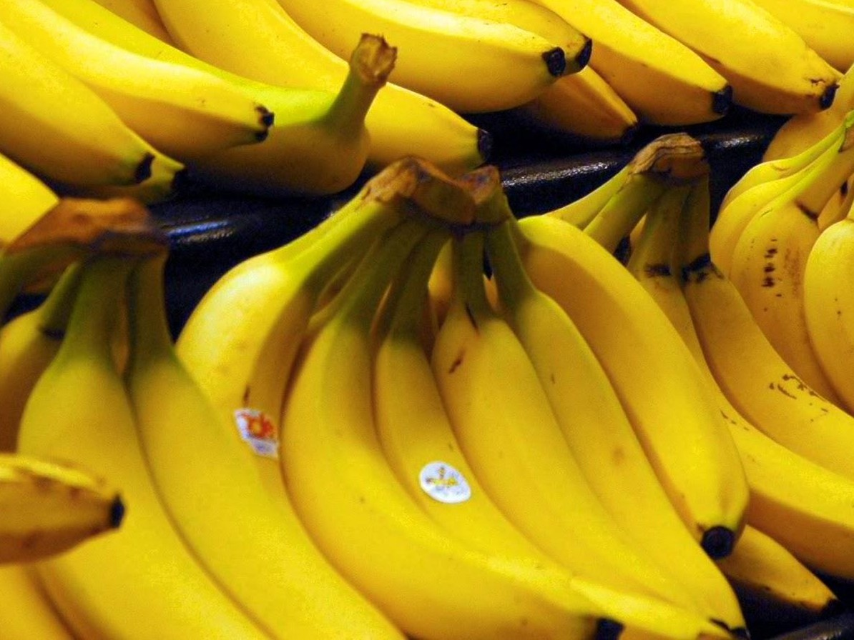
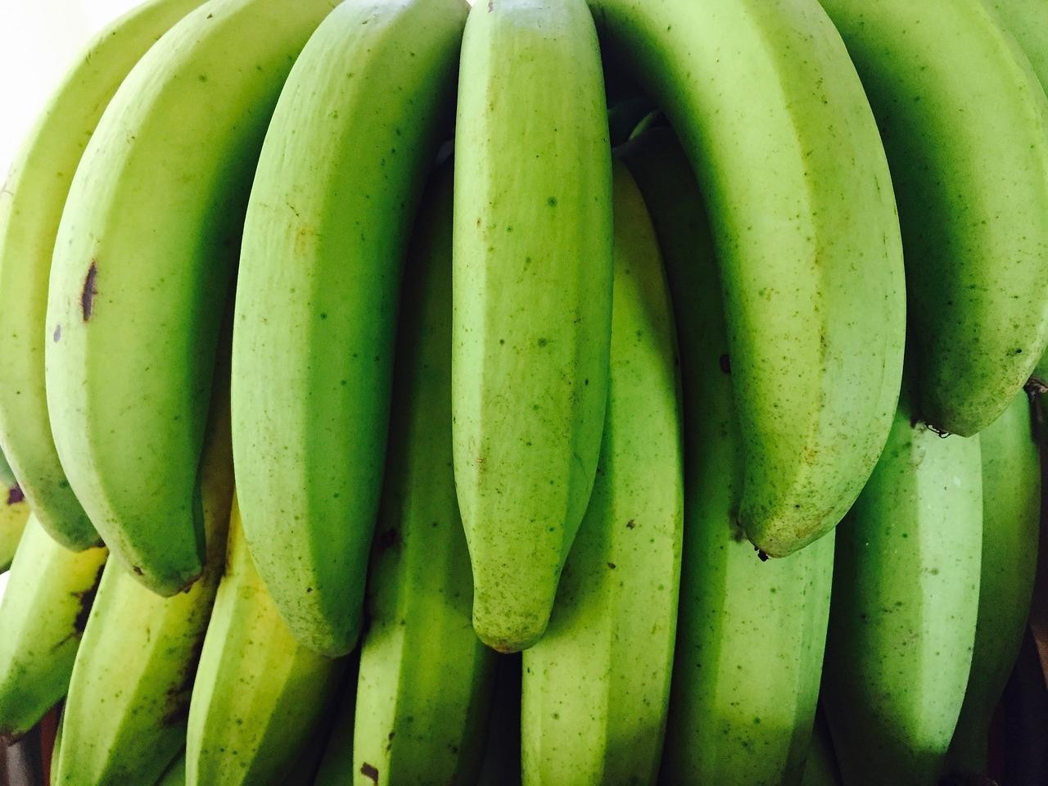
Prototype Theory
One purpose of categorization is to reduce the infinite differences among stimuli to behaviourally and cognitively usable proportions
There may be some central, prototypical notions of items that arise from stored typical properties for an object category (Rosch, 1975)
May also store exemplars (Wu & Barsalou, 2009)
Banana
Fruit
Bananas
“Basic Level”
Unripe Bananas, Cavendish Bananas
Margaret Mitchell

Slide 26
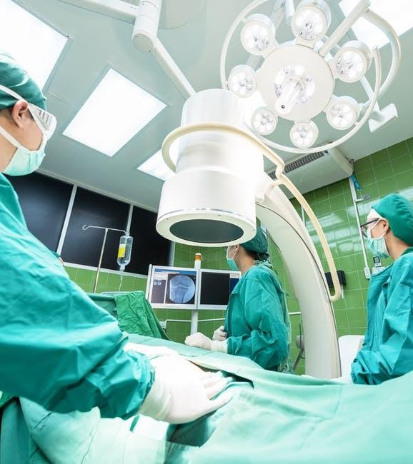
A man and his son are in a terrible accident and are rushed to the hospital in critical care.
The doctor looks at the boy and exclaims "I can't operate on this boy, he's my son!"
How could this be?
Margaret Mitchell

Slide 27

A man and his son are in a terrible accident and are rushed to the hospital in critical care.
The doctor looks at the boy and exclaims "I can't operate on this boy, he's my son!"
How could this be?
Margaret Mitchell

Slide 28

Margaret Mitchell

Slide 29













Margaret Mitchell

Slide 30
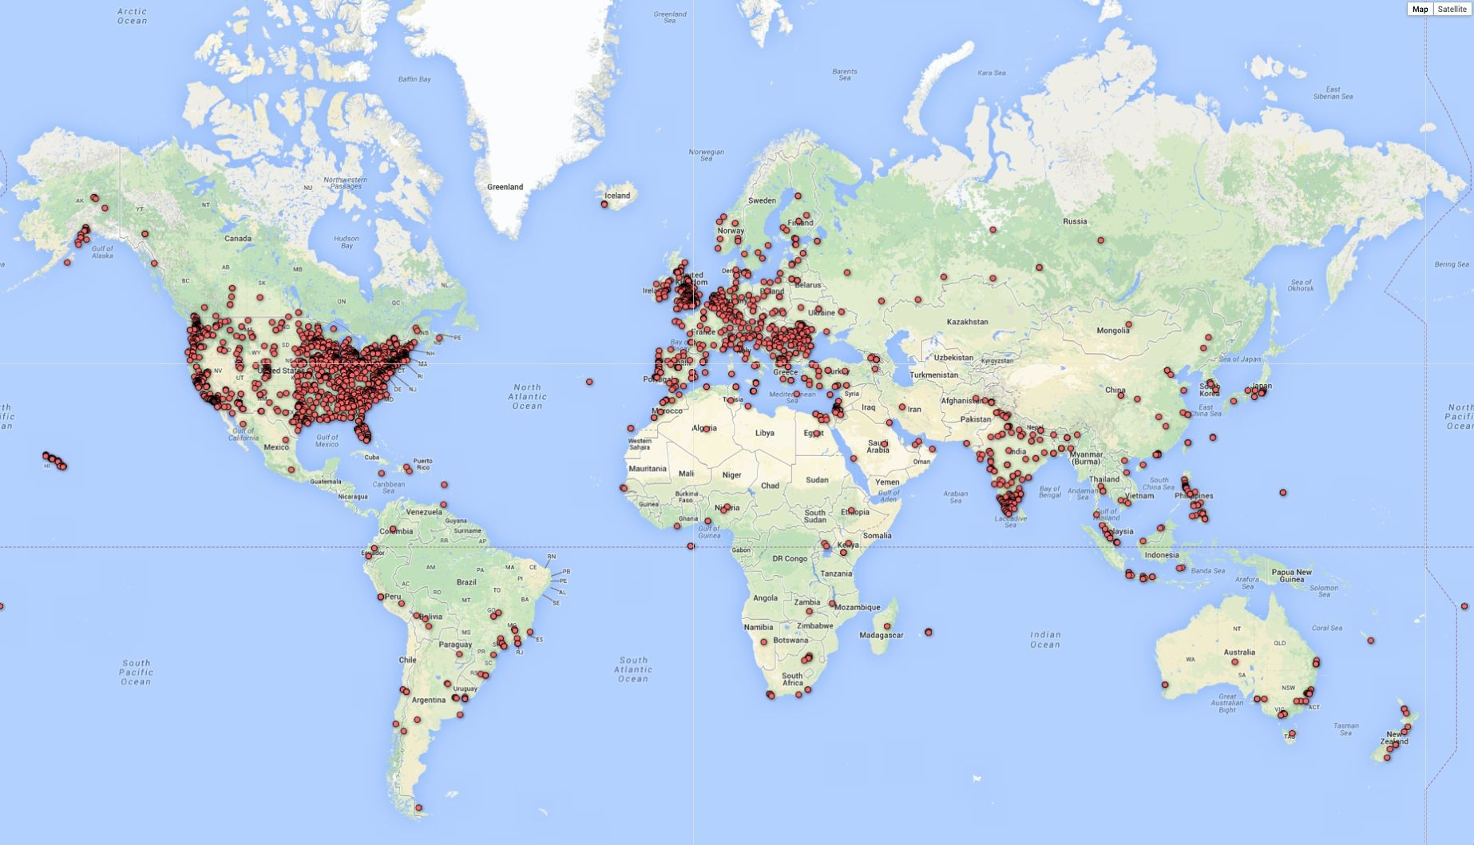
Biases in Data
Selection Bias: Selection does not reflect a random sample
CREDIT
© 2013–2016 Michael Yoshitaka Erlewine and Hadas Kotek
Margaret Mitchell

Slide 31
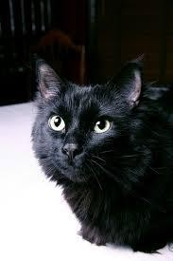
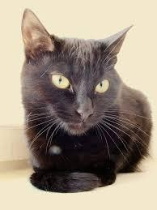

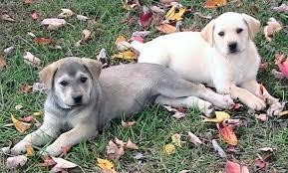



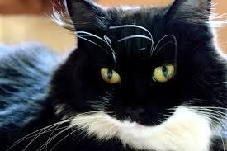
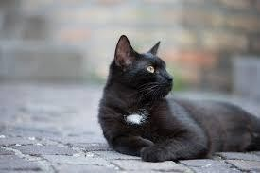
Biases in Data
Out-group homogeneity bias: Tendency to see outgroup members as more alike than ingroup members
Margaret Mitchell

Slide 32











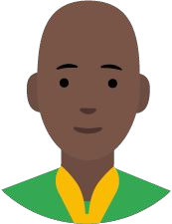



Biases in Data →
Biased Data Representation
It's possible that you have an appropriate amount of data for every group you can think of but that some groups are represented less positively than others.
Margaret Mitchell

Slide 33
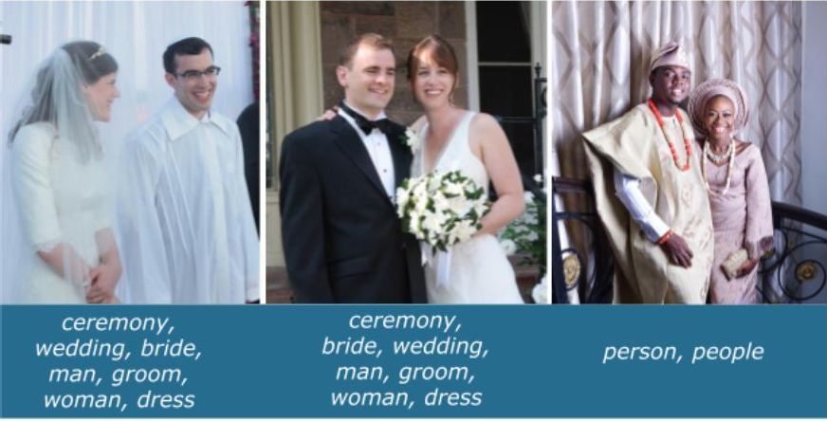
Biases in Data → Biased Labels
Annotations in your dataset will reflect the worldviews of your annotators.
https://ai.googleblog.com/2018/09/introducing-inclusive-images-competition.html
Margaret Mitchell

Slide 34
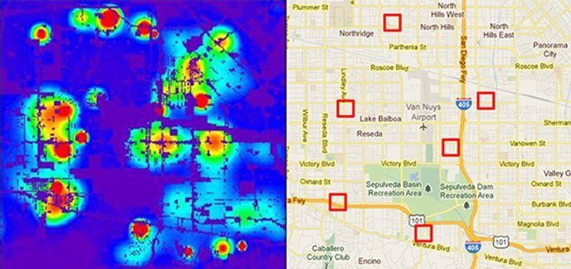
Predicting Policing
Algorithms identify potential crime hot-spots
Based on where crime is previously reported, not where it is known to have occurred
Predicts future events from past
CREDIT
Smithsonian. Artificial Intelligence Is Now Used to Predict Crime. But Is It Biased? 2018
Margaret Mitchell

Slide 35
Predicting Sentencing
Prater (who is white) rated low risk after shoplifting, despite two armed robberies; one attempted armed robbery.
Borden (who is black) rated high risk after she and a friend took (but returned before police arrived) a bike and scooter sitting outside.
Two years later, Borden has not been charged with any new crimes. Prater serving 8-year prison term for grand theft.
CREDIT
ProPublica. Northpointe: Risk in Criminal Sentencing. 2016.
Margaret Mitchell

Slide 36
Predicting Criminality
Israeli startup, Faception
“Faception is first-to-technology and first-to-market with proprietary computer vision and machine learning technology for profiling people and revealing their personality based only on their facial image.”
Offering specialized engines for recognizing “High IQ”, “White-Collar Offender”, “Pedophile”, and “Terrorist” from a face image.
Main clients are in homeland security and public safety.
Margaret Mitchell

Slide 37

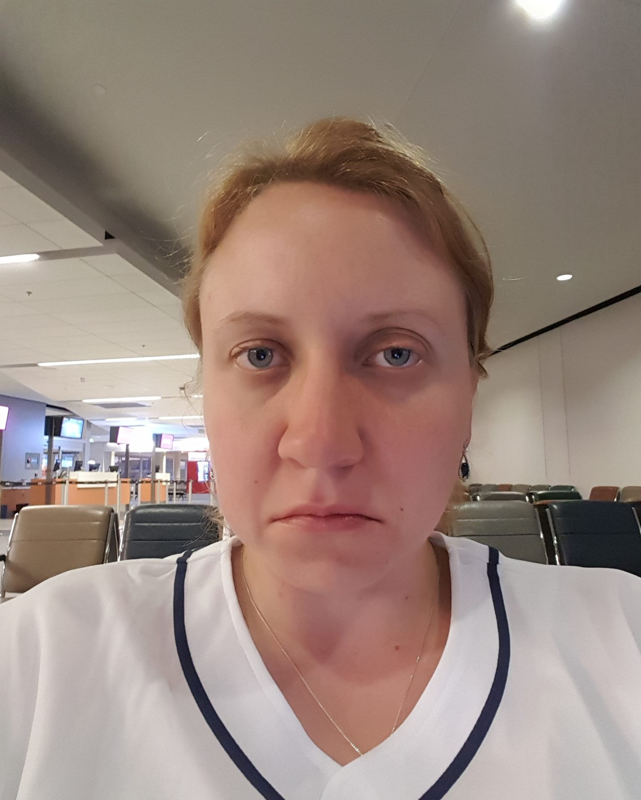
Predicting Criminality
“Automated Inference on Criminality using Face Images” Wu and Zhang, 2016. arXiv
1,856 closely cropped images of faces; Includes “wanted suspect” ID pictures from specific regions.
θ
θ
“[…] angle θ from nose tip to two mouth corners is on average 19.6% smaller for criminals than for
non-criminals ...”
See our longer piece on Medium, “Physiognomy’s New Clothes”
Margaret Mitchell

Slide 38
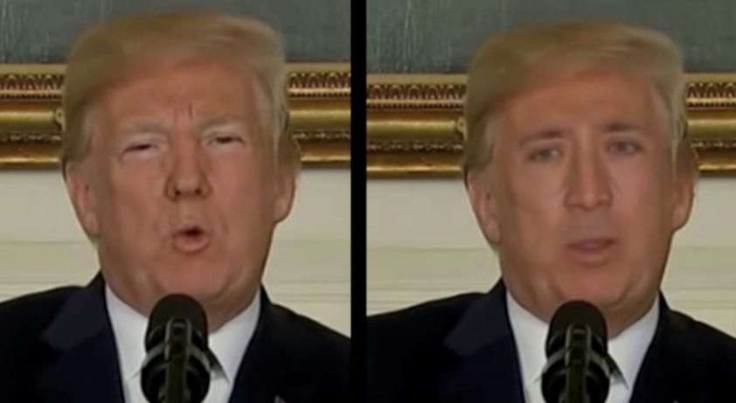
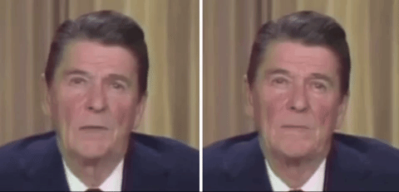
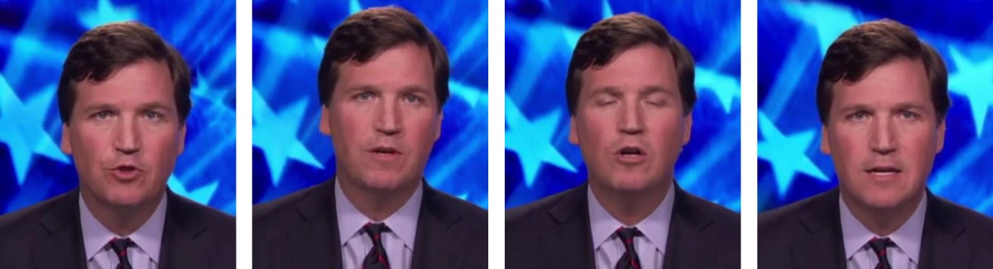
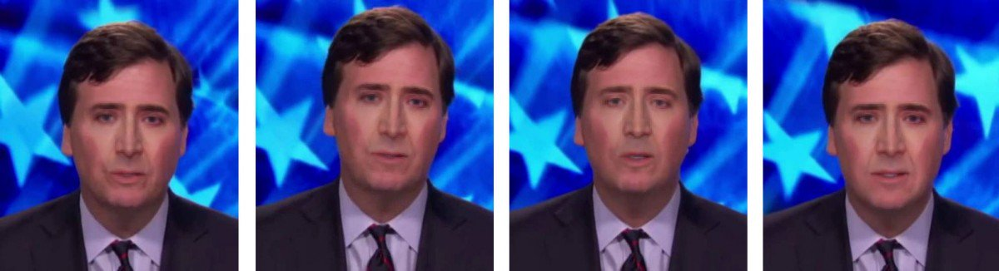
“Deepfakes”
https://www.technologyreview.com/s/611726/the-defense-department-has-produced-the-first-tools-for-catching-deepfakes/
https://www.niemanlab.org/2018/11/how-the-wall-street-journal-is-preparing-its-journalists-to-detect-deepfakes/

Slide 39
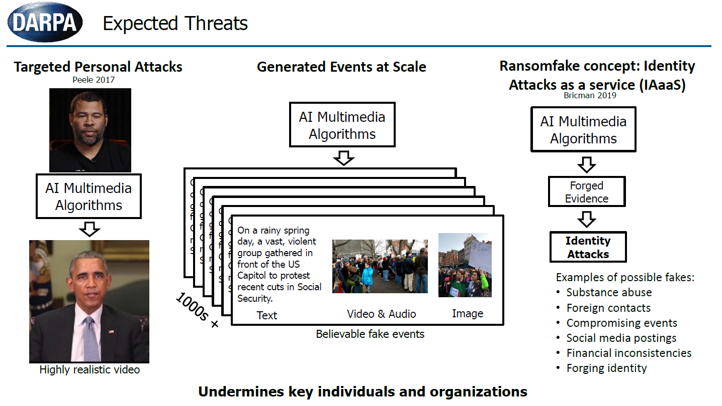
Matt Turek

Slide 40
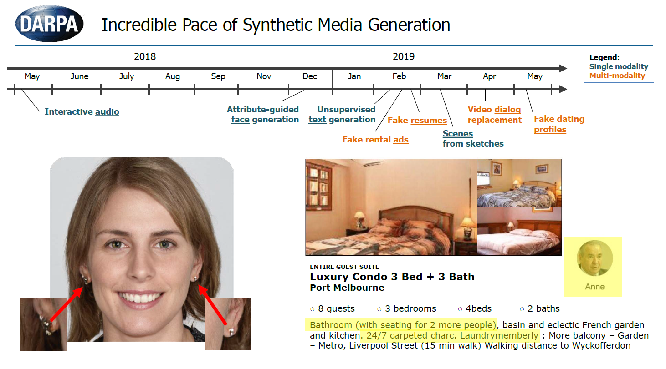
Matt Turek

Slide 41
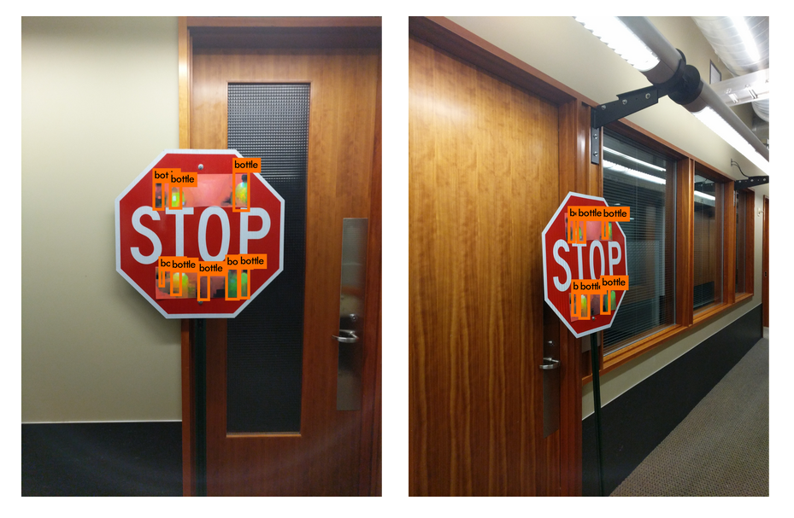
Adversarial Attacks
https://bair.berkeley.edu/blog/2017/12/30/yolo-attack/

Slide 42
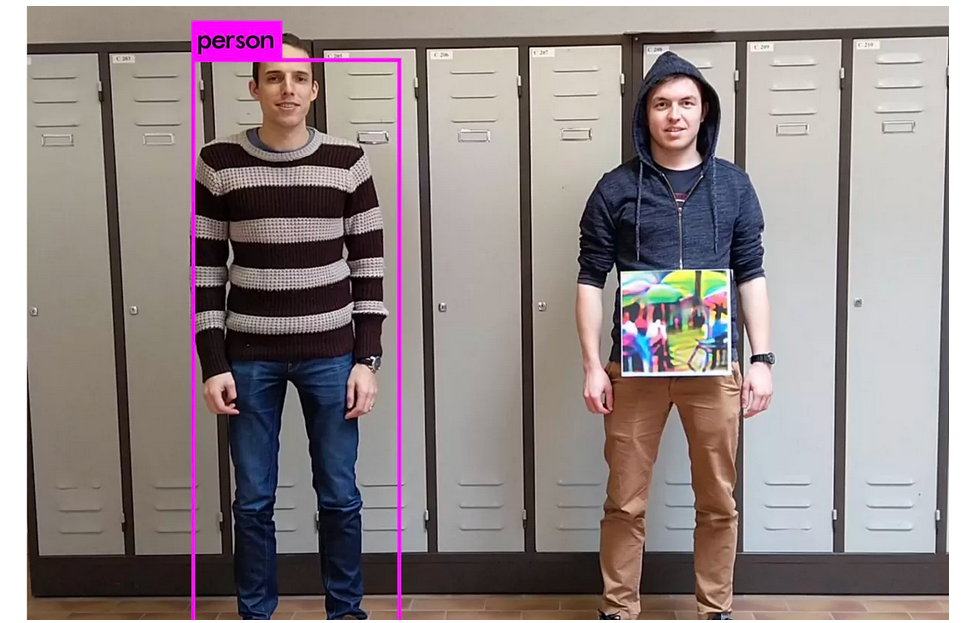
Adversarial Attacks
https://www.theverge.com/2019/4/23/18512472/fool-ai-surveillance-adversarial-example-yolov2-person-detection

Slide 43
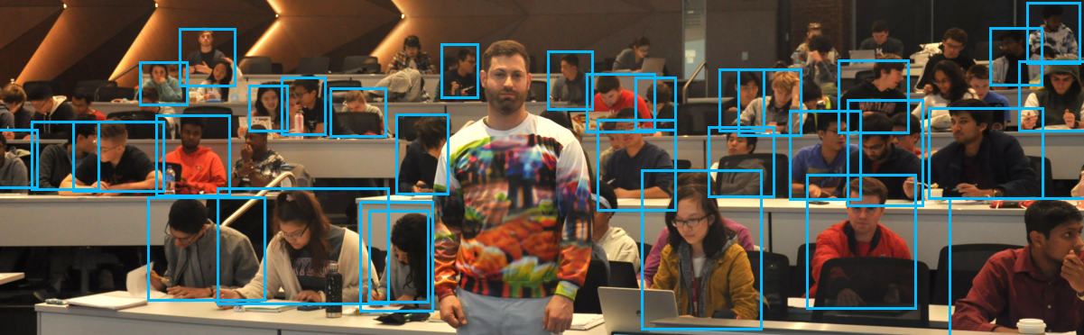
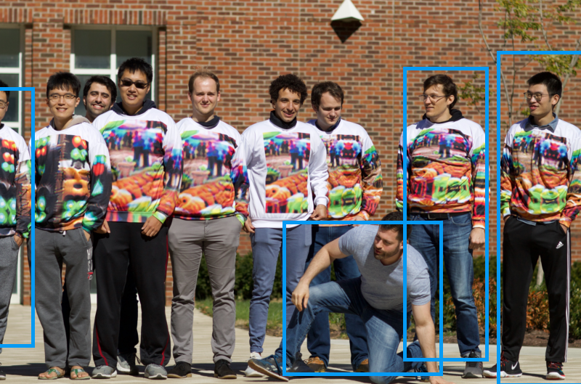
Adversarial Attacks
Tom Goldstein https://www.cs.umd.edu/~tomg/projects/invisible/

Slide 44
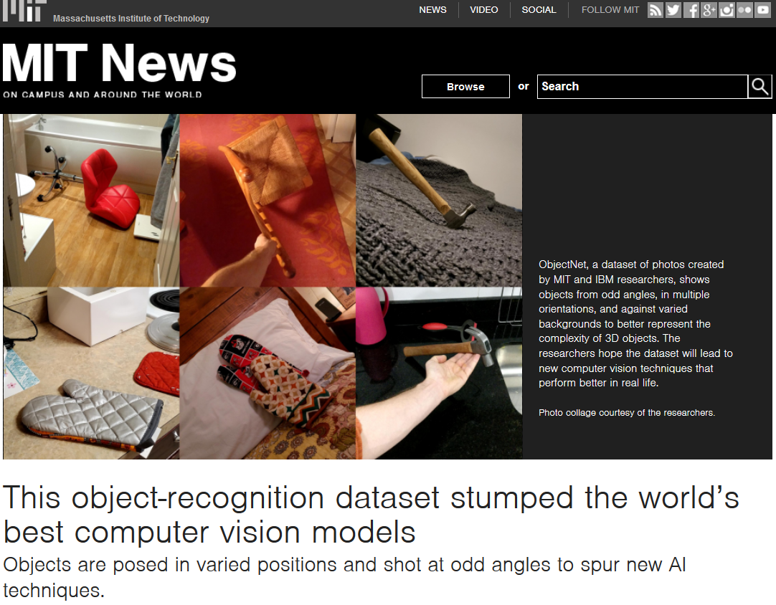
Adversarial Attacks
http://news.mit.edu/2019/object-recognition-dataset-stumped-worlds-best-computer-vision-models-1210

