Slide 1
CS 1678/2078: Intro to Deep Learning
Reinforcement Learning
Prof. Adriana Kovashka
University of Pittsburgh
April 8, 2024

Slide 2
Plan for this lecture
Basics: actions, states, rewards, MDP
Different techniques (Q learning, policy gradients, actor-critic, etc.)
Example applications

Slide 3
Reinforcement Learning
Agent
State s_{t}
Reward r_{t} Next state s
Action a
t
t+1
Environment
Lecture 14 - 3
Fei-Fei Li, Andrej Karpathy, Justin Johnson, Serena Yeung

Slide 4
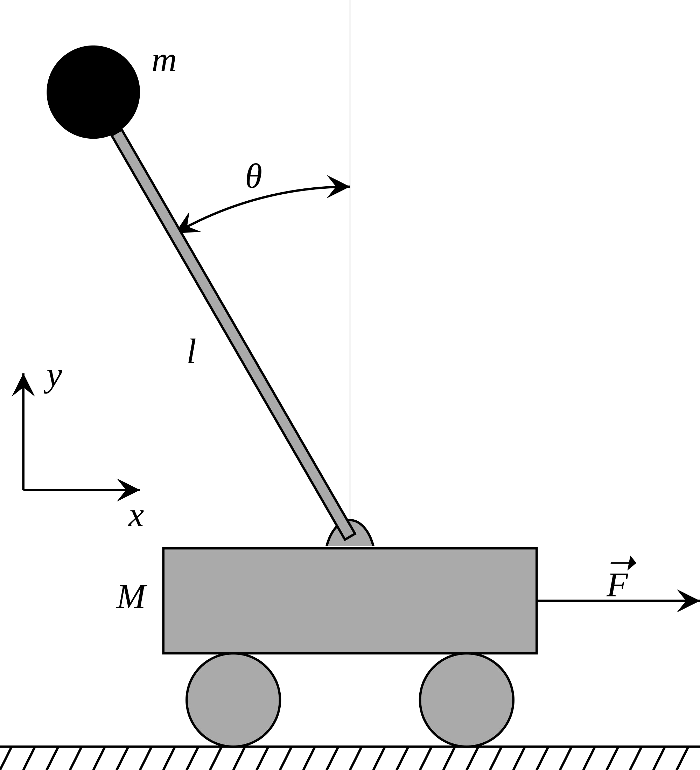
Cart-Pole Problem
Objective: Balance a pole on top of a movable cart
State: angle, angular speed, position, horizontal velocity
Action: horizontal force applied on the cart
Reward: 1 at each time step if the pole is upright
Lecture 14 -
Fei-Fei Li, Andrej Karpathy, Justin Johnson, Serena Yeung

Slide 5
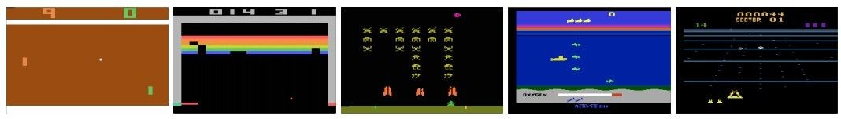
Atari Games
Objective: Complete the game with the highest score
State: Raw pixel inputs of the game state
Action: Game controls e.g. Left, Right, Up, Down
Reward: Score increase/decrease at each time step
Lecture 14 -
Fei-Fei Li, Andrej Karpathy, Justin Johnson, Serena Yeung

Slide 6
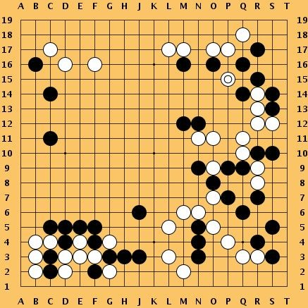
Go
Objective: Win the game!
State: Position of all pieces
Action: Where to put the next piece down
Reward: 1 if win at the end of the game, 0 otherwise
Lecture 14 -
Fei-Fei Li, Andrej Karpathy, Justin Johnson, Serena Yeung

Slide 7
How can we mathematically formalize the RL problem?
Agent
State s_{t}
Reward r_{t} Next state s
Action a
t
t+1
Environment
Fei-Fei Li, Andrej Karpathy, Justin Johnson, Serena Yeung

Slide 8

Markov Decision Process
Mathematical formulation of the RL problem
Markov property: Current state completely characterises the state of the world
Defined by:
: set of possible states
: set of possible actions
: distribution of reward given (state, action) pair
: transition probability i.e. distribution over next state given (state, action) pair
: discount factor
Fei-Fei Li, Andrej Karpathy, Justin Johnson, Serena Yeung

Slide 9

Markov Decision Process
At time step t=0, environment samples initial state s₀ ~ p(s₀)
Then, for t=0 until done:
  Agent selects action a_{t}
  Environment samples reward r_{t} ~ R( . | s_{t}, a_{t})
  Environment samples next state s_{t+1} ~ P( . | s_{t}, a_{t})
  Agent receives reward r_{t} and next state s_{t+1}
A policy u is a function from S to A that specifies what action to take in each state
Objective: find policy u* that maximizes cumulative discounted reward:
Fei-Fei Li, Andrej Karpathy, Justin Johnson, Serena Yeung

Slide 10
A simple MDP: Grid World
actions = {
states
right
left
up
down
★
 |  |  | ★
Set a negative “reward” for each transition
(e.g. r = -1)
}
Objective: reach one of terminal states (greyed out) in least number of actions
Fei-Fei Li, Andrej Karpathy, Justin Johnson, Serena Yeung

Slide 11



A simple MDP: Grid World
★
 |  |  | ★
★
 |  |  | ★
Random Policy
Optimal Policy
Fei-Fei Li, Andrej Karpathy, Justin Johnson, Serena Yeung

Slide 12
The optimal policy u*
We want to find optimal policy u* that maximizes the sum of rewards.
How do we handle the randomness (initial state, transition probability…)?
Fei-Fei Li, Andrej Karpathy, Justin Johnson, Serena Yeung

Slide 13

The optimal policy u*
We want to find optimal policy u* that maximizes the sum of rewards.
How do we handle the randomness (initial state, transition probability…)? Maximize the expected sum of rewards!
Formally:
with
Fei-Fei Li, Andrej Karpathy, Justin Johnson, Serena Yeung

Slide 14


Definitions: Value and Q-value functions
Following a policy produces sample trajectories (or paths) s₀, a₀, r₀, s₁, a₁, r₁, …
How good is a state?
The value function at state s, is the expected cumulative reward from following the policy from state s:
How good is a state-action pair?
The Q-value function at state s and action a, is the expected cumulative reward from taking action a in state s and then following the policy:
Fei-Fei Li, Andrej Karpathy, Justin Johnson, Serena Yeung

Slide 15
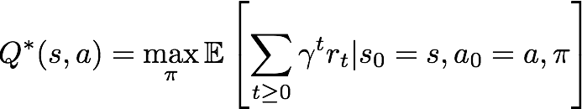


Bellman equation
The optimal Q-value function Q*
is the maximum expected cumulative reward achievable from a given (state, action) pair:
Q* satisfies the following Bellman equation:
Intuition: if the optimal state-action values for the next time-step Q*(s’,a’) are known, then the optimal strategy is to take the action that maximizes the expected value of
The optimal policy u* corresponds to taking the best action in any state as specified by Q*
Fei-Fei Li, Andrej Karpathy, Justin Johnson, Serena Yeung

Slide 16

Solving for the optimal policy:
Q-learning
Q-learning: Use a function approximator to estimate the action-value function
function parameters (weights)
If the function approximator is a deep neural network => deep q-learning!
Fei-Fei Li, Andrej Karpathy, Justin Johnson, Serena Yeung

Slide 17

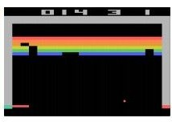
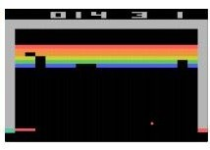
Q-network Architecture
[Mnih et al. NIPS Workshop 2013; Nature 2015]
:
neural network with weights
Last FC layer has 4-d
output (if 4 actions), corresponding to
Q(s_{t}, a₁), Q(s_{t}, a₂), Q(s_{t}, a₃), Q(s_{t},a₄)
A single feedforward pass to compute Q-values for all actions from the current state => efficient!
Number of actions between 4-18 depending on Atari game
Current state s_{t}: 84x84x4 stack of last 4 frames
(after RGB->grayscale conversion, downsampling, and cropping)
Fei-Fei Li, Andrej Karpathy, Justin Johnson, Serena Yeung

Slide 18
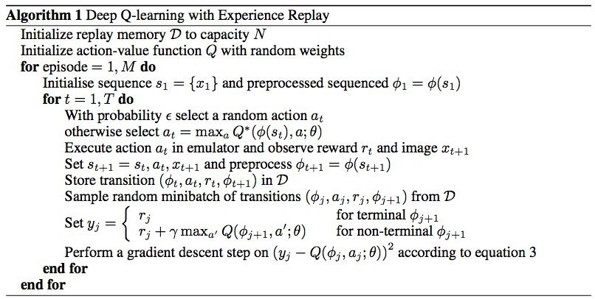
[Mnih et al. NIPS Workshop 2013; Nature 2015]
Putting it together: Deep Q-Learning with Experience Replay
Fei-Fei Li, Andrej Karpathy, Justin Johnson, Serena Yeung

Slide 19
[Mnih et al. NIPS Workshop 2013; Nature 2015]
Putting it together: Deep Q-Learning with Experience Replay
Initialize replay memory, Q-network
Fei-Fei Li, Andrej Karpathy, Justin Johnson, Serena Yeung

Slide 20
[Mnih et al. NIPS Workshop 2013; Nature 2015]
Putting it together: Deep Q-Learning with Experience Replay
Play M episodes (full games)
Fei-Fei Li, Andrej Karpathy, Justin Johnson, Serena Yeung

Slide 21
Putting it together: Deep Q-Learning with Experience Replay
[Mnih et al. NIPS Workshop 2013; Nature 2015]
Initialize state (starting game screen pixels) at the beginning of each episode
Fei-Fei Li, Andrej Karpathy, Justin Johnson, Serena Yeung

Slide 22
[Mnih et al. NIPS Workshop 2013; Nature 2015]
Putting it together: Deep Q-Learning with Experience Replay
For each timestep t of the game
Fei-Fei Li, Andrej Karpathy, Justin Johnson, Serena Yeung

Slide 23
Putting it together: Deep Q-Learning with Experience Replay
[Mnih et al. NIPS Workshop 2013; Nature 2015]
With small probability, select a random action (explore), otherwise select greedy action from current policy
Fei-Fei Li, Andrej Karpathy, Justin Johnson, Serena Yeung

Slide 24
Putting it together: Deep Q-Learning with Experience Replay
[Mnih et al. NIPS Workshop 2013; Nature 2015]
Take the action (a_{t}), and observe the reward r_{t} and next state s_{t+1}
Fei-Fei Li, Andrej Karpathy, Justin Johnson, Serena Yeung

Slide 25
Putting it together: Deep Q-Learning with Experience Replay
[Mnih et al. NIPS Workshop 2013; Nature 2015]
Store transition in
replay memory
Fei-Fei Li, Andrej Karpathy, Justin Johnson, Serena Yeung

Slide 26
Putting it together: Deep Q-Learning with Experience Replay
[Mnih et al. NIPS Workshop 2013; Nature 2015]
Experience Replay:
Sample a random minibatch of transitions from replay memory and perform a gradient descent step
https://arxiv.org/pdf/1312.5602.pdf
Fei-Fei Li, Andrej Karpathy, Justin Johnson, Serena Yeung

Slide 27
Policy Gradients
What is a problem with Q-learning?
The Q-function can be very complicated!
Example: a robot grasping an object has a very high-dimensional state => hard to learn exact value of every (state, action) pair
But the policy can be much simpler: just close your hand
Can we learn a policy directly, e.g. finding the best policy from a collection of policies?
Fei-Fei Li, Andrej Karpathy, Justin Johnson, Serena Yeung

Slide 28

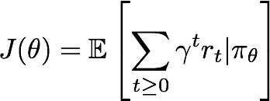

Policy Gradients
Formally, let’s define a class of parameterized policies:
For each policy, define its value:
We want to find the optimal policy
How can we do this?
Gradient ascent on policy parameters!
Fei-Fei Li, Andrej Karpathy, Justin Johnson, Serena Yeung

Slide 29

REINFORCE Algorithm (Williams 1992)
Gradient estimator:
Interpretation:
If r(τ) is high, push up the probabilities of the actions seen
If r(τ) is low, push down the probabilities of the actions seen
Might seem simplistic to say that if a trajectory is good then all its actions were good. But in expectation, it averages out!
Fei-Fei Li, Andrej Karpathy, Justin Johnson, Serena Yeung

Slide 30
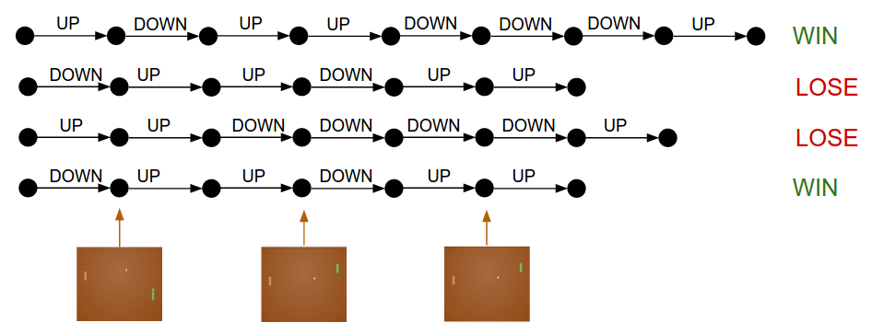
Policy Gradients
Andrej Karpathy

Slide 31
REINFORCE Algorithm (Williams 1992)
Gradient estimator:
Interpretation:
If r(τ) is high, push up the probabilities of the actions seen
If r(τ) is low, push down the probabilities of the actions seen
Might seem simplistic to say that if a trajectory is good then all its actions were good. But in expectation, it averages out!
However, this also suffers from high variance because credit assignment is really hard. Can we help the estimator?
Fei-Fei Li, Andrej Karpathy, Justin Johnson, Serena Yeung

Slide 32
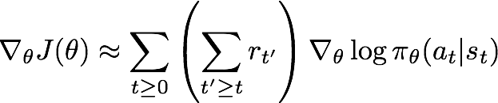
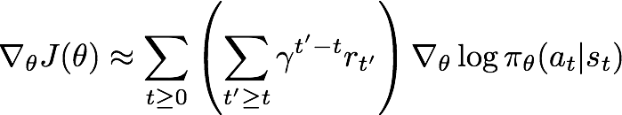
Variance Reduction
Gradient estimator:
First idea: Push up probabilities of an action seen, only by the cumulative future reward from that state
Second idea: Use discount factor 𝛾 to ignore delayed effects
Lecture 14 -
Fei-Fei Li, Ranjay Krishna, Danfei Xu

Slide 33
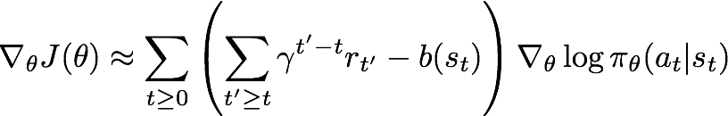
Variance Reduction: Baseline
Problem: The raw value of a trajectory isn’t necessarily meaningful. For example, if rewards are all positive, you keep pushing up probabilities of actions.
What is important then? Whether a reward is better or worse than what you expect to get
Idea: Introduce a baseline function dependent on the state. Concretely, estimator is now:
Lecture 14 -
Fei-Fei Li, Ranjay Krishna, Danfei Xu

Slide 34


How to choose the baseline?
Want to push up the probability of an action from a state, if this action was better than the expected value of what we should get from that state.
Intuitively, we are happy with an action a_{t} in a state s_{t} if
is large. On the contrary, we are unhappy with an action if it’s small.
Using this, we get the estimator:
Lecture 14 -
Fei-Fei Li, Ranjay Krishna, Danfei Xu

Slide 35
Actor-Critic Algorithm
We can combine Policy Gradients and Q-learning by training both an actor (the policy) and a critic (the Q-function).
The actor decides which action to take, and the critic tells the actor how good its action was and how it should adjust
Also alleviates the task of the critic as it only has to learn the values of (state, action) pairs generated by the policy
Can also incorporate Q-learning tricks e.g. experience replay
Define by the advantage function how much an action was better than expected
Adapted from Fei-Fei Li, Andrej Karpathy, Justin Johnson, Serena Yeung

Slide 36
Policy Gradients tl;dr
∑i Ai log p(yi∣xi)
Objective:
x_{i} = state
y_{i} = sampled action
A_{i} = “advantage” e.g. +1/-1 for win/lose in simplest version, or discounted, or improvement over “baseline”
Adapted from Andrej Karpathy

Slide 37
Policy Gradients vs Q-Learning
Policy gradients suffers from high variance and instability; might want to make gradients smaller (e.g. relative to a baseline)
Policy gradients can handle continuous action spaces (Gaussian policy)
Estimating exact value of state-action pairs vs choosing what actions to take (value not important)
Step-by-step (did I correctly estimate the reward at this time) vs delayed feedback (run policy and wait until game terminates)

Slide 38
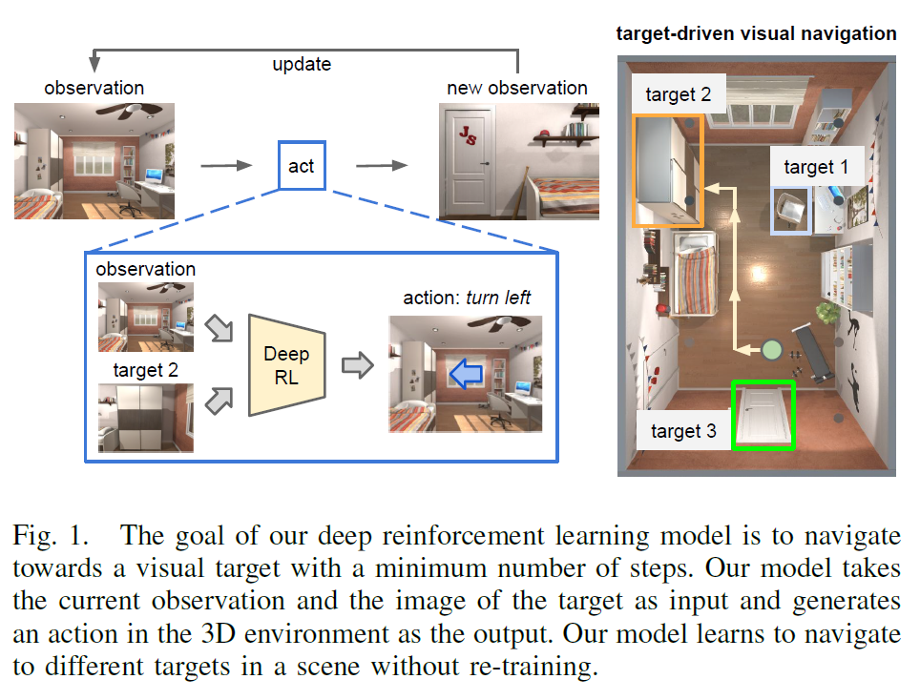
RL for navigation
Zhu et al., “Target-driven Visual Navigation in Indoor Scenes using Deep Reinforcement Learning”, ICRA 2017

Slide 39
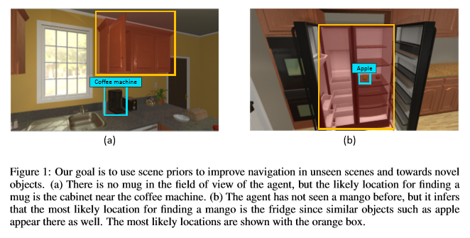
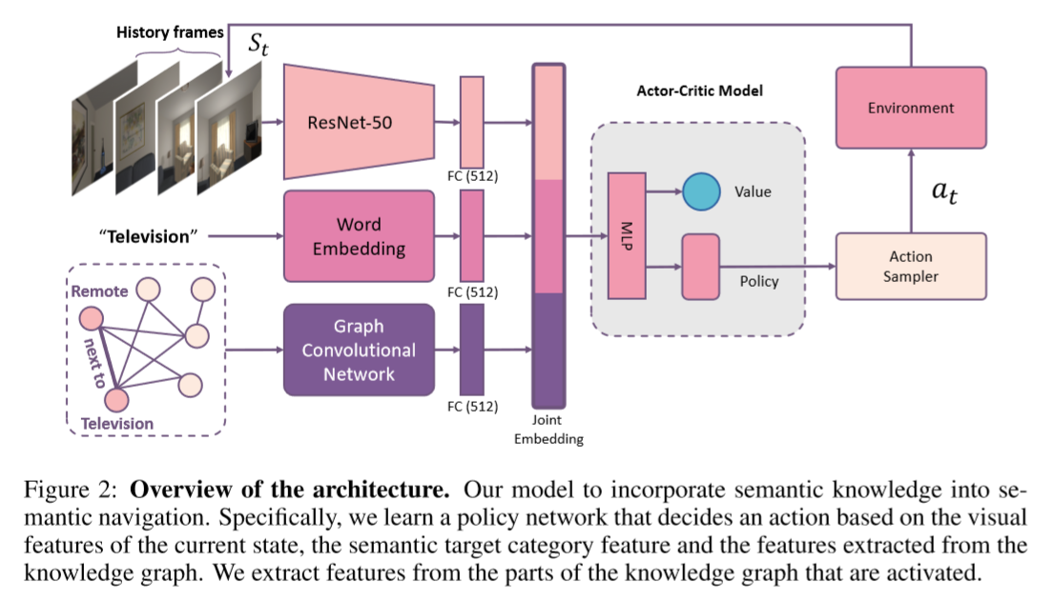
RL for navigation
Yang et al., “Visual Semantic Navigation using Scene Priors”, ICLR 2019

Slide 40
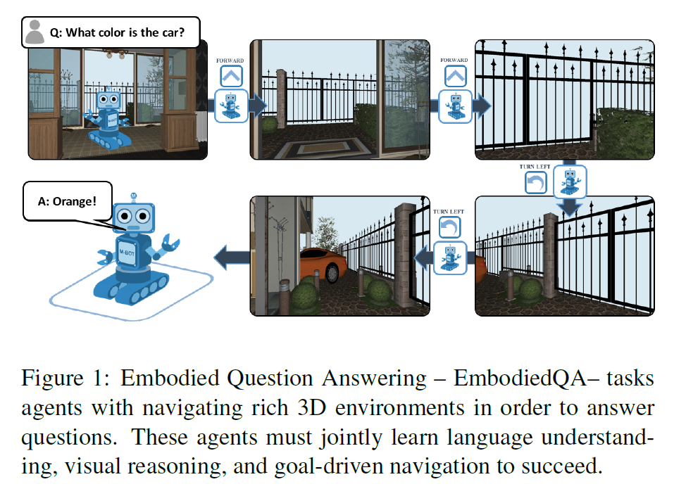
RL for question-answering
Das et al., “Embodied Question Answering”, CVPR 2018

Slide 41
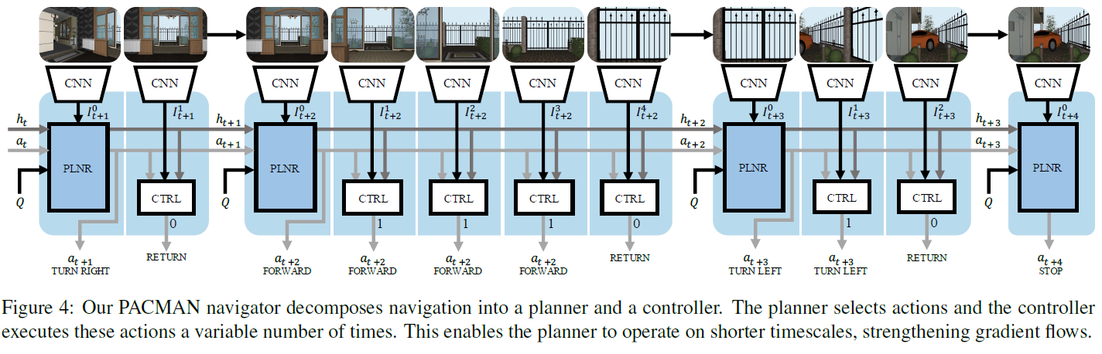
RL for question-answering
Das et al., “Embodied Question Answering”, CVPR 2018

Slide 42
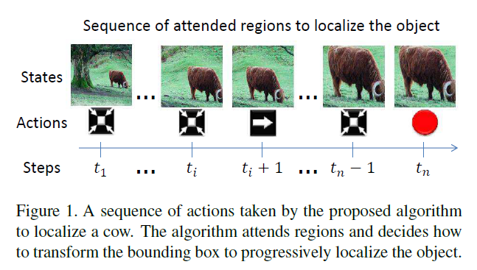
RL for object detection
Caicedo and Lazebnik, “Active Object Localization with Deep Reinforcement Learning”, ICCV 2015

Slide 43
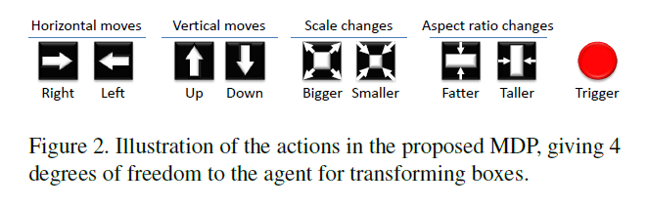
RL for object detection
Caicedo and Lazebnik, “Active Object Localization with Deep Reinforcement Learning”, ICCV 2015

