Slide 1
CS 1678: Intro to Deep Learning
Recurrent Neural Networks
Prof. Adriana Kovashka
University of Pittsburgh
March 16, 2021

Slide 2
Plan for this lecture
Recurrent neural networks
  Basics
  Training (backprop through time, vanishing gradient)
  Recurrent networks with gates (GRU, LSTM)
Applications in NLP and vision
  Neural machine translation (beam search, attention)
  Image/video captioning

Slide 3
Recurrent neural networks

Slide 4
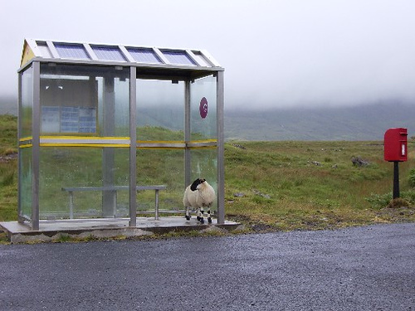
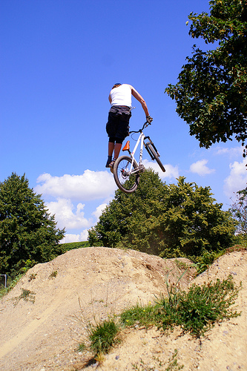
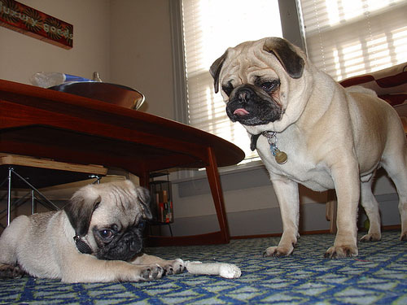
Some pre-RNN captioning results
This is a picture of one sky, one road and one sheep. The gray sky is over the gray road. The gray sheep is by the gray road.
Here we see one road, one sky and one bicycle. The road is near the blue sky, and near the colorful bicycle. The colorful bicycle is within the blue sky.
This is a picture of two dogs. The first dog is near the second furry dog.
Kulkarni et al., CVPR 2011
Notes:
This is a picture of one sky, one road…

Slide 5
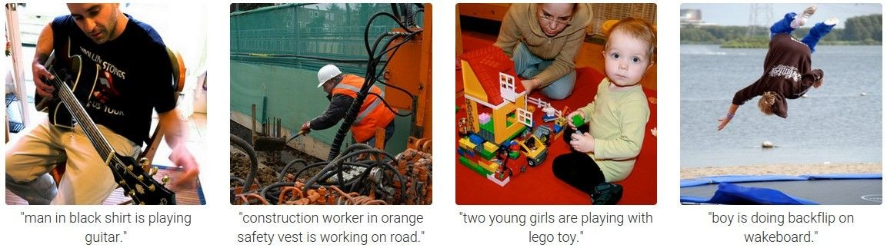
Results with Recurrent Neural Networks
Karpathy and Fei-Fei, CVPR 2015

Slide 6
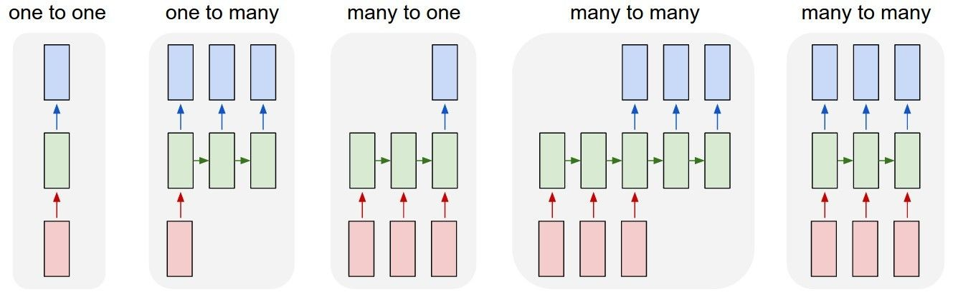
Recurrent Networks offer a lot of flexibility:
vanilla neural networks
Andrej Karpathy

Slide 7
Recurrent Networks offer a lot of flexibility:
e.g. image captioning
image -> sequence of words
Andrej Karpathy

Slide 8
Recurrent Networks offer a lot of flexibility:
e.g. sentiment classification
sequence of words -> sentiment
Andrej Karpathy

Slide 9
Recurrent Networks offer a lot of flexibility:
e.g. machine translation
seq of words -> seq of words
Andrej Karpathy

Slide 10
Recurrent Networks offer a lot of flexibility:
e.g. video classification on frame level
Andrej Karpathy

Slide 11
Recurrent Neural Network
RNN
RNN
x
Andrej Karpathy

Slide 12
Recurrent Neural Network
y
usually want to output a prediction at some time steps
RNN
x
Adapted from Andrej Karpathy

Slide 13

Recurrent Neural Network
We can process a sequence of vectors x by applying a recurrence formula at every time step:
y
RNN
new state
old state input vector at
some time step
some function
with parameters W
x
Andrej Karpathy

Slide 14
Recurrent Neural Network
We can process a sequence of vectors x by applying a recurrence formula at every time step:
y
RNN
Notice: the same function and the same set of parameters are used at every time step.
x
Andrej Karpathy

Slide 15

(Vanilla) Recurrent Neural Network
The state consists of a single “hidden” vector h:
y
RNN
x
Andrej Karpathy

Slide 16
Character-level language model example
Example
RNN
x
y
Vocabulary: [h,e,l,o]
Example training sequence: “hello”
Andrej Karpathy

Slide 17
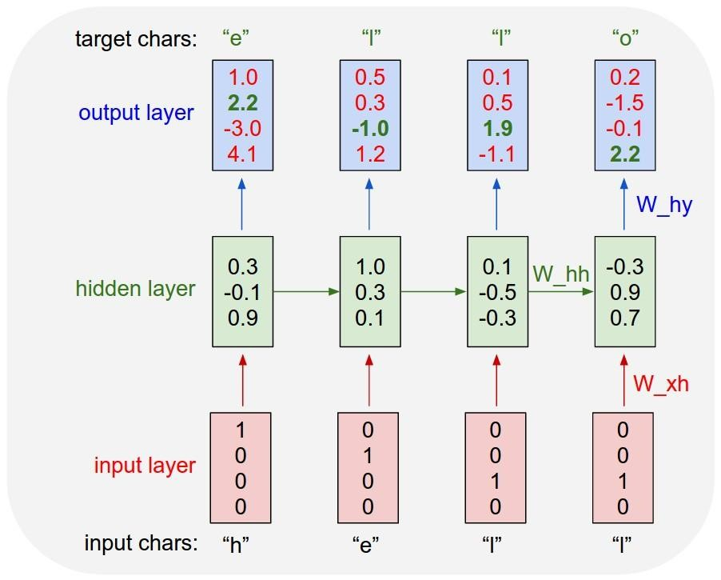
Example
Character-level language model example
Vocabulary: [h,e,l,o]
Example training sequence: “hello”
Andrej Karpathy

Slide 18
Example
Character-level language model example
Vocabulary: [h,e,l,o]
Example training sequence: “hello”
Andrej Karpathy

Slide 19
Example
Character-level language model example
Vocabulary: [h,e,l,o]
Example training sequence: “hello”
What do we still need to specify, for this to work?
What kind of loss can we formulate?
Andrej Karpathy

Slide 20




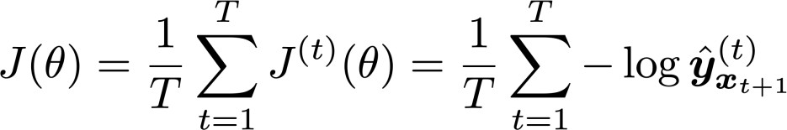
Training a Recurrent Neural Network
Get a big corpus of text which is a sequence of words
Feed into RNN; compute output distribution for every step t.
  i.e. predict probability distribution of every word, given words so far
Loss function on step t is cross-entropy between predicted probability
distribution , and true next word (one-hot); V is vocabulary
Average this to get overall loss for entire training set:
Adapted from Abigail See

Slide 21








The vanishing/exploding gradient problem
The error at a time step ideally can tell a previous time step from many steps away to change during backprop
Multiply the same matrix at each time step during backprop
yt−1
y_{t}
yt+1
ht−1
h_{t}
ht+1
W
W
xt−1
x_{t}
xt+1
Richard Socher

Slide 22
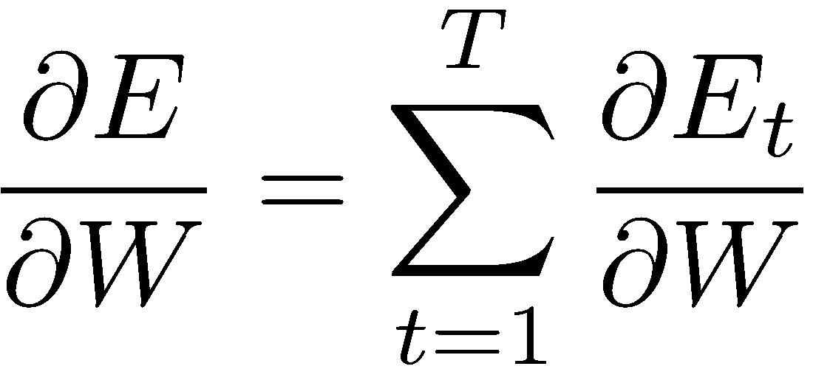
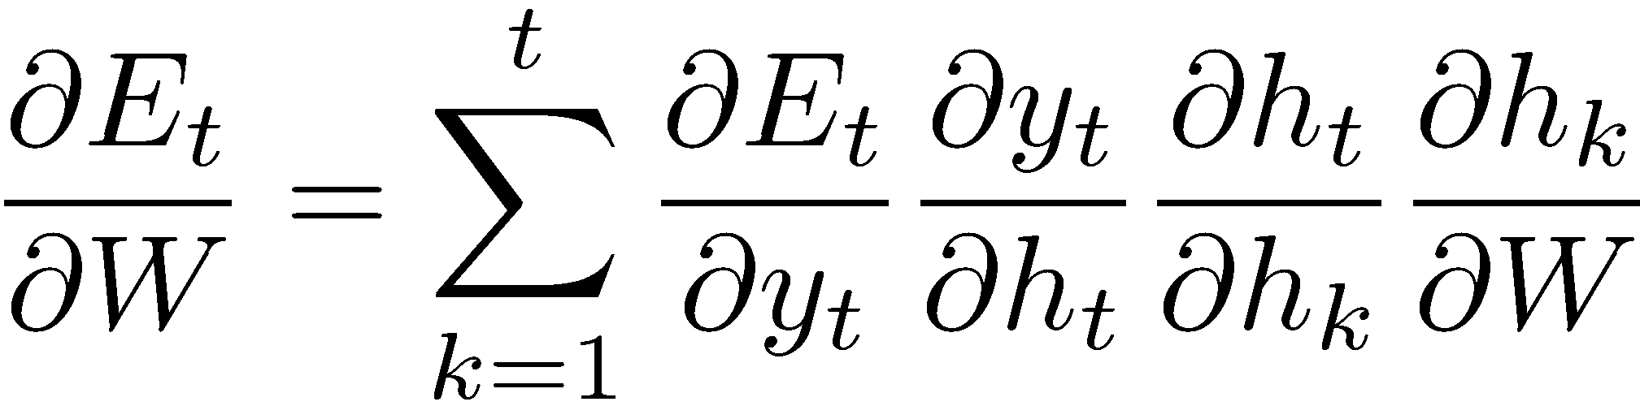
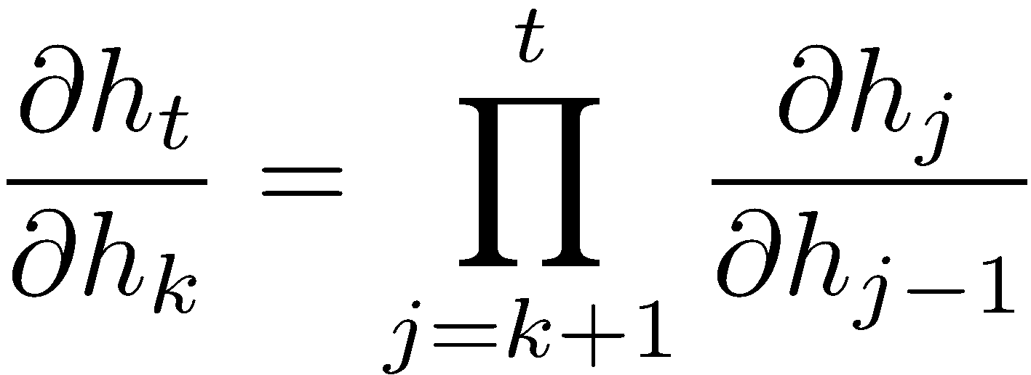
The vanishing gradient problem
Total error is the sum of each error at time steps t
Chain rule:
More chain rule:
Derivative of vector wrt vector is a Jacobian matrix of partial derivatives; norm of this matrix can become very small or very large quickly [Bengio et al 1994, Pascanu et al. 2013], leading to vanishing/exploding gradient
Adapted from Richard Socher

Slide 23
What uses of language models from everyday life can you think of?

Slide 24
Now in more detail…

Slide 25


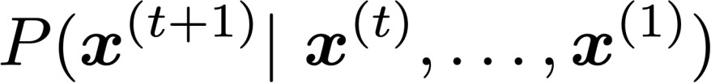


Language Modeling
Language Modeling is the task of predicting what word comes next.
books
laptops
the students opened their
exams
minds
More formally: given a sequence of words
compute the probability distribution of the next word
,
:
where can be any word in the vocabulary
A system that does this is called a Language Model.
Abigail See

Slide 26
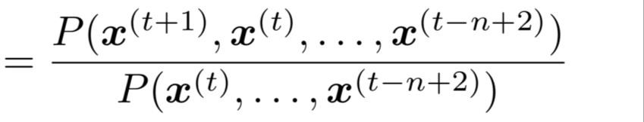
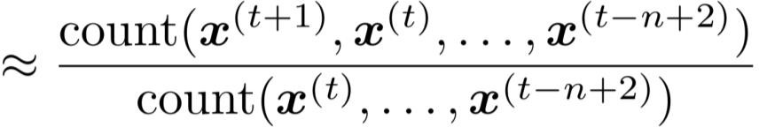
n-gram Language Models
First we make a simplifying assumption:
preceding n-1 words.
n-1 words
depends only on the
(assumption)
prob of a n-gram
(definition of conditional prob)
prob of a (n-1)-gram
Question: How do we get these n-gram and (n-1)-gram probabilities?
Answer: By counting them in some large corpus of text!
(statistical approximation)
Abigail See

Slide 27


Sparsity Problems with n-gram Language Models
Sparsity Problem 1
Problem: What if “students opened their ” never occurred in data? Then
has probability 0!
(Partial) Solution: Add small 𝛿 to the count for every . This is called smoothing.
Sparsity Problem 2
Problem: What if “students opened their” never occurred in data? Then we can’t calculate probability for any !
(Partial) Solution: Just condition
on “opened their” instead.
This is called backoff.
Note: Increasing n makes sparsity problems worse.
Typically we can’t have n bigger than 5.
Abigail See

Slide 28















A fixed-window neural Language Model
books
laptops
output distribution
a
zoo
hidden layer
concatenated word embeddings
words / one-hot vectors
the
students
opened
their
Abigail See

Slide 29


A fixed-window neural Language Model
Improvements over n-gram LM:
books
No sparsity problem
Don’t need to store all observed n-grams
laptops
Remaining problems:
a
zoo
Fixed window is too small
Enlarging window enlarges
Window can never be large enough!
and are multiplied by completely different weights in
•
.
No symmetry in how the inputs are processed.
We need a neural architecture that can process any length input
the
students
opened
their
Abigail See

Slide 30




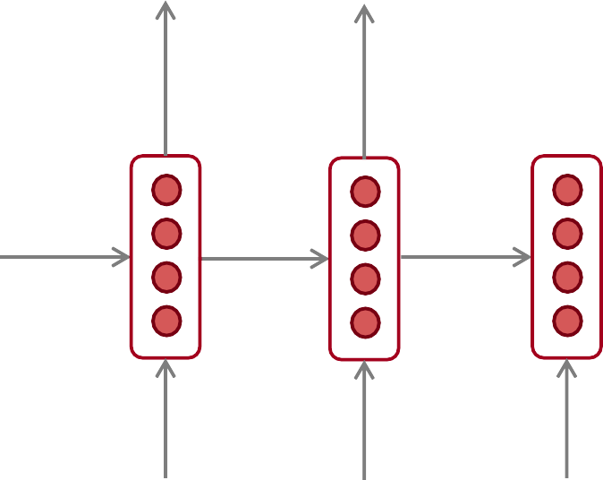










Recurrent Neural Networks (RNN)
A family of neural architectures
Core idea: Apply the same weights repeatedly
outputs (optional)
…
hidden states
…
input sequence (any length)
…
Abigail See

Slide 31


















A RNN Language Model
books
laptops
output distribution
a
zoo
hidden states
is the initial hidden state
word embeddings
words / one-hot vectors the students
opened
their
Note: this input sequence could be much
longer, but this slide doesn’t have space!
Abigail See

Slide 32
A RNN Language Model
books
laptops
RNN Advantages:
Can process any length input
Computation for step t can (in theory) use information from many steps back
Model size doesn’t
increase for longer input
Same weights applied on every timestep, so there is symmetry in how inputs are processed
a
zoo
RNN Disadvantages:
Recurrent computation is slow
In practice, difficult to access information from many steps back
the
students
opened
their
Abigail See

Slide 33

Recall: Training a RNN Language Model
Get a big corpus of text which is a sequence of words
Feed into RNN-LM; compute output distribution for every step t.
  i.e. predict probability distribution of every word, given words so far
Loss function on step t is cross-entropy between predicted probability
distribution , and the true next word (one-hot for ):
Average this to get overall loss for entire training set:
Abigail See

Slide 34




Training a RNN Language Model
= negative log prob
of “students”
Loss
Predicted prob dists
…
Corpus
the
students
opened
their
exams
…
Abigail See

Slide 35
Training a RNN Language Model
= negative log prob
of “opened”
Loss
Predicted prob dists
…
Corpus
the
students
opened
their
exams
…
Abigail See

Slide 36
Training a RNN Language Model
= negative log prob
of “their”
Loss
Predicted prob dists
…
Corpus
the
students
opened
their
exams
…
Abigail See

Slide 37
Training a RNN Language Model
= negative log prob
of “exams”
Loss
Predicted prob dists
…
Corpus
the
students
opened
their
exams
…
Abigail See

Slide 38
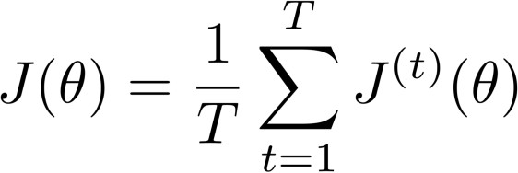
Training a RNN Language Model
Loss
+
+
+
+ … =
Predicted prob dists
…
Corpus
the
students
opened
their
exams
…
Abigail See

Slide 39










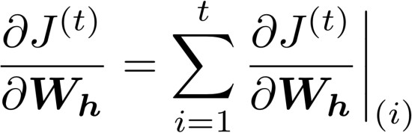
Backpropagation for RNNs
…
…
Question: What’s the derivative of
w.r.t. the repeated weight matrix
?
“The gradient w.r.t. a repeated weight is the sum of the gradient
w.r.t. each time it appears”
Answer:
Abigail See

Slide 40
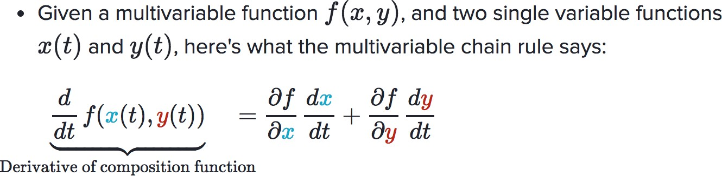
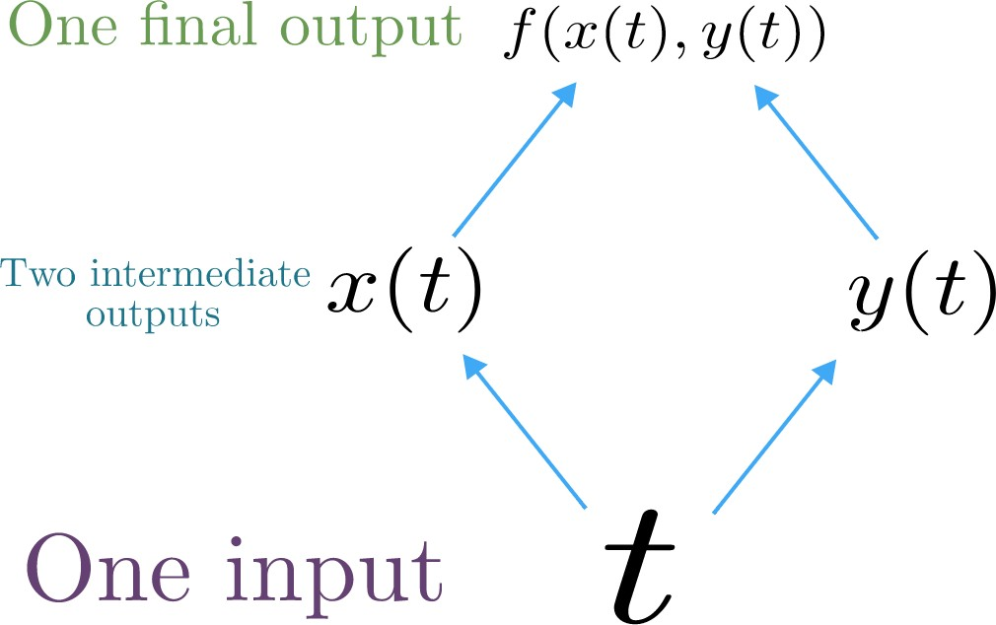
Multivariable Chain Rule
Source:
https://www.khanacademy.org/math/multivariable-calculus/multivariable-derivatives/differentiating-vector-valued-functions/a/multivariable-chain-rule-simple-version
Abigail See

Slide 41
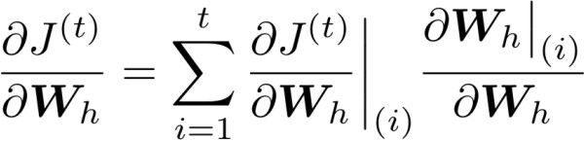




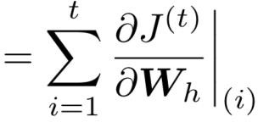



Backpropagation for RNNs: Proof sketch
In our example:
Apply the multivariable chain rule:
= 1
…
Source:
https://www.khanacademy.org/math/multivariable-calculus/multivariable-derivatives/differentiating-vector-valued-functions/a/multivariable-chain-rule-simple-version
Abigail See

Slide 42
Backpropagation for RNNs
…
…
Answer: Backpropagate over timesteps i=t,…,0, summing gradients as you go.
This algorithm is called
“backpropagation through time”
Question: How do we calculate this?
Abigail See

Slide 43
Vanishing gradient intuition
Abigail See

Slide 44
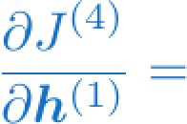
Vanishing gradient intuition
?
Abigail See

Slide 45









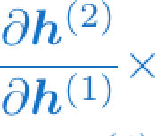
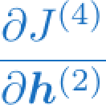
Vanishing gradient intuition
chain rule!
Abigail See

Slide 46
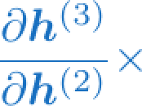
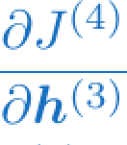
Vanishing gradient intuition
chain rule!
Abigail See

Slide 47
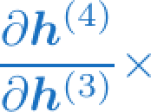
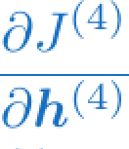
Vanishing gradient intuition
chain rule!
Abigail See

Slide 48
Vanishing gradient intuition
Vanishing gradient problem: When these are small, the gradient signal gets smaller and smaller as it backpropagates further
What happens if these are small?
Abigail See

Slide 49

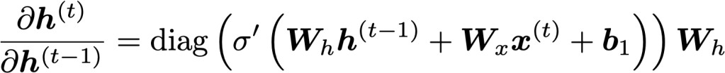


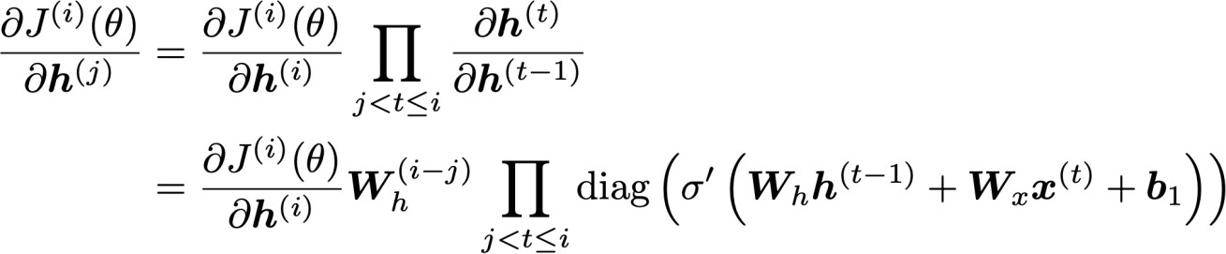

Vanishing gradient proof sketch
Recall:
Therefore:
(chain rule)
Consider the gradient of the loss on step i, with respect
to the hidden state on some previous step j.
(chain rule) (value of )
If W_{h} is small, then this term gets
vanishingly small as i and j get further apart
Abigail See
Source: “On the difficulty of training recurrent neural networks”, Pascanu et al, 2013. http://proceedings.mlr.press/v28/pascanu13.pdf

Slide 50
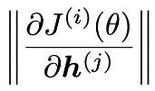
Vanishing gradient proof sketch
Consider matrix L2 norms:
Pascanu et al showed that that if the largest eigenvalue of W_{h} is
less than 1, then the gradient will shrink exponentially
There’s a similar proof relating a largest eigenvalue >1 to
exploding gradients
Source: “On the difficulty of training recurrent neural networks”, Pascanu et al, 2013. http://proceedings.mlr.press/v28/pascanu13.pdf
Adapted from Abigail See

Slide 51

Why is vanishing gradient a problem?
Gradient signal from faraway is lost because it’s much
smaller than gradient signal from close-by.
So model weights are only updated only with respect to near effects, not long-term effects.
Abigail See

Slide 52
Effect of vanishing gradient on RNN-LM
LM task: When she tried to print her tickets, she found that the printer was out of toner. She went to the stationery store to buy more toner. It was very overpriced. After installing the toner into the printer, she finally printed her
To learn from this training example, the RNN-LM needs to model the dependency between “tickets” on the 7th step and the target word “tickets” at the end.
But if gradient is small, the model can’t learn this dependency
  So the model is unable to predict similar long-distance dependencies at test time
Abigail See

Slide 53
Effect of vanishing gradient on RNN-LM
is
LM task: The writer of the books
are
Correct answer: The writer of the books is planning a sequel
Syntactic recency: The writer of the books is (correct)
Sequential recency: The writer of the books are (incorrect)
Due to vanishing gradient, RNN-LMs are better at learning from sequential recency than syntactic recency, so they make this
type of error more often than we’d like [Linzen et al 2016]
Abigail See
“Assessing the Ability of LSTMs to Learn Syntax-Sensitive Dependencies”, Linzen et al, 2016. https://arxiv.org/pdf/1611.01368.pdf

Slide 54
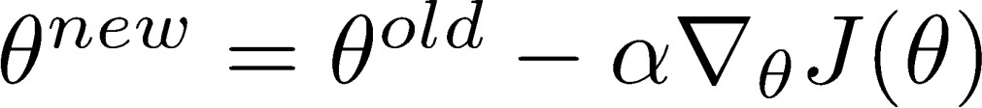
Why is exploding gradient a problem?
If the gradient becomes too big, then the SGD update step becomes too big:
learning rate
gradient
This can cause bad updates: we take too large a step and reach a bad parameter configuration (with large loss)
In the worst case, this will result in Inf or NaN in your network (then you have to restart training from an earlier checkpoint)
Abigail See

Slide 55
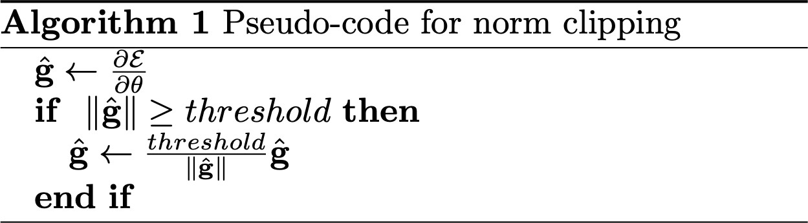
Gradient clipping: solution for exploding gradient
Gradient clipping: if the norm of the gradient is greater than some threshold, scale it down before applying SGD update
Intuition: take a step in the same direction, but a smaller step
Abigail See
Source: “On the difficulty of training recurrent neural networks”, Pascanu et al, 2013. http://proceedings.mlr.press/v28/pascanu13.pdf

Slide 56
RNNs with Gates

Slide 57
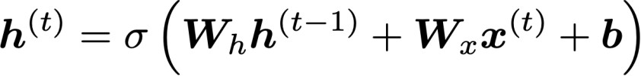
How to fix vanishing gradient problem?
The main problem is that it’s too difficult for the RNN to learn to
preserve information over many timesteps.
In a vanilla RNN, the hidden state is constantly being rewritten
How about a RNN with separate memory?
Richard Socher

Slide 58
Gated Recurrent Units (GRUs)
More complex hidden unit computation in recurrence!
Introduced by Cho et al. 2014
Main ideas:
  keep around memories to capture long distance dependencies
  allow error messages to flow at different strengths depending on the inputs
Richard Socher

Slide 59
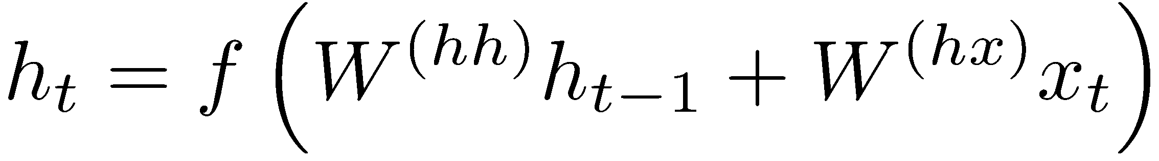
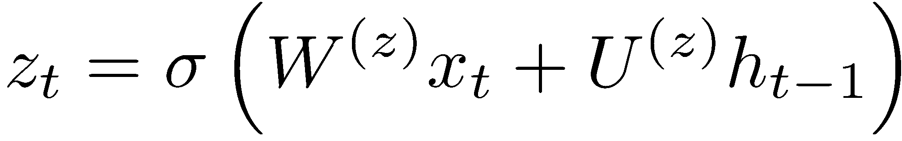
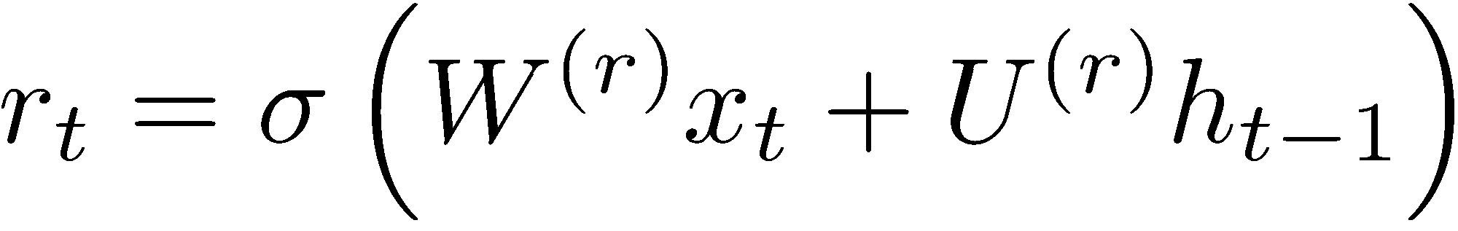
Gated Recurrent Units (GRUs)
Standard RNN computes hidden layer at next time step directly:
GRU first computes an update gate (another layer) based on current input word vector and hidden state
Compute reset gate similarly but with different weights
Richard Socher

Slide 60
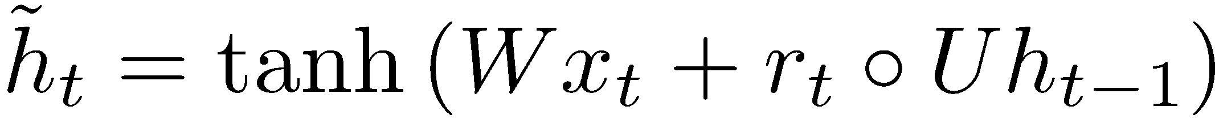
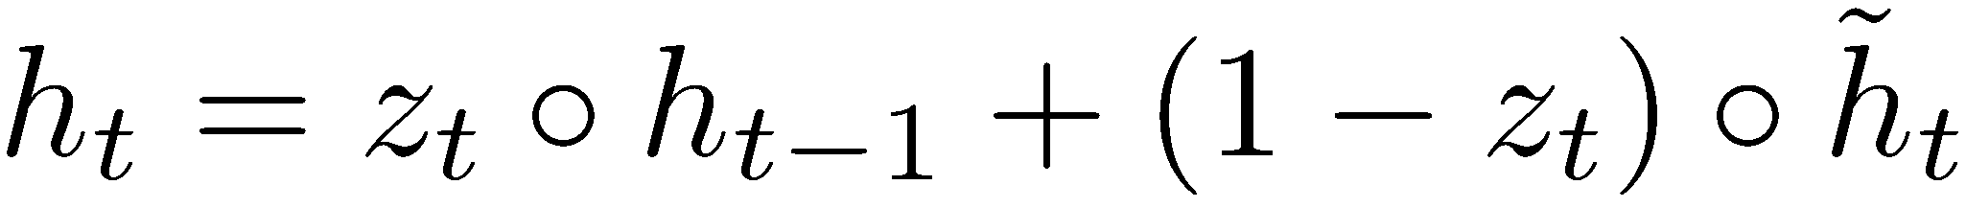
Gated Recurrent Units (GRUs)
Update gate
Reset gate
New memory content:
If reset gate unit is ~0, then this ignores previous memory and only stores the new word information
Final memory at time step combines current and previous time steps:
Richard Socher

Slide 61
Gated Recurrent Units (GRUs)
ht-1
h_{t}
Final memory
~_{ht}
Memory (reset)
~ht-1
Update gate
zt-1
z_{t}
Reset gate
rt-1
r_{t}
Input:
xt-1
x_{t}
Richard Socher

Slide 62
Gated Recurrent Units (GRUs)
If reset r is close to 0, ignore previous hidden state: Allows model to drop information that is irrelevant in the future
If update z is close to 1, can copy information through many time steps, i.e. copy-paste state: Less vanishing gradient!
Units with short-term dependencies often have reset gates (r) very active; ones with long-term dependencies have active update gates (z)
Adapted from Richard Socher

Slide 63
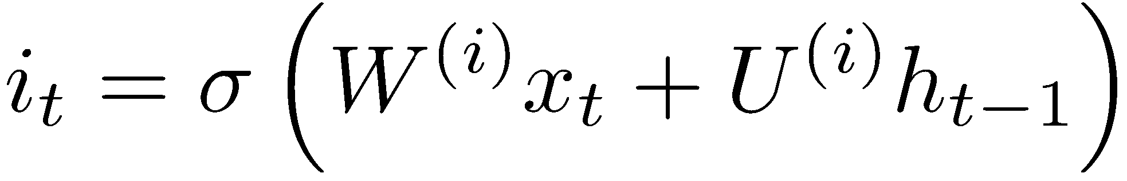
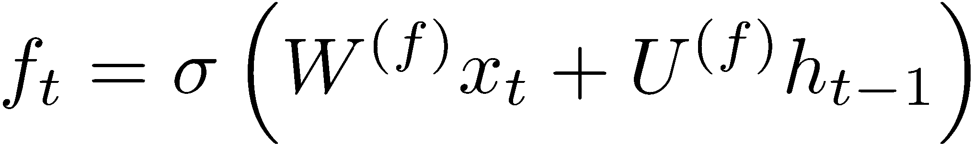
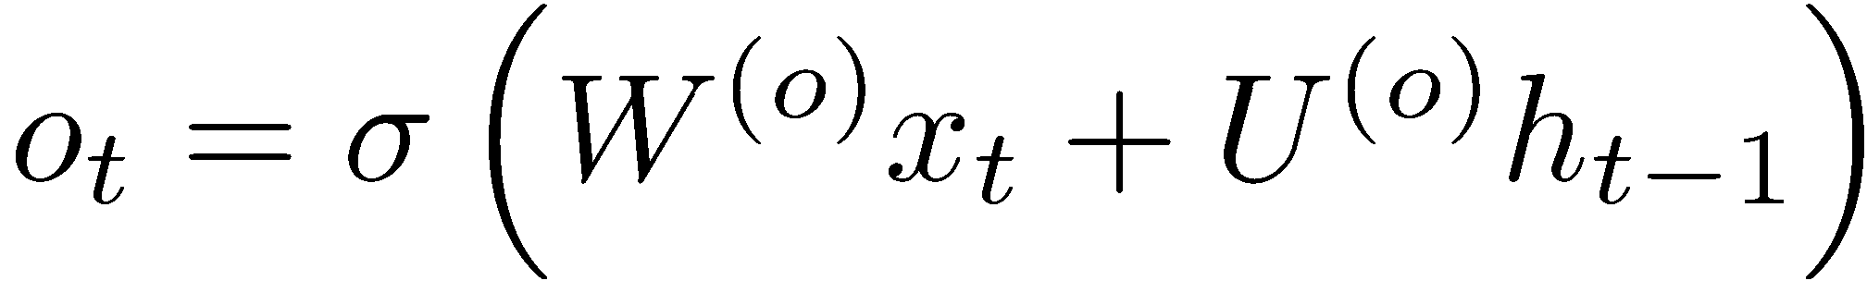
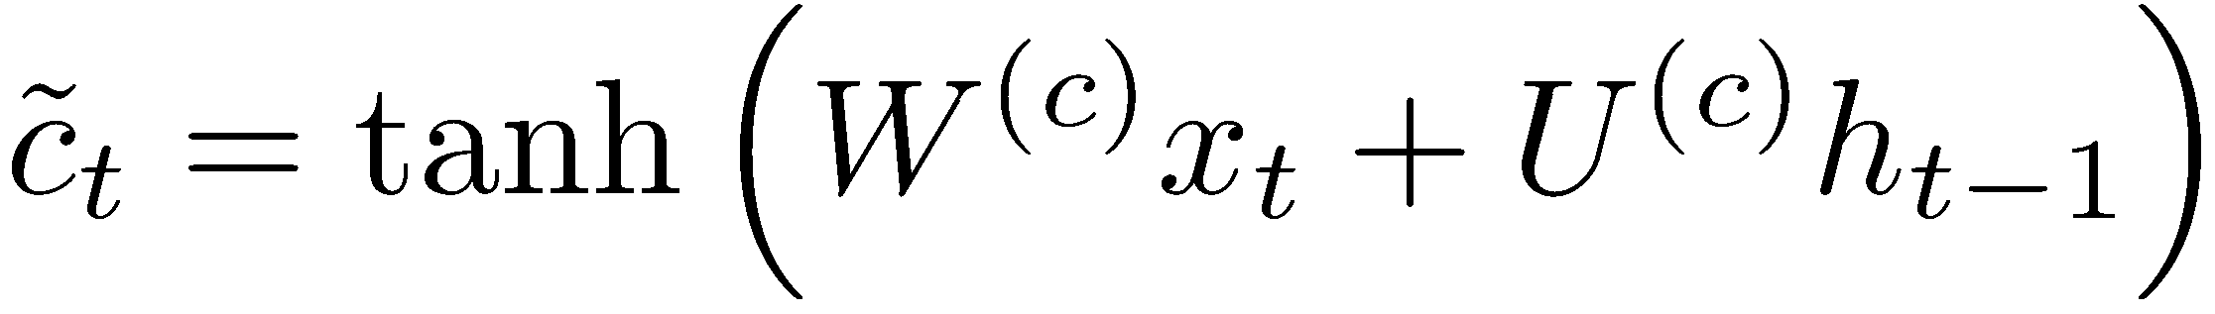
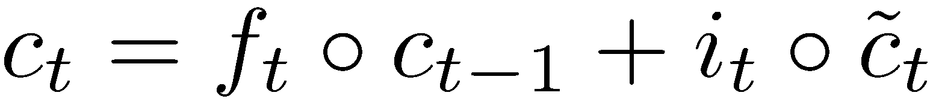
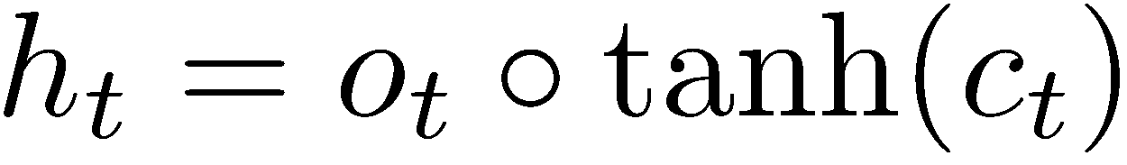
Long-short-term-memories (LSTMs)
Proposed by Hochreiter and Schmidhuber in 1997
We can make the units even more complex
Allow each time step to modify
  Input gate (current cell matters)
  Forget (gate 0, forget past)
  Output (how much cell is exposed)
  New memory cell
Final memory cell:
Final hidden state:
Adapted from Richard Socher

Slide 64
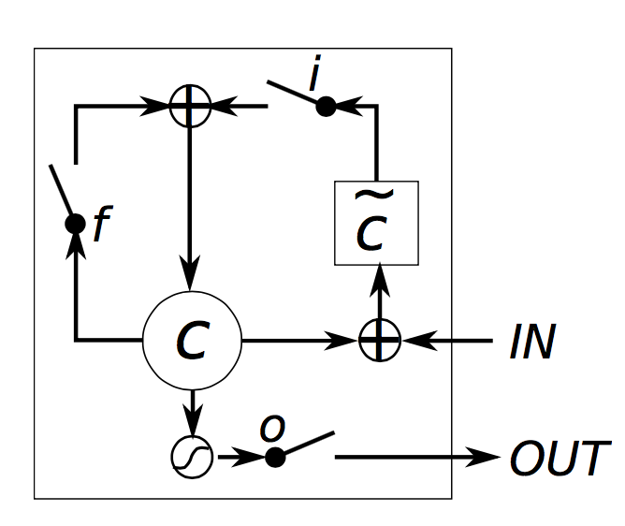
Long-short-term-memories (LSTMs)
Intuition: memory cells can keep information intact, unless inputs makes them forget it or overwrite it with new input
Cell can decide to output this information or just store it
Richard Socher, figure from wildml.com

Slide 65


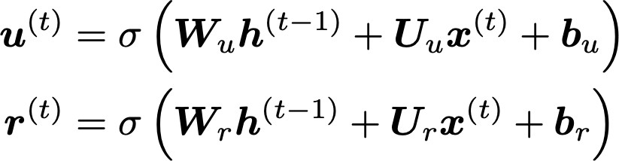
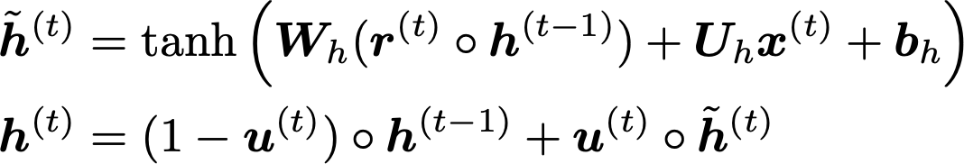
Review on your own: Gated Recurrent Units (GRU)
Proposed by Cho et al. in 2014 as a simpler alternative to the LSTM.
On each timestep t we have input and hidden state (no cell state).
Update gate: controls what parts of hidden state are updated vs preserved
Reset gate: controls what parts of previous hidden state are used to compute new content
New hidden state content: reset gate selects useful parts of prev hidden state. Use this and current input to compute new hidden content.
Hidden state: update gate simultaneously controls what is kept from previous hidden state, and what is updated to new hidden state content
How does this solve vanishing gradient? GRU makes it easier to retain info long-term (e.g. by setting update gate to 0)
Abigail See
"Learning Phrase Representations using RNN Encoder–Decoder for Statistical Machine Translation", Cho et al. 2014, https://arxiv.org/pdf/1406.1078v3.pdf

Slide 66

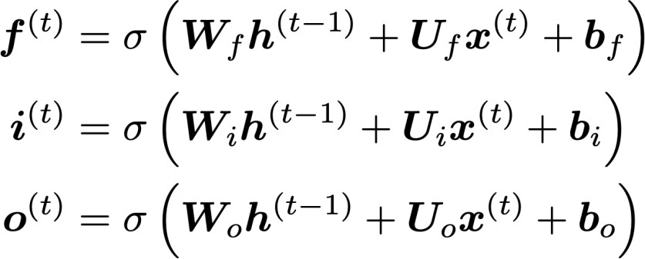
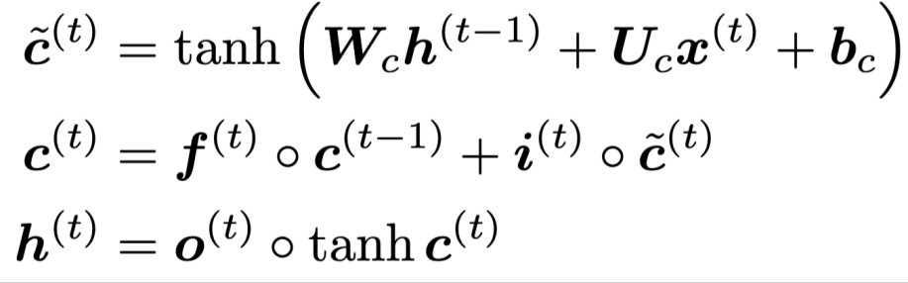
Review on your own: Long Short-Term Memory (LSTM)
We have a sequence of inputs , and we will compute a sequence of hidden states and cell states . On timestep t:
Sigmoid function: all gate values are between 0 and 1
Forget gate: controls what is kept vs forgotten, from previous cell state
Input gate: controls what parts of the new cell content are written to cell
All these are vectors of same length n
Output gate: controls what parts of cell are output to hidden state
New cell content: this is the new content to be written to the cell
Cell state: erase (“forget”) some content from last cell state, and write (“input”) some new cell content
Hidden state: read (“output”) some content from the cell
Gates are applied using element-wise product
Abigail See

Slide 67
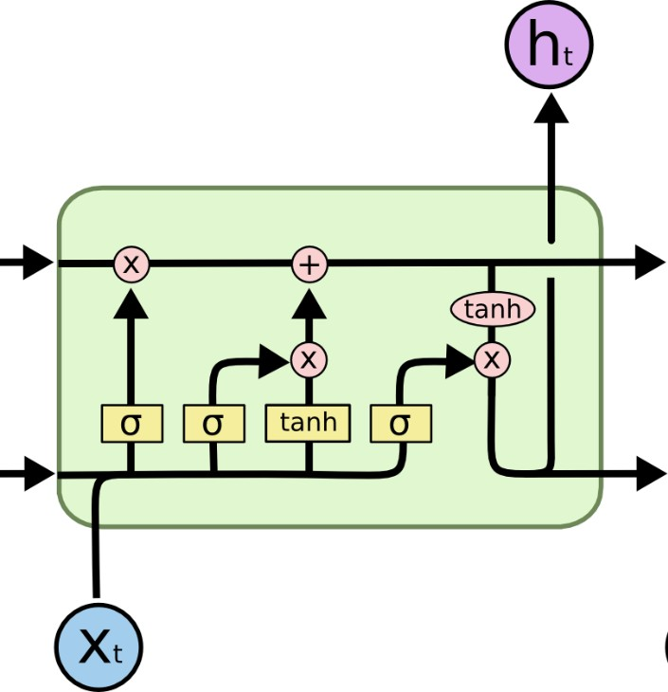

Review on your own: Long Short-Term Memory (LSTM)
You can think of the LSTM equations visually like this:
Write some new cell content
Forget some
cell content
c_{t}
c_{t}
^{c}t-1
f
i_{t}
o_{t}
Output some cell content to the hidden state
Compute the forget gate
t
~_{c}
t
^{h}t-1
h_{t}
Compute the input gate
Compute the new cell content
Compute the output gate
Abigail See
Source: http://colah.github.io/posts/2015-08-Understanding-LSTMs/

Slide 68
LSTM vs GRU
Researchers have proposed many gated RNN variants, but LSTM and GRU are the most widely-used
The biggest difference is that GRU is quicker to compute and has fewer parameters
There is no conclusive evidence that one consistently performs better than the other
LSTM is a good default choice (especially if your data has particularly long dependencies, or you have lots of training data)
Rule of thumb: start with LSTM, but switch to GRU if you want something more efficient
Abigail See

Slide 69
LSTMs: real-world success
In 2013-2015, LSTMs started achieving state-of-the-art results for sequence modeling
  Successful tasks include: handwriting recognition, speech recognition, machine translation, parsing, image captioning
  LSTM became the dominant approach
Starting in 2019, other approaches (e.g. Transformers) became more dominant for certain NLP tasks (will discuss next lecture)
  For example in WMT (machine translation competition):
  In WMT 2016, the summary report contains ”RNN” 44 times
  In WMT 2018, the report contains “RNN” 9 times and
“Transformer” 63 times
Source: "Findings of the 2016 Conference on Machine Translation (WMT16)", Bojar et al. 2016, http://www.statmt.org/wmt16/pdf/W16-2301.pdf
Source: "Findings of the 2018 Conference on Machine Translation (WMT18)", Bojar et al. 2018, http://www.statmt.org/wmt18/pdf/WMT028.pdf
Adapted from Abigail See

Slide 70

Is vanishing/exploding gradient just a RNN problem?
No! It can be a problem for all neural architectures (including feed-forward and convolutional), especially deep ones.
  Due to chain rule / choice of nonlinearity function, gradient can become vanishingly small as it backpropagates
  Thus lower layers are learnt very slowly (hard to train)
  Solution: lots of new deep feedforward/convolutional architectures that
add more direct connections (thus allowing the gradient to flow)
For example:
Residual connections aka “ResNet”
Also known as skip-connections
The identity connection preserves information by default
This makes deep networks much
easier to train
Abigail See
"Deep Residual Learning for Image Recognition", He et al, 2015. https://arxiv.org/pdf/1512.03385.pdf

Slide 71

Is vanishing/exploding gradient just a RNN problem?
No! It can be a problem for all neural architectures (including feed-forward and convolutional), especially deep ones.
  Due to chain rule / choice of nonlinearity function, gradient can become vanishingly small as it backpropagates
  Thus lower layers are learnt very slowly (hard to train)
  Solution: lots of new deep feedforward/convolutional architectures that
add more direct connections (thus allowing the gradient to flow)
For example:
Dense connections aka “DenseNet”
Directly connect everything to everything!
Abigail See
”Densely Connected Convolutional Networks", Huang et al, 2017. https://arxiv.org/pdf/1608.06993.pdf

Slide 72




Bidirectional RNNs: motivation
Task: Sentiment Classification
We can regard this hidden state as a
representation of the word “terribly” in the context of this sentence. We call this a contextual representation.
positive
Sentence encoding
These contextual representations only contain information about the left context (e.g. “the movie
was”).
What about right
context?
In this example, “exciting” is in the right context and this modifies the meaning of “terribly” (from negative to positive)
the
movie
was
terribly
exciting
!
Abigail See

Slide 73

Bidirectional RNNs
This contextual representation of “terribly”
has both left and right context!
Concatenated hidden states
Backward RNN
Forward RNN
the
movie
was
terribly
exciting
!
Abigail See

Slide 74

Bidirectional RNNs
On timestep t:
This is a general notation to mean “compute one forward step of the RNN” – it could be a vanilla, LSTM or GRU computation.
Forward RNN
Generally, these two RNNs have separate weights
Backward RNN
Concatenated hidden states
We regard this as “the hidden state” of a bidirectional RNN. This is what we pass on to the next parts of the network.
Abigail See

Slide 75

Multi-layer RNNs
The hidden states from RNN layer i
are the inputs to RNN layer i+1
RNN layer 3
RNN layer 2
RNN layer 1
the
movie
was
terribly
exciting
!
Abigail See

Slide 76



Evaluating Language Models
The standard evaluation metric for Language Models is perplexity.
Normalized by number of words
Inverse probability of corpus, according to Language Model
This is equal to the exponential of the cross-entropy loss
:
Lower perplexity is better!
Abigail See

Slide 77
Recap thus far
Language Model: A system that predicts the next word
Recurrent Neural Network: A family of neural networks that:
  Take sequential input of any length
  Apply the same weights on each step
  Can optionally produce output on each step
Vanishing gradient problem: what it is, why it happens, and
why it’s bad for RNNs
LSTMs and GRUs: more complicated RNNs that use gates to control information flow; more resilient to vanishing gradients
Abigail See

Slide 78
Plan for this lecture
Recurrent neural networks
  Basics
  Training (backprop through time, vanishing gradient)
  Recurrent networks with gates (GRU, LSTM)
Applications in NLP and vision
  Neural machine translation (beam search, attention)
  Image/video captioning

Slide 79
Applications

Slide 80
Why should we care about Language Modeling?
Language Modeling is a benchmark task that helps us measure our progress on understanding language
Language Modeling is a subcomponent of many NLP tasks, especially those involving generating text or
estimating the probability of text:
  Predictive typing
  Speech recognition
  Handwriting recognition
  Spelling/grammar correction
  Authorship identification
  Machine translation
  Summarization
  Dialogue
  etc.
Abigail See

Slide 81




Generating text with a RNN Language Model
You can use a RNN Language Model to generate text by repeated sampling. Sampled output is next step’s input.
favorite season is
sample sample sample
spring
sample
…
Abigail See
my
favorite
season
is
spring

Slide 82


Generating text with a RNN Language Model
Let’s have some fun!
You can train a RNN-LM on any kind of text, then generate text in that style.
RNN-LM trained on Obama speeches:
Source: https://medium.com/@samim/obama-rnn-machine-generated-political-speeches-c8abd18a2ea0
Abigail See

Slide 83


Generating text with a RNN Language Model
Let’s have some fun!
You can train a RNN-LM on any kind of text, then generate text in that style.
RNN-LM trained on Harry Potter:
Source: https://medium.com/deep-writing/harry-potter-written-by-artificial-intelligence-8a9431803da6
Abigail See

Slide 84


Generating text with a RNN Language Model
Let’s have some fun!
You can train a RNN-LM on any kind of text, then generate text in that style.
RNN-LM trained on paint color names:
This is an example of a character-level RNN-LM (predicts what character comes next)
Source: http://aiweirdness.com/post/160776374467/new-paint-colors-invented-by-neural-network
Abigail See

Slide 85

Generating poetry with RNNs
Fei-Fei Li & Andrej Karpathy & Justin Johnson Lecture 10 - 8 Feb 2016
Lecture 10 -
35
Andrej Karpathy

Slide 86



at first:
Generating poetry with RNNs
train more
train more
train more
Fei-Fei Li & Andrej Karpathy & Justin Johnson Lecture 10 - 8 Feb 2016
Lecture 10 -
36
More info: http://karpathy.github.io/2015/05/21/rnn-effectiveness/
Andrej Karpathy

Slide 87


Generating poetry with RNNs
Fei-Fei Li & Andrej Karpathy & Justin Johnson Lecture 10 - 8 Feb 2016
Lecture 10 -
37
Andrej Karpathy

Slide 88

Generating textbooks with RNNs
Fei-Fei Li & Andrej Karpathy & Justin Johnson Lecture 10 - 8 Feb 2016
Lecture 10 -
39
Andrej Karpathy

Slide 89

Generated C code
Generating code with RNNs
Fei-Fei Li & Andrej Karpathy & Justin Johnson Lecture 10 - 8 Feb 2016
Lecture 10 -
42
Andrej Karpathy

Slide 90
Neural Machine Translation
Neural Machine Translation (NMT) is a way to do Machine Translation with a single neural network
The neural network architecture is called sequence-to-sequence (aka seq2seq) and it involves two RNNs.
Abigail See

Slide 91


Neural Machine Translation (NMT)
The sequence-to-sequence model
Encoding of the source sentence.
Target sentence (output)
Provides initial hidden state
for Decoder RNN.
he
hit
me
with
a
pie <END>
argmax
argmax
argmax
argmax
argmax
argmax
argmax
Encoder RNN
Decoder RNN
il
a
m’ entarté
<START> he hit me with a pie
Source sentence (input)
Decoder RNN is a Language Model that generates target sentence, conditioned on encoding.
Encoder RNN produces an encoding of the source sentence.
Note: This diagram shows test time behavior:
decoder output is fed in as next step’s input
Abigail See

Slide 92

Greedy decoding
We saw how to generate (or “decode”) the target sentence by
taking argmax on each step of the decoder
he hit me with a pie <END>
argmax
argmax
argmax
argmax
argmax
argmax
argmax
<START> he hit me with a pie
This is greedy decoding (take most probable word on each step)
Problems with this method?
Abigail See

Slide 93
Problems with greedy decoding
Greedy decoding has no way to undo decisions!
Input: il a m’entarté
→ he
→ he hit
→ he hit a
(he hit me with a pie)
(whoops! no going back now…)
How to fix this?
Abigail See

Slide 94

Exhaustive search decoding
Ideally we want to find a (length T) translation y that maximizes
We could try computing all possible sequences y
  This means that on each step t of the decoder, we’re tracking V^{T} possible partial translations, where V is vocabulary size
  This O(V^{T}) complexity is far too expensive!
Abigail See

Slide 95

Beam search decoding
Core idea: On each step of decoder, keep track of the k most probable partial translations (hypotheses)
  k is the beam size (in practice around 5 to 10)
A hypothesis has a score which is its log probability:
Scores are all negative, and higher score is better
We search for high-scoring hypotheses, tracking top k on each step
Beam search is not guaranteed to find optimal solution
But much more efficient than exhaustive search!
Abigail See

Slide 96

Beam search decoding: example
Beam size = k = 2. Blue numbers =
<START>
Calculate prob
dist of next word
Abigail See

Slide 97
Beam search decoding: example
Beam size = k = 2. Blue numbers =
-0.7 = log P_{LM}(he|<START>)
he
<START>
I
-0.9 = log P_{LM}(I|<START>)
Take top k words and compute scores
Abigail See

Slide 98
Beam search decoding: example
Beam size = k = 2. Blue numbers =
-1.7 = log P_{LM}(hit|<START> he) + -0.7
-0.7
hit
he
struck
-2.9 = log P_{LM}(struck|<START> he) + -0.7
<START>
-1.6 = log P_{LM}(was|<START> I) + -0.9
was
I
got
-0.9
-1.8 = log P_{LM}(got|<START> I) + -0.9
For each of the k hypotheses, find
top k next words and calculate scores
Abigail See

Slide 99
Beam search decoding: example
Beam size = k = 2. Blue numbers =
-1.7
-0.7
hit
he
struck
-2.9
<START>
-1.6
was
I
got
-0.9
-1.8
Of these k² hypotheses,
just keep k with highest scores
Abigail See

Slide 100
Beam search decoding: example
Beam size = k = 2. Blue numbers =
-2.8 = log P_{LM}(a|<START> he hit) + -1.7
-1.7
a
-0.7
hit
he
me
struck
-2.5 = log P_{LM}(me|<START> he hit) + -1.7
-2.9
<START>
-2.9 = log P_{LM}(hit|<START> I was) + -1.6
-1.6
hit
was
I
struck
got
-0.9
-3.8 = log P_{LM}(struck|<START> I was) + -1.6
-1.8
For each of the k hypotheses, find
top k next words and calculate scores
Abigail See

Slide 101
Beam search decoding: example
Beam size = k = 2. Blue numbers =
-2.8
-1.7
a
-0.7
hit
he
me
struck
-2.5
-2.9
<START>
-2.9
-1.6
hit
was
I
struck
got
-0.9
-3.8
-1.8
Of these k² hypotheses,
just keep k with highest scores
Abigail See

Slide 102
Beam search decoding: example
Beam size = k = 2. Blue numbers =
-4.0
tart
-2.8
pie
-1.7
a
-0.7
hit
-3.4
he
me
-3.3
struck
-2.5
with
-2.9
<START>
-2.9
on
-1.6
hit
-3.5
was
I
struck
got
-0.9
-3.8
-1.8
For each of the k hypotheses, find
top k next words and calculate scores
Abigail See

Slide 103
Beam search decoding: example
Beam size = k = 2. Blue numbers =
-4.0
tart
-2.8
pie
-1.7
a
-0.7
hit
-3.4
he
me
-3.3
struck
-2.5
with
-2.9
<START>
-2.9
on
-1.6
hit
-3.5
was
I
struck
got
-0.9
-3.8
-1.8
Of these k² hypotheses,
just keep k with highest scores
Abigail See

Slide 104
Beam search decoding: example
Beam size = k = 2. Blue numbers =
-4.0
-4.8
tart
in
-2.8
pie
with
-1.7
a
-0.7
hit
-3.4
-4.5
he
me
-3.3
-3.7
struck
-2.5
with
a
-2.9
<START>
-2.9
on
one
-1.6
hit
-3.5
-4.3
was
I
struck
got
-0.9
-3.8
-1.8
For each of the k hypotheses, find
top k next words and calculate scores
Abigail See

Slide 105
Beam search decoding: example
Beam size = k = 2. Blue numbers =
-4.0
-4.8
tart
in
-2.8
pie
with
-1.7
a
-0.7
hit
-3.4
-4.5
he
me
-3.3
-3.7
struck
-2.5
with
a
-2.9
<START>
-2.9
on
one
-1.6
hit
-3.5
-4.3
was
I
struck
got
-0.9
-3.8
-1.8
Of these k² hypotheses,
just keep k with highest scores
Abigail See

Slide 106
Beam search decoding: example
Beam size = k = 2. Blue numbers =
-4.0
-4.8
tart
in
-2.8
-4.3
pie
with
-1.7
a
pie
-0.7
hit
-3.4
-4.5
he
me
-3.3
-3.7
tart
struck
-2.5
with
a
-4.6
-2.9
<START>
-2.9
on
one
-5.0
-1.6
hit
pie
-3.5
-4.3
was
I
struck
tart
got
-0.9
-3.8
-5.3
-1.8
For each of the k hypotheses, find
top k next words and calculate scores
Abigail See

Slide 107
Beam search decoding: example
Beam size = k = 2. Blue numbers =
-4.0
-4.8
tart
in
-2.8
-4.3
pie
with
-1.7
a
pie
-0.7
hit
-3.4
-4.5
he
me
-3.3
-3.7
tart
struck
-2.5
with
a
-4.6
-2.9
<START>
-2.9
on
one
-5.0
-1.6
hit
pie
-3.5
-4.3
was
I
struck
tart
got
-0.9
-3.8
-5.3
-1.8
This is the top-scoring hypothesis!
Abigail See

Slide 108
Beam search decoding: example
Beam size = k = 2. Blue numbers =
-4.0
-4.8
tart
in
-2.8
-4.3
pie
with
-1.7
a
pie
-0.7
hit
-3.4
-4.5
he
me
-3.3
-3.7
tart
struck
-2.5
with
a
-4.6
-2.9
<START>
-2.9
on
one
-5.0
-1.6
hit
pie
-3.5
-4.3
was
I
struck
tart
got
-0.9
-3.8
-5.3
-1.8
Backtrack to obtain the full hypothesis
Abigail See

Slide 109
Beam search decoding: stopping criterion
In greedy decoding, usually we decode until the model produces an <END> token
  For example: <START> he hit me with a pie <END>
In beam search decoding, different hypotheses may produce
<END> tokens on different timesteps
  When a hypothesis produces <END>, that hypothesis is complete.
  Place it aside and continue exploring other hypotheses via beam search.
Usually we continue beam search until:
  We reach timestep T (where T is some pre-defined cutoff), or
  We have at least n completed hypotheses (where n is pre-defined cutoff)
Abigail See

Slide 110

Beam search decoding: finishing up
We have our list of completed hypotheses.
How to select top one with highest score?
Each hypothesis on our list has a score
Problem with this: longer hypotheses have lower scores
Fix: Normalize by length. Use this to select top one instead:
Abigail See

Slide 111
How do we evaluate Machine Translation?
BLEU (Bilingual Evaluation Understudy)
BLEU compares the machine-written translation to one or several human-written translation(s), and computes a similarity score based on:
  n-gram precision (usually for 1, 2, 3 and 4-grams)
  Plus a penalty for too-short system translations
BLEU is useful but imperfect
  There are many valid ways to translate a sentence
  So a good translation can get a poor BLEU score because it has low n-gram overlap with the human translation ☹
Abigail See
Source: ” BLEU: a Method for Automatic Evaluation of Machine Translation", Papineni et al, 2002.

Slide 112
MT progress over time
[Edinburgh En-De WMT newstest2013 Cased BLEU; NMT 2015 from U. Montréal]
Phrase-based SMT Syntax-based SMT Neural MT
25
20
15
10
5
0
2013
2014
2015
2016
Source: http://www.meta-net.eu/events/meta-forum-2016/slides/09_sennrich.pdf
Abigail See

Slide 113
NMT: the biggest success story of NLP Deep Learning
Neural Machine Translation went from a fringe research activity in 2014 to the leading standard method in 2016
2014: First seq2seq paper published
2016: Google Translate switches from SMT to NMT
This is amazing!
  SMT systems, built by hundreds of engineers over many years, outperformed by NMT systems trained by a handful of engineers in a few months
Abigail See

Slide 114
So is Machine Translation solved?
Nope!
Many difficulties remain:
  Out-of-vocabulary words
  Domain mismatch between train and test data
  Maintaining context over longer text
  Low-resource language pairs
Further reading: “Has AI surpassed humans at translation? Not even close!”
https://www.skynettoday.com/editorials/state_of_nmt
Abigail See

Slide 115



So is Machine Translation solved?
Nope!
Using common sense is still hard
?
Abigail See

Slide 116

So is Machine Translation solved?
Nope!
NMT picks up biases in training data
Didn’t specify gender
Source: https://hackernoon.com/bias-sexist-or-this-is-the-way-it-should-be-ce1f7c8c683c
Abigail See

Slide 117
NMT research continues
NMT is the flagship task for NLP Deep Learning
NMT research has pioneered many of the recent innovations of NLP Deep Learning
In 2019: NMT research continues to thrive
  Researchers have found many, many improvements to the “vanilla” seq2seq NMT system
  But one improvement is so integral that it is the new vanilla…
ATTENTION
Abigail See

Slide 118

Sequence-to-sequence: the bottleneck problem
Encoding of the
source sentence.
This needs to capture all information about the source sentence.
Information bottleneck!
Target sentence (output)
he
hit
me with
a
pie <END>
Encoder RNN
Decoder RNN
il
a
m’ entarté
<START> he
hit
me with
a
pie
Source sentence (input)
Abigail See

Slide 119

Attention
Attention provides a solution to the bottleneck problem.
Core idea: on each step of the decoder, use direct connection to the encoder to focus on a particular part of the source sequence
First we will show via diagram (no equations), then we will show with equations
Abigail See

Slide 120

Sequence-to-sequence with attention
dot product
Attention
scores
Decoder RNN
Encoder
RNN
il
a
m’ entarté
<START>
Source sentence (input)
Abigail See

Slide 121

Sequence-to-sequence with attention
dot product
Attention
scores
Decoder RNN
Encoder
RNN
il
a
m’ entarté
<START>
Source sentence (input)
Abigail See

Slide 122

Sequence-to-sequence with attention
dot product
Attention
scores
Decoder RNN
Encoder
RNN
il
a
m’ entarté
<START>
Source sentence (input)
Abigail See

Slide 123

Sequence-to-sequence with attention
dot product
Attention
scores
Decoder RNN
Encoder
RNN
il
a
m’ entarté
<START>
Source sentence (input)
Abigail See

Slide 124
Sequence-to-sequence with attention
On this decoder timestep, we’re mostly focusing on the first encoder hidden state (”he”)
Attention
distribution
Take softmax to turn the scores into a probability distribution
Attention
scores
Decoder RNN
Encoder
RNN
il
a
m’ entarté
<START>
Source sentence (input)
Abigail See

Slide 125

Sequence-to-sequence with attention
Attention output
Use the attention distribution to take a weighted sum of the encoder hidden states.
The attention output mostly contains information from the hidden states that received high attention.
Attention
distribution
Attention
scores
Decoder RNN
Encoder
RNN
il
a
m’ entarté
<START>
Source sentence (input)
Abigail See

Slide 126
Sequence-to-sequence with attention
Attention output
he
Concatenate attention output with decoder hidden state, then use to compute 𝑦₁ as before
Attention
distribution
𝑦₁
Attention
scores
Decoder RNN
Encoder
RNN
il
a
m’ entarté
<START>
Source sentence (input)
Abigail See

Slide 127


Sequence-to-sequence with attention
Attention output
hit
Attention
distribution
𝑦₂
Attention
scores
Decoder RNN
Encoder
RNN
Sometimes we take the attention output from the previous step, and also feed it into the decoder (along with the usual decoder input).
il
a
m’ entarté
<START> he
Source sentence (input)
Abigail See

Slide 128











Attention: in equations
We have encoder hidden states
On timestep t, we have decoder hidden state
We get the attention scores for this step:
We take softmax to get the attention distribution
a probability distribution and sums to 1)
for this step (this is
We use to take a weighted sum of the encoder hidden states to get the attention output
Finally we concatenate the attention output with the decoder hidden state and proceed as in the non-attention seq2seq model
Abigail See

Slide 129
Attention is great
Attention significantly improves NMT performance
  It’s very useful to allow decoder to focus on certain parts of the source
Attention solves the bottleneck problem
  Attention allows decoder to look directly at source; bypass bottleneck
Attention helps with vanishing gradient problem
  Provides shortcut to faraway states
Attention provides some interpretability
  By inspecting attention distribution, we can see what the decoder was focusing on
  We get (soft) alignment for free!
  This is cool because we never explicitly trained an alignment system
  The network just learned alignment by itself
he | hit | me | with | a | pie
il
a
m’
entarté
Abigail See

Slide 130
Attention is a general Deep Learning technique
We’ve seen that attention is a great way to improve the
sequence-to-sequence model for Machine Translation.
However: You can use attention in many architectures (not just seq2seq) and many tasks (not just MT)
More general definition of attention:
  Given a set of vector values, and a vector query, attention is a technique to compute a weighted sum of the values, dependent on the query.
We sometimes say that the query attends to the values.
For example, in seq2seq + attention model, each decoder hidden state (query) attends to all encoder hidden states (values).
Abigail See

Slide 131

Image Captioning
CVPR 2015:
Deep Visual-Semantic Alignments for Generating Image Descriptions, Karpathy and Fei-Fei Show and Tell: A Neural Image Caption Generator, Vinyals et al.
Long-term Recurrent Convolutional Networks for Visual Recognition and Description, Donahue et al. Learning a Recurrent Visual Representation for Image Caption Generation, Chen and Zitnick
Adapted from Andrej Karpathy

Slide 132
Recurrent Neural Network
Image Captioning
Convolutional Neural Network
Andrej Karpathy

Slide 133


test image
Image Captioning
x0
<START>
<START>
Andrej Karpathy

Slide 134
Image Captioning
test image
y0
before:
h = tanh(W_{xh} * x + W_{hh} * h)
h0
Wih
now:
h = tanh(W_{xh} * x + W_{hh} * h + W_{ih} * im)
x0
<START>
im
<START>
Andrej Karpathy

Slide 135
test image
Image Captioning
y0
sample!
h0
x0
<START>
straw
<START>
Andrej Karpathy

Slide 136
test image
Image Captioning
y0
y1
h0
h1
x0
<START>
straw
<START>
Andrej Karpathy

Slide 137
test image
Image Captioning
y0
y1
sample!
h0
h1
x0
<START>
straw
hat
<START>
Andrej Karpathy

Slide 138
test image
Image Captioning
y0
y1
y2
h0
h1
h2
x0
<START>
straw
hat
<START>
Andrej Karpathy

Slide 139
test image
Image Captioning
Caption generated:
“straw hat”
y0
y1
y2
sample
<END> token
=> finish.
h0
h1
h2
x0
<START>
straw
hat
<START>
Adapted from Andrej Karpathy

Slide 140

Image Captioning
Andrej Karpathy

Slide 141


Video Captioning
English Sentence
RNN
encoder
RNN
decoder
French Sentence
[Sutskever et al. NIPS’14]
RNN
decoder
[Donahue et al. CVPR’15] [Vinyals et al. CVPR’15]
Encode
Sentence
RNN
decoder
Encode
Sentence
[Venugopalan et. al. NAACL’15] (this work)
Key Insight:
Generate feature representation of the video and “decode” it to a sentence
Venugopalan et al., “Translating Videos to Natural Language using Deep Recurrent Neural Networks”, NAACL-HTL 2015

Slide 142





Video Captioning
Input Video
Convolutional Net Recurrent Net
LSTM LSTM
LSTM LSTM
LSTM LSTM
LSTM LSTM
LSTM LSTM
LSTM LSTM
Output
A
boy
. .
.
is
playing
golf
<EOS>
Mean across all frames
Venugopalan et al., “Translating Videos to Natural Language using Deep Recurrent Neural Networks”, NAACL-HTL 2015

Slide 143








Video Captioning
FGM: A person is dancing with the person on the stage. YT: A group of men are riding the forest.
I+V: A group of people are dancing.
GT: Many men and women are dancing in the street.
FGM: A person is cutting a potato in the kitchen. YT: A man is slicing a tomato.
I+V: A man is slicing a carrot.
GT: A man is slicing carrots.
FGM: A person is walking with a person in the forest. YT: A monkey is walking.
I+V: A bear is eating a tree.
GT: Two bear cubs are digging into dirt and plant matter at the base of a tree.
FGM: A person is riding a horse on the stage. YT: A group of playing are playing in the ball. I+V: A basketball player is playing.
GT: Dwayne wade does a fancy layup in an allstar game.
Venugopalan et al., “Translating Videos to Natural Language using Deep Recurrent Neural Networks”, NAACL-HTL 2015

Slide 144


Video Captioning
English Sentence
RNN
encoder
RNN
decoder
French Sentence
[Sutskever et al. NIPS’14]
RNN
decoder
[Donahue et al. CVPR’15] [Vinyals et al. CVPR’15]
Encode
Sentence
RNN
decoder
Encode
Sentence
[Venugopalan et. al. NAACL’15]
Encode
RNN
encoder
RNN
decoder
Sentence
[Venugopalan et. al. ICCV’ 15] (this work)
3
Venugopalan et al., “Sequence to Sequence - Video to Text”, ICCV 2015

Slide 145




S2VT Overview
Video Captioning
CNN
CNN
CNN
CNN
Now decode it to a sentence!
LSTM
LSTM
LSTM
LSTM
LSTM
LSTM
LSTM
LSTM
...
LSTM
LSTM
LSTM
LSTM
LSTM
LSTM
LSTM
LSTM
Encoding stage
A
man
is
talking ...
Decoding stage
Venugopalan et al., “Sequence to Sequence - Video to Text”, ICCV 2015

