Slide 1
CS 1678: Deep Learning
Introduction
Prof. Adriana Kovashka
University of Pittsburgh
January 19, 2021

Slide 2




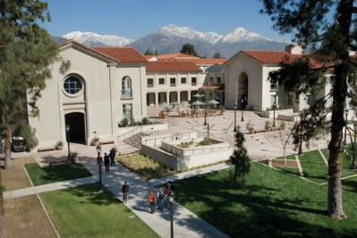
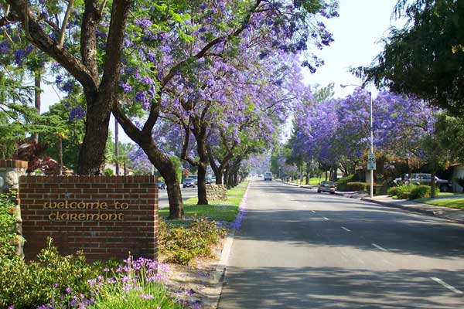
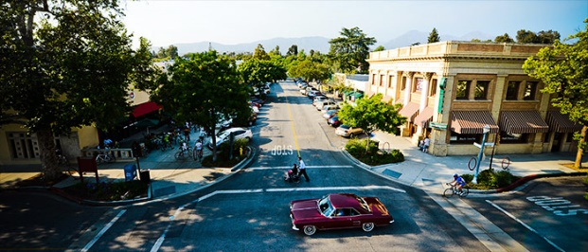
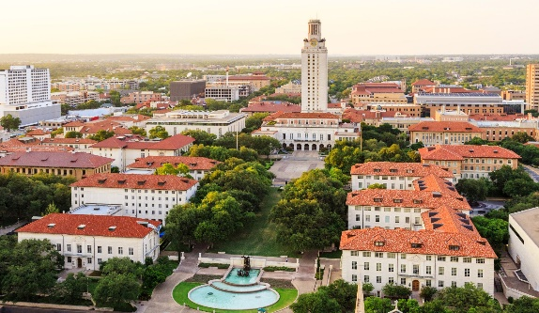

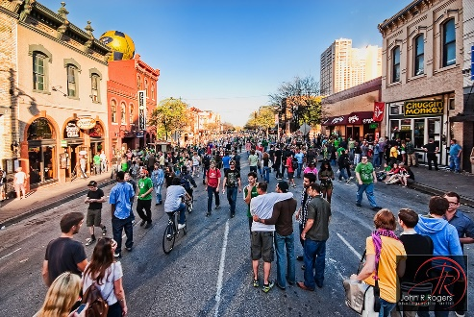
About the Instructor
Born 1985 in
Sofia, Bulgaria
Got BA in 2008 at
Pomona College, CA
(Computer Science &
Media Studies)
Got PhD in 2014
at University of
Texas at Austin
(Computer Vision)

Slide 3
Course Info
Course website: https://people.cs.pitt.edu/~kovashka/cs1678_sp21
Instructor: Adriana Kovashka (kovashka@cs.pitt.edu )
  → Use "CS1678" at the beginning of your Subject
Office: Same Zoom link
Class: Tue/Thu, 2:50pm-4:05pm
Office hours:
  Tue/Thu, 9am-11am, 1-2pm
TA: TBD
TA’s office: Zoom link TBD
TA’s office hours: TBD (Do Doodle by end of Jan. 24)
Notes:
Plan + website (4 min)
Introductions of students (10 min)
Intro to visual recognition (12 min)
Topics (12 min)
Structure of course (14 min)
Prereqs test (15 min)
Questions + extra (8 min)

Slide 4
Course Goals
To develop intuitions for machine learning techniques and challenges, in the context of deep neural networks
To learn the basic techniques, including the math behind basic neural network operations
To become familiar with advances/specialized neural frameworks (e.g. convolutional/recurrent/transformer)
To understand advantages/disadvantages of methods
To practice implementing and using these techniques for simple problems
To develop practical solutions for one real problem (course project)

Slide 5
Textbooks
Ian Goodfellow, Yoshua Bengio, Aaron Courville. Deep Learning. MIT Press, 2016. online version
Additional readings from papers
Important: Your notes from class are your best study material, slides are not complete with notes

Slide 6
Programming Language/Frameworks
We’ll use Python, NumPy, and PyTorch
The TA will do a PyTorch tutorial

Slide 7
Computing Resources
Will use Google Colab (free) and cloud credits (for project)

Slide 8
Course Structure
Lectures
Three programming assignments
Course project (teams of 3-4)
  Proposal – early February
  Report 1 – early March
  Report 2 – late March
  Presentations – April (last three classes)
Quizzes (daily)
Participation

Slide 9
Tips for a successful project
From your perspective:
  Learn something
  Try something out for a real problem
  Reminder: sample list of project ideas on Canvas

Slide 10
Tips for a successful project
From your classmates’ perspective:
  Hear about a niche of DL we haven’t covered, or learn about a niche of DL in more depth
  Hear about challenges and how you handled them, that they can use in their own work
  Listen to an engaging presentation on a topic they care about

Slide 11
Tips for a successful project
From my perspective:
  Hear about the creative solutions you came up with to handle challenges
  Hear your perspective on a topic that I care about
  Co-author a publication with you, potentially with a small amount of follow-up work – a really good deal, and looks good on your CV!

Slide 12
Tips for a successful project
Summary
  Don’t reinvent the wheel – your audience will be bored
  But it’s ok to adapt an existing method to a new domain/problem…
  If you show interesting experimental results…
  You analyze them and present them in a clear and engaging fashion

Slide 13
Policies and Schedule
See course website!

Slide 14
Should I take this class?
It will be a lot of work!
  I expect you’ll spend 6-8 hours on homework or the project each week
  But you will learn a lot
Some parts will be hard and require that you pay close attention!
  Quizzes help ensure we’re on the same page
  Use instructor’s and TA’s office hours!

Slide 15
Zoom Etiquette
Please turn your camera on
Please send me email if you are unable to do so and explain the reason

Slide 16
Your Homework
Read entire course website
Fill out Doodle for TA’s office hours
Sign up for Piazza
Do first reading
Go through NumPy tutorial

Slide 17
Questions?

Slide 18
Plan for Today
Blitz introductions
What is deep learning
  Example problems and challenges
Machine Learning overview
  ML framework
  Linear classifiers
  Elements of a ML algorithm
  Evaluation and generalization
Review: Linear algebra and calculus

Slide 19
Blitz introductions (10 sec)
What is your name?
What one thing outside of school are you passionate about?
What do you hope to get out of this class?
Every time you speak, please remind me your name

Slide 20
What is deep learning?
One approach to finding patterns and relationships in data
Finding the right representations of the data, that enable correct automatic performance of a given task
Examples: Learn to predict the category (label) of an image, learn to translate between languages

Slide 21
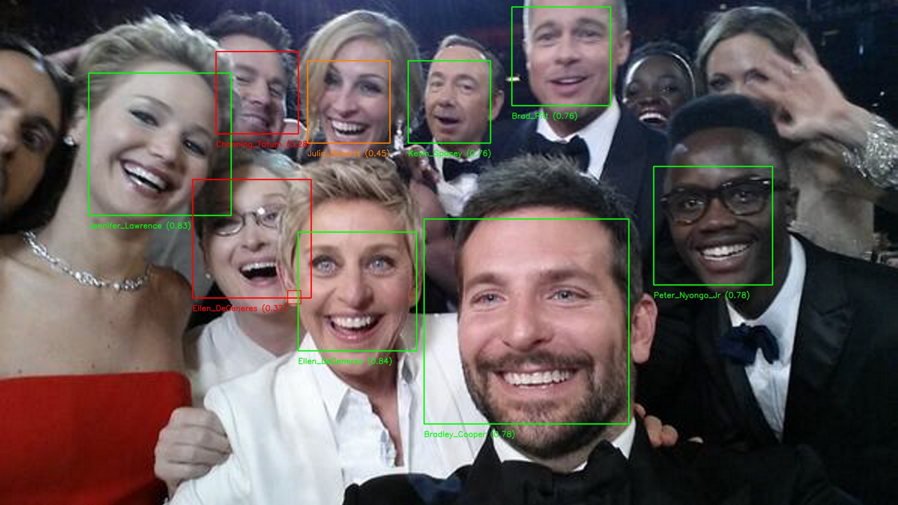
Example deep learning tasks
Face recognition
https://towardsdatascience.com/an-intro-to-deep-learning-for-face-recognition-aa8dfbbc51fb

Slide 22

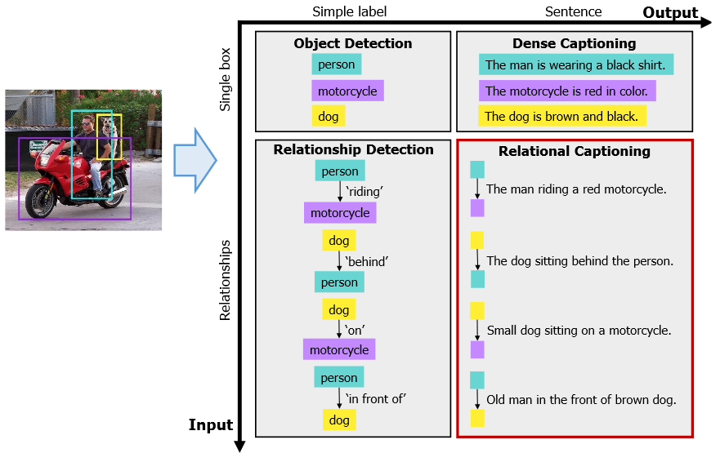
Example deep learning tasks
Image captioning
http://openaccess.thecvf.com/content_CVPR_2019/papers/Guo_MSCap_Multi-Style_Image_Captioning_With_Unpaired_Stylized_Text_CVPR_2019_paper.pdf
http://openaccess.thecvf.com/content_CVPR_2019/papers/Kim_Dense_Relational_Captioning_Triple-Stream_Networks_for_Relationship-Based_Captioning_CVPR_2019_paper.pdf

Slide 23
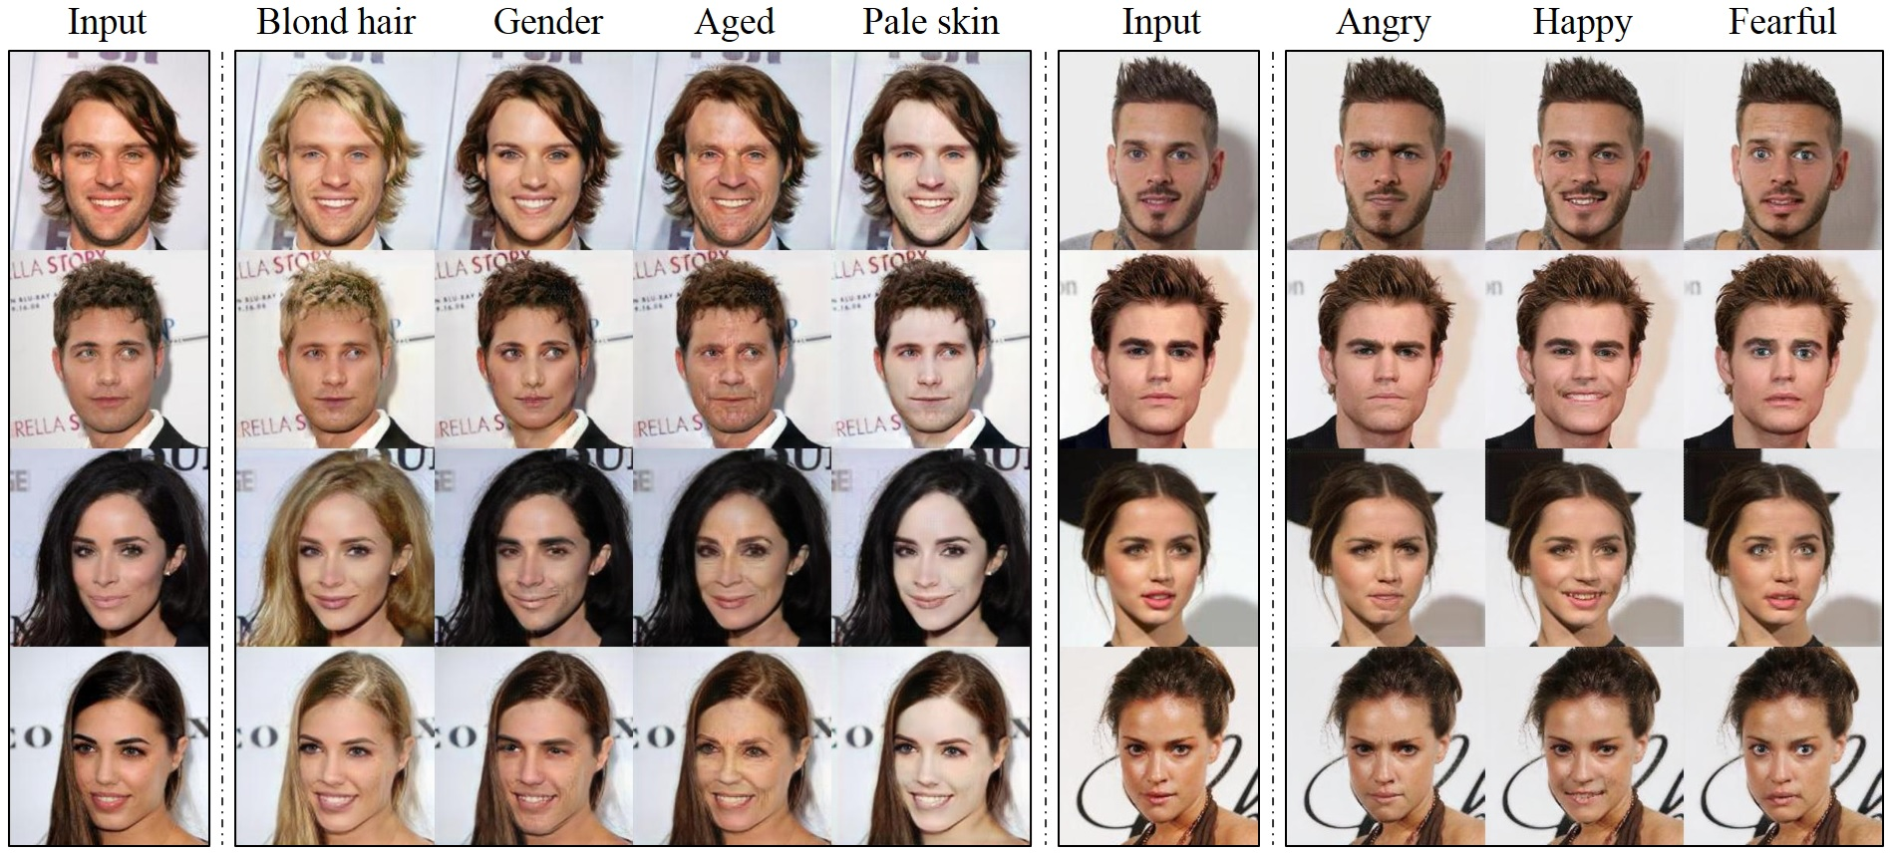
Example deep learning tasks
Image generation
Choi et al., “StarGAN: Unified Generative Adversarial Networks for Multi-Domain Image-to-Image Translation”, CVPR 2018

Slide 24

Example deep learning tasks
Fake news generation
https://www.youtube.com/watch?v=-QvIX3cY4lc

Slide 25
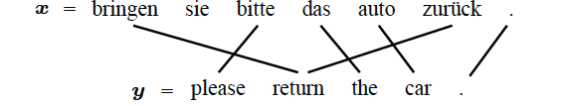
Example deep learning tasks
Machine translation
Slide credit: Carlos Guestrin

Slide 26

Example deep learning tasks
Speech recognition
Slide credit: Carlos Guestrin

Slide 27
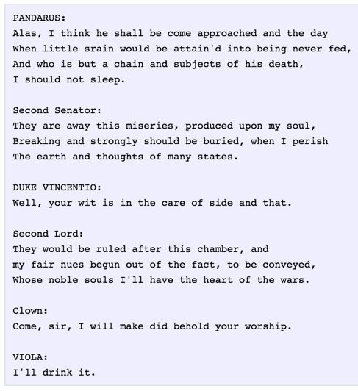
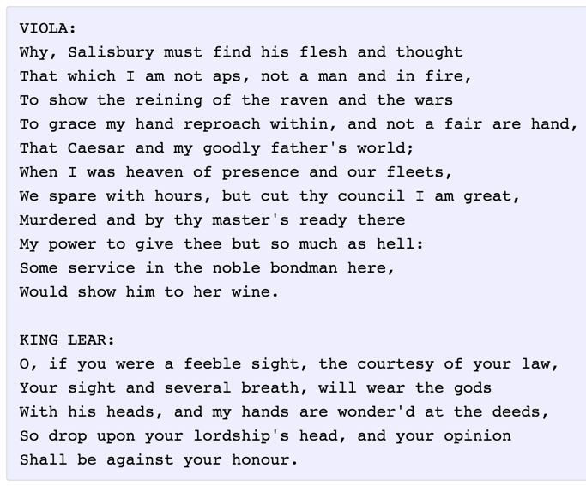
Example deep learning tasks
Text generation
Andrej Karpathy

Slide 28

Example deep learning tasks
Fake news generation and detection
https://grover.allenai.org/detect

Slide 29
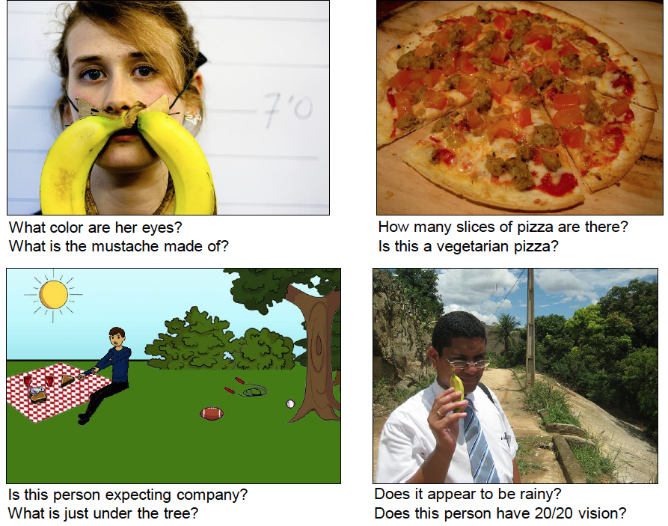
Example deep learning tasks
Question answering
Agrawal et al., “VQA: Visual Question Answering”, ICCV 2015

Slide 30

https://visualcommonsense.com/

Slide 31
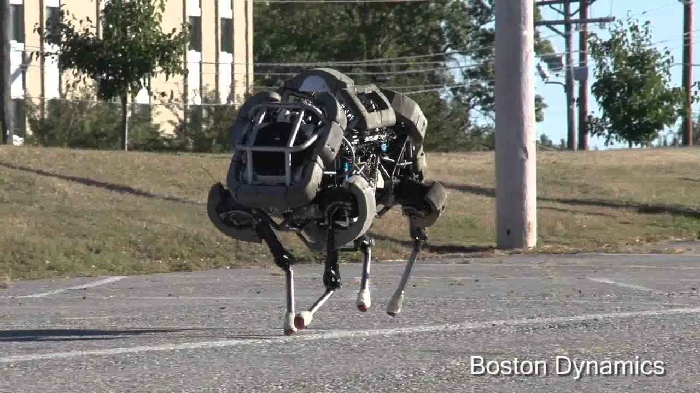
Example deep learning tasks
Robotic pets
https://www.youtube.com/watch?v=wE3fmFTtP9g

Slide 32
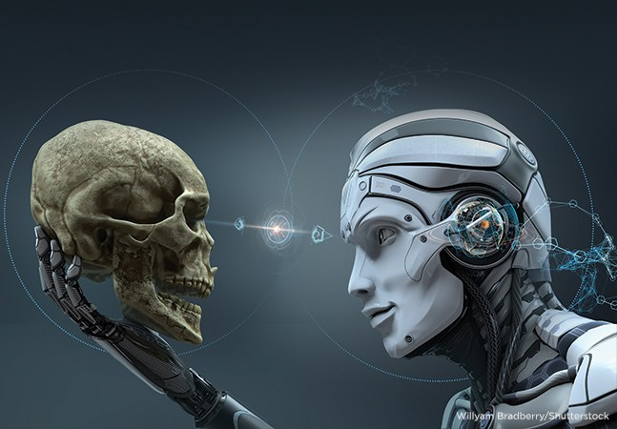
Example deep learning tasks
Artificial general intelligence???
https://www.dailymail.co.uk/sciencetech/article-5287647/Humans-robot-second-self.html

Slide 33
Example deep learning tasks
Why are these tasks challenging?
What are some problems from everyday life that can be helped by deep learning?
What are some ethical concerns about using deep learning?

Slide 34
Klingon vs Mlingon Classification
Training Data
  Klingon: klix, kour, koop
  Mlingon: moo, maa, mou
Testing Data: kap
Which language? Why?
Slide credit: Dhruv Batra

Slide 35
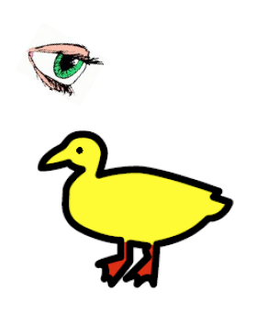
“I saw her duck”
Slide credit: Dhruv Batra, figure credit: Liang Huang

Slide 36

“I saw her duck”
Slide credit: Dhruv Batra, figure credit: Liang Huang

Slide 37
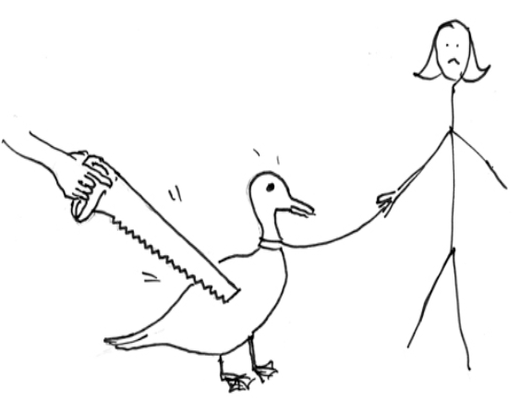
“I saw her duck”
Slide credit: Dhruv Batra, figure credit: Liang Huang

Slide 38
“I saw her duck with a telescope…”
Slide credit: Dhruv Batra, figure credit: Liang Huang

Slide 39

What humans see
Slide credit: Larry Zitnick

Slide 40
What computers see
243 | 239 | 240 | 225 | 206 | 185 | 188 | 218 | 211 | 206 | 216 | 225
242 | 239 | 218 | 110 | 67 | 31 | 34 | 152 | 213 | 206 | 208 | 221
243 | 242 | 123 | 58 | 94 | 82 | 132 | 77 | 108 | 208 | 208 | 215
235 | 217 | 115 | 212 | 243 | 236 | 247 | 139 | 91 | 209 | 208 | 211
233 | 208 | 131 | 222 | 219 | 226 | 196 | 114 | 74 | 208 | 213 | 214
232 | 217 | 131 | 116 | 77 | 150 | 69 | 56 | 52 | 201 | 228 | 223
232 | 232 | 182 | 186 | 184 | 179 | 159 | 123 | 93 | 232 | 235 | 235
232 | 236 | 201 | 154 | 216 | 133 | 129 | 81 | 175 | 252 | 241 | 240
235 | 238 | 230 | 128 | 172 | 138 | 65 | 63 | 234 | 249 | 241 | 245
237 | 236 | 247 | 143 | 59 | 78 | 10 | 94 | 255 | 248 | 247 | 251
234 | 237 | 245 | 193 | 55 | 33 | 115 | 144 | 213 | 255 | 253 | 251
248 | 245 | 161 | 128 | 149 | 109 | 138 | 65 | 47 | 156 | 239 | 255
190 | 107 | 39 | 102 | 94 | 73 | 114 | 58 | 17 | 7 | 51 | 137
23 | 32 | 33 | 148 | 168 | 203 | 179 | 43 | 27 | 17 | 12 | 8
17 | 26 | 12 | 160 | 255 | 255 | 109 | 22 | 26 | 19 | 35 | 24
Slide credit: Larry Zitnick

Slide 41
Challenges
Some challenges: ambiguity and context
Machines take data representations too literally
Humans are much better than machines at generalization, which is needed since test data will rarely look exactly like the training data

Slide 42
Machine Learning Overview
Deep learning is a specific group of algorithms falling in the broader realm of machine learning
All ML/DL algorithms roughly match schema:
  Learn a mapping from input to output f: x → y
  x: image, text, etc.
  y: {cat, notcat}, {1, 1.5, 2, …}, etc.
  f: this is where the magic happens

Slide 43
Machine Learning Overview
y' = f(x)
Training: given a training set of labeled examples {(x₁,y₁), …, (x_{N},y_{N})}, estimate the prediction function f by minimizing the prediction error on the training set
Testing: apply f to a never before seen test example x and output the predicted value y’ = f(x)
output
prediction function
input
Slide credit: L. Lazebnik

Slide 44
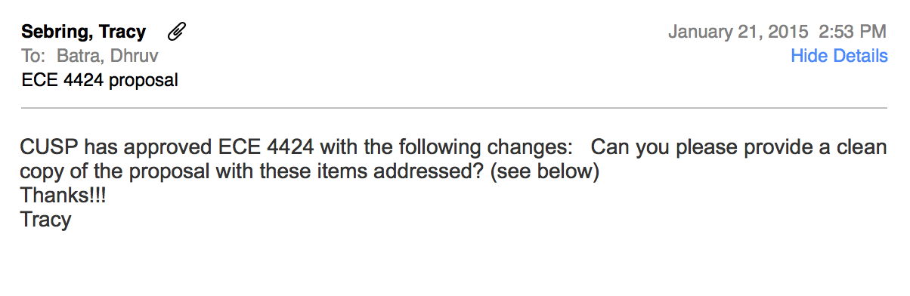
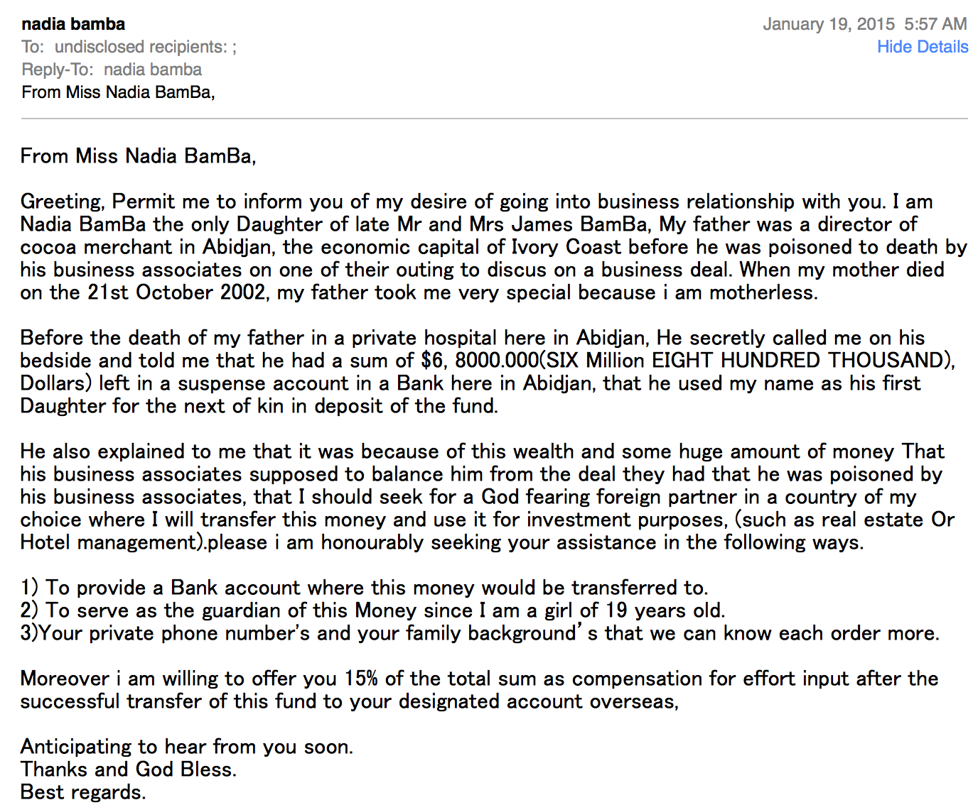
Machine Learning Overview
Example:
  Predict whether an email is spam or not:
vs
Figures from Dhruv Batra

Slide 45
Machine Learning Overview
Example:
  Predict whether an email is spam or not.
  x = words in the email, one-hot representation of size |V|x1, where V is the full vocabulary and x(j) = 1 iff word j is mentioned
  y = 1 (if spam) or 0 (if not spam)
  y’ = f(x) = w^{T} x
    w is a vector of the same size as x
    One weight per dimension of x (i.e. one weight per word)
    Weight can be positive, zero, negative…
    What might these weights look like?

Slide 46
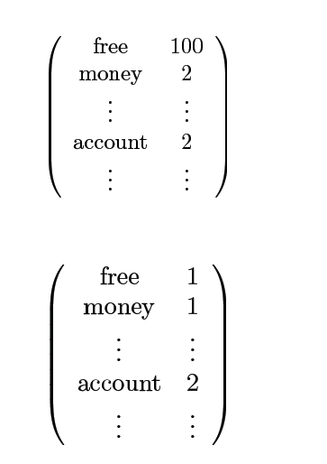

Simple strategy: Let’s count!
This is X
This is Y
= 1 оr 0?
Adapted from Dhruv Batra, Fei Sha

Slide 47
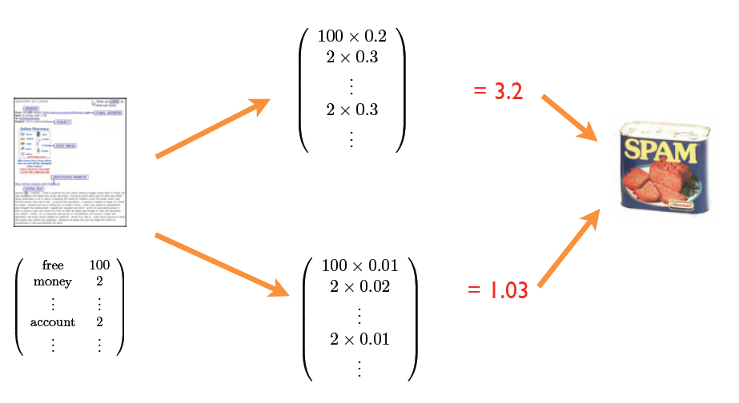
Weigh counts and sum to get prediction
Where do the weights come from?
This is a linear classifier
Adapted from Dhruv Batra, Fei Sha

Slide 48



Machine Learning Overview
Example:
  Apply a prediction function to an image to get the desired label output:
f( ) = “apple”
f( ) = “tomato”
f( ) = “cow”
Slide credit: L. Lazebnik

Slide 49
Machine Learning Overview
Example:
  x = pixels of the image (concatenated to form a vector)
  y = integer (1 = apple, 2 = tomato, etc.)
  y’ = f(x) = w^{T} x
    w is a vector of the same size as x
    One weight per each dimension of x (i.e. one weight per pixel)

Slide 50
Linear classifier
Find a linear function to separate the classes
f(x) = sgn(w₁x₁ + w₂x₂ + … + w_{D}x_{D}) = sgn(w ⋅ x)
Slide credit: L. Lazebnik

Slide 51
Linear classifier
Decision = sign(w^{T}x) = sign(w1*x1 + w2*x2)
x2
w
x1
(0, 0)
(1, 0)
What should the weights be?

Slide 52
Lines in R²
Let
distance from point to line
Kristen Grauman

Slide 53
Linear classifiers
Find linear function to separate positive and negative examples
Which line
is best?
C. Burges, A Tutorial on Support Vector Machines for Pattern Recognition, Data Mining and Knowledge Discovery, 1998

Slide 54
Support vector machines
Discriminative classifier based on optimal separating line (for 2d case)
Maximize the margin between the positive and negative training examples
C. Burges, A Tutorial on Support Vector Machines for Pattern Recognition, Data Mining and Knowledge Discovery, 1998

Slide 55
Support vector machines
Want line that maximizes the margin.
wx+b=1
wx+b=0
wx+b=-1
For support, vectors,
Distance between point and line:
For support vectors:
Support vectors
Margin
C. Burges, A Tutorial on Support Vector Machines for Pattern Recognition, Data Mining and Knowledge Discovery, 1998

Slide 56
Finding the maximum margin line
Maximize margin 2/||w||
Correctly classify all training data points:
Quadratic optimization problem:
Minimize
Subject to y_{i}(w·x_{i}+b) ≥ 1
One constraint for each training point.
Note sign trick.
C. Burges, A Tutorial on Support Vector Machines for Pattern Recognition, Data Mining and Knowledge Discovery, 1998

Slide 57
Finding the maximum margin line
Solution:
b = y_{i} – w·x_{i} (for any support vector)
Classification function:
Notice that it relies on an inner product between the test point x and the support vectors x_{i}
(Solving the optimization problem also involves computing the inner products x_{i} · x_{j} between all pairs of training points)
If f(x) < 0, classify as negative, otherwise classify as positive.
C. Burges, A Tutorial on Support Vector Machines for Pattern Recognition, Data Mining and Knowledge Discovery, 1998

Slide 58
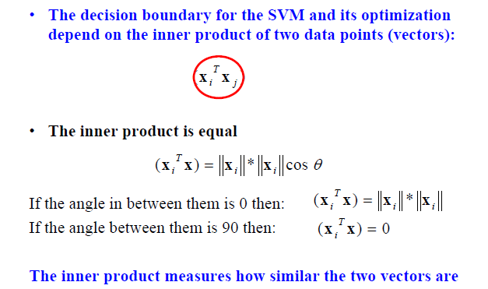
Inner product
Adapted from Milos Hauskrecht

Slide 59
Nonlinear SVMs
Datasets that are linearly separable work out great:
But what if the dataset is just too hard?
We can map it to a higher-dimensional space:
0
x
0
x
x²
0
x
Andrew Moore

Slide 60
Nonlinear SVMs
General idea: the original input space can always be mapped to some higher-dimensional feature space where the training set is separable:
Φ: x → φ(x)
Andrew Moore

Slide 61
Nonlinear kernel: Example
Consider the mapping
x²
Svetlana Lazebnik

Slide 62
The “Kernel Trick”
The linear classifier relies on dot product between vectors K(x_{i} , x_{j}) = x_{i} · x_{j}
If every data point is mapped into high-dimensional space via some transformation Φ: x_{i} → φ(x_{i} ), the dot product becomes: K(x_{i} , x_{j}) = φ(x_{i} ) · φ(x_{j})
A kernel function is similarity function that corresponds to an inner product in some expanded feature space
The kernel trick: instead of explicitly computing the lifting transformation φ(x), define a kernel function K such that: K(x_{i} , x_{j}) = φ(x_{i} ) · φ(x_{j})
Andrew Moore

Slide 63
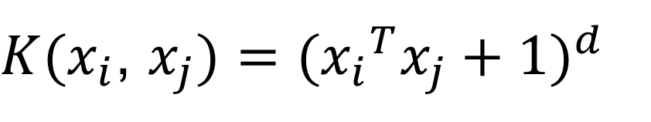
Examples of kernel functions
Linear:
Polynomials of degree up to d:
Gaussian RBF:
Histogram intersection:
$K(x_{i}$, $x_{j})={({x_{i}}^{T}x_{j}+1)}^{d}$
Andrew Moore / Carlos Guestrin

Slide 64
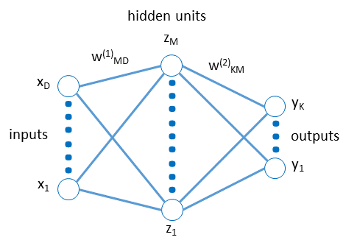
Deep Learning in a Nutshell
Input → network → outputs
Input X is raw (e.g. raw image,
one-hot representation of text)
Network extracts features: abstraction of input
Output is the labels Y
All parameters of the network trained by checking how well predicted/true Y agree, using labels in the training set

Slide 65
Elements of Machine Learning
Every machine learning algorithm has:
  Data representation (x, y)
  Problem representation (network)
  Evaluation / objective function
  Optimization (solve for parameters of network)
Adapted from Pedro Domingos

Slide 66
Data representation
Let’s brainstorm what our “X” should be for various “Y” prediction tasks…

Slide 67
Problem representation
Instances
Decision trees
Sets of rules / Logic programs
Support vector machines
Graphical models (Bayes/Markov nets)
Neural networks
Model ensembles
Etc.
Slide credit: Pedro Domingos

Slide 68
Evaluation / objective function
Accuracy
Precision and recall
Squared error
Likelihood
Posterior probability
Cost / Utility
Margin
Entropy
K-L divergence
Etc.
Slide credit: Pedro Domingos

Slide 69
Loss functions
Measure error
Can be defined for discrete or continuous outputs
E.g. if task is classification – could use cross-entropy loss
If task is regression – use L2 loss i.e. ||y-y’||

Slide 70
Optimization
Optimization means we need to solve for the parameters w of the model
For a (non-linear) neural network, there is no closed-form solution to solve for w; cannot set up linear system with w as the unknowns
Thus, optimization solutions look like this:
  Initialize w (e.g. randomly)
  Check error (ground-truth vs predicted labels on training set) under current model
  Use gradient (derivative) of error wrt w to update w
  Repeat from 2 until convergence

Slide 71
Types of Learning
Supervised learning
  Training data includes desired outputs
Unsupervised learning
  Training data does not include desired outputs
Weakly or Semi-supervised learning
  Training data includes a few desired outputs, or contains labels that only approximate the labels desired at test time
Reinforcement learning
  Rewards from sequence of actions
Adapted from: Dhruv Batra

Slide 72
Types of Prediction Tasks
Supervised Learning
x
Classification
y
Discrete
x
Regression
y
Continuous
Unsupervised Learning
x
Clustering
x'
Discrete ID
x
Dimensionality
Reduction
x'
Continuous
Adapted from Dhruv Batra

Slide 73
Validation strategies
Ultimately, for our application, what do we want?
  High accuracy on training data?
  No, high accuracy on unseen/new/test data!
  Why is this tricky?
Training data
  Features (x) and labels (y) used to learn mapping f
Test data
  Features used to make a prediction
  Labels only used to see how well we’ve learned f!!!
Validation data
  Held-out set of the training data
  Can use both features and labels to tune model hyperparameters
  Hyperparameters are “knobs” of the algorithm tuned by the designer: number of iterations for learning, learning rate, etc.
  We train multiple model (one per hyperparameter setting) and choose the best one, on the validation set

Slide 74
Validation strategies
BAD: Overfitting; e.g. in K-nearest neighbors, K = 1 always works perfectly on training data
Idea #1: Choose hyperparameters that work best on the data
Your Dataset
Idea #2: Split data into train and test, choose hyperparameters that work best on test data
BAD: No idea how algorithm will perform on new data; cheating
train
test
Idea #3: Split data into train, val, and test; choose hyperparameters on val and evaluate on test
Better!
train | validation | test
Adapted from Fei-Fei, Johnson, Yeung

Slide 75
Validation strategies
Your Dataset
Idea #4: Cross-Validation: Split data into folds, try each fold as validation and average the results
fold 1 | fold 2 | fold 3 | fold 4 | fold 5 | test
fold 1 | fold 2 | fold 3 | fold 4 | fold 5 | test
fold 1 | fold 2 | fold 3 | fold 4 | fold 5 | test
Useful for small datasets, but not used too frequently in deep learning
Adapted from Fei-Fei, Johnson, Yeung

Slide 76
Why do we hope this would work?
Statistical estimation view:
  x and y are random variables
  D = (x₁,y₁), (x₂,y₂), …, (x_{N},y_{N}) ~ P(X,Y)
  Both training & testing data sampled IID from P(X,Y)
    IID: Independent and Identically Distributed
  Learn on training set, have some hope of generalizing to test set
Adapted from Dhruv Batra

Slide 77
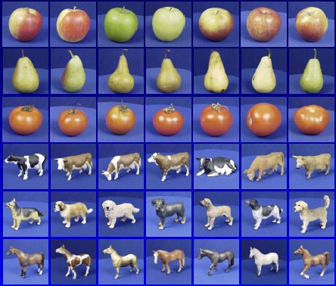

Generalization
Training set (labels known)
Test set (labels unknown)
How well does a learned model generalize from the data it was trained on to a new test set?
Slide credit: L. Lazebnik

Slide 78
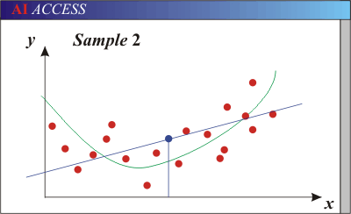
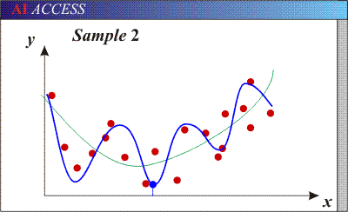
Generalization
Underfitting: Models with too few parameters are inaccurate because of a large bias (not enough flexibility).
Overfitting: Models with too many parameters are inaccurate because of a large variance (too much sensitivity to the sample).
Purple dots = possible test points
Red dots = training data (all that we see before we ship off our model!)
Green curve = true underlying model Blue curve = our predicted model/fit
Adapted from D. Hoiem

Slide 79
Generalization
Components of generalization error
  Noise in our observations: unavoidable
  Bias: due to inaccurate assumptions/simplifications by model
  Variance: models estimated from different training sets differ greatly rom each other
Underfitting: model is too “simple” to represent all the relevant class characteristics
  High bias and low variance
  High training error and high test error
Overfitting: model is too “complex” and fits irrelevant characteristics (noise) in the data
  Low bias and high variance
  Low training error and high test error
Slide credit: L. Lazebnik

Slide 80
Generalization
Dataset subset 1
Model 1
…
Variance
Dataset subset 2
Model 2
Dataset subset 3
Model 3
Dataset subset 4
Model 4
Dataset subset 5
Model 5
Average model
Bias
True model?

Slide 81
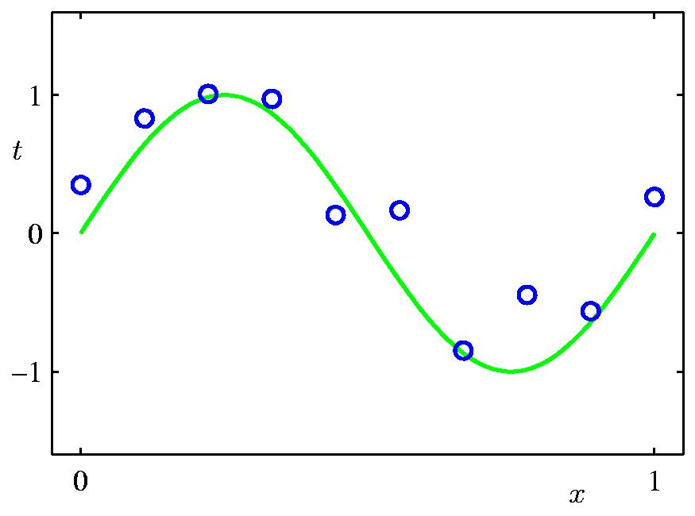
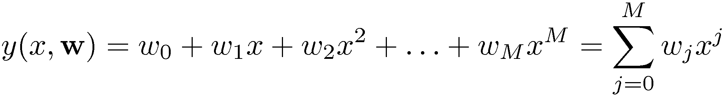
Polynomial Curve Fitting
Slide credit: Chris Bishop

Slide 82
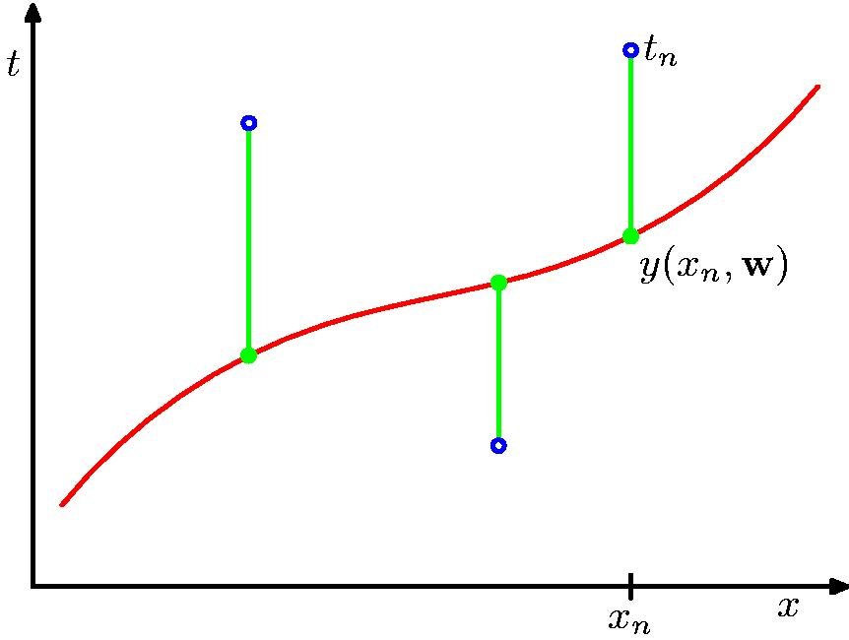
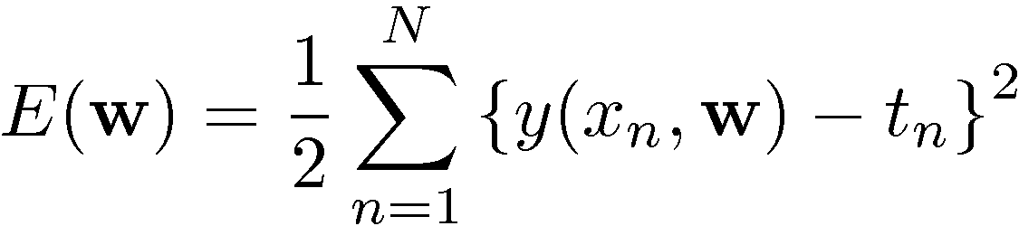
Sum-of-Squares Error Function
Slide credit: Chris Bishop

Slide 83
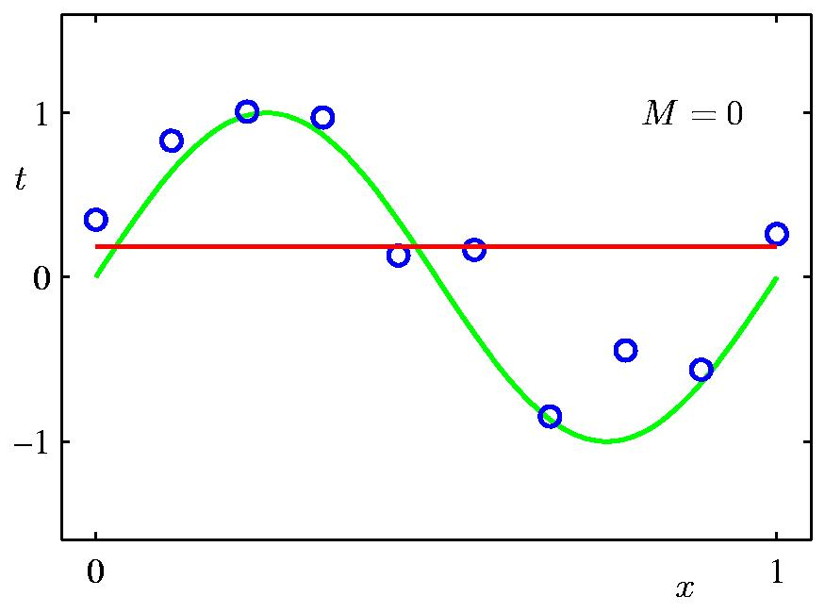
0th Order Polynomial
Slide credit: Chris Bishop

Slide 84
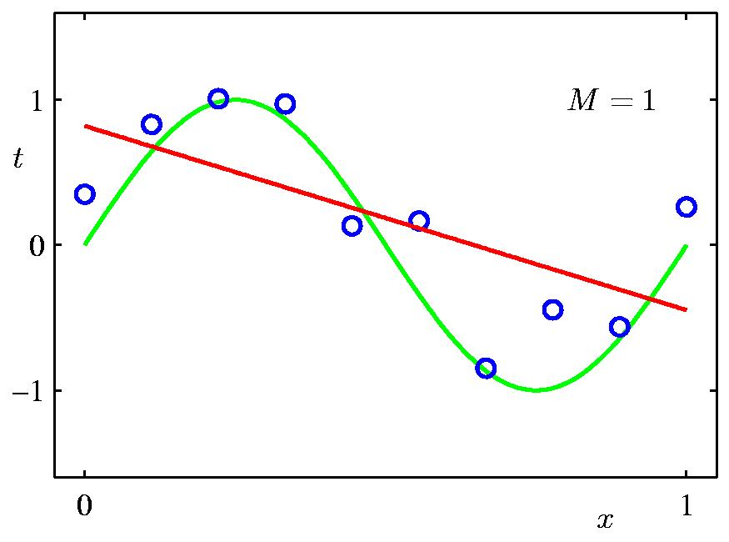
1st Order Polynomial
Slide credit: Chris Bishop

Slide 85
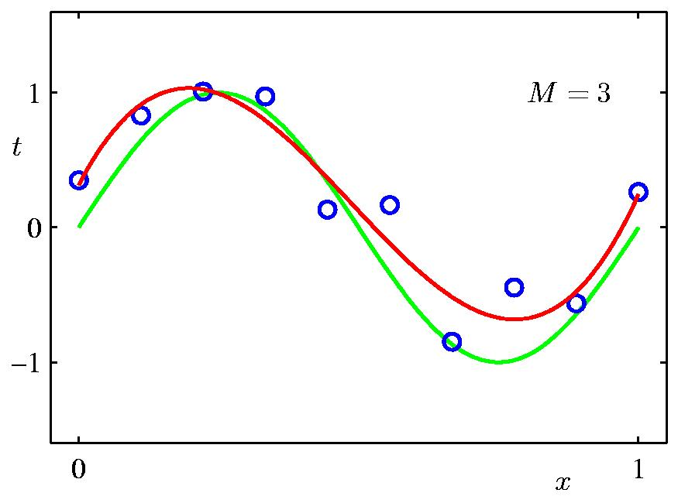
3rd Order Polynomial
Slide credit: Chris Bishop

Slide 86
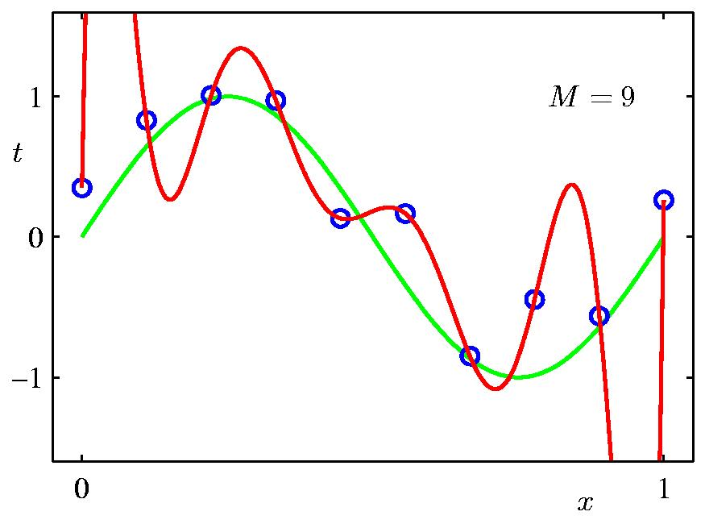
9th Order Polynomial
Slide credit: Chris Bishop

Slide 87
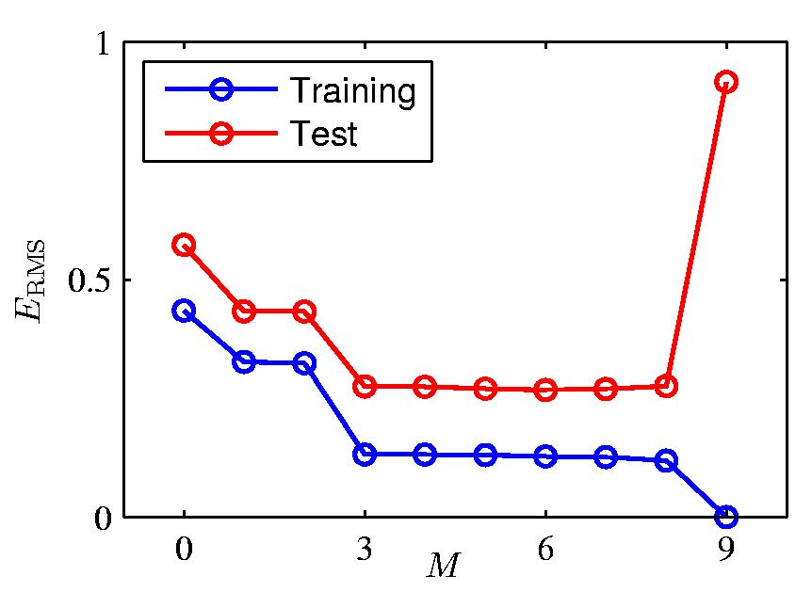
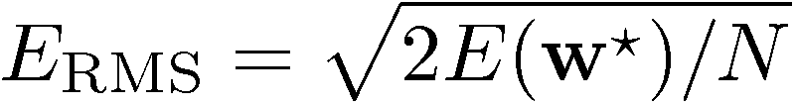
Over-fitting
Root-Mean-Square (RMS) Error:
Slide credit: Chris Bishop

Slide 88

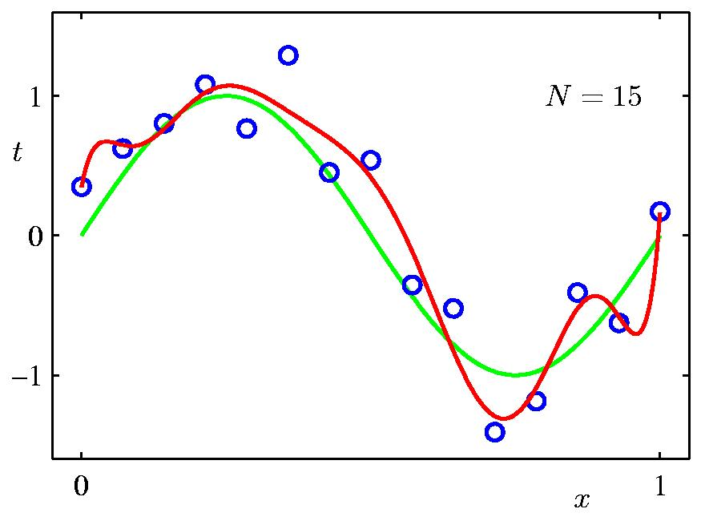
Data Set Size:
9th Order Polynomial
Slide credit: Chris Bishop

Slide 89

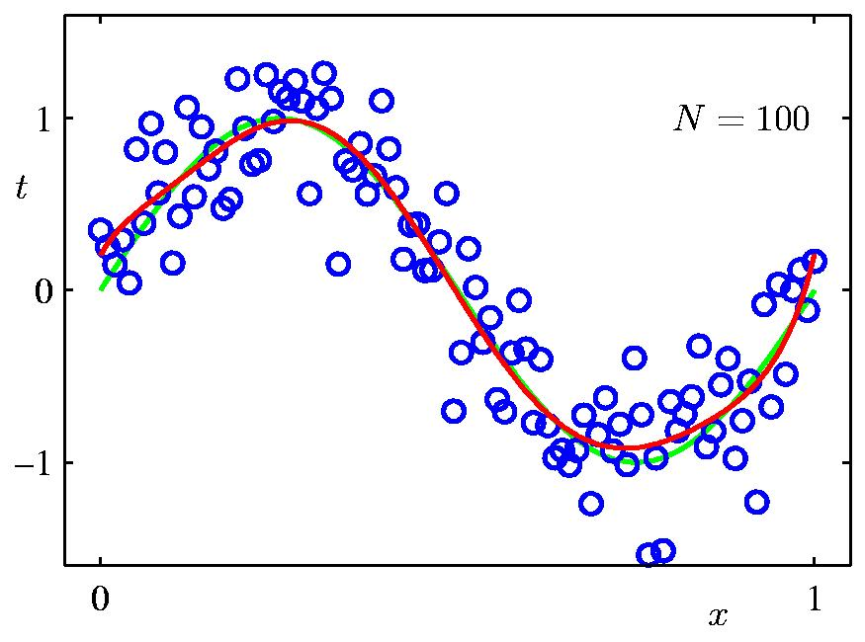
Data Set Size:
9th Order Polynomial
Slide credit: Chris Bishop

Slide 90
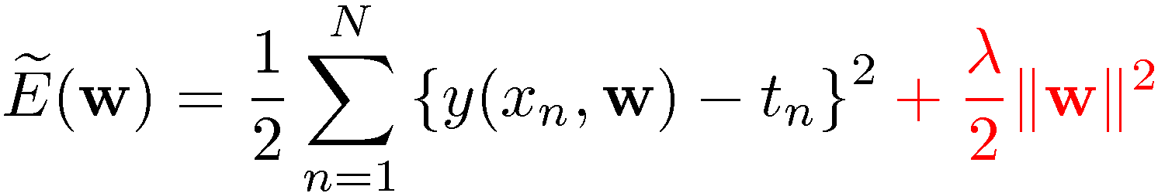
Regularization
Penalize large coefficient values
(Remember: We want to minimize this expression.)
Adapted from Chris Bishop

Slide 91

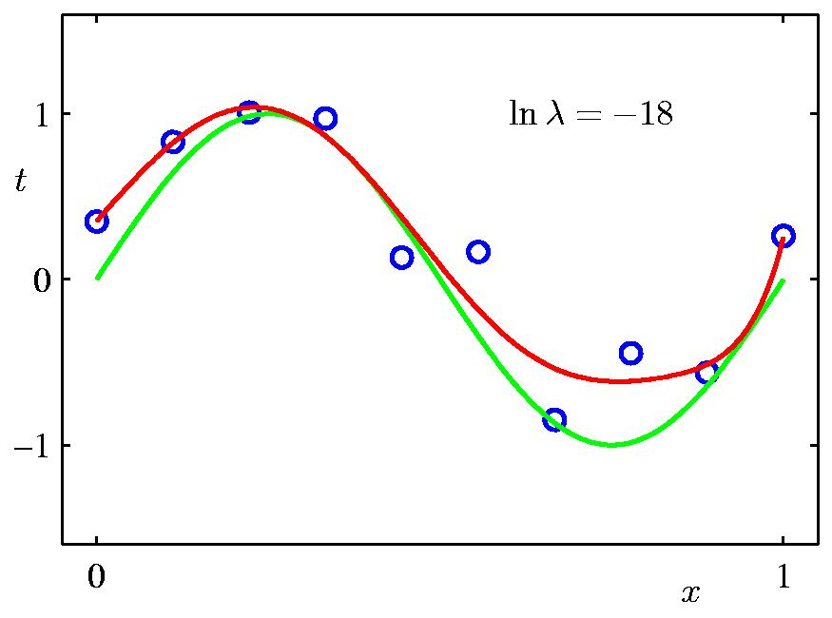
Regularization:
Slide credit: Chris Bishop

Slide 92

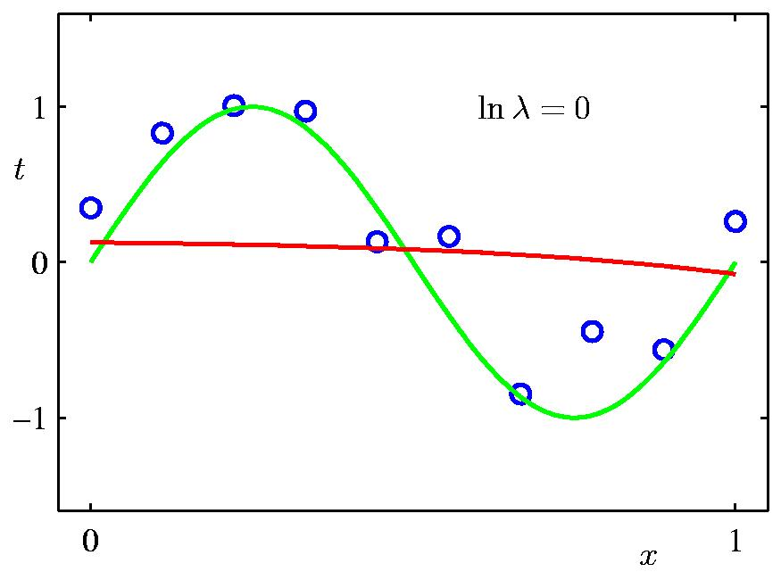
Regularization:
Slide credit: Chris Bishop

Slide 93
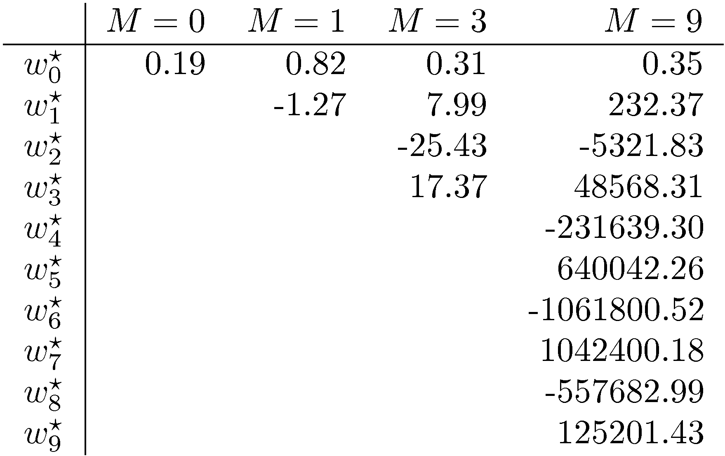
Polynomial Coefficients
Slide credit: Chris Bishop

Slide 94
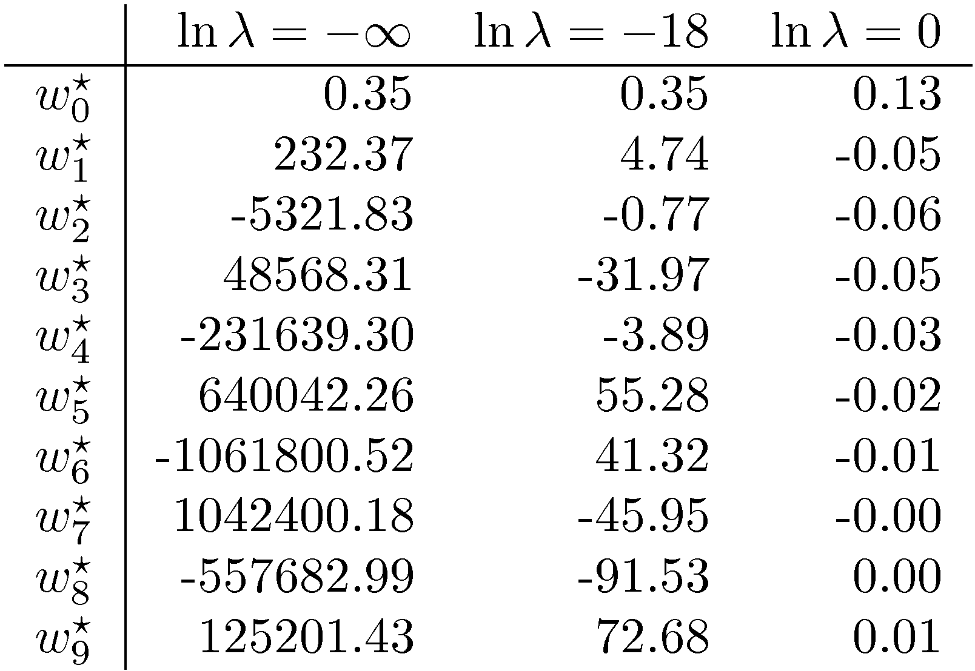
Polynomial Coefficients
No regularization Huge regularization
Adapted from Chris Bishop

Slide 95


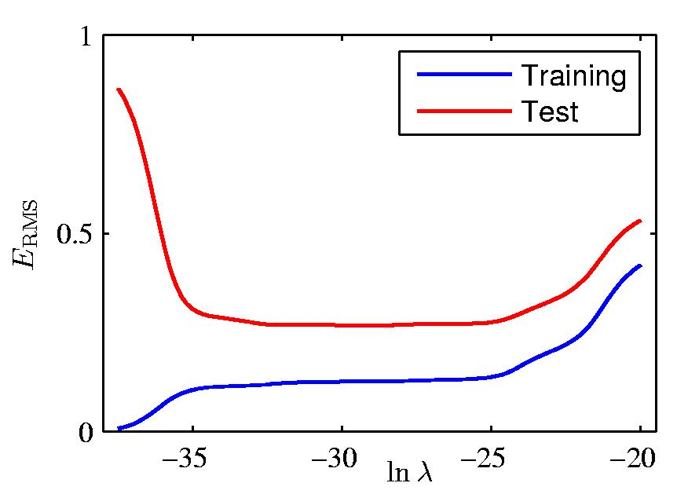
Regularization: vs.
Slide credit: Chris Bishop

Slide 96
Training vs test error
Underfitting
Overfitting
Error
Test error
Training error
High Bias
Low Variance
Complexity
Low Bias
High Variance
Slide credit: D. Hoiem

Slide 97
The effect of training set size
Few training examples
Test Error
Many training examples
High Bias
Low Variance
Complexity
Low Bias
High Variance
Slide credit: D. Hoiem
Notes:
Note: these figures don’t work in pdf

Slide 98
Choosing the trade-off between bias and variance
Need validation set (separate from the test set)
Apply this model to test set
Validation error
Error
Training error
High Bias
Low Variance
Complexity
Low Bias
High Variance
Slide credit: D. Hoiem

Slide 99
Summary of generalization
Try simple classifiers first
Better to have smart features and simple classifiers than simple features and smart classifiers
Use increasingly powerful classifiers with more training data
As an additional technique for reducing variance, try regularizing the parameters
Slide credit: D. Hoiem
Notes:
You can only get generalization through assumptions.

Slide 100
Linear algebra review
See http://cs229.stanford.edu/section/cs229-linalg.pdf for more

Slide 101
Vectors and Matrices
Vectors and matrices are just collections of ordered numbers that represent something: movements in space, scaling factors, word counts, movie ratings, pixel brightnesses, etc.
We’ll define some common uses and standard operations on them.

Slide 102
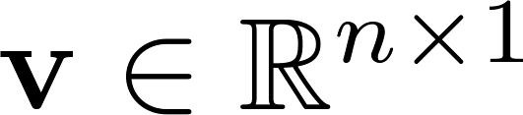
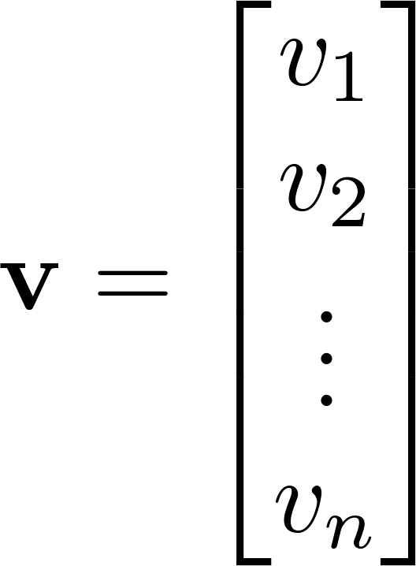
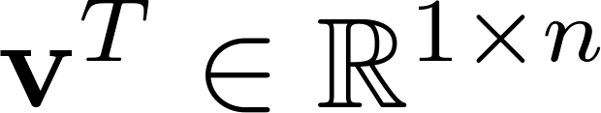
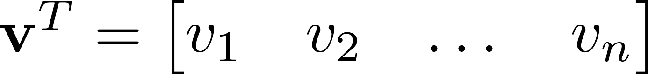

Vector
A column vector where
A row vector where
denotes the transpose operation
You need to keep track of orientation

Slide 103
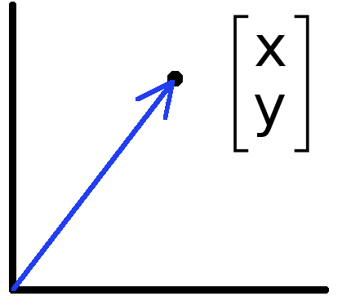
Vectors have two main uses
Data can also be treated as a vector
Such vectors don’t have a geometric interpretation, but calculations like “distance” still have value
Vectors can represent an offset in 2D or 3D space
Points are just vectors from the origin

Slide 104
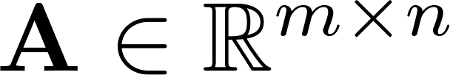




Matrix
A matrix is an array of numbers with size $m↓$ by $n→$, i.e. m rows and n columns.
If , we say that is square.

Slide 105



Matrix Operations
Addition
  Can only add a matrix with matching dimensions, or a scalar.
Scaling

Slide 106
Inner vs outer vs matrix vs element-wise product
x, y = column vectors (nx1)
X, Y = matrices (mxn)
x, y = scalars (1x1)
x · y = x^{T} y = inner product (1xn x nx1 = scalar)
x ⊗ y = x y^{T} = outer product (nx1 x 1xn = matrix)
X * Y = matrix product
  Watch out: could also be element-wise product in NumPy, if class is array rather than matrix– see tutorial

Slide 107


Inner Product
Multiply corresponding entries of two vectors and add up the result
x·y is also |x||y|Cos( angle between x and y )
If B is a unit vector, then A·B gives the length of A which lies in the direction of B (projection)
(if B is unit-length hence norm is 1)

Slide 108
Matrix Multiplication
Let X be an axb matrix, Y be an bxc matrix
Then Z = X*Y is an axc matrix
Second dimension of first matrix, and first dimension of second matrix have to be the same, for matrix multiplication to be possible
Practice: Let X be an 10x5 matrix. Let’s factorize it into 3 matrices…

Slide 109

Matrix Multiplication
The product AB is:
Each entry in the result is (that row of A) dot product with (that column of B)

Slide 110

Matrix Multiplication
Example:
  Each entry of the matrix product is made by taking the dot product of the corresponding row in the left matrix, with the corresponding column in the right one.

Slide 111
Matrix Operation Properties
Matrix addition is commutative and associative
  A + B = B + A
  A + (B + C) = (A + B) + C
Matrix multiplication is associative and distributive but not commutative
  A(B*C) = (A*B)C
  A(B + C) = A*B + A*C
  A*B != B*A

Slide 112



Matrix Operations
Transpose – flip matrix, so row 1 becomes column 1
A useful identity:

Slide 113

Inverse
Given a matrix A, its inverse A⁻¹ is a matrix such that AA⁻¹ = A⁻¹A = I
E.g.
Inverse does not always exist. If A⁻¹ exists, A is invertible or non-singular. Otherwise, it’s singular.

Slide 114


Special Matrices
Identity matrix I
  Square matrix, 1’s along diagonal, 0’s elsewhere
  I ∙ [another matrix] = [that matrix]
Diagonal matrix
  Square matrix with numbers along diagonal, 0’s elsewhere
  A diagonal ∙ [another matrix] scales the rows of that matrix

Slide 115


Special Matrices
Symmetric matrix

Slide 116



Norms
L1 norm
L2 norm
L^{p} norm (for real numbers p ≥ 1)

Slide 117


System of Linear Equations
MATLAB example // linalg.solve or lingalg.lstsq in Python
>> x = A\B
x =
1.0000
-0.5000

Slide 118
Matrix Rank
Column/row rank
Column rank always equals row rank
Matrix rank
If a matrix is not full rank, inverse doesn’t exist
  Inverse also doesn’t exist for non-square matrices

Slide 119
Linear independence
Suppose we have a set of vectors v₁, …, v_{n}
If we can express v₁ as a linear combination of the other vectors v₂…v_{n}, then v₁ is linearly dependent on the other vectors.
  The direction v₁ can be expressed as a combination of the directions v₂…v_{n}. (E.g. v₁ = .7 v₂ -.5 v₄)
If no vector is linearly dependent on the rest of the set, the set is linearly independent.
  Common case: a set of vectors v₁, …, v_{n} is always linearly independent if each vector is perpendicular to every other vector (and non-zero)

Slide 120
Linear independence
Linearly independent set
Not linearly independent

Slide 121
Singular Value Decomposition (SVD)
There are several computer algorithms that can “factor” a matrix, representing it as the product of some other matrices
The most useful of these is the Singular Value Decomposition
Represents any matrix A as a product of three matrices: UΣV^{T}

Slide 122

Singular Value Decomposition (SVD)
UΣV^{T} = A
Where U and V are rotation matrices, and Σ is a scaling matrix. For example:

Slide 123

Singular Value Decomposition (SVD)
In general, if A is m x n, then U will be m x m, Σ will be m x n, and V^{T} will be n x n.

Slide 124
Singular Value Decomposition (SVD)
U and V are always rotation matrices.
  Geometric rotation may not be an applicable concept, depending on the matrix. So we call them “unitary” matrices – each column is a unit vector.
Σ is a diagonal matrix
  The number of nonzero entries = rank of A
  The algorithm always sorts the entries high to low

Slide 125

Singular Value Decomposition (SVD)
M = UΣV^{T}
Illustration from Wikipedia

Slide 126
Calculus review

Slide 127
Differentiation
The derivative provides us information about the rate of change of a function.
The derivative of a function is also a function. Example:
The derivative of the rate function is the
acceleration function.
Texas A&M Dept of Statistics

Slide 128

Derivative = rate of change
Image: Wikipedia

Slide 129


Derivative = rate of change
Linear function y = mx + b
Slope
Image: Wikipedia

Slide 130
Ways to Write the Derivative
Given the function f(x), we can write its derivative in the following ways:
- f '(x)
- ^{d} f(x)
dx
The derivative of x is commonly written dx.
Texas A&M Dept of Statistics

Slide 131
Differentiation Formulas
The following are common differentiation formulas:
- The derivative of a constant is 0.
^{d} c = 0
du
- The derivative of a sum is the sum of the derivatives.
^{d} ( f (u) + g(u)) = f '(u) + g'(u)
du
Texas A&M Dept of Statistics

Slide 132
Examples
- The derivative of a constant is 0.
^{d} 7 =
du
- The derivative of a sum is the sum of the derivatives.
^{d} (t + 4) =
dt
Texas A&M Dept of Statistics

Slide 133
More Formulas
- The derivative of u to a constant power:
^{d} u^{n} = n *u^{n−1}du
du
- The derivative of e:
^{d} e^{u} = e^{u}du
du
- The derivative of log:
^{d} log(u) = ¹ du du u
Texas A&M Dept of Statistics

Slide 134
More Examples
- The derivative of u to a constant power:
^{d} 3x³ =
dx
The derivative of e:
^{d} _{e}4 y ₌
dy
The derivative of log:
^{d} 3log(x) =
dx
Texas A&M Dept of Statistics

Slide 135
Product and Quotient
The product rule and quotient rules are commonly used in differentiation.
- Product rule:
^{d} ( f (u)* g(u)) = f (u)g'(u) + g(u) f '(u)
du
- Quotient rule:
d ⎛ f (u) ⎞
g(u) f '(u) − f (u)g'(u)
⎜ ⎟ =
du ⎝ g(u) ⎠
(g(u))
2
Texas A&M Dept of Statistics

Slide 136
Chain Rule
The chain rule allows you to combine any of the differentiation rules we have already covered.
- First, do the derivative of the outside and then do the derivative of the inside.
d
f (g(u)) = f '(g(u))* g'(u)* du
du
Texas A&M Dept of Statistics

Slide 137
Try These
f (z) = z +11
s( y) = 4 ye^{2 y}
log(x² )
g( y) = 4 y³ + 2 y
p(x) =
x
h(x) = e^{3x}
q(z) = (e^{z} − z)³
Texas A&M Dept of Statistics

Slide 138
Solutions
f '(z) = 1
s'( y) = 8ye^{2 y}
4e^{2 y}
2 − log(x² )
p'(x) =
_{x}2
g'( y) = 12 y² + 2
h'(x) = 3e^{3x}
q'(z) = 3(e^{z} − z)² (e^{z} −1)
Texas A&M Dept of Statistics

Slide 139
Python/NumPy/SciPy http://cs231n.github.io/python-numpy-tutorial/ https://docs.scipy.org/doc/numpy/user/numpy-for-matlab-users.html
Go through at home, and ask TA if you need help.

