Slide 1
CS 1675: Intro to Machine Learning
Probabilistic Graphical Models
Prof. Adriana Kovashka
University of Pittsburgh
November 27, 2018

Slide 2
Plan for This Lecture
Motivation for probabilistic graphical models
Directed models: Bayesian networks
Undirected models: Markov random fields (briefly)
Directed models for sequence classification: Hidden Markov models

Slide 3
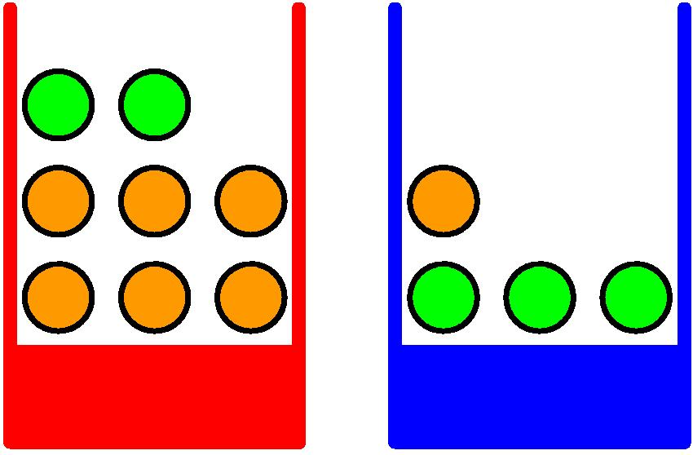
Probabilities: Example Use
Apples and Oranges
Chris Bishop

Slide 4
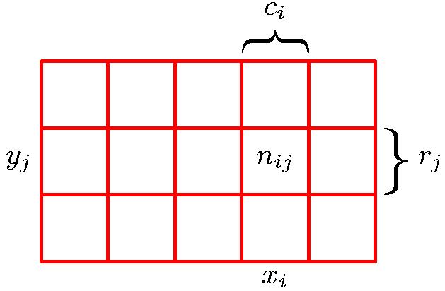
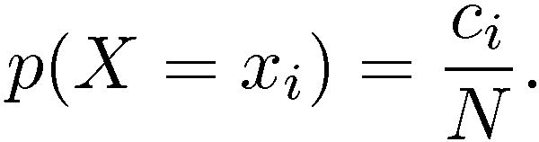
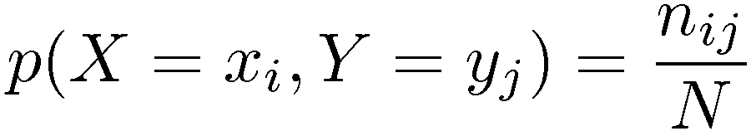
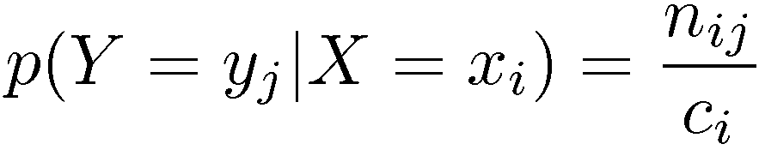
Marginal, Joint, Conditional
Marginal Probability
Conditional Probability
Joint Probability
Chris Bishop

Slide 5
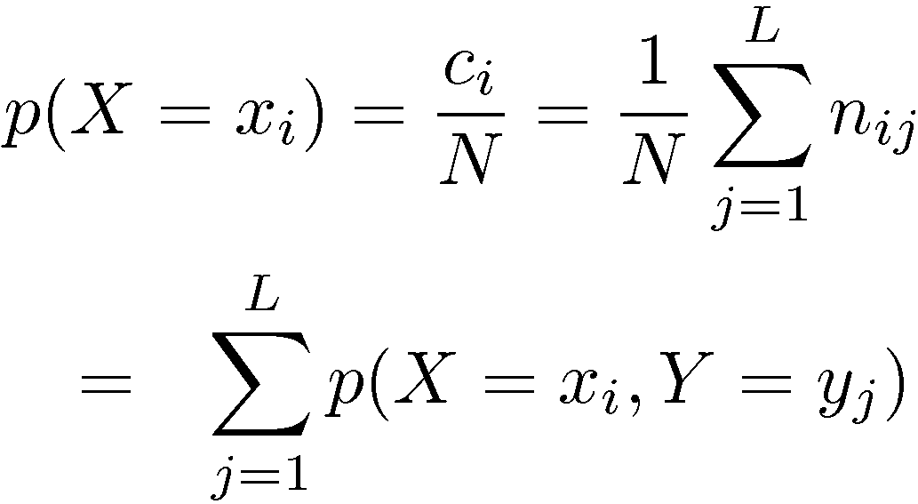
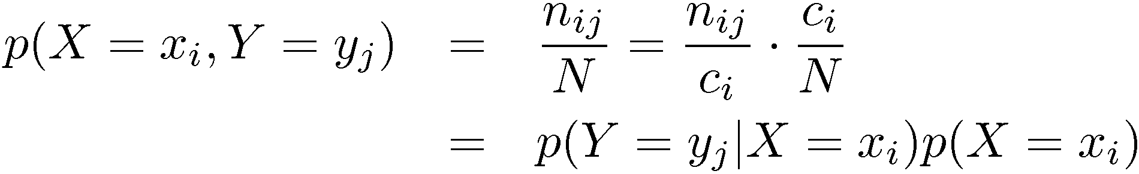
Sum and Product Rules
Sum Rule
Product Rule
Chris Bishop

Slide 6
Independence
Marginal: P satisfies (X ⊥ Y) if and only if
  P(X=x,Y=y) = P(X=x) P(Y=y), ∀x∈Val(X), y∈Val(Y)
Conditional: P satisfies (X ⊥ Y | Z) if and only if
  P(X,Y|Z) = P(X|Z) P(Y|Z), ∀x∈Val(X), y∈Val(Y), z∈Val(Z)
Dhruv Batra

Slide 7
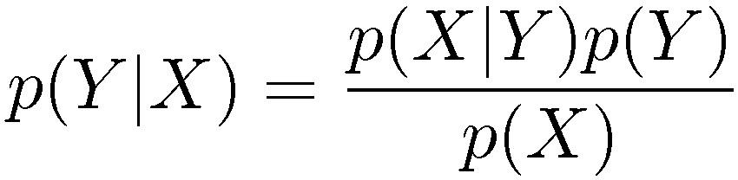
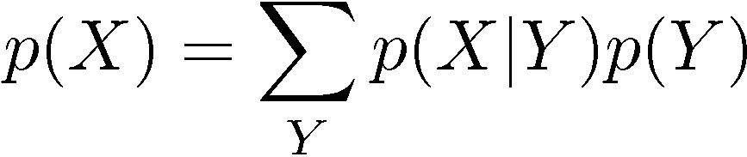
Bayes’ Theorem
Chris Bishop

Slide 8
Probabilistic Graphical Models
It is sometimes desirable to have not only a prediction y given features x, but a measure of confidence P(y|x)
Let x be a d-dim vector, each dim can take 2 values
For each such vector x, y=1 or y=0
We need statistics about how frequently y=1 occurs with each of 2^{d} possible feature vectors → 2^{d} parameters to estimate
Thus we require an unrealistic amount of data to estimate parameters (probabilities); graphical models allow simplifying assumptions

Slide 9
A simple alternative: Naïve Bayes
Assume all features are independent given the class i.e. P(x|y) = Π_{d} P(x_{d}|y)
Model P(x_{d}=1|y=1) and P(x_{d}=1|y=0), for all d → 2d parameters (as opposed to 2^{d})
Then use Bayes rule to compute P(y|x) = P(x|y) P(y) / Z = Π_{d} P(x_{d}|y) P(y) / Z
Where Z is a normalizing constant

Slide 10
Naïve Bayes example
jazz
Waking Life
Borat
Cinema Paradiso
Requiem for a Dream
If J=1 | Prob W=1 | Prob B=1 | Prob C=1 | Prob R=1
True | 0.8 | 0.2 | 0.7 | 0.5
False | 0.3 | 0.5 | 0.3 | 0.4

Slide 11
Advantages of Graphical Models
If no assumption of independence is made, must estimate an exponential number of parameters
If we assume all variables independent, efficient training and inference possible, but assumption too strong
Graphical models use graphs over random variables to specify variable dependencies (relationships)
  Allows for less restrictive independence assumptions while limiting the number of parameters that must be estimated
  Allows some interpretability
  Bayesian networks: Directed acyclic graphs indicate causal structure
  Markov networks: Undirected graphs capture general dependencies
Adapted from Ray Mooney

Slide 12
Bayesian Networks
Directed Acyclic Graph (DAG)
Nodes are random variables
Edges indicate causal influences
Burglary
Earthquake
Alarm
JohnCalls
MaryCalls
Ray Mooney

Slide 13
Conditional Probability Tables
Each node has a conditional probability table (CPT) that gives the probability of each of its values given every possible combination of values for its parents
  Roots of the DAG that have no parents are given prior probabilities
P(B)
.001
Burglary
Earthquake
P(E)
.002
B | E | P(A)
T | T | .95
T | F | .94
F | T | .29
F | F | .001
Alarm
A | P(J)
T | .90
F | .05
A | P(M)
T | .70
F | .01
JohnCalls
MaryCalls
Ray Mooney

Slide 14
Aside: Naïve Bayes version
Burglary
JohnCalls
Alarm
MaryCalls

Slide 15
CPT Comments
Probability of false not given since rows must add to 1
Example requires 10 parameters rather than 2⁵–1=31 for specifying the full joint distribution
Number of parameters in the CPT for a node is exponential in the number of parents
Ray Mooney

Slide 16
Bayes Net Inference
Given known values for some evidence variables, determine the posterior probability of some query variables
Example: Given that John calls, what is the probability that there is a Burglary?
???
Burglary
Earthquake
John calls 90% of the time there
is an Alarm and the Alarm detects
94% of Burglaries so people
generally think it should be fairly high.
However, this ignores the prior
probability of John calling.
Alarm
JohnCalls
MaryCalls
Ray Mooney

Slide 17
Bayes Net Inference
Example: Given that John calls, what is the probability that there is a Burglary?
???
P(B)
.001
John also calls 5% of the time when there
is no Alarm. So over 1,000 days we
expect 1 Burglary and John will probably call. However, he will also call with a false report 50 times on average. So the call is about 50 times more likely a false report: P(Burglary | JohnCalls) ≈ 0.02
Burglary
Earthquake
Alarm
JohnCalls
MaryCalls
A | P(J)
T | .90
F | .05
Ray Mooney

Slide 18
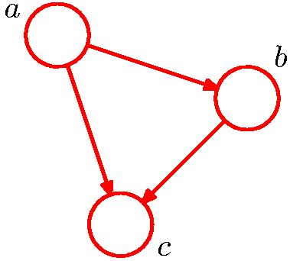
Bayes Nets (not yet useful)
No independence encoded
Chris Bishop

Slide 19
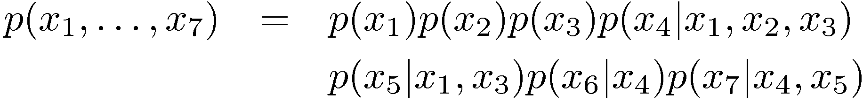
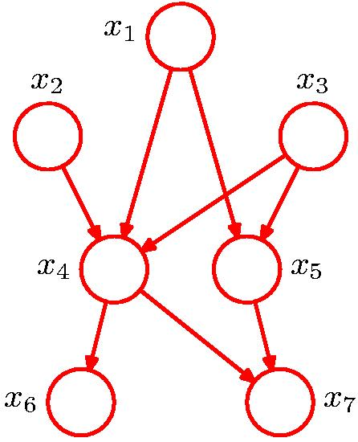
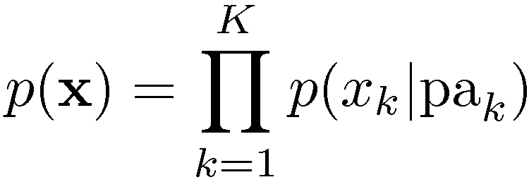
Bayes Nets (formulation)
More interesting: Some independences encoded
General Factorization
Chris Bishop

Slide 20

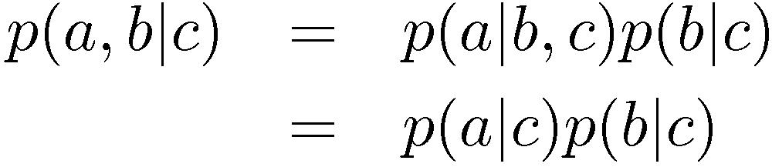

Conditional Independence
a is independent of b given c
Equivalently
Notation
Chris Bishop

Slide 21
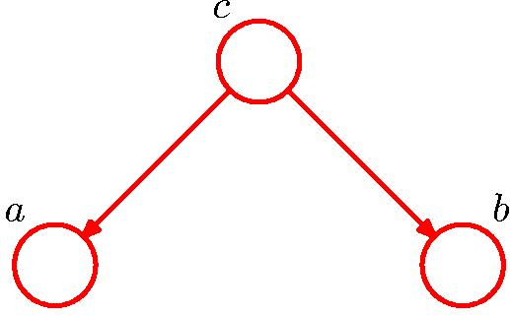
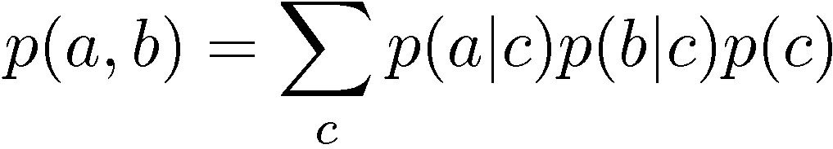

Conditional Independence: Example 1
Node c is “tail to tail” for path from a to b:
No independence of a and b follows from this path
Chris Bishop

Slide 22
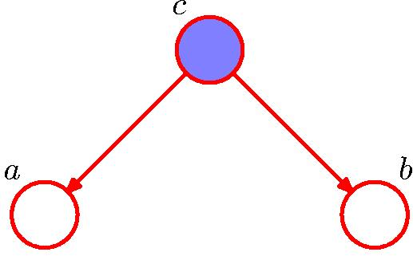
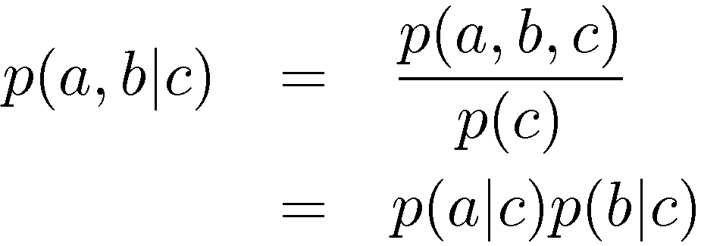
Conditional Independence: Example 1
Node c is “tail to tail” for path from a to b:
Observing c blocks the path thus making a and b conditionally independent
Chris Bishop

Slide 23
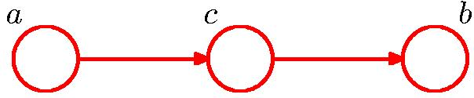
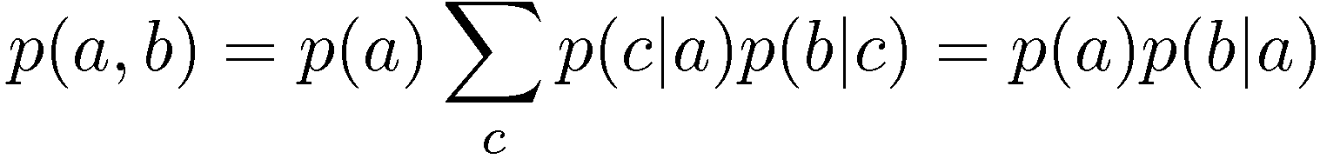
Conditional Independence: Example 2
Σ_{c} p(c|a) p(b|c) =
Σ_{c} p(c|a) p(b|c, a) = // next slide
Σ_{c} p(b, c|a) =
p(b|a)
Node c is “head to tail” for path from a to b:
No independence of a and b follows from this path
Chris Bishop

Slide 24
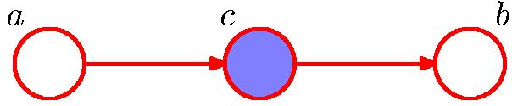
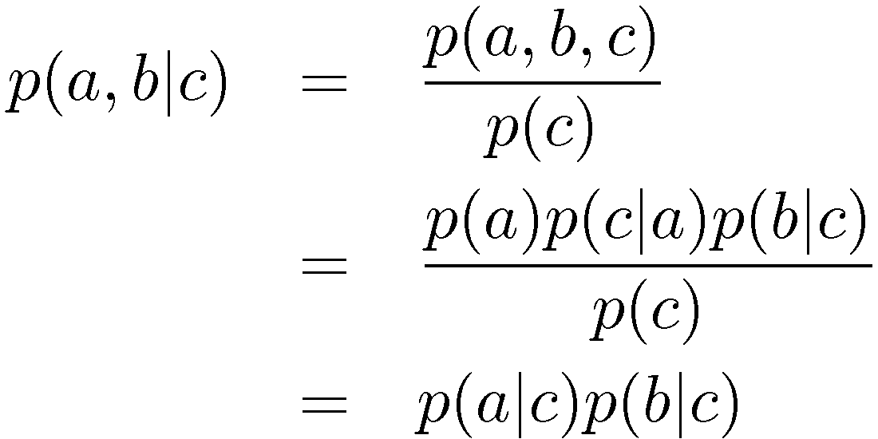
Conditional Independence: Example 2
Node c is “head to tail” for path from a to b:
Observing c blocks the path thus making a and b conditionally independent
Chris Bishop

Slide 25
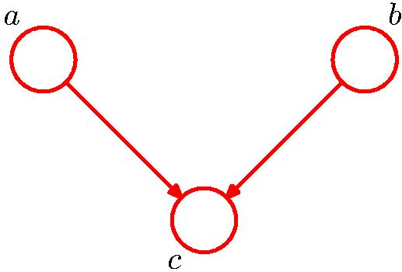


Conditional Independence: Example 3
Note: this is the opposite of Example 1, with c unobserved.
Node c is “head to head” for path from a to b:
Unobserved c blocks the path thus making a and b independent
Chris Bishop

Slide 26
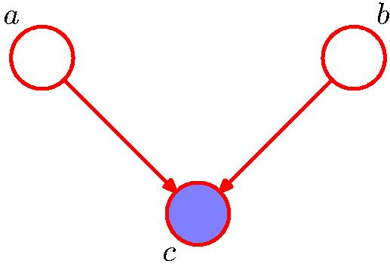
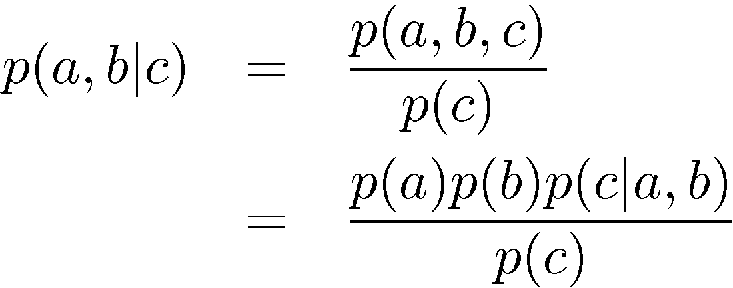

Conditional Independence: Example 3
Note: this is the opposite of Example 1, with c observed.
Node c is “head to head” for path from a to b:
Observing c unblocks the path thus making a and b conditionally dependent
Chris Bishop

Slide 27
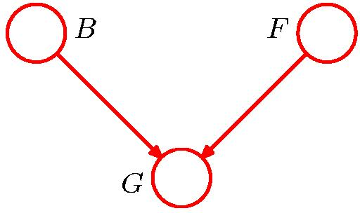
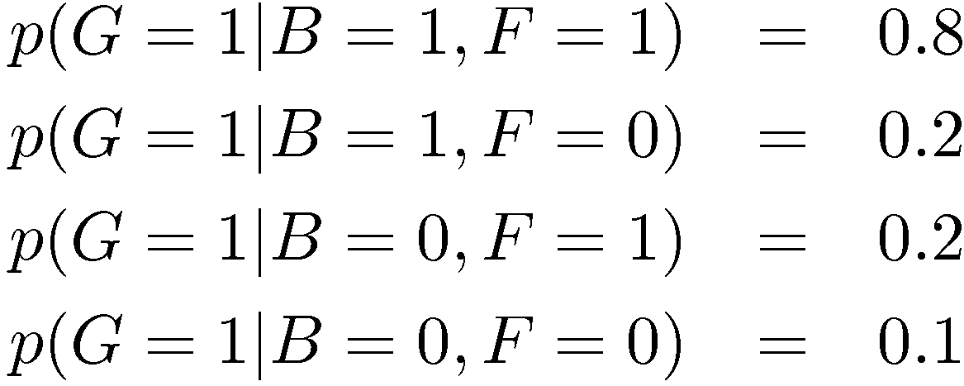
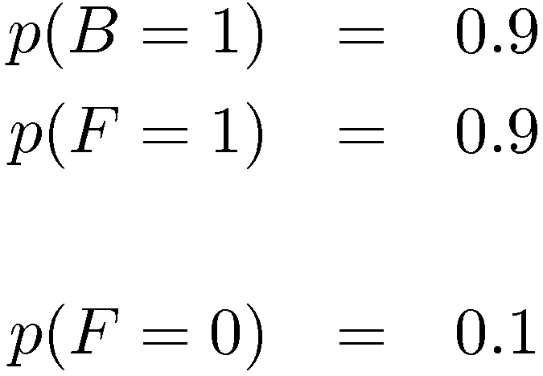
Example: “Am I out of fuel?”
B = Battery (0=flat, 1=fully charged)
F = Fuel Tank (0=empty, 1=full)
G = Fuel Gauge Reading
(0=empty, 1=full)
and hence
Chris Bishop

Slide 28
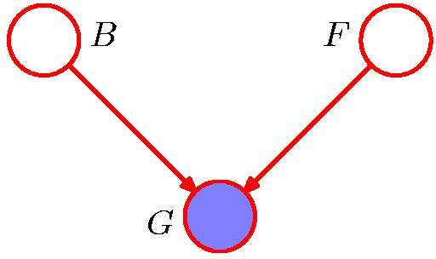
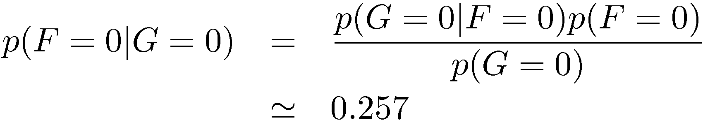
Example: “Am I out of fuel?”
Probability of an empty tank increased by observing G = 0.
Chris Bishop

Slide 29
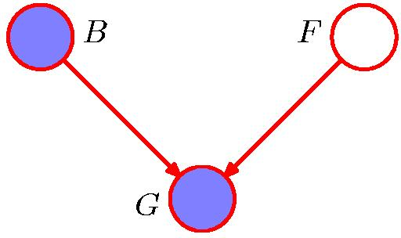
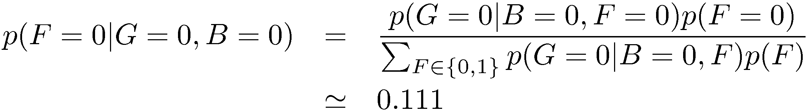
Example: “Am I out of fuel?”
Probability of an empty tank reduced by observing B = 0.
This is referred to as “explaining away”.
Chris Bishop

Slide 30

D-separation
A, B, and C are non-intersecting subsets of nodes in a directed graph.
A path from A to B is blocked if it contains a node such that either
  the arrows on the path meet either head-to-tail or tail-to-tail at the node, and the node is in the set C, or
  the arrows meet head-to-head at the node, and neither the node, nor any of its descendants, are in the set C.
If all paths from A to B are blocked, A is said to be d-separated from B by C.
If A is d-separated from B by C, the joint distribution over all variables in the graph satisfies .
Chris Bishop

Slide 31
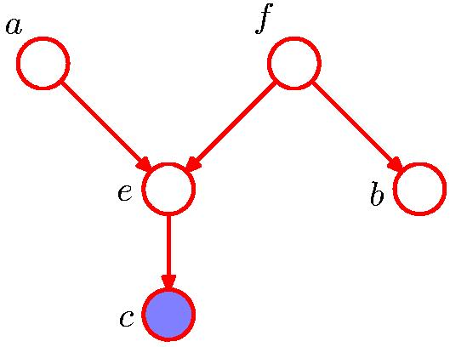
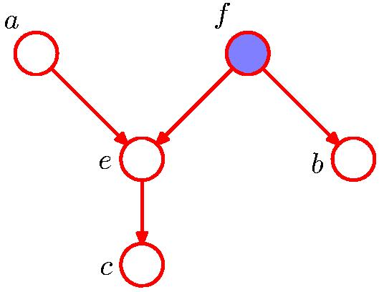

D-separation: Example
Chris Bishop

Slide 32
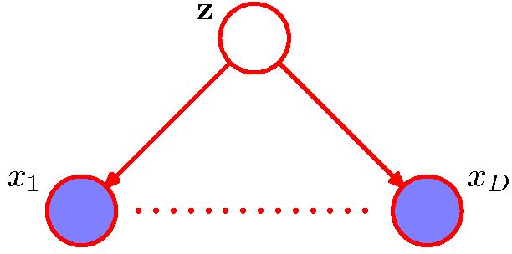
Naïve Bayes
Conditioned on the class z,
the distributions of the input variables x₁, …, x_{D} are independent.
Are the x₁, …, x_{D} marginally independent?
Chris Bishop

Slide 33
Bayes Nets vs. Markov Nets
Bayes nets represent a subclass of joint distributions that capture non-cyclic causal dependencies between variables.
A Markov net can represent any joint distribution.
Ray Mooney

Slide 34
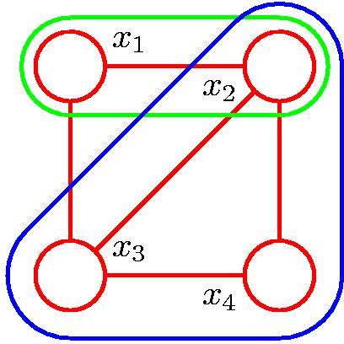
Cliques and Maximal Cliques
Clique
Maximal Clique
Chris Bishop

Slide 35
Joint Distribution for a Markov Net
The distribution of a Markov net is described in terms of a set of potential functions, ψ_{c}, for each clique C in the graph.
For each joint assignment of values to the variables in clique C, ψ_{c} assigns a non-negative real value that represents the compatibility of these values.
Adapted from Ray Mooney

Slide 36
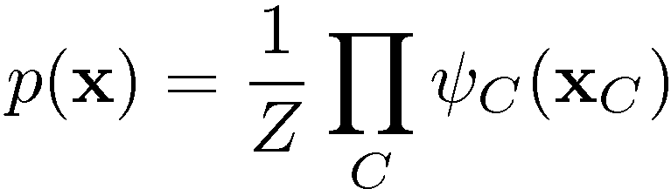

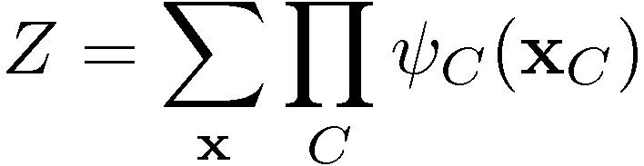

Joint Distribution for a Markov Net
where is the potential over clique C and
is the normalization coefficient; note: M K-state variables → K^{M} terms in Z.
Energies and the Boltzmann distribution
Chris Bishop

Slide 37
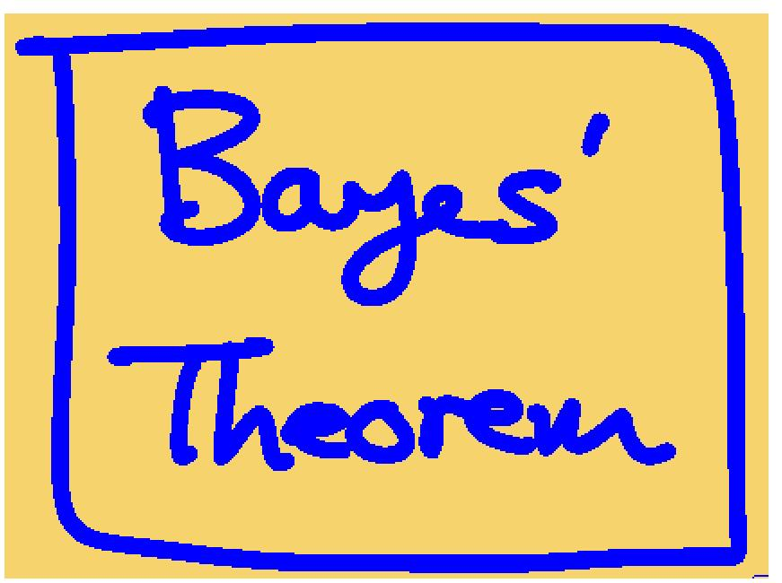
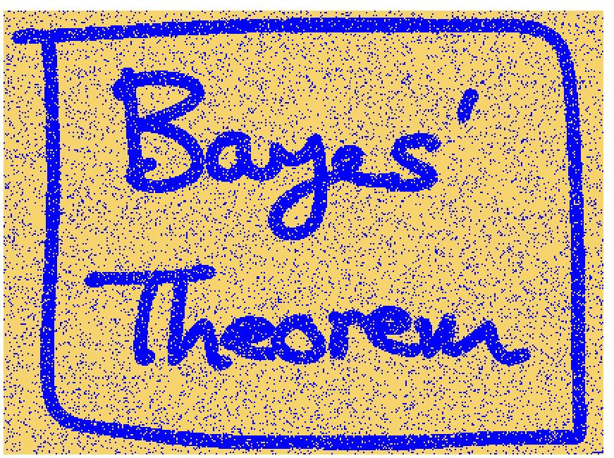
Illustration: Image De-Noising
Original Image
Noisy Image
Chris Bishop

Slide 38
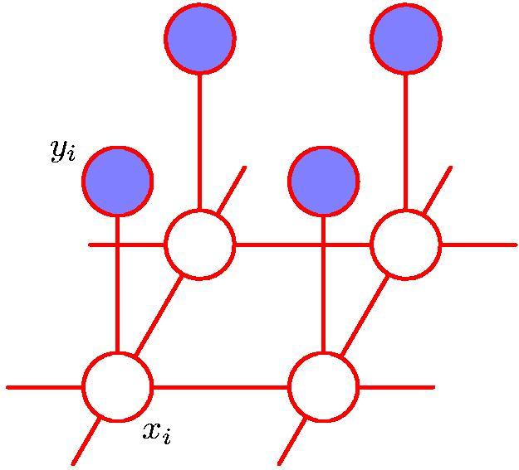
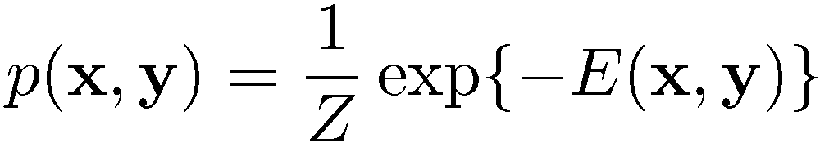
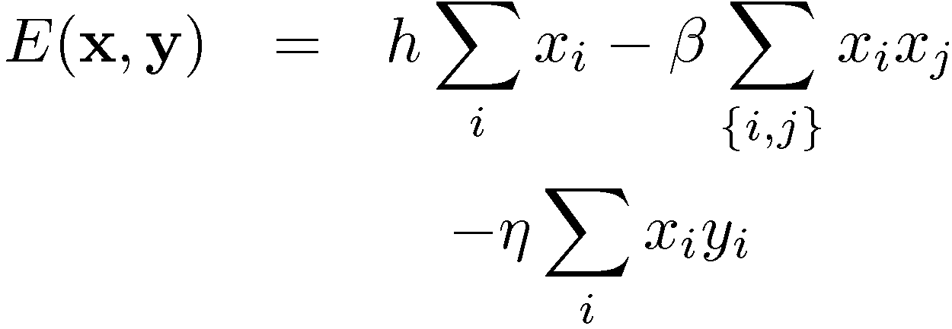
Illustration: Image De-Noising
y_{i} in {+1, -1}: labels in noisy image (which we have),
x_{i} in {+1, -1}: labels in noise-free image
(which we want to recover),
i is the index over pixels
x_{j}
Prior
Pixels are like their neighbors
Pixels of noisy and noise-free images are related
Adapted from Chris Bishop

Slide 39
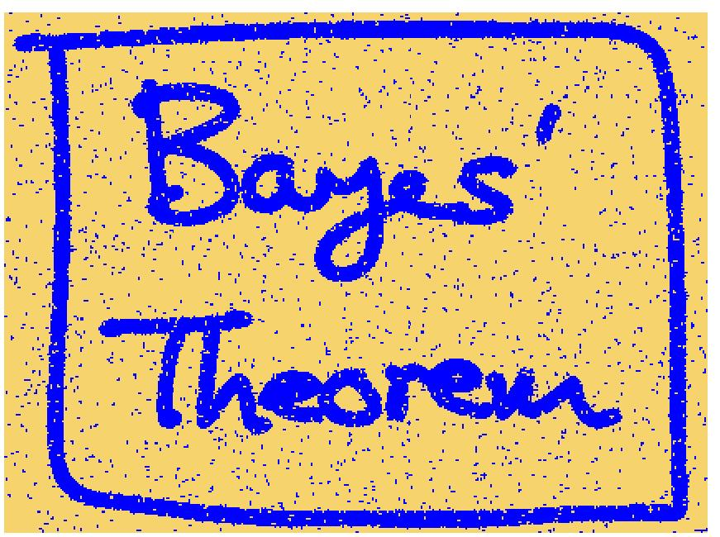
Illustration: Image De-Noising
Noisy Image
Restored Image (ICM)
Chris Bishop

Slide 40
Aside: Graphical vs other models
Some graphical models are generative i.e. model p(x) not just p(y|x)
Consider relationships of the features
Somewhat interpretable
We’ll also discuss one model appropriate for sequence classification (e.g. weather)

Slide 41
Classifying Connected Samples (Sequences)
Standard classification problem assumes individual cases are disconnected and independent (i.i.d.: independently and identically distributed).
Many problems do not satisfy this assumption and involve making many connected decisions which are mutually dependent.
Adapted from Ray Mooney

Slide 42
Markov Chains
A finite state machine with probabilistic state transitions.
Makes Markov assumption that next state only depends on the current state and independent of previous history.
Ray Mooney

Slide 43


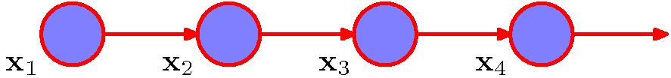
Markov Chains
General joint probability distribution:
First-order Markov chain:
Figures from Chris Bishop

Slide 44

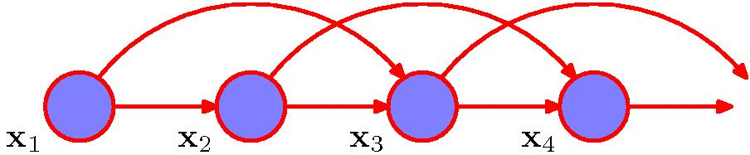
Markov Chains
Second-order Markov chain:
Figures from Chris Bishop

Slide 45
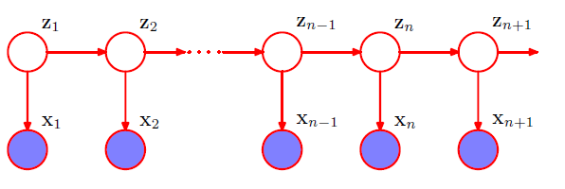
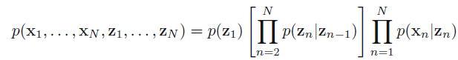
Hidden Markov Models
Latent variables (z) satisfy Markov property
Observed variables/predictions (x) do not
Example: x = words, z = parts of speech
Figures from Chris Bishop

Slide 46
Example: Part Of Speech Tagging
Annotate each word in a sentence with a part-of-speech marker.
John saw the saw and decided to take it to the table.
NNP VBD DT NN CC VBD TO VB PRP IN DT NN
Adapted from Ray Mooney

Slide 47
English Parts of Speech
Noun (person, place or thing)
  Singular (NN): dog, fork
  Plural (NNS): dogs, forks
  Proper (NNP, NNPS): John, Springfields
  Personal pronoun (PRP): I, you, he, she, it
  Wh-pronoun (WP): who, what
Verb (actions and processes)
  Base, infinitive (VB): eat
  Past tense (VBD): ate
  Gerund (VBG): eating
  Past participle (VBN): eaten
  Non 3rd person singular present tense (VBP): eat
  3rd person singular present tense: (VBZ): eats
  Modal (MD): should, can
  To (TO): to (to eat)
Ray Mooney

Slide 48
English Parts of Speech (cont.)
Adjective (modify nouns)
  Basic (JJ): red, tall
  Comparative (JJR): redder, taller
  Superlative (JJS): reddest, tallest
Adverb (modify verbs)
  Basic (RB): quickly
  Comparative (RBR): quicker
  Superlative (RBS): quickest
Preposition (IN): on, in, by, to, with
Determiner:
  Basic (DT) a, an, the
  WH-determiner (WDT): which, that
Coordinating Conjunction (CC): and, but, or,
Particle (RP): off (took off), up (put up)
Ray Mooney

Slide 49
Ambiguity in POS Tagging
“Like” can be a verb or a preposition
  I like/VBP candy.
  Time flies like/IN an arrow.
“Around” can be a preposition, particle, or adverb
  I bought it at the shop around/IN the corner.
  I never got around/RP to getting a car.
  A new Prius costs around/RB $25K.
Context from other words can help classify
Adapted from Ray Mooney

Slide 50
Aside: Why talking about HMMs
A probabilistic graphical model
Introduce sequence classification, nice way to model dynamical processes
Introduce dealing with latent variables (not observed during training)

Slide 51
First Attempt: Markov Model
No hidden variables
Assume all POS are annotated by a human
We can then reason about transitions between POS
Goal: tag (classify) all words in a sentence with their POS

Slide 52
Sample Markov Model for POS
0.05
0.1
Det
Noun
0.95
0.5
0.85
stop
0.05
Verb
0.25
0.1
PropNoun
0.8
0.4
0.5
0.1
0.25
0.1
start
Ray Mooney

Slide 53
Sample Markov Model for POS
0.05
0.1
Det
Noun
0.95
0.5
0.85
stop
0.05
Verb
0.25
0.1
PropNoun
0.8
0.4
0.5
0.1
0.25
0.1
start
P(PropNoun Verb Det Noun) = 0.4*0.8*0.25*0.95*0.1=0.0076
Ray Mooney

Slide 54
Hidden Markov Models
Probabilistic generative model for sequences.
Assume an underlying set of hidden (unobserved) states in which the model can be (e.g. parts of speech, abbreviated POS).
Assume probabilistic transitions between states over time (e.g. transition from POS to another POS as sequence is generated).
Assume probabilistic generation of tokens from states (e.g. words generated per POS).
Advantages of using hidden (un-annotated) variables?
Ray Mooney

Slide 55
Sample HMM for POS
0.05
the
cat
0.1
a
the
dog
a
the
car
bed
the
a
apple
that
pen
0.95
0.5
Det
Noun
0.85
bit
saw
stop
0.05
ate
played
Tom
0.25
hit
gave
0.1
John
Verb
Mary
Alice
0.8
0.4
Jerry
0.5
PropNoun
0.1
0.25
0.1
start
Ray Mooney

Slide 56
Sample HMM Generation
0.05
the
cat
0.1
a
the
dog
a
the
car
bed
the
a
apple
that
pen
0.95
0.5
Det
Noun
0.85
bit
saw
stop
0.05
ate
played
Tom
0.25
hit
gave
0.1
John
Verb
Mary
Alice
0.8
0.4
Jerry
0.5
PropNoun
0.1
0.25
0.1
start
Ray Mooney

Slide 57
Sample HMM Generation
0.05
the
cat
0.1
a
the
dog
a
the
car
bed
the
a
apple
that
pen
0.95
0.5
Det
Noun
0.85
bit
saw
stop
0.05
ate
played
Tom
0.25
hit
gave
0.1
John
Verb
Mary
Alice
0.8
0.4
Jerry
0.5
PropNoun
0.1
0.1
start
Ray Mooney

Slide 58
Sample HMM Generation
0.05
the
cat
0.1
a
the
dog
a
the
car
bed
the
a
apple
that
pen
0.95
0.5
Det
Noun
0.85
bit
saw
stop
0.05
ate
played
Tom
0.25
hit
gave
0.1
John
Verb
Mary
Alice
0.8
0.4
Jerry
0.5
PropNoun
0.1
0.25
0.1
start
John
Ray Mooney

Slide 59
Sample HMM Generation
0.05
the
cat
0.1
a
the
dog
a
the
car
bed
the
a
apple
that
pen
0.95
0.5
Det
Noun
0.85
bit
saw
stop
0.05
ate
played
Tom
0.25
hit
gave
0.1
John
Verb
Mary
Alice
0.8
0.4
Jerry
0.5
PropNoun
0.1
0.25
0.1
start
John
Ray Mooney

Slide 60
Sample HMM Generation
0.05
the
cat
0.1
a
the
dog
a
the
car
bed
the
a
apple
that
pen
0.95
0.5
Det
Noun
0.85
bit
saw
stop
0.05
ate
played
Tom
0.25
hit
gave
0.1
John
Verb
Mary
Alice
0.8
0.4
Jerry
0.5
PropNoun
0.1
0.25
0.1
start
John bit
Ray Mooney

Slide 61
Sample HMM Generation
0.05
the
cat
0.1
a
the
dog
a
the
car
bed
the
a
apple
that
pen
0.95
0.5
Det
Noun
0.85
bit
saw
stop
0.05
ate
played
Tom
0.25
hit
gave
0.1
John
Verb
Mary
Alice
0.8
0.4
Jerry
0.5
PropNoun
0.1
0.25
0.1
start
John bit
Ray Mooney

Slide 62
Sample HMM Generation
0.05
the
cat
0.1
a
the
dog
a
the
car
bed
the
a
apple
that
pen
0.95
0.5
Det
Noun
0.85
bit
saw
stop
0.05
ate
played
Tom
0.25
hit
gave
0.1
John
Verb
Mary
Alice
0.8
0.4
Jerry
0.5
PropNoun
0.1
0.25
0.1
start
John bit the
Ray Mooney

Slide 63
Sample HMM Generation
0.05
the
cat
0.1
a
the
dog
a
the
car
bed
the
a
apple
that
pen
0.95
0.5
Det
Noun
0.85
bit
saw
stop
0.05
ate
played
Tom
0.25
hit
gave
0.1
John
Verb
Mary
Alice
0.8
0.4
Jerry
0.5
PropNoun
0.1
0.25
0.1
start
John bit the
Ray Mooney

Slide 64
Sample HMM Generation
0.05
the
cat
0.1
a
the
dog
a
the
car
bed
the
a
apple
that
pen
0.95
0.5
Det
Noun
0.85
bit
saw
stop
0.05
ate
played
Tom
0.25
hit
gave
0.1
John
Verb
Mary
Alice
0.8
0.4
Jerry
0.5
PropNoun
0.1
0.25
0.1
start
John bit the apple
Ray Mooney

Slide 65
Sample HMM Generation
0.05
the
cat
0.1
a
the
dog
a
the
car
bed
the
a
apple
that
pen
0.95
0.5
Det
Noun
0.85
bit
saw
stop
0.05
ate
played
Tom
0.25
hit
gave
0.1
John
Verb
Mary
Alice
0.8
0.4
Jerry
0.5
PropNoun
0.1
0.25
0.1
start
John bit the apple
Ray Mooney

Slide 66
Formal Definition of an HMM
A set of N +2 states S={s₀,s₁,s₂, … s_{N,} s_{F}}
  Distinguished start state: s₀
  Distinguished final state: s_{F}
A set of M possible observations V={v₁,v₂…v_{M}}
A state transition probability distribution A={a_{ij}}
Observation probability distribution for each state j B={b_{j}(k)}
Total parameter set λ={A,B}
Ray Mooney

Slide 67
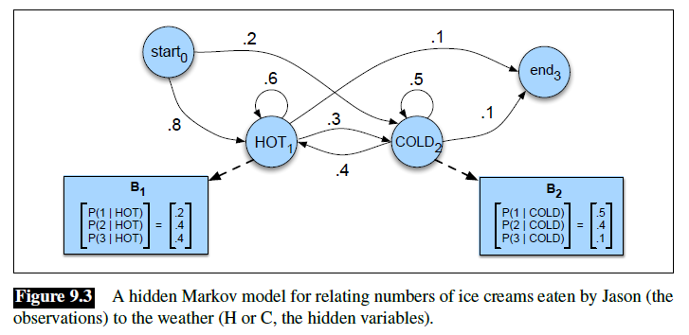
Example
States = weather (hot/cold)
Observations = number of ice-creams eaten

Slide 68
Three Useful HMM Tasks
Compute observation likelihood: How likely is a given sequence of words, regardless of how they might be POS-tagged?
Estimate most likely state sequence: What is the most likely underlying sequence of tags for the observed sequence of words?
Maximum likelihood training: Estimate transition/emission probabilities given training data (not discussed in this class)
Adapted from Ray Mooney

Slide 69
HMM: Observation Likelihood
Given a sequence of observations, O, and a model with a set of parameters, λ, what is the probability that this observation was generated by this model: P(O| λ) ?
Allows HMM to be used as a language model: Assigns a probability to each string saying how likely that string is to be generated by the language.
Example uses:
  Sequence Classification
  Most Likely Sequence
Adapted from Ray Mooney

Slide 70
Sequence Classification
Assume an HMM is available for each category (i.e. language or word).
What is the most likely category for a given observation sequence, i.e. which category’s HMM is most likely to have generated it?
Used in speech recognition to find most likely word model to have generated a given sound or phoneme sequence.
O
ah s t e n
?
?
Austin
P(O | Austin) > P(O | Boston) ?
Boston
Ray Mooney

Slide 71
Most Likely Sequence
Of two or more possible sequences, which one was most likely generated by a given model?
Used to score alternative word sequence interpretations in speech recognition.
O₁
?
dice precedent core
?
vice president Gore
O₂
Ordinary English
P(O₂ | OrdEnglish) > P(O₁ | OrdEnglish) ?
Ray Mooney

Slide 72
HMM: Observation Likelihood
Naïve Solution
Consider all possible state sequences, Q, of length T that the model could have traversed in generating the given observation sequence.
Compute
  the probability of a given state sequence from A, and
  multiply it by the probabilities (from B) of generating each of the given observations in each of the corresponding states in this sequence,
  to get P(O,Q| λ) = P(O| Q, λ) P(Q| λ) .
Sum this over all possible state sequences to get P(O| λ).
Computationally complex: O(TN^{T}).
Adapted from Ray Mooney

Slide 73
Example
States = weather (hot/cold), observations = number of ice-creams eaten
What is the probability of observing {3, 1, 3}?

Slide 74
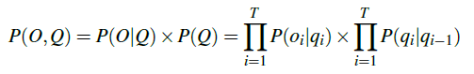



Example
What is the probability of observing {3, 1, 3} and the state sequence being {hot, hot, cold}?
What is the probability of observing {3, 1, 3}?
…

Slide 75
HMM: Observation Likelihood
Efficient Solution
Due to the Markov assumption, the probability of being in any state at any given time t only relies on the probability of being in each of the possible states at time t−1.
Forward Algorithm: Uses dynamic programming to exploit this fact to efficiently compute observation likelihood in O(TN²) time.
  Compute a forward trellis that compactly and implicitly encodes information about all possible state paths.
Ray Mooney

Slide 76
Forward Probabilities
Let α_{t}(j) be the probability of being in state j after seeing the first t observations (by summing over all initial paths leading to j).
Ray Mooney

Slide 77
Forward Step
Consider all possible ways of getting to s_{j} at time t by coming from all possible states s_{i} and determine probability of each.
Sum these to get the total probability of being in state s_{j} at time t while accounting for the first t −1 observations.
Then multiply by the probability of actually observing o_{t} in s_{j.}
s₁
a_{1j}
s₂
a_{2j}
•
•
•
a_{2j}
s_{j}
a_{Nj}
s_{N}
α_{t-1}(i)
α_{t}(i)
Ray Mooney

Slide 78
Forward Trellis
s₁
• • •
s₂
• • •
•
•
•
•
•
•
•
•
•
•
•
•
•
•
•
s₀
• • •
s_{F}
s_{N}
• • •
t₁
t₂
t₃
t_{T-1}
t_{T}
Continue forward in time until reaching final time point, and sum probability of ending in final state.
Ray Mooney

Slide 79
Computing the Forward Probabilities
Initialization
Recursion
Termination
Ray Mooney

Slide 80

Example

Slide 81
Forward Computational Complexity
Requires only O(TN²) time to compute the probability of an observed sequence given a model.
Exploits the fact that all state sequences must merge into one of the N possible states at any point in time and the Markov assumption that only the last state effects the next one.
Ray Mooney

Slide 82
Three Useful HMM Tasks
Compute observation likelihood: How likely is a given sequence of words, regardless of how they might be POS-tagged?
Estimate most likely state sequence: What is the most likely underlying sequence of tags for the observed sequence of words?
Maximum likelihood training: Estimate transition/emission probabilities given training data (not discussed in this class)
Adapted from Ray Mooney

Slide 83
Most Likely State Sequence (Decoding)
Given an observation sequence, O, and a model, λ, what is the most likely state sequence, Q=q₁,q₂,…q_{T}, that generated this sequence from this model?
John gave the dog an apple.
Ray Mooney

Slide 84
Most Likely State Sequence
Given an observation sequence, O, and a model, λ, what is the most likely state sequence, Q=q₁,q₂,…q_{T}, that generated this sequence from this model?
John gave the dog an apple.
Det Noun PropNoun Verb
Ray Mooney

Slide 85
Most Likely State Sequence
Given an observation sequence, O, and a model, λ, what is the most likely state sequence, Q=q₁,q₂,…q_{T}, that generated this sequence from this model?
John gave the dog an apple.
Det Noun PropNoun Verb
Ray Mooney

Slide 86
Most Likely State Sequence
Given an observation sequence, O, and a model, λ, what is the most likely state sequence, Q=q₁,q₂,…q_{T}, that generated this sequence from this model?
John gave the dog an apple.
Det Noun PropNoun Verb
Ray Mooney

Slide 87
Most Likely State Sequence
Given an observation sequence, O, and a model, λ, what is the most likely state sequence, Q=q₁,q₂,…q_{T}, that generated this sequence from this model?
John gave the dog an apple.
Det Noun PropNoun Verb
Ray Mooney

Slide 88
Most Likely State Sequence
Given an observation sequence, O, and a model, λ, what is the most likely state sequence, Q=q₁,q₂,…q_{T}, that generated this sequence from this model?
John gave the dog an apple.
Det Noun PropNoun Verb
Ray Mooney

Slide 89
Most Likely State Sequence
Given an observation sequence, O, and a model, λ, what is the most likely state sequence, Q=q₁,q₂,…q_{T}, that generated this sequence from this model?
Used for sequence labeling, assuming each state corresponds to a tag, it determines the globally best assignment of tags to all tokens in a sequence using a principled approach grounded in probability theory.
John gave the dog an apple.
Det Noun PropNoun Verb
Ray Mooney

Slide 90
HMM: Most Likely State Sequence
Efficient Solution
Could use naïve algorithm, examining every possible state sequence of length T.
Dynamic Programming can also be used to exploit the Markov assumption and efficiently determine the most likely state sequence for a given observation and model.
Standard procedure is called the Viterbi algorithm (Viterbi, 1967) and also has O(TN²) time complexity.
Ray Mooney

Slide 91
Viterbi Scores
Recursively compute the probability of the most likely subsequence of states that accounts for the first t observations and ends in state s_{j}.
Also record “backpointers” that subsequently allow backtracing the most probable state sequence.
  bt_{t}(j) stores the state at time t-1 that maximizes the probability that system was in state s_{j} at time t (given the observed sequence).
Ray Mooney

Slide 92
Computing the Viterbi Scores
Initialization
Recursion
Termination
Analogous to Forward algorithm except take max instead of sum
Ray Mooney

Slide 93
Computing the Viterbi Backpointers
Initialization
Recursion
Termination
Final state in the most probable state sequence. Follow
backpointers to initial state to construct full sequence.
Ray Mooney

Slide 94
Viterbi Backpointers
s₁
• • •
s₂
• • •
•
•
•
•
•
•
•
•
•
•
•
•
•
•
•
s₀
• • •
s_{F}
s_{N}
• • •
t₁
t₂
t₃
t_{T-1}
t_{T}
Ray Mooney

Slide 95
Viterbi Backtrace
s₁
• • •
s₂
• • •
•
•
•
•
•
•
•
•
•
•
•
•
•
•
•
s₀
• • •
s_{F}
s_{N}
• • •
t₁
t₂
t₃
t_{T-1}
t_{T}
Most likely Sequence: s₀ s_{N} s₁ s₂ …s₂ s_{F}
Ray Mooney

Slide 96
HMM Learning
Supervised Learning: All training sequences are completely labeled (tagged).
Unsupervised Learning: All training sequences are unlabelled (but generally know the number of tags, i.e. states).
Adapted from Ray Mooney

Slide 97
Supervised Parameter Estimation
Estimate state transition probabilities based on tag bigram and unigram statistics in the labeled data.
Estimate the observation probabilities based on tag/word co-occurrence statistics in the labeled data.
Use appropriate smoothing if training data is sparse.
Ray Mooney

Slide 98
Maximum Likelihood Training
Given an observation sequence, O, what set of parameters, λ, for a given model maximizes the probability that this data was generated from this model (P(O| λ))?
Used to train an HMM model and properly induce its parameters from a set of training data.
Only need to have an unannotated observation sequence (or set of sequences) generated from the model. Does not need to know the correct state sequence(s) for the observation sequence(s). In this sense, it is unsupervised.
Ray Mooney

Slide 99
HMM: Maximum Likelihood Training
Efficient Solution
There is no known efficient algorithm for finding the parameters, λ, that truly maximizes P(O| λ).
However, using iterative re-estimation, the Baum-Welch algorithm (a.k.a. forward-backward), a version of a standard statistical procedure called Expectation Maximization (EM), is able to locally maximize P(O| λ).
Recall: K-means (also an example of EM)
Adapted from Ray Mooney

Slide 100
Sketch of Baum-Welch (EM) Algorithm for Training HMMs
Assume an HMM with N states.
Randomly set its parameters λ=(A,B)
(making sure they represent legal distributions)
Until convergence (i.e. λ no longer changes) do:
E Step: Use the forward/backward procedure to
determine the probability of various possible
state sequences for generating the training data
M Step: Use these probability estimates to
re-estimate values for all of the parameters λ
Ray Mooney

