Slide 1
CS 1675: Intro to Machine Learning Ensemble Methods, Decision Trees
Prof. Adriana Kovashka University of Pittsburgh
November 13, 2018

Slide 2
Plan for This Lecture
Ensemble methods: introduction
Boosting
Algorithm
Application to face detection
Decision trees
Example
Algorithm

Slide 3
Learning Ensembles
Learn multiple alternative definitions of a concept using different training data or different learning algorithms
Train several classifiers: SVM, KNN, logistic regression, decision tree, neural network etc.
Call these classifiers f₁(x), f₂(x), …, f_{M}(x)
Take majority of predictions: y = majority( f₁(x), f₂(x), …, f_{M}(x) )
For regression use mean or median of the predictions
Averaging is a form of regularization: each model can individually overfit but the average is able to overcome the overfitting
Ray Mooney, Subhransu Maji

Slide 4
Learning Ensembles
Learn multiple alternative definitions of a concept using different training data or different learning algorithms
Combine decisions of multiple definitions
Training Data
⋅ ⋅ ⋅ ⋅ ⋅ ⋅ ⋅ ⋅
Data1
Data2
Data m
Learner1
Learner2
⋅ ⋅ ⋅ ⋅ ⋅ ⋅ ⋅ ⋅
Learner m
⋅ ⋅ ⋅ ⋅ ⋅ ⋅ ⋅ ⋅
Model1
Model2
Model m
Model Combiner
Final Model
Ray Mooney

Slide 5
Value of Ensembles
When combing multiple independent and diverse decisions each of which is at least more accurate than random guessing, random errors cancel each other out, correct decisions are reinforced.
Human ensembles are demonstrably better
How many jelly beans in the jar?: Individual estimates vs. group average.
Who Wants to be a Millionaire: Expert friend vs. audience vote.
http://www.telegraph.co.uk/culture/books/3620109/Always-ask-the-audience.html
Adapted from Ray Mooney

Slide 6
Homogenous Ensembles
Use a single learning algorithm but manipulate training data to make it learn multiple models.
Data1 ≠ Data2 ≠ … ≠ Data m
Learner1 = Learner2 = … = Learner m
Different methods for changing training data:
Bagging: Resample training data
Boosting: Reweight training data
Adapted from Ray Mooney

Slide 7
Bagging
Create ensembles by repeatedly randomly resampling the training data.
Given a training set of size n, create m samples of size n by drawing n examples from the original data, with replacement.
Train m models and combine them using simple majority vote.
Decreases error by decreasing the variance in the results due to unstable (high-variance) learners, algorithms (like decision trees) whose output can change dramatically when the training data is slightly changed.
However, often the errors of the different models are correlated, which defies the purpose of bagging.
Adapted from Ray Mooney

Slide 8
Boosting
Originally proposed in (Schapire, 1990), revised to be a practical algorithm, AdaBoost, for building ensembles that empirically improves generalization performance (Freund & Shapire, 1996).
Relies on weak learners which only need to generate a hypothesis with a training accuracy greater than 0.5.
Examples are given weights. At each iteration, a new hypothesis is learned and the examples are reweighted to focus the system on examples that the most recently learned classifier got wrong.
Adapted from Ray Mooney

Slide 9
Boosting: Basic Algorithm
General Loop:
Set all examples to have equal uniform weights.
For m from 1 to M do:
Find the weak learner h_{m} that achieves lowest weighted training error
Increase the weights of examples that h_{m} classifies incorrectly
During testing:
Each of the M classifiers gets a weighted vote proportional to its accuracy on the training data; final classifier is a linear combination of all weak learners.
Intuition/advantage:
Base (weak) learner must focus on correctly classifying the most highly weighted examples while strongly avoiding over-fitting.
Assumption:
Weak learners must perform better than chance.
Ray Mooney, Lana Lazebnik, Kristen Grauman

Slide 10
Boosting Illustration
Weak
Classifier 1
Paul Viola

Slide 11
Boosting Illustration
Weights
Increased
Paul Viola

Slide 12
Boosting Illustration
Weak
Classifier 2
Paul Viola

Slide 13
Boosting Illustration
Weights
Increased
Paul Viola

Slide 14
Boosting Illustration
Weak
Classifier 3
Paul Viola

Slide 15
Boosting Illustration
Final classifier is
a combination of weak classifiers
Paul Viola

Slide 16
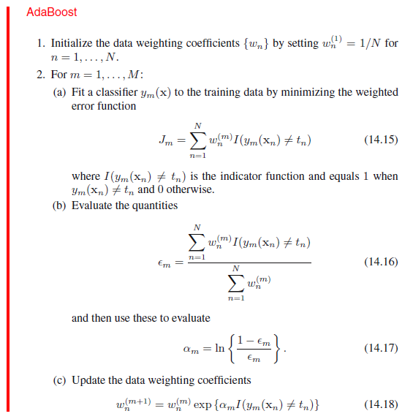
Start with uniform weights on training examples.
For M rounds
Evaluate weighted error for each weak learner, pick best learner.
y_{m}(x_{n}) is the prediction, t_{n} is ground truth for x_{n}
Optional: If error > 0.5, exit loop
Re-weight the examples:
Incorrectly classified
get more weight.
(d) Normalize the weights so they sum to 1
Final classifier is combination of weak ones, weighted according to error they had.
Figure from C. Bishop, notes from K. Grauman

Slide 17
Another Version of the AdaBoost Pseudocode
TrainAdaBoost(Dataset, BaseLearn)
For each example x_{i} let its weight w_{i}=1/|N| where N is number of samples
Let H be an empty set of hypotheses
For t from 1 to T do:
Learn a hypothesis, h_{t}, from the weighted examples: h_{t}=BaseLearn(Dataset)
Add h_{t} to H
Calculate the error, ε_{t}, of the hypothesis h_{t} as the total sum weight of the
examples that it classifies incorrectly.
If ε_{t} > 0.5 then exit loop, else continue.
Let β_{t} = ε_{t} / (1 – ε_{t} )
Multiply the weights of the examples that h_{t} classifies correctly by β_{t}
Rescale the weights of all of the examples so the total sum weight remains 1.
Return H
TestAdaBoost(ex, H)
Let each hypothesis, h_{t}, in H vote for ex’s classification with weight log(1/ β_{t} )
Return the class with the highest weighted vote total.
Adapted from Ray Mooney

Slide 18
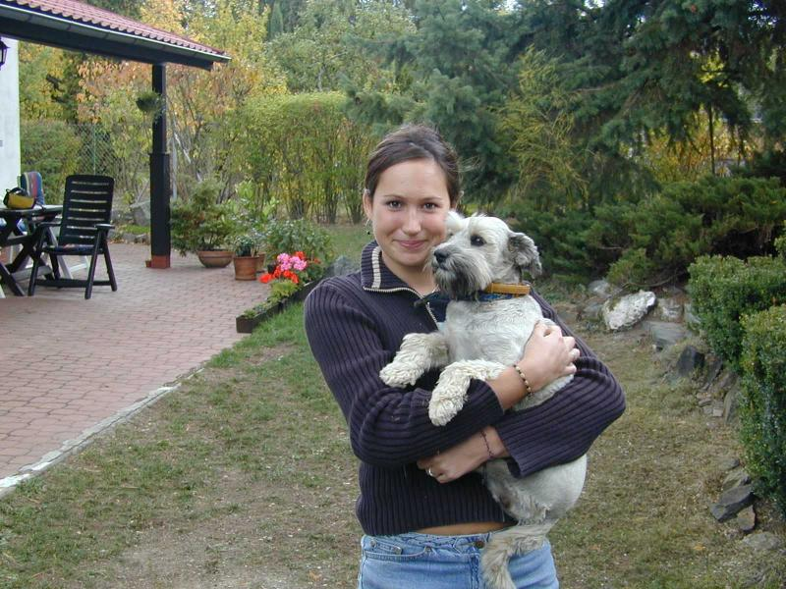
Boosting application: Face detection
Detection
Lana Lazebnik

Slide 19
Viola-Jones face detector (CVPR 2001)
14,765 citations
Main idea:
Represent local texture with efficiently computable “rectangular” features within window of interest
Select discriminative features to be weak classifiers
Use boosted combination of them as final classifier
Form a cascade of such classifiers, rejecting clear negatives quickly (not discussed)
Kristen Grauman

Slide 20
Viola-Jones detector: features
“Rectangular” filters
Feature output is difference between adjacent regions
Value = ∑ (pixels in white area) – ∑ (pixels in black area)
Kristen Grauman, Lana Lazebnik

Slide 21
Viola-Jones detector: features
Considering all possible filter parameters: position, scale, and type:
180,000+ possible features associated with each 24 x 24 window
Which subset of these features should we use to determine if a window has a face?
Use AdaBoost both to select the informative features and to form the classifier
Kristen Grauman

Slide 22
Viola-Jones detector: AdaBoost
Want to select the single rectangle feature and threshold that best separates positive (faces) and negative (non-faces) training examples, in terms of weighted error.
Resulting weak classifier:
For next round, reweight the examples according to errors, choose another filter/threshold combo.
…
Outputs of a possible rectangle feature on faces and non-faces.
Kristen Grauman

Slide 23
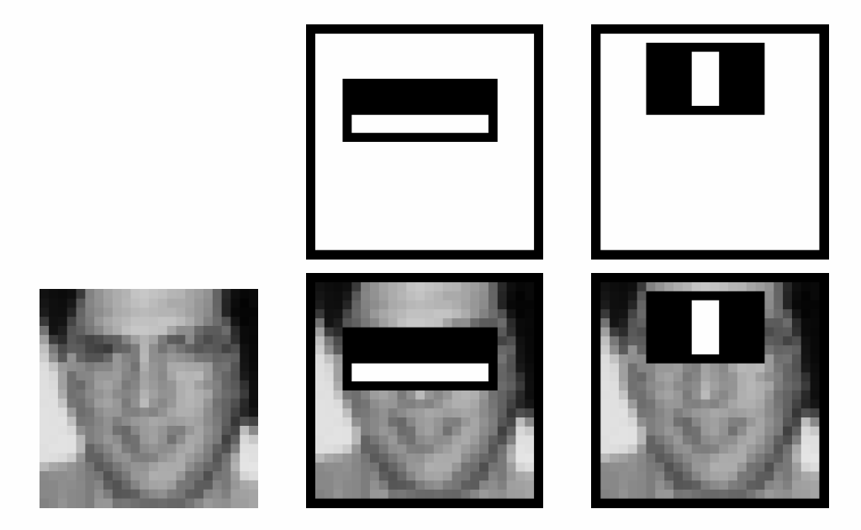
Boosting for face detection
First two features selected by boosting:
This feature combination can yield 100% detection rate and 50% false positive rate
Lana Lazebnik

Slide 24
Viola-Jones face detector: Results
Kristen Grauman
Notes:
24

Slide 25
Decision Stumps
Like the thresholded features=classifiers in face detection
A single-level decision tree (discussed next)
Figure from Wikipedia

Slide 26
Decision Trees
Tree-based classifiers
Nodes test features, there is one branch for each value of the feature, and leaves specify the category
Can be rewritten as a set of rules:
red ∧ circle → pos
red ∧ circle → A
blue → B
red ∧ square → B
green → C
red ∧ triangle → C
color
color
red
green
red
blue
green
blue
shape
shape
C
neg
pos
B
circle
square
triangle
circle
square
triangle
pos
neg
neg
A
B
C
Adapted from Ray Mooney

Slide 27
What about continuous features?
Continuous (real-valued) features can be handled by allowing nodes to split a real valued feature into two ranges based on a threshold (e.g. length < 3 and length ≥3)
Classification trees have discrete class labels at the leaves.
Adapted from Ray Mooney

Slide 28
Top-Down Decision Tree Induction
Recursively build a tree top-down by divide and conquer.
<big, red, circle>: + <small, red, circle>: +
<small, red, square>: − <big, blue, circle>: −
color
red
blue
green
<big, red, circle>: +
<small, red, circle>: +
<small, red, square>: −
Ray Mooney

Slide 29
Top-Down Decision Tree Induction
Recursively build a tree top-down by divide and conquer.
<big, red, circle>: + <small, red, circle>: +
<small, red, square>: − <big, blue, circle>: −
color
red
blue
green
<big, red, circle>: +
<small, red, circle>: +
<small, red, square>: −
shape
neg
neg
circle
<big, blue, circle>: −
square
triangle
pos
neg
pos
<big, red, circle>: +
<small, red, circle>: +
<small, red, square>: −
Ray Mooney

Slide 30
Decision Tree Induction Pseudocode
DTree(examples, features) returns a tree
If all examples are in one category, return a leaf node with that category label.
Else if the set of features is empty, return a leaf node with the category label that
is the most common in examples.
Else pick a feature F and create a node R for it
For each possible value v_{i} of F:
Add an out-going edge E to node R labeled with the value v_{i.}
Let examples_{i} be the subset of examples that have value v_{i} for F
If examples_{i} is empty
then attach a leaf node to edge E labeled with the category that
is the most common in examples.
else call DTree(examples_{i} , features – {F}) and attach the resulting
tree as the subtree under edge E.
Return the subtree rooted at R.
Adapted from Ray Mooney

Slide 31
Picking a Good Split Feature
Goal is to have the resulting tree be as small as possible, per Occam’s razor.
Finding a minimal decision tree (nodes, leaves, or depth) is an NP-hard optimization problem.
Want to pick a feature that creates subsets of examples that are relatively “pure” in a single class so they are “closer” to being leaf nodes.
There are a variety of heuristics for picking a good test, a popular one is based on information gain that originated with the ID3 system of Quinlan (1979).
Adapted from Ray Mooney

Slide 32
Entropy
Entropy (disorder, impurity) of a set of examples, S, relative to a binary classification is:
where p₁ is the fraction of positive examples in S and p₀ is the fraction of negatives.
If all examples are in one category, entropy is zero (we define 0⋅log(0)=0)
If examples are equally mixed (p₁=p₀=0.5), entropy is a maximum of 1.
For multi-class problems with c categories, entropy generalizes to:
Adapted from Ray Mooney

Slide 33
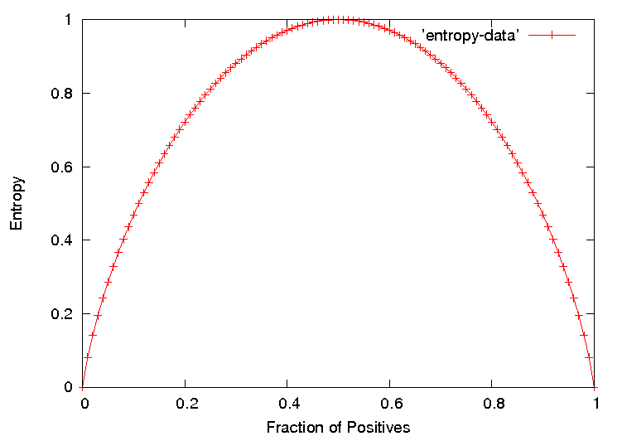
Entropy Plot for Binary Classification
Ray Mooney

Slide 34
Information Gain
The information gain of a feature F is the expected reduction in entropy resulting from splitting on this feature.
where S_{v} is the subset of S having value v for feature F.
Entropy of each resulting subset weighted by its relative size.
Example:
<big, red, circle>: + <small, red, circle>: +
<small, red, square>: − <big, blue, circle>: −
2+, 2 −: E=1
size
2+, 2 − : E=1
color
2+, 2 − : E=1
shape
big small
1+,1− 1+,1−
E=1 E=1
red blue
2+,1− 0+,1−
E=0.918 E=0
circle square
2+,1− 0+,1−
E=0.918 E=0
Gain=1−(0.5⋅1 + 0.5⋅1) = 0
Gain=1−(0.75⋅0.918 +
0.25⋅0) = 0.311
Gain=1−(0.75⋅0.918 +
0.25⋅0) = 0.311
Ray Mooney

Slide 35
Another Example Decision Tree Classifier
Problem: decide whether to wait for a table at a restaurant, based on the following attributes:
Alternate: is there an alternative restaurant nearby?
Bar: is there a comfortable bar area to wait in?
Fri/Sat: is today Friday or Saturday?
Hungry: are we hungry?
Patrons: number of people in the restaurant (None, Some, Full)
Price: price range ($, $$, $$$)
Raining: is it raining outside?
Reservation: have we made a reservation?
Type: kind of restaurant (French, Italian, Thai, Burger)
WaitEstimate: estimated waiting time (0-10, 10-30, 30-60, >60)
Lana Lazebnik

Slide 36
Another Example Decision Tree Classifier
Lana Lazebnik

Slide 37
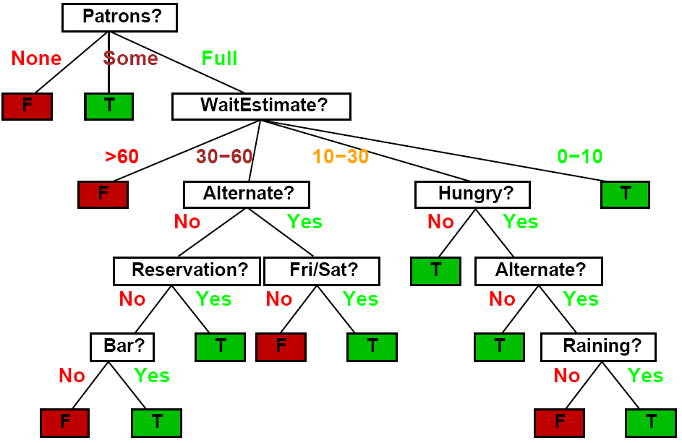
Another Example Decision Tree Classifier
Lana Lazebnik

Slide 38
Overfitting
Learning a tree that classifies the training data perfectly may not lead to the tree with the best generalization to unseen data.
There may be noise in the training data that the tree is erroneously fitting.
The algorithm may be making poor decisions towards the leaves of the tree that are based on very little data and may not reflect reliable trends.
on training data
on test data
accuracy
hypothesis complexity
Ray Mooney

Slide 39
Overfitting Noise in Decision Trees
Category or feature noise can easily cause overfitting.
Add noisy instance <medium, blue, circle>: pos (but really neg)
color
red
green
blue
shape
neg
neg
circle
square
triangle
pos
neg
pos
Ray Mooney

Slide 40
Overfitting Noise in Decision Trees
Category or feature noise can easily cause overfitting.
Add noisy instance <medium, blue, circle>: pos (but really neg)
color
red
green
blue
<big, blue, circle>: −
<medium, blue, circle>: +
shape
neg
circle
square
triangle
small
med
big
pos
neg
pos
neg
pos
neg
Noise can also cause different instances of the same feature vector to have different classes. Impossible to fit this data and must label leaf with the majority class.
<big, red, circle>: neg (but really pos)
Adapted from Ray Mooney

Slide 41
Overfitting Prevention (Pruning) Methods
Two basic approaches for decision trees
Prepruning: Stop growing tree as some point during top-down construction when there is no longer sufficient data to make reliable decisions.
Postpruning: Grow the full tree, then remove subtrees that do not have sufficient evidence.
Label leaf resulting from pruning with the majority class of the remaining data.
Some methods for determining which subtrees to prune:
Cross-validation: Reserve some training data as a hold-out set (validation set) to evaluate utility of subtrees.
Minimum description length (MDL): Determine if the additional complexity of the hypothesis is less complex than just explicitly remembering any exceptions resulting from pruning.
Adapted from Ray Mooney

