Slide 1
CS 1675: Intro to Machine Learning
Neural Networks
Prof. Adriana Kovashka
University of Pittsburgh
November 1, 2018

Slide 2
Plan for this lecture
Neural network basics
  Definition and architecture
  Biological inspiration
Training
  Loss functions
  Backpropagation
  Dealing with sparse data and overfitting
Specialized variants (briefly)
  Convolutional networks (CNNs) – e.g. for images
  Recurrent networks (RNNs) – for sequences, language

Slide 3
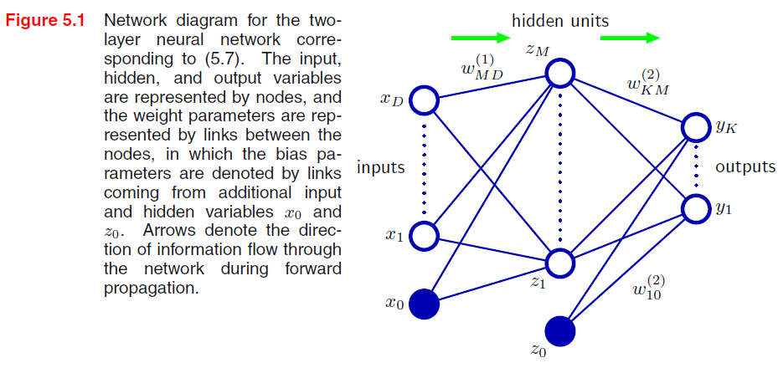



Neural network definition
Activations:
Nonlinear activation function h (e.g. sigmoid, tanh, RELU):
Figure from Christopher Bishop

Slide 4

Neural network definition
Layer 2
Layer 3 (final)
Outputs
Finally:
(multiclass)
(binary)
(binary)

Slide 5
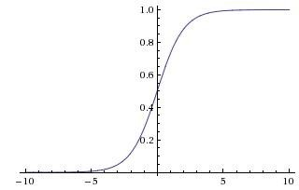

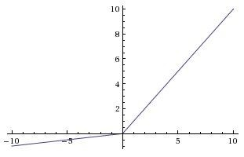
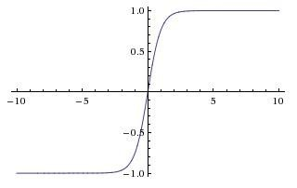
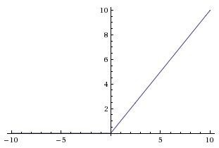


Leaky ReLU
max(0.1x, x)
Activation functions
Sigmoid
tanh
tanh(x)
Maxout ELU
ReLU
max(0,x)
Andrej Karpathy

Slide 6
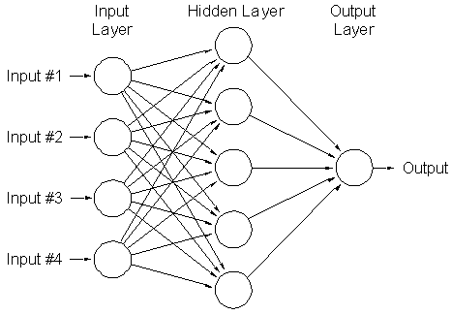
A multi-layer neural network
Nonlinear classifier
Can approximate any continuous function to arbitrary accuracy given sufficiently many hidden units
Lana Lazebnik

Slide 7
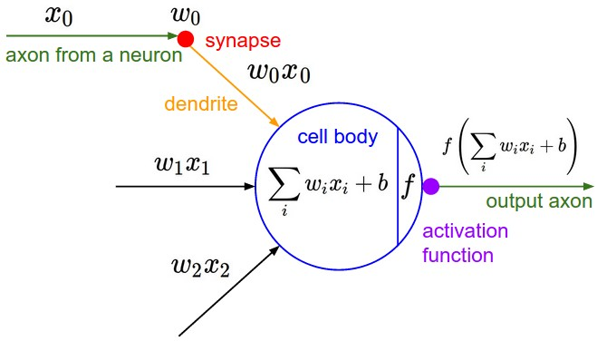
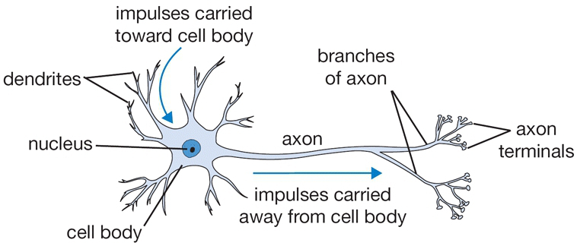
Inspiration: Neuron cells
Neurons
  accept information from multiple inputs
  transmit information to other neurons
Multiply inputs by weights along edges
Apply some function to the set of inputs at each node
If output of function over threshold, neuron “fires”
Text: HKUST, figures: Andrej Karpathy
Notes:
From Wikipedia: At the majority of synapses, signals are sent from the axon of one neuron to a dendrite of another... All neurons are electrically excitable, maintaining voltage gradients across their membranes… If the voltage changes by a large enough amount, an all-or-none electrochemical pulse called an action potential is generated, which travels rapidly along the cell's axon, and activates synaptic connections with other cells when it arrives.

Slide 8
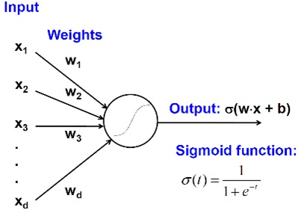
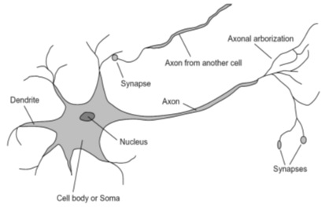
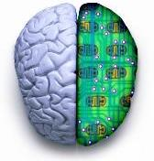
Biological analog
A biological neuron
An artificial neuron
Jia-bin Huang

Slide 9
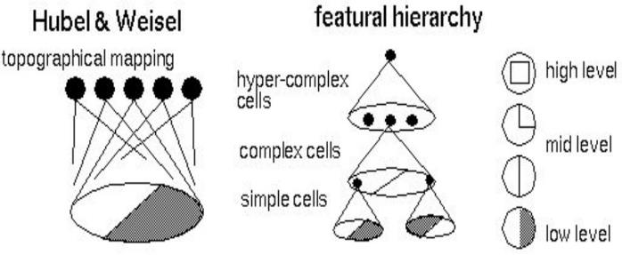
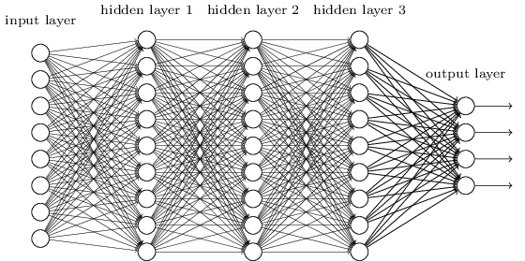
Biological analog
Hubel and Weisel’s architecture
Multi-layer neural network
Adapted from Jia-bin Huang

Slide 10
Multilayer networks
Cascade neurons together
Output from one layer is the input to the next
Each layer has its own sets of weights
HKUST

Slide 11
Feed-forward networks
Predictions are fed forward through the network to classify
HKUST

Slide 12
Feed-forward networks
Predictions are fed forward through the network to classify
HKUST

Slide 13
Feed-forward networks
Predictions are fed forward through the network to classify
HKUST

Slide 14
Feed-forward networks
Predictions are fed forward through the network to classify
HKUST

Slide 15
Feed-forward networks
Predictions are fed forward through the network to classify
HKUST

Slide 16
Feed-forward networks
Predictions are fed forward through the network to classify
HKUST

Slide 17
Deep neural networks
Lots of hidden layers
Depth = power (usually)
Weights to learn!
Weights to learn!
Weights to learn!
Weights to learn!
Figure from http://neuralnetworksanddeeplearning.com/chap5.html

Slide 18
How do we train them?
No closed-form solution for the weights
We will iteratively find such a set of weights that allow the outputs to match the desired outputs
We want to minimize a loss function (a function of the weights in the network)
For now let’s simplify and assume there’s a single layer of weights in the network

Slide 19
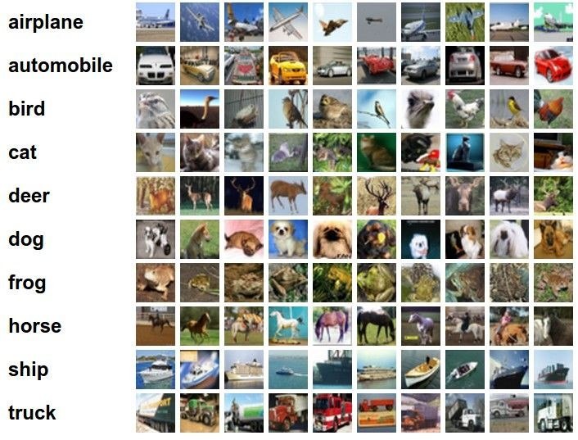
Classification goal
Example dataset: CIFAR-10 10 labels
50,000 training images each image is 32x32x3
10,000 test images.
Andrej Karpathy

Slide 20

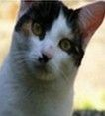
Classification scores
image
parameters
f(x,W)
10 numbers, indicating class scores
[32x32x3]
array of numbers 0...1 (3072 numbers total)
Andrej Karpathy

Slide 21
Linear classifier
3072x1
(+b)
10x1
10x1
10x3072
10 numbers, indicating class scores
[32x32x3]
array of numbers 0...1
parameters, or “weights”
Andrej Karpathy

Slide 22
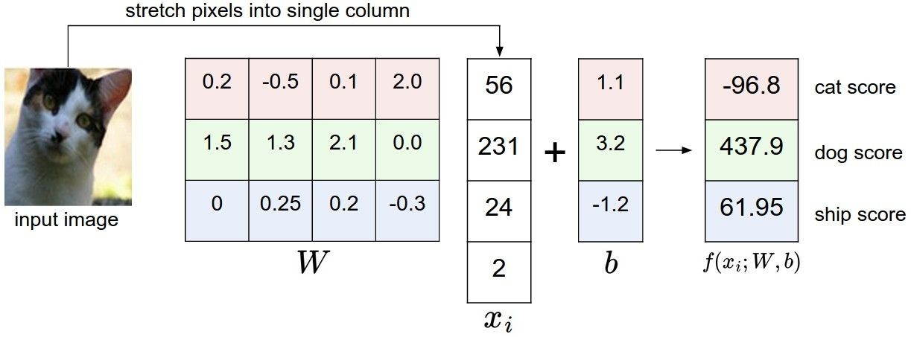
Linear classifier
Example with an image with 4 pixels, and 3 classes (cat/dog/ship)
Andrej Karpathy

Slide 23

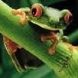
Linear classifier
Going forward: Loss function/Optimization
TODO:
1. Define a loss function that quantifies our unhappiness with the scores across the training data.
cat car frog
3.2
5.1
-1.7
1.3
4.9
2.0
2.2
2.5
-3.1
2. Come up with a way of efficiently finding the parameters that minimize the loss function. (optimization)
Adapted from Andrej Karpathy

Slide 24
Linear classifier
Suppose: 3 training examples, 3 classes. With some W the scores
are:
cat car frog
3.2
5.1
-1.7
1.3
4.9
2.0
2.2
2.5
-3.1
Adapted from Andrej Karpathy

Slide 25





Linear classifier: Hinge loss
Suppose: 3 training examples, 3 classes. With some W the scores
Hinge loss:
Given an example
are:
where where
is the image and
is the (integer) label,
and using the shorthand for the scores vector:
cat car frog
the loss has the form:
3.2
5.1
-1.7
1.3
4.9
2.0
2.2
2.5
-3.1
Want: s_{yi} >= s_{j} + 1
i.e. s_{j} – s_{yi} + 1 <= 0
If true, loss is 0
If false, loss is magnitude of violation
Adapted from Andrej Karpathy

Slide 26
Linear classifier: Hinge loss
Suppose: 3 training examples, 3 classes. With some W the scores
Hinge loss:
Given an example
are:
where where
is the image and
is the (integer) label,
and using the shorthand for the scores vector:
the loss has the form:
cat car frog | 3.2 5.1 -1.7 | 1.3 2.2 4.9 2.5 2.0 -3.1
Losses: | 2.9
= max(0, 5.1 - 3.2 + 1)
+max(0, -1.7 - 3.2 + 1)
= max(0, 2.9) + max(0, -3.9)
= 2.9 + 0
= 2.9
Adapted from Andrej Karpathy

Slide 27
Linear classifier: Hinge loss
Suppose: 3 training examples, 3 classes. With some W the scores
Hinge loss:
Given an example
are:
where where
is the image and
is the (integer) label,
and using the shorthand for the scores vector:
the loss has the form:
cat 3.2 car 5.1 frog -1.7 | 1.3 4.9 2.0 | 2.2 2.5 -3.1
Losses: 2.9 | 0
= max(0, 1.3 - 4.9 + 1)
+max(0, 2.0 - 4.9 + 1)
= max(0, -2.6) + max(0, -1.9)
= 0 + 0
= 0
Adapted from Andrej Karpathy

Slide 28
Linear classifier: Hinge loss
Suppose: 3 training examples, 3 classes. With some W the scores
Hinge loss:
Given an example
are:
where where
is the image and
is the (integer) label,
and using the shorthand for the scores vector:
the loss has the form:
cat car frog | 3.2 5.1 -1.7 | 1.3 4.9 2.0 | 2.2 2.5 -3.1
Losses: | 2.9 | 0 | 12.9
= max(0, 2.2 - (-3.1) + 1)
+max(0, 2.5 - (-3.1) + 1)
= max(0, 5.3 + 1)
+ max(0, 5.6 + 1)
= 6.3 + 6.6
= 12.9
Adapted from Andrej Karpathy

Slide 29

Linear classifier: Hinge loss
Suppose: 3 training examples, 3 classes. With some W the scores
Hinge loss:
Given an example
are:
where where
is the image and
is the (integer) label,
and using the shorthand for the scores vector:
cat car frog
the loss has the form:
3.2
5.1
-1.7
1.3
4.9
2.0
2.2
2.5
-3.1
and the full training loss is the mean over all examples in the training data:
L = (2.9 + 0 + 12.9)/3
Losses:
2.9
0
12.9
= 15.8 / 3 = 5.3
Lecture 3 - 12
Adapted from Andrej Karpathy

Slide 30
Linear classifier: Hinge loss
Adapted from Andrej Karpathy

Slide 31


Linear classifier: Hinge loss
λ = regularization strength (hyperparameter)
Weight Regularization
In common use: L2 regularization L1 regularization
Dropout (will see later)
Adapted from Andrej Karpathy

Slide 32



Another loss: Softmax (cross-entropy)
scores = unnormalized log probabilities of the classes.
where
cat car frog
Want to maximize the log likelihood, or (for a loss function) to minimize the negative log likelihood of the correct class:
3.2
5.1
-1.7
Andrej Karpathy

Slide 33

Another loss: Softmax (cross-entropy)
unnormalized probabilities
cat car frog
3.2 5.1 -1.7 | exp
0.13
0.87
0.00
24.5
164.0
0.18
L_i = -log(0.13)
= 0.89
normalize
unnormalized log probabilities
probabilities
Adapted from Andrej Karpathy

Slide 34

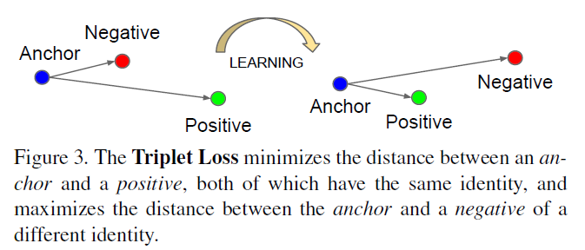
Other losses
Triplet loss (Schroff, FaceNet, CVPR 2015)
Anything you want! (almost)
a denotes anchor
p denotes positive
n denotes negative

Slide 35
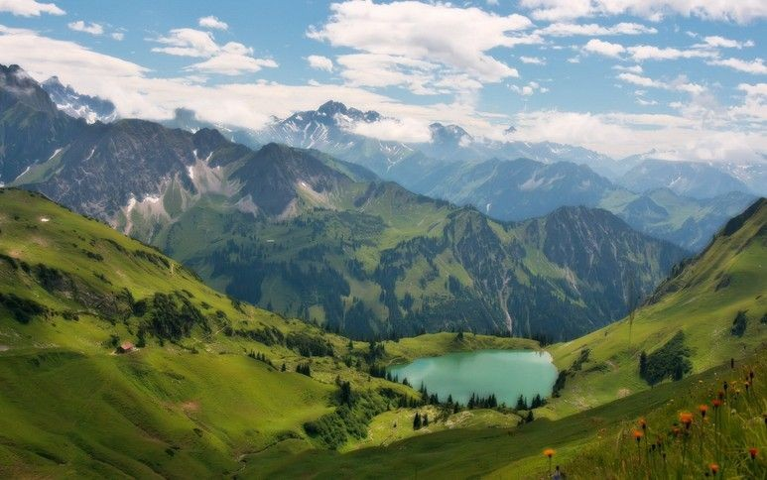

To minimize loss, use gradient descent
Andrej Karpathy

Slide 36
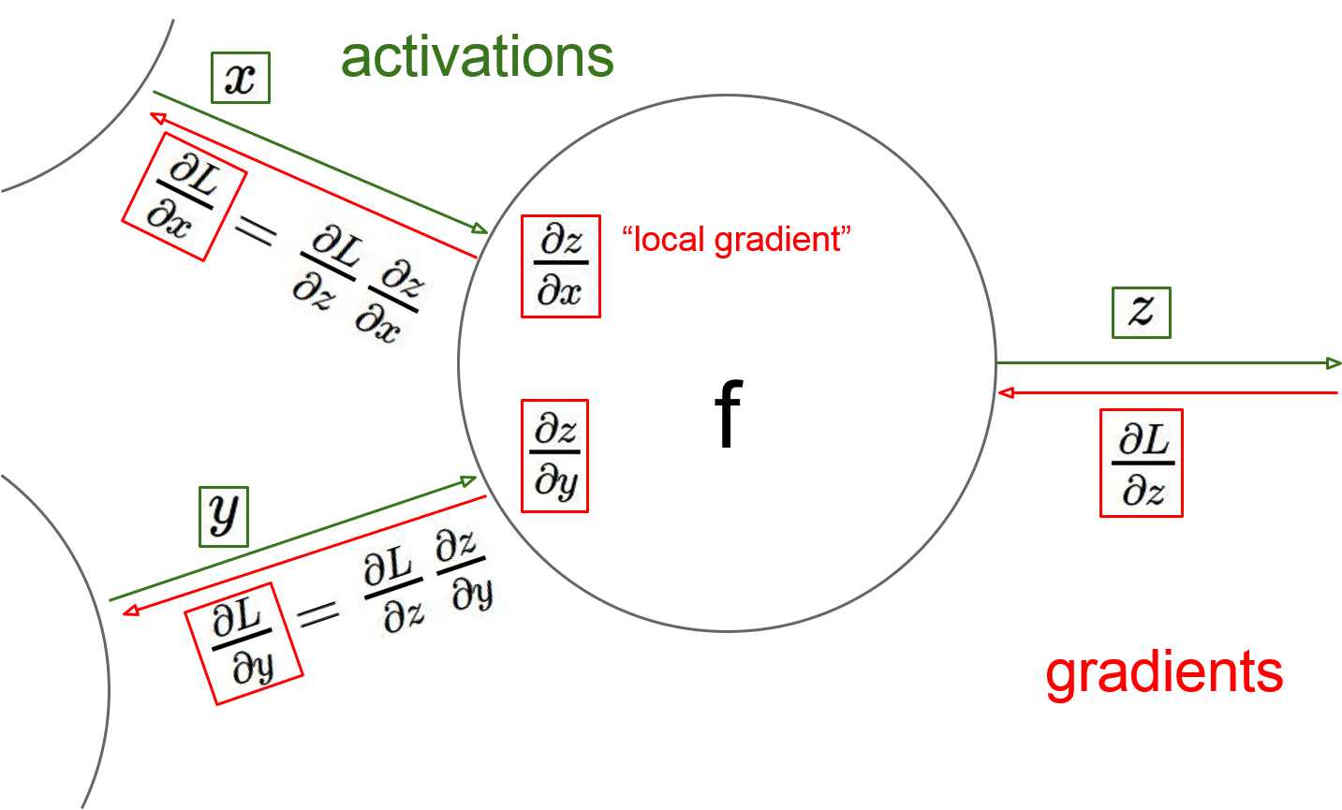
Gradient descent in multi-layer nets
How to update the weights at all layers?
Answer: backpropagation of error from higher layers to lower layers
Figure from Andrej Karpathy

Slide 37
Computing gradient for each weight
We need to move weights in direction opposite to gradient of loss wrt that weight:
w_{ji} = w_{ji} – η dE/dw_{ji}
w_{kj} = w_{kj} – η dE/dw_{kj}
Loss depends on weights in an indirect way, so we’ll use the chain rule and compute:
dE/dw_{ji} = dE/dz_{j} dz_{j}/da_{j} da_{j}/dw_{ji}
(and similarly for dE/dw_{kj} )
The error (dE/dz_{j}) is hard to compute (indirect, need chain rule again)
We’ll simplify the computation by doing it step by step via backpropagation of error

Slide 38
Backpropagation: Graphic example
First calculate error of output units and use this to change the top layer of weights.
output
k
j
i
Update weights into j
w⁽²⁾
hidden
w⁽¹⁾
input
Adapted from Ray Mooney, equations from Chris Bishop

Slide 39
Backpropagation: Graphic example
Next calculate error for hidden units based on errors on the output units it feeds into.
output
k
j
i
hidden
input
Adapted from Ray Mooney, equations from Chris Bishop

Slide 40
Backpropagation: Graphic example
Finally update bottom layer of weights based on errors calculated for hidden units.
output
k
j
i
Update weights into i
hidden
input
Adapted from Ray Mooney, equations from Chris Bishop

Slide 41


activations
Generic example
f
Fei-Fei Li & Andrej Karpathy & Justin Johnson Lecture 4 - 13 Jan 2016
Lecture 4 - 22
Andrej Karpathy

Slide 42


activations
Generic example
“local gradient”
f
gradients
Fei-Fei Li & Andrej Karpathy & Justin Johnson Lecture 4 - 13 Jan 2016
Lecture 4 - 23
Andrej Karpathy

Slide 43

activations
Generic example
“local gradient”
f
gradients
Fei-Fei Li & Andrej Karpathy & Justin Johnson Lecture 4 - 13 Jan 2016
Lecture 4 - 24
Andrej Karpathy

Slide 44
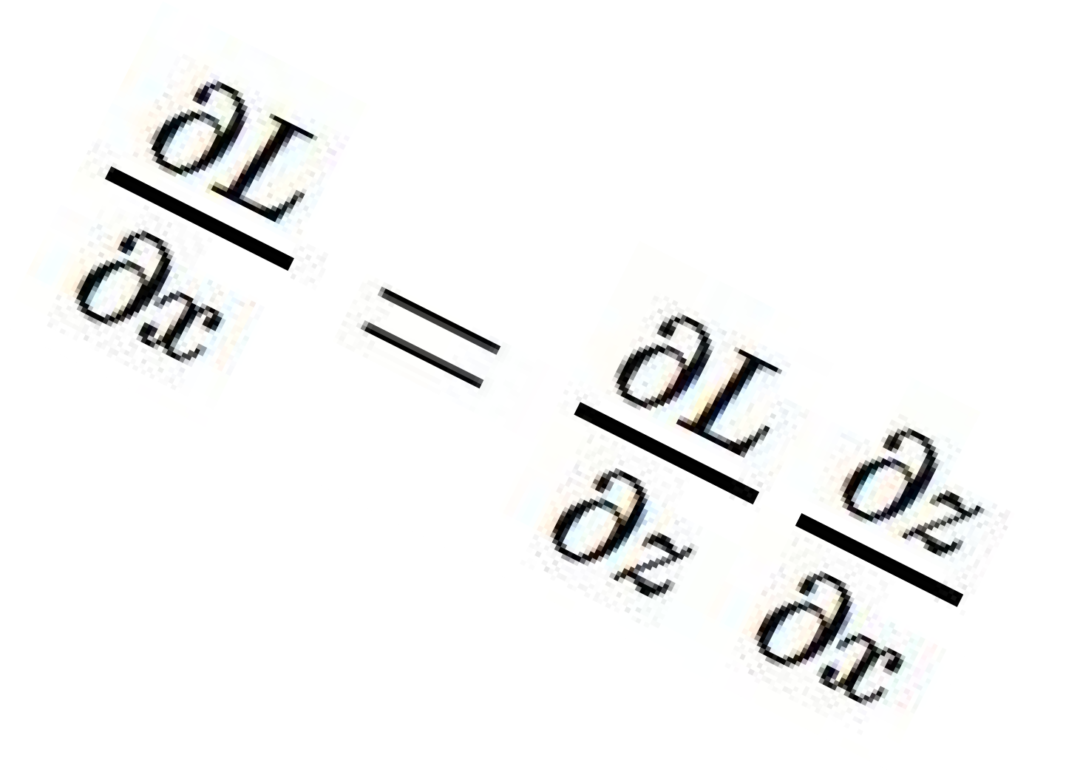
activations
Generic example
“local gradient”
f
gradients
Fei-Fei Li & Andrej Karpathy & Justin Johnson Lecture 4 - 13 Jan 2016
Lecture 4 - 25
Andrej Karpathy

Slide 45
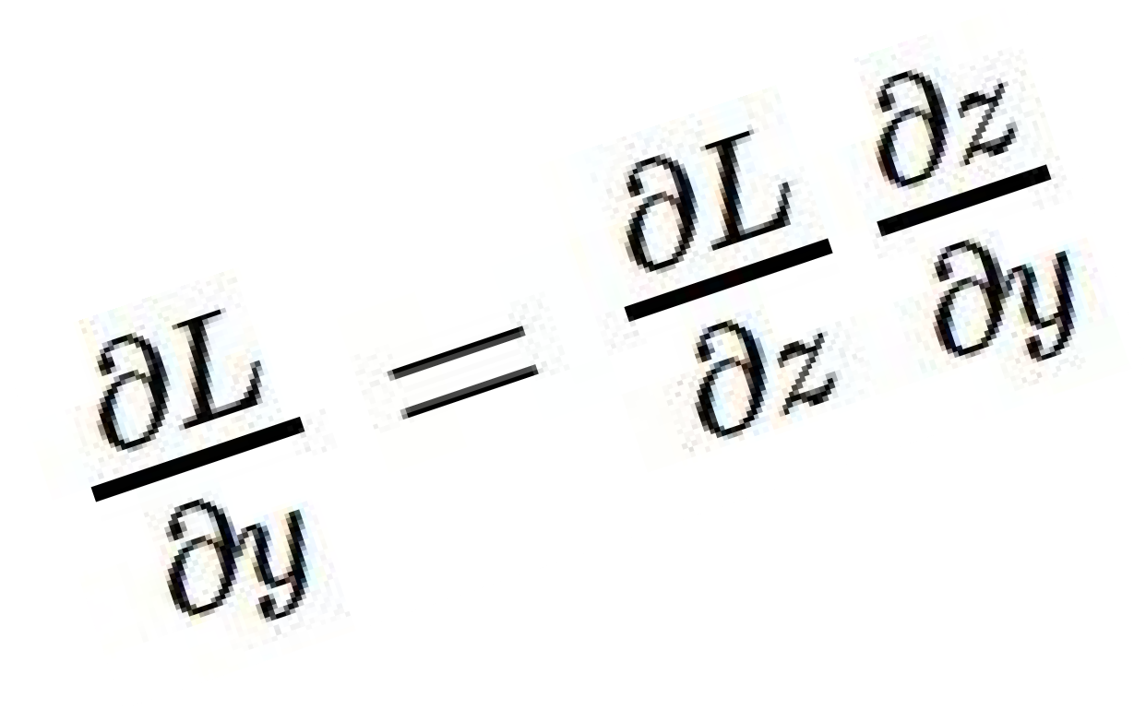
activations
Generic example
“local gradient”
f
gradients
Fei-Fei Li & Andrej Karpathy & Justin Johnson Lecture 4 - 13 Jan 2016
Lecture 4 - 26
Andrej Karpathy

Slide 46
activations
Generic example
“local gradient”
f
gradients
Fei-Fei Li & Andrej Karpathy & Justin Johnson Lecture 4 - 13 Jan 2016
Lecture 4 - 27
Andrej Karpathy

Slide 47
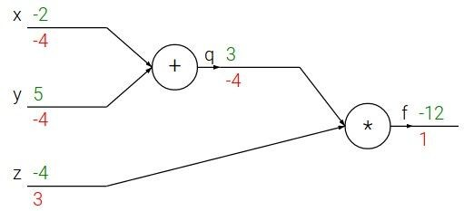

e.g. x = -2, y = 5, z = -4
Another generic example
Fei-Fei Li & Andrej Karpathy & Justin Johnson Lecture 4 - 13 Jan 2016
Lecture 4 - 10
Andrej Karpathy
Notes:
https://www.youtube.com/watch?v=QWfmCyLEQ8U&list=PL16j5WbGpaM0_Tj8CRmurZ8Kk1gEBc7fg&index=4

Slide 48





e.g. x = -2, y = 5, z = -4
Another generic example
Want:
Fei-Fei Li & Andrej Karpathy & Justin Johnson Lecture 4 - 13 Jan 2016
Lecture 4 - 11
Andrej Karpathy

Slide 49

e.g. x = -2, y = 5, z = -4
Another generic example
Want:
Fei-Fei Li & Andrej Karpathy & Justin Johnson Lecture 4 - 13 Jan 2016
Lecture 4 - 12
Andrej Karpathy

Slide 50
e.g. x = -2, y = 5, z = -4
Another generic example
Want:
Fei-Fei Li & Andrej Karpathy & Justin Johnson Lecture 4 - 13 Jan 2016
Lecture 4 - 13
Andrej Karpathy

Slide 51

e.g. x = -2, y = 5, z = -4
Another generic example
Want:
Fei-Fei Li & Andrej Karpathy & Justin Johnson Lecture 4 - 13 Jan 2016
Lecture 4 - 14
Andrej Karpathy

Slide 52
e.g. x = -2, y = 5, z = -4
Another generic example
Want:
Fei-Fei Li & Andrej Karpathy & Justin Johnson Lecture 4 - 13 Jan 2016
Lecture 4 - 15
Andrej Karpathy

Slide 53

e.g. x = -2, y = 5, z = -4
Another generic example
Want:
Fei-Fei Li & Andrej Karpathy & Justin Johnson Lecture 4 - 13 Jan 2016
Lecture 4 - 16
Andrej Karpathy

Slide 54
e.g. x = -2, y = 5, z = -4
Another generic example
Want:
Fei-Fei Li & Andrej Karpathy & Justin Johnson Lecture 4 - 13 Jan 2016
Lecture 4 - 17
Andrej Karpathy

Slide 55

e.g. x = -2, y = 5, z = -4
Another generic example
Want:
Fei-Fei Li & Andrej Karpathy & Justin Johnson Lecture 4 - 13 Jan 2016
Lecture 4 - 18
Andrej Karpathy

Slide 56


e.g. x = -2, y = 5, z = -4
Another generic example
Chain rule:
Want:
Fei-Fei Li & Andrej Karpathy & Justin Johnson Lecture 4 - 13 Jan 2016
Lecture 4 - 19
Andrej Karpathy

Slide 57

e.g. x = -2, y = 5, z = -4
Another generic example
Want:
Fei-Fei Li & Andrej Karpathy & Justin Johnson Lecture 4 - 13 Jan 2016
Lecture 4 - 20
Andrej Karpathy

Slide 58
e.g. x = -2, y = 5, z = -4
Another generic example
Chain rule:
Want:
Fei-Fei Li & Andrej Karpathy & Justin Johnson Lecture 4 - 13 Jan 2016
Lecture 4 - 21
Andrej Karpathy

Slide 59
How to compute gradient in neural net?
In a neural network:
Gradient is (using chain rule):
Denote the “errors” as:
Also:

Slide 60
How to compute gradient in neural net?
For output units (identity output, squared error loss):
For hidden units (using chain rule again):
Backprop formula:

Slide 61
Example
Two layer network w/ tanh at hidden layer:
Derivative:
Minimize:
Forward propagation:

Slide 62
Example
Errors at output (identity function at output):
Errors at hidden units:
Derivatives wrt weights:

Slide 63
Same example with graphic and math
First calculate error of output units and use this to change the top layer of weights.
output
k
j
i
Update weights into j
hidden
input
Adapted from Ray Mooney, equations from Chris Bishop

Slide 64
Same example with graphic and math
Next calculate error for hidden units based on errors on the output units it feeds into.
output
k
j
i
hidden
input
Adapted from Ray Mooney, equations from Chris Bishop

Slide 65
Same example with graphic and math
Finally update bottom layer of weights based on errors calculated for hidden units.
output
k
j
i
Update weights into i
hidden
input
Adapted from Ray Mooney, equations from Chris Bishop

Slide 66
Example: algorithm for sigmoid, sqerror
Initialize all weights to small random values
Until convergence (e.g. all training examples’ error small, or error stops decreasing) repeat:
  For each (x, t=class(x)) in training set:
    Calculate network outputs: y_{k}
    Compute errors (gradients wrt activations) for each unit:
      δ_{k} = y_{k} (1-y_{k}) (y_{k} - t_{k}) for output units
      δ_{j} = z_{j} (1-z_{j}) ∑_{k} w_{kj} δ_{k} for hidden units
    Update weights:
      w_{kj} = w_{kj} - η δ_{k} z_{j} for output units
      w_{ji} = w_{ji} - η δ_{j} x_{i} for hidden units
Recall: w_{ji} = w_{ji} – η dE/dz_{j} dz_{j}/da_{j} da_{j}/dw_{ji}
Adapted from R. Hwa, R. Mooney

Slide 67
Comments on training algorithm
Not guaranteed to converge to zero training error, may converge to local optima or oscillate indefinitely.
However, in practice, does converge to low error for many large networks on real data.
Thousands of epochs (epoch = network sees all training data once) may be required, hours or days to train.
To avoid local-minima problems, run several trials starting with different random weights (random restarts), and take results of trial with lowest training set error.
May be hard to set learning rate and to select number of hidden units and layers.
Neural networks had fallen out of fashion in 90s, early 2000s; back with a new name and significantly improved performance (deep networks trained with dropout and lots of data).
Ray Mooney, Carlos Guestrin, Dhruv Batra

Slide 68
Dealing with sparse data
Deep neural networks require lots of data, and can overfit easily
The more weights you need to learn, the more data you need
That’s why with a deeper network, you need more data for training than for a shallower network
Ways to prevent overfitting include:
  Using a validation set to stop training or pick parameters
  Regularization
  Transfer learning
  Data augmentation

Slide 69
Over-training prevention
Running too many epochs can result in over-fitting.
Keep a hold-out validation set and test accuracy on it after every epoch. Stop training when additional epochs actually increase validation error.
error
on test data
on training data
0
# training epochs
Adapted from Ray Mooney

Slide 70
Determining best number of hidden units
Too few hidden units prevents the network from adequately fitting the data.
Too many hidden units can result in over-fitting.
Use internal cross-validation to empirically determine an optimal number of hidden units.
error
on test data
on training data
0
# hidden units
Ray Mooney

Slide 71
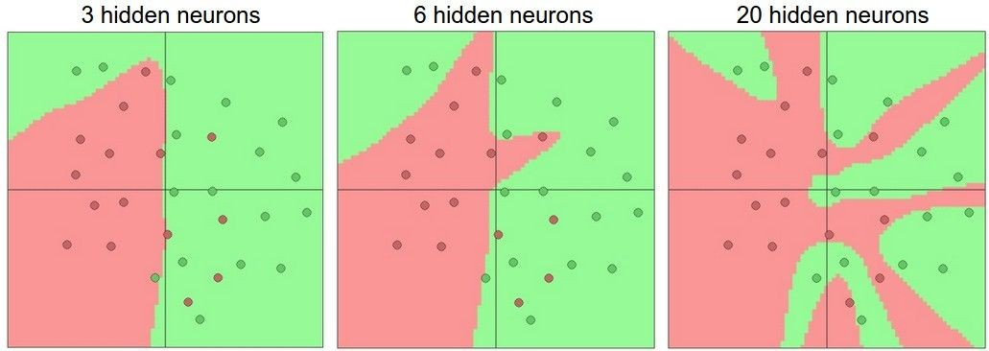
Effect of number of neurons
more neurons = more capacity
Andrej Karpathy

Slide 72
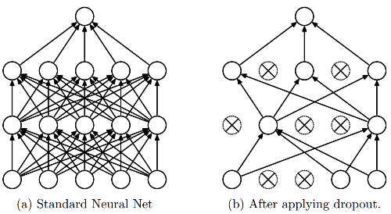
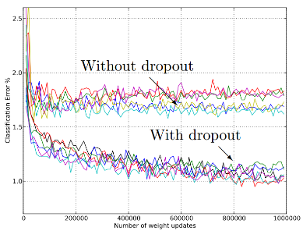
Regularization
L1, L2 regularization (weight decay)
Dropout
  Randomly turn off some neurons
  Allows individual neurons to independently be responsible for performance
Dropout: A simple way to prevent neural networks from overfitting [Srivastava JMLR 2014]
Adapted from Jia-bin Huang

Slide 73
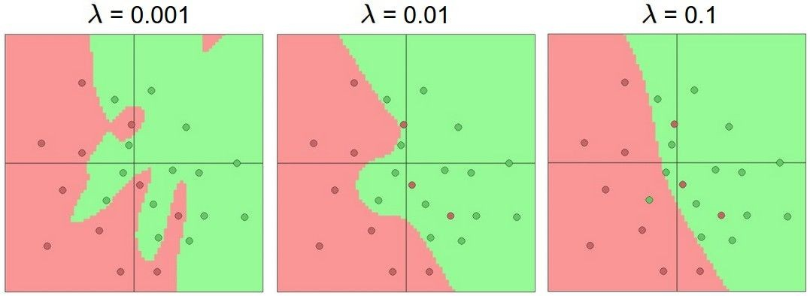
Do not use size of neural network as a regularizer. Use stronger regularization instead:
Effect of regularization
(you can play with this demo over at ConvNetJS: http://cs.stanford. edu/people/karpathy/convnetjs/demo/classify2d.html)
Andrej Karpathy

Slide 74
Transfer learning
If you have sparse data in your domain of interest (target), but have rich data in a disjoint yet related domain (source),
You can train the early layers on the source domain, and only the last few layers on the target domain:
Set these to the already learned
weights from another network
Learn these on your own task

Slide 75
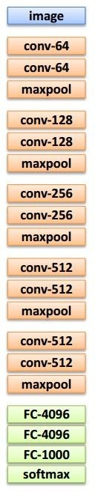
Transfer learning
Source: e.g. classification of animals Target: e.g. classification of cars
1. Train on source (large dataset)
2. Small dataset:
3. Medium dataset:
finetuning
more data = retrain more of the network (or all of it)
Freeze these
Freeze these
Train this
Train this
Lecture 11 - 29
Another option: use network as feature extractor,
train SVM/LR on extracted features for target task
Adapted from Andrej Karpathy

Slide 76
more generic
Transfer learning
 | very similar dataset | very different dataset
very little data | Use linear classifier on top layer | You’re in trouble… Try linear classifier from different stages
quite a lot of data | Finetune a few layers | Finetune a larger number of layers
more specific
Lecture 11 - 34
Andrej Karpathy

Slide 77
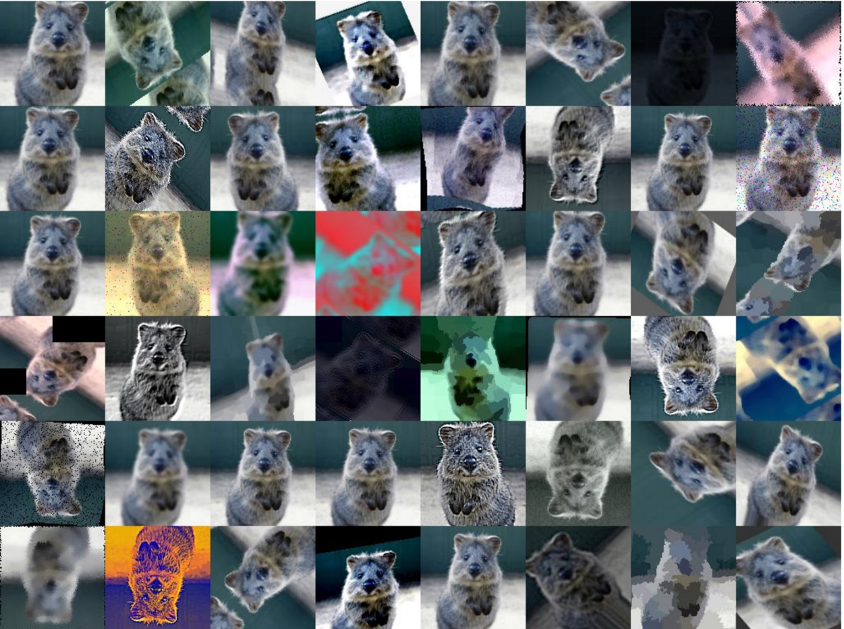
Another solution: Data augmentation
Create virtual training samples; if images:
  Horizontal flip
  Random crop
  Color casting
  Geometric distortion
Jia-bin Huang, Image: https://github.com/aleju/imgaug

Slide 78
Packages
TensorFlow
Torch / PyTorch
Keras
Caffe and Caffe Model Zoo

Slide 79
Learning Resources
http://deeplearning.net/
http://cs231n.stanford.edu (CNNs, vision)
http://cs224d.stanford.edu/ (RNNs, language)

Slide 80
Summary
Feed-forward network architecture
Training deep neural nets
  We need an objective function that measures and guides us towards good performance
  We need a way to minimize the loss function: (stochastic, mini-batch) gradient descent
  We need backpropagation to propagate error towards all layers and change weights at those layers
Practices for preventing overfitting, training with little data

Slide 81
Convolutional Neural Networks

Slide 82
“Shallow” vs. “deep” vision architectures
Traditional recognition: “Shallow” architecture
Image/ Video
Pixels
Hand-designed
feature extraction
Trainable
classifier
Object
Class
Deep learning: “Deep” architecture
Image/ Video
Pixels
Layer 1
Layer N
Simple classifier
…
Object Class
Lana Lazebnik

Slide 83
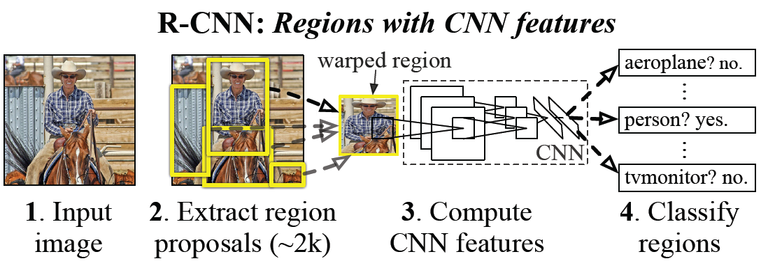
Example: CNN features for detection
Object detection system overview. Our system (1) takes an input image, (2) extracts around 2000 bottom-up region proposals, (3) computes features for each proposal using a large convolutional neural network (CNN), and then (4) classifies each region using class-specific linear SVMs. R-CNN achieves a mean average precision (mAP) of 53.7% on PASCAL VOC 2010. For comparison, Uijlings et al. (2013) report 35.1% mAP using the same region proposals, but with a spatial pyramid and bag-of-visual-words approach. The popular deformable part models perform at 33.4%.
R. Girshick, J. Donahue, T. Darrell, and J. Malik, Rich Feature Hierarchies for Accurate Object Detection and Semantic Segmentation, CVPR 2014.
Lana Lazebnik

Slide 84
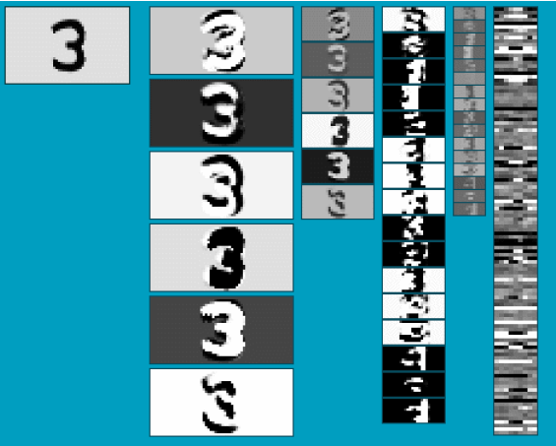
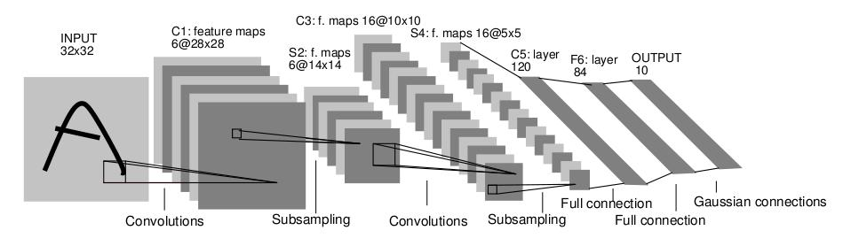
Convolutional Neural Networks (CNN)
Neural network with specialized connectivity structure
Stack multiple stages of feature extractors
Higher stages compute more global, more invariant, more abstract features
Classification layer at the end
Y. LeCun, L. Bottou, Y. Bengio, and P. Haffner, Gradient-based learning applied to document recognition, Proceedings of the IEEE 86(11): 2278–2324, 1998.
Adapted from Rob Fergus

Slide 85
Convolutional Neural Networks (CNN)
Feed-forward feature extraction:
  Convolve input with learned filters
  Apply non-linearity
  Spatial pooling (downsample)
Supervised training of convolutional
filters by back-propagating
classification error
Output (class probs)
…
Spatial pooling
Non-linearity
Convolution (Learned)
Input Image
Adapted from Lana Lazebnik

Slide 86
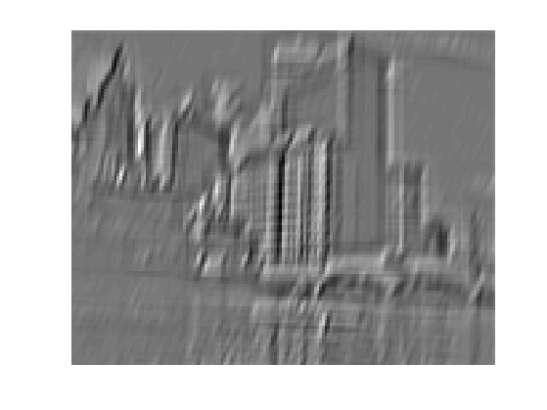
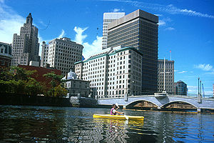
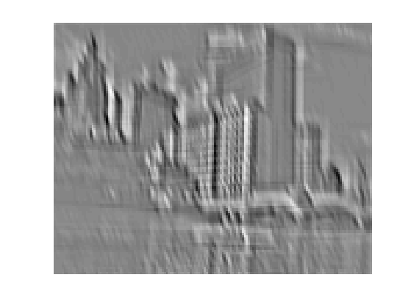
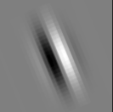
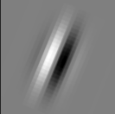
1. Convolution
Apply learned filter weights
One feature map per filter
Stride can be greater than 1 (faster, less memory)
...
Input
Feature Map
Adapted from Rob Fergus

Slide 87
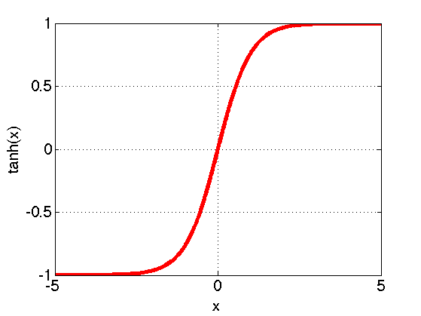
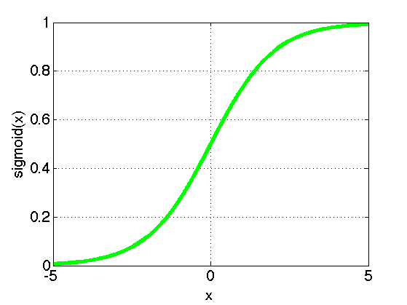
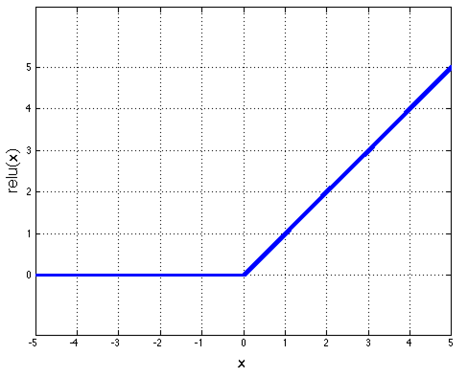
2. Non-Linearity
Per-element (independent)
Options:
  Tanh
  Sigmoid
  Rectified linear unit (ReLU)
    Avoids saturation issues
Adapted from Rob Fergus

Slide 88
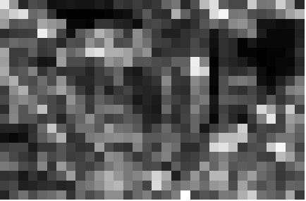
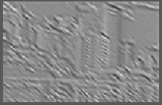
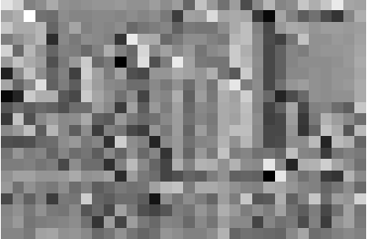
3. Spatial Pooling
Sum or max over non-overlapping / overlapping regions
Role of pooling:
  Invariance to small transformations
  Larger receptive fields (neurons see more of input)
  Max
  Sum
Adapted from Rob Fergus

Slide 89
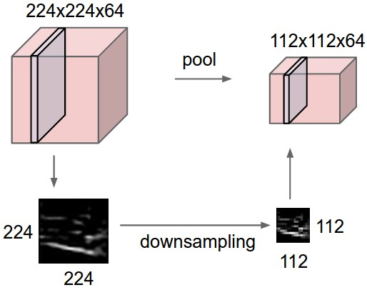
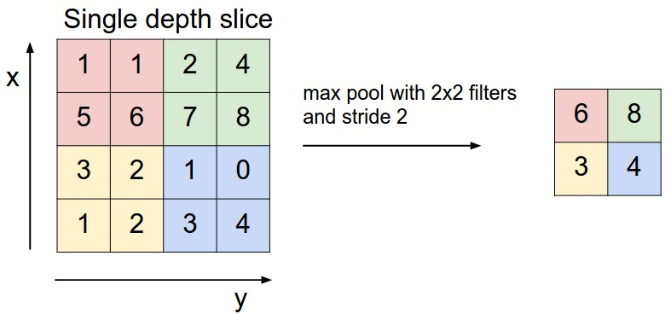
3. Spatial Pooling
Sum or max over non-overlapping / overlapping regions
Role of pooling:
  Invariance to small transformations
  Larger receptive fields (neurons see more of input)
Rob Fergus, figure from Andrej Karpathy

Slide 90
Convolutions: More detail
32x32x3 image
32
height
32
depth
width
3
Andrej Karpathy

Slide 91
Convolutions: More detail
32x32x3 image
5x5x3 filter
32
Convolve the filter with the image
i.e. “slide over the image spatially, computing dot products”
32
3
Andrej Karpathy

Slide 92


Convolution Layer
Convolutions: More detail
32x32x3 image 5x5x3 filter
32
1 number:
the result of taking a dot product between the filter and a small 5x5x3 chunk of the image
(i.e. 5*5*3 = 75-dimensional dot product + bias)
32
3
Andrej Karpathy

Slide 93
Convolution Layer
Convolutions: More detail
activation map
32x32x3 image
5x5x3 filter
32
28
convolve (slide) over all spatial locations
32
28
3
1
Andrej Karpathy

Slide 94
consider a second, green filter
Convolutions: More detail
Convolution Layer
32x32x3 image 5x5x3 filter
activation maps
32
28
convolve (slide) over all spatial locations
32
28
3
1
Andrej Karpathy

Slide 95
For example, if we had 6 5x5 filters, we’ll get 6 separate activation maps:
Convolutions: More detail
activation maps
32
28
Convolution Layer
32
28
3
6
We stack these up to get a “new image” of size 28x28x6!
Andrej Karpathy

Slide 96
Preview: ConvNet is a sequence of Convolution Layers, interspersed with activation functions
Convolutions: More detail
32
28
CONV, ReLU
e.g. 6 5x5x3 filters
32
28
3
6
Andrej Karpathy

Slide 97
Preview: ConvNet is a sequence of Convolutional Layers, interspersed with activation functions
Convolutions: More detail
32
28
24
….
CONV, ReLU
e.g. 6 5x5x3 filters
CONV, ReLU
e.g. 10 5x5x6 filters
CONV, ReLU
32
28
24
3
6
10
Andrej Karpathy

Slide 98
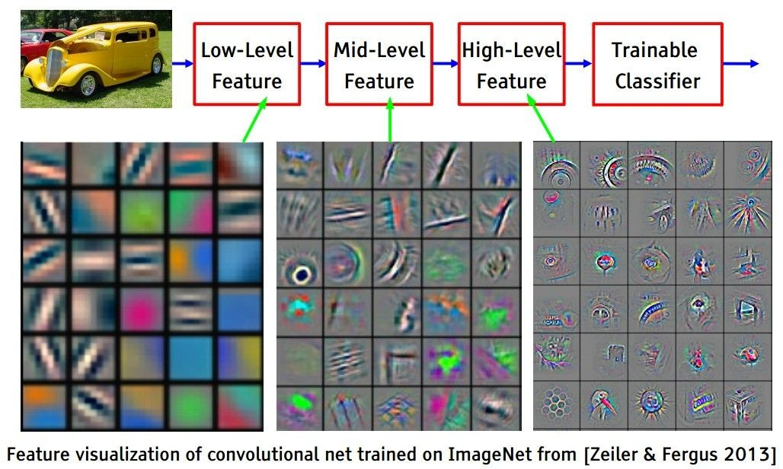
Preview
Convolutions: More detail
[From recent Yann LeCun slides]
Andrej Karpathy

Slide 99
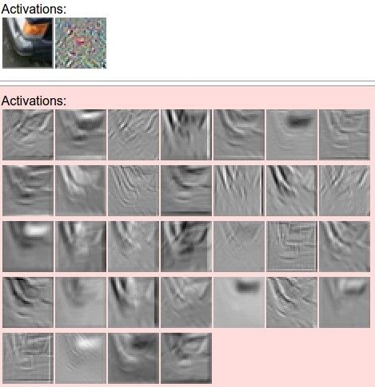
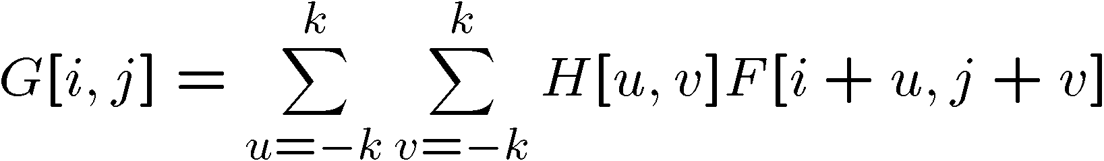
one filter =>
one activation map
Convolutions: More detail
example 5x5 filters
(32 total)
We call the layer convolutional because it is related to convolution of two signals:
Element-wise multiplication and sum of a filter and the signal (image)
Adapted from Andrej Karpathy, Kristen Grauman

Slide 100
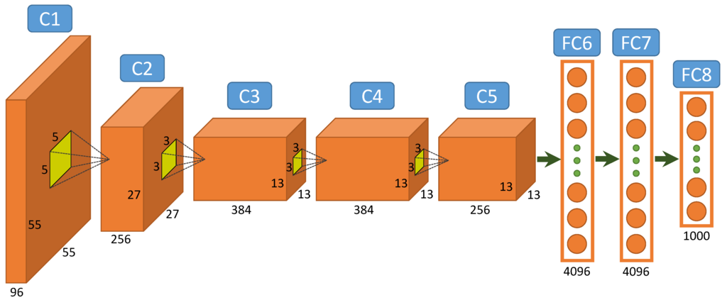
The First Popular Architecture: AlexNet
Figure from http://www.mdpi.com/2072-4292/7/11/14680/htm

Slide 101
Recurrent Neural Networks

Slide 102
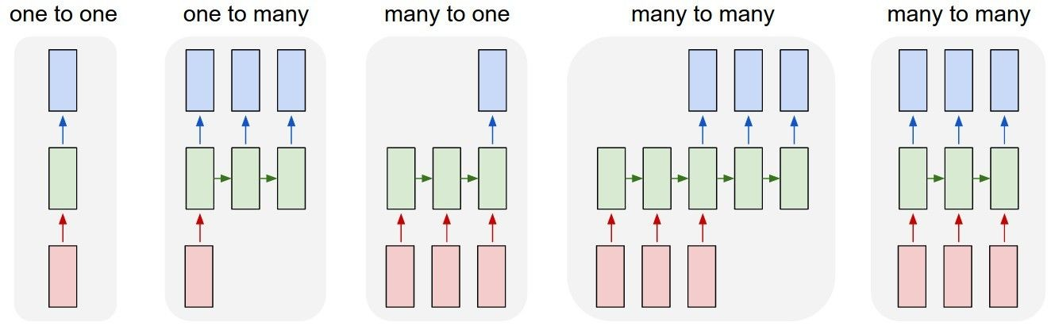
Examples of Recurrent Networks
vanilla neural networks
Andrej Karpathy

Slide 103
Examples of Recurrent Networks
e.g. image captioning
image -> sequence of words
Andrej Karpathy

Slide 104
Examples of Recurrent Networks
e.g. sentiment classification
sequence of words -> sentiment
Andrej Karpathy

Slide 105
Examples of Recurrent Networks
e.g. machine translation
seq of words -> seq of words
Andrej Karpathy

Slide 106
Examples of Recurrent Networks
e.g. video classification on frame level
Andrej Karpathy

Slide 107
Recurrent Neural Network
RNN
RNN
x
Andrej Karpathy

Slide 108
Recurrent Neural Network
y
usually want to output a prediction at some time steps
RNN
x
Adapted from Andrej Karpathy

Slide 109

Recurrent Neural Network
We can process a sequence of vectors x by applying a recurrence formula at every time step:
y
RNN
new state
old state input vector at
some time step
some function
with parameters W
x
Andrej Karpathy

Slide 110
Recurrent Neural Network
We can process a sequence of vectors x by applying a recurrence formula at every time step:
y
RNN
Notice: the same function and the same set of parameters are used at every time step.
x
Andrej Karpathy

Slide 111

(Vanilla) Recurrent Neural Network
The state consists of a single “hidden” vector h:
y
RNN
x
Andrej Karpathy

Slide 112
Character-level language model example
Example
RNN
x
y
Vocabulary: [h,e,l,o]
Example training sequence: “hello”
Andrej Karpathy

Slide 113

Example
Character-level language model example
Vocabulary: [h,e,l,o]
Example training sequence: “hello”
Andrej Karpathy

Slide 114
Example
Character-level language model example
Vocabulary: [h,e,l,o]
Example training sequence: “hello”
Andrej Karpathy

Slide 115
Example
Character-level language model example
Vocabulary: [h,e,l,o]
Example training sequence: “hello”
Andrej Karpathy

Slide 116
Extensions
Vanishing gradient problem makes it hard to model long sequences
  Multiplying together many values between 0 and 1 (range of gradient of sigmoid, tanh)
One solution: Use RELU
Another solution: Use RNNs with gates
  Adaptively decide how much of memory to keep
  Gated Recurrent Units (GRUs), Long Short Term Memories (LSTMs)

Slide 117

Generating poetry with RNNs
Fei-Fei Li & Andrej Karpathy & Justin Johnson Lecture 10 - 8 Feb 2016
Lecture 10 -
35
Andrej Karpathy

Slide 118



at first:
Generating poetry with RNNs
train more
train more
train more
Fei-Fei Li & Andrej Karpathy & Justin Johnson Lecture 10 - 8 Feb 2016
Lecture 10 -
36
More info: http://karpathy.github.io/2015/05/21/rnn-effectiveness/
Andrej Karpathy

Slide 119


Generating poetry with RNNs
Fei-Fei Li & Andrej Karpathy & Justin Johnson Lecture 10 - 8 Feb 2016
Lecture 10 -
37
Andrej Karpathy

Slide 120

open source textbook on algebraic geometry
Generating textbooks with RNNs
Latex source
Fei-Fei Li & Andrej Karpathy & Justin Johnson Lecture 10 - 8 Feb 2016
Lecture 10 -
38
Andrej Karpathy

Slide 121

Generating textbooks with RNNs
Fei-Fei Li & Andrej Karpathy & Justin Johnson Lecture 10 - 8 Feb 2016
Lecture 10 -
39
Andrej Karpathy

Slide 122

Generating textbooks with RNNs
Fei-Fei Li & Andrej Karpathy & Justin Johnson Lecture 10 - 8 Feb 2016
Lecture 10 -
40
Andrej Karpathy

Slide 123

Generated C code
Generating code with RNNs
Fei-Fei Li & Andrej Karpathy & Justin Johnson Lecture 10 - 8 Feb 2016
Lecture 10 -
42
Andrej Karpathy

Slide 124

Image Captioning
CVPR 2015:
Deep Visual-Semantic Alignments for Generating Image Descriptions, Karpathy and Fei-Fei Show and Tell: A Neural Image Caption Generator, Vinyals et al.
Long-term Recurrent Convolutional Networks for Visual Recognition and Description, Donahue et al. Learning a Recurrent Visual Representation for Image Caption Generation, Chen and Zitnick
Adapted from Andrej Karpathy

Slide 125
Recurrent Neural Network
Image Captioning
Convolutional Neural Network
Andrej Karpathy

Slide 126

test image
Image Captioning
Andrej Karpathy

Slide 127
test image
Andrej Karpathy

Slide 128
test image
X
Andrej Karpathy

Slide 129
test image
Image Captioning
x0
<START>
<START>
Andrej Karpathy

Slide 130
Image Captioning
test image
y0
before:
h = tanh(W_{xh} * x + W_{hh} * h)
h0
Wih
now:
h = tanh(W_{xh} * x + W_{hh} * h + W_{ih} * im)
x0
<START>
im
<START>
Andrej Karpathy

Slide 131
test image
Image Captioning
y0
sample!
h0
x0
<START>
straw
<START>
Andrej Karpathy

Slide 132
test image
Image Captioning
y0
y1
h0
h1
x0
<START>
straw
<START>
Andrej Karpathy

Slide 133
test image
Image Captioning
y0
y1
sample!
h0
h1
x0
<START>
straw
hat
<START>
Andrej Karpathy

Slide 134
test image
Image Captioning
y0
y1
y2
h0
h1
h2
x0
<START>
straw
hat
<START>
Andrej Karpathy

Slide 135
test image
Image Captioning
Caption generated:
“straw hat”
y0
y1
y2
sample
<END> token
=> finish.
h0
h1
h2
x0
<START>
straw
hat
<START>
Adapted from Andrej Karpathy

Slide 136

Image Captioning
Andrej Karpathy

