Slide 1
CS 1675: Intro to Machine Learning
Support Vector Machines
Prof. Adriana Kovashka
University of Pittsburgh
October 23, 2018

Slide 2
Plan for this lecture
Linear Support Vector Machines
Non-linear SVMs and the “kernel trick”
Extensions and further details (briefly)
  Soft-margin SVMs
  Multi-class SVMs
  Comparison: SVM vs logistic regression
  Why SVM solution is what it is (briefly)

Slide 3
Linear classifiers
Find linear function to separate positive and negative examples
Which line
is best?
C. Burges, A Tutorial on Support Vector Machines for Pattern Recognition, Data Mining and Knowledge Discovery, 1998

Slide 4
Support vector machines
Discriminative classifier based on optimal separating line (for 2d case)
Maximize the margin between the positive and negative training examples
C. Burges, A Tutorial on Support Vector Machines for Pattern Recognition, Data Mining and Knowledge Discovery, 1998

Slide 5
Support vector machines
Want line that maximizes the margin.
wx+b=1
wx+b=0
wx+b=-1
For support, vectors,
Support vectors
Margin
C. Burges, A Tutorial on Support Vector Machines for Pattern Recognition, Data Mining and Knowledge Discovery, 1998

Slide 6
Aside: Lines in R²
Let
Kristen Grauman

Slide 7
Aside: Lines in R²
Let
Kristen Grauman

Slide 8
Aside: Lines in R²
Let
Kristen Grauman

Slide 9
Aside: Lines in R²
Let
distance from point to line
Kristen Grauman

Slide 10
Support vector machines
Want line that maximizes the margin.
wx+b=1
wx+b=0
wx+b=-1
For support, vectors,
Distance between point and line:
For support vectors:
Support vectors
Margin
C. Burges, A Tutorial on Support Vector Machines for Pattern Recognition, Data Mining and Knowledge Discovery, 1998

Slide 11
Support vector machines
Want line that maximizes the margin.
wx+b=1
wx+b=0
wx+b=-1
For support, vectors,
Distance between point and line:
Therefore, the margin is 2 / ||w||
Support vectors
Margin
C. Burges, A Tutorial on Support Vector Machines for Pattern Recognition, Data Mining and Knowledge Discovery, 1998

Slide 12
Finding the maximum margin line
Maximize margin 2/||w||
Correctly classify all training data points:
Quadratic optimization problem:
Minimize
Subject to y_{i}(w·x_{i}+b) ≥ 1
One constraint for each training point.
Note sign trick.
C. Burges, A Tutorial on Support Vector Machines for Pattern Recognition, Data Mining and Knowledge Discovery, 1998

Slide 13
Finding the maximum margin line
Solution:
Learned
weight
Support
vector
C. Burges, A Tutorial on Support Vector Machines for Pattern Recognition, Data Mining and Knowledge Discovery, 1998

Slide 14
Finding the maximum margin line
Solution:
b = y_{i} – w·x_{i} (for any support vector)
Classification function:
Notice that it relies on an inner product between the test point x and the support vectors x_{i}
(Solving the optimization problem also involves computing the inner products x_{i} · x_{j} between all pairs of training points)
MORE DETAILS NEXT TIME
If f(x) < 0, classify as negative, otherwise classify as positive.
C. Burges, A Tutorial on Support Vector Machines for Pattern Recognition, Data Mining and Knowledge Discovery, 1998

Slide 15
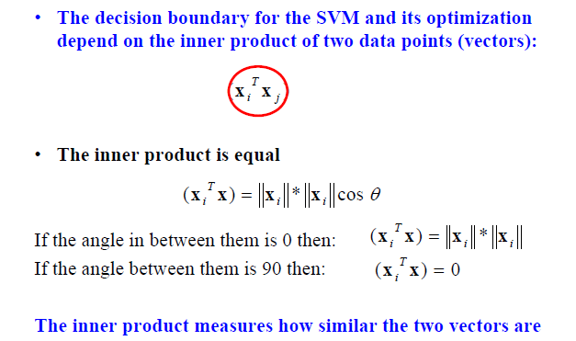
Inner product
Adapted from Milos Hauskrecht

Slide 16
Example
4
3
2
1
-1
POS
NEG
-1 0 1
= support vectors
Example adapted from Dan Ventura

Slide 17
Solving for the alphas
We know that for the support vectors, f(x) = 1 or -1 exactly
Add a 1 in the feature representation for the bias
The support vectors have coordinates and labels:
  x1 = [0 1 1], y1 = -1
  x2 = [-1 3 1], y2 = +1
  x3 = [1 3 1], y3 = +1
Thus we can form the following system of linear equations:

Slide 18
Solving for the alphas
System of linear equations:
α1 y1 dot(x1, x1) + α2 y2 dot(x1, x2) + α3 y3 dot(x1, x3) = y1
α1 y1 dot(x2, x1) + α2 y2 dot(x2, x2) + α3 y3 dot(x2, x3) = y2
α1 y1 dot(x3, x1) + α2 y2 dot(x3, x2) + α3 y3 dot(x3, x3) = y3
-2 * α1 + 4 * α2 + 4 * α3 = -1
-4 * α1 + 11 * α2 + 9 * α3 = +1
-4 * α1 + 9 * α2 + 11 * α3 = +1
Solution: α1 = 3.5, α2 = 0.75, α3 = 0.75

Slide 19
Solving for w, b; plotting boundary
We know w = α₁ y₁ x₁ + … + α_{N} y_{N} x_{N} where N = # SVs
Thus w = -3.5 * [0 1 1] + 0.75 [-1 3 1] + 0.75 [1 3 1] = [0 1 -2]
Separating out weights and bias, we have: w = [0 1] and b = -2
For SVMs, we used this eq for a line: ax + cy + b = 0 where w = [a c]
Thus ax + b = -cy ➔ y = (-a/c) x + (-b/c)
Thus y-intercept is -(-2)/1 = 2
The decision boundary is perpendicular to w and it has slope -0/1 = 0

Slide 20
Example
4
3
2
1
-1
POS
DECISION BOUNDARY
NEG
-1 0 1
= support vectors

Slide 21
Plan for this lecture
Linear Support Vector Machines
Non-linear SVMs and the “kernel trick”
Extensions and further details (briefly)
  Soft-margin SVMs
  Multi-class SVMs
  Comparison: SVM vs logistic regression
  Why SVM solution is what it is (briefly)

Slide 22
Nonlinear SVMs
Datasets that are linearly separable work out great:
But what if the dataset is just too hard?
We can map it to a higher-dimensional space:
0
x
0
x
x²
0
x
Andrew Moore

Slide 23
Nonlinear SVMs
General idea: the original input space can always be mapped to some higher-dimensional feature space where the training set is separable:
Φ: x → φ(x)
Andrew Moore

Slide 24
Nonlinear kernel: Example
Consider the mapping
x²
Svetlana Lazebnik

Slide 25
The “kernel trick”
The linear classifier relies on dot product between vectors K(x_{i} , x_{j}) = x_{i} · x_{j}
If every data point is mapped into high-dimensional space via some transformation Φ: x_{i} → φ(x_{i} ), the dot product becomes: K(x_{i} , x_{j}) = φ(x_{i} ) · φ(x_{j})
A kernel function is similarity function that corresponds to an inner product in some expanded feature space
The kernel trick: instead of explicitly computing the lifting transformation φ(x), define a kernel function K such that: K(x_{i} , x_{j}) = φ(x_{i} ) · φ(x_{j})
Andrew Moore

Slide 26
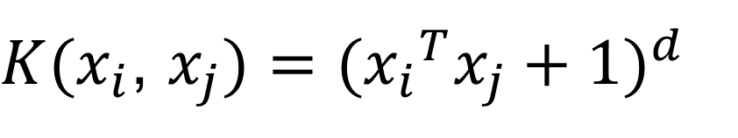
Examples of kernel functions
Linear:
Polynomials of degree up to d:
Gaussian RBF:
Histogram intersection:
$K(x_{i}$, $x_{j})={({x_{i}}^{T}x_{j}+1)}^{d}$
Andrew Moore / Carlos Guestrin

Slide 27
The benefit of the “kernel trick”
Example: Polynomial kernel for 2-dim features
… lives in 6 dimensions
With the kernel trick, we directly compute an inner product in 2-dim space, obtaining a scalar that we add 1 to and exponentiate

Slide 28
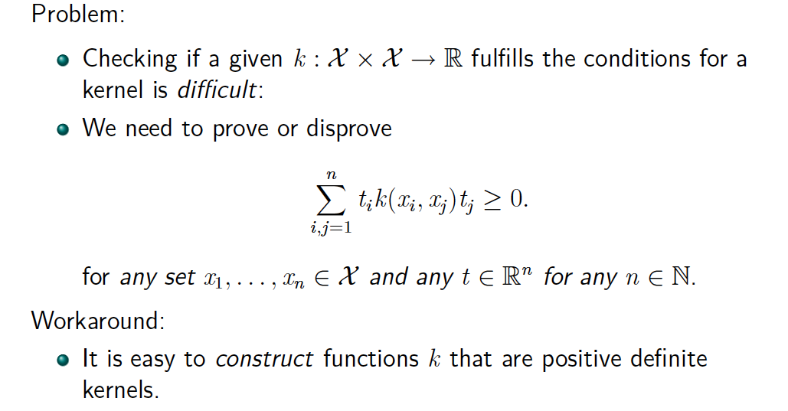
Is this function a kernel?
Blaschko / Lampert

Slide 29
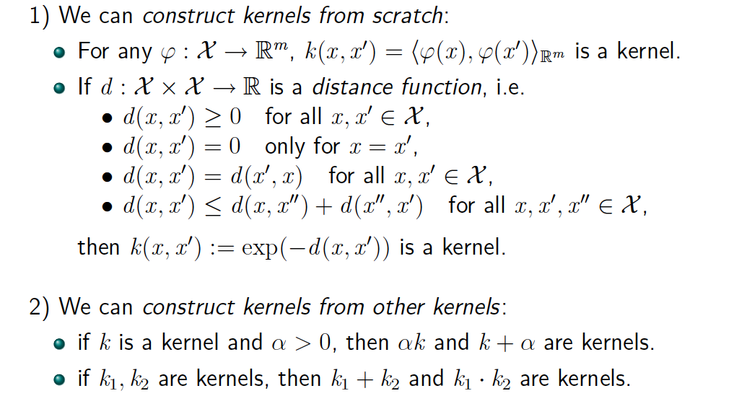
Constructing kernels
Blaschko / Lampert

Slide 30
Using SVMs
Select a kernel function.
Compute pairwise kernel values between labeled examples.
Use this “kernel matrix” to solve for SVM support vectors & alpha weights.
To classify a new example: compute kernel values between new input and support vectors, apply alpha weights, check sign of output.
Adapted from Kristen Grauman

Slide 31
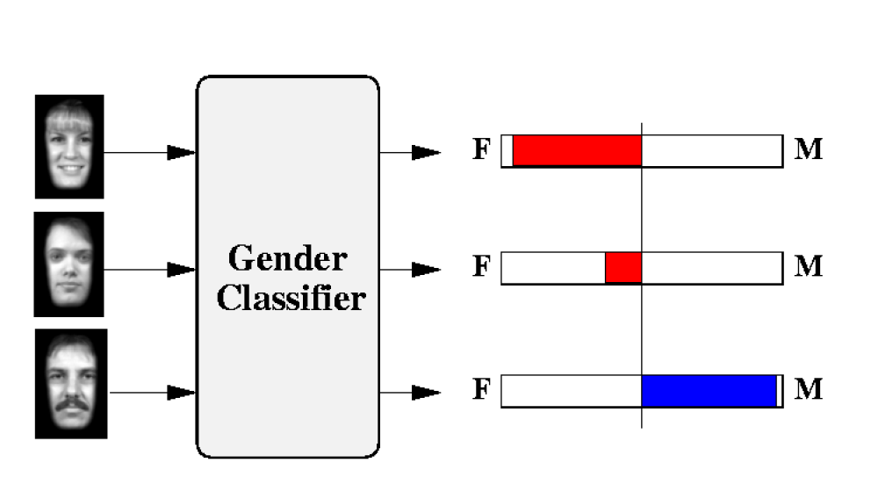
Example: Learning gender w/ SVMs
Moghaddam and Yang, Learning Gender with Support Faces, TPAMI 2002
Moghaddam and Yang, Face & Gesture 2000
Kristen Grauman

Slide 32
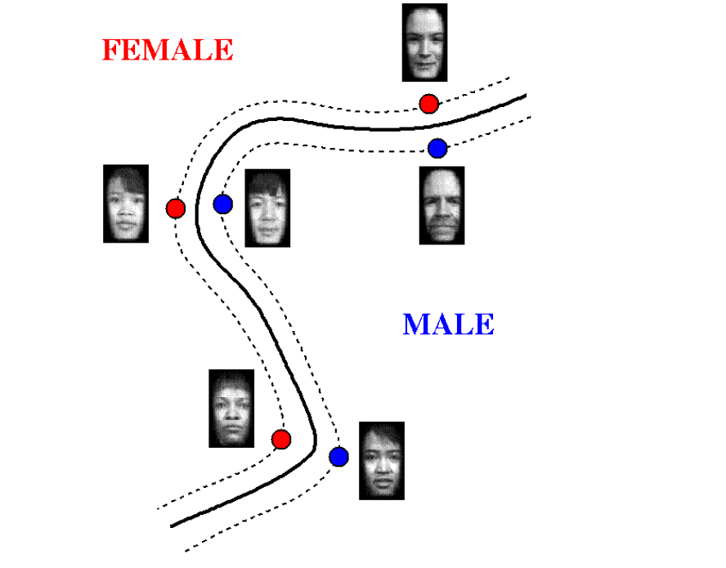
Example: Learning gender w/ SVMs
Support faces
Kristen Grauman

Slide 33
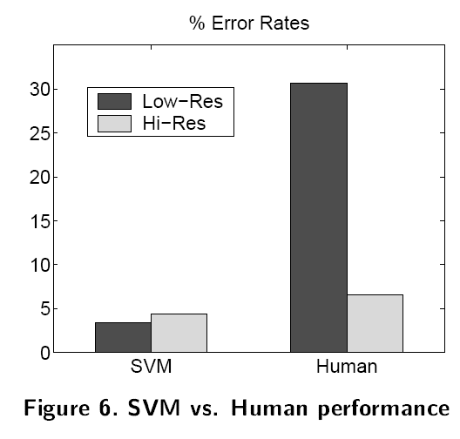
Example: Learning gender w/ SVMs
SVMs performed better than humans, at either resolution
Kristen Grauman

Slide 34
Plan for this lecture
Linear Support Vector Machines
Non-linear SVMs and the “kernel trick”
Extensions and further details (briefly)
  Soft-margin SVMs
  Multi-class SVMs
  Comparison: SVM vs logistic regression
  Why SVM solution is what it is (briefly)

Slide 35
Hard-margin SVMs
The w that minimizes…
Maximize margin

Slide 36
Soft-margin SVMs (allow misclassification)
# data samples
Misclassification
cost
Slack variable
The w that minimizes…
Maximize margin
Minimize misclassification

Slide 37
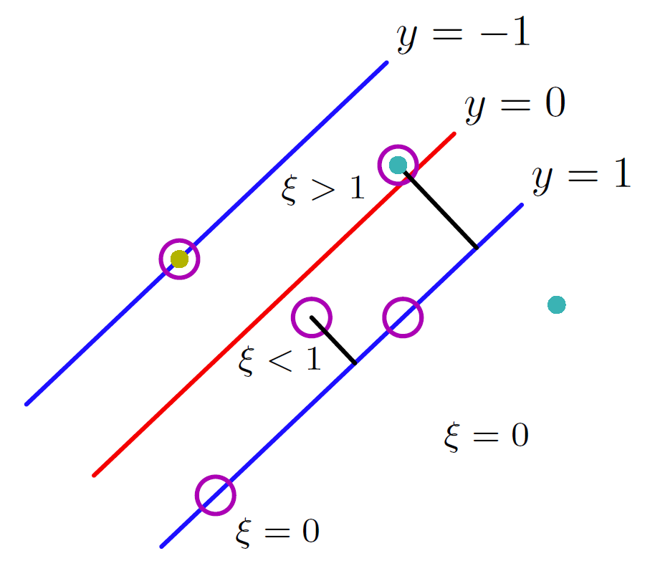
Slack variables in soft-margin SVMs
Figure from Bishop

Slide 38
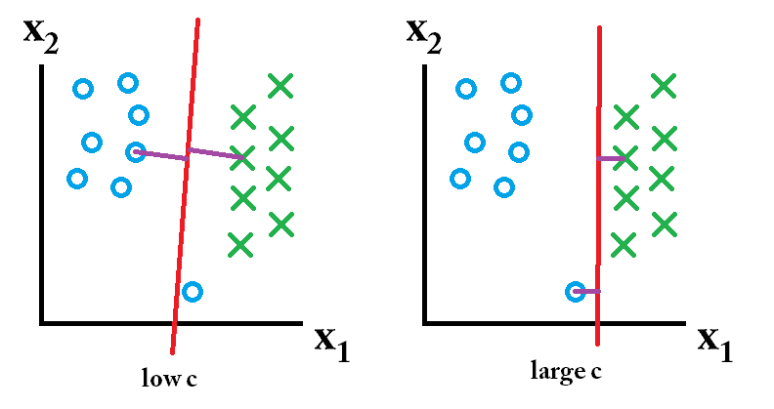
Effect of margin size vs miscl. cost (c)
Training set
Misclassification ok, want large margin
Misclassification not ok
Image: Kent Munthe Caspersen

Slide 39
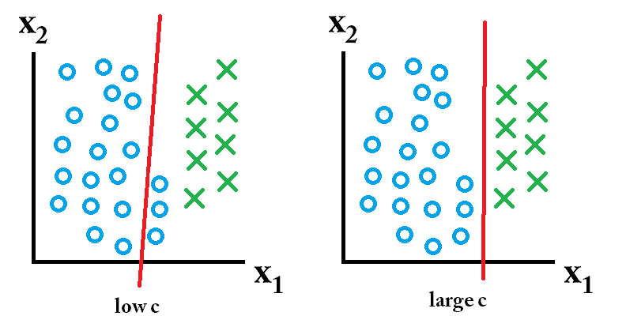
Effect of margin size vs miscl. cost (c)
Including test set A
Misclassification ok, want large margin
Misclassification not ok
Image: Kent Munthe Caspersen

Slide 40
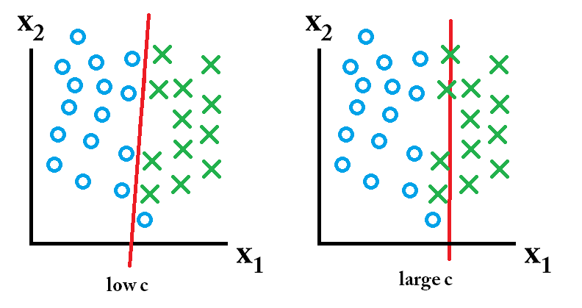
Effect of margin size
Including test set B
Misclassification ok, want large margin
Misclassification not ok
Image: Kent Munthe Caspersen

Slide 41
Multi-class problems
Instead of just two classes, we now have C classes
  E.g. predict which movie genre a viewer likes best
  Possible answers: action, drama, indie, thriller, etc.
Two approaches:
  One-vs-all
  One-vs-one

Slide 42
Multi-class problems
One-vs-all (a.k.a. one-vs-others)
  Train C classifiers
  In each, pos = data from class i, neg = data from classes other than i
  The class with the most confident prediction wins
  Example:
    You have 4 classes, train 4 classifiers
    1 vs others: score 3.5
    2 vs others: score 6.2
    3 vs others: score 1.4
    4 vs other: score 5.5
    Final prediction: class 2
  Issues?

Slide 43
Multi-class problems
One-vs-one (a.k.a. all-vs-all)
  Train C(C-1)/2 binary classifiers (all pairs of classes)
  They all vote for the label
  Example:
    You have 4 classes, then train 6 classifiers
    1 vs 2, 1 vs 3, 1 vs 4, 2 vs 3, 2 vs 4, 3 vs 4
    Votes: 1, 1, 4, 2, 4, 4
    Final prediction is class 4

Slide 44





Hinge loss (unconstrained objective)
Let
We have the objective to minimize where:
Then we can define a loss:
and unconstrained SVM objective:

Slide 45
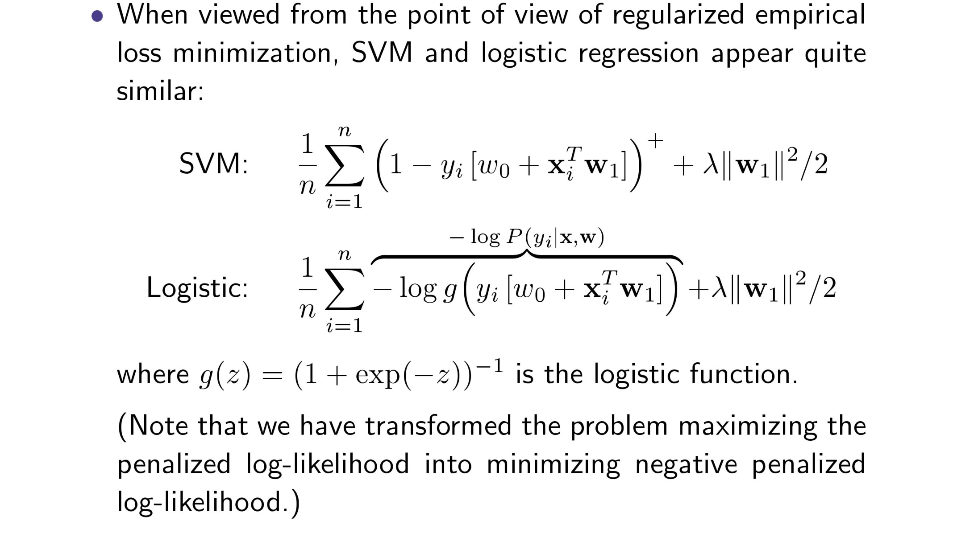
SVMs vs logistic regression
σ
σ
Adapted from Tommi Jaakola

Slide 46
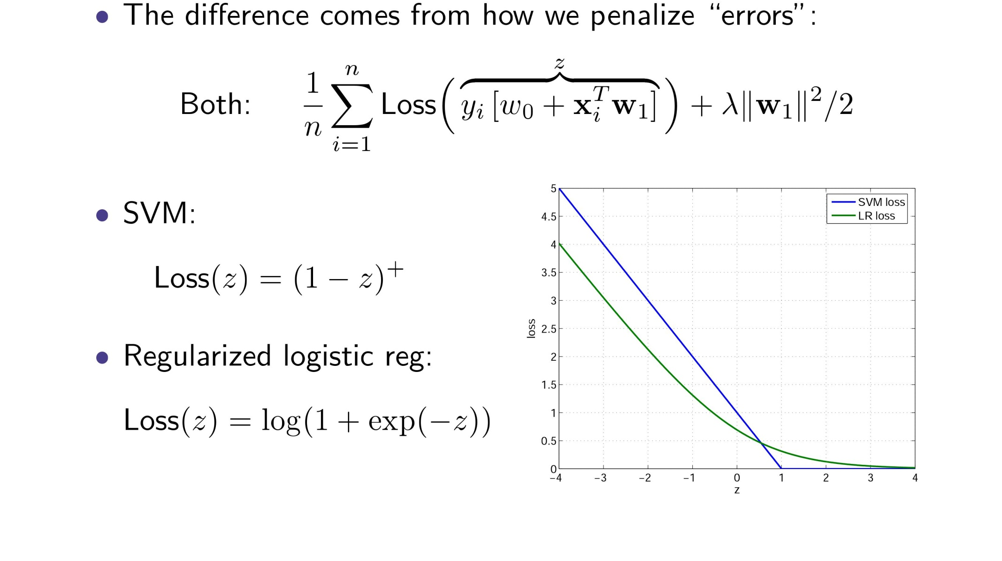
SVMs vs logistic regression
Adapted from Tommi Jaakola

Slide 47
SVMs: Pros and cons
Pros
  Kernel-based framework is very powerful, flexible
  Often a sparse set of support vectors – compact at test time
  Work very well in practice, even with very small training sample sizes
  Solution can be formulated as a quadratic program (next time)
  Many publicly available SVM packages: e.g. LIBSVM, LIBLINEAR, SVMLight
Cons
  Can be tricky to select best kernel function for a problem
  Computation, memory
    At training time, must compute kernel values for all example pairs
    Learning can take a very long time for large-scale problems
Adapted from Lana Lazebnik

