Slide 1
CS 1675: Intro to Machine Learning
Intro to Classification
(Nearest Neighbors,
Logistic Regression, Perceptron)
Prof. Adriana Kovashka
University of Pittsburgh
September 27, 2018

Slide 2
Classification
Given features x, predict categorical output y
For example:
  Given attributes of a house (e.g. square footage and age built), predict whether it will be bought for the asking price or for less
  Given temperature, predict whether it will rain, snow, or be sunny
The rest of the course will cover different supervised approaches to classification

Slide 3
Plan for this lecture
The simplest classifier: K-Nearest Neighbors
  Algorithm and example use
  Generalizing: Distance metrics, weighing neighbors
  Problems: curse of dimensionality, picking K
Logistic regression
  Probability: review
  Linear regression for classification?
  Maximum likelihood solution for logistic regression
  Related algorithm: perceptron

Slide 4
Nearest Neighbors: Key Idea
A type of supervised learning: We want to learn to predict, for a new data point x, its label y (e.g. spam / not spam)
Don’t learn an explicit function F: X → Y
Keep all training data {X, Y}
For a test example x, find the training example x_{i} closest to it (e.g. using Euclidean distance)
Then copy the target label y_{i} as the label for x

Slide 5
Related Methods / Synonyms
Instance-based methods
Exemplar methods
Memory-based methods
Non-parametric methods

Slide 6
Instance/Memory-based Learning
Four things make a memory based learner:
A distance metric
How many nearby neighbors to look at?
A weighting function (optional)
How to fit with the local points?
Slide credit: Carlos Guestrin

Slide 7
1-Nearest Neighbor Classifier
Four things make a memory based learner:
A distance metric
  Euclidean (and others)
How many nearby neighbors to look at?
  1
A weighting function (optional)
  Not used
How to fit with the local points?
  Predict the same output as the nearest neighbor
Slide credit: Carlos Guestrin

Slide 8
1-Nearest Neighbor Classifier
Test example
Training examples from class 2
Training examples from class 1
f(x) = label of the training example nearest to x
Adapted from Lana Lazebnik

Slide 9
K-Nearest Neighbor Classifier
Four things make a memory based learner:
A distance metric
  Euclidean (and others)
How many nearby neighbors to look at?
  K
A weighting function (optional)
  Not used
How to fit with the local points?
  Predict the average output among the nearest neighbors
Slide credit: Carlos Guestrin

Slide 10
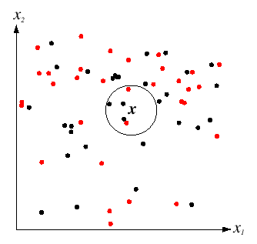
K-Nearest Neighbor Classifier
For a new point, find the k closest points from training data (e.g. k=5)
Labels of the k points “vote” to classify
Black = negative
Red = positive
If query lands here, the 5 NN consist of 3 negatives and 2 positives, so we classify it as negative.
Slide credit: David Lowe

Slide 11
1-nearest neighbor
x
x
x
o
x
x
x
+
o
o
x
x
o
o
+
o
o
x2
x1
Slide credit: Derek Hoiem

Slide 12
3-nearest neighbor
x
x
x
o
x
x
x
+
o
o
x
x
o
o
+
o
o
x2
x1
Slide credit: Derek Hoiem

Slide 13
5-nearest neighbor
x
x
x
o
x
x
x
+
o
o
x
x
o
o
+
o
o
x2
x1
What are the tradeoffs of having a too large k? Too small k?
Slide credit: Derek Hoiem

Slide 14

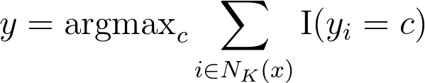
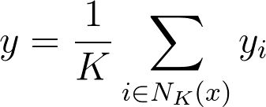
Formal Definition
Let x be our test data point, and N_{K}(x) be the indices of the k nearest neighbors of x
Classification:
Regression:

Slide 15
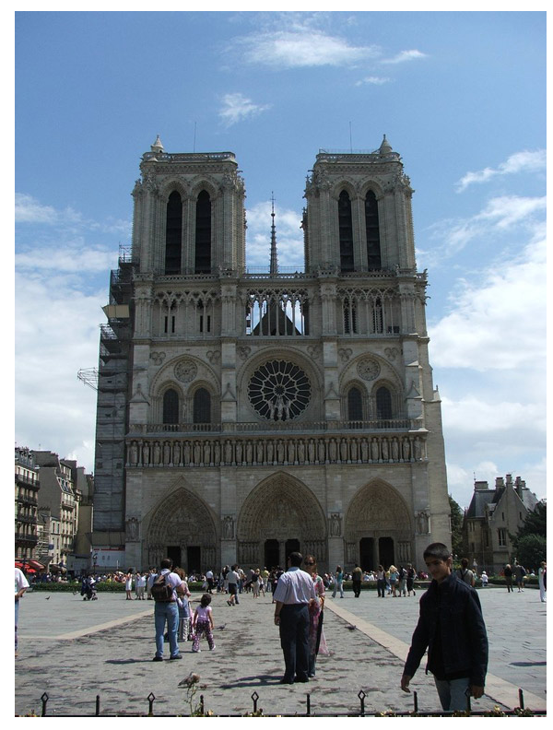
Example: Predict where this picture was taken
Hays and Efros, IM2GPS: Estimating Geographic Information from a Single Image, CVPR 2008

Slide 16
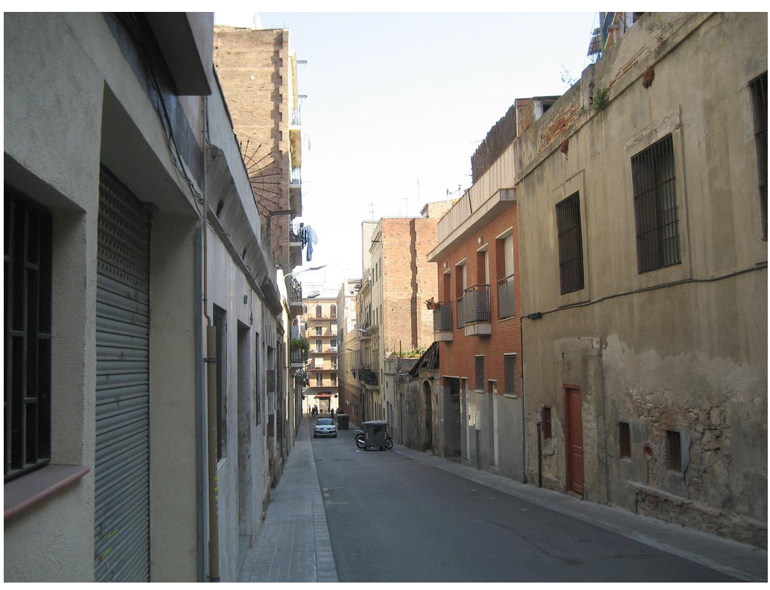
Example: Predict where this picture was taken
Hays and Efros, IM2GPS: Estimating Geographic Information from a Single Image, CVPR 2008

Slide 17

Example: Predict where this picture was taken
Hays and Efros, IM2GPS: Estimating Geographic Information from a Single Image, CVPR 2008

Slide 18

6+ million geotagged photos by 109,788 photographers
Hays and Efros, IM2GPS: Estimating Geographic Information from a Single Image, CVPR 2008

Slide 19
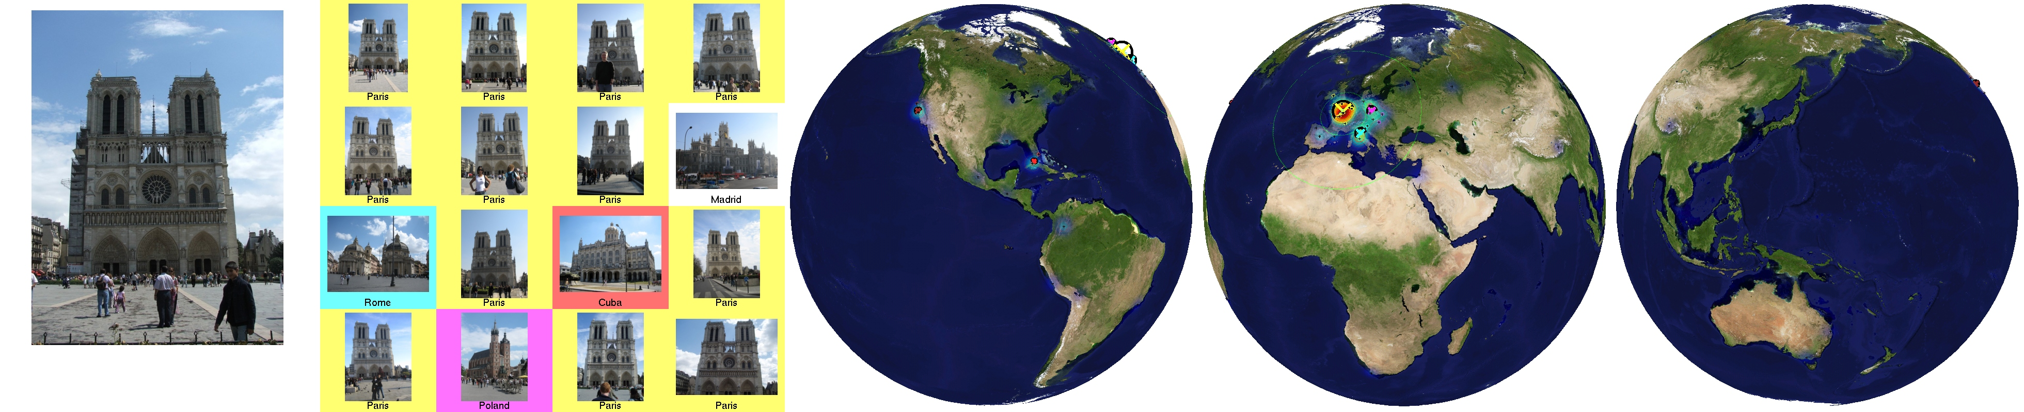
Scene Matches
Hays and Efros, IM2GPS: Estimating Geographic Information from a Single Image, CVPR 2008

Slide 20

Hays and Efros, IM2GPS: Estimating Geographic Information from a Single Image, CVPR 2008

Slide 21
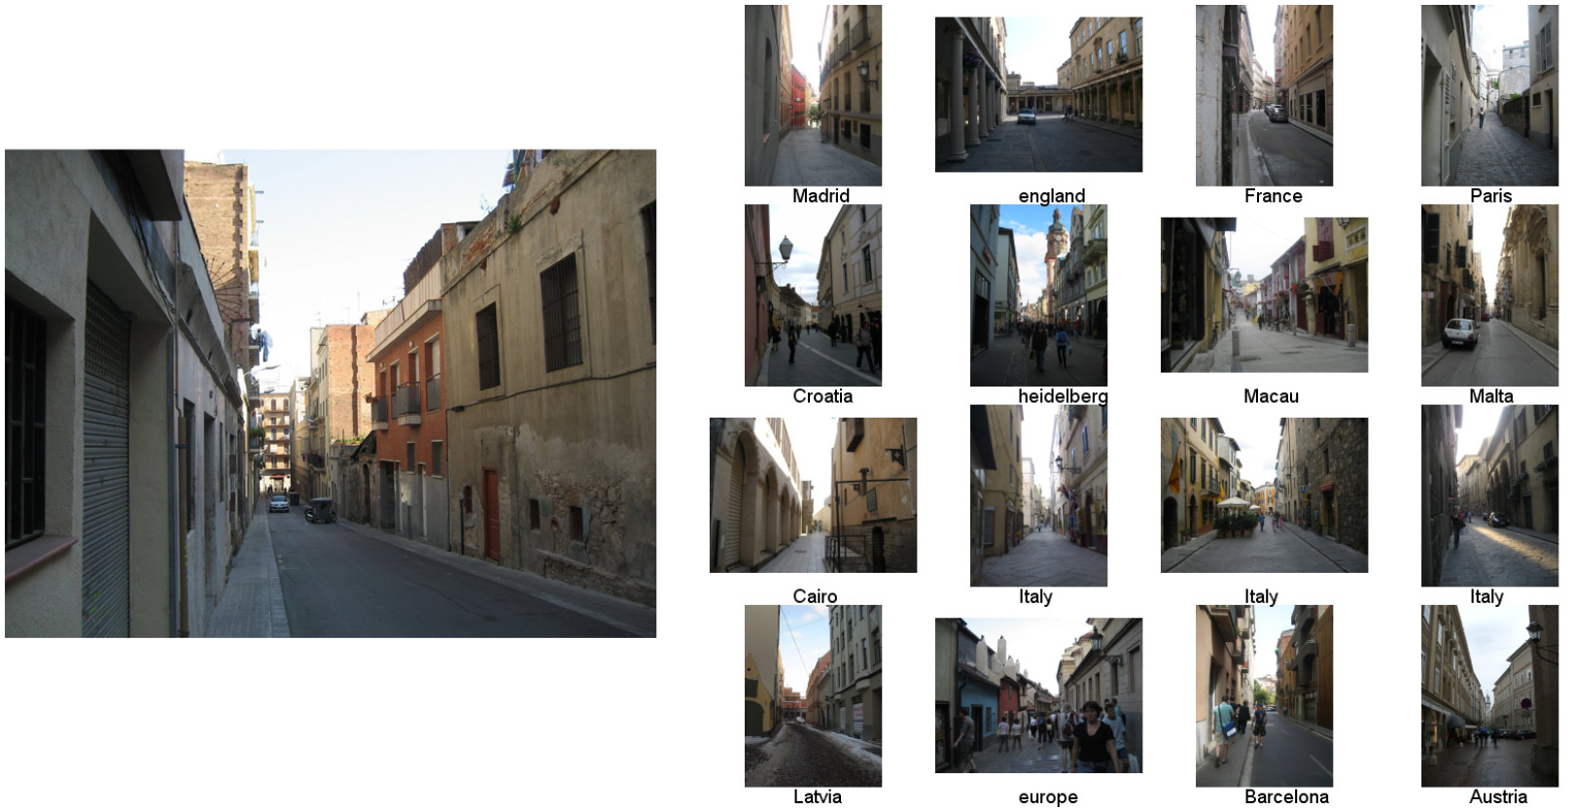
Scene Matches
Hays and Efros, IM2GPS: Estimating Geographic Information from a Single Image, CVPR 2008

Slide 22

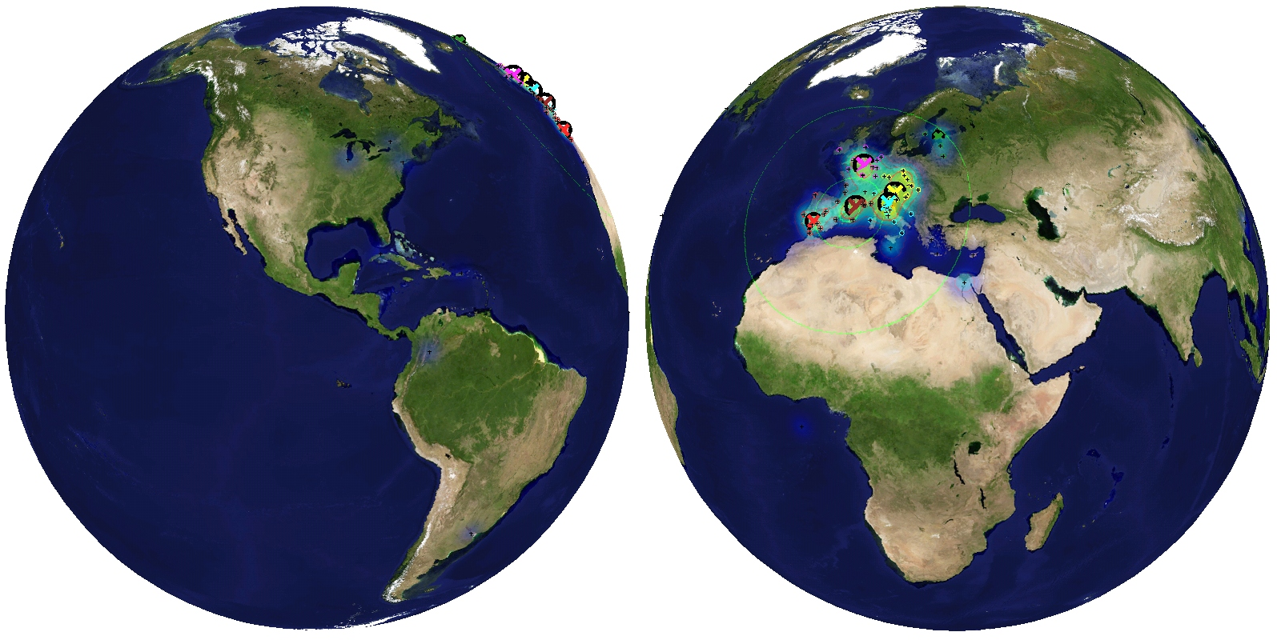
Hays and Efros, IM2GPS: Estimating Geographic Information from a Single Image, CVPR 2008

Slide 23

Scene Matches
Hays and Efros, IM2GPS: Estimating Geographic Information from a Single Image, CVPR 2008

Slide 24


Hays and Efros, IM2GPS: Estimating Geographic Information from a Single Image, CVPR 2008

Slide 25
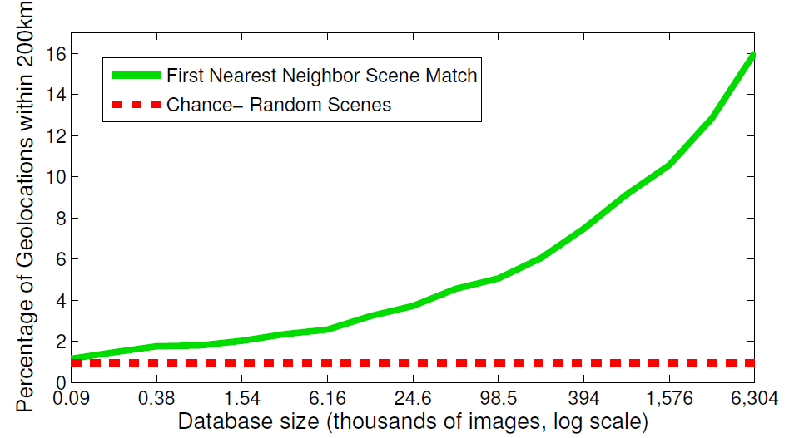
The Importance of Data
Hays and Efros, IM2GPS: Estimating Geographic Information from a Single Image, CVPR 2008

Slide 26
k-Nearest Neighbor
Four things make a memory based learner:
A distance metric
  Euclidean (and others)
How many nearby neighbors to look at?
  k
A weighting function (optional)
  Not used
How to fit with the local points?
  Just predict the average output among the nearest neighbors
Slide credit: Carlos Guestrin

Slide 27
Distances
Suppose I want to charge my overall distance more for differences in x₂ direction as opposed to x₁ direction
Setup A: equal weighing on all directions
Setup B: more weight on x₂ direction
Will my neighborhoods be longer in the x₁ or x₂ direction?

Slide 28

Voronoi partitioning
Nearest neighbor regions
All points in a region are closer to the seed in that region than to any other seed (black dots = seeds)
Figure from Wikipedia

Slide 29
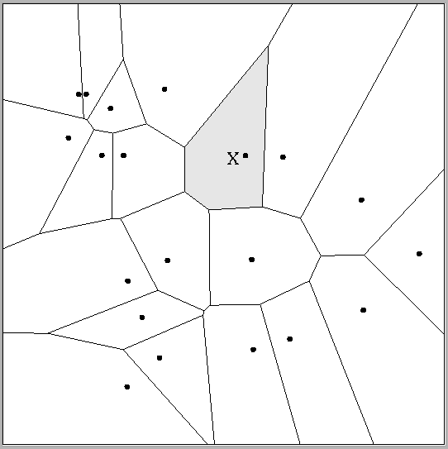
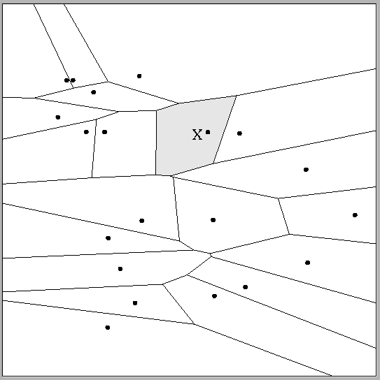
Multivariate distance metrics
Suppose the input vectors x₁, x₂, …x_{N} are two dimensional:
x₁ = ( x₁¹ , x₁² ) , x₂ = ( x₂¹ , x₂² ) , … , x_{N} = ( x_{N}¹ , x_{N}² ).
 | Dist(x_{i},x_{j}) =(x_{i}¹ – x_{j}¹)²+(3x_{i}² – 3x_{j}²)²
Dist(x_{i},x_{j}) = (x_{i}¹ – x_{j}¹)² + (x_{i}² – x_{j}²)²
The relative scalings in the distance metric affect region shapes
Adapted from Carlos Guestrin

Slide 30
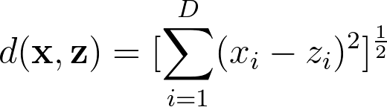
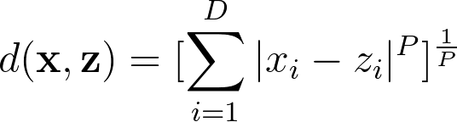
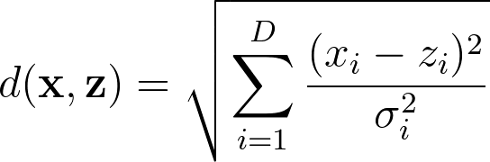
Distance metrics
Euclidean:
Minkowski:
Mahalanobis:
(where A is a positive semidefinite matrix,
i.e. symmetric matrix with all non-negative eigenvalues)

Slide 31
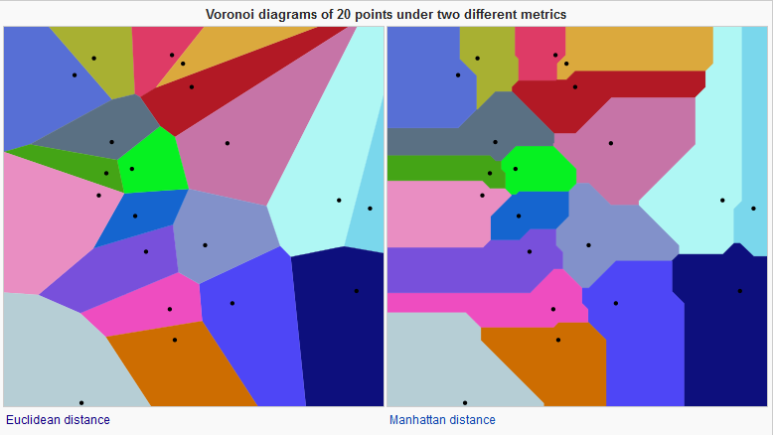
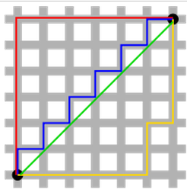
Distance metrics
Euclidean
Manhattan
Figures from Wikipedia

Slide 32

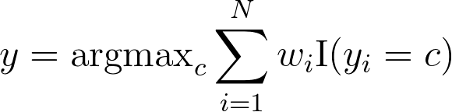
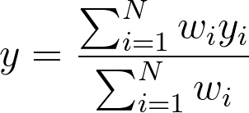
Another generalization: Weighted K-NNs
Neighbors weighted differently:
  Use all samples, i.e. K = N
  Weight on i-th sample:
  σ = the bandwidth parameter, expresses how quickly our weight function “drops off” as points get further and further from the query x
Classification:
Regression:

Slide 33
Another generalization: Weighted K-NNs
Extremes
  Bandwidth = infinity: prediction is dataset average
  Bandwidth = zero: prediction becomes 1-NN

Slide 34
Kernel Regression/Classification
Four things make a memory based learner:
A distance metric
  Euclidean (and others)
How many nearby neighbors to look at?
  All of them
A weighting function (optional)
  w_{i} = exp(-d(x_{i}, query)² / σ²)
  Nearby points to the query are weighted strongly, far points weakly. The σ parameter is the kernel width / bandwidth.
How to fit with the local points?
  Predict the weighted average of the outputs
Adapted from Carlos Guestrin

Slide 35
Problems with Instance-Based Learning
Too many features?
  Doesn’t work well if large number of irrelevant features, distances overwhelmed by noisy features
  Distances become meaningless in high dimensions (the curse of dimensionality)
What is the impact of the value of K?
Expensive
  No learning: most real work done during testing
  For every test sample, must search through all dataset – very slow!
  Must use tricks like approximate nearest neighbor search
  Need to store all training data
Adapted from Dhruv Batra

Slide 36
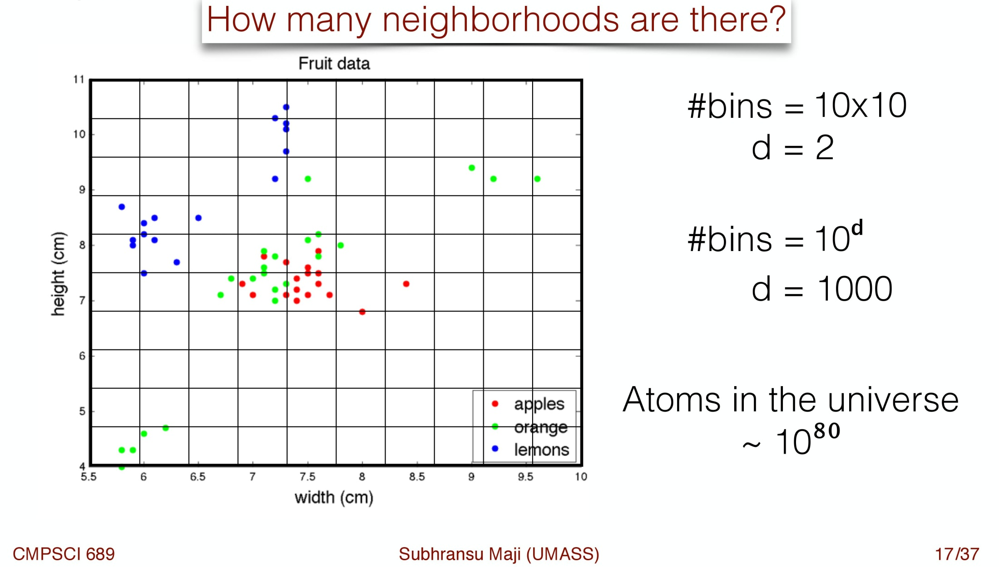
Curse of Dimensionality

Slide 37
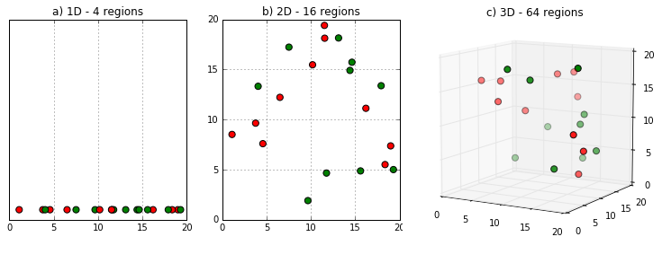
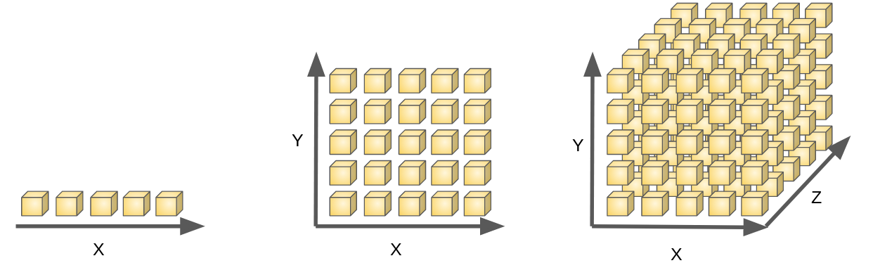
Curse of Dimensionality
Regions become more sparsely populated given the same amount of data
Need more data to densely populate them
Figures from https://www.kdnuggets.com/2017/04/must-know-curse-dimensionality.html, https://medium.freecodecamp.org/the-curse-of-dimensionality-how-we-can-save-big-data-from-itself-d9fa0f872335

Slide 38
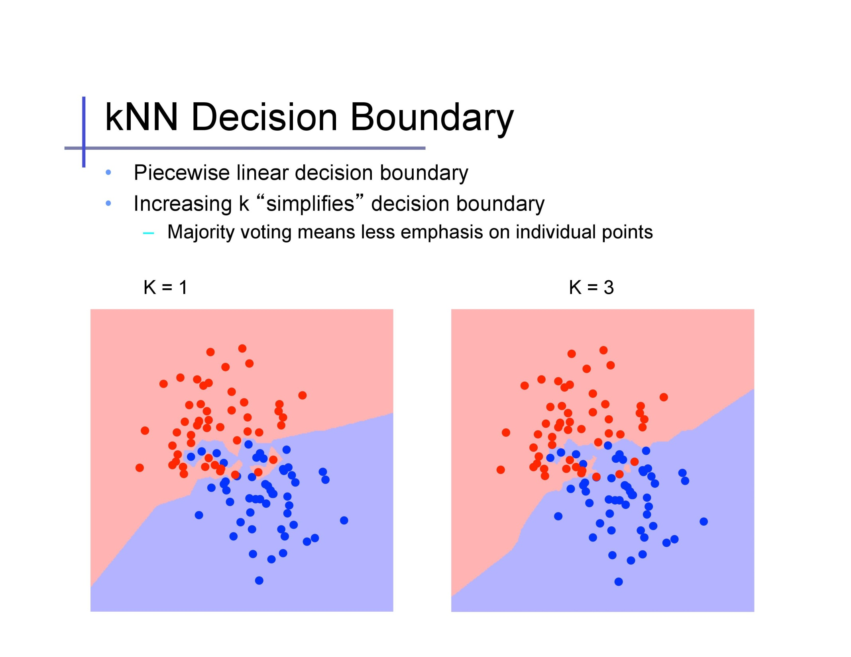
simplifies /
complicates

Slide 39
Slide credit: Alexander Ihler

Slide 40
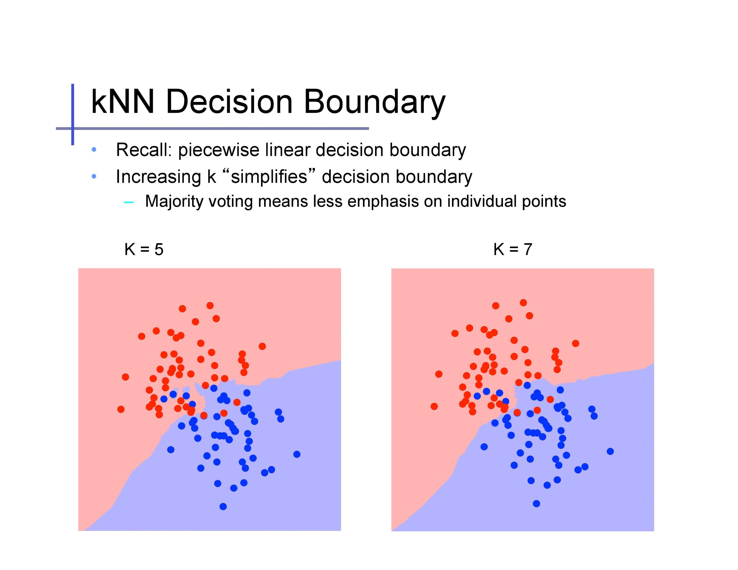
Slide credit: Alexander Ihler

Slide 41
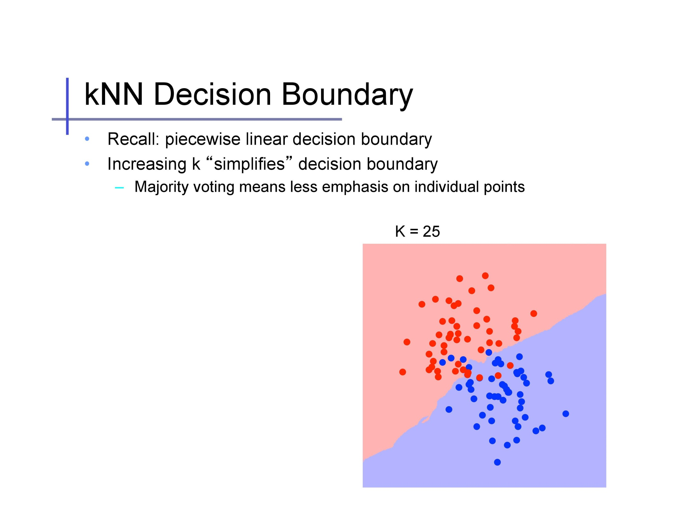
Slide credit: Alexander Ihler

Slide 42
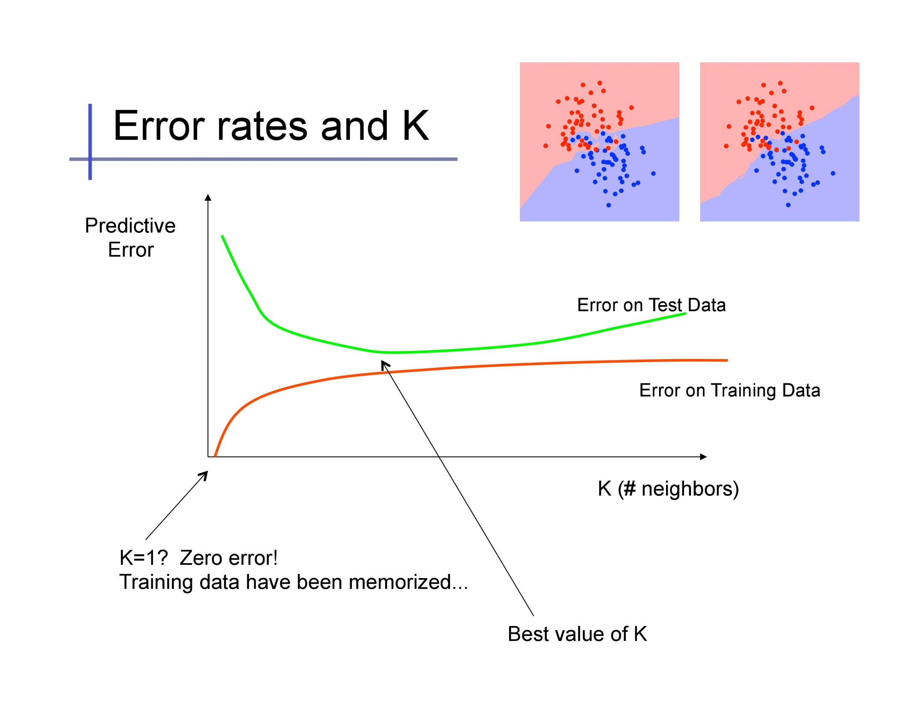
Use a validation set to pick K
Too “complex”
Slide credit: Alexander Ihler

Slide 43
Summary
K-Nearest Neighbor is the most basic and simplest to implement classifier
Cheap at training time, expensive at test time
Unlike other methods we’ll see later, naturally works for any number of classes
Pick K through a validation set, use approximate methods for finding neighbors
Success of classification depends on the amount of data and the meaningfulness of the distance function (also true for other algorithms)

Slide 44
Plan for this lecture
The simplest classifier: K-Nearest Neighbors
  Algorithm and example use
  Generalizing: Distance metrics, weighing neighbors
  Problems: curse of dimensionality, picking K
Logistic regression
  Probability: review
  Linear regression for classification?
  Maximum likelihood solution for logistic regression
  Related algorithm: perceptron

Slide 45
Probability Review
A is non-deterministic event
  Can think of A as a Boolean-valued variable
Examples
  A = your next patient has cancer
  A = Steelers win Super Bowl LIII
Dhruv Batra

Slide 46
Interpreting Probabilities
What does P(A) mean?
Frequentist View
  limit N→∞ #(A is true)/N
  frequency of a repeating non-deterministic event
Bayesian View
  P(A) is your “belief” about A
Adapted from Dhruv Batra

Slide 47
Axioms of Probability
0<= P(A) <= 1
P(false) = 0
P(true) = 1
P(A v B) = P(A) + P(B) – P(A ^ B)
Dhruv Batra, Andrew Moore

Slide 48
Axioms of Probability
0<= P(A) <= 1
P(false) = 0
P(true) = 1
P(A v B) = P(A) + P(B) – P(A ^ B)
’
Dhruv Batra, Andrew Moore

Slide 49
Axioms of Probability
0<= P(A) <= 1
P(false) = 0
P(true) = 1
P(A v B) = P(A) + P(B) – P(A ^ B)
’
Dhruv Batra, Andrew Moore

Slide 50
Axioms of Probability
0<= P(A) <= 1
P(false) = 0
P(true) = 1
P(A v B) = P(A) + P(B) – P(A ^ B)
Dhruv Batra, Andrew Moore

Slide 51
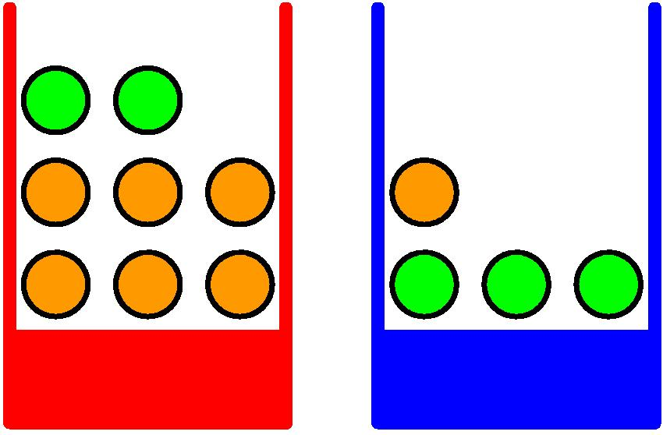
Probabilities: Example Use
Apples and Oranges
Chris Bishop

Slide 52
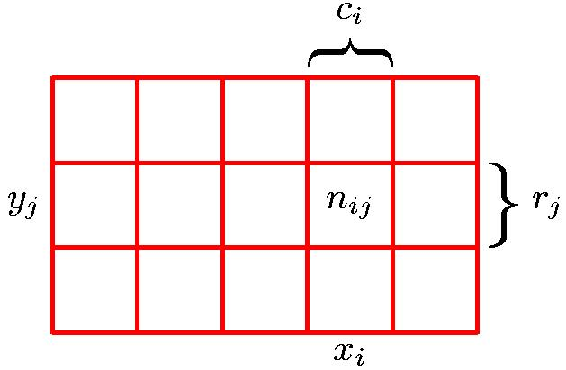
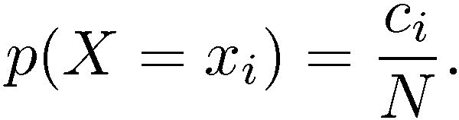
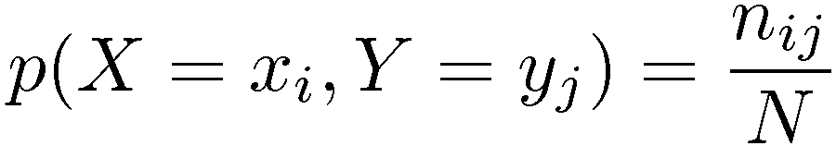
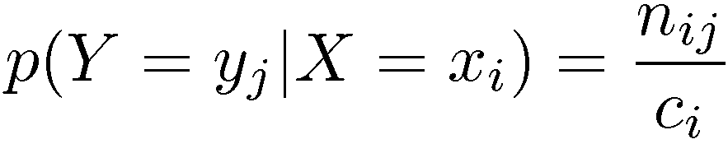
Marginal, Joint, Conditional
Marginal Probability
Conditional Probability
Joint Probability
Chris Bishop

Slide 53
Joint Probability
P(X₁,…,X_{n}) gives the probability of every combination of values (an n-dimensional array with v^{n} values if all variables are discrete with v values, all v^{n} values must sum to 1):
The probability of all possible conjunctions (assignments of values to some subset of variables) can be calculated by summing the appropriate subset of values from the joint distribution.
Therefore, all conditional probabilities can also be calculated.
positive
negative
 | circle | square
red | 0.20 | 0.02
blue | 0.02 | 0.01
 | circle | square
red | 0.05 | 0.30
blue | 0.20 | 0.20
Adapted from Ray Mooney

Slide 54
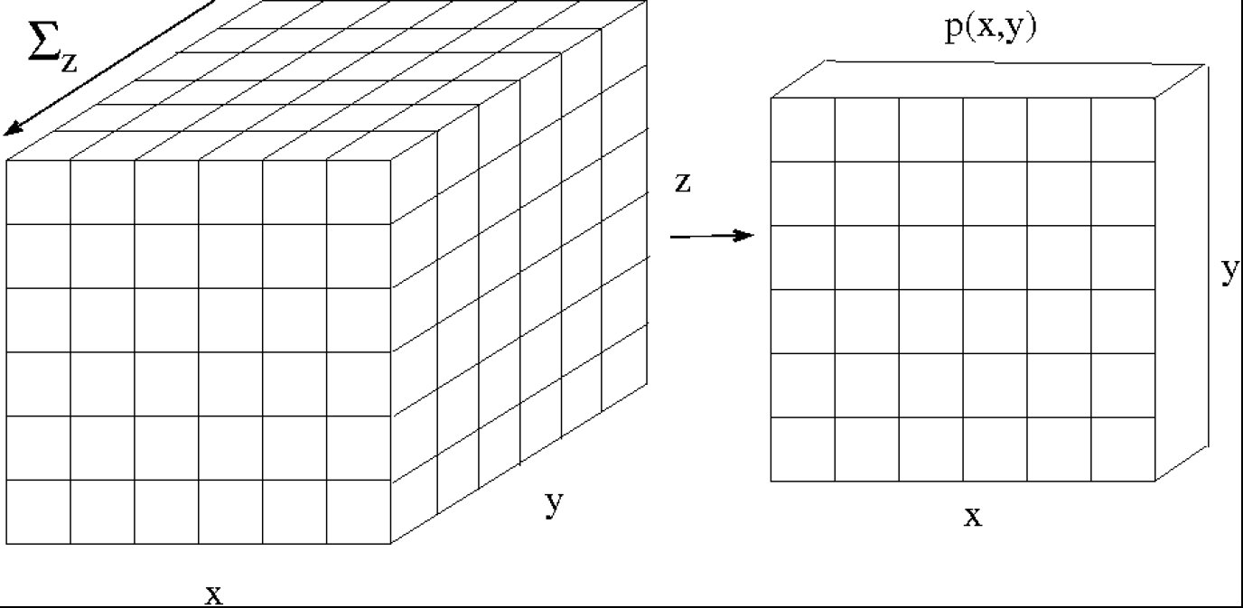
Marginal Probability
y
z
Dhruv Batra, Erik Suddherth

Slide 55
Conditional Probability
P(Y=y | X=x): What do you believe about Y=y, if I tell you X=x?
P(Andy Murray wins Australian Open 2019)?
What if I tell you:
  He has won it five times before
  He is currently ranked #307
Dhruv Batra

Slide 56
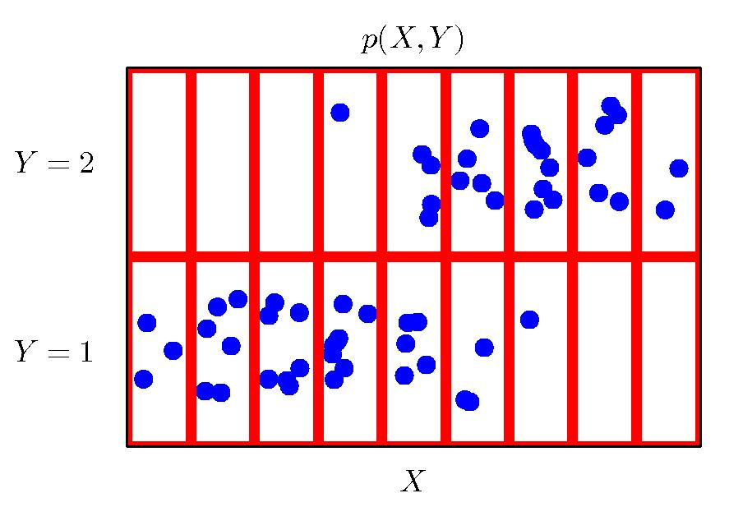
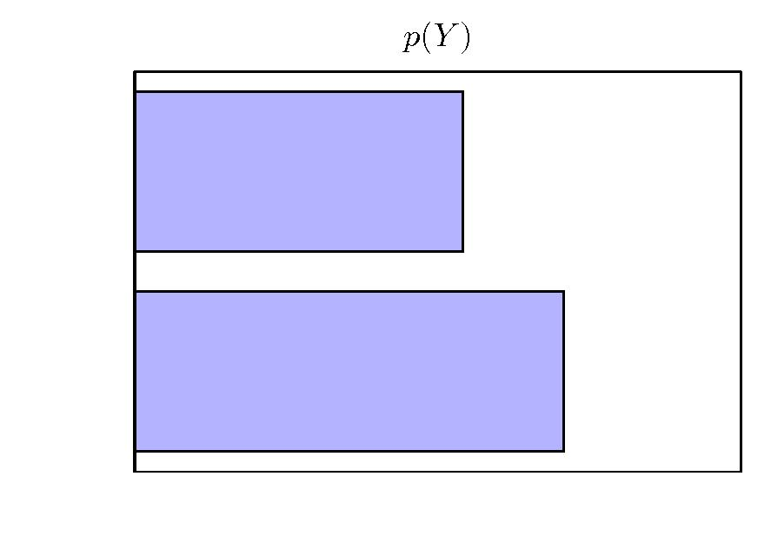
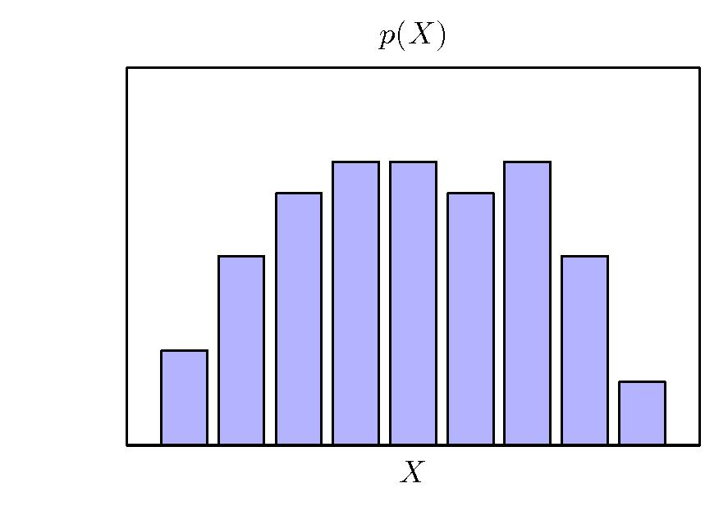
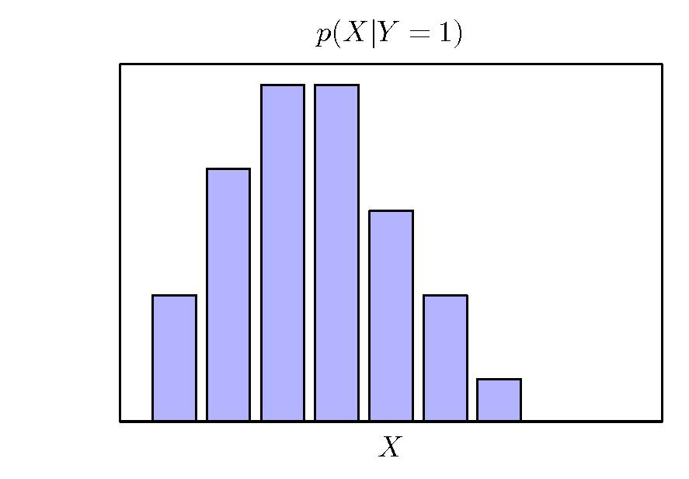
Conditional Probability
Chris Bishop

Slide 57
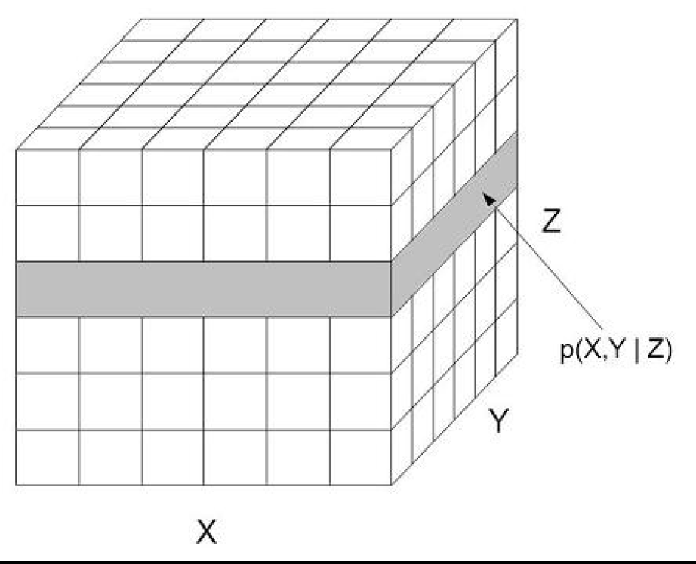
Conditional Probability
Dhruv Batra, Erik Suddherth

Slide 58
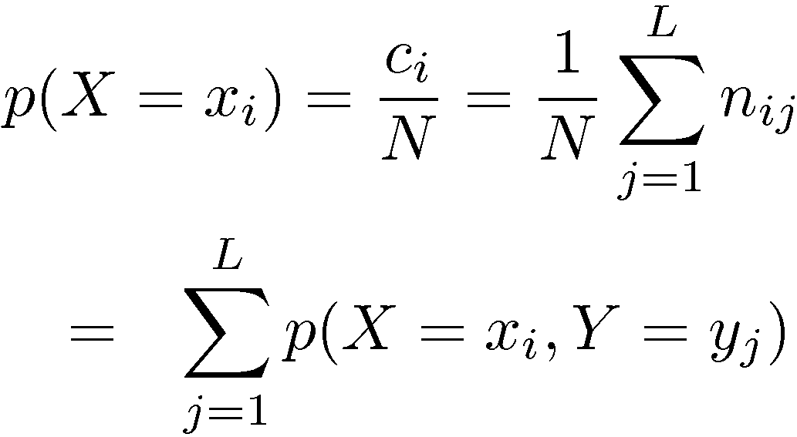
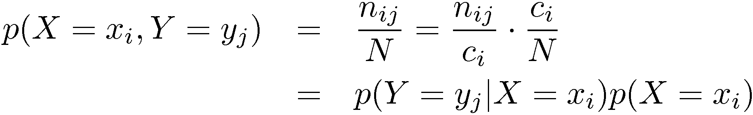
Sum and Product Rules
Sum Rule
Product Rule
Chris Bishop

Slide 59

Chain Rule
Generalizes the product rule:
Example:
Equations from Wikipedia

Slide 60
Independence
A and B are independent iff:
Therefore, if A and B are independent:
These two constraints are logically equivalent
Ray Mooney

Slide 61
Independence
Marginal: P satisfies (X ⊥ Y) if and only if
  P(X=x,Y=y) = P(X=x) P(Y=y), ∀x∈Val(X), y∈Val(Y)
Conditional: P satisfies (X ⊥ Y | Z) if and only if
  P(X,Y|Z) = P(X|Z) P(Y|Z), ∀x∈Val(X), y∈Val(Y), z∈Val(Z)
Dhruv Batra

Slide 62
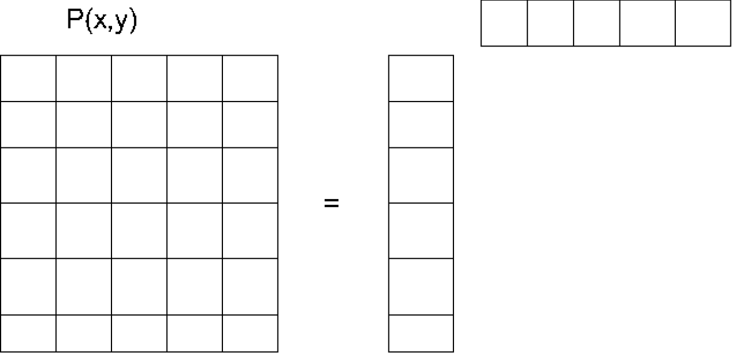
Independence
Dhruv Batra, Erik Suddherth

Slide 63
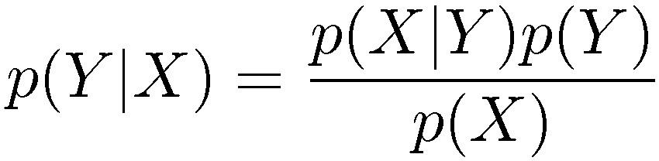
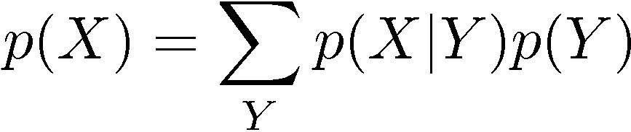
Bayes’ Theorem
posterior ∝ likelihood × prior
Chris Bishop

Slide 64
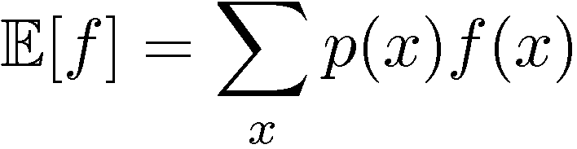
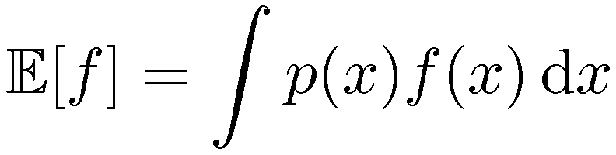
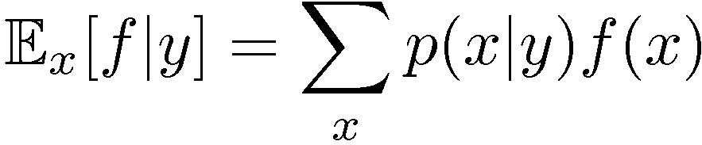
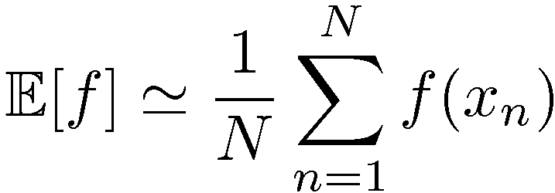
Expectations
Conditional Expectation
(discrete)
Approximate Expectation
(discrete and continuous)
Chris Bishop

Slide 65
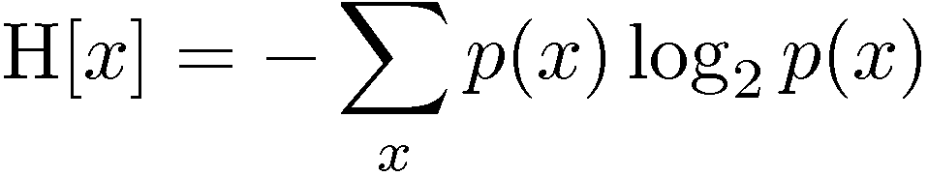
Entropy
Important quantity in
  coding theory
  statistical physics
  machine learning
Chris Bishop

Slide 66
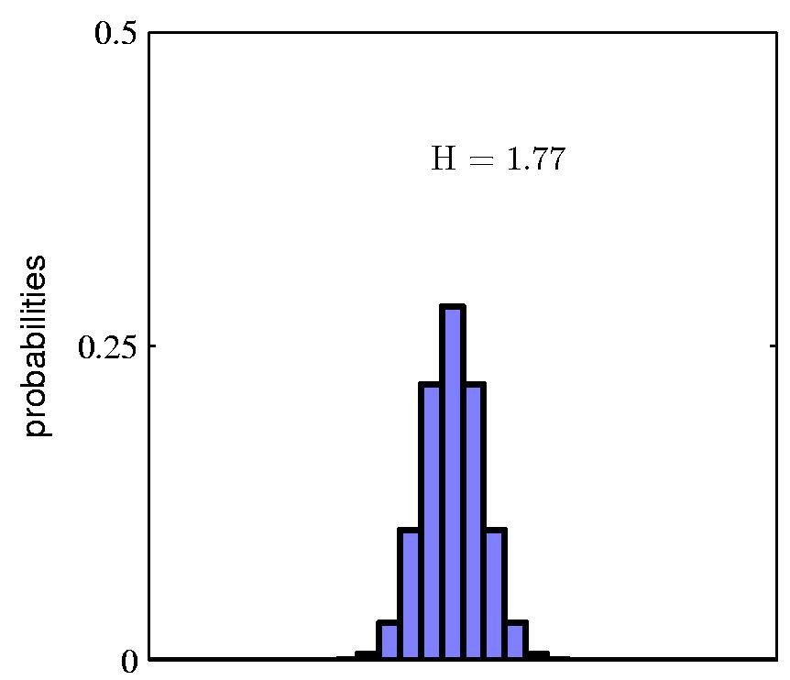
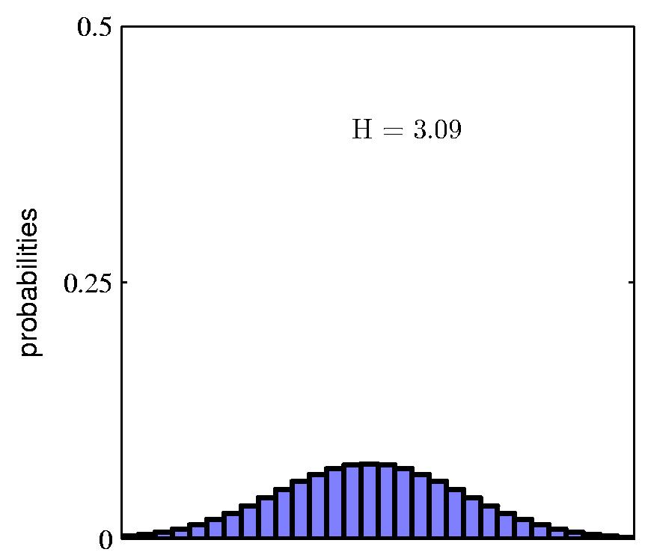
Entropy
Chris Bishop

Slide 67
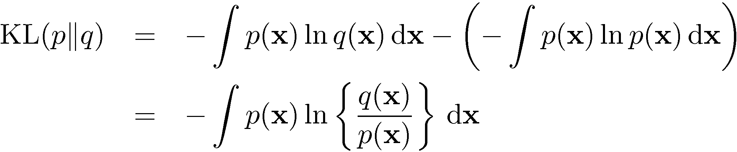
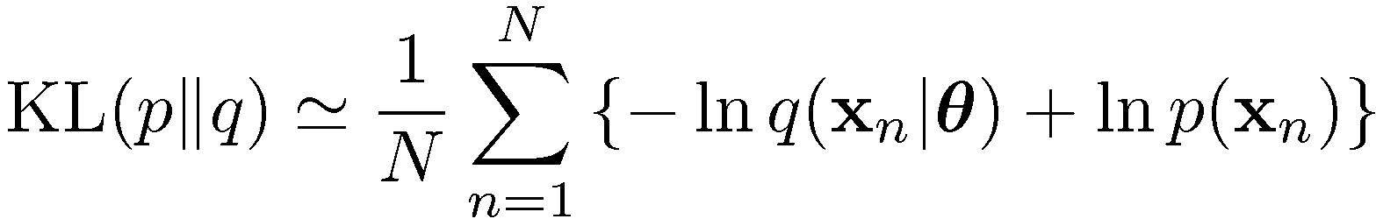


The Kullback-Leibler Divergence
Chris Bishop

Slide 68

Mutual Information
Chris Bishop

Slide 69
Likelihood / Prior / Posterior
A hypothesis (model, function, parameter set, weights) is denoted as h; it is one member of the hypothesis space H
A set of training examples is denoted as D, a collection of (x, y) pairs for training
Pr(h) – the prior probability of the hypothesis – without observing any training data, what is the probability that h is the target function we want?
Adapted from Rebecca Hwa

Slide 70
Likelihood / Prior / Posterior
Pr(D) – the prior probability of the observed data – chance of getting the particular set of training examples D
Pr(h|D) – the posterior probability of h – what is the probability that h is the target given that we have observed D?
Pr(D|h) – the probability of getting D if h were true (a.k.a. likelihood of the data)
Pr(h|D) = Pr(D|h)Pr(h)/Pr(D)
Rebecca Hwa

Slide 71
MLE and MAP Estimation
Maximum likelihood estimation (MLE):
  h_{ML} = argmax Pr(D|h)
Maximum-a-posteriori (MAP) estimation:
  h_{MAP} = argmax_{h} Pr(h|D)
  = argmax_{h} Pr(D|h)Pr(h)/Pr(D)
  = argmax_{h} Pr(D|h)Pr(h)
Rebecca Hwa

Slide 72

Objective we want to minimize:

Slide 73


Slide 74


Slide 75

f(x, w) = 0.5
Figures adapted from from Andrew Ng

Slide 76

f(x, w) = 0.5
f(x, w) = 0.5
Figures adapted from from Andrew Ng

Slide 77


The effect of outliers: Another example
Magenta = least squares, green = logistic regression
Figures from Bishop

Slide 78

Logistic regression
Also has “regression” in the name but it’s a method for classification
Also uses a linear combination of the features to predict label, but in a slightly different way
Fit a sigmoid function to model the probability of the data belonging to a certain class
P(y=1|x)
f(x) = dot(w, x) + b

Slide 79


Slide 80


Slide 81


Slide 82


Slide 83

σ
σ

Slide 84


Slide 85


We can fit the logistic models using the maximum (conditional) log-likelihood criterion
σ
Solution: find roots of = 0

Slide 87
Whiteboard: solution

Slide 88
Logistic Regression / MLE Example
Want to find the weight vector that gives us the highest P(y_i|x_i, w),
where P(y_i=1|x_i, w) = 1 / (1 + exp(-w’*x))
Consider two weight vectors and three samples, with corresponding likelihoods:
 | P(y_1 = 1 | x_1, w_i) | P(y_2 = 1 | x_2, w_i) | P(y_3 = 1 | x_3, w_i)
w_1 | 0.3 | 0.1 | 0.4
w_2 | 0.7 | 0.8 | 0.2
True label: | 1 | 0 | 1

Slide 89
Logistic Regression / MLE Example
Then the value of the objective for w_i is: P(y_1 = 1 | x_1, w_i) * (1 – P(y_2 = 1 | x_2, w_i)) *
P(y_3 = 1 | x_3, w_i)
So the score for w_1 is: 0.3 * 0.9 * 0.4
And the score for w_2 is: 0.7 * 0.2 * 0.2
Thus, w_1 is a better weight vector = model

Slide 90
Plan for this lecture
The simplest classifier: K-Nearest Neighbors
  Algorithm and example use
  Generalizing: Distance metrics, weighing neighbors
  Problems: curse of dimensionality, picking K
Logistic regression
  Probability: review
  Linear regression for classification?
  Maximum likelihood solution for logistic regression
  Related algorithm: perceptron

Slide 91



The perceptron algorithm
x
Rosenblatt (1962)
Prediction rule:
where
Want: (t_{n} = +1 or -1)
Loss:
(just using the Misclassified examples)

Slide 92

The perceptron algorithm
Loss:
Learning algorithm update rule:
Interpretation:
  If sample is misclassified and is positive, make the weight vector more like it
  If sample is misclassified and negative… unlike it

Slide 93




The perceptron algorithm (red=pos)
w = w + x
(x is pos)
Figures from Bishop

Slide 94
Summary: Tradeoffs of classification methods thus far
Nearest neighbors
  Non-parametric method; basic formulation cannot ignore/focus on different feature dimensions
  Slow at test time (large search problem to find neighbors)
  Need to store all data points (unlike SVM, coming next)
  Decision boundary not necessarily linear
  Naturally handles multiple classes
Logistic regression (a classification method)
  Models the probability of a label given the data
  Decision boundary corresponds to w^{T} x = 0 (a line)
Perceptron
  Same decision boundary as logistic regression (a line)
  Simple update rule
  Won’t converge for non-linearly-separable data

