Slide 1
CS 1675: Intro to Machine Learning
Regression and Overfitting
Prof. Adriana Kovashka
University of Pittsburgh
September 18, 2018

Slide 2
Regression
Given some features x, predict a continuous variable y, e.g.
  Predict the cost of a house based on square footage, age built, neighborhood, photos
  Predict temperature tomorrow based on temperature today
  Predict how far a car will go based on car’s speed and environment
These all involve fitting a function (curve) given training pairs (x_{i}, y_{i})

Slide 3
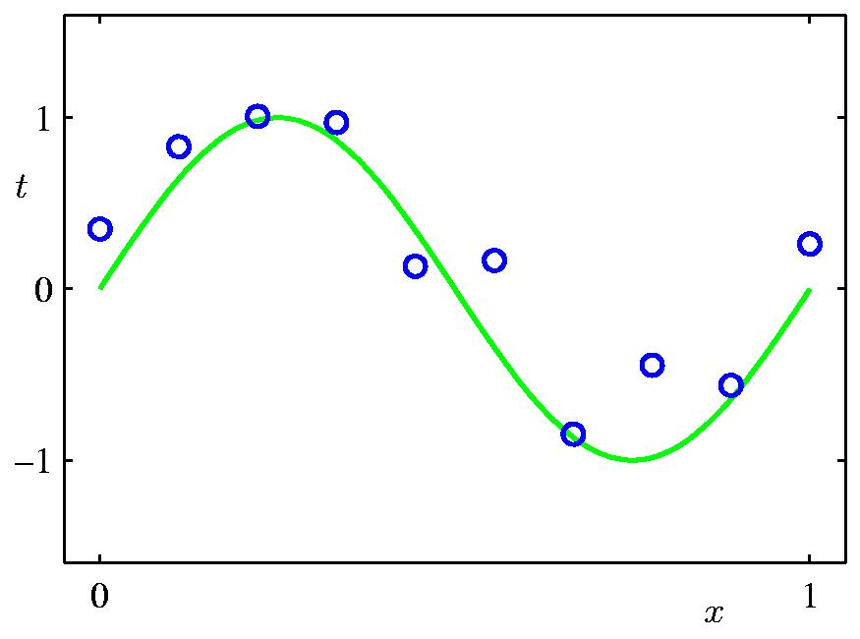
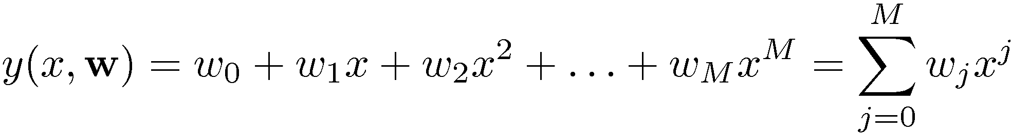
Polynomial Curve Fitting
Slide credit: Chris Bishop

Slide 4
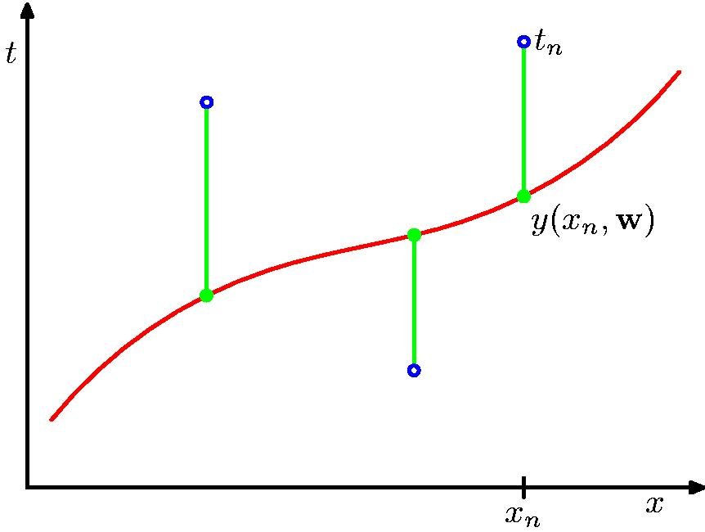
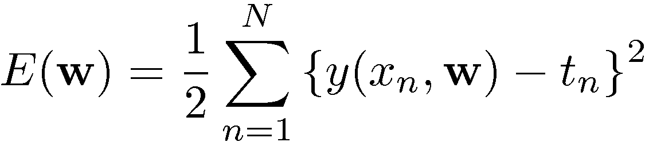
Sum-of-Squares Error Function
Slide credit: Chris Bishop

Slide 5
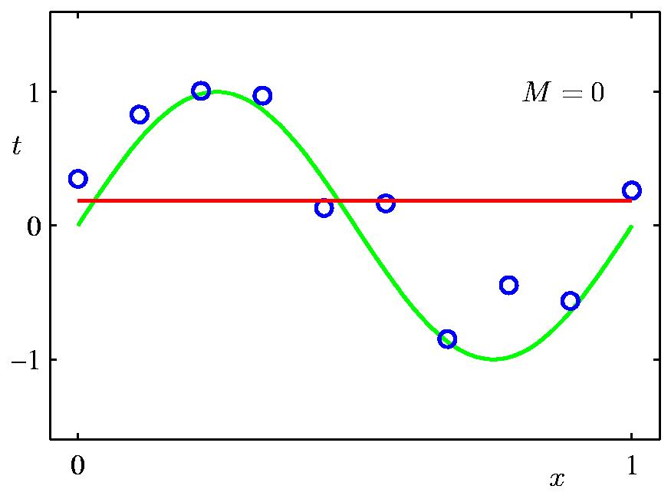
0th Order Polynomial
Slide credit: Chris Bishop

Slide 6
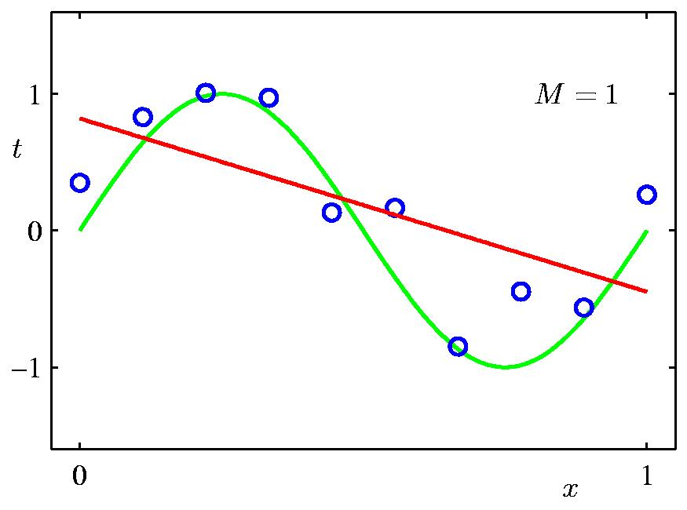
1st Order Polynomial
Slide credit: Chris Bishop

Slide 7
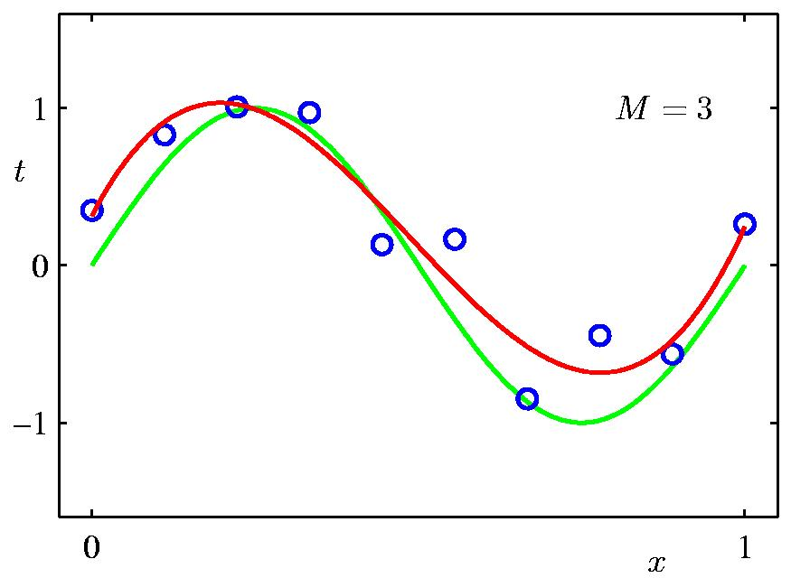
3rd Order Polynomial
Slide credit: Chris Bishop

Slide 8
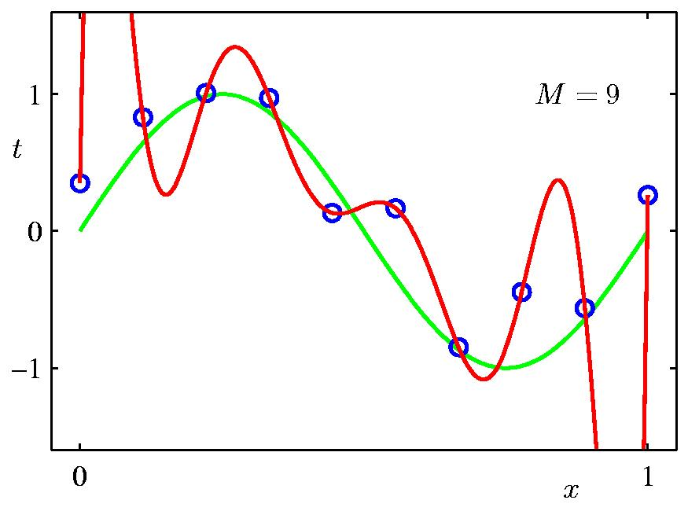
9th Order Polynomial
Slide credit: Chris Bishop

Slide 9
Plan for Today
Linear regression
Closed-form solution via least squares
Solution via gradient descent
Dealing with outliers
Generalization: bias and variance
Regularization

Slide 10
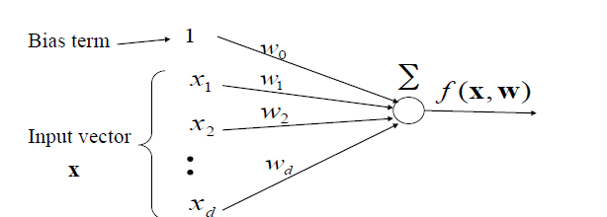
Linear Models
Represent label y as a linear combination of the features x (i.e. weighted average of the features)
Sometimes want to add a bias term: can add 1 as x₀ such that x = (1, x₁, …, x_{d})
Figure from Milos Hauskrecht

Slide 11
Regression
f(x, w): x → y
At training time: Use given {(x₁,y₁), …, (x_{N},y_{N})}, to estimate mapping function f
  Objective: minimize (y_{i} – f(w, x_{i}))², for all i = 1, …, N
  x_{i} are the input features (d-dimensional)
  y_{i} is the target continuous output label (given by human/oracle)
At test time: Use f to make prediction for a new sample x_{test} (not in the training set)

Slide 12
= b + mx

Slide 13
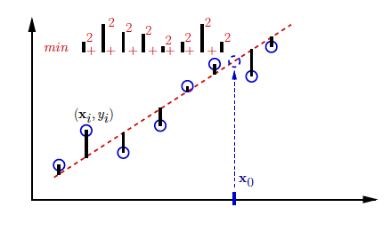
1-d example
Fit line to points
Use parameters of line to predict the y-coordinate of a new data point x_{new}
new
Figure from Greg Shakhnarovich

Slide 14
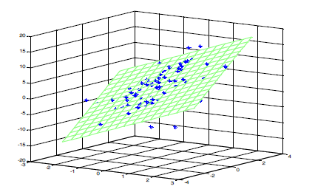
2-d example
Find parameters of plane
Figure from Milos Hauskrecht

Slide 15
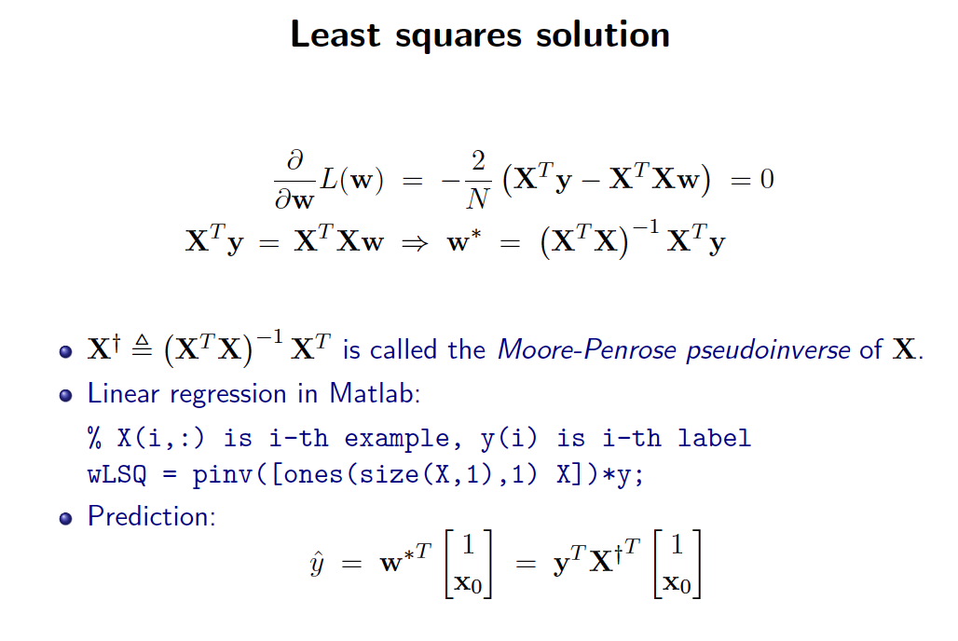
(Derivation on board)
test
test
Slide credit: Greg Shakhnarovich

Slide 16
Challenges
Computing the pseudoinverse might be slow for large matrices
  Cubic in number of features D
  Linear in number of samples N
We might want to adjust solution as new examples come in, without recomputing the pseudoinverse for each new sample that comes in
Another solution: Gradient descent
  Cost: linear in both D and N
  If D > 10,000, use gradient descent

Slide 17


Gradient descent
Andrej Karpathy

Slide 18
Want to minimize a loss function
Loss function: squared error, true/predicted y
How to minimize?
  Model is a function of the weights w, hence loss is a function of the weights
  Find derivative of loss with respect to weights, set to 0 (minimum will be an extremum and if function is convex, there will be only one)

Slide 19

Derivative of the loss function
In 1-dimension, the derivative of a function:
In multiple dimensions, the derivative is called a gradient, which is the vector of partial derivatives with respect to each dimension of the input.
Adapted from Andrej Karpathy

Slide 20
current W:
gradient dW:
[0.34,
-1.11,
0.78,
0.12,
0.55,
2.81,
-3.1,
-1.5,
0.33,…]
loss 1.25347
[?,
?,
?,
?,
?,
?,
?,
?,
?,…]
Andrej Karpathy

Slide 21
current W:
W + h (first dim):
gradient dW:
[0.34,
-1.11,
0.78,
0.12,
0.55,
2.81,
-3.1,
-1.5,
0.33,…]
loss 1.25347
[0.34 + 0.0001,
-1.11,
0.78,
0.12,
0.55,
2.81,
-3.1,
-1.5,
0.33,…]
loss 1.25322
[?,
?,
?,
?,
?,
?,
?,
?,
?,…]
Andrej Karpathy

Slide 22
current W:
W + h (first dim):
gradient dW:
[0.34,
-1.11,
0.78,
0.12,
0.55,
2.81,
-3.1,
-1.5,
0.33,…]
loss 1.25347
[0.34 + 0.0001,
-1.11,
0.78,
0.12,
0.55,
2.81,
-3.1,
-1.5,
0.33,…]
loss 1.25322
[-2.5,
?,
?,
?,
?,
?,
?,
(1.25322 - 1.25347)/0.0001
= -2.5
?,
?,…]
Andrej Karpathy

Slide 23
current W:
W + h (second dim):
gradient dW:
[0.34,
-1.11,
0.78,
0.12,
0.55,
2.81,
-3.1,
-1.5,
0.33,…]
loss 1.25347
[0.34,
-1.11 + 0.0001,
0.78,
0.12,
0.55,
2.81,
-3.1,
-1.5,
0.33,…]
loss 1.25353
[-2.5,
?,
?,
?,
?,
?,
?,
?,
?,…]
Andrej Karpathy

Slide 24
current W:
W + h (second dim):
gradient dW:
[0.34,
-1.11,
0.78,
0.12,
0.55,
2.81,
-3.1,
-1.5,
0.33,…]
loss 1.25347
[0.34,
-1.11 + 0.0001,
0.78,
0.12,
0.55,
2.81,
-3.1,
-1.5,
0.33,…]
loss 1.25353
[-2.5,
0.6,
?,
?,
?,
?,
?,
?,
(1.25353 - 1.25347)/0.0001
= 0.6
?,…]
Andrej Karpathy

Slide 25
current W:
W + h (third dim):
gradient dW:
[0.34,
-1.11,
0.78,
0.12,
0.55,
2.81,
-3.1,
-1.5,
0.33,…]
loss 1.25347
[0.34,
-1.11,
0.78 + 0.0001,
0.12,
0.55,
2.81,
-3.1,
-1.5,
0.33,…]
loss 1.25347
[-2.5,
0.6,
?,
?,
?,
?,
?,
?,
?,…]
Andrej Karpathy

Slide 26

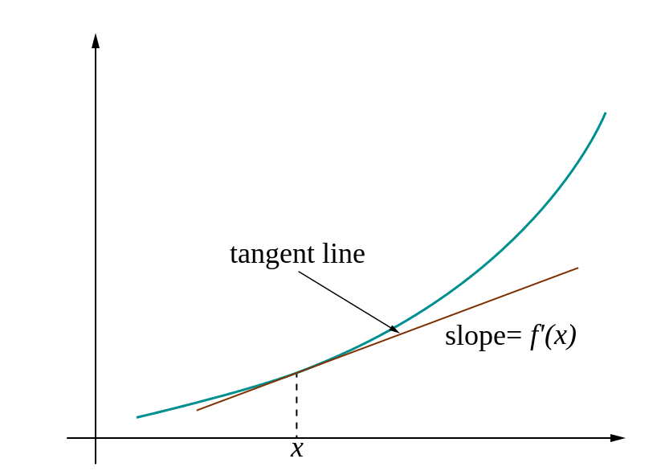
Loss gradients
Denoted as (diff notations):
i.e. how loss changes as function of weights
Change the weights in such a way that makes the loss decrease as fast as possible

Slide 27
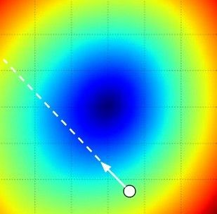
Gradient descent
Update weights: move opposite to gradient
L
Time
Learning rate
w₂
original w
w₁
negative gradient direction
Figure from Andrej Karpathy

Slide 28
Gradient descent
Iteratively subtract the gradient with respect to the model parameters (w)
I.e. we’re moving in a direction opposite to the gradient of the loss
I.e. we’re moving towards smaller loss

Slide 29
Classic vs stochastic gradient descent
In classic gradient descent, we compute the gradient from the loss for all training examples
Could also only use some of the data for each gradient update
We cycle through all the training examples multiple times
Each time we’ve cycled through all of them once is called an ‘epoch’
Allows faster training (e.g. on GPUs), parallelization

Slide 30
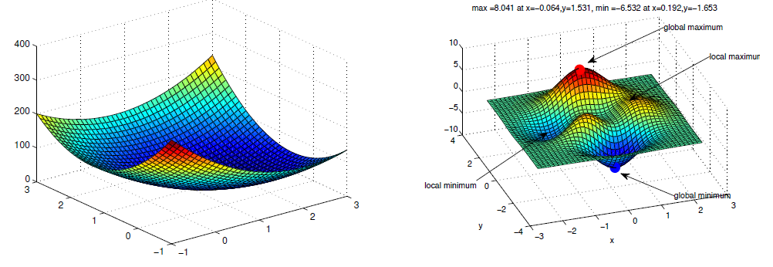
Solution optimality
Global vs local minima
Fortunately, least squares is convex
Adapted from Erik Sudderth

Slide 31
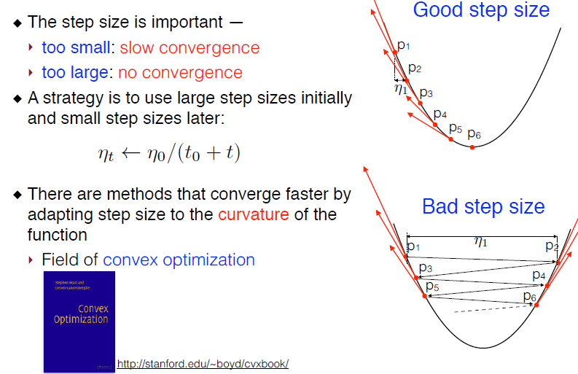
Solution optimality
Slide credit: Subhransu Maji

Slide 32
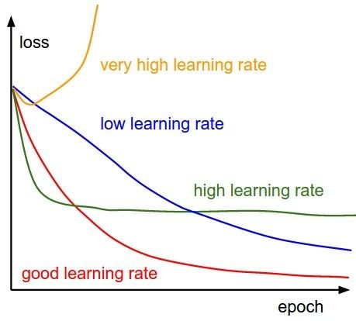
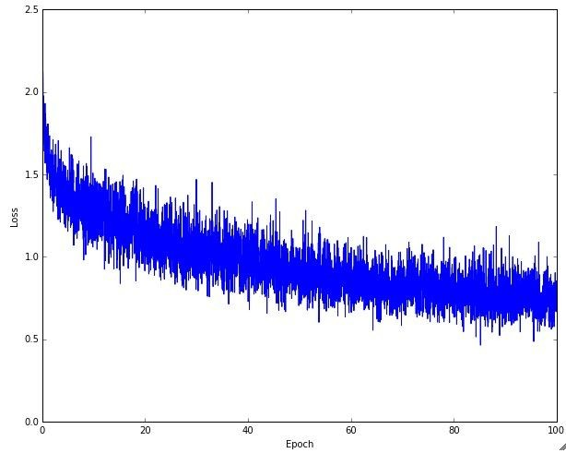
Learning rate selection
The effects of step size (or “learning rate”)
Andrej Karpathy

Slide 33
Summary: Closed form vs gradient descent
Closed form:
  Deterministic and elegant
  Need to compute pseudoinverse of a large matrix from all data samples’ features
Gradient descent:
  Update solution based on randomly chosen samples, iterate over all samples many times
  Update model=weights with negative increment of the derivative of the loss function wrt weights
  More efficient if lots of samples
  Can be parallelized

Slide 34
Plan for Today
Linear regression
Closed-form solution via least squares
Solution via gradient descent
Dealing with outliers
Generalization: bias and variance
Regularization

Slide 35
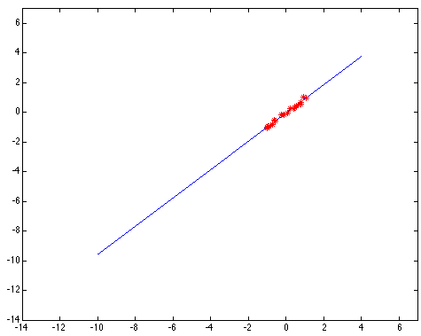
Outliers affect least squares fit
Kristen Grauman
Notes:
35

Slide 36
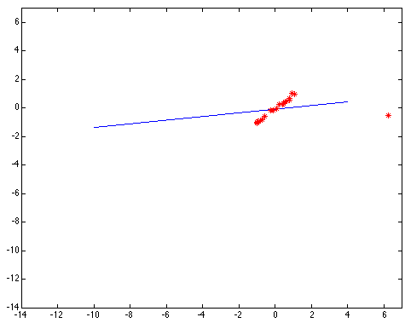
Outliers affect least squares fit
Kristen Grauman
Notes:
36

Slide 37
Hypothesize and test
Try all possible parameter combinations
  Repeatedly sample enough points to solve for parameters
  Each point votes for all consistent parameters
  E.g. each point votes for all possible lines on which it might lie
Score the given parameters: Number of consistent points
Choose the optimal parameters using the scores
Noise & clutter features?
  They will cast votes too, but typically their votes should be inconsistent with the majority of “good” features
Two methods: Hough transform and RANSAC
Adapted from Derek Hoiem and Kristen Grauman

Slide 38

Hough transform for finding lines
y
b
b₀
x
m₀
m
feature space
Hough (parameter) space
Connection between feature (x,y) and Hough (m,b) spaces
  A line in the feat space corresponds to a point in Hough space
Steve Seitz

Slide 39

Hough transform for finding lines
y
b
y₀
x₀
x
m
feature space
Hough (parameter) space
Connection between feature (x,y) and Hough (m,b) spaces
  A line in the feat space corresponds to a point in Hough space
  What does a point (x₀, y₀) in the feature space map to?
    Answer: the solutions of b = -x₀m + y₀
    This is a line in Hough space
Steve Seitz

Slide 40
Hough transform for finding lines
y
b
x
m
feature space
Hough (parameter) space
How can we use this to find the most likely parameters (m,b) for the most prominent line in the feature space?
Let each edge point in feature space vote for a set of possible parameters in Hough space
Accumulate votes in discrete set of bins; parameters with the most votes indicate line in feature space
Steve Seitz

Slide 41
RANdom Sample Consensus (RANSAC)
RANSAC loop:
Randomly select a seed group of s points on which to base model estimate
Fit model to these s points
Find inliers to this model (i.e., points whose distance from the line is less than t)
If there are d or more inliers, re-compute estimate of model on all of the inliers
Repeat N times
Keep the model with the largest number of inliers
Modified from Kristen Grauman and Svetlana Lazebnik

Slide 42
RANSAC
_{(RANdom SAmple Consensus) :}
Fischler & Bolles in ‘81.
Algorithm:
Sample (randomly) the number of points required to fit the model
Solve for model parameters using samples
Score by the fraction of inliers within a preset threshold of the model
Repeat 1-3 until the best model is found with high confidence
Silvio Savarese
Notes:
Let me give you an intuition of what is going on. Suppose we have the standard line fitting problem in presence of outliers.
We can formulate this problem as follows: want to find the best partition of points in inlier set and outlier set such that…
The objective consists of adjusting the parameters of a model function so as to best fit a data set.
"best" is defined by a function f that needs to be minimized.
Such that the best parameter of fitting the line give rise to a residual error lower that delta
as when the sum, S, of squared residuals

Slide 43
RANSAC
Line fitting example
Algorithm:
Sample (randomly) the number of points required to fit the model (#=2)
Solve for model parameters using samples
Score by the fraction of inliers within a preset threshold of the model
Repeat 1-3 until the best model is found with high confidence
Silvio Savarese
Notes:
Let me give you an intuition of what is going on. Suppose we have the standard line fitting problem in presence of outliers.
We can formulate this problem as follows: want to find the best partition of points in inlier set and outlier set such that…
The objective consists of adjusting the parameters of a model function so as to best fit a data set.
"best" is defined by a function f that needs to be minimized.
Such that the best parameter of fitting the line give rise to a residual error lower that delta
as when the sum, S, of squared residuals

Slide 44
RANSAC
Line fitting example
Algorithm:
Sample (randomly) the number of points required to fit the model (#=2)
Solve for model parameters using samples
Score by the fraction of inliers within a preset threshold of the model
Repeat 1-3 until the best model is found with high confidence
Silvio Savarese
Notes:
Let me give you an intuition of what is going on. Suppose we have the standard line fitting problem in presence of outliers.
We can formulate this problem as follows: want to find the best partition of points in inlier set and outlier set such that…
The objective consists of adjusting the parameters of a model function so as to best fit a data set.
"best" is defined by a function f that needs to be minimized.
Such that the best parameter of fitting the line give rise to a residual error lower that delta
as when the sum, S, of squared residuals

Slide 45
RANSAC
Line fitting example
Algorithm:
Sample (randomly) the number of points required to fit the model (#=2)
Solve for model parameters using samples
Score by the fraction of inliers within a preset threshold of the model
Repeat 1-3 until the best model is found with high confidence
Silvio Savarese
Notes:
Let me give you an intuition of what is going on. Suppose we have the standard line fitting problem in presence of outliers.
We can formulate this problem as follows: want to find the best partition of points in inlier set and outlier set such that…
The objective consists of adjusting the parameters of a model function so as to best fit a data set.
"best" is defined by a function f that needs to be minimized.
Such that the best parameter of fitting the line give rise to a residual error lower that delta
as when the sum, S, of squared residuals

Slide 46
RANSAC
Algorithm:
Sample (randomly) the number of points required to fit the model (#=2)
Solve for model parameters using samples
Score by the fraction of inliers within a preset threshold of the model
Repeat 1-3 until the best model is found with high confidence
Silvio Savarese
Notes:
Let me give you an intuition of what is going on. Suppose we have the standard line fitting problem in presence of outliers.
We can formulate this problem as follows: want to find the best partition of points in inlier set and outlier set such that…
The objective consists of adjusting the parameters of a model function so as to best fit a data set.
"best" is defined by a function f that needs to be minimized.
Such that the best parameter of fitting the line give rise to a residual error lower that delta
as when the sum, S, of squared residuals

Slide 47
Plan for Today
Linear regression
Closed-form solution via least squares
Solution via gradient descent
Dealing with outliers
Generalization: bias and variance
Regularization

Slide 48
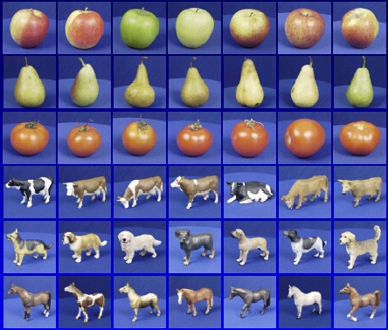

Generalization
Training set (labels known)
Test set (labels unknown)
How well does a learned model generalize from the data it was trained on to a new test set?
Slide credit: L. Lazebnik

Slide 49
Generalization
Components of expected loss
  Noise in our observations: unavoidable
  Bias: how much avg model over all training sets differs from true model
    Error due to inaccurate assumptions/simplifications by the model
  Variance: how much models estimated from different training sets differ from each other
Underfitting: model too “simple” to represent all relevant class characteristics
  High bias and low variance
  High training error and high test error
Overfitting: model too “complex” and fits irrelevant characteristics (noise) in the data
  Low bias and high variance
  Low training error and high test error
Adapted from L. Lazebnik

Slide 50
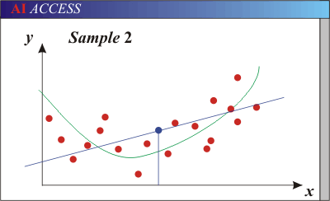
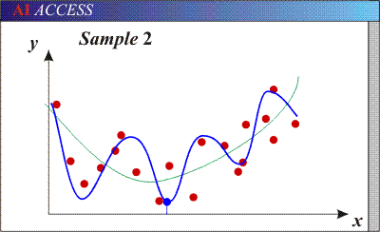
Bias-Variance Trade-off
Models with too few parameters are inaccurate because of a large bias (not enough flexibility).
Models with too many parameters are inaccurate because of a large variance (too much sensitivity to the sample).
Red dots = training data (all that we see before we ship off our model!)
Purple dots = possible test points
Green curve = true underlying model Blue curve = our predicted model/fit
Adapted from D. Hoiem

Slide 51
Polynomial Curve Fitting
Slide credit: Chris Bishop

Slide 52
Sum-of-Squares Error Function
Slide credit: Chris Bishop

Slide 53
0th Order Polynomial
Slide credit: Chris Bishop

Slide 54
1st Order Polynomial
Slide credit: Chris Bishop

Slide 55
3rd Order Polynomial
Slide credit: Chris Bishop

Slide 56
9th Order Polynomial
Slide credit: Chris Bishop

Slide 57
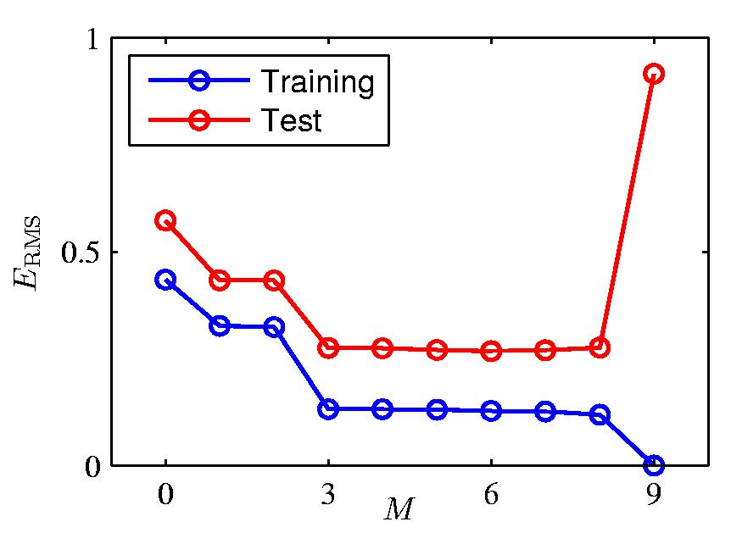
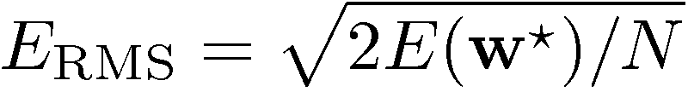
Over-fitting
Root-Mean-Square (RMS) Error:
Slide credit: Chris Bishop

Slide 58
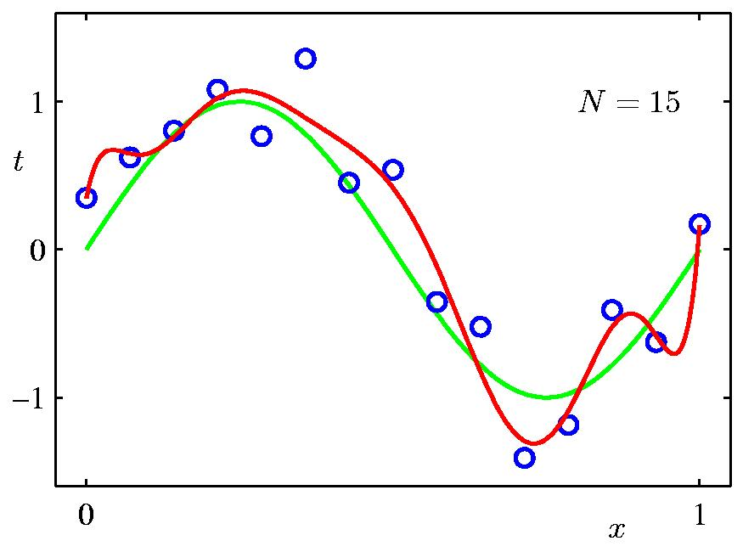
Effect of Data Set Size
9th Order Polynomial
Slide credit: Chris Bishop

Slide 59
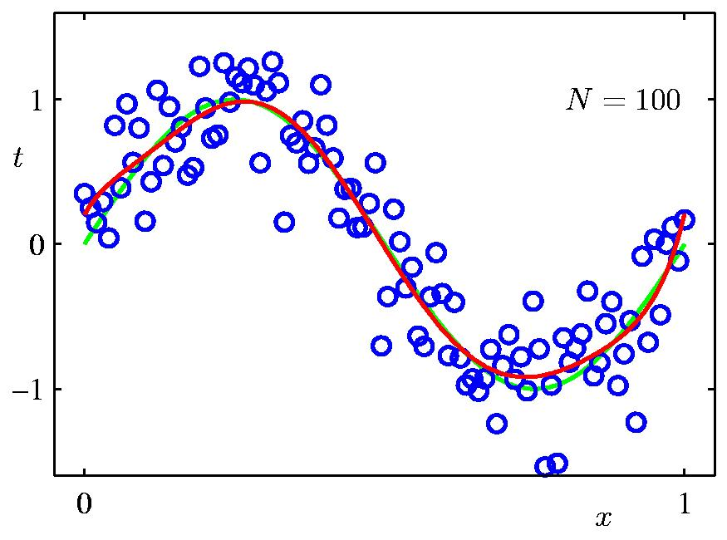
Effect of Data Set Size
9th Order Polynomial
Slide credit: Chris Bishop

Slide 60
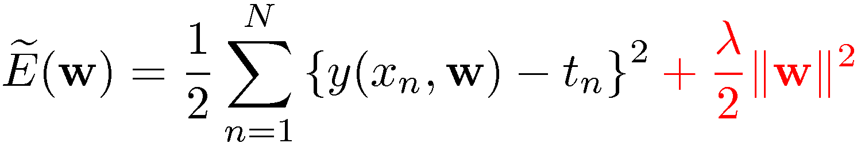
Regularization
Penalize large coefficient values
(Remember: We want to minimize this expression.)
Adapted from Chris Bishop

Slide 61
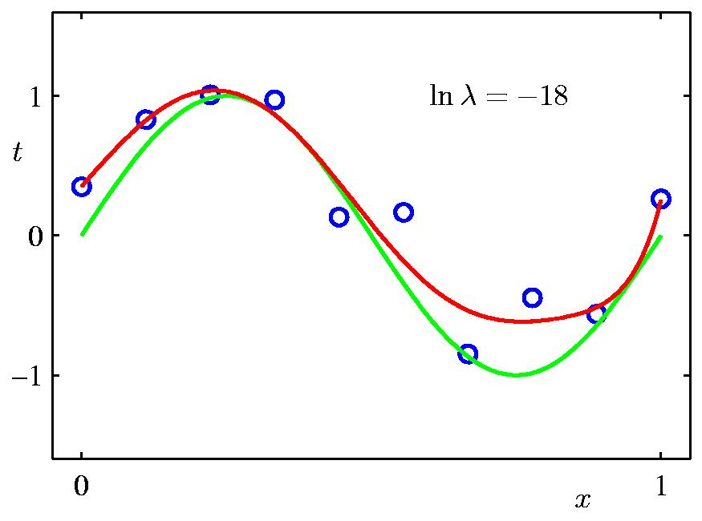
Regularization
Slide credit: Chris Bishop

Slide 62
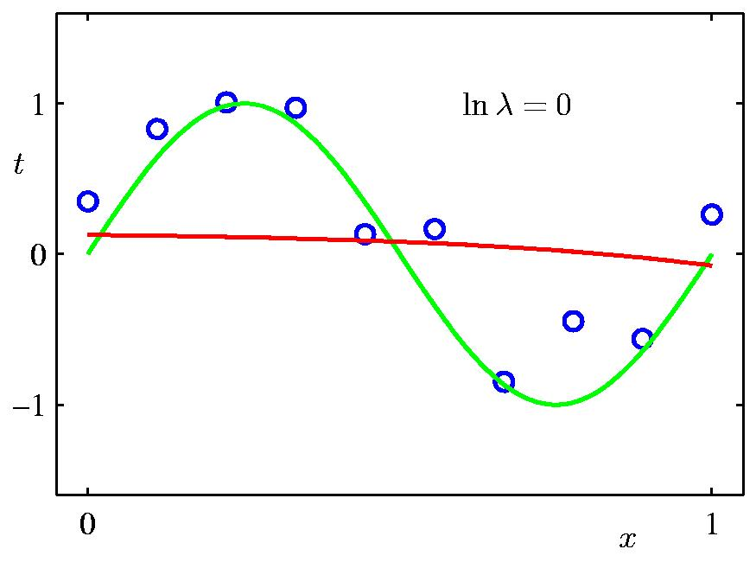
Regularization
Slide credit: Chris Bishop

Slide 63
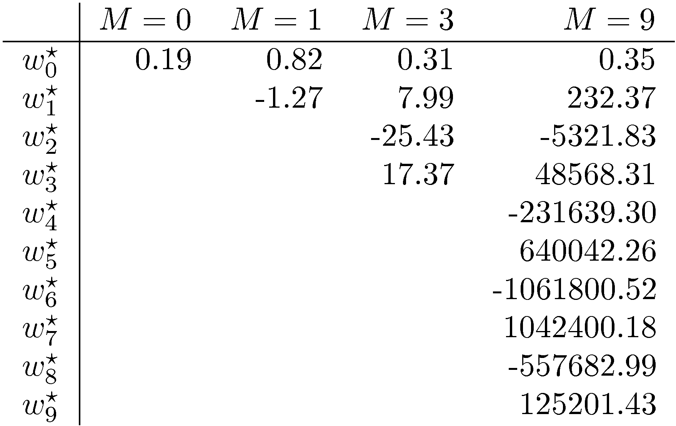
Polynomial Coefficients
Slide credit: Chris Bishop

Slide 64
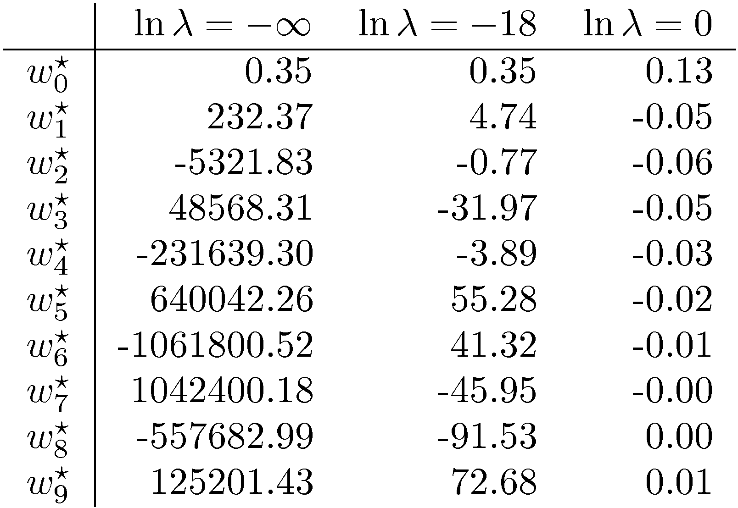
Polynomial Coefficients
No regularization Huge regularization
Adapted from Chris Bishop

Slide 65
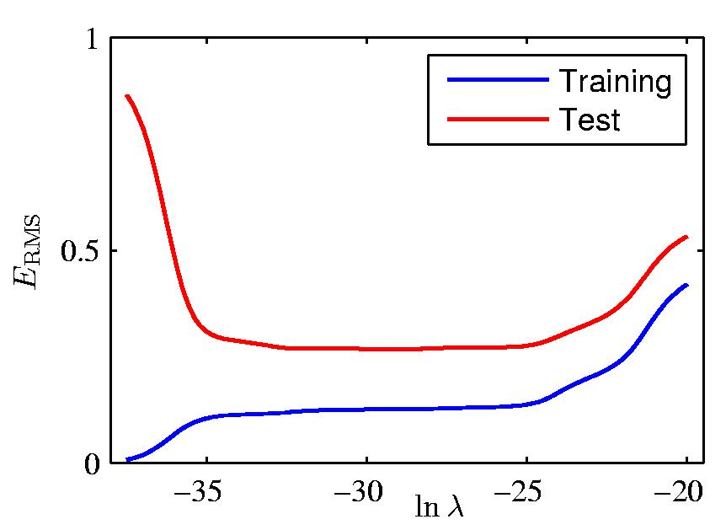
Effect of Regularization
Slide credit: Chris Bishop

Slide 66
Training vs test error
Underfitting
Overfitting
Error
Test error
Training error
High Bias
Low Variance
Complexity
Low Bias
High Variance
Slide credit: D. Hoiem

Slide 67
Effect of Training Set Size
Few training examples
Test Error
Many training examples
High Bias
Low Variance
Complexity
Low Bias
High Variance
Slide credit: D. Hoiem
Notes:
Note: these figures don’t work in pdf

Slide 68
Effect of Training Set Size
Fixed prediction model
Error
Testing
Generalization Error
Training
Number of Training Examples
Adapted from D. Hoiem

Slide 69
Choosing the trade-off between bias and variance
Need validation set (separate from the test set)
Validation error
Error
Training error
High Bias
Low Variance
Complexity
Low Bias
High Variance
Slide credit: D. Hoiem

Slide 70
How to reduce variance?
Choose a simpler classifier
Regularize the parameters
Get more training data
Slide credit: D. Hoiem

Slide 71
Overfitting take-away
Three kinds of error
  Inherent: unavoidable
  Bias: due to over-simplifications
  Variance: due to inability to perfectly estimate parameters from limited data
Try simple models first, and use increasingly powerful models with more training data
Important note: Overfitting applies to all tasks in machine learning, not just regression!
Adapted from D. Hoiem

