Slide 1
CS 1675: Intro to Machine Learning
Unsupervised Learning
(Clustering,
Dimensionality Reduction)
Prof. Adriana Kovashka
University of Pittsburgh
September 6, 2018

Slide 2
Unsupervised Learning
We only use the features X, not the labels Y
This is useful because we may not have any labels but we can still detect patterns
For example:
  We can detect that news articles revolve around certain topics, and group them accordingly
  Discover a distinct set of objects appear in a given environment, even if we don’t know their names, then ask humans to label each group
  Identify health factors that correlate with a disease

Slide 3
Plan for this lecture
Clustering
  Motivation and uses
  K-means clustering
  Other methods and evaluation
Dimensionality reduction
  PCA algorithm (briefly) and demo
  Some applications of PCA

Slide 4
What is clustering?
Grouping items that “belong together” (i.e. have similar features)

Slide 5
Feature representation (x)
A vector representing measurable characteristics of a data sample we have
E.g. a glass of juice can be represented via its color = {yellow=1, red=2, green=3, purple=4} and taste = {sweet=1, sour=2}
For a given glass i, this can be represented as a vector: x_{i} = [3 2] represents sour green juice
For D features, this defines a D-dimensional space where we can measure similarity between samples

Slide 6
Feature representation (x)
2
1
taste
0 1 2 3 4
color

Slide 7
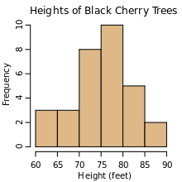
Why do we cluster?
Counting
  Feature histograms: by grouping similar features and counting how many of each a data sample has
Summarizing data
  Look at large amounts of data
  Represent a large continuous vector with the cluster number
Prediction
  Data points in the same cluster may have the same labels
  Ask a human to label the clusters
[3 2] → “juice type 3”
[3 2] → “kombucha”
Slide credit: J. Hays, D. Hoiem

Slide 8
Two uses of clustering in one application
Cluster, then ask human to label groups
Compute a histogram to summarize the data
1
2
“panda”
“cat”
Count in this sample
Feature cluster
3
“giraffe”
3d feature
2d feature

Slide 9

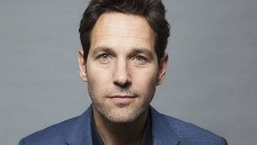
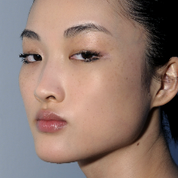
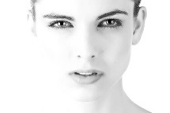
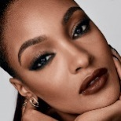
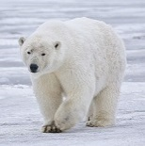
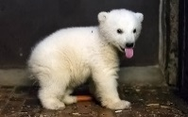
Unsupervised discovery

Slide 10
Clustering algorithms
In depth
  K-means (iterate between finding centers and assigning points)
Briefly
  Mean-shift (find modes in the data)
  Hierarchical clustering (start with all points in separate clusters and merge)
Notes:
10

Slide 11
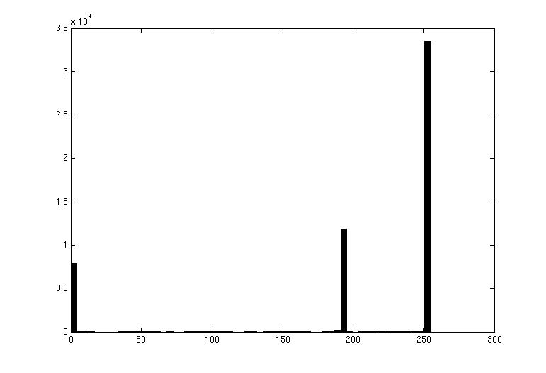

Image segmentation: toy example
white pixels
pixel count
3
black pixels
gray pixels
1
2
input image
intensity
These intensities define the three groups.
We could label every pixel in the image according to which of these primary intensities it is.
  i.e., segment the image based on the intensity feature.
What if the image isn’t quite so simple?
Source: K. Grauman

Slide 12
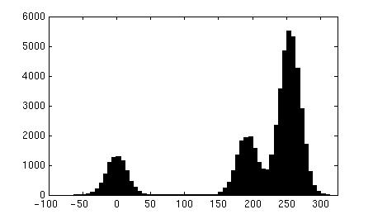
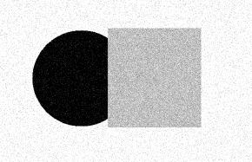
Now how to determine the three main intensities that define our groups?
We need to cluster.
pixel count
input image
intensity
pixel count
input image
intensity
Source: K. Grauman

Slide 13
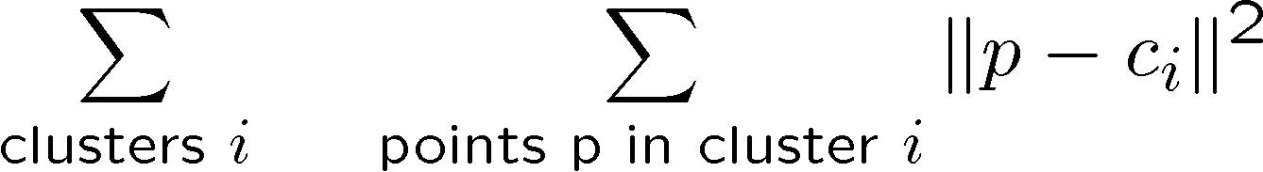
0
190
255
intensity
3
1
2
Goal: choose three “centers” as the representative intensities, and label every pixel according to which of these centers it is nearest to.
Best cluster centers are those that minimize SSD between all points and their nearest cluster center c_{i}:
Source: K. Grauman

Slide 14
Clustering
With this objective, it is a “chicken and egg” problem:
  If we knew the cluster centers, we could allocate points to groups by assigning each to its closest center.
  If we knew the group memberships, we could get the centers by computing the mean per group.
Source: K. Grauman

Slide 15
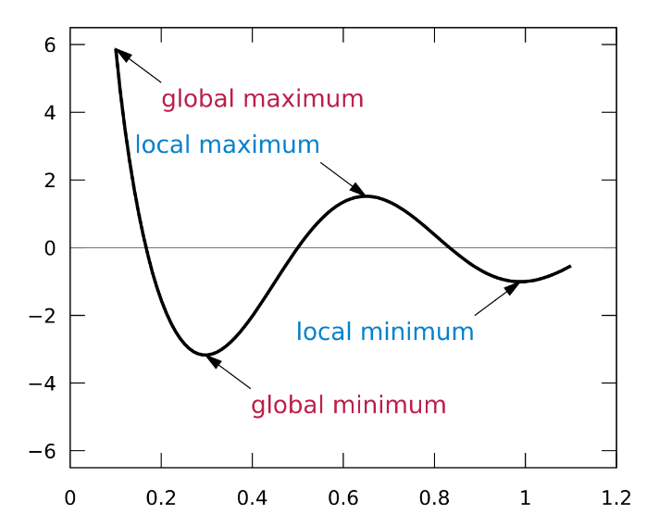
K-means clustering
Basic idea: randomly initialize the k cluster centers, and iterate between the two steps we just saw.
  Randomly initialize the cluster centers, c₁, ..., c_{K}
  Given cluster centers, determine points in each cluster
    For each point p, find the closest c_{i}. Put p into cluster i
  Given points in each cluster, solve for c_{i}
    Set c_{i} to be the mean of points in cluster i
  If c_{i} have changed, repeat Step 2
Properties
  Will always converge to some solution
  Can be a “local minimum” of objective:
Slide: Steve Seitz, image: Wikipedia

Slide 16
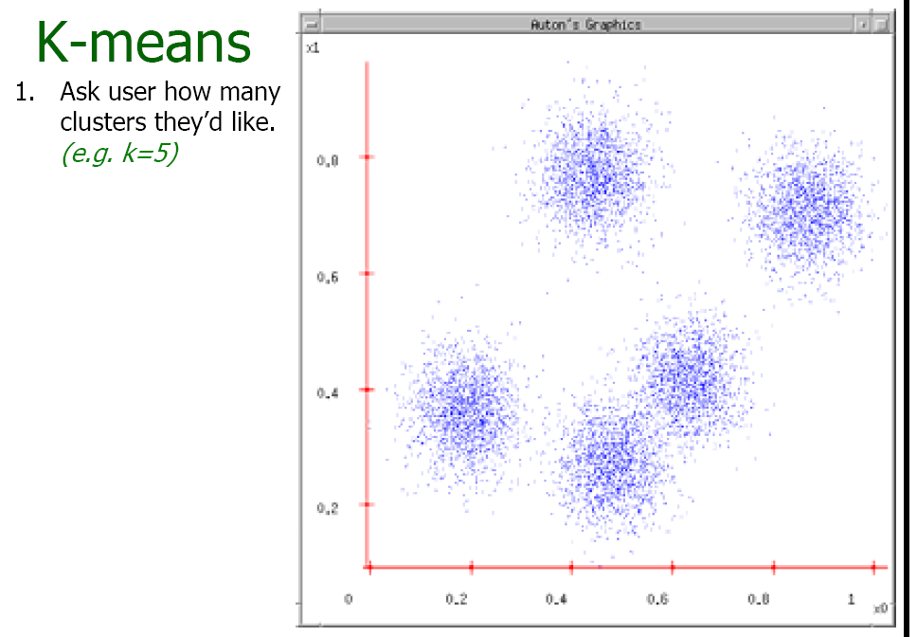
Source: A. Moore

Slide 17
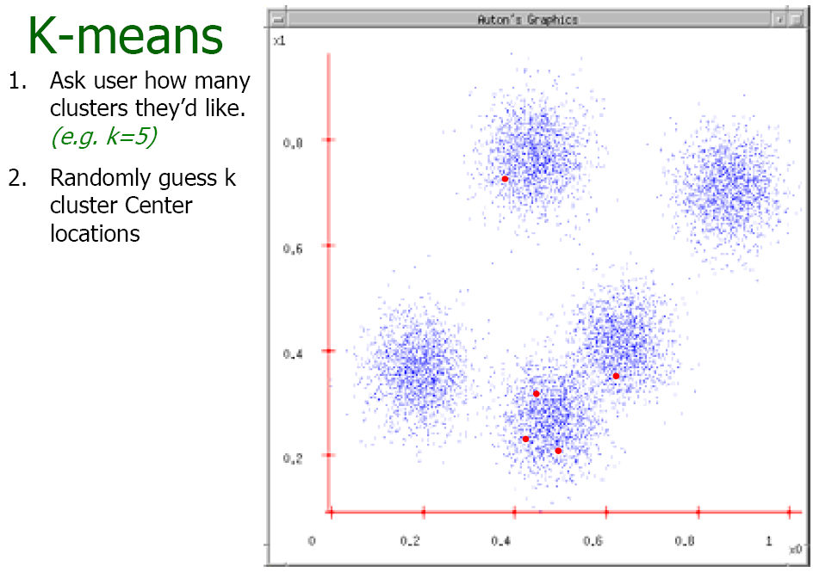
Source: A. Moore

Slide 18
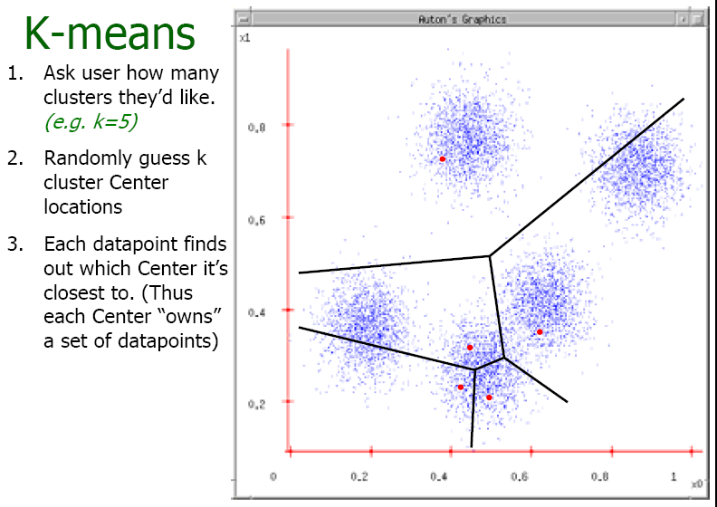
Source: A. Moore

Slide 19
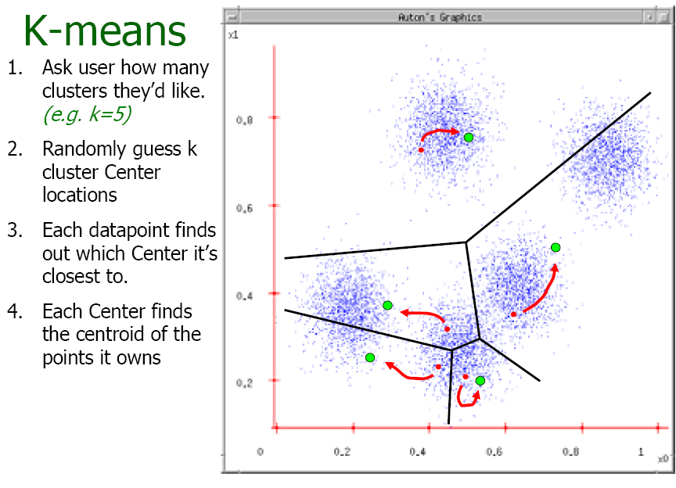
Source: A. Moore

Slide 20
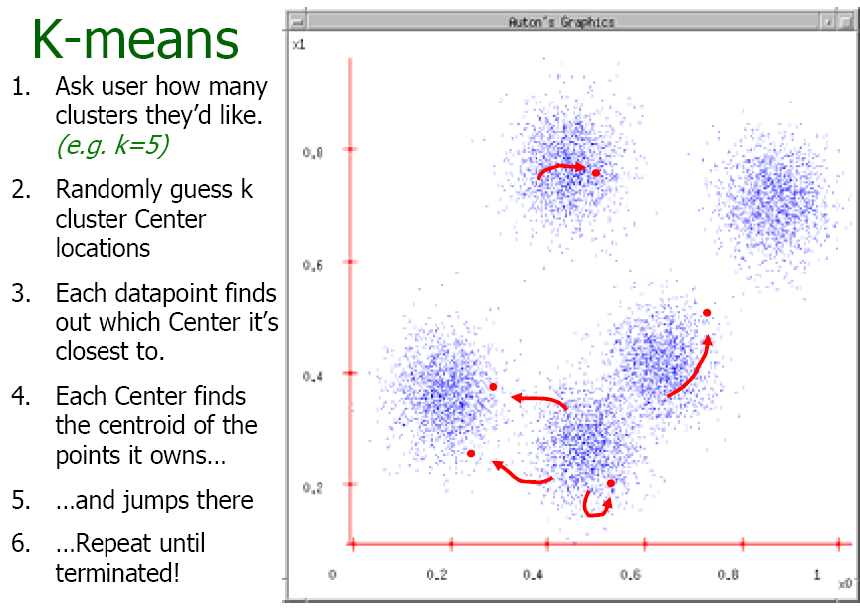
Source: A. Moore

Slide 21
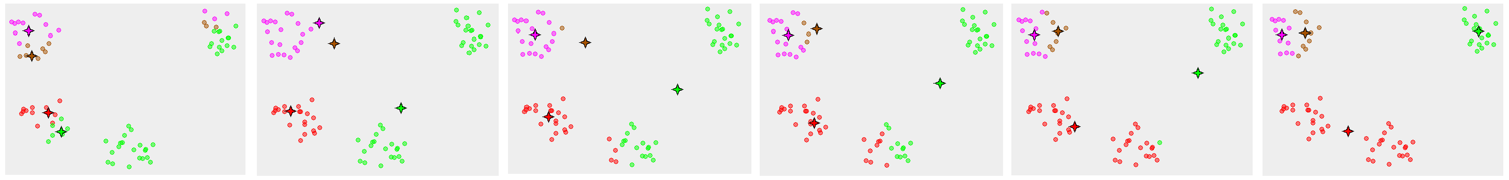
K-means converges to a local minimum
Figure from Wikipedia

Slide 22
K-means clustering
Visualization
https://www.naftaliharris.com/blog/visualizing-k-means-clustering/
Java demo
http://home.dei.polimi.it/matteucc/Clustering/tutorial_html/AppletKM.html
Matlab demo
http://www.cs.pitt.edu/~kovashka/cs1699_fa15/kmeans_demo.m

Slide 23
Time Complexity
Let n = number of instances, d = dimensionality of the features, k = number of clusters
Assume computing distance between two instances is O(d)
Reassigning clusters:
  O(kn) distance computations, or O(knd)
Computing centroids:
  Each instance vector gets added once to a centroid: O(nd)
Assume these two steps are each done once for a fixed number of iterations I: O(Iknd)
  Linear in all relevant factors
Adapted from Ray Mooney

Slide 24
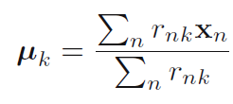
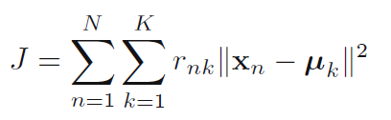
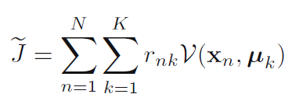
Another way of writing objective
K-means:
K-medoids (more general distances):
Let r_{nk} = 1 if instance n belongs to cluster k, 0 otherwise

Slide 25
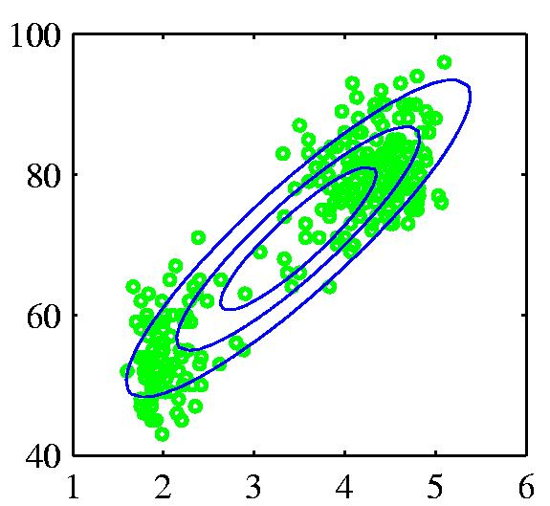
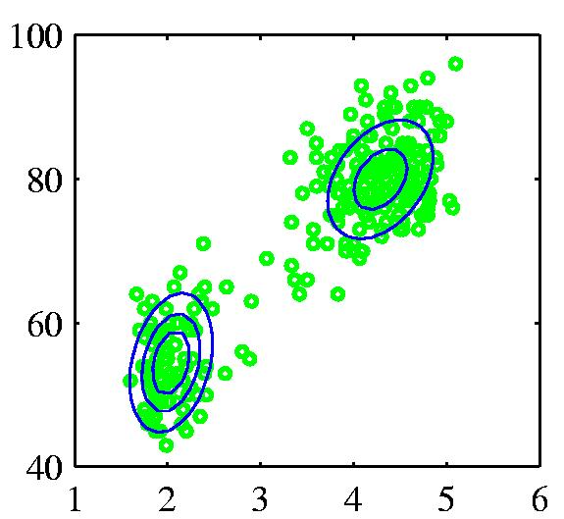
Probabilistic version:
Mixtures of Gaussians
Old Faithful data set
Single Gaussian
Mixture of two Gaussians
Chris Bishop

Slide 26
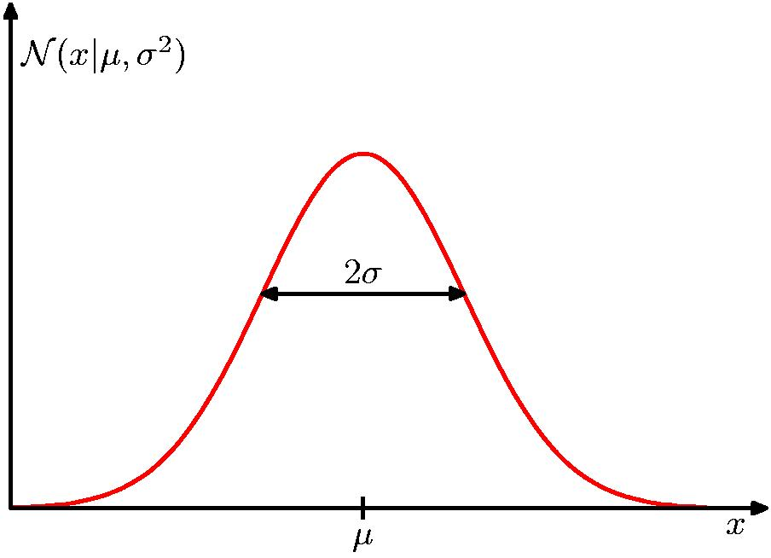
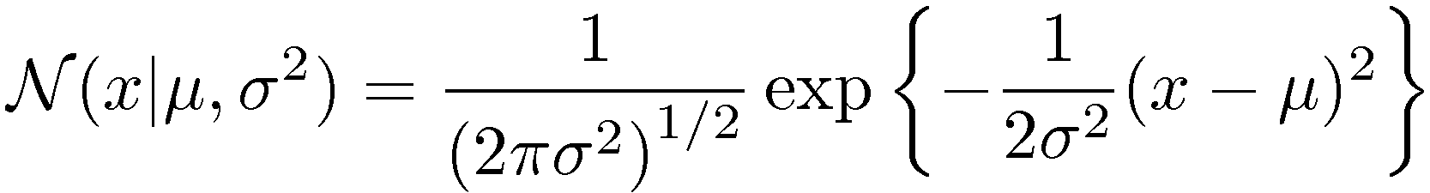
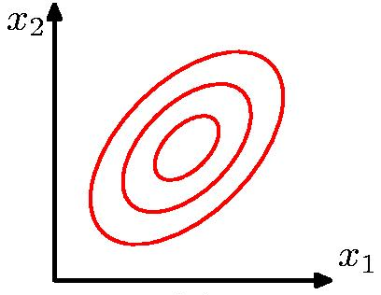
Review: Gaussian Distribution
Chris Bishop

Slide 27
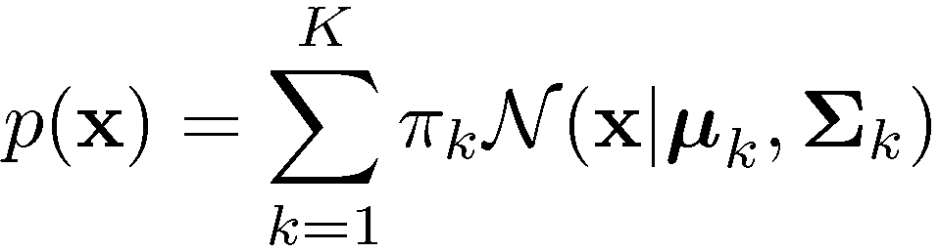
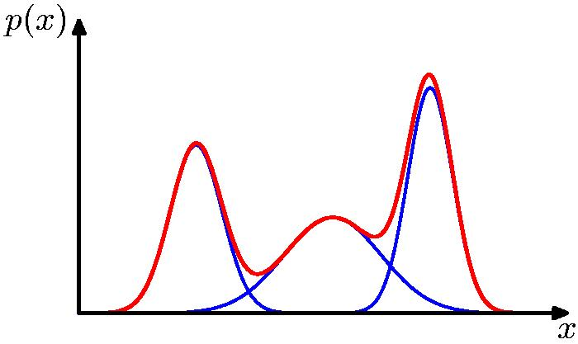
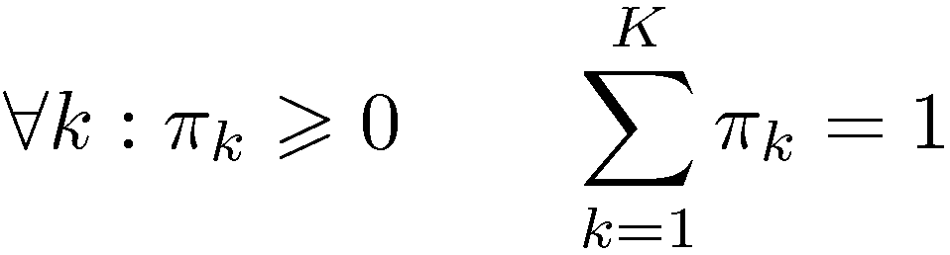
Mixtures of Gaussians
Combine simple models into a complex model:
Find parameters through EM (Expectation Maximization) algorithm
Component
Mixing coefficient
K=3
Adapted from Chris Bishop

Slide 28
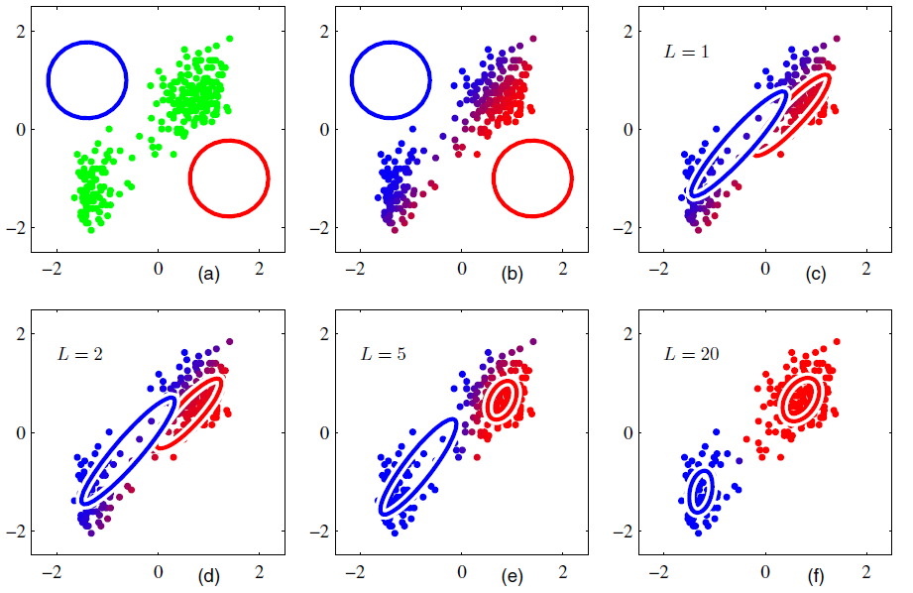
Initialization
E step
M step
Figures from Chris Bishop

Slide 29
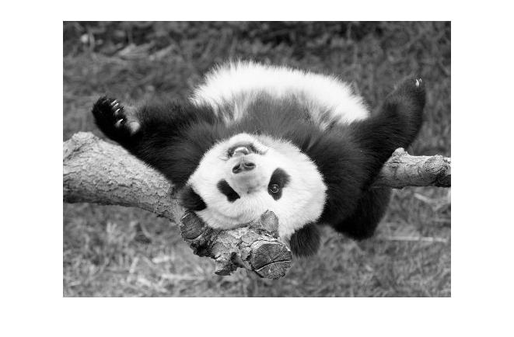
Segmentation as clustering
Depending on what we choose as the feature space, we can group pixels in different ways.
Grouping pixels based on intensity similarity
Feature space: intensity value (1-d)
Source: K. Grauman
Notes:
29

Slide 30
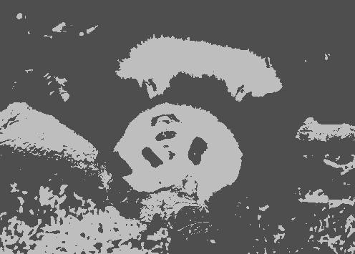
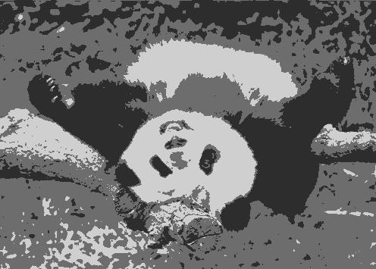
K=2
K=3
quantization of the feature space; segmentation label map
Source: K. Grauman

Slide 31
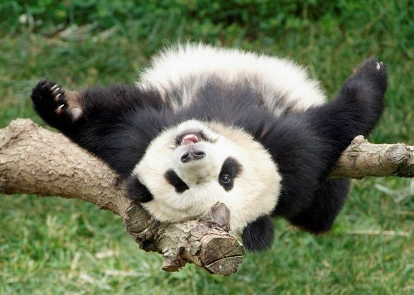
Segmentation as clustering
Depending on what we choose as the feature space, we can group pixels in different ways.
R=255
G=200
B=250
Grouping pixels based on color similarity
B
R=245
G=220
B=248
G
R=15
G=189
B=2
R=3
G=12
B=2
R
Feature space: color value (3-d)
Source: K. Grauman
Notes:
31

Slide 32
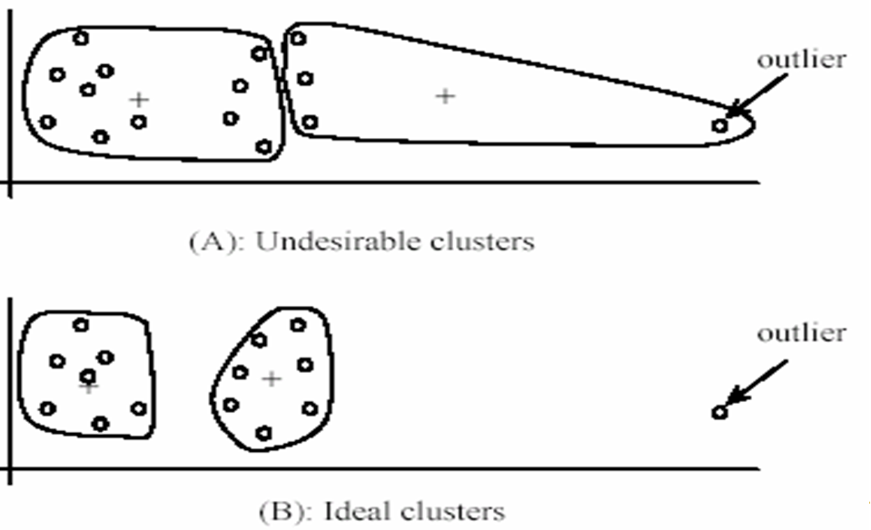
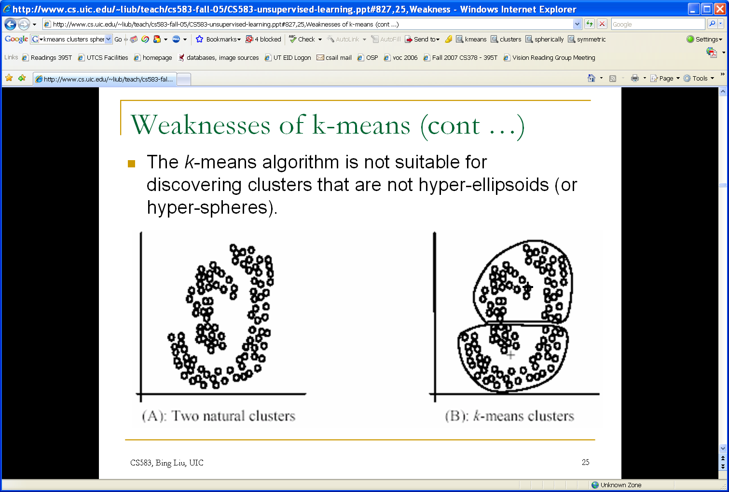
K-means: pros and cons
Pros
Simple, fast to compute
Converges to local minimum of within-cluster squared error
Cons/issues
Setting k?
  One way: silhouette coefficient
Sensitive to initial centers
  Use heuristics or output of another method
Sensitive to outliers
Detects spherical clusters
Adapted from K. Grauman
Notes:
32

Slide 33
Clustering algorithms
In depth
  K-means (iterate between finding centers and assigning points)
Briefly
  Mean-shift (find modes in the data)
  Hierarchical clustering (start with all points in separate clusters and merge)
Notes:
33

Slide 34
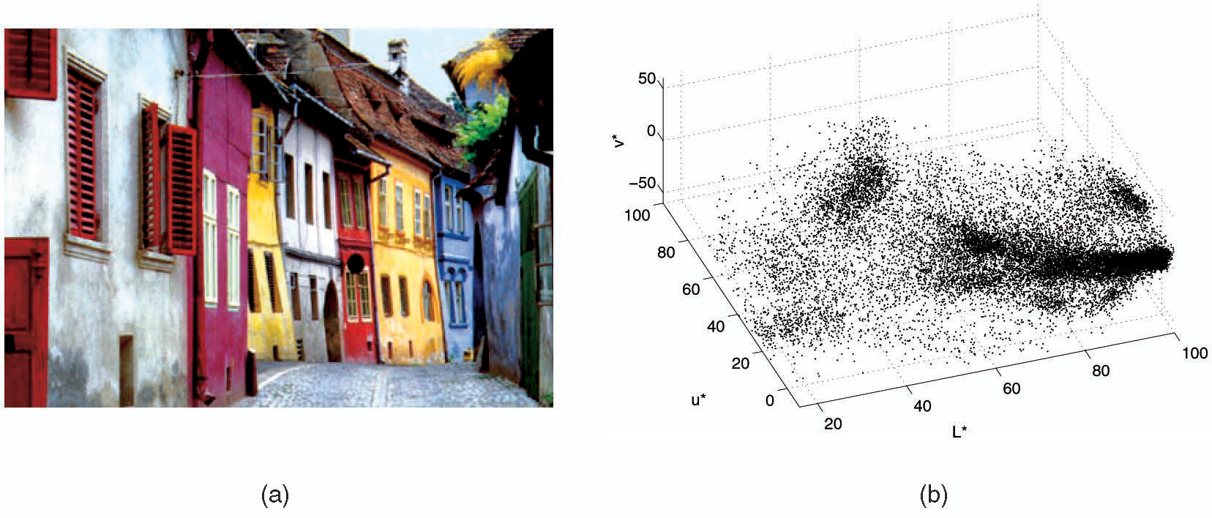
Mean shift algorithm
The mean shift algorithm seeks modes or local maxima of density in the feature space
Feature space
(L*u*v* color values)
image
Source: K. Grauman

Slide 35
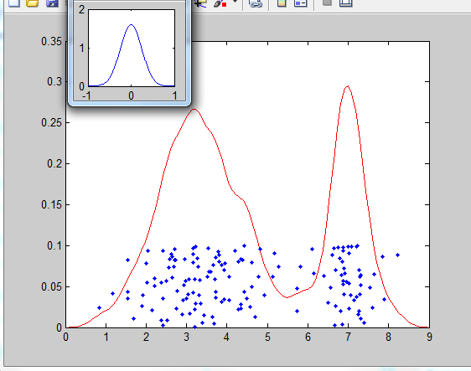
Density estimation
Kernel / window with weights that we slide over
Estimated density
Data (1-D)
Adapted from D. Hoiem

Slide 36
Mean shift
Search
window
Center of
mass
Mean Shift
vector
Slide by Y. Ukrainitz & B. Sarel

Slide 37
Mean shift
Search
window
Center of
mass
Mean Shift
vector
Slide by Y. Ukrainitz & B. Sarel

Slide 38
Mean shift
Search
window
Center of
mass
Mean Shift
vector
Slide by Y. Ukrainitz & B. Sarel

Slide 39
Mean shift
Search
window
Center of
mass
Mean Shift
vector
Slide by Y. Ukrainitz & B. Sarel

Slide 40
Mean shift
Search
window
Center of
mass
Mean Shift
vector
Slide by Y. Ukrainitz & B. Sarel

Slide 41
Mean shift
Search
window
Center of
mass
Mean Shift
vector
Slide by Y. Ukrainitz & B. Sarel

Slide 42
Mean shift
Search
window
Center of
mass
Slide by Y. Ukrainitz & B. Sarel

Slide 43
Points in same cluster converge
Source: D. Hoiem

Slide 44
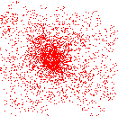
Mean shift clustering
Cluster: all data points in the attraction basin of a mode
Attraction basin: the region for which all trajectories lead to the same mode
Slide by Y. Ukrainitz & B. Sarel

Slide 45
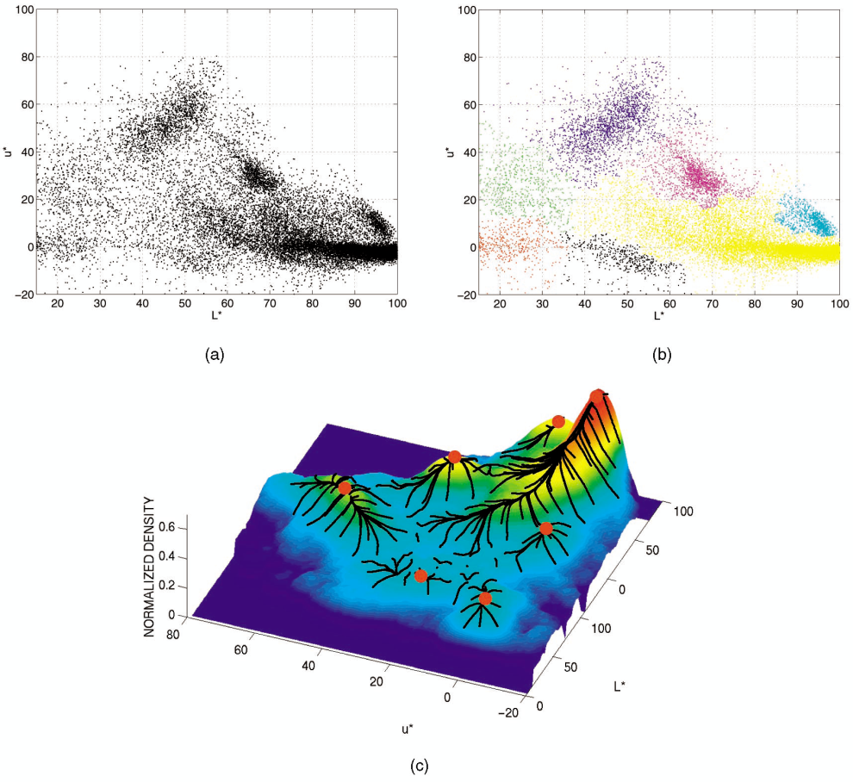
Mean shift clustering/segmentation
Compute features for each point (intensity, word counts, etc)
Initialize windows at individual feature points
Perform mean shift for each window until convergence
Merge windows that end up near the same “peak” or mode
Source: D. Hoiem

Slide 46
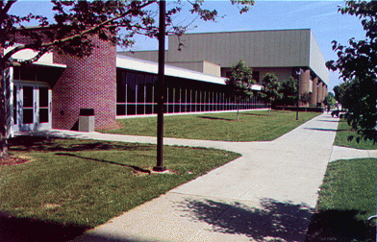
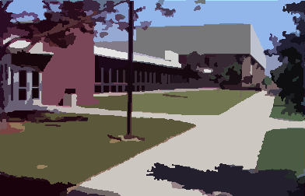
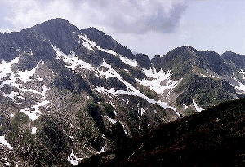
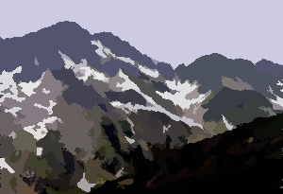
Mean shift segmentation results
http://www.caip.rutgers.edu/~comanici/MSPAMI/msPamiResults.html

Slide 47
Mean shift: Pros and cons
Pros:
  Does not assume shape on clusters
  Robust to outliers
Cons:
  Need to choose window size
  Quadratic in the number of samples

Slide 48
Hierarchical Agglomerative Clustering (HAC)
Assumes a similarity function for determining the similarity of two instances.
Starts with all instances in separate clusters and then repeatedly joins the two clusters that are most similar until there is only one cluster.
The history of merging forms a binary tree or hierarchy.
Slide credit: Ray Mooney

Slide 49
HAC Algorithm
Start with all instances in their own cluster.
Until there is only one cluster:
Among the current clusters, determine the two
clusters, c_{i} and c_{j}, that are most similar.
Replace c_{i} and c_{j} with a single cluster c_{i} ∪ c_{j}
Slide credit: Ray Mooney

Slide 50
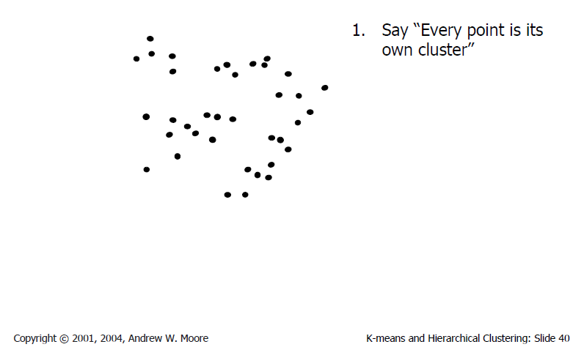
Agglomerative clustering

Slide 51
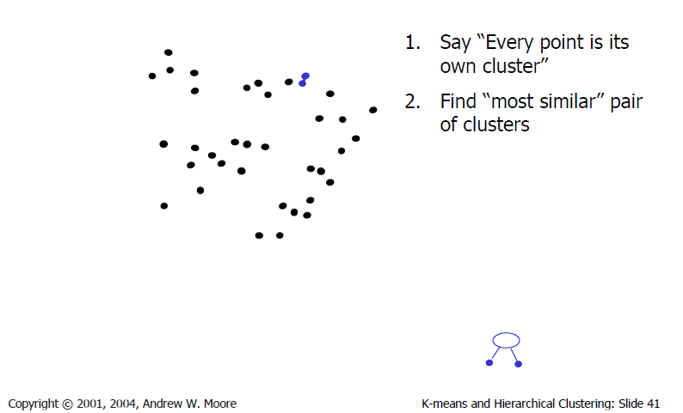
Agglomerative clustering

Slide 52
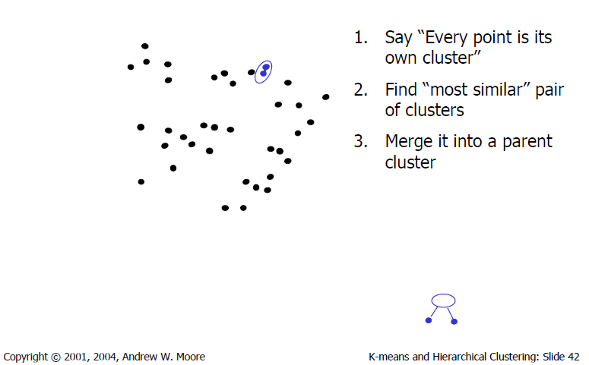
Agglomerative clustering

Slide 53
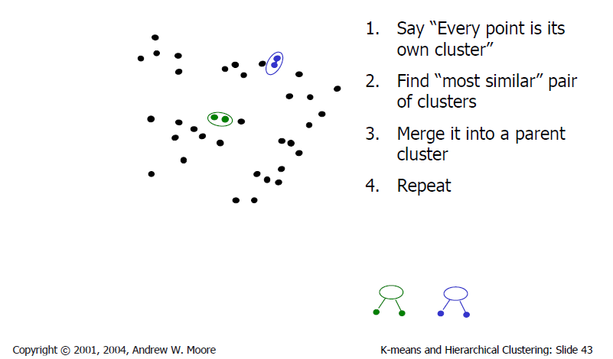
Agglomerative clustering

Slide 54
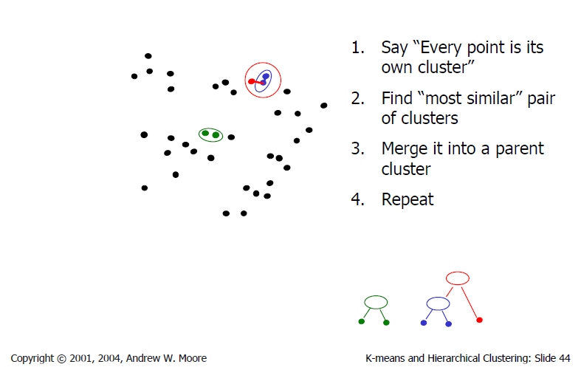
Agglomerative clustering

Slide 55
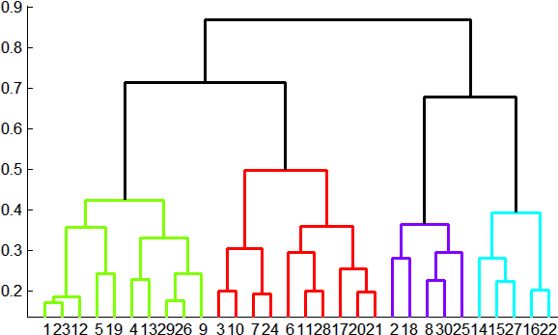
Agglomerative clustering
How many clusters?
Clustering creates a dendrogram (a tree)
To get final clusters, pick a threshold
  max number of clusters or
  max distance within clusters (y axis)
distance
Adapted from J. Hays

Slide 56
Cluster Similarity
How to compute similarity of two clusters each possibly containing multiple instances?
  Single Link: Similarity of two most similar members.
  Complete Link: Similarity of two least similar members.
  Group Average: Average similarity between members.
Adapted from Ray Mooney

Slide 57
Agglomerative clustering: pros & cons
Pros
  Deterministic
  Flexible (can use any cutoff to declare clusters)
  Interpretable?
Cons
  Some variants sensitive to noise
  Quadratic in the number of samples

Slide 58




How to evaluate clustering?
Might depend on application
Purity
where is the set of clusters
and is the set of classes
http://nlp.stanford.edu/IR-book/html/htmledition/evaluation-of-clustering-1.html

Slide 59
Summary of Clustering Strategies
K-means
  Iteratively re-assign points to the nearest cluster center
Mean-shift clustering
  Estimate modes
Agglomerative clustering
  Start with each point as its own cluster and iteratively merge the closest clusters

Slide 60
Dimensionality reduction
Motivation
Principal Component Analysis (PCA)
Applications
Other methods for dimensionality reduction

Slide 61
Why reduce dimensionality?
Data may intrinsically live in a lower-dim space
Too many features and too few data
Lower computational expense (memory, train/test time)
Want to visualize the data in a lower-dim space
Want to use data of different dimensionality

Slide 62
Goal
Input: Data in a high-dim feature space
Output: Projection of same data into a lower-dim space
Function: high-dim X → low-dim X

Slide 63

Goal
Slide credit: Erik Sudderth

Slide 64
Some criteria for success
Find a projection where the data has:
  Low reconstruction error
  High variance of the data

Slide 65

Principal Components Analysis
Slide credit: Subhransu Maji

Slide 66
Demo
http://www.cs.pitt.edu/~kovashka/cs1675_fa18/PCA_demo.m
http://www.cs.pitt.edu/~kovashka/cs1675_fa18/PCA.m

Slide 67

Application: Face Recognition
Image from cnet.com

Slide 68

The space of all face images
When viewed as vectors of pixel values, face images are extremely high-dimensional
  24x24 image = 576 dimensions
  Slow and lots of storage
But few 576-dimensional vectors are valid face images
We want to effectively model the subspace of face images
Adapted from Derek Hoiem
M. Turk and A. Pentland, Face Recognition using Eigenfaces, CVPR 1991

Slide 69



Representation and reconstruction
Face x in “face space” coordinates:
Reconstruction:
=
=
+
^
x
=
µ + w₁u₁+w₂u₂+w₃u₃+w₄u₄+ …
Slide credit: Derek Hoiem

Slide 70

Slide credit: Alexander Ihler

Slide 71

Slide credit: Alexander Ihler

Slide 72

Slide credit: Alexander Ihler

Slide 73

Slide credit: Alexander Ihler

Slide 74
Other dimensionality reduction methods
Non-linear:
  Kernel PCA (Schölkopf et al., Neural Computation 1998)
  Independent component analysis – Comon, Signal Processing 1994
  LLE (locally linear embedding) – Roweis and Saul, Science 2000
  ISOMAP (isometric feature mapping) – Tenenbaum et al., Science 2000
  t-SNE (t-distributed stochastic neighbor embedding) – van der Maaten and Hinton, JMLR 2008

Slide 75

t-SNE example
Figure from Genevieve Patterson, IJCV 2014

Slide 76

t-SNE example
Baseline from Thomas and Kovashka, CVPR 2016

