Slide 1
CS 1675: Intro to Machine Learning
Introduction
Prof. Adriana Kovashka
University of Pittsburgh
August 28, 2018

Slide 2
Course Info
Course website: http://people.cs.pitt.edu/~kovashka/cs1675_fa18
Instructor: Adriana Kovashka (kovashka@cs.pitt.edu)
  → Use "CS1675" at the beginning of your Subject
Office: Sennott Square 5325
Class: Tue/Thu, 11am-12:15pm
Office hours: Tue 2-3:55pm, Thu 1-3:55pm
Notes:
Plan + website (4 min)
Introductions of students (10 min)
Intro to visual recognition (12 min)
Topics (12 min)
Structure of course (14 min)
Prereqs test (15 min)
Questions + extra (8 min)

Slide 3




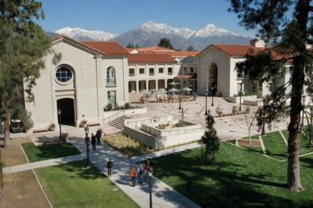
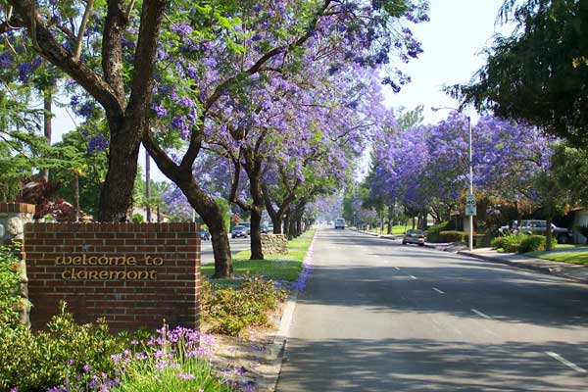
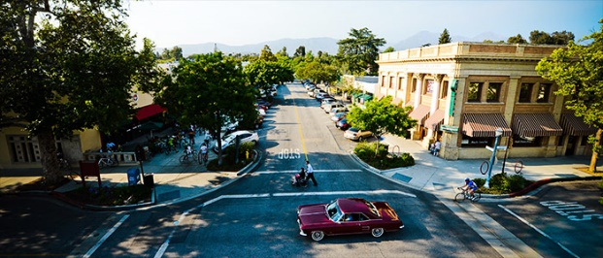
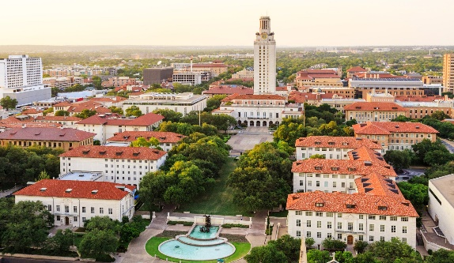

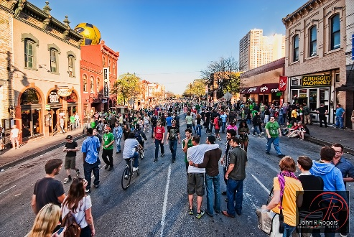
About the Instructor
Born 1985 in
Sofia, Bulgaria
Got BA in 2008 at
Pomona College, CA
(Computer Science &
Media Studies)
Got PhD in 2014
at University of
Texas at Austin
(Computer Vision)

Slide 4
About the TA
Karin Cox
Office: Sennott Square 6150
Office hours: TBD
  Do the Doodle by the end of Friday: https://doodle.com/poll/r8kbccezcrzuuh8a

Slide 5
Recitations
Time: Friday, 9am and 1pm
Room: Sennott Square 6110
Instructor: TBD

Slide 6
Course Goals
To learn the basic machine learning techniques, both from a theoretical and practical perspective
To practice implementing and using these techniques for simple problems
To understand the advantages/disadvantages of machine learning algorithms and how they relate to each other

Slide 7
Textbooks
Christopher M. Bishop. Pattern Recognition and Machine Learning. Springer, 2006
More resources available on course webpage
Your notes from class are your best study material, slides are not complete with notes

Slide 8
Programming Language
We’ll use Matlab
It can be downloaded for free from MyPitt
We’ll do a short tutorial; ask TA if you need further help

Slide 9
Course Structure
Lectures
Weekly assignments
Two exams
Participation component

Slide 10
Policies and Schedule
http://people.cs.pitt.edu/~kovashka/cs1675_fa18

Slide 11
Should I take this class?
It will be a lot of work!
  I expect you’ll spend 6-8 hours on HW each week
  But you will learn a lot
Some parts will be hard and require that you pay close attention!
  But I will have periodic ungraded pop quizzes to see how you’re doing
  I will also pick on students randomly to answer questions
  Use instructor’s and TA’s office hours!!!

Slide 12
Questions?

Slide 13
Plan for Today
Blitz introductions
What is machine learning?
  Example problems and tasks
  ML in a nutshell
  Challenges
  Measuring performance
Review
  Linear algebra
  Calculus
Matlab tutorial

Slide 14
Blitz introductions (10 sec)
What is your name?
What one thing outside of school are you passionate about?
What do you hope to get out of this class?
Every time you speak, please remind me your name

Slide 15
What is machine learning?
Finding patterns and relationships in data
Using these patterns to make useful predictions or to summarize the data automatically
E.g.
  predict how much a user will like a movie, even though that user never rated that movie
  identify common types of movies without knowing about genres

Slide 16

Example machine learning tasks
Netflix challenge
  Given lots of data about how users rated movies (training data)
  But we don’t know how user i will rate movie j and want to predict that (test data)
  Why is that hard? How can we do it?

Slide 17
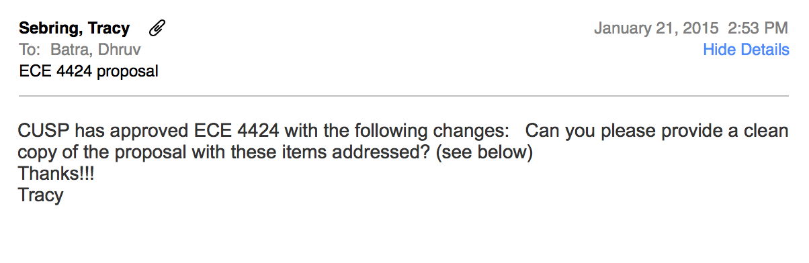
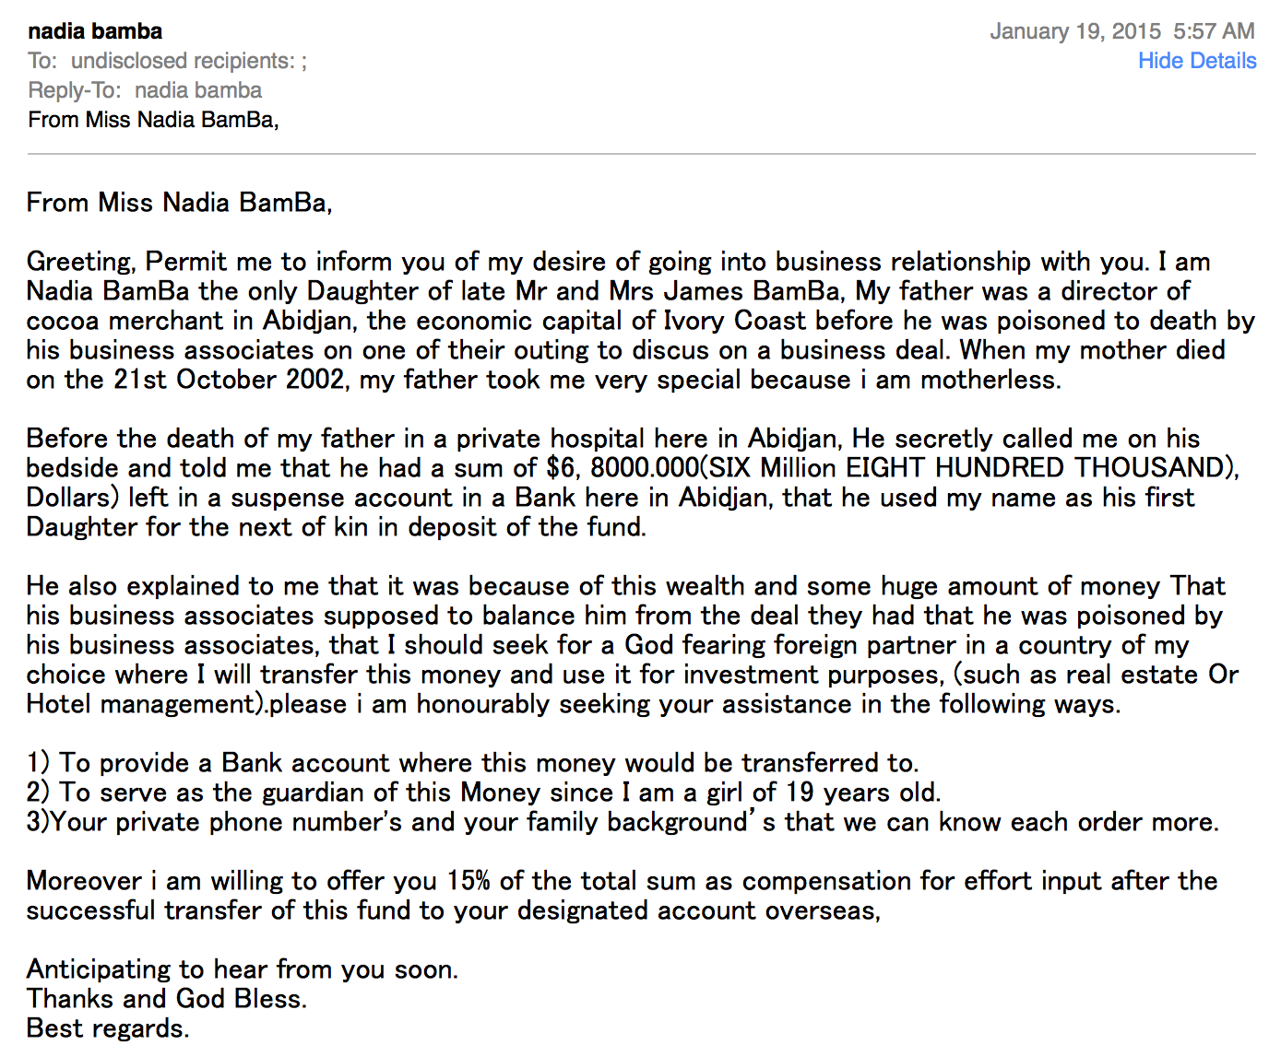
Example machine learning tasks
Spam or not?
vs
Slide credit: Dhruv Batra

Slide 18

Example machine learning tasks
Weather prediction
Temperature
Slide credit: Carlos Guestrin

Slide 19
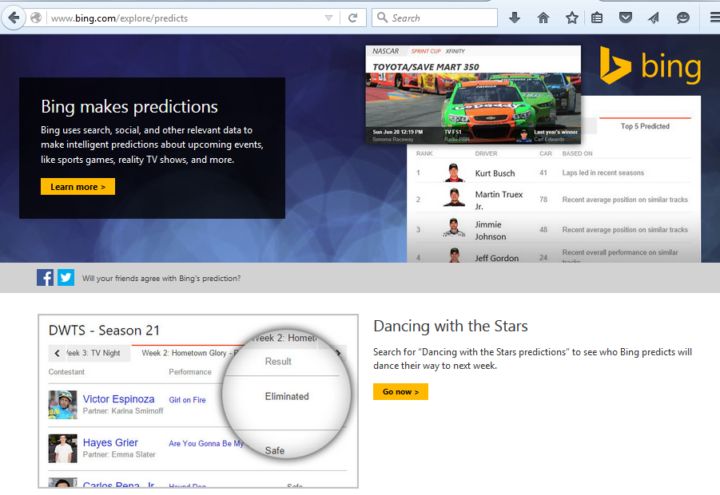
Example machine learning tasks
Who will win <contest of your choice>?

Slide 20
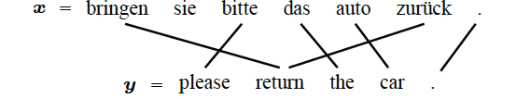
Example machine learning tasks
Machine translation
Slide credit: Dhruv Batra, figure credit: Kevin Gimpel

Slide 21

Example machine learning tasks
Speech recognition
Slide credit: Carlos Guestrin

Slide 22
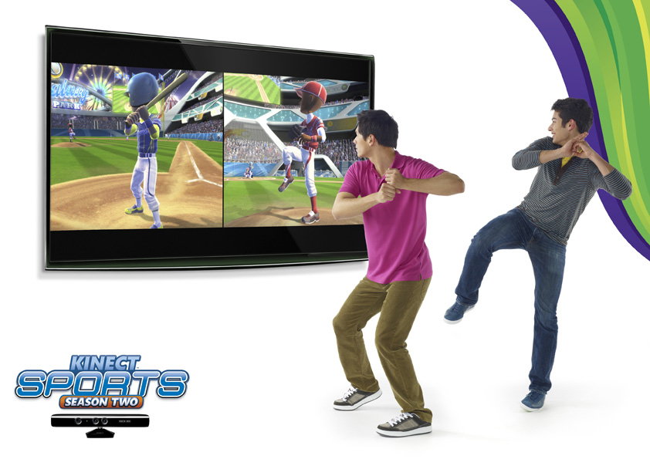
Example machine learning tasks
Pose estimation
Slide credit: Noah Snavely

Slide 23

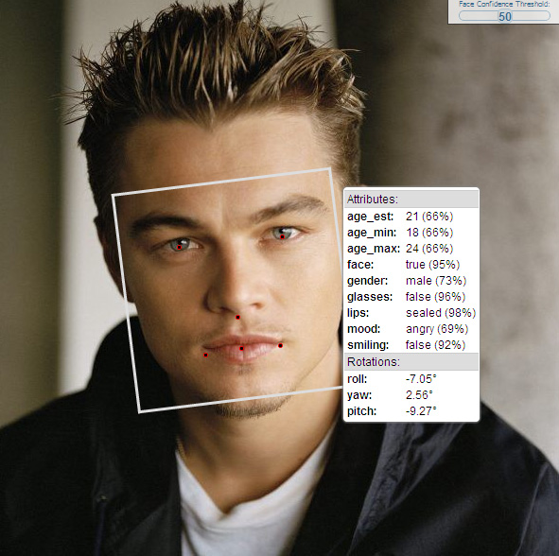

Example machine learning tasks
Face recognition
Slide credit: Noah Snavely

Slide 24
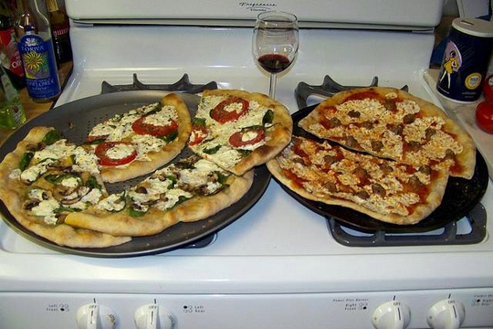
Example machine learning tasks
Image categorization
Pizza
Wine
Stove
Slide credit: Dhruv Batra

Slide 25
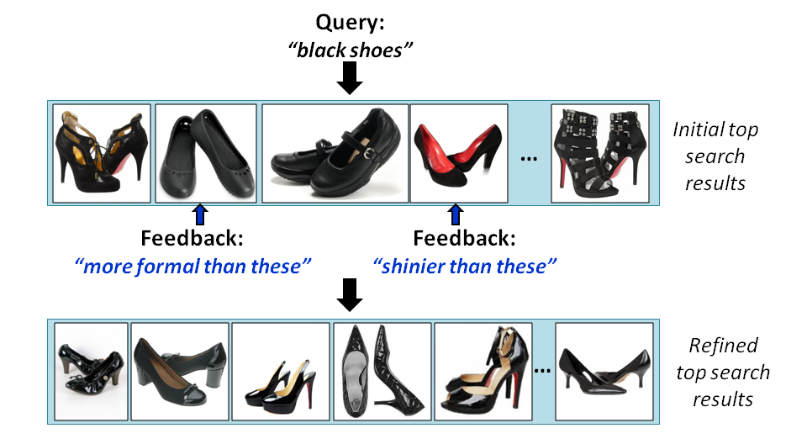
Example machine learning tasks
Image retrieval
Kovashka et al., “WhittleSearch: Image Search with Relative Attribute Feedback”, CVPR 2012

Slide 26
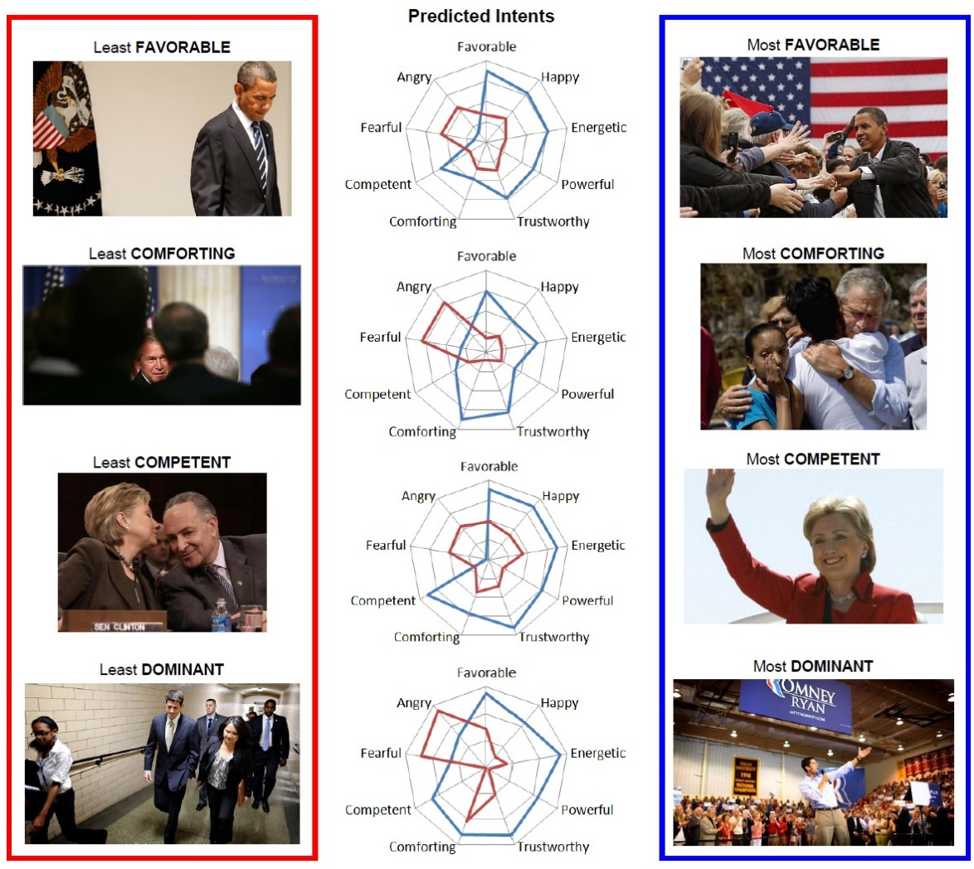
Example machine learning tasks
Inferring visual persuasion
Joo et al., “Visual Persuasion: Inferring Communicative Intents of Images”, CVPR 2014

Slide 27
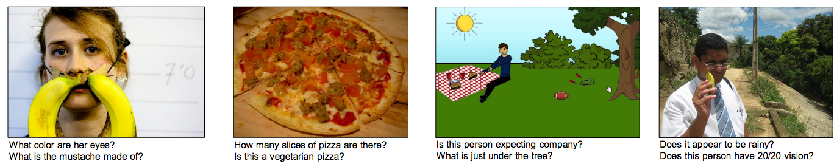
Example machine learning tasks
Answering questions about images
Antol et al., “VQA: Visual Question Answering”, ICCV 2015

Slide 28
Example machine learning tasks
What else?
What are some problems from everyday life that can be helped by machine learning?

Slide 29
ML in a Nutshell
Tens of thousands of machine learning algorithms
Decades of ML research oversimplified:
  Learn a mapping from input to output f: X → Y
  X: emails, Y: {spam, notspam}
Slide credit: Pedro Domingos

Slide 30
ML in a Nutshell
y = f(x)
Training: given a training set of labeled examples {(x₁,y₁), …, (x_{N},y_{N})}, estimate the prediction function f by minimizing the prediction error on the training set
Testing: apply f to a never before seen test example x and output the predicted value y = f(x)
output
prediction function
features
Slide credit: L. Lazebnik

Slide 31



ML in a Nutshell
Apply a prediction function to a feature representation of the image to get the desired output:
f( ) = “apple”
f( ) = “tomato”
f( ) = “cow”
Slide credit: L. Lazebnik

Slide 32
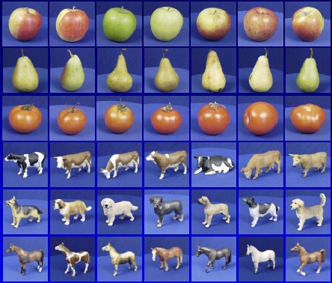

ML in a Nutshell
Training
Training Labels
Training Images
Features
Training
Learned model
Testing
Features
Learned model
Prediction
Test Image
Slide credit: D. Hoiem and L. Lazebnik

Slide 33
Training vs Testing
What do we want?
  High accuracy on training data?
  No, high accuracy on unseen/new/test data!
  Why is this tricky?
Training data
  Features (x) and labels (y) used to learn mapping f
Test data
  Features used to make a prediction
  Labels only used to see how well we’ve learned f!!!
Validation data
  Held-out set of the training data
  Can use both features and labels to tune parameters of the model we’re learning

Slide 34
Why do we hope this would work?
Statistical estimation view:
  x and y are random variables
  D = (x₁,y₁), (x₂,y₂), …, (x_{N},y_{N}) ~ P(X,Y)
  Both training & testing data sampled IID from P(X,Y)
    IID: Independent and Identically Distributed
  Learn on training set, have some hope of generalizing to test set
Adapted from Dhruv Batra

Slide 35
ML in a Nutshell
Every machine learning algorithm has:
  Data representation (x, y)
  Problem representation
  Evaluation / objective function
  Optimization
Adapted from Pedro Domingos

Slide 36
Data representation
Let’s brainstorm what our “X” should be for various “Y” prediction tasks…

Slide 37
Problem representation
Decision trees
Sets of rules / Logic programs
Instances
Graphical models (Bayes/Markov nets)
Neural networks
Support vector machines
Model ensembles
Etc.
Slide credit: Pedro Domingos

Slide 38
Evaluation / objective function
Accuracy
Precision and recall
Squared error
Likelihood
Posterior probability
Cost / Utility
Margin
Entropy
K-L divergence
Etc.
Slide credit: Pedro Domingos

Slide 39

Optimization
Discrete / combinatorial optimization
  E.g. graph algorithms
Continuous optimization
  E.g. linear programming
Adapted from Dhruv Batra, image from Wikipedia

Slide 40
Defining the Learning Task
Improve on task, T, with respect to
performance metric, P, based on experience, E.
T: Categorize email messages as spam or legitimate
P: Percentage of email messages correctly classified
E: Database of emails, some with human-given labels
T: Recognizing hand-written words
P: Percentage of words correctly classified
E: Database of human-labeled images of handwritten words
T: Playing checkers
P: Percentage of games won against an arbitrary opponent
E: Playing practice games against itself
T: Driving on four-lane highways using vision sensors
P: Average distance traveled before a human-judged error
E: A sequence of images and steering commands recorded while
observing a human driver.
Slide credit: Ray Mooney

Slide 41
Types of Learning
Supervised learning
  Training data includes desired outputs
Unsupervised learning
  Training data does not include desired outputs
Weakly or Semi-supervised learning
  Training data includes a few desired outputs
Reinforcement learning
  Rewards from sequence of actions
Slide credit: Dhruv Batra

Slide 42
Types of Prediction Tasks
Supervised Learning
x
Classification
y
Discrete
x
Regression
y
Continuous
Unsupervised Learning
x
Clustering
x'
Discrete ID
x
Dimensionality
Reduction
x'
Continuous
Adapted from Dhruv Batra

Slide 43
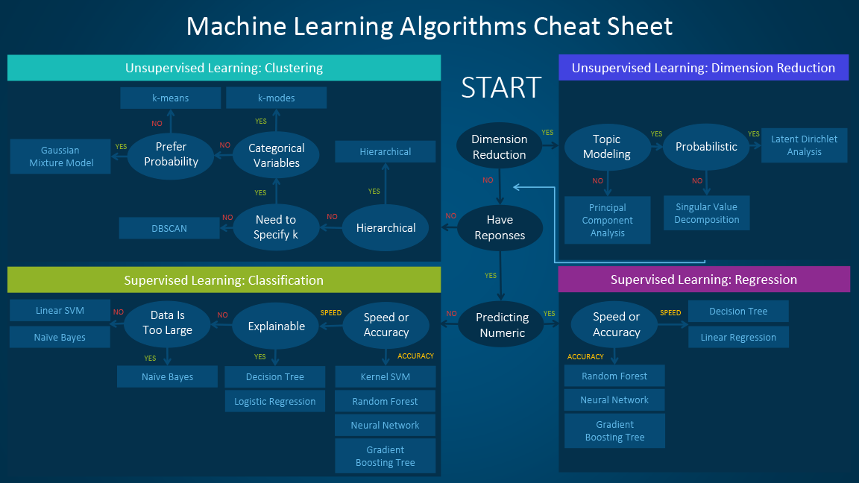
Navigating ML World
https://blogs.sas.com/content/subconsciousmusings/2017/04/12/machine-learning-algorithm-use/

Slide 44
Example of Solving a ML Problem
Spam or not?
vs
Slide credit: Dhruv Batra

Slide 45
Intuition
Spam Emails
  a lot of words like
    “money”
    “free”
    “bank account”
Regular Emails
  word usage pattern is more spread out
Slide credit: Dhruv Batra, Fei Sha

Slide 46
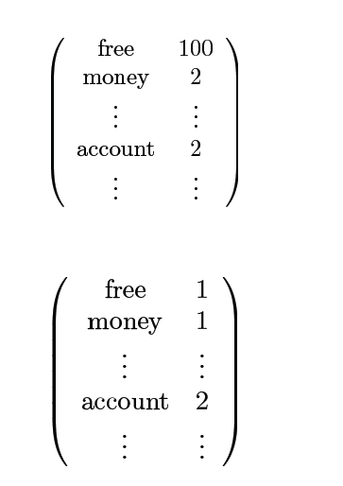

Simple strategy: Let’s count!
This is X
This is Y
= 1 оr 0?
Adapted from Dhruv Batra, Fei Sha

Slide 47
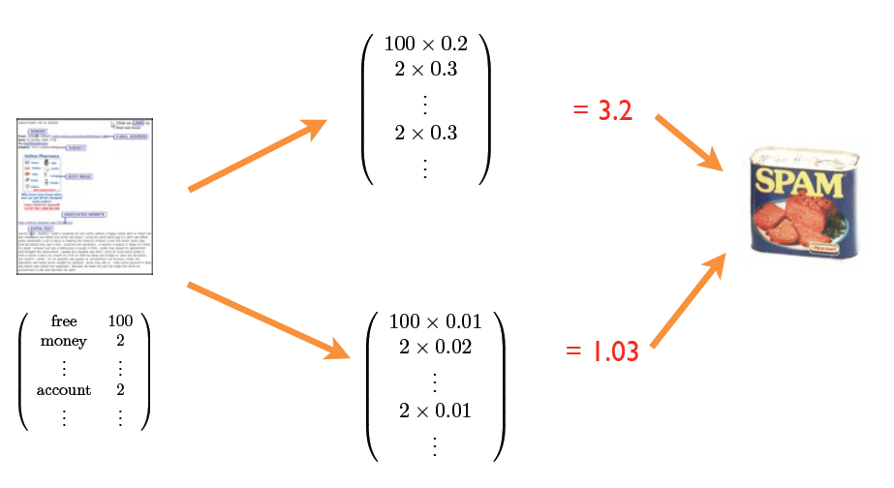
Weigh counts and sum to get prediction
Why these words?
Where do the weights come from?
Adapted from Dhruv Batra, Fei Sha

Slide 48
Why not just hand-code these weights?
We’re letting the data do the work rather than develop hand-code classification rules
  The machine is learning to program itself
But there are challenges…

Slide 49
Klingon vs Mlingon Classification
Training Data
  Klingon: klix, kour, koop
  Mlingon: moo, maa, mou
Testing Data: kap
Which language? Why?
Slide credit: Dhruv Batra

Slide 50
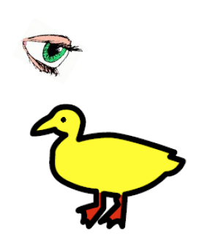
“I saw her duck”
Slide credit: Dhruv Batra, figure credit: Liang Huang

Slide 51

“I saw her duck”
Slide credit: Dhruv Batra, figure credit: Liang Huang

Slide 52
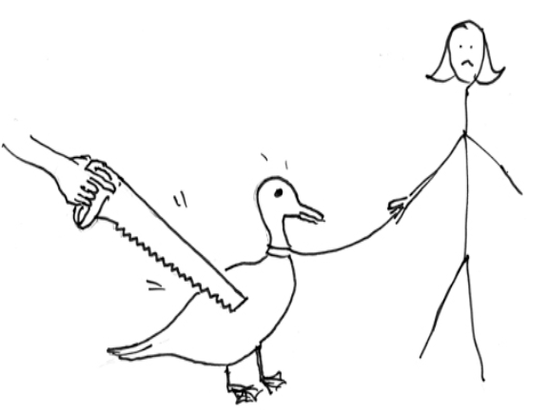
“I saw her duck”
Slide credit: Dhruv Batra, figure credit: Liang Huang

Slide 53
“I saw her duck with a telescope…”
Slide credit: Dhruv Batra, figure credit: Liang Huang

Slide 54

What humans see
Slide credit: Larry Zitnick

Slide 55
What computers see
243 | 239 | 240 | 225 | 206 | 185 | 188 | 218 | 211 | 206 | 216 | 225
242 | 239 | 218 | 110 | 67 | 31 | 34 | 152 | 213 | 206 | 208 | 221
243 | 242 | 123 | 58 | 94 | 82 | 132 | 77 | 108 | 208 | 208 | 215
235 | 217 | 115 | 212 | 243 | 236 | 247 | 139 | 91 | 209 | 208 | 211
233 | 208 | 131 | 222 | 219 | 226 | 196 | 114 | 74 | 208 | 213 | 214
232 | 217 | 131 | 116 | 77 | 150 | 69 | 56 | 52 | 201 | 228 | 223
232 | 232 | 182 | 186 | 184 | 179 | 159 | 123 | 93 | 232 | 235 | 235
232 | 236 | 201 | 154 | 216 | 133 | 129 | 81 | 175 | 252 | 241 | 240
235 | 238 | 230 | 128 | 172 | 138 | 65 | 63 | 234 | 249 | 241 | 245
237 | 236 | 247 | 143 | 59 | 78 | 10 | 94 | 255 | 248 | 247 | 251
234 | 237 | 245 | 193 | 55 | 33 | 115 | 144 | 213 | 255 | 253 | 251
248 | 245 | 161 | 128 | 149 | 109 | 138 | 65 | 47 | 156 | 239 | 255
190 | 107 | 39 | 102 | 94 | 73 | 114 | 58 | 17 | 7 | 51 | 137
23 | 32 | 33 | 148 | 168 | 203 | 179 | 43 | 27 | 17 | 12 | 8
17 | 26 | 12 | 160 | 255 | 255 | 109 | 22 | 26 | 19 | 35 | 24
Slide credit: Larry Zitnick

Slide 56
Challenges
Some challenges: ambiguity and context
Machines take data representations too literally
Humans are much better than machines at generalization, which is needed since test data will rarely look exactly like the training data

Slide 57
Challenges
Why might it be hard to:
  Predict if a viewer will like a movie?
  Recognize cars in images?
  Translate between languages?

Slide 58
The Time is Ripe to Study ML
Many basic effective and efficient algorithms available.
Large amounts of on-line data available.
Large amounts of computational resources available.
Slide credit: Ray Mooney

Slide 59
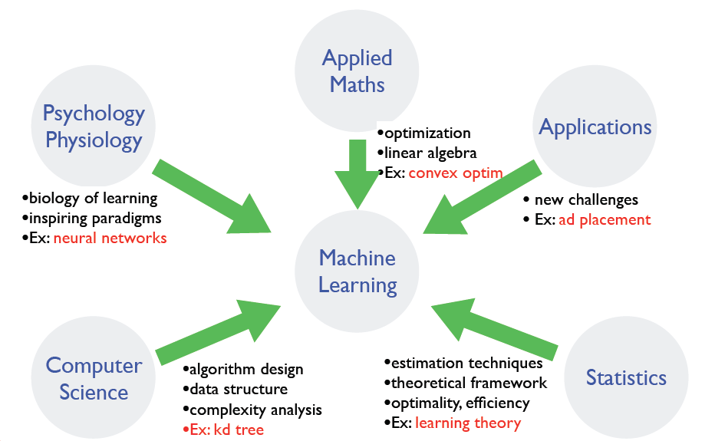
Where does ML fit in?
Slide credit: Dhruv Batra, Fei Sha

Slide 60
Plan for Today
Blitz introductions
What is machine learning?
  Example problems and tasks
  ML in a nutshell
  Challenges
  Measuring performance
Review
  Linear algebra
  Calculus
Matlab tutorial

Slide 61
Measuring Performance
If y is discrete:
  Accuracy: # correctly classified / # all test examples
  Precision/recall
    True Positive, False Positive, True Negative, False Negative
    Precision = TP / (TP + FP) = # predicted true pos / # predicted pos
    Recall = TP / (TP + FN) = # predicted true pos / # true pos
  F-measure
    = 2PR / (P + R)
Want evaluation metric to be in some range, e.g. [0 1]
  0 = worst possible classifier, 1 = best possible classifier
Notes:
Diagnosis example

Slide 62
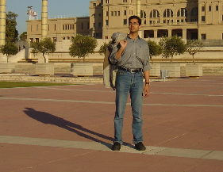

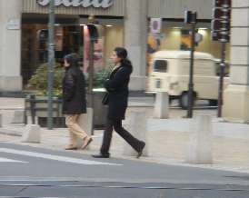
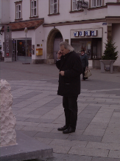
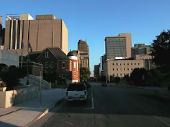
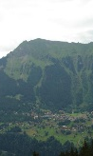
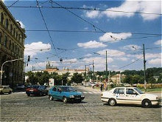
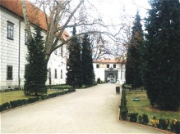


Precision / Recall / F-measure
True positives
(images that contain people)
True negatives
(images that do not contain people)
Predicted positives
(images predicted to contain people)
Predicted negatives
(images predicted not to contain people)
Precision = TP / (TP + FP) = 2 / 5 = 0.4
Recall = TP / (TP + FN) = 2 / 4 = 0.5
F-measure = 2*0.4*0.5 / 0.4+0.5 = 0.44
Accuracy: 5 / 10 = 0.5

Slide 63
Measuring Performance
If y is continuous:
  Sum-of-Squared-Differences (SSD) error between predicted and true y:

Slide 64
Linear algebra review
See http://cs229.stanford.edu/section/cs229-linalg.pdf for more

Slide 65
Vectors and Matrices
Vectors and matrices are just collections of ordered numbers that represent something: movements in space, scaling factors, word counts, movie ratings, pixel brightnesses, etc.
We’ll define some common uses and standard operations on them.

Slide 66
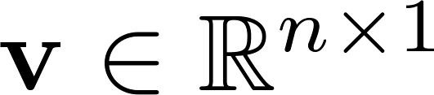
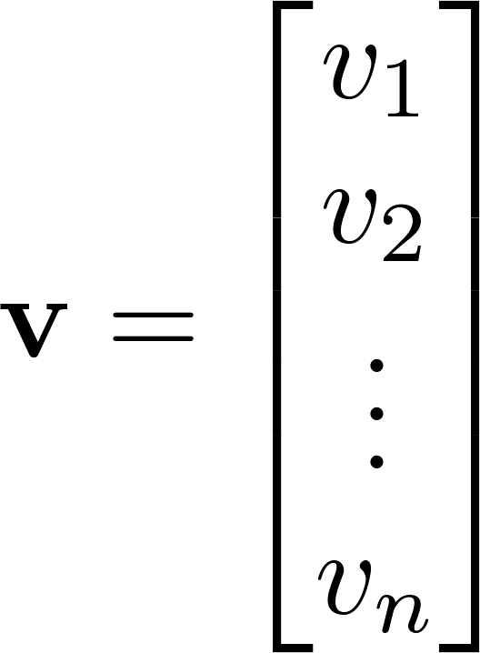
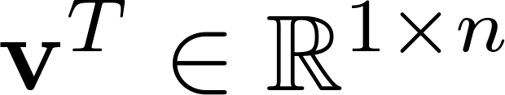
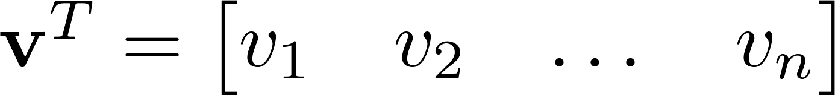

Vector
A column vector where
A row vector where
denotes the transpose operation

Slide 67
Vector
You’ll want to keep track of the orientation of your vectors when programming in MATLAB.
You can transpose a vector V in MATLAB by writing V’.

Slide 68
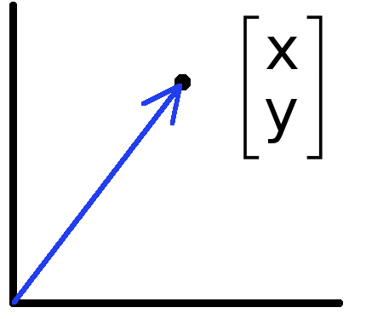
Vectors have two main uses
Data can also be treated as a vector
Such vectors don’t have a geometric interpretation, but calculations like “distance” still have value
Vectors can represent an offset in 2D or 3D space
Points are just vectors from the origin

Slide 69
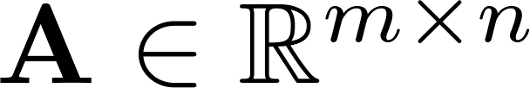
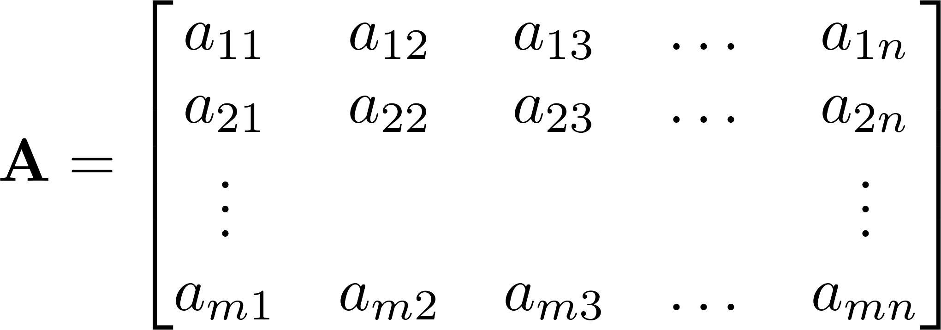



Matrix
A matrix is an array of numbers with size $m↓$ by $n→$, i.e. m rows and n columns.
If , we say that is square.

Slide 70
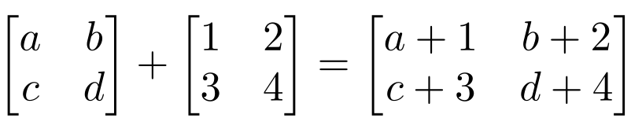
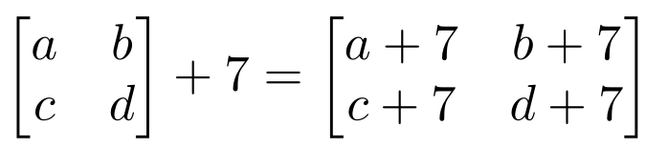
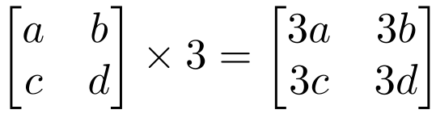
Matrix Operations
Addition
  Can only add a matrix with matching dimensions, or a scalar.
Scaling

Slide 71
Matrix Multiplication
Let X be an axb matrix, Y be an bxc matrix
Then Z = X*Y is an axc matrix
Second dimension of first matrix, and first dimension of first matrix have to be the same, for matrix multiplication to be possible
Practice: Let X be an 10x5 matrix. Let’s factorize it into 3 matrices…

Slide 72
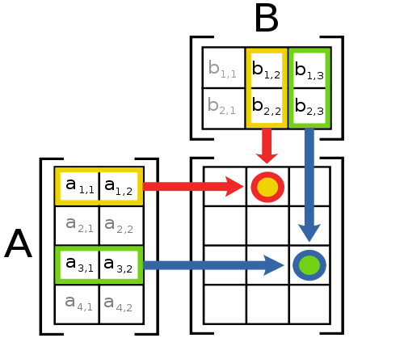
Matrix Multiplication
The product AB is:
Each entry in the result is (that row of A) dot product with (that column of B)

Slide 73
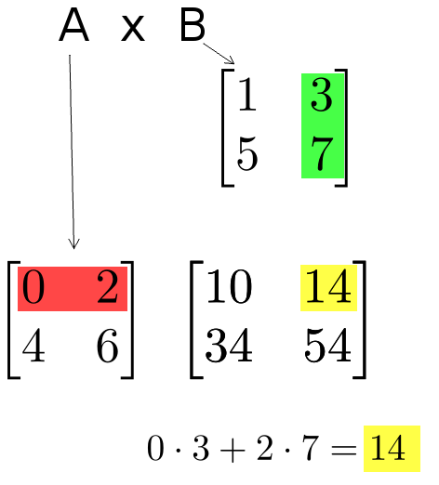
Matrix Multiplication
Example:
  Each entry of the matrix product is made by taking the dot product of the corresponding row in the left matrix, with the corresponding column in the right one.

Slide 74
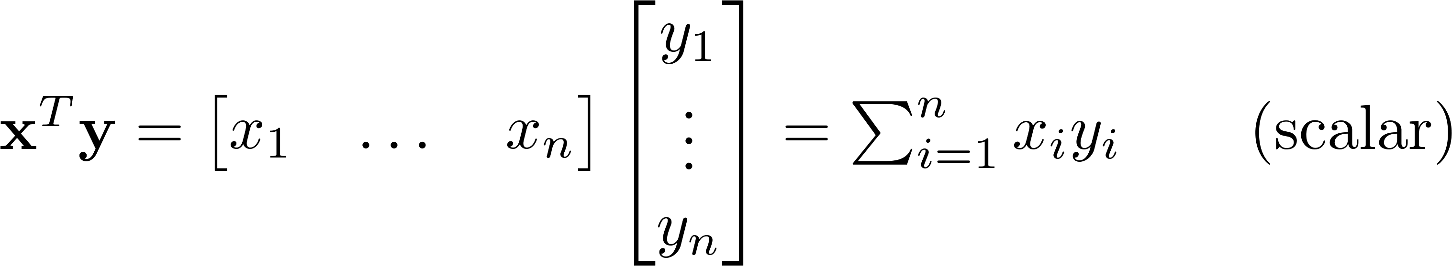
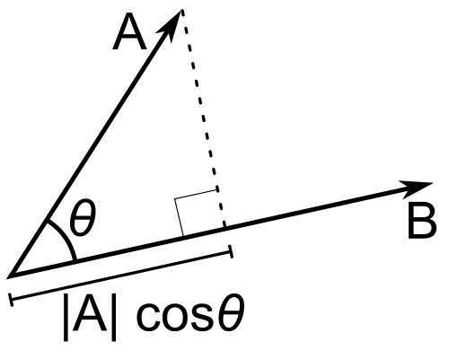
Inner Product
Multiply corresponding entries of two vectors and add up the result
x·y is also |x||y|Cos( angle between x and y )
If B is a unit vector, then A·B gives the length of A which lies in the direction of B (projection)
(if B is unit-length hence norm is 1)

Slide 75
Different types of product
x, y = column vectors (nx1)
X, Y = matrices (mxn)
x, y = scalars (1x1)
x^{T} y = x · y = inner product (1xn x nx1 = scalar)
x ⊗ y = x y^{T} = outer product (nx1 x 1xn = matrix)
X * Y = matrix product
X .* Y = element-wise product

Slide 76
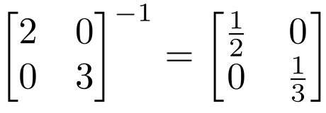
Inverse
Given a matrix A, its inverse A⁻¹ is a matrix such that AA⁻¹ = A⁻¹A = I
E.g.
Inverse does not always exist. If A⁻¹ exists, A is invertible or non-singular. Otherwise, it’s singular.

Slide 77
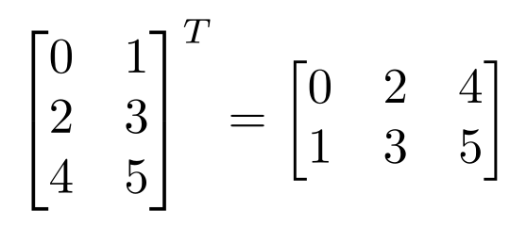
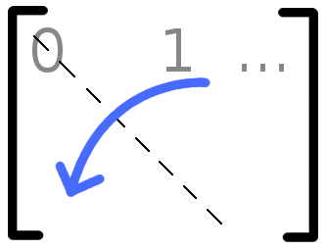

Matrix Operations
Transpose – flip matrix, so row 1 becomes column 1
A useful identity:

Slide 78
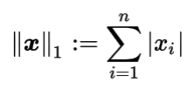
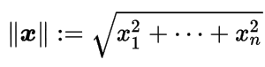
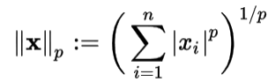
Norms
L1 norm
L2 norm
L^{p} norm (for real numbers p ≥ 1)

Slide 79
Matrix Rank
Column/row rank
Column rank always equals row rank
Matrix rank
If a matrix is not full rank, inverse doesn’t exist
  Inverse also doesn’t exist for non-square matrices

Slide 80
Matrix Operation Properties
Matrix addition is commutative and associative
  A + B = B + A
  A + (B + C) = (A + B) + C
Matrix multiplication is associative and distributive but not commutative
  A(B*C) = (A*B)C
  A(B + C) = A*B + A*C
  A*B != B*A

Slide 81


Special Matrices
Identity matrix I
  Square matrix, 1’s along diagonal, 0’s elsewhere
  I ∙ [another matrix] = [that matrix]
Diagonal matrix
  Square matrix with numbers along diagonal, 0’s elsewhere
  A diagonal ∙ [another matrix] scales the rows of that matrix

Slide 82


Special Matrices
Symmetric matrix

Slide 83


Matrix Operations
MATLAB example:
>> x = A\B
x =
1.0000
-0.5000

Slide 84
Linear independence
Suppose we have a set of vectors v₁, …, v_{n}
If we can express v₁ as a linear combination of the other vectors v₂…v_{n}, then v₁ is linearly dependent on the other vectors.
  The direction v₁ can be expressed as a combination of the directions v₂…v_{n}. (E.g. v₁ = .7 v₂ -.7 v₄)
If no vector is linearly dependent on the rest of the set, the set is linearly independent.
  Common case: a set of vectors v₁, …, v_{n} is always linearly independent if each vector is perpendicular to every other vector (and non-zero)

Slide 85
Linear independence
Linearly independent set
Not linearly independent

Slide 86
Singular Value Decomposition (SVD)
There are several computer algorithms that can “factor” a matrix, representing it as the product of some other matrices
The most useful of these is the Singular Value Decomposition
Represents any matrix A as a product of three matrices: UΣV^{T}
MATLAB command: [U,S,V] = svd(A);

Slide 87

Singular Value Decomposition (SVD)
UΣV^{T} = A
Where U and V are rotation matrices, and Σ is a scaling matrix. For example:

Slide 88

Singular Value Decomposition (SVD)
In general, if A is m x n, then U will be m x m, Σ will be m x n, and V^{T} will be n x n.

Slide 89
Singular Value Decomposition (SVD)
U and V are always rotation matrices.
  Geometric rotation may not be an applicable concept, depending on the matrix. So we call them “unitary” matrices – each column is a unit vector.
Σ is a diagonal matrix
  The number of nonzero entries = rank of A
  The algorithm always sorts the entries high to low

Slide 90

Singular Value Decomposition (SVD)
M = UΣV^{T}
Illustration from Wikipedia

Slide 91
Calculus review

Slide 92
Differentiation
The derivative provides us information about the rate of change of a function.
The derivative of a function is also a function. Example:
The derivative of the rate function is the
acceleration function.
Texas A&M Dept of Statistics

Slide 93

Derivative = rate of change
Image: Wikipedia

Slide 94


Derivative = rate of change
Linear function y = mx + b
Slope
Image: Wikipedia

Slide 95
Ways to Write the Derivative
Given the function f(x), we can write its derivative in the following ways:
- f '(x)
- ^{d} f(x)
dx
The derivative of x is commonly written dx.
Texas A&M Dept of Statistics

Slide 96
Differentiation Formulas
The following are common differentiation formulas:
- The derivative of a constant is 0.
^{d} c = 0
du
- The derivative of a sum is the sum of the derivatives.
^{d} ( f (u) + g(u)) = f '(u) + g'(u)
du
Texas A&M Dept of Statistics

Slide 97
Examples
- The derivative of a constant is 0.
^{d} 7 =
du
- The derivative of a sum is the sum of the derivatives.
^{d} (t + 4) =
dt
Texas A&M Dept of Statistics

Slide 98
More Formulas
- The derivative of u to a constant power:
^{d} u^{n} = n *u^{n−1}du
du
- The derivative of e:
^{d} e^{u} = e^{u}du
du
- The derivative of log:
^{d} log(u) = ¹ du du u
Texas A&M Dept of Statistics

Slide 99
More Examples
- The derivative of u to a constant power:
^{d} 3x³ =
dx
The derivative of e:
^{d} _{e}4 y ₌
dy
The derivative of log:
^{d} 3log(x) =
dx
Texas A&M Dept of Statistics

Slide 100
Product and Quotient
The product rule and quotient rules are commonly used in differentiation.
- Product rule:
^{d} ( f (u)* g(u)) = f (u)g'(u) + g(u) f '(u)
du
- Quotient rule:
d ⎛ f (u) ⎞
g(u) f '(u) − f (u)g'(u)
⎜ ⎟ =
du ⎝ g(u) ⎠
(g(u))
2
Texas A&M Dept of Statistics

Slide 101
Chain Rule
The chain rule allows you to combine any of the differentiation rules we have already covered.
- First, do the derivative of the outside and then do the derivative of the inside.
d
f (g(u)) = f '(g(u))* g'(u)* du
du
Texas A&M Dept of Statistics

Slide 102
Try These
f (z) = z +11
s( y) = 4 ye^{2 y}
log(x² )
g( y) = 4 y³ + 2 y
p(x) =
x
h(x) = e^{3x}
q(z) = (e^{z} − z)³
Texas A&M Dept of Statistics

Slide 103
Solutions
f '(z) = 1
s'( y) = 8ye^{2 y}
4e^{2 y}
2 − log(x² )
p'(x) =
_{x}2
g'( y) = 12 y² + 2
h'(x) = 3e^{3x}
q'(z) = 3(e^{z} − z)² (e^{z} −1)
Texas A&M Dept of Statistics

Slide 104
Matlab

Slide 105
Matlab tutorial http://www.cs.pitt.edu/~kovashka/cs1675_fa18/tutorial.m http://www.cs.pitt.edu/~kovashka/cs1675_fa18/myfunction.m http://www.cs.pitt.edu/~kovashka/cs1675_fa18/myotherfunction.m
Please cover whatever we don’t finish at home.

Slide 106
Other tutorials and exercises
https://people.cs.pitt.edu/~milos/courses/cs2750/Tutorial/
http://www.math.udel.edu/~braun/M349/Matlab_probs2.pdf
http://www.facstaff.bucknell.edu/maneval/help211/basicexercises.html
  Do Problems 1-8, 12
  Most also have solutions
  Ask the TA if you have any problems

