Slide 1
CS 1674: Intro to Computer Vision
Object Recognition
Prof. Adriana Kovashka
University of Pittsburgh
April 5, 2022

Slide 2
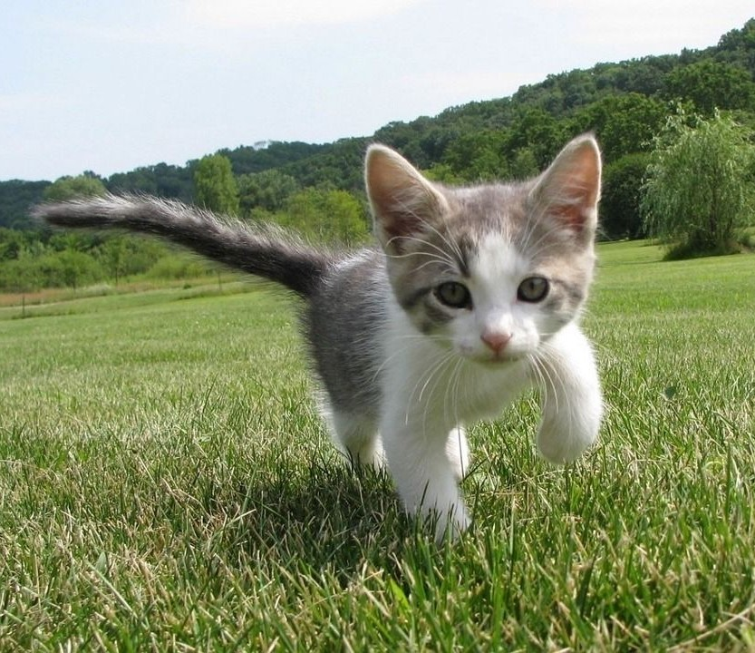
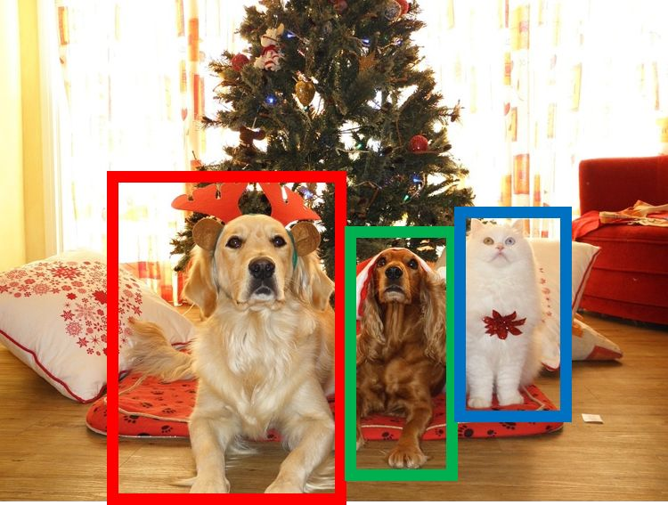

Different Flavors of Object Recognition
Semantic Segmentation
Classification
+ Localization
Object Detection
Instance Segmentation
GRASS, CAT,
TREE, SKY
CAT
DOG, DOG, CAT
DOG, DOG, CAT
No objects, just pixels
Single Object
Multiple Object
May 10, 2017
Adapted from Justin Johnson

Slide 3
Plan for the next three lectures
Detection approaches
  Pre-CNNs
    Detection with whole windows: Pedestrian detection
    Part-based detection: Deformable Part Models
  Post-CNNs
    Detection with region proposals: R-CNN, Fast R-CNN, Faster-R-CNN
    Detection without region proposals: YOLO, SSD
Segmentation approaches
  Semantic segmentation: FCN
  Instance segmentation: Mask R-CNN

Slide 4

Object Detection
GRASS, CAT, TREE, SKY
CAT
DOG, DOG, CAT
DOG, DOG, CAT
No objects, just pixels
Single Object
Multiple Object
53
May 10, 2017
Slide by: Justin Johnson

Slide 5
Object detection: basic framework
Build/train object model
Generate candidate regions in new image
Score the candidates
Adapted from Kristen Grauman

Slide 6
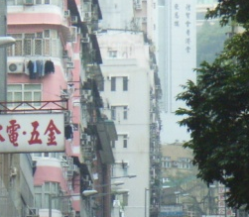

Window-template-based models
Building an object model
Given the representation, train a binary classifier
Car/non-car Classifier
Yes, car.
No, not a car.
Kristen Grauman

Slide 7


Window-template-based models
Generating and scoring candidates
Car/non-car Classifier
Kristen Grauman

Slide 8
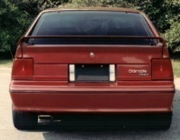
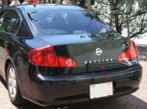
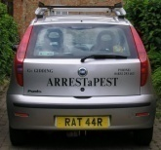
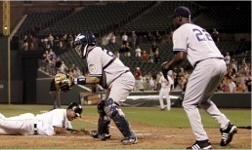
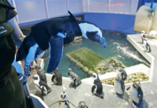
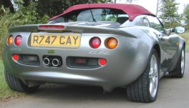
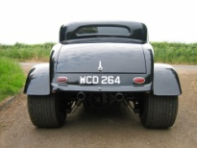

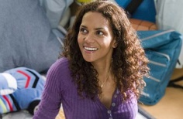


Window-template-based object detection: recap
Training:
Obtain training data
Define features
Define classifier
Given new image:
Slide window
Score by classifier
Training examples
Car/non-car Classifier
Feature extraction
Kristen Grauman

Slide 9
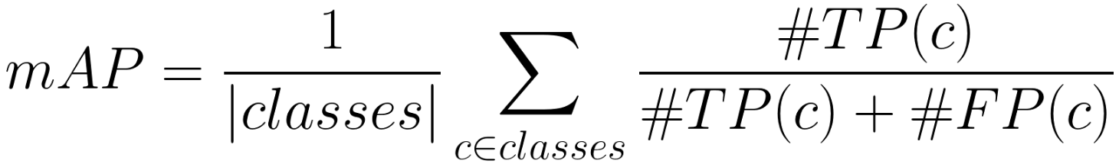
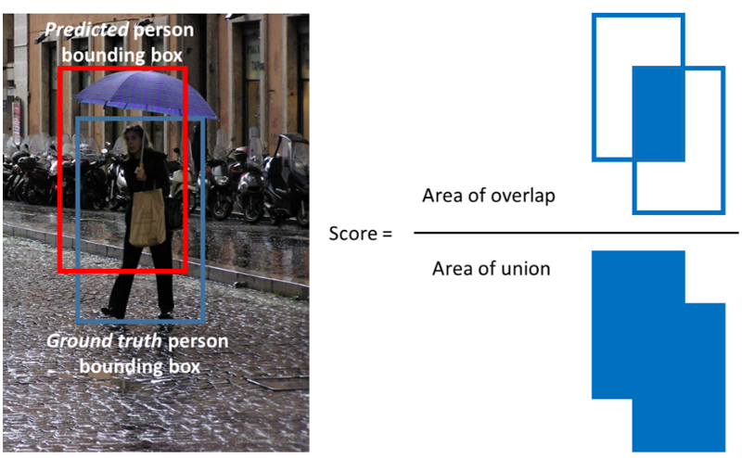
Evaluating detection methods
True Positive - TP(c): a predicted bounding box (pred_bb) was made for class c, there is a ground truth bounding box (gt_bb) of class c, and IoU(pred_bb, gt_bb) >= 0.5.
False Positive - FP(c): a pred_bb was made for class c, and there is no gt_bb of class c. Or there is a gt_bb of class c, but IoU(pred_bb, gt_bb) < 0.5.
Predicted person / cat box

Slide 10
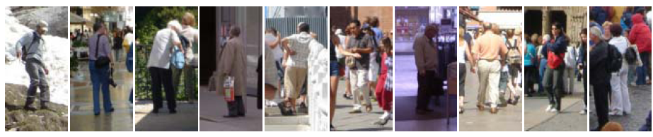
Dalal-Triggs pedestrian detector
Extract fixed-sized (64x128 pixel) window at multiple positions and scales
Compute HOG (histogram of gradient) features within each window
Score the window with a linear SVM classifier
Perform non-maxima suppression to remove overlapping detections with lower scores
Navneet Dalal and Bill Triggs, Histograms of Oriented Gradients for Human Detection, CVPR05

Slide 11
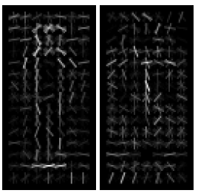
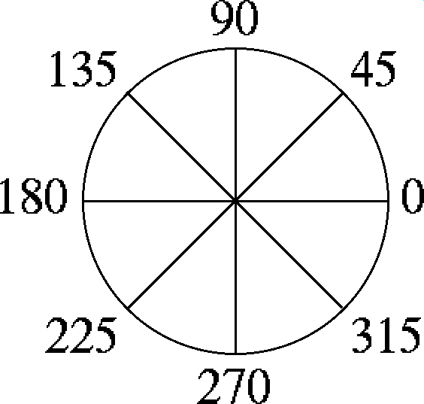

Histograms of oriented gradients (HOG)
  Divide image into 8x8 regions
Orientation: 9 bins (for unsigned angles)
Histograms in 8x8 pixel cells
  Votes weighted by magnitude
Adapted from Pete Barnum
Navneet Dalal and Bill Triggs, Histograms of Oriented Gradients for Human Detection, CVPR05

Slide 12
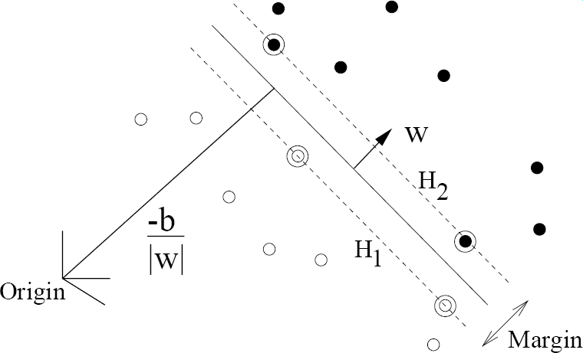
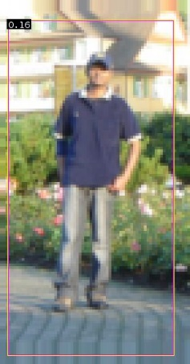


Train SVM for pedestrian detection using HoG
pos w
+
pedestrian
Adapted from Pete Barnum
Navneet Dalal and Bill Triggs, Histograms of Oriented Gradients for Human Detection, CVPR05

Slide 13
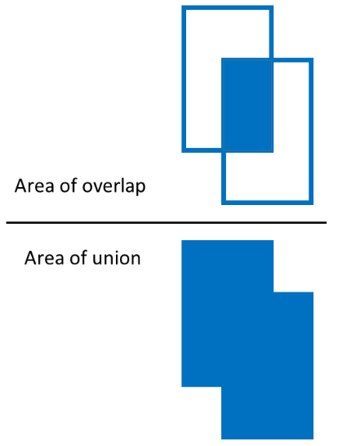
Remove overlapping detections
Non-max suppression
Score = 0.8
Score = 0.8
Score = 0.1
Adapted from Derek Hoiem

Slide 14
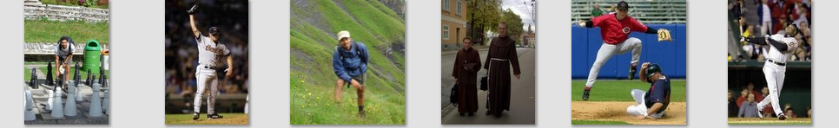
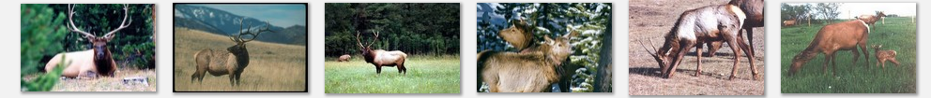
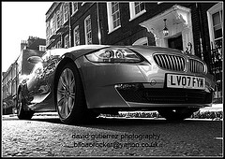
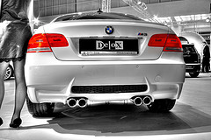
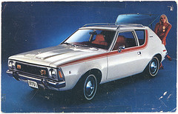
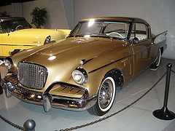
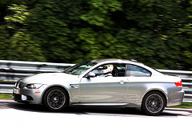
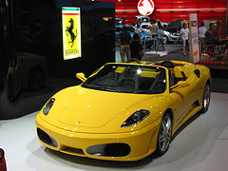
Are window templates enough?
  Many objects are articulated, or have parts that can vary in configuration
  Many object categories look very different from different viewpoints, or from instance to instance
Images from Caltech-256, D. Ramanan
Adapted from N. Snavely, D. Tran

Slide 15
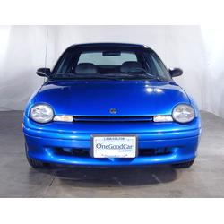
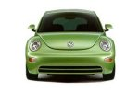
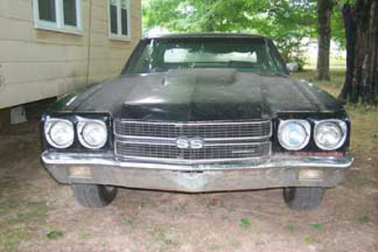
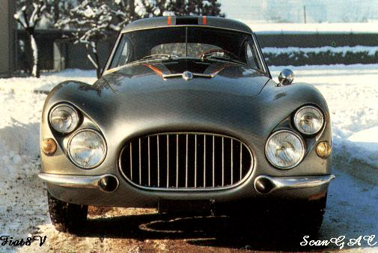
Parts-based Models
Define object by collection of parts modeled by
  Appearance
  Spatial configuration
Slide credit: Rob Fergus

Slide 16
How to model spatial relations?
One extreme: fixed template
Derek Hoiem

Slide 17
Fixed part-based template
Object model = sum of scores of features at fixed positions
?
+3
+2
-2
-1
-2.5
= -0.5
> 7.5
Non-object
?
+4
+1
+0.5
+3
+0.5
= 10.5
> 7.5
Object
Derek Hoiem

Slide 18
How to model spatial relations?
Another extreme: bag of words
=
Derek Hoiem

Slide 19
How to model spatial relations?
Star-shaped model
=
X
X
≈
X
Derek Hoiem

Slide 20
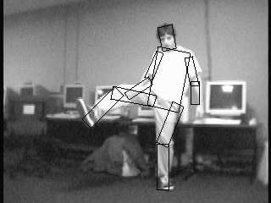
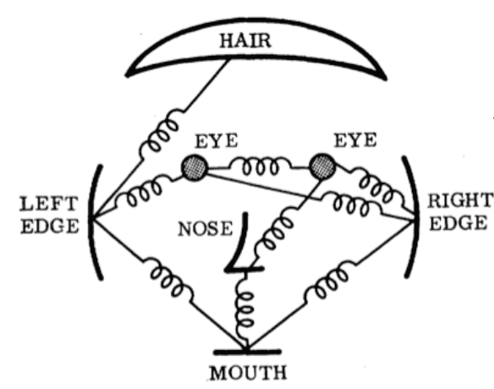
Parts-based Models
Articulated parts model
  Object is configuration of parts
  Each part is detectable and can move around
Adapted from Derek Hoiem, images from Felzenszwalb

Slide 21
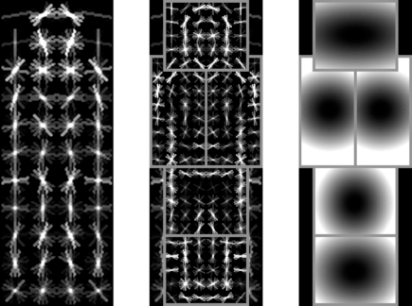
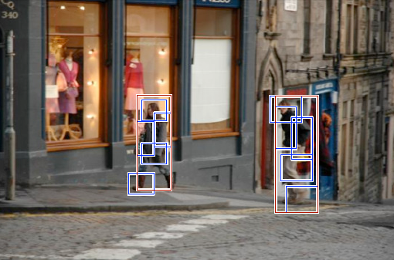
Deformable Part Models
Root filter
Part filters
Deformation weights
P. Felzenszwalb, R. Girshick, D. McAllester, D. Ramanan, Object Detection with Discriminatively Trained Part Based Models, PAMI 32(9), 2010
Lana Lazebnik

Slide 22
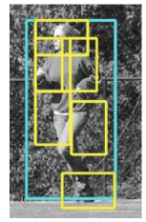
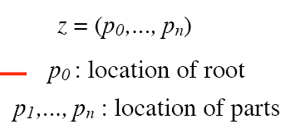
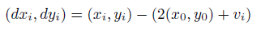
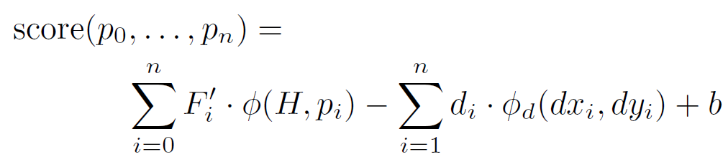
Scoring an object hypothesis
The score of a hypothesis is the sum of appearance scores minus the sum of deformation costs
part loc
(where we see part)
anchor loc (where we
expect to see part)
Displacements
i.e. how much the part p_{i} moved from its
expected anchor location in the x, y directions
Appearance weights
Part features
Deformation weights
i.e. how much we’ll penalize the part p_{i} for moving from its expected location
Felzenszwalb et al.

Slide 23
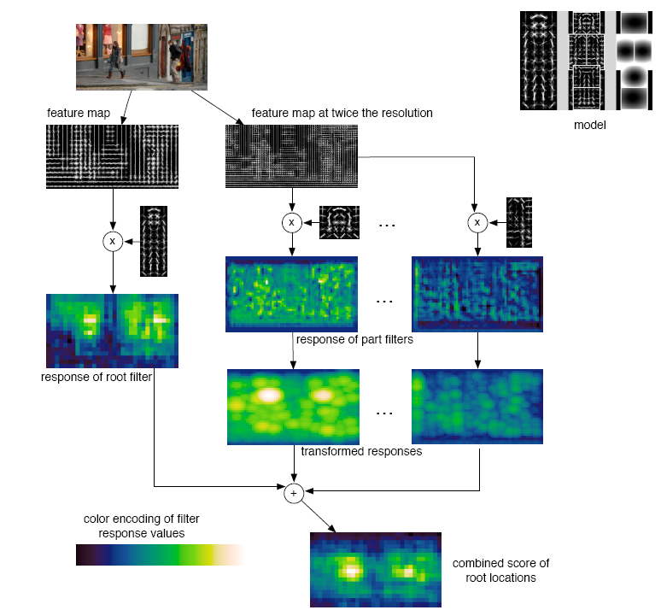
Detection
Felzenszwalb et al.

Slide 24


Car model
Component 1
Component 2
Lana Lazebnik

Slide 25
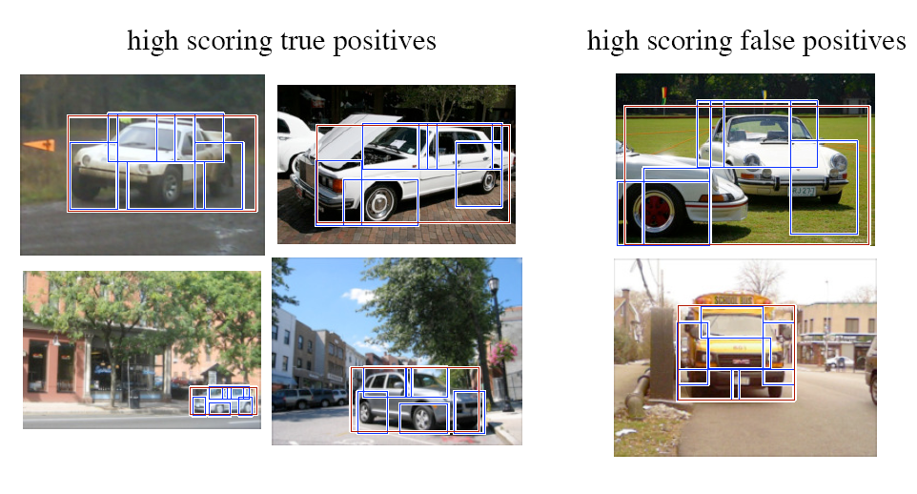
Car detections
Lana Lazebnik

Slide 26
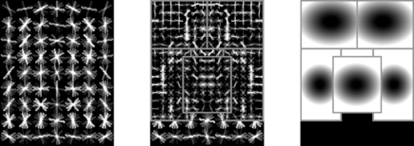
Person model
Lana Lazebnik

Slide 27
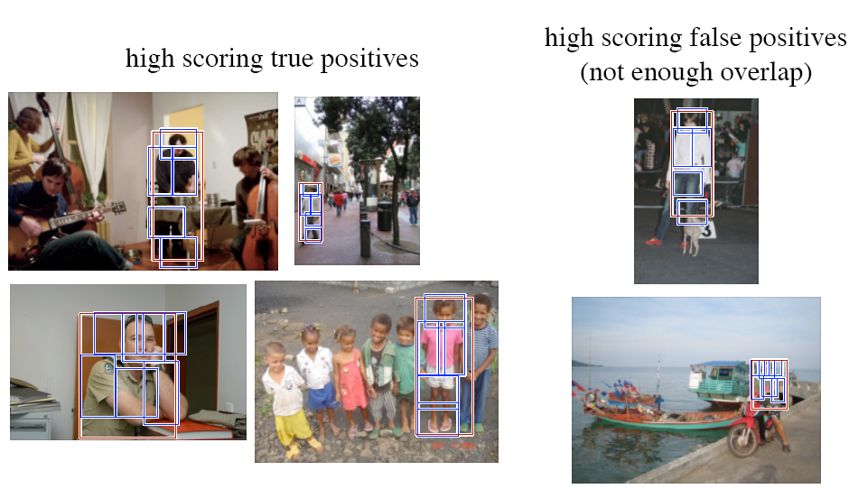
Person detections
Lana Lazebnik

Slide 28

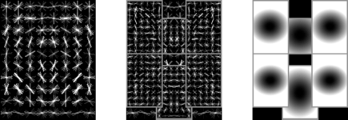
Cat model
Lana Lazebnik

Slide 29
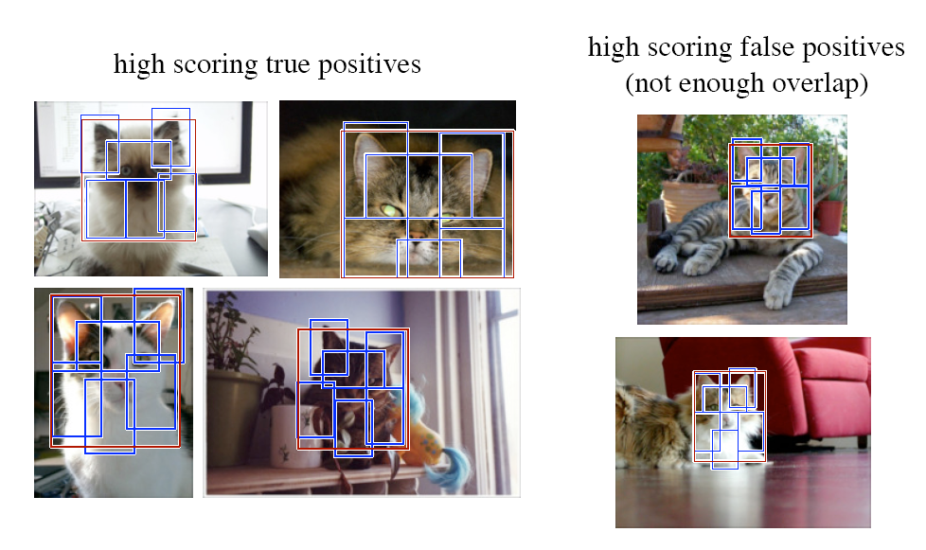
Cat detections
Lana Lazebnik

Slide 30
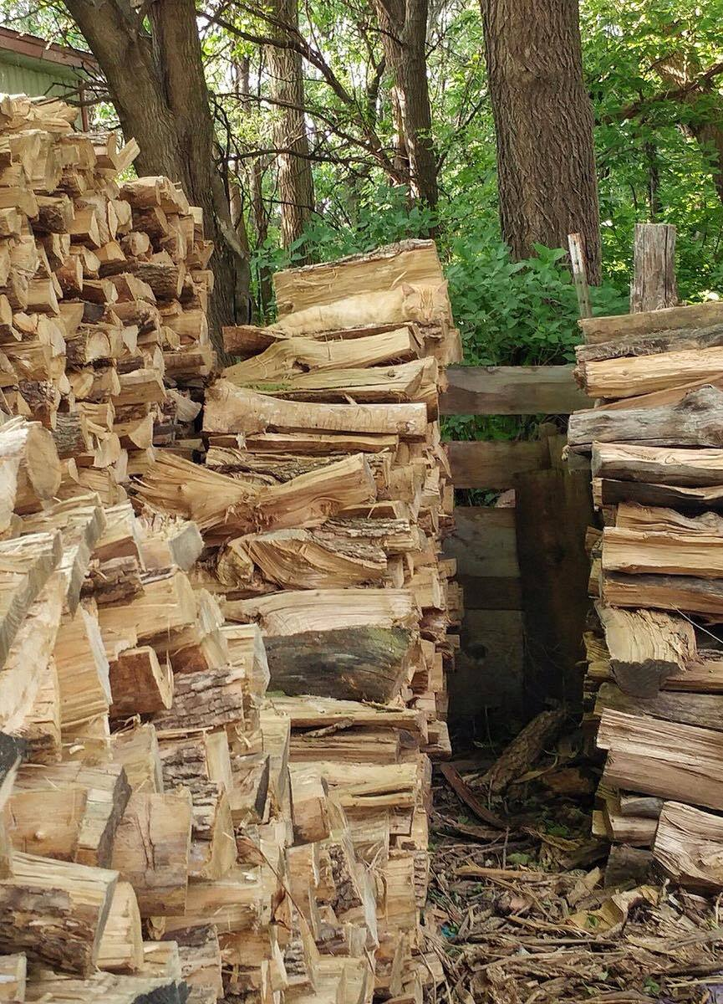
“Sliding window” detector

Slide 31
Plan for the next three lectures
Detection approaches
  Pre-CNNs
    Detection with whole windows: Pedestrian detection
    Part-based detection: Deformable Part Models
  Post-CNNs
    Detection with region proposals: R-CNN, Fast R-CNN, Faster-R-CNN
    Detection without region proposals: YOLO, SSD
Segmentation approaches
  Semantic segmentation: FCN
  Instance segmentation: Mask R-CNN

Slide 32
Complexity and the plateau
[Source: http://pascallin.ecs.soton.ac.uk/challenges/VOC/voc20{07,08,09,10,11,12}/results/index.html]
70
60
plateau & increasing complexity
50
41% 41%
40
37%
(%)
DPM++, MKL,
Selective Search,
28%
DPM++
mAP
30
Selective Search
DPM++, MKL
Top competition results (2007 -
2012)
23%
DPM, MKL
20
17%
DPM,
DPM
HOG+BOW
10
0
VOC’07
VOC’08 VOC’09 VOC’10 VOC’11
PASCAL VOC challenge dataset
VOC’12
PASCAL VOC challenge dataset
Girshick et al., “Rich Feature Hierarchies for Accurate Object Detection and Semantic Segmentation”, CVPR 2014

Slide 33
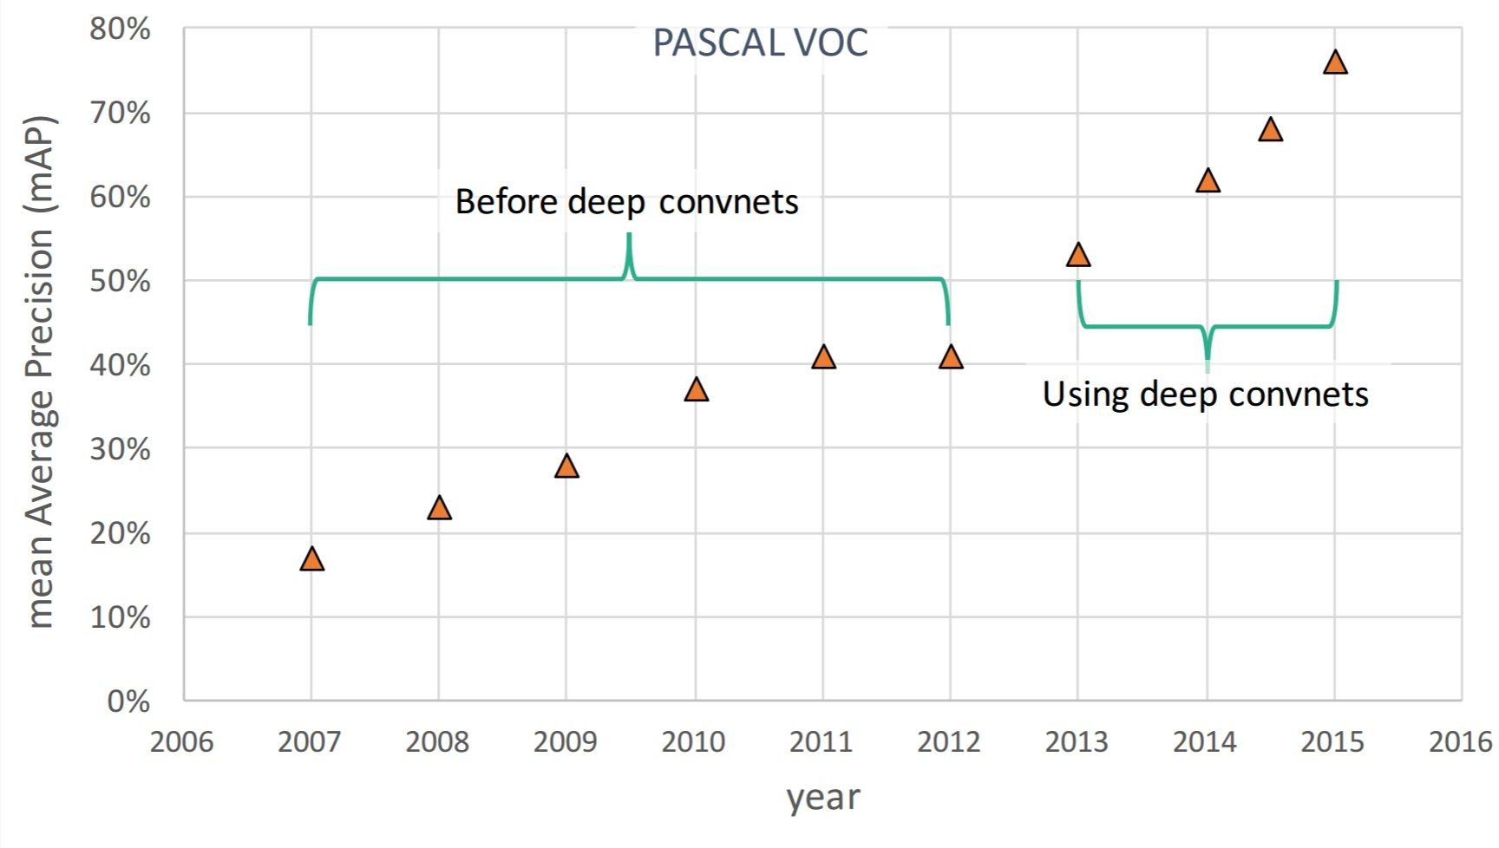
Impact of Deep Learning
May 10, 2017
Slide by: Justin Johnson

Slide 34
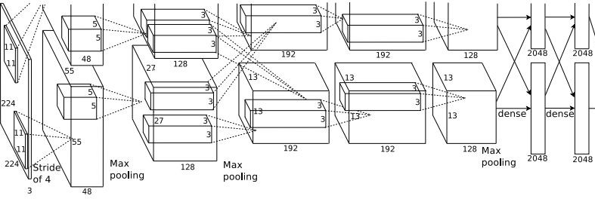
Before: Image Classification with CNNs
Class Scores
Cat: 0.9
Dog: 0.05
Car: 0.01
...
Fully-Connected: 4096 to 1000
Vector:
4096
May 10, 2017
Slide by: Justin Johnson

Slide 35

Classification + Localization
GRASS, CAT, TREE, SKY
CAT
DOG, DOG, CAT
DOG, DOG, CAT
No objects, just pixels
Single Object
Multiple Object
May 10, 2017
Slide by: Justin Johnson

Slide 36
Classification + Localization
Class Scores
Cat: 0.9
Dog: 0.05
Car: 0.01
...
Fully Connected: 4096 to 1000
Vector:
4096
Fully Connected: 4096 to 4
Box Coordinates (x, y, w, h)
Treat localization as a regression problem!
May 10, 2017
Slide by: Justin Johnson

Slide 37
Classification + Localization
Correct label:
Cat
Class Scores
Fully Connected: 4096 to 1000
Cat: 0.9
Dog: 0.05
Car: 0.01
...
Softmax Loss
Vector:
4096
Fully Connected: 4096 to 4
Box Coordinates
L2 Loss
(x, y, w, h)
Treat localization as a
regression problem!
Correct box: (x’, y’, w’, h’)
May 10, 2017
Slide by: Justin Johnson

Slide 38
Classification + Localization
Correct label:
Cat
Class Scores
Fully Connected: 4096 to 1000
Cat: 0.9
Dog: 0.05
Car: 0.01
...
Softmax Loss
Multitask Loss
+
Loss
Vector:
4096
Fully Connected: 4096 to 4
Box Coordinates
L2 Loss
(x, y, w, h)
Treat localization as a
regression problem!
Correct box: (x’, y’, w’, h’)
May 10, 2017
Slide by: Justin Johnson

Slide 39
Classification + Localization
Correct label:
Cat
Class Scores
Fully Connected: 4096 to 1000
Cat: 0.9
Dog: 0.05
Car: 0.01
...
Softmax Loss
+
Loss
Vector:
4096
Fully Connected: 4096 to 4
Often pretrained on ImageNet (Transfer learning)
Box Coordinates
L2 Loss
(x, y, w, h)
Treat localization as a
regression problem!
Correct box: (x’, y’, w’, h’)
May 10, 2017
Slide by: Justin Johnson

Slide 40
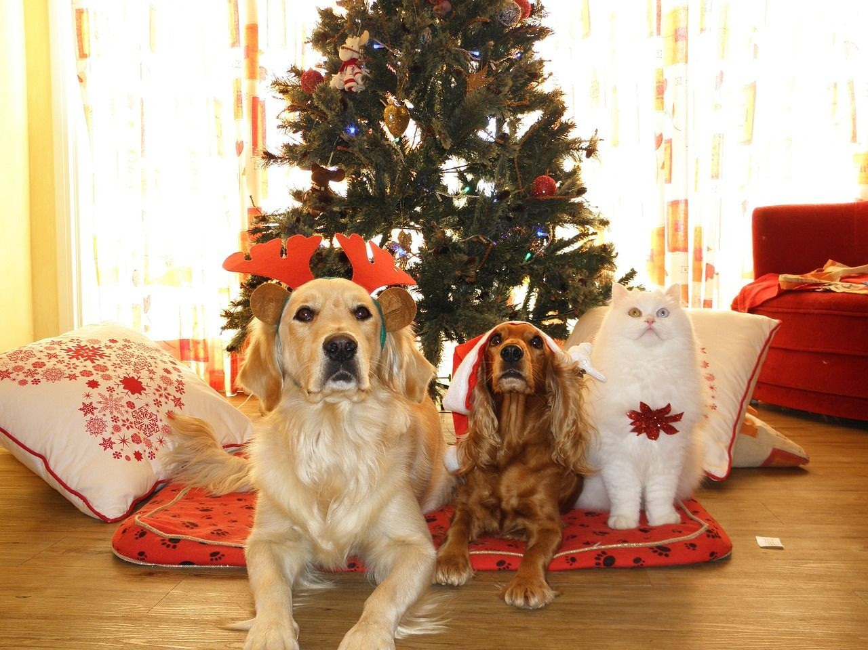
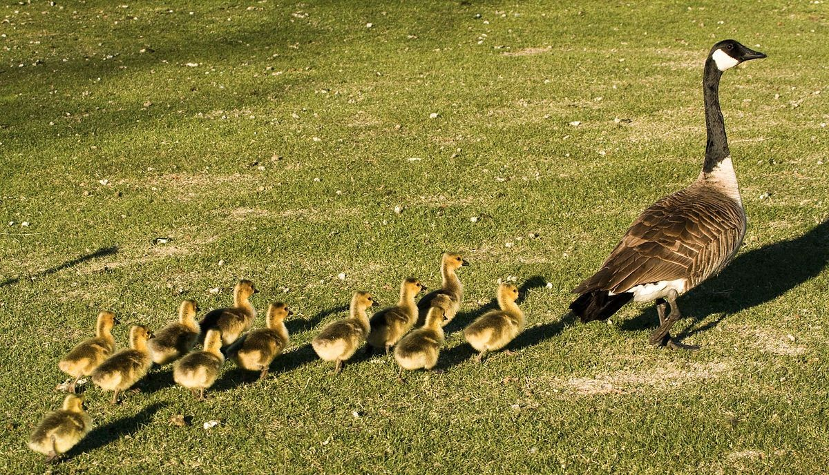
Object Detection as Regression?
CAT: (x, y, w, h)
DOG: (x, y, w, h)
DOG: (x, y, w, h)
CAT: (x, y, w, h)
DUCK: (x, y, w, h)
DUCK: (x, y, w, h)
….
May 10, 2017
Slide by: Justin Johnson

Slide 41
Each image needs a different number of outputs!
Object Detection as Regression?
CAT: (x, y, w, h)
4 numbers
DOG: (x, y, w, h)
DOG: (x, y, w, h)
CAT: (x, y, w, h)
16 numbers
DUCK: (x, y, w, h) _{Many}
DUCK: (x, y, w, h) _{numbers!}
….
May 10, 2017
Slide by: Justin Johnson

Slide 42
Object Detection as Classification: Sliding Window
Apply a CNN to many different crops of the image, CNN classifies each crop as object or background
Dog? NO Cat? NO
Background? YES
May 10, 2017
Slide by: Justin Johnson

Slide 43
Object Detection as Classification: Sliding Window
Apply a CNN to many different crops of the image, CNN classifies each crop as object or background
Dog? YES
Cat? NO Background? NO
May 10, 2017
Slide by: Justin Johnson

Slide 44
Object Detection as Classification: Sliding Window
Apply a CNN to many different crops of the image, CNN classifies each crop as object or background
Dog? YES
Cat? NO Background? NO
May 10, 2017
Slide by: Justin Johnson

Slide 45
Object Detection as Classification: Sliding Window
Apply a CNN to many different crops of the image, CNN classifies each crop as object or background
Dog? NO Cat? YES
Background? NO
May 10, 2017
Slide by: Justin Johnson

Slide 46
Object Detection as Classification: Sliding Window
Apply a CNN to many different crops of the image, CNN classifies each crop as object or background
Dog? NO Cat? YES
Background? NO
Problem: Need to apply CNN to huge number of locations and scales, very computationally expensive!
May 10, 2017
Slide by: Justin Johnson

Slide 47

Region Proposals
Find “blobby” image regions that are likely to contain objects
Relatively fast to run; e.g. Selective Search gives 1000 region proposals in a few seconds on CPU
Alexe et al, “Measuring the objectness of image windows”, TPAMI 2012
Uijlings et al, “Selective Search for Object Recognition”, IJCV 2013
Cheng et al, “BING: Binarized normed gradients for objectness estimation at 300fps”, CVPR 2014
Zitnick and Dollar, “Edge boxes: Locating object proposals from edges”, ECCV 2014
Slide by: Justin Johnson

Slide 48
Speeding up detection: Restrict set of windows we pass through SVM to those w/ high “objectness”
Alexe et al., CVPR 2010

Slide 49

Objectness cue #1: Where people look
Alexe et al., CVPR 2010

Slide 50

Objectness cue #2: color contrast at boundary
Alexe et al., CVPR 2010

Slide 51

Objectness cue #3: no segments “straddling” the object box
Alexe et al., CVPR 2010

Slide 52

R-CNN
May 10, 2017
Girshick et al., “Rich Feature Hierarchies for Accurate Object Detection and Semantic Segmentation”, CVPR 2014

Slide 53




R-CNN
May 10, 2017
Girshick et al., “Rich Feature Hierarchies for Accurate Object Detection and Semantic Segmentation”, CVPR 2014

Slide 54

R-CNN
May 10, 2017
Girshick et al., “Rich Feature Hierarchies for Accurate Object Detection and Semantic Segmentation”, CVPR 2014

Slide 55



R-CNN
Conv
Net
Conv
Net
Conv
Net
May 10, 2017
Girshick et al., “Rich Feature Hierarchies for Accurate Object Detection and Semantic Segmentation”, CVPR 2014

Slide 56


R-CNN
Conv
Net
Conv
Net
Conv
Net
May 10, 2017
Girshick et al., “Rich Feature Hierarchies for Accurate Object Detection and Semantic Segmentation”, CVPR 2014

Slide 57



R-CNN
Conv
Net
Conv
Net
Conv
Net
May 10, 2017
Girshick et al., “Rich Feature Hierarchies for Accurate Object Detection and Semantic Segmentation”, CVPR 2014

Slide 58







R-CNN: Regions with CNN features
aeroplane? no.
.
CNN
.
person? yes.
.
.
tvmonitor? no.
Input image
Extract region proposals (~2k / image)
Compute CNN features
Classify regions (linear SVM)
Girshick et al., “Rich Feature Hierarchies for Accurate Object Detection and Semantic Segmentation”, CVPR 2014

Slide 59
R-CNN at test time: Step 1
aeroplane? no.
.
CNN
.
person? yes.
.
.
tvmonitor? no.
Input image
Extract region proposals (~2k / image)
Proposal-method agnostic, many choices
Selective Search [van de Sande, Uijlings et al.]
Objectness [Alexe et al.]
(Used in this work)
Category independent object proposals [Endres & Hoiem]
CPMC [Carreira & Sminchisescu]
Girshick et al., “Rich Feature Hierarchies for Accurate Object Detection and Semantic Segmentation”, CVPR 2014

Slide 60

R-CNN at test time: Step 2
aeroplane? no.
.
CNN
.
person? yes.
.
.
tvmonitor? no.
Input image
Extract region proposals (~2k / image)
Compute CNN features
Girshick et al., “Rich Feature Hierarchies for Accurate Object Detection and Semantic Segmentation”, CVPR 2014

Slide 61


R-CNN at test time: Step 2
aeroplane? no.
.
CNN
.
person? yes.
.
.
tvmonitor? no.
Input image
Extract region proposals (~2k / image)
Compute CNN features
Dilate proposal
Girshick et al., “Rich Feature Hierarchies for Accurate Object Detection and Semantic Segmentation”, CVPR 2014

Slide 62

R-CNN at test time: Step 2
aeroplane? no.
.
CNN
.
person? yes.
.
.
tvmonitor? no.
Input image
Extract region proposals (~2k / image)
Compute CNN features
a. Crop
Girshick et al., “Rich Feature Hierarchies for Accurate Object Detection and Semantic Segmentation”, CVPR 2014

Slide 63
R-CNN at test time: Step 2
aeroplane? no.
.
CNN
.
person? yes.
.
.
tvmonitor? no.
Input image
Extract region proposals (~2k / image)
Compute CNN features
227 x 227
a. Crop
b. Scale (anisotropic)
Girshick et al., “Rich Feature Hierarchies for Accurate Object Detection and Semantic Segmentation”, CVPR 2014

Slide 64

R-CNN at test time: Step 2
aeroplane? no.
.
CNN
.
person? yes.
.
.
tvmonitor? no.
Input image
Extract region proposals (~2k / image)
Compute CNN features
c. Forward propagate Output: “fc7” features
. Crop
b. Scale (anisotropic)
Girshick et al., “Rich Feature Hierarchies for Accurate Object Detection and Semantic Segmentation”, CVPR 2014

Slide 65

R-CNN at test time: Step 3
aeroplane? no.
.
CNN
.
person? yes.
.
.
tvmonitor? no.
Input image
Extract region proposals (~2k / image)
Compute CNN features
Classify regions
person? 1.6
...
horse? -0.3
...
4096-dimensional fc7 feature vector
linear classifiers (SVM or softmax)
proposal
Girshick et al., “Rich Feature Hierarchies for Accurate Object Detection and Semantic Segmentation”, CVPR 2014

Slide 66

Step 4: Object proposal refinement
Linear regression
on CNN features
Original proposal
Predicted object bounding box
Bounding-box regression
Girshick et al., “Rich Feature Hierarchies for Accurate Object Detection and Semantic Segmentation”, CVPR 2014

Slide 67
R-CNN on ImageNet detection
ILSVRC2013 detection test set mAP
*R−CNN BB
31.4%
*OverFeat (2)
24.3%
UvA−Euvision
22.6%
*NEC−MU
20.9%
*OverFeat (1)
19.4%
Toronto A
11.5%
SYSU_Vision
10.5%
GPU_UCLA
9.8%
Delta
6.1%
post competition result competition result
UIUC−IFP
1.0%
0
20 40 60 80
mean average precision (mAP) in %
100
Girshick et al., “Rich Feature Hierarchies for Accurate Object Detection and Semantic Segmentation”, CVPR 2014

Slide 68
R-CNN
Conv
Net
Conv
Net
Conv
Net
May 10, 2017
Post hoc component
Girshick et al., “Rich Feature Hierarchies for Accurate Object Detection and Semantic Segmentation”, CVPR 2014

Slide 69

What’s wrong with slow R-CNN?
Ad-hoc training objectives
  Train post-hoc linear SVMs (hinge loss)
  Train post-hoc bounding-box regressions (L2 loss)
Training is slow (84h), takes a lot of disk space
  Need to store all region crops
Inference (detection) is slow
  47s / image with VGG16 [Simonyan & Zisserman, ICLR15]
Adapted from Girshick, “Fast R-CNN”, ICCV 2015
~2000 ConvNet forward passes per image

Slide 70
Fast R-CNN
One network, applied one time, not 2000 times
Trained end-to-end (in one stage)
Fast test time
Higher mean average precision
Adapted from Girshick, “Fast R-CNN”, ICCV 2015

Slide 71


Fast R-CNN
May 10, 2017
Girshick, “Fast R-CNN”, ICCV 2015

Slide 72


Fast R-CNN
May 10, 2017
Girshick, “Fast R-CNN”, ICCV 2015

Slide 73




Fast R-CNN
May 10, 2017
Girshick, “Fast R-CNN”, ICCV 2015

Slide 74



Fast R-CNN
May 10, 2017
Girshick, “Fast R-CNN”, ICCV 2015

Slide 75



Fast R-CNN
May 10, 2017
Girshick, “Fast R-CNN”, ICCV 2015

Slide 76


Fast R-CNN
May 10, 2017
Girshick, “Fast R-CNN”, ICCV 2015

Slide 77



Fast R-CNN (Training)
May 10, 2017
Girshick, “Fast R-CNN”, ICCV 2015

Slide 78







Fast R-CNN (Training)
May 10, 2017
Girshick, “Fast R-CNN”, ICCV 2015

Slide 79
Fast R-CNN vs R-CNN
 | Fast R-CNN | R-CNN
Train time (h) | 9.5 | 84
Speedup | 8.8x | 1x
Test time / image | 0.32s | 47.0s
Test speedup | 146x | 1x
mAP | 66.9% | 66.0%
Timings exclude object proposal time, which is equal for all methods. All methods use VGG16 from Simonyan and Zisserman.
Girshick, “Fast R-CNN”, ICCV 2015

Slide 80

Faster R-CNN
Make CNN do proposals!
Insert Region Proposal Network (RPN) to predict proposals from features
Jointly train with 4 losses:
RPN classify object / not object
RPN regress box coordinates
Final classification score (object classes)
Final box coordinates
May 10, 2017
Ren et al, “Faster R-CNN: Towards Real-Time Object Detection with Region Proposal Networks”, NIPS 2015

Slide 81

Accurate object detection is slow!
 | Pascal 2007 mAP | Speed
DPM v5 | 33.7 | .07 FPS | 14 s/img
R-CNN | 66.0 | .05 FPS | 20 s/img
⅓ Mile, 1760 feet
Redmon et al., “You Only Look Once: Unified, Real-Time Object Detection”, CVPR 2016

Slide 82
Accurate object detection is slow!
 | Pascal 2007 mAP | Speed
DPM v5 | 33.7 | .07 FPS | 14 s/img
R-CNN | 66.0 | .05 FPS | 20 s/img
Fast R-CNN | 70.0 | .5 FPS | 2 s/img
Faster R-CNN | 73.2 | 7 FPS | 140 ms/img
YOLO | 69.0 | 45 FPS | 22 ms/img
2 feet
Redmon et al., “You Only Look Once: Unified, Real-Time Object Detection”, CVPR 2016

Slide 83

Detection without Proposals: YOLO
Redmon et al., “You Only Look Once: Unified, Real-Time Object Detection”, CVPR 2016

Slide 84

Each cell predicts boxes and confidences:
P(Object)
Redmon et al., “You Only Look Once: Unified, Real-Time Object Detection”, CVPR 2016

Slide 85

Each cell also predicts a probability
P(Class | Object)
Bicycle
Car
Dog
Dining Table
Redmon et al., “You Only Look Once: Unified, Real-Time Object Detection”, CVPR 2016

Slide 86

Combine the box and class predictions
Redmon et al., “You Only Look Once: Unified, Real-Time Object Detection”, CVPR 2016

Slide 87

Finally do NMS and threshold detections
Redmon et al., “You Only Look Once: Unified, Real-Time Object Detection”, CVPR 2016

Slide 88
Detection without Proposals: YOLO
Within each grid cell:
Regress from each of the B base boxes to a final box with 5 numbers:
(dx, dy, dh, dw, confidence)
Predict scores for each of C classes (including background as a class)
Input image 3 x H x W
Divide image into grid 7 x 7
Image a set of base boxes centered at each grid cell Here B = 3
Output:
7 x 7 x (5 * B + C)
May 10, 2017
Redmon et al, “You Only Look Once: Unified, Real-Time Object Detection”, CVPR 2016
Liu et al, “SSD: Single-Shot MultiBox Detector”, ECCV 2016
Slide by: Justin Johnson

Slide 89

This parameterization fixes the output size
Each cell predicts:
For each bounding box:
  4 coordinates (x, y, w, h)
  1 confidence value
Some number of class
probabilities
For Pascal VOC:
7x7 grid
2 bounding boxes / cell
20 classes
7 x 7 x (2 x 5 + 20) = 7 x 7 x 30 tensor = 1470 outputs
Redmon et al., “You Only Look Once: Unified, Real-Time Object Detection”, CVPR 2016

Slide 90



YOLO works across many natural images
Redmon et al., “You Only Look Once: Unified, Real-Time Object Detection”, CVPR 2016

Slide 91



It also generalizes well to new domains
Redmon et al., “You Only Look Once: Unified, Real-Time Object Detection”, CVPR 2016

Slide 92

Redmon and Farhadi, “YOLO9000: Better, Faster, Stronger”, CVPR 2017

Slide 93

Redmon and Farhadi, “YOLO9000: Better, Faster, Stronger”, CVPR 2017

Slide 94

Redmon and Farhadi, “YOLO9000: Better, Faster, Stronger”, CVPR 2017

Slide 95

Redmon and Farhadi, “YOLO9000: Better, Faster, Stronger”, CVPR 2017

Slide 96

Redmon and Farhadi, “YOLO9000: Better, Faster, Stronger”, CVPR 2017

Slide 97

Redmon and Farhadi, “YOLO9000: Better, Faster, Stronger”, CVPR 2017

Slide 98
Plan for the next two lectures
Detection approaches
  Pre-CNNs
    Detection with whole windows: Pedestrian detection
    Part-based detection: Deformable Part Models
  Post-CNNs
    Detection with region proposals: R-CNN, Fast R-CNN, Faster-R-CNN
    Detection without region proposals: YOLO, SSD
Segmentation approaches
  Semantic segmentation: FCN
  Instance segmentation: Mask R-CNN

Slide 99

Semantic Segmentation
GRASS, CAT,
TREE, SKY
CAT
DOG, DOG, CAT
DOG, DOG, CAT
No objects, just pixels
Single Object
Multiple Object
May 10, 2017
Slide by: Justin Johnson

Slide 100

Semantic Segmentation
Label each pixel in the image with a category label
Sky
Trees
Sky
Cow
Grass
Trees
Don’t differentiate instances, only care about pixels
Cat
Grass
May 10, 2017
Slide by: Justin Johnson

Slide 101






Semantic Segmentation Idea:
Sliding Window
Extract patch
Classify center pixel with CNN
Full image
Cow
Cow
Grass
Farabet et al, “Learning Hierarchical Features for Scene Labeling,” TPAMI 2013
Pinheiro and Collobert, “Recurrent Convolutional Neural Networks for Scene Labeling”, ICML 2014
May 10, 2017
Slide by: Justin Johnson

Slide 102
Semantic Segmentation Idea:
Sliding Window
Extract patch
Classify center pixel with CNN
Full image
Cow
Cow
Grass
Problem: Very inefficient! Not reusing shared features between overlapping patches
Farabet et al, “Learning Hierarchical Features for Scene Labeling,” TPAMI 2013
Pinheiro and Collobert, “Recurrent Convolutional Neural Networks for Scene Labeling”, ICML 2014
May 10, 2017
Slide by: Justin Johnson

Slide 103
Semantic Segmentation Idea:
Fully Convolutional
Design a network as a bunch of convolutional layers to make predictions for pixels all at once!
Conv
Conv
Conv
Conv
argmax
Input:
3 x H x W
Predictions: H x W
Scores: C x H x W
Convolutions: D x H x W
May 10, 2017
Slide by: Justin Johnson

Slide 104
Semantic Segmentation Idea:
Fully Convolutional
Design a network as a bunch of convolutional layers to make predictions for pixels all at once!
Conv
Conv
Conv
Conv
argmax
Input:
3 x H x W
Predictions: H x W
Scores: C x H x W
Problem: convolutions at original image resolution will be very expensive ...
Convolutions: D x H x W
May 10, 2017
Slide by: Justin Johnson

Slide 105
Semantic Segmentation Idea:
Fully Convolutional
Design network as a bunch of convolutional layers, with
downsampling and upsampling inside the network!
Med-res: D₂ x H/4 x W/4
Med-res: D₂ x H/4 x W/4
Low-res: D₃ x H/4 x W/4
Input:
3 x H x W
High-res: D₁ x H/2 x W/2
High-res: D₁ x H/2 x W/2
Predictions: H x W
Long, Shelhamer, and Darrell, “Fully Convolutional Networks for Semantic Segmentation”, CVPR 2015
Noh et al, “Learning Deconvolution Network for Semantic Segmentation”, ICCV 2015
May 10, 2017
Slide by: Justin Johnson

Slide 106
Semantic Segmentation Idea:
Fully Convolutional
Downsampling: Pooling, strided convolution
Design network as a bunch of convolutional layers, with
downsampling and upsampling inside the network!
Upsampling:
???
Med-res: D₂ x H/4 x W/4
Med-res: D₂ x H/4 x W/4
Low-res: D₃ x H/4 x W/4
Input:
3 x H x W
High-res: D₁ x H/2 x W/2
High-res: D₁ x H/2 x W/2
Predictions: H x W
Long, Shelhamer, and Darrell, “Fully Convolutional Networks for Semantic Segmentation”, CVPR 2015
Noh et al, “Learning Deconvolution Network for Semantic Segmentation”, ICCV 2015
May 10, 2017
Slide by: Justin Johnson

Slide 107
In-Network upsampling: “Unpooling”
Nearest Neighbor
1 | 1 | 2 | 2
1 | 1 | 2 | 2
3 | 3 | 4 | 4
3 | 3 | 4 | 4
“Bed of Nails”
1 | 0 | 2 | 0
0 | 0 | 0 | 0
3 | 0 | 4 | 0
0 | 0 | 0 | 0
1 | 2
3 | 4
1 | 2
3 | 4
Input: 2 x 2
Output: 4 x 4
Input: 2 x 2
Output: 4 x 4
May 10, 2017
Slide by: Justin Johnson

Slide 108
In-Network upsampling: “Max Unpooling”
Max Pooling
Max Unpooling Use positions from pooling layer
Remember which element was max!
1 | 2 | 6 | 3
3 | 5 | 2 | 1
1 | 2 | 2 | 1
7 | 3 | 4 | 8
0 | 0 | 2 | 0
0 | 1 | 0 | 0
0 | 0 | 0 | 0
3 | 0 | 0 | 4
…
Rest of the network
1 | 2
3 | 4
5 | 6
7 | 8
Input: 4 x 4
Output: 2 x 2
Input: 2 x 2
Output: 4 x 4
Corresponding pairs of downsampling and upsampling layers
May 10, 2017
Slide by: Justin Johnson

Slide 109
Learnable Upsampling:
Transpose Convolution
3 x 3 transpose convolution, stride 2 pad 1
Input: 2 x 2
Output: 4 x 4
May 10, 2017
Slide by: Justin Johnson

Slide 110
Learnable Upsampling:
Transpose Convolution
3 x 3 transpose convolution, stride 2 pad 1
Input gives weight for filter
Input: 2 x 2
Output: 4 x 4
May 10, 2017
Slide by: Justin Johnson

Slide 111
Learnable Upsampling:
Transpose Convolution
3 x 3 transpose convolution, stride 2 pad 1
Sum where output overlaps
Filter moves 2 pixels in the output for every one pixel in the input
Input gives weight for filter
Stride gives ratio between movement in output and input
Input: 2 x 2
Output: 4 x 4
May 10, 2017
Slide by: Justin Johnson

Slide 112
Transpose Convolution: 1D Example
Output
Input
Filter
 | ax
 | ay
 | az
 |  | + | bx
 |  |  | by
 |  |  | bz
Output contains copies of the filter weighted by the input, summing at where at overlaps in the output
x
a
y
b
z
May 10, 2017
Adapted from Justin Johnson

Slide 113

Instance Segmentation
GRASS, CAT, TREE, SKY
CAT
DOG, DOG, CAT
DOG, DOG, CAT
No objects, just pixels
Single Object
Multiple Object
May 10, 2017
Slide by: Justin Johnson

Slide 114

Mask R-CNN
He et al, “Mask R-CNN”, ICCV 2017
May 10, 2017
Slide by: Kaiming He

Slide 115




Mask R-CNN
He et al, “Mask R-CNN”, ICCV 2017
Classification Scores: C
Box coordinates (per class): 4 * C
CNN
Conv
Conv
RoI Align
Predict a mask for each of C classes
May 10, 2017
Adapted from Justin Johnson

