Slide 1
CS 1674: Intro to Computer Vision
Convolutional Neural Networks
Prof. Adriana Kovashka
University of Pittsburgh
March 22, 2022

Slide 2
Plan for the next few lectures
Why (convolutional) neural networks?
Neural network basics
  Architecture and biological inspiration
  Loss functions
  Optimization / gradient descent
  Training with backpropagation
Convolutional neural networks (CNNs)
  Special operations
  Common architectures
Practical matters
  Tips and tricks for training
  Transfer learning
  Software packages
Understanding CNNs
  Visualization
  Synthesis / style transfer
  Breaking CNNs

Slide 3
Neural network basics

Slide 4
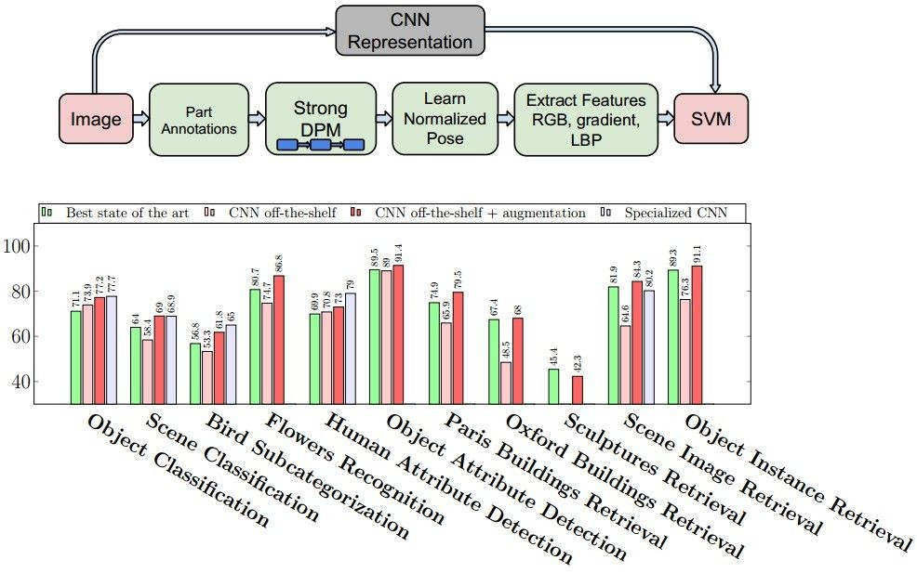
Why (convolutional) neural networks?
State of the art performance on many problems
Most papers in recent vision conferences use deep neural networks
Razavian et al., CVPR 2014 Workshops (4000+ citations)

Slide 5
ImageNet Challenge 2012
~14 million labeled images, 20k classes
Images gathered from Internet
Human labels via Amazon Mechanical Turk
Challenge: 1.2 million training images, 1000 classes
[Deng et al. CVPR 2009]
A. Krizhevsky, I. Sutskever, and G. Hinton, ImageNet Classification with Deep Convolutional Neural Networks, NIPS 2012
Lana Lazebnik

Slide 6

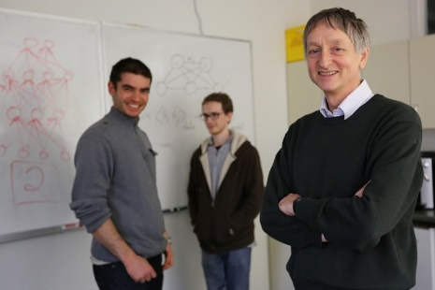
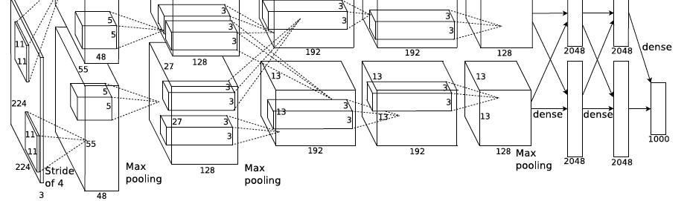
ImageNet Challenge 2012
AlexNet: Similar framework to LeCun’98 but:
  Bigger model (7 hidden layers, 650,000 units, 60,000,000 params)
  More data (10⁶ vs. 10³ images)
  GPU implementation (50x speedup over CPU)
    Trained on two GPUs for a week
  Better regularization for training (DropOut)
A. Krizhevsky, I. Sutskever, and G. Hinton, ImageNet Classification with Deep Convolutional Neural Networks, NIPS 2012
Adapted from Lana Lazebnik
Notes:
Two-GPU architecture

Slide 7
ImageNet Challenge 2012
Krizhevsky et al. -- 16.4% error (top-5)
Next best (non-convnet) – 26.2% error
Lana Lazebnik

Slide 8
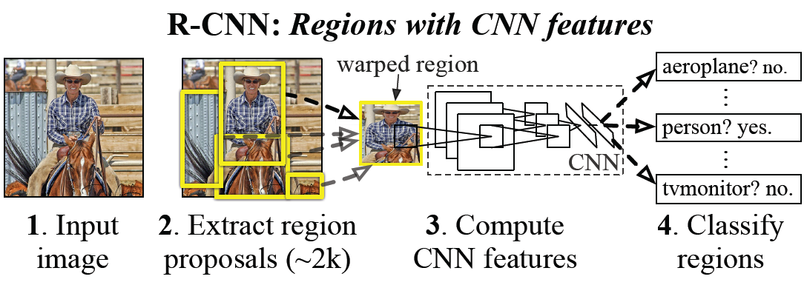
Easy win, always? Example: detection
Object detection system overview. Our system (1) takes an input image, (2) extracts around 2000 bottom-up region proposals, (3) computes features for each proposal using a large convolutional neural network (CNN), and then (4) classifies each region using class-specific linear SVMs. R-CNN achieves a mean average precision (mAP) of 53.7% on PASCAL VOC 2010. For comparison, Uijlings et al. (2013) report 35.1% mAP using the same region proposals, but with a spatial pyramid and bag-of-visual-words approach. The popular deformable part models perform at 33.4%.
R. Girshick, J. Donahue, T. Darrell, and J. Malik, Rich Feature Hierarchies for Accurate Object Detection and Semantic Segmentation, CVPR 2014.
Adapted from Lana Lazebnik

Slide 9
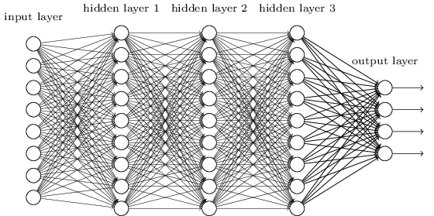
What are CNNs?
Convolutional neural networks (CNNs) are a type of neural network with layers that perform special operations
Used in vision but also in NLP, biomedical etc.
Often deep, but usually not fully connected
Figure from http://neuralnetworksanddeeplearning.com/chap5.html

Slide 10
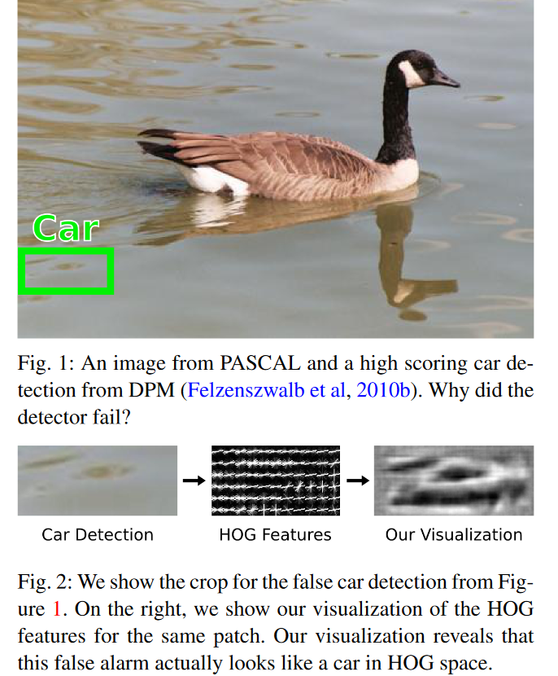
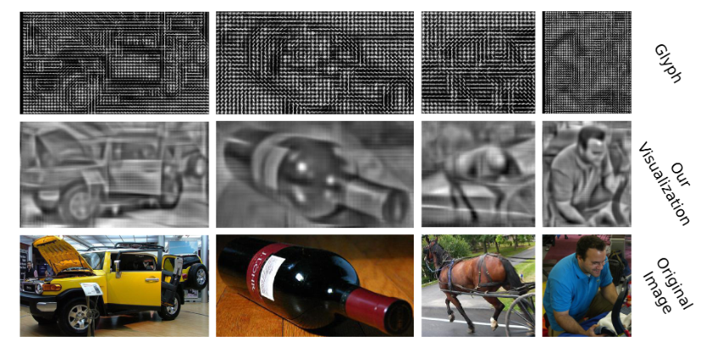
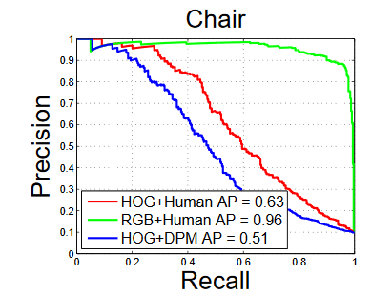
Traditional Recognition Approach
Hand-designed
feature extraction (SIFT+BOW, HOG)
Trainable
classifier
Image/ Video
Pixels
Object
Class
  Features are key to recent progress in recognition, but research shows they’re flawed… Where next?
Adapted from Lana Lazebnik, figures from Vondrick: http://www.cs.columbia.edu/~vondrick/ihog/ijcv.pdf

Slide 11
What about learning the features?
  Learn a feature hierarchy all the way from pixels to classifier
  Each layer extracts features from the output of previous layer
  Train all layers jointly
Image/ Video
Pixels
Layer 1
Layer 2
Layer 3
Object
Class
Lana Lazebnik

Slide 12
“Shallow” vs. “deep” architectures
Traditional recognition: “Shallow” architecture
Image/ Video
Pixels
Hand-designed
feature extraction
Trainable
classifier
Object
Class
Deep learning: “Deep” architecture
Image/ Video
Pixels
Layer 1
Layer N
Simple classifier
…
Object Class
Lana Lazebnik

Slide 13
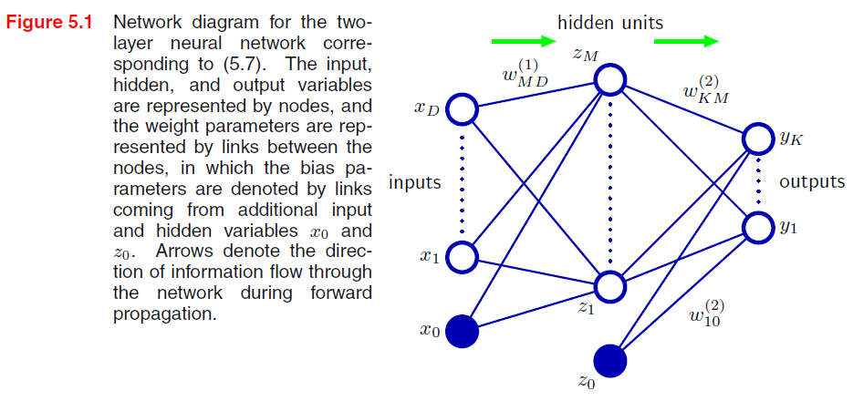


Neural network definition
Activations:
Nonlinear activation function h (e.g. sigmoid, RELU):
Recall SVM:
w^{T}x + b
Figure from Christopher Bishop

Slide 14

Neural network definition
Layer 2
Layer 3 (final)
Outputs (e.g. sigmoid/softmax)
Finally:
(multiclass)
(binary)
(binary)

Slide 15
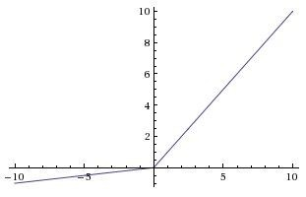
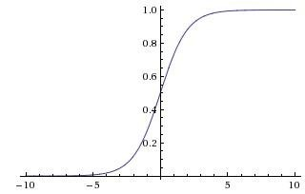

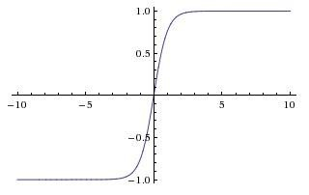


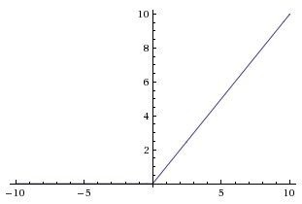
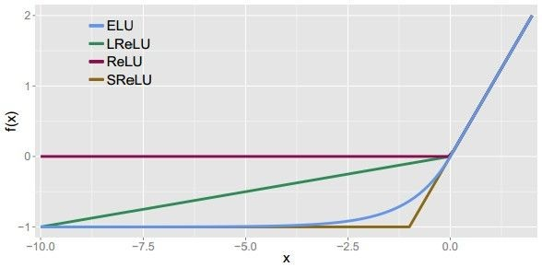
Leaky ReLU
max(0.1x, x)
Activation functions
Sigmoid
Maxout ELU
tanh
tanh(x)
ReLU
max(0,x)
Andrej Karpathy

Slide 16
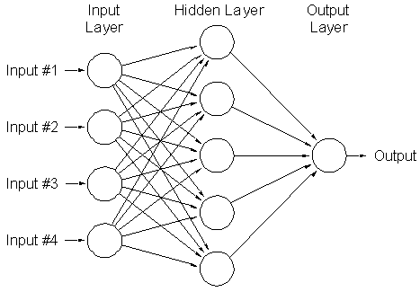
A multi-layer neural network
Nonlinear classifier
Can approximate any continuous function to arbitrary accuracy given sufficiently many hidden units
Lana Lazebnik

Slide 17
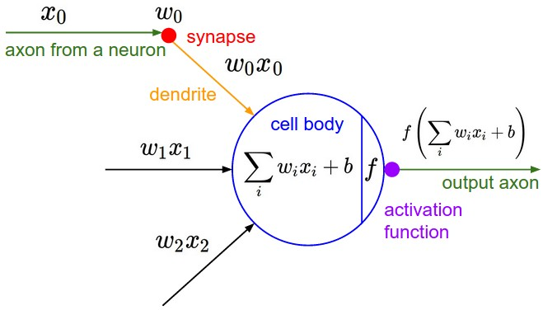
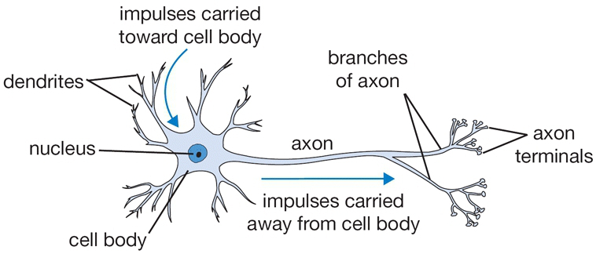
Inspiration: Neuron cells
Neurons
  accept information from multiple inputs,
  transmit information to other neurons.
Multiply inputs by weights along edges
Apply some function to the set of inputs at each node
If output of function over threshold, neuron “fires”
Text: HKUST, figures: Andrej Karpathy
Notes:
From Wikipedia: At the majority of synapses, signals are sent from the axon of one neuron to a dendrite of another... All neurons are electrically excitable, maintaining voltage gradients across their membranes… If the voltage changes by a large enough amount, an all-or-none electrochemical pulse called an action potential is generated, which travels rapidly along the cell's axon, and activates synaptic connections with other cells when it arrives.

Slide 18
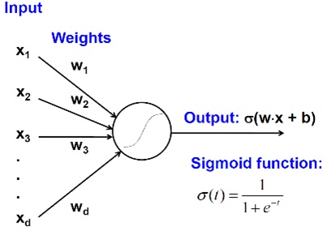
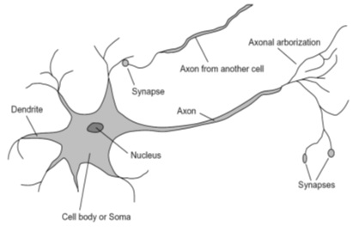
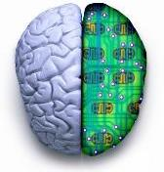
Biological analog
A biological neuron
An artificial neuron
Jia-bin Huang

Slide 19
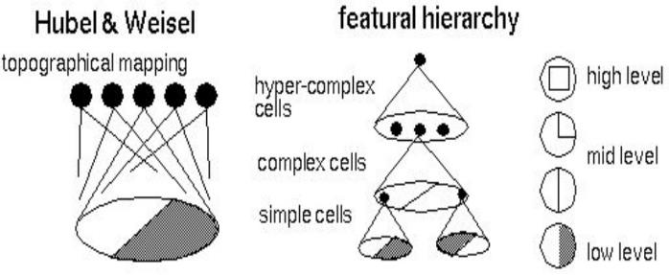
Biological analog
Hubel and Weisel’s architecture
Multi-layer neural network
Adapted from Jia-bin Huang

Slide 20
Multilayer networks
Cascade neurons together
Output from one layer is the input to the next
Each layer has its own sets of weights
HKUST

Slide 21
Feed-forward networks
Predictions are fed forward through the network to classify
HKUST

Slide 22
Feed-forward networks
Predictions are fed forward through the network to classify
HKUST

Slide 23
Feed-forward networks
Predictions are fed forward through the network to classify
HKUST

Slide 24
Feed-forward networks
Predictions are fed forward through the network to classify
HKUST

Slide 25
Feed-forward networks
Predictions are fed forward through the network to classify
HKUST

Slide 26
Feed-forward networks
Predictions are fed forward through the network to classify
HKUST

Slide 27
Deep neural networks
Lots of hidden layers
Depth = power (usually)
“With great power comes great responsibility”
Weights to learn!
Weights to learn!
Weights to learn!
Weights to learn!
Figure from http://neuralnetworksanddeeplearning.com/chap5.html

Slide 28
How do we train deep neural networks?
The goal is to find such a set of weights that allow the activations/outputs to match the desired output: f(W, x_{i}) ~ y_{i}
Unfortunately, no closed-form solution for weights W, but we can express our objective
We want to minimize a loss function (a function of the weights in the network), we’ll do so iteratively
For now let’s simplify and assume there’s a single layer of weights in the network

Slide 29
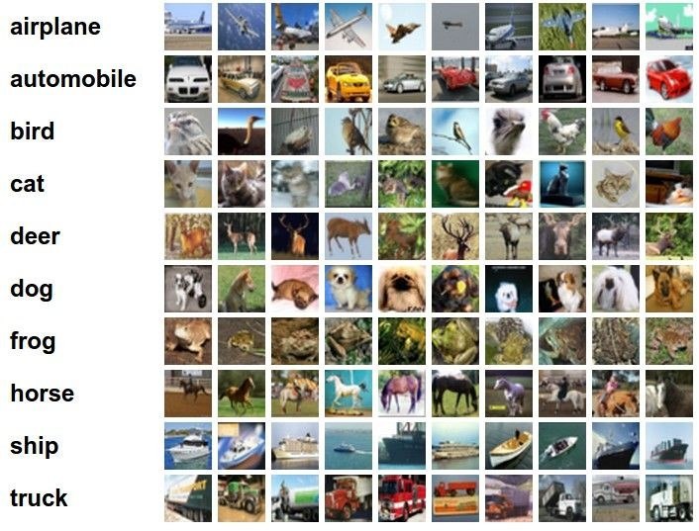
Classification goal
Example dataset: CIFAR-10 10 labels
50,000 training images each image is 32x32x3
10,000 test images
Andrej Karpathy

Slide 30


Classification scores
image
parameters
f(x,W)
10 numbers, indicating class scores
[32x32x3]
array of numbers 0...1 (3072 numbers total)
Andrej Karpathy

Slide 31
Linear classifier
3072x1
(+b)
10x1
10x1
10x3072
10 numbers, indicating class scores
[32x32x3]
array of numbers 0...1
parameters, or “weights”
Andrej Karpathy

Slide 32
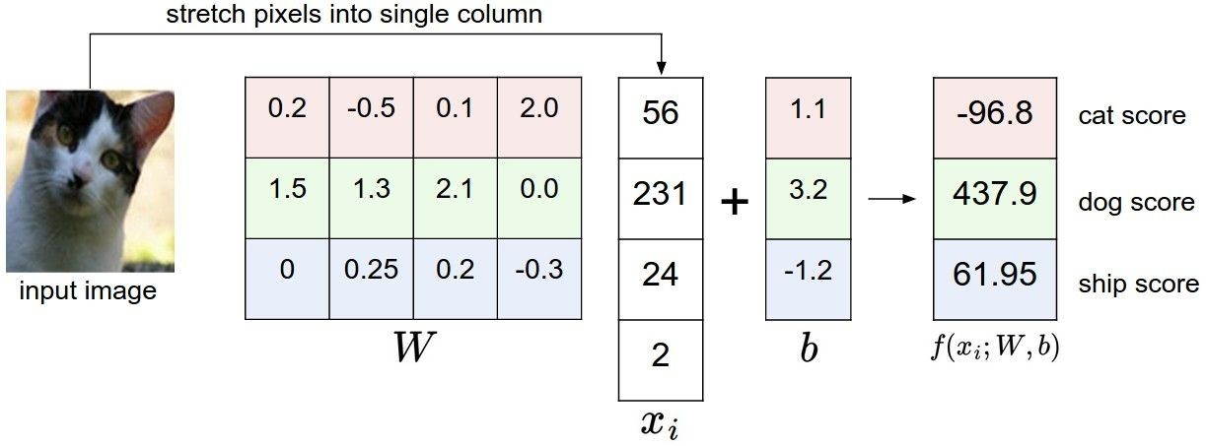
Linear classifier
Example with an image with 4 pixels, and 3 classes (cat/dog/ship)
Andrej Karpathy

Slide 33

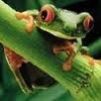
Linear classifier
Going forward: Loss function/Optimization
TODO:
1. Define a loss function that quantifies our unhappiness with the scores across the training data.
cat car frog
3.2
5.1
-1.7
1.3
4.9
2.0
2.2
2.5
-3.1
2. Come up with a way of efficiently finding the parameters that minimize the loss function (optimization)
Andrej Karpathy

Slide 34
Linear classifier
Suppose: 3 training examples, 3 classes. With some W the scores
are:
cat car frog
3.2
5.1
-1.7
1.3
4.9
2.0
2.2
2.5
-3.1
Adapted from Andrej Karpathy

Slide 35





Linear classifier: Hinge loss
Suppose: 3 training examples, 3 classes. With some W the scores
Hinge loss:
Given an example
are:
where where
is the image and
is the (integer) label,
and using the shorthand for the scores vector:
cat car frog
the loss has the form:
3.2
5.1
-1.7
1.3
4.9
2.0
2.2
2.5
-3.1
Want: s_{yi} >= s_{j} + 1, for j != y_{i}
i.e. s_{j} – s_{yi} + 1 <= 0
If true, loss is 0
If false, loss is magnitude of violation
Adapted from Andrej Karpathy

Slide 36
Linear classifier: Hinge loss
Suppose: 3 training examples, 3 classes. With some W the scores
Hinge loss:
Given an example
are:
where where
is the image and
is the (integer) label,
and using the shorthand for the scores vector:
the loss has the form:
cat car frog | 3.2 5.1 -1.7 | 1.3 2.2 4.9 2.5 2.0 -3.1
Losses: | 2.9
= max(0, 5.1 - 3.2 + 1)
+max(0, -1.7 - 3.2 + 1)
= max(0, 2.9) + max(0, -3.9)
= 2.9 + 0
= 2.9
Adapted from Andrej Karpathy

Slide 37
Linear classifier: Hinge loss
Suppose: 3 training examples, 3 classes. With some W the scores
Hinge loss:
Given an example
are:
where where
is the image and
is the (integer) label,
and using the shorthand for the scores vector:
the loss has the form:
cat 3.2 car 5.1 frog -1.7 | 1.3 4.9 2.0 | 2.2 2.5 -3.1
Losses: 2.9 | 0
= max(0, 1.3 - 4.9 + 1)
+max(0, 2.0 - 4.9 + 1)
= max(0, -2.6) + max(0, -1.9)
= 0 + 0
= 0
Adapted from Andrej Karpathy

Slide 38
Linear classifier: Hinge loss
Suppose: 3 training examples, 3 classes. With some W the scores
Hinge loss:
Given an example
are:
where where
is the image and
is the (integer) label,
and using the shorthand for the scores vector:
the loss has the form:
cat car frog | 3.2 5.1 -1.7 | 1.3 4.9 2.0 | 2.2 2.5 -3.1
Losses: | 2.9 | 0 | 12.9
= max(0, 2.2 - (-3.1) + 1)
+max(0, 2.5 - (-3.1) + 1)
= max(0, 5.3 + 1)
+ max(0, 5.6 + 1)
= 6.3 + 6.6
= 12.9
Adapted from Andrej Karpathy

Slide 39

Linear classifier: Hinge loss
Suppose: 3 training examples, 3 classes. With some W the scores
Hinge loss:
Given an example
are:
where where
is the image and
is the (integer) label,
and using the shorthand for the scores vector:
cat car frog
the loss has the form:
3.2
5.1
-1.7
1.3
4.9
2.0
2.2
2.5
-3.1
and the full training loss is the mean over all examples in the training data:
L = (2.9 + 0 + 12.9)/3
Losses:
2.9
0
12.9
= 15.8 / 3 = 5.3
Lecture 3 - 12
Adapted from Andrej Karpathy

Slide 40
Linear classifier: Hinge loss
Adapted from Andrej Karpathy

Slide 41


Linear classifier: Hinge loss
λ = regularization strength (hyperparameter)
Weight Regularization
In common use: L2 regularization L1 regularization
Dropout (will see later)
Adapted from Andrej Karpathy

Slide 42



Another loss: Softmax (cross-entropy)
scores = unnormalized log probabilities of the classes
where
cat car frog
3.2
5.1
-1.7
Want to maximize the log likelihood, or (for a loss function) to minimize the negative log likelihood of the correct class:
maximize
minimize
Adapted from Andrej Karpathy

Slide 43

Another loss: Softmax (cross-entropy)
unnormalized probabilities
cat car frog
3.2 5.1 -1.7 | exp
0.13
0.87
0.00
24.5
164.0
0.18
L_i = -log(0.13)
= 0.89
normalize
unnormalized log probabilities
probabilities
Adapted from Andrej Karpathy

Slide 44

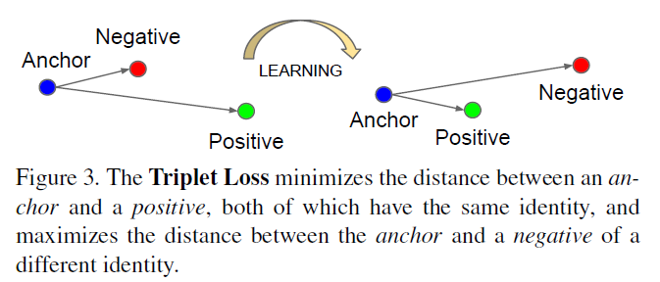
Other losses
Triplet loss (Schroff, FaceNet)
Anything you want!
a denotes anchor
p denotes positive
n denotes negative

Slide 45
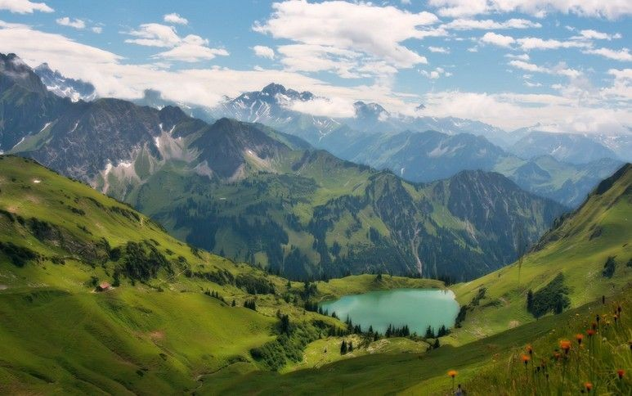

How to minimize the loss function?
Andrej Karpathy

Slide 46

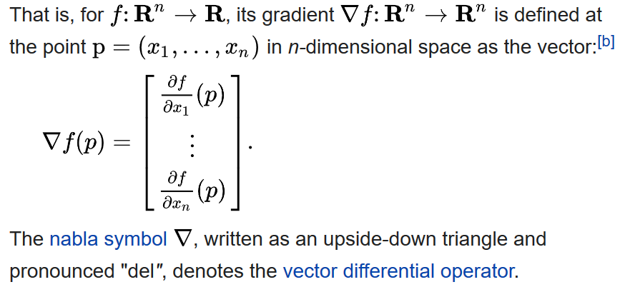
How to minimize the loss function?
In 1-dimension, the derivative of a function is:
In multiple dimensions, the gradient is the vector of (partial derivatives):
Adapted from Andrej Karpathy, definition/equation from https://en.wikipedia.org/wiki/Gradient

Slide 47
Computing the gradient numerically
current W:
gradient dW:
[0.34,
-1.11,
0.78,
0.12,
0.55,
2.81,
-3.1,
-1.5,
0.33,…]
loss 1.25347
[?,
?,
?,
?,
?,
?,
?,
?,
?,…]
Andrej Karpathy

Slide 48
Computing the gradient numerically
current W:
W + h (first dim):
gradient dW:
[0.34,
-1.11,
0.78,
0.12,
0.55,
2.81,
-3.1,
-1.5,
0.33,…]
loss 1.25347
[0.34 + 0.0001,
-1.11,
0.78,
0.12,
0.55,
2.81,
-3.1,
-1.5,
0.33,…]
loss 1.25322
[?,
?,
?,
?,
?,
?,
?,
?,
?,…]
Andrej Karpathy

Slide 49
current W:
Computing the gradient numerically
W + h (first dim):
gradient dW:
[0.34,
-1.11,
0.78,
0.12,
0.55,
2.81,
-3.1,
-1.5,
0.33,…]
loss 1.25347
[0.34 + 0.0001,
-1.11,
0.78,
0.12,
0.55,
2.81,
-3.1,
-1.5,
0.33,…]
loss 1.25322
[-2.5,
?,
?,
?,
?,
?,
?,
(1.25322 - 1.25347)/0.0001
= -2.5
?,
?,…]
Andrej Karpathy

Slide 50
Computing the gradient numerically
current W:
W + h (second dim):
gradient dW:
[0.34,
-1.11,
0.78,
0.12,
0.55,
2.81,
-3.1,
-1.5,
0.33,…]
loss 1.25347
[0.34,
-1.11 + 0.0001,
0.78,
0.12,
0.55,
2.81,
-3.1,
-1.5,
0.33,…]
loss 1.25353
[-2.5,
?,
?,
?,
?,
?,
?,
?,
?,…]
Andrej Karpathy

Slide 51
current W:
Computing the gradient numerically
W + h (second dim):
gradient dW:
[0.34,
-1.11,
0.78,
0.12,
0.55,
2.81,
-3.1,
-1.5,
0.33,…]
loss 1.25347
[0.34,
-1.11 + 0.0001,
0.78,
0.12,
0.55,
2.81,
-3.1,
-1.5,
0.33,…]
loss 1.25353
[-2.5,
0.6,
?,
?,
?,
?,
?,
?,
(1.25353 - 1.25347)/0.0001
= 0.6
?,…]
Andrej Karpathy

Slide 52
Computing the gradient numerically
current W:
W + h (third dim):
gradient dW:
[0.34,
-1.11,
0.78,
0.12,
0.55,
2.81,
-3.1,
-1.5,
0.33,…]
loss 1.25347
[0.34,
-1.11,
0.78 + 0.0001,
0.12,
0.55,
2.81,
-3.1,
-1.5,
0.33,…]
loss 1.25347
[-2.5,
0.6,
?,
?,
?,
?,
?,
?,
?,…]
Andrej Karpathy

Slide 53



The loss is just a function of W:
Computing the gradient analytically
want
Andrej Karpathy

Slide 54

The loss is just a function of W:
Computing the gradient analytically
want
Calculus
= ...
Andrej Karpathy

Slide 55
Computing the gradient analytically
current W:
gradient dW:
[0.34,
-1.11,
0.78,
0.12,
0.55,
2.81,
-3.1,
-1.5,
0.33,…]
loss 1.25347
[-2.5,
0.6,
0,
0.2,
0.7,
-0.5,
1.1,
1.3,
-2.1,…]
dW = ...
(some function of data and W)
Andrej Karpathy

Slide 56
Example of gradient calculation
f(x, w) = dot(w, x) = w1*x1 + w2*x2 + … + wD*xD
d f(x, w) / d w1 = ?
d f(x, w) / d w1 = x1
d f(x, w) / d w2 = x2
…
Gradient of f(x, w) wrt w is [x1 x2 … xD] i.e. x

Slide 57
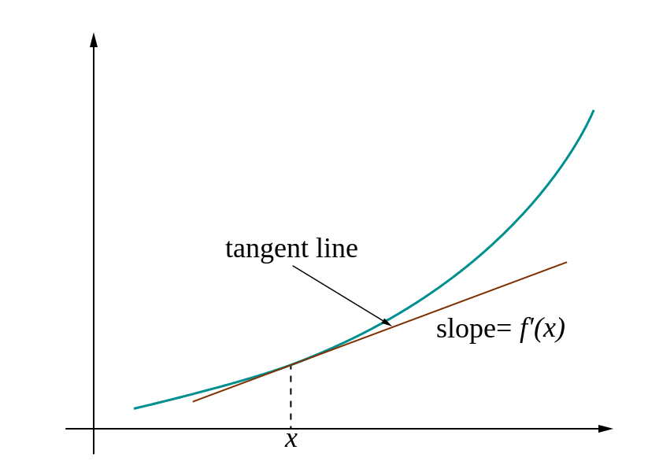
Loss gradients
Different notations:
i.e. how does the loss change as a function of the weights
We want to change weights in a way that makes the loss decrease as fast as possible

Slide 58
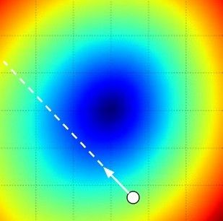
Gradient descent
We’ll update weights
Move in direction opposite to gradient:
L
Time
Learning rate
W_2
original W
W_1
negative gradient direction
Figure from Andrej Karpathy

Slide 59
Gradient descent
Iteratively subtract the gradient with respect to the model parameters (w)
I.e. we’re moving in a direction opposite to the gradient of the loss
I.e. we’re moving towards smaller loss

Slide 60
How to compute the loss/gradient?
In classic gradient descent, we compute the gradient from the loss for all training examples
Mini-batch gradient descent: Only use some of the data for each gradient update, cycle through training examples multiple times
  Each time we’ve cycled through all of them once is called an ‘epoch’
  Allows faster training (e.g. on GPUs), parallelization
  Some benefits for learning due to randomness

Slide 61
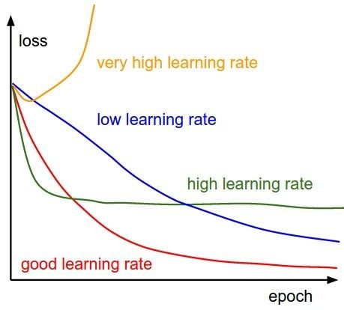
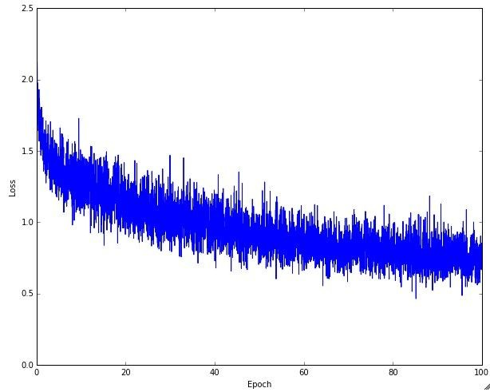
Learning rate selection
The effects of step size (or “learning rate”)
https://www.deeplearning.ai/ai-notes/optimization/
Andrej Karpathy

Slide 62
Gradient descent in multi-layer nets
We’ll update weights
Move in direction opposite to gradient:
How to update the weights at all layers?
Answer: backpropagation of error from higher layers to lower layers

Slide 63
Backpropagation: Graphic example
First calculate error of output units and use this to change the top layer of weights.
output
k
j
i
Calculate how to
update weights into j
(update at end of iter)
w⁽²⁾
hidden
w⁽¹⁾
input
Adapted from Ray Mooney, equations from Chris Bishop

Slide 64
Backpropagation: Graphic example
Next calculate error for hidden units based on errors on the output units it feeds into.
output
k
j
i
hidden
input
Adapted from Ray Mooney, equations from Chris Bishop

Slide 65
Backpropagation: Graphic example
Finally update bottom layer of weights based on errors calculated for hidden units.
output
k
j
i
Update weights into i
hidden
input
Adapted from Ray Mooney, equations from Chris Bishop

Slide 66
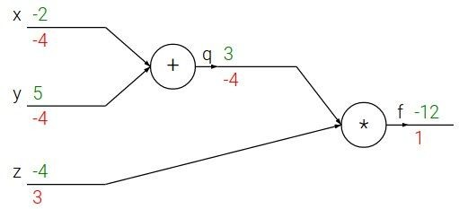

e.g. x = -2, y = 5, z = -4
Fei-Fei Li & Andrej Karpathy & Justin Johnson Lecture 4 - 13 Jan 2016
Lecture 4 - 10
Andrej Karpathy
Notes:
https://www.youtube.com/watch?v=QWfmCyLEQ8U&list=PL16j5WbGpaM0_Tj8CRmurZ8Kk1gEBc7fg&index=4

Slide 67





e.g. x = -2, y = 5, z = -4
Want:
Fei-Fei Li & Andrej Karpathy & Justin Johnson Lecture 4 - 13 Jan 2016
Lecture 4 - 11
Andrej Karpathy

Slide 68

e.g. x = -2, y = 5, z = -4
Want:
Fei-Fei Li & Andrej Karpathy & Justin Johnson Lecture 4 - 13 Jan 2016
Lecture 4 - 12
Andrej Karpathy

Slide 69
e.g. x = -2, y = 5, z = -4
Want:
Fei-Fei Li & Andrej Karpathy & Justin Johnson Lecture 4 - 13 Jan 2016
Lecture 4 - 13
Andrej Karpathy

Slide 70

e.g. x = -2, y = 5, z = -4
Want:
Fei-Fei Li & Andrej Karpathy & Justin Johnson Lecture 4 - 13 Jan 2016
Lecture 4 - 14
Andrej Karpathy

Slide 71
e.g. x = -2, y = 5, z = -4
Want:
Fei-Fei Li & Andrej Karpathy & Justin Johnson Lecture 4 - 13 Jan 2016
Lecture 4 - 15
Andrej Karpathy

Slide 72

e.g. x = -2, y = 5, z = -4
Want:
Fei-Fei Li & Andrej Karpathy & Justin Johnson Lecture 4 - 13 Jan 2016
Lecture 4 - 16
Andrej Karpathy

Slide 73
e.g. x = -2, y = 5, z = -4
Want:
Fei-Fei Li & Andrej Karpathy & Justin Johnson Lecture 4 - 13 Jan 2016
Lecture 4 - 17
Andrej Karpathy

Slide 74

e.g. x = -2, y = 5, z = -4
Want:
Fei-Fei Li & Andrej Karpathy & Justin Johnson Lecture 4 - 13 Jan 2016
Lecture 4 - 18
Andrej Karpathy

Slide 75


e.g. x = -2, y = 5, z = -4
Chain rule:
Want:
Fei-Fei Li & Andrej Karpathy & Justin Johnson Lecture 4 - 13 Jan 2016
Lecture 4 - 19
Andrej Karpathy

Slide 76

e.g. x = -2, y = 5, z = -4
Want:
Fei-Fei Li & Andrej Karpathy & Justin Johnson Lecture 4 - 13 Jan 2016
Lecture 4 - 20
Andrej Karpathy

Slide 77
e.g. x = -2, y = 5, z = -4
Chain rule:
Want:
Fei-Fei Li & Andrej Karpathy & Justin Johnson Lecture 4 - 13 Jan 2016
Lecture 4 - 21
Andrej Karpathy

Slide 78


activations
f
Fei-Fei Li & Andrej Karpathy & Justin Johnson Lecture 4 - 13 Jan 2016
Lecture 4 - 22
Andrej Karpathy

Slide 79


activations
“local gradient”
f
gradients
Fei-Fei Li & Andrej Karpathy & Justin Johnson Lecture 4 - 13 Jan 2016
Lecture 4 - 23
Andrej Karpathy

Slide 80

activations
“local gradient”
f
gradients
Fei-Fei Li & Andrej Karpathy & Justin Johnson Lecture 4 - 13 Jan 2016
Lecture 4 - 24
Andrej Karpathy

Slide 81
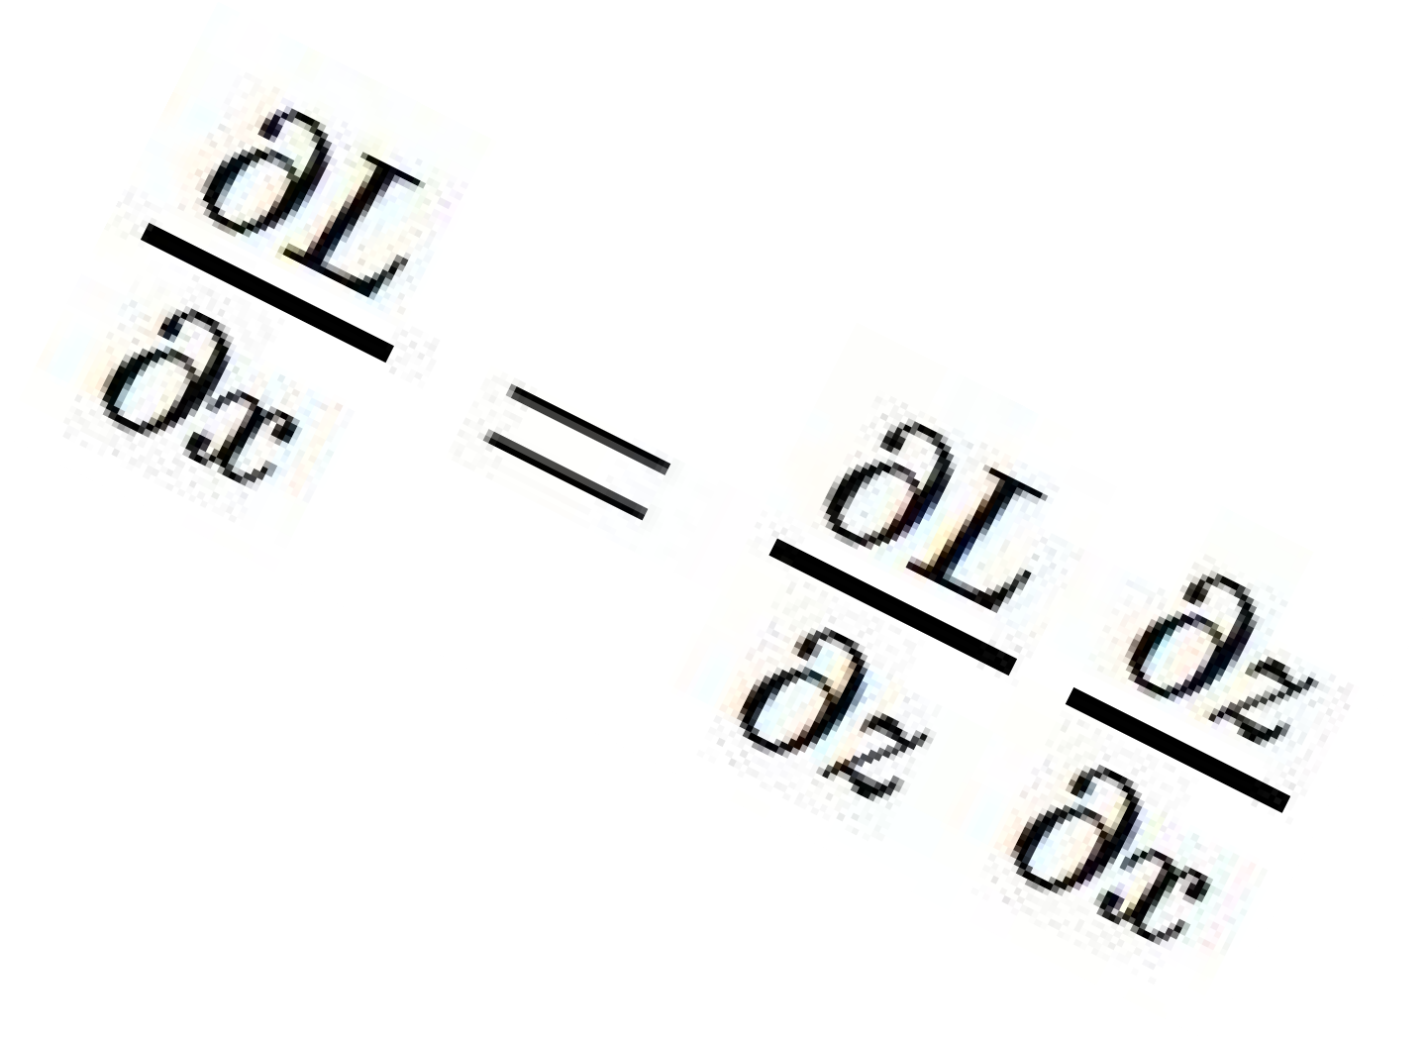
activations
“local gradient”
f
gradients
Fei-Fei Li & Andrej Karpathy & Justin Johnson Lecture 4 - 13 Jan 2016
Lecture 4 - 25
Andrej Karpathy

Slide 82
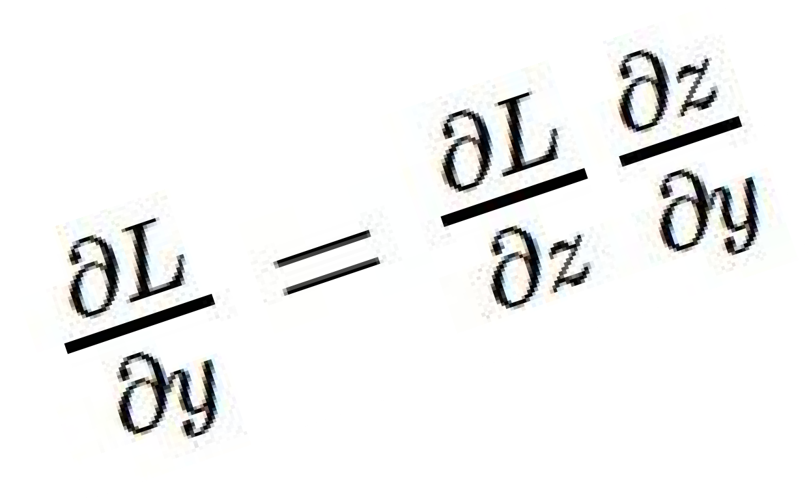
activations
“local gradient”
f
gradients
Fei-Fei Li & Andrej Karpathy & Justin Johnson Lecture 4 - 13 Jan 2016
Lecture 4 - 26
See hidden slides for more details.
Andrej Karpathy

Slide 83
Computing gradient for each weight
We need to move weights in direction opposite to gradient of loss wrt that weight:
w_{kj} = w_{kj} – η dE/dw_{kj} (output layer)
w_{ji} = w_{ji} – η dE/dw_{ji} (hidden layer)
Loss depends on weights in an indirect way, so we’ll use the chain rule and compute:
dE/dw_{kj} = dE/dy_{k} dy_{k}/da_{k} da_{k}/dw_{kj}
dE/dw_{ji} = dE/dz_{j} dz_{j}/da_{j} da_{j}/dw_{ji}

Slide 84
Gradient for output layer weights
Loss depends on weights in an indirect way, so we’ll use the chain rule and compute:
dE/dw_{kj} = dE/dy_{k} dy_{k}/da_{k} da_{k}/dw_{kj}
How to compute each of these?
dE/dy_{k} : need to know form of error function
  Example: if E = (y_{k} – y_{k}’)², where y_{k}’ is the ground-truth label, then dE/dy_{k} = 2(y_{k} – y_{k}’)
dy_{k}/da_{k} : need to know output layer activation
  If h(a_{k})=σ(a_{k}), then d h(a_{k})/d a_{k} = σ(a_{k})(1-σ(a_{k}))
da_{k}/dw_{kj} : z_{j} since a_{k} is a linear combination
  a_{k} = w_{k:}^{T} z = Σ_{j} w_{kj} z_{j}

Slide 85
Gradient for hidden layer weights
We’ll use the chain rule again and compute:
dE/dw_{ji} = dE/dz_{j} dz_{j}/da_{j} da_{j}/dw_{ji}
Unlike the previous case (weights for output layer), the error (dE/dz_{j}) is hard to compute (indirect, need chain rule again)
We’ll simplify the computation by doing it step by step via backpropagation of error
You could directly compute this term– you will get the same result as with backprop (do as an exercise!)

Slide 86
Gradients – slightly different notation
The following is a framework, slightly imprecise
Let us denote the inputs at a layer i by in_{i}, the linear combination of inputs computed at that layer as raw_{i}, the activation as act_{i}
We define a new quantity that will roughly correspond to accumulated error, err_{i}
Then we can write the updates as
w = w – η * err_{i} * in_{i}
We can compute error as:
err_{i} =
d E / d act_{i} * d act_{i} / d raw_{i}

Slide 87
Gradients – slightly different approach
We’ll write the weight updates as follows
  w_{kj} = w_{kj} - η δ_{k} z_{j} for output units
  w_{ji} = w_{ji} - η δ_{j} x_{i} for hidden units
What are δ_{k}, δ_{j}?
  They store error, gradient wrt raw activations (i.e. dE/da)
  They’re of the form dE/dz_{j} dz_{j}/da_{j}
  The latter is easy to compute – just use derivative of activation function
  The former is easy for output – e.g. (y_{k} – y_{k}’)
  It is harder to compute for hidden layers
  dE/dz_{j} = ∑_{k} w_{kj} δ_{k} (where did this come from?)
Figure from Chris Bishop

Slide 88
Deriving backprop (Bishop Eq. 5.56)
In a neural network:
Gradient is (using chain rule):
Denote the “errors” as:
Also:
Equations from Bishop

Slide 89
Deriving backprop (Bishop Eq. 5.56)
For output (identity output, L2 loss):
For hidden units (using chain rule again):
Backprop formula:
Equations from Bishop

Slide 90
Putting it all together
Example: use sigmoid at hidden layer and output layer, loss is L2 between true/predicted labels

Slide 91
Example algorithm for sigmoid, L2 error
Initialize all weights to small random values
Until convergence (e.g. all training examples’ error small, or error stops decreasing) repeat:
  For each (x, y’=class(x)) in training set:
    Calculate network outputs: y_{k}
    Compute errors (gradients wrt activations) for each unit:
      δ_{k} = y_{k} (1-y_{k}) (y_{k} – y_{k}’) for output units
      δ_{j} = z_{j} (1-z_{j}) ∑_{k} w_{kj} δ_{k} for hidden units
    Update weights:
      w_{kj} = w_{kj} - η δ_{k} z_{j} for output units
      w_{ji} = w_{ji} - η δ_{j} x_{i} for hidden units
Recall: w_{ji} = w_{ji} – η dE/dz_{j} dz_{j}/da_{j} da_{j}/dw_{ji}
Adapted from R. Hwa, R. Mooney

Slide 92
Convolutional neural networks

Slide 93
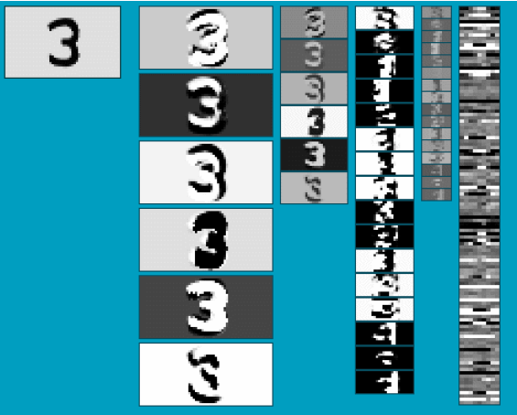
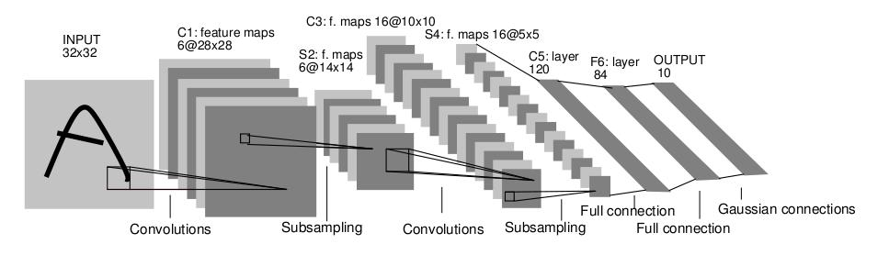
Convolutional Neural Networks (CNN)
Neural network with specialized connectivity structure
Stack multiple stages of feature extractors
Higher stages compute more global, more invariant, more abstract features
Classification layer at the end
Y. LeCun, L. Bottou, Y. Bengio, and P. Haffner, Gradient-based learning applied to document recognition, Proceedings of the IEEE 86(11): 2278–2324, 1998.
Adapted from Rob Fergus

Slide 94
Convolutional Neural Networks (CNN)
Feed-forward feature extraction:
  Convolve input with learned filters
  Apply non-linearity
  Spatial pooling (downsample)
Supervised training of convolutional
filters by back-propagating
classification error
Output (class probs)
…
Spatial pooling
Non-linearity
Convolution (Learned)
Input Image
Adapted from Lana Lazebnik

Slide 95
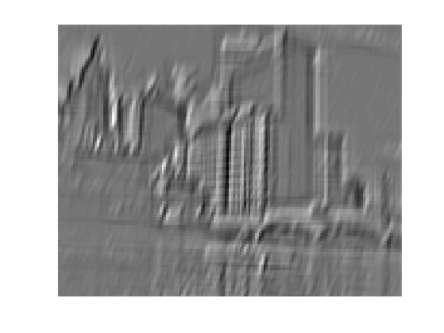
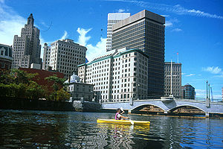
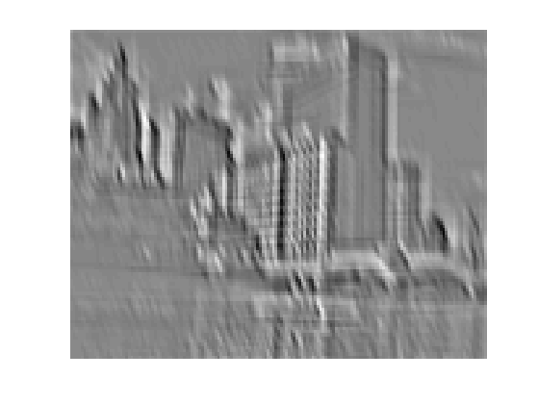
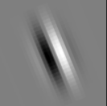
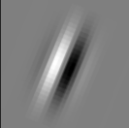
1. Convolution
Apply learned filter weights
One feature map per filter
Stride can be greater than 1 (faster, less memory)
...
Input
Feature Map
Adapted from Rob Fergus

Slide 96
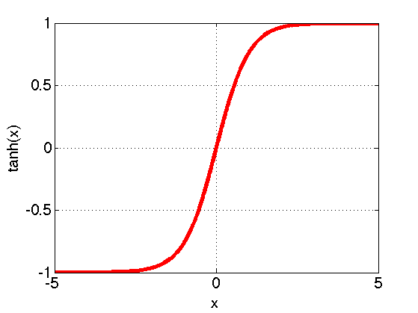
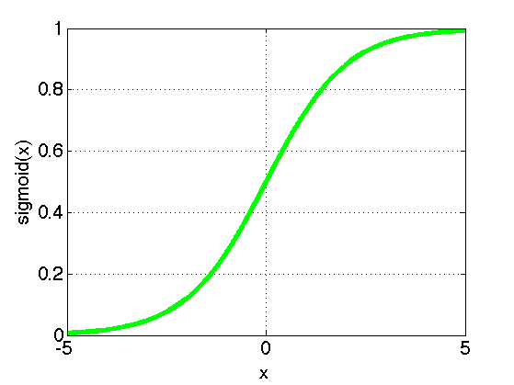
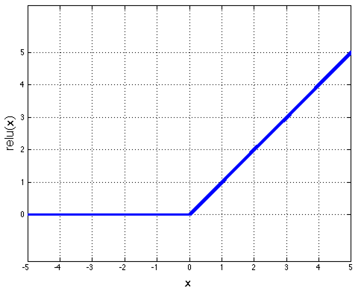
2. Non-Linearity
Per-element (independent)
Some options:
  Tanh
  Sigmoid: 1/(1+exp(-x))
  Rectified linear unit (ReLU)
    Avoids saturation issues
Adapted from Rob Fergus

Slide 97
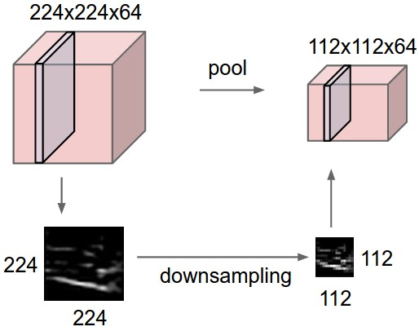
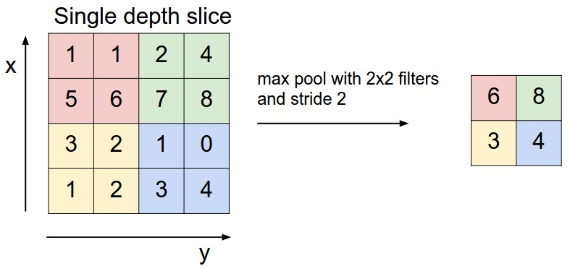
3. Spatial Pooling
Sum or max over non-overlapping / overlapping regions
Rob Fergus, figure from Andrej Karpathy

Slide 98
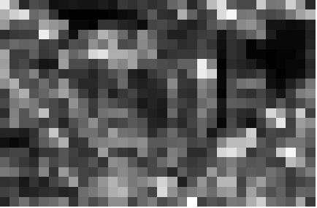
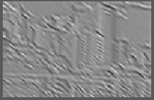
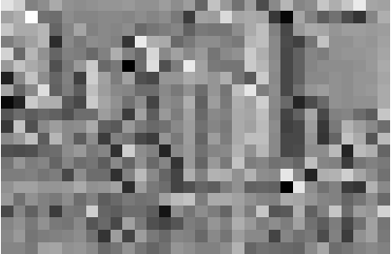
3. Spatial Pooling
Sum or max over non-overlapping / overlapping regions
Role of pooling:
  Invariance to small transformations
  Larger receptive fields (neurons see more of input)
  Max
  Sum
Adapted from Rob Fergus

Slide 99
Convolutions: More detail
32x32x3 image
32
height
32
depth
width
3
Andrej Karpathy

Slide 100
Convolutions: More detail
32x32x3 image
5x5x3 filter
32
Convolve the filter with the image
i.e. “slide over the image spatially, computing dot products”
32
3
Andrej Karpathy

Slide 101


Convolution Layer
Convolutions: More detail
32x32x3 image 5x5x3 filter
32
1 number:
the result of taking a dot product between the filter and a small 5x5x3 chunk of the image
(i.e. 5*5*3 = 75-dimensional dot product + bias)
32
3
Andrej Karpathy

Slide 102
Convolution Layer
Convolutions: More detail
activation map
32x32x3 image
5x5x3 filter
32
28
convolve (slide) over all spatial locations
32
28
3
1
Andrej Karpathy

Slide 103
consider a second, green filter
Convolutions: More detail
Convolution Layer
32x32x3 image 5x5x3 filter
activation maps
32
28
convolve (slide) over all spatial locations
32
28
3
1
Andrej Karpathy

Slide 104
For example, if we had 6 5x5 filters, we’ll get 6 separate activation maps:
Convolutions: More detail
activation maps
32
28
Convolution Layer
32
28
3
6
We stack these up to get a “new image” of size 28x28x6!
Andrej Karpathy

Slide 105
Preview: ConvNet is a sequence of Convolution Layers, interspersed with activation functions
Convolutions: More detail
32
28
CONV, ReLU
e.g. 6 5x5x3 filters
32
28
3
6
Andrej Karpathy

Slide 106
Preview: ConvNet is a sequence of Convolutional Layers, interspersed with activation functions
Convolutions: More detail
32
28
24
….
CONV, ReLU
e.g. 6 5x5x3 filters
CONV, ReLU
e.g. 10 5x5x6 filters
CONV, ReLU
32
28
24
3
6
10
Andrej Karpathy

Slide 107
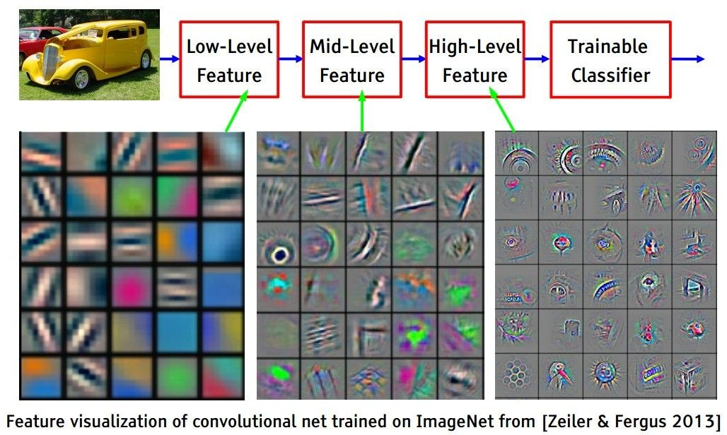
Preview
Convolutions: More detail
[From recent Yann LeCun slides]
Andrej Karpathy

Slide 108


one filter =>
one activation map
Convolutions: More detail
example 5x5 filters
(32 total)
We call the layer convolutional because it is related to convolution of two signals:
Element-wise multiplication and sum of a filter and the signal (image)
Adapted from Andrej Karpathy, Kristen Grauman

Slide 109
A closer look at spatial dimensions:
Convolutions: More detail
activation map
32x32x3 image
5x5x3 filter
32
28
convolve (slide) over all spatial locations
32
28
3
1
Andrej Karpathy

Slide 110
A closer look at spatial dimensions:
Convolutions: More detail
7
7x7 input (spatially) assume 3x3 filter
7
Andrej Karpathy

Slide 111
A closer look at spatial dimensions:
Convolutions: More detail
7
7x7 input (spatially) assume 3x3 filter
7
Andrej Karpathy

Slide 112
A closer look at spatial dimensions:
Convolutions: More detail
7
7x7 input (spatially) assume 3x3 filter
7
Andrej Karpathy

Slide 113
A closer look at spatial dimensions:
Convolutions: More detail
7
7x7 input (spatially) assume 3x3 filter
7
Andrej Karpathy

Slide 114
A closer look at spatial dimensions:
Convolutions: More detail
7
7x7 input (spatially) assume 3x3 filter
=> 5x5 output
7
Andrej Karpathy

Slide 115
A closer look at spatial dimensions:
Convolutions: More detail
7
7x7 input (spatially) assume 3x3 filter applied with stride 2
7
Andrej Karpathy

Slide 116
A closer look at spatial dimensions:
Convolutions: More detail
7
7x7 input (spatially) assume 3x3 filter applied with stride 2
7
Andrej Karpathy

Slide 117
A closer look at spatial dimensions:
Convolutions: More detail
7
7x7 input (spatially) assume 3x3 filter applied with stride 2
=> 3x3 output!
7
Andrej Karpathy

Slide 118
A closer look at spatial dimensions:
Convolutions: More detail
7
7x7 input (spatially) assume 3x3 filter applied with stride 3?
7
Andrej Karpathy

Slide 119
A closer look at spatial dimensions:
Convolutions: More detail
7
7x7 input (spatially) assume 3x3 filter applied with stride 3?
7
doesn’t fit!
cannot apply 3x3 filter on 7x7 input with stride 3.
Andrej Karpathy

Slide 120
Convolutions: More detail
N
Output size:
(N - F) / stride + 1
 |  |  | F
 | F
e.g. N = 7, F = 3:
stride 1 => (7 - 3)/1 + 1 = 5
stride 2 => (7 - 3)/2 + 1 = 3
stride 3 => (7 - 3)/3 + 1 = 2.33 :\
N
Andrej Karpathy

Slide 121
In practice: Common to zero pad the border
Convolutions: More detail
0 | 0 | 0 | 0 | 0 | 0
0
0
0
0
e.g. input 7x7
3x3 filter, applied with stride 1
pad with 1 pixel border => what is the output?
(recall:)
(N - F) / stride + 1
Andrej Karpathy

Slide 122
In practice: Common to zero pad the border
Convolutions: More detail
0 | 0 | 0 | 0 | 0 | 0
0
0
0
0
e.g. input 7x7
3x3 filter, applied with stride 1
pad with 1 pixel border => what is the output?
7x7 output!
Andrej Karpathy

Slide 123
In practice: Common to zero pad the border
Convolutions: More detail
0 | 0 | 0 | 0 | 0 | 0
0
0
0
0
e.g. input 7x7
3x3 filter, applied with stride 1
pad with 1 pixel border => what is the output?
7x7 output!
in general, common to see CONV layers with stride 1, filters of size FxF, and zero-padding with (F-1)/2. (will preserve size spatially)
e.g. F = 3 => zero pad with 1 F = 5 => zero pad with 2 F = 7 => zero pad with 3
(N + 2*padding - F) / stride + 1
Andrej Karpathy

Slide 124
Convolutions: More detail
Examples time:
Input volume: 32x32x3
10 5x5x3 filters with stride 1, pad 2
Output volume size: ?
Andrej Karpathy

Slide 125
Convolutions: More detail
Examples time:
Input volume: 32x32x3
10 5x5x3 filters with stride 1, pad 2
Output volume size:
(32+2*2-5)/1+1 = 32 spatially, so
32x32x10
Andrej Karpathy

Slide 126
Convolutions: More detail
Examples time:
Input volume: 32x32x3
10 5x5x3 filters with stride 1, pad 2
Number of parameters in this layer?
Andrej Karpathy

Slide 127
Examples time:
Convolutions: More detail
Input volume: 32x32x3
10 5x5x3 filters with stride 1, pad 2
Number of parameters in this layer? each filter has 5*5*3 + 1 = 76 params
=> 76*10 = 760
(+1 for bias)
Andrej Karpathy

Slide 128

Putting it all together
Andrej Karpathy

Slide 129

A Common Architecture: AlexNet
Figure from http://www.mdpi.com/2072-4292/7/11/14680/htm

Slide 130

[Krizhevsky et al. 2012]
Case Study: AlexNet
Full (simplified) AlexNet architecture: [227x227x3] INPUT
[55x55x96] CONV1: 96 11x11 filters at stride 4, pad 0 [27x27x96] MAX POOL1: 3x3 filters at stride 2 [27x27x96] NORM1: Normalization layer
[27x27x256] CONV2: 256 5x5 filters at stride 1, pad 2 [13x13x256] MAX POOL2: 3x3 filters at stride 2 [13x13x256] NORM2: Normalization layer [13x13x384] CONV3: 384 3x3 filters at stride 1, pad 1 [13x13x384] CONV4: 384 3x3 filters at stride 1, pad 1 [13x13x256] CONV5: 256 3x3 filters at stride 1, pad 1 [6x6x256] MAX POOL3: 3x3 filters at stride 2
Details/Retrospectives:
first use of ReLU
used Norm layers (not common anymore)
heavy data augmentation
dropout 0.5
batch size 128
SGD Momentum 0.9
Learning rate 1e-2, reduced by 10 manually when val accuracy plateaus
L2 weight decay 5e-4
[4096] FC6: 4096 neurons
[4096] FC7: 4096 neurons
[1000] FC8: 1000 neurons (class scores)
Fei-Fei Li & Justin Johnson & Serena Yeung Lecture 9 - May 1, 2018
Fei-Fei Li, Andrej Karpathy, Justin Johnson, Serena Yeung

Slide 131

Case Study: VGGNet
[Simonyan and Zisserman, 2014]
Only 3x3 CONV stride 1, pad 1 and 2x2 MAX POOL stride 2
best model
11.2% top 5 error in ILSVRC 2013
->
7.3% top 5 error
Andrej Karpathy

Slide 132


Case Study: GoogLeNet
[Szegedy et al., 2014]
Inception module
ILSVRC 2014 winner (6.7% top 5 error)
Andrej Karpathy

Slide 133

Case Study: ResNet
[He et al., 2015]
ILSVRC 2015 winner (3.6% top 5 error)
Slide from Kaiming He’s presentation https://www.youtube.com/watch?v=1PGLj-uKT1w
Andrej Karpathy

Slide 134

Case Study: ResNet
(slide from Kaiming He’s presentation)
Andrej Karpathy

Slide 135
Case Study: ResNet
[He et al., 2016]
Very deep networks using residual connections
relu
F(x) + x
..
.
152-layer model for ImageNet
ILSVRC’15 classification winner (3.57% top 5 error)
Swept all classification and detection competitions in ILSVRC’15 and COCO’15!
X
identity
F(x)
relu
X
Residual block
Fei-Fei Li & Justin Johnson & Serena Yeung Lecture 9 - May 1, 2018
Fei-Fei Li, Andrej Karpathy, Justin Johnson, Serena Yeung

Slide 136


Case Study: ResNet
[He et al., 2016]
What happens when we continue stacking deeper layers on a “plain” convolutional neural network?
Q: What’s strange about these training and test curves? [Hint: look at the order of the curves]
56-layer model performs worse on both training and test error
-> The deeper model performs worse, but it’s not caused by overfitting!
Fei-Fei Li & Justin Johnson & Serena Yeung Lecture 9 - May 1, 2018
Fei-Fei Li, Andrej Karpathy, Justin Johnson, Serena Yeung

Slide 137
Case Study: ResNet
[He et al., 2016]
Hypothesis: the problem is an optimization problem, deeper models are harder to optimize
The deeper model should be able to perform at least as well as the shallower model.
A solution by construction is copying the learned layers from the shallower model and setting additional layers to identity mapping.
Fei-Fei Li & Justin Johnson & Serena Yeung Lecture 9 - May 1, 2018
Fei-Fei Li, Andrej Karpathy, Justin Johnson, Serena Yeung

Slide 138
Case Study: ResNet
[He et al., 2016]
Solution: Use network layers to fit a residual mapping instead of directly trying to fit a desired underlying mapping
H(x) = F(x) + x
relu
H(x)
F(x) + x
Use layers to fit residual F(x) = H(x) - x
instead of H(x) directly
F(x)
relu
X
identity
relu
X
“Plain” layers
X
Residual block
Fei-Fei Li & Justin Johnson & Serena Yeung Lecture 9 - May 1, 2018
Fei-Fei Li, Andrej Karpathy, Justin Johnson, Serena Yeung

Slide 139

Case Study: ResNet
[He et al., 2016]
Full ResNet architecture:
Stack residual blocks
Every residual block has two 3x3 conv layers
relu
F(x) + x
..
.
F(x)
relu
X
identity
X
Residual block
Fei-Fei Li & Justin Johnson & Serena Yeung Lecture 9 - May 1, 2018
Fei-Fei Li, Andrej Karpathy, Justin Johnson, Serena Yeung

Slide 140
Practical matters

Slide 141
Comments on training algorithm
Not guaranteed to converge to zero training error, may converge to local optima or oscillate indefinitely.
However, in practice, does converge to low error for many large networks on real data, with good choice of hyperparameters (e.g. learning rate).
Thousands of epochs (epoch = network sees all training data once) may be required, hours or days to train.
To avoid local-minima problems, run several trials starting with different random weights (random restarts), and take results of trial with lowest training set error, use transfer learning, regularization, …
May be hard to set learning rate and to select number of hidden units and layers.
Neural networks had fallen out of fashion in 90s, early 2000s; back with a new name and improved performance (deep networks trained with dropout and lots of data).
Ray Mooney, Carlos Guestrin, Dhruv Batra

Slide 142
Over-training prevention
Running too many epochs can result in over-fitting.
Keep a hold-out validation set and test accuracy on it after every epoch. Stop training when additional epochs actually increase validation error.
error
on test data
on training data
0
# training epochs
Adapted from Ray Mooney

Slide 143
Training: Best practices
Data
  Center (subtract mean from) your data
  Use data augmentation
  Use mini-batch
Weights/activations
  To initialize weights, use “Xavier initialization”
  Use regularization
  Use RELU (most common), don’t use sigmoid
Hyperparameters:
  Learning rate: too high? Too low?
  Use cross-validation to pick

Slide 144


Regularization: Dropout
Randomly turn off some neurons
Allows individual neurons to independently be responsible for performance
Dropout: A simple way to prevent neural networks from overfitting [Srivastava JMLR 2014]
Adapted from Jia-bin Huang

Slide 145

Data Augmentation (Jittering)
Create virtual training samples
  Horizontal flip
  Random crop
  Color casting
  Geometric distortion
Jia-bin Huang, Image: https://github.com/aleju/imgaug

Slide 146
Transfer Learning
“You need a lot of a data if you want to train/use CNNs”
BUSTED
Andrej Karpathy

Slide 147
Transfer Learning with CNNs
The more weights you need to learn, the more data you need
That’s why with a deeper network, you need more data to train than for a shallower net
One possible solution:
Set these to the already learned
weights from another network
Learn these on your own task

Slide 148

Transfer Learning with CNNs
Source: classification on ImageNet Target: some other task/data
1. Train on ImageNet
2. Small dataset:
3. Medium dataset:
finetuning
more data = retrain more of the network (or all of it)
Freeze these
Freeze these
Train this
Train this
Lecture 11 - 29
Another option: use network as feature extractor,
train SVM on extracted features for target task
Adapted from Andrej Karpathy

Slide 149
more generic
Transfer Learning with CNNs
 | very similar dataset | very different dataset
very little data | Use simple classifier from top layer | You’re in trouble… Try simple classifier from different stages
quite a lot of data | Finetune a few layers | Finetune a larger number of layers
more specific
Lecture 11 - 34
Adapted from Andrej Karpathy

Slide 150

Pre-training on ImageNet
Have a source domain and target domain
Train a network to classify ImageNet classes
  Coarse classes and ones with fine distinctions (dog breeds)
Remove last layers and train layers to replace them, that predict target classes
Oquab et al., “Learning and Transferring Mid-Level Image Representations…”, CVPR 2014

Slide 151

Transfer learning with CNNs is pervasive…
Image Captioning
Karpathy and Fei-Fei, “Deep Visual-Semantic Alignments for Generating Image Descriptions”, CVPR 2015
CNN pretrained on ImageNet
Object Detection
Ren et al., “Faster R-CNN“, NIPS 2015
Adapted from Andrej Karpathy

Slide 152



Semantic segmentation
Extract patch
Run through a CNN
Classify center pixel
CNN
COW
Repeat for every pixel
Lecture 13 -
28
Andrej Karpathy

Slide 153

Photographer identification
Who took this photograph?
Deep net features achieve 74% accuracy
  Chance is less than 3%, human performance is 47%
Method learns what proto-objects + scenes authors shoot
Thomas and Kovashka, CVPR 2016

Slide 154
Analysis of pre-training on ImageNet
Source:
  distinguish 1000 ImageNet categories (incl. many dog breeds)
Target tasks:
  object detection and action recognition on PASCAL
  scene recognition on SUN
Pre-training with 500 images per class is about as good as pre-training with 1000
Pre-training with 127 classes is about as good as pre-training with 1000
Pre-training with (fewer classes, more images per class) > (more classes, fewer images)
Small drop in if classes with fine-grained distinctions removed from pre-training set
Huh et al., “What makes ImageNet good for transfer learning?”, arxiv 2016

Slide 155
Packages
TensorFlow
Torch / PyTorch
Keras
Caffe and Caffe Model Zoo

Slide 156
Some Learning Resources
http://deeplearning.net/
http://cs231n.stanford.edu

Slide 157
Understanding CNNs

Slide 158
Recall: Biological analog
Hubel and Weisel’s architecture
Multi-layer neural network
Adapted from Jia-bin Huang

Slide 159

Layer 1
Visualizing and Understanding Convolutional Networks [Zeiler and Fergus, ECCV 2014]

Slide 160

Layer 2
Activations projected down to pixel level via decovolution
Patches from validation images that give maximal activation of a given feature map
Visualizing and Understanding Convolutional Networks [Zeiler and Fergus, ECCV 2014]

Slide 161

Layer 3
Visualizing and Understanding Convolutional Networks [Zeiler and Fergus, ECCV 2014]

Slide 162

Layer 4 and 5
Visualizing and Understanding Convolutional Networks [Zeiler and Fergus, ECCV 2014]

Slide 163


Occlusion experiments
(as a function of the position of the square of zeros in the original image)
[Zeiler & Fergus 2014]
Andrej Karpathy

Slide 164
Occlusion experiments
(as a function of the position of the square of zeros in the original image)
[Zeiler & Fergus 2014]
Andrej Karpathy

Slide 165

What image maximizes a class score?
Repeat:
Forward an image
Set activations in layer of interest to all zero, except for a 1.0 for a neuron of interest
Backprop to image
Do an “image update”
Andrej Karpathy

Slide 166

What image maximizes a class score?
[Understanding Neural Networks Through Deep Visualization, Yosinski et al. , 2015]
http://yosinski.com/deepvis
Andrej Karpathy

Slide 167

What image maximizes a class score?
Andrej Karpathy

Slide 168

Breaking CNNs
Intriguing properties of neural networks [Szegedy ICLR 2014]
Andrej Karpathy

Slide 169

Fooling a linear classifier
How to fool?
Add a small multiple of the weight vector to the training example:
x ← x + α w
http://karpathy.github.io/2015/03/30/breaking-convnets/
Jia-bin Huang

Slide 170

Breaking CNNs
Deep Neural Networks are Easily Fooled: High Confidence Predictions for Unrecognizable Images [Nguyen et al. CVPR 2015]
Jia-bin Huang

Slide 171


Shape vs texture
ImageNet-trained CNNs are biased towards texture; increasing shape bias improves accuracy and robustness [Geirhos et al., ICLR 2019]

Slide 172
Summary
We use deep neural networks because of their strong performance in practice
Convolutional neural network (CNN)
  Special operations: Convolution, max pooling
Training deep neural nets
  We need an objective function that measures and guides us towards good performance
  We need a way to minimize the loss function: stochastic gradient descent
  We need backpropagation to propagate error from end of net towards all layers and change weights at those layers
Practices for preventing overfitting
  Dropout; data augmentation; transfer learning

