Slide 1
CS 1674: Intro to Computer Vision
Sequential Data:
Language and Vision;
Video and Motion
Prof. Adriana Kovashka
University of Pittsburgh
April 17, 2018

Slide 2
Plan for this lecture
Language and vision
  Image captioning
  Tool: Recurrent neural networks
  Video captioning
  Visual question answering
Motion and video
  Modeling and replicating motion
  Tracking how an object moves

Slide 3
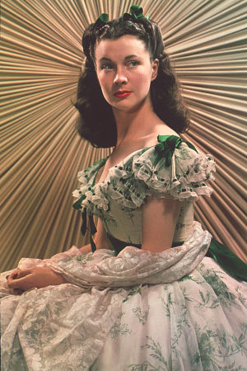
Motivation: Descriptive Text for Images
“It was an arresting face, pointed of chin, square of jaw. Her eyes were pale green without a touch of hazel, starred with bristly black lashes and slightly tilted at the ends. Above them, her thick black brows slanted upward, cutting a startling oblique line in her magnolia-white skin–that skin so prized by Southern women and so carefully guarded with bonnets, veils and mittens against hot Georgia suns”
Scarlett O’Hara described in Gone with the Wind
Tamara Berg
Notes:
People sometimes produce very vivid and richly informative descriptions about the visual world. For example, here the writer says “it was an arresting face, pointed of chin, …”

Slide 4
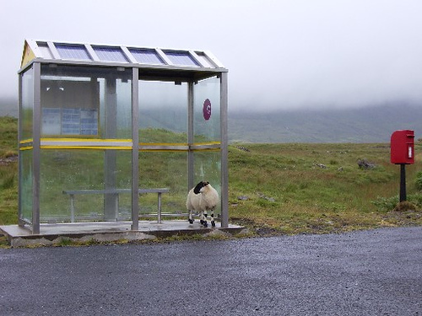
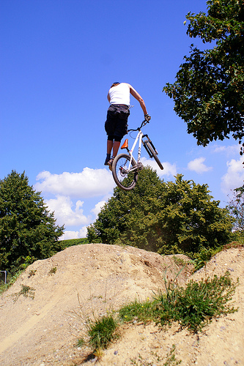
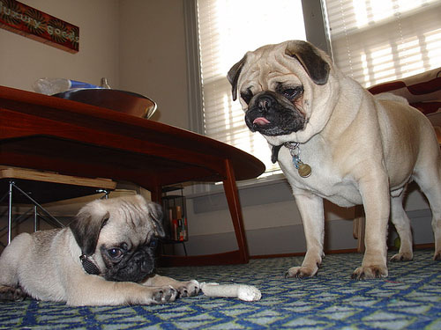
Some pre-RNN good results
This is a picture of one sky, one road and one sheep. The gray sky is over the gray road. The gray sheep is by the gray road.
Here we see one road, one sky and one bicycle. The road is near the blue sky, and near the colorful bicycle. The colorful bicycle is within the blue sky.
This is a picture of two dogs. The first dog is near the second furry dog.
Kulkarni et al., CVPR 2011
Notes:
This is a picture of one sky, one road…

Slide 5
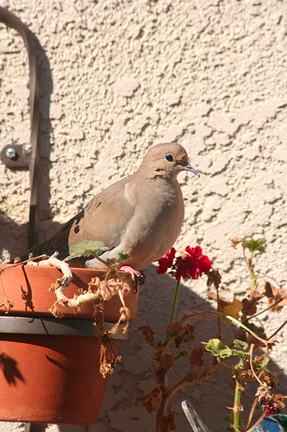
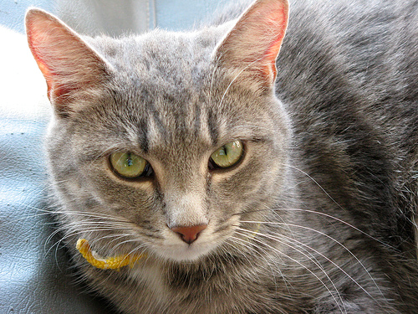
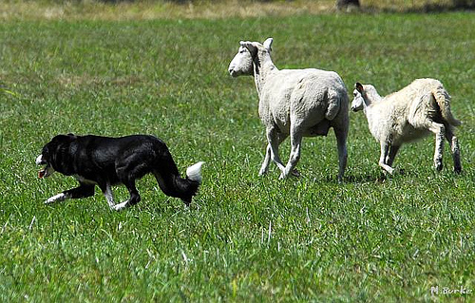
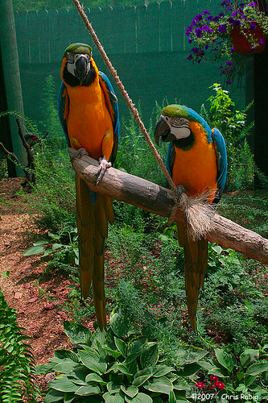
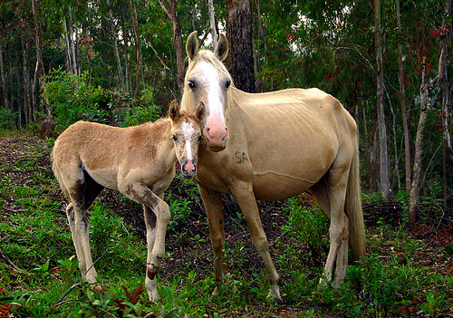
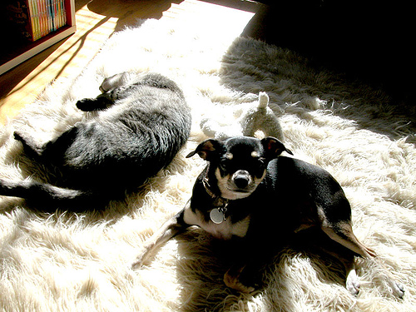
Some pre-RNN bad results
Missed detections:
False detections:
Incorrect attributes:
There are one road and one cat. The furry road is in the furry cat.
This is a photograph of two sheeps and one grass. The first black sheep is by the green grass, and by the second black sheep. The second black sheep is by the green grass.
Here we see one potted plant.
This is a picture of one tree, one road and one person. The rusty tree is under the red road. The colorful person is near the rusty tree, and under the red road.
This is a photograph of two horses and one grass. The first feathered horse is within the green grass, and by the second feathered horse. The second feathered horse is within the green grass.
This is a picture of one dog.
Kulkarni et al., CVPR 2011
Notes:
Of course it doesn’t always work!
Some common mistakes are: missing detections, false detections,
Incorrectly predicted attributes.

Slide 6
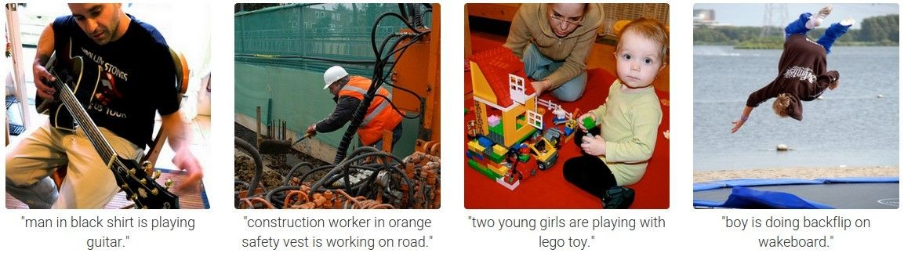
Results with Recurrent Neural Networks
Karpathy and Fei-Fei, CVPR 2015

Slide 7
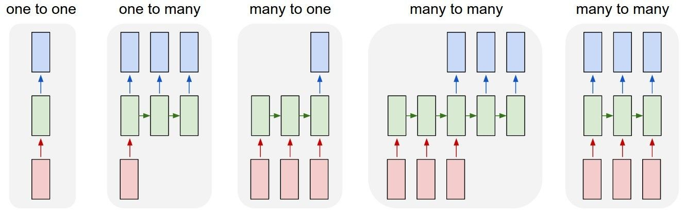
Recurrent Networks offer a lot of flexibility:
vanilla neural networks
Andrej Karpathy

Slide 8
Recurrent Networks offer a lot of flexibility:
e.g. image captioning
image -> sequence of words
Andrej Karpathy

Slide 9
Recurrent Networks offer a lot of flexibility:
e.g. sentiment classification
sequence of words -> sentiment
Andrej Karpathy

Slide 10
Recurrent Networks offer a lot of flexibility:
e.g. machine translation
seq of words -> seq of words
Andrej Karpathy

Slide 11
Recurrent Networks offer a lot of flexibility:
e.g. video classification on frame level
Andrej Karpathy

Slide 12
Recurrent Neural Network
RNN
RNN
x
Andrej Karpathy

Slide 13
Recurrent Neural Network
y
usually want to output a prediction at some time steps
RNN
x
Adapted from Andrej Karpathy

Slide 14

Recurrent Neural Network
We can process a sequence of vectors x by applying a recurrence formula at every time step:
y
RNN
new state
old state input vector at
some time step
some function
with parameters W
x
Andrej Karpathy

Slide 15
Recurrent Neural Network
We can process a sequence of vectors x by applying a recurrence formula at every time step:
y
RNN
Notice: the same function and the same set of parameters are used at every time step.
x
Andrej Karpathy

Slide 16

(Vanilla) Recurrent Neural Network
The state consists of a single “hidden” vector h:
y
RNN
x
Andrej Karpathy

Slide 17
Character-level language model example
Example
RNN
x
y
Vocabulary: [h,e,l,o]
Example training sequence: “hello”
Andrej Karpathy

Slide 18
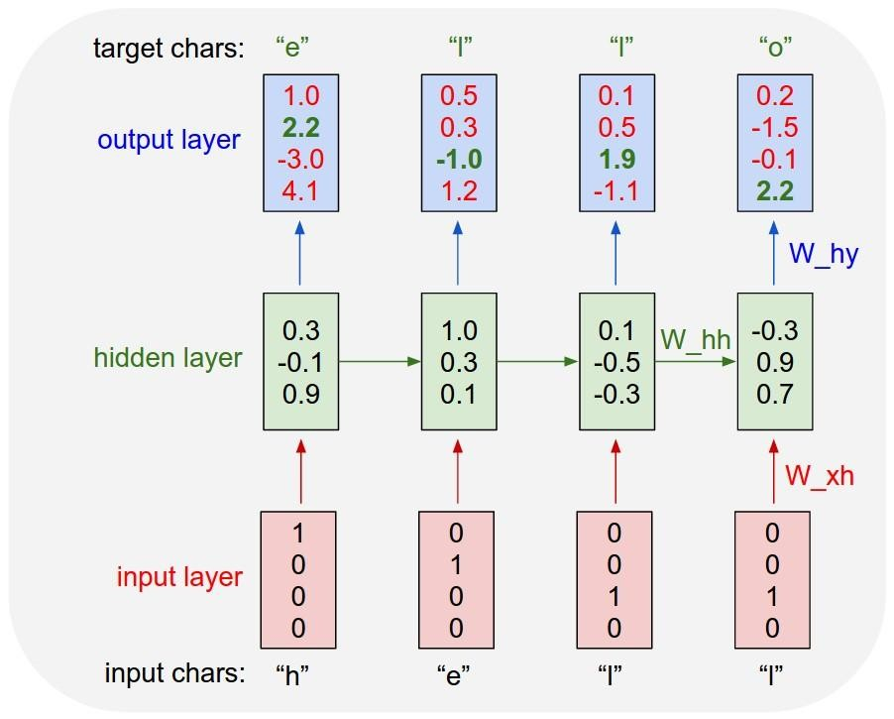
Example
Character-level language model example
Vocabulary: [h,e,l,o]
Example training sequence: “hello”
Andrej Karpathy

Slide 19
Example
Character-level language model example
Vocabulary: [h,e,l,o]
Example training sequence: “hello”
Andrej Karpathy

Slide 20
Example
Character-level language model example
Vocabulary: [h,e,l,o]
Example training sequence: “hello”
Andrej Karpathy

Slide 21
Extensions
Vanishing gradient problem makes it hard to model long sequences
  Multiplying together many values between 0 and 1 (range of gradient of sigmoid, tanh)
One solution: Use RELU
Another solution: Use RNNs with gates
  Adaptively decide how much of memory to keep
  Gated Recurrent Units (GRUs), Long Short Term Memories (LSTMs)

Slide 22
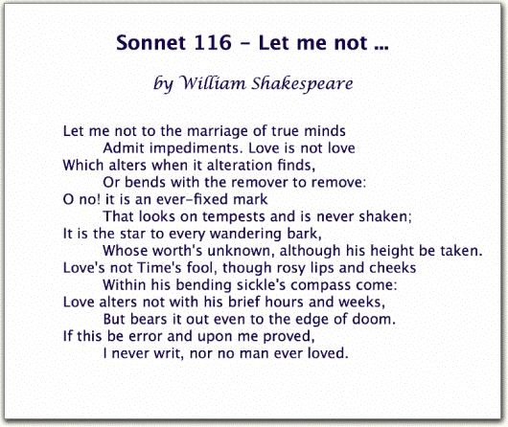
Generating poetry with RNNs
Fei-Fei Li & Andrej Karpathy & Justin Johnson Lecture 10 - 8 Feb 2016
Lecture 10 -
35
Andrej Karpathy

Slide 23
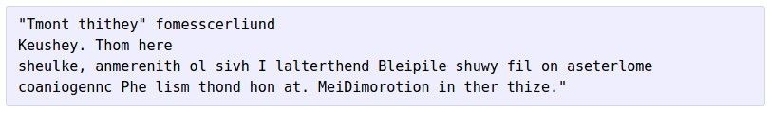


at first:
Generating poetry with RNNs
train more
train more
train more
Fei-Fei Li & Andrej Karpathy & Justin Johnson Lecture 10 - 8 Feb 2016
Lecture 10 -
36
More info: http://karpathy.github.io/2015/05/21/rnn-effectiveness/
Andrej Karpathy

Slide 24
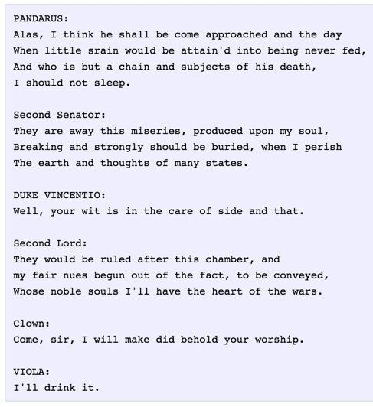
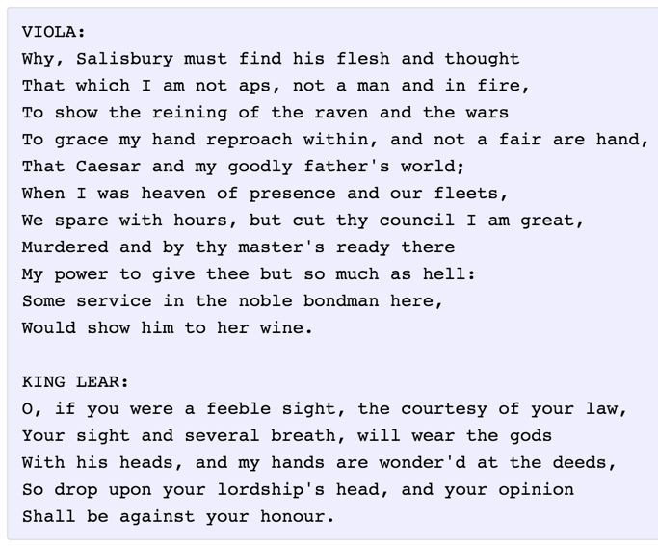
Generating poetry with RNNs
Fei-Fei Li & Andrej Karpathy & Justin Johnson Lecture 10 - 8 Feb 2016
Lecture 10 -
37
Andrej Karpathy

Slide 25
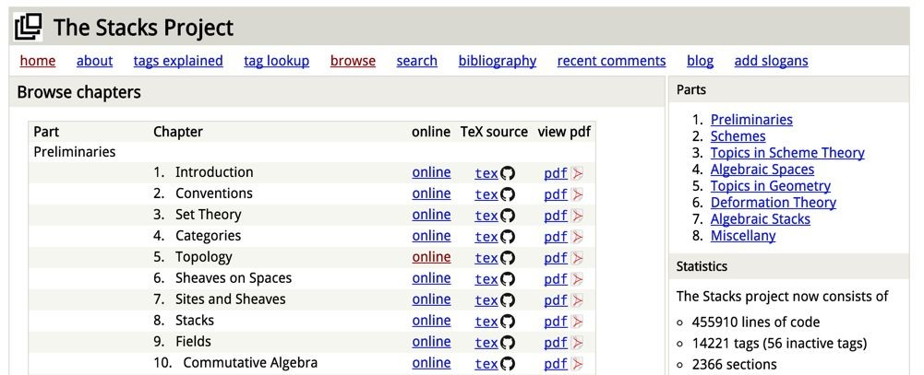
open source textbook on algebraic geometry
Generating textbooks with RNNs
Latex source
Fei-Fei Li & Andrej Karpathy & Justin Johnson Lecture 10 - 8 Feb 2016
Lecture 10 -
38
Andrej Karpathy

Slide 26
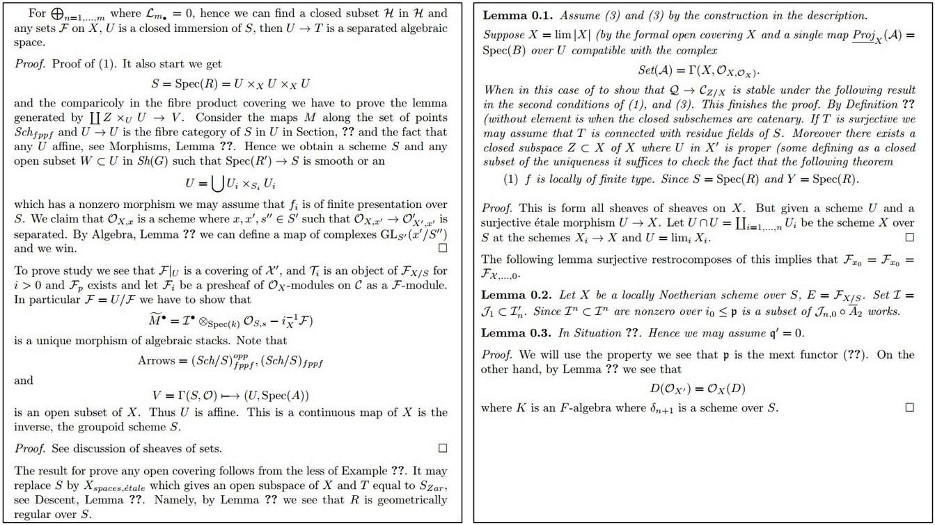
Generating textbooks with RNNs
Fei-Fei Li & Andrej Karpathy & Justin Johnson Lecture 10 - 8 Feb 2016
Lecture 10 -
39
Andrej Karpathy

Slide 27
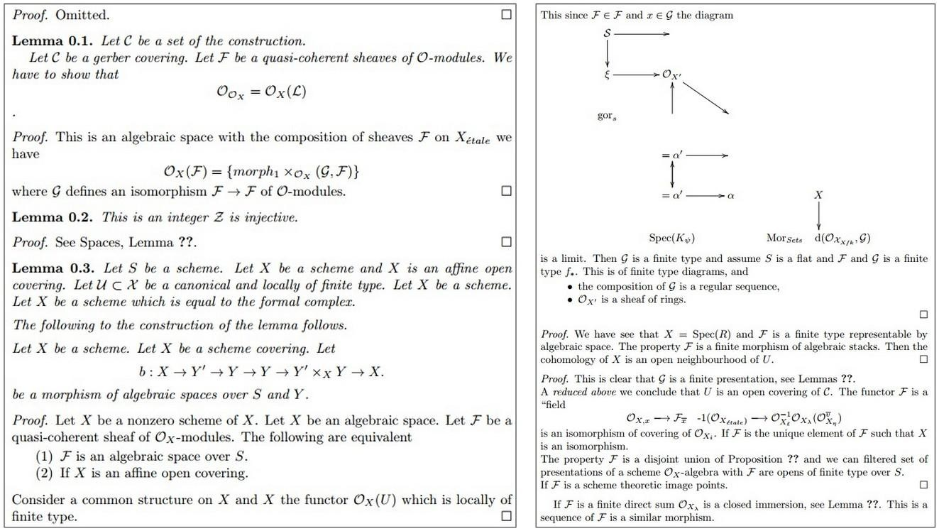
Generating textbooks with RNNs
Fei-Fei Li & Andrej Karpathy & Justin Johnson Lecture 10 - 8 Feb 2016
Lecture 10 -
40
Andrej Karpathy

Slide 28
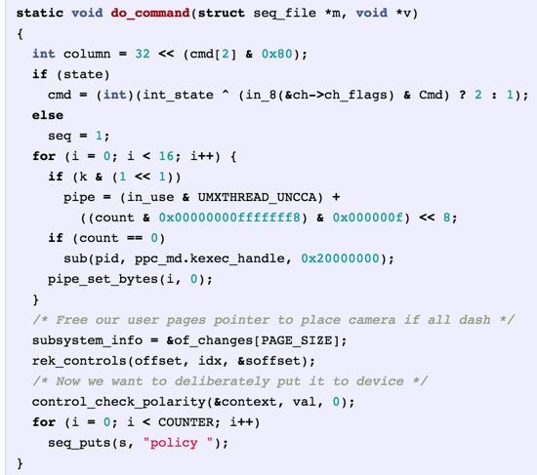
Generated C code
Generating code with RNNs
Fei-Fei Li & Andrej Karpathy & Justin Johnson Lecture 10 - 8 Feb 2016
Lecture 10 -
42
Andrej Karpathy

Slide 29
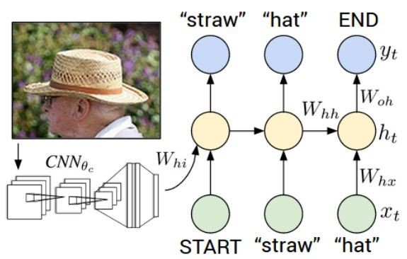
Image Captioning
CVPR 2015:
Deep Visual-Semantic Alignments for Generating Image Descriptions, Karpathy and Fei-Fei Show and Tell: A Neural Image Caption Generator, Vinyals et al.
Long-term Recurrent Convolutional Networks for Visual Recognition and Description, Donahue et al. Learning a Recurrent Visual Representation for Image Caption Generation, Chen and Zitnick
Adapted from Andrej Karpathy

Slide 30
Recurrent Neural Network
Image Captioning
Convolutional Neural Network
Andrej Karpathy

Slide 31
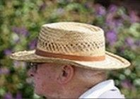
test image
Image Captioning
Andrej Karpathy

Slide 32
test image
Andrej Karpathy

Slide 33
test image
X
Andrej Karpathy

Slide 34
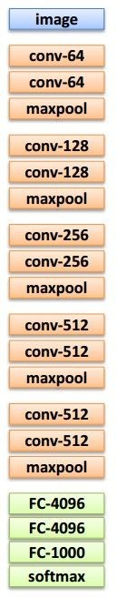
test image
Image Captioning
x0
<START>
<START>
Andrej Karpathy

Slide 35
Image Captioning
test image
y0
before:
h = tanh(W_{xh} * x + W_{hh} * h)
h0
Wih
now:
h = tanh(W_{xh} * x + W_{hh} * h + W_{ih} * im)
x0
<START>
im
<START>
Andrej Karpathy

Slide 36
test image
Image Captioning
y0
sample!
h0
x0
<START>
straw
<START>
Andrej Karpathy

Slide 37
test image
Image Captioning
y0
y1
h0
h1
x0
<START>
straw
<START>
Andrej Karpathy

Slide 38
test image
Image Captioning
y0
y1
sample!
h0
h1
x0
<START>
straw
hat
<START>
Andrej Karpathy

Slide 39
test image
Image Captioning
y0
y1
y2
h0
h1
h2
x0
<START>
straw
hat
<START>
Andrej Karpathy

Slide 40
test image
Image Captioning
Caption generated:
“straw hat”
y0
y1
y2
sample
<END> token
=> finish.
h0
h1
h2
x0
<START>
straw
hat
<START>
Adapted from Andrej Karpathy

Slide 41
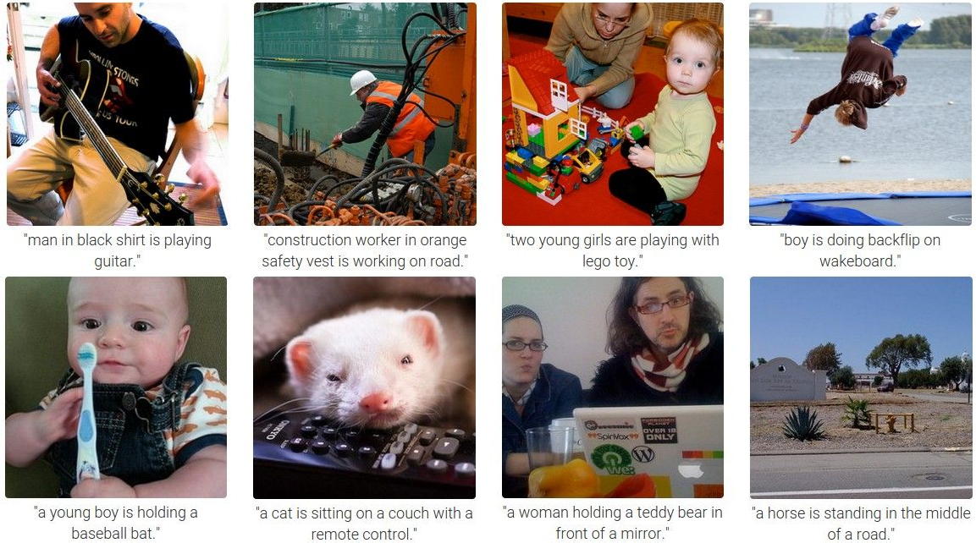
Image Captioning
Andrej Karpathy

Slide 42
Plan for this lecture
Language and vision
  Image captioning
  Tool: Recurrent neural networks
  Video captioning
  Visual question answering
Motion and video
  Modeling and replicating motion
  Tracking how an object moves

Slide 43
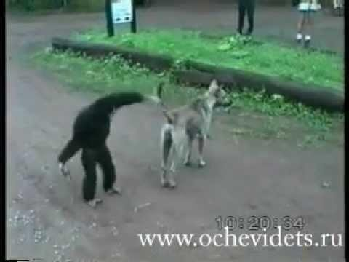
Generate descriptions for events depicted in video clips
Video Captioning
A monkey pulls a dog’s tail and is chased by the dog.
Venugopalan et al., “Translating Videos to Natural Language using Deep Recurrent Neural Networks”, NAACL-HTL 2015

Slide 44


Video Captioning
English Sentence
RNN
encoder
RNN
decoder
French Sentence
[Sutskever et al. NIPS’14]
RNN
decoder
[Donahue et al. CVPR’15] [Vinyals et al. CVPR’15]
Encode
Sentence
RNN
decoder
Encode
Sentence
[Venugopalan et. al. NAACL’15] (this work)
Key Insight:
Generate feature representation of the video and “decode” it to a sentence
Venugopalan et al., “Translating Videos to Natural Language using Deep Recurrent Neural Networks”, NAACL-HTL 2015

Slide 45
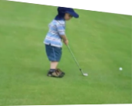
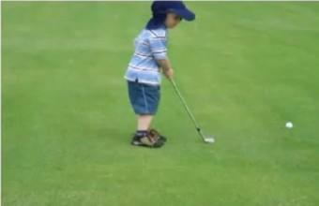
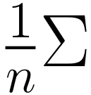

Video Captioning
CNN
Input
Video
Forward propagate Output: “fc7” features
(activations before classification layer)
Sample frames
@1/10
fc7: 4096 dimension “feature vector”
Venugopalan et al., “Translating Videos to Natural Language using Deep Recurrent Neural Networks”, NAACL-HTL 2015

Slide 46
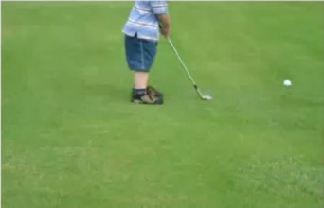
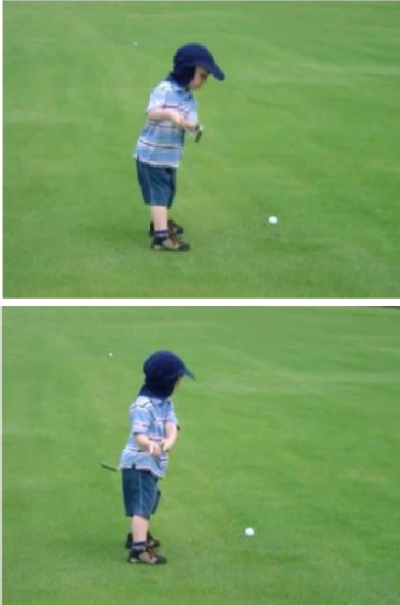
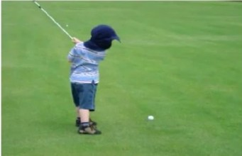
Video Captioning
Input Video
Convolutional Net Recurrent Net
LSTM LSTM
LSTM LSTM
LSTM LSTM
LSTM LSTM
LSTM LSTM
LSTM LSTM
Output
A
boy
. .
.
is
playing
golf
<EOS>
Mean across all frames
Venugopalan et al., “Translating Videos to Natural Language using Deep Recurrent Neural Networks”, NAACL-HTL 2015

Slide 47
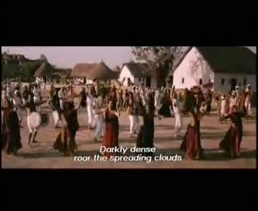
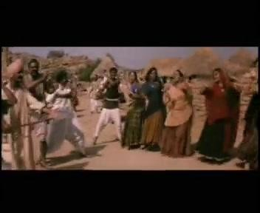
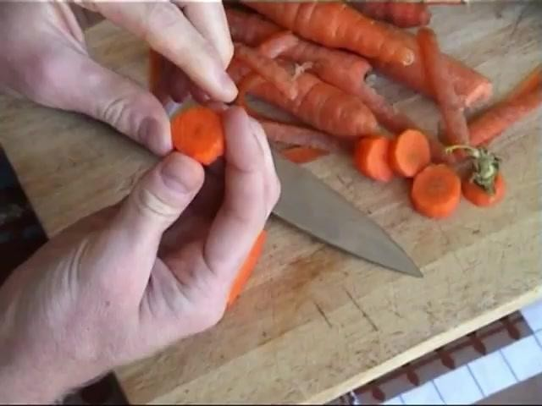
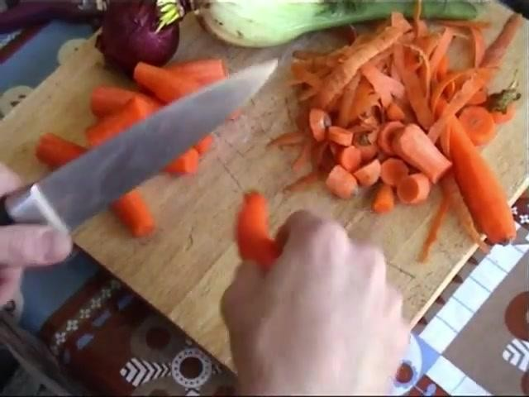
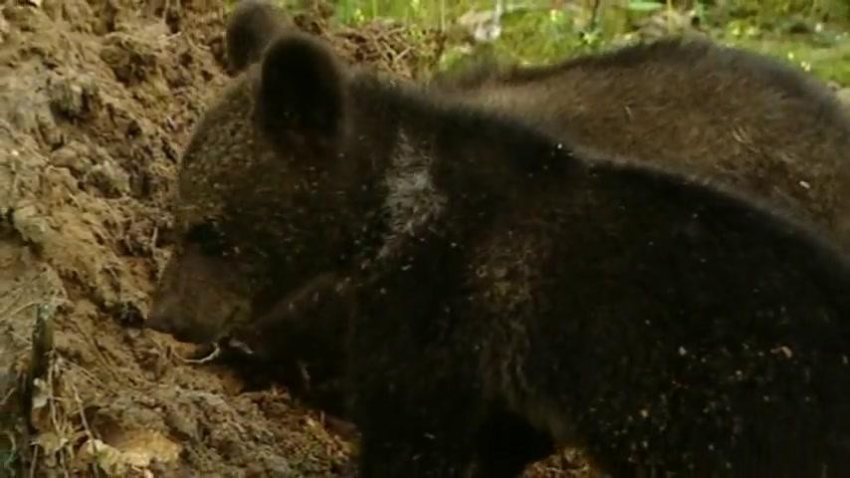
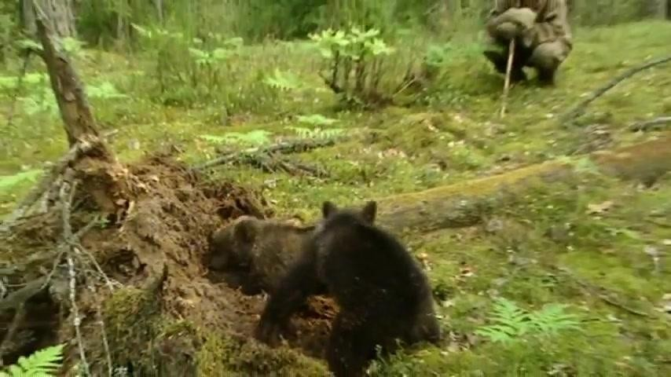
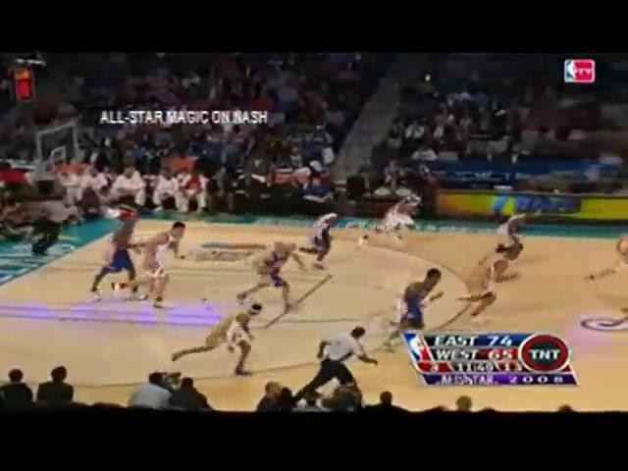
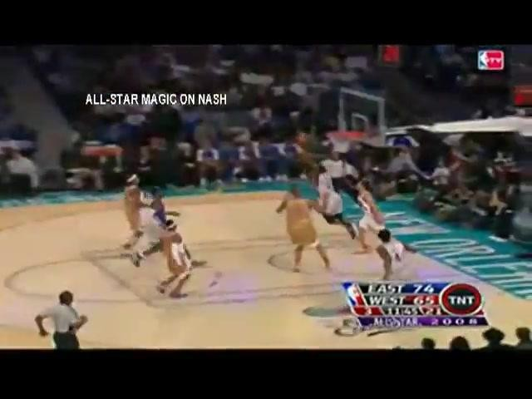
Video Captioning
FGM: A person is dancing with the person on the stage. YT: A group of men are riding the forest.
I+V: A group of people are dancing.
GT: Many men and women are dancing in the street.
FGM: A person is cutting a potato in the kitchen. YT: A man is slicing a tomato.
I+V: A man is slicing a carrot.
GT: A man is slicing carrots.
FGM: A person is walking with a person in the forest. YT: A monkey is walking.
I+V: A bear is eating a tree.
GT: Two bear cubs are digging into dirt and plant matter at the base of a tree.
FGM: A person is riding a horse on the stage. YT: A group of playing are playing in the ball. I+V: A basketball player is playing.
GT: Dwayne wade does a fancy layup in an allstar game.
Venugopalan et al., “Translating Videos to Natural Language using Deep Recurrent Neural Networks”, NAACL-HTL 2015

Slide 48

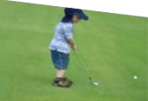
Video Captioning
English Sentence
RNN
encoder
RNN
decoder
French Sentence
[Sutskever et al. NIPS’14]
RNN
decoder
[Donahue et al. CVPR’15] [Vinyals et al. CVPR’15]
Encode
Sentence
RNN
decoder
Encode
Sentence
[Venugopalan et. al. NAACL’15]
Encode
RNN
encoder
RNN
decoder
Sentence
[Venugopalan et. al. ICCV’ 15] (this work)
3
Venugopalan et al., “Sequence to Sequence - Video to Text”, ICCV 2015

Slide 49
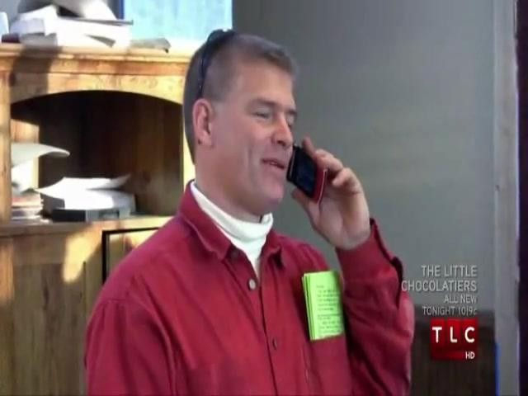
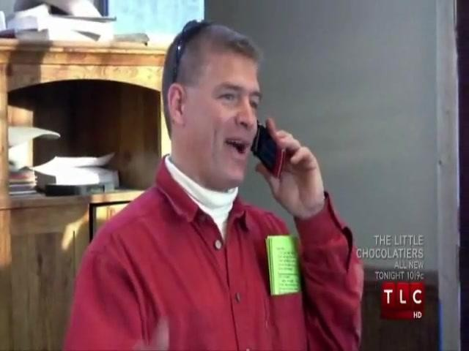
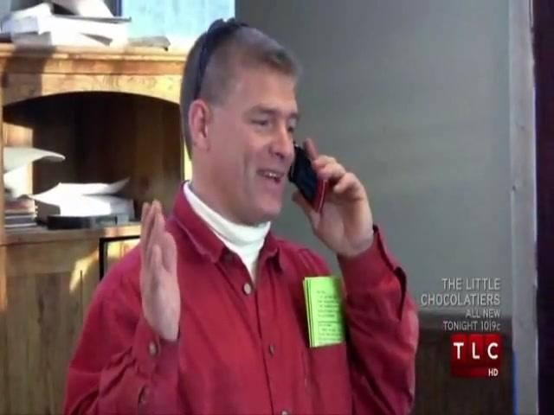
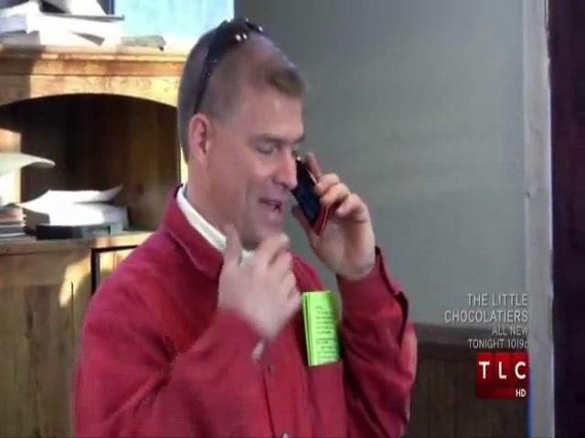
S2VT Overview
Video Captioning
CNN
CNN
CNN
CNN
Now decode it to a sentence!
LSTM
LSTM
LSTM
LSTM
LSTM
LSTM
LSTM
LSTM
...
LSTM
LSTM
LSTM
LSTM
LSTM
LSTM
LSTM
LSTM
Encoding stage
A
man
is
talking ...
Decoding stage
Venugopalan et al., “Sequence to Sequence - Video to Text”, ICCV 2015

Slide 50
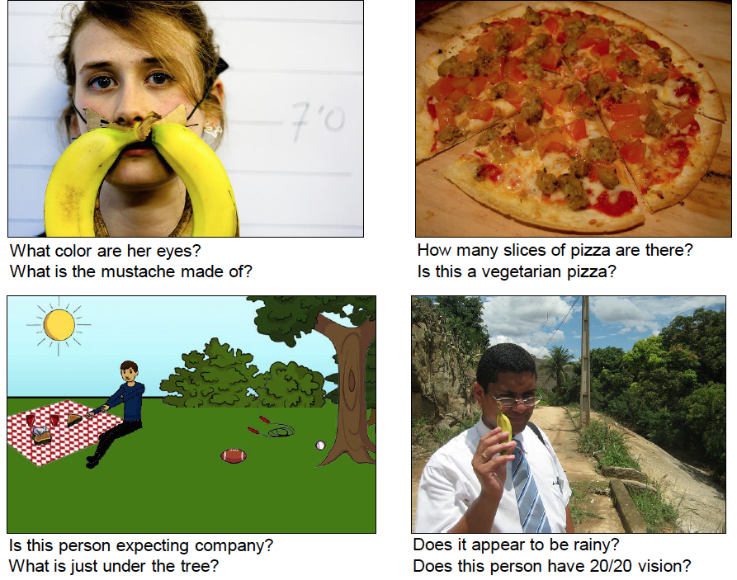
Visual Question Answering (VQA)
Task: Given an image and a natural language open-ended question, generate a natural language answer.
Agrawal et al., “VQA: Visual Question Answering”, ICCV 2015

Slide 51
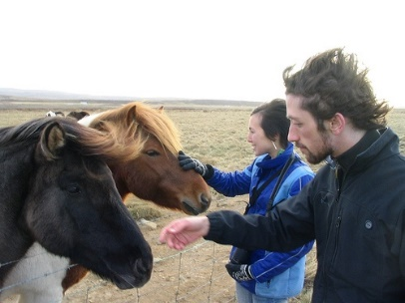
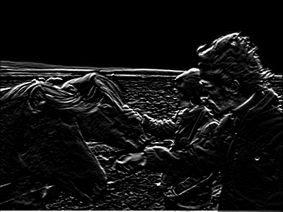
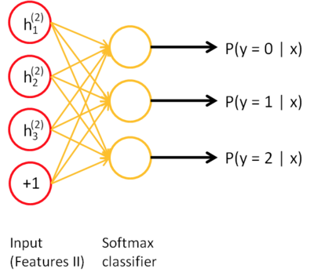
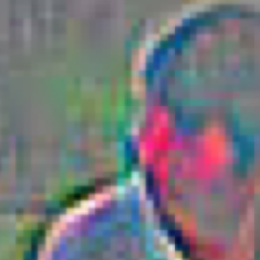
Visual Question Answering (VQA)
Neural Network
Softmax
over top K answers
Image
Embedding
4096-dim
Convolution Layer
+ Non-Linearity
Pooling Layer
Convolution Layer
+ Non-Linearity
Pooling Layer
Fully-Connected
Embedding
Question
“How many horses are in this image?”
1024-dim
LSTM
Agrawal et al., “VQA: Visual Question Answering”, ICCV 2015

Slide 52

Visual Question Answering (VQA)
Wu et al., “Ask Me Anything: Free-Form Visual Question Answering Based on Knowledge From External Sources”, CVPR 2016

Slide 53

Visual Question Answering (VQA)
Agrawal et al., “VQA: Visual Question Answering”, ICCV 2015

Slide 54

Reasoning for VQA
Andreas et al., “Neural Module Networks”, CVPR 2016

Slide 55

Reasoning for VQA
Johnson et al., “Inferring and Executing Programs for Visual Reasoning”, ICCV 2017

Slide 56
Plan for this lecture
Language and vision
  Image captioning
  Tool: Recurrent neural networks
  Video captioning
  Visual question answering
Motion and video
  Modeling and replicating motion
  Tracking how an object moves

Slide 57

Motion: Why is it useful?
Derek Hoiem

Slide 58
Motion: Why is it useful?
Even “impoverished” motion data can evoke a strong percept
G. Johansson, “Visual Perception of Biological Motion and a Model For Its Analysis", Perception and Psychophysics 14, 201-211, 1973.
Derek Hoiem

Slide 59

Modeling Motion: Optical Flow
Walker et al., “Dense Optical Flow Prediction from a Static Scene”, ICCV 2015

Slide 60


Transferring Motion
Optical flow in generated video
Optical flow in source video
Key idea: Generate videos with similar flow patterns as source videos (+ many details).
Thomas, Song and Kovashka, in submission to ECCV 2018

Slide 61







Transferring Motion
Thomas, Song and Kovashka, in submission to ECCV 2018

Slide 62








Transferring Motion
Baking
Blooming
Thomas, Song and Kovashka, in submission to ECCV 2018

Slide 63





Tracking: some applications
Body pose tracking, activity recognition
Censusing a bat population
Video-based interfaces
Medical apps
Surveillance
Kristen Grauman

Slide 64
Tracking examples
Traffic: https://www.youtube.com/watch?v=DiZHQ4peqjg
Soccer: http://www.youtube.com/watch?v=ZqQIItFAnxg
Face: http://www.youtube.com/watch?v=i_bZNVmhJ2o
Body: https://www.youtube.com/watch?v=_Ahy0Gh69-M
Eye: http://www.youtube.com/watch?v=NCtYdUEMotg
Gaze: http://www.youtube.com/watch?v=-G6Rw5cU-1c
Amin Sadeghi

Slide 65

Things that make visual tracking difficult
Erratic movements, moving very quickly
Occlusions, leaving and coming back
Surrounding similar-looking objects
Adapted from Amin Sadeghi

Slide 66
Strategies for tracking
Tracking by repeated detection
  Works well if object is easily detectable (e.g., face or colored glove) and there is only one
  Need some way to link up detections
  Best you can do, if you can’t predict motion
Amin Sadeghi

Slide 67

Strategies for tracking
Tracking w/ dynamics: Using model of expected motion, predict object location in next frame
  Restrict search for the object
  Measurement noise is reduced by trajectory smoothness
  Robustness to missing or weak observations
  Assumptions: Camera is not moving instantly to new viewpoint, objects do not disappear/reappear in different places in the scene
Amin Sadeghi

Slide 68




Detection vs. tracking
…
t=1
t=2
t=20
t=21
Kristen Grauman

Slide 69
Detection vs. tracking
…
Detection: We detect the object independently in each frame and can record its position over time, e.g., based on detection window coordinates
Adapted from Kristen Grauman

Slide 70
Detection vs. tracking
…
Tracking with dynamics: We use image measurements to estimate position of object, but also incorporate position predicted by dynamics, i.e., our expectation of the object’s motion pattern
Kristen Grauman

Slide 71
Tracking: prediction + correction
Time t
Time t+1
Belief
Measurement
Corrected prediction
Kristen Grauman

Slide 72



Tracking: prediction + correction
measurement
belief: prediction
belief: prediction
corrected prediction
measurement
old belief
Time t
Time t+1
Kristen Grauman

Slide 73

General model for tracking
State X: The actual state of the moving object that we want to estimate but cannot observe
  E.g. position, velocity
Observations Y: Our actual measurement or observation of state X, which can be very noisy
At each time t, the state changes to X_{t} and we get a new observation Y_{t}
Our goal is to recover the most likely state X_{t} given:
  All observations so far, i.e. y₁, y₂, …, y_{t}
  Knowledge about dynamics of state transitions
X₀
X₁
X₂
…
X_{t-1}
X_{t}
Y₀
Y₁
Y₂
Y_{t-1}
Y_{t}
Adapted from Amin Sadeghi and Kristen Grauman

Slide 74
Steps of tracking
Prediction: What is the next state of the object given past measurements?
…
Kristen Grauman

Slide 75
Steps of tracking
Prediction: What is the next state of the object given past measurements?
Correction: Compute an updated estimate of the state from prediction and measurements
…
…
Kristen Grauman

Slide 76
Problem statement
We have models for
  Likelihood of next state given current state (dynamics model):
  Likelihood of observation given the state (observation or measurement model):
We want to recover, for each t:
…
Amin Sadeghi

Slide 77
The Kalman filter
Linear dynamics model: state undergoes linear transformation plus Gaussian noise
Observation model: measurement is linearly transformed state plus Gaussian noise
The predicted/corrected state distributions are Gaussian
  You only need to maintain the mean and covariance
  The calculations are easy
Amin Sadeghi

Slide 78

Example: Constant velocity (1D points)
1 d position
1 d position
measurements
states
time
Kristen Grauman

Slide 79
Example: Constant velocity (1D points)
State vector: position p and velocity v
Measurement is position only
Kristen Grauman

Slide 80
Prediction and correction
See hidden slides
for derivation
Prediction:
Correction:
…
…
dynamics
model
corrected estimate
from previous step
t++
observation
model
predicted
estimate
…
…
…
Adapted from Amin Sadeghi

Slide 81

Example w/ constant velocity
Kalman filter processing
o state
x measurement
* predicted mean estimate
+ corrected mean estimate
bars: variance estimates
position
time
Adapted from Kristen Grauman
Time t
Time t+1

Slide 82
Example w/ constant velocity
Kalman filter processing
o state
x measurement
* predicted mean estimate
+ corrected mean estimate
bars: variance estimates
position
time
Adapted from Kristen Grauman
Time t
Time t+1

Slide 83
Example w/ constant velocity
Kalman filter processing
o state
x measurement
* predicted mean estimate
+ corrected mean estimate
bars: variance estimates
position
time
Adapted from Kristen Grauman
Time t
Time t+1

Slide 84
Example w/ constant velocity
Kalman filter processing
o state
x measurement
* predicted mean estimate
+ corrected mean estimate
bars: variance estimates
position
time
Adapted from Kristen Grauman
Time t
Time t+1

Slide 85
Example w/ constant velocity
Ground Truth
Observation
Correction
Amin Sadeghi

Slide 86
Simplifying assumptions
Only the immediate past matters
Measurements depend only on the current state
…
dynamics model
…
observation model
…
X₀
X₁
X₂
X_{t-1}
X_{t}
Y₀
Y₁
Y₂
Y_{t-1}
Y_{t}
Kristen Grauman

Slide 87

Prediction
Prediction involves representing
given
…
…
…
…
Law of total probability
Amin Sadeghi

Slide 88
Prediction
Prediction involves representing
given
…
…
…
…
…
…
Conditioning on X_{t–1}
Amin Sadeghi

Slide 89
Prediction
Prediction involves representing
given
…
…
…
…
…
…
…
Independence assumption (only immediate past state matters)
Adapted from Amin Sadeghi

Slide 90
Prediction
Prediction involves representing
given
…
…
…
…
…
…
…
dynamics
model
corrected estimate
from previous step
Amin Sadeghi

Slide 91
Correction
Correction involves computing
given predicted value
…
…
Amin Sadeghi

Slide 92

Correction
Correction involves computing
given predicted value
…
…
…
…
…
…
Bayes’ Rule
Amin Sadeghi

Slide 93
Correction
Correction involves computing
given predicted value
…
…
…
…
…
…
…
…
Independence assumption
(observation y_{t} directly depends only on state X_{t})
Amin Sadeghi

Slide 94
Correction
Correction involves computing
given predicted value
…
…
…
…
…
…
…
…
…
…
Law of total probability
Adapted from Amin Sadeghi

Slide 95
Correction
Correction involves computing
given predicted value
…
…
…
…
…
…
…
…
observation
model
predicted
estimate
…
…
normalization factor
Amin Sadeghi

