Slide 1
CS 1674: Intro to Computer Vision
Linear Algebra Review
Prof. Adriana Kovashka
University of Pittsburgh
January 11, 2018

Slide 2
What are images? (in Matlab)
Matlab treats images as matrices of numbers
To proceed, let’s talk very briefly about how images are formed

Slide 3
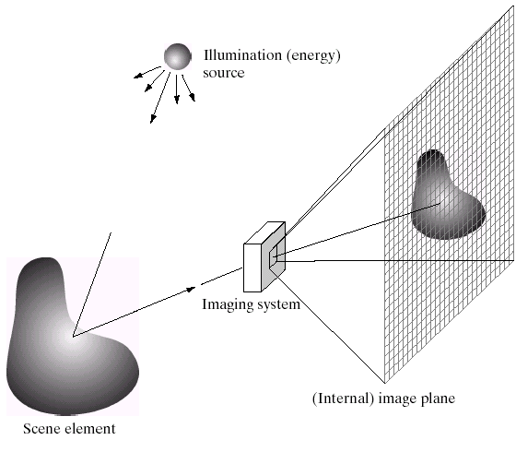
Image formation
(film)
Slide credit: Derek Hoiem

Slide 4

Digital camera
A digital camera replaces film with a sensor array
Each cell in the array is light-sensitive diode that converts photons to electrons
http://electronics.howstuffworks.com/cameras-photography/digital/digital-camera.htm
Slide by Steve Seitz

Slide 5
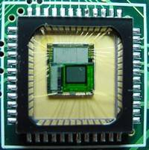
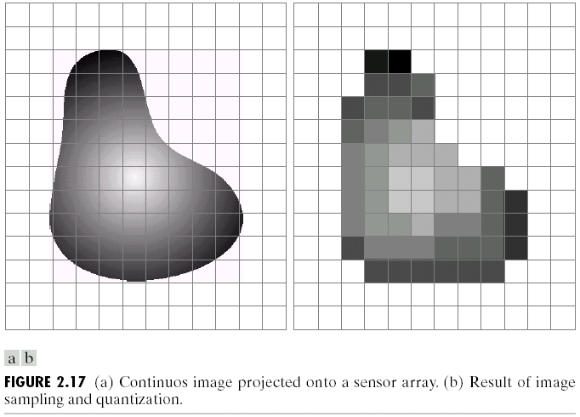
Digital images
Sample the 2D space on a regular grid
Quantize each sample (round to nearest integer)
Slide credit: Derek Hoiem, Steve Seitz

Slide 6
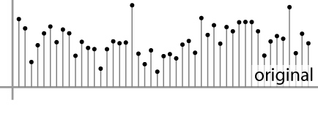

Digital images
Sample the 2D space on a regular grid
Quantize each sample (round to nearest integer)
What does quantizing signal look like?
Image thus represented as a matrix of integer values.
6 5
5.9 4.6
1D
2D
Adapted from S. Seitz

Slide 7
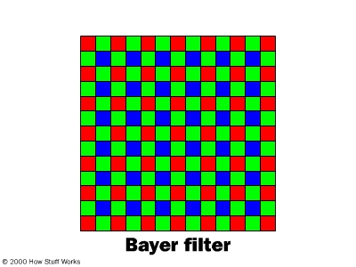
Digital color images
Slide credit: Kristen Grauman

Slide 8
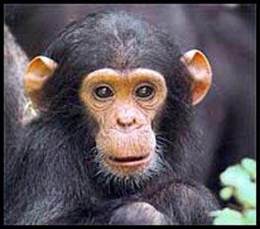
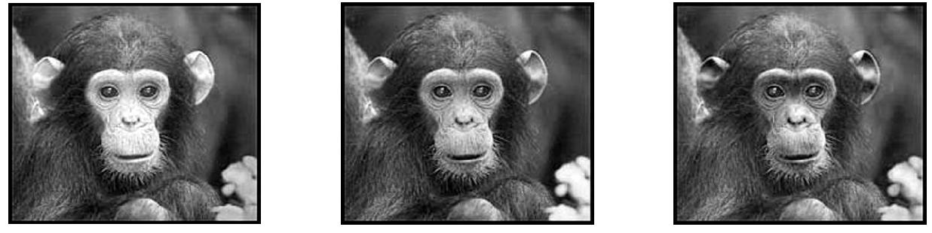
Digital color images
Color images, RGB color space:
Split image into three channels
R
G
B
Adapted from Kristen Grauman

Slide 9
Images in Matlab
Color images represented as a matrix with multiple channels (=1 if grayscale)
Suppose we have a NxM RGB image called “im”
  im(1,1,1) = top-left pixel value in R-channel
  im(y, x, b) = y pixels down, x pixels to right in the b^{th} channel
  im(N, M, 3) = bottom-right pixel in B-channel
imread(filename) returns a uint8 image (values 0 to 255)
  Convert to double format with double or im2double
column
row
R
0.92 | 0.93 | 0.94 | 0.97 | 0.62 | 0.37 | 0.85 | 0.97 | 0.93 | 0.92 | 0.99
0.95 | 0.89 | 0.82 | 0.89 | 0.56 | 0.31 | 0.75 | 0.92 | 0.81 | 0.95 | 0.91
0.89 | 0.72 | 0.51 | 0.55 | 0.51 | 0.42 | 0.57 | 0.41 | 0.49 | 0.91 | 0.92
0.96 | 0.95 | 0.88 | 0.94 | 0.56 | 0.46 | 0.91 | 0.87 | 0.90 | 0.97 | 0.95
0.71 | 0.81 | 0.81 | 0.87 | 0.57 | 0.37 | 0.80 | 0.88 | 0.89 | 0.79 | 0.85
0.49 | 0.62 | 0.60 | 0.58 | 0.50 | 0.60 | 0.58 | 0.50 | 0.61 | 0.45 | 0.33
0.86 | 0.84 | 0.74 | 0.58 | 0.51 | 0.39 | 0.73 | 0.92 | 0.91 | 0.49 | 0.74
0.96 | 0.67 | 0.54 | 0.85 | 0.48 | 0.37 | 0.88 | 0.90 | 0.94 | 0.82 | 0.93
0.69 | 0.49 | 0.56 | 0.66 | 0.43 | 0.42 | 0.77 | 0.73 | 0.71 | 0.90 | 0.99
0.79 | 0.73 | 0.90 | 0.67 | 0.33 | 0.61 | 0.69 | 0.79 | 0.73 | 0.93 | 0.97
0.91 | 0.94 | 0.89 | 0.49 | 0.41 | 0.78 | 0.78 | 0.77 | 0.89 | 0.99 | 0.93
G
0.92 | 0.93 | 0.94 | 0.97 | 0.62 | 0.37 | 0.85 | 0.97 | 0.93 | 0.92 | 0.99
0.95 | 0.89 | 0.82 | 0.89 | 0.56 | 0.31 | 0.75 | 0.92 | 0.81 | 0.95 | 0.91
0.89 | 0.72 | 0.51 | 0.55 | 0.51 | 0.42 | 0.57 | 0.41 | 0.49 | 0.91 | 0.92
0.96 | 0.95 | 0.88 | 0.94 | 0.56 | 0.46 | 0.91 | 0.87 | 0.90 | 0.97 | 0.95
0.71 | 0.81 | 0.81 | 0.87 | 0.57 | 0.37 | 0.80 | 0.88 | 0.89 | 0.79 | 0.85
0.49 | 0.62 | 0.60 | 0.58 | 0.50 | 0.60 | 0.58 | 0.50 | 0.61 | 0.45 | 0.33
0.86 | 0.84 | 0.74 | 0.58 | 0.51 | 0.39 | 0.73 | 0.92 | 0.91 | 0.49 | 0.74
0.96 | 0.67 | 0.54 | 0.85 | 0.48 | 0.37 | 0.88 | 0.90 | 0.94 | 0.82 | 0.93
0.69 | 0.49 | 0.56 | 0.66 | 0.43 | 0.42 | 0.77 | 0.73 | 0.71 | 0.90 | 0.99
0.79 | 0.73 | 0.90 | 0.67 | 0.33 | 0.61 | 0.69 | 0.79 | 0.73 | 0.93 | 0.97
0.91 | 0.94 | 0.89 | 0.49 | 0.41 | 0.78 | 0.78 | 0.77 | 0.89 | 0.99 | 0.93
B
0.92 | 0.93 | 0.94 | 0.97 | 0.62 | 0.37 | 0.85 | 0.97 | 0.93 | 0.92 | 0.99
0.95 | 0.89 | 0.82 | 0.89 | 0.56 | 0.31 | 0.75 | 0.92 | 0.81 | 0.95 | 0.91
0.89 | 0.72 | 0.51 | 0.55 | 0.51 | 0.42 | 0.57 | 0.41 | 0.49 | 0.91 | 0.92
0.96 | 0.95 | 0.88 | 0.94 | 0.56 | 0.46 | 0.91 | 0.87 | 0.90 | 0.97 | 0.95
0.71 | 0.81 | 0.81 | 0.87 | 0.57 | 0.37 | 0.80 | 0.88 | 0.89 | 0.79 | 0.85
0.49 | 0.62 | 0.60 | 0.58 | 0.50 | 0.60 | 0.58 | 0.50 | 0.61 | 0.45 | 0.33
0.86 | 0.84 | 0.74 | 0.58 | 0.51 | 0.39 | 0.73 | 0.92 | 0.91 | 0.49 | 0.74
0.96 | 0.67 | 0.54 | 0.85 | 0.48 | 0.37 | 0.88 | 0.90 | 0.94 | 0.82 | 0.93
0.69 | 0.49 | 0.56 | 0.66 | 0.43 | 0.42 | 0.77 | 0.73 | 0.71 | 0.90 | 0.99
0.79 | 0.73 | 0.90 | 0.67 | 0.33 | 0.61 | 0.69 | 0.79 | 0.73 | 0.93 | 0.97
0.91 | 0.94 | 0.89 | 0.49 | 0.41 | 0.78 | 0.78 | 0.77 | 0.89 | 0.99 | 0.93
Adapted from Derek Hoiem

Slide 10
Vectors and Matrices
Vectors and matrices are just collections of ordered numbers that represent something: movements in space, scaling factors, word counts, movie ratings, pixel brightnesses, etc.
We’ll define some common uses and standard operations on them.

Slide 11
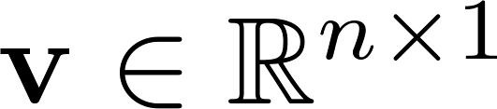
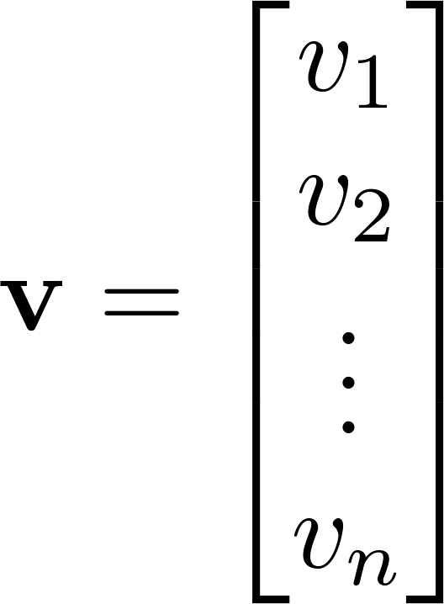
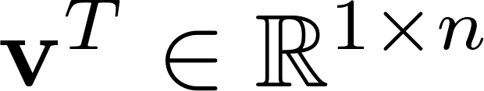
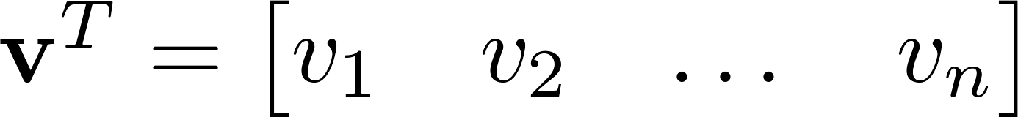

Vector
A column vector where
A row vector where
denotes the transpose operation

Slide 12
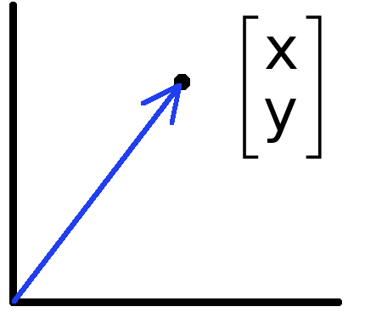
Vectors have two main uses
Data can also be treated as a vector
Such vectors don’t have a geometric interpretation, but calculations like “distance” still have value
Vectors can represent an offset in 2D or 3D space
Points are just vectors from the origin

Slide 13
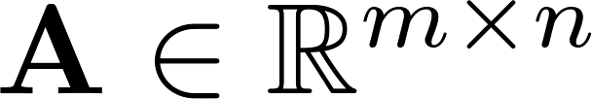
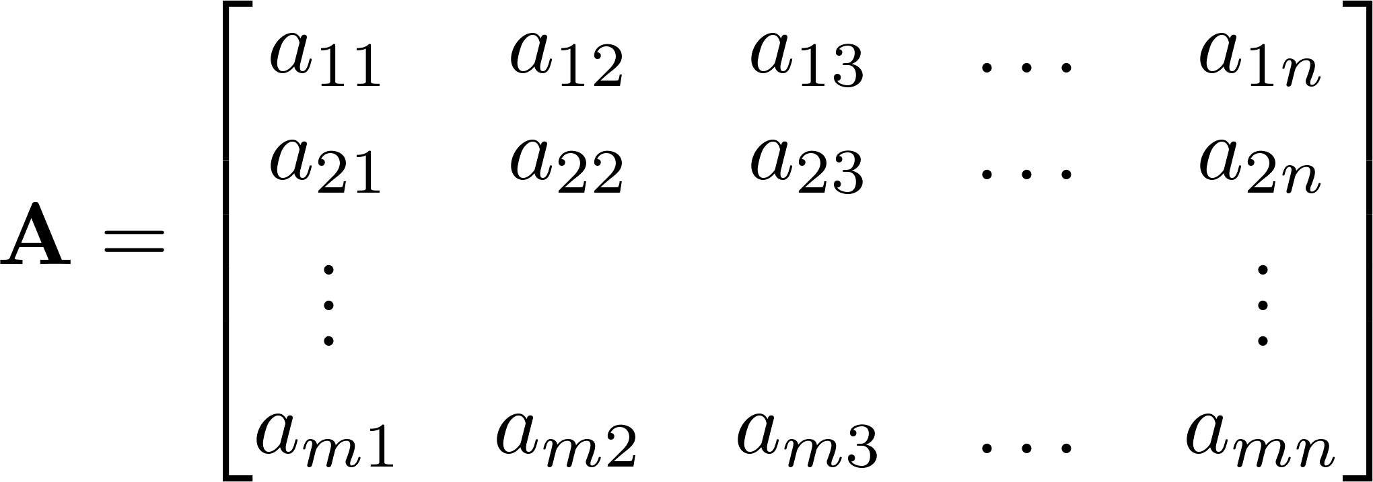



Matrix
A matrix is an array of numbers with size $m↓$ by $n→$, i.e. m rows and n columns.
If , we say that is square.

Slide 14
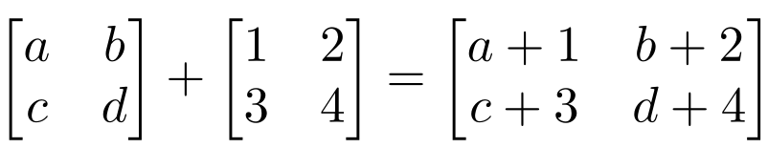
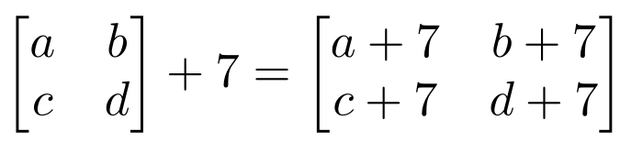
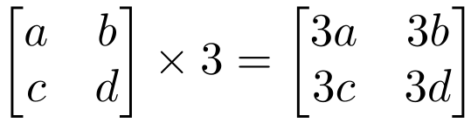
Matrix Operations
Addition
  Can only add matrices with matching dimensions, or a scalar to a matrix.
Scaling

Slide 15
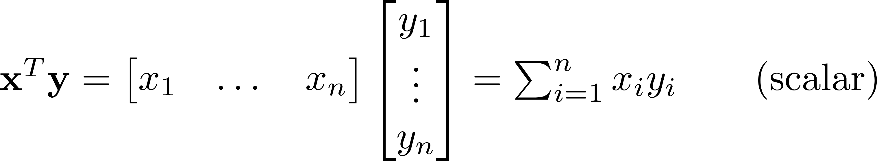
Matrix Operations
Inner product (dot · product) of vectors
  Multiply corresponding entries of two vectors and add up the result
  We won’t worry about the geometric interpretation for now

Slide 16
Inner vs outer vs matrix vs element-wise product
x, y = column vectors (nx1)
X, Y = matrices (mxn)
x, y = scalars (1x1)
x · y = x^{T} y = inner product (1xn x nx1 = scalar)
x ⊗ y = x y^{T} = outer product (nx1 x 1xn = matrix)
X * Y = matrix product
X .* Y = element-wise product

Slide 17
Matrix Multiplication
Let X be an axb matrix, Y be an bxc matrix
Then Z = X*Y is an axc matrix
Second dimension of first matrix, and first dimension of first matrix have to be the same, for matrix multiplication to be possible
Practice: Let X be an 10x5 matrix. Let’s factorize it into 3 matrices…

Slide 18
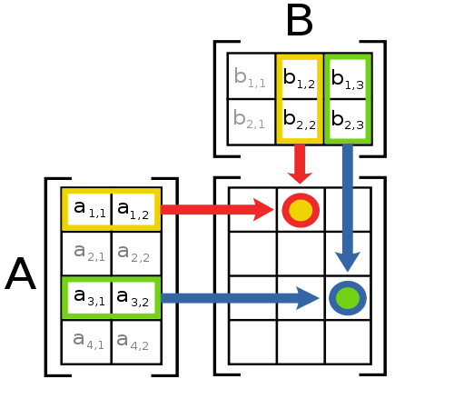
Matrix Operations
Multiplication
The product AB is:
Each entry in the result is (that row of A) dot product with (that column of B)

Slide 19
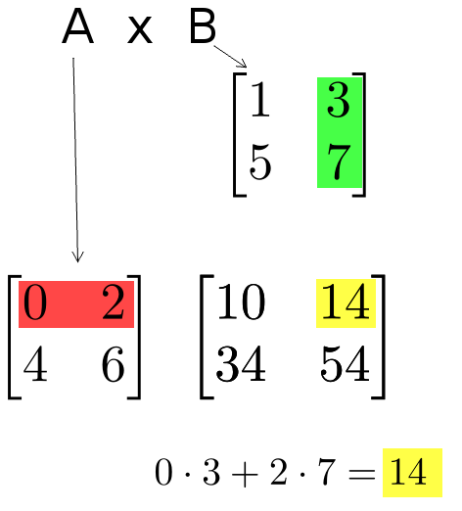
Matrix Operations
Multiplication example:
  Each entry of the matrix product is made by taking the dot product of the corresponding row in the left matrix, with the corresponding column in the right one.

Slide 20
Matrix Operation Properties
Matrix addition is commutative and associative
  A + B = B + A
  A + (B + C) = (A + B) + C
Matrix multiplication is associative and distributive but not commutative
  A(B*C) = (A*B)C
  A(B + C) = A*B + A*C
  A*B != B*A

Slide 21
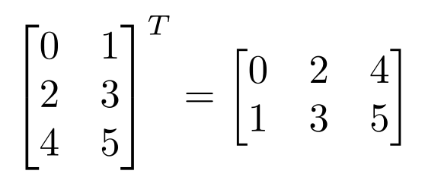
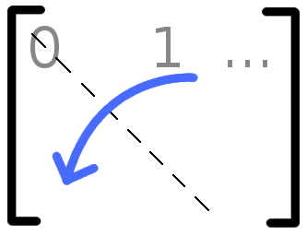

Matrix Operations
Transpose – flip matrix, so row 1 becomes column 1
A useful identity:

Slide 22
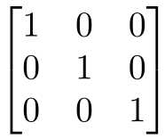
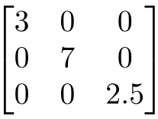
Special Matrices
Identity matrix I
  Square matrix, 1’s along diagonal, 0’s elsewhere
  I ∙ [another matrix] = [that matrix]
Diagonal matrix
  Square matrix with numbers along diagonal, 0’s elsewhere
  A diagonal ∙ [another matrix] scales the rows of that matrix

Slide 23
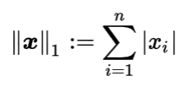
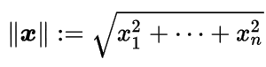
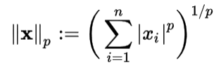
Norms
L1 norm
L2 norm
L^{p} norm (for real numbers p ≥ 1)

