Slide 1
CS 1674: Intro to Computer Vision
Final Review
Prof. Adriana Kovashka
University of Pittsburgh
December 7, 2016

Slide 2
Final info
Format: multiple-choice, true/false, fill in the blank, short answers, apply an algorithm
Non-cumulative
  I expect you to know how to do a convolution
Unlike last time, I’ll have one handout with the exam questions, and a separate one where you’re supposed to write the answers

Slide 3
Algorithms you should be able to apply
K-means – apply a few iterations to a small example
Mean-shift – to see where a single point ends up
Hough transform – write pseudocode only
Hough transform – how can we use it to find the parameters (matrix) of a transformation, when we have noisy examples?
Compute a Spatial Pyramid at level 1 (2x2 grid)
Formulate the SVM objective and constraints (in math) and explain it
Work through an example for zero-shot prediction
Boosting – show how to increase weights
Pedestrian detection – write high-level pseudocode

Slide 4
Algorithms … able to apply (cont’d)
Compute neural network activations
Compute SVM and softmax loss
Show how to use weights to compute loss
Show how to numerically compute gradient
Show one iteration of gradient descent (with gradient computed for you)
Apply convolution, RELU, max pooling
Compute output dimensions from convolution

Slide 5
Extra office hours
Monday, 3:30-5:30pm
Anyone for whom this does not work?

Slide 6
Requested topics
Convolutional neural networks (16 requests)
Hough transform (8)
Support vector machines (7)
Deformable part models (6)
Zero-shot learning (4)
Face detection (2)
Recurrent neural networks (2)
K-means / mean-shift (1)
Spatial pyramids (1)

Slide 7
Convolutional neural networks
Backpropagation + meaning of weights and how computed (5 requests)
Math for neural networks + computing activations (4)
Gradients + gradient descent (3)
Convolution/non-linearity/pooling + convolution output size + architectures (3)
Losses and finding weights that minimize them (2)
Minibatch – are the training examples cycled over more than once? (1)
Effect of number of neurons and regularization (1)

Slide 8
Neural networks

Slide 9
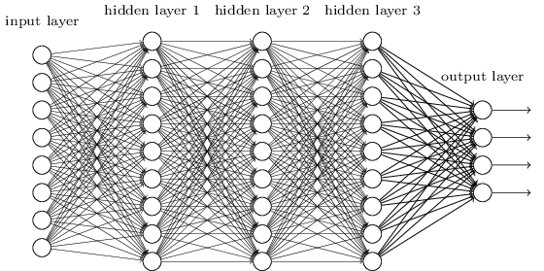
Deep neural network
Figure from http://neuralnetworksanddeeplearning.com/chap5.html

Slide 10
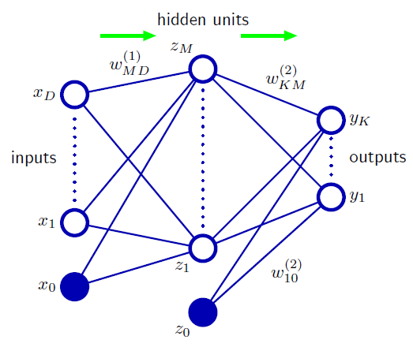



Neural network definition
Activations:
Nonlinear activation function h (e.g. sigmoid, tanh):
Outputs:
How can I write y₁ as a function of x₁ … x_{D}?
(binary)
(multiclass)
Figure from Christopher Bishop

Slide 11
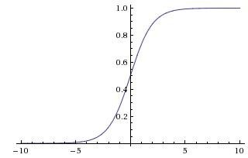

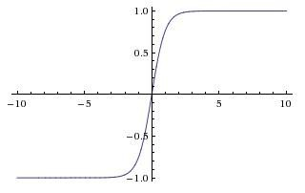
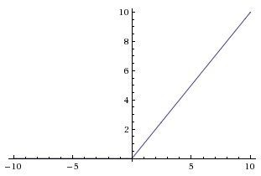
Activation functions
Sigmoid
tanh
tanh(x)
ReLU
max(0,x)
Adapted from Andrej Karpathy

Slide 12
Activation computation vs training
When do I need to compute activations?
How many times do I need to do that?
How many times do I need to train a network to extract features from it?
Activations: Forward propagation (start from inputs, compute activations from inputs to outputs)
Training: Backward propagation (compute a loss at the outputs, backpropagate error towards the inputs)

Slide 13
Backpropagation: Graphic example
First calculate error of output units and use this to change the top layer of weights.
output
k
j
i
Update weights into j
hidden
input
Adapted from Ray Mooney

Slide 14
Backpropagation: Graphic example
Next calculate error for hidden units based on errors on the output units it feeds into.
output
k
j
i
hidden
input
Adapted from Ray Mooney

Slide 15
Backpropagation: Graphic example
Finally update bottom layer of weights based on errors calculated for hidden units.
output
k
j
i
Update weights into i
hidden
input
Adapted from Ray Mooney

Slide 16

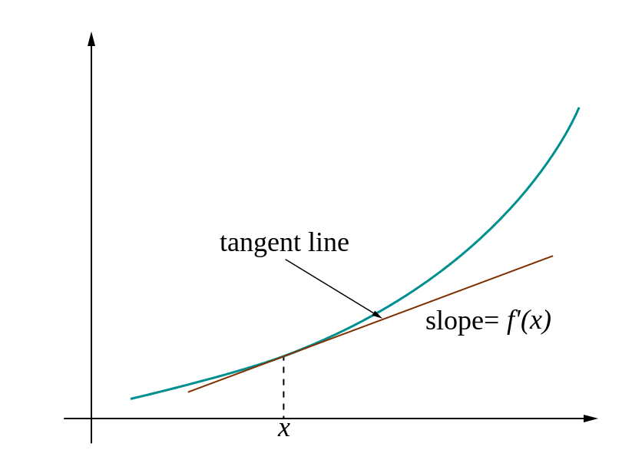
Loss gradients
Denoted as (diff notations):
i.e. how does the loss change as a function of the weights
We want to find those weights (change the weights in such a way) that makes the loss decrease as fast as possible

Slide 17
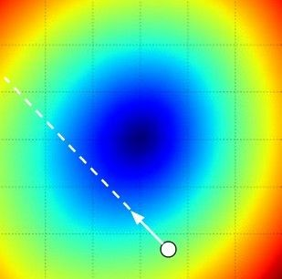
Gradient descent
We’ll update weights
Move in direction opposite to gradient:
L
Time
Learning rate
W_2
original W
W_1
negative gradient direction
Figure from Andrej Karpathy

Slide 18

Computing derivatives
In 1-dimension, the derivative of a function:
w
w
w
w
In multiple dimensions, the gradient is the vector of (partial derivatives).
Andrej Karpathy

Slide 19
Computing derivatives
current W:
gradient dW:
[0.34,
-1.11,
0.78,
0.12,
0.55,
2.81,
-3.1,
-1.5,
0.33,…]
loss 1.25347
[?,
?,
?,
?,
?,
?,
?,
?,
?,…]
Andrej Karpathy

Slide 20
Computing derivatives
current W:
W + h (first dim):
gradient dW:
[0.34,
-1.11,
0.78,
0.12,
0.55,
2.81,
-3.1,
-1.5,
0.33,…]
loss 1.25347
[0.34 + 0.0001,
-1.11,
0.78,
0.12,
0.55,
2.81,
-3.1,
-1.5,
0.33,…]
loss 1.25322
[?,
?,
?,
?,
?,
?,
?,
?,
?,…]
Andrej Karpathy

Slide 21
Computing derivatives
W + h (first dim):
current W:
gradient dW:
[0.34,
-1.11,
0.78,
0.12,
0.55,
2.81,
-3.1,
-1.5,
0.33,…]
loss 1.25347
[0.34 + 0.0001,
-1.11,
0.78,
0.12,
0.55,
2.81,
-3.1,
-1.5,
0.33,…]
loss 1.25322
[-2.5,
?,
?,
?,
?,
?,
?,
(1.25322 - 1.25347)/0.0001
= -2.5
?,
?,…]
Andrej Karpathy

Slide 22

How to formulate losses?
Losses depend on the prediction functions (scores), e.g. f_{W}(x) = 3.2 for class “cat”
One set of weights for each class!
The prediction functions (scores) depend on the inputs (x) and the model parameters (W)
Hence losses depend on W
E.g. for a linear classifier, scores are:
For a neural network:

Slide 23
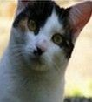
Linear classifier
3072x1
(+b)
10x1
10x1
10x3072
10 numbers, indicating class scores
[32x32x3]
array of numbers 0...1
parameters, or “weights”
Andrej Karpathy

Slide 24
Neural network
In the second layer of weights, one set of weights to compute the probability of each class

Slide 25


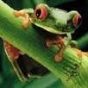




Linear classifier: SVM loss
Suppose: 3 training examples, 3 classes. With some W the scores
Multiclass SVM loss:
Given an example
are:
where where
is the image and
is the (integer) label,
and using the shorthand for the scores vector:
cat car frog
the SVM loss has the form:
3.2
5.1
-1.7
1.3
4.9
2.0
2.2
2.5
-3.1
Andrej Karpathy

Slide 26
Linear classifier: SVM loss
Suppose: 3 training examples, 3 classes. With some W the scores
Multiclass SVM loss:
Given an example
are:
where where
is the image and
is the (integer) label,
and using the shorthand for the scores vector:
the SVM loss has the form:
cat car frog | 3.2 5.1 -1.7 | 1.3 2.2 4.9 2.5 2.0 -3.1
Losses: | 2.9
= max(0, 5.1 - 3.2 + 1)
+max(0, -1.7 - 3.2 + 1)
= max(0, 2.9) + max(0, -3.9)
= 2.9 + 0
= 2.9
Andrej Karpathy

Slide 27
Linear classifier: SVM loss
Suppose: 3 training examples, 3 classes. With some W the scores
Multiclass SVM loss:
Given an example
are:
where where
is the image and
is the (integer) label,
and using the shorthand for the scores vector:
the SVM loss has the form:
cat 3.2 car 5.1 frog -1.7 | 1.3 4.9 2.0 | 2.2 2.5 -3.1
Losses: 2.9 | 0
= max(0, 1.3 - 4.9 + 1)
+max(0, 2.0 - 4.9 + 1)
= max(0, -2.6) + max(0, -1.9)
= 0 + 0
= 0
Andrej Karpathy

Slide 28
Linear classifier: SVM loss
Suppose: 3 training examples, 3 classes. With some W the scores
Multiclass SVM loss:
Given an example
are:
where where
is the image and
is the (integer) label,
and using the shorthand for the scores vector:
the SVM loss has the form:
cat car frog | 3.2 5.1 -1.7 | 1.3 4.9 2.0 | 2.2 2.5 -3.1
Losses: | 2.9 | 0 | 10.9
= max(0, 2.2 - (-3.1) + 1)
+max(0, 2.5 - (-3.1) + 1)
= max(0, 5.3) + max(0, 5.6)
= 5.3 + 5.6
= 10.9
Andrej Karpathy

Slide 29

Linear classifier: SVM loss
Suppose: 3 training examples, 3 classes. With some W the scores
Multiclass SVM loss:
Given an example
are:
where where
is the image and
is the (integer) label,
and using the shorthand for the scores vector:
cat car frog
the SVM loss has the form:
3.2
5.1
-1.7
1.3
4.9
2.0
2.2
2.5
-3.1
and the full training loss is the mean over all examples in the training data:
L = (2.9 + 0 + 10.9)/3
Losses:
2.9
0
10.9
= 4.6
Lecture 3 - 12
Andrej Karpathy

Slide 30
Linear classifier: SVM loss
Andrej Karpathy

Slide 31


Linear classifier: SVM loss
λ = regularization strength (hyperparameter)
Weight Regularization
In common use: L2 regularization L1 regularization
Dropout (will see later)
In the case of a neural network:
Regularization turns some neurons off
(they don’t matter for computing an activation)
Adapted from Andrej Karpathy

Slide 32
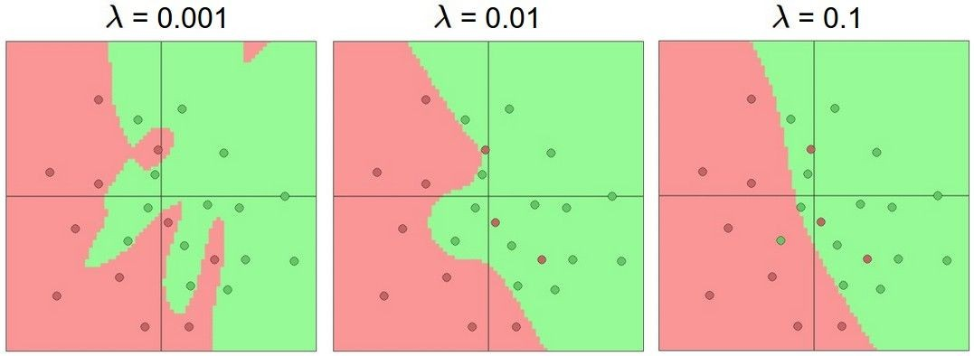
Do not use size of neural network as a regularizer. Use stronger regularization instead:
Effect of regularization
(you can play with this demo over at ConvNetJS: http://cs.stanford. edu/people/karpathy/convnetjs/demo/classify2d.html)
Andrej Karpathy

Slide 33
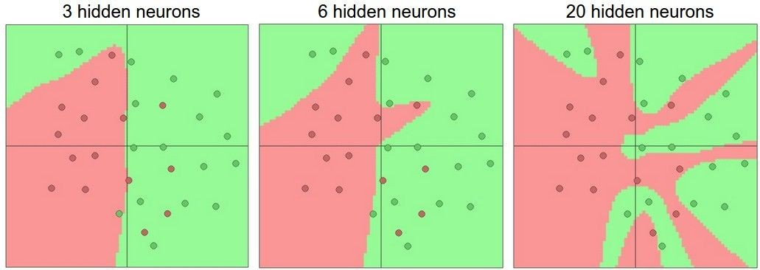
Effect of number of neurons
more neurons = more capacity
Andrej Karpathy

Slide 34

Softmax loss
unnormalized probabilities
cat car frog
3.2 5.1 -1.7 | exp
0.13
0.87
0.00
24.5
164.0
0.18
L_i = -log(0.13)
normalize
unnormalized log probabilities
probabilities
Andrej Karpathy

Slide 35
Mini-batch gradient descent
In classic gradient descent, we compute the gradient from the loss for all training examples
Could also only use some of the data for each gradient update, then cycle through all training samples
Yes, we cycle through the training examples multiple times (each time we’ve cycled through all of them once is called an ‘epoch’)
Allows faster training (e.g. on GPUs), parallelization

Slide 36
A note on training
The more weights you need to learn, the more data you need
That’s why with a deeper network, you need more data for training than for a shallower network
That’s why if you have sparse data, you only train the last few layers of a deep net
Set these to the already learned
weights from another network
Learn these on your own task

Slide 37
Convolutional neural networks

Slide 38
Convolutional Neural Networks (CNN)
Feed-forward feature extraction:
  Convolve input with learned filters
  Apply non-linearity
  Spatial pooling (downsample)
Output (class probs)
…
Spatial pooling
Non-linearity
Convolution (Learned)
Input Image
Adapted from Lana Lazebnik

Slide 39
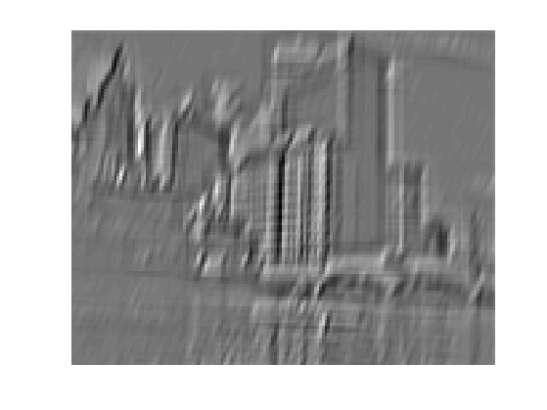
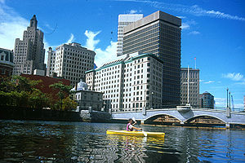
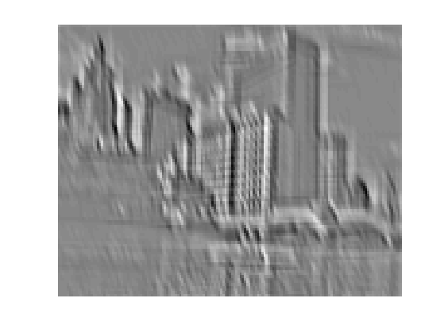
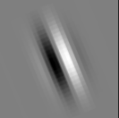
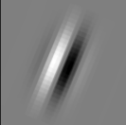
1. Convolution
Apply learned filter weights
One feature map per filter
Stride can be greater than 1 (faster, less memory)
...
Input
Feature Map
Adapted from Rob Fergus

Slide 40
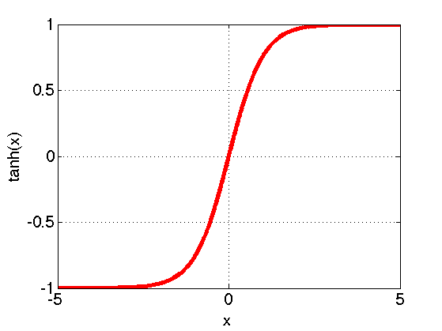
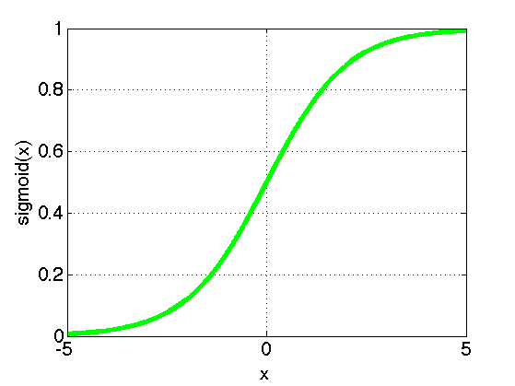
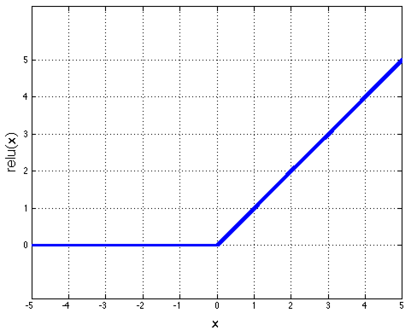
2. Non-Linearity
Per-element (independent)
Options:
  Tanh
  Sigmoid: 1/(1+exp(-x))
  Rectified linear unit (ReLU)
    Avoids saturation issues
Adapted from Rob Fergus

Slide 41
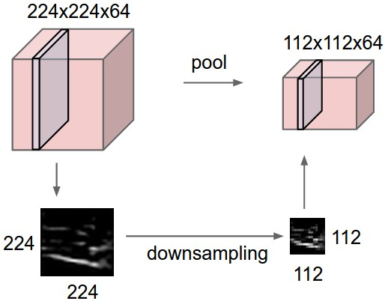
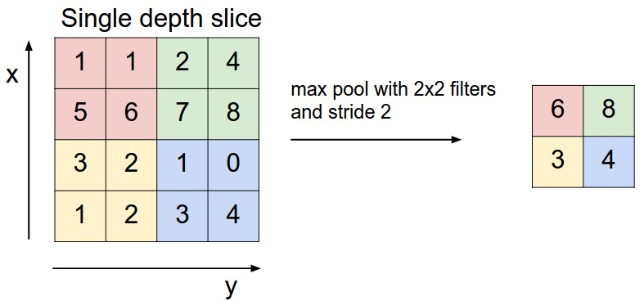
3. Spatial Pooling
Sum or max over non-overlapping / overlapping regions
Role of pooling:
  Invariance to small transformations
  Larger receptive fields (neurons see more of input)
Rob Fergus, figure from Andrej Karpathy

Slide 42


Convolution Layer
Convolutions: More detail
32x32x3 image 5x5x3 filter
32
1 number:
the result of taking a dot product between the filter and a small 5x5x3 chunk of the image
(i.e. 5*5*3 = 75-dimensional dot product + bias)
32
3
Andrej Karpathy

Slide 43
Convolution Layer
Convolutions: More detail
activation map
32x32x3 image
5x5x3 filter
32
28
convolve (slide) over all spatial locations
32
28
3
1
Andrej Karpathy

Slide 44
For example, if we had 6 5x5 filters, we’ll get 6 separate activation maps:
Convolutions: More detail
activation maps
32
28
Convolution Layer
32
28
3
6
We stack these up to get a “new image” of size 28x28x6!
Andrej Karpathy

Slide 45
Preview: ConvNet is a sequence of Convolutional Layers, interspersed with activation functions
Convolutions: More detail
32
28
24
….
CONV, ReLU
e.g. 6 5x5x3 filters
CONV, ReLU
e.g. 10 5x5x6 filters
CONV, ReLU
32
28
24
3
6
10
Andrej Karpathy

Slide 46
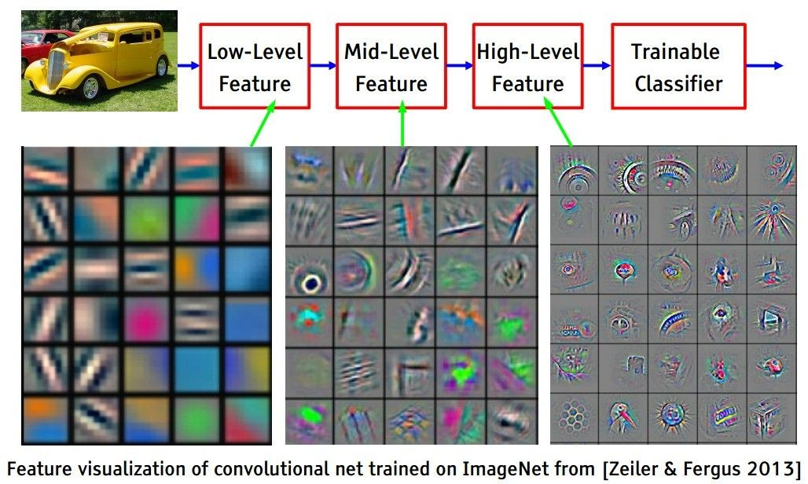
Preview
Convolutions: More detail
[From recent Yann LeCun slides]
Andrej Karpathy

Slide 47
Convolutions with some stride
N
Output size:
(N - F) / stride + 1
 |  |  | F
 | F
e.g. N = 7, F = 3:
stride 1 => (7 - 3)/1 + 1 = 5
stride 2 => (7 - 3)/2 + 1 = 3
stride 3 => (7 - 3)/3 + 1 = 2.33 :\
N
Andrej Karpathy

Slide 48
In practice: Common to zero pad the border
Convolutions with some padding
0 | 0 | 0 | 0 | 0 | 0
0
0
0
0
e.g. input 7x7
3x3 filter, applied with stride 1
pad with 1 pixel border => what is the output?
7x7 output!
in general, common to see CONV layers with stride 1, filters of size FxF, and zero-padding with (F-1)/2. (will preserve size spatially)
e.g. F = 3 => zero pad with 1 F = 5 => zero pad with 2 F = 7 => zero pad with 3
(N + 2*padding - F) / stride + 1
Andrej Karpathy

Slide 49
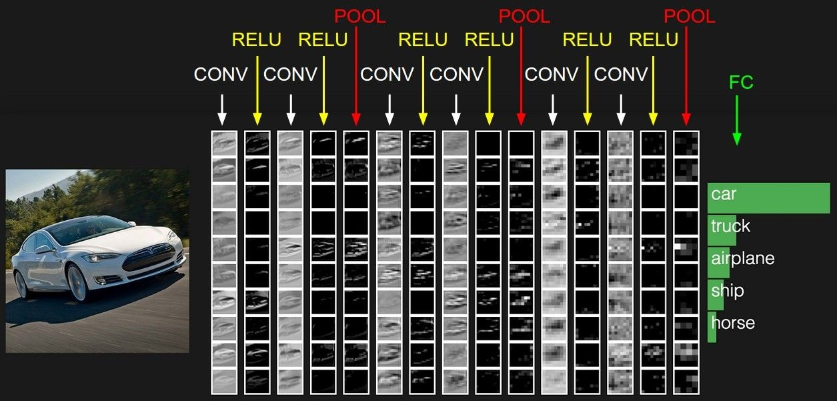
Combining all three steps
Andrej Karpathy

Slide 50
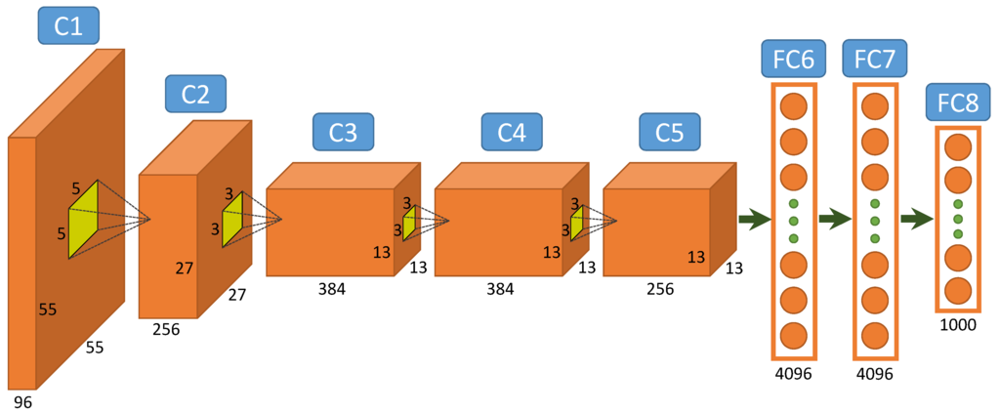
A common architecture: AlexNet
Figure from http://www.mdpi.com/2072-4292/7/11/14680/htm

Slide 51
Hough transform
(RANSAC won’t be on the exam)

Slide 52
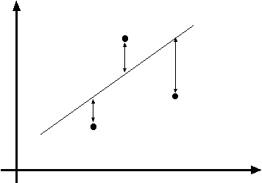
Least squares line fitting
Data: (x₁, y₁), …, (x_{n}, y_{n})
Line equation: y_{i} = m x_{i} + b
Find (m, b) to minimize
y=mx+b
(x_{i}, y_{i})
where line you found tells you point is along y axis
where point really is along y axis
You want to find a single line that “explains” all of the points in your data,
but data may be noisy!
Adapted from Svetlana Lazebnik

Slide 53
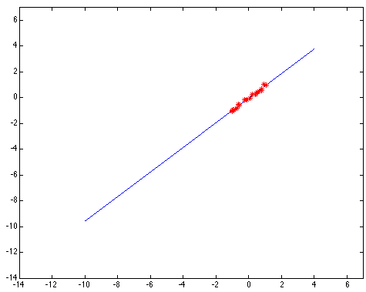
Outliers affect least squares fit
Kristen Grauman
Notes:
53

Slide 54
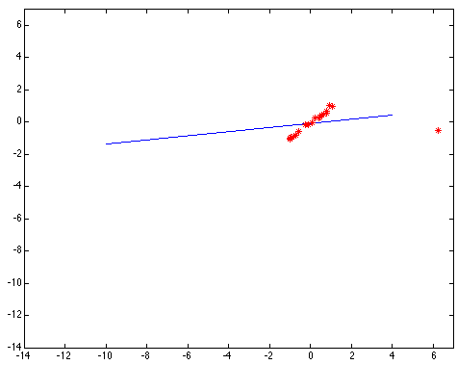
Outliers affect least squares fit
Kristen Grauman
Notes:
54

Slide 55
Dealing with outliers: Voting
Voting is a general technique where we let the features vote for all models that are compatible with it.
  Cycle through features, cast votes for model parameters.
  Look for model parameters that receive a lot of votes.
Noise & clutter features?
  They will cast votes too, but typically their votes should be inconsistent with the majority of “good” features.
Adapted from Kristen Grauman

Slide 56

Finding lines in an image: Hough space
y
b
b₀
x
m₀
m
image space
Hough (parameter) space
Connection between image (x,y) and Hough (m,b) spaces
  A line in the image corresponds to a point in Hough space
Steve Seitz

Slide 57

Finding lines in an image: Hough space
y
b
y₀
x₀
x
m
image space
Hough (parameter) space
Connection between image (x,y) and Hough (m,b) spaces
  A line in the image corresponds to a point in Hough space
  What does a point (x₀, y₀) in the image space map to?
  To go from image space to Hough space:
    given a pair of points (x,y), find all (m,b) such that y = mx + b
    Answer: the solutions of b = -x₀m + y₀
    This is a line in Hough space
Adapted from Steve Seitz

Slide 58
Finding lines in an image: Hough space
y
b
(x₁, y₁)
y₀
(x₀, y₀)
b = –x₁m + y₁
x₀
x
m
image space
Hough (parameter) space
What are the line parameters for the line that contains both (x₀, y₀) and (x₁, y₁)?
  It is the intersection of the lines b = –x₀m + y₀ and
  b = –x₁m + y₁
Steve Seitz

Slide 59
Finding lines in an image: Hough space
y
b
x
m
image space
Hough (parameter) space
How can we use this to find the most likely parameters (m,b) for the most prominent line in the image space?
Let each edge point in image space vote for a set of possible parameters in Hough space
Accumulate votes in discrete set of bins; parameters with the most votes indicate line in image space.
Steve Seitz

Slide 60
Parameter space representation
P.V.C. Hough, Machine Analysis of Bubble Chamber Pictures, Proc. Int. Conf. High Energy Accelerators and Instrumentation, 1959
Use a polar representation for the parameter space
Each line is a sinusoid in Hough parameter space
y
x
Hough space
Silvio Savarese

Slide 61
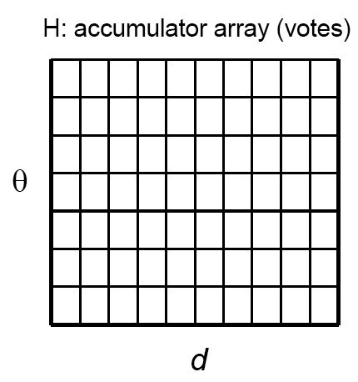
Algorithm outline
Initialize accumulator H
to all zeros
For each feature point (x,y)
in the image
θ = gradient orientation at (x,y)
ρ = x cos θ + y sin θ
H(θ, ρ) = H(θ, ρ) + 1
end
Find the value(s) of (θ*, ρ*) where H(θ, ρ) is a local maximum
  The detected line in the image is given by
  ρ* = x cos θ* + y sin θ*
ρ
θ
Svetlana Lazebnik

Slide 62
Hough transform for circles
x = a + r cos(θ)
y = b + r sin(θ)
For every edge pixel (x,y):
θ = gradient orientation at (x,y)
For each possible radius value r:
a = x – r cos(θ)
b = y – r sin(θ)
H[a,b,r] += 1
end
end
x
θ
Modified from Kristen Grauman

Slide 63
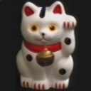
Hough transform for finding transformation parameters
A₁
A₂
A₃
B₁
B₂
B₃
Given matched points in {A} and {B}, estimate the translation of the object
Derek Hoiem

Slide 64
Hough transform for finding transformation parameters
B₄
A₁
B₅
B₆
A₂
A₃
(t_{x}, t_{y})
B₁
A₄
B₂
B₃
A₅
A₆
Problem: outliers, multiple objects, and/or many-to-one matches
Hough transform solution
Initialize a grid of parameter values
Each matched pair casts a vote for consistent values
Find the parameters with the most votes
Adapted from Derek Hoiem

Slide 65
Support vector machines

Slide 66
Linear classifiers
Find linear function to separate positive and negative examples
Which line
is best?
C. Burges, A Tutorial on Support Vector Machines for Pattern Recognition, Data Mining and Knowledge Discovery, 1998

Slide 67
Support vector machines
Discriminative classifier based on optimal separating line (for 2d case)
Maximize the margin between the positive and negative training examples
C. Burges, A Tutorial on Support Vector Machines for Pattern Recognition, Data Mining and Knowledge Discovery, 1998

Slide 68
Support vector machines
Want line that maximizes the margin.
wx+b=1
wx+b=0
wx+b=-1
For support, vectors,
Distance between point and line:
For support vectors:
Support vectors
Margin
C. Burges, A Tutorial on Support Vector Machines for Pattern Recognition, Data Mining and Knowledge Discovery, 1998

Slide 69
Finding the maximum margin line
Maximize margin 2/||w||
Correctly classify all training data points:
Quadratic optimization problem:
Minimize
Subject to y_{i}(w·x_{i}+b) ≥ 1
Objective
Constraints
One constraint for each training point.
Note sign trick.
C. Burges, A Tutorial on Support Vector Machines for Pattern Recognition, Data Mining and Knowledge Discovery, 1998

Slide 70
Finding the maximum margin line
Solution:
Learned
weight
Support
vector
C. Burges, A Tutorial on Support Vector Machines for Pattern Recognition, Data Mining and Knowledge Discovery, 1998

Slide 71
Finding the maximum margin line
Solution:
b = y_{i} – w·x_{i} (for any support vector)
Classification function:
Notice that it relies on an inner product between the test point x and the support vectors x_{i}
If f(x) < 0, classify as negative, otherwise classify as positive.
C. Burges, A Tutorial on Support Vector Machines for Pattern Recognition, Data Mining and Knowledge Discovery, 1998

Slide 72
The “Kernel Trick”
The linear classifier relies on dot product between vectors K(x_{i} , x_{j}) = x_{i} · x_{j}
If every data point is mapped into high-dimensional space via some transformation Φ: x_{i} → φ(x_{i} ), the dot product becomes: K(x_{i} , x_{j}) = φ(x_{i} ) · φ(x_{j})
The kernel trick: instead of explicitly computing the lifting transformation φ(x), define a kernel function K such that: K(x_{i} , x_{j}) = φ(x_{i} ) · φ(x_{j})
Andrew Moore

Slide 73
Nonlinear SVMs
Datasets that are linearly separable work out great:
But what if the dataset is just too hard?
We can map it to a higher-dimensional space:
0
x
0
x
x²
0
x
Andrew Moore

Slide 74
Nonlinear kernel: Example
Consider the mapping
x²
Svetlana Lazebnik

Slide 75
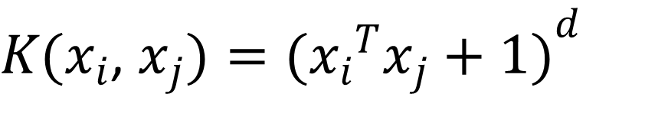
Examples of kernel functions
Linear:
Polynomials of degree up to d:
Gaussian RBF:
Histogram intersection:
$K(x_{i}$, $x_{j})={({x_{i}}^{T}x_{j}+1)}^{d}$
Andrew Moore / Carlos Guestrin

Slide 76
Allowing misclassifications: Before
Objective
The w that minimizes…
Maximize margin
Constraints

Slide 77
Allowing misclassifications: After
Objective
# data samples
Misclassification
cost
Slack variable
The w that minimizes…
Maximize margin
Minimize misclassification
Constraints

Slide 78
Deformable part models?

Slide 79
Zero-shot learning

Slide 80
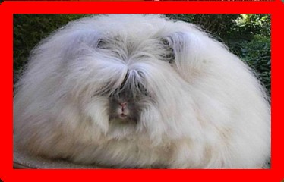
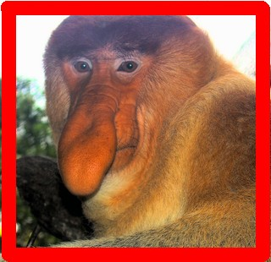
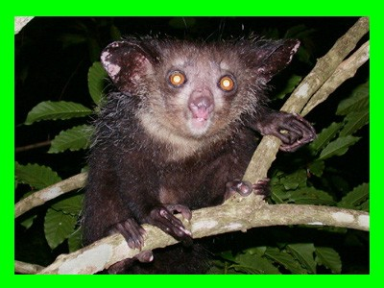
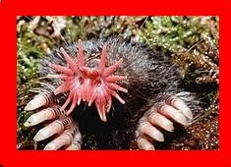
Image Classification: Textual descriptions
Introduction
Which image shows an aye-aye?
Description, Aye-aye . . .
is nocturnal lives in trees has large eyes
has long middle fingers
We can classify based on textual descriptions
Thomas Mensink

Slide 81
Zero-shot recognition (2)
Introduction
Vocabulary of attributes and class descriptions:
Aye-ayes have properties X, and Y, but not Z
Train classifiers for each attibute X, Y, Z.
From visual examples of related classes
Make image attributes predictions:
4.Combine into decision: this image is not an Aye-aye
Thomas Mensink

Slide 82
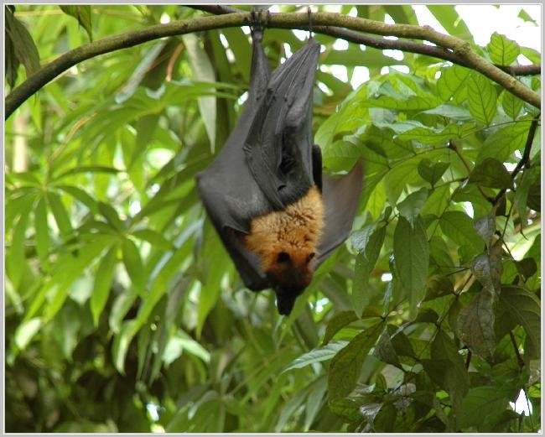
Zero-shot recognition (2)
Introduction
P (X|img) = 0.8
⇒ P (Y |img) = 0.3
P (Z|img) = 0.6
Vocabulary of attributes and class descriptions:
Aye-ayes have properties X, and Y, but not Z
Train classifiers for each attibute X, Y, Z.
From visual examples of related classes
Make image attributes predictions:
4.Combine into decision: this image is not an Aye-aye
Thomas Mensink

Slide 83
DAP: Probabilistic model
Attribute-based classification
Define attribute probability:
.p(a_{m}|x )
if a^{z} = 1
z
m
p(a = a |x ) =
m
m
1 − p(a_{m}|x ) otherwise
Assign a given image to class z∗
Adapted from Thomas Mensink

Slide 84
Example
Cat attributes: [1 0 0 1 0]
Bear attributes: [0 1 0 0 0]
Image X’s probability of the attributes:
  P(attribute_{i} = 1|X) = [0.7 0.4 0.8 0.5 0.1]
Probability that class(X) = “cat”:
Probability that class(X) = “bear”:

