Slide 1
CS 1674: Intro to Computer Vision
Motion:
Tracking, Pose and Actions
Prof. Adriana Kovashka
University of Pittsburgh
December 5, 2016

Slide 2
In this slide deck
Tracking how an object moves
Estimating human pose
Recognizing human actions

Slide 3
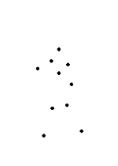
Motion: Why is it useful?
Derek Hoiem

Slide 4
Motion: Why is it useful?
Even “impoverished” motion data can evoke a strong percept
G. Johansson, “Visual Perception of Biological Motion and a Model For Its Analysis", Perception and Psychophysics 14, 201-211, 1973.
Derek Hoiem

Slide 5
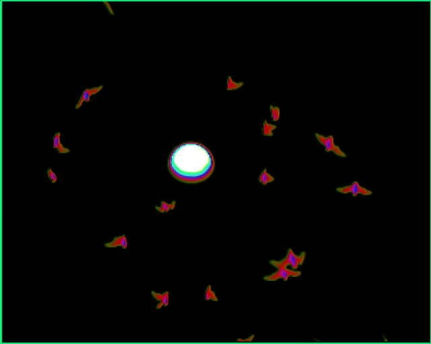
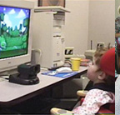
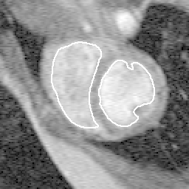
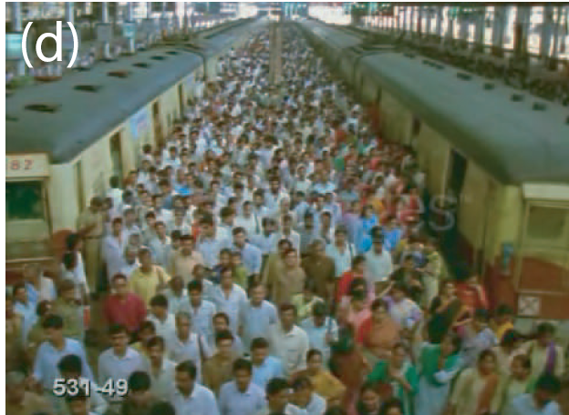
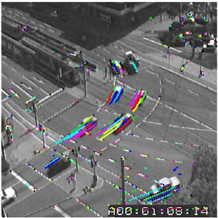
Tracking: some applications
Video examples in
hidden slide that follows
Body pose tracking, activity recognition
Censusing a bat population
Video-based interfaces
Medical apps
Surveillance
Kristen Grauman

Slide 6
Tracking Examples
Traffic: https://www.youtube.com/watch?v=DiZHQ4peqjg
Soccer: http://www.youtube.com/watch?v=ZqQIItFAnxg
Face: http://www.youtube.com/watch?v=i_bZNVmhJ2o
Body: https://www.youtube.com/watch?v=_Ahy0Gh69-M
Eye: http://www.youtube.com/watch?v=NCtYdUEMotg
Gaze: http://www.youtube.com/watch?v=-G6Rw5cU-1c
Amin Sadeghi

Slide 7
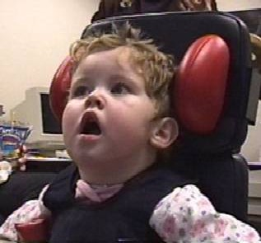
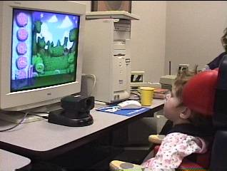
Example: A Camera Mouse
Video interface: use feature tracking as mouse replacement
Specialized software for communication, games
James Gips and Margrit Betke
http://www.bc.edu/schools/csom/eagleeyes/
Kristen Grauman

Slide 8
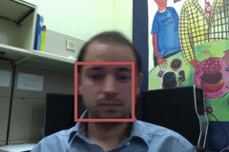
Things that make visual tracking difficult
Erratic movements, moving very quickly
Occlusions, leaving and coming back
Surrounding similar-looking objects
Adapted from Amin Sadeghi

Slide 9
Strategies for tracking
Tracking by repeated detection
  Works well if object is easily detectable (e.g., face or colored glove) and there is only one
  Need some way to link up detections
  Best you can do, if you can’t predict motion
Amin Sadeghi

Slide 10
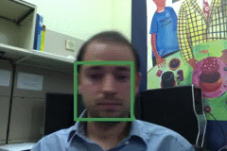
Tracking with dynamics
Key idea: Based on a model of expected motion, predict where objects will occur in next frame, before even seeing the image
  Restrict search for the object
  Measurement noise is reduced by trajectory smoothness
  Robustness to missing or weak observations
  Assumptions: camera is not moving instantly to new viewpoint, objects do not disappear and reappear in different places in the scene
Amin Sadeghi

Slide 11
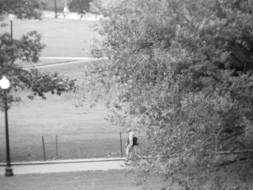
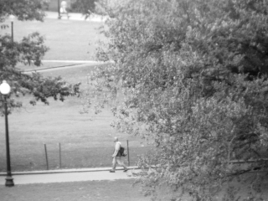
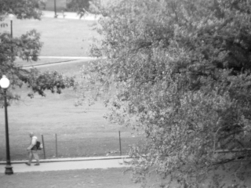

Detection vs. tracking
…
t=1
t=2
t=20
t=21
Kristen Grauman

Slide 12
Detection vs. tracking
…
Detection: We detect the object independently in each frame and can record its position over time, e.g., based on detection window coordinates
Adapted from Kristen Grauman

Slide 13
Detection vs. tracking
…
Tracking with dynamics: We use image measurements to estimate position of object, but also incorporate position predicted by dynamics, i.e., our expectation of object’s motion pattern.
Kristen Grauman

Slide 14
Tracking: prediction + correction
Time t
Time t+1
Belief
Measurement
Corrected prediction
Kristen Grauman

Slide 15
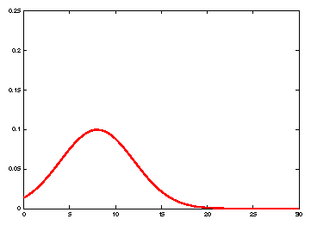
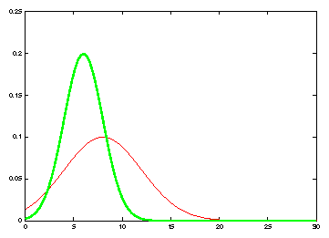
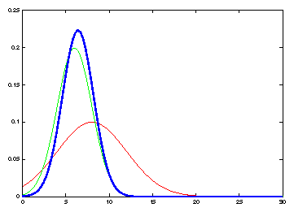
Tracking: prediction + correction
measurement
Belief: prediction
Belief: prediction
Corrected prediction
measurement
old belief
Time t
Time t+1
Kristen Grauman

Slide 16
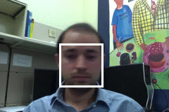
General model for tracking
state X: The actual state of the moving object that we want to estimate but cannot observe
  E.g. position
observations Y: Our actual measurement or observation of state X, which can be very noisy
At each time t, the state changes to X_{t} and we get a new observation Y_{t}
Our goal is to recover the most likely state X_{t} given:
  All observations so far, i.e. y₁, y₂, …, y_{t}
  Knowledge about dynamics of state transitions
X₀
X₁
X₂
…
X_{t-1}
X_{t}
Y₀
Y₁
Y₂
Y_{t-1}
Y_{t}
Adapted from Amin Sadeghi and Kristen Grauman

Slide 17
Steps of tracking
Prediction: What is the next state of the object given past measurements?
Kristen Grauman

Slide 18
Steps of tracking
Prediction: What is the next state of the object given past measurements?
Correction: Compute an updated estimate of the state from prediction and measurements
Kristen Grauman

Slide 19
Problem statement
We have models for
  Likelihood of next state given current state (dynamics model):
  Likelihood of observation given the state (observation or measurement model):
We want to recover, for each t:
Details in hidden slides that follow
Amin Sadeghi

Slide 20
The Kalman filter
Linear dynamics model: state undergoes linear transformation plus Gaussian noise
Observation model: measurement is linearly transformed state plus Gaussian noise
The predicted/corrected state distributions are Gaussian
  You only need to maintain the mean and covariance
  The calculations are easy
Amin Sadeghi

Slide 21
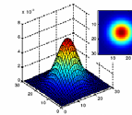
Notation: Normal distribution
Random variable with Gaussian probability distribution that has the mean vector μ and covariance matrix Σ.
x and μ are d-dimensional, Σ is d x d.
d=2
d=1
If x is 1-d, we just have one Σ parameter → the variance: σ²
Kristen Grauman

Slide 22
Dynamics and observation models
Dynamics model (represents evolution of state over time)
Observation or measurement model (at every time step we get a noisy measurement of the state)
This is how these models are defined in the Kalman filter.
Adapted from Kristen Grauman, Simon Prince

Slide 23
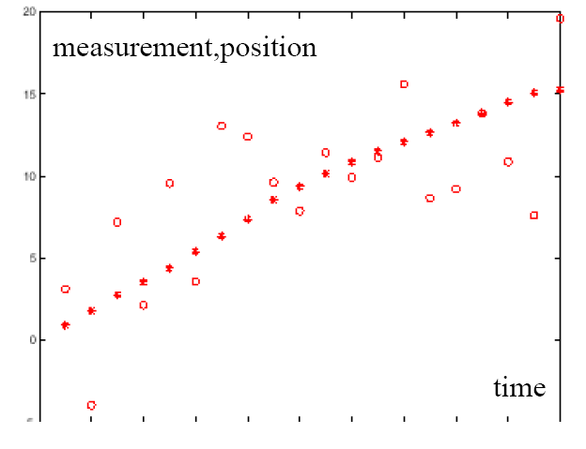
Example: Constant velocity (1D points)
1 d position
1 d position
measurements
states
time
Kristen Grauman

Slide 24
Example: Constant velocity (1D points)
State vector: position p and velocity v
Measurement is position only
Kristen Grauman

Slide 25
Prediction and correction
Details in hidden slides that follow
Prediction:
Correction:
dynamics
model
corrected estimate
from previous step
observation
model
predicted
estimate
Amin Sadeghi

Slide 26
Simplifying assumptions
Only the immediate past matters
dynamics model
Kristen Grauman

Slide 27
Simplifying assumptions
Only the immediate past matters
Measurements depend only on the current state
dynamics model
observation model
Kristen Grauman

Slide 28
Simplifying assumptions
Only the immediate past matters
Measurements depend only on the current state
dynamics model
observation model
…
X₀
X₁
X₂
X_{t-1}
X_{t}
Y₀
Y₁
Y₂
Y_{t-1}
Y_{t}
Amin Sadeghi

Slide 29

Prediction
Prediction involves representing
given
Law of total probability
Amin Sadeghi

Slide 30
Prediction
Prediction involves representing
given
Conditioning on X_{t–1}
Amin Sadeghi

Slide 31
Prediction
Prediction involves representing
given
Independence assumption (only immediate past state matters)
Adapted from Amin Sadeghi

Slide 32
Prediction
Prediction involves representing
given
dynamics
model
corrected estimate
from previous step
Amin Sadeghi

Slide 33
Correction
Correction involves computing
given predicted value
Amin Sadeghi

Slide 34
Correction
Correction involves computing
given predicted value
Amin Sadeghi

Slide 35

Correction
Correction involves computing
given predicted value
Bayes’ Rule
Amin Sadeghi

Slide 36
Correction
Correction involves computing
given predicted value
Independence assumption
(observation y_{t} directly depends only on state X_{t})
Amin Sadeghi

Slide 37
Correction
Correction involves computing
given predicted value
Conditioning on X_{t}
Amin Sadeghi

Slide 38
Correction
Correction involves computing
given predicted value
observation
model
predicted
estimate
normalization factor
Amin Sadeghi

Slide 39
Summary: Prediction and correction
Prediction:
Know corrected state from previous time step, and all measurements up to (excluding) the current one →
Predict distribution over next state
Correction:
  Know prediction of state, and next measurement →
  Update distribution over current state
Time advances:
t++
Receive measurement
Kristen Grauman

Slide 40
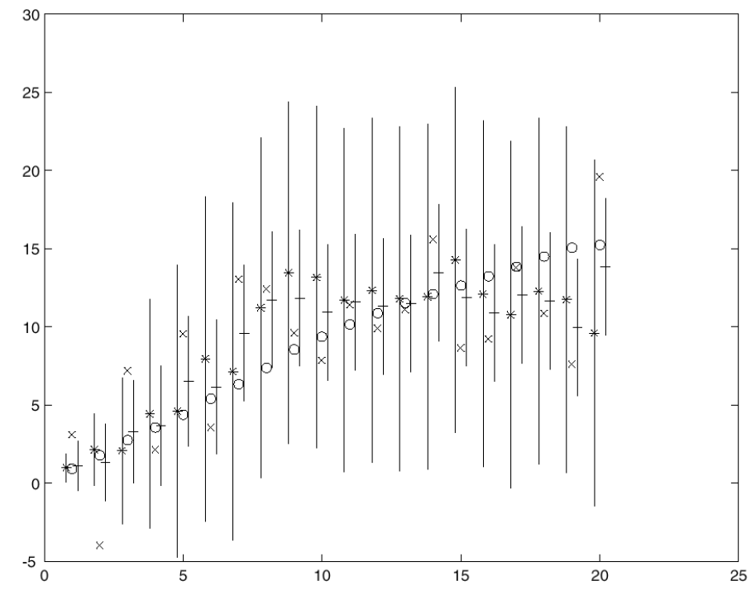
Example w/ constant velocity
Kalman filter processing
o state
x measurement
* predicted mean estimate
+ corrected mean estimate
bars: variance estimates before and after measurements
position
time
Kristen Grauman
Time t
Time t+1

Slide 41
Example w/ constant velocity
Kalman filter processing
o state
x measurement
* predicted mean estimate
+ corrected mean estimate
bars: variance estimates before and after measurements
position
time
Kristen Grauman
Time t
Time t+1

Slide 42
Example w/ constant velocity
Kalman filter processing
o state
x measurement
* predicted mean estimate
+ corrected mean estimate
bars: variance estimates before and after measurements
position
time
Kristen Grauman
Time t
Time t+1

Slide 43
Example w/ constant velocity
Kalman filter processing
o state
x measurement
* predicted mean estimate
+ corrected mean estimate
bars: variance estimates before and after measurements
position
time
Kristen Grauman
Time t
Time t+1

Slide 44
Example w/ constant velocity
Ground Truth
Observation
Correction
Amin Sadeghi

Slide 45
In this slide deck
Tracking how an object moves
Estimating human pose
Recognizing human actions

Slide 46

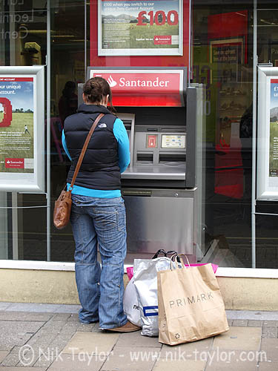
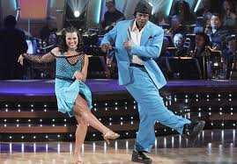
What is an action/activity?
Action: a transition from one state to another
What is the name of the action?
Who is the actor?
How is the state of the actor changing?
What (if anything) is being acted on?
How is that thing changing?
What is the purpose of the action (if any)?
Adapted from Derek Hoiem

Slide 47
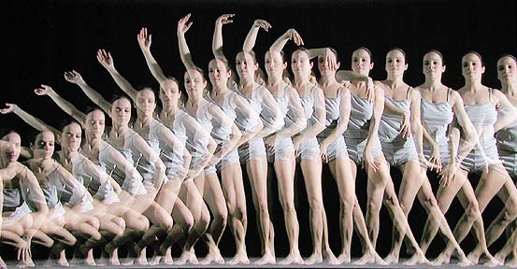
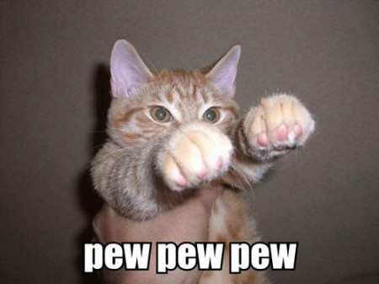

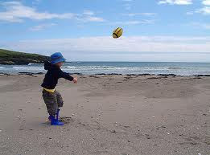
How can we identify actions?
Motion
Pose
Held Objects
Nearby Objects
Derek Hoiem

Slide 48



Real-Time Human Pose Recognition in Parts from Single Depth Images
Jamie Shotton, Andrew Fitzgibbon, Mat Cook,
Toby Sharp, Mark Finocchio, Richard Moore,
Alex Kipman, Andrew Blake
Best paper award at CVPR 2011
Adapted from Jamie Shotton

Slide 49
The mission
Recognize large variety of human poses, all shapes & sizes
Limited compute budget
  super-real time on Xbox 360 to allow games to run concurrently
Adapted from Jamie Shotton

Slide 50

The approach: body part recognition
right hand
left
shoulder
neck
right
elbow
Jamie Shotton

Slide 51
Body part recognition
No temporal information
  frame-by-frame
Local pose estimate of parts
  each pixel & each body joint treated independently
Very fast
  simple depth image features
  decision forest classifier
Adapted from Jamie Shotton

Slide 52
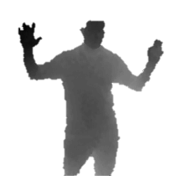

The Kinect pose estimation pipeline
capture
depth image &
remove bg
infer
body parts
per pixel
cluster pixels to
hypothesize
body joint
positions
fit model &
track skeleton
Jamie Shotton

Slide 53
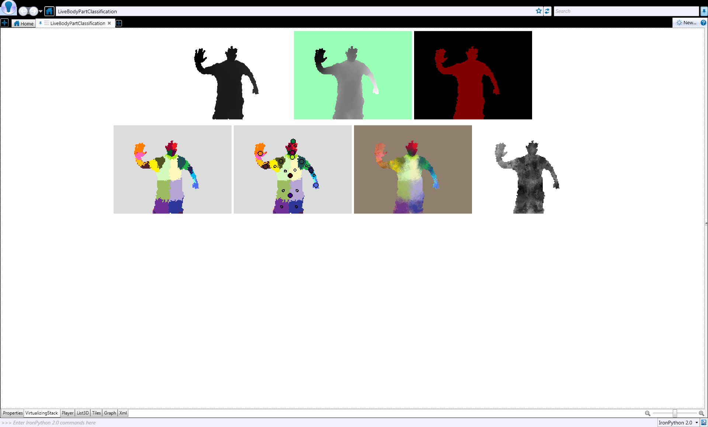
Classifying pixels
Compute P(c_{i}|w_{i})
  31 body parts considered
  body part c_{i}
  image window w_{i}
Discriminative approach
  learn classifier P(c_{i}|w_{i}) from training data
Adapted from Jamie Shotton

Slide 54
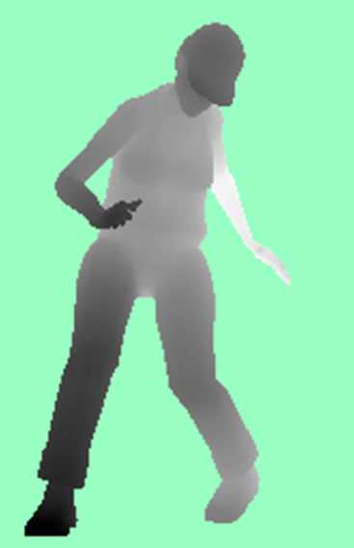

Fast depth image features
f_{Θ} (I, x) =
input
depth
image
Depth comparisons
  Very fast to compute
Δ
Δ
x
Δ
Δ
x
x
x
image
depth
offset depth
Δ
Δ
feature
response
$$f\left(I, \text{x}\right)=d_{I}\left(\text{x}\right)−d_{I}(\text{x}+Δ)$$
x
x
Θ
image coordinate
Adapted from Jamie Shotton

Slide 55
Decision tree classification
To classify pixel x, start here
Toy example:
distinguish
left (L) and right (R)
sides of the body
f_{Θ}(I, x; Δ₁) > t₁
no
yes
f_{Θ}(I, x; Δ₂) > t₂
no
yes
P(c)
L R
P(c)
P(c)
L R
L R
Adapted from Jamie Shotton

Slide 56



Decision forest classifier
[Amit & Geman 97]
[Breiman 01]
[Geurts et al. 06]
$$(I, \text{x})$$
$$(I, \text{x})$$
tree 1
tree T
………
P_{T}(c)
P₁(c)
c
c
Trained on different random subset of images
  “bagging” helps avoid over-fitting
Average tree posteriors
$$P\left(c | I,\text{x}\right)=\frac{1}{T}\sum_{t=1}^{T}{P_{t}(c|I,\text{x})}$$
Jamie Shotton

Slide 57
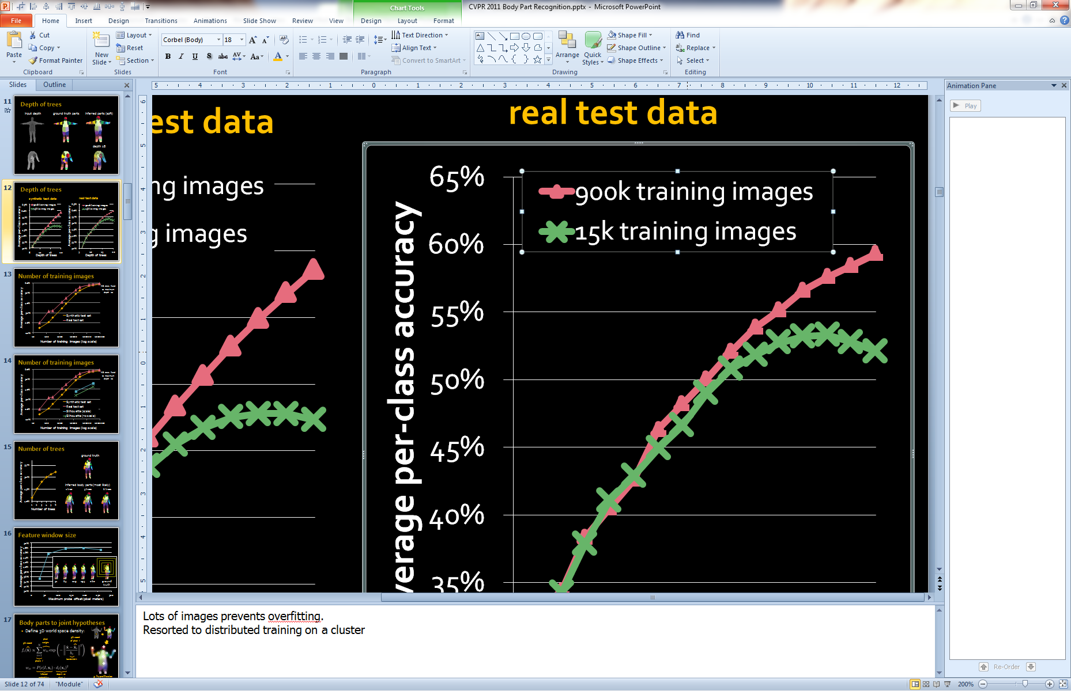
Number and depth of trees
Adapted from Jamie Shotton

Slide 58
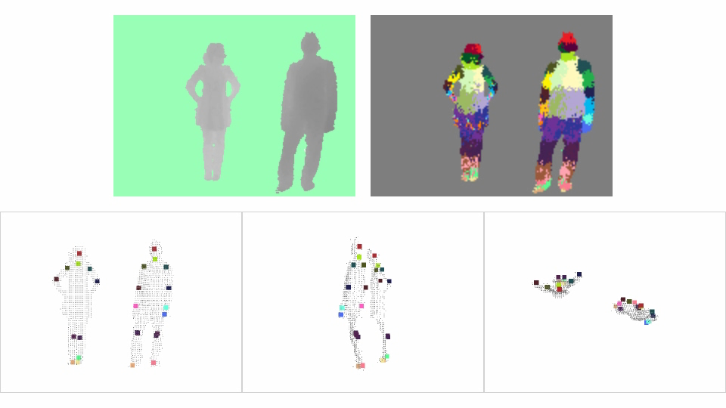
input depth
inferred body parts
front view
side view
top view
inferred joint positions (modes found using mean shift)
no tracking or smoothing
Jamie Shotton

Slide 59
Representing Actions
Via the pose of persons in the video, how it changes

Slide 60
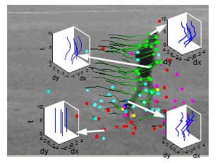
Representing Actions
Via tracked points
Adapted from Derek Hoiem
Matikainen et al. 2009
Notes:
Point tracks reflect long-term motions

Slide 61
Representing Actions
Via spatio-temporal interest points (corners in space+time)
Adapted from Derek Hoiem
Laptev 2005
Notes:
Detect interest points in time and position

Slide 62

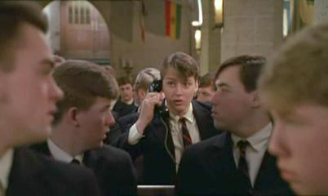
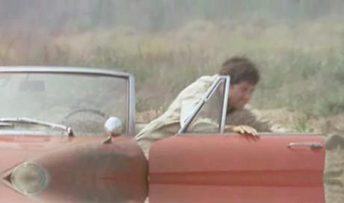
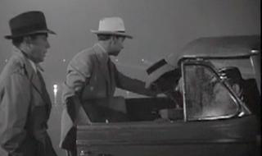
Learning realistic human actions from movies, Laptev et al. 2008
“Talk on phone”
“Get out of car”
Derek Hoiem

Slide 63
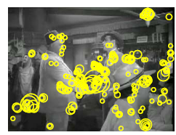
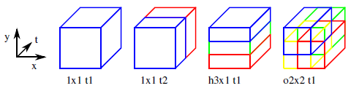
Approach
Space-time interest point detectors
Descriptors
  HOG, HOF
Pyramid histograms (3x3x2)
SVMs with Chi-Squared Kernel
Spatio-Temporal Binning
Interest Points
Derek Hoiem, figures from Ivan Laptev

Slide 64
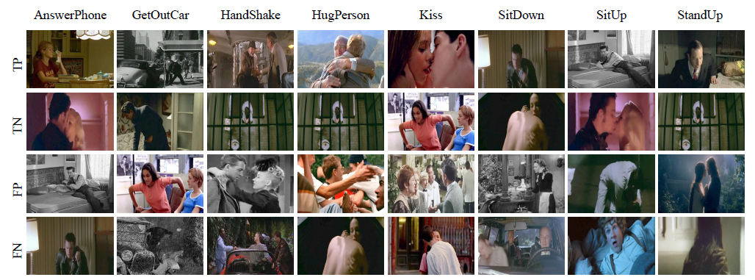
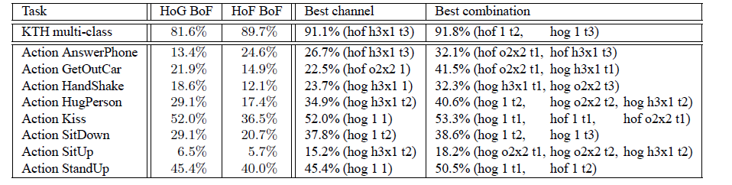
Results
Derek Hoiem, figures from Ivan Laptev

Slide 65
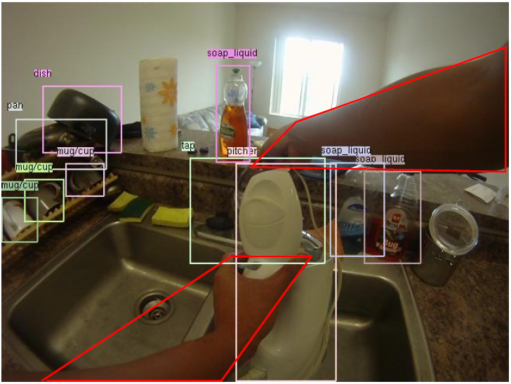
Detecting Activities of Daily Living in First-person Camera Views
Hamed Pirsiavash, Deva Ramanan
CVPR 2012
Hamed Pirsiavash
Notes:
Hi, my name is Hamed. I’ll talk about detecting activities of daily living in first person camera views. This is a joint work with my advisor Deva Ramanan at UC Irvine.

Slide 66
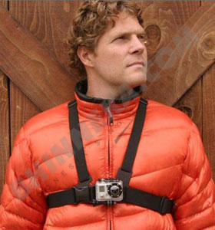
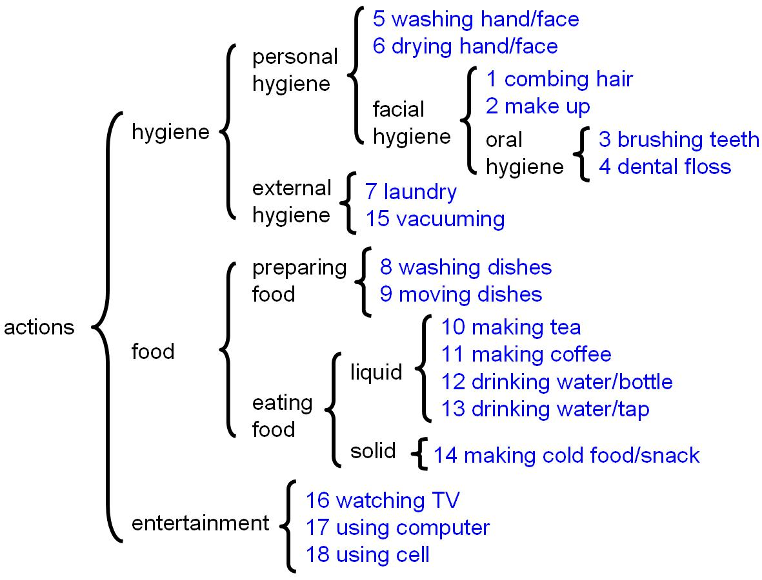
Wearable ADL detection
It is easy to collect natural data
ADL actions derived from medical literature on patient rehabilitation
66
Hamed Pirsiavash
Notes:
Second, we define ADL-categories adopted from the medical literature. Examples include making coffee and washing hands. Again, these are everyday tasks that a typical person must be able to do to function at home.

Slide 67
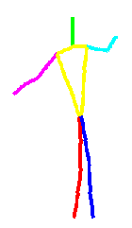
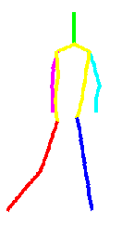
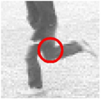
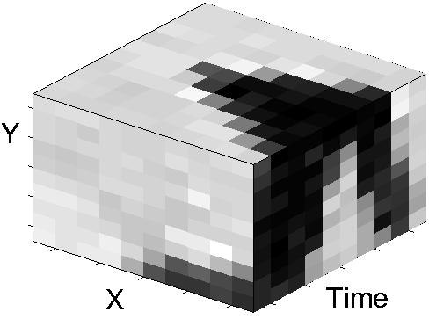
Challenges
What features to use?
Low level features
High level features
Space-time interest points
Laptev, IJCV’05
Human pose
Difficulties of pose:
Detectors are not accurate enough
Not useful in first person camera views
Adapted from Hamed Pirsiavash
Notes:
In recognition, we usually use some appearance features. Many previous action recognition algorithms use low-level features like space-time interest points. These features can do well but they are low-level, often lacking a clear semantic meaning. Ideally, one would use a high-level feature such as human pose. However, human pose is not particularly useful for wearable data since the person is behind the camera and not seen.

Slide 68



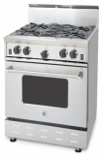

Challenges
What features to use?
Low level features
High level features
Space-time interest points
Laptev, IJCV’05
Human pose
Object-centric features
Difficulties of pose:
Detectors are not accurate enough
Not useful in first person camera views
Hamed Pirsiavash
Notes:
Instead, we focus on objects as an alternative set of high-level features for wearable ADL recognition.
Now, to successfully use such features, we need accurate object detectors…

Slide 69
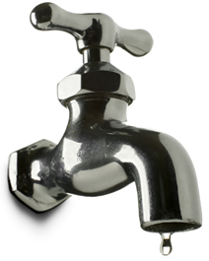
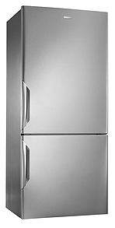

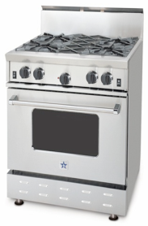
Appearance feature: bag of objects
fridge
stove
TV
SVM classifier
fridge
stove
TV
Video clip
Bag of detected objects
Hamed Pirsiavash
Notes:
For a given video clip, we build a bag of detected objects descriptor, which is a histogram of what objects are present. We have a bin for each object, such as a Fridge, Stove and so on. We use a soft histogram where the value of a bin is the confidence, or score, of that associated object detector.
To capture active vs passive cues…

Slide 70
Accuracy on 18 action categories
  Our model: 40.6%
  STIP baseline: 22.8%
Hamed Pirsiavash
Notes:
Interestingly, we make mistakes on functionally related categories like brushing teeth and flossing them. We believe the reason is that functionally-related actions occur in similar scenes; people brush their teeth and floss in the bathroom. Our bag-of-objects descriptor acts as a coarse scene-descriptor, and hence tends to make such reasonable mistakes. If one was penalizing mistakes based on their functional relevance, we might do even better.

Slide 71
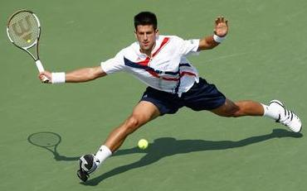

Human-Object Interaction
Holistic image based classification
Integrated reasoning
Human pose estimation
Head
Right-arm
Left-arm
Torso
Right-leg
Left-leg
Yao/Fei-Fei

Slide 72

Human-Object Interaction
Holistic image based classification
Integrated reasoning
Human pose estimation
Object detection
Tennis racket
Yao/Fei-Fei

Slide 73

Human-Object Interaction
Holistic image based classification
Integrated reasoning
Human pose estimation
Object detection
Action categorization
Head
Right-arm
Left-arm
Tennis racket
Torso
Right-leg
Left-leg
Activity: Tennis Forehand
Yao/Fei-Fei

Slide 74


Human pose estimation & Object detection
Human pose estimation is challenging.
Felzenszwalb & Huttenlocher, 2005
Ren et al, 2005
Ramanan, 2006
Ferrari et al, 2008
Yang & Mori, 2008
Andriluka et al, 2009
Eichner & Ferrari, 2009
Yao/Fei-Fei

Slide 75
Human pose estimation & Object detection
Facilitate
Given the object is detected.
Yao/Fei-Fei

Slide 76
Human pose estimation & Object detection
Object detection is challenging
Small, low-resolution, partially occluded
Image region similar to detection target
Yao/Fei-Fei

Slide 77
Human pose estimation & Object detection
Facilitate
Given the pose is estimated.
Yao/Fei-Fei

Slide 78

Human pose estimation & Object detection
Mutual Context
Yao/Fei-Fei

