Slide 1
CS 1674: Intro to Computer Vision
Neural Networks
Prof. Adriana Kovashka
University of Pittsburgh
November 16, 2016

Slide 2
Announcements
Please watch the videos I sent you, if you haven’t yet (that’s your reading)
We won’t be ready to release HW10P until tomorrow night, so we’re pushing HW9P’s deadline until then (11:59pm, Thursday)
HW10W, HW10P will be due after Thanksgiving

Slide 3
Plan for next few CNN lectures
Why convolutional neural networks?
Neural network basics
  Architecture
  Biological inspiration
  Loss functions
  Optimization
  Training with backprop
CNNs
  Special operations
  Common architectures
Understanding CNNs
  Visualization
  Synthesis / style transfer
  Breaking CNNs
Practical matters
  Tips and tricks for training
  Transfer learning
  Software packages

Slide 4
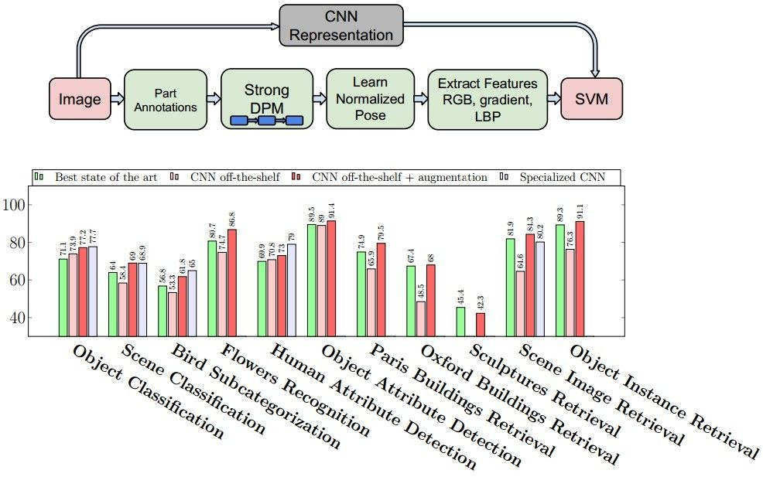
Why CNNs?
Obtained state of the art performance on many problems…
Most papers in CVPR 2016 use deep learning
Razavian et al., CVPR 2014 Workshops

Slide 5
ImageNet Challenge 2012
~14 million labeled images, 20k classes
Images gathered from Internet
Human labels via Amazon Turk
Challenge: 1.2 million training images, 1000 classes
[Deng et al. CVPR 2009]
A. Krizhevsky, I. Sutskever, and G. Hinton, ImageNet Classification with Deep Convolutional Neural Networks, NIPS 2012
Lana Lazebnik

Slide 6
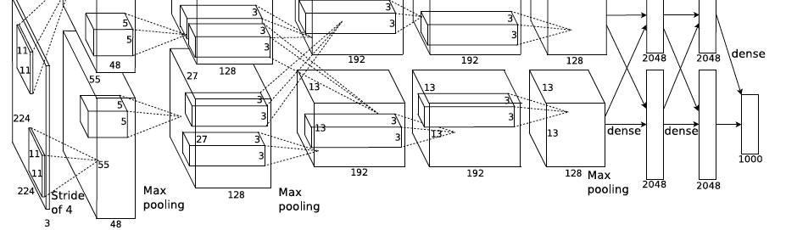
ImageNet Challenge 2012
AlexNet: Similar framework to LeCun’98 but:
  Bigger model (7 hidden layers, 650,000 units, 60,000,000 params)
  More data (10⁶ vs. 10³ images)
  GPU implementation (50x speedup over CPU)
    Trained on two GPUs for a week
  Better regularization for training (DropOut)
A. Krizhevsky, I. Sutskever, and G. Hinton, ImageNet Classification with Deep Convolutional Neural Networks, NIPS 2012
Lana Lazebnik
Notes:
Two-GPU architecture

Slide 7
ImageNet Challenge 2012
Krizhevsky et al. -- 16.4% error (top-5)
Next best (non-convnet) – 26.2% error
Lana Lazebnik

Slide 8
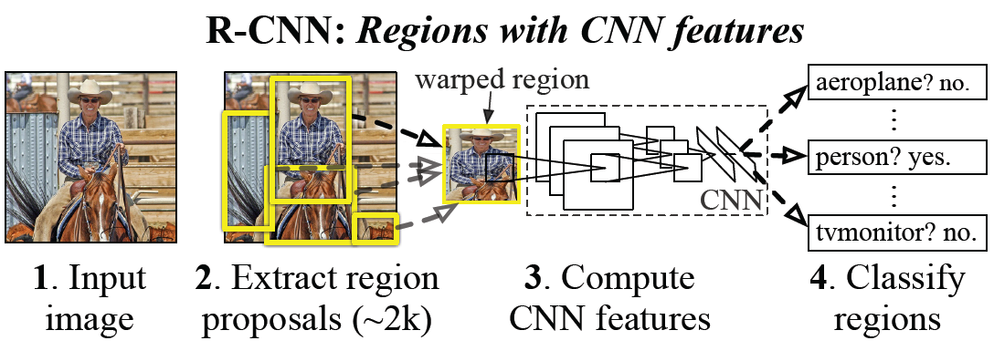
CNN features for detection
Object detection system overview. Our system (1) takes an input image, (2) extracts around 2000 bottom-up region proposals, (3) computes features for each proposal using a large convolutional neural network (CNN), and then (4) classifies each region using class-specific linear SVMs. R-CNN achieves a mean average precision (mAP) of 53.7% on PASCAL VOC 2010. For comparison, Uijlings et al. (2013) report 35.1% mAP using the same region proposals, but with a spatial pyramid and bag-of-visual-words approach. The popular deformable part models perform at 33.4%.
R. Girshick, J. Donahue, T. Darrell, and J. Malik, Rich Feature Hierarchies for Accurate Object Detection and Semantic Segmentation, CVPR 2014.
Lana Lazebnik

Slide 9
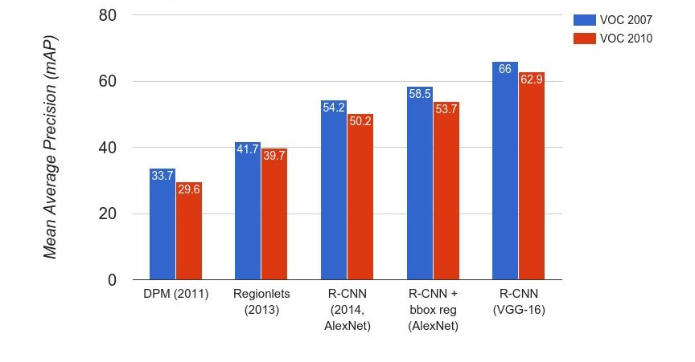
Object Detection
Andrej Karpathy

Slide 10
Object Detection
 | R-CNN | Fast R-CNN
Training Time: | 84 hours | 9.5 hours
(Speedup) | 1x | 8.8x
Test time per image | 47 seconds | 0.32 seconds
(Speedup) | 1x | 146x
mAP (VOC 2007) | 66.0 | 66.9
Faster!
FASTER!
Better!
Using VGG-16 CNN on Pascal VOC 2007 dataset
Andrej Karpathy

Slide 11
Beyond classification
Detection
Segmentation
Regression
Pose estimation
Synthesis
and many more…
Adapted from Jia-bin Huang

Slide 12
What are CNNs?
Convolutional neural networks are a type of neural network
The neural network includes layers that perform special operations
Used in vision, but to a lesser extent also in NLP, biomedical, etc.
Often they are deep

Slide 13
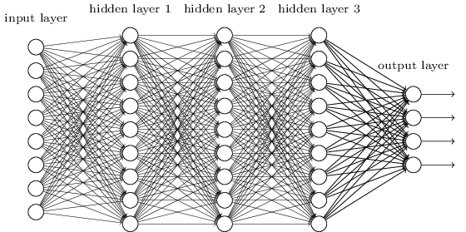
Deep neural network
Figure from http://neuralnetworksanddeeplearning.com/chap5.html

Slide 14
Traditional Recognition Approach
Hand-designed
feature extraction (e.g. SIFT, HOG)
Trainable
classifier
Image/ Video
Pixels
Object
Class
  Features are key to recent progress in recognition, but research shows they’re flawed…
Where next? Better classifiers? Or keep building more features?
Adapted from Lana Lazebnik

Slide 15
What about learning the features?
  Learn a feature hierarchy all the way from pixels to classifier
  Each layer extracts features from the output of previous layer
  Train all layers jointly
Image/ Video
Pixels
Layer 1
Layer 2
Layer 3
Simple
Classifier
Lana Lazebnik
Notes:
Make clear that classic methods, e.g. convnets are purely supervised.

Slide 16
“Shallow” vs. “deep” architectures
Traditional recognition: “Shallow” architecture
Image/ Video
Pixels
Hand-designed
feature extraction
Trainable
classifier
Object
Class
Deep learning: “Deep” architecture
Image/ Video
Pixels
Layer 1
Layer N
Simple classifier
…
Object Class
Lana Lazebnik

Slide 17
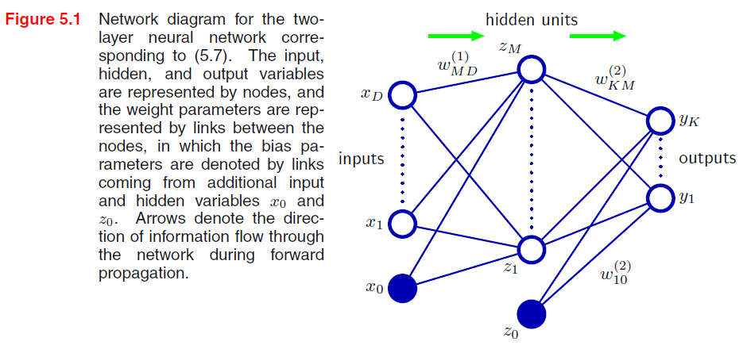



Neural network definition
Activations:
Nonlinear activation function h (e.g. sigmoid, tanh):
Recall SVM:
w^{T}x + b
Figure from Christopher Bishop

Slide 18

Neural network definition
Layer 2
Layer 3 (final)
Outputs
Finally:
(multiclass)
(binary)
(binary)

Slide 19
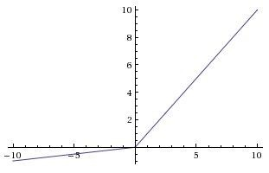
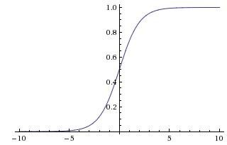

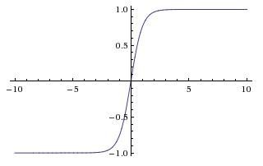


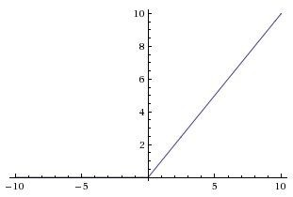
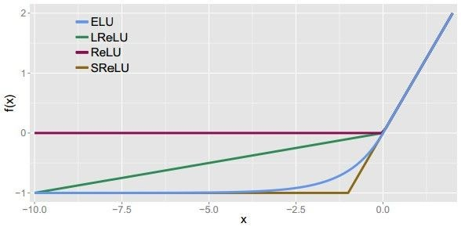
Leaky ReLU
max(0.1x, x)
Activation functions
Sigmoid
Maxout ELU
tanh
tanh(x)
ReLU
max(0,x)
Andrej Karpathy

Slide 20
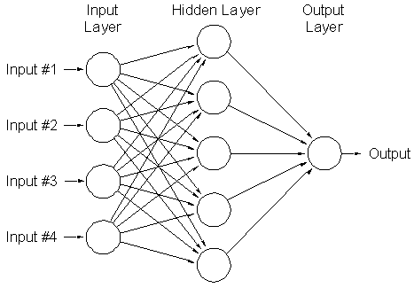
A multi-layer neural network
Nonlinear classifier
Can approximate any continuous function to arbitrary accuracy given sufficiently many hidden units
Lana Lazebnik

Slide 21
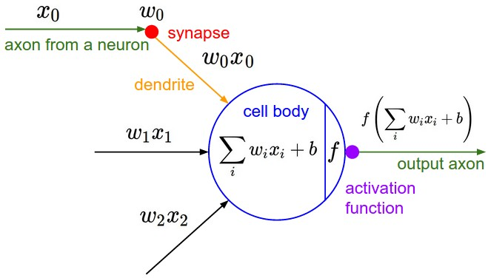
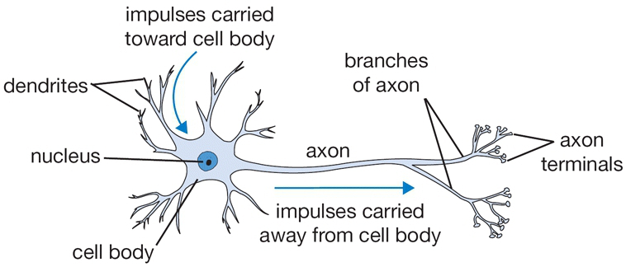
Inspiration: Neuron cells
Neurons
  accept information from multiple inputs,
  transmit information to other neurons.
Multiply inputs by weights along edges
Apply some function to the set of inputs at each node
If output of function over threshold, neuron “fires”
Text: HKUST, figures: Andrej Karpathy
Notes:
From Wikipedia: At the majority of synapses, signals are sent from the axon of one neuron to a dendrite of another... All neurons are electrically excitable, maintaining voltage gradients across their membranes… If the voltage changes by a large enough amount, an all-or-none electrochemical pulse called an action potential is generated, which travels rapidly along the cell's axon, and activates synaptic connections with other cells when it arrives.

Slide 22
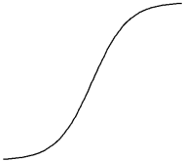
A neuron (perceptron)
Input
Weights
x₁
w₁
x₂
w₂
Output: σ(w⋅x + b)
x₃
w₃
.
.
.
Sigmoid function:
w_{d}
x_{d}
Lana Lazebnik

Slide 23
Types of neurons
Linear Neuron
Logistic Neuron
Θ denotes the same as w!
Perceptron
HKUST

Slide 24
Multilayer networks
Cascade neurons together
Output from one layer is the input to the next
Each layer has its own sets of weights
HKUST

Slide 25
Feed-forward networks
Predictions are fed forward through the network to classify
HKUST

Slide 26
Feed-forward networks
Predictions are fed forward through the network to classify
HKUST

Slide 27
Feed-forward networks
Predictions are fed forward through the network to classify
HKUST

Slide 28
Feed-forward networks
Predictions are fed forward through the network to classify
HKUST

Slide 29
Feed-forward networks
Predictions are fed forward through the network to classify
HKUST

Slide 30
Feed-forward networks
Predictions are fed forward through the network to classify
HKUST

Slide 31
Deep neural networks
Lots of hidden layers
Depth = power (usually)
Weights to learn!
Weights to learn!
Weights to learn!
Weights to learn!
Figure from http://neuralnetworksanddeeplearning.com/chap5.html

Slide 32
How do we train them?
It involves computing gradients
Backpropagation (backprop): Propagates error from output layer to intermediate layers
Goal is to iteratively find such a set of weights that allow the activations to match the desired output
Trained with stochastic gradient descent
We want to minimize a loss function

Slide 33
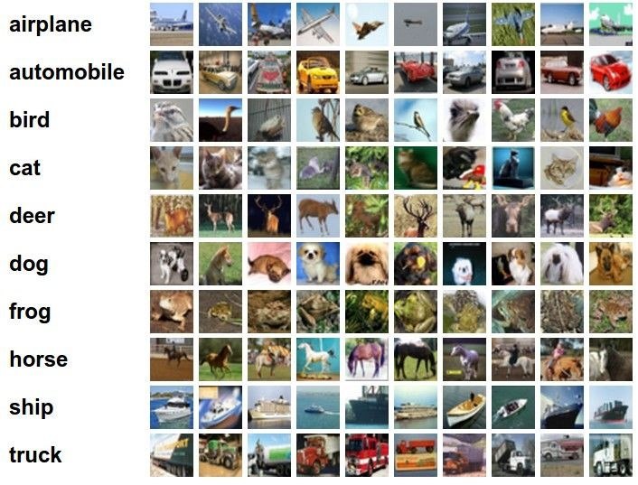
Classification goal
Example dataset: CIFAR-10 10 labels
50,000 training images each image is 32x32x3
10,000 test images.
Andrej Karpathy

Slide 34

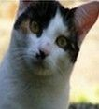
Classification scores
image
parameters
f(x,W)
10 numbers, indicating class scores
[32x32x3]
array of numbers 0...1 (3072 numbers total)
Andrej Karpathy

Slide 35
Linear classifier
SVM: Decision = sign(w^{T}x) = sign(w1*x1 + w2*x2)
x2
x1
(0, 0)
What should the weights be?

Slide 36
Linear classifier
We want to train a “spam or not” classifier
Features are how many times each word occurs
Let’s say you only have 5 words in your vocabulary: “cash”, “bank”, “homework”, “beer”, “book”
Say I want a high score for “spam”, and low score for “not spam”
What would the weights be on each?

Slide 37
Linear classifier
3072x1
(+b)
10x1
10x1
10x3072
10 numbers, indicating class scores
[32x32x3]
array of numbers 0...1
parameters, or “weights”
Andrej Karpathy

Slide 38
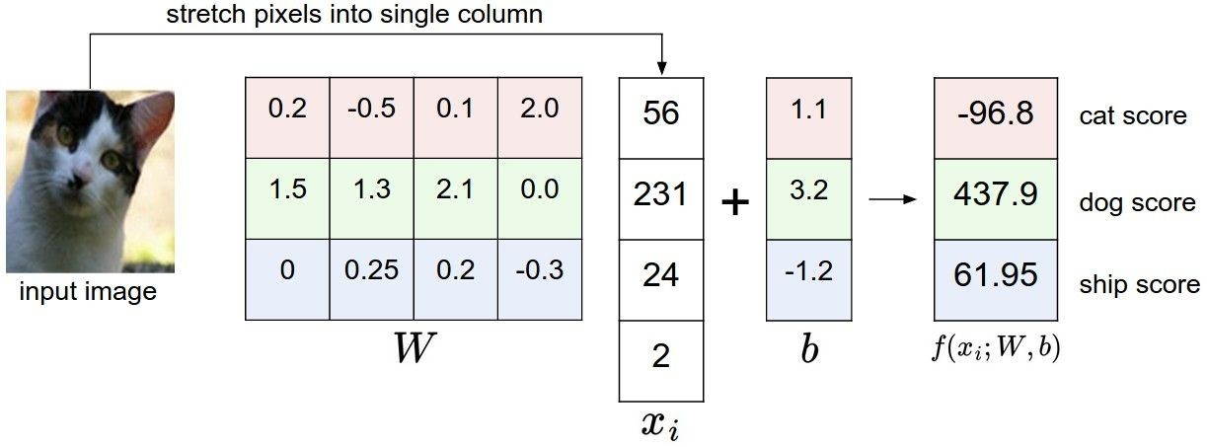
Linear classifier
Example with an image with 4 pixels, and 3 classes (cat/dog/ship)
Andrej Karpathy

Slide 39

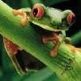
Linear classifier
Going forward: Loss function/Optimization
TODO:
1. Define a loss function that quantifies our unhappiness with the scores across the training data.
-3.45
-8.87
0.09
2.9
4.48
8.02
3.78
1.06
-0.36
-0.72
-0.51
6.04
5.31
-4.22
-4.19
3.58
4.49
-4.37
-2.09
-2.93
3.42
4.64
2.65
5.1
2.64
5.55
-4.34
-1.5
-4.79
6.14
2. Come up with a way of efficiently finding the parameters that minimize the loss function. (optimization)
Andrej Karpathy

Slide 40
Linear classifier
Suppose: 3 training examples, 3 classes. With some W the scores
are:
cat car frog
3.2
5.1
-1.7
1.3
4.9
2.0
2.2
2.5
-3.1
Andrej Karpathy

Slide 41





Linear classifier: SVM loss
Suppose: 3 training examples, 3 classes. With some W the scores
Multiclass SVM loss:
Given an example
are:
where where
is the image and
is the (integer) label,
and using the shorthand for the scores vector:
cat car frog
the SVM loss has the form:
3.2
5.1
-1.7
1.3
4.9
2.0
2.2
2.5
-3.1
Andrej Karpathy

Slide 42
Linear classifier: SVM loss
Suppose: 3 training examples, 3 classes. With some W the scores
Multiclass SVM loss:
Given an example
are:
where where
is the image and
is the (integer) label,
and using the shorthand for the scores vector:
the SVM loss has the form:
cat car frog | 3.2 5.1 -1.7 | 1.3 2.2 4.9 2.5 2.0 -3.1
Losses: | 2.9
= max(0, 5.1 - 3.2 + 1)
+max(0, -1.7 - 3.2 + 1)
= max(0, 2.9) + max(0, -3.9)
= 2.9 + 0
= 2.9
Andrej Karpathy

Slide 43
Linear classifier: SVM loss
Suppose: 3 training examples, 3 classes. With some W the scores
Multiclass SVM loss:
Given an example
are:
where where
is the image and
is the (integer) label,
and using the shorthand for the scores vector:
the SVM loss has the form:
cat 3.2 car 5.1 frog -1.7 | 1.3 4.9 2.0 | 2.2 2.5 -3.1
Losses: 2.9 | 0
= max(0, 1.3 - 4.9 + 1)
+max(0, 2.0 - 4.9 + 1)
= max(0, -2.6) + max(0, -1.9)
= 0 + 0
= 0
Andrej Karpathy

Slide 44
Linear classifier: SVM loss
Suppose: 3 training examples, 3 classes. With some W the scores
Multiclass SVM loss:
Given an example
are:
where where
is the image and
is the (integer) label,
and using the shorthand for the scores vector:
the SVM loss has the form:
cat car frog | 3.2 5.1 -1.7 | 1.3 4.9 2.0 | 2.2 2.5 -3.1
Losses: | 2.9 | 0 | 10.9
= max(0, 2.2 - (-3.1) + 1)
+max(0, 2.5 - (-3.1) + 1)
= max(0, 5.3) + max(0, 5.6)
= 5.3 + 5.6
= 10.9
Andrej Karpathy

Slide 45

Linear classifier: SVM loss
Suppose: 3 training examples, 3 classes. With some W the scores
Multiclass SVM loss:
Given an example
are:
where where
is the image and
is the (integer) label,
and using the shorthand for the scores vector:
cat car frog
the SVM loss has the form:
3.2
5.1
-1.7
1.3
4.9
2.0
2.2
2.5
-3.1
and the full training loss is the mean over all examples in the training data:
L = (2.9 + 0 + 10.9)/3
Losses:
2.9
0
10.9
= 4.6
Lecture 3 - 12
Andrej Karpathy

Slide 46
Linear classifier: SVM loss
Andrej Karpathy

Slide 47


Linear classifier: SVM loss
λ = regularization strength (hyperparameter)
Weight Regularization
In common use: L2 regularization L1 regularization
Dropout (will see later)
Adapted from Andrej Karpathy

Slide 48



Another loss: Softmax
scores = unnormalized log probabilities of the classes.
where
cat car frog
Want to maximize the log likelihood, or (for a loss function) to minimize the negative log likelihood of the correct class:
3.2
5.1
-1.7
Andrej Karpathy

Slide 49

Another loss: Softmax
unnormalized probabilities
cat car frog
3.2 5.1 -1.7 | exp
0.13
0.87
0.00
24.5
164.0
0.18
L_i = -log(0.13)
= 0.89
normalize
unnormalized log probabilities
probabilities
Andrej Karpathy

Slide 50
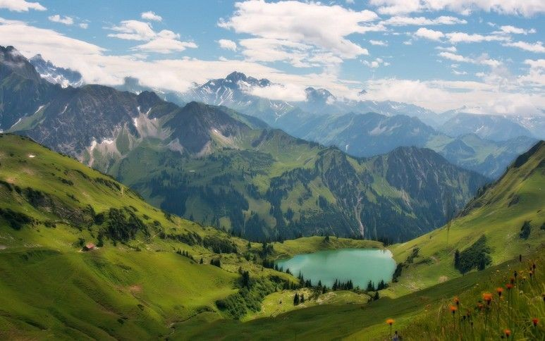

How to minimize the loss function?
Andrej Karpathy

Slide 51

How to minimize the loss function?
In 1-dimension, the derivative of a function:
In multiple dimensions, the gradient is the vector of (partial derivatives).
Andrej Karpathy

Slide 52
current W:
gradient dW:
[0.34,
-1.11,
0.78,
0.12,
0.55,
2.81,
-3.1,
-1.5,
0.33,…]
loss 1.25347
[?,
?,
?,
?,
?,
?,
?,
?,
?,…]
Andrej Karpathy

Slide 53
current W:
W + h (first dim):
gradient dW:
[0.34,
-1.11,
0.78,
0.12,
0.55,
2.81,
-3.1,
-1.5,
0.33,…]
loss 1.25347
[0.34 + 0.0001,
-1.11,
0.78,
0.12,
0.55,
2.81,
-3.1,
-1.5,
0.33,…]
loss 1.25322
[?,
?,
?,
?,
?,
?,
?,
?,
?,…]
Andrej Karpathy

Slide 54
current W:
W + h (first dim):
gradient dW:
[0.34,
-1.11,
0.78,
0.12,
0.55,
2.81,
-3.1,
-1.5,
0.33,…]
loss 1.25347
[0.34 + 0.0001,
-1.11,
0.78,
0.12,
0.55,
2.81,
-3.1,
-1.5,
0.33,…]
loss 1.25322
[-2.5,
?,
?,
?,
?,
?,
?,
(1.25322 - 1.25347)/0.0001
= -2.5
?,
?,…]
Andrej Karpathy

Slide 55
current W:
W + h (second dim):
gradient dW:
[0.34,
-1.11,
0.78,
0.12,
0.55,
2.81,
-3.1,
-1.5,
0.33,…]
loss 1.25347
[0.34,
-1.11 + 0.0001,
0.78,
0.12,
0.55,
2.81,
-3.1,
-1.5,
0.33,…]
loss 1.25353
[-2.5,
?,
?,
?,
?,
?,
?,
?,
?,…]
Andrej Karpathy

Slide 56
current W:
W + h (second dim):
gradient dW:
[0.34,
-1.11,
0.78,
0.12,
0.55,
2.81,
-3.1,
-1.5,
0.33,…]
loss 1.25347
[0.34,
-1.11 + 0.0001,
0.78,
0.12,
0.55,
2.81,
-3.1,
-1.5,
0.33,…]
loss 1.25353
[-2.5,
0.6,
?,
?,
?,
?,
?,
?,
(1.25353 - 1.25347)/0.0001
= 0.6
?,…]
Andrej Karpathy

Slide 57
current W:
W + h (third dim):
gradient dW:
[0.34,
-1.11,
0.78,
0.12,
0.55,
2.81,
-3.1,
-1.5,
0.33,…]
loss 1.25347
[0.34,
-1.11,
0.78 + 0.0001,
0.12,
0.55,
2.81,
-3.1,
-1.5,
0.33,…]
loss 1.25347
[-2.5,
0.6,
?,
?,
?,
?,
?,
?,
?,…]
Andrej Karpathy

Slide 58



This is silly. The loss is just a function of W:
want
Andrej Karpathy

Slide 59

This is silly. The loss is just a function of W:
want
Calculus
= ...
Andrej Karpathy

Slide 60
current W:
gradient dW:
[0.34,
-1.11,
0.78,
0.12,
0.55,
2.81,
-3.1,
-1.5,
0.33,…]
loss 1.25347
[-2.5,
0.6,
0,
0.2,
0.7,
-0.5,
1.1,
1.3,
-2.1,…]
dW = ...
(some function data and W)
Andrej Karpathy

Slide 61
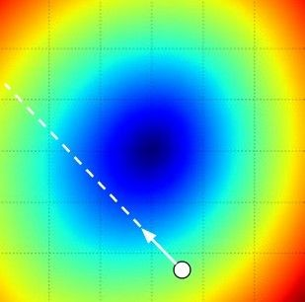
W_2
original W
W_1
negative gradient direction
Andrej Karpathy

Slide 62
Gradient descent in multi-layer nets
We’ll update weights
Move in direction opposite to gradient:
L
Time
Learning rate

Slide 63
How to minimize the loss function?
Use gradient descent
Iteratively subtract the gradient with respect to the model parameters (w)
I.e. we’re moving in a direction opposite to the gradient of the loss
I.e. we’re moving towards smaller loss

Slide 64
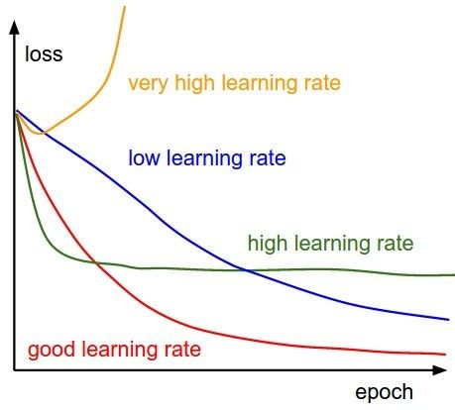
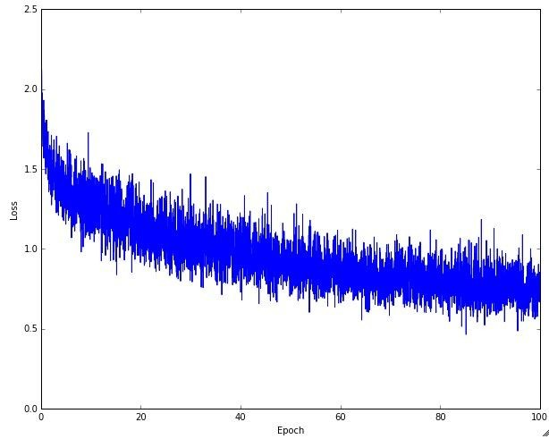
Learning rate selection
The effects of step size (or “learning rate”)
Andrej Karpathy

Slide 65
Mini-batch gradient descent
In classic gradient descent, we compute the gradient from the loss for all training examples
Could also only use some of the data for each gradient update, then cycle through all training samples
Allows faster training (e.g. on GPUs), parallelization

Slide 66
Gradient descent in multi-layer nets
We’ll update weights
Move in direction opposite to gradient:
How to update the weights at all layers?
Answer: backpropagation of error from higher layers to lower layers
L

Slide 67
Backpropagation general algorithm
(Using sigmoid activations, two-layer net)
Initialize all weights to small random values
Until convergence (error stops decreasing) repeat:
  For each (x, t=class(x)) in training set:
    Calculate network outputs: y_{k}
    Compute errors (gradients wrt activations) for each unit:
      δ_{k} := y_{k} (1-y_{k}) (t_{k} - y_{k}) for output units
      δ_{j} := y_{k} (1-y_{k}) ∑_{k} w_{kj} δ_{k} for hidden units
    Update weights:
      w_{kj} ← w_{kj} - η δ_{k} z_{j} for output units
      w_{ji} ← w_{ji} - η δ_{j} x_{i} for hidden units
Adapted from Rebecca Hwa and Ray Mooney

Slide 68

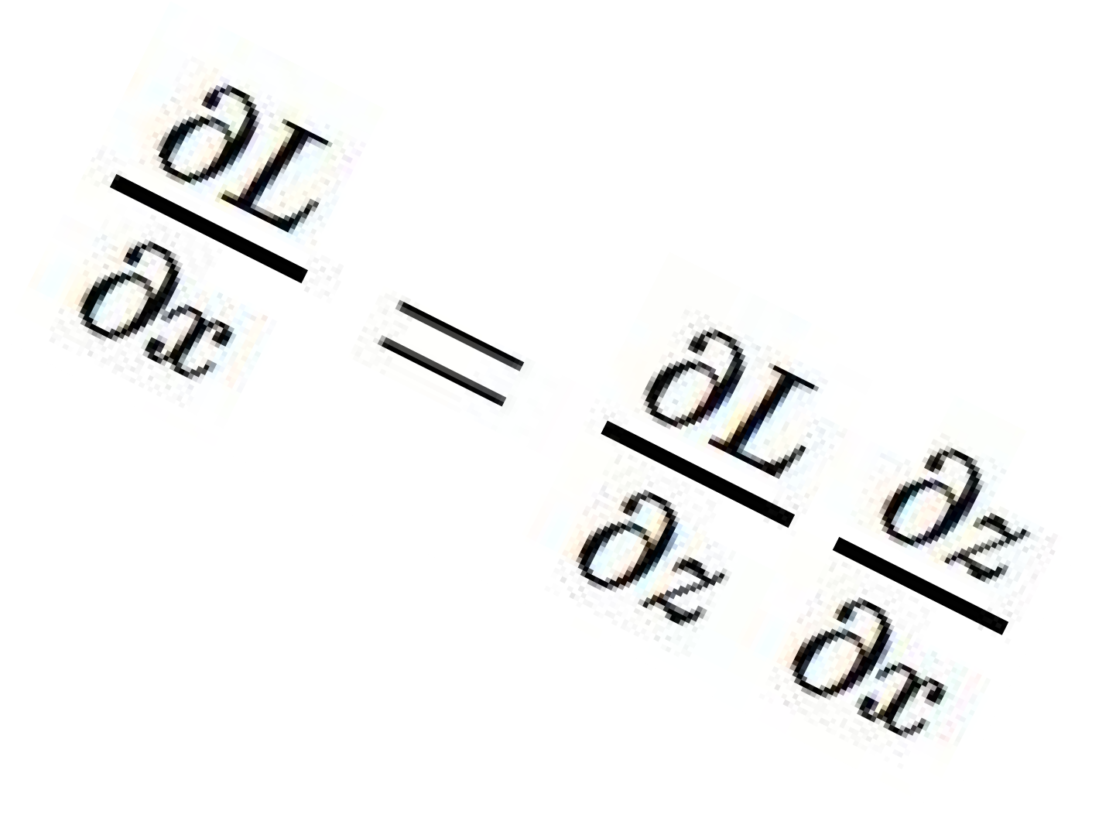




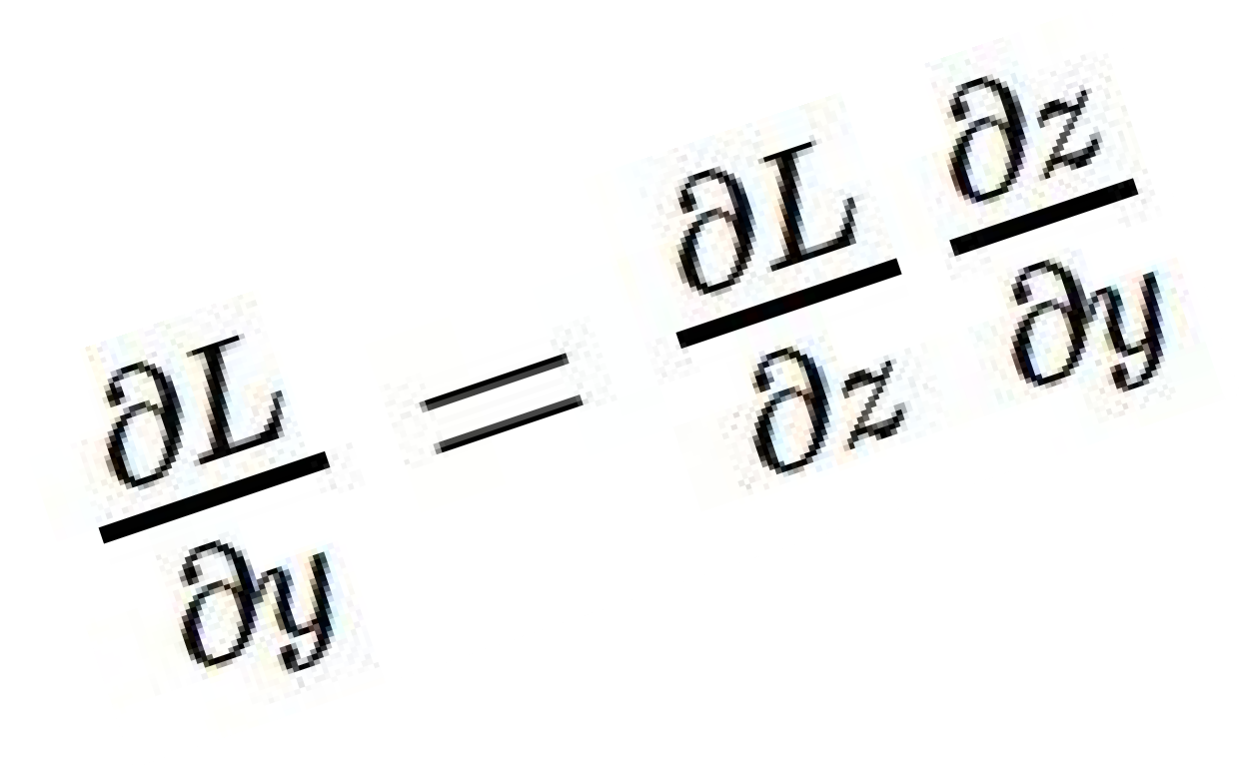
activations
Backpropagation
“local gradient”
f
gradients
Entire lecture on backpropagation:
Karpathy Lecture 4 (second video I sent you)
Andrej Karpathy

Slide 69
Comments on training algorithm
Not guaranteed to converge to zero training error, may converge to local optima or oscillate indefinitely.
However, in practice, does converge to low error for many large networks on real data.
Thousands of epochs (epoch = network sees all training data once) may be required, hours or days to train.
To avoid local-minima problems, run several trials starting with different random weights (random restarts), and take results of trial with lowest training set error.
May be hard to set learning rate and to select number of hidden units and layers.
Neural networks had fallen out of fashion in 90s, early 2000s; back with a new name and significantly improved performance (deep networks trained with dropout and lots of data).
Ray Mooney, Carlos Guestrin, Dhruv Batra

Slide 70
Over-training prevention
Running too many epochs can result in over-fitting.
Keep a hold-out validation set and test accuracy on it after every epoch. Stop training when additional epochs actually increase validation error.
error
on test data
on training data
0
# training epochs
Adapted from Ray Mooney

Slide 71
Determining best number of hidden units
Too few hidden units prevents the network from adequately fitting the data.
Too many hidden units can result in over-fitting.
Use internal cross-validation to empirically determine an optimal number of hidden units.
error
on test data
on training data
0
# hidden units
Ray Mooney

Slide 72
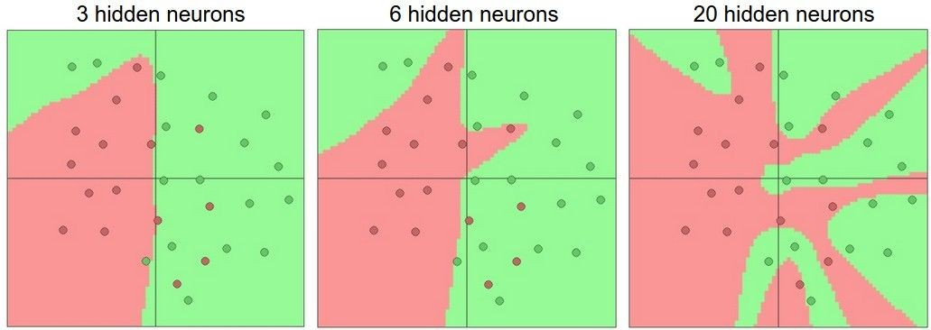
Effect of number of neurons
more neurons = more capacity
Andrej Karpathy

Slide 73
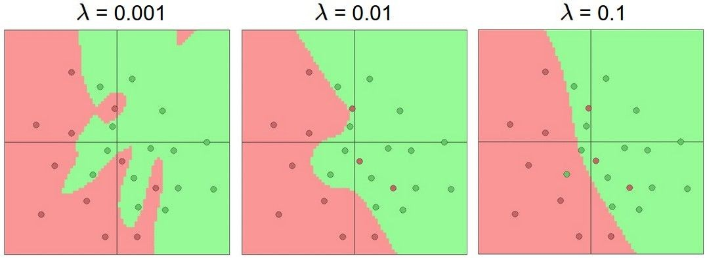
Do not use size of neural network as a regularizer. Use stronger regularization instead:
Effect of regularization
(you can play with this demo over at ConvNetJS: http://cs.stanford. edu/people/karpathy/convnetjs/demo/classify2d.html)
Andrej Karpathy

Slide 74
Hidden unit interpretation
Trained hidden units can be seen as newly constructed features that make the target concept linearly separable in the transformed space.
On many real domains, hidden units can be interpreted as representing meaningful features such as vowel detectors or edge detectors, etc.
However, the hidden layer can also become a distributed representation of the input in which each individual unit is not easily interpretable as a meaningful feature.
Ray Mooney

