Slide 1
CS 1674: Intro to Computer Vision
Attributes
Prof. Adriana Kovashka
University of Pittsburgh
November 2, 2016

Slide 2
Plan for today
What are attributes and why are they useful? (paper 1)
Attributes for zero-shot recognition (paper 2)
Attributes for image search (paper 3)

Slide 3
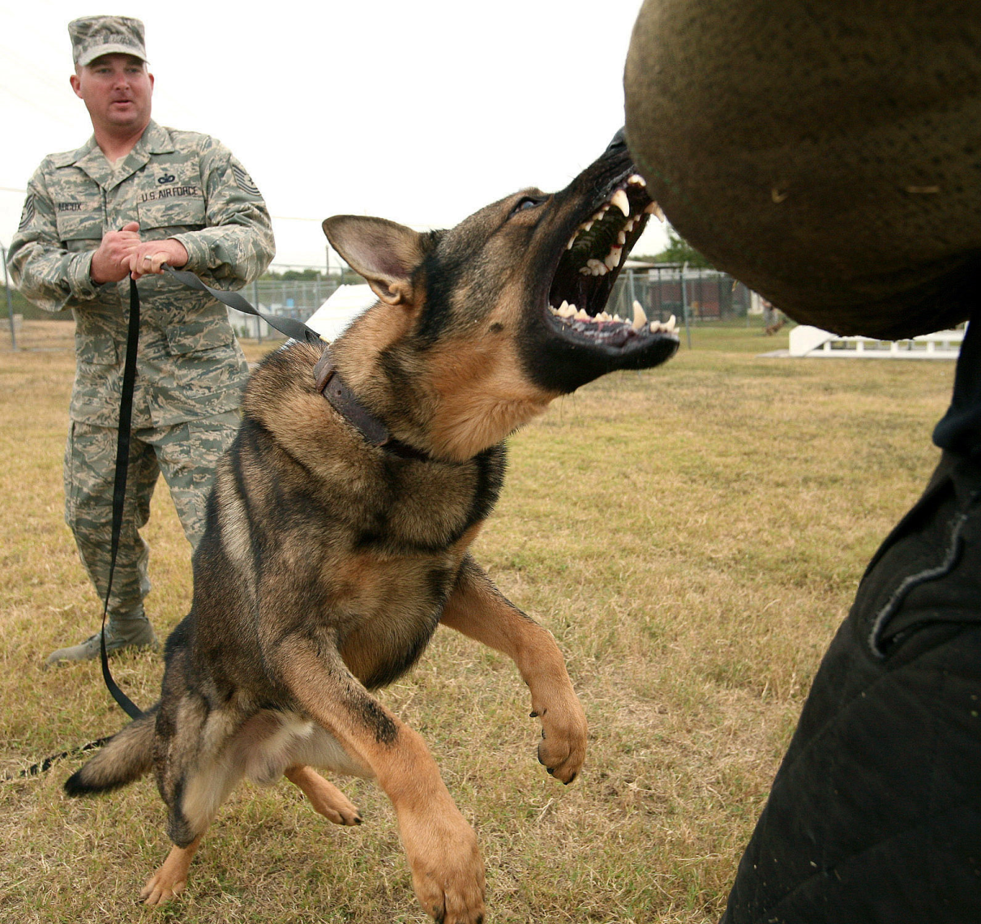
What do we want to know about this object?
Derek Hoiem

Slide 4
What do we want to know about this object?
Object recognition expert:
“Dog”
Derek Hoiem

Slide 5
What do we want to know about this object?
Object recognition expert:
“Dog”
Person in the Scene:
“Big pointy teeth”, “Can move fast”, “Looks angry”
Derek Hoiem

Slide 6

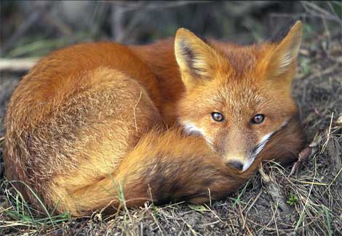
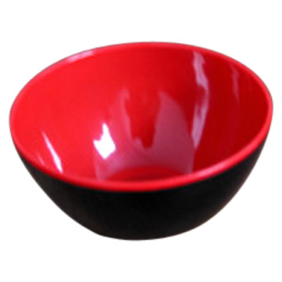
Our Goal: Infer Object Properties
Can I poke with it?
Can I put stuff in it?
Is it alive?
What shape is it?
Is it soft?
Does it have a tail?
Will it blend?
Farhadi, Endres, Hoiem, Forsyth, CVPR 2009
Derek Hoiem

Slide 7
Why Infer Properties
We want detailed information about objects
“Dog”
vs.
“Large, angry animal with pointy teeth”
Derek Hoiem

Slide 8
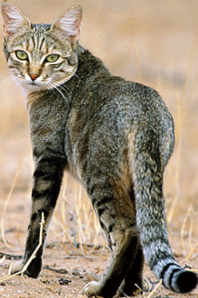
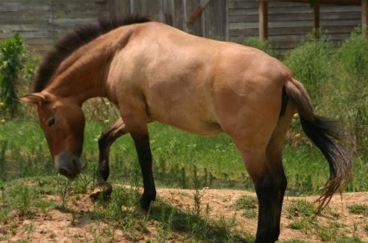
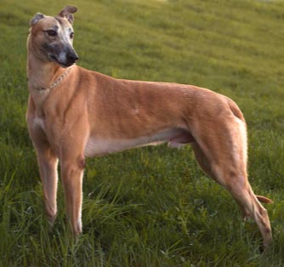
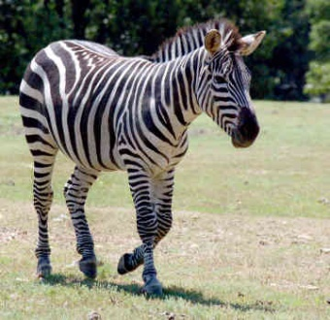
Why Infer Properties
2. We want to be able to infer something about unfamiliar objects
If we can infer category names…
Familiar Objects
New Object
Cat
Horse
Dog
???
Derek Hoiem

Slide 9
Why Infer Properties
2. We want to be able to infer something about unfamiliar objects
If we can infer properties…
Familiar Objects
New Object
Has Stripes
Has Ears
Has Eyes
….
Has Four Legs
Has Mane
Has Tail
Has Snout
….
Brown
Muscular
Has Snout
….
Has Stripes (like cat)
Has Mane and Tail (like horse)
Has Snout (like horse and dog)
Derek Hoiem

Slide 10
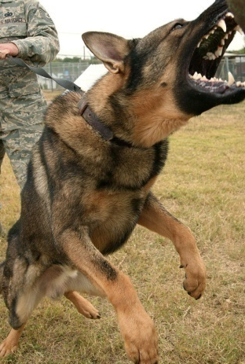


Why Infer Properties
3. We want to make comparisons between objects or categories
What is unusual about this dog?
What is the difference between horses and zebras?
Derek Hoiem

Slide 11
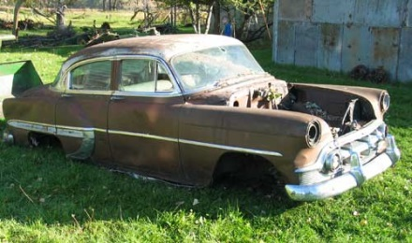
Strategy 1: Category Recognition
Object Image
Category
associated properties
Has Wheels
Used for Transport
Made of Metal
Has Windows
…
classifier
“Car”
Derek Hoiem
Notes:
Note that much work on recognition, but little on inferring attributes

Slide 12
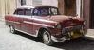
Strategy 2: Exemplar Matching
Object Image
Similar Image
similarity function
associated properties
Has Wheels
Used for Transport Made of Metal
Old
…
Derek Hoiem
Notes:
Note that much work on recognition, but little on inferring attributes

Slide 13

Strategy 3: Infer Properties Directly
Object Image
No Wheels
Old
Brown
Made of Metal
…
classifier for each attribute
Derek Hoiem
Notes:
Note that much work on recognition, but little on inferring attributes

Slide 14
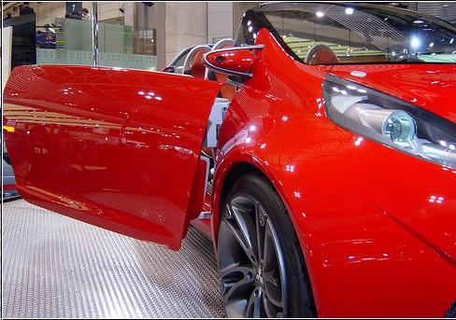
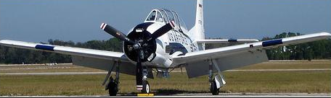
Attribute Examples
Shape: Horizontal Cylinder
Part: Wing, Propeller, Window, Wheel
Material: Metal, Glass
Shape:
Part: Window, Wheel, Door, Headlight, Side Mirror
Material: Metal, Shiny
Derek Hoiem

Slide 15
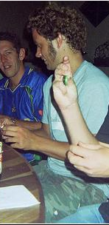
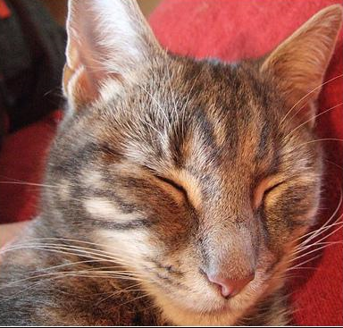
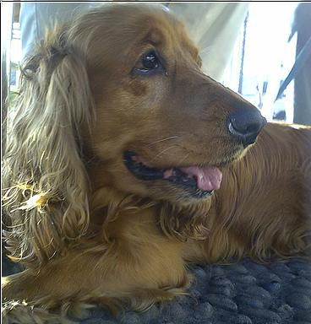
Attribute Examples
Shape:
Part: Head, Ear, Nose, Mouth, Hair, Face, Torso, Hand, Arm
Material: Skin, Cloth
Shape:
Part: Head, Ear, Snout, Eye
Material: Furry
Shape:
Part: Head, Ear, Snout, Eye, Torso, Leg
Material: Furry
Derek Hoiem

Slide 16
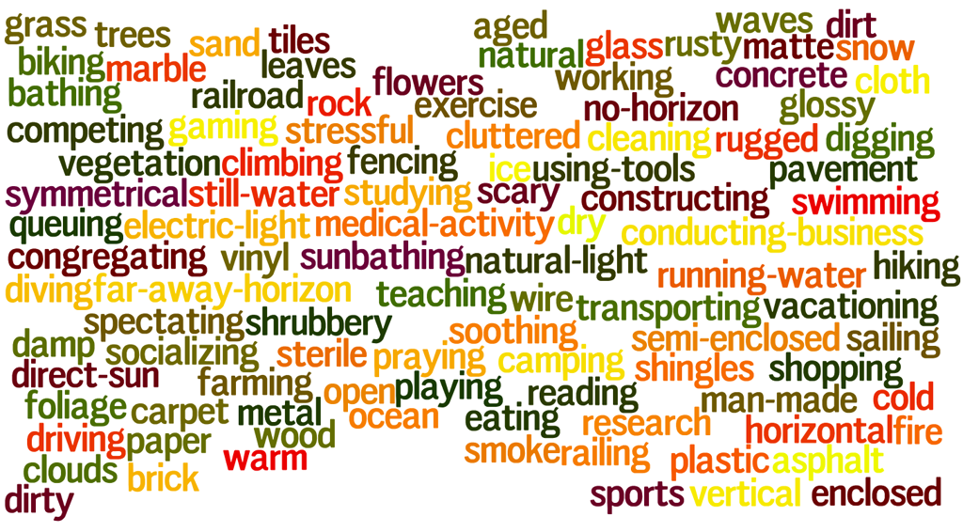
Scene Attributes
Derek Hoiem

Slide 17
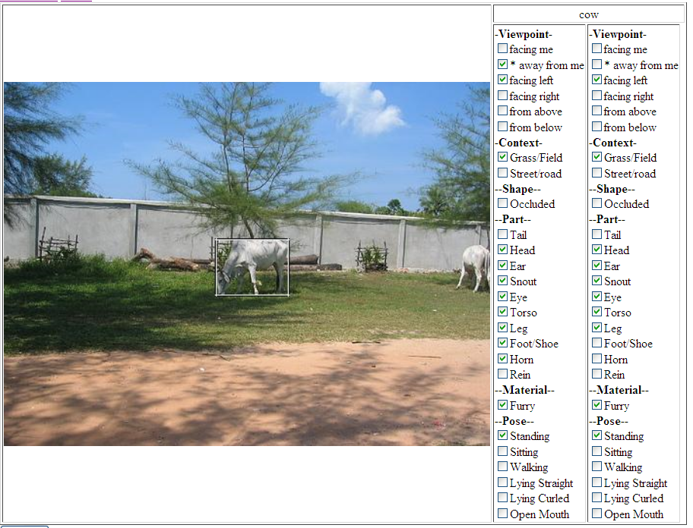
Annotation on Amazon Turk
Derek Hoiem

Slide 18
Features
Strategy: cover our bases
Spatial pyramid histograms of quantized
  Color and texture for materials
  Histograms of gradients (HOG) for parts
  Canny edges for shape
Derek Hoiem

Slide 19
Learning Attributes
Learn to distinguish between things that have an attribute and things that do not
Train one classifier (linear SVM) per attribute
Derek Hoiem

Slide 20
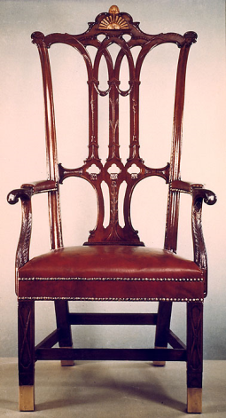
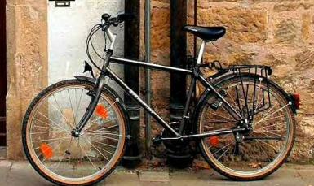
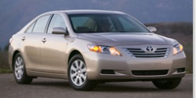

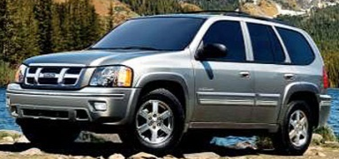
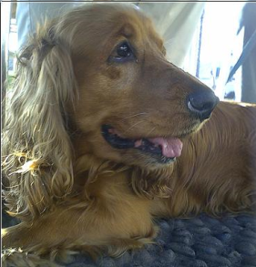

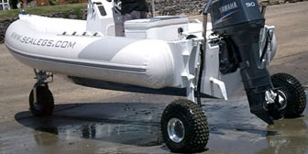
Learning Attributes
Simplest approach: Train classifier using all features for each attribute independently
“Has Wheels”
“No Wheels Visible”
Derek Hoiem

Slide 21
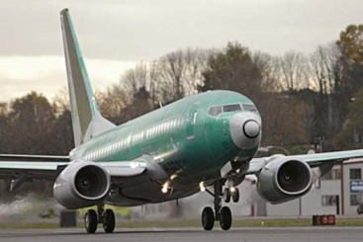
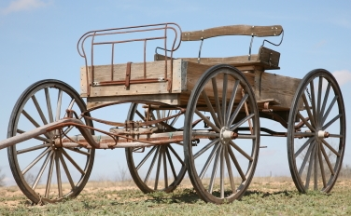
Dealing with Correlated Attributes
Big Problem: Many attributes are strongly correlated through the object category
Most things that “have wheels” are “made of metal”
When we try to learn “has wheels”, we may accidentally learn “made of metal”
Has Wheels, Made of Metal?
Derek Hoiem

Slide 22
Attribute Prediction: Quantitative Analysis
Area Under the ROC for Familiar (PASCAL) vs. Unfamiliar (Yahoo) Object Classes
Worst
Wing
Handlebars
Leather
Clear
Cloth
Best
Eye
Side Mirror
Torso
Head
Ear
Derek Hoiem

Slide 23
Describing Objects by their Attributes
No examples from these object categories were seen during training
Derek Hoiem

Slide 24
Describing Objects by their Attributes
No examples from these object categories were seen during training
Derek Hoiem

Slide 25
Semantic vs Discriminative Attributes
Semantic attributes not enough
  74% accuracy even with ground truth attributes
Introduce discriminative attributes
  Trained by selecting subset of classes and features
    Dogs vs. sheep using color
    Cars and buses vs. motorbikes and bicycles using edges
  Train 10,000 and select 1,000 most reliable, according to a validation set
Derek Hoiem

Slide 26
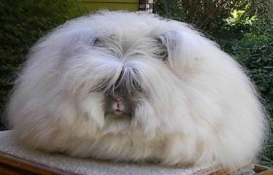
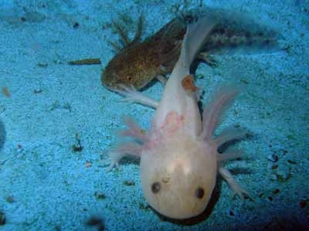
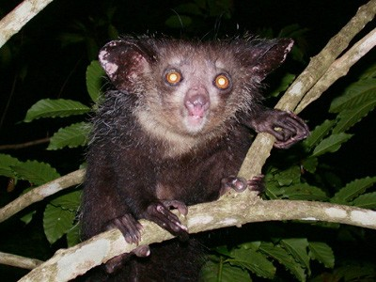
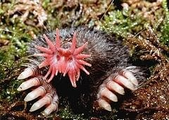
Image Classification: Visual examples
Introduction
Which image shows an axolotl?
Thomas Mensink

Slide 27
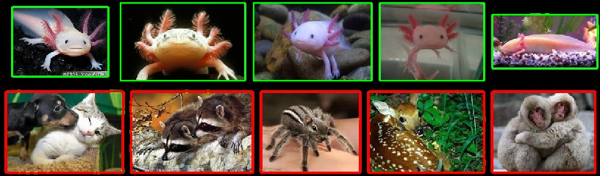
Image Classification: Visual examples
Introduction
Which image shows an axolotl?
Traindata:
Thomas Mensink

Slide 28
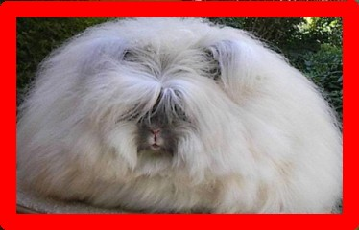
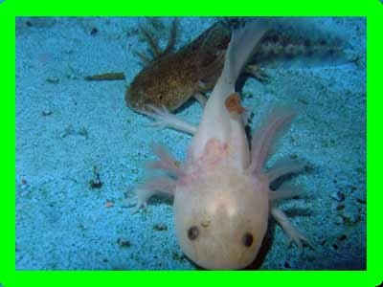
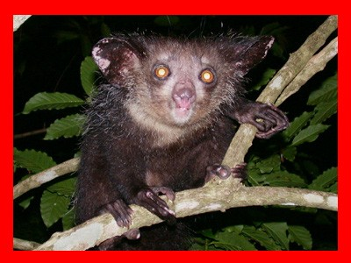
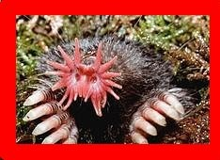
Image Classification: Visual examples
Introduction
Which image shows an axolotl?
Traindata:
We can classify based on visual examples
Thomas Mensink

Slide 29
Image Classification: Textual descriptions
Introduction
Which image shows an aye-aye?
Thomas Mensink

Slide 30
Image Classification: Textual descriptions
Introduction
Which image shows an aye-aye?
Description, Aye-aye . . .
is nocturnal lives in trees has large eyes
has long middle fingers
Lampert, Nickisch, Harmeling, CVPR 2009
Thomas Mensink

Slide 31
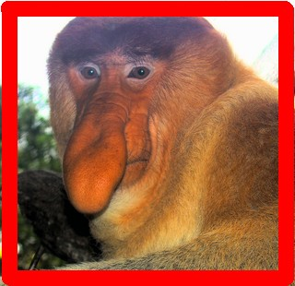
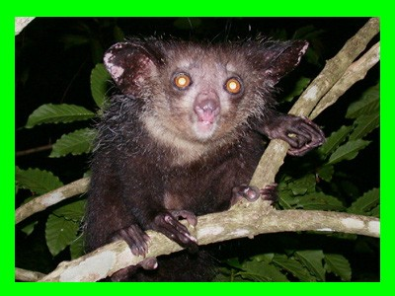
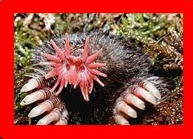
Image Classification: Textual descriptions
Introduction
Which image shows an aye-aye?
Description, Aye-aye . . .
is nocturnal lives in trees has large eyes
has long middle fingers
We can classify based on textual descriptions
Thomas Mensink

Slide 32
Attribute-Based Classification
Introduction
Definition
Classification using a class description in terms of semantic properties or attributes
Thomas Mensink

Slide 33
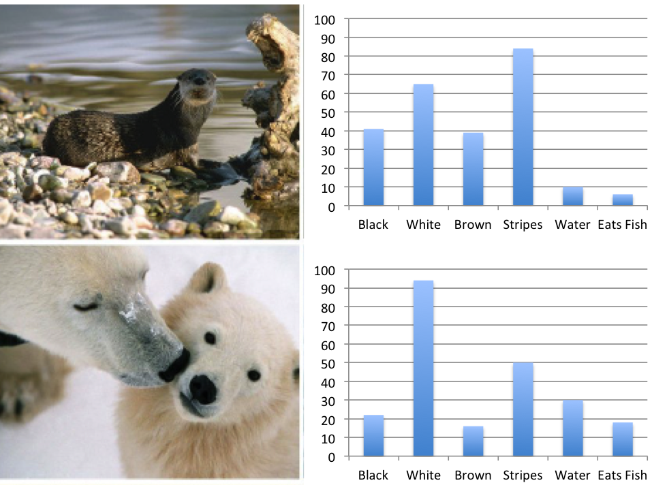
Attribute-Based Classification: Properties
Introduction
Semantic interpretable representation Dimension reduction:
1.high-dimensional low-level features 2.low-dimensional semantic representation
Thomas Mensink

Slide 34
Attribute-Based Classification: Requirements
Introduction
Vocabulary of Attributes and Attribute-to-class Mapping Attribute predictors
Learning model to make decision
Thomas Mensink

Slide 35
Zero-shot recognition
Introduction
Goal: Classify images into classes which we have never seen Assumption 1: Text descriptions of unseen+related classes Assumption 2: Visual examples from related classes.
Thomas Mensink

Slide 36
Zero-shot recognition (2)
Introduction
Vocabulary of attributes and class descriptions:
Aye-ayes have properties X, and Y, but not Z
Train classifiers for each attibute X, Y, Z.
From visual examples of related classes
Make image attributes predictions:
4.Combine into decision: this image is not an Aye-aye
Thomas Mensink

Slide 37
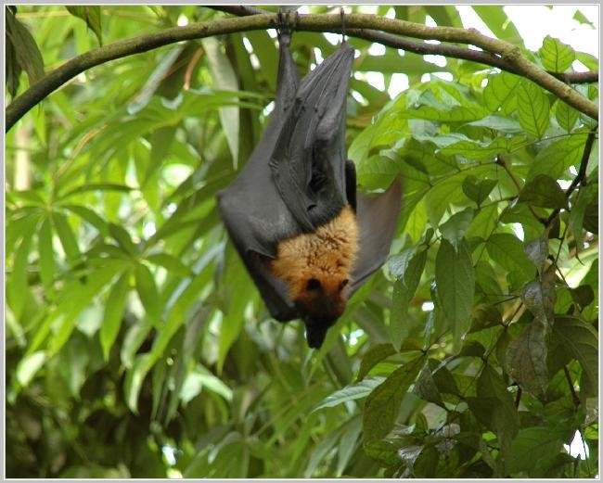
Zero-shot recognition (2)
Introduction
P (X|img) = 0.8
⇒ P (Y |img) = 0.3
P (Z|img) = 0.6
Vocabulary of attributes and class descriptions:
Aye-ayes have properties X, and Y, but not Z
Train classifiers for each attibute X, Y, Z.
From visual examples of related classes
Make image attributes predictions:
4.Combine into decision: this image is not an Aye-aye
Thomas Mensink

Slide 38
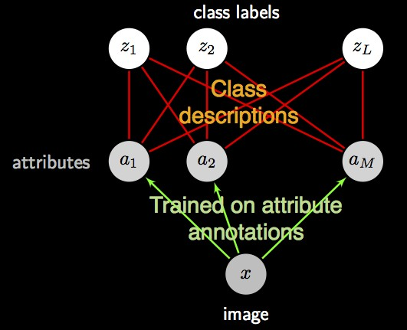
Direct Attribute Prediction (DAP)
Attribute-based classification
Learn attribute classifiers from related classes [Lampert CVPR’09]
Train and test classes are disjoint
Use Attribute-to-class mapping for prediction
Thomas Mensink

Slide 39
DAP: Probabilistic model
Attribute-based classification
Define attribute probability:
.p(a_{m}|x )
if a^{z} = 1
z
m
p(a = a |x ) =
m
m
1 − p(a_{m}|x ) otherwise
Assign a given image to class z∗
See example from HW8P
Adapted from Thomas Mensink

Slide 40




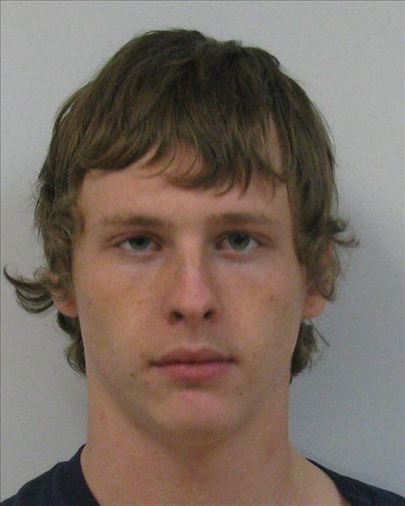


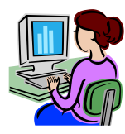


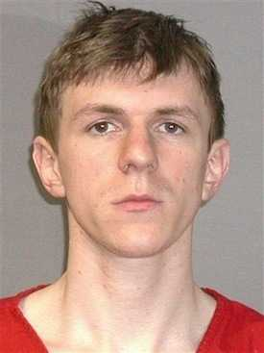

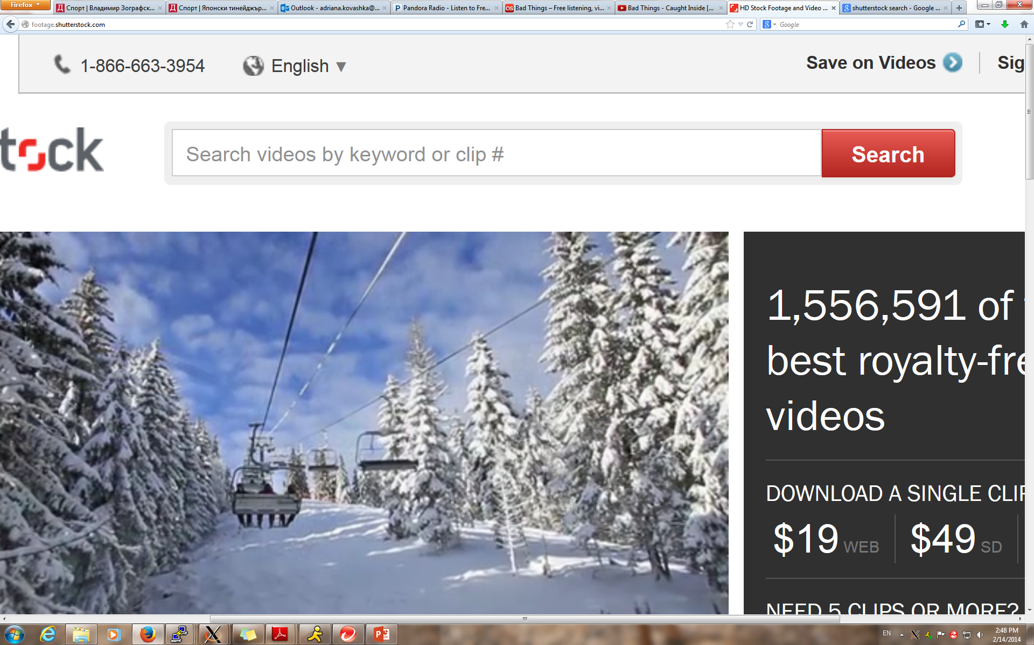
Image Search: Status Quo
Keywords
+ binary relevance feedback
irrelevant
relevant
thin white male
Traditional binary feedback imprecise; allows only coarse communication between user and system
[Rui et al. 1998, Zhou et al. 2003, Tong & Chang 2001, Cox et al. 2000, Ferecatu & Geman 2007, …]
Notes:
6:40 min

Slide 41
Image Search: Using Attributes
“Like this… but with curlier hair”
Allow user to “whittle away” irrelevant images via comparative feedback on properties of results
Kovashka, Parikh, and Grauman, CVPR 2012
Notes:
Instead, we propose a new form of feedback where the user can compare her search target to results images with respect to certain visual properties.

Slide 42
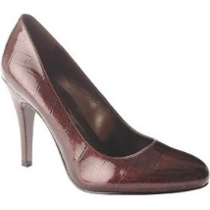
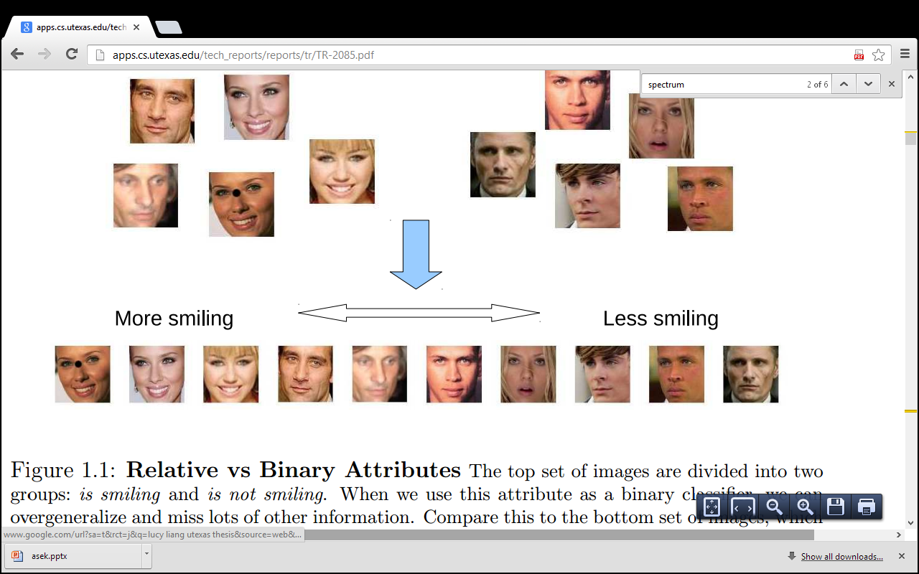
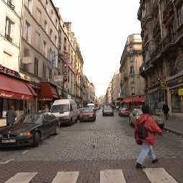
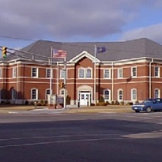
Binary Attributes
bright / not bright
smiling / not smiling
natural / not natural

Slide 43
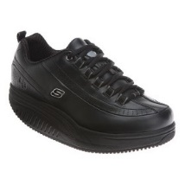
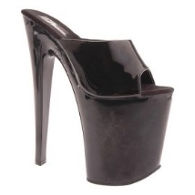
















Relative Attributes
We need ability to compare images by attribute “strength”
bright
smiling
natural

Slide 44
Learning Relative Attributes
At test time, predict attribute strength of each database image
  Input: Image features x
  Output: Real-valued attribute strength a_{m} (x)
At training time, learn a mapping between image features and attribute strength
  Input: Pairs of ordered images with features
  Output: Ranking functions a₁, … , a_{M}
Parikh and Grauman, ICCV 2011

Slide 45


















Learning Relative Attributes
We want to learn a spectrum (ranking model) for an attribute, e.g. “brightness”.
Supervision from human annotators consists of:
Ordered pairs
Similar pairs
Parikh and Grauman, ICCV 2011

Slide 46


Learning Relative Attributes
Learn a ranking function
Image features
Learned parameters
that best satisfies the constraints:

Slide 47


Learning Relative Attributes
Max-margin learning to rank formulation
w_{m}
Image Relative attribute score
Parikh and Grauman, ICCV 2011; Joachims, KDD 2002

Slide 48
Relative Attributes
We need ability to compare images by attribute “strength”
bright
smiling
natural

Slide 49





WhittleSearch with Relative Attribute Feedback
?
Results Page 1
User: “I want something
more natural than this.”
Update relevance
scores
score=5
score=7
score=4
score=4
score=1
Kovashka, Parikh, and Grauman, CVPR 2012

Slide 50


WhittleSearch with Relative Attribute Feedback
“I want something more natural than this.”
perspective
+1
+1
“I want something less natural than this.”
+1
+1
+1
+1
+1
natural
+1
+1
+1
“I want something with more perspective than this.”
+1
Kovashka, Parikh, and Grauman, CVPR 2012

Slide 51










Qualitative Result (Relative Attribute Feedback)
Query: “I want a bright, open shoe that is short
on the leg.”
Selected feedback
More open than
Less high at the heel than
Round 1
More bright in color than
Less ornaments than
Round 2
Round 3
More formal than
More bright in color than
Higher at the heel than
Match
More open than

Slide 52









































Datasets
Data from 147 users
Shoes [Berg10, Kovashka12]:
14,658 shoe images;
10 attributes:
“pointy”, “bright”, “high-heeled”, “feminine” etc.
OSR [Oliva01]:
2,688 scene images;
6 attributes:
“natural”, “perspective”, “open-air”, “close-depth” etc.
PubFig [Kumar08]:
772 face images;
11 attributes:
“masculine”, “young”, “smiling”, “round-face”, etc.
Notes:
While a lot of the illustrations in this talk focus on shoes, we have tested our method extensively on multiple domains, as shown here […]

Slide 53

WhittleSearch Results (Summary)
Binary feedback represents status quo [Rui et al. 1998, Cox et al. 2000, Ferecatu & Geman 2007, …]
WhittleSearch finds relevant results faster than traditional binary feedback

Slide 54

WhittleSearch Demo
Notes:
No pre-tagging

Slide 55


Impact of WhittleSearch: Adobe Font Selection
Users retrieve fonts that match requested attributes
Fonts sorted by relative attribute scores
O’Donovan et al., Exploratory Font Selection using Crowdsourced Attributes, SIGGRAPH 2014

