Slide 1
CS 1674: Intro to Computer Vision
Affine and Projective Transformations
Prof. Adriana Kovashka
University of Pittsburgh
October 3, 2016

Slide 2
Alignment problem
We previously discussed how to match features across images, of the same or different objects
Now let’s focus on the case of “two images of the same object”(e.g. x_{i} and x_{i}’) and examine it in more detail
What transformation relates x_{i} and x_{i}’?
In alignment, we will fit the parameters of some transformation according to a set of matching feature pairs (“correspondences”).
x_{i}
x_{i}
'
T
Adapted from Kristen Grauman and Derek Hoiem

Slide 3
Two questions
Alignment: Given two images, what is the transformation between them?
T
Warping: Given a source image and a transformation, what does the transformed output look like?
T
Kristen Grauman

Slide 4
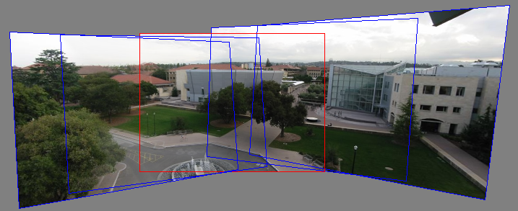
Motivation for feature-based alignment:
Image mosaics
Kristen Grauman
Image from http://graphics.cs.cmu.edu/courses/15-463/2010_fall/

Slide 5
What are the correspondences?
Min SSD = match
?
Compare content in local patches, find best matches.
  Simplest approach:
  Scan x_{i}’ with template formed from a point in x_{i}, and compute Euclidean distance (a.k.a. SSD) or normalized cross-correlation between list of pixel intensities in the patch.
Kristen Grauman

Slide 6
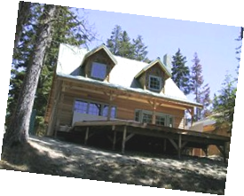
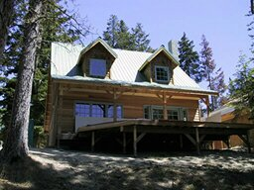
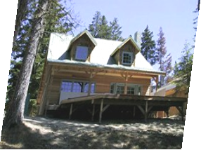
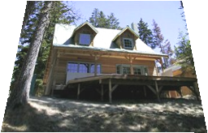
What are the transformations?
Examples of transformations:
translation
rotation
aspect
perspective
affine
Alyosha Efros

Slide 7
Parametric (global) warping
T
p = (x,y)
p’ = (x’,y’)
Transformation T is a coordinate-changing machine:
p’ = T(p)
What does it mean that T is global?
  It is the same for any point p
  It can be described by just a few numbers (parameters)
Let’s represent T as a matrix:
p’ = Mp
Alyosha Efros

Slide 8
Scaling
Scaling a coordinate means multiplying each of its components by a scalar
Uniform scaling means this scalar is the same for all components:
× 2
Alyosha Efros

Slide 9
Scaling
Non-uniform scaling: different scalars per component:
X × 2,
Y × 0.5
Alyosha Efros

Slide 10
Scaling
Scaling operation:
Or, in matrix form:
scaling matrix S
Alyosha Efros

Slide 11
2D Linear Transformations
Only linear 2D transformations can be represented with a 2x2 matrix.
Linear transformations are combinations of …
  Scale,
  Rotation,
  Shear, and
  Mirror
Alyosha Efros

Slide 12

What transforms can we write with a 2x2 matrix?
2D Scaling?
2D Rotate around (0,0)?
2D Shear?
Modified from Alyosha Efros
Fig. from https://www.siggraph.org/education/materials/HyperGraph/modeling/mod_tran/2dshear.htm

Slide 13
More on how to write 2-D rotation
Polar coordinates…
x = r cos (φ)
y = r sin (φ)
x’ = r cos (φ + θ)
y’ = r sin (φ + θ)
Trig Identity…
x’ = r cos(φ) cos(θ) – r sin(φ) sin(θ)
y’ = r sin(φ) cos(θ) + r cos(φ) sin(θ)
Substitute…
x’ = x cos(θ) - y sin(θ)
y’ = x sin(θ) + y cos(θ)
(x’, y’)
(x, y)
θ
φ
Derek Hoiem

Slide 14
What transforms can we write with a 2x2 matrix?
2D Mirror about Y axis?
2D Mirror over (0,0)?
2D Translation?
CAN’T DO!
Alyosha Efros

Slide 15
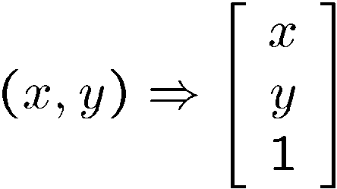
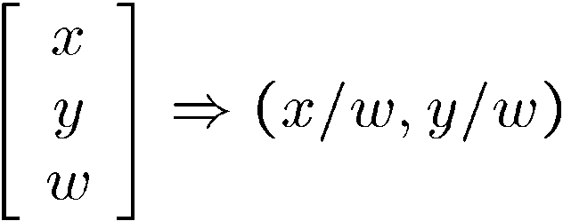
Homogeneous coordinates
To convert to homogeneous coordinates:
homogeneous image
coordinates
Converting from homogeneous coordinates
Kristen Grauman

Slide 16
Translation
Homogeneous Coordinates
t_{x} = 2
t_{y} = 1
Alyosha Efros

Slide 17
2D Affine Transformations
Affine transformations are combinations of …
  Linear transformations, and
  Translations
Maps lines to lines, parallel lines remain parallel
Adapted from Alyosha Efros

Slide 18
Fitting an affine transformation
Assuming we know the correspondences, how do we get the transformation?
Alyosha Efros

Slide 19
Fitting an affine transformation
How many matches (correspondence pairs) do we need to solve for the transformation parameters?
Once we have solved for the parameters, how do we compute given ?
Where do the matches come from?
Modified from Kristen Grauman

Slide 20
Projective Transformations
Projective transformations:
  Affine transformations, and
  Projective warps
Parallel lines do not necessarily remain parallel
Kristen Grauman

Slide 21
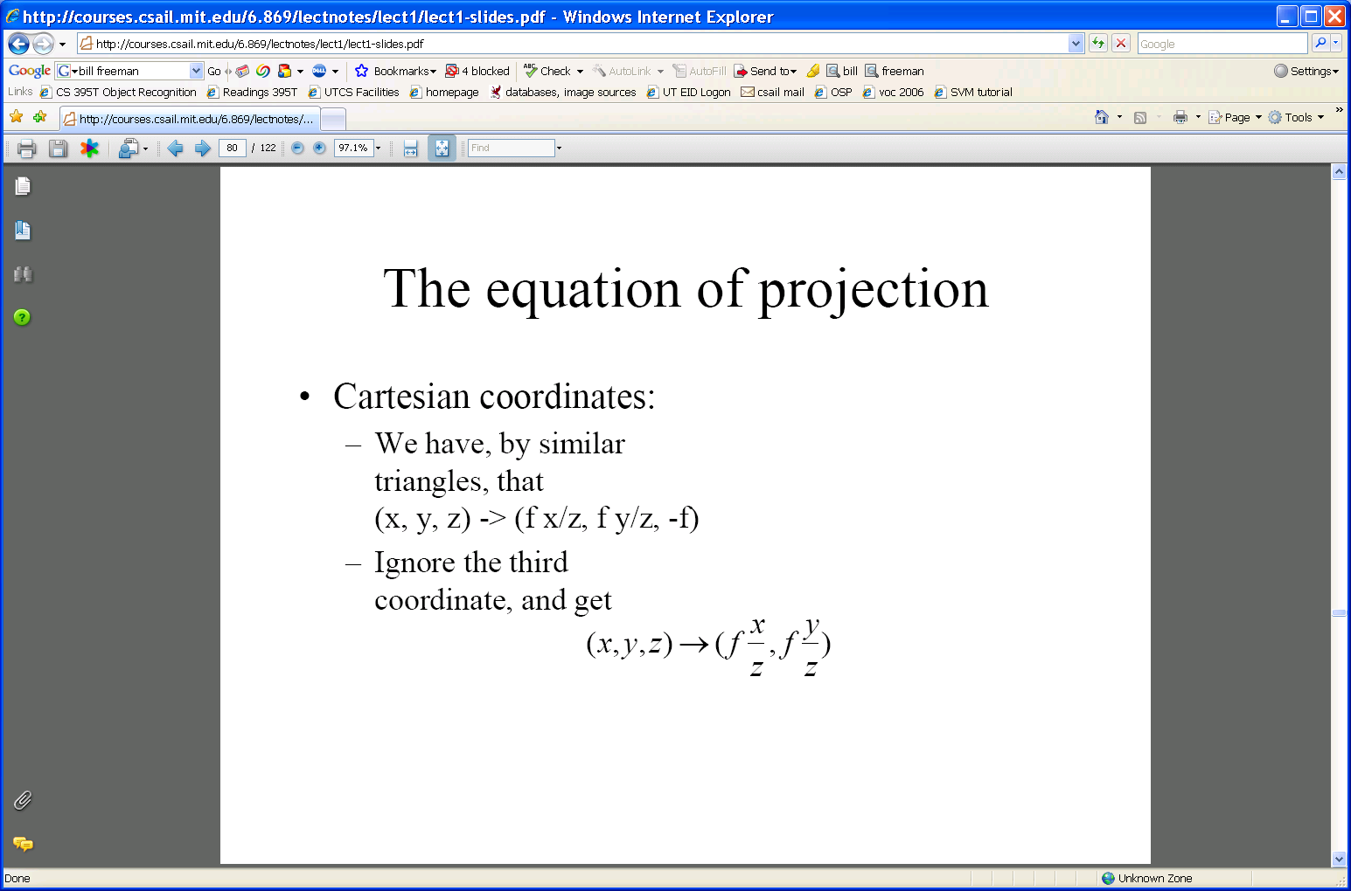
Projection: world coord → image coord
.
Optical center
.
.
y
f'
z
x
.
y’
Camera center
x’
x’
y’
‘’
‘’
Scene point
Image coordinates
Modified from Derek Hoiem and Kristen Grauman

Slide 22
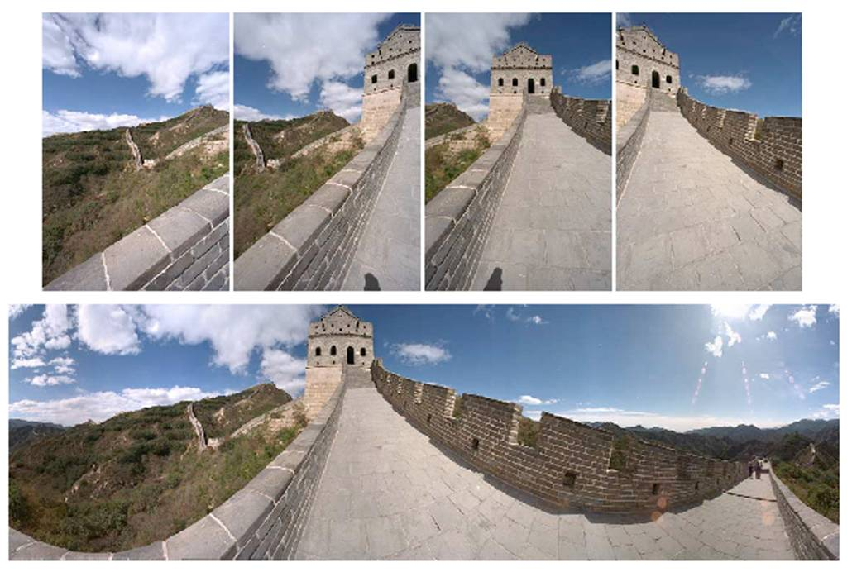
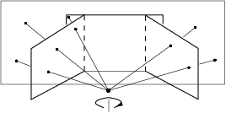

Image mosaics: Goals
. . .
image from S. Seitz
Obtain a wider angle view by combining multiple images.
Kristen Grauman

Slide 23


Image mosaics: Camera setup
Two images with camera rotation/zoom but no translation
Camera Center
Adapted from Derek Hoiem

Slide 24
Mosaic: Many 2D views of same 3D object
mosaic plane
The mosaic has a natural interpretation in 3D
  The images are reprojected onto a common plane
  The mosaic is formed on this plane
  Mosaic is a synthetic wide-angle camera
Steve Seitz

Slide 25
Image reprojection
Basic question
  How to relate two images from the same camera center?
    how to map a pixel from PP1 to PP2
PP2
Answer
  Cast a ray through each pixel in PP1
  Draw the pixel where that ray intersects PP2
Observation:
  Rather than thinking of this as a 3D reprojection, think of it as a 2D image warp from one image to another.
PP1
Alyosha Efros

Slide 26
Projective transforms
A projective transform is a mapping between any two PPs with the same center of projection
  rectangle should map to arbitrary quadrilateral
  parallel lines aren’t
  but preserves straight lines
Also called Homography
PP2
PP1
p’
H
p
Adapted from Alyosha Efros

Slide 27
How to stitch together a panorama (a.k.a. mosaic)?
Basic Procedure
  Take a sequence of images from the same position
    Rotate the camera about its optical center
  Compute the homography (transformation) between second image and first
  Transform the second image to overlap with the first
  Blend the two together to create a mosaic
  (If there are more images, repeat)
Modified from Steve Seitz

Slide 28
Computing the homography
…
…
To compute the homography given pairs of corresponding points in the images, we need to set up an equation where the parameters of H are the unknowns…
Kristen Grauman

Slide 29
Computing the homography
p’ = Hp
Can set scale factor i=1. So, there are 8 unknowns.
Set up a system of linear equations:
Ah = b
where vector of unknowns h = [a,b,c,d,e,f,g,h]^{T}
Need at least 8 eqs, but the more the better…
Solve for h. If overconstrained, solve using least-squares:
Kristen Grauman

Slide 30
Computing the homography
Assume we have four matched points: How do we compute homography H?
p’=Hp
A
Apply SVD: UDV^{T} = A → [U, S, V] = svd(A);
h = V_{smallest} (column of V corr. to smallest singular value)
Derek Hoiem

Slide 31
How to stitch together a panorama (a.k.a. mosaic)?
Basic Procedure
  Take a sequence of images from the same position
    Rotate the camera about its optical center
  Compute the homography (transformation) between second image and first
  Transform the second image to overlap with the first
  Blend the two together to create a mosaic
  (If there are more images, repeat)
Modified from Steve Seitz

Slide 32
Transforming the second image
Image 2
Image 1 canvas
To apply a given homography H
  Compute p’ = Hp (regular matrix multiply)
  Convert p’ from homogeneous to image coordinates
p’
H
p
Modified from Kristen Grauman

Slide 33
Transforming the second image
Image 2
Image 1 canvas
H(x,y)
y
y’
x
x’
f(x,y)
g(x’,y’)
Forward warping:
Send each pixel f(x,y) to its corresponding location
(x’,y’) = H(x,y) in the right image
Modified from Alyosha Efros

Slide 34
Transforming the second image
H(x,y)
y
y’
x
x’
f(x,y)
g(x’,y’)
Forward warping:
Send each pixel f(x,y) to its corresponding location
(x’,y’) = H(x,y) in the right image
Q: what if pixel lands “between” two pixels?
A: distribute color among neighboring pixels (x’,y’)
Alyosha Efros

Slide 35
Transforming the second image
Image 2
Image 1 canvas
H⁻¹(x,y)
y
y’
x
x
x’
f(x,y)
g(x’,y’)
Inverse warping:
Get each pixel g(x’,y’) from its corresponding location
(x,y) = H⁻¹(x’,y’) in the left image
Modified from Alyosha Efros

Slide 36
Transforming the second image
H⁻¹(x,y)
y
y’
x
x
x’
f(x,y)
g(x’,y’)
Inverse warping:
Get each pixel g(x’,y’) from its corresponding location
(x,y) = H⁻¹(x’,y’) in the left image
Q: what if pixel comes from “between” two pixels?
A: interpolate color value from neighbors
>> help interp2
Alyosha Efros

Slide 37
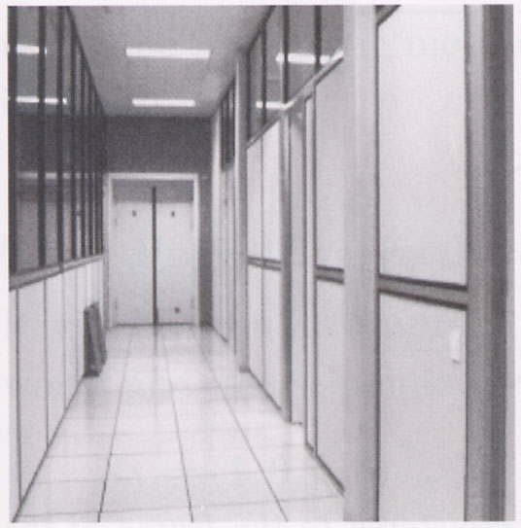
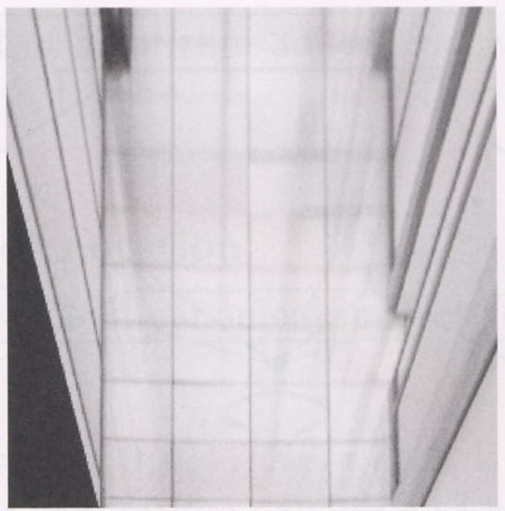
Homography example: Image rectification
p’
p
To unwarp (rectify) an image solve for homography H given p and p’: p’=Hp
Derek Hoiem

Slide 38
Summary
  Write 2d transformations as matrix-vector multiplication (including translation when we use homogeneous coordinates)
    Projection equations express how world points mapped to 2d image.
  Fitting transformations: solve for unknown parameters given corresponding points from two views – linear, affine, projective (homography)
  Mosaics: uses homography and image warping to merge views taken from same center of projection
  Perform image warping (forward, inverse)
Adapted from Kristen Grauman

Slide 39
The next 15 hidden slides give some more detail about how image formation works, i.e. how 3D objects are mapped to 2D images.
Please review on your own time if you’re interested.

Slide 40
Image formation
How are objects in the world captured in an image?
Kristen Grauman

Slide 41
Image formation
Let’s design a camera
  Idea 1: put a piece of film in front of an object
  Do we get a reasonable image?
Steve Seitz

Slide 42
Pinhole camera
Idea 2: Add a barrier to block off most of the rays
  This reduces blurring
  The opening is known as the aperture
  How does this transform the image?
Steve Seitz

Slide 43
Adding a lens
focal point
f
A lens focuses light onto the film
  Rays passing through the center are not deviated
  All parallel rays converge to one point on a plane located at the focal length f
Slide by Steve Seitz

Slide 44
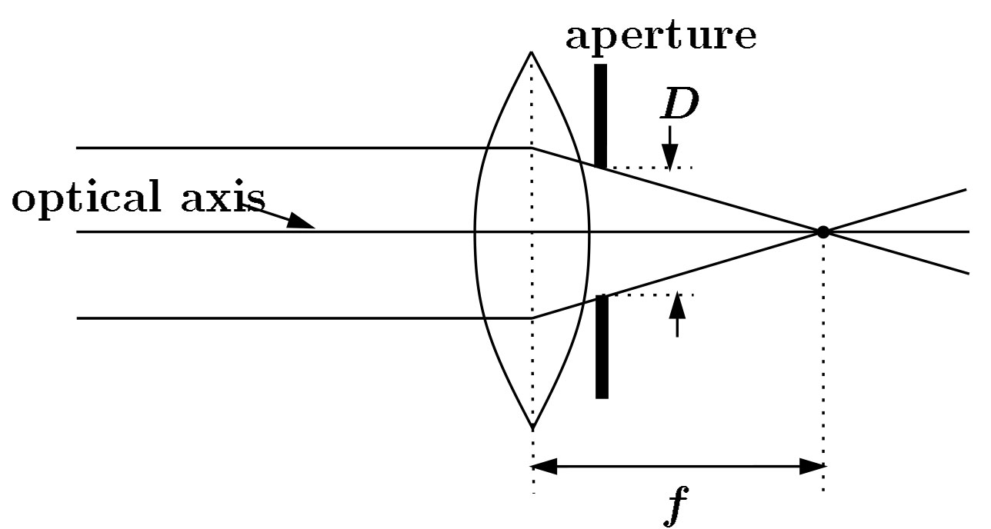
Cameras with lenses
F
focal point
optical center
(Center Of Projection)
A lens focuses parallel rays onto a single focal point
Gather more light, while keeping focus; make pinhole perspective projection practical
Kristen Grauman

Slide 45
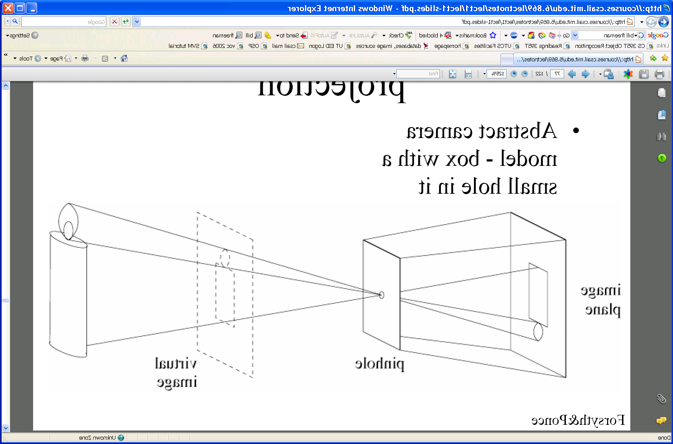
Pinhole camera
Pinhole camera is a simple model to approximate imaging process, perspective projection.
Image plane
Virtual image
Pinhole
If we treat pinhole as a point, only one ray from any given point can enter the camera.
Modified from Kristen Grauman, figure from Forsyth and Ponce

Slide 46
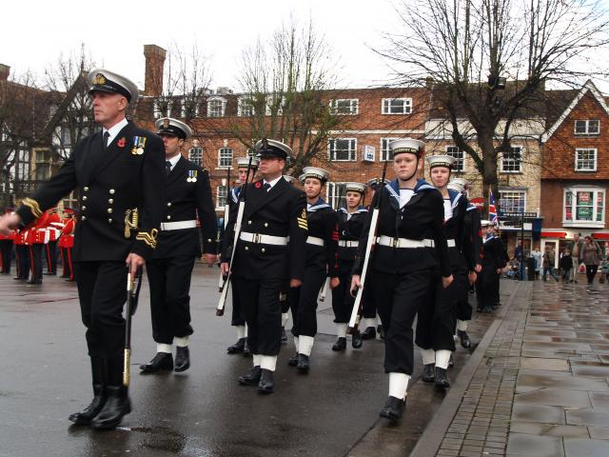
Perspective effects
Kristen Grauman

Slide 47
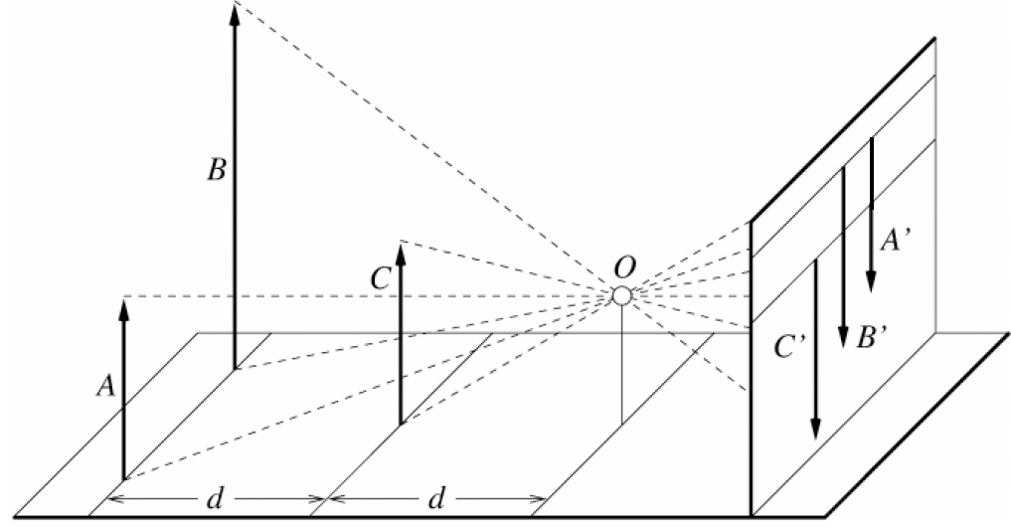
Perspective effects
Far away objects appear smaller
Forsyth and Ponce

Slide 48
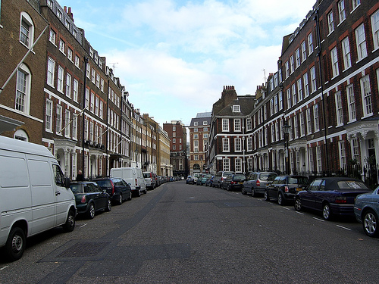
Perspective effects
Kristen Grauman

Slide 49
Projection properties
Many-to-one: any points along same ray map to same point in image
Points → points
Lines → lines (collinearity preserved)
Distances and angles are not preserved
Degenerate cases, e.g.:
  – Line through focal point projects to a point
  – Plane through focal point projects to line
Kristen Grauman

Slide 50
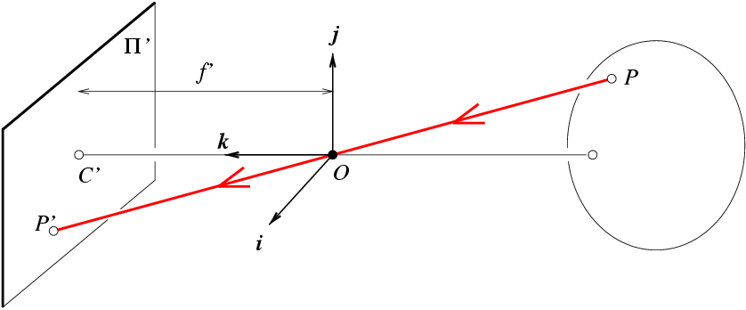
Projection matrix and camera parameters
x: Image Coordinates: (u,v,1)
K: Intrinsic Matrix (3x3)
R: Rotation (3x3)
t: Translation (3x1)
X: World Coordinates: (X,Y,Z,1)
Extrinsic params R, t
Intrinsic params K: focal length, pixel sizes (mm), etc.
We’ll assume that these parameters are given and fixed.
Silvio Savarese, Kristen Grauman
Notes:
We can use homogeneous coordinates to write camera matrix in linear form.

Slide 51
Projection matrix: Simplest case
Intrinsic Assumptions
Unit aspect ratio
Optical center at (0,0)
No skew
Extrinsic Assumptions
No rotation
Camera at (0,0,0)
K
Silvio Savarese

Slide 52
Projection matrix: General case
Derek Hoiem
Notes:
As review:
1) Example of my eye and their eye, where both coordinate frames are known. Suppose that I know a 3D point on the board in relation to me, and I want to figure out where that point will appear on their retina. First, I translate from my eye to their eye. Then, I rotate from my orientation to theirs. Finally, I project from 3D onto the 2D visual field.
2) Suppose I know x, K, R, and t. Can I compute X? What can I know about X?

Slide 53
Camera calibration
Derek Hoiem

Slide 54
Homogeneous coordinates
Invariant to scaling
Point in Cartesian is ray in Homogeneous
Homogeneous Coordinates
Cartesian Coordinates
Derek Hoiem

