Slide 1
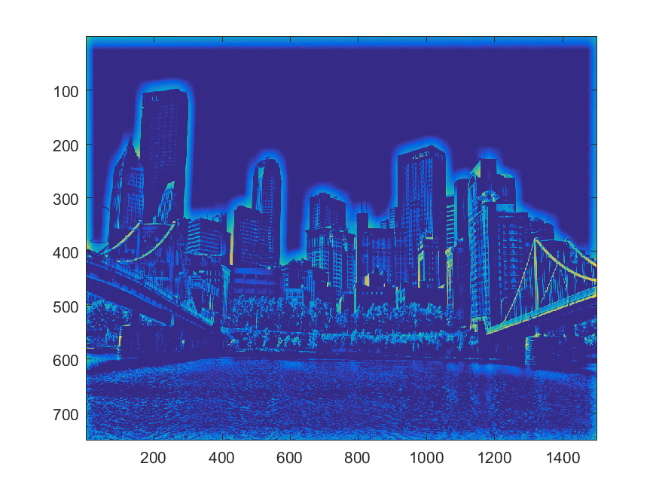
CS 1674: Intro to Computer Vision
Image Filtering
Prof. Adriana Kovashka
University of Pittsburgh
September 7, 2016
Slides from Kristen Grauman

Slide 2
Plan for today
Matlab tutorial (part 2)
Image filtering
HW2P overview
Note: HW2W and HW2P are out

Slide 3
Questions from HW1W
Graded with comments and answers, see CourseWeb
Practical skills: See next
What are programming assignments like? See http://people.cs.pitt.edu/~kovashka/cs1699/hw1.html (and hw2, hw3, hw4, hw5)
What is my research like? See http://isp.pitt.edu/sites/default/files/ISP%20Newsletter%202016.pdf

Slide 4
Objectives
Be more comfortable with Matlab
Know one way to remove noise from images (filtering)
Know how to resize images in a content-aware way

Slide 5
Objectives for Course
You will be able to remove noise from images, detect basic patterns such as lines, compute a meaningful representation of the image beyond pixels that allows you to do higher-level tasks (e.g. finding cars), stitch panoramas from multiple images of the same object, automatically recognize different types of scenes (e.g. beaches vs forests vs cities), detect faces in images, track moving objects, use and understand support vector machines, use neural networks, automatically group data, etc.

Slide 6
Matrix Multiplication
Let X be an axb matrix, Y be an bxc matrix
Then Z = X*Y is an axc matrix
Second dimension of first matrix, and first dimension of first matrix have to be the same, for matrix multiplication to be possible
Matrix multiplication is not commutative (X*Y != Y*X), but is distributive over addition and associative
Practice: Let X be an 10x5 matrix. Let’s factorize it into 3 matrices…

Slide 7
Inner vs outer vs matrix vs element-wise product
x, y = column vectors (nx1)
X, Y = matrices (mxn)
x, y = scalars (1x1)
x^{T} y = x · y = inner product (1xn x nx1 = scalar)
x ⊗ y = x y^{T} = outer product (nx1 x 1xn = matrix)
X * Y = matrix product
X .* Y = element-wise product

Slide 8
Images in Matlab
Color images represented as a matrix with multiple channels (=1 if grayscale)
Suppose we have a NxM RGB image called “im”
  im(1,1,1) = top-left pixel value in R-channel
  im(y, x, b) = y pixels down (rows), x pixels to right (cols) in b^{th} channel
  im(N, M, 3) = bottom-right pixel in B-channel
imread(filename) returns a uint8 image (values 0 to 255)
column
row
R
0.92 | 0.93 | 0.94 | 0.97 | 0.62 | 0.37 | 0.85 | 0.97 | 0.93 | 0.92 | 0.99
0.95 | 0.89 | 0.82 | 0.89 | 0.56 | 0.31 | 0.75 | 0.92 | 0.81 | 0.95 | 0.91
0.89 | 0.72 | 0.51 | 0.55 | 0.51 | 0.42 | 0.57 | 0.41 | 0.49 | 0.91 | 0.92
0.96 | 0.95 | 0.88 | 0.94 | 0.56 | 0.46 | 0.91 | 0.87 | 0.90 | 0.97 | 0.95
0.71 | 0.81 | 0.81 | 0.87 | 0.57 | 0.37 | 0.80 | 0.88 | 0.89 | 0.79 | 0.85
0.49 | 0.62 | 0.60 | 0.58 | 0.50 | 0.60 | 0.58 | 0.50 | 0.61 | 0.45 | 0.33
0.86 | 0.84 | 0.74 | 0.58 | 0.51 | 0.39 | 0.73 | 0.92 | 0.91 | 0.49 | 0.74
0.96 | 0.67 | 0.54 | 0.85 | 0.48 | 0.37 | 0.88 | 0.90 | 0.94 | 0.82 | 0.93
0.69 | 0.49 | 0.56 | 0.66 | 0.43 | 0.42 | 0.77 | 0.73 | 0.71 | 0.90 | 0.99
0.79 | 0.73 | 0.90 | 0.67 | 0.33 | 0.61 | 0.69 | 0.79 | 0.73 | 0.93 | 0.97
0.91 | 0.94 | 0.89 | 0.49 | 0.41 | 0.78 | 0.78 | 0.77 | 0.89 | 0.99 | 0.93
G
0.92 | 0.93 | 0.94 | 0.97 | 0.62 | 0.37 | 0.85 | 0.97 | 0.93 | 0.92 | 0.99
0.95 | 0.89 | 0.82 | 0.89 | 0.56 | 0.31 | 0.75 | 0.92 | 0.81 | 0.95 | 0.91
0.89 | 0.72 | 0.51 | 0.55 | 0.51 | 0.42 | 0.57 | 0.41 | 0.49 | 0.91 | 0.92
0.96 | 0.95 | 0.88 | 0.94 | 0.56 | 0.46 | 0.91 | 0.87 | 0.90 | 0.97 | 0.95
0.71 | 0.81 | 0.81 | 0.87 | 0.57 | 0.37 | 0.80 | 0.88 | 0.89 | 0.79 | 0.85
0.49 | 0.62 | 0.60 | 0.58 | 0.50 | 0.60 | 0.58 | 0.50 | 0.61 | 0.45 | 0.33
0.86 | 0.84 | 0.74 | 0.58 | 0.51 | 0.39 | 0.73 | 0.92 | 0.91 | 0.49 | 0.74
0.96 | 0.67 | 0.54 | 0.85 | 0.48 | 0.37 | 0.88 | 0.90 | 0.94 | 0.82 | 0.93
0.69 | 0.49 | 0.56 | 0.66 | 0.43 | 0.42 | 0.77 | 0.73 | 0.71 | 0.90 | 0.99
0.79 | 0.73 | 0.90 | 0.67 | 0.33 | 0.61 | 0.69 | 0.79 | 0.73 | 0.93 | 0.97
0.91 | 0.94 | 0.89 | 0.49 | 0.41 | 0.78 | 0.78 | 0.77 | 0.89 | 0.99 | 0.93
B
0.92 | 0.93 | 0.94 | 0.97 | 0.62 | 0.37 | 0.85 | 0.97 | 0.93 | 0.92 | 0.99
0.95 | 0.89 | 0.82 | 0.89 | 0.56 | 0.31 | 0.75 | 0.92 | 0.81 | 0.95 | 0.91
0.89 | 0.72 | 0.51 | 0.55 | 0.51 | 0.42 | 0.57 | 0.41 | 0.49 | 0.91 | 0.92
0.96 | 0.95 | 0.88 | 0.94 | 0.56 | 0.46 | 0.91 | 0.87 | 0.90 | 0.97 | 0.95
0.71 | 0.81 | 0.81 | 0.87 | 0.57 | 0.37 | 0.80 | 0.88 | 0.89 | 0.79 | 0.85
0.49 | 0.62 | 0.60 | 0.58 | 0.50 | 0.60 | 0.58 | 0.50 | 0.61 | 0.45 | 0.33
0.86 | 0.84 | 0.74 | 0.58 | 0.51 | 0.39 | 0.73 | 0.92 | 0.91 | 0.49 | 0.74
0.96 | 0.67 | 0.54 | 0.85 | 0.48 | 0.37 | 0.88 | 0.90 | 0.94 | 0.82 | 0.93
0.69 | 0.49 | 0.56 | 0.66 | 0.43 | 0.42 | 0.77 | 0.73 | 0.71 | 0.90 | 0.99
0.79 | 0.73 | 0.90 | 0.67 | 0.33 | 0.61 | 0.69 | 0.79 | 0.73 | 0.93 | 0.97
0.91 | 0.94 | 0.89 | 0.49 | 0.41 | 0.78 | 0.78 | 0.77 | 0.89 | 0.99 | 0.93
Adapted from Derek Hoiem

Slide 9
Matlab Tutorial http://www.cs.pitt.edu/~kovashka/cs1674/tutorial.m
We’ll cover parts 1-4, do parts 5-6 at home.

Slide 10
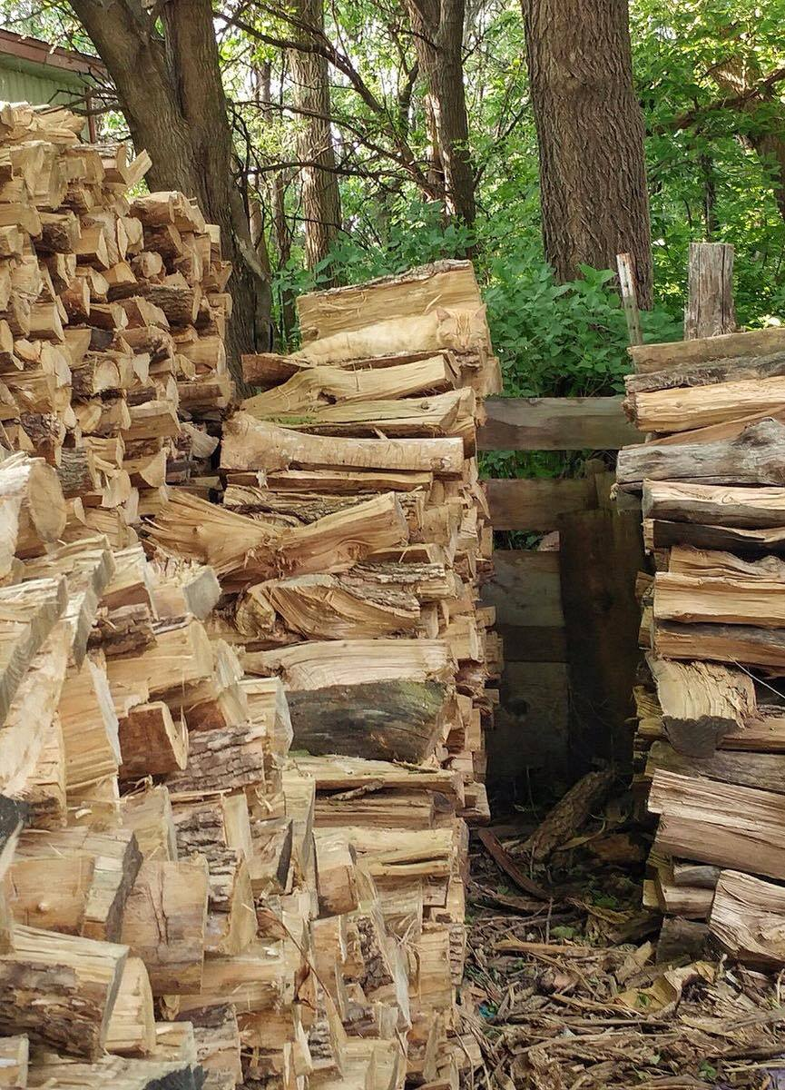
“Sliding window” detector

Slide 11
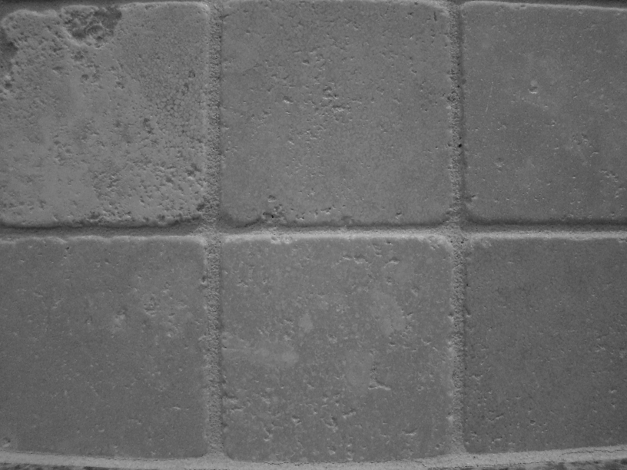
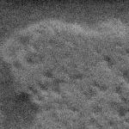
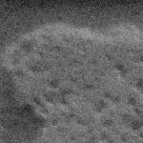

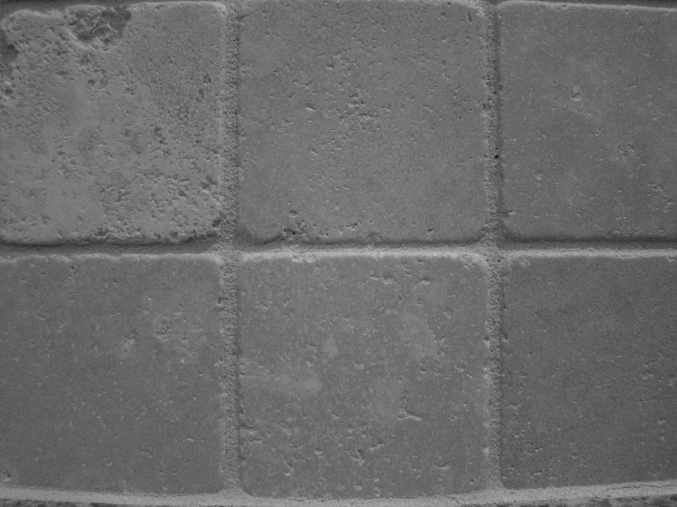
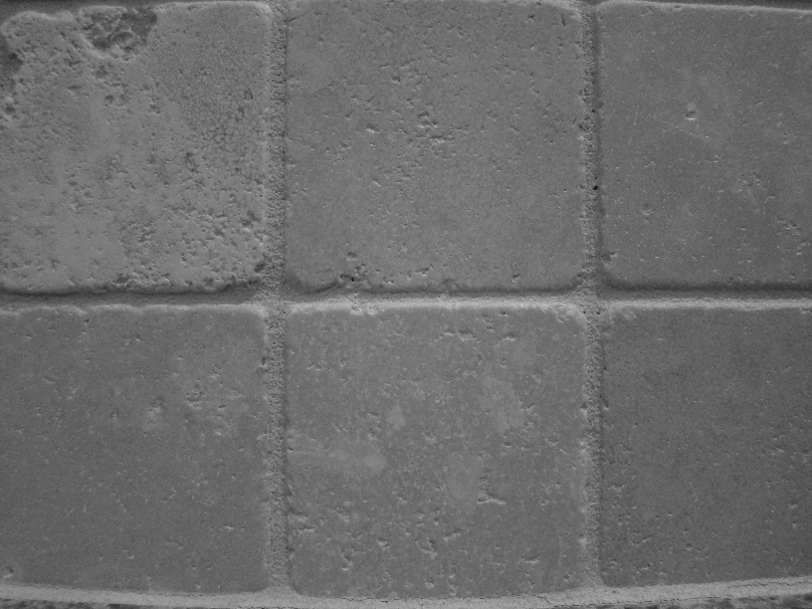


Enter: Noise
We talked about how the same object will look very different across images
Even multiple images of the same static scene will not be identical.
How could we reduce the noise, i.e., give an estimate of the true intensities?
What if there’s only one image?

Slide 12
Common types of noise
  Salt and pepper noise: random occurrences of black and white pixels
  Impulse noise: random occurrences of white pixels
  Gaussian noise: variations in intensity drawn from a Gaussian normal distribution
Source: S. Seitz

Slide 13
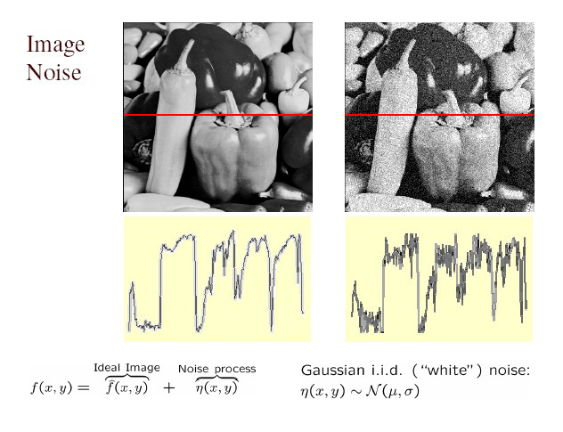
Gaussian noise
>> noise = randn(size(im)).*sigma;
>> output = im + noise;
What is impact of the sigma?
Fig: M. Hebert

Slide 14
First attempt at a solution
Let’s replace each pixel with an average of all the values in its neighborhood
Assumptions:
  Expect pixels to be like their neighbors
  Expect noise processes to be independent from pixel to pixel

Slide 15
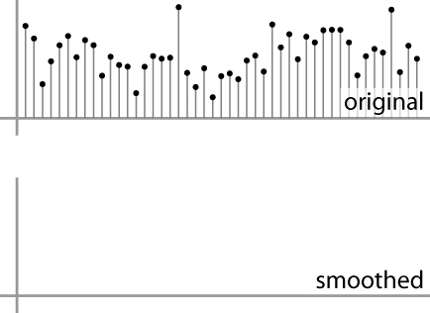
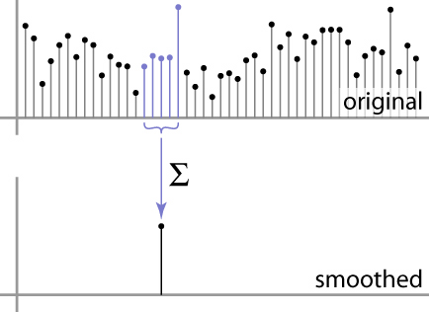
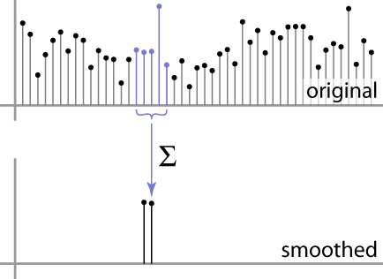
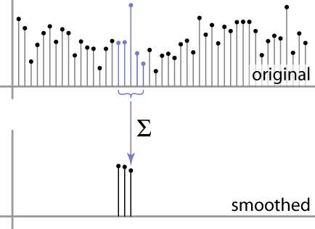
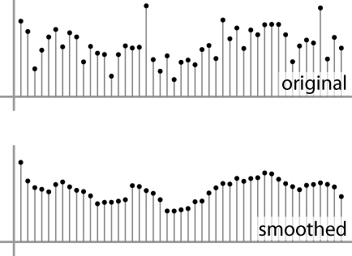
First attempt at a solution
Let’s replace each pixel with an average of all the values in its neighborhood
Moving average in 1D:
Source: S. Marschner

Slide 16
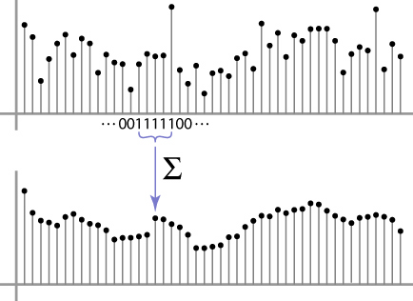
Weighted Moving Average
Can add weights to our moving average
Weights [1, 1, 1, 1, 1] / 5
Source: S. Marschner

Slide 17

Weighted Moving Average
Non-uniform weights [1, 4, 6, 4, 1] / 16
10 14 12 13 20
BOARD
Source: S. Marschner

Slide 18


Moving Average In 2D
0 | 0 | 0 | 0 | 0 | 0 | 0 | 0 | 0 | 0
0 | 0 | 0 | 0 | 0 | 0 | 0 | 0 | 0 | 0
0 | 0 | 0 | 90 | 90 | 90 | 90 | 90 | 0 | 0
0 | 0 | 0 | 90 | 90 | 90 | 90 | 90 | 0 | 0
0 | 0 | 0 | 90 | 90 | 90 | 90 | 90 | 0 | 0
0 | 0 | 0 | 90 | 0 | 90 | 90 | 90 | 0 | 0
0 | 0 | 0 | 90 | 90 | 90 | 90 | 90 | 0 | 0
0 | 0 | 0 | 0 | 0 | 0 | 0 | 0 | 0 | 0
0 | 0 | 90 | 0 | 0 | 0 | 0 | 0 | 0 | 0
0 | 0 | 0 | 0 | 0 | 0 | 0 | 0 | 0 | 0
 | 0
0 | 0 | 0 | 0 | 0 | 0 | 0 | 0 | 0 | 0
0 | 0 | 0 | 0 | 0 | 0 | 0 | 0 | 0 | 0
0 | 0 | 0 | 90 | 90 | 90 | 90 | 90 | 0 | 0
0 | 0 | 0 | 90 | 90 | 90 | 90 | 90 | 0 | 0
0 | 0 | 0 | 90 | 90 | 90 | 90 | 90 | 0 | 0
0 | 0 | 0 | 90 | 0 | 90 | 90 | 90 | 0 | 0
0 | 0 | 0 | 90 | 90 | 90 | 90 | 90 | 0 | 0
0 | 0 | 0 | 0 | 0 | 0 | 0 | 0 | 0 | 0
0 | 0 | 90 | 0 | 0 | 0 | 0 | 0 | 0 | 0
0 | 0 | 0 | 0 | 0 | 0 | 0 | 0 | 0 | 0
Source: S. Seitz

Slide 19
Moving Average In 2D
0 | 0 | 0 | 0 | 0 | 0 | 0 | 0 | 0 | 0
0 | 0 | 0 | 0 | 0 | 0 | 0 | 0 | 0 | 0
0 | 0 | 0 | 90 | 90 | 90 | 90 | 90 | 0 | 0
0 | 0 | 0 | 90 | 90 | 90 | 90 | 90 | 0 | 0
0 | 0 | 0 | 90 | 90 | 90 | 90 | 90 | 0 | 0
0 | 0 | 0 | 90 | 0 | 90 | 90 | 90 | 0 | 0
0 | 0 | 0 | 90 | 90 | 90 | 90 | 90 | 0 | 0
0 | 0 | 0 | 0 | 0 | 0 | 0 | 0 | 0 | 0
0 | 0 | 90 | 0 | 0 | 0 | 0 | 0 | 0 | 0
0 | 0 | 0 | 0 | 0 | 0 | 0 | 0 | 0 | 0
 | 0 | 10
0 | 0 | 0 | 0 | 0 | 0 | 0 | 0 | 0 | 0
0 | 0 | 0 | 0 | 0 | 0 | 0 | 0 | 0 | 0
0 | 0 | 0 | 90 | 90 | 90 | 90 | 90 | 0 | 0
0 | 0 | 0 | 90 | 90 | 90 | 90 | 90 | 0 | 0
0 | 0 | 0 | 90 | 90 | 90 | 90 | 90 | 0 | 0
0 | 0 | 0 | 90 | 0 | 90 | 90 | 90 | 0 | 0
0 | 0 | 0 | 90 | 90 | 90 | 90 | 90 | 0 | 0
0 | 0 | 0 | 0 | 0 | 0 | 0 | 0 | 0 | 0
0 | 0 | 90 | 0 | 0 | 0 | 0 | 0 | 0 | 0
0 | 0 | 0 | 0 | 0 | 0 | 0 | 0 | 0 | 0
Source: S. Seitz

Slide 20
Moving Average In 2D
0 | 0 | 0 | 0 | 0 | 0 | 0 | 0 | 0 | 0
0 | 0 | 0 | 0 | 0 | 0 | 0 | 0 | 0 | 0
0 | 0 | 0 | 90 | 90 | 90 | 90 | 90 | 0 | 0
0 | 0 | 0 | 90 | 90 | 90 | 90 | 90 | 0 | 0
0 | 0 | 0 | 90 | 90 | 90 | 90 | 90 | 0 | 0
0 | 0 | 0 | 90 | 0 | 90 | 90 | 90 | 0 | 0
0 | 0 | 0 | 90 | 90 | 90 | 90 | 90 | 0 | 0
0 | 0 | 0 | 0 | 0 | 0 | 0 | 0 | 0 | 0
0 | 0 | 90 | 0 | 0 | 0 | 0 | 0 | 0 | 0
0 | 0 | 0 | 0 | 0 | 0 | 0 | 0 | 0 | 0
 | 0 | 10 | 20
0 | 0 | 0 | 0 | 0 | 0 | 0 | 0 | 0 | 0
0 | 0 | 0 | 0 | 0 | 0 | 0 | 0 | 0 | 0
0 | 0 | 0 | 90 | 90 | 90 | 90 | 90 | 0 | 0
0 | 0 | 0 | 90 | 90 | 90 | 90 | 90 | 0 | 0
0 | 0 | 0 | 90 | 90 | 90 | 90 | 90 | 0 | 0
0 | 0 | 0 | 90 | 0 | 90 | 90 | 90 | 0 | 0
0 | 0 | 0 | 90 | 90 | 90 | 90 | 90 | 0 | 0
0 | 0 | 0 | 0 | 0 | 0 | 0 | 0 | 0 | 0
0 | 0 | 90 | 0 | 0 | 0 | 0 | 0 | 0 | 0
0 | 0 | 0 | 0 | 0 | 0 | 0 | 0 | 0 | 0
Source: S. Seitz

Slide 21
Moving Average In 2D
0 | 0 | 0 | 0 | 0 | 0 | 0 | 0 | 0 | 0
0 | 0 | 0 | 0 | 0 | 0 | 0 | 0 | 0 | 0
0 | 0 | 0 | 90 | 90 | 90 | 90 | 90 | 0 | 0
0 | 0 | 0 | 90 | 90 | 90 | 90 | 90 | 0 | 0
0 | 0 | 0 | 90 | 90 | 90 | 90 | 90 | 0 | 0
0 | 0 | 0 | 90 | 0 | 90 | 90 | 90 | 0 | 0
0 | 0 | 0 | 90 | 90 | 90 | 90 | 90 | 0 | 0
0 | 0 | 0 | 0 | 0 | 0 | 0 | 0 | 0 | 0
0 | 0 | 90 | 0 | 0 | 0 | 0 | 0 | 0 | 0
0 | 0 | 0 | 0 | 0 | 0 | 0 | 0 | 0 | 0
 | 0 | 10 | 20 | 30
0 | 0 | 0 | 0 | 0 | 0 | 0 | 0 | 0 | 0
0 | 0 | 0 | 0 | 0 | 0 | 0 | 0 | 0 | 0
0 | 0 | 0 | 90 | 90 | 90 | 90 | 90 | 0 | 0
0 | 0 | 0 | 90 | 90 | 90 | 90 | 90 | 0 | 0
0 | 0 | 0 | 90 | 90 | 90 | 90 | 90 | 0 | 0
0 | 0 | 0 | 90 | 0 | 90 | 90 | 90 | 0 | 0
0 | 0 | 0 | 90 | 90 | 90 | 90 | 90 | 0 | 0
0 | 0 | 0 | 0 | 0 | 0 | 0 | 0 | 0 | 0
0 | 0 | 90 | 0 | 0 | 0 | 0 | 0 | 0 | 0
0 | 0 | 0 | 0 | 0 | 0 | 0 | 0 | 0 | 0
Source: S. Seitz

Slide 22
Moving Average In 2D
0 | 0 | 0 | 0 | 0 | 0 | 0 | 0 | 0 | 0
0 | 0 | 0 | 0 | 0 | 0 | 0 | 0 | 0 | 0
0 | 0 | 0 | 90 | 90 | 90 | 90 | 90 | 0 | 0
0 | 0 | 0 | 90 | 90 | 90 | 90 | 90 | 0 | 0
0 | 0 | 0 | 90 | 90 | 90 | 90 | 90 | 0 | 0
0 | 0 | 0 | 90 | 0 | 90 | 90 | 90 | 0 | 0
0 | 0 | 0 | 90 | 90 | 90 | 90 | 90 | 0 | 0
0 | 0 | 0 | 0 | 0 | 0 | 0 | 0 | 0 | 0
0 | 0 | 90 | 0 | 0 | 0 | 0 | 0 | 0 | 0
0 | 0 | 0 | 0 | 0 | 0 | 0 | 0 | 0 | 0
 | 0 | 10 | 20 | 30 | 30
Source: S. Seitz

Slide 23
Moving Average In 2D
0 | 0 | 0 | 0 | 0 | 0 | 0 | 0 | 0 | 0
0 | 0 | 0 | 0 | 0 | 0 | 0 | 0 | 0 | 0
0 | 0 | 0 | 90 | 90 | 90 | 90 | 90 | 0 | 0
0 | 0 | 0 | 90 | 90 | 90 | 90 | 90 | 0 | 0
0 | 0 | 0 | 90 | 90 | 90 | 90 | 90 | 0 | 0
0 | 0 | 0 | 90 | 0 | 90 | 90 | 90 | 0 | 0
0 | 0 | 0 | 90 | 90 | 90 | 90 | 90 | 0 | 0
0 | 0 | 0 | 0 | 0 | 0 | 0 | 0 | 0 | 0
0 | 0 | 90 | 0 | 0 | 0 | 0 | 0 | 0 | 0
0 | 0 | 0 | 0 | 0 | 0 | 0 | 0 | 0 | 0
 | 0 | 10 | 20 | 30 | 30 | 30 | 20 | 10
 | 0 | 20 | 40 | 60 | 60 | 60 | 40 | 20
 | 0 | 30 | 60 | 90 | 90 | 90 | 60 | 30
 | 0 | 30 | 50 | 80 | 80 | 90 | 60 | 30
 | 0 | 30 | 50 | 80 | 80 | 90 | 60 | 30
 | 0 | 20 | 30 | 50 | 50 | 60 | 40 | 20
 | 10 | 20 | 30 | 30 | 30 | 30 | 20 | 10
 | 10 | 10 | 10 | 0 | 0 | 0 | 0 | 0
Source: S. Seitz
Notes:
ones, divide by 9

Slide 24
Image filtering
Compute a function of the local neighborhood at each pixel in the image
  Function specified by a “filter” or mask saying how to combine values from neighbors.
  Element-wise multiplication
Uses of filtering:
  Enhance an image (denoise, resize, etc)
  Extract information (texture, edges, etc)
  Detect patterns (template matching)
Adapted from Derek Hoiem

Slide 25
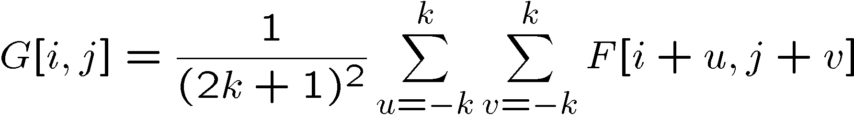
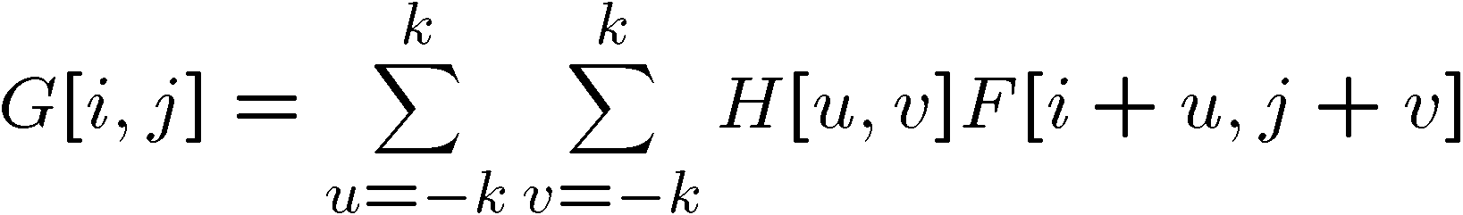
Correlation filtering
Say the averaging window size is 2k+1 x 2k+1:
Attribute uniform weight to each pixel
Loop over all pixels in neighborhood around image pixel F[i,j]
Now generalize to allow different weights depending on neighboring pixel’s relative position:
Non-uniform weights

Slide 26

Correlation filtering
This is called cross-correlation, denoted
Filtering an image: replace each pixel with a linear combination of its neighbors.
The filter “kernel” or “mask” H[u,v] is the prescription for the weights in the linear combination.

Slide 27


Averaging filter
What values belong in the kernel H for the moving average example?
0 | 0 | 0 | 0 | 0 | 0 | 0 | 0 | 0 | 0
0 | 0 | 0 | 0 | 0 | 0 | 0 | 0 | 0 | 0
0 | 0 | 0 | 90 | 90 | 90 | 90 | 90 | 0 | 0
0 | 0 | 0 | 90 | 90 | 90 | 90 | 90 | 0 | 0
0 | 0 | 0 | 90 | 90 | 90 | 90 | 90 | 0 | 0
0 | 0 | 0 | 90 | 0 | 90 | 90 | 90 | 0 | 0
0 | 0 | 0 | 90 | 90 | 90 | 90 | 90 | 0 | 0
0 | 0 | 0 | 0 | 0 | 0 | 0 | 0 | 0 | 0
0 | 0 | 90 | 0 | 0 | 0 | 0 | 0 | 0 | 0
0 | 0 | 0 | 0 | 0 | 0 | 0 | 0 | 0 | 0
 | 0 | 10 | 20 | 30 | 30
1
1
1
1
?
1
1
1
1
1
“box filter”

Slide 28
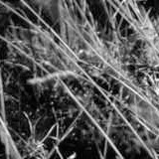
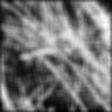
Smoothing by averaging
depicts box filter:
white = high value, black = low value
original
filtered
What if the filter size was 5 x 5 instead of 3 x 3?

Slide 29
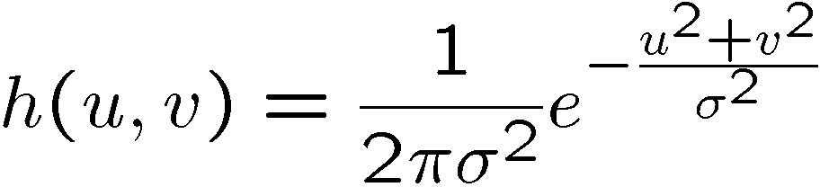
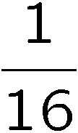
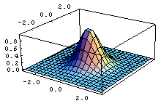
Gaussian filter
What if we want nearest neighboring pixels to have the most influence on the output?
Removes high-frequency components from the image (“low-pass filter”).
This kernel is an approximation of a 2d Gaussian function:
0 | 0 | 0 | 0 | 0 | 0 | 0 | 0 | 0 | 0
0 | 0 | 0 | 0 | 0 | 0 | 0 | 0 | 0 | 0
0 | 0 | 0 | 90 | 90 | 90 | 90 | 90 | 0 | 0
0 | 0 | 0 | 90 | 90 | 90 | 90 | 90 | 0 | 0
0 | 0 | 0 | 90 | 90 | 90 | 90 | 90 | 0 | 0
0 | 0 | 0 | 90 | 0 | 90 | 90 | 90 | 0 | 0
0 | 0 | 0 | 90 | 90 | 90 | 90 | 90 | 0 | 0
0 | 0 | 0 | 0 | 0 | 0 | 0 | 0 | 0 | 0
0 | 0 | 90 | 0 | 0 | 0 | 0 | 0 | 0 | 0
0 | 0 | 0 | 0 | 0 | 0 | 0 | 0 | 0 | 0
1 | 2 | 1
2 | 4 | 2
1 | 2 | 1
Source: S. Seitz

Slide 30

Smoothing with a Gaussian

Slide 31
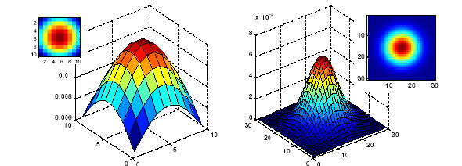
Gaussian filters
What parameters matter here?
Size of kernel or mask
  Note, Gaussian function has infinite support, but discrete filters use finite kernels
σ = 5 with 10 x 10 kernel
σ = 5 with 30 x 30 kernel

Slide 32
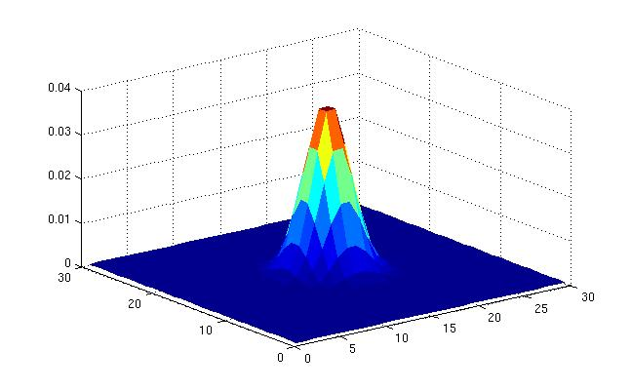
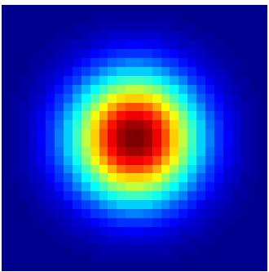
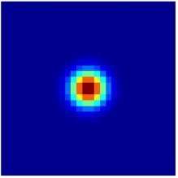
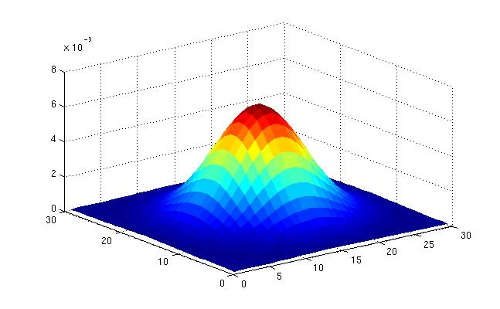
Gaussian filters
What parameters matter here?
Variance of Gaussian: determines extent of smoothing
σ = 2 with 30 x 30 kernel
σ = 5 with 30 x 30 kernel

Slide 33
Gaussian filters
How big should the filter be?
Values at edges should be near zero ← important!
Rule of thumb for Gaussian: set filter half-width to about 3 σ
Source: Derek Hoiem

Slide 34

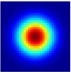
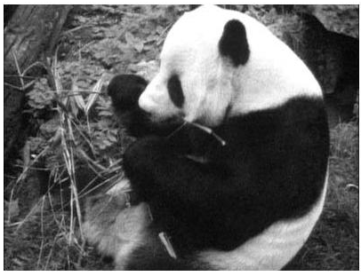
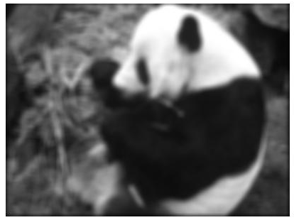
Matlab
>> hsize = 10;
>> sigma = 5;
>> h = fspecial(‘gaussian’ hsize, sigma);
>> mesh(h);
>> imagesc(h);
>> outim = imfilter(im, h); % correlation
>> imshow(outim);
outim
Notes:
In matlab, conv2 does convolution, filter2 does correlation. Imfilter does either if specified, correlation by default (‘conv’, ‘corr’ option)

Slide 35
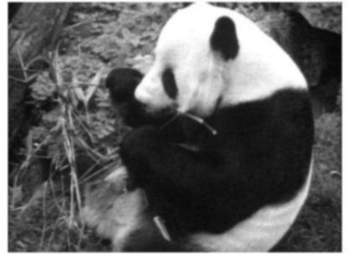
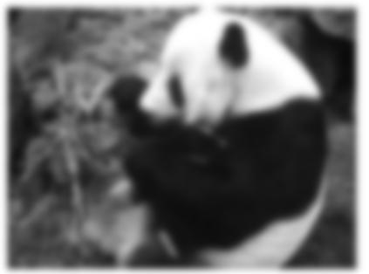
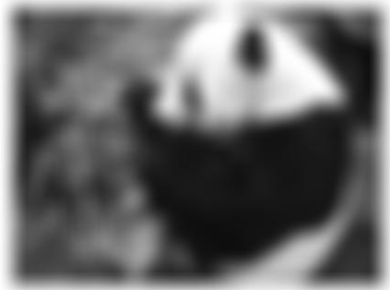
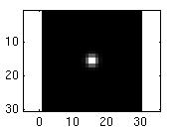
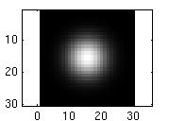
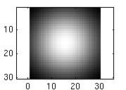
Smoothing with a Gaussian
Parameter σ is the “scale” / “width” / “spread” of the Gaussian kernel, and controls the amount of smoothing.
…
for sigma=1:3:10
h = fspecial('gaussian‘, fsize, sigma);
out = imfilter(im, h);
imshow(out);
pause;
end

Slide 36
Properties of smoothing filters
Smoothing
  Values positive
  Sum to 1 → overall intensity same as input
  Amount of smoothing proportional to mask size
  Remove “high-frequency” components; “low-pass” filter

Slide 37
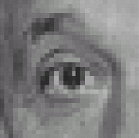
Predict the outputs using correlation filtering
0
0
0
0
0
0
*
= ?
*
= ?
0
1
0
0
0
1
0
0
0
0
0
0
0
0
0
-
1
1
1
*
= ?
0
2
0
1
1
1
0
0
0
1
1
1

Slide 38
Practice with linear filters
0
0
0
?
0
1
0
0
0
0
Original
Source: D. Lowe

Slide 39
Practice with linear filters
0
0
0
0
1
0
0
0
0
Original
Filtered
(no change)
Source: D. Lowe

Slide 40
Practice with linear filters
0
0
0
?
0
0
1
0
0
0
Original
Source: D. Lowe

Slide 41
Practice with linear filters
0
0
0
0
0
1
0
0
0
Original
Shifted left
by 1 pixel with correlation
Source: D. Lowe

Slide 42
Practice with linear filters
1
1
1
?
1
1
1
1
1
1
Original
Source: D. Lowe

Slide 43
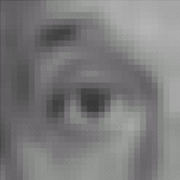
Practice with linear filters
1
1
1
1
1
1
1
1
1
Original
Blur (with a
box filter)
Source: D. Lowe

Slide 44
Practice with linear filters
0
0
0
-
1
1
1
?
0
2
0
1
1
1
0
0
0
1
1
1
Original
Source: D. Lowe

Slide 45
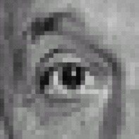
Practice with linear filters
0
0
0
-
1
1
1
0
2
0
1
1
1
0
0
0
1
1
1
Original
Sharpening filter:
  accentuates differences with local average
Source: D. Lowe

Slide 46
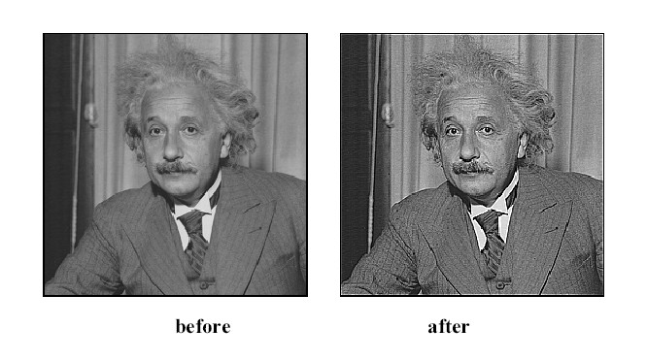
Sharpening

Slide 47
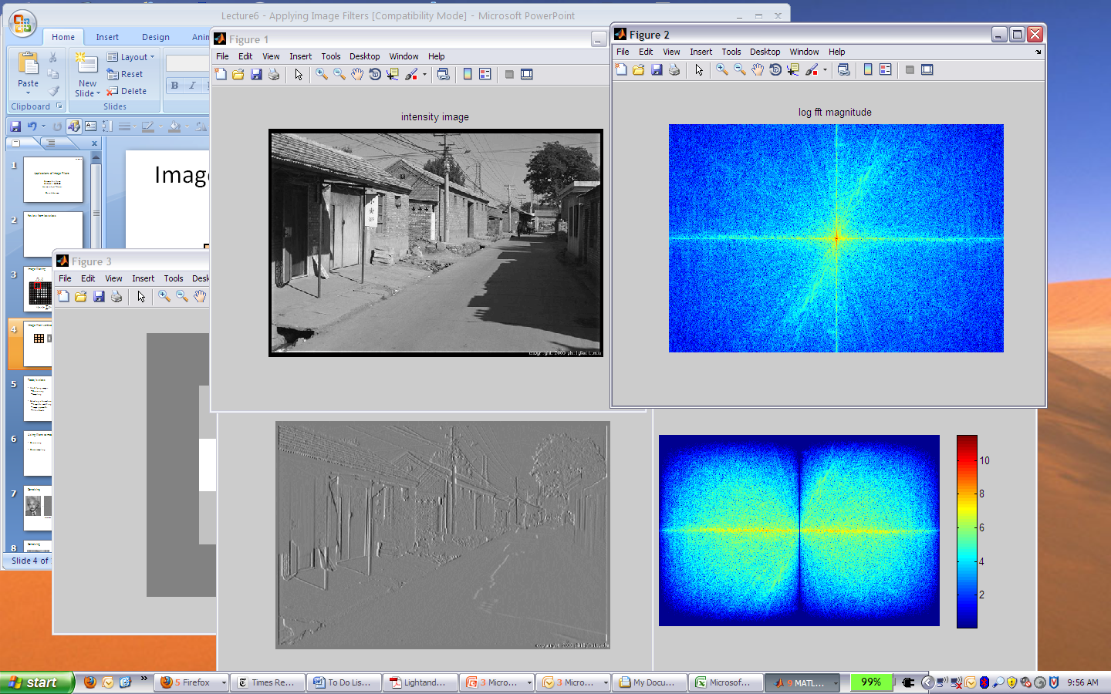
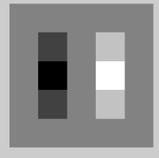
Final example
1
0
-1
2
0
-2
1
0
-1
*
=
Slide credit: Derek Hoiem

Slide 48

Homework 2P:
Seam Carving /
Content-aware Image Resizing
Notes:
The goal of this video is to explain the premise and goals of the second programming assignment.
This assignment implements a graphics paper that performs seam carving, a.k.a. content-aware image resizing.
A link to the paper can be found on the homework page for HW2P.

Slide 49
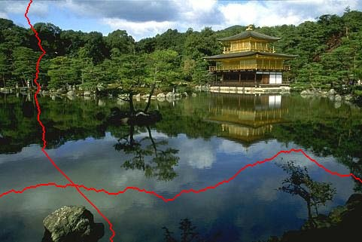
Seam carving: main idea
Resize effect:
6x10 → 5x10
[Shai & Avidan, SIGGRAPH 2007]
Notes:
The idea behind seam carving is to resize images (i.e. remove rows or columns) in such a way that “interesting” content is preserved. So if we want to remove a row, rather than removing a straight line, we will remove one pixel from each column along a “seam”, i.e. the red horizontal line. If we zoom in, a seam might look something like the image in the bottom right. Even though we are removing a non-straight seam from the image, there is only one pixel removed from each column, so each column will contain the same number of pixels. If we remove a single seam from the image on the bottom-right, which originally was a 6x10 image, we obtain a 5x10 image.

Slide 50
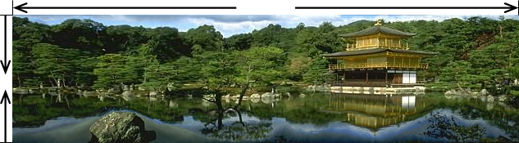
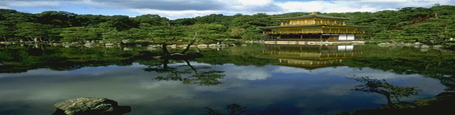
Seam carving: main idea
Content-aware resizing
Traditional resizing
[Shai & Avidan, SIGGRAPH 2007]
Notes:
In contrast to traditional resizing, content-aware resizing allows us to reduce the uninteresting content (e.g. the water which is a relatively uniform region) and to preserve interesting content with a lot of detail (like the building or trees). The results look visually more appealing than traditional resizing.

Slide 51
Seam carving: main idea
Content-aware resizing
Intuition:
Preserve the most “interesting” content
  → Prefer to remove pixels with low gradient energy
To reduce or increase size in one dimension, remove irregularly shaped (non-straight) “seams”
  → Optimal solution via dynamic programming.
Kristen Grauman, UT-Austin
Notes:
So again, we will preserve the most interesting content, and we will reduce (or can also increase, which we won’t discuss) the image in one dimension, by removing irregularly shaped (in other words non-straight) seams.
To preserve interesting content, we will remove pixels with “low-gradient energy” (to be discussed next), and to find the optimal seam which to remove, we will use dynamic programming.

Slide 52
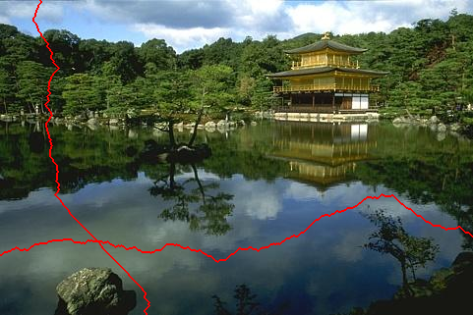
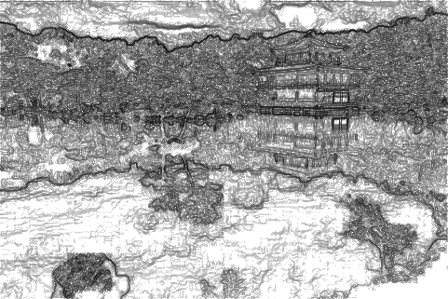
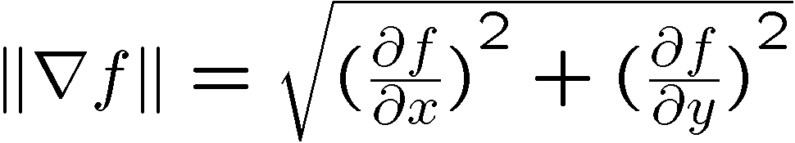
Seam carving: main idea
Want to remove seams where they won’t be very noticeable:
  Measure “energy” as gradient magnitude (horizontal/vertical change)
Choose seam based on minimum total energy path across image, subject to 8-connectedness.
Kristen Grauman, UT-Austin
Notes:
We want to remove seams where they won’t be very noticeable. So we’ll measure the “energy” of an image as the image gradient magnitude, i.e. the horizontal and vertical change. The formula shows you how the energy of the image f, at each pixel (where pixel indices are not shown in the formula) is the squared sum of two derivatives. Rather than thinking of these as derivatives, think of them as the change of image intensity (which we denote by f) in the x direction and the change in the y direction. To compute this change, you can use one of the filters we discussed in class, which measures distances between pixels on the left/right, or analogously, between pixels above/below. Remember from class that horizontal gradients (i.e. dramatic change in intensity in the x direction) detect vertical edges, and vice versa.
We will choose a seam based on the minimum cumulative energy across and image, subject to 8-connectedness. By 8-connectedness we mean that a pixel has 8 neighbors, i.e. all pixels in a 3x3 window around the pixel itself.

Slide 53
Seam carving: algorithm
s₁
s₂
s₃
s₄
s₅
Let a vertical seam s consist of h positions that form an 8-connected path.
Let the cost of a seam be:
Optimal seam minimizes this cost:
Compute it efficiently with dynamic programming.
Kristen Grauman, UT-Austin
Notes:
Let a vertical seam s consist of h positions, where each pixel along the seam has 8 neighbors. It turns out we’ll only examine the 3 neighbors above or to the left of a pixel, but in order to ensure that a seam is actually connected, we’ll think of a pixel as having 8 neighbors.
So in the example on the left, we have a chain (seam) of 5 pixels.
The optimal seam we want to cut from the image is the one that has the lowest cumulative energy. The energy of a seam is the sum of the energies of the constituent pixels.
So we can compute the energy of all possible seams, and choose to cut the one that minimizes that energy across all possible seams.
We will use dynamic programming to efficiently find the seam that has the smallest energy.

Slide 54
How to identify the minimum cost seam?
First, consider a greedy approach:
Energy matrix
(gradient magnitude)
Kristen Grauman, UT-Austin

Slide 55

Seam carving: algorithm
Compute the cumulative minimum energy for all possible connected seams at each entry (i,j):
Then, min value in last row of M indicates end of the minimal connected vertical seam.
Backtrack up from there, selecting min of 3 above in M.
Computing horizontal seams is analogous.
row i-1
j-1
j
j+1
row i
j
Energy matrix
(gradient magnitude)
M matrix:
cumulative min energy
(for vertical seams)
Kristen Grauman, UT-Austin
Notes:
Our first task is to find the cumulative energy of all possible connected seams. We will store one cumulative energy value for each pixel, into a matrix we call M.
The cumulative energy M(i, j) is the sum of the raw energy at pixel (i, j), and the minimum cumulative energy above that pixel.
So we’ll plot both the raw energy matrix (on the left) and the cumulative energy (on the right).
Let’s say that we are at pixel j (column j) in row i.
To find the minimum energy above, we consider pixels in row i-1, and only those pixels in that row that are neighbors to pixel j. In other words, we only consider pixels j-1, j, and j+1 in row i-1.
We start at the top, and keep computing values for M going down the image.
Then, the minimum value in the last row of M indicates the end of the optimal seam.
We can backtrack from there to find the full optimal seam, selecting the minimum of the 3 neighbors above each pixel, starting from the bottom.
Computing the optimal seam for horizontal seams is analogous, you just start from the left rather than the top and go to the right rather than to the bottom.

Slide 56
Example
First, compute cumulative energy from raw energy
Energy matrix
(gradient magnitude)
M matrix
(for vertical seams)
Kristen Grauman, UT-Austin
Notes:
Here is an example. On the left is the raw energy, which is the sum of the difference between pixels to the left/right and above/below each pixel.
For the first row of the cumulative energy, which we’ll show on the right, there is no preceding row, so we just copy the raw energy values.
For the second row, we start at the left, i.e. what corresponds to a value of 2 from the original energy matrix.
To compute M(2, 1), we take 2, and add to it the minimum value above the 2. We have to choose between 1 and 3, since M(2, 1) only has 2 neighbors above. 1 is smaller, so we add 1 to 2, and we obtain M(2, 1) = 3.
Now we need to compute the cumulative energy at the pixel that has 8 in the raw map, i.e. we have to compute M(2, 2). That’s equal to 8 plus the smallest among (1, 3, 0), i.e. the final value is 8+0 since the minimum is 0.
For M(2, 3), we compute 9 + min(3, 0), i.e. 9.
Now we move on to the third row.
Things get a little trickier because now we have to reuse the previous rows already computed for the cumulative energy map M, shown on the right, so we’ll be taking minima over the row of M that we just computed.
For M(3, 1), which in the raw energy map is 5, we compute 5 + the minimum of (3, 8), i.e. 5+3 = 8.
For M(3, 2), what do we have? Take a moment to compute it.
You should have gotten 5, which is 2 + min(3, 8, 9) = 5.
What do you get for M(3, 3)?
You should get 14.
Please post on Piazza if the algorithm still doesn’t make sense.

Slide 57
Example
Now backtrack
Energy matrix
(gradient magnitude)
M matrix
(for vertical seams)
Kristen Grauman, UT-Austin
Notes:
Now we’ve computed the cumulative energy, and we need to use it to compute the optimal seam.
We’ll start at the bottom of the cumulative energy map M (on the right), and take the minimum value of that row.
That’s the value 5.
Now we need to pick the minimum from the values above the 5 in M, and we have three options: 3, 8, 9. We pick the 3.
Now we need to pick among the values above the 3, but we only have two values, 1 and 3. We pick the 1.
Now the highlighted values form our vertical seam.
Of course this is just a tiny example, usually there will be longer seams for larger images.
The next step would be to remove that seam from our toy 3x3 image, thus obtaining a 3x2 image, i.e. we removed one column, corresponding to a vertical seam.
Note that if you use a greedy approach over the original raw energy map to select the minimum seam, you’ll get a different seam. We won’t go into detail.

Slide 58
Good News!
Computing cumulative energy and finding the optimal seam with back-tracking is implemented for you!
  But you still have to understand how to use it
Notes:
The good news for you is that the tricky parts, computing the cumulative energy and finding the optimal seams, are implemented for you, and they are attached to HW2P on CourseWeb.
This was done because the Matlab assignment HW1P was pushed back, so I didn’t want you to have to do too much for this assignment.
You still get the fun of playing with seams though, and finding successful and failure cases.
See the required naming of all functions on the page description for HW2P on the course website.
If you are interested, you can try to implement the functions that are already provided, as an exercise, and come to me with questions or ask for tips.

Slide 59
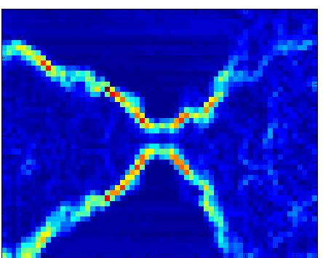

Real image example
Original Image
Energy Map
Blue = low energy
Red = high energy
Kristen Grauman, UT-Austin
Notes:
Now we look at a real example, which has the following raw energy map. Blue means low energy and red means high energy.
We see that places in the image where intensity changes have high energy.

Slide 60



























Real image example
Kristen Grauman, UT-Austin
Notes:
We can see how we remove several columns (along vertical seams) from the image, each time computing the optimal vertical seam in the image that we obtained in the previous step. In other words, if you want to remove n vertical seams, you are not just computing the n best seams from the original image, but computing the single best seam in the image you obtained after the last resize.

Slide 61
Real image example
Kristen Grauman, UT-Austin
Notes:
This is again the original image we had.

Slide 62



Seam Carving Results from Last Year
David Fioravanti
Notes:
Here are some fun results from last year’s assignments. On the left is the original image, in the middle is the result of a traditional resize, and on the right is the result of our content-aware resize. Notice how the algorithm just removed uninteresting black seams.

Slide 63
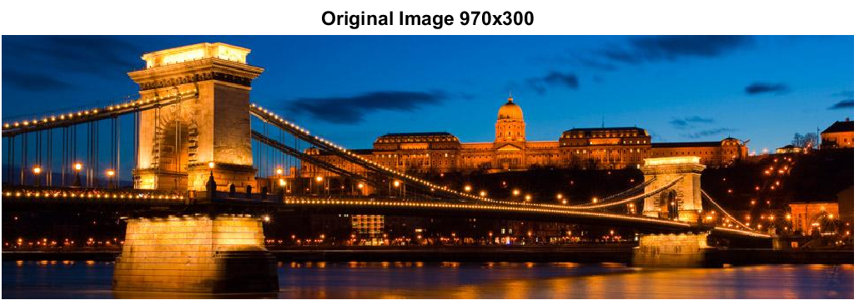
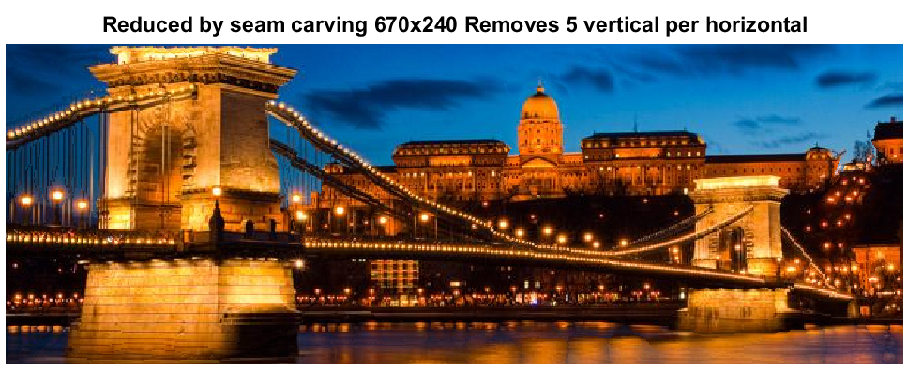
Seam Carving Results from Last Year
Edwin Mellett
Notes:
Here we see the original and the content-aware resize, which preserves more building than it preserves sky.

Slide 64

Seam Carving Results from Last Year
Sarah Dubnik
Notes:
And here is another example, with content-aware resizing in the middle and traditional resizing on the right. The algorithm preserved the giraffes and got rid of some sky.

Slide 65


Seam Carving Results from Last Year
Joel Roggeman
Notes:
And here are some failure cases, which you’ll also have to include in your assignments.
For things like a face, which has a certain structure, removing uniform regions may not be a good idea.

Slide 66




Seam Carving Results from Last Year
John Phillips
Notes:
In the snowman example, why do you think we got rid of the snowman? Please post on Piazza if you have any guesses.
And here is another example where we ended up removing whitespace.
That’s all! Thanks for your attention, and have fun implementing the seam carving assignment and as always, let me know if you have any questions.

Slide 67
Summary
Linear filters useful for
  Enhancing images (smoothing, removing noise)
    Box filter
    Gaussian filter
    Impact of scale / width of smoothing filter
  Detecting patterns (e.g. gradients)
Content-aware image resizing using image energy and gradients

Slide 68
Next Time
More filters, properties of filters
Applications:
  Texture representation and synthesis
  Pattern matching
Reminders: HW1P and HW2W due Monday

