Slide 1
Linux Scheduling

Slide 2
Real World Scheduling
Select process to run next
Must handle…
  Priorities
  Forking – where does child go?
  What about if you only use part of your quantum?
    E.g., blocking I/O

Slide 3
Linux 2.4
Linux scheduler had a single list of tasks
  Scanned entire list looking for best task to run
  Applied a goodness function to each task
    Generated a priority metric to compare tasks with
  O(n) Linear complexity (n = number of tasks)
Time broken into epochs
  Each process had a window of time in epoch
  If time wasn’t used:
    half of left over time saved for next epoch

Slide 4
Linux O(1) Scheduler (2.6)
runqueue: a list of runnable processes
  Blocked processes are not on any runqueue
  A runqueue belongs to a specific CPU
  Each task is on exactly one runqueue
    Task only scheduled on runqueue’s CPU unless migrated
2 *40 * #CPUs = # of runqueues
  40 dynamic priority levels (more on this later)
  2 sets of runqueues – one active and one expired

Slide 5
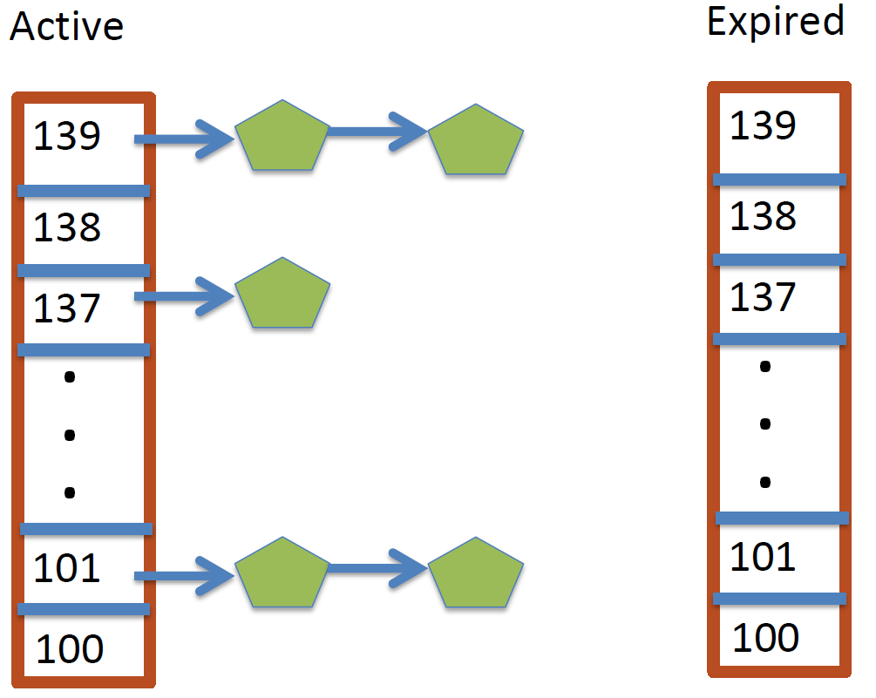
Run Queues

Slide 6
Approach
Take first task from lowest runqueue on active set
  Lower priority value means higher priority
When done, put it on runqueue on expired set
On empty active, swap active and expired runqueues
Constant time
  Fixed number of queues to check
  Only take first item from non-empty queue

Slide 7
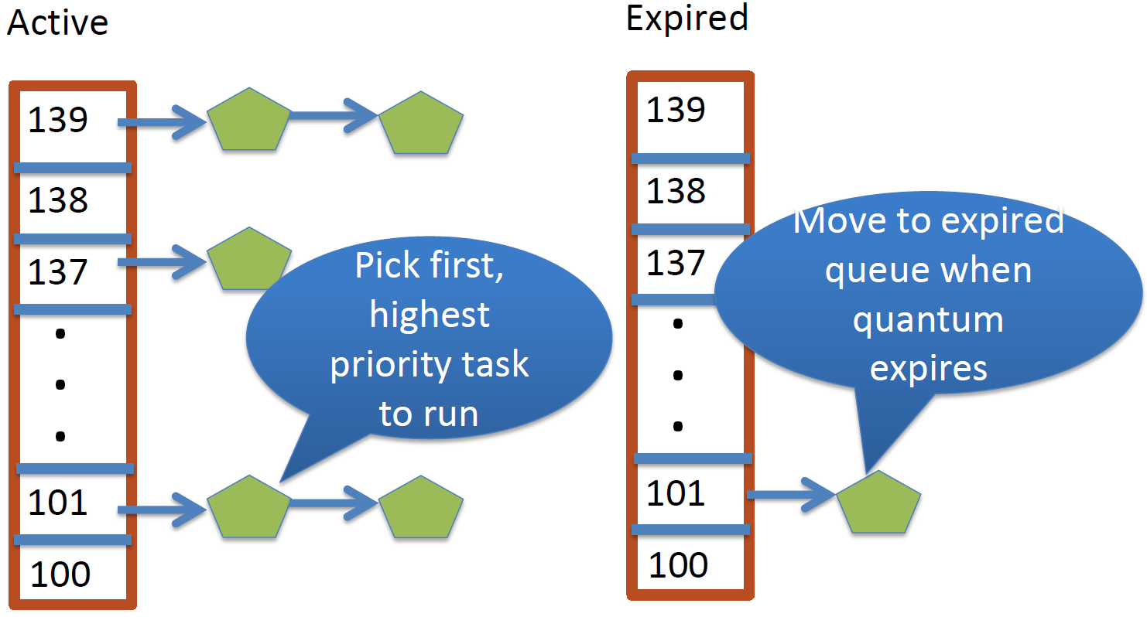
Example

Slide 8
Blocking
What if a program blocks on I/O?
  Still has part of its quantum left
  Has nothing to execute
    Removed from active and expired runqueues
Need a wait queue for each blocking event
  Disk, lock, pipe, network socket, etc…

Slide 9
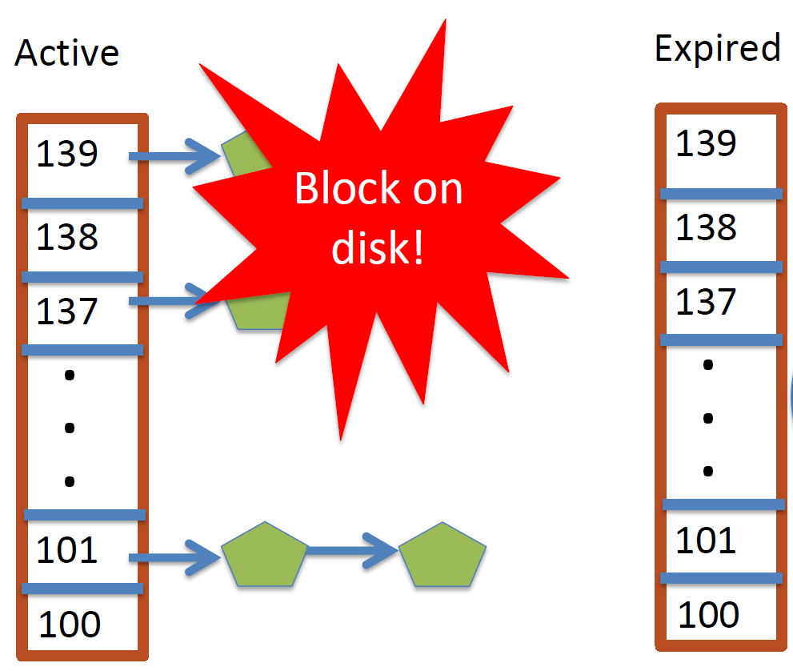
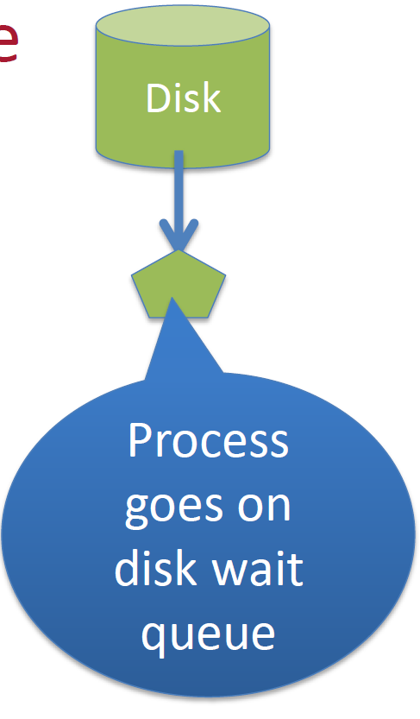
Wait Queues

Slide 10
Wait Queues
Blocked tasks are stored on wait queues
  Moved back when event happens
  No longer on any active or expired queue!
Disk example:
  I/O completes
    IRQ handler moves task from wait queue to active runqueue

Slide 11
Time Slices
A process blocks and then becomes runnable
  How much time did it have left?
Each task tracks time left in ‘time_slice’ field
  On each clock period: current->time_slice--
  If time slice goes to zero, move to expired queue
    Refill time slice
    Schedule someone else
  An unblocked task can use balance of time slice
  Forking halves time slice with child

Slide 12
Priorities
Based on “nice” levels
  “nice” value: user-specified adjustment to base priority
100 = highest priority
139 = lowest priority
120 = base priority
  Selfish (not nice) = -20 (I want to go first)
  Really nice = +19 (I will go last)

Slide 13
Time Slice assignment
Priority < 120
  Time slice = (140 – priority) * 20ms
Priority >= 120
  Time slice = (140 – priority) * 5ms
“Higher” priority tasks get longer time slices
  And run first

Slide 14
Interactive Tasks
Most GUI programs are I/O bound on the user
  Unlikely to use entire time slice
Users care about interactivity
  Latency or responsiveness to user events
  Typically Keyboard/Mouse events
Scheduler tries to give UI programs a priority boost
  Move to front of line, run briefly, block on I/O again
Scheduler must somehow identify interactive tasks

Slide 15
Heuristic based classification
I/O bound applications wait on I/O
  Don’t need much CPU time
Scheduler monitors I/O wait time
  Infer which programs are GUI (and disk intensive)
  Processes that do a lot of I/O get a priority boost
Note that this behavior can be dynamic
  GUI does something compute intensive
    E.g. image rendering
  Scheduling should match program phases

Slide 16
Dynamic Priorities
Real Priority = static priority − bonus + 5;
  floor(100) && ceil(139)
Bonus is calculated based on sleep time
Dynamic priority determines a tasks’ runqueue
Balance throughput and latency with infrequent I/O
  May not be optimal
Heuristically driven
  Seems to work, but is pretty ugly
  Edge cases can cause it to break

Slide 17
Dynamic Priorities
Runqueue determined by the dynamic priority
  Not the static priority
  Dynamic priority mostly based on time spent waiting
    To boost UI responsiveness and “fairness” to I/O intensive apps
“nice” values influence static priority
  Can’t boost dynamic priority without being in wait queue!
  No matter how “nice” you are (or aren’t)

Slide 18
Setting static priorities
int setpriority(int which, int who, int prio);
int getpriority(int which, int who);
  which: process, process group, or user id
  who: PID, PGID, or UID
  prio: nice value (-20 to +19)
int nice(int inc);
  Historical interface (backwards compatible)
  Equivalent to:
    setpriority(PRIO_PROCESS, getpid(), niceval)

Slide 19
CFS Scheduler (later 2.6)
O(1) scheduler is complicated
  Heuristics for various issues makes it more complicated
  Heuristics can end up working at cross-purposes
Desire for something simpler and elegant
Based on a simple list of tasks (conceptually)
  Ordered by how much time they’ve used
Always pick the “neediest” task to run
  Until it is no longer neediest
  Then re-insert old task in the timeline
  Schedule the new neediest
Implements a form of Weighted Fair Queueing

Slide 20
Fairness
50 tasks, each should get 2% of CPU time
Do we really want this?
  What about priorities?
  Interactive vs. batch jobs?
  Per-user fairness?
Alice has 1 task and Bob has 49;
  Why should Bob get 98% of CPU?

Slide 21
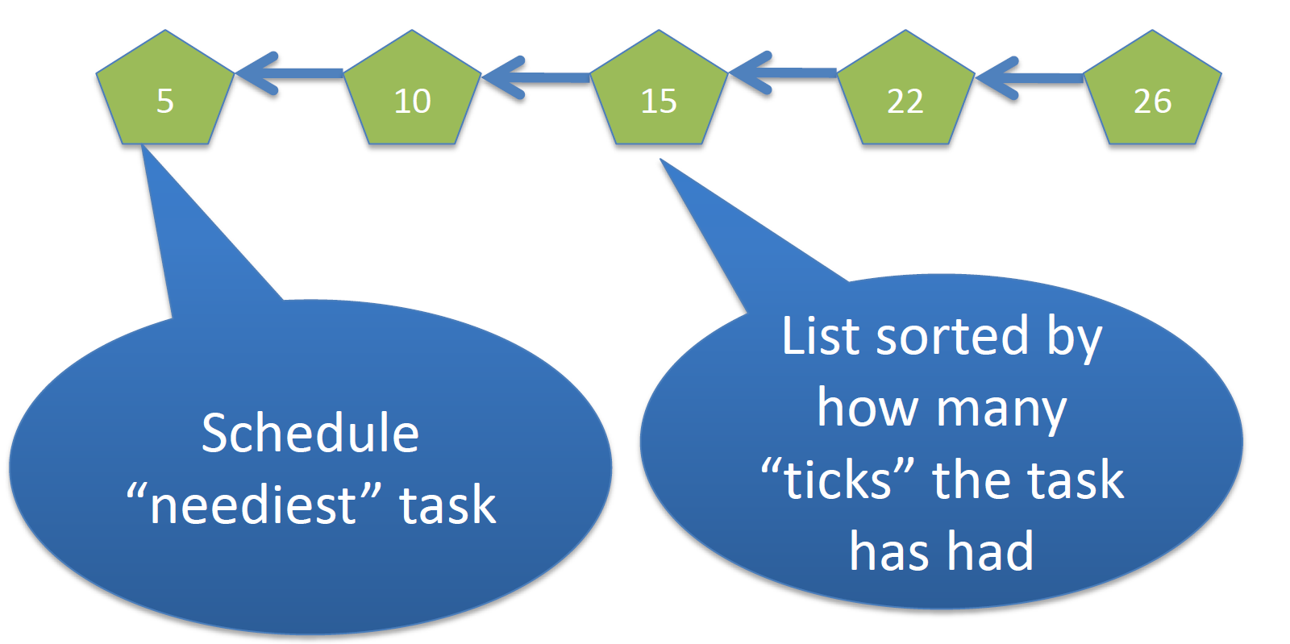
CFS

Slide 22
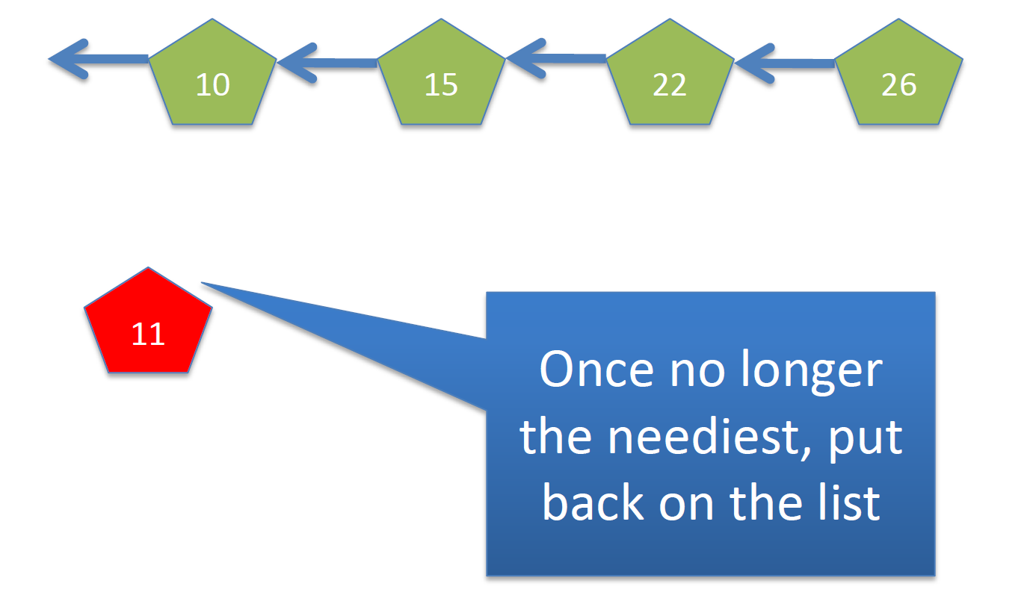
CFS

Slide 23
CFS details
Global virtual clock: ticks at a fraction of real time
  Fraction is number of total tasks
  Each task accumulates time in proportion to total # of tasks
  Stores accumulated time as a variable
  Accumulated time subtracted as task runs
Example: 4 tasks
  Global vclock ticks once every 4 real ticks
  Each task allocated one real tick
Tasks stored in a red-black tree sorted based on their allocation of ticks
  struct rbtree;
  Generic kernel data structure
  Task with largest allocation of ticks is scheduled next
CPU time is allotted based on the tick allocations
  Messing with the tick allocations allows flexibility

Slide 24
Priorities
Priorities allow scheduler to be unfair
In CFS, priorities determine the ticks allocated to a task
Example:
  For a high-priority task
    10 real clock ticks may be allocated per global virtual tick
  For a low-priority task
    A virtual, task-local tick may only last for 1 actual clock tick
Higher-priority tasks run longer
Low-priority tasks make some progress

Slide 25
Weighted Fair Queueing
GUI programs are I/O bound
  We want them to be responsive to user input
  Need to be scheduled as soon as input is available
  Will only run for a short time
CFS blocked tasks removed from RB-tree
  Just like O(1) scheduler
Virtual clock keeps ticking while tasks are blocked
  Increasingly large deficit between task and global vclock
When a GUI task is runnable, goes to the front
  Dramatically lower vclock value than CPU-bound jobs

Slide 26
Grouping
Per group or user scheduling
  Controlled by real to virtual tick ratio
    Function of number of global and user’s/group’s tasks
  Can group processes in multiple ways
    Can support group hierarchies
Scheduler doesn’t operate on tasks, threads or processes
  Uses a generic “sched_entity” structure
  Sched entity can refer to anything that can run
    Can also refer to a set of “sched_entities”
    Allows recursiveness in the scheduler
Easily extendable to support “cgroups”
  Basis for containerization

