Slide 1
Threads

Slide 2
Linked Lists

Slide 3
structs and memory layout
fox
fox
fox
list.next
list.next
list.next
list.prev
list.prev
list.prev

Slide 4
Linked lists in Linux
Node;
fox
fox
fox
list {
.next
.prev
}
list {
.next
.prev
}
list {
.next
.prev
}

Slide 5
What about types?
Calculates a pointer to the containing struct
struct list_head fox_list;
struct fox * fox_ptr = list_entry(fox_list->next, struct fox, node);

Slide 6
List access methods
struct list_head some_list;
list_add(struct list_head * new_entry,
struct list_head * list);
list_del(struct list_head * entry_to_remove);
struct type * ptr;
list_for_each_entry(ptr, &some_list, node){
…
}
struct type * ptr, * tmp_ptr;
list_for_each_entry_safe(ptr, tmp_ptr, &some_list, node) {
list_del(ptr);
kfree(ptr);
}

Slide 7
Why use threads
Web servers can handle multiple requests concurrently
Web browsers can initiate multiple requests concurrently
Parallel programs running on a multiprocessor concurrently employ multiple processors
  Multiplying a large matrix –
    split the output matrix into k regions and compute the entries in each region concurrently using k processors

Slide 8
Programming models
Concurrent programs tend to be structured using common models:
  Manager/worker
    Single manager handles input and assigns work to the worker threads
  Producer/consumer
    Multiple producer threads create data (or work) that is handled by one of the multiple consumer threads
  Pipeline
    Task is divided into series of subtasks, each of which is handled in series by a different thread

Slide 9
Needed environment
Concurrent programs are generally tightly coupled
  Everybody wants to run the same code
  Everybody wants to access the same data
  Everybody has the same privileges
  Everybody uses the same resources (open files, network connections, etc.)
But they need multiple hardware execution states
  Stack and stack pointer (RSP)
    Defines current execution context (function call stack)
  Program counter (RIP), indicating the next instruction
  Set of general-purpose processor registers and their values

Slide 10
Supporting Concurrency
Key idea
  separate the concept of a process (address space, etc.) from that of a minimal “thread of control” (execution state: PC, etc.)
  creating concurrency does not require creating new processes
This execution state is usually called a thread, or sometimes, a lightweight process

Slide 11
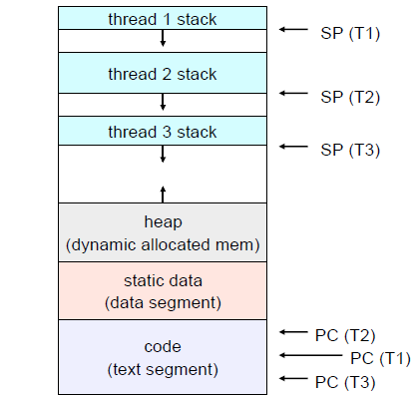
Address Spaces
VDSO
kernel virtual memory
kernel physical memory
stack
Memory mapped devices
Memory mapped region for
shared libraries
run-time heap (via malloc)‏
run-time heap (via malloc)‏
run-time heap (via malloc)‏
uninitialized data (.bss)‏
initialized data (.data)‏
program text (.text)‏
0

Slide 12
Threads and processes
Most modern OS’s (Mach, Chorus, Windows XP, modern Unix (not Linux)) therefore support two entities:
  process: defines the address space and general process attributes (such as open files, etc.)
  Thread: defines a sequential execution stream within a process
A thread is bound to a single process
  But processes can have multiple threads executing within them
  Sharing data between threads is easy: same address space
Threads become the unit of scheduling
  Processes are just containers in which threads execute

Slide 13
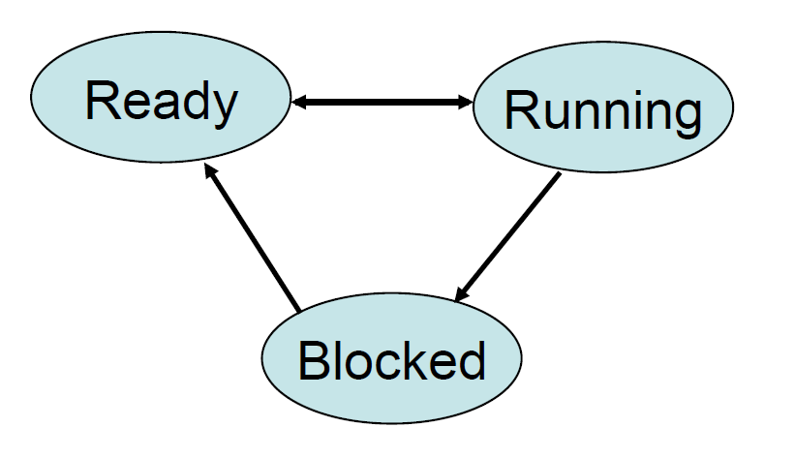
Execution States
Threads also have execution states

Slide 14
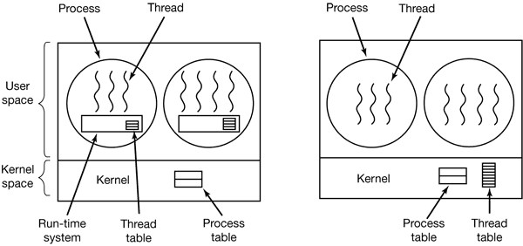
Types of threads
User Threads vs Kernel Threads

Slide 15
Kernel threads
OS now manages threads and processes
  All thread operations are implemented in the kernel
  OS schedules all of the threads in a system
    if one thread in a process blocks (e.g., on I/O), the OS knows about it, and can run other threads from that process
    possible to overlap I/O and computation inside a process
Kernel threads are cheaper than processes
  less state to allocate and initialize
But, they’re still pretty expensive for fine-grained use (e.g., orders of magnitude more expensive than a procedure call)
  Thread operations are all system calls
    context switch
    argument checks
  Must maintain kernel state for each thread

Slide 16
Context Switching
Like process context switch
  Trap to kernel
  Save context of currently running thread
    Push machine state onto thread stack
  Restore context of the next thread
    Pop machine state from next thread’s stack
  Return as the new thread
    Execution resumes at PC of next thread
What’s not done?
  Change address space

Slide 17
User Level Threads
To make threads cheap and fast, they need to be implemented at the user level
  managed entirely by user-level library, e.g. libpthreads.a
User-level threads are small and fast
  each thread is represented simply by a PC, registers, a stack, and a small thread control block (TCB)
  creating a thread, switching between threads, and synchronizing threads are done via function calls
no kernel involvement is necessary!
  user-level thread operations can be 10-100x faster than kernel threads as a result
A user-level thread is managed by a run-time system
  user-level code that is linked with your program

Slide 18
Context Switching
Like process context switch
  trap to kernel
  save context of currently running thread
    push machine state onto thread stack
  restore context of the next thread
    pop machine state from next thread’s stack
  return as the new thread
    execution resumes at PC of next thread
What’s not done:
  change address space

Slide 19
ULT implementation
A process executes the code in the address space
  Process: the kernel-controlled executable entity associated with the address space
This code includes the thread support library and its associated thread scheduler
The thread scheduler determines when a thread runs
  it uses queues to keep track of what threads are doing: run, ready, wait
    just like the OS and processes
    but, implemented at user-level as a library

Slide 20
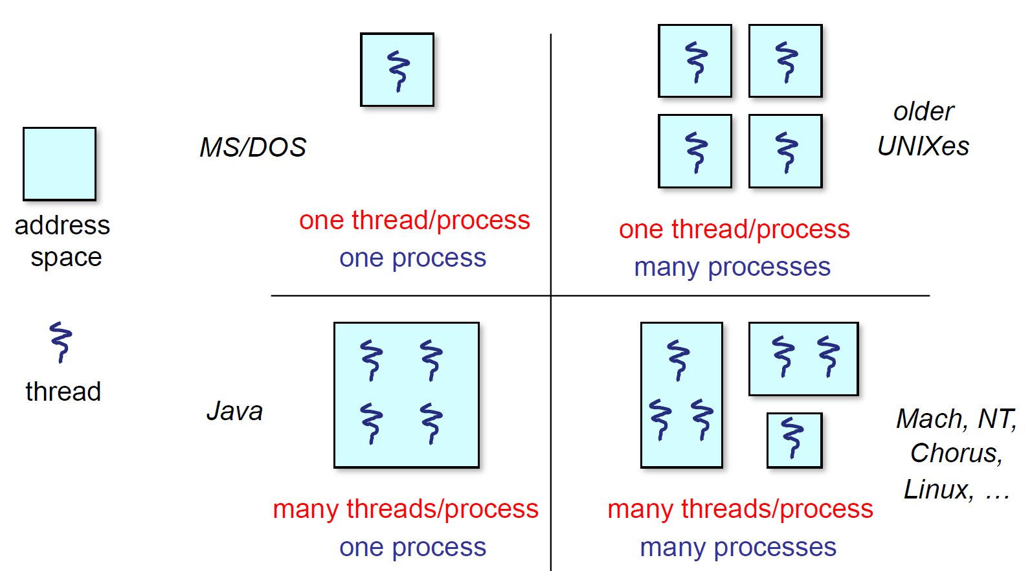

Slide 21
ULTs Pros and Cons
Advantages
Thread switching does not involve the kernel – no need for mode switching
  Fast context switch time,
Threads semantics are defined by application
Scheduling can be application specific
  Best algorithm can be selected
ULTs are highly portable – Only a thread library is needed
Disadvantages
Most system calls are blocking for processes
  All threads within a process will be implicitly blocked
  Waste of resource and decreased performance
The kernel can only assign processors to processes.
  Two threads within the same process cannot run simultaneously on two processors

Slide 22
KLT Pros and Cons
Advantages
The kernel can schedule multiple threads of the same process on multiple processors
Blocking at thread level, not process level
  If a thread blocks, the CPU can be assigned to another thread in the same process
Even the kernel routines can be multithreaded
Disadvantages
Thread switching always involves the kernel
  This means two mode switches per thread switch are required
KTLs switching is slower compared ULTs
  Still faster than a full process switch

Slide 23
pthread API
This is taken from the POSIX pthreads API:
  t = pthread_create(attributes, start_procedure)
    creates a new thread of control
    new thread begins executing at start_procedure
  pthread_cond_wait(condition_variable)
    the calling thread blocks, sometimes called thread_block()
  pthread_signal(condition_variable)
    starts the thread waiting on the condition variable
  pthread_exit()
    terminates the calling thread
  pthread_join(t)
    waits for the named thread to terminate

Slide 24
Preemption
Strategy 1: Force everyone to cooperate
  A thread willingly gives up the CPU by calling yield()
  yield() calls into the scheduler, which context switches to another ready thread
  What happens if a thread never calls yield()?
Strategy 2: Use preemption
  Scheduler requests that a timer interrupt be delivered by the OS periodically
    Usually delivered as a UNIX signal (man signal)
    Signals are just like software interrupts, but delivered to userlevel by the OS instead of delivered to OS by hardware
  At each timer interrupt, scheduler gains control and context switches as appropriate

Slide 25
Cooperative Threads
Cooperative threads use non pre-emptive scheduling
Advantages:
  Simple
    Scientific apps
Disadvantages:
  For badly written code
Scheduler gets invoked only when Yield is called
A thread could yield the processor when it blocks for I/O
Does this lock the system?

Slide 26
Threads and I/O
The kernel thread issuing an I/O request blocks until the request completes
  Blocked by the kernel scheduler
How to address this?
One kernel thread for each user level thread
  “common case” operations (e.g., synchronization) would be quick
Limited-size “pool” of kernel threads for all the user-level threads
  The kernel will be scheduling its threads obliviously to what’s going on at user-level

Slide 27
Combined ULTs and KLTs
Solaris Approach

Slide 28
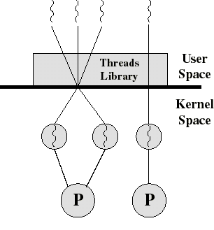
Combined ULT/KLT Approaches
Thread creation done in the user space
Bulk of thread scheduling and synchronization done in user space
ULT’s mapped onto KLT’s
  The programmer may adjust the number of KLTs
KLT’s may be assigned to processors
Combines the best of both approaches
“Many-to-Many” Model

Slide 29
Solaris Process Structure
Process includes the user’s address space, stack, and process control block
User-level threads – Threads library
  Library supports for application parallelism
  Invisible to the OS
Kernel threads
  Visible to the kernel
  Represents a unit that can be dispatched on a processor
Lightweight processes (LWP)
  Each LWP supports one or more ULTs and maps to exactly one KLT

Slide 30
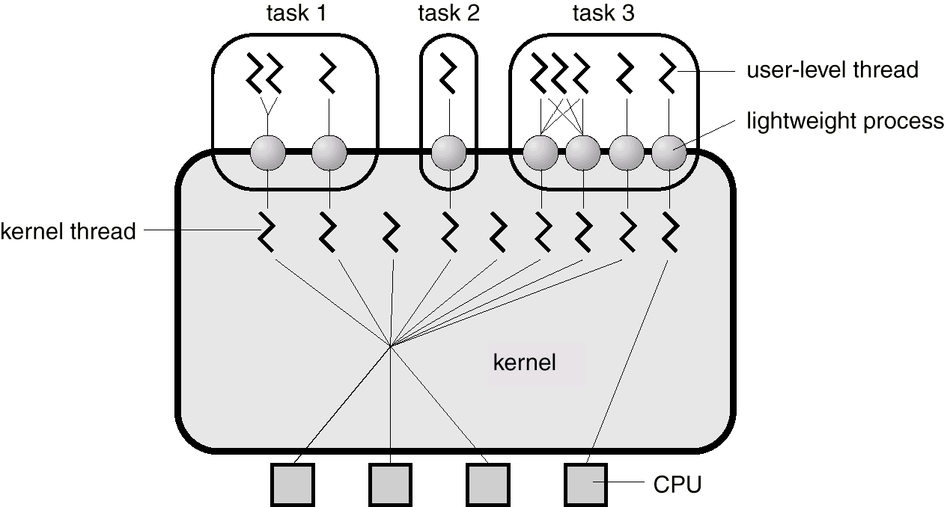
Solaris Threads
“bound” thread
Task 2 is equivalent to a pure ULT approach – Traditional Unix process structure
Tasks 1 and 3 map one or more ULT’s onto a fixed number of LWP’s, which in turn map onto KLT’s
Note how task 3 maps a single ULT to a single LWP bound to a CPU

Slide 31
Solaris – User Level Threads
Share the execution environment of the task
  Same address space, instructions, data, file (any thread opens file, all threads can read).
Can be tied to a LWP or multiplexed over multiple LWPs
Represented by data structures in address space of the task – but kernel knows about them indirectly via LWPs

Slide 32
Solaris – Kernel Level Threads
Only objects scheduled within the system
May be multiplexed on the CPU’s or tied to a specific CPU
Each LWP is tied to a kernel level thread

Slide 33
Solaris – Versatility
ULTs can be used when logical parallelism does not need to be supported by hardware parallelism
  Eliminates mode switching
    Multiple windows but only one is active at any one time
If ULT threads can block then more LWPs can be added to avoid blocking the whole application
High Versatility – System can operate in a Windows style or conventional Unix style, for example

Slide 34
ULTs, LWPs and KLTs
LWP can be viewed as a virtual CPU
  The kernel schedules the LWP by scheduling the KLT that it is attached to
Run-time library (RTL) handles multiple
  When a thread invokes a system call, the associated LWP makes the actual call
    LWP blocks, along with all the threads tied to the LWP
    Any other thread in same task will not block.

Slide 35
Thread Implementation
Scheduler Activation

Slide 36
Threads and locking
If one thread holds a lock and is scheduled out
  Other threads will be unable to enter the critical section and will block (stall)
Solving this requires coordination between the kernel and the user-level thread manager
  “scheduler activations”
    each process can request one or more kernel threads
      process is given responsibility for mapping user-level threads onto kernel threads
      kernel promises to notify user-level before it suspends or destroys kernel thread

Slide 37
Scheduler Activation – Motivation
Application has knowledge of the user-level thread state but has little knowledge of or influence over critical kernel-level events
  By design, to achieve the virtual machine abstraction
Kernel has inadequate knowledge of user-level thread state to make optimal scheduling decisions
Underscores the need for a mechanism that facilitates exchange of information between user-level and kernel-level mechanisms.
A general system design problem: communicating information and control across layer boundaries while preserving the inherent advantages of layering, abstraction, and virtualization.

Slide 38
Scheduler Activations: Structure
User
Change in Processor
Requirements
. . .
Thread
Library
Scheduler Activation
Kernel Support
Change in Processor
Allocation
Change in Thread
Status
Kernel

Slide 39
Communication via Upcalls
The kernel-level scheduler activation mechanism communicates with the user-level thread library by a set of upcalls
Add this processor (processor #)
Processor has been preempted (preempted activation #, machine state)
Scheduler activation has blocked (blocked activation #)
Scheduler activation has unblocked (unblocked activation #, machine state)
The thread library must maintain the association between a thread’s identity and thread’s scheduler activation number.

Slide 40
Role of Scheduler Activations
Abstraction
Implementation
. . .
. . .
User-level
Threads
Thread
Library
Kernel
P1
P2
. . .
Pn
SA
SA
. . .
SA
Invariant: There is one running scheduler activation (SA) for each processor assigned to the user process.
Virtual
Multiprocessor

Slide 41
Avoiding Effects of Blocking
User
User
5: Start
1: System Call
1
4: Upcall
3: New
2: Block
2
kernel
Kernel
Kernel Threads
Scheduler Activations

Slide 42
Resuming Blocked Thread
user
5
4
4: preempt
5: resume
3: upcall
2: preempt
1: unblock
kernel

Slide 43
Scheduler Activations – Summary
Threads implemented entirely in user-level libraries
Upon calling a blocking system call
  Kernel makes an up-call to the threads library
Upon completing a blocking system call
  Kernel makes an up-call to the threads library
Is this the best possible solution? Why not?
  Specifically, what popular principle does it appear to violate?

Slide 44
You really want multiple threads per address space
Kernel threads are much more efficient than processes, but they’re still not cheap
  all operations require a kernel call and parameter verification
User-level threads are:
  fast as blazes
  great for common-case operations
    creation, synchronization, destruction
  can suffer in uncommon cases due to kernel obliviousness
    I/O
    preemption of a lock-holder
Scheduler activations are the answer
  pretty subtle though

