Slide 1
Processes

Slide 2
Process Concept
A primary task of an operating system is to execute and manage processes
What is a program and what is a process?
  A program is a specification, which contains data type definitions, how data can be accessed, and set of instructions that when executed accomplishes useful “work”
  A sequential process is the activity resulting from the execution of a program with its data by a sequential processor
  Program is passive, while a process is active
    A process is an instance of a program in execution

Slide 3
What is a program
A program consists of:
  Code: machine instructions
  Data: variables stored and manipulated in memory
    initialized variables (globals)
    dynamically allocated variables (malloc, new)
    stack variables (C automatic variables, function arguments)
What is added by a process?
  DLLs: libraries that were not compiled or linked with the program
    containing code & data, possibly shared with other programs
  mapped files: memory segments containing variables (mmap())
    used frequently in database programs
  OS resources: open files
Whats the relationship between a program and process?
  A process is a executing program

Slide 4
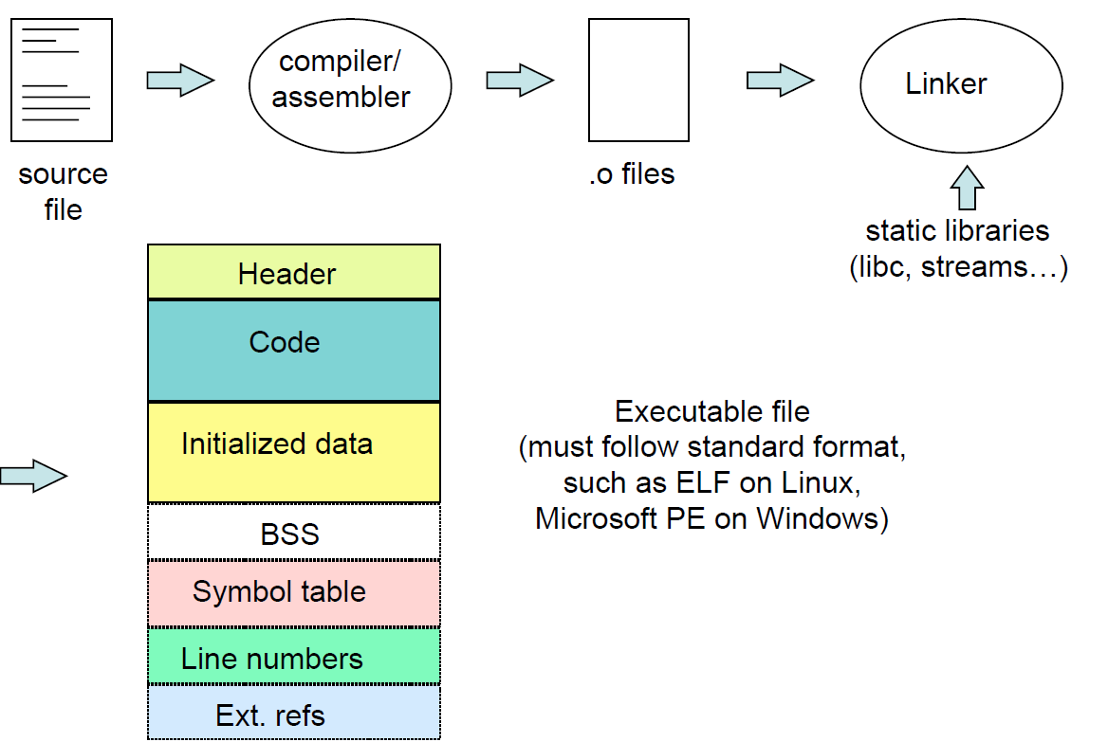
Preparing a Program

Slide 5
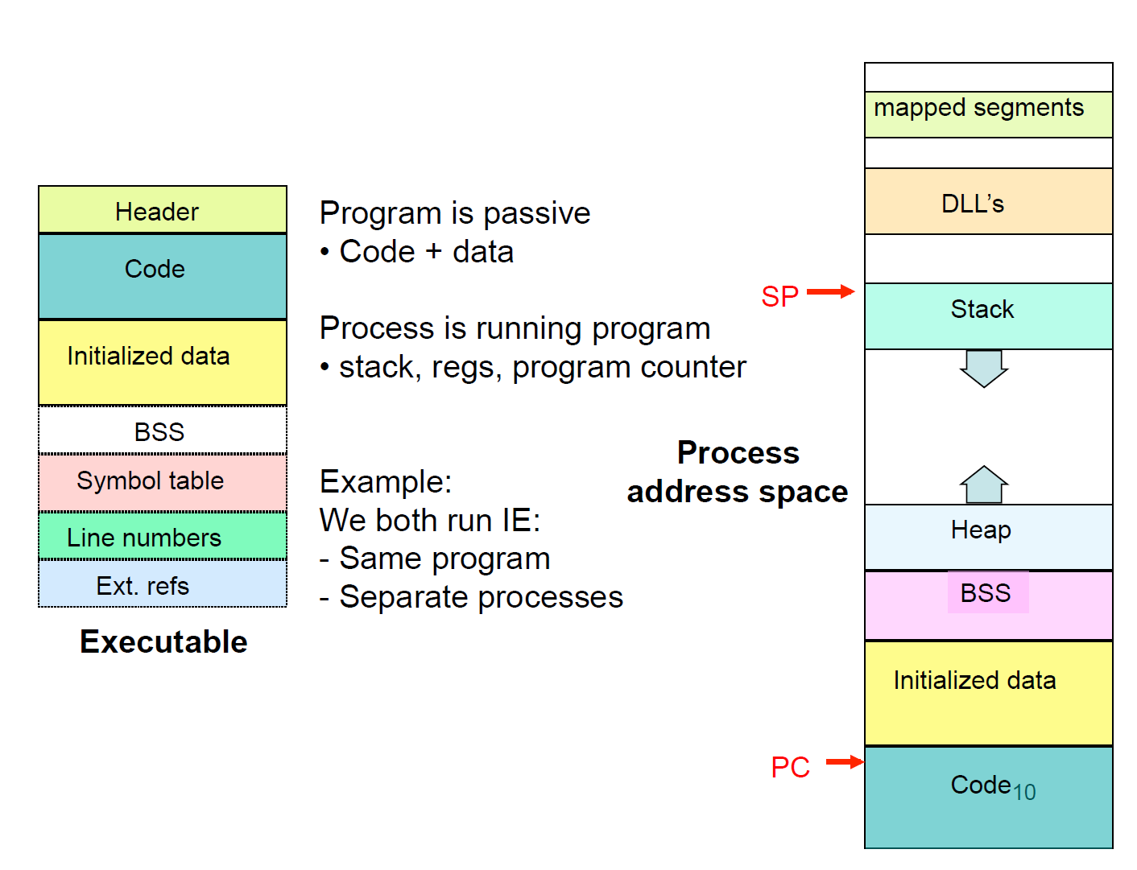
Processes vs Programs

Slide 6
When are processes created
Processes can be created in two ways
  System initialization: one or more processes created when the OS starts up
  Execution of a process creation system call: something explicitly asks for a new process
System calls can come from:
  User request to create a new process (system call executed from user shell)
  Already running processes
    User programs
    System daemons

Slide 7
UNIX Shells
int main(int argc, char ** argv)
{
while (1) {
char * cmd = get_next_command();
int child_pid = fork();
if (child_pid == 0) {
// manipulate STDIN/STDOUT/STDERR fd’s
exec(cmd);
panic(“exec failed!”);
} else {
wait(child_pid);
}
}
}

Slide 8
Process hierarchies
Parent creates a child process
  Child processes can create their own children
Forms a hierarchy
  top of the hierarchy is the init process
  UNIX calls this a “process group”
  If a process exits, its children are “inherited” by the exiting process’s parent
Windows has no concept of process hierarchy
  All processes are created equal
jarusl@gander:~$ ps axu | grep init
root 1 0.0 0.0 38144 6124 ? Ss Aug23 31:14 /sbin/init

Slide 9
What is in a Process?
A process consists of (at least):
  an address space
  the code for the running program
  the data for the running program
  an execution stack and stack pointer (SP)
    traces state of procedure calls made
  the program counter (PC), indicating the next instruction
  a set of general-purpose processor registers and their values
  a set of OS resources
    open files, network connections, sound channels, …
The process is a container for all of this state
  a process is named by a process ID (PID)
    just an integer

Slide 10
Process States
Each process has an execution state, which indicates what it is currently doing
  ready: waiting to be assigned to CPU
    could run, but another process has the CPU
  running: executing on the CPU
    is the process that currently controls the CPU
    pop quiz: how many processes can be running simultaneously?
  waiting: waiting for an event, e.g. I/O
    cannot make progress until event happens
As a process executes, it moves from state to state
  UNIX: run ps, STAT column shows current state
    which state is a process is most of the time?

Slide 11
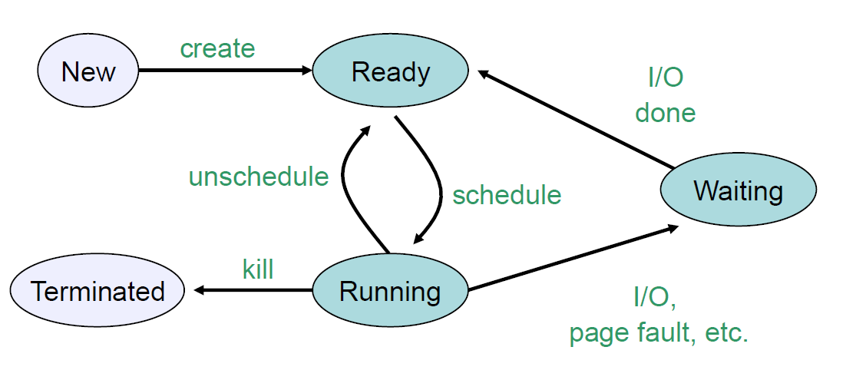
Process States

Slide 12
Process Data Structures
How does the OS represent a process in the kernel?
  At any time, there are many processes, each in its own particular state
  The OS data structure that represents each is called the process control block (PCB)
PCB contains all info about the process
  OS keeps all of a process’ hardware execution state in the PCB when the process isn’t running
    Program Counter (%RIP on x86_64)
    Stack Pointer (%RSP on x86_64)
    Other registers
  When process is unscheduled, the state is transferred out of the hardware into the PCB

Slide 13
Process Control Block
The PCB is a data structure with many, many fields:
  process ID (PID)
  execution state
  program counter, stack pointer, registers
  memory management info
  UNIX username of owner
  scheduling priority
  accounting info
  pointers into state queues
PCB is a large data structure that contains or points to all information about the process
  Linux: struct task_struct;
    ~100 fields
    defined in <include/linux/sched.h>
  NT: defined in EPROCESS – It contains about 60 fields

Slide 14
What’s In A PCB?
Process management
Registers
Program counter
CPU status word
Stack pointer
Process state
Priority / scheduling parameters
Process ID
Parent process ID
Signals
Process start time
Total CPU usage
File management
Root directory
Working (current) directory
File descriptors
User ID
Group ID
May be
stored
on stack
Memory management
Pointers to text, data, stack
or
Pointer to page table

Slide 15
PCBs and Hardware State
When a process is running, its hardware state is inside the CPU
  RIP, RSP, other registers
  CPU contains current values
When the OS stops running a process (puts it in the waiting state), it saves the registers’ values in the PCB
  when the OS puts the process in the running state, it loads the hardware registers from the values in that process’ PCB
The act of switching the CPU from one process to another is called a context switch
  timesharing systems may do 100s or 1000s of switches/s
  takes about 5 microseconds on today’s hardware

Slide 16
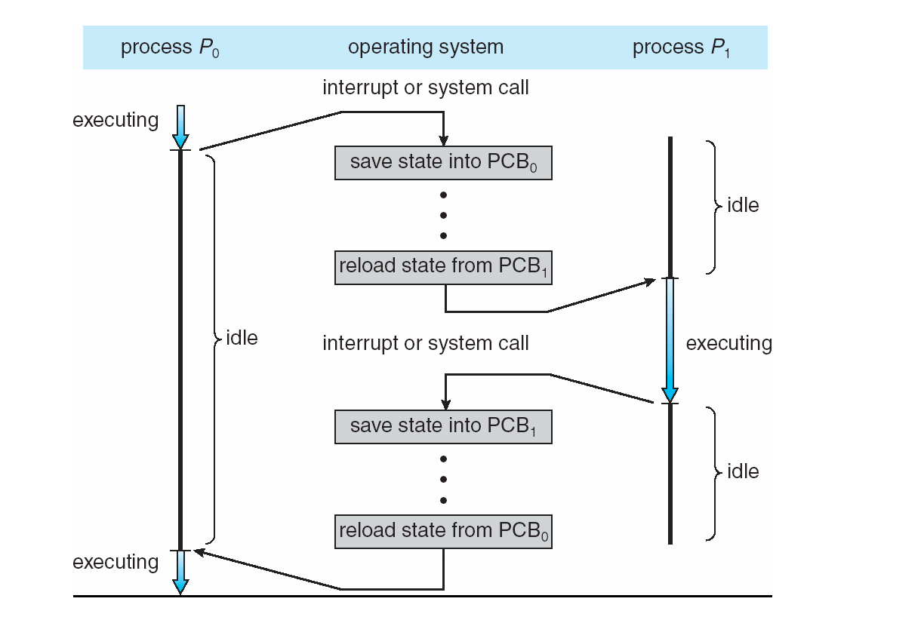
CPU Switch From Process to Process

Slide 17
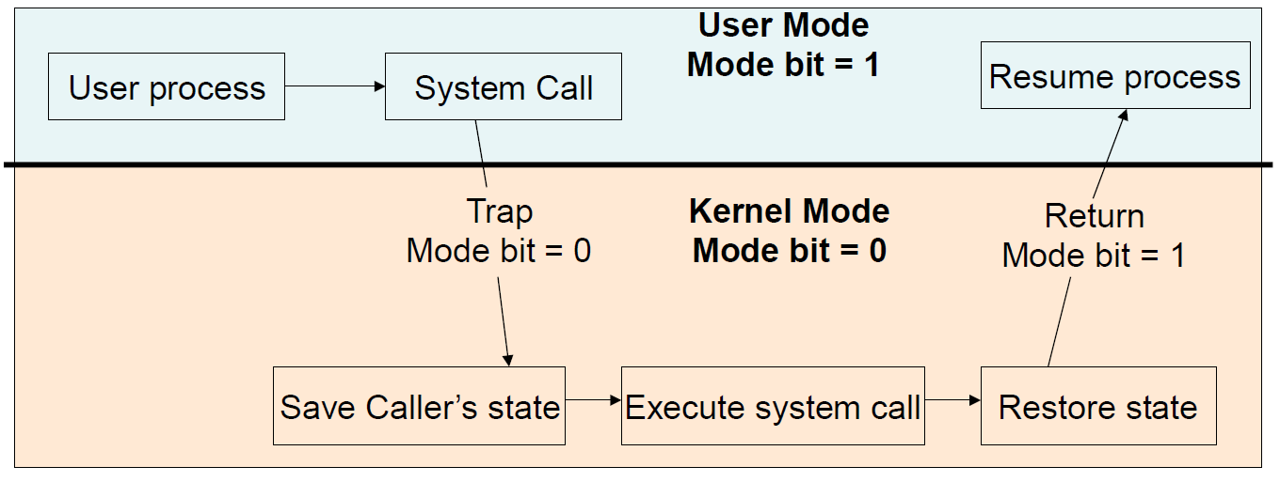
Context Switch vs Mode Switch

Slide 18
Process Queues
You can think of the OS as a collection of queues that represent the state of all processes in the system
  typically one queue for each state
    e.g., ready, waiting, …
  each PCB is queued onto a state queue according to its current state
  as a process changes state, its PCB is unlinked from from queue, and linked onto another
Job queue – set of all processes in the system
Ready queue – set of all processes residing in main memory, ready and waiting to execute
Device queues – set of processes waiting for an I/O device

Slide 19
Switching between processes
When should OS switch between processes, and how does it make it happen?
  Want to switch when one process is running
  Implies OS is not running!
Solution 1: cooperation
  Wait for process to make system call into OS
    E.g. read, write, fork
  Wait for process to voluntarily give up CPU
    E.g. yield()
  Wait for process to do something illegal
    Divide by zero, dereference zero
  Problem: what if process is buggy and has infinite loop?
Solution 2: Forcibly take control

Slide 20
Preemptive Context Switches
How can OS get control while a process runs?
  How does OS ever get control?
    Traps: exceptions, interrupts (system call = exception)
  Solution: force an interrupt with a timer
    OS programs hardware timer to go off every x ms
    On timer interrupt, OS can decide whether to switch programs or keep running
How does the OS actually save/restore context for a process?
  Context = registers describing running code
  Assembly code to save current registers (stack pointer, frame pointer, GPRs, address space & load new ones)
  Switch routine: pass old and new PCBs
    Enter as old process, return as new process

Slide 21
Context Switch Design Issues
Context switches are expensive and should be minimized
  Context switch is purely system overhead, as no “useful” work accomplished during context switching
  The actual cost depends on the OS and the support provided by the hardware
    The more complex the OS and the PCB -> longer the context switch
    The more registers and hardware state -> longer the context swich
    Some hardware provides multiple sets of registers per CPU, allowing multiple contexts to be loaded at once
    A “full” process switch may require a significant number of instruction execution.
Notes:
Apparently duration of a timeslice on linux is 10ms
http://www.linux.org/docs/ldp/howto/KernelAnalysis-HOWTO-6.html
But in 2.6.36 kernel, in kernel/sched.c, default for SCHED_RR tasks is 100 msec (assuming that is milliseconds)
sched_rr_get_interval system call returns the time quantum of a SCHED_RR process on Linux (e.g., around 2.6.35 kernel)
I haven’t been able to get this to work.

Slide 22
Context Switch Implementation
# void swtch(struct context *old, struct context *new);
#
# Save current register context in old
# and then load register context from new.
.globl swtch swtch:
# Save old registers
# put old ptr into eax
movl 4(%esp), %eax
popl 0(%eax)
# save the old IP and stack and other registers
movl %esp, 4(%eax)
movl %ebx, 8(%eax)
movl %ecx, 12(%eax)
movl %edx, 16(%eax)
movl %esi, 20(%eax)
movl %edi, 24(%eax)
movl %ebp, 28(%eax)
pushl 0(%eax)
# put new ptr into eax
# restore other registers
movl 4(%esp), %eax
movl 28(%eax), %ebp
movl 24(%eax), %edi
movl 20(%eax), %esi
movl 16(%eax), %edx
movl 12(%eax), %ecx
movl 8(%eax), %ebx
# stack is switched here
# return addr put in place
# finally return into new ctxt
movl 4(%eax),%esp
Ret
Note: do not explicitly switch IP; happens when return from switch function

