Slide 1
NFS and AFS
Adapted from slides by Ed Lazowska, Hank Levy, Andrea and Remzi Arpaci-Dussea, Michael Swift

Slide 2
Distributed File Systems
Goal: access your data through normal file system APIs but store on some other machine
  Sharing/collaboration with other people
  Reliability via common backup
  Efficient use of capacity
Issues not common to usual file systems
  Naming transparency
  Load balancing
  Scalability
  Location and network transparency
  Fault tolerance

Slide 3
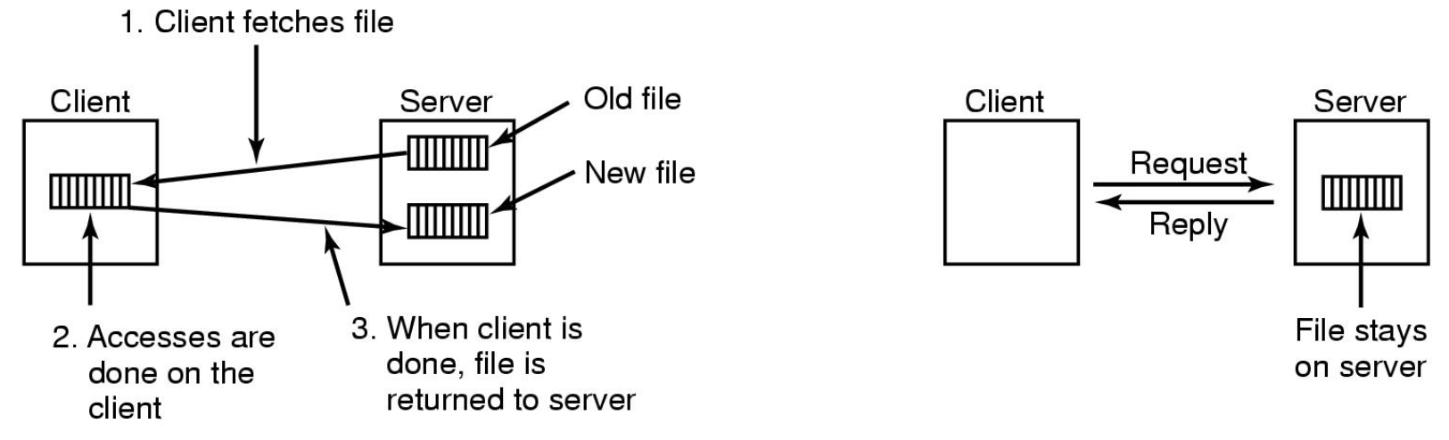
Transfer Model
Upload/download Model
  Client downloads file, works on it, and writes it back on server
  Simple and good performance
Remote Access Model
  File only on server; client sends commands to get work done
  Provides regular behavior with multiple clients

Slide 4
Naming Schemes
Files named by combination of their host name and local name;
  guarantees a unique system-wide name
  \\server\share\dir\file on Windows, or http://server/file
Attach remote directories to local directories, giving the appearance of a coherent directory tree;
  Only previously mounted remote directories can be accessed transparently
  /mnt/dir1/dir2/file – dir1 refers to a directory on a server
Total integration of the component file systems.
  A single global name structure spans all the files in the system.
  If a server is unavailable, some arbitrary set of directories on different machines also becomes unavailable.

Slide 5
Caching
Keep repeatedly accessed blocks in cache
  Improves performance of further accesses
How it works:
  If needed block not in cache, it is fetched and cached
  Accesses performed on local copy
  One master file copy on server, other copies distributed in DFS
Where to cache?
  Client Disk/FS: Pros: larger, data present locally on recovery
  Client Memory: Pros: diskless workstations, quicker data access,
  Servers: memory

Slide 6
Cache Update Policy
Write-through
  write data through to disk as soon as they are placed on any cache.
  Reliable, but poor performance.
Delayed-write
  modifications written to the cache and then written through to the server later.
  Write accesses complete quickly;
    some data may be overwritten before they are written back, and so need never be written at all.
  Poor reliability;
    unwritten data will be lost whenever a user machine crashes.
Delayed-write with Scan
  scan cache at regular intervals and flush blocks that have been modified since the last scan.
Write-on-close
  writes data back to the server when the file is closed
  Best for files that are open for long periods and frequently modified.

Slide 7
Cache Consistency
Is locally cached copy of the data consistent with the master copy?
  What happens if another client modifies a file you are caching?
Client-initiated approach
  Client initiates a validity check. (when?)
  Server checks whether the local data are consistent with the master copy.
Server-initiated approach
  Server records, for each client, the (parts of) files it caches.
  When server detects a potential inconsistency, it must react

Slide 8
Network File System (NFS)
Developed by Sun Microsystems in 1984
  Used to join FSes on multiple computers as one logical whole
Used commonly today with UNIX systems
Assumptions
  Allows arbitrary collection of users to share a file system
  Machines can be clients and servers at the same time
Architecture:
  A server exports one or more of its directories to remote clients
  Clients access exported directories by mounting them
    The contents are then accessed as if they were local

Slide 9
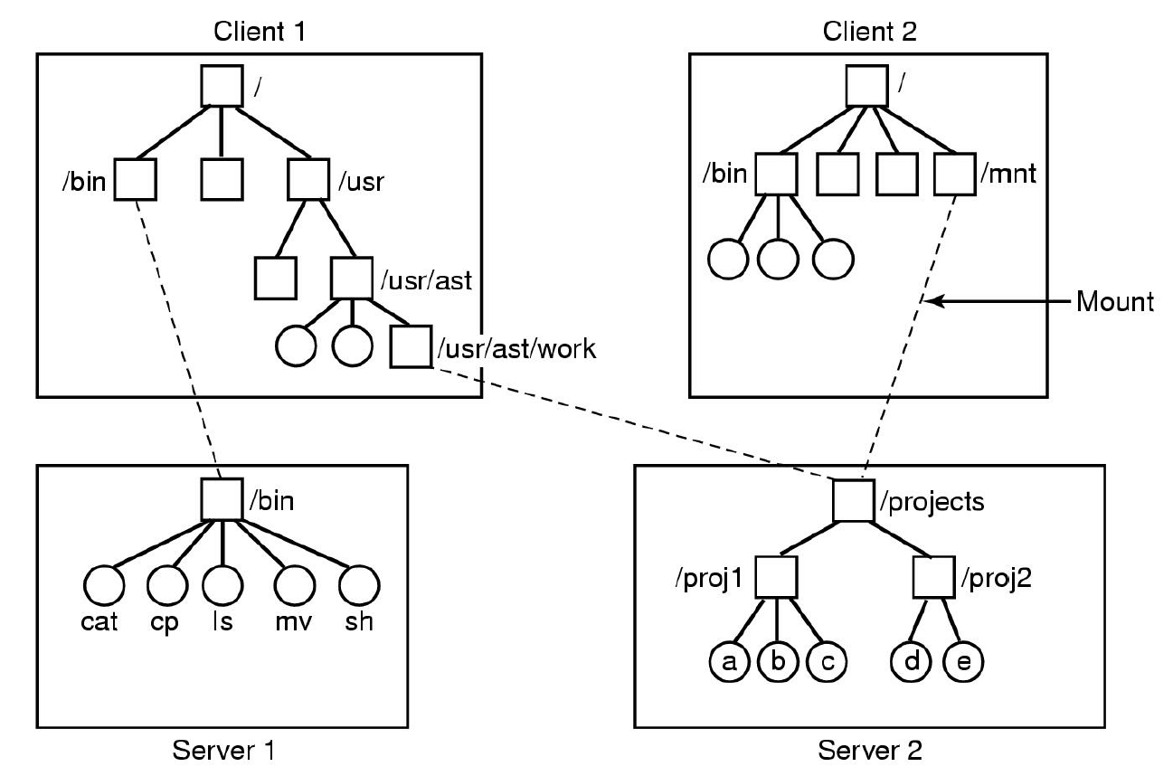
Example

Slide 10
NFS
Naming
  Client chooses where to mount a remote file system in its local directory hierarchy
  Files in NFS may have a different name on every client based on where the volume is mounted
  A common name space can be achieved by mounting the same set of servers in the same place on every client

Slide 11
NFS Protocol
Supports directory and file access via remote procedure calls (RPCs)
All UNIX system calls supported other than open & close
Open and close are intentionally not supported
  For a read, client sends lookup message to server
  Server looks up file and returns handle
  Unlike open, lookup does not copy info in internal system tables
  Subsequently, read contains file handle, offset and num bytes
  Each message is self-contained
Pros: server is stateless, i.e. no state about open files
Cons: Locking is difficult, no concurrency control

Slide 12
NFS Client Implementation
System call layer:
  Handles calls like open, read and close
Virtual File System Layer:
  Maintains table with one entry (v-node) for each open file
  v-nodes indicate if file is local or remote
    If remote it has enough info to access them
    For local files, FS and i-node are recorded
NFS Service Layer:
  This lowest layer implements the NFS protocol
  Makes RPCs for various operations to NFS server

Slide 13
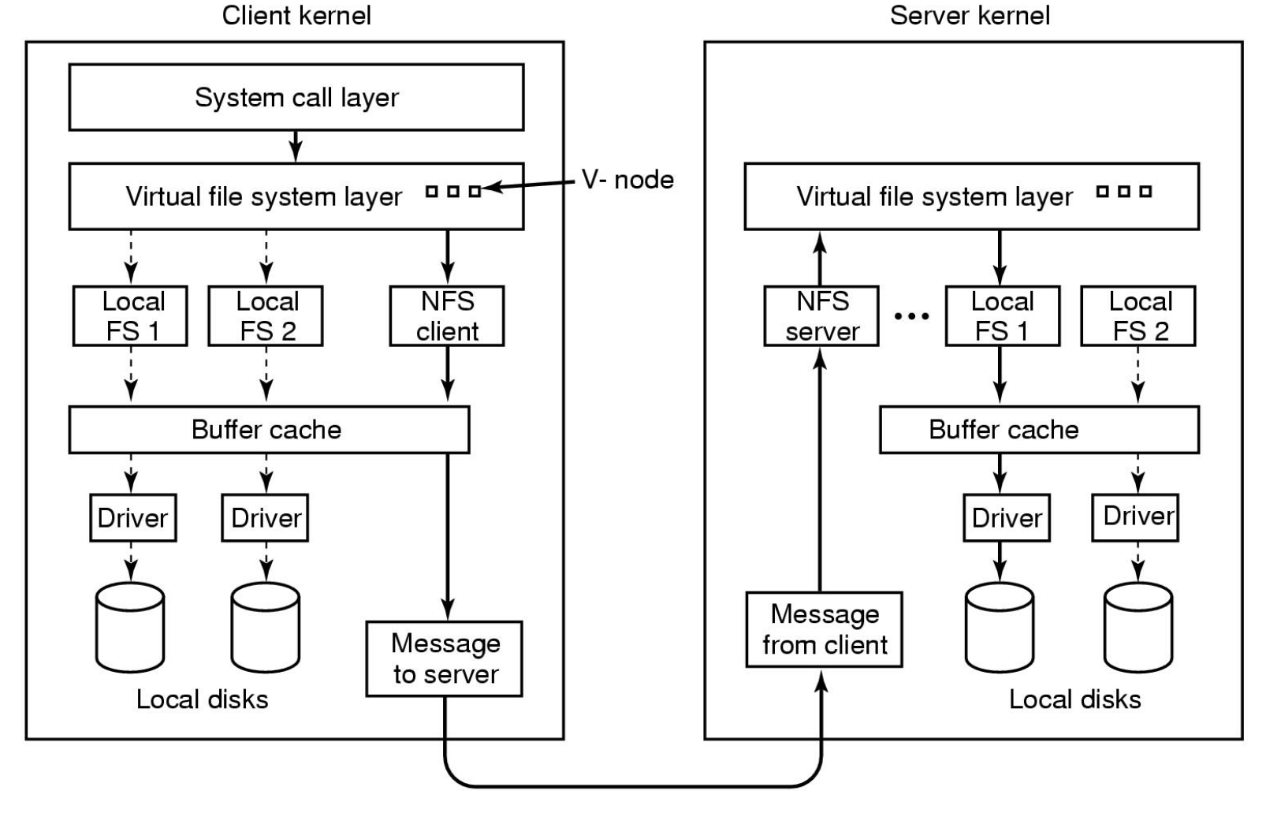
NFS Layers

Slide 14
Cache coherency
Clients cache file attributes and data
  If two clients cache the same data, cache coherency is lost
  Modifications by one client may not be seen by the other
Solutions:
  Each cache block has a timer (3-30 sec)
    Entry is discarded when timer expires
  On open of cached file, its last modify time on server is checked
    If cached copy is old, it is discarded
  Every 30 sec, cache time expires
    All dirty blocks are written back to the server
Impact:
  One client can modify data, another client may not see it for a while, but not forever.
  New files not visible for 30 seconds

Slide 15
Andrew File System (AFS)
Developed at CMU to support all of its student computing.
Consists of workstation clients and dedicated file server machines.
Workstations have local disks, used to cache files being used locally (originally whole files, now 64K file chunks).
Andrew has a single name space -- your files have the same names everywhere in the world.

Slide 16
AFS Overview
Based on the upload/download model
  Clients download and cache files
  Server keeps track of clients that cache the file
  Clients upload files at end of session
Whole file caching is central idea behind AFS
  Download whole file first time you open it
  Upload whole file when you modify it
AFS servers are stateful
  Keep track of clients that have cached files
  Recall files that have been modified

Slide 17
AFS Details
Has dedicated server machines
Clients have partitioned name space:
  Local name space and shared name space
  Cluster of dedicated AFS servers present shared name space
AFS file name works anywhere:
      You don’t know what server has files, nor where on that server.
  /afs/cs.pitt.edu/usr0/jacklange

Slide 18
AFS: Operations and Consistency
AFS caches entire files from servers
  Client interacts with servers only during open and close
Client OS intercepts calls, and passes them to AFS service on client
AFS service is a client process that caches files from servers
  AFS service contacts AFS server only on open and close
    Does not contact if file is already in the cache, and not invalidated
  Reads and writes bypass AFS service and go right to file cached in local file system.

Slide 19
AFS Caching and Consistency
Need for scaling led to reduction of client-server message traffic.
Once a file is cached, all operations are performed locally.
  Cache is on disk, so normal FS and FS operations work here
On close, if the file is modified, it is replaced on the server.
  What happens when multiple clients share a file?
The client assumes that its cache is up to date, unless it receives a callback message from the server saying otherwise.
  On file open, if the client has received a callback on the file, it must fetch a new copy; otherwise it uses its locally-cached copy.

Slide 20
Name Lookups
Looking up file path names is slow
  Lots of searching directories and
AFS offloads problem to client:
  Client reads directory contents
    Name, File ID (like inode number)
  Client scans directory for name
  Client opens file on directory by File ID
Performance:
  Slower than having server to lookup directly
    more data back and forth
  Supports more clients on a single server than having server do lookup

