Slide 1
Filesystems 2
Adapted from slides of Hank Levy
Adapted from slides of Brett Fleisch
Adapted from slides of John Kubiatowicz and Anthony Joseph

Slide 2
Unix FS shortcomings
Original Unix file system (1970’s) was simple and straightforward
  But: Could only achieve ~20KB/sec/arm
    ~2% of disk bandwidth available in 1982
Issues:
  Small blocks
    512 bytes (matched disk sector size)
  No locality
    Consecutive file blocks were placed randomly
  Inodes were not stored near data
    Inodes were stored at the beginning of the disk
    Data was stored at the end
  No read-ahead capabilities
    Could not pre-fetch contents of large files

Slide 3
Data/Inode placement
Original (non-FFS) unix FS had two major problems:
  1. data blocks are allocated randomly in aging file systems (using linked list)
    blocks for the same file allocated sequentially when FS is new
    as FS “ages” and fills, need to allocate blocks freed up when other files are deleted
      problem: deleted files are essentially randomly placed
      so, blocks for new files become scattered across the disk!
  2. inodes are allocated far from blocks
    all inodes at beginning of disk, far from data
    traversing file name paths, manipulating files, directories requires going back and forth from inodes to data blocks
  BOTH of these generate many long seeks!

Slide 4

BSD Fast File System (FFS)
Redesign by BSD in the mid 1980’s
  Main idea 1: Map design to hardware characteristics
  Main idea 2: Locality is important
Block size set to 4096 or 8192
Disk divided into cylinder groups
  Laid data out according to HW architecture
  Replicated FS structure in each cylinder
    Access FS contents with drastically lower seek times
Inodes were spread across disk
  Allowed inodes to be near file and directory data

Slide 5
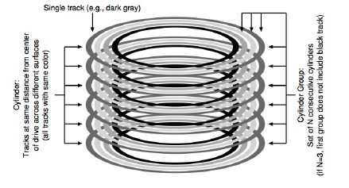
Disk Cylinders
Side effect of how rotating storage is designed
Disk consists of multiple platters
  Data is stored on both sides of the platter
Data is read by a sensor on a mechanical arm
  Each platter side has 1 arm
  Arm moves sensor to a given radius from the center and reads data as the disk spins
  Changing arm position is very expensive

Slide 6
Cylinder Group
FFS developed notion of a cylinder group
  disk partitioned into groups of cylinders
  data blocks from a file all placed in same cylinder group
  files in same directory placed in same cylinder group
  inode for file in same cylinder group as file’s data
Introduces a free space requirement
  to be able to allocate according to cylinder group, the disk must have free space scattered across all cylinders
    Need index of free blocks/inodes within a cylinder group
  in FFS, 10% of the disk is reserved just for this purpose!
    good insight: keep disk partially free at all times!
    this is why it may be possible for df to report >100%

Slide 7
FFS locality
Approaches to maintain locality:
  Contain a directories contents to a single cylinder group
  Spread directories across different cylinders
  Make large contiguous allocations from a single cylinder group
Results
  Achieved 20-40% of disk bandwith for large accesses
  10-20x performance improvement over Unix FS
  3800 lines of code vs 2700 for Unix FS
  10% of total disk space unusable
  First time OS designers realized they needed to care about the file system

Slide 8
Log Structured/Journaling File Systems
Radically different file system design
Motivations:
  Disk bandwidth scaling significantly (40% a year), but latency was not
  CPUs outpacing disks: I/O becoming more of a bottleneck
  Larger RAM capacities: file caches work well and trap most writes
Problems with existing approaches
  Lots of small writes
  metadata required synchronous writes for correctness after a crash
    With small files, most writes are to metadata
    synchronous writes are very slow: cannot use scheduling to improve performance
  5 disk seeks to create a file
    File inode (create)
    File data
    Directory entry
    File inode (finalize)
    Directory inode (modification time)

Slide 9
LFS basic idea
Treat the entire disk as a single log for appending
Coalesce all data and metadata writes into a log
  Single large record of all modifications
  Write out log to disk as a single large write operation
  Do not update data in place, just write a new version in the log
Maintains good temporal locality on disk
  Good for writing
Trades off on logical locality
  Bad for Reads
  Reading data means parsing the log to find the latest version
  But we can handle poor read performance via cache
    Hardware trends: Lots of available RAM
    Once reconstructed from the log, data can be cached in memory

Slide 10
LFS implementation
Simple in theory, really complicated in practice
  collect writes in the disk buffer cache
  Periodically write out the entire collection of writes in one large request
Log structure
  Each write operation consists of modified blocks
    Data blocks, inodes, etc
  Log contains data blocks first, followed by inode
    Basic approach to ensure consistency
    Write the data first, then update the metadata to “activate” the change
    Writing data takes a long time relative to metadata
      If system crashes during write, more likely FS will not be corrupted
LFS assumes a disk of infinite size
  What happens when we hit the end?

Slide 11
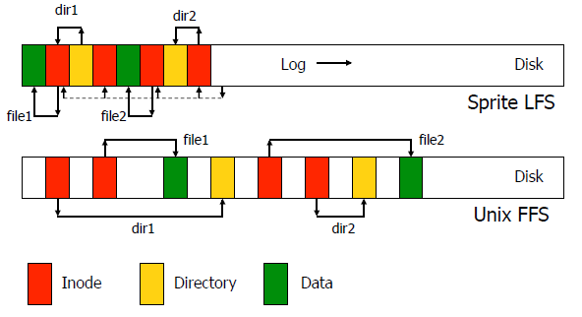
Basic disk layout examples

Slide 12
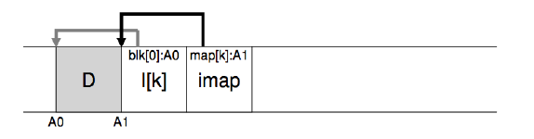
Locating data
How to actually find an inode without reading entire log?
  Solution: 1 more layer of abstraction
Create a single Inode Map (imap) of all inodes in use
  Array of block locations
  Use the inode # to index into the array
Every time a inode is modified, change map to point to new location in the log
  For performance cache map in memory
  But write it out at the end of every log flush to disk
To find a file you just need the latest version of the imap
  But how to you locate the imap?

Slide 13
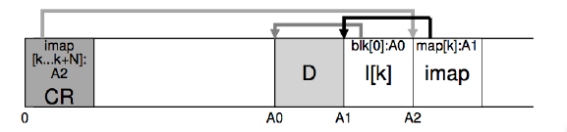
Checkpoint Region (CR)
At start of disk maintain a special area that stores the location of the imap
  Location does not change
Every time a log is flushed to disk, change the CR to point to the new imap location
  The CR is only updated after the log has been fully written
  Provides resiliency to crashes
What happens if machine crashes during a log flush operation?
  Very small window of time for a crash to happen that would lead to inconsistent state

Slide 14
Garbage Collection
What happens when the disk runs out of free space?
  Lots of data is expired (overwritten more recently)
    Can be discarded
Read in old log entries and look for expired data
  Expired Data = inodes that have been overwritten
Delete old inodes from the log
Write the new log to disk
  Expired data is removed
  Current data is just updated with a new location
    looks like a new write
  Space used for old log is now free

