Slide 1
Filesystems

Slide 2
File Systems
In general file systems are simple
  Abstraction for secondary storage
    Files
  Logical organization of files
    Directories
  Sharing of data between users/processes
    Permissions/ACLs

Slide 3
Files
Collection of data with some properties
  Contents, size, owner, permissions
Files may also have types
  Understood by file system
    Device, directory, symbolic link, …
  Understood by other parts of OS/runtime
    Executable, DLL, source code, object code, …
Types can be encoded in name or contents
  File extension: .exe, .txt, .jpg, .dll
  Content: “#!<interpreter>”
Operating system view
  Bytes mapped to collection of blocks on persistent physical storage

Slide 4
Directories
Provides:
  Method for organizing files
  Namespace that is accessible by both users and FS
  Map from file name to file data
    Actually maps name to meta-data, meta-data maps to data
Directories contain files and other directories
  /, /usr, /usr/local,
Most file systems support notion of a current directory
  Absolute names: fully qualified starting from root of FS
    /usr/local (absolute)
  Relative names: specified with respect to current directory
    ./local (relative)

Slide 5
File Meta-Data
Meta-Data: Additional information associated with a file
  Name
  Type
  Location of data blocks on disk
  Size
  Times: Creation, access, modification
  Ownership
  Permissions (read/write)
In unix, the data representing a file is called an inode (for indirect node)
  Inodes contain file size, access times, owner, permissions
  Inodes contain information on how to find the file data (locations on disk)
Every inode has a location on disk.

Slide 6
Directory entries
A directory is a file (inode) that contains only meta-data
  Directory = list of (name of file, file attributes)
  Attributes include:
    Size, protection, location on disk, creation time, …
  List is usually un-ordered (effectively random)
    Running ‘ls’ sorts files in memory

Slide 7
Directory Implementation
A directory is a file containing
  name
  metadata about file (Windows)
    size
    owner
    data locations
  Pointer to file metadata (Unix)
Organization
  Linear list of file names with pointer to the data blocks
    simple to program
    time-consuming to execute
  BTree – balanced tree sorted by name
    Faster searching for large directories

Slide 8
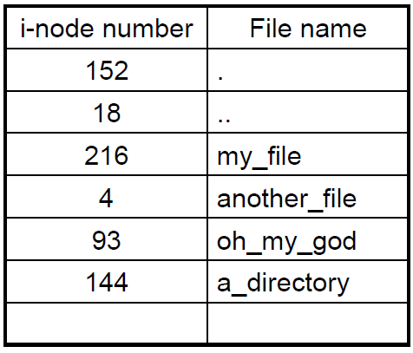
Unix directory files
A directory is a flat file of fixed size entries
Each entry consists of an inode # and a file name

Slide 9
Directory Trees
Directory entries specify files…
But a directory is a file
  Special bit in meta-data stored in directory entry
User programs can read directories
But, only system programs can write directories
  Why is this true?
Special directories
  This directory: ‘.’
  Parent directory: ‘..’
  Root: ‘/’
    Fixed directory entry for its own meta-data

Slide 10
Workloads
Workloads provide design target of a system
Common file characteristics
  Most files are small (~8KB)
  Large files use most of disk space
    90% of data is used by 10% of files
Access Patterns
  Sequential: Files read/written in order
    Most common
  Random: Access block without referencing predecessors
  Locality based: Files in same directory accessed together
  Relative access: Meta-data accessed first to find data

Slide 11
Allocation Strategies
Progression of approaches
  Contiguous
  Extent based
  Linked
  File-Allocation Tables
  Indexed
  Multi-level indexed
Issues
  Amount of fragmentation (internal and external)
  Ability of file to grow over time
  Seek cost for sequential accesses
  Speed to find data blocks for random accesses
  Wasted space to track state

Slide 12
Contiguous Allocation
Allocate each file to contiguous blocks on disk
  Meta-data includes first block and size of file
  OS allocates single chunk of free space
Advantages
  Low overhead for meta-data
  Excellent sequential performance
  Simple to calculate random addresses
Disadvantages
  Horrible external fragmentation (requires compaction)
  Usually must move entire file to resize it

Slide 13
Extent Based Allocation
Allocate multiple contiguous regions (extents)
  Meta-data: Small array of extents (first block + size)
D
D
A
A
A
D
B
B
B
B
C
C
C
D
D
Improves contiguous allocation
  File can grow over time
  External fragmentation reduced
Advantages
  Limited overhead for meta-data
  Good performance with sequential accesses
  Simple to calculate random addresses
Disadvantages
  External fragmentation can still be a problem
  Extents can be exhausted (fixed size array in meta-data)

Slide 14
Linked Allocation
Allocate linked-list of fixed size blocks
  Meta-data: location of file’s first block
  Each block stores pointer to next block
D
D
A
A
A
D
B
B
B
B
C
C
C
B
B
D
B
D
Advantages
  No External fragmentation
  File size can be very dynamic
Disadvantages
  Random access takes a long time
  Sequential accesses can be slow
    Can try to allocate contiguously to avoid this
  Very sensitive to corruption

Slide 15
File Allocation Table (FAT)
Variation of Linked Allocation
  Linked list information stored in FAT table (on disk)
  Meta-data: Location of first block of file
Comparison to Linked Allocation
  Same basic advantages and disadvantages
  Additional disadvantage:
    Two disk reads for 1 data block
  Optimization: Cache FAT table in memory

Slide 16
File-Allocation Table
Directory Entry
File Allocation
Table
Name
Meta-Data
Start Block
Data blocks
Foo.txt
Meta-Data
23
632
Block 23
Name
Meta-Data
Start Block
Name
Meta-Data
Start Block
Name
Meta-Data
Start Block
NULL
Block 317
317
Block 632

Slide 17
Indexed Allocation
Allocate fixed-size blocks for each file
  Meta-data: Fixed size array of block pointers
    Array allocated at file creation time
Advantages
  No external fragmentation
  Files can be easily grown, with no limit
  Supports random access
Disadvantages
  Large overhead for meta-data
    Unneeded pointers are still allocated

Slide 18
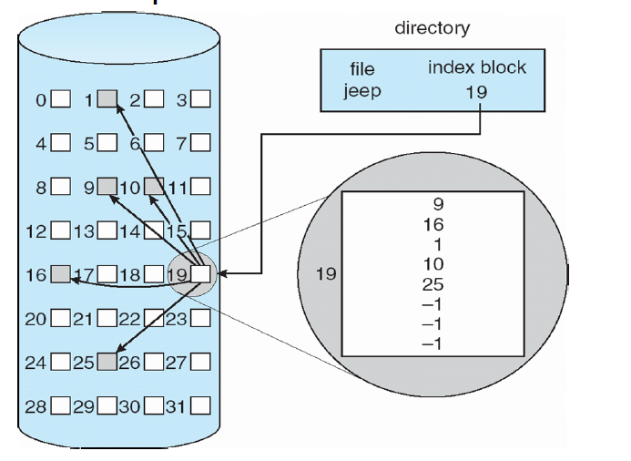

Slide 19
Multi-level Index Files
Variation of Indexed Allocation
  Dynamically allocate hierarchy of pointers to blocks as needed
  Meta-data: Small number of pointers allocated statically
    Allocate blocks of pointers as needed
Comparison to Indexed Allocation
  Advantage: Less wasted space
  Disadvantage: Random reads require multiple disk reads

Slide 20
Free Space Management
How do you remember which blocks are free
  Operations: Free block, allocate block
Free List: Linked list of free blocks
  Advantages: Simple, constant time operations
  Disadvantage: Quickly loses locality
Bitmap: Bitmap of all blocks indicating which are free
  Advantages: Can find sequence of consecutive blocks
  Disadvantage: Space overhead

Slide 21
UNIX File System
Implemented as part of original UNIX system
  Ritchie and Thompson, Bell Labs, 1969
Designed for workgroup scenario
  Multiple users sharing a single system
Still forms the basis of all UNIX based file systems

Slide 22
5 parts of a UNIX Disk
Boot Block
  Contains boot loader
Superblock
  The file systems “header”
  Specifies location of file system data structures
inode area
  Contains descriptors (inodes) for each file on the disk
  All inodes are the same size
  Head of the inode free list is stored in superblock
File contents area
  Fixed size blocks containing data
  Head of freelist stored in superblock
Swap area
  Part of disk given to virtual memory system

Slide 23
So…
With a boot block you can boot a machine
  Stores code for boot loader
With a superblock you can access a file system
  Superblock always kept at a fixed location
  Specifies where you can find FS state information
    By convention root directory (‘/’) is stored in second inode
  Most current boot loaders read superblock to find kernel image

Slide 24
Inode format
User and group IDs
Protection bits
Access times
File Type
  Directory, normal file, symbolic link, etc
Size
  Length in bytes
Block list
  Location of data blocks in file contents area
Link Count
  Number of directories (hard links) referencing this inode

Slide 25
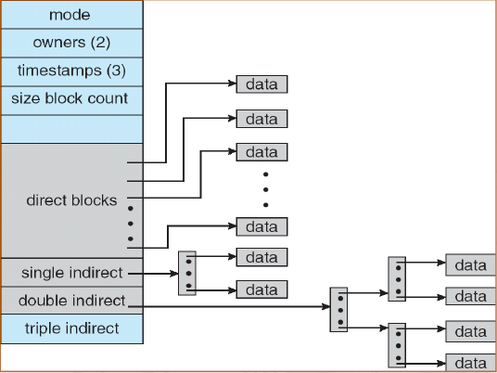
Unix Filesystem (Inodes)
Metadata
  Ownership, permissions
  Access/Modification times
  etc…
Direct blocks:
  Array of consecutive data blocks
  Block size = 512 bytes
  Inlined in the inode
Indirect blocks:
  i-node only holds a small number of data block pointers (direct pointers)
  For larger files, i-node points to an indirect block containing 1024 4-byte entries in a 4K block
  Each indirect block entry points to a data block
  Can have multiple levels of indirect blocks for even larger files

Slide 26
Hierarchical File Systems
Directory is a flat file of fixed size entries
Each entry consists of an inode number and file name
Inode Number | Filename
152 | .
18 | ..
216 | My_file
4 | Another file
93 | Dir_3

Slide 27
Unix Inodes and Path Search
Unix Inodes are not directories
  Inodes describe where on disk a file’s blocks are stored
  Directories are files
    Inodes describe where a directory’s blocks are stored
Directory entries map file names to inodes
  To open “/foo”, use Master Block to find inode for “/”
    Open “/”, search for entry “foo”
    This entry specifies block number for inode of “foo”
  Read “foo”’s inode into memory
    Get first data block location from inode
    Read block into memory

Slide 28
FS characteristics
Only occupies 15 x 4bytes in inode
Can get to 12 x 4KB (48KB) of data directly
  Very fast accesses to small files
Can get to 1024 x 4KB (4MB) with a single indirection
  Reasonably fast access to medium files
Can get to 1024 x 1024 x 4KB (4GB) with 2 indirections
Maximum file size is 4TB with 3 indirections

Slide 29
Consistency Issues
Both Inodes and file blocks are cached in memory
“sync” command forces a flush of all disk info in memory
  System forces sync every few seconds
System crashes between sync points can corrupt file system
Example: Creating a file
  Allocate an inode (remove from free list)
  Write inode data
  Add entry to directory file
What if you crash between 1 and 2?

