Slide 1
Multiprocessing and NUMA

Slide 2
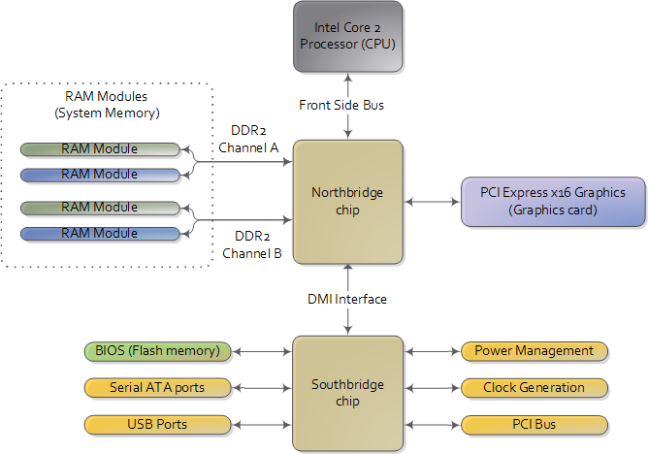
What Hardware used to look like…
Northbridge connects CPU and memory to rest of system
  Memory controller implemented in Northbridge chipset
    Devices and CPU can access memory via requests to Northbridge
CPU connects using a Front Side Bus

Slide 3
Modern Systems
Almost all current systems all have more than one CPU/core
  IPhone 4’s have 2 CPU and 3 GPU cores
  Galaxy S3 has 4 cores
Multiprocessor
  More than one physical CPU
  SMP: Symmetric multiprocessing,
    Each CPU is identical to every other
    Each has the same capabilities and privileges
  Each CPU is plugged into system via its own slot/socket
Multicore
  More than one CPU in a single physical package
  Multiple CPUs connect to system via a shared slot /socket
  Currently most multicores are SMP

Slide 4
SMP Operation
Each processor in system can perform the same tasks
  Execute same set of instructions
  Access memory
  Interact with devices
Each proc. connects to system in same way
  Traditional approach: Bus
  Modern approach: Interconnect
  Interacting with the rest of the system (memory/devices) done via communication over the shared bus/interconnect
Obviously this can easily lead to chaos
  Why we need synchronization

Slide 5
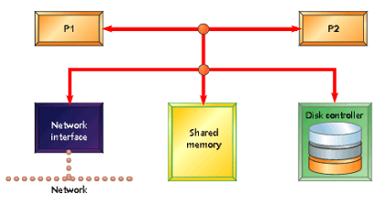
SMP architecture
First approach to multiprocessing
Just connect another CPU to the northbridge
Most of these systems used a shared bus
  CPUs could communicate with each other and with the northbridge
  But, only one user at a time, so scalability was limited (bus contention)

Slide 6
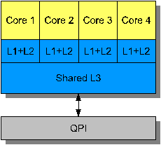
Multicore architecture
During the early/mid 2000s CPUs started to change dramatically
  Could no longer increase speeds exponentially
  But: transistor density was still increasing
  Only thing architects could do was add more computing elements
    Replicated entire CPUs inside the same processor die
The standard architecture is just like SMP, but with only one CPU slot in the system

Slide 7
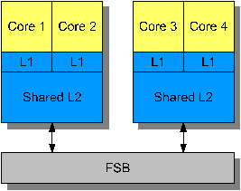
Multiprocessor-Multicores
SMP with multicore CPUs
  Multiple processor slots in system
  Each slot hosts multiple CPU cores
What does this mean for the OS?
  Mostly hidden by the hardware
  OS sees N cpus that are identical, so treats them the same way
But the similarity does not always hold for memory
  More on that in a minute

Slide 8
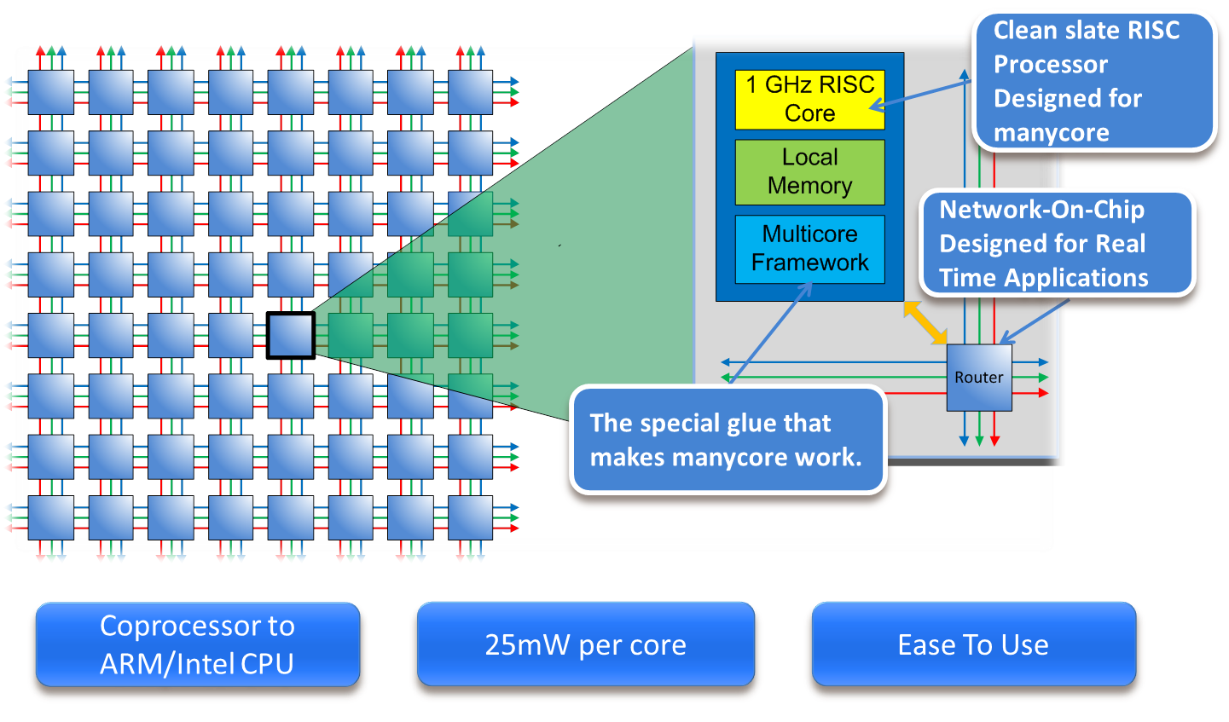
Manycore
Manycore CPUs are currently available
  Intel’s Knights Corner and Knights Landing architectures (Xeon Phi)
  A single machine now looks like a distributed system

Slide 9
What does this mean for the OS?
Many more resources must be managed
OS must ensure that all CPUs cooperate together
  Example: If two CPUs try to schedule the same process simultaneously
How do we identify CPUs?
  Hardware must provide identification interface
    X86: Each CPU assigned a number at boot time
    ID tied to local APIC
      gateway for all inter-CPU communication

Slide 10
Programming models
What do we do with all these CPUs?
  Actually we don’t really know yet…
  6 cores are about as much as we can effectively use in a desktop environment
    Still waiting for the killer app
Some ideas…
  Side core: Dedicate entire cores for a single task
    I/O core: Dedicate entire core to handle an I/O device
    GUI core: Dedicate entire core to handle GUI
  Fine grain parallelization of Apps
    Pretty difficult… How much parallelism is actually in an interactive task?
  Virtual Machines
    Run an entirely separate OS environment on dedicated cores

Slide 11
Dealing with devices
Current I/O devices must generally be handled by a single core
  Device interrupts are delivered to only one core
  CPUs must coordinate access to the device controller
  But this is changing
Basic approach: Dedicate a single core for I/O
  All I/O requests forwarded to one CPU core
  Cores queue up I/O requests that the I/O core then services
Slightly more advanced approach
  I/O devices are balanced across cores
  E.g. 1 core handles network, another core handles disk
Even more advanced approach
  I/O devices reassigned to cores that are using them
  Interrupts are routed to the core that is making the most I/O requests

Slide 12
Cross CPU Communication
(Shared Memory)
OS must still track state of entire system
  Global data structure updated by each core
  i.e. the system load avg is computed based on load avg across every core
Traditional approach
  Single copy of data, protected by locks
  Bad scalability, every CPU constantly takes a global lock to update its own state
Modern approach
  Replicate state across all CPUs/cores
  Each core updates its own local copy (so NO locks!)
  Contention only when state is read
    Global lock Is required, but reads are rare

Slide 13
Cross CPU Communication
(Signals)
System allows CPUs to explicitly signal each other
  Two approaches: notifications and cross-calls
  Almost always built on top of interrupts
    X86: Inter Processor Interrupts (IPIs)
Notifications
  CPU is notified that “something” has happened
  No other information
  Mostly used to wakeup a remote CPU
Cross Calls
  The target CPU jumps to a specified instruction
    Source CPU makes a function call that execs on target CPU
  Synchronous or asynchronous?
    Can be both, up to the programmer

Slide 14
CPU interconnects
Mechanism by which CPUs communicate
  Old way: Front Side Bus (FSB)
    Slow with limited scalability
    With potentially 100s of CPUs in a system, a bus won’t work
  Modern Approach: Exploit HPC networking techniques
    Embed a true interconnect into the system
    Intel: QPI (QuickPath Interconnects)
    AMD: HyperTransport
Interconnects allow point to point communication
  Multiple messages can be sent in parallel if they don’t intersect

Slide 15
Interconnects and Memory
Interconnects allow for complex message types
  Can interface directly with memory
    Memory controllers can be moved onto CPU
    Memory references no longer have to go through Northbridge
Definition of memory has become… less concrete
  PCIe devices can handle memory operations
  NVRAM and DRAM can exist in same address space
    Is it a disk or is it main memory?

Slide 16
Multiprocessing and memory
Shared memory is by far the most popular approach to multiprocessing
  Each CPU can access all of a system’s memory
  Conflicting accesses resolved via synchronization (locks)
  Benefits
    Easy to program, allows direct communication
  Disadvantages
    Limits scalability and performance
Requires more advanced caching behavior
  Systems contain a cache hierarchy with different scopes

Slide 17
Multiprocessor caching
On multicore CPUs some (but not all) caches are shared
  Each core has its own private L1 cache
  L2 cache can either be private to a core, or shared between cores
  L3 cache almost always shared between cores
  Caches not shared across physical CPU dies
What if two CPUs update the same memory location stored in their L1 caches?
  Shared memory systems require an absolute ordering of operations
  Cache coherency ensures this ordering
    Implemented in hardware to ensure that memory updates are propagated throughout the entire system
    Utilizes CPU interconnect for communication

Slide 18
Memory Issues
As core count increases shared memory becomes harder
  Increasingly difficult for HW to provide shared memory behavior to all CPU cores
    Manycore CPUs: Need to cross other cores to access memory
    Some cores are closer to memory and thus faster
Memory is slow or fast depending on which CPU is accessing it
  This is called Non Uniform Memory Access (NUMA)

Slide 19
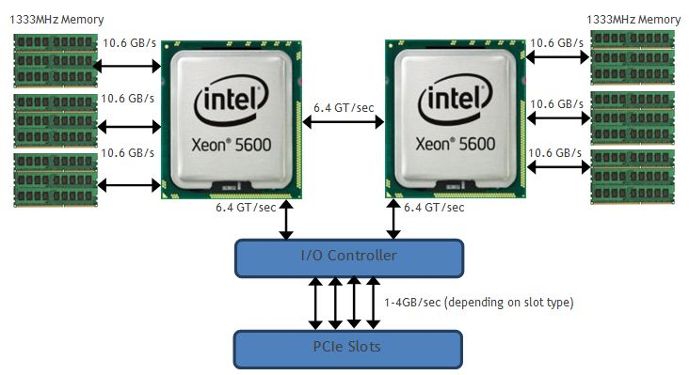
Dell R710

Slide 20
Non Uniform Memory Access
Memory is organized in a non uniform manner
  Its closer to some CPUs than others
  Far away memory is slower than close memory
  Not required to be cache coherent, but usually is
    ccNUMA: Cache Coherent NUMA
Typical organization is to divide system into “zones”
  A zone usually contains a CPU socket/slot and a portion of the system memory
  Memory is “local” if its in the CPU’s zone
    Fast to access

Slide 21
NUMA cont’d
Accessing memory in the local zone does not impact performance in other zones
  Interconnect is point to point
Looks a lot like a distributed shared memory (DSM) system…
  Local operations are fast, but if you go to another zone you take a performance hit
  DSM died in the 90s because it couldn’t scale and was hard to program
  Unclear whether NUMA will share that same fate

Slide 22
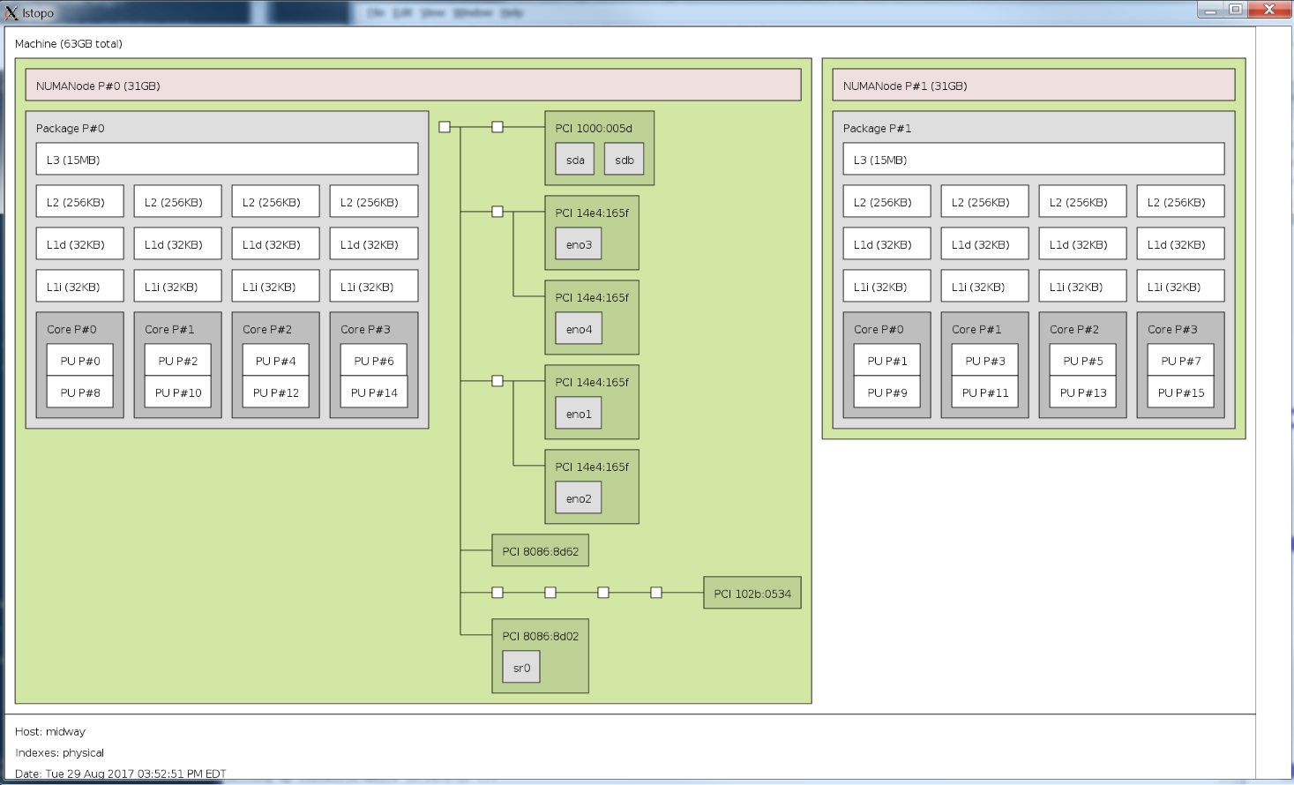
Dell R730

Slide 23
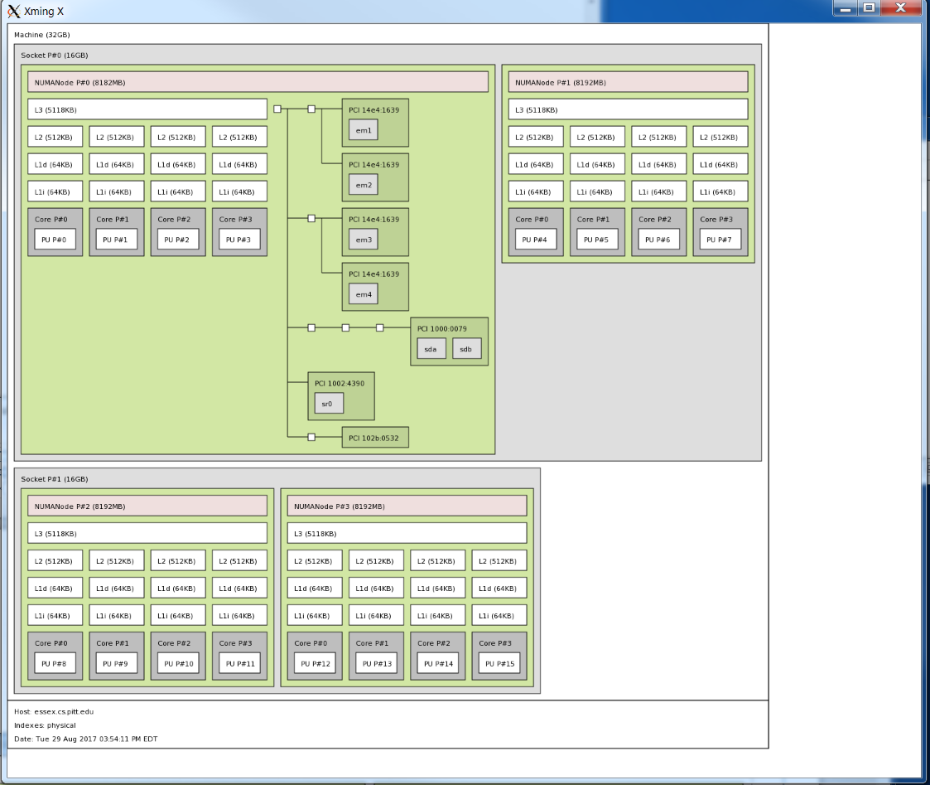
Dell R815

Slide 24
Dealing with NUMA
Programming a NUMA system is hard
  Ultimately it’s a failed abstraction
  Goal: Make all memory ops the same
    But they aren’t, because some are slower
    AND the abstraction hides the details
Result: Very few people explicitly design an application with NUMA support
  Those that do are generally in the HPC community
  So its up to the user and the OS to deal with it
    But mostly people just ignore it…

Slide 25
Dealing with NUMA (users)
Users can query the system for the NUMA layout
  Typically via libtopology or the HWLOC library
[jarusl@essex]~% numactl –hardware
available: 4 nodes (0-3)
node 0 cpus: 0 1 2 3
node 0 size: 8182 MB
node 0 free: 2945 MB
node 1 cpus: 4 5 6 7
node 1 size: 8192 MB
node 1 free: 2802 MB
node 2 cpus: 8 9 10 11
node 2 size: 8192 MB
node 2 free: 7087 MB
node 3 cpus: 12 13 14 15
node 3 size: 8192 MB
node 3 free: 7083 MB
node distances:
node 0 1 2 3
0: 10 16 16 22
1: 16 10 22 16
2: 16 22 10 16
3: 22 16 16 10

Slide 26
Dealing with NUMA (users)
Users can force OS to confine a process to a specific zone
  Restricts what memory a process gets allocated
  Restricts which CPUs process can run on
Per process via command line
  ‘numactl --physcpubind=<cpus> <cmd>’
Groups of processes using scheduling domains
  Linux: cgroups and containers

Slide 27
Dealing with NUMA (OS)
An OS can deal with NUMA systems by restricting its own behavior
  Force processes to always execute in a zone, and always allocate memory from the same zone
  This makes balancing resource utilization tricky
However, nothing prevents an application from forcing bad behavior
  E.g. two applications in separate zones want to communicate using shared memory…

Slide 28
Managing NUMA (OS)
How can OS know what zone a process should run in?
  Needs to know what the process behavior will be
  OS cannot know the future, but it can predict it based on past events
  Recent OS X and Windows versions profile application behavior
When should a process switch zones?
  If it is communicating with a process in another zone
  If the system load is currently imbalanced in one zone
  If we can save power by shutting down a zone’s CPUs
How should we layout process memory?
  Keep all memory in a single zone, or just the working set?

Slide 29
Multiprocessing and Power
More cores require more energy (and heat)
  Managing the energy consumption of a system becoming critically important
  Modern systems cannot fully utilize all resources for very long
Approaches
  Slow down processors periodically
    CPUs no longer identical (some faster, some slower)
  Shutdown entire cores
    System dynamically powers down CPUs
    OS must deal with processors coming and going
This doesn’t really match the SMP model anymore

Slide 30
Heterogeneous CPUs
Systems are beginning to look much different
  The SMP model is on its way out
Heterogeneous computing resources across system
  Core specialization: CPU resources tailored to specific workloads
  GPUs, lightweight cores, I/O cores, stream processors
OS must manage these dynamically
  What to schedule where and when?
  How should the OS approach this issue?
    Active area of current research

