Slide 1
IPC and RPC

Slide 2
Interprocess Communication (IPC)
Processes within a system may be independent or cooperating
  Cooperating process can affect or be affected by other processes, including sharing data
Reasons for cooperating processes:
  Information sharing
  Computation speedup
  Modularity
  Convenience
Cooperating processes need interprocess communication (IPC)
Two models of IPC
  Shared memory
  Message passing

Slide 3
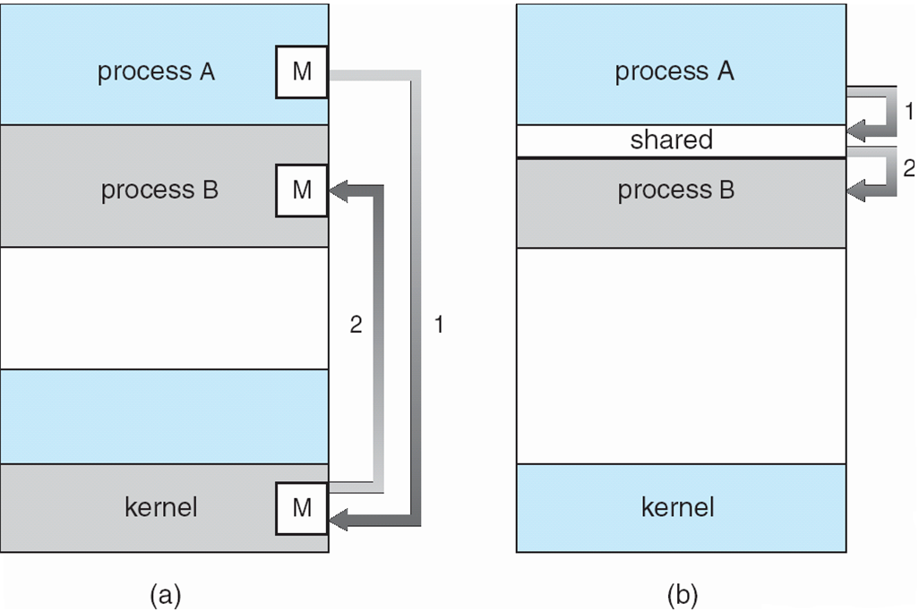
Communication Models

Slide 4
Shared memory
Processes
  Each process has private address space
  Explicitly set up shared memory segment within each address space
Threads
  Always share address space (use heap for shared data)
Advantages
  Fast and easy to share data
Disadvantages
  Must synchronize data accesses; error prone

Slide 5
Message Passing
Message passing most commonly used between processes
  Explicitly pass data between sender and receiver
  Example: Unix pipes, Windows LPC
Advantages:
  Makes sharing explicit
  Improves modularity (narrow interface)
  Does not require trust between sender and receiver
Disadvantages:
  Performance overhead to copy messages
Issues:
  How to name source and destination?
    One process, set of processes, or mailbox (port)
  Does sending process wait (I.e., block) for receiver?
    Blocking: Slows down sender
    Non-blocking: Requires buffering between sender and receiver

Slide 6
Message Passing Details
Mechanism for processes to communicate and to synchronize their actions
Message system – processes communicate with each other without resorting to shared variables
If P and Q wish to communicate, they need to:
  establish a communication link between them
  exchange messages via send/receive
Implementation of communication link
  physical (e.g., shared memory, hardware bus)
  logical (e.g., logical properties)

Slide 7
Producer-Consumer Problem
Paradigm for cooperating processes
  producer process produces data
    Writes data into a shared buffer
  consumer process consumes data
    Reads data from shared buffer
Makes synchronized access easier
  unbounded-buffer places no practical limit on the size of the buffer
  bounded-buffer assumes that there is a fixed buffer size

Slide 8
Example: Unix Pipes
int pipedes[2], pid; // pipedes[0] = read, pipedes[1] = write
pipe(pipedes);
pid = fork();
if (pid == 0) { // child
write(pipedes[1], ”hello”, sizeof(“hello”);
} else { //parent
read(pipedes[0], buffer, 100);
}
Access to pipes is through file system calls; can be used most places a file can (Q: where not?)
Kernel implements a bounded buffer; reader blocks if full and writer blocks if empty

Slide 9
Message Passing Libraries (MPI)
A message-passing library specifications for parallel computers, clusters, and heterogeneous networks
  Extended message-passing model
Communication modes
  Standard, synchronous, buffered, and ready.
Designed for parallel applications and tailored to transient communications
Provides access to advanced parallel hardware
  It assumes that serious failures are fatal and do not require automatic recovery
    For example, process crashes or network disconnect

Slide 10
Group and Context
MPI assumes communication takes place with a group of processes – (groupID, procID)
  Use in lieu of a transport-level address
MPI ties the concepts of process group and communication context into a communicator
Communicator
Group
Context

Slide 11
MPI Abstractions
A process group is high-level abstraction, visible to users
A context is a system-defined object that uniquely identifies a communicator
  Mechanism to isolate messages in distinct libraries and the user programs from one another
  A message sent in one context can't be received in other contexts.
  The communication context is low-level abstraction, not visible to users
A communicator is a data object that specializes the scope of a communication.
  MPI_COMM_WORLD is an initial communicator, which is predefined and consists of all the processes running when program execution begins

Slide 12
MPI Communication Semantics
Point-to-point communication is the basic concept of MPI standard and fundamental for send and receive operations for typed data with associated message tag.
  Using the point-to point communication, messages can be passed to another process with explicit message tag and implicit communication context.
  MPI is made thread-safe by not using global state.

Slide 13
MPI Communication Primitives
Primitive | Meaning
MPI_bsend | Append outgoing message to a local send buffer
MPI_send | Send a message and wait until copied to local or remote buffer
MPI_ssend | Send a message and wait until receipt starts
MPI_sendrecv | Send a message and wait for reply
MPI_isend | Pass reference to outgoing message, and continue
MPI_issend | Pass reference to outgoing message, and wait until receipt starts
MPI_recv | Receive a message; block if there are none
MPI_irecv | Check if there is an incoming message, but do not block

Slide 14
MPI Send/Recv
MPI_Send(void * data,
int count,
MPI_Datatype datatype,
int destination, // Rank (address) of destination
int tag, // Message ID
MPI_Comm communicator); // Set of processes in application
MPI_Recv(void * data,
int count,
MPI_Datatype datatype,
int source, // Rank (address) of sender
int tag, // Message ID
MPI_Comm communicator, // Set of processes in application
MPI_Status * status);

Slide 15
REMOTE PROCEDURE CALL
Basic Operation, Stubs, Parameter Passing

Slide 16
Remote Procedure Call
Explicit message passing has been typically used in early distributed systems
  The paradigm does not achieve access transparency
    send() and receive() primitives do not conceal communication from the communicating entities
Alternative method to message passing:
  Have programs call procedures on other machines
  Simple and elegant in theory
  Ugly to implement in practice

Slide 17
Procedure Call – Basic Operation
Conventional procedure call:
  count = read(fd, buf, nbytes);
  fd = file descriptor, handle
  buf = an array of characters
  nbyte = number of bytes to be read
The execution of a procedure call made from the main program requires the following steps:
  Caller sets up function params: on stack and in registers
  The read() transfers control back to caller with return value

Slide 18
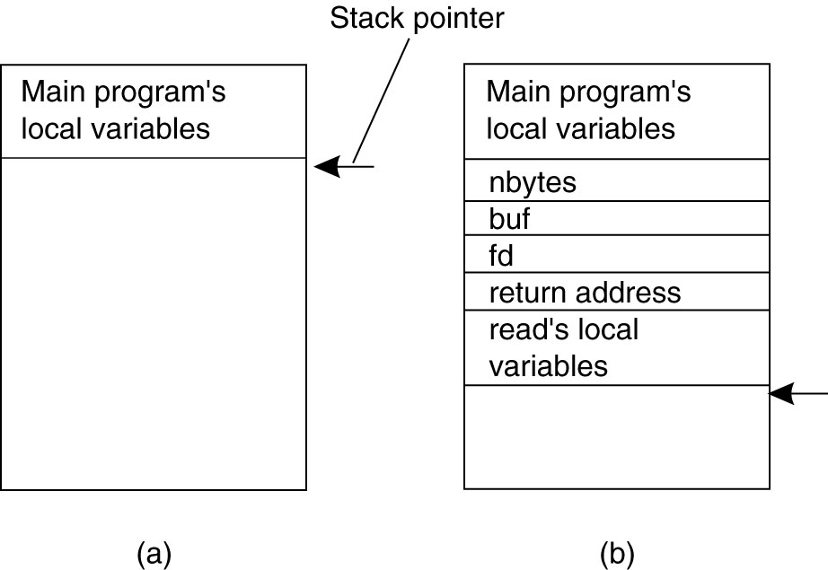
Conventional Procedure Call
  Parameter passing in a local procedure call (stack based)
Stack before the call to read Stack while called procedure is active

Slide 19
Parameter Passing
Call-by-Value – To the called procedure a value is just an initialized local variable
Call-by-Reference – The reference parameter is a pointer to a variable, rather than the value of the variable
  The called procedure modifies the variable in the calling procedure
Call-by-Copy/Restore – The variable is copied onto the stack by the caller and copied back after the call, overwriting the caller’s original value
  Not often used in computer languages
Which Mechanism to Use in RPC?

Slide 20
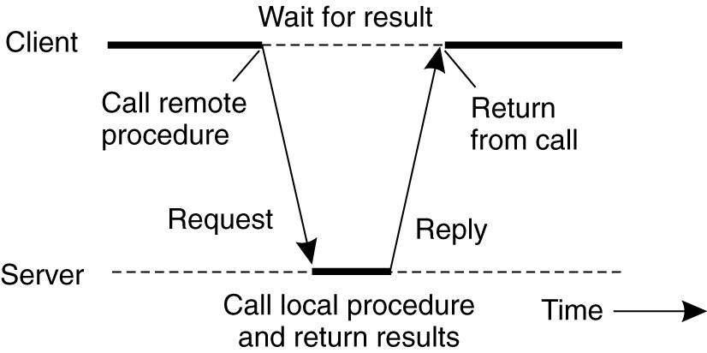
Remote Procedure Call
Principle of RPC between a client and server program.

Slide 21
RPC Design Issue
Make RPC look like LPC, as much as possible
  Transparency – Local procedure should not be aware that the called procedure is executing remotely
RPC achieves its transparency in a similar way as LPC by invoking a library function call
  The execution of the RPC uses the concept of a stub
    A client stub, at the calling procedure
    A server stub, at the called procedure
    Communication between the stubs is achieved through message passing, transparently from the local procedure

Slide 22
RPC Information Flow
Pack Parameters
Client
(Caller)
Call
Client
Stub
Send
Packet
Handler
Client
Mbox
Return
Receive
Unpack
Results
Client
Network
Network
Server
Pack
Results
Server
(Callee)
Return
Server
Stub
Send
Packet
Handler
Server
Mbox
Call
Receive
Unpack
Parameters

Slide 23
RPC COMPILATION
Interface Definition
IDL Compiler
Client Stub
Header File
Server Stub

Slide 24

RPC COMPILATION
Interface Definition
IDL Compiler
Client Stub
Header File
Server Stub
Server Code
Language Compiler
Server Application

Slide 25

RPC COMPILATION
Interface Definition
IDL Compiler
Client Code
Client Stub
Header File
Server Stub
Server Code
Language Compiler
Language Compiler
Server Application
Server Application

Slide 26
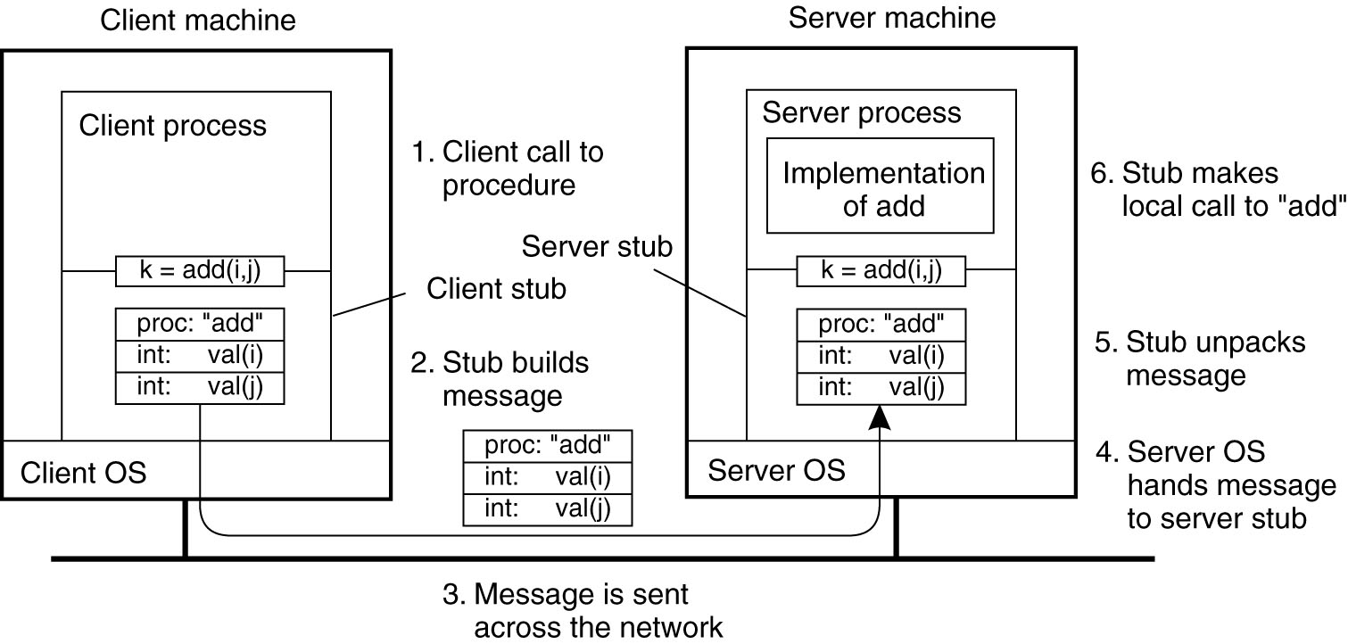
RPC Steps – Example
The steps involved in a doing a remote computation through RPC.

Slide 27
RPC Details
Equivalence with regular procedure call
  Parameters – Request Message
  Result – Reply message
  Name of Procedure – Passed in request message
  Return Address – client return mail box
Where do stubs come from?
  Compiler generates stubs
  Input: interface definitions in an “interface definition language (IDL)”
    Contains, among other things, types of arguments/return
  Output: stub code in the appropriate source language
    Client code to pack and send message, wait for result, unpack result and return to caller
    Server Code to unpack message, call procedure, pack and send back results

Slide 28
RPC Implementation Issues
Cross-platform issues
  What if client/server machines are different architectures or in different languages?
How does client know where to send call request?
  Biding process –
    Need to translate name of remote service into network endpoint: Server network address, port number, possibly other information
How to pass complex structures, pointers, big arrays?
  Handling these structure could be very costly, and perhaps impractical to pass as arguments
  Should there be limitation on size and types of RPC arguments?

Slide 29
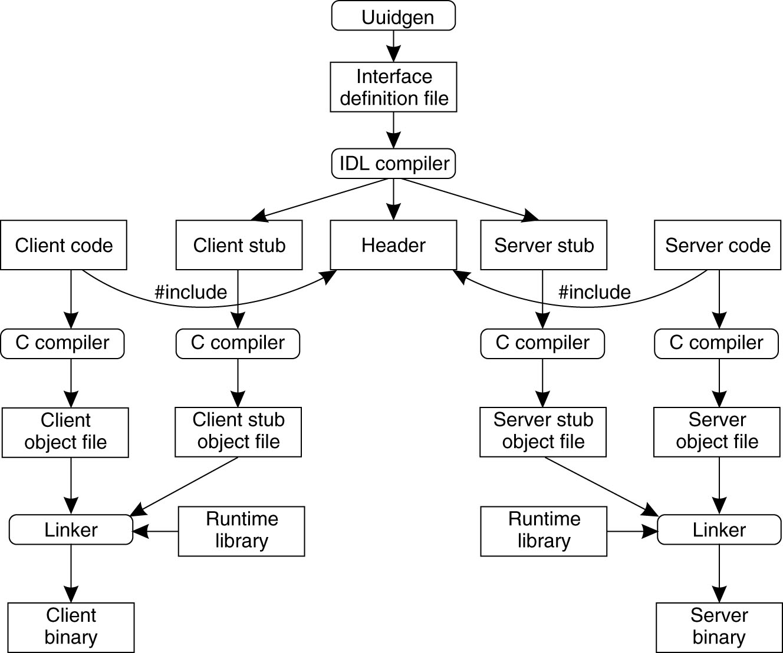
Writing a Client and a Server
The steps in writing a client and a server in DCE RPC

Slide 30
Writing a Client and a Server
Three files output by the IDL compiler:
A header file (e.g., interface.h, in C terms).
The client stub.
The server stub.

Slide 31
Binding a Client to a Server
Registration of a server makes it possible for a client to locate the server and bind to it.
Server location is done in two steps:
  Locate the server’s machine.
  Locate the server on that machine.

Slide 32
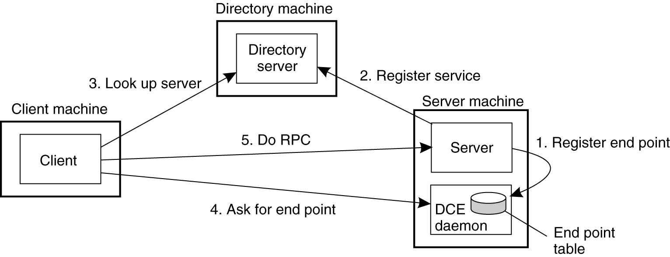
Binding a Client to a Server
Client-to-server binding in DCE

