Slide 1
Paging
Adapted from:
© 2004-2007 Ed Lazowska, Hank Levy, Andrea And Remzi Arpaci-Dussea, Michael Swift

Slide 2
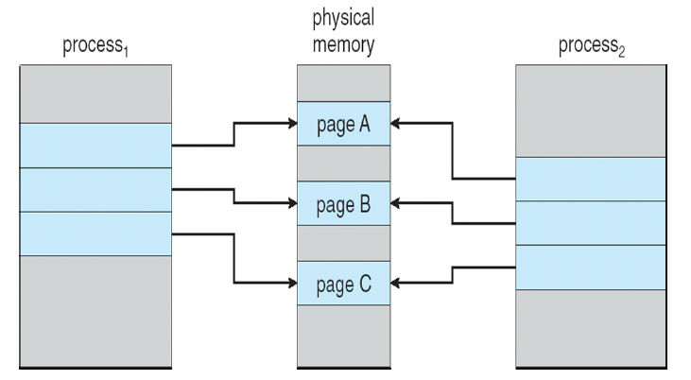
Leveraging Page Tables
Virtual Addresses point to any Physical Addresses
  Multiple PTEs can point to the same Physical Address
    But each has its own permissions
  Different processes can map the same physical memory
This is why fork() is fast and cheap
  OS doesn’t have to allocate memory for children
Read only
Read only
Read only
Read only
Read only
Read only

Slide 3
Copy On Write
Copy-on-Write (COW)
  On fork, both parent and child point to same physical memory
    Make shared mappings read-only for both child and parent
  On write, page fault occurs
    OS copies the physical page, updates page tables, and resumes process
Copy-on-Write (COW) allows both parent and child processes to initially share the same pages in memory
If either process modifies a shared page, only then is the page copied
COW allows more efficient process creation as only modified pages are copied

Slide 4
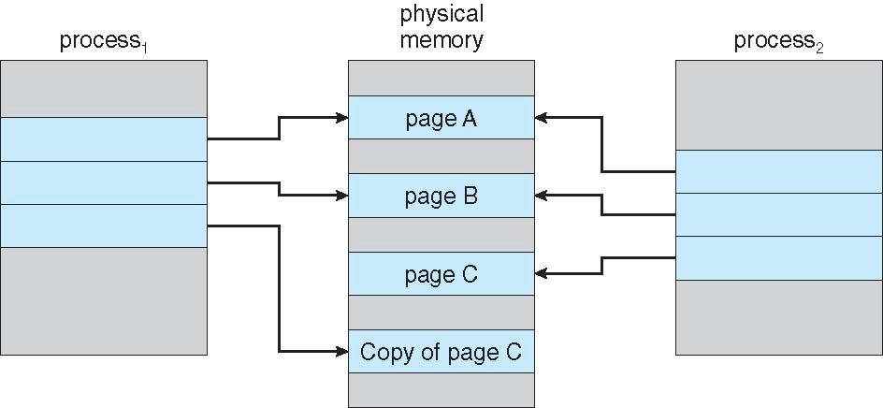
Read only
Read only
Read only
Read only
Read only
Read only
Process 1 Writes to Page C
Read only
Read only
Read only
Read/Write
Read only
Read/Write

Slide 5
Review: File I/O
File I/O System Calls
  open, read, write, and close
  Request OS to copy file data into process address space
But: File data is buffered (cached) inside the OS
  Buffer cache: Collection of pages that stores file data
  OS keeps buffer cache consistent with data on disk
    Consistency Model?
So: File data is actually sitting in memory pages
  Inside the kernel’s address space
  Why not make them accessible to process address space?

Slide 6
Memory-mapped Files
Instead of using open, read, write, close
  “map” a file into a process’ virtual address space
    Configure process pages tables to point to buffer cache pages
    read()/write() become CPU loads/stores
OS must still manage buffer cache
  What about very large files?
  Standard I/O data is fetched/flushed on demand
    Based on read/write system calls
Initially, all process PTEs are marked as invalid
  CPU instruction accesses memory
    Causes page fault, notifies OS of what part of the file the process wants to read
    OS fetches disk data into memory
    Updates PTE to point to page in buffer cache

Slide 7
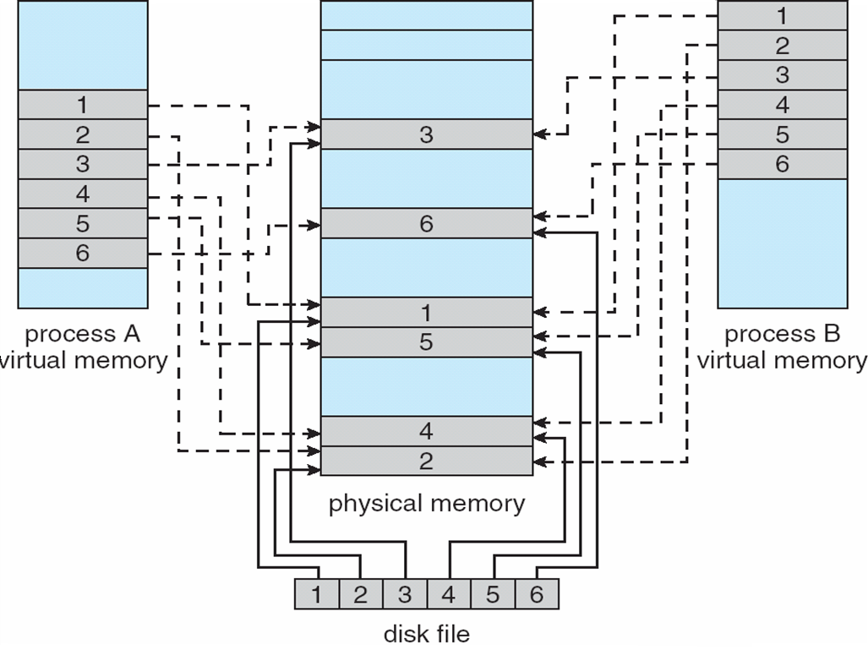
Example
Multiple Processes can map in the same file at the same time
  File updates are seen immediately by each process with no OS interaction

Slide 8
Shared Memory
Modern Method:
void * mmap( void * addr,
size_t length, // Length of data to map in
int prot,
int flags,
int fd, // Open file descriptor
off_t offset ); // Offset of data in file
int munmap(void * addr, size_t length);
Older Method (System V Shared memory)
// Gets a handle to a shared memory region id’d via ‘key’
int shmget(key_t key, size_t size, int shmflg);
// Maps shared memory region into local address space
void * shmat(int shmid, const void * shmaddr, int shmflg);
// Detaches shared memory region
int shmdt(const void * shmaddr);

Slide 9
Memory Mapped IPC
mmap() maps in file data page stored in buffer cache
  What happens if two processes are communicating heavily?
    To OS it looks like a lot of file I/O
    OS spends a lot of time flushing changes to disk
Special case: Shared memory purely for process communication
  Shared data is not persistent
  Don’t want to the OS to flush anything to disk
  Linux provides a special file system for this
    Tmpfs: Ram based file system
    Stores temporary files backed by memory not disk

Slide 10
Demand Paging
Pages can be moved between memory and disk
  process is called demand paging
  OS uses main memory as a (page) cache of all of the data allocated by processes in the system
    initially, pages are allocated in physical memory frames
    when physical memory fills up, allocating a page in requires some other page to be evicted
Moving pages between memory / disk is handled by the OS
  transparent to the application
    except for performance

Slide 11
Moving Memory to/from Disk
When there is not enough memory for all our processes, the OS can copy data to disk and re-use the memory for something else
  Copying a whole process is called “swapping”
  Copying a single page is called “paging”
Where does data go?
  If it came from a file:
    Unmodified: data is still consistent
      Just delete the memory page
    Modified (“dirty”): data is inconsistent
      Data on disk must be modified
  If it is raw memory allocated to a process
    “Anonymous Memory”: (Heap, stack, etc…)
    Swapped to dedicated storage device
      Unix: Swap partition
      Windows: Swap File

Slide 12
Demand paging
Think about when a process first starts up:
  It has a brand new page table: all PTEs set as invalid
    No pages are yet mapped to physical memory
  When process starts executing:
    Instructions immediately fault on both code and data pages
    Faults stop when all necessary code/data pages are in memory
    Only the code/data that is needed (demanded!) by process needs to be loaded
    But, what is needed changes can over time

Slide 13
Page Faults
What happens to a process that references a VA in a page that has been evicted?
  when the page was evicted, the OS sets the PTE as invalid and stores (in PTE) the location of the page in the swap file
  when a process accesses the page, the invalid PTE will cause an exception (page fault) to be thrown
  the OS will run the page fault handler in response
    handler uses invalid PTE to locate page in swap file
    handler reads page into a physical frame, updates PTE to point to it
    handler restarts the faulted process
But: where does the page that’s read in go?
  have to evict something else (page replacement algorithm)
    OS typically tries to keep a pool of free pages around so that allocations don’t inevitably cause evictions

Slide 14
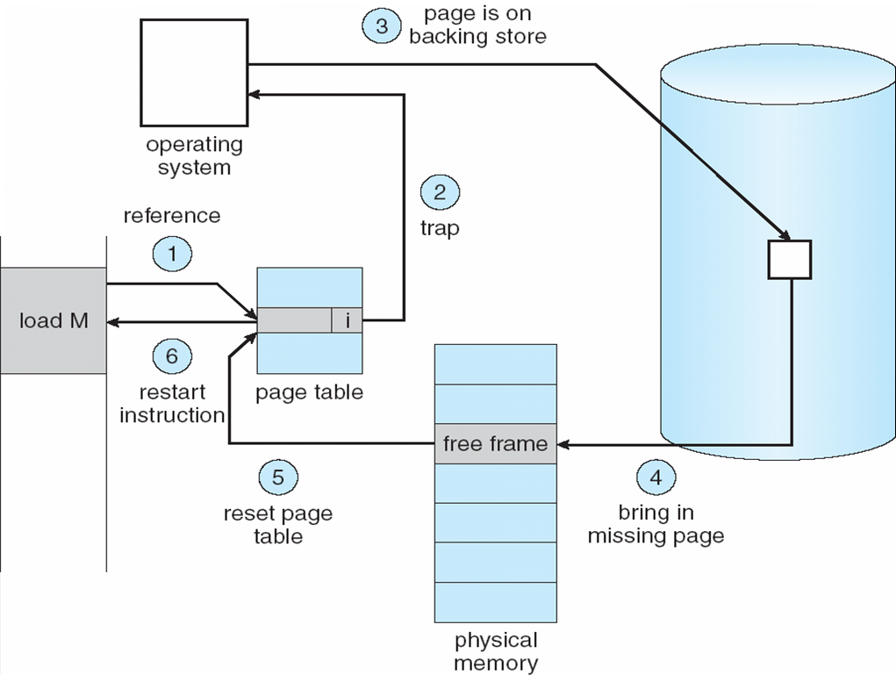
Data movement during swap operation

Slide 15
Swapping Approach
When should the OS write pages to disk to free memory?
Swap Daemon (a kernel thread) periodically wakes up and scans pages
  Runs clock algorithm or adjusts working set sizes
  Moves pages from “active” list – in use - to “inactive list” – candidate for eviction
On Demand Paging
  Swap out only when memory is needed
Worse case scenario:
  Out Of Memory (OOM) Killer
  Cannot swap out enough memory in time
  So kill a random process to take its memory

Slide 16
Evicting the best page
OS must choose victim page to be evicted
  Goal: Reduce the page fault rate
  The best page to evict is one that will never be accessed again
    Not really possible…
    Belady’s proof: Evicting the page that won’t be used for the longest period of time minimizes page fault rate

Slide 17
Belady’s Algorithm
Find page that won’t be used for the longest amount of time
  Not possible
So why is it here?
  Provably optimal solution
  Comparison for other practical algorithms
  Upper bound on possible performance
Lower bound?
  Depends on workload…
    Random replacement is generally a bad idea

Slide 18
FIFO
Obvious and simple
  When a page is brought in, goes to tail of list
  On eviction take the head of the list
Advantages
  If it was brought in a while ago, then it might not be used...
Disadvantages
  Or its being used by everybody (glibc)
  Does not measure access behavior at all
FIFO suffers from Belady’s Anomaly
  Fault rate might increase when given more physical memory
    Very bad property…
    Exercise: Develop a workload where this is true

Slide 19
Least Recently Used (LRU)
Use access behavior during selection
  Idea: Use past behavior to predict future behavior
  On replacement, evict page that hasn’t been used for the longest amount of time
    LRU looks at the past, Belady’s looks at future
Implementation
  To be perfect, every access must be detected and timestamped (way too expensive)
    So it must be approximated

Slide 20
Approximating LRU
Many approximations, all use PTE flags
  x86: Accessed bit, set by HW on every access
  Each page has a counter (unused PTE bits)
  Periodically, scan entire list of pages
    If accessed = 0, increment counter (not used)
    If accessed = 1, clear counter (used)
    Clear accessed flag in PTE
  Counter will contain # of iterations since last reference
    Page with largest counter is least recently used
Some CPUs don’t have PTE flags
  Can simulate it by forcing page faults with invalid PTE

Slide 21
LRU Clock
Not Recently Used (NRU) or Second Chance
  Replace page that is “old enough”
Arrange page in circular list (like a clock)
  Clock hand (ptr value) sweeps through list
    If accessed = 0, not used recently so evict it
    If accessed = 1, recently used
      Set accessed to 0, go to next PTE
Problem:
  If memory is large, “accuracy” of information degrades

Slide 22
N-Chance clock
Basic Clock only has two states
  used or not used
Can we add more?
  Answer: Embed counter into PTE
Clock hand (ptr value) sweeps through list
  If accessed = 0, not used recently
    if counter = 0, evict
    else, decrement counter and go to next PTE
  If accessed = 1, recently used
    Set accessed to 0
    Increment counter
    Go to next PTE

Slide 23
Allocation of Pages
OS must allocate physical memory to competing processes
  What if a victim page belongs to another process?
  Replacement algorithms can take this into account
Fixed space algorithms
  Each process is given a limit of pages it can use
  When it reaches its limit, it replaces from its own pages
  Local replacement: some process may do well, others suffer
Variable space algorithms
  Processes’ set of pages grows and shrinks dynamically
  Global replacement: one process can ruin it for the rest
Linux uses global replacement
  But Containers allow local replacement

Slide 24
2nd Chance FIFO
LRU Clock is a global algorithm
  It looks at all physical pages, from all processes
  Every process gets its memory taken away gradually
Local algorithms: run page replacement separately for each process
2nd Chance FIFO:
  Maintain 2 FIFO queues per process
  On first access, pages go at end of queue 1
  When the drop off queue 1, page are invalidated and move to queue 2
  When they drop off queue 2, they are replaced
  If they are accessed in queue 2, they are put back on queue 1
Options:
  Move to queue 1 immediately when referenced: mark “invalid” when on queue 2
  Move to queue 2 when about to be evicted: looks like clock
Comparison to LRU clock: – Per-­process, not whole machine
  No scanning
  Replacement order is FIFO, not PFN – Used in Windows NT, VMS

Slide 25
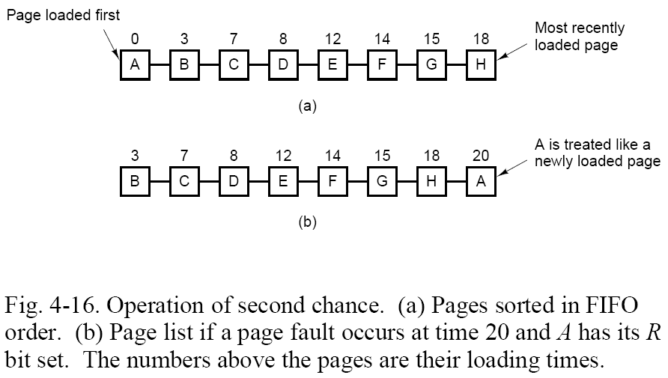
2nd Change Page Replacement

Slide 26
Working Set Size
The working set size changes with program locality
  During periods of poor locality, more pages are referenced
  Within that period of time, the working set size is larger
Intuitively, working set must be in memory, otherwise you’ll experience heavy faulting (thrashing)
  When people ask “How much memory does Firefox need?”
    Really asking: “what is Firefox's average (or worst case) working set size?”
Hypothetical algorithm:
  Associate parameter “w” with each process
    # of unique pages referenced in the last “t” ms that it executed
  Only allow a process to start if it’s “w”, when added to all other processes, still fits in memory
    Use a local replacement algorithm within each process (e.g. clock, 2nd chance FIFO)

Slide 27
Working Set Strategy
The working set concept suggests the following strategy to determine the resident set size
  Monitor the working set for each process
  Periodically remove from the resident set of a process those pages that are not in the working set
  When the resident set of a process is smaller than its working set, allocate more frames to it
    If not enough free frames are available, suspend the process (until more frames are available)
      ie: a process may execute only if its working set is in main memory

Slide 28
Working Set Strategy
Practical problems with this working set strategy
  Measurement of the working set for each process is impractical
    Necessary to time stamp the referenced page at every memory reference
    Necessary to maintain a time-ordered queue of referenced pages for each process
  The optimal value for D is unknown and time varying
Solution: rather than monitor the working set, monitor the page fault rate!

Slide 29
Page Fault Frequency Strategy
Define an upper bound U and lower bound L for page fault rates
Allocate more frames to a process if fault rate is higher than U
Allocate less frames if fault rate is < L
The resident set size should be close to the working set size W
We suspend the process if the PFF > U and no more free frames are available

