Slide 1
Paging
Adapted from:
© 2004-2007 Ed Lazowska, Hank Levy, Andrea And Remzi Arpaci-Dussea, Michael Swift

Slide 2
Paging
Translating virtual addresses
  a virtual address has two parts: virtual page number & offset
  virtual page number (VPN) is index into a page table
  page table entry contains page frame number (PFN)
  physical address is PFN::offset
Page tables
  managed by the OS
  map virtual page number (VPN) to page frame number (PFN)
    VPN is simply an index into the page table
  one page table entry (PTE) per page in virtual address space
    i.e., one PTE per VPN

Slide 3
Simple Page Table

Slide 4
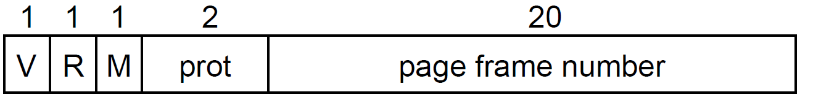
Simple PTE
PTE’s control mapping
  the valid bit says whether or not the PTE can be used
    Says whether or not a virtual address is valid
    It is checked each time a virtual address is used
  the reference bit says whether the page has been accessed
    It is set when a page has been read or written to
  the modify bit says whether or not the page is dirty
    it is set when a write to the page has occurred
  the protection bits control which operations are allowed
    read, write, execute
  the page frame number determines the physical page
    Physical page start address = PFN << (#bits / page)

Slide 5
Page table operation
Translation
  Separate (set of) page table(s) per process
  VPN forms index into page table (points to a page table entry)‏
page table base register
virtual address
n–1
p
p–1
0
VPN acts as
table index
VPN acts as
table index
virtual page number (VPN)‏
page offset
valid
access
physical page number (PPN)‏
Page table address for process
Page table
if valid=0
then page
not in memory
m–1
p
p–1
0
physical page number (PPN)‏
page offset
physical address
5
Notes:
5

Slide 6
Page table operation
Computing physical address
  Page Table Entry (PTE) provides info about page
    if (valid bit = 1) then the page is in memory.
      Use physical page number (PPN) to construct address
    if (valid bit = 0) then the page is on disk - page fault
page table base register
virtual address
n–1
p
p–1
0
VPN acts as
table index
virtual page number (VPN)‏
page offset
valid
access
physical page number (PPN)‏
Page table
if valid=0
then page
not in memory
m–1
p
p–1
0
physical page number (PPN)‏
page offset
physical address
6
Notes:
6

Slide 7
Page table operation
Checking protection
  Access rights field indicate allowable access
    e.g., read-only, read-write, execute-only
    typically support multiple protection modes
  Protection violation fault if user doesn’t have necessary permission
page table base register
virtual address
n–1
p
p–1
0
VPN acts as
table index
virtual page number (VPN)‏
page offset
page offset
valid
access
physical page number (PPN)‏
Page table
if valid=0
then page
not in memory
m–1
p
p–1
0
physical page number (PPN)‏
page offset
physical page number (PPN)‏
page offset
physical address
7
Notes:
7

Slide 8
Multi-level translation
Problem: what if you have a sparse address space?
  need one PTE per page in virtual address space
  For 32 bit addresses: 1,048,576 PTEs are needed to map 4GB of pages
  What if you only use ~1024 of them?
Use a tree based Page Table
  Upper level entries:
    Contain address of page containing lower level entries
    NULL for unused lower levels
  Lowest level entries:
    Contains actual physical page address translation
    Null for unallocated page
Could have any number of levels
  x86-32 has 2
  x86-64 has 4

Slide 9
2 level page tables
Virtual Address
Master Page #
(10 bits)
Secondary Page #
(10 bits)
Offset (12 bits)
Physical Address
Page Frame #
Offset
Physical Memory
Secondary
Page Table
Page Frame 0
Page Frame 1
Page Frame 2
Page Frame
Number
Page Frame 3
Master Page
Table
Page Frame 4
Secondary
Page Table

Slide 10
Multilevel page tables
Page table with N levels
  Virtual addresses split into N+1 parts
    N indexes to different levels
    1 offset into page
Each level of a multi-level page table resides on one page
Example: 32 bit paging on x86
  4KB pages, 4 bytes/PTE
    12 bits in offset: 2^12 = 4096
  Want to fit page table entries into 1 page
    4KB / 4 bytes = 1024 PTEs per page
  So level indexes = 10 bits each
    2^10 = 1024

Slide 11
Inverted Page Table
Previous examples: “Forward Page tables”
  Page table size relative to size of virtual memory
  Physical memory could be much less
    Lots of wasted space
Separate approach: Use a hash table
  Inverted page table
  Size is independent of virtual address space
  Directly related to size of physical memory
Cons:
  Have to manage a hash table (collisions, rebalancing, etc)
Virtual
Page #
Offset
Hash Table
Phsyical
Page #
Offset

Slide 12
Page Size Tradeoffs
Small pages (VAX had 512 byte pages):
  Little internal fragmentation
  Lots of space needed for page tables
    1 gb (230 bytes) takes (230/29 PTEs) at 4 (22)bytes each = 8 MB
    Lots of space spent caching translations
  Slow to translate
  Easy to allocate
Large pages, e.g. 64 KB pages
  Smaller page tables
    1 GB (230 bytes) takes (230/216) at 4 bytes = 64 KB of page tables
    Less space in cache for translations
  More internal fragmentation as only part of a page is used
  Fast to translate
  Hard to allocate

Slide 13
Paging infrastructure
Hardware:
  Page table base register
  TLB (will discuss soon)
Software:
  Page frame database
    One entry per physical page
    Information on page, owning process
  Memory map
    Address space configuration defined using regions
  Page table
    Maps regions in memory map to pages in page frame database

Slide 14
Page Frame Database
/* Each physical page in the system has a struct page associated with
* it to keep track of whatever it is we are using the page for at the
* moment. Note that we have no way to track which tasks are using
* a page
*/
struct page {
unsigned long flags; // Atomic flags: locked, referenced, dirty, slab, disk
atomic_t _count; // Usage count,
atomic_t _mapcount; // Count of ptes mapping in this page
struct {
unsigned long private; // Used for managing page used in file I/O
struct address_space * mapping; // Used to define the data this page is holding
};
pgoff_t index; // Our offset within mapping
struct list_head lru; // Linked list node containing LRU ordering of pages
void * virtual; // Kernel virtual address
};

Slide 15
Addressing Page Tables
Where are page tables stored?
  And in which address space?
Possibility #1: Physical memory
  Easy address, no translation required
  But page tables must stay resident in memory
Possibility #2: Virtual Memory (OS VA space)
  Cold (unused) page table pages can be swapped out
  But page table addresses must be translated through page tables
    Don’t page the outer page table page (called wiring)
Question: Can the kernel be paged?

Slide 16
X86 address translation (32 bit)
Page Tables organized as a 2 level tree
  Efficiently handle sparse address space
One set of page tables per process
  Current page tables pointed to by CR3
CPU “walks” page tables to find translations
  Accessed and Dirty bits updated by CPU
32 bit: 4KB or 4MB pages
64 bit: 4 levels; 4KB or 2MB pages

Slide 17
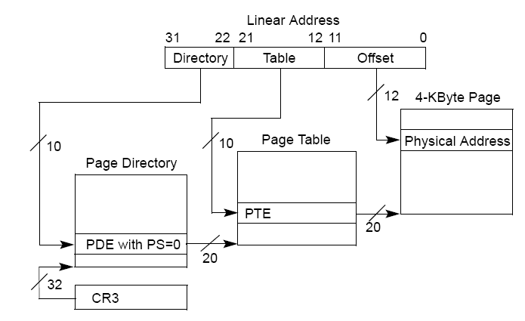
Paging Translation
Pages of Memory
Hardware Control Register

Slide 18

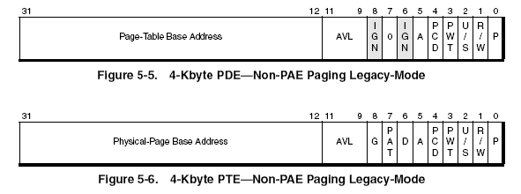
X86 32 bit PDE/PTE details
Hardware Control Register (cr3)
PWT: Write through
PCD: Cache Disable
P: Present
R/W: Read/Write
U/S: User/System
AVL: Available for OS use
A: Accessed
D: Dirty
PAT: Cache behavior definition
G: Global
Pages of Memory
  1 Page contains an array of 1024 of these entries

Slide 19
Making it efficient
Basic page table scheme doubles cost of memory accesses
  1 page table access, 1 data access
2-level page tables triple the cost
  2 page table accesses + 1 data access
4-level page tables quintuple the cost
  4 page table accesses + 1 data access
How to achieve efficiency
  Goal: Make virtual memory accesses as fast as physical memory accesses
  Solution: Use a hardware cache
    Cache virtual-to-physical translations in hardware
    Translation Lookaside Buffer (TLB)
    X86:
      TLB is managed by CPU’s MMU
      1 per CPU/core

Slide 20
TLBs
Translation Lookaside buffers
  Translates Virtual page #s into PTEs (NOT physical addresses)
    Why?
  Can be done in single machine cycle
Implemented in hardware
  Associative cache (many entries searched in parallel)
  Cache tags are virtual page numbers
  Cache values are PTEs
  With PTE + offset, MMU directly calculates PA
TLBs rely on locality
  Processes only use a handful of pages at a time
    16-48 entries in TLB is typical (64-192KB for 4kb pages)
    Targets “hot set” or “working set” of process
  TLB hit rates are critical for performance

Slide 21
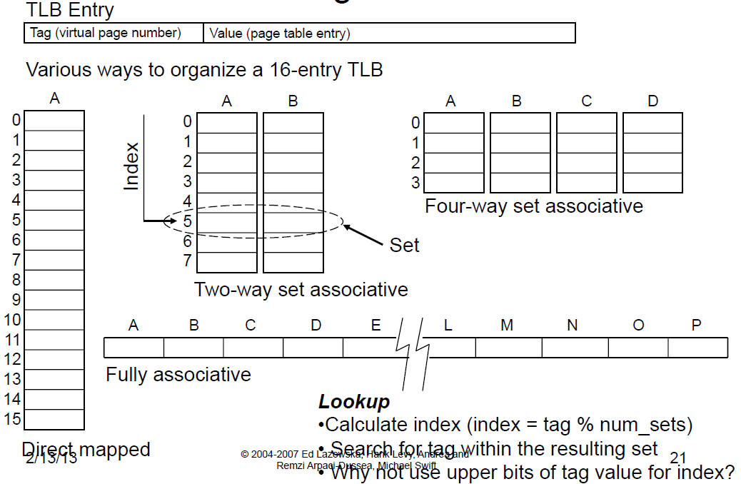
TLB Organization

Slide 22
Managing TLBs
Address translations are mostly handled by TLB
  (>99%) hit rate, but there are occasional TLB misses
On miss, who places translations into TLB?
Hardware (MMU)
  Knows where page tables are in memory (CR3)
    OS maintains them, HW accesses them
  Tables setup in HW-defined format
  X86
Software loaded TLB (OS)
  TLB miss faults to OS, OS finds right PTE and loads it into TLB
  Must be fast
    CPU ISA has special TLB access instructions
    OS uses its own page table format
  SPARC and IBM Power

Slide 23
Managing TLBs (2)
OS must ensure TLB and page tables are consistent
  If OS changes PTE, it must invalidate cached PTE in TLB
  Explicit instruction to invalidate PTE
    X86: invlpg
What happens on a context switch?
  Each process has its own page table
  Entire TLB must be invalidated (TLB flush)
  X86: Certain instructions automatically flush entire TLB
    Reloading CR3: asm (“mov %1, %%cr3”);
When TLB misses, a new PTE is loaded, and cached PTE is evicted
  Which PTE should be evicted?
    TLB Replacement Policy
    Defined and implemented in hardware (usually LRU)

Slide 24
x86 TLB
TLB management is shared by CPU and OS
CPU:
  Fills TLB on demand from page tables
    OS is unaware of TLB misses
  Evicts entries as needed
OS:
  Ensures TLB and page tables are consistent
    Flushes entire TLB when page tables are switched (e.g. context switch)
      asm (“mov %0, %%cr3”:: “r”(page_table_addr));
    Modifications to a single PTE are flushed explicitly
      asm (“invlpg %0;”:: “r”(virtual_addr));

Slide 25
Software TLBs (SPARC / POWER)
Typically found on RISC (simpler is better) CPUs
Example of a “software-managed” TLB
  TLB miss causes a fault, handled by OS
  OS explicitly adds entries to TLB
  OS is free to organize its page tables in any way it wants because the CPU does not use them
  E.g. Linux uses a tree like X86, Solaris uses a hash table

Slide 26
Managing Software TLB
On SPARC, TLB misses trap to OS (SLOW)
  We want to avoid TLB misses
  Retain TLB contents across context switch
SPARC TLB entries enhanced with a context id (also called ASID)
  Context allows multiple address spaces to be stored in the TLB
    (e.g. entries from different process address spaces)
  Context id allows entries with the same VPN to coexist in the TLB
  Avoids a full TLB flush whenever there is a context switch
  ASIDS now supported by x86 as well (Why?)
Some TLB entries shared (OS kernel memory)
  Special global ID – entries match every ASID

Slide 27
HW vs SW TLBs
Hardware benefits:
  TLB miss handled more quickly (without flushing pipeline)
  Easier to use; simpler to write OS
Software benefits:
  Flexibility in page table format
  Easier support for sparse address spaces
  Faster lookups if multi-level lookups can be avoided

Slide 28
Impact on Applications
Paging impacts performance
  Managing virtual memory costs ~ 3%
TLB management impacts performance
  If you address more than fits in your TLB
  If you context switch
Page table layout impacts performance
  Some architectures have natural amounts of data to share:
    4mb on x86

Slide 29
Page Faults
Page faults occur when CPU accesses an invalid address
  Invalid defined by policy set in HW page table configuration
  CPU notifies OS it can’t access memory at that address
  Violation detected in the TLB or via a page table walk (on TLB miss)
Page fault exceptions
  CPU Exception (Interrupts defined by CPU ISA)
  x86 Page faults: IRQ vector 14

Slide 30
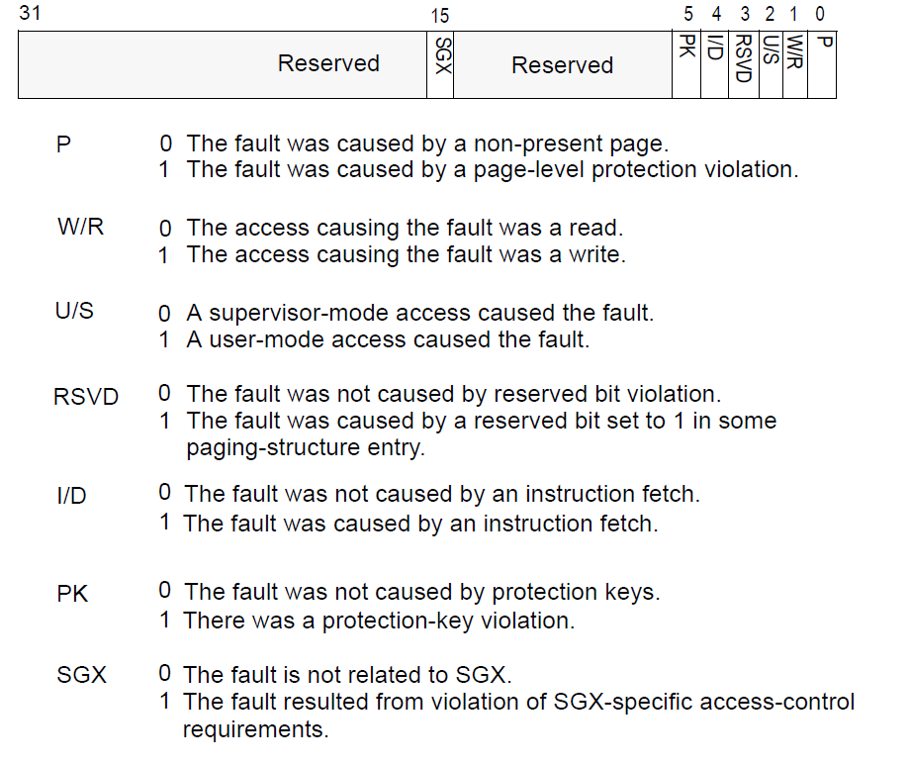
Determining the cause of a page fault
Hardware passes info to Exception (Interrupt) handler
  Faulting Address in Control Register (CR2)
  Fault reason in Interrupt Error Code

Slide 31
Handling Page faults
Page faults are signals that a memory access was attempted
Default Behavior
  OS Checks if address is valid
    Checks if it is in a region of the process’ memory map
    Checks if access type is allowed (e.g. region is read-only)
  If address is valid, OS updates page table configuration
    Potentially allocates a new physical page
    Updates Page table to map the address
  Returns from exception and re-executes faulting instruction
Other behaviors
  Next lecture

