Slide 1
Client Centric Consistency

Slide 2
Client-Centric Consistency Models
Data-centric consistency models aim at providing the system-wide view on a data store.
Client-centric consistency models are generally used for applications that lack simultaneous updates
  Most operations involve reading data.
Weak, client-centric consistency models
  Eventual consistency
  Monotonic reads
  Monotonic writes
  Read your writes
  Writes follow reads

Slide 3
Client-Centric Consistency Models
Goal: Show how we can perhaps avoid system-wide consistency, by concentrating on what specific clients want, instead of what should be maintained by servers.
Background: Most large-scale distributed systems apply replication for scalability, but can support only weak consistency.
DNS: Updates are propagated slowly, and inserts may not be immediately visible.
News: Articles and reactions are pushed and pulled throughout the Internet, such that reactions can be seen before postings.
Lotus Notes: Geographically dispersed servers replicate documents, but make no attempt to keep (concurrent) updates mutually consistent.
WWW: Caches all over the place, but there need be no guarantee that you are reading the most recent version of a page.

Slide 4
Eventual Consistency
Systems such as DNS and WWW can be viewed as applications of large scale distributed and replicated databases that tolerate a relatively high degree of inconsistency
Common Assumption – if no updates take place for a long time, all replicas will gradually and eventually become consistent
This form of consistency is called eventual consistency
Eventual consistency requires only that updates are guaranteed to propagate to all replicas
Eventual consistent data stores work fine as long as clients always access the same replica – what happens when different replicas are accessed?

Slide 5
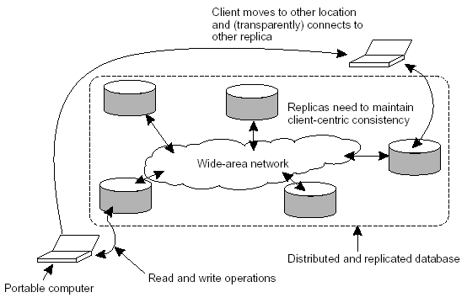
Basic Architecture

Slide 6
Consistency for Mobile Users – Inconsistencies
Various inconsistencies may occur as a mobile user moves from location A to location B
  Updates at A may not have yet been propagated to B
  May be reading newer entries than the ones available at A
  Updates at B may eventually conflict with those at A
The consistency model must ensure that the entries updated and/or read at by the mobile user at A, are in B the way you left them in A.
  This requirement ensures that the database will appear to be consistent to you.

Slide 7
Client-centric Consistency
For the mobile user example, eventual consistent data stores will not work properly
Client-centric consistency provides guarantees for a single client concerning the consistency of access to a data store by that client
No guarantees are given concerning concurrent accesses by different clients

Slide 8
Client-Centric Consistency – Guarantees
Guarantees are the responsibility of “session manager”, not servers
Two sets are maintained
  Read-set – set of writes that are relevant to session reads
  Write-set – set of writes performed in session
Update dependencies captured in read sets and write sets
Four different client-central consistency models
  Monotonic reads
  Monotonic writes
  Read your writes
  Writes follow reads

Slide 9
Monotonic-Read Consistency
A data store is said to be monotonic-read consistent if the following condition holds:
  If a process reads the value of a data item x, any successive read operation on x by that process will always return that same or a more recent value.
  Consequently, if a process has seen a value of x at time t, it will never see an older version of x at a later time
Notation: WS(xi[t]) is the set of write operations (at Li) that lead to version xi of x (at time t)
  WS(xi[t1];xj [t2]) indicates that it is known that WS(xi[t1]) is part of WS(xj[t2])

Slide 10
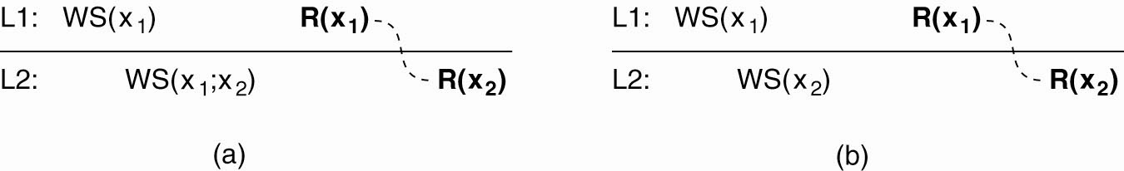
Monotonic Reads – Consistency
A data store that is monotonic-read consistent
  P performs a read operation on x at L1, R(x₁).
  Later, P performs a read operation on x at L2, R(x₂)
  Effects of write operations can be seen by succeeding read operations
    Expressed by WS(x_{1;}x₂) which states WS(x₁) is part of WS(x₂)

Slide 11
Monotonic Reads – No Consistency
The read operations performed by a single process P at two different local copies of the same data store.
(b) A data store that does not provide monotonic reads.

Slide 12
Monotonic Writes
In a monotonic-write consistent store, the following
condition holds:
A write operation by a process on a data
item x is completed before any successive write operation on x by the same process.

Slide 13
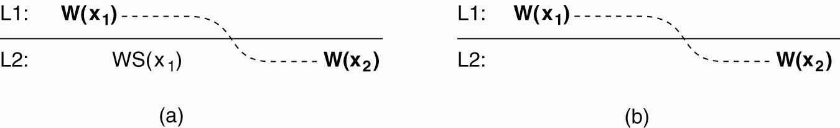
Monotonic Writes ‏
A monotonic-write consistent data store.
  Two write operations performed by a single process P at two different locations
  WS(x₁) indicates that previous write operation at L1 has been propagated to L2

Slide 14
Monotonic Writes (3)‏
A data store that does not provide monotonic-write consistency
  Write operation at L1 has not propagated to L2

Slide 15
Read Your Writes
A data store is said to provide read-your-writes consistency, if the following condition holds:
The effect of a write operation by a process on data item x will always be seen by a successive read operation on x by the same process.

Slide 16
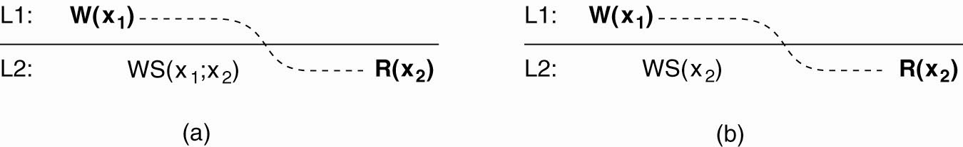
Read Your Writes
A data store that provides read-your-writes consistency
  WS(x₁) is the series of write operations that took place since initialization at a local copy.
  WS(x₁; x₂) denotes that operations in WS(x₁) also been performed at another local copy that has its set of operations in WS(x₂).

Slide 17
Read Your Writes
A data store that does not provide read-your-writes consistency

Slide 18
Writes Follow Reads
A data store is said to provide writes-follow-reads consistency, if the following holds:
A write operation by a process on a data
item x following a previous read operation
on x by the same process is guaranteed to take
place on the same or a more recent
value of x that was read.

Slide 19

Writes Follow Reads (2)‏
A writes-follow-reads consistent data store.

Slide 20
Writes Follow Reads ‏
A data store that does not provide writes-follow-reads consistency.

Slide 21
Consistency Models
Background – Replication Motivation
Data-Centric Consistency Models
  Continuous Consistency
  Consistent Ordering of Operations
Client-Centric Consistency Models
  Eventual Consistency
  Monotonic Reads
  Monotonic Writes
  Read Your Writes
  Writes Follow Reads

