Slide 1
Consistency Models

Slide 2
Replication
Replication Benefits
  Replication enhances tolerance to failure
  Performance can be improved in different ways
    Placing replicas in the proximity of the process using them
    Replicating servers and subsequently dividing the work among them
Consistency Requirements – Replication may lead to consistency problems
  Modifications need to be carried out on all copies
  When and how modifications are carried out is the price of replications

Slide 3
Replication and Scalability
Replication and caching for performance are widely used as scaling techniques
  Adding replicas improves scalability, but incurs the overhead of keeping the replicas up-to-date
How to efficiently synchronize all of the replicas created to solve the scalability issue?
  A challenging problem!

Slide 4
Performance and Scalability
Main issue – To keep replicas consistent, we generally need to ensure that all conflicting operations are done in the same order, across all servers
Conflicting Operations – Concurrent Transactions
  Read–Write Conflict: a read operation and a write operation act concurrently
  Write–Write Conflict: two concurrent write operations
Guaranteeing global ordering on conflicting operations is expensive
Solution – Weaken consistency requirements to avoid global synchronization, when possible

Slide 5
Weakening Consistency Requirements
What does it mean to “weaken consistency requirements”?
  Relax the requirement that “updates need to be executed as atomic operations”
  Do not require global synchronizations
  Replicas may not always be the same everywhere
To what extent can consistency be weakened?
  Depends highly on the access and update patterns of the replicas
  Depends on the replicated data use patterns
    Application requirements and behavior

Slide 6
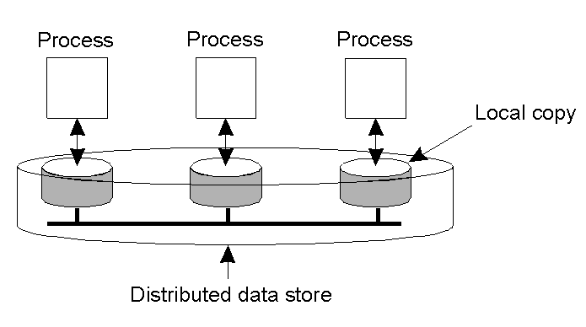
Data-Centric Consistency Models
A data store is physically distributed and replicated across multiple machines.
  A data-store can be read from or written to by any process
  A local copy of the data-store (replica) can support “fast reads”
  A write to a local replica needs to be propagated to all remote replicas
Various consistency models can be used to ensure “correct” operation, as agreed upon by access rules

Slide 7
What is a Consistency Model?
A “consistency model” is a contract between a distributed data-store and its processes.
  If the processes agree to the rules, the data-store will perform correctly and as advertised.

Slide 8
Data-Centric Consistency Models – Strong and Weak Models
Strong consistency models: Operations on shared data are synchronized – Do not require synchronization operations
  Strict consistency – Related to absolute global time
  Sequential Consistency – Also knows as serializability
  Linearizability – To achieve atomicity
  Causal Consistency – To maintain only causal relations
  FIFO Consistency – To maintain only individual ordering
Weak consistency models: Synchronization occurs only when shared data is locked and unlocked –Rely on synchronization operations
  Weak Consistency
  Release Consistency
  Entry Consistency
Note – Weaker the consistency model are more scalable

Slide 9
Consistency Model Diagram Notation
W_{i}(x)a – A write operation performed by process i on item x with a value of a.
  Process P_{i} sets x to a.
R_{i}(x)b – A read operation performed by process i on item x producing the value b.
  Process P_{i} read operation on x returns b.
In all diagrams, time moves from left to right

Slide 10

Strict Consistency Diagrams
With Strict Consistency, all writes are visible instantaneously to all processes
  Any read to a shared data item X returns the value stored by the most recent write operation on X.
Strict Consistency relies on absolute global time, making it difficult to implement in a distributed system.
Time
Strictly Consistent Data Store
Not strictly Consistent Data Store
Behavior of two processes, operating on the same data item

Slide 11
Sequential Consistency – Definition
  Sequential consistency – The result of any execution is the same as if the read and write operations by all processes were executed in some sequential order and the operations of each individual process appear in this sequence in the order specified by its program
Any valid interleaving of read and write operations is OK, but all processes must see the same interleaving.
  The events observed by each process must globally occur in the same order, or it is not sequentially consistent.
    It doesn't actually matter if the events don't really agree with clock time, as long as they are consistent.

Slide 12

Sequential Consistency – Interleaving
Sequentially Consistent Data Store
Sequentially Not Consistent Data Store
P3 and P4 do see the
same interleaving of writes
P3 and P4 do not see the
same interleaving of writes

Slide 13
Sequential Consistency – Example
Process P1 | Process P2 | Process P3
x = 1; print ( y, z); | y = 1; print (x, z); | z = 1; print (x, y);
Three processes, executing concurrently.
  The 6 statements shown can be ordered (and executed) in 6! = 720 possible ways, but most of the orderings are invalid
  Analysis shows that 90 possible valid execution sequences exist.
  x = 1;
  print(y,z);
  print(x,z); // Invalid because it violates program
  y = 1; // order of process P2.
  z = 1;
  print(x,y);

Slide 14
Linearizability
In sequential consistency, absolute time is somewhat irrelevant – The order of events is most important.
Linearizability – Sequential Operations are ordered according to a global time
A data store is said to be linearizable when each operation is timestamped and the following condition holds:
  “The result of any execution is the same as if the operations by all processes on the data store were executed in some sequential order and the operations of each individual process appear in this sequence in the order specified by its program.
  In addition, if ts_Op₁(x) < ts_Op₂(y), thenOp₁ (x) should precede Op₂(y) in this sequence.”

Slide 15
Sequential consistency vs. Linearizability
Linearizability is weaker than strict consistency, but stronger than sequential consistency
Linearizability has proven useful for reasoning about program correctness but has not typically been used otherwise.
Sequential consistency is implementable and widely used but has poor performance.
To get around performance problems, weaker models that have better performance have been developed.

Slide 16
Causal Consistency
Necessary condition – Writes that are potentially causally related must be seen by all processes in the same order.
  Concurrent writes may be seen in a different order on different machines.
If event A is a direct or indirect result of another prior event B, then all processes should observe event A before observing event B.
  A = A + 1; // First two events are causally related,
  B = A * 5; // because B reads A after A was written.
  C = C * 3; // This is a concurrent statement.

Slide 17

Causal Consistency - Sequence
W₂(x)b and W₁(x)c are concurrent
Not strictly consistent because P₃ and P₄ "R(x)“ operations don’t return most recent write on x, in all cases.
Not sequentially consistent because P₃ and P₄ don't read the same values in the same order.
The sequence is allowed with a causally-consistent store

Slide 18
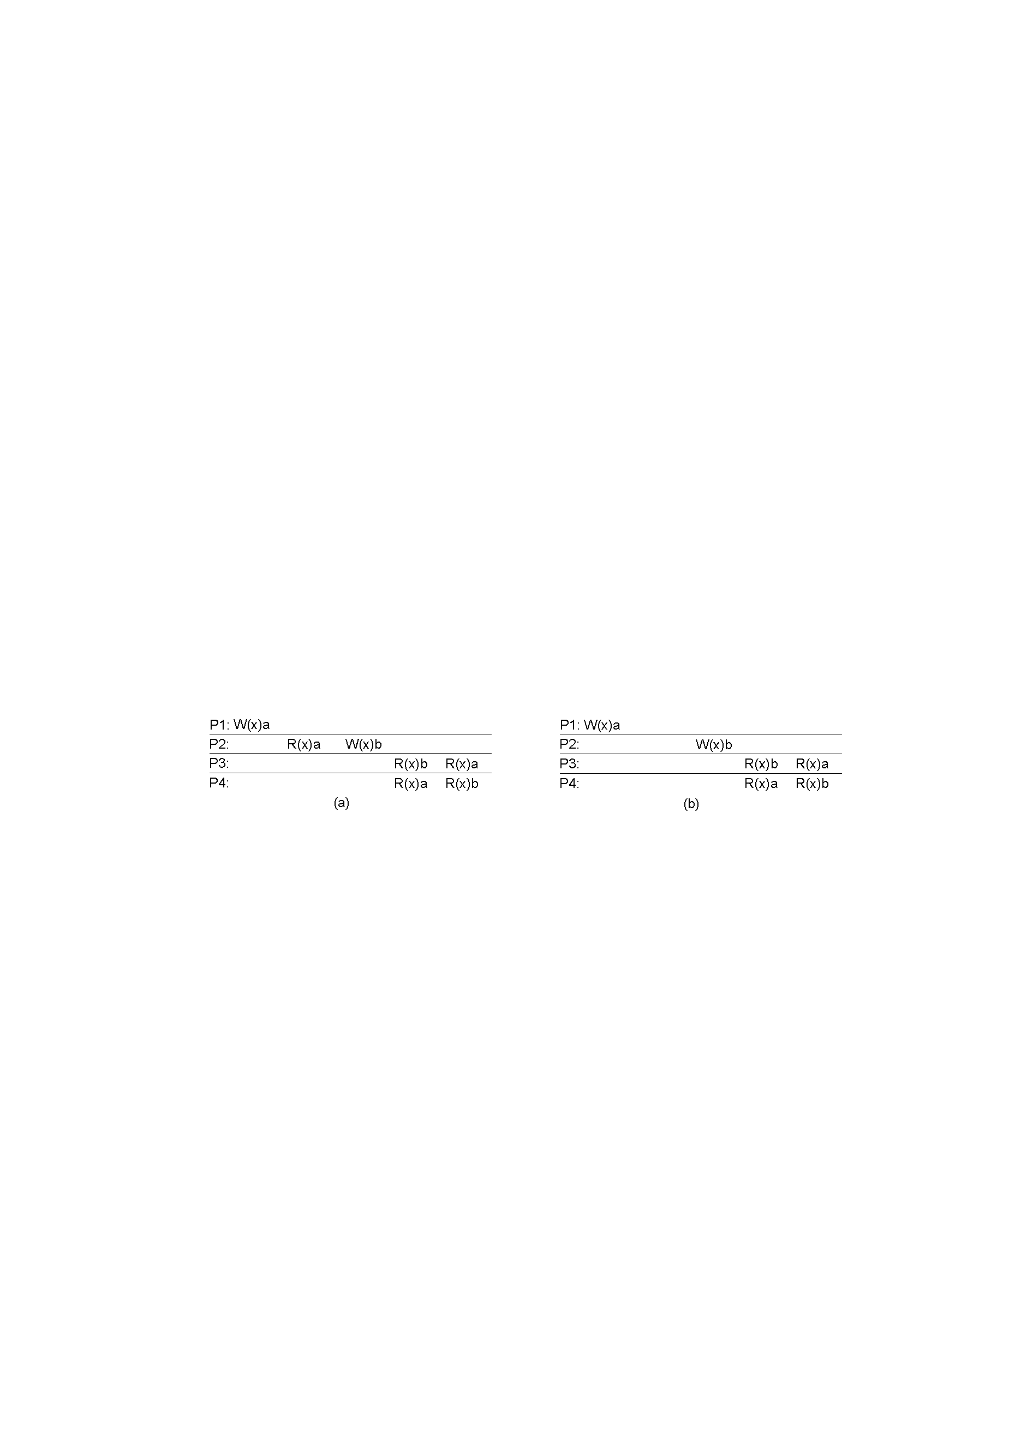
Causal Consistency
(a) A violation of a causally-consistent store
  W₁(x)a and W₂ (x)b are causally dependent – all processes must them in the same order
(b) A correct sequence of events in a causally-consistent store
  W₁(x)a and W₂ (x)b are concurrent.

Slide 19
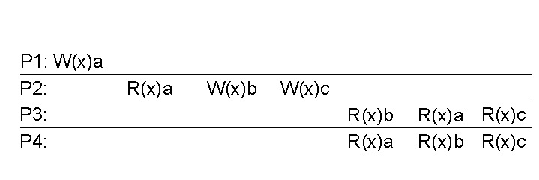
FIFO Consistency
Necessary Condition – Writes performed by a single process are seen by all other processes in the order in which they were issued, but writes from different processes may be seen in a different order by different processes.
A valid sequence of events of FIFO consistency.
  P₂’s writes are seen in the correct order.
FIFO consistency is easy to implement.

Slide 20
Weak Consistency – Motivation
Not all applications need to see all writes, let alone seeing them in the same order
This leads to “Weak Consistency”
  It is primarily designed to work with distributed critical regions
This model introduces the notion of a “synchronization variable”, which is used to update all copies of the data-store

Slide 21
Weak Consistency - Criteria
The following criteria must be met
  Accesses to synchronization variables associated with a data store are sequentially consistent – all processes see the synchronization calls in the same order.
  No operation on a synchronization variable is allowed to be performed until all previous writes have been completed everywhere.
  No read or write operation on data items are allowed to be performed until all previous operations to synchronization variables have been performed.

Slide 22
Weak Consistency - Semantics
The weak consistency models enforce consistency on a group of operations
A synchronize(S) operation by P, causes all writes by P to be propagated to all other replicas and all external writes are propagated to P.
  Process P forces the just written value out to all the other replicas
  Process P can be sure it’s getting the most recently written value before it reads

Slide 23
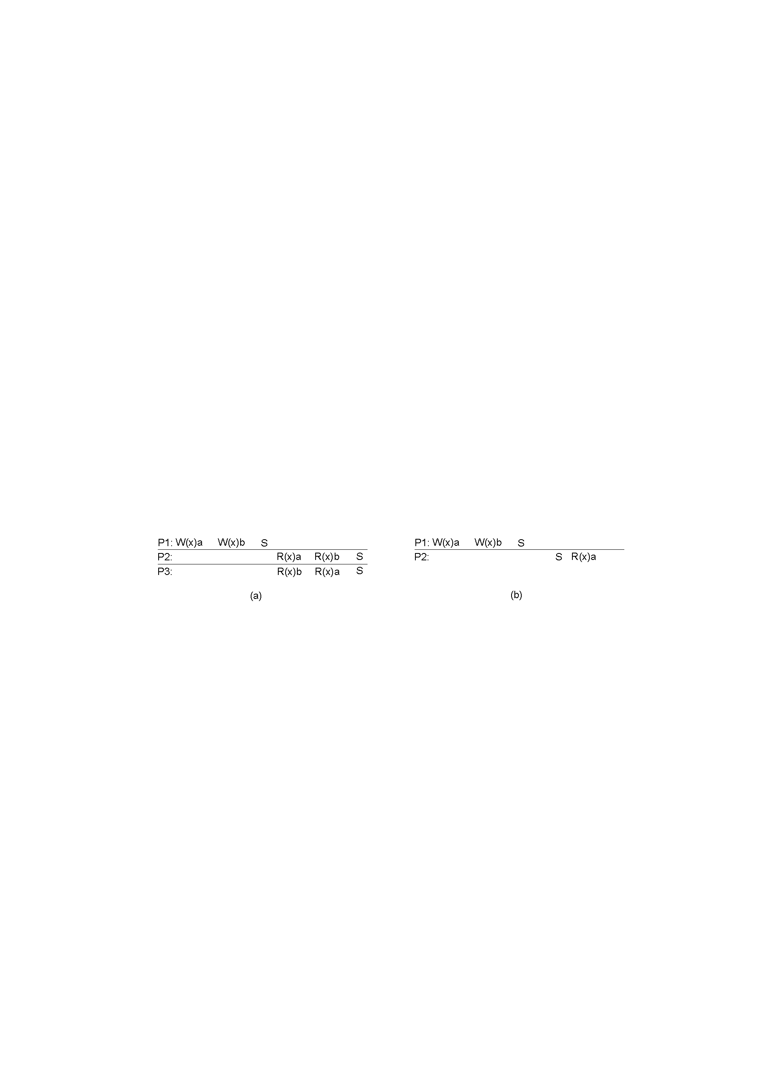
Weak Consistency - Example
P₂ and P₃ have not
synchronized, so no
guarantee about what
order they see.
This S ensures that
P₂ sees all updates
A valid sequence of events for weak consistency -- This is because P₂ and P₃ have yet to synchronize, so there’s no guarantees about the value in ‘x’.
An invalid sequence for weak consistency – P₂ has synchronized, so it cannot read ‘a’ from ‘x’ and should be getting ‘b’.

Slide 24
Release Consistency – Motivation
Weak consistency has the problem that when a synchronization variable is accessed, the data store does NOT know what caused this access:
  Process finished writing the shared data, or
  Process is about to start reading data
Consequently, the data store must take the actions required in both cases
  Make sure that all locally initiated writes have been completed, thereby propagated to other replicas
  Gathering in all writes from other replicas
If the data store could tell the difference between entering a critical region or leaving one, a more efficient implementation might be possible.

Slide 25
Release Consistency Basic Idea
Divide access to a synchronization variable into two parts:
  acquire and release.
When a process is about to start accessing data
  Acquire forces a requester to wait until the shared data can be accessed
When a process finished accessing the shared data
  Release sends requester’s local value to other servers in data store.

Slide 26
Release Consistency Definition
A distributed data-store is “Release Consistent” if it obeys the following rules:
  Before a read or write operation on shared data is performed, all previous acquires done by the process must have completed successfully.
  Before a release is allowed to be performed, all previous reads and writes by the process must have completed
  Accesses to synchronization variables need only be FIFO consistent
    Sequential consistency is not required

Slide 27

Release Consistency – Example
A valid event sequence for release consistency
Process P₃ has not performed an acquire, so there are no guarantees that the read of ‘x’ is consistent.
  The data-store is simply not obligated to provide the correct answer
Process P₂ does perform an acquire, so its read of ‘x’ is consistent
No Consistency
Guarantee

Slide 28
Entry Consistency – Introduction
With release consistency, all local updates are propagated to other replica servers during release of shared data.
With entry consistency, each shared data item is associated with a synchronization variable.
In order to access consistent data, each synchronization variable must be explicitly acquired.
Release consistency affects all shared data but entry consistency affects only shared data associated with a synchronization variable.

Slide 29
Entry Consistency
Acquire and release are still used, and the data-store meets the following conditions:
  An acquire access of a synchronization variable is not allowed to perform with respect to a process until all updates to the guarded shared data have been performed with respect to that process.
  Before an exclusive mode access to a synchronization variable by a process is allowed to perform with respect to that process, no other process may hold the synchronization variable, not even in nonexclusive mode.
  After an exclusive mode access to a synchronization variable has been performed, any other process's next nonexclusive mode access to that synchronization variable may not be performed until it has performed with respect to that variable's owner.

Slide 30
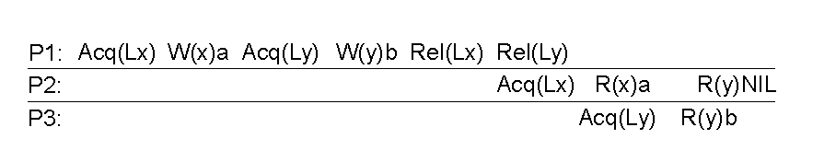
Entry Consistency – Semantics
At an acquire, all remote changes to guarded data must be brought up to date.
Before a write to a data item, a process must ensure that no other process is trying to write at the same time.
Locks associate with individual data items, as opposed to the entire data-store.
P₂’s read on ‘y’ returns NIL as no locks have been requested.

Slide 31
Summary of Consistency Models
Consistency | Description
Strict | Absolute time ordering of all shared accesses matters.
Linearizability | All processes must see all shared accesses in the same order. Accesses are furthermore ordered according to a (nonunique) global timestamp
Sequential | All processes see all shared accesses in the same order. Accesses are not ordered in time
Causal | All processes see causally-related shared accesses in the same order.
FIFO | All processes see writes from each other in the order they were used. Writes from different processes may not always be seen in that order
 | (a)
Consistency | Description
Weak | Shared data can be counted on to be consistent only after a synchronization is done
Release | Shared data are made consistent when a critical region is exited
Entry | Shared data pertaining to a critical region are made consistent when a critical region is entered.
 | (b)
(a) Consistency models not using synchronization operations.
(b) Models with synchronization operations.

