Slide 1
Distributed Hash Tables

Slide 2
Distributed Hash Table
A common approach is to use a Distributed Hash Table (DHT) to organize nodes
Traditional hash functions convert a key to a hash value, which can be used as an index into a hash table.
  Keys are unique – Each represents an object to store in the table
  The hash function value is used to insert an object in the hash table and to retrieve it.

Slide 3
Distributed Hash Table (DHT)
DHT = distributed P2P database
Database has (key, value) pairs;
  key: ss number; value: human name
  key: content type; value: IP address
Peers query DB with key
  DB returns values that match the key
Peers can also insert (key, value) peers

Slide 4
DHT Identifiers
Assign integer identifier to each peer in range [0,2^{n}-1].
  Each identifier can be represented by n bits.
Require each key to be an integer in same range.
To get integer keys, hash original key.
  eg, key = h(“Led Zeppelin IV”)
  This is why they call it a distributed “hash” table

Slide 5
How to assign keys to peers?
Central issue:
  Assigning (key, value) pairs to peers.
Rule: assign key to the peer that has the closest ID.
Convention in lecture: closest is the immediate successor of the key.
Ex: n=4; peers: 1,3,4,5,8,10,12,14;
  key = 13, then successor peer = 14
  key = 15, then successor peer = 1

Slide 6
Circular DHT (1)
1
3
15
4
12
5
10
8
Each peer only aware of immediate successor and predecessor.
“Overlay network”

Slide 7
Circle DHT (2)
O(N) messages
on avg to resolve
query, when there
are N peers
0001
Who’s resp
for key 1110 ?
I am
0011
1111
1110
1110
0100
1110
1100
1110
0101
1110
Define closest
as closest
successor
1110
1010
1000

Slide 8
Circular DHT with Shortcuts
1
Who’s resp
for key 1110?
3
15
4
12
5
10
8
Each peer keeps track of IP addresses of predecessor, successor, short cuts.
Reduced from 6 to 2 messages.
Possible to design shortcuts so O(log N) neighbors, O(log N) messages in query

Slide 9
Peer Churn
1
To handle peer churn, require
each peer to know the IP address
of its two successors.
Each peer periodically pings its
two successors to see if they
are still alive.
3
15
4
12
5
10
8
Peer 5 abruptly leaves
Peer 4 detects; makes 8 its immediate successor; asks 8 who its immediate successor is; makes 8’s immediate successor its second successor.
What if peer 13 wants to join?

Slide 10
SYNCHORNIZATION
CLOCK SYNCHRONIZATION

Slide 11
Motivation
Why clock synchronization matters?
  Control access to a single, shared resource
  Agree on the ordering of events
  Time-based computations on multiple machines
  Many applications require that clocks advance at similar rates
    Real-time scheduling events based on processor clock
    Setting timeouts and measuring latencies

Slide 12
Synchronization
Synchronization within one system is hard enough
  Messages
  Semaphores,
  Monitors,
  Barriers,
  …
Synchronization among processes in a distributed system is much harder
Two approaches to achieve synchronization
  Synchronization based on physical time
  Synchronization using relative ordering rather than absolute time

Slide 13
Clock Synchronization
In a centralized system, time is unambiguous
In a distributed system, achieving agreement on time is hard
  It is impossible to guarantee that independent physical clocks are fully synchronized
Lack of a single global time source can cause errors

Slide 14
SYNCHORNIZATION
PHYSICAL CLOCKs

Slide 15
Clock Synchronization – Actual Time
For time dependent applications the actual time is important
  External physical clocks become critical
  For efficiency and redundancy, multiple physical clocks are needed
Two issues arise:
  How to synchronize the physical clocks with real-world clocks?
  How to synchronize these clocks with each other?

Slide 16
Time Measurement
Atomic clocks make it possible to measure time accurately
  Several laboratories, equipped with Cesium 133 clocks, periodically report the number of times their clock has ticket to the Bureau International de l’Heure (BIH)
  BIH computes the average to produce the International Atomic Time (TAI), the number of seconds since 01/01/1958 midnight divided by 9,192,631,370
  TAI seconds are of constant length, unlike solar seconds.
    As the mean solar day is getting longer, TAI get out of synch
      Now, 86,600 TAI seconds are about 3 msec less than a mean solar day

Slide 17
Physical clocks
Computer Clocks are acutually Timers, a precisely machined quartz crystal
  When kept under tension, crystals oscillate at a known fixed frequency
Associated with the crystal are two registers, a counter and holding register
  At each oscillation, the counter decrements by 1
  When counter reaches zero, an interrupt is generated
    Each interrupt corresponds to a clock tick
Timers have manufacturing defects
  On a single node a clock being slightly off is tolerable
  With multiple nodes clock skew is problematic

Slide 18
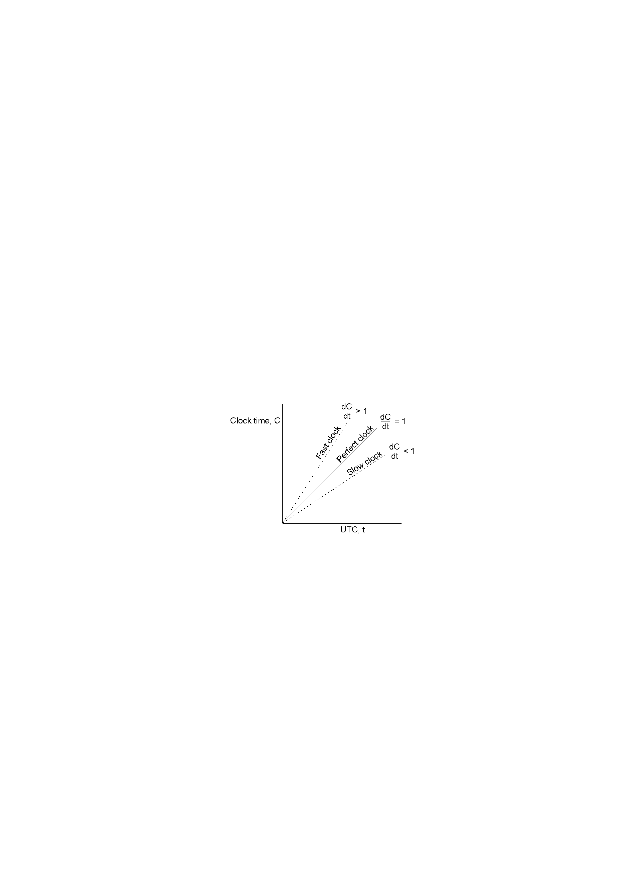
Relation between Clock Time and UTC

Slide 19
Dealing with drift
Set computer to true time
  Generally not good idea to set clock back
  Software can get very confused
Gradual clock correction
  If fast then make clock run slower until it synchronizes
  If slow then make clock run faster until it synchronizes

Slide 20

Compensating for a fast clock
$\frac{dC}{dt}$ > 1
Clock Synchronized
skew
Computer’s time, C
Linear Compensating
Function Applied
UTC time, t

Slide 21
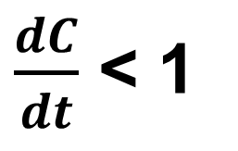
Compensating for a fast clock
$\frac{dC}{dt}$ < 1
Computer’s time, C
UTC time, t

Slide 22
SYNCHORNIZATION
Network Time Protocol

Slide 23
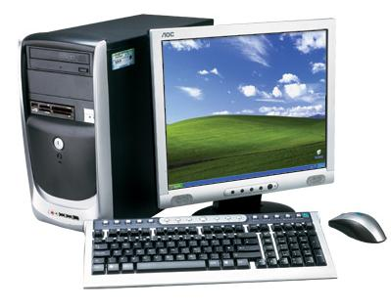
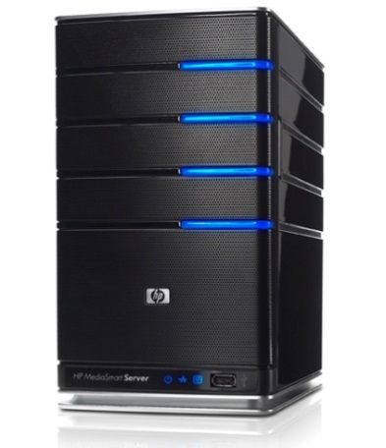
Network Time Protocols
Clients contact a time server for synchronization,
  Time server is typically equipped with an accurate time source
Does not account for processing and communication delay
  Delay Approximation
client
Request ()
server
Reply(Crnt_Time)

Slide 24
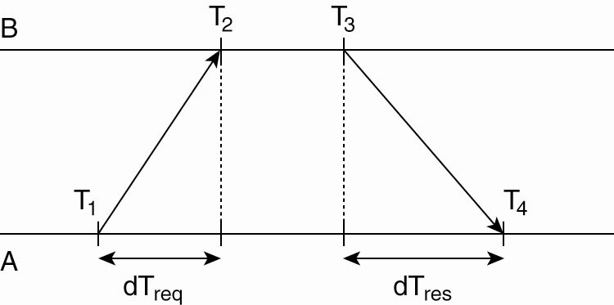
Network Time Protocol
Getting the current time from a time server.

Slide 25
NTP Skew
Assume delay is nearly symmetric
Offset estimation
  θ = [(T2 – T1) + (T3 – T4 )]/2.
If θ < 0 then clock must be set backward
  Not advisable
  Change must be introduced gradually, until the correction is made

Slide 26
NTP Basic Operation
NTP is set up pairwise
  A probes B for its current time and B also probes A
Compute the offset, θ, and the delay estimation, δ
  δ = (T₄ – T₁) - (T₃ – T₂ )
Buffer 8 pairs of (θ, δ), and select the minimal value for δ as the best delay estimation between the two servers
  The associated θ with the minimal delay δ is the most reliable estimation of the offset

Slide 27
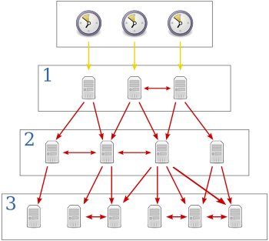
NTP Hierarchy
NTP divides servers into strata
Strata-1 Servers – Servers with a reference clock
  Clock itself is said to operate at stratum 0

Slide 28
SYNCHORNIZATION
Berkeley Protocol

Slide 29
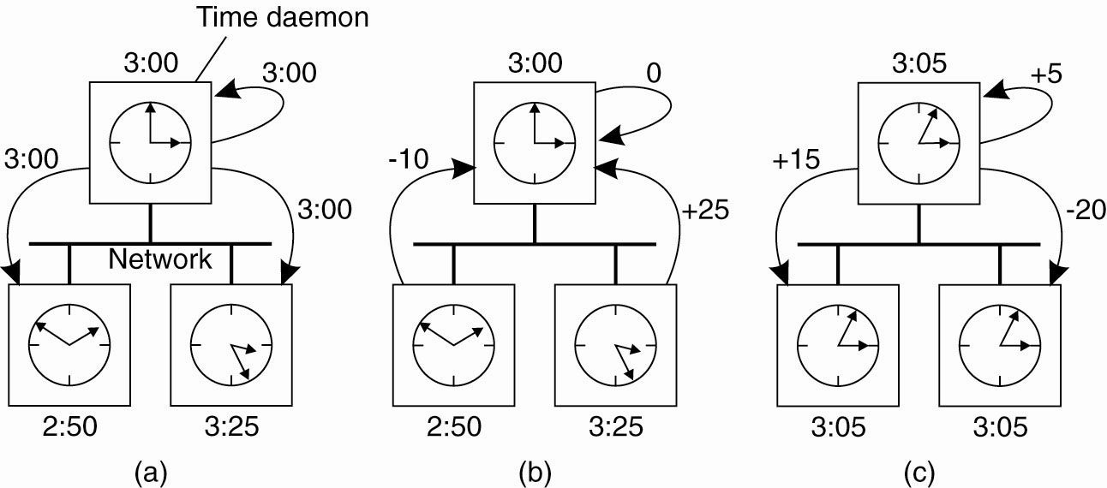
The Berkeley Algorithm – Request
For systems where no machine has an accurate time source
The time daemon asks all the other machines for their clock values.

Slide 30
The Berkeley Algorithm – Reply
The machines answer with their current time
  Daemon computes the average of the received answers

Slide 31
The Berkeley Algorithm (3)
The time daemon tells everyone how to adjust their clock.
  Speed up or jump ahead
  Slow down

