Slide 1
Synchronization

Slide 2
Mutual Exclusion – Classification
Mutual Exclusion
Permission-Based
Token-Based
Centralized
Token Ring
Decentralized
Distributed

Slide 3
PERMISSION BASED DME
CENTRALIZED ALGORITHM

Slide 4
Centralized Algorithm
– Free Resource
Centralized Algorithm achieves DME by closely “mimicking” ME in single processor systems
  One process, C, is the Coordinator – Coordinates access to resources
  Other processes issue requests to access resource
Request(R)
Request Resource
Wait for Response
Receive Grant
Access Resource
Release Resource
P
C
Grant(R)
Release(R)

Slide 5
Centralized Algorithm
– Allocated Resource
If resource is currently by another process, C does not reply until resource is released
  Maintain queue of pending requests, serviced in FIFO order
Q
{∅}
C
P₃
Request(R)
Q
{P₂}
Request(R)
Q
{P₂}
{P₃}
Request(R)
Q
{P₃}
Grant(R)
Grant(R)
P₁
P₂
Release(R)

Slide 6
Centralized Algorithm
Advantages
  Easy to understand, verify and implement
  Access Fairness – FIFO order of service is simple to implement
    Note FIFO policy does not guarantee “Fair Share” access
Limitations
  Not scalable to large scale distributed systems – Coordinator is likely to become a bottleneck
  A process requesting a resource cannot distinguish between being in a “blocked state”, waiting for the resource to be released, from waiting for a failed coordinator
    Timeout mechanisms or alive messages may be required – to be designed carefully to avoid early and late timeouts or unnecessary alive messages

Slide 7
PERMISSION BASED DME
DECENTRALIZED ALGORITHM

Slide 8
Decentralized Permission Based DME
Fully decentralized algorithms attempt to address the bottleneck problem of centralized algorithms
  Basic tenet of the algorithm is coordination replication and majority voting
Each resource is assumed to be replicated n times
Each replica has its own coordinator
  Therefore, n coordinators are needed

Slide 9
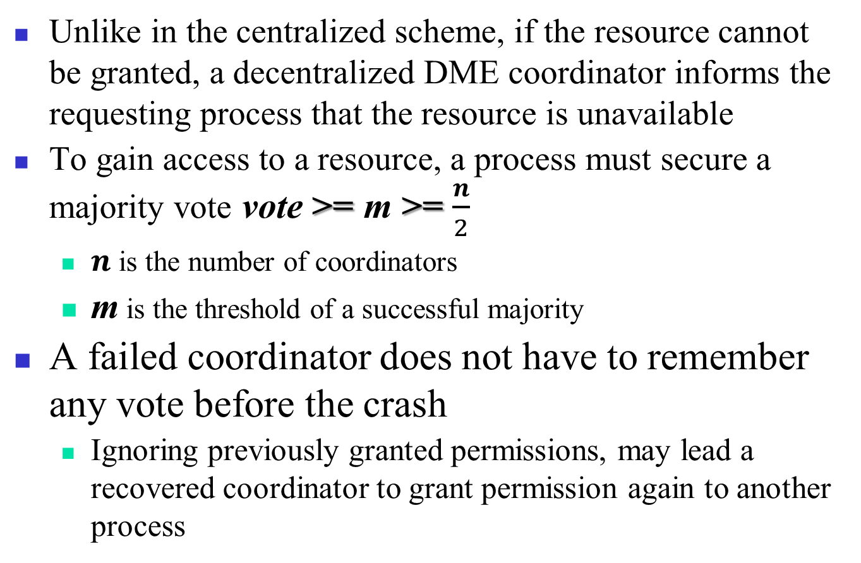
DME Decentralized Voting Algorithm
Unlike in the centralized scheme, if the resource cannot be granted, a decentralized DME coordinator informs the requesting process that the resource is unavailable
To gain access to a resource, a process must secure a majority vote vote >= m >= $\frac{n}{2}$
  $n$ is the number of coordinators
  m is the threshold of a successful majority
A failed coordinator does not have to remember any vote before the crash
  Ignoring previously granted permissions, may lead a recovered coordinator to grant permission again to another process

Slide 10
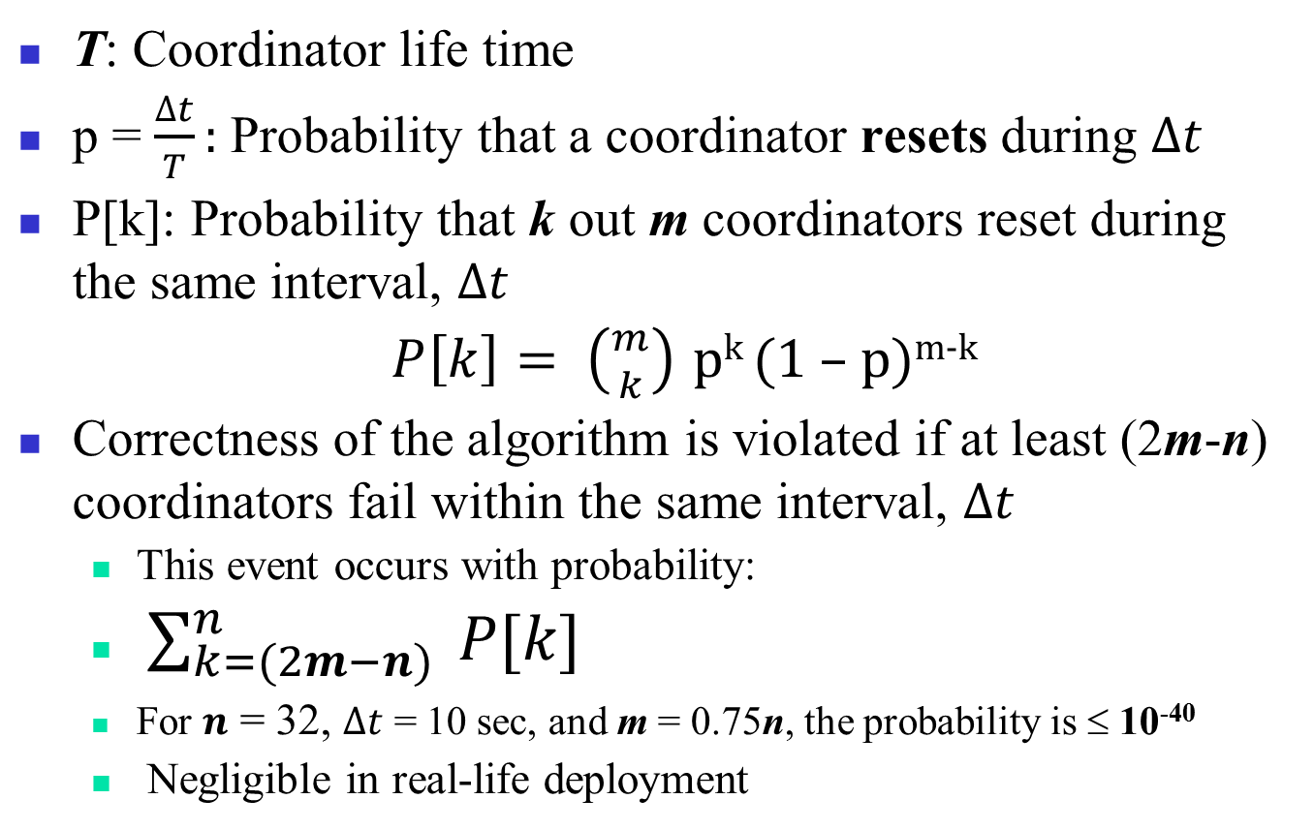
Voting Algorithm Analysis
T: Coordinator life time
p = $\frac{∆t}{T}:$ Probability that a coordinator resets during $∆t$
P[k]: Probability that k out m coordinators reset during the same interval, $∆t$
  $P\left[k\right]= \left({m \atop k}\right)$ p^{k} (1 – p)^{m-k}
Correctness of the algorithm is violated if at least (2m-n) coordinators fail within the same interval, $∆t$
  This event occurs with probability:
  $\sum_{k=(2m−n)}^{n}{ P[k]}$
  For $n$ = 32, $∆t$ = 10 sec, and m = 0.75n, the probability is ≤ 10⁻⁴⁰
  Negligible in real-life deployment

Slide 11
Decentralized Permissions – Analysis
Benefits
  No single point of failure
  Implementable using DHT based structure
    A resource is known under its unique name, rname
      The i^{th} replica is name rname.i
    If permission to access a resource is denied, because the process cannot obtain a majority vote, the process backs off a random amount of time and tries again later
Limitations
  Overhead in terms of the number of messages generated can be prohibitively high
    Messages to secure majority, which may require multiple attempts
  Failure may be difficult to handle

Slide 12
PERMISSION BASED DME
DISTRIBUTED ALGORITHM

Slide 13
A Distributed ME Algorithm
Ricart and Agrawala Algorithm assumes there is a mechanism for “totally ordering of all events” in the system and a reliable message system
  Lamport’s algorithm can be used for total ordering
A process wanting to enter a CS sends a message with (CS name, process id, current time) to all processes, including itself
When a process receives a CS request from another process, it reacts based on its current state with respect to the CS requested.
  Three possible cases must be considered

Slide 14
RicartANDAgrawala Algorithm – Basic Cases
RA Algorithm distinguishes between 3 cases
  If the receiver is not in the CS and it does not want to enter the CS, it sends an OK message to the sender.
  If the receiver is in the CS, it does not reply and queues the request.
  If the receiver wants to enter the CS but has not yet, it compares the timestamp of the incoming message with the timestamp of its message sent to everyone – The lowest timestamp wins.
  If the incoming timestamp is lower, the receiver sends an OK message to the sender.
  If its own timestamp is lower, the receiver queues the request and sends nothing.

Slide 15
RA DME Algorithm – CS Entry and Exit
After a process sends out a request to enter a CS, it waits for an OK from all the other processes.
  Upon receiving all OK message, process enters the CS
Upon exiting CS, it sends OK messages to all processes on its queue, which are waiting for that CS
  Upon sending OK messages, processes are deleted from the queue.

Slide 16
RA Algorithm – Example
P₀ and P₂ request access to the same resource, nearly at the same time
  Both send requests with timestamps, 8 and 12, respectively
P₀ has the lowest timestamp, 8
  P₀ wins access to the resource
Upon completion of its CS, P₀ sends OK message to P₂
  P₂ can enter its own CS
8
P₀
P₀
P₀
8
12
OK
OK
8
OK
P₁
P₂
P₁
P₂
P₁
P₂
12
OK
12

Slide 17
Distributed Permissions Analysis
Benefits
  No central bottleneck
    This results in improved performance
  Fewer messages than the decentralized algorithm
Limitations
  The system is exposed to n points of failure
    If a node fails to respond, the entire system locks up

Slide 18
TOKEN BASED DME
TOKEN RING ALGORITHM

Slide 19
A Token Ring Algorithm
An unordered group of processes on a network.
P₂
A logical ring constructed in software
P₁
P₃
P₀
P₂
P₄
P₆
P₀
P₄
P₁
P₃
P₅
P₇
P₇
P₅
P₆
Token circulates at high speed on the network
A process must have a token to enter its CS

Slide 20
DME Algorithm Comparison
Centralized is the most efficient.
Token ring efficient when a large of processes seek to use critical region.
Algorithm | Messages per Entry/Exit | Problems
Centralized | 3 | Coordinator Crash
Decentralized | 2mk+m, k=1,2,… K is the number of attempts, before success | Starvation, Low Efficiency
Distributed | 2 ( n – 1 ) | Process Crash
Token ring | 1 to ∞ | Lost Token, Process Crash

Slide 21
ELECTION
BACKGROUND

Slide 22
Election Algorithms
Many distributed algorithms such as mutual exclusion and deadlock detection require a coordinator process.
When the coordinator process fails, the distributed group of processes must execute an election algorithm to determine a new coordinator process.
  Different criteria can be used to select the new coordinator

Slide 23
Assumptions and Requirements
Any process can call for an election.
  A process can call for at most one election at a time.
  Multiple processes can call an election simultaneously.
  Election results should not depend on which process calls for it.
Each process maintains the following data structure
  Variable called elected
  An attribute value called attr
The non-faulty process with the highest attribute value (e.g., highest ID or MAC address, or fastest CPU, etc.) is elected

Slide 24
ELECTION ALGORITHMS
BULLY ALGORITHM

Slide 25
Bully Algorithm Main Characteristics
Operating Assumptions
  Synchronous system
    All messages arrive within T_{M} units transmission of time.
    A reply is dispatched within P_{P} units of processing time after the receipt of a message.
    If no response is received in 2×T_{M} + P_{P}, the node is assumed to be faulty
      Node crashed
  Attribute = Process ID
  Each process knows all the other processes in the system
    Therefore, processes know each others’ IDs

Slide 26
The Bully Algorithm
When any process, P, notices that the coordinator is no longer responding it initiates an election:
P sends an election message to all processes with higher id numbers.
If no one responds, P wins the election and becomes coordinator.
If a higher process responds, it takes over.
  Process P’s job is done.

Slide 27
The Bully Algorithm
At any moment, a process can receive an election message from one of its lower-numbered colleagues.
The receiver sends an OK back to the sender and conducts its own election.
Eventually only the bully process remains.
  Bully process becomes the new coordinator
  The bully announces victory to all processes in the distributed group.

Slide 28
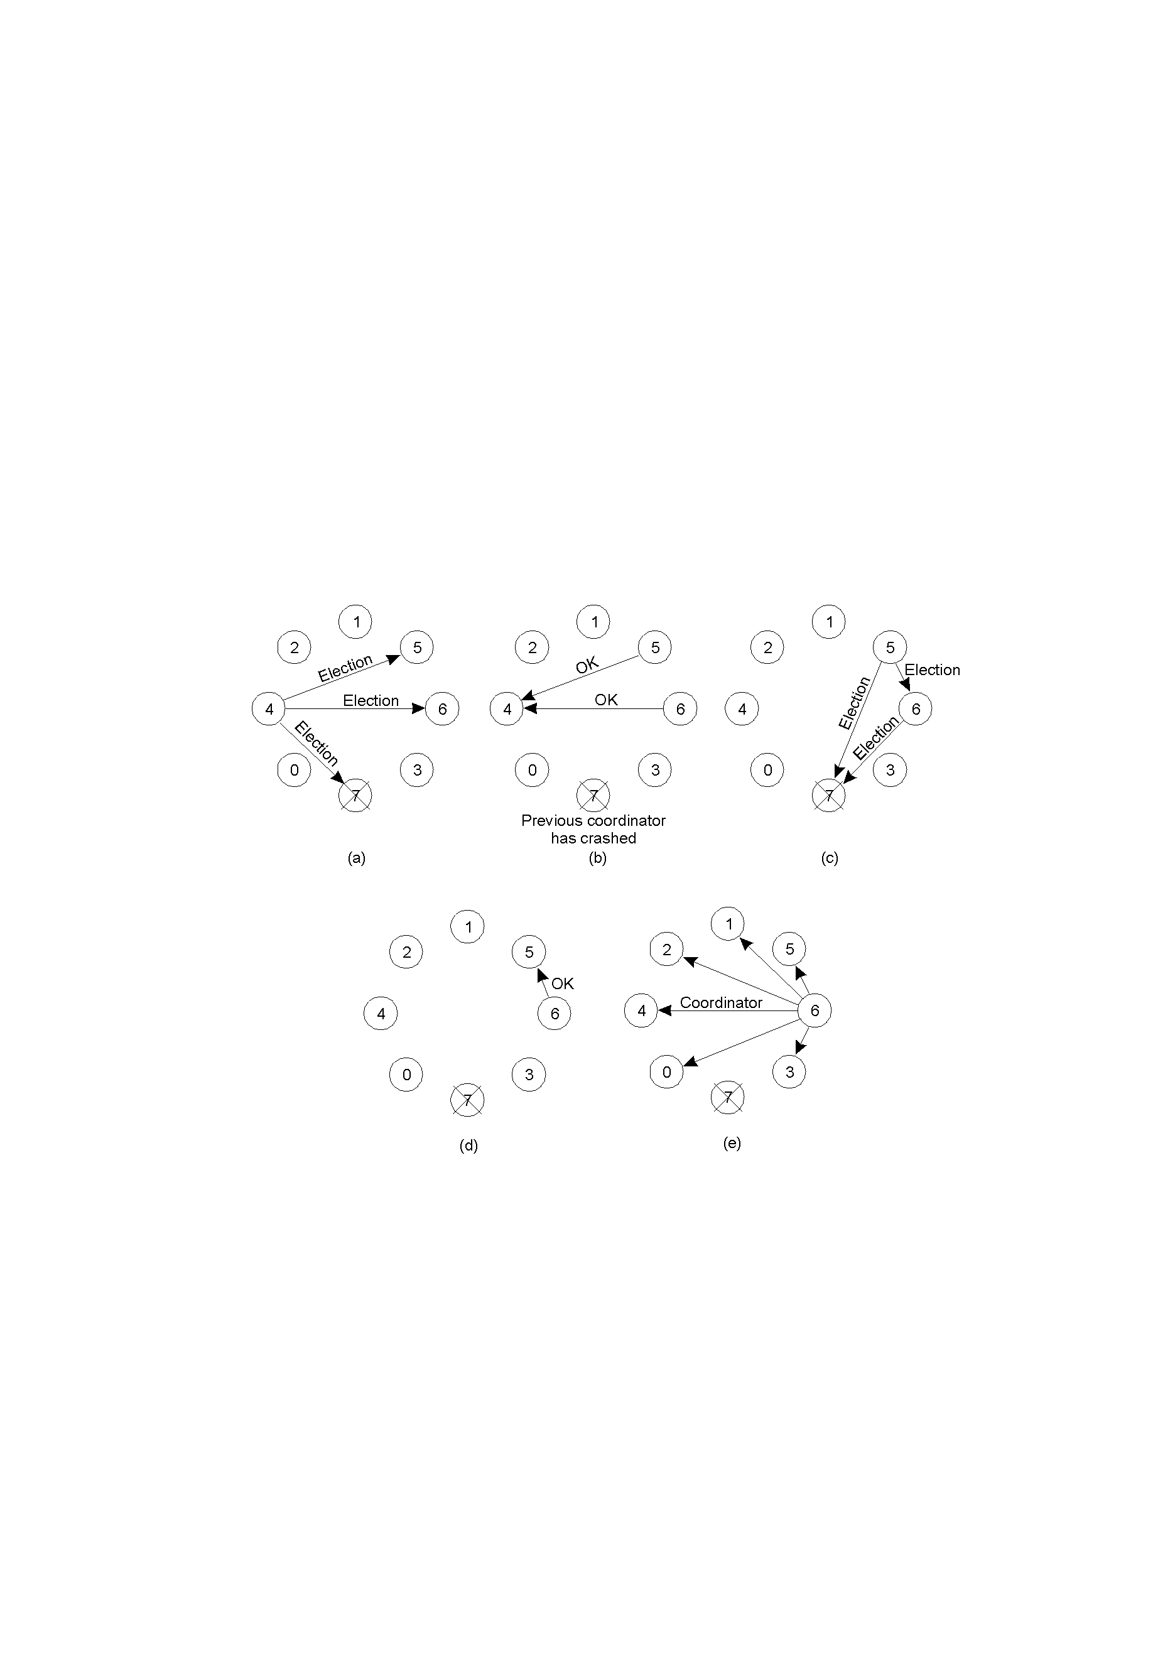
Bully Algorithm Example
Process 4 notices 7 down.
Process 4 holds an election.
Process 5 and 6 respond, telling 4 to stop.
Now 5 and 6 each hold an election.

Slide 29
Bully Algorithm Example
Process 6 tells process 5 to stop
Process 6 (the bully) wins and tells everyone
If processes 7 recovers, it restarts election process

Slide 30
Performance of Bully Algorithm
Best case scenario: The process with the second highest id notices the failure of the coordinator and elects itself.
  N-2 coordinator messages are sent.
  Turnaround time is one message transmission time.
Worst case scenario: When the process with the least id detects the failure.
  N-1 processes altogether begin elections, each sending messages to processes with higher ids.
  The message overhead is O(N²).
  Turnaround time is approximately 5 message transmission times if there are no failures during the run: election, answer, election, answer, coordinator

Slide 31
ELECTION ALGORITHMS
RING ALGORITHM

Slide 32
Ring Algorithm – Basic Operation
RA assumes that the processes are logically ordered in a ring {implies a successor pointer and an active process list} that is unidirectional.
When any process, P, notices that the coordinator is no longer responding it initiates an election:
1. P sends message containing P’s process ID to the next available successor.

Slide 33
Ring Algorithm – Basic Operation
2. At each active process, the receiving process adds its process number to the list of processes in the message and forwards it to its successor.
  Eventually, the message gets back to the sender.
3. The initial sender sends out a second message letting everyone know who the coordinator is {the process with the highest number} and indicating the current members of the active list of processes.

Slide 34
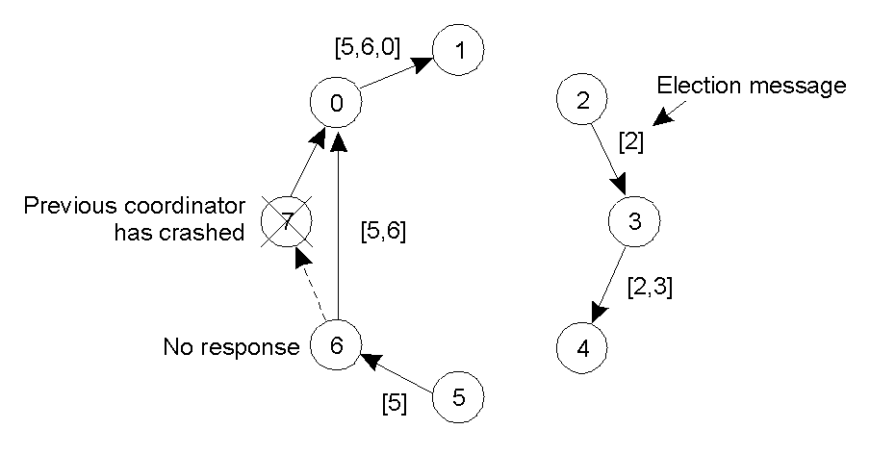
Ring Algorithm – Example
Even if two ELECTIONS start at once, every node will pick the same leader.

