Slide 1
CS 2510
Graduate Operating Systems
Jack Lange
Associate Professor
University of Pittsburgh

Slide 2
Course Objectives
Understand basic OS principals
Understand historical background of OS design
Gain practical experience with current systems
  x86 and Linux
Learn how modern systems are designed and operated
Gain some exposure to systems research

Slide 3
Administrative Stuff
Instructor: Jack Lange
  Email: jacklange@cs.pitt.edu
  Office: Sennott Square #5407
  Office Hours: Weds 2-4PM
Course homepage
  http://www.cs.pitt.edu/~jacklange/teaching/cs2510-f17/
  Announcements, clarifications, corrections
  Additional resources for projects
Grading
  Midterm (30%)
  Final (30%)
  3 Projects (40%)

Slide 4
Projects
Work in groups of 2
  C is required
  Some assembly will ne needed
Highly Recommended: OS or having some familiarity with Unix systems programming, preferably in C or C++
  All projects are in C
  BUILDING software is 50% of the grade of this class
1-9

Slide 5
Textbooks
See course website
Primary:
  Operating Systems: Three Easy Pieces
  Remzi H. Arpaci-Dusseau and Andrea C. Arpaci-Dusseau, http://pages.cs.wisc.edu/~remzi/OSTEP/
Secondary:
  Intel x86 Architectural Manuals (Vols. 2 and 3 are necessary for Projects)
  Linux Device Drivers (Very helpful for Projects)
  Jonathan Corbet, Alessandro Rubini, and Greg Kroah-Hartman
  Linux Kernel Development
  Robert Love
  Understanding the Linux Kernel, Marco Cesati nad Daniel P. Bovet

Slide 6
Why learn about Operating Systems?
Tangible reasons
  Build or modify a real operating system
  Administer and use system well
  Tune application performance
Intangibles
  Intrinsic curiosity
    Understand how your computer works
  Gain/apply knowledge in other areas of Computer Science
    Computer architecture and devices
    Synchronization in programming languages
    Data structures and algorithms
    Performance analysis
  Challenge of designing large, complex systems

Slide 7
What is an operating System
Not easy to define:
Users
Applications
Operating System
Hardware
OS:
  Everything that isn’t an application or hardware
OS:
  Software that abstract hardware into a useful form for applications
  Standard Library
  Resource Coordinator

Slide 8
First Function: Standard Library
Advantages of standard library
  Allow applications to reuse common facilities
  Make different devices look the same
  Provide higher level abstractions
Challenges
  What are the right
  abstractions?

Slide 9
Second Function:
Resource Coordinator
Resource: “Anything valuable”
  (e.g. CPU, memory, disk, network)
Advantages of resource coordinator
  Virtualize resource so multiple users/applications can share
  Protect applications from one another
  Provide efficient and fair access to resources
Challenges
  What mechanisms?
  What policies?

Slide 10
What Functionality in OS?
No single right answer
  Desired functionality depends on outside factors
Expectations
Technology
Changes
Users &
Applications
Operating
System
Computer
Architecture
OS must adapt
  Change abstractions provided to users
  Change algorithms to implement those abstractions
  Change low-level interfaces to deal with new hardware
Current operating systems driven by technological evolution

Slide 11

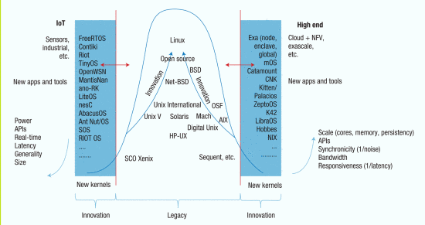
Outlook on Operating Systems
“Will OSs in 2025 still resemble the Unix-like consensus of today, or will a very different design achieve widespread adoption?”
Dejan Milojicic and Timothy Roscoe. 2016. Outlook on Operating Systems. Computer 49, 1 (January 2016), 43-51. DOI=http://dx.doi.org/10.1109/MC.2016.19
http://ieeexplore.ieee.org/document/7383138/

Slide 12
Types of OSes
Monolithic kernels
  Linux, Windows, BSDs, …
UniKernel / Library OS
  SunMOS, Mirage, …
Exokernels
Microkernels
  MINIX
Multi-kernels
  Barrelfish
Lightweight Kernels
  Kitten (my work), Catamount, IBM CNK
Co-kernels
  Pisces (my work), McKernel, Intel mOS

Slide 13
Operating System Architectures
What do the applications really need?
  Really: “What do we think the applications need?”
What abstractions should OS provide?
  Abstractions == Combination of mechanisms and policies
Performance
  OS abstractions add overhead
Hardware Capabilities
  OS abstractions inherently reduce the capabilities of the hardware
Working with “others”
  OS abstractions determine how applications communicate
Isolation
  OS abstractions determine amount of isolation
  Both for security and performance

Slide 14
Monolithic Kernels
“Jack of all trades, master of none”
Defacto standard OS design approach
  Linux, Windows, etc
Goal is universal compatibility
  Support all possible hardware
  Support all possible applications
Easy to use
  Does everything “good enough”
  Many high level abstractions
Large and complex
  Linux kernel source code is 850MB
  Constant security vulnerabilities

Slide 15
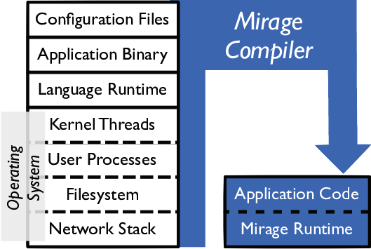
Unikernel
Link OS to application as a library
  Application and OS are a single entity
  OS Library:
    Abstractions to interface directly with hardware
    Policies to manage isolation in application
Very high performance
  Minimal and highly specialized abstractions
  No context switching
No protection!
  Application runs as the kernel
  Application has control over entire machine
Very low system utilization
  Only one application at a time can run on a machine

Slide 16
Unikernel use cases
Supercomputing / HPC
  Historically extreme scale HPC systems have run a single app at a time
    1990’s – early 2000’s
  Early OS’s could not scale
    Unikernels were adopted to “fill the gap”
  Fell out of favor as OSes (Linux) caught up
Cloud (Virtual Machines)
  Virtualization sparked a renaissance in unikernels
    Performance benefits without the costs
    Multiple virtualized unikernels can run on a single system
  Unikernels can actually increase cloud system utilization
    Why?

Slide 17
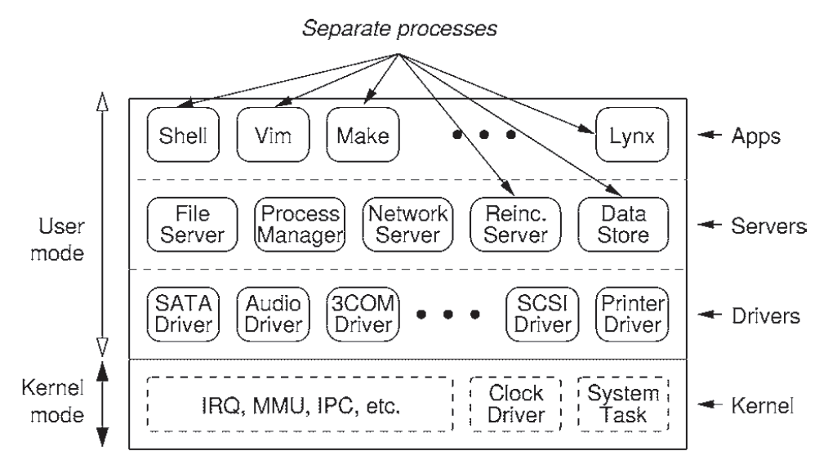
Microkernels
Minimalistic kernel
  Provide very few mechanisms
  Basic HW protection/isolation and IPC channels
Higher level abstractions implemented in user space as “servers”
  Clients request functionality from a specific server
  OS as a distributed system (designed by Tannenbaum)
Client-server communicate via message passing
  Performance depends on a very fast message passing mechanism (the most important OS mechanism)
  Why Message Passing for IPC?

Slide 18
Exokernels
A combination of micro- and uni- kernels
  Very small kernel provides basic HW protection
  No OS provided IPC mechanisms
  Applications provide own higher level services
Applications can choose their level of abstraction
  Implement their own services

Slide 19
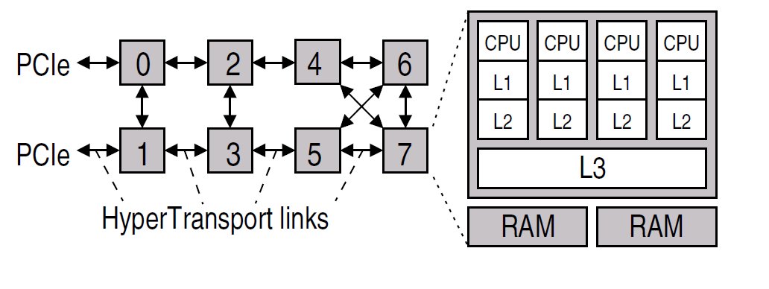
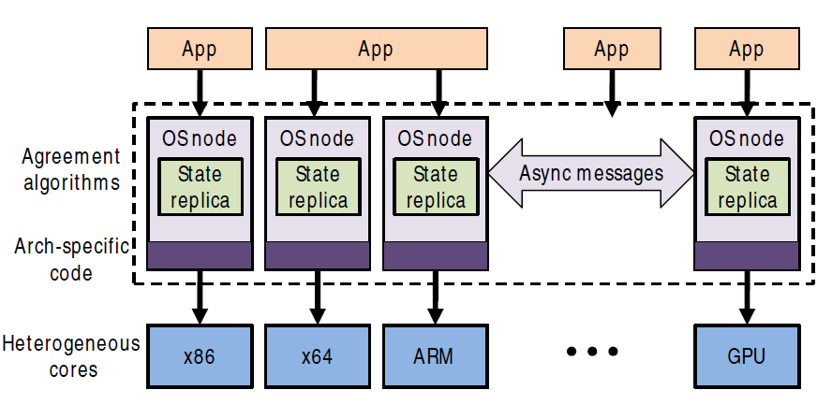
Multi-kernels
“Your computer is already a distributed system. Why isn’t your OS?”
Goal: Make microkernels scalable to modern systems
  Modern many-/multi-core systems are basically distributed systems
Distributed Operating System
  Communicate via asynchronous messages
    Shared memory doesn’t work in a distributed system
  Replicate state, but use messages to keep it consistent
  Support heterogeneous architectures

Slide 20
Lightweight kernels (LWKs)
Designed specifically for extreme scale HPC
  Large scale supercomputers in the upper ranks of the top 500 (http://www.top500.org)
Large scale, but small world
  Small number of applications
  Small number of application requirements
  Small number of systems
LWKs provide a stripped down OS environment
  Provide the OS features needed and nothing else
  “Leaky” microkernel
    Will provide functionality in OS when it makes sense
What is a Lightweight Kernel?
http://dl.acm.org/citation.cfm?id=2768414

Slide 21
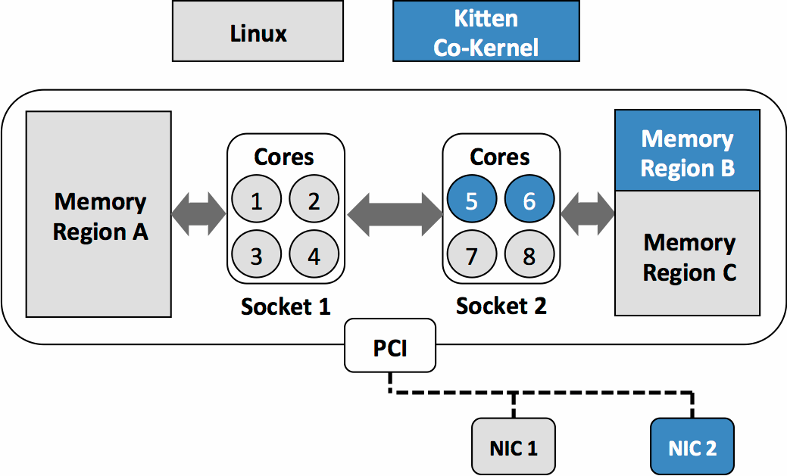
Lightweight Co-kernels
Fact: Programmers are lazy
  Everyone just wants to use Linux
  LWKs lack many Linux features (i.e. shells)
Co-kernels couple an LWK and a FWK (Linux) on the same machine
  Missing features in LWK can be provided by Linux
  Machine can be managed via Linux
  Applications can be launched onto an LWK partition
Best of both worlds
  Functionality of Linux
  Performance of an LWK for HPC Apps
  Non-interference between the two partitions

Slide 22
Hypervisors/VMMs
A Virtual Machine is a software version of the hardware state of a computer system
  An operating system running within a virtual machine is called a guest operating system

Slide 23
Virtual Machine Monitors (VMMs)
Virtual Machines run an OS as an application
  Implements hardware interface in software
Ways to build a VMM (Type 1 vs Type 2)
  Type 2: VMs run as apps in a native OS
    VMWare Player, KVM, VirtualBox
  Type 1: Hypervisor is the native OS
    No native apps, everything runs in a VM
    Xen, VMWare ES

Slide 24
Some References
Andrew Baumann, Simon Peter, Adrian Schüpbach, Akhilesh Singhania, Timothy Roscoe, Paul Barham, and Rebecca Isaacs. 2009. Your computer is already a distributed system. why isn't your OS?. In Proceedings of the 12th conference on Hot topics in operating systems (HotOS'09). USENIX Association, Berkeley, CA, USA, 12-12.
Avi Kivity, Dor Laor, Glauber Costa, Pekka Enberg, Nadav Har'El, Don Marti, and Vlad Zolotarov. 2014. OS^{v}: optimizing the operating system for virtual machines. In Proceedings of the 2014 USENIX conference on USENIX Annual Technical Conference (USENIX ATC'14), Garth Gibson and Nickolai Zeldovich (Eds.). USENIX Association, Berkeley, CA, USA, 61-72.
Simon Peter, Jialin Li, Irene Zhang, Dan R. K. Ports, Doug Woos, Arvind Krishnamurthy, Thomas Anderson, and Timothy Roscoe. 2014. Arrakis: the operating system is the control plane. In Proceedings of the 11th USENIX conference on Operating Systems Design and Implementation(OSDI'14). USENIX Association, Berkeley, CA, USA, 1-16.
Tanenbaum-Torvalds Debate (https://groups.google.com/forum/#!topic/comp.os.minix/wlhw16QWltI%5B1-25%5D)
Jorrit N. Herder, Herbert Bos, Ben Gras, Philip Homburg, and Andrew S. Tanenbaum. 2006. MINIX 3: a highly reliable, self-repairing operating system. SIGOPS Oper. Syst. Rev. 40, 3 (July 2006), 80-89. DOI=http://dx.doi.org/10.1145/1151374.1151391
J. Ouyang, B. Kocoloski, J. Lange and K. Pedretti,
Achieving Performance Isolation with Lightweight Co-Kernels,
Proceedings of the 24th International ACM Symposium on High Performance Parallel and Distributed Computing, (HPDC 2015)
J. Lange, K. Pedretti, T. Hudson, P. Dinda, Z. Cui, L. Xia, P. Bridges, M.Levenhagen, R. Brightwell, A. Gocke, S. Jaconette,
Palacios: A New Open Source Virtual Machine Monitor for Scalable High Performance Computing,
Proceedings of the 24th IEEE International Parallel and Distributed Processing Symposium, (IPDPS 2010)

