Slide 1

De La Briandais (DLB) Trees
Injung Kim
9/13/2019

Slide 2
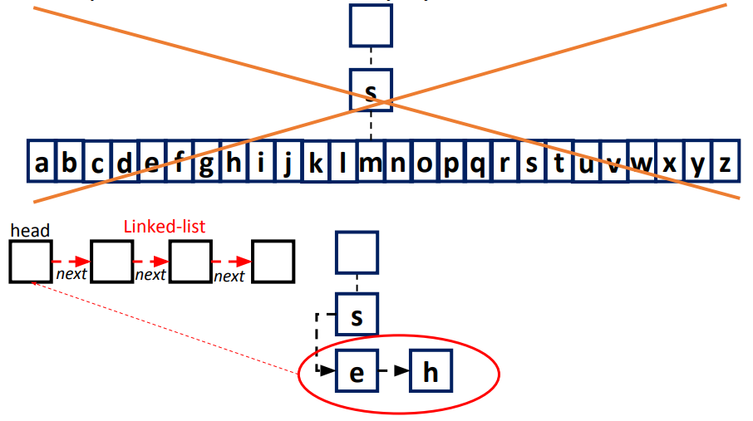
DLB
Replace the fixed link array by a flexible linked list

Slide 3
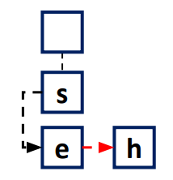
Trade off
+ Save a lot of space, especially when the real case has sparse strings
- Increase searching time. Why?
  R-way trie: Directly go to a child in the array
  DLB: linearly go the child in the linked list

Slide 4
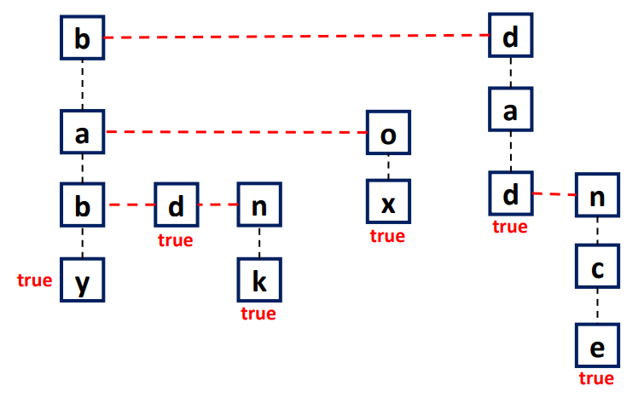
Create a tree for…
baby, bad, bank, box, dad, dance

Slide 5
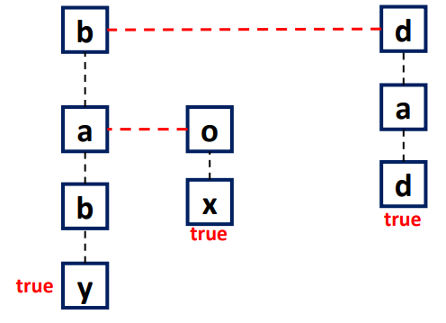
Delete words…
bad, bank, dance

Slide 6
Node structure
Char
Reference to sibling node
(same level)
Value (NULL / ‘^’)
Reference to child node
(next level)

