Slide 1
CS0004: Introduction to Programming
Relational Operators, Logical Operators, and If Statements

Slide 2
Review
Date literals are surrounded by…
  Number (pound) signs (#)
Some date functions
  Today
    Returns today’s date
  DateDiff(DateInterval.Day, date1, date2)
    Returns the number of days between date1 and date2 as an integer.
    See course webpage for different date intervals
  theDate.AddYears(n), theDate.AddMonths(n), and theDate.AddDays(n)
    Returns the date after adding n years, months, and days (respectively) to theDate.
  CDate(dateString)
    Typecasts the string dataString to a date data type
Input Dialog Box
  InputBox(prompt, title)
Output Dialog Box
  MessageBox.show(prompt, title)

Slide 3
Conditions
A condition is an expression involving relational operators that is either true or false.
  They may also include logical operators
Relational Operators – compare two entities. Return either True or False.
Logical Operators – combine two or more relational expressions. Return either True or False.
Conditions can involve both literals and variables.
With conditions we can make decisions about what we should execute based on input.
Conditions are used in both decisions and loops.

Slide 4
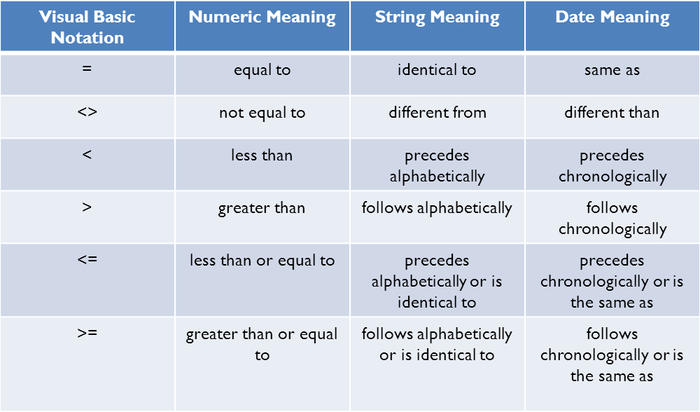
Relational Operators

Slide 5
Relational Operators
Examples:
  3 = 4
    Returns False, because 3 is not equal to 4
  3 <> 4
    Returns True, because 3 is not equal to 4
  “Apple” < “Orange”
    Returns true, because “A” comes before “O” alphabetically
  “apple” > “Orange”
    Returns True because “O” has a lower ASCII value than “a”
      What the computer actually does when comparing Strings is compare each character left to right by their ASCII values.
      ASCII values- numeric representation of characters
      See course webpage for ASCII numbers for characters
      Important Note: Capital letters have lower ASCII values then lowercase letters
  #12/16/1986# <= #2/8/2011#
    Returns True, because 12/16/1986 precedes 2/8/2011 chronologically
  #12/16/1986# <= #12/16/1986#
    Returns True, because 12/16/1986 is the same as 12/16/1986

Slide 6
Logical Operators
Three Logical Operators
  And, Or, and Not
Op1 | Op2 | Op1 And Op2
T | T | T
T | F | F
F | T | F
F | F | F
Op1 | Op2 | Op1 Or Op2
T | T | T
T | F | T
F | T | T
F | F | F
Op1 | Not Op2
T | F
F | T

Slide 7
Logical Operators
Examples:
  (2 < 3) And (4 < 6)
    Returns True
  (2 < 3) And (4 > 6)
    Returns False
  (2 < 3) Or (4 > 6)
    Returns True
  (2 > 3) Or (4 > 6)
    Returns False
  Not (2 > 3)
    Returns True
  Not (2 < 3)
    Returns False

Slide 8
Boolean Data Type, Boolean Methods, and a Boolean Function
You have variables store the result of a condition by using the Boolean data type.
Dim boolVar As Boolean
Boolean variables can take the values of True or False (both are keywords in VB)
There are a couple pre-defined helpful boolean string functions (Assume strVar and strVar2 are both string variables)
  strVar.EndWith(strVar2)
    Returns True is strVar ends with strVar2
  strVar.StartsWith(strVar2)
    Returns True is strVar starts with strVar2
  isNumeric(strVar)
    Returns True if strVar is a string of a number

Slide 9
If Statements
An if statement allows a program to decide on a course of action based on whether a condition is True or False
General Form
If condition Then
some code
End If
If the condition is true then some code will execute, otherwise it won’t
There is also an if/else statement
If condition Then
some code
Else
some other code
End If
If the condition is true then some code will execute, otherwise some other code will execute
After the End If, the program continues normally.

Slide 10
If Statement Example
New Topics:
  Variable Scoping
  Random Numbers
    Rnd() function
  Single Data Type
    Can hold only half the numbers Double can
  Event procedures calling other event procedures
  Relational Operators
  Logical Operators
  If/Else Statement

Slide 11
Nested If Statements
You can put if statements in other if statements. This is called nesting.
If condition Then
If condition2 Then
some code
End If
Else
some different code
End If
If condition is false some different code will be executed, if condition is true AND condition2 is true then some code will be executed.

Slide 12
Nested If Statement Example
New Topics:
  Boolean Function: isNumeric
  Nested If Statement

Slide 13
ElseIf Clauses
You can check for multiple conditions in the same if statement using ElseIf clauses.
If condition Then
some code
ElseIf condition2 Then
some other code
ElseIf condition3 Then
yet some more code
Else
even more code
End If
some code will execute if condition is true, some other code will execute if condition2 is true, yet some more code will execute if condition3 is true, and even more code will execute if none of the above are true.

Slide 14
ElseIf Clause Example
New Topic:
  Generating Random Integers
  ElseIf Clauses

