Slide 1
Facilitating Discourse Analysis with Interactive Visualization
Wei Guo

Slide 2
Overview
Background
Discourse Parser
Discourse Analysis
Existing Visualization Methods
DAViewer
Interface
Methodology
Use case scenarios

Slide 3
Background
discourse parser:
a natural language processing system which can represent the organization of a document based on a rhetorical structure tree—one of the key data structures enabling applications such as text summarization, question answering and dialogue generation.

Slide 4
Background
Discourse Analysis:
RST frame work: Rhetorical Structure Theory
EDUs: Elementary discourse units
Rhetorical relation
Nucleus / Satellite
Notes:
Discourse analysis in the NLP community is mostly driven by the RST framework. In RST, the discourse structure is a binary tree built from non-overlapping text chunks called elementary discourse units (EDUs).
The EDUs are segmented from the text document, and serve as the leaves of the discourse tree.
Then the discourse parsing algorithm successively combines EDUs to create internal nodes, each of which corresponds to a rhetorical relation between its branches (e.g., Attribution, Cause, etc. 18 relations in this research).
Under each relation, the children can be either nucleus or satellite. With respect to the parent relation, the text associated with a nucleus branch is considered more prominent or important than the text associated with a satellite branch.

Slide 5
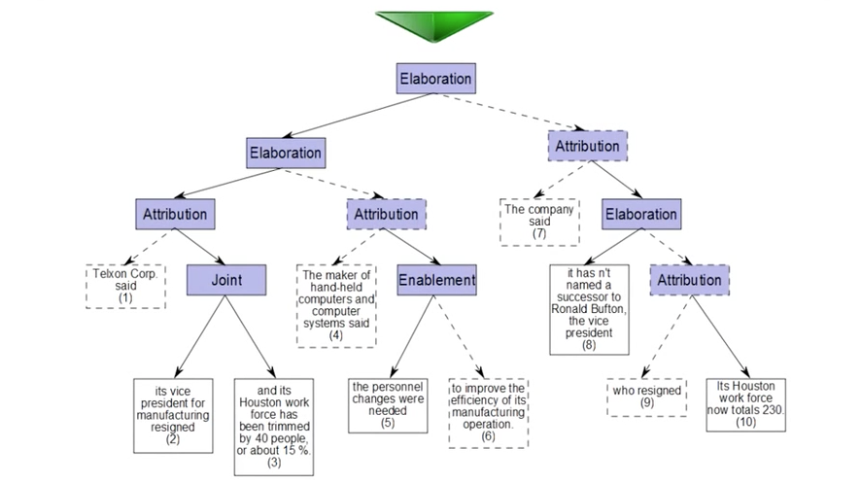
Background
Discourse Analysis:
RST frame work: Rhetorical Structure Theory
EDUs: Elementary discourse units
Rhetorical relation
Nucleus / Satellite
Notes:
This shows a typical rendering of a discourse tree, generated over the text of an article:
rhetorical relations shown in purple-filled boxes,
EDUs depicted with white boxes labeled with sequence numbers
Solid indicate the branch (or EDU) is nucleus
dashed lines indicate the branch (or EDU) is satellite.

Slide 6
Background
Q1 At a given intermediate level in the discourse tree, is the text separated into meaningful groups (chunks)? Do the nucleus branches capture the prominent content of the text?
Q2 Where are the errors in the generated discourse tree? Do errors at low levels propagate to upper levels of the tree structure?
Q3 What are the structural differences between branches generated by two parsing algorithms over the same EDUs?
Q4 Does the algorithm generate common parsing structures (or errors) across all the documents in the corpus?
Q5 How consistently does each algorithm perform across documents in the corpus? Which types of documents are more problematic?
Notes:
The generation of highly accurate discourse structures over a text document remains an open research question in NLP. Linguists are interested in answering the following questions:

Slide 7
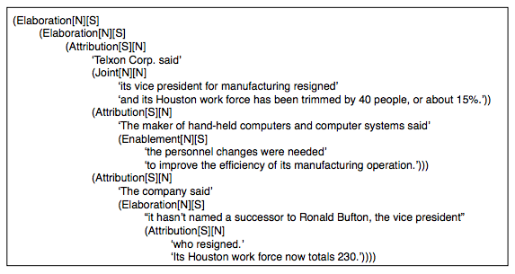
Background
indented text encoding the tree structure
Notes:
With the lack of efficient visualization systems to address their needs, linguists struggle to answer such questions effectively, as they are currently working with a collection of indented text encoding the tree structure

Slide 8
Challenges
Accurate discourse analysis remains a challenge due to the complex and nuanced nature of language
Computational linguistics researchers currently rely on manually exploring and comparing the discourse structures to get intuitions for improving parsing algorithms.

Slide 9
Background
Existing Visualization Method:
Side-by-side views
Merged views
Animation
Notes:
Side-by-side views can be based on visual cues to convey the relationships. Explicit links can be drawn between the matched nodes, and the alpha channel of the links tuned to indicate the similarity measure between the corresponding branches, as for example in the syntax trees by Chevalier et al. [6]. However, such an explicit linking can lead to a cluttered view due to the numerous lines. Side-by-side views can leverage interaction through dynamic queries: for instance, TreeJuxtaposer [22] allows the user to interactively visualize similar subtree structures by highlighting a query pattern. A system particularly related to our work was developed by Bremm et al. [2] for the comparison of phylogenic trees. In that work, several visualization techniques are combined as coordinated views, including a tabular view of the trees of interest and a similarity matrix view indicating similarity scores between the trees of the dataset.

Slide 10
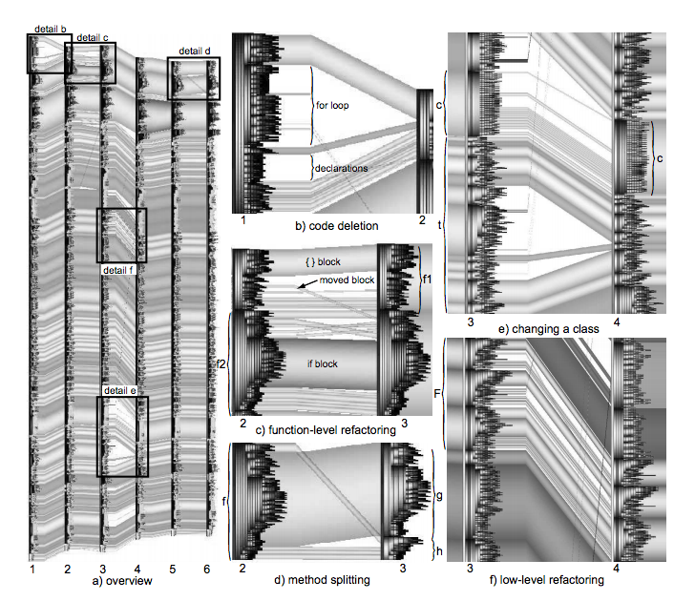
Background
Existing Visualization Method:
1. Side-by-side views based on visual cues to convey the relationships
Notes:
Side-by-side views can be based on visual cues to convey the relationships.
Explicit links can be drawn between the matched nodes, and the alpha channel of the links tuned to indicate the similarity measure between the corresponding branches, as for example in the syntax trees by Chevalier et al. [6]. However, such an explicit linking can lead to a cluttered view due to the numerous lines.
Figure 4 a shows a visualization of six versions of one file containing about 1500 lines.
Node colors indicate syntax construct types.
Edges have the colors of the matched nodes they connect.

Slide 11
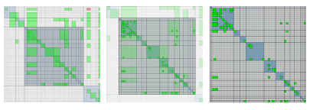
Background
Existing Visualization Method:
1. Side-by-side views based on visual cues to convey the relationships
2. Merged views
Notes:
An alternative to side-by-side views is to use merged views in which two trees are combined in a single visualization that encodes the differences. Similarity matrices fall into this category. The nodes of the trees to compare correspond to rows and columns, and the cells of the matrix indicate the similarity between the nodes.
Van Ham [30] uses such an approach for software analysis.
These techniques constitute a powerful and space-efficient way for comparing the different nodes with one another. This is, however, to the detriment of making the hierarchical structure apparent.

Slide 12
Background
Existing Visualization Method:
1. Side-by-side views based on visual cues to convey the relationships
2. Merged views
3. Animation
Notes:
Use animations to convey changes between two different trees are also a main stream approach.
However, users may lose track of the overall difference since the positions of many nodes are varying during the animation.
While animations can help keep track of changes while smoothly transitioning between trees, only one of the tree is visible at any given time, making comparison difficult.

Slide 13
DAViewer
An interactive visualization tool for computational linguists to visually explore, compare, evaluate, and annotate automatically generated discourse structures
Allowing linguists researchers to: verify hypothesis, discover insights, and obtain intuitions for new algorithms.

Slide 14
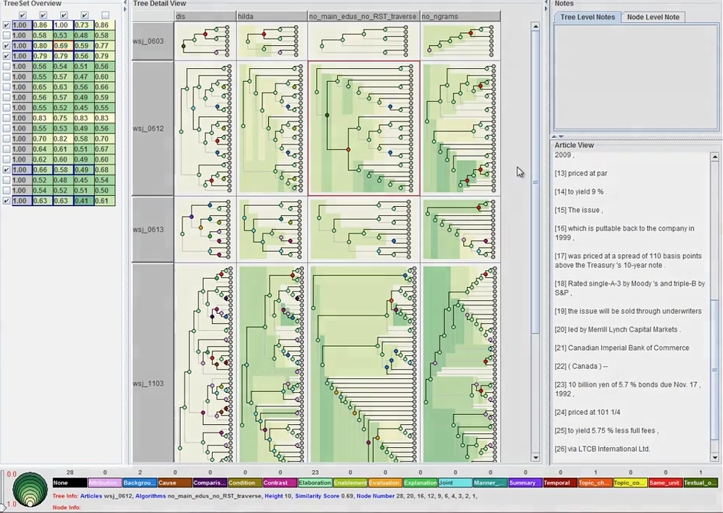
Notes:
An overview of the entire dataset
A detailed view showing selected discourese trees
An information panel,
An article view showing the associated text
An notation panel.
The interface of DAViewer is comprised of: (a) an overview which displays the overall performance of all the parsers over all the documents in the dataset, (b) a detail panel which visualizes the discourse tree structures of the focused algorithms and documents as node-link or icicle dendrograms (see [1]), (c)a status panel which provides the basic properties of the currently selected items as well as an interactive legend for filtering operations, (d) an annotation panel which allows users to edit notes, (e) a text panel which shows the content of the active document as parsed by the focused algorithm, and (f) a search window which for querying based on keyword and structure over the data in the detail panel.

Slide 15
Methodology
User-centered design process
Four stages of design process:
Problem identification and quick prototyping
Initial implementation with core functionality
Refined prototype
System release and field test
Notes:
A standard user-centered design process is followed in DAViewer design, including 2 experts: an expert in both computational linguistics and visual design.
Through a regular consultation with two experts, this paper gathered an refined list of requirements.

Slide 16
Methodology
Design Requirements
R1 Discourse tree representation.
R2 Errors, distributions and statistical information.
R3 Article views and textual contexts.
General requirements: dynamic queries, visual consistancy, flexible data management, and annotation.
Notes:
Through the iterative process with our expert users, they learned a lot about the process of research to improve discourse analysis.
Gathered from and validated by our observations, and in response to the questions linguists are interested in, they defined the following specific design requirements for analytic tools to support discourse analysis.
R1:
Experts explicitly requested that the core visualization resemble the representation they currently use for analysis of the parsing structure. In particular, immutable constraints are the presentation of leaf nodes in the same order as the associated text chunks appear in the document, and the explicit visual encoding of nodes’ type (satellite or nucleus) and relation.
R2:
In order to gain better intuitions for designing new algorithms, linguists must discover the pros and cons of different parsers. Statistical information, such as the distribution of relationship types appearing in a tree or the similarity scores assigned to branches of the tree should be readily available, as they provide an important overview of the discourse structure and performance of the parsers.
R3:
In order to observe whether the parsing algorithm groups EDUs into meaningful units when building the discourse tree, it is important to be able to see how EDUs are grouped under a relation. At any level of a discourse tree, the tool should support separating the source text into proper chunks (groups of EDUs) according to the branching pattern. It is also important to be able to view the text of individual EDUs in isolation. Finally, to support close reading of the documents under analysis, a standard paragraph-based layout of the document should be supported.
In addition to the above requirements, the visual exploration tool should support general requirements including dynamic queries such as filtering and querying, to allow for a focused attention on specific types of relations or structural patterns (R4), and which effect should instantaneously be reflected in all of the coordinated views to guarantee visual consistency across the different visualization components for a fluid and effective exploration (R5); flexible data management, to assist researchers to do long-term progressive research during which the datasets may expand (R6); and finally, annotation, to support documentation of the findings for future reference (R7).

Slide 17
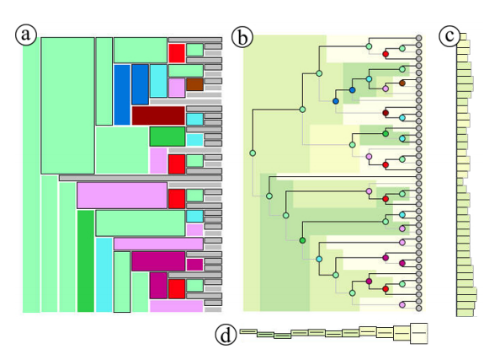
Discourse Tree Representations
1. Expanded Views
(a) icicle plot view, (b) dendrogram view, (c) vertical compact view, and (d) horizontal compact view.
Notes:
The author designed two main types of representations to visualize the discourse trees: expanded views
(a) icicle plot view: an adapted version of the icicle plot imported from other paper.
(b) dendrogram view: a branching node-link diagram particularly suited to reflect relationships (Figure 3b)
In both representations, the nodes are colour-coded according to the assigned relation label. The hue of the links between the nodes and their parent relation indicates the nuclearity of the children Fig. 3. In the icicle, the colour of the outline of the children node indicates this property.
Showing the errors: In order to inspire the development of improved parsing algorithms, it is essential for linguists to develop a good understanding of the specific flaws of the existing algorithms compared to the gold standard. In particular, our experts are interested in identifying precisely which step(s) of the greedy bottom-up process fail, and to what extent such errors have an impact on the steps that follow (Q2). To facilitate such analysis, dendrogram is designed where nodes are colour-coded according to the similarity scores of the internal nodes using a yellow-to-green palette. This dendrogram is used as a background on top of which the node-link dendrogram is overlaid (Figure 3b), thus serving as a heatmap where errors are made more salient because of the darker colour.

Slide 18
Discourse Tree Representations
2. Compact Views
(a) icicle plot view, (b) dendrogram view, (c) vertical compact view, and (d) horizontal compact view.
Notes:
When many trees have to be compared, as it is the case for our users, space limitation can become an issue.
Therefore, authors of this paper designed two new compact representations of the discourse trees: a vertical (Figure 3c) or horizontal (Figure 3d) informative representation that summarizes important characteristics of the compacted discourse trees (R2).
Vertical compact view.
In this view, each bin corresponds to a leaf node, i.e., an EDU.
The width of a bin encodes the depth of its associated leaf in the tree
The colour of a bin is mapped to the average similarity score of its corresponding leaf node
Hence, the compact representation conveys the average error an EDU contributes across the levels.
For example, a wide dark bin indicates an early grouped EDU whose initial error strongly impacts all its upper levels.
Horizontal compact view. In this view, each bin corresponds to a level of the compacted tree. The height of a bin encodes the number of nodes at the associated level. The colour is mapped to the average similarity score of the set of nodes.
Hence, the compact representation allows a viewer to identify at which stage of the clustering process the algorithm starts to fail and whether such errors propagate to upper levels or not.

Slide 19
Notes:
An overview of the entire dataset
A detailed view showing selected discourese trees
An information panel,
An article view showing the associated text
An notation panel.
The interface of DAViewer is comprised of: (a) an overview which displays the overall performance of all the parsers over all the documents in the dataset, (b) a detail panel which visualizes the discourse tree structures of the focused algorithms and documents as node-link or icicle dendrograms (see [1]), (c)a status panel which provides the basic properties of the currently selected items as well as an interactive legend for filtering operations, (d) an annotation panel which allows users to edit notes, (e) a text panel which shows the content of the active document as parsed by the focused algorithm, and (f) a search window which for querying based on keyword and structure over the data in the detail panel.

Slide 20
Notes:
An overview of the entire dataset
A detailed view showing selected discourese trees
An information panel,
An article view showing the associated text
An notation panel.
The interface of DAViewer is comprised of: (a) an overview which displays the overall performance of all the parsers over all the documents in the dataset, (b) a detail panel which visualizes the discourse tree structures of the focused algorithms and documents as node-link or icicle dendrograms (see [1]), (c)a status panel which provides the basic properties of the currently selected items as well as an interactive legend for filtering operations, (d) an annotation panel which allows users to edit notes, (e) a text panel which shows the content of the active document as parsed by the focused algorithm, and (f) a search window which for querying based on keyword and structure over the data in the detail panel.

Slide 21
Notes:
An overview of the entire dataset
A detailed view showing selected discourese trees
An information panel,
An article view showing the associated text
An notation panel.
The interface of DAViewer is comprised of: (a) an overview which displays the overall performance of all the parsers over all the documents in the dataset, (b) a detail panel which visualizes the discourse tree structures of the focused algorithms and documents as node-link or icicle dendrograms (see [1]), (c)a status panel which provides the basic properties of the currently selected items as well as an interactive legend for filtering operations, (d) an annotation panel which allows users to edit notes, (e) a text panel which shows the content of the active document as parsed by the focused algorithm, and (f) a search window which for querying based on keyword and structure over the data in the detail panel.

Slide 22
Notes:
An overview of the entire dataset
A detailed view showing selected discourese trees
An information panel,
An article view showing the associated text
An notation panel.
The interface of DAViewer is comprised of: (a) an overview which displays the overall performance of all the parsers over all the documents in the dataset, (b) a detail panel which visualizes the discourse tree structures of the focused algorithms and documents as node-link or icicle dendrograms (see [1]), (c)a status panel which provides the basic properties of the currently selected items as well as an interactive legend for filtering operations, (d) an annotation panel which allows users to edit notes, (e) a text panel which shows the content of the active document as parsed by the focused algorithm, and (f) a search window which for querying based on keyword and structure over the data in the detail panel.

Slide 23
Notes:
An overview of the entire dataset
A detailed view showing selected discourese trees
An information panel,
An article view showing the associated text
An notation panel.
The interface of DAViewer is comprised of: (a) an overview which displays the overall performance of all the parsers over all the documents in the dataset, (b) a detail panel which visualizes the discourse tree structures of the focused algorithms and documents as node-link or icicle dendrograms (see [1]), (c)a status panel which provides the basic properties of the currently selected items as well as an interactive legend for filtering operations, (d) an annotation panel which allows users to edit notes, (e) a text panel which shows the content of the active document as parsed by the focused algorithm, and (f) a search window which for querying based on keyword and structure over the data in the detail panel.

Slide 24
Articles
Parser
Notes:
5 parsers
18 articles
90 parse trees in total

Slide 25

Notes:
First column is the gold standard, discourse tree is labeled manually by linguists
The remaining columns as parses A->D
The overall similarity is calculated by using the distance from A to D for each article. These scores are shown in colors from yellow to green color scale in the background.
More yellow means more similar to the gold standard
When a user selects a tree, it is highlighted with red outline, and then the detail will be shown in the tree detail view and information panel.

Slide 26
Formative study
Goal:
1. Evaluate the overall acceptance and usability of DAViewer as an analytical tool assisting computational linguists in their research progress
2. Investigating the patterns of use of different interaction and visualization components

Slide 27
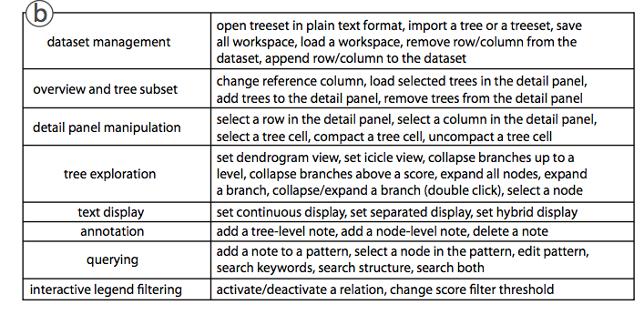
Formative study
39 operations, 8 higher level categories, are collected.

Slide 28
Usability and Satisfaction
DAView offered significant benefits for analyzing the outputs of discourse parsing algorithms:
“It is great to have all the [discourse] trees available and see them visually. I can print [trees] in text files and look at them all day long, but never found it could be that clear and easy with the visual representations.”
“The collapsed views are very handy, because sometimes I just want an overall comparison, not the deep deep details,” and reported to be highly satified with the GUI design and interactions that she found to be “handy and straightforward”.
DAViewer proved to be very efficient to our users as it greatly increased their productivity:
“I used to draw trees by hand according to the output text files, so I could only compare 2 or 3 trees at the time and they are basically simple trees around 5 levels. With DAViewer I can compare many large trees efficiently. All trees are nicely aligned and the interactions allow me to focus on subtrees easily.”
“For the same data, now I can spot the [tree structure] differences in 2 seconds by observing the [similarity] score heatmap.
Other valuable functions for our user were the searching and filtering capabilities, especially the structure-based query.
“I used to insert debug code inside the parsers, for a verbose output, but it is tedious and almost impossible to find patterns. Now, I can do it visually by just creating what I need and clicking a button.”

Slide 29
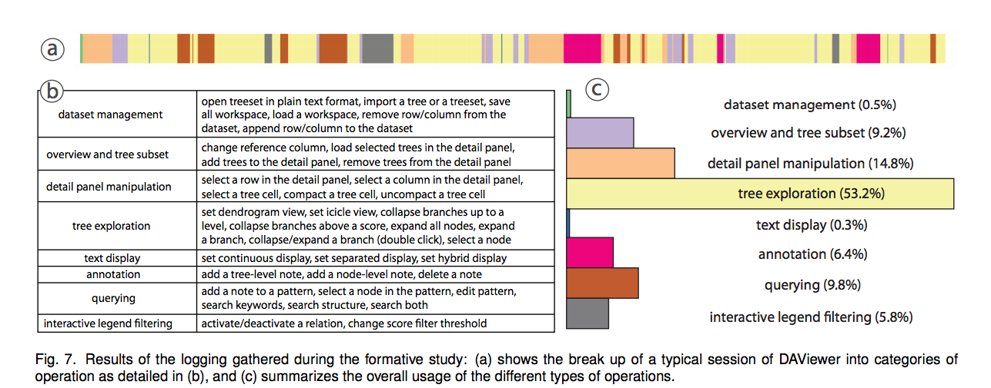
Pattern of Usage

Slide 30
Future Work
Color usage
Branch size
Rhetorical structure
Interactive control

