Slide 1
PEGASUS: A PETA-SCALE GRAPH MINING SYSTEM
PRESENTER : ANURADHA KULKARNI

Slide 2
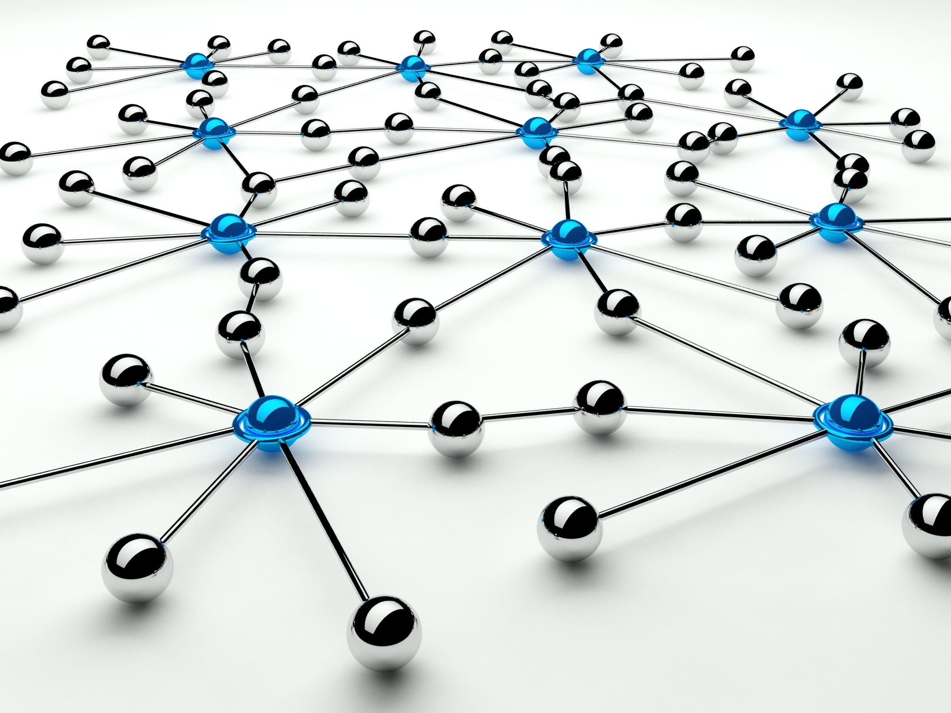
CONTENT
Background
PEGUSUS
PageRank Example
Performance and Scalability
Real World Applications

Slide 3

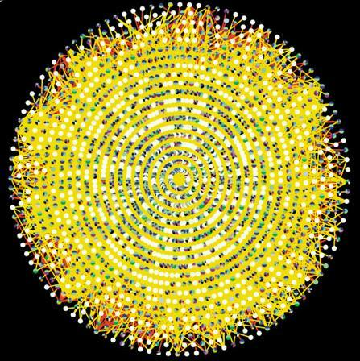
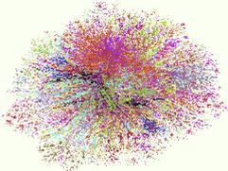
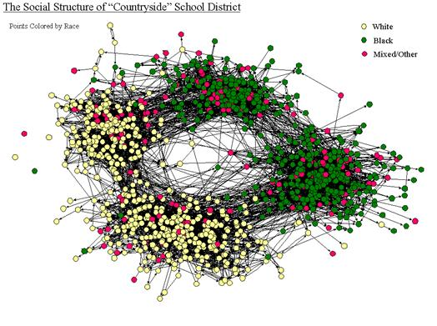

Why GRAPHS?
Internet Map [lumeta.com]
Social Networking
Sites
Protein Interactions [genomebiology.com]
D₁
T₁
...
...
D_{N}
T_{M}
Friendship Network [Moody ’01]
IR : BI-PARTITE
GRAPHS
WEB: HYPER TEXT
LINK

Slide 4
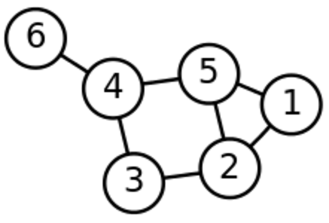
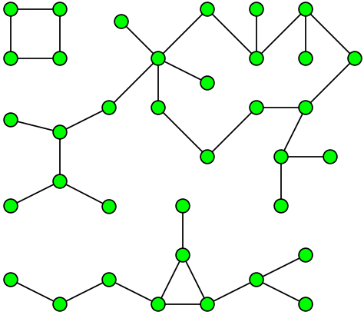

BACKGROUND
What is Graph Mining ?
… is an area of data mining to find patterns, rules, and anomalies of graphs
…graph mining tasks such as PageRank, diameter estimation, connected components etc.

Slide 5
BACKGROUND
What is the problem?
Why is it important?
Large volume of available data
Limited scalability
Rely on a shared memory model
- limits their ability to handle large disk-resident graph
Graphs or networks are everywhere
We must find graph mining algorithms that are faster and can scale up to billions of nodes and edges to tackle real world applications

Slide 6
PEGASUS
Based on Hadoop
Handling graphs with billions of nodes and edges
Unification of seemingly different graph mining tasks
Generalized Iterated Matrix-Vector multiplication(GIM-V)

Slide 7
PEGASUS
Linear runtime on the numbers of edges
Scales up well with the number of available machines
Combination of optimizations can speed up 5 times

Slide 8
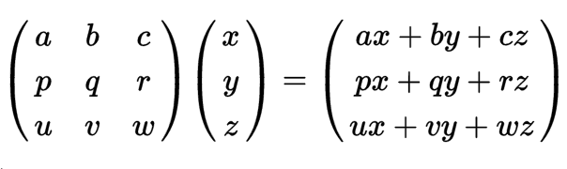
GIM-V
Generalized Iterated Matrix-Vector multiplication
Main idea
Matrix-Vector Multiplication
Three operations
n by n matrix M, vector v of size n, m_{i,j} denote the (i,j) element of M
Combine2: multiply m_{i,j}, and v_{j}
CombineAll: sum n multiplication results for node i
Assign: overwrite previous value of v_{i} with new result to make v_{i}’

Slide 9
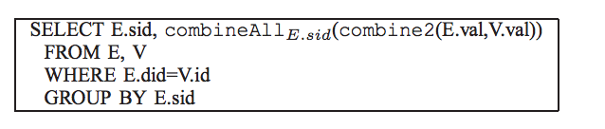
GIM-V
Main idea
Operator X_{G}, where the three functions can be defined arbitrarily
where v_{i}’=assign(vi, combineAll_{i} ({x_{j}|j=1…n, and x_{j}=combine2(m_{i,j}, v_{j})}))
Three functions
Strong connection of GIM-V with SQL
Combine2(m_{i,j},v_{j}), CombineAll(x₁,…,x_{n}), Assign(v_{i},v_{new})

Slide 10
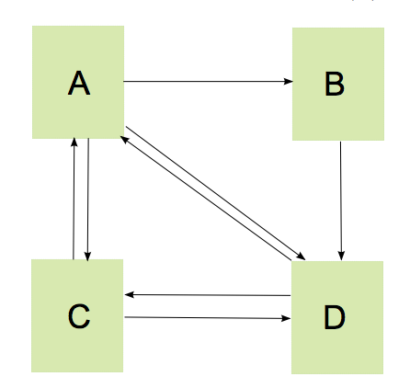
Eample1. PageRank
PageRank: calculate relative importance of web pages
Main idea
Formula

Slide 11
Eample1. PageRank
Three operations
Combine2(m_{i,j},v_{j}) = c x m_{i,j} x v_{j}
CombineAll(x₁,…,x_{n}) =
Assign(v_{i},v_{new}) = v_{new}

Slide 12
GIM-V Base: Naïve Multiplication
How can we implement a matrix by vector multiplication in MapReduce?
Stage1: performs combine2 operation by combing columns of matrix with rows of vector.
Stage2: combines all partial results from stage1 and assigns the new vector to the old vector.

Slide 13
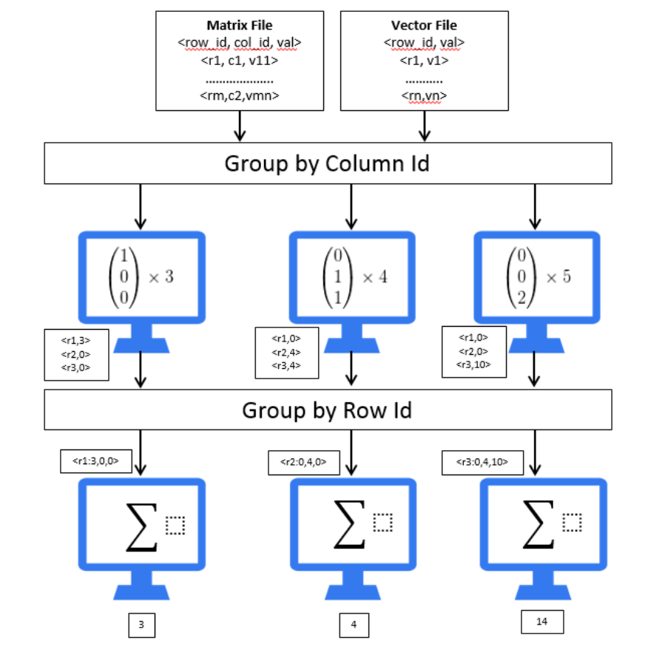
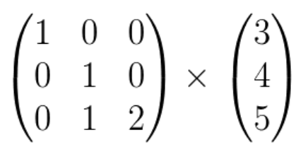
Stage 1
Stage 2
Distribution of work among machines during GIM-V execution

Slide 14
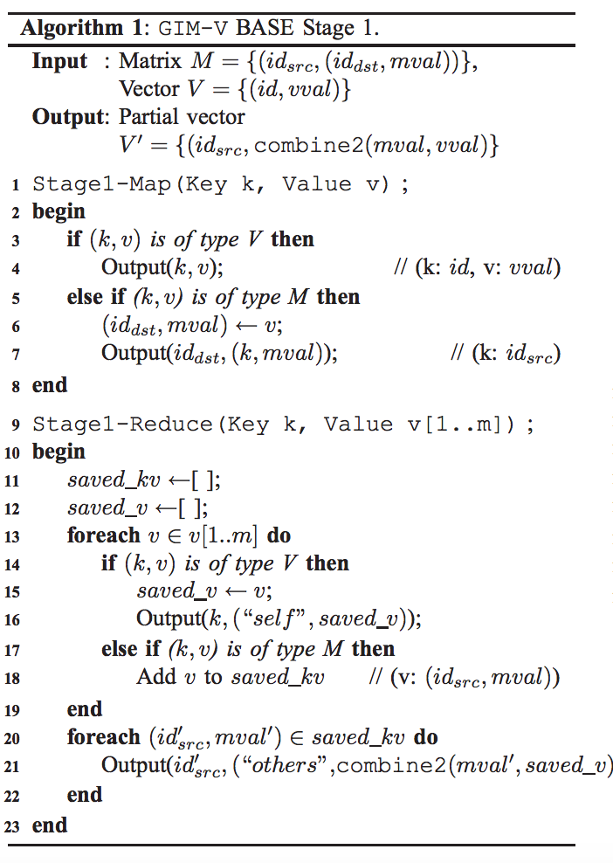
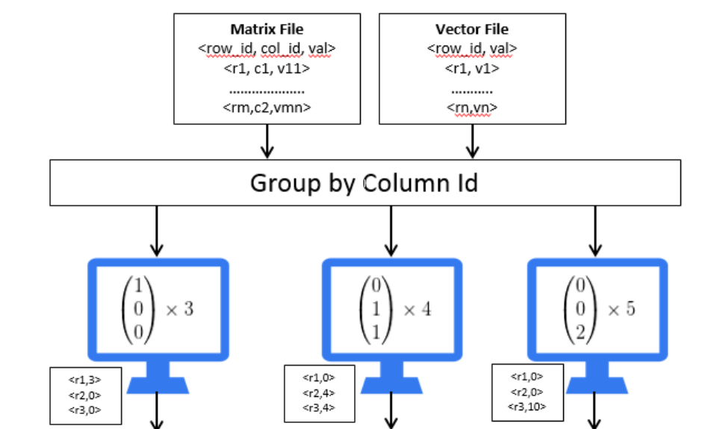

Slide 15
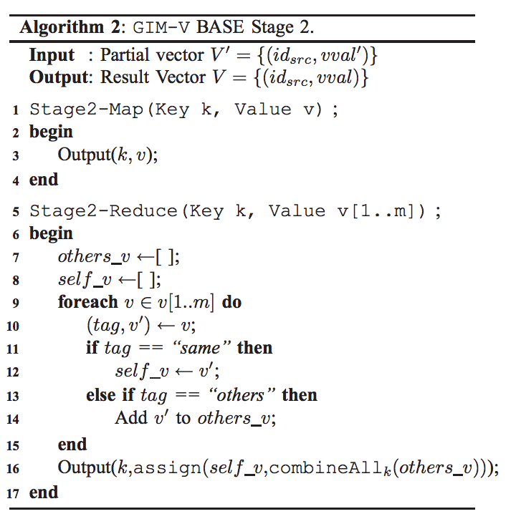
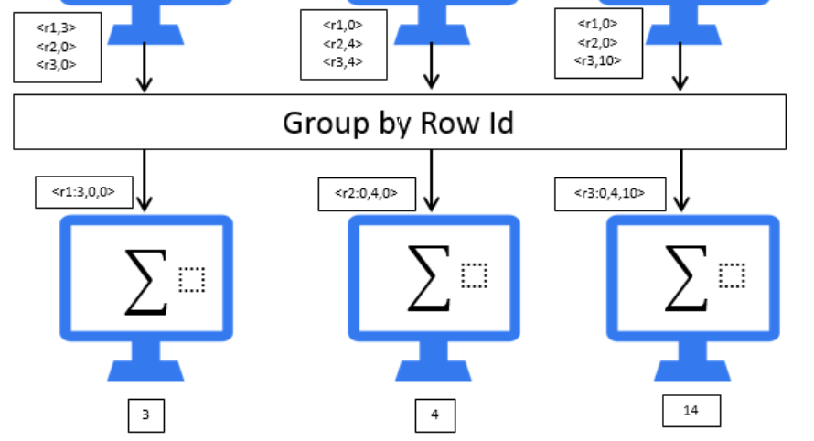
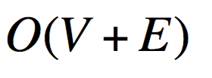
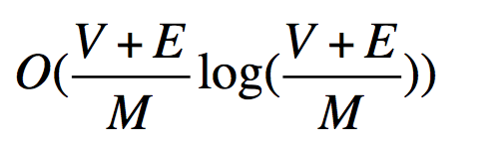

Slide 16
Example 2. Connected Components
Main idea- finding connected components in large graph
Formula
Three operations
Combine2(m_{i,j},v_{j}) = m_{i,j} x v_{j}
CombineAll(x₁,…,x_{n}) = MIN{X_{j} | j=1…n}
Assign(v_{i},v_{new}) = MIN(v_{i}, v_{new)}

Slide 17
Example 3. RANDOM WALK WITH RESTART
Main idea- measure proximity of nodes in graph
Three operations
Combine2(m_{i,j},v_{j}) = c x m_{i,j} x v_{j}
CombineAll(x₁,…,x_{n}) = (1-c)I(i !=k)+ {X_{j} | j=1…n}
Assign(v_{i},v_{new}) = v_{new}

Slide 18
Example 3. DIAMETER ESTIMATION
Main idea- estimate diameter and radius of large graphs
Three operations
Combine2(m_{i,j},v_{j}) = m_{i,j} x v_{j}
CombineAll(x₁,…,x_{n}) = BITWISE-OR {X_{j} | j=1…n}
Assign(v_{i},v_{new}) = BITWISE-OR(v_{i},v_{new})

Slide 19
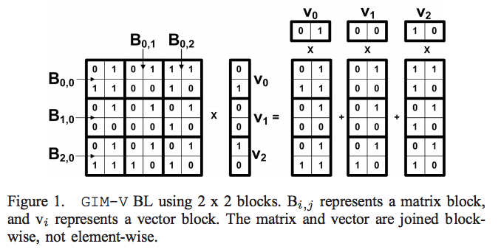
Fast Algorithm for GIM-V
GIM-V BL: Block Multiplication
Main idea: Group elements of the input matrix into blocks of size b by b. Elements of the input vectors are also divided into blocks of length b

Slide 20
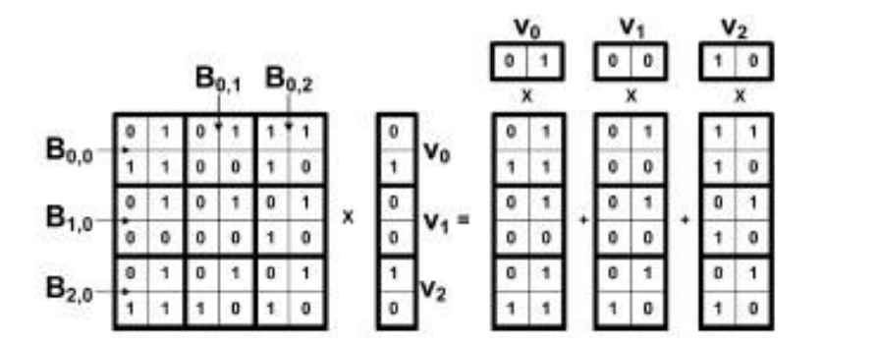
Only blocks with at least one non-zero element are saved to disk
More than 5 times faster than GIM-V Base since
The bottleneck of naïve implementation is the grouping stage which is implemented by sorting. GIM-BL reduced the number of elements sorted. [shuffling stage of HADOOP]
E.g. 36 elements are sorted before, 9 elements sorted now
Compression – the size of the data decreases significantly by converting edges and vectors to block format, which speeds up as fewer I/O operations are needed

Slide 21
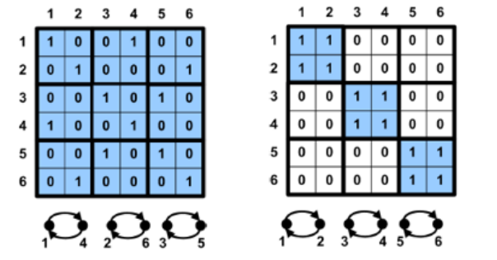
Fast Algorithm for GIM-V
GIM-V CL: Clustered Edges
Main idea: Clustering is a pre-processing step which can be ran only once on the data file and reused in the future. This can be used to reduce the number of used blocks.
Only useful when combined with block encoding.

Slide 22
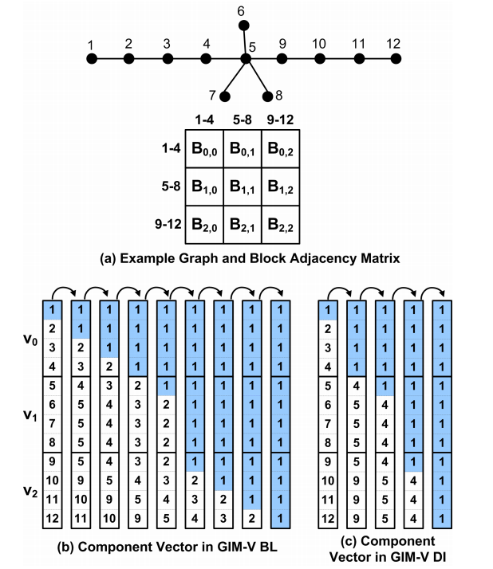
Fast Algorithm for GIM-V
GIM-V DI: Diagonal Block Iteration
Main idea: Reduce the number of iterations required to converge.
In HCC, (algorithm for finding connected component),the idea is to multiply diagonal matrix blocks and corresponding vector blocks until
the contents of the vector don’t
change in one iteration.

Slide 23
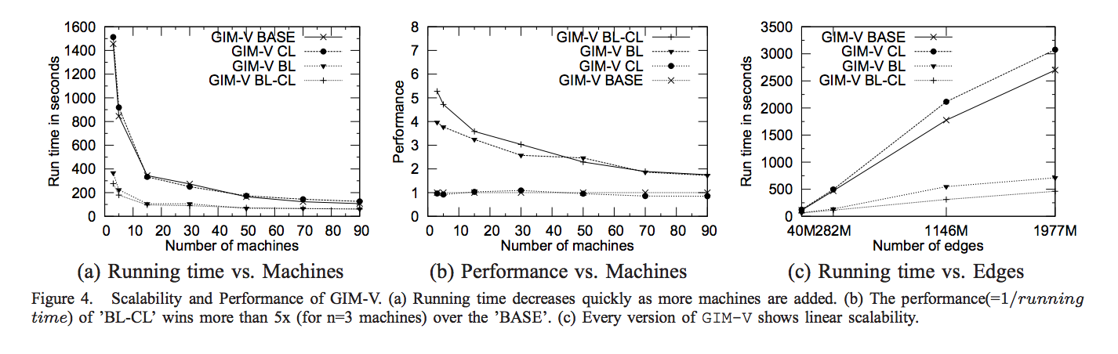
Performance and Scalability
How the performance of the methods changes as we add more machines?

Slide 24
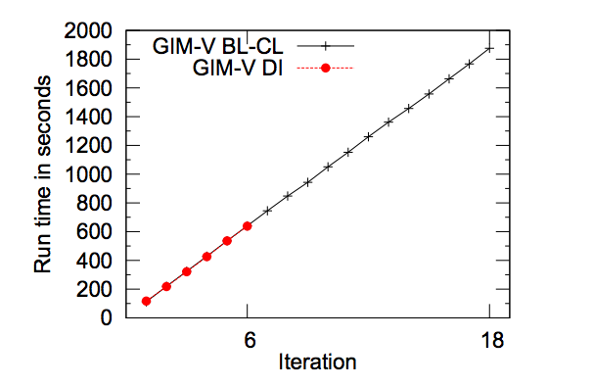
Performance and Scalability
GIM-V DI vs. GIM-V BL-CL for HCC

Slide 25
Real World Applications
PEGASUS can be useful for finding patterns, outliers, and interesting observations.
Connected Components of Real Networks
PageRanks of Real Networks
Diameter of Real Networks

Slide 26
INSTALLATION:ENVIrONMENT
PEGASUS needs the following software's to be installed in the system:
Hadoop 0.20.1 or greater
Apache Ant 1.7.0 or greater
Java 1.6.x or greater, preferably from Sun
Python 2.4.x or greater
Gnuplot 4.2.x or greater

Slide 27
USE PEGASUS FOR MINING LARGE GRAPHS
PEGASUS supports an interactive shell so that users can manage graphs, run algorithms, and generate plots.
To access the shell, type pegasus.sh in the PEGASUS installation directory.
Then, the PEGASUS shell will appear. For available commands in the shell, type help.

Slide 28
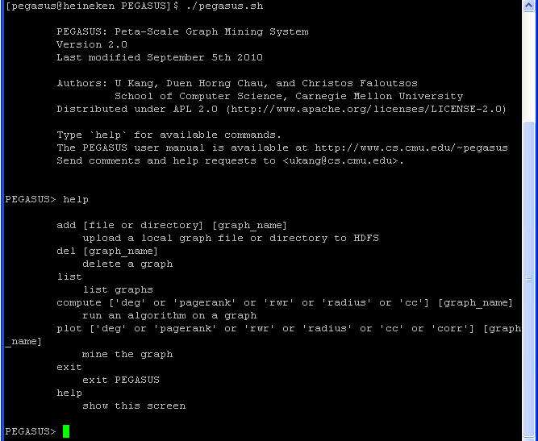
USE PEGASUS FOR MINING LARGE GRAPHS

Slide 29
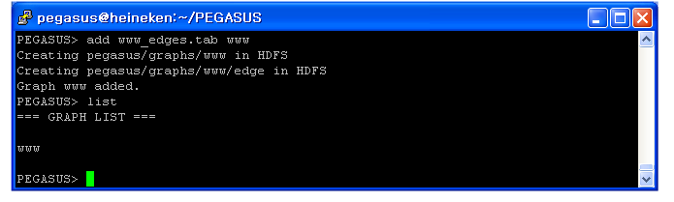
MANAGING GRAPHS
The graphs to be analyzed should be uploaded to the Hadoop File System (HDFS).
In the shell, the add command is used for uploading a graph to HDFS.
To add a local edge file 'www_edges.tab' to HDFS and name it to 'www', issue the following command:
add www_edges.tab www
View the list of the current graphs by the list command.

Slide 30
RUNNING ALGORITHMS: PAGE RANK
Command:
compute pagerank [graph_name]
Additional parameters:
the number of nodes in the graph
the number of reducers
whether to symmetrize the graph. (sym or nosym)

Slide 31
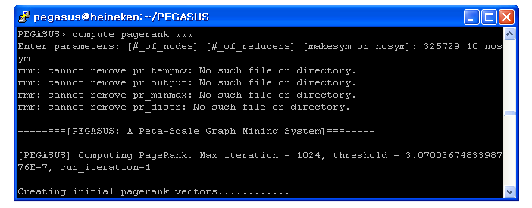
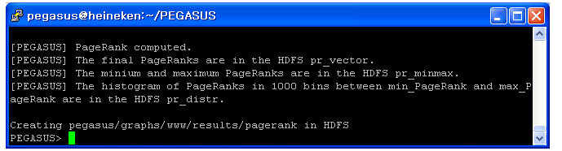
RUNNING ALGORITHMS: PAGE RANK

Slide 32
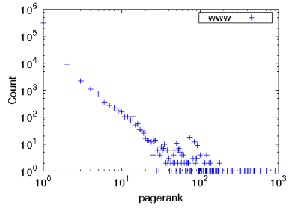
PLOTTING RESULT: PAGERANk
The PageRank distribution is plotted by the
plot pagerank [graph_name]
The output file yweb_pagerank.eps is generated in the current directory.
Here is the PageRank distribution plotted.

Slide 33
RUNNING ALGORITHMS: DEGREE
Command:
compute deg [graph_name]
Additional parameters:
the type of the degree (inout,in,out)
the number of reducers

Slide 34
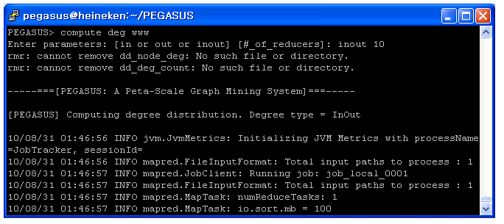
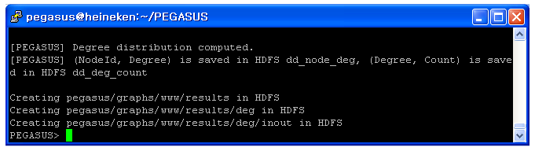
RUNNING ALGORITHMS: DEGREE

Slide 35
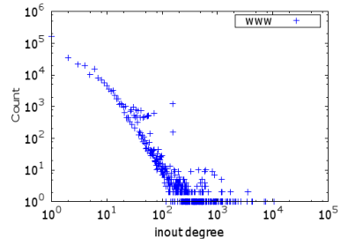
PLOTTING RESULT: DEGREE
The Degree distribution is plotted by the
plot deg [graph_name]
The output file www_deg_inout.eps is generated in the current directory.
Here is the Degree distribution plotted.

Slide 36
RUNNING ALGORITHMS: RADIUS
Command:
compute radius [graph_name]
Additional parameters:
the number of nodes in the graph
the number of reducers
whether to symmetrize the graph

Slide 37
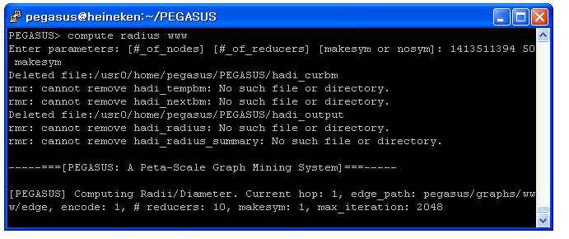
RUNNING ALGORITHMS: RADIUS

Slide 38
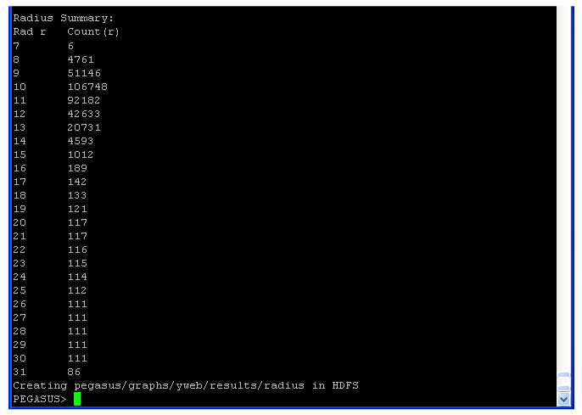
RUNNING ALGORITHMS: RADIUS

Slide 39
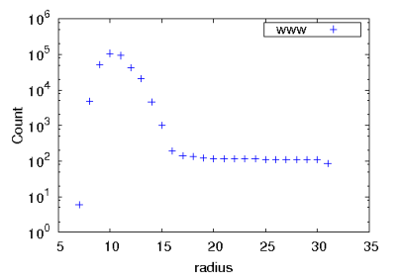
PLOTTING RESULT: RADIUS
The Degree distribution is plotted by the
plot radius [graph_name]
The output file yweb_radius.eps is generated in the current directory.
Here is the Radius distribution plotted.

Slide 40

Reference
[1] U Kang, Charalampos E. Tsourakakis, and Christos Faloutsos, PEGASUS: A Peta Mining System - Implementation and Observations. Proc. Intl. Conf. Data Mining, 2009, 229-238
[2] U Kang. "Mining Tera-Scale Graphs: Theory, Engineering and Discoveries." Diss. Carnegie Mellon U, 2012. Print.
[3]Kenneth Shum. “Notes on PageRank Algorithm.”
Http://home.ie.cuhk.edu.hk/~wkshum/papers/pagerank.pdf .N.p., n.d.Web.20 Sept.2016.

Slide 41
Thank you!!!

