Slide 1

Neural Machine Translation
Omid Kashefi
omid.Kashefi@pitt.edu
Visual Languages Seminar
November, 2016
Notes:
Instructions for editing school and department titles:
Select from menu: View > Master > Slide Master
Click on each text area you wish to edit. Text will become editable.
1

Slide 2
Outline
Machine Translation
Deep Learning
Neural Machine Translation
Notes:
The study of naturally occurring connected/coherent sentences
In linguistics, the term “discourse” refers to a structural unit larger than the sentence.
Discourse minimally involves more than one sentence, and the sentences must be contingent.
Pragmatics, context contributes to meaning.
The objects of discourse analysis (discourse, writing, conversation, communicative event) are variously defined in terms of coherent sequences of sentences, propositions, speech, or turns-at-talk
A discourse relation (or rhetorical relation) is a description of how two segments of discourse are logically connected to one another.

Slide 3
Machine Translation
Machine Translation
Use of software in translating from one language into another
Oldest Natural Language Processing Problem
Late 40’s (Weaver 1949)
Cryptoanalysis
Rule-based Approaches
Notes:
A discourse relation (or rhetorical relation) is a description of how two segments of discourse are logically connected to one another.
Rhetorical relations or coherence relations or discourse relations
RST explains coherence hierarchical, connected structure of texts
RST relations are applied recursively in a text, until all units in that text are constituents in an RST relation. The result of such analyses is that RST structure are typically represented as trees, with one top level relation that encompasses other relations at lower levels.
Shallow discourse parsing is the task of parsing a piece of text into a set of discourse relations between two adjacent or non-adjacent discourse units. We call this task shallow discourse parsing because the relations in a text are not connected to one another to form a connected structure in the form of a tree or graph.
Yield more reliable human annotation

Slide 4
Machine Translation
Statistical Machine Translation
Parallel corpus
The mathematics of statistical machine translation (Brown et al. 1993)
Introduced five models
Word alignments
Phrase-based Machine Translation (Koehn et al., 2003)
Phrase alignment
Notes:
A discourse relation (or rhetorical relation) is a description of how two segments of discourse are logically connected to one another.
Rhetorical relations or coherence relations or discourse relations
RST explains coherence hierarchical, connected structure of texts
RST relations are applied recursively in a text, until all units in that text are constituents in an RST relation. The result of such analyses is that RST structure are typically represented as trees, with one top level relation that encompasses other relations at lower levels.
Shallow discourse parsing is the task of parsing a piece of text into a set of discourse relations between two adjacent or non-adjacent discourse units. We call this task shallow discourse parsing because the relations in a text are not connected to one another to form a connected structure in the form of a tree or graph.
Yield more reliable human annotation

Slide 5
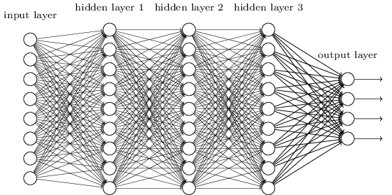
Deep Learning
Good Old Neural Networks
Computation Power
Data
Deep Learning
Notes:
A discourse relation (or rhetorical relation) is a description of how two segments of discourse are logically connected to one another.
Rhetorical relations or coherence relations or discourse relations
RST explains coherence hierarchical, connected structure of texts
RST relations are applied recursively in a text, until all units in that text are constituents in an RST relation. The result of such analyses is that RST structure are typically represented as trees, with one top level relation that encompasses other relations at lower levels.
Shallow discourse parsing is the task of parsing a piece of text into a set of discourse relations between two adjacent or non-adjacent discourse units. We call this task shallow discourse parsing because the relations in a text are not connected to one another to form a connected structure in the form of a tree or graph.
Yield more reliable human annotation

Slide 6
Deep Learning
Deep Learning
Simplicity
Hand-crafting features
Feature engineering
Representation Learning
Does it works (remarkably) better?
Not necessarily
When to use it?
Having a lot of data
Notes:
A discourse relation (or rhetorical relation) is a description of how two segments of discourse are logically connected to one another.
Rhetorical relations or coherence relations or discourse relations
RST explains coherence hierarchical, connected structure of texts
RST relations are applied recursively in a text, until all units in that text are constituents in an RST relation. The result of such analyses is that RST structure are typically represented as trees, with one top level relation that encompasses other relations at lower levels.
Shallow discourse parsing is the task of parsing a piece of text into a set of discourse relations between two adjacent or non-adjacent discourse units. We call this task shallow discourse parsing because the relations in a text are not connected to one another to form a connected structure in the form of a tree or graph.
Yield more reliable human annotation

Slide 7
Neural Machine Translation
Translation Problem
Find target sentence y
Maximize the conditional probability of y given source sentence x
arg max p(y|x)
Encoder-Decoder (Sutskever et al., 2014)
Encode the source sentence x
Decode that to target sentence y

Slide 8

Neural Machine Translation
RNN Encoder
Read input sentence $\text{x}\text{ = (}\text{x}\text{1}\text{, }\text{x}\text{2}\text{, }\text{… }\text{, }\text{xn}\text{)}$ into a vector c
$\text{h}\text{t} \text{= }\text{f}\text{(}\text{xt}\text{,}\text{h}\text{t}\text{-}\text{1}$)
c = q({$\text{h}\text{1}\text{,} \text{h}\text{2}\text{,}$ … ,$\text{h}\text{n}$ })

Slide 9
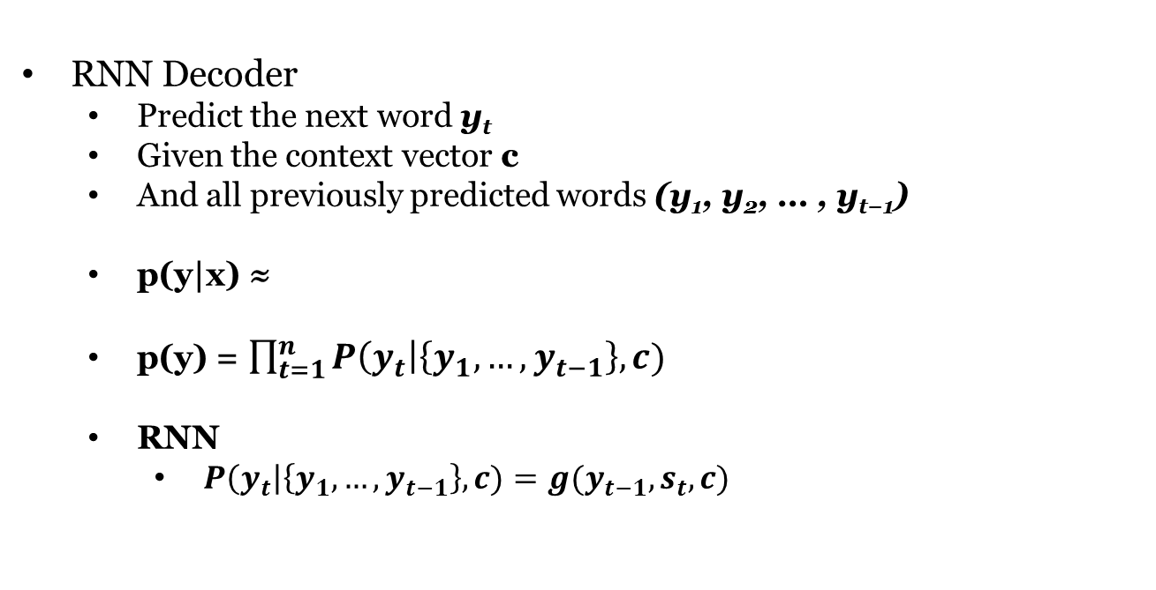
Neural Machine Translation
RNN Decoder
Predict the next word $\text{y}\text{t}$
Given the context vector c
And all previously predicted words $\text{(}\text{y}\text{1}\text{, }\text{y}\text{2}\text{, … , }\text{y}\text{t}\text{−1)}$
p(y|x) ≈
p(y) = $\prod_{t=1}^{n}{P\left(y_{t}\right|\left\{y_{1}, …, y_{t−1}\right\}, c)}$
RNN
$P\left(y_{t}\right|\left\{y_{1}, …, y_{t−1}\right\}, c)=g(y_{t−1}, s_{t}, c)$

Slide 10
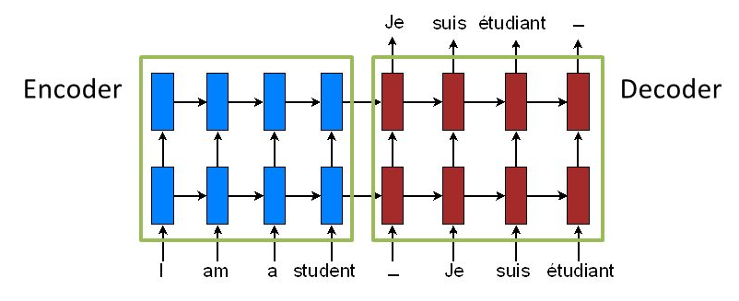
Neural Machine Translation

Slide 11
Neural Machine Translation
Compared to even easiest model, IBM Model 1 (Brown et al. 1993)
Extensive domain knowledge
20 slides of complex formula
Compared to state-of-the-art (Koehn et al., 2003)
Performs comparably good

Slide 12
Neural Machine Translation
Improvements
Jointly train decoder and encoder (Cho et al., 2015)
Variable length context vector (Bahdanau et al., 2015)
Hybrid Models
Phrase-based translation
Score phrase pairs with RNN (Cho et al., 2014)
Reorder translation candidates (Sutskever et al., 2014)

Slide 13
Thank You

