Slide 1
Restrict Range of Data Collection for Topic Trend Detection
Ji Eun Kim
November 9, 2010
CS2650

Slide 2
Crawler & Extractor
Social Media
User’s
Keywords of
Interests
HTML
documents
Web
Crawler
Information
Extractor
Text
documents
Web data
DB
Topic
Extractor
* Extract articles and metadata (title, author, content, etc) from semi-structured web content
Crawler & Extractor

Slide 3
Outline
Restriction of data
  Focused Crawler
  Other approaches
Extraction of Web data
  Partial Tree Alignment
Implication to SIS

Slide 4
Restriction of Data

Slide 5
Motivation
Large amount of info on web
Standard crawler: traverses web download all
Burden of indexing millions of pages
Focused, adaptive crawler: selects only related documents, ignores rest
Small investment in hardware
Low network resource usage

Slide 6
Focused Crawler Key Concepts
Example-driven automatic porthole generator
Based on canonical topic taxonomy with examples
Guided by a classifier and a distiller.
  Classifier: evaluates the relevance of a hypertext document with respect to the focus topics
  Distiller: identifies hypertext nodes that are great access points to many relevant pages within a few links

Slide 7
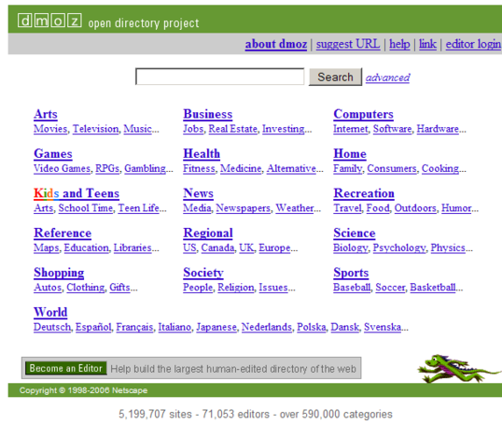
Classification
Taxonomy Creation
Yahoo!
Open Directory
Project
Example Collection
URLs
Browsing
Taxonomy Selection
and Refinement
System proposes the most common classes
User marks as GOOD
User change trees
System propose URLs found in small neighborhood of examples.
User examines and includes some of these examples.
Interactive Exploration
Training
Integrate refinements into statistical class model
(classifier-specific action).

Slide 8
Distillation
Identify relevant hubs by running a topic distillation algorithm.
Raise visit priorities of hubs and immediate neighbors.
Distillation
Report most popular sites and resources.
Mark results as useful/useless.
Send feedback to classifier and distiller.
Feedback

Slide 9
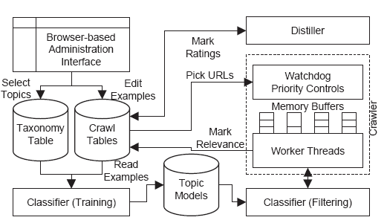
Integration

Slide 10
Other focused crawlers
Tunneling
  allow a limited number of ‘bad’ pages, to avoid loosing info (close topic pages may not point to each other)
Contextual crawling
  Context graph: for each page with a related distance (min no links to traverse from initial set)
  Naïve Bayes classifiers – category identification, according to distance; predictions of a generic document’s distance is possible
Semantic Web
  Ontologies
  Improvements in performance

Slide 11
Adaptive Focus Crawler
Focused crawler + learning methods
  to adapt its behavior to the particular environment and its relationships with the given input parameters (e.g. set of retrieved pages and the user-defined topic )
Example
  Researcher’s pages vs. companies pages.
Genetic-based crawling
  Genetic operations: inheritance, mutation, crossover+ population evolution
  GA crawler agent (InfoSpiders)
Notes:
Traditional non-adaptive focused crawlers: suitable for user communities w/ shared interests & goals that do not change with time.
11

Slide 12
Extraction of Web Data

Slide 13
Information Extraction
Information Extraction resource
  Unstructured
    free text written in natural language
  Semi-structured
    HTML Tables
  Structured
    (XML)
    Relational Database
Manual
Wrapper
Induction
Automation
Web DB

Slide 14
General Concepts
Given a Web page:
  Build the HTML tag tree
  Mine data regions
    Mining data records directly is hard
  Identify data records from each data region
  Learn the structure of a general data record
    A data record can contain optional fields
  Extract the data

Slide 15
Building a tag tree
Most HTML tags work in pairs. Within each corresponding tag-pair, there can be other pairs of tags, resulting in a nested structure.
  Some tags do not require closing tags (e.g., <li>, <hr> and <p>) although they have closing tags.
  Additional closing tags need to be inserted to ensure all tags are balanced.
Building a tag tree from a page using its HTML code is thus natural.

Slide 16
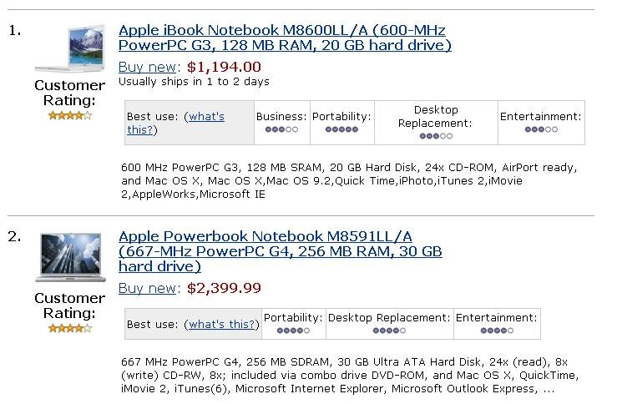
An example

Slide 17
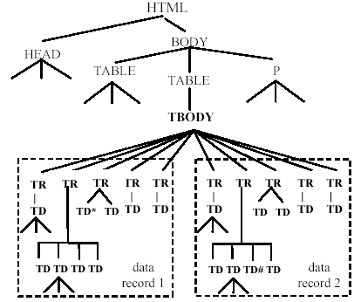
The tag tree

Slide 18
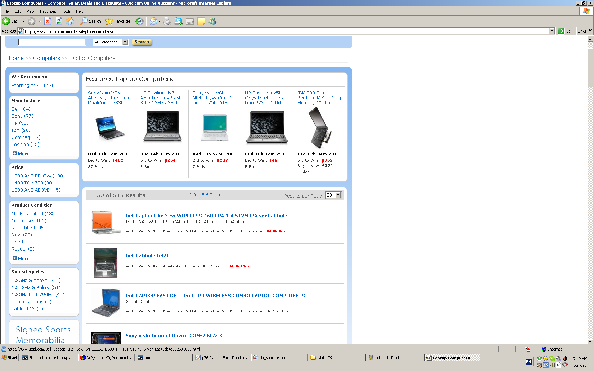
Data Region Example 1
More than one
data region!

Slide 19
Mining Data Regions
Definition: A generalized node of length r consists of r (r ≥ 1) nodes in the tag tree with the following two properties:
  the nodes all have the same parent.
  the nodes are adjacent.
Definition: A data region is a collection of two or more generalized nodes with the following properties:
  the generalized nodes all have the same parent.
  the generalized nodes all have the same length.
  the generalized nodes are all adjacent.
  the similarity between adjacent generalized nodes is greater than a fixed threshold.

Slide 20
Data Region Example 2
The regions were found using
tree edit distance.
For example, nodes 5 and 6
are similar (low cost mapping),
have same parents
and are adjacent
1
2
3
4
6
9
5
7
8
10
11
12
Region 1
Region 2
13
14
15
16
17
18
19
Region 3

Slide 21
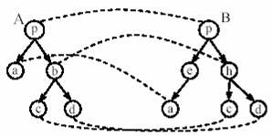
Tree Edit Distance
Tree edit distance between two trees A and B is the cost associated with the minimum set of operations needed to transform A into B.
The set of operations used to define tree edit distance includes three operations:
  node removal
  node insertion
  node replacement
  A cost is assigned to
  each of the operations.

Slide 22
Partial Tree Alignment
For each data region we have found we need to understand the structure of the data records in the region.
  Not all data records contain the same fields (optional fields are possible)
We will use (partial) tree alignment to gather the structure.

Slide 23
Partial Tree Alignment of two trees
T_{s}
p
T_{i}
p
a
b
e
b
c
d
e
Insertion is possible
New part of T_{s}
p
e
a
b
c
d
T_{s}
p
T_{i}
p
Insertion is not possible
a
b
e
a
x
e

Slide 24
Extraction given multiple pages
The described technique is good for a single list page.
  It can clearly be used for multiple list pages.
  Templates from all input pages may be found separately and merged to produce a single refined pattern.
  Extraction results will get more accurate.
In many applications, one needs to extract the data from the detail pages as they contain more information on the object.

Slide 25
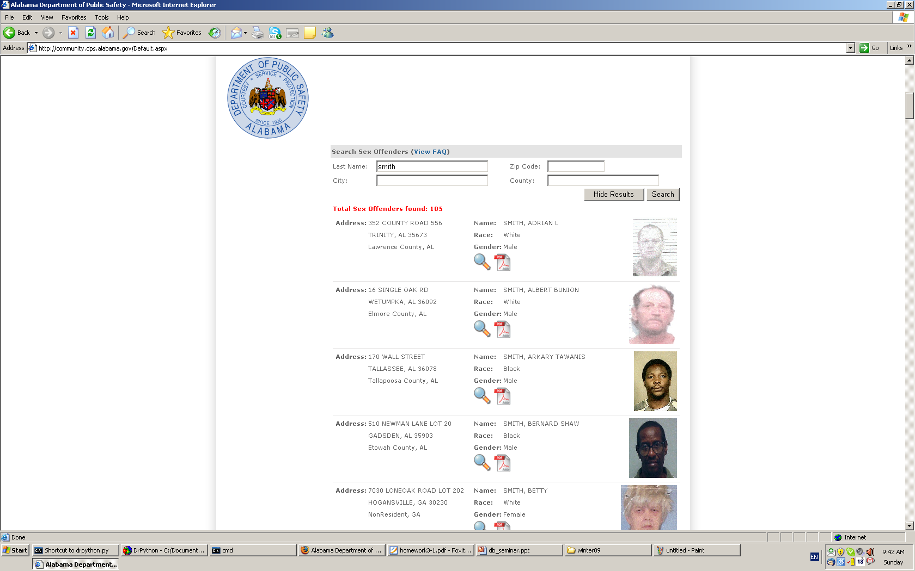
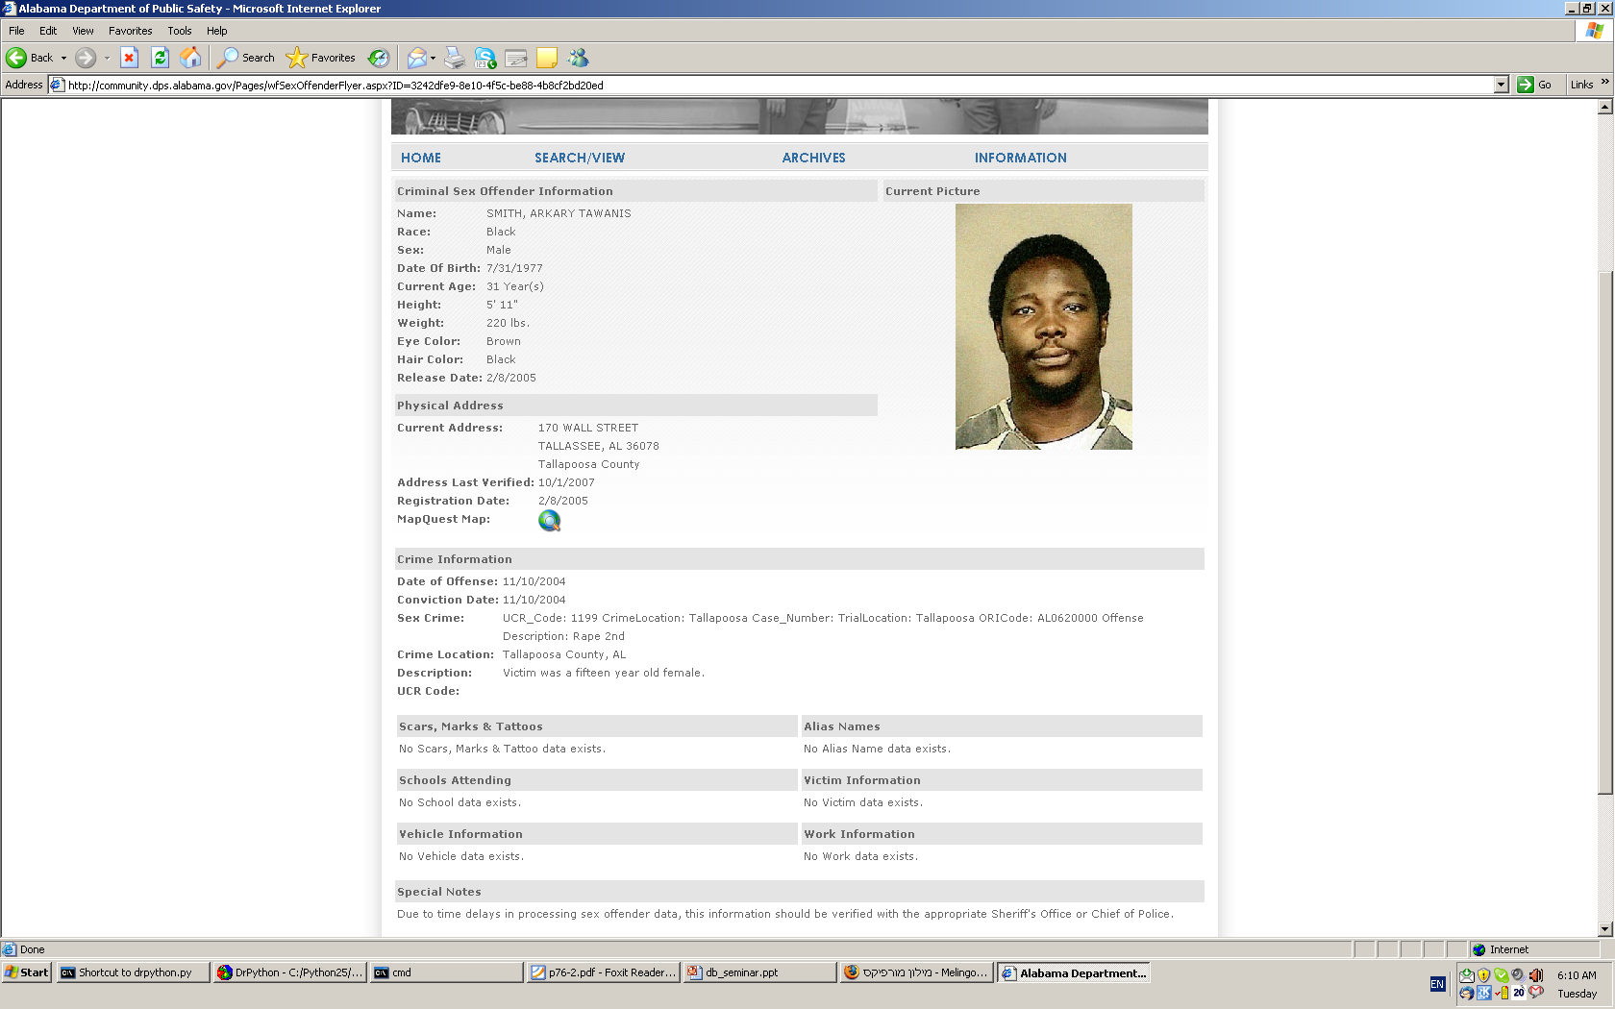
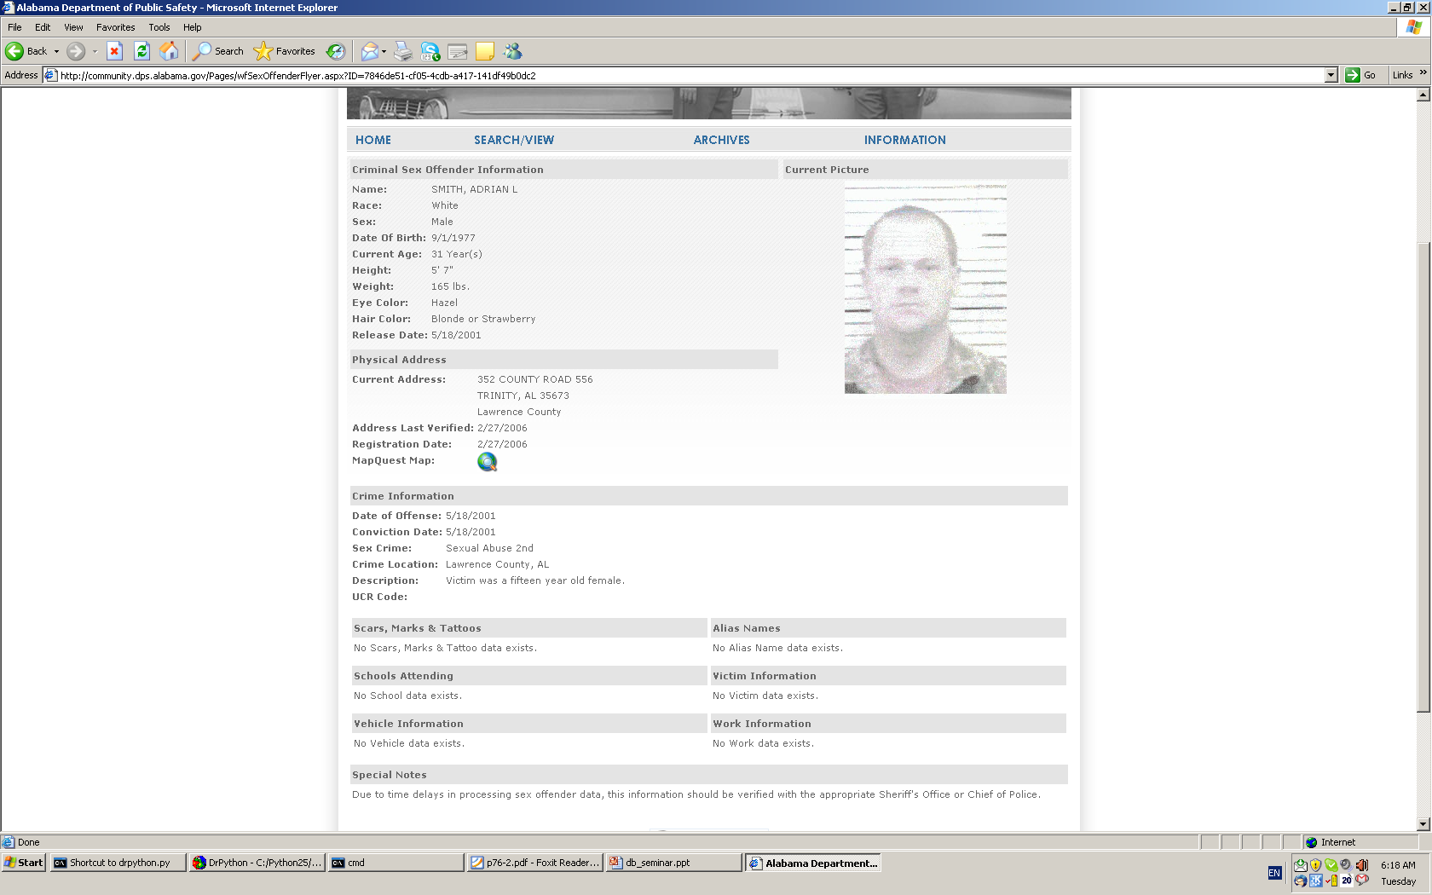
Detail pages – an example
More data in
the detail pages
A list page

Slide 26
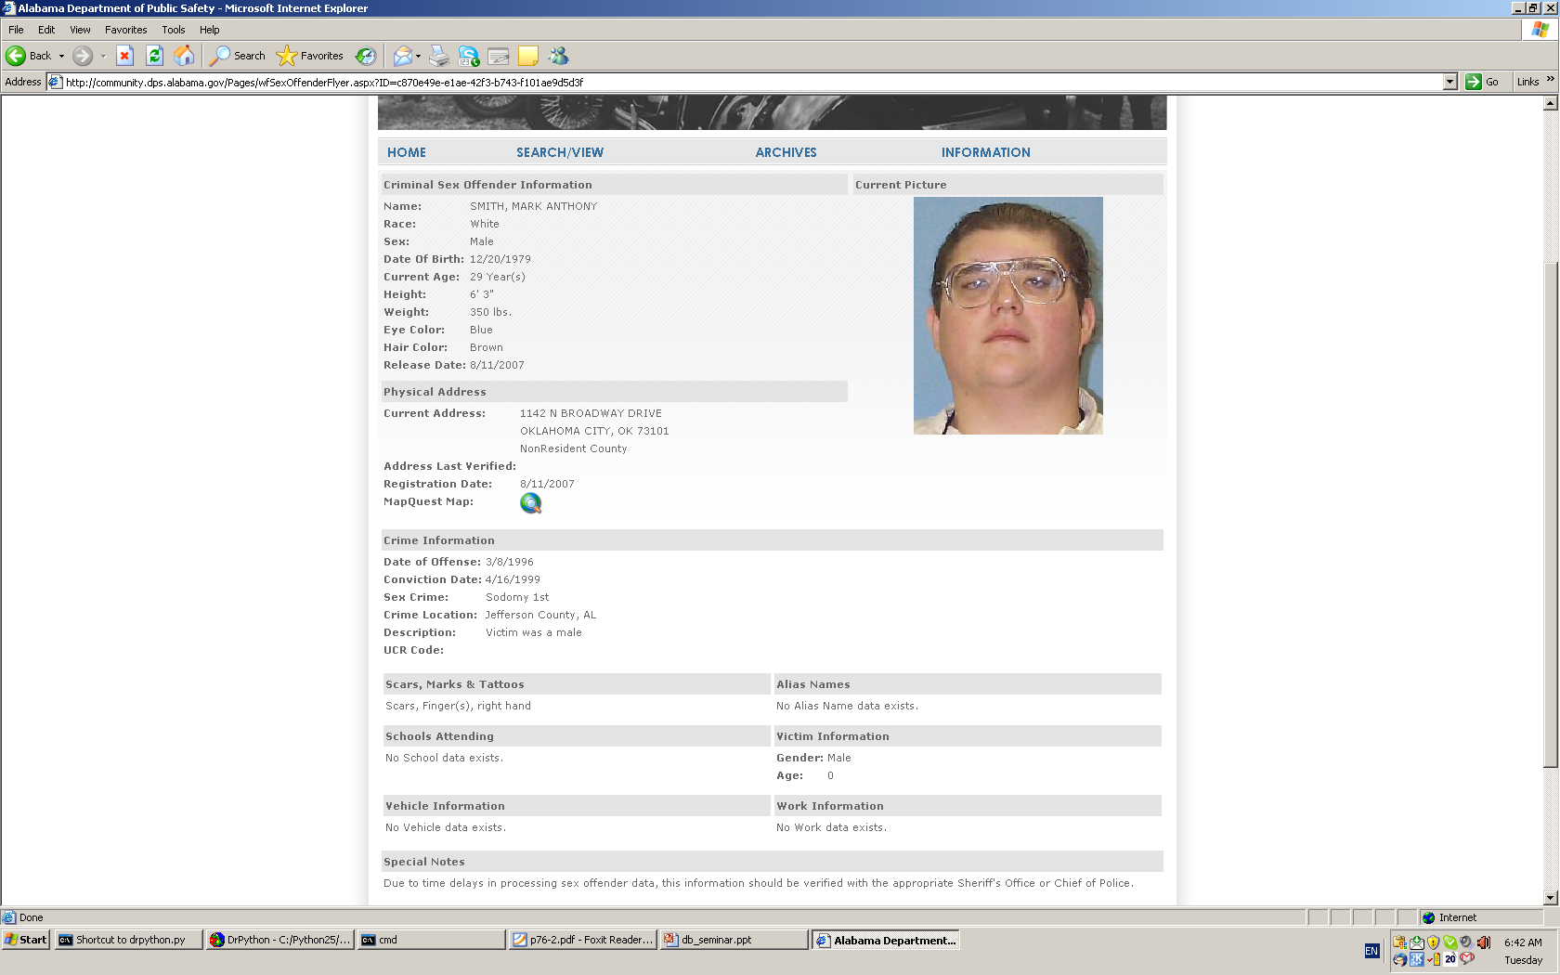
An example
r
…
We already know how to extract data from a data region

Slide 27
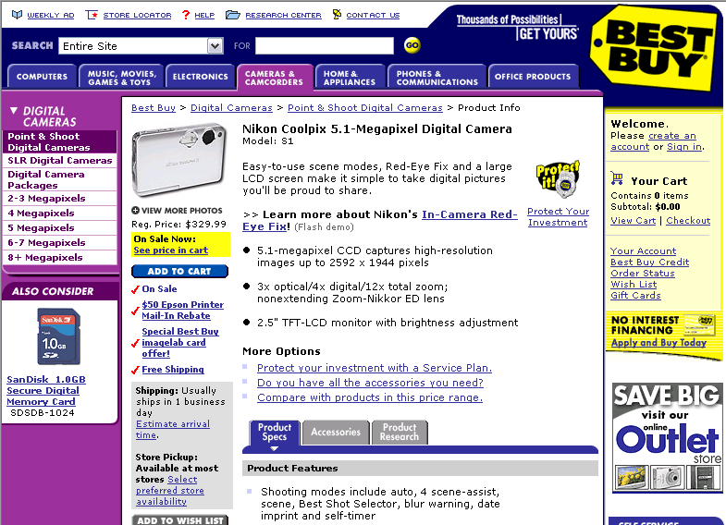
A lot of noise in a detailed page

Slide 28
The Solution
To start, a sample page is taken as the wrapper.
The wrapper is then refined by solving mismatches between the wrapper and each sample page, which generalizes the wrapper.
  A mismatch occurs when some token in the sample does not match the grammar of the wrapper.

Slide 29
Wrapper Generalization
Different types of mismatches:
  Text string mismatches: indicate data fields (or items).
  Tag mismatches: indicate list of repeated patterns or optional elements.
    Find the last token of the mismatch position and identify some candidate repeated patterns from the wrapper and sample by searching forward.

Slide 30
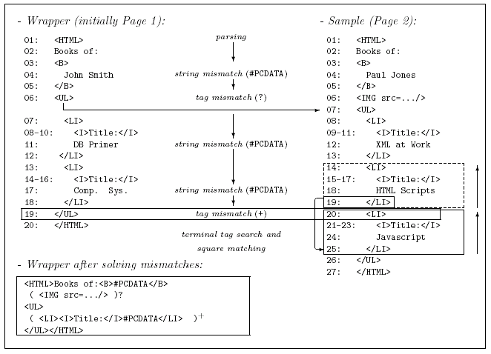
An example

Slide 31
Summary
Automatic extraction of data from a web page requires understanding of the data records’ structure.
  First step is finding the data records in the page.
  Second step is merging the different structures and build a generic template for a data record.
    Partial tree alignment is one method for building the template.

Slide 32
Implication to SIS
Notes:
I think each method have embedded concept of SIS.

Slide 33
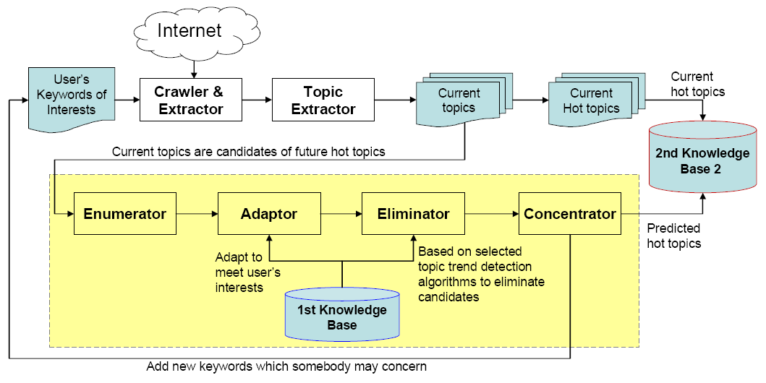
SIS to help restrict the range of data collection
Knowledge of data
Knowledge of user’s profile and algorithm
Notes:
It needs careful resource allocation to collect huge amount of up-to-date data based on limited computing resource.
It is unlikely to collect all web data based on limited amount of computing resources. The system needs to develop data collection strategies which can concentrate limited resources on collecting important web data.
Crawler & Extractor:
- Collect web pages from internet
- Needs to be selective: only collect web pages that satisfy redefined requirements.

Slide 35
Implications
SIS concepts are embedded in many solutions of Crawlers and Extractors
  How do we distinguish or incorporate already available approaches to the SIS model?
  Selection of the most proper solutions can be modeled in SIS
  Maintenance of existing solutions can exploit SIS concepts
    know what users are currently concerned
    automatically adjust the range of data collection

Slide 36
References
[1] Building Topic/Trend Detection System based on Slow Intelligence, Shin and Peng
[2] Focused crawling: a new approach to topic-specific web resource discovery, Computer Networks, Vol. 310, pp. 1623-1640, 1999, Chakravarti
[3] A survey of web information extraction systems, IEEE transactions on knowledge and data engineering, vol. 18, pp.1411-1428, 2006
[4] Web data extraction based on partial tree alignment, Proceedings of the 14th international conference on World Wide Web, 2005, p.85
[5] Lecture Notes: Adaptive Focused Crawler, http://www.dcs.warwick.ac.uk/~acristea/
[6] http://en.wikipedia.org/wiki/Focused_crawler

